Slide 1
Close out session civil engineering
Timothy WATSON
Civil Engineering Coordinator

Slide 2
2 sessions with presentations by:
5 June 2023 / FCC Week
Timothy WATSON
Liam Bromiley CERN SCE – Update on underground civil engineering
Tim Watson CERN SCE – strategy and look ahead
Roddy Cunningham CERN SCE – Site Investigations
Professor Andrea Moscariello UNIGE – De-risking design
Luisa Ulrici CERN HSE – Strategies for excavated materials
Professor Robert Galler (Montanuniversitat Leoben – online characterization of excavated materials

Slide 3
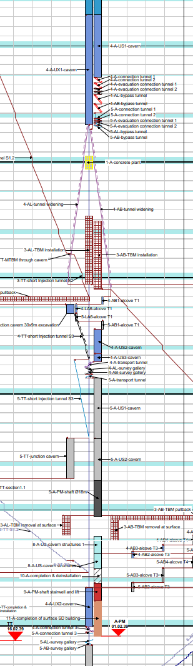
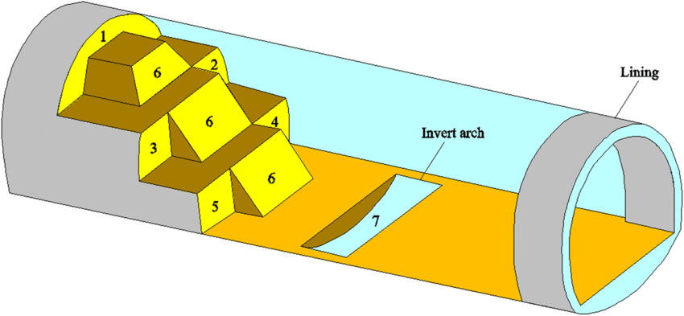
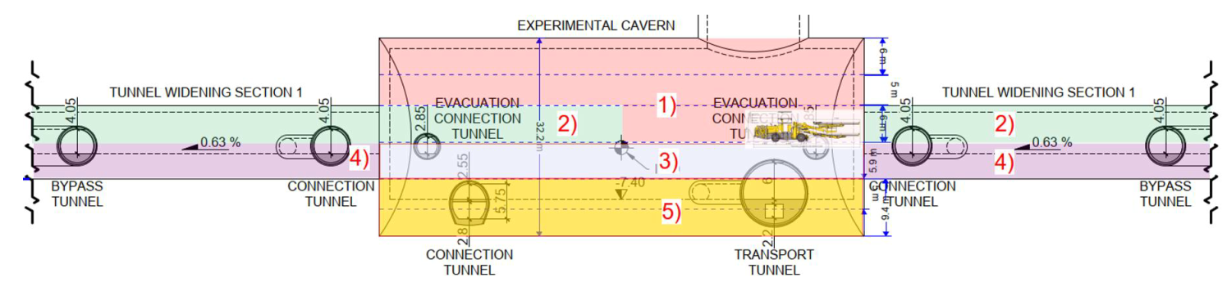

Experiment Cavern Construction
Liam Bromiley – CERN SCE Dept.
Excavation split into phases
Tunnel widening completed before full cavern excavation
Allows for earliest possible TBM installation
Phase 1 initiated end of 2033
Phase 5 completed in 2038
1 - 4
Example of benched cavern excavation. Credit: Geotech Geol Eng (2019); X, Deng et al.
5
Cavern excavation phases
Construction schedule phases

Slide 4
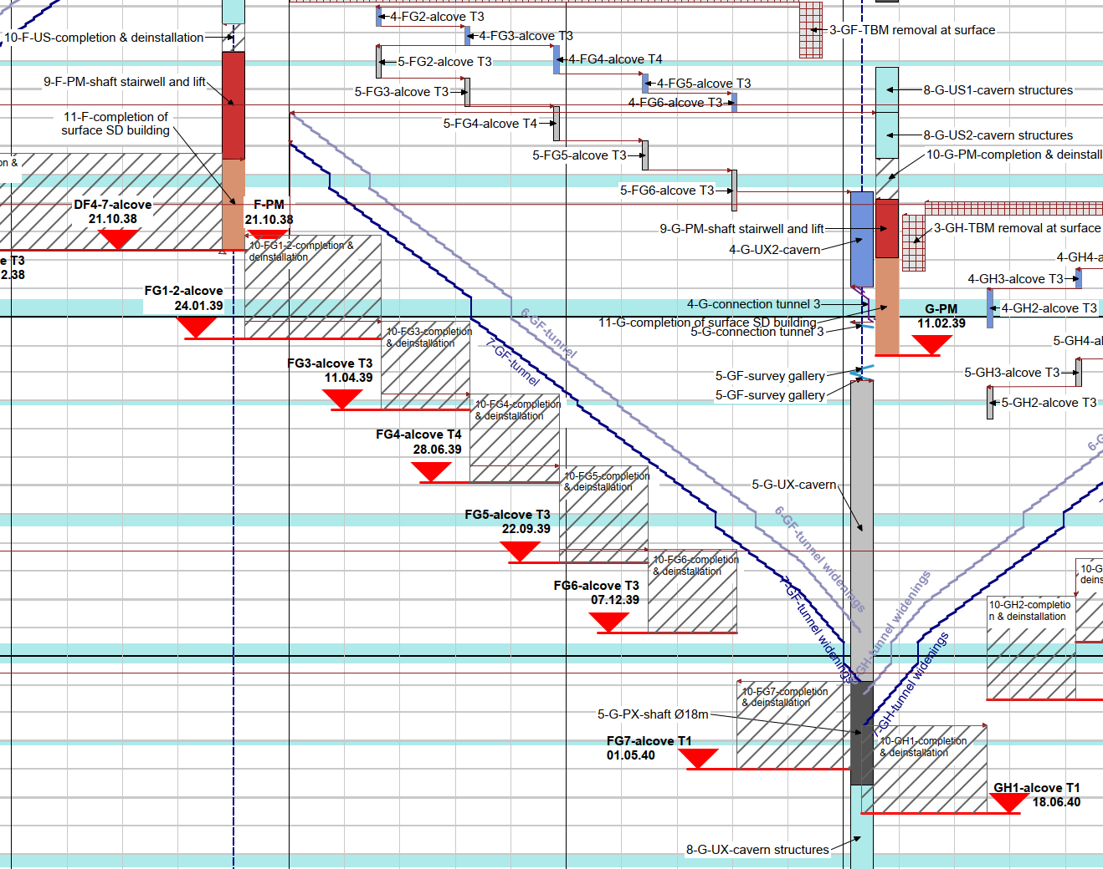
Handover to CERN
Liam Bromiley – CERN SCE Dept.
Staged handover to CERN along the arc sectors
Allows earlier handover for infrastructure and machine installation (approx. 24 months)
Staged handover of tunnel sectors

Slide 5
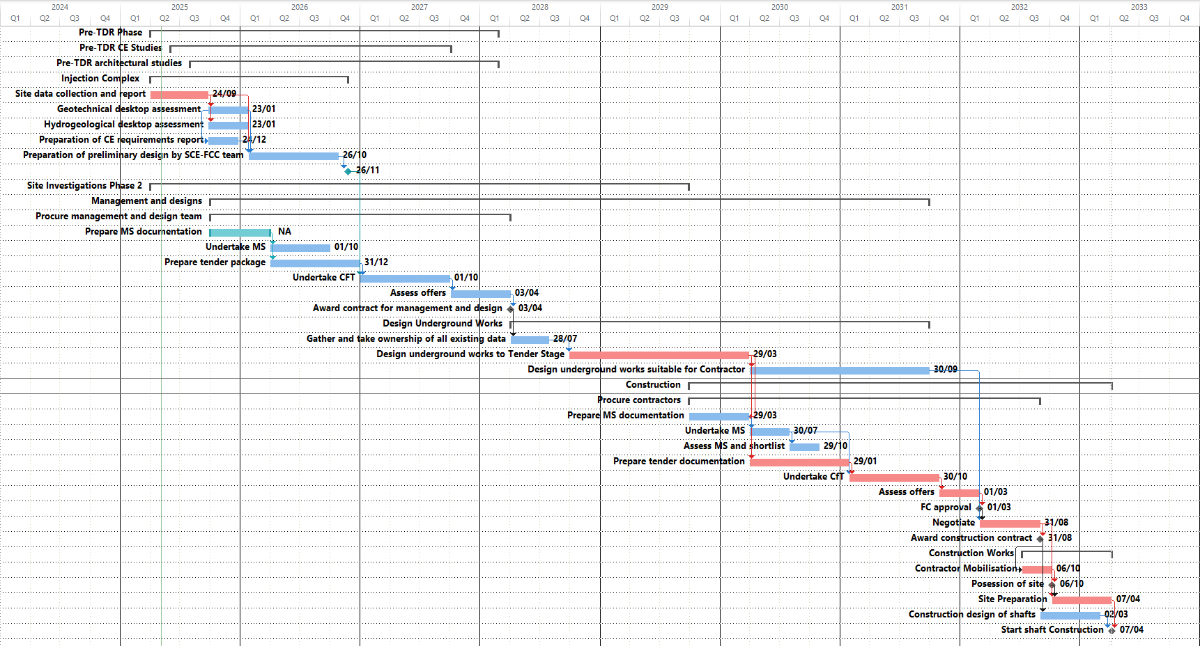
Tim Watson– CERN SCE Dept.
Critical Civil Engineering Tasks to Construction
Procure main consultants
Procure works contractors

Slide 6
First Estimate of CE Resources
Tim Watson– CERN SCE Dept.
Current staff
T. Watson – CE team leader
R. Cunningham – Geotech contract manager
P. Magnano – civil engineer injection complex
Mayoux – permitting and surface
L. Bromiley – civil engineer underground
G. Guihlem (Geotech grad)
Designer support (1 FTE)
GIS support (0.1 FTE)
7.1 FTE
Staff needed during construction
CE Project Manager
Deputy Project Manager
Support Team
2 Designers
Scheduler
Admin/doc control
Snr Geotech Engineer
Snr Underground Engineer
Snr structural engineer/architect
Claims/Disputes manager
Team 1
Contract Manager
Engineer
Site supervisor
Team 2
Contract Manager
Engineer
Site supervisor
Team 3
Contract Manager
Engineer
Site supervisor
Team 4
Contract Manager
Engineer
Site supervisor
Team 5
Contract Manager
Engineer
Site supervisor
~25 FTE

Slide 7
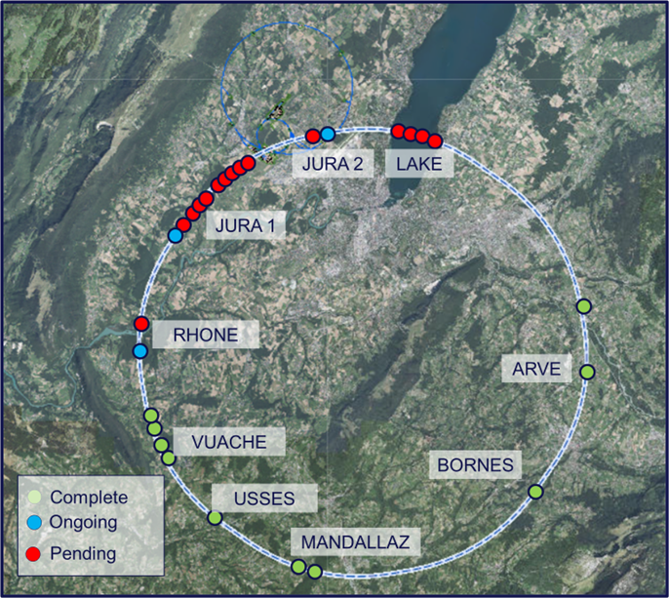
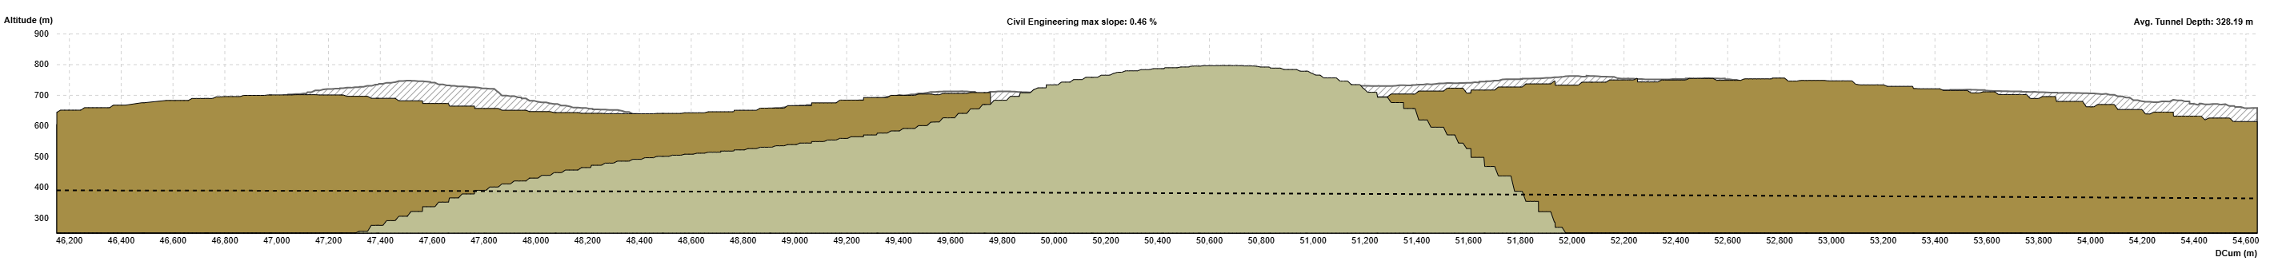
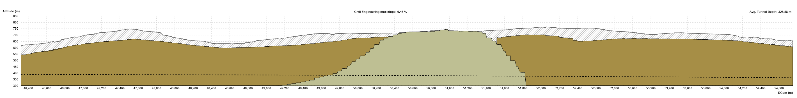

Results from SSI: Mandallaz
Roddy Cunningham– CERN SCE Dept.
Objective: Understand the characteristics and width of the limestone outcrop
FCC tunnel
Mandallaz profile based on baseline ILF/GADZ model
FCC tunnel
Mandallaz profile based on UNIGE v5. model
Results positive suggesting the limestone is approx. 1.6km narrower than originally modelled at tunnel depth
Geophysics show the presence of an inclined fault which boreholes did not reach at executed depths
Karsts were encountered but were not filled with water
Further targeted seismic and additional boreholes will be required to fully understand the nature of the faulting

Slide 8
Summary
Roddy Cunningham– CERN SCE Dept.
Preliminary results from site investigations are positive
In Vuache, Arve, Usses and Bornes the tunnel will remain entirely in molasse
In Mandallaz the section of tunnel located in limestone is less than originally modelled
No unforeseen geological features encountered so far
Challenges and uncertainties still to be resolved
Works permits in Switzerland are still to be issued
In Jura section the interface between limestone and molasse still to be defined
In critical Lake section interface between moraines and molasse still to be defined
Future site investigations campaign being prepared
Larger, targeted campaign envisaged to allow civil design works and construction tenders to be launched
Market survey for consultants is out and invitation to tender foreseen over summer 2025
Consultants contract to begin around March 2026 and site works if project given approval in 2028

Slide 9
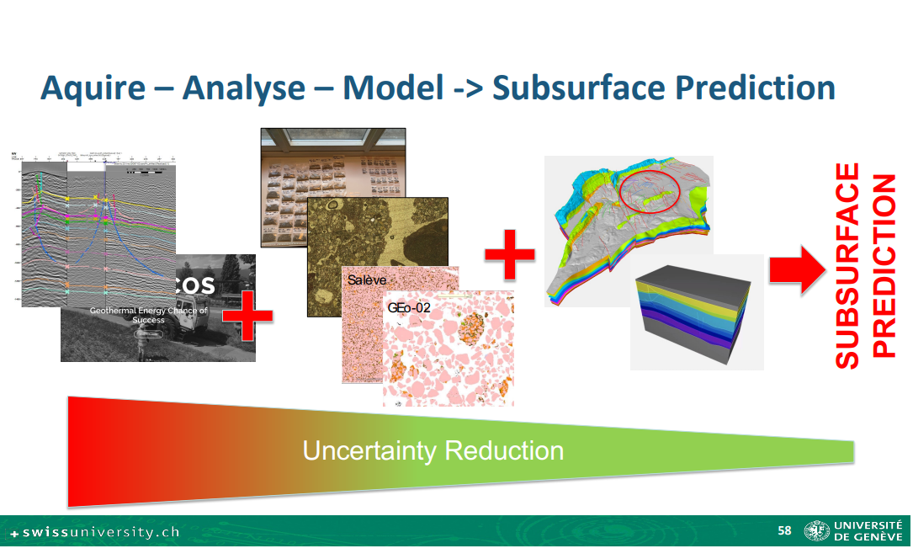
Professor Andrea Moscariello - UNIGE

Slide 10
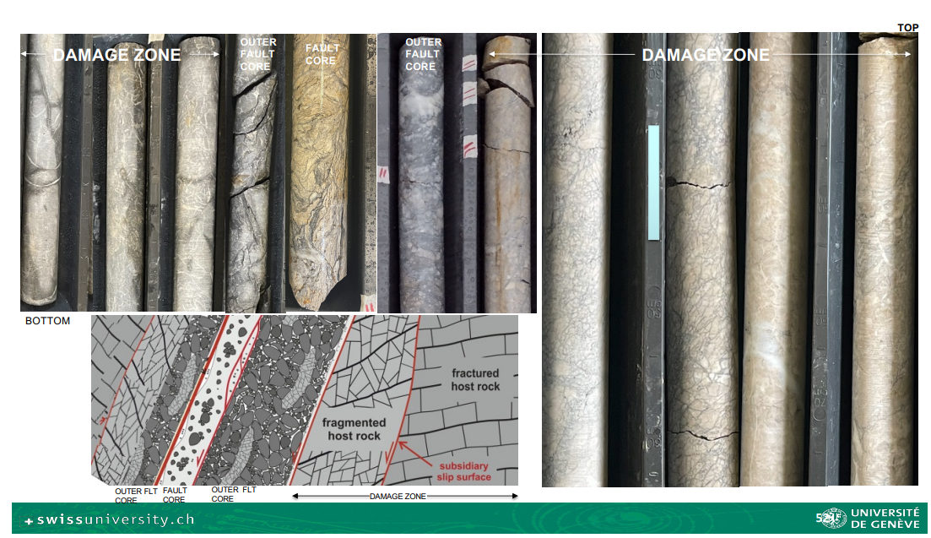
Professor Andrea Moscariello - UNIGE

Slide 11
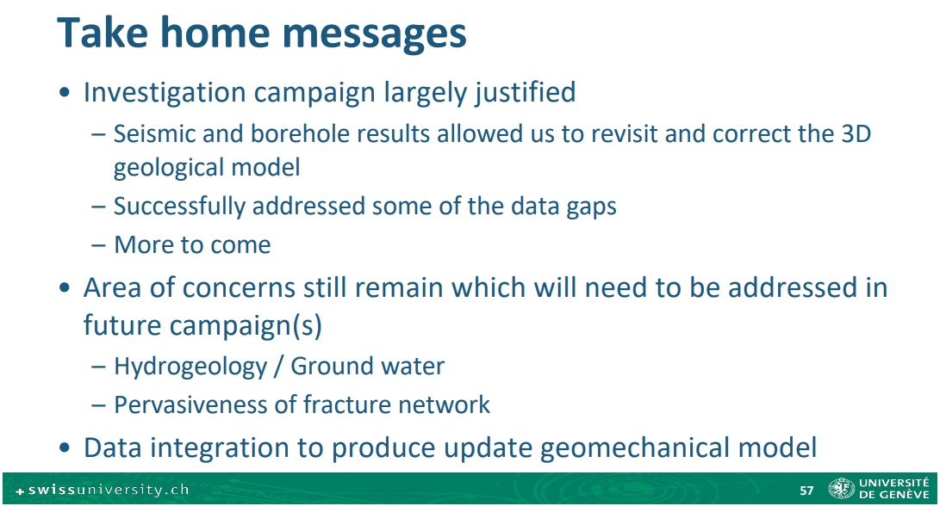
Professor Andrea Moscariello - UNIGE

Slide 12
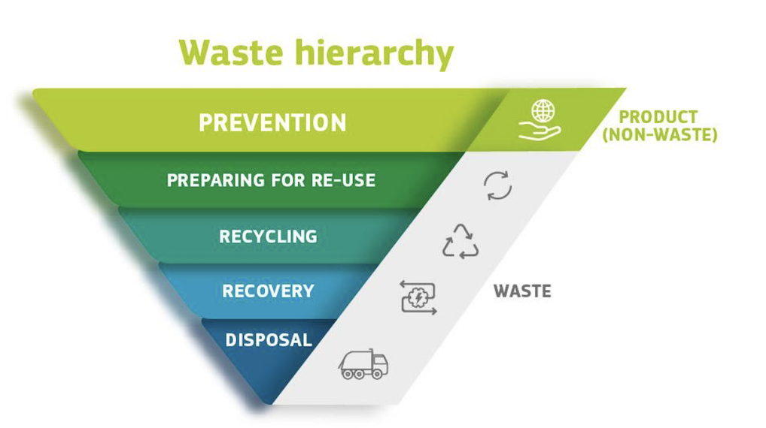
Focus on reuse
FCC Week 2025 / 20 May 2025
Luisa ULRICI - CERN
Luisa Ulrici- CERN HSE Dept.
The negative impacts created by landfilling include degradation of the countryside, potential impacts on nature and potential degrade of the quality of life of surrounding residents.
According to the current regulation in France excavated material is classified as waste as soon as it exits the project site. This is why it is important that FCC is considered an undividable, single project in a transnational context. Discussion with the authorities of the Host States.
The five-step “waste hierarchy”, established in the EU Waste Framework Directive is applied. It establishes an order of preference for managing and disposing of waste.
The focus on finding reuse opportunities addresses the following aims:
Reduce pressure on existing suitable deposits.
Reduce the need for long transport (lowering the local nuisances and carbon emissions).
Reduce the overall project costs.
Contribute to the socio-economic benefits, beyond the project itself, by proposing innovative reuses.

Slide 13
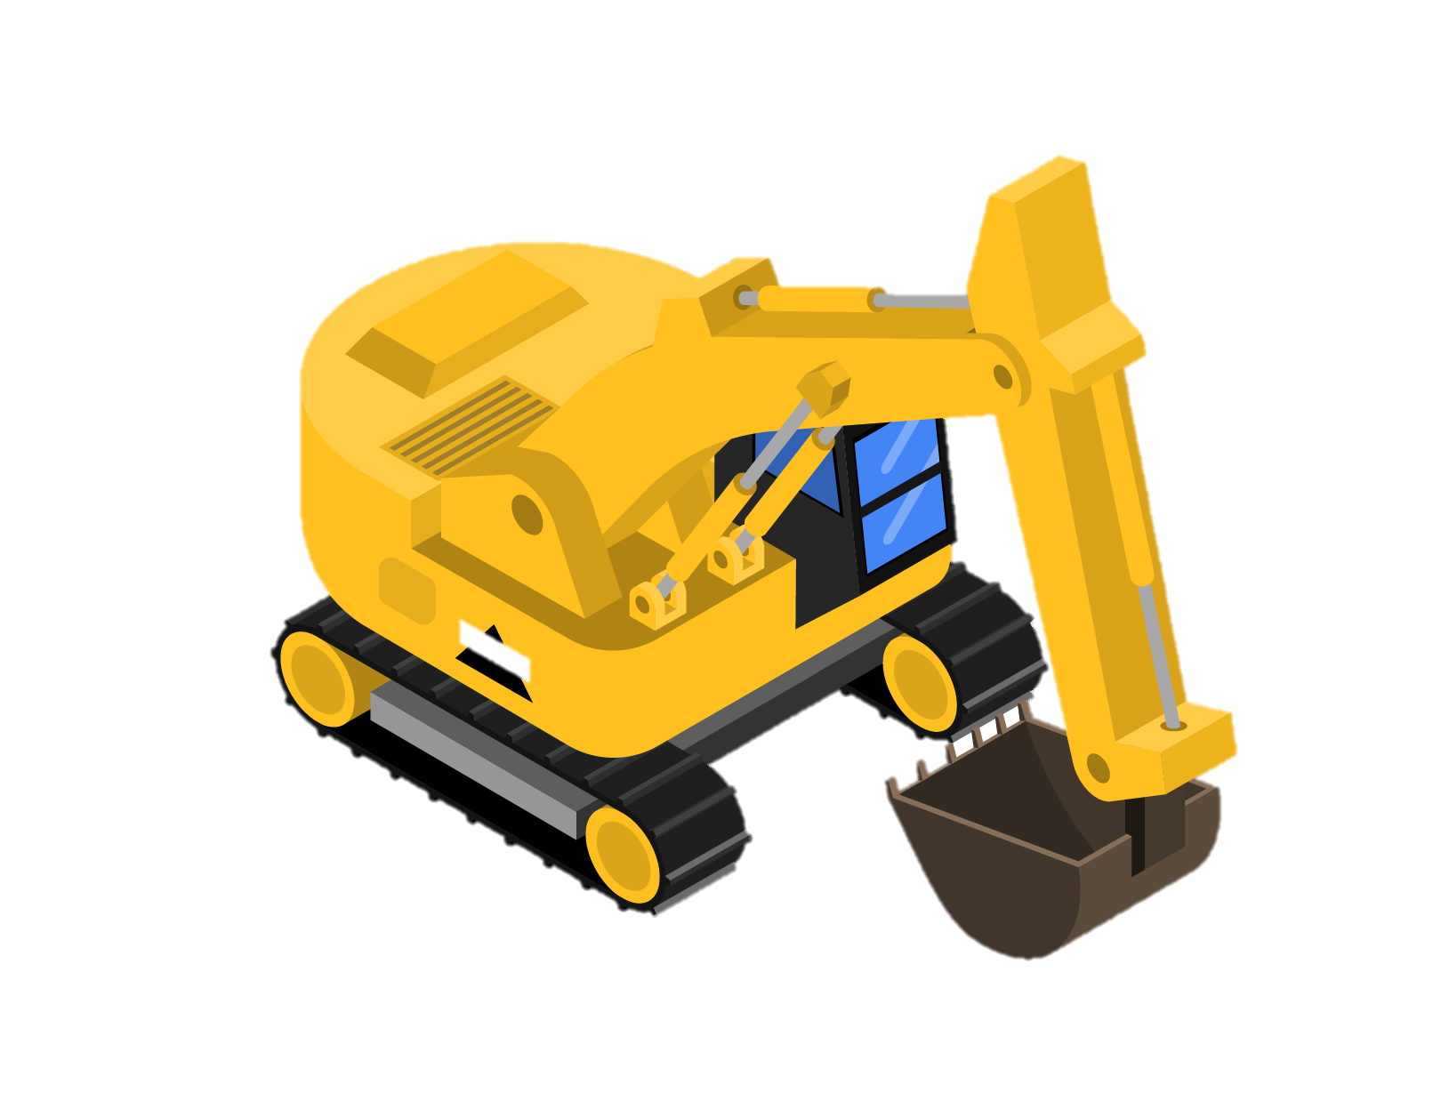
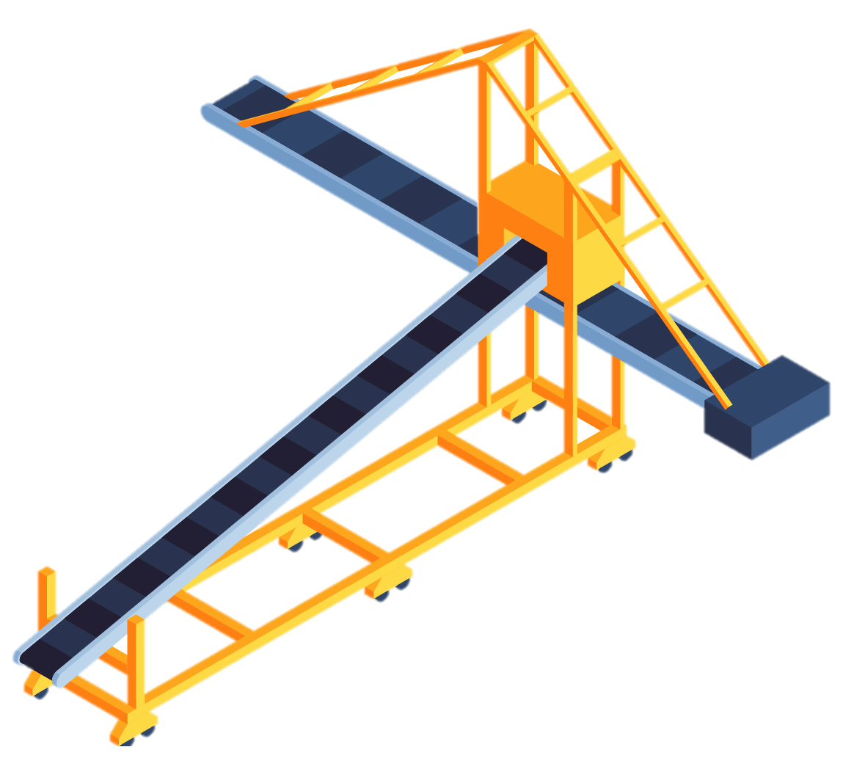





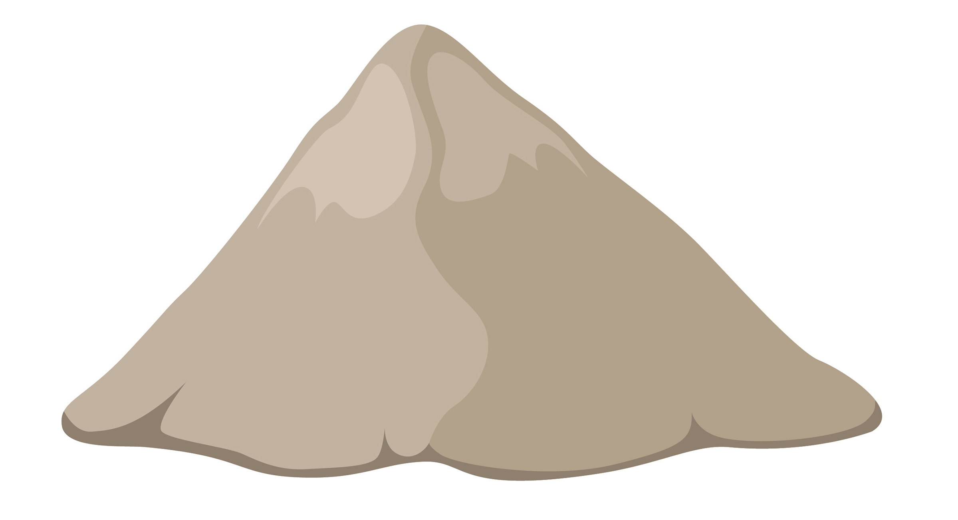
Future roadmap
FCC Week 2025 / 20 May 2025
Luisa ULRICI - CERN
Luisa Ulrici- CERN HSE Dept.
Developing processes for using excavated materials including an evaluation of the environmental, economic and societal impact
  reuse as construction or isolation materials.
  Continuation of the OpenSkyLab for landscaping and forestry purposes
Confirmation of the characteristics of the excavated material (subsurface investigations)
Correlation between the material properties and the acceptance criteria of the potential receivers.
Technical methods for the real-time analysis of the materials and their sorting.
Definition of the regulatory framework for the management of the excavated materials with the host States
Study on the excavation material logistics (traceability, fluxes, conveyors etc.), including the evaluation of environmental and societal impacts and the potential limitations.
Regularly update of the regional treatment and disposal opportunities (e.g., quarries, final deposits, treatment facilities);

Slide 14
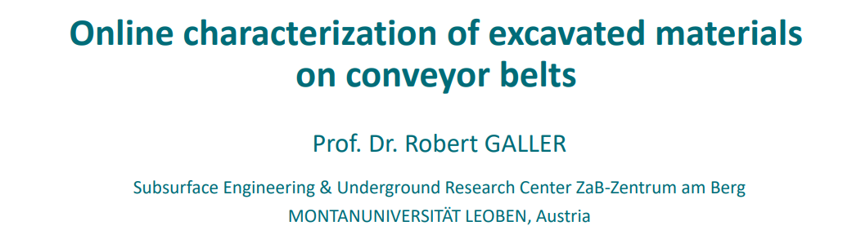
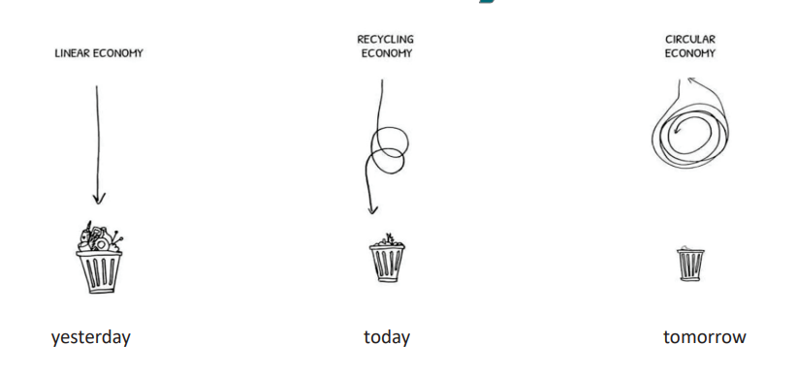
Professor Galler MontanUniverisitat

Slide 15
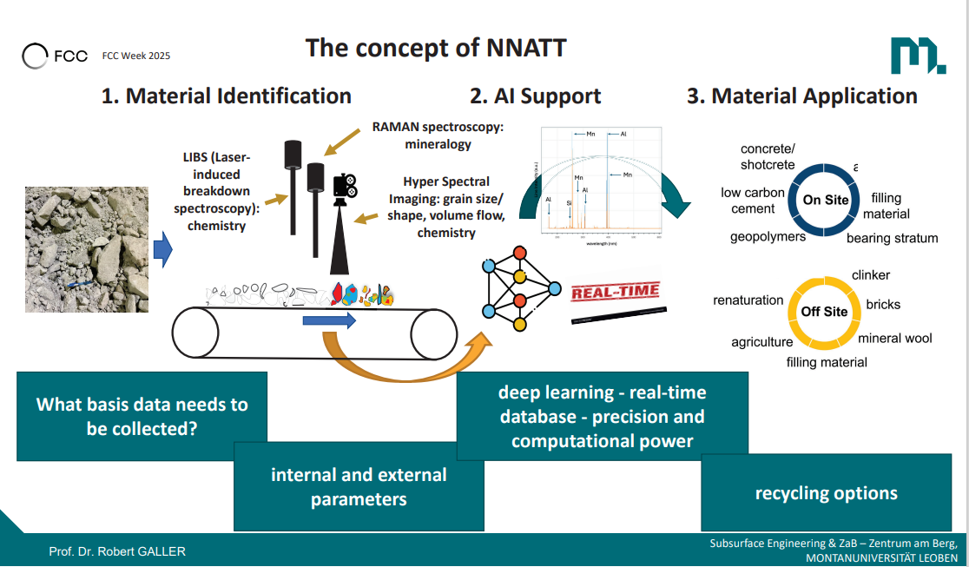

Slide 16
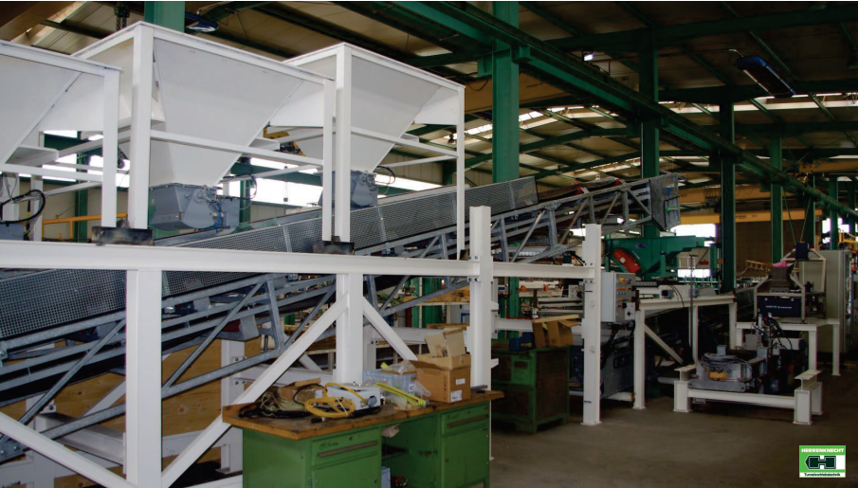
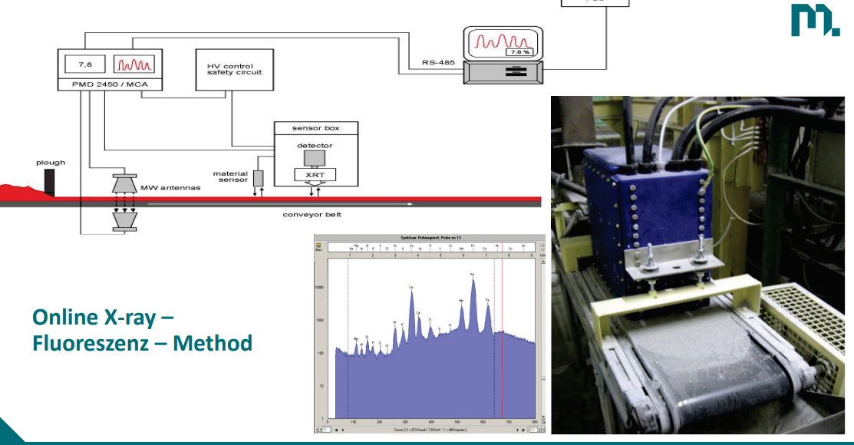
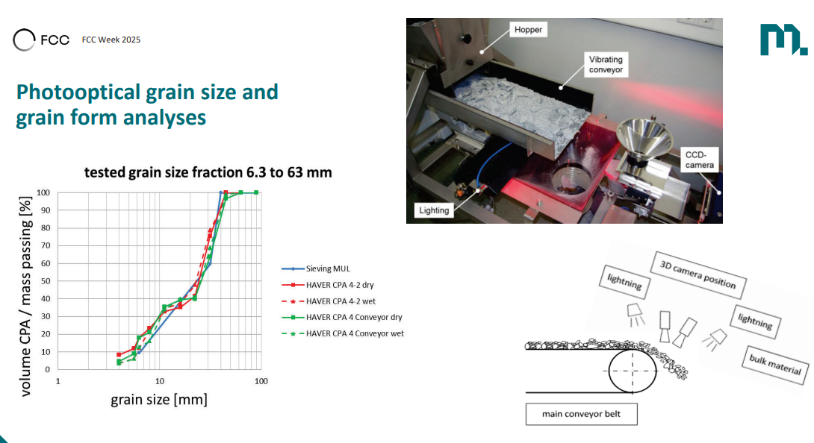
Prototype for grain size and chemical analysis
On-line X-Ray for mineralogical composition
Photo optical analysis for grain size analysis

Slide 17
Conclusions
Lots of exciting things going on directly and indirectly related to Civil Engineering
Completion of current Site Investigation is critical to enable final tunnel altitude to be fixed and further work on material re-use/disposal to move advance
Working with experts to make sure FCC civil engineering is state of the art
Procurement activities for Pre-TDR tasks are underway
Need to be ready to “hit the ground running” as soon as FCC becomes an approved, funded Project..
Lots of work to be done to reach that state….

Slide 18
Thank you
18

