Slide 1
Klaus Hanke
1
Technical infrastructure Summary
K Hanke, FCC Week 2025, 23/05/2025

Slide 2
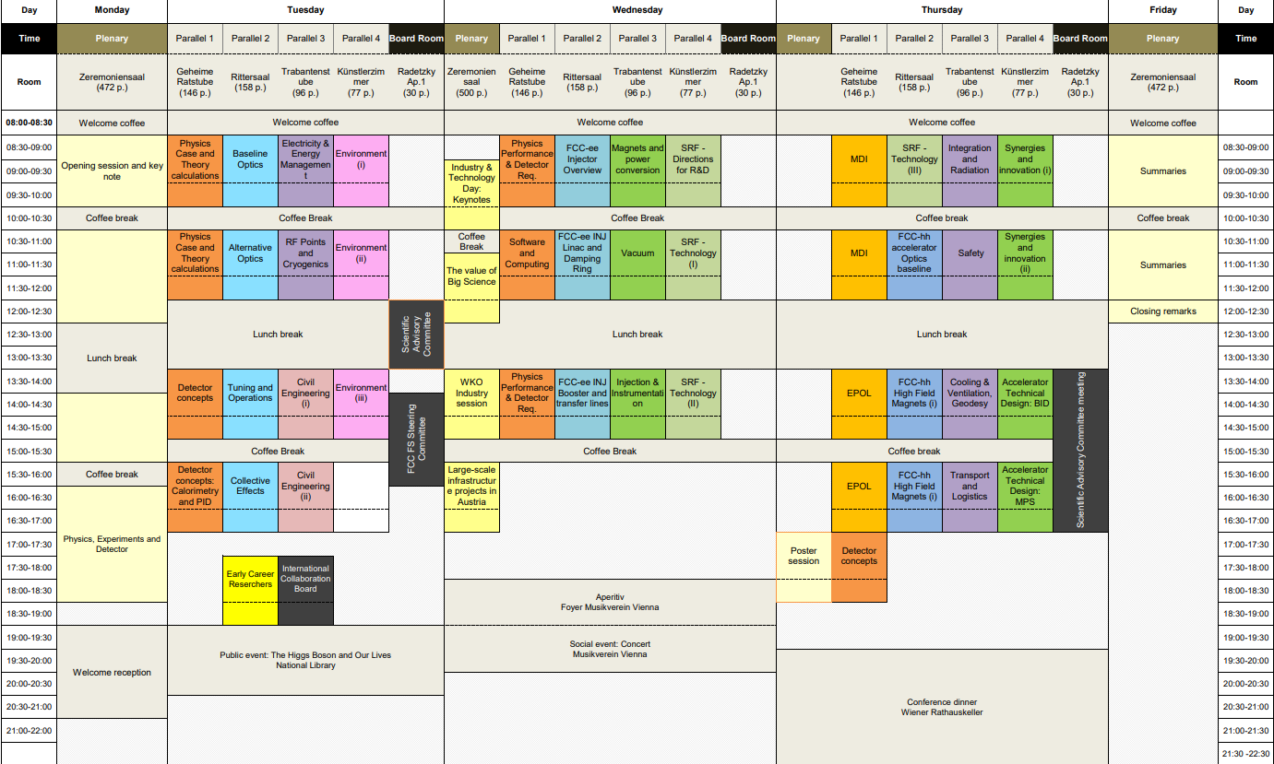
Klaus Hanke
2
6 sessions
24 presentations

Slide 3
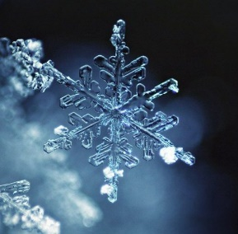
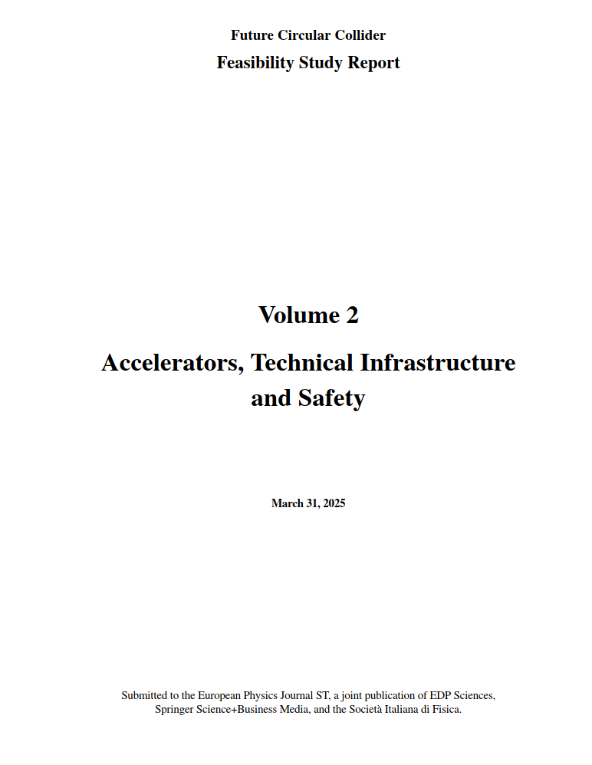
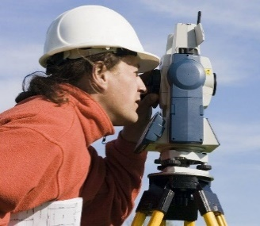
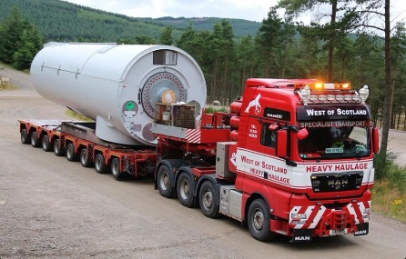
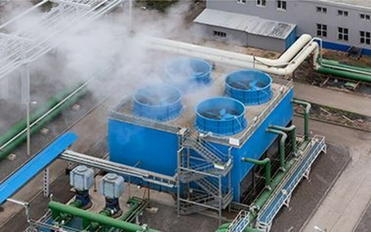

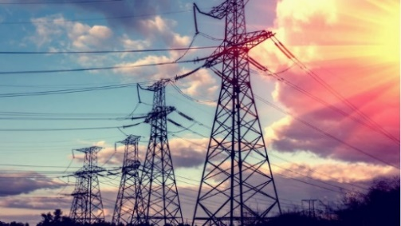
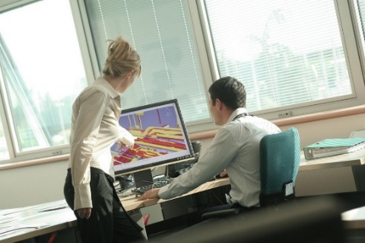
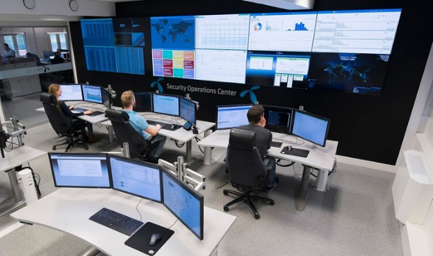
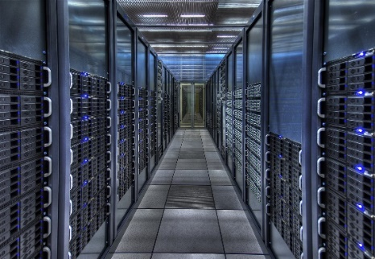
Klaus Hanke
3

Slide 4
Klaus Hanke
4
Electricity and Energy Management
Chair: Nicolas Bellegarde
Mario Parodi, New technologies for electrical transmission and distribution
Santiago Hernán Suarez, Integrating renewable energy and hydrogen storage into the FCC
Charline Marcel, Electrical grid and infrastructure update
Hannah Dostmann, Technical infrastructure availability: Challenges and opportunities from LHC to FCC-ee
M. Parodi, M. Colmenero:
The problem of power quality
Data from PMUs (phasor measurement units), detected e.g. instabilities before black-out
Unified Power Flow Controllers for FCC
S. Hernan Suarez:
Renewable energy (solar, wind); hydrogen storage

Slide 5
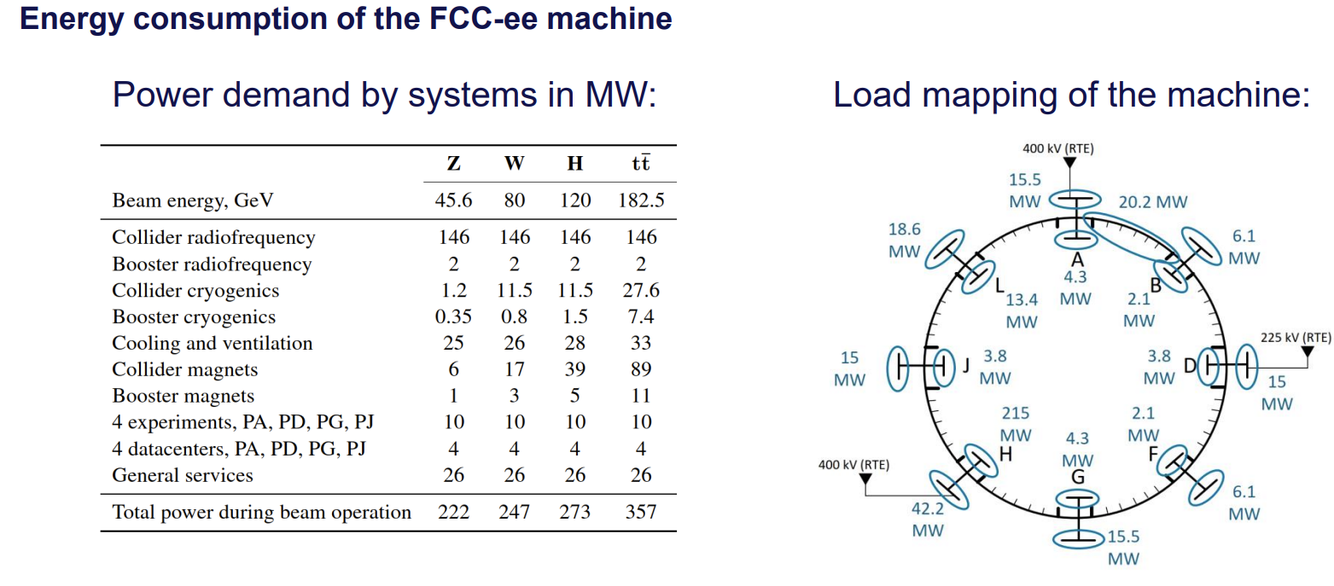
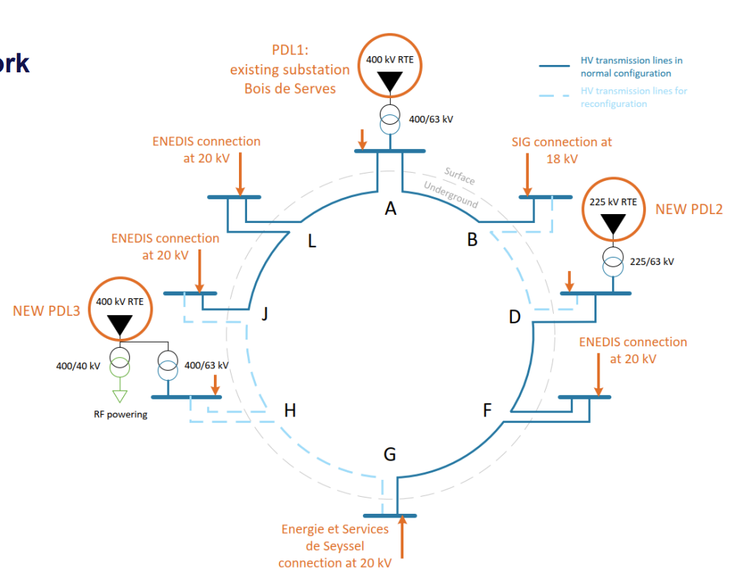
Klaus Hanke
5
Electricity and Energy Management
Concept of the electrical grid for FCC-ee
C. Marcel:
Electrical infrastructure layout
Secured network concept

Slide 6
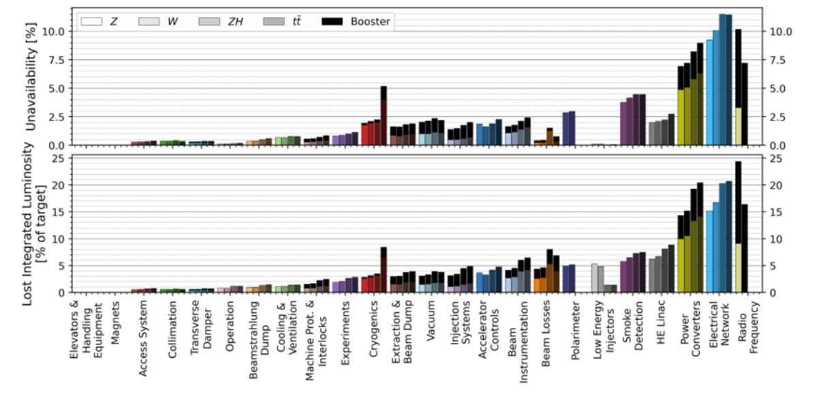
Klaus Hanke
6
Electricity and Energy Management
H. Dostmann, availability
electrical system, cryogenics, cooling & ventilation;
data based on experience, along with mitigation measures

Slide 7
Klaus Hanke
7
RF Points and Cryogenics
Chair: Frank Gerigk
Fani Valchkova, Mark Timmins, Integration of RF points for FCC-ee
Davide Aguglia, Powering of RF for FCC-ee
Anita Petrovic, FCC-ee cryogenics status update from FSR
Laurent Delprat, FCC-hh cryogenics update for 1.9 K and 4.5 K options
F. Valchkova, M. Timmins: updated integration of PH, PL, based on new cryostat design

Slide 8
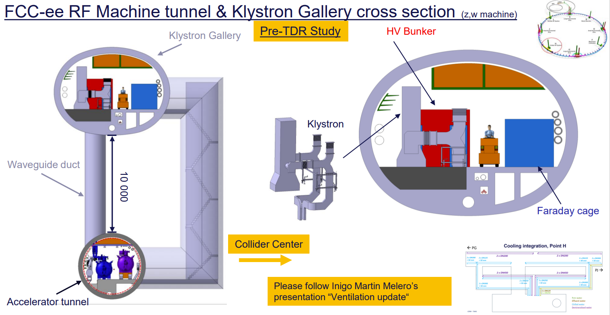
Klaus Hanke
8
RF Points and Cryogenics

Slide 9
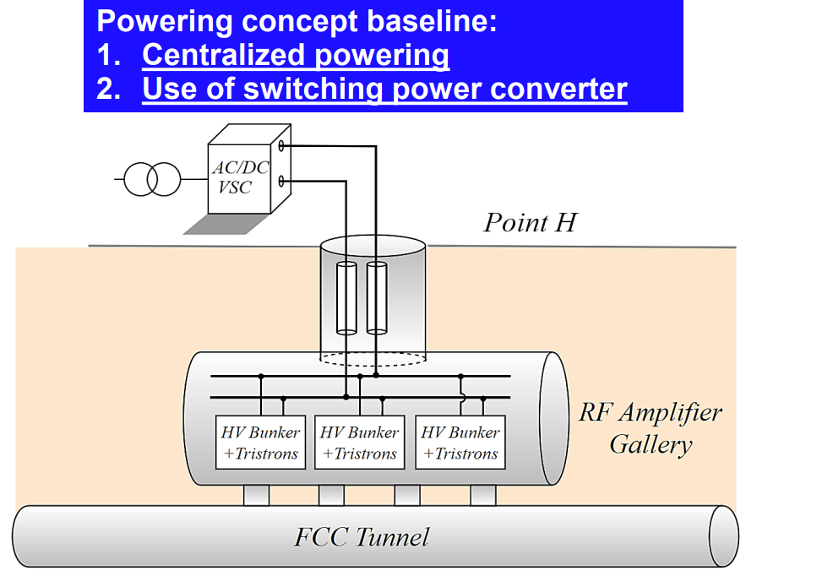
Klaus Hanke
9
RF Points and Cryogenics
D. Aguglia, powering of the RF
new baseline Tristron
Modular Multilevel Converter MMC
existing facilities feature high availability and efficiency
available technology, centralized powering scheme seems to be the best

Slide 10
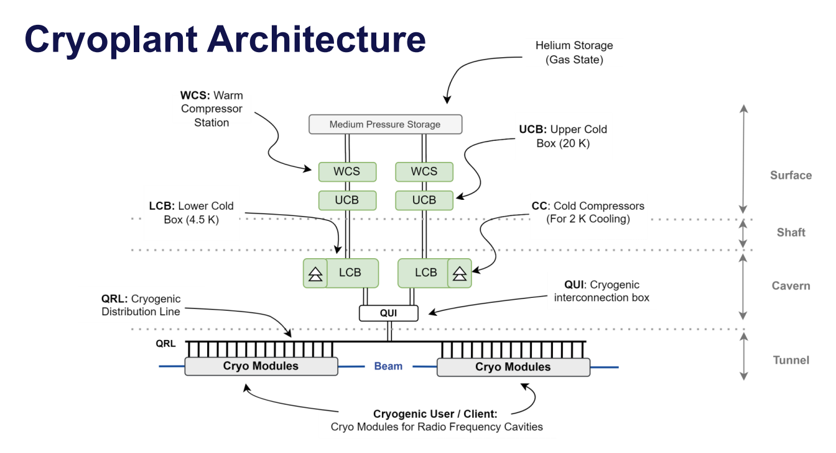
Klaus Hanke
10
RF Points and Cryogenics
A. Petrovic, cryo system for FCC-ee
L. Delprat, cryo system for FCC-hh
baseline 1.9 K

Slide 11

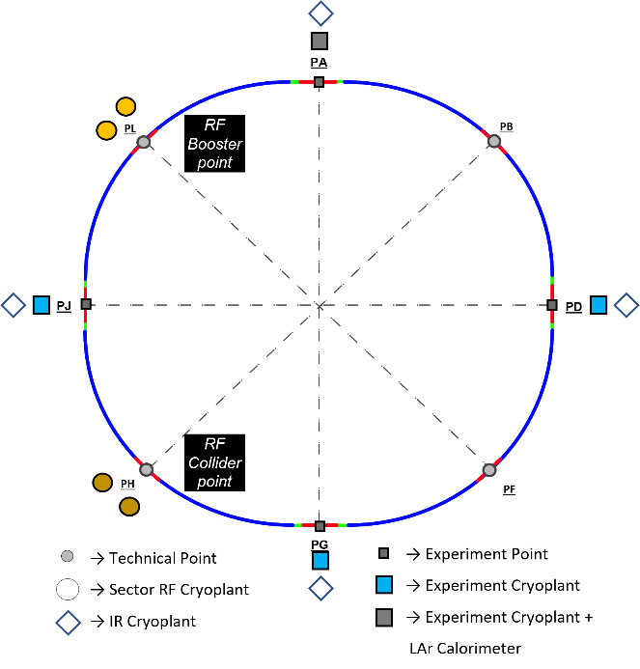

FCC-ee @ ttbar
Klaus Hanke
11
FCC-ee collider cryogenic system layout for $\overline{tt}$ operation

Slide 12
Klaus Hanke
12
Integration and Radiation
Chair: Sonia Bartolome
Fani Valchkova, Integration update
Federico Carra, Audrey Piccini, Arc half-cell mock-up status
Barbara Humann, Radiation environment in the FCC-ee arcs

Slide 13
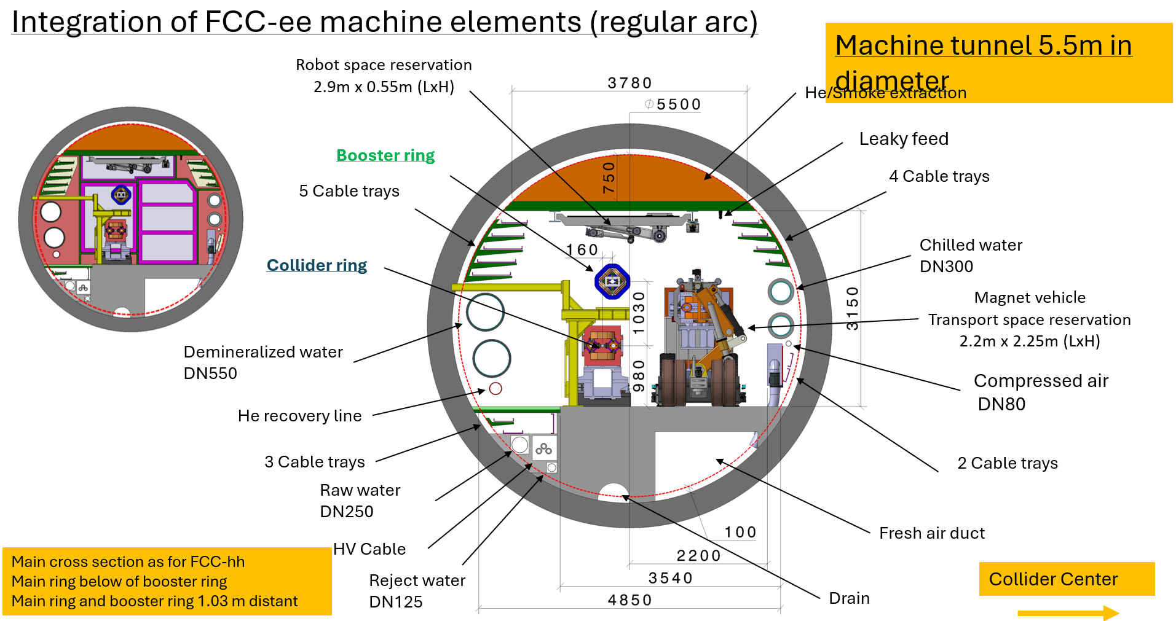
Klaus Hanke
13
experimental Points
technical Points
RF sections
alcoves
service caverns
etc.

Slide 14
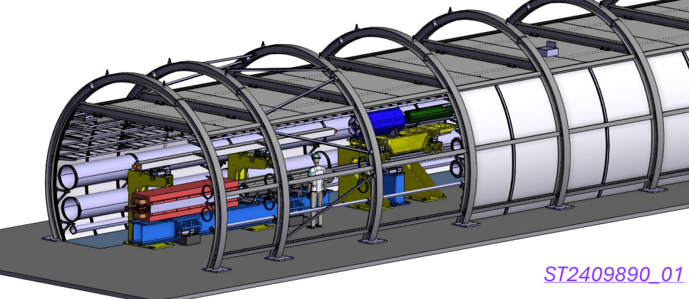
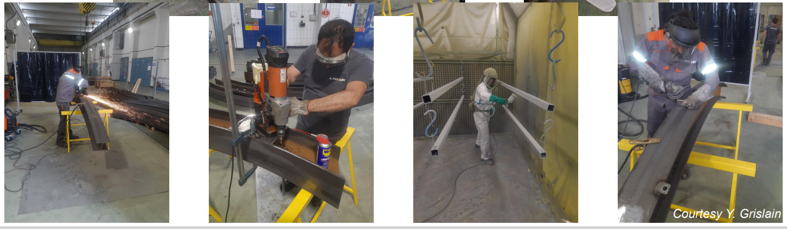
Klaus Hanke
14
F. Carra, A. Piccini, status of arc half-cell mock-up
arc represents 85% of the machine
installation at CERN in an existing building
preparatory works ongoing

Slide 15
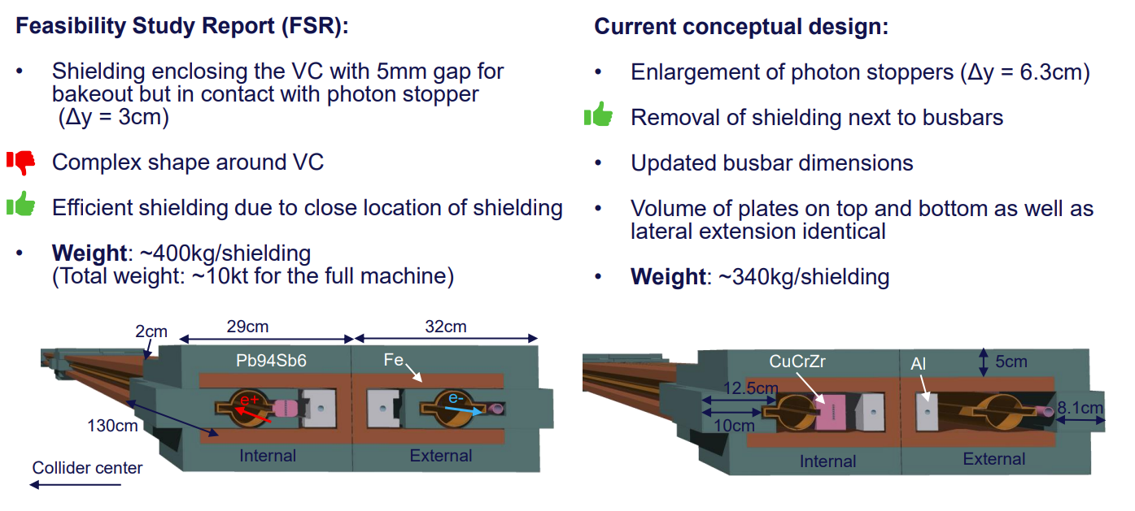
Klaus Hanke
15
B. Humann
radiation environment in the FCC-ee arcs
challenges: dissipated power, ionizing dose, radiation to electronics

Slide 16
Klaus Hanke
16
Safety
Chair: Benoit Delille
Andre Henriques, Review of the safety concept - pre-TDR roadmap
Giacomo Lavezzari, Radiation protection studies for the FCC
Oriol Rios, Reviewed fire safety concept and future studies
Guven Nergiz, ODH simulations: benchmark and access conditions to RF sector
Marc Nas & Hannes Gamper, FRS intervention: use of robotics

Slide 17
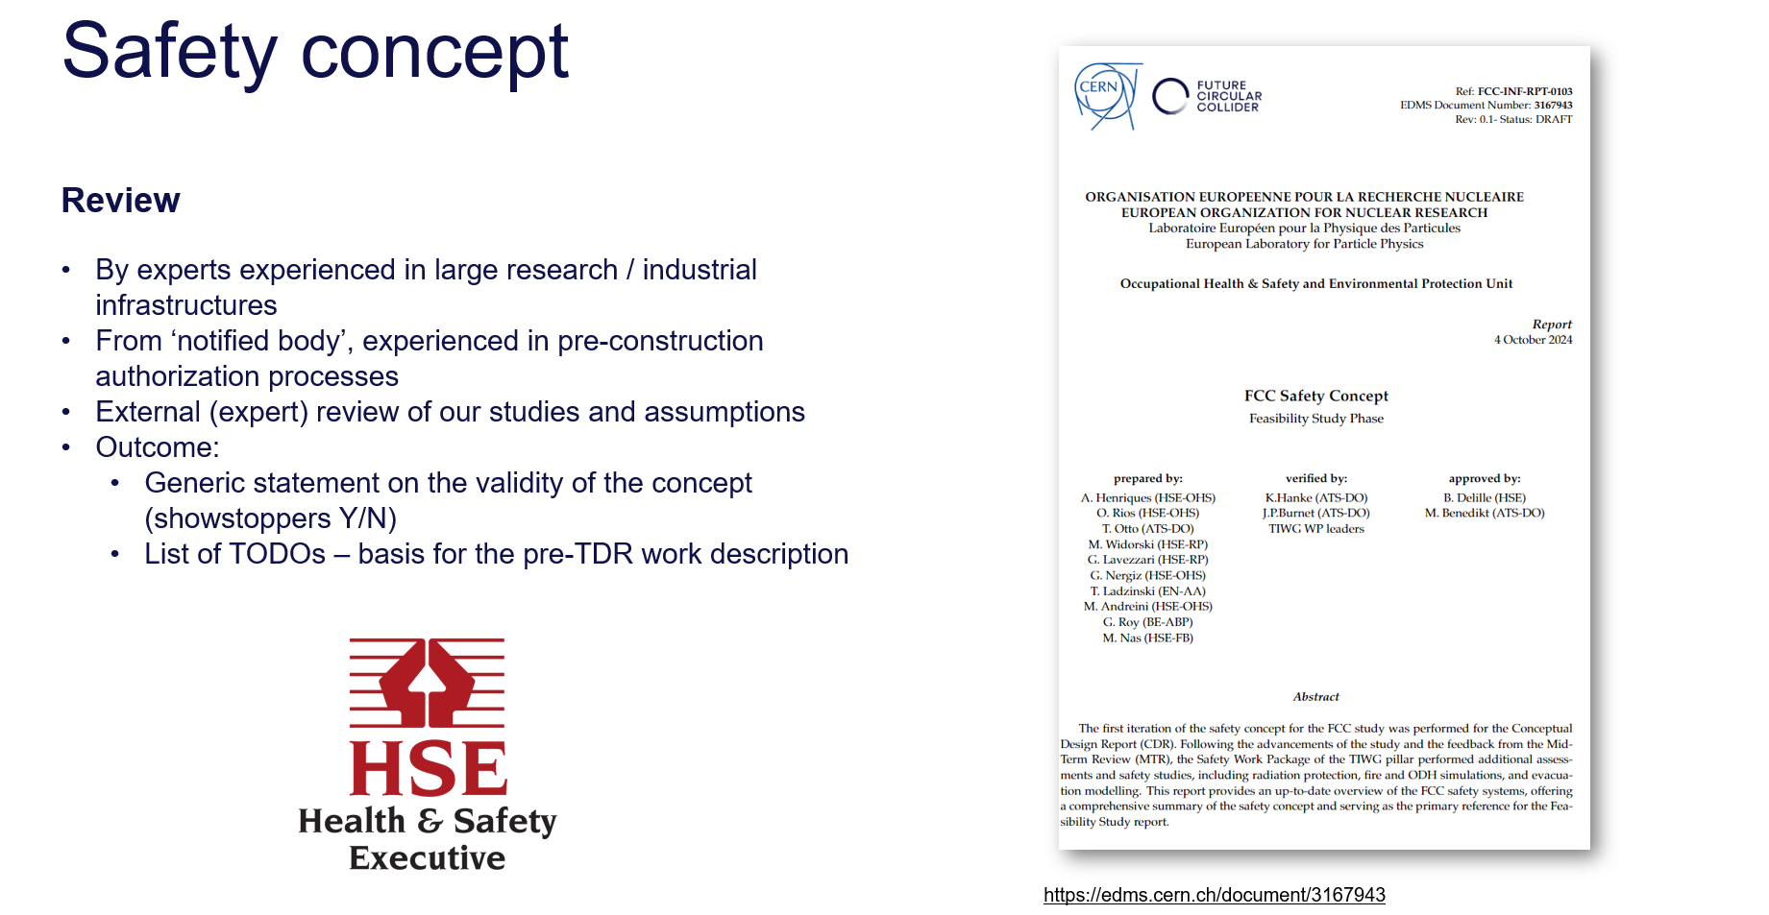
Klaus Hanke
17

Slide 18
Klaus Hanke
18
Cooling and Ventilation, Geodesy
Chair: Ingo Ruehl
Inigo Martin Melero, Cooling update
Inigo Martin Melero, Ventilation update
Armin Hafner (NTNU), Heat recovery perspectives with CO₂
Benjamin Weyer, Geodesy update

Slide 19
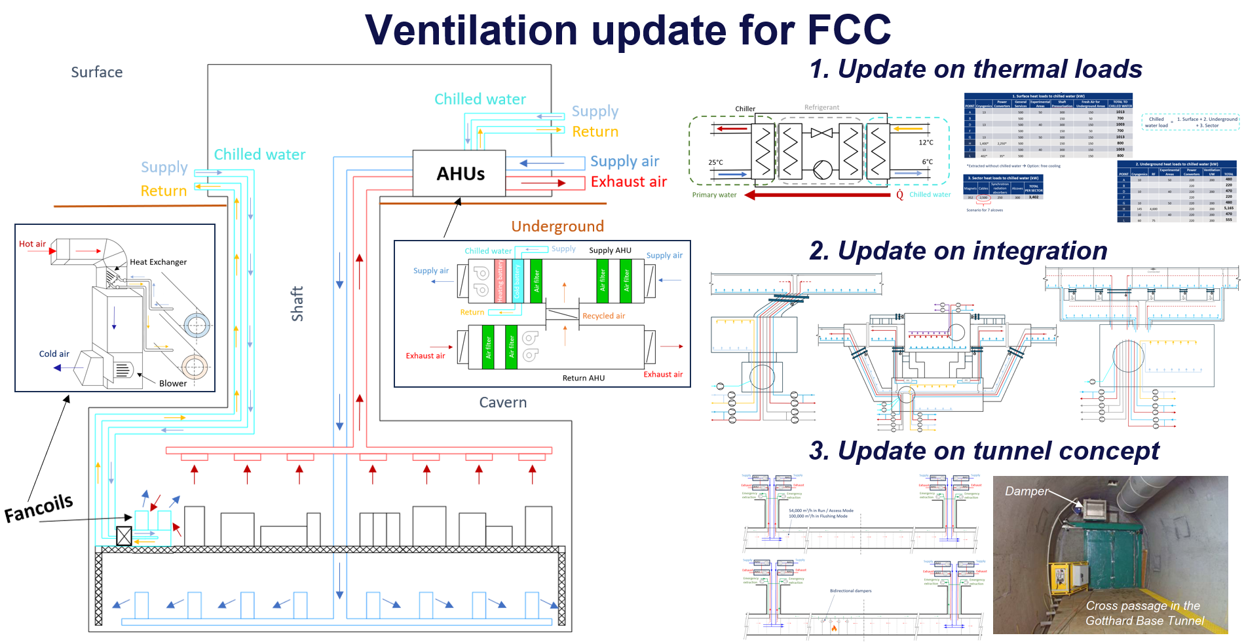
Klaus Hanke

Slide 20

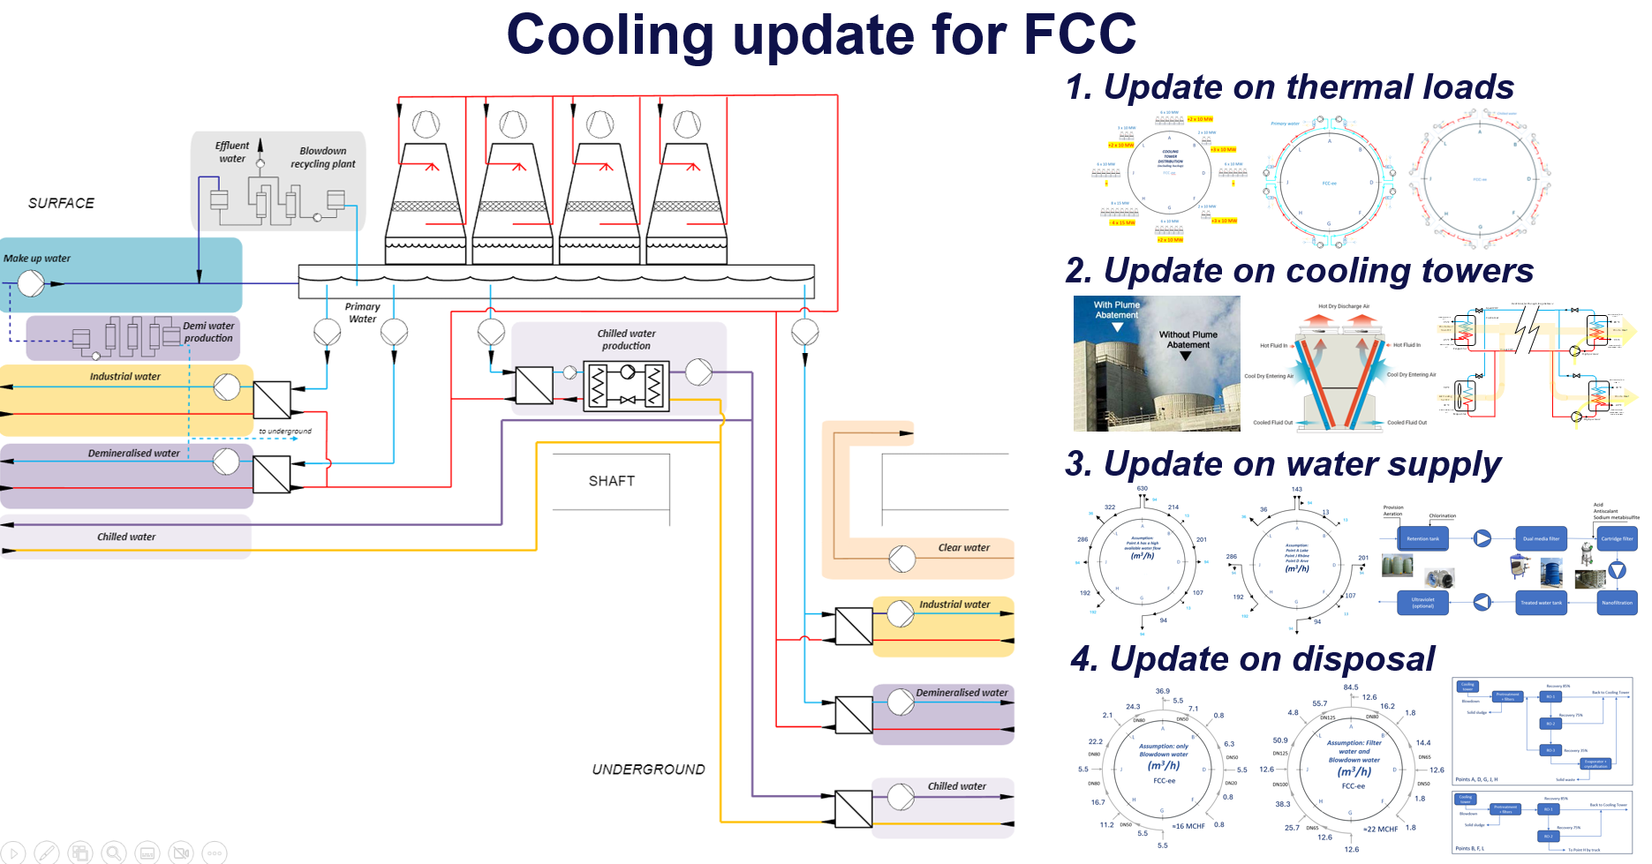
Klaus Hanke
20

Slide 21
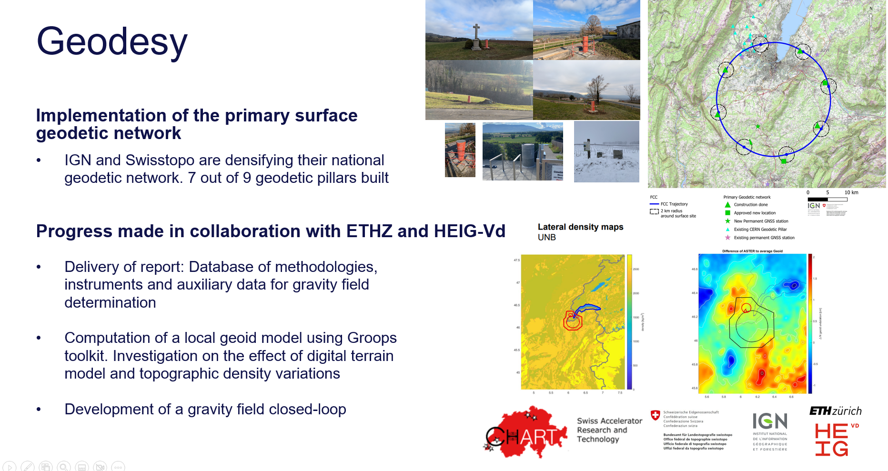
Klaus Hanke
21

Slide 22

Klaus Hanke
22
Transport and Logistics
Chair: Benedikt Müller / FIML
Damien Lafarge, Transport concept (personal and material)
Hannes Gamper, Robotics update
Milosz Zielinski, Magnet production
Sarah Fleury, Installation schedule

Slide 23
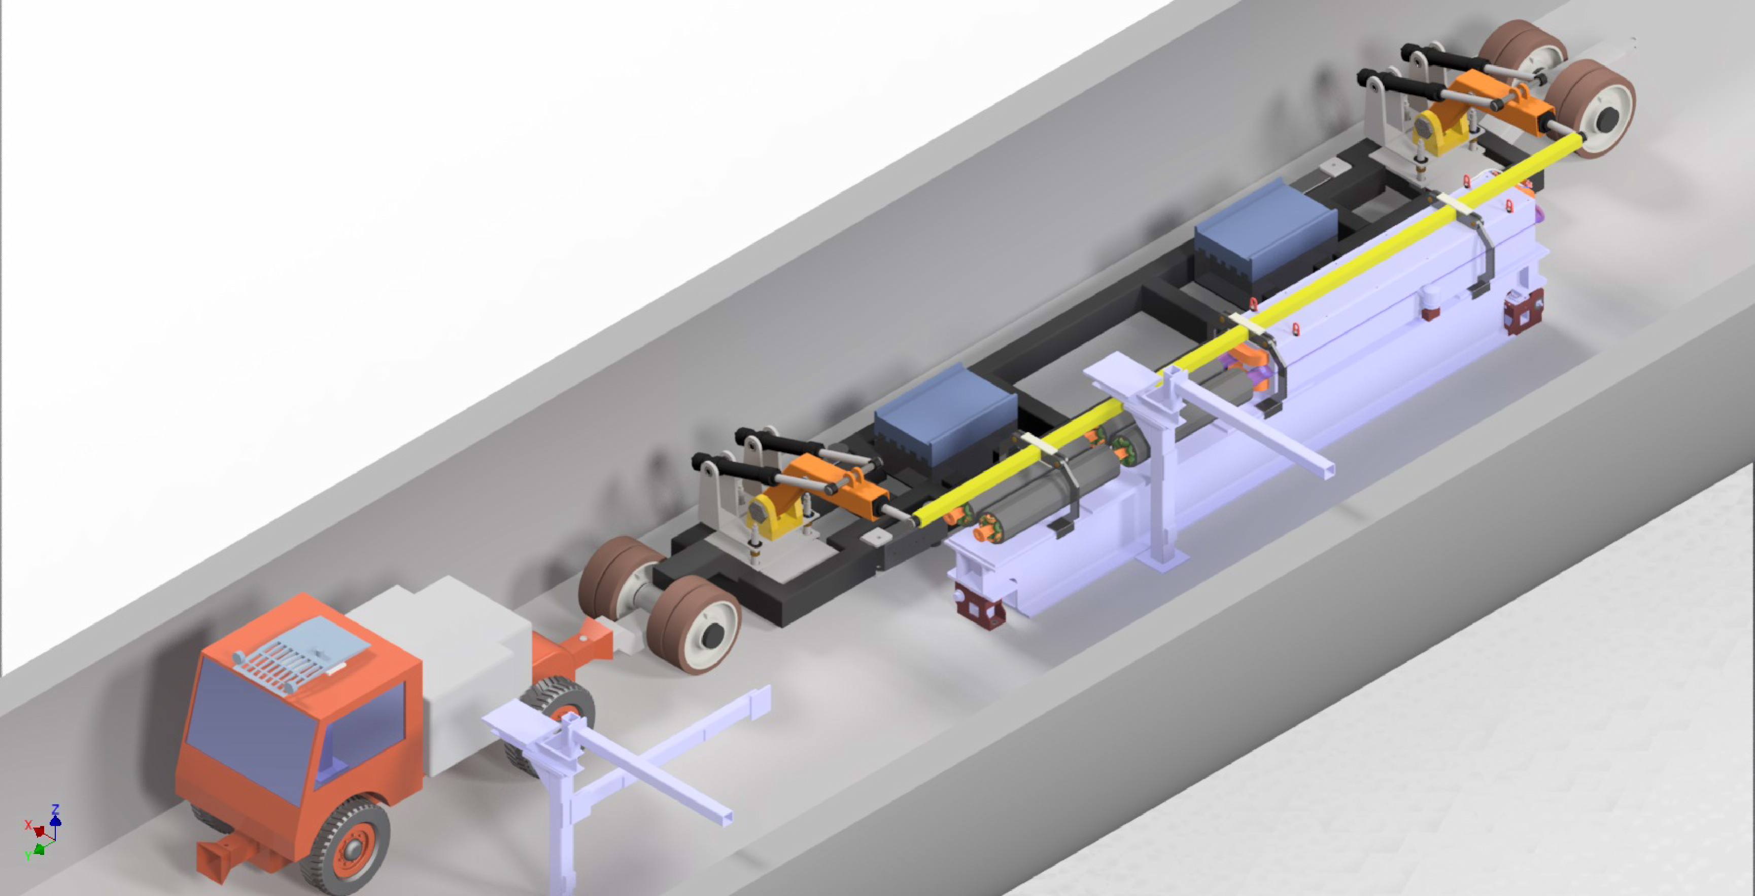
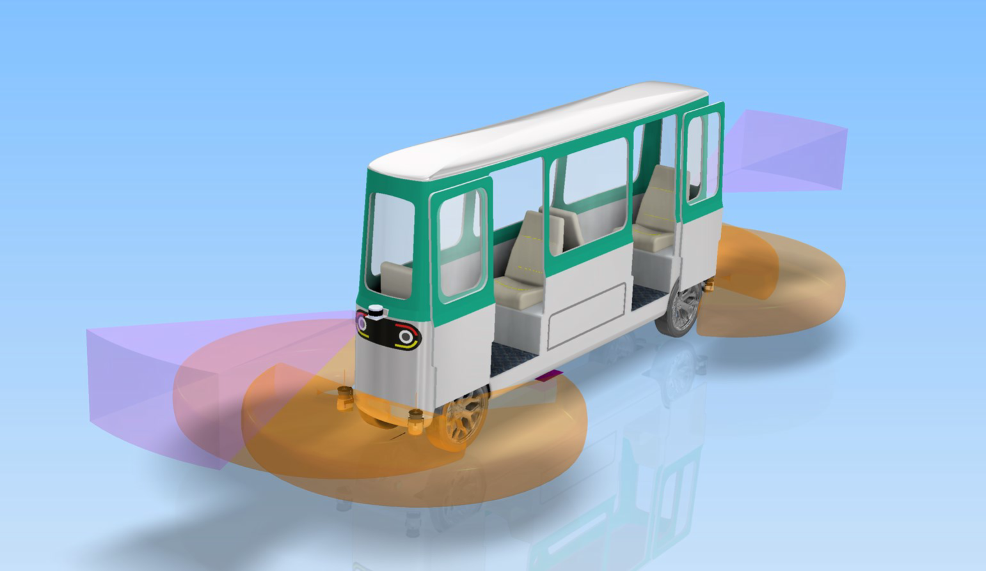
Klaus Hanke
23
Transport and Logistics
max speed 30 km/h
autonomous driving
driveway width is 2.2 m
Transport and installation of a quadrupole with two sextupoles and the supporting girder (QSS unit)

Slide 24
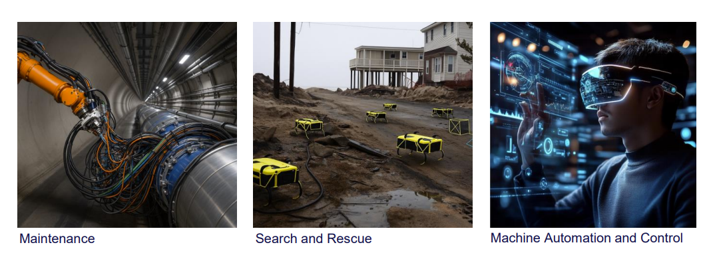
Klaus Hanke
24
H. Gamper, robotics update

Slide 25
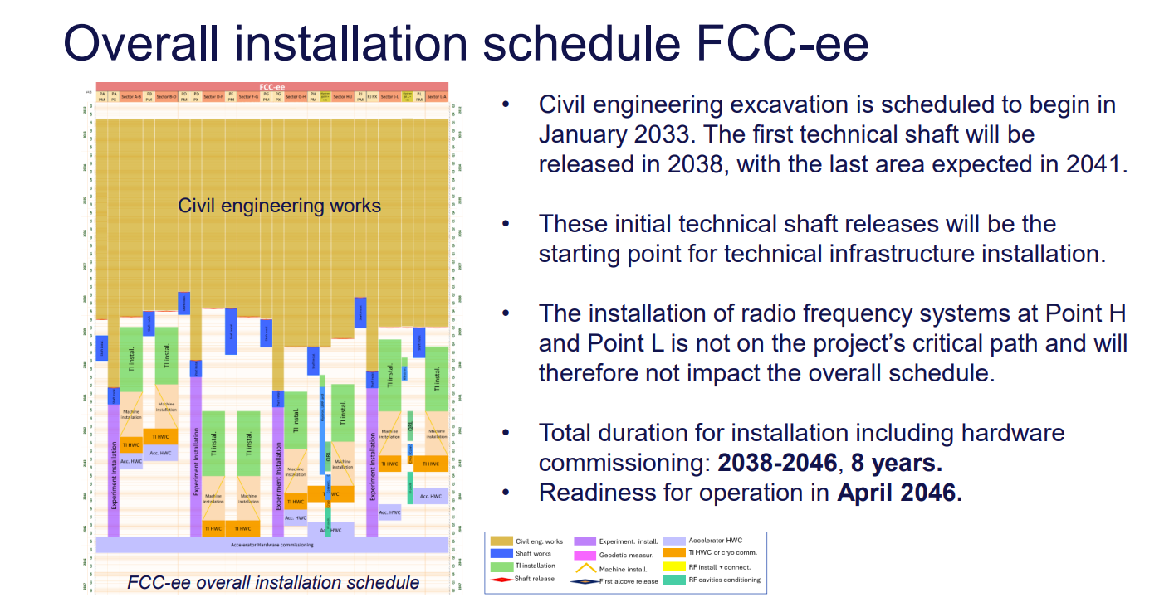
S. Fleury, updated installation schedule

Slide 26
Klaus Hanke
Big thanks to the chairpersons and speakers of the infrastructure sessions

Slide 27

Klaus Hanke
27
27

