Slide 1

Accelerator summary
K. André, F. Zimmermann

Slide 2
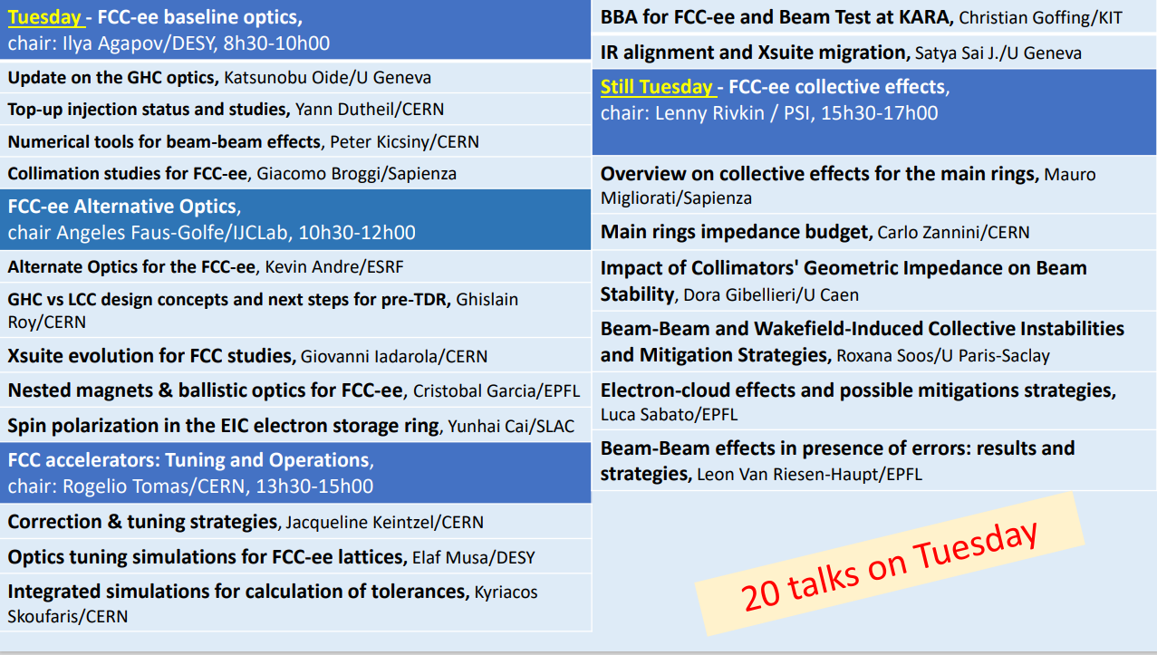

Slide 3
1st Session -
FCC-ee accelerator:
Baseline optics
Update on GHC optics and lattice design
Top-up injection status and studies
Numerical tools for FCC-ee beam-beam studies
Collimation studies for FCC-ee

Slide 4
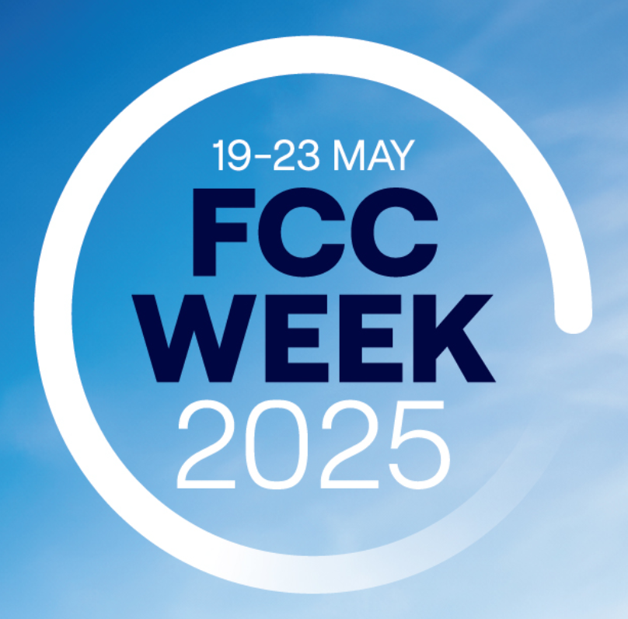
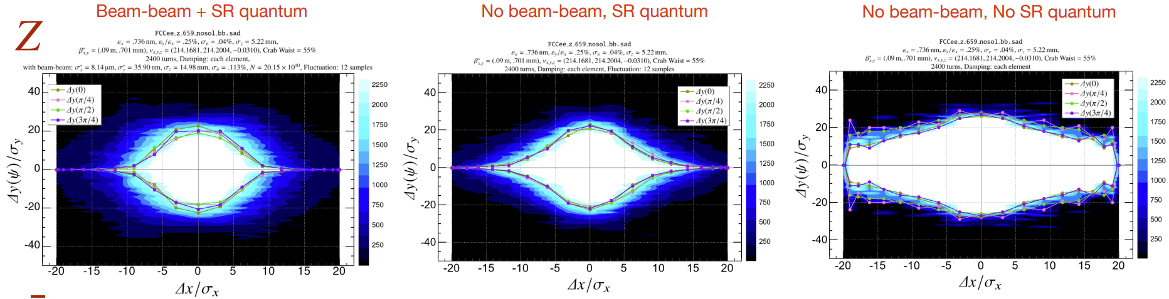
Updates on the GHC optics and lattice design
K.Oide
β*_{x}=9cm and Q’_{x}=12 to relax the X-Z beam-beam instability at Z.
Extension of L* from 2.2 to 2.4m is possible for more radial space.
A common technical straight section (TSS) for injection/extraction, collimation, and RF (Z/W) maintaining the ring super-periodicity.
Extension of the available space for the cryomodules in the RF section for ttbar, still remains insufficient –swap 400MHz with 800MHz ?
Beam-beam + SR quantum
No beam-beam, SR quantum
No beam-beam, no SR quantum

Slide 5
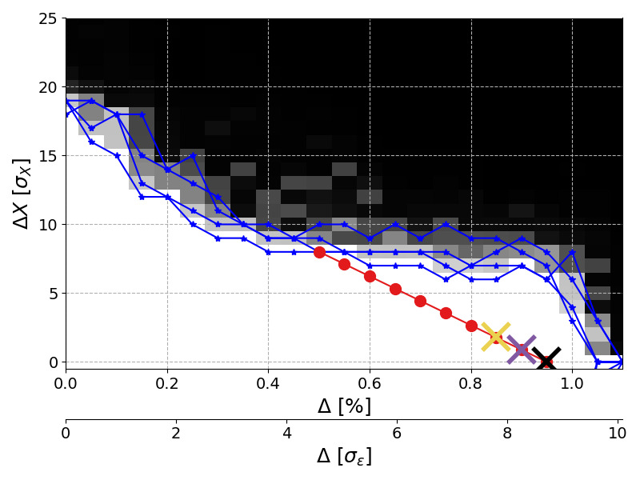
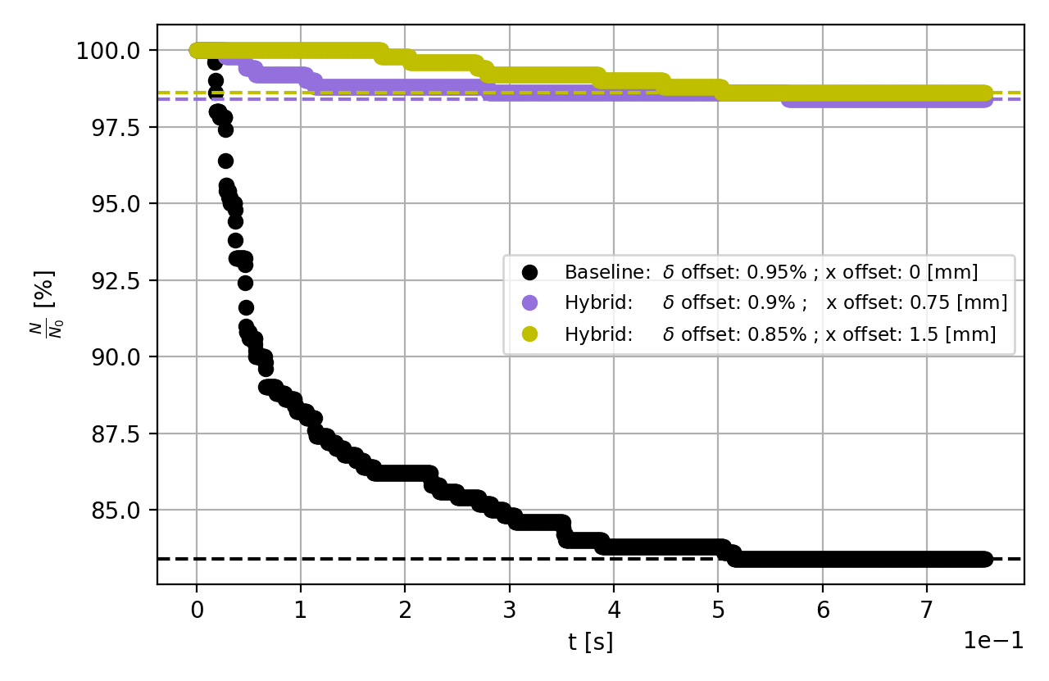
Top-up injection status and studies
Y.Dutheil
Hardware:
  Orbit π-bump comprising 2 kickers (might be extended to 4 for more flexibility).
  Thin magnetic septum (2.8mm blade and 304µs flat-top)
Particle tracking including beam-beam effects indicates that an hybrid injection maximizes the injection efficiency (w.r.t. on-axis).
Initial bootstrapping simulations from low intensity indicate a vertical optics mismatch and ε_{z} increases with intensity.
Preliminary injection losses simulations performed to set protection requirements.

Slide 6
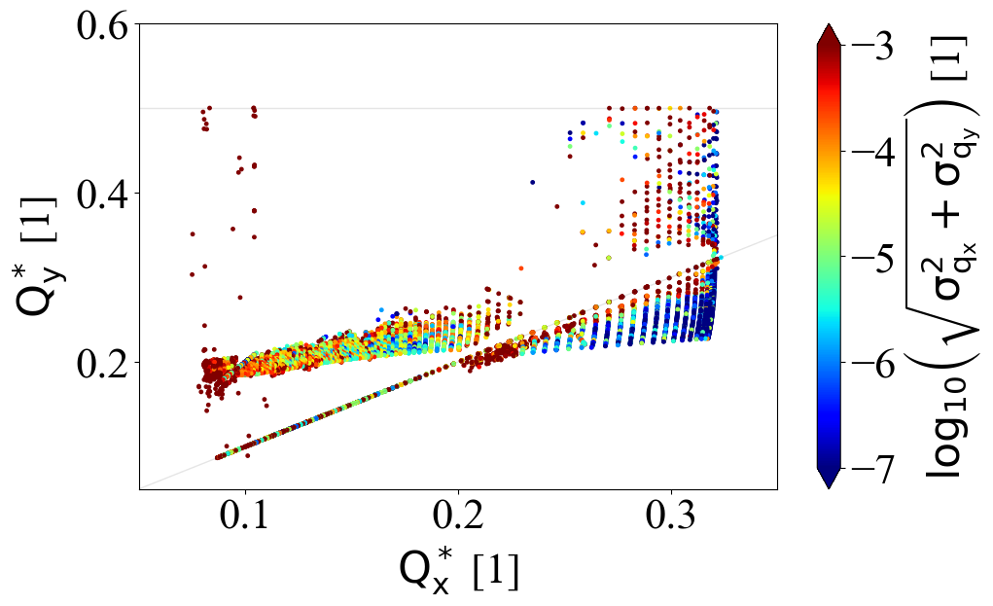
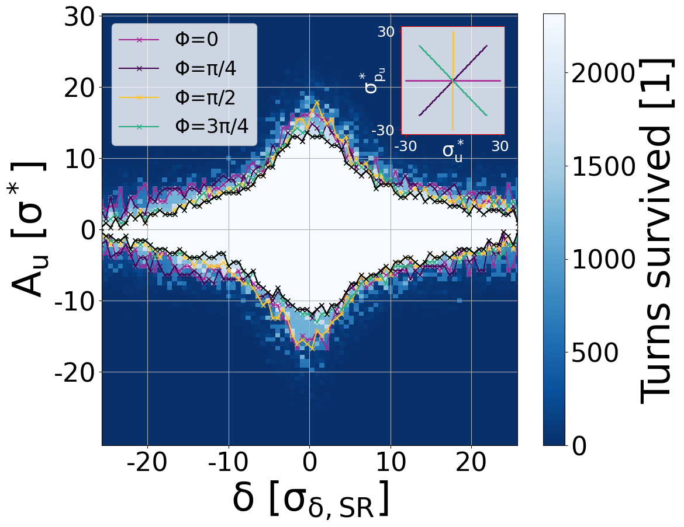
Numerical tools for FCC-ee beam-beam studies
P.Kicsiny
Xsuite used for self-consistent FCC-ee beam dynamics studies.
Interest in highlighting correlation between beam lifetime (time consuming) and DA studies (comparatively fast computation).
Standardized setups and submission scripts for DA/MA, FMA evaluation tools are being developed. -> xutil has started this process.
 | Weak-strong 6D | Quasi-strong-strong 6D | Strong-strong 6D |  | Beamstrahlung | Bhabha-scattering | Transverse wakefields | Longitudinal wakefields | Linear tracking | Nonlinear tracking | Open source
Xsuite
Strong-strong 6D PIC
Strong-strong 6D SG
Longitudinal wakefields
Quasi-strong-strong 6D
Beamstrahlung
Transverse wakefields
Lattice tracking
Runs on GPU
Weak-strong 6D
Bhabha-scattering
Linear tracking
Open source
Available
Not available

Slide 7
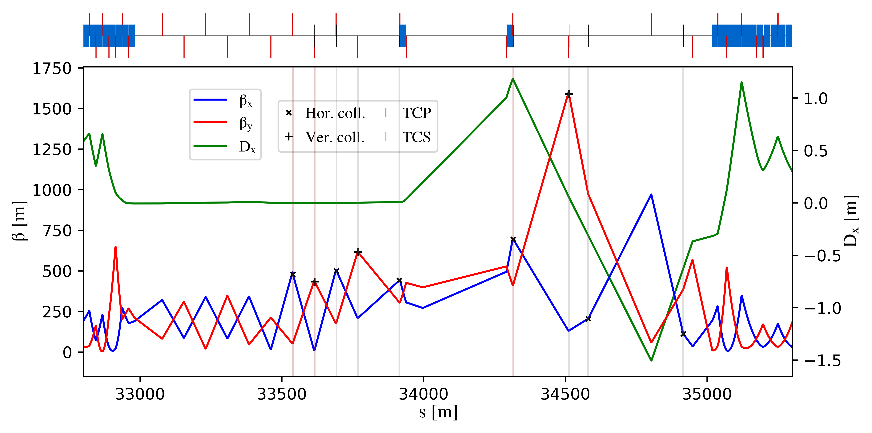
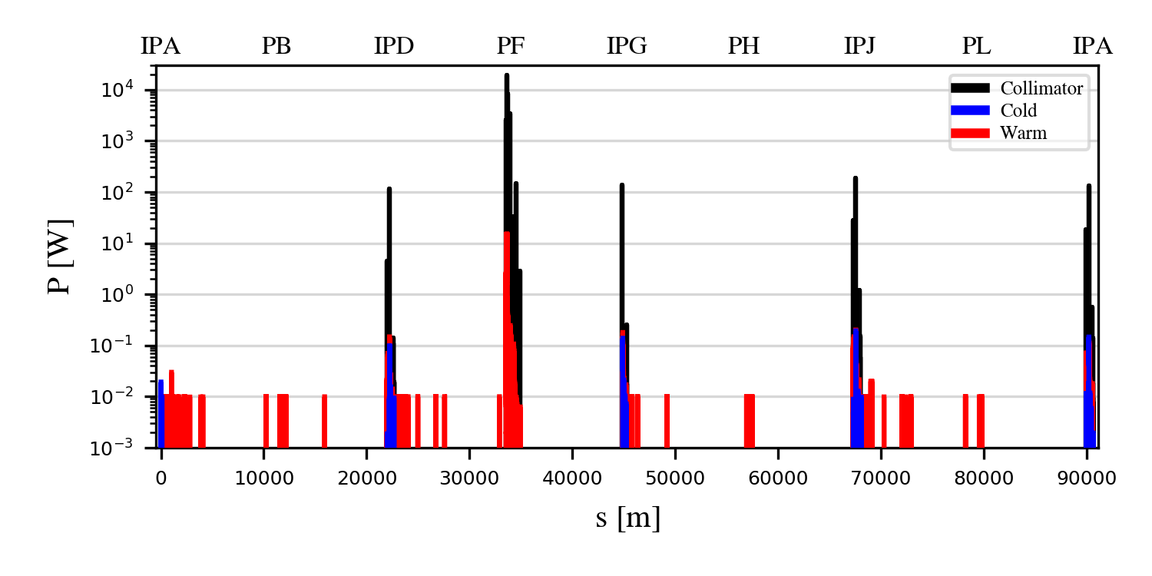
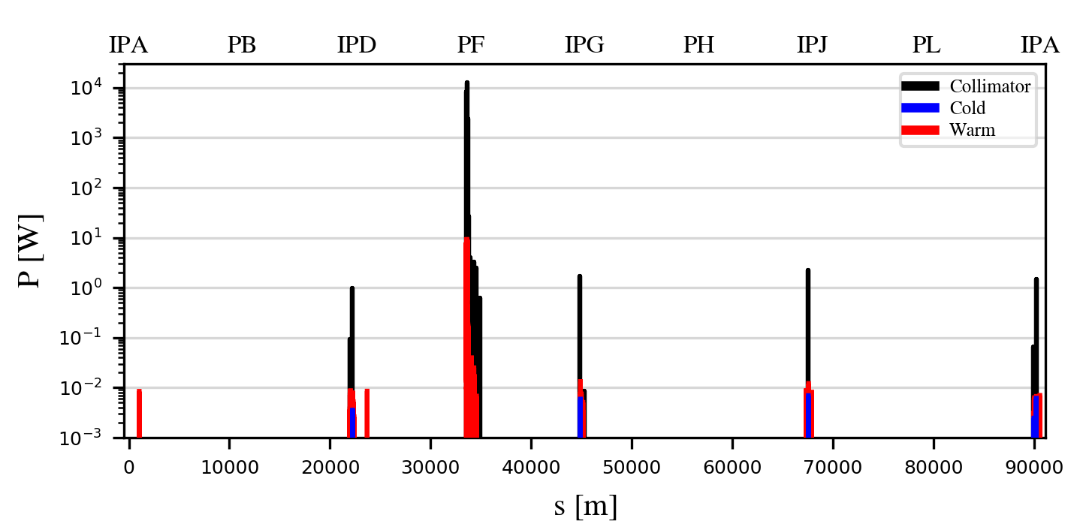
Collimation studies for FCC-ee
G.Broggi
The collimation system consists of beam halo collimators with shower absorbers in between, synchrotron radiation collimators and local protection collimators.
Use of the universal technical insertion conserving super-periodicity.
Beam loss scenarios simulated for FCC-ee include: generic halo, beam-gas interactions, top-up injection, fast instabilities and more to be studied including their impacts on the particle detector (background).
Xsuite-BDSIM benchmark at SKEKB accurately reproducing measured background trend.(beam-gas and Touschek scattering).
betatron
off-momentum
B1H
B1H + tilt
Beam halo losses w/o (left) and w/ (right) collimator angular alignment.

Slide 8
2nd Session -
FCC-ee accelerator:
Alternative optics
Alternate optics for the FCC-ee
GHC vs LCC design concepts and next steps for pre-TDR phase
Xsuite evolution for FCC studies
Nested magnets and ballistic optics for the FCC-ee
Spin polarization in the EIC electron storage ring

Slide 9
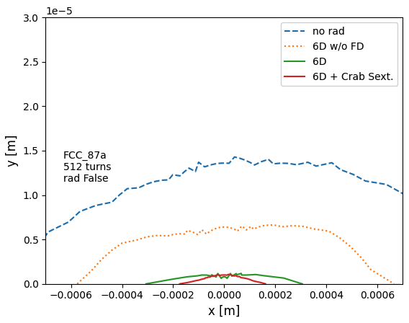
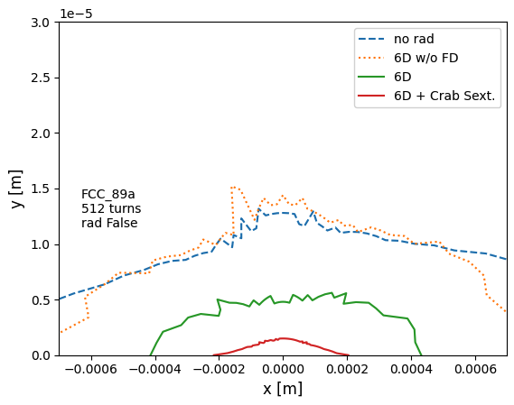
Alternate optics for the FCC-ee
K.André
Beam parameters: comparable to GHC, smaller energy loss per turn for LCC.
Number of magnets: at ttbar the LCC optics has less magnets with smaller gradients.
Dynamic Aperture: larger DA on- and off-energy for the LCC optics, especially vertically (@Z).
Work needed to perform tuning studies and to adapt the straight sections to compare with the GHC lattice.
including decapoles
including decapoles

Slide 10
GHC vs. LCC design concepts and next steps for the pre-TDR phase
G.Roy
Presentation of the comparison exercise: arcs, insertions, hardware, …
Active “FCC-ee Layout and Optics Design working group”
Ambitious timeline post FCC Week 2025:
Summer 2025:
Repository re-organized and ready; optics layout; naming conventions
September 2025:
Beam optics with technical insertions, complete layouts.
December 2025:
Optics comparison report; geometry frozen for Civil Engineering
March 2026: Decision on Optics – review from expert panel ?
FCC Week 2026:
First Technical Design of Optic

Slide 11
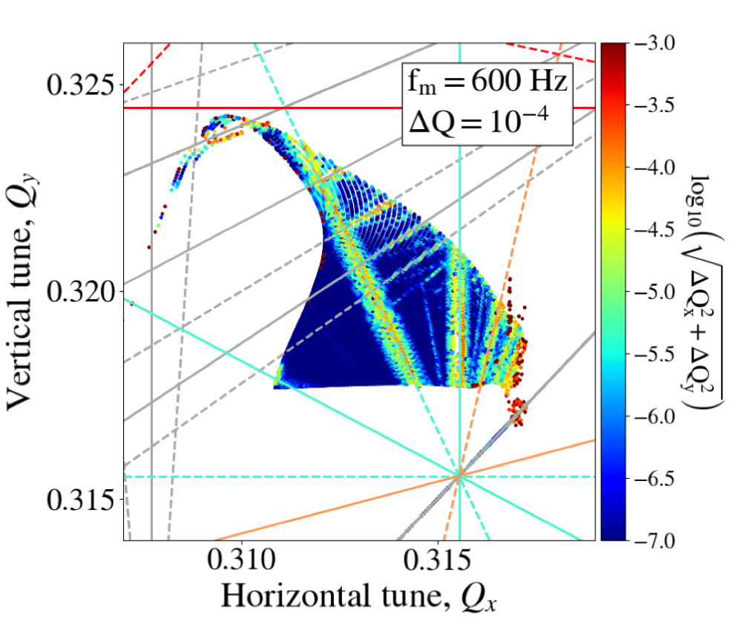
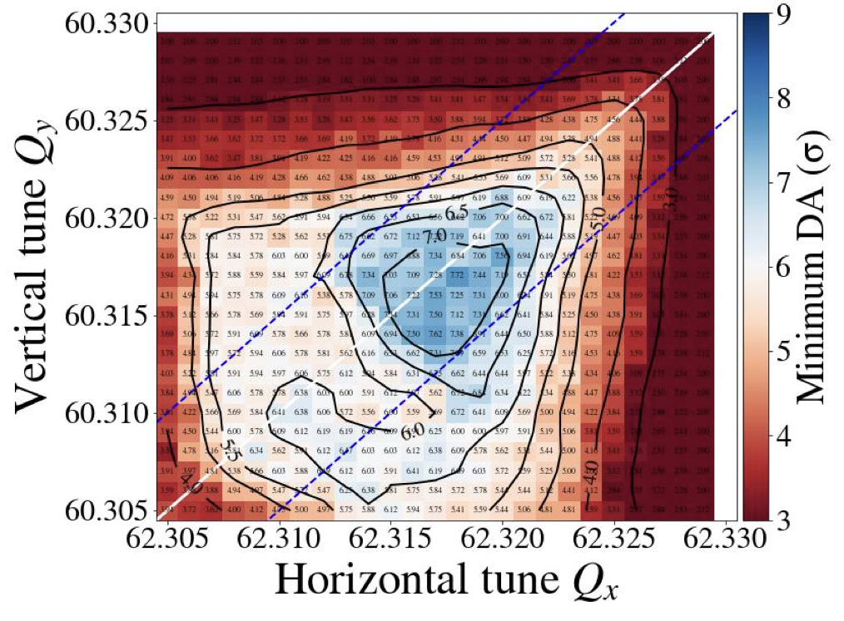
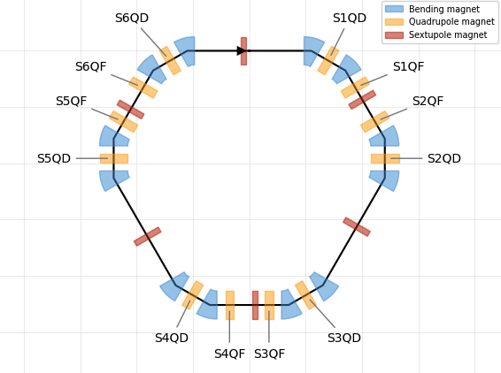
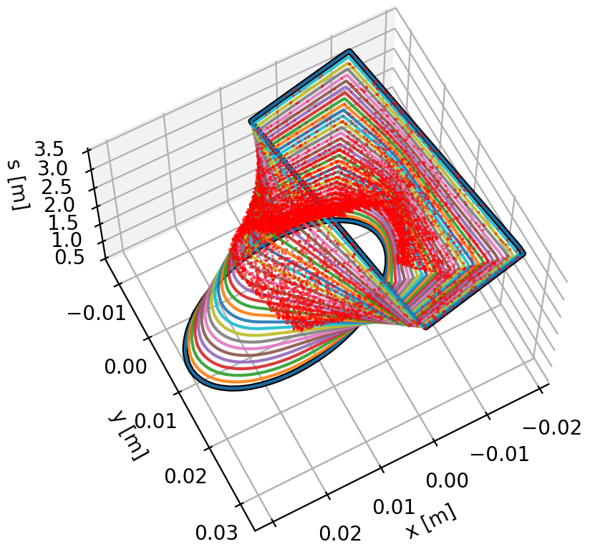
Xsuite evolution for FCC studies
G.Iadarola
Xsuite considered a workhorse for FCC-ee beam dynamics studies
Alleviate extendibility and integration issues from legacy tools, offers python interface and supports single/multi-threaded CPU and GPU.
Xsuite capabilities comprise: Optics and lattice design, imperfections and correction, interface with MAD-NG, RF-Track, BDSIM/FLUKA, collective effects and recently polarization tracking (analytical & stochastic).
Beam-Beam Effects
Tracking (dynamic aperture)
Lattice Design
Collimation

Slide 12
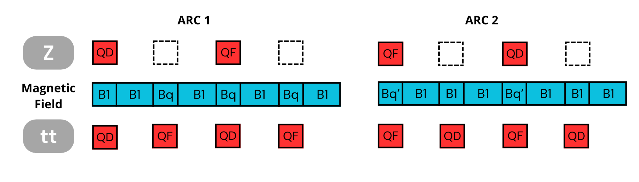
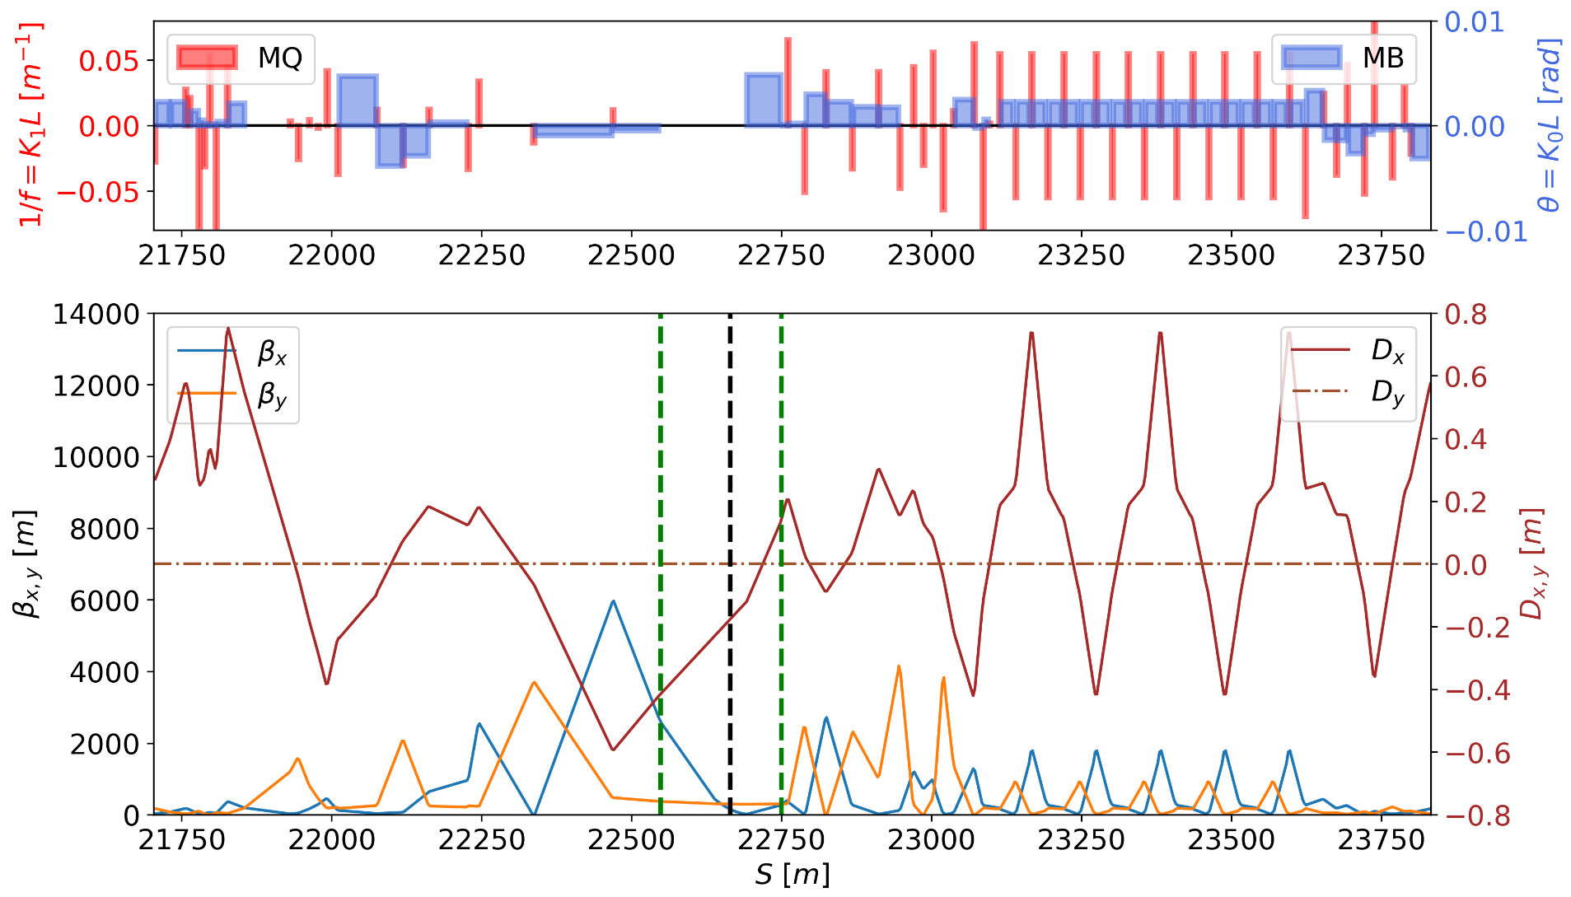
Nested magnets and ballistic optics for the FCC-ee
C.Garcia-Jaimes
Nested magnet arc design
Nested magnets for Z and ttbar:
  Fully integrated in the GHC lattice.
  Compatibility issues between Z and ttbar has been resolved.
Ballistic optics for the Z energy
  Turn off quadrupoles and sextupoles 200m around the IP → Significant increase of the DA and relaxed magnet sensitivities.
  Further work needed to improve the MA and beam lifetime (sextupole optimization).
Ballistic lattice

Slide 13
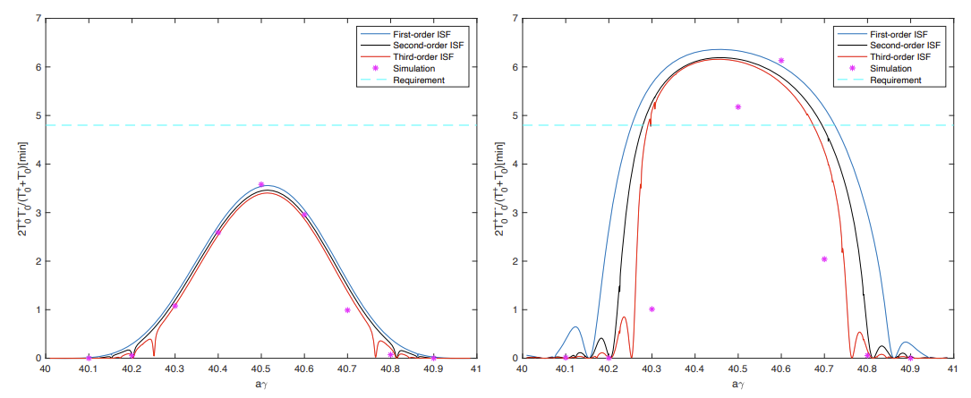
Spin polarisation in the ESR of EIC
Y.Cai
Developed normal forms up to arbitrary order for orbital motion and spin precession analytical solution. Good agreement with tracking.
Semi-local spin matching scheme: Four orthogonal vertical bumps to match the spin longitudinally along the spin closed orbit.
w/o bumps
w/ bumps
  Equilibrium polarization is nearly doubled.
  Almost no impact on the dynamic aperture.

Slide 14
3rd Session -
FCC-ee accelerator:
Tuning and operations
Correction and tuning strategies for FCC-ee
Optics tuning simulations for FCC-ee lattices
Integrated simulations for calculation of tolerances
BBA for FCC-ee and beam test at KARA
IR alignment and Xsuite migration

Slide 15
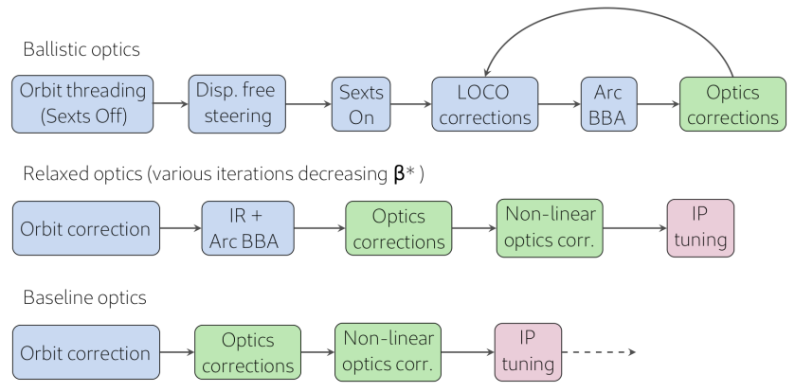
Correction and tuning strategies for FCC-ee
J.Keintzel
Commissioning and tuning strategy developed and progressing.
Good global optics tuning performance (w/o IR errors nor multipole errors), efficient IP tuning knobs, small errors in the IR cause blow-up.
SKEKB: complexity and manufacturing errors in the IR lead to degradation of the optics, impacting DA but also injection efficiency.
Studies focused on using GHC at Z; plan to look at the other beam energies and perform the same studies for the LCC lattice.
Element | Transv. Tol. | Rot. Tol. | Field. Tol.
Arc quad. | 50µm | 50µrad | 2e-4
Arc sext. | 50µm | 50µrad | 2e-4
Dipoles | 1000µm | 1000µrad | 2e-4
Girders | 150µm | 150µrad | -
BPM-quad. | 100µm | - | -

Slide 16
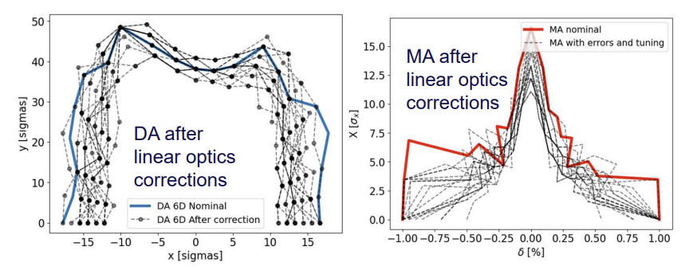
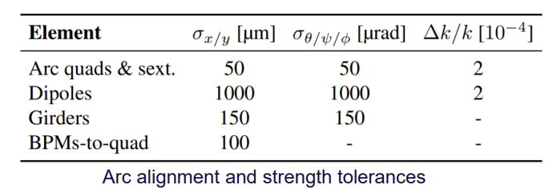
Optics tuning simulations for FCC-ee lattices
E.Musa
Developed a correction procedure
  With tuning simulations for the ballistic and nominal GHC optics
Comparison of correction procedure in favor of TbT compared to LOCO because it focuses on the phase advance between BPMs.
Improved correction when having BPMs attached to quadrupoles.
10

Slide 17
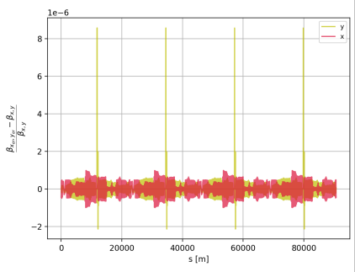
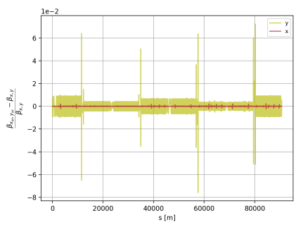
Integrated simulations for calculation of tol.
K.Skoufaris
Reduced sextupole strengths during commissioning: ballistic optics gives a larger lifetime –LCC presents a 350 turns lifetime with sextupoles turned off.
Injection performance about 90%, optics aberrations from beam-beam interaction, tolerances are low -> iterations needed.
Impact of ground motion: correlated and uncorrelated motions.
Magnetic field errors tolerances are challenging.
Xutil repository
Beta-beating from uncorrelated ground motion
Beta-beating from correlated ground motion

Slide 18
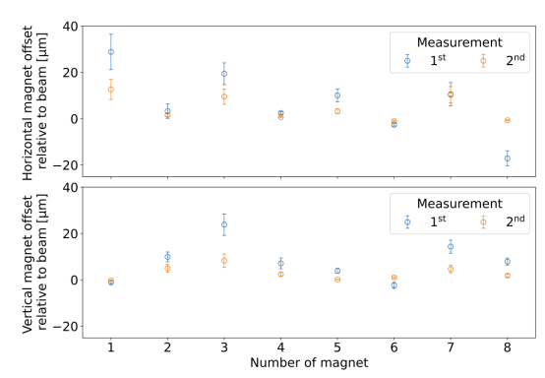
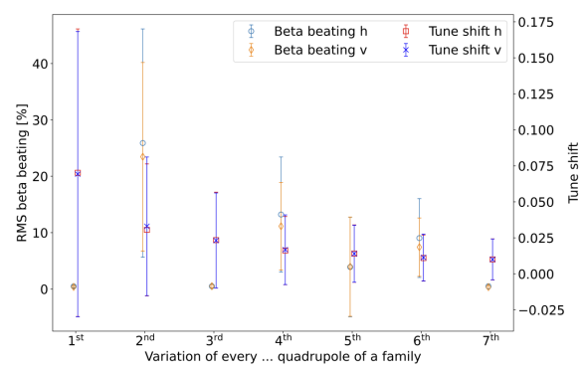
BBA for FCC-ee and beam test at KARA
C.Goffing
Parallel BBA with focus on arc quadrupoles to reduce the mechanical tolerances for quadrupoles and sextupoles.
Studies performed for GHC and LCC relaxed optics:
  Promising results to achieve the target of 10 to 20 micrometers accuracy
  Magnet selection is important e.g. beta-beating and tune change
Proof-of-principle at KARA
FCC-ee
KARA

Slide 19
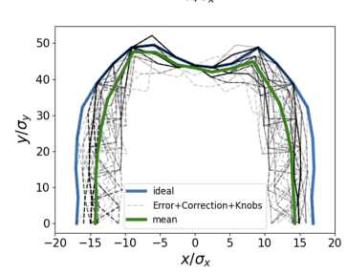
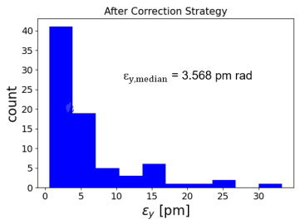
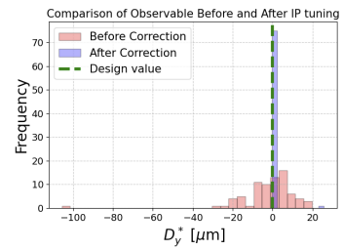
IR alignment and Xsuite migration
S.S. Jagabathuni
Global correction combined with IP tuning knobs are efficient at recovering the IP optics parameters. The median of the vertical emittance over 100 seeds remains twice larger than the design.
The errors in the final focus doublet largely dominates the tuning of vertical emittance.
Efforts on-going to integrate tuning and correction algorithms within Xsuite.

Slide 20
4th Session -
FCC-ee accelerator:
Collective effects
Overview on collective effects for the main rings
Main rings impedance budget
Impact of collimators geometric impedance on beam stability in the FCC-ee
Beam-beam and wakefield-induced collective instabilities for FCC-ee at Z energy
Electron-cloud effects and possible mitigation strategies
Beam-beam effects in presence of errors

Slide 21
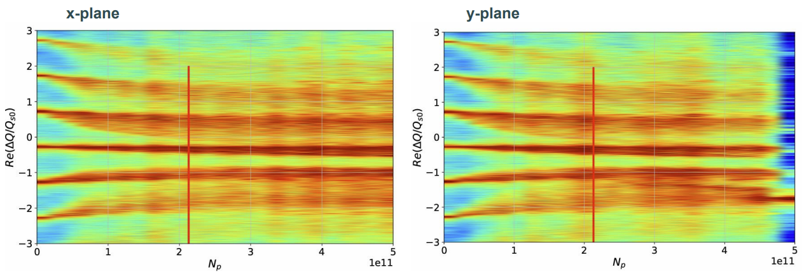
Overview on collective effects for the main rings
M. Migliorati
With the current impedance model, the vertical plane shows an instability threshold close to the nominal beam intensity.
Feedback system and chromaticity help, but vertical instability remains critical.
Still missing several impedance sources and updated of some devices is needed.
Interplay with beam-beam and beamstrahlung must be considered in the future.
Wake with reduced collimators’ geometric contribution.
Chromaticity = 20
Feedback system on 4 turns

Slide 22
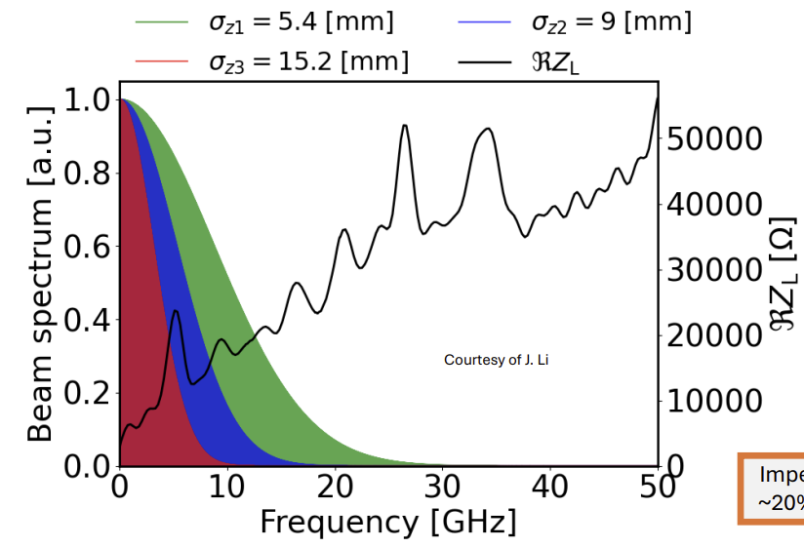
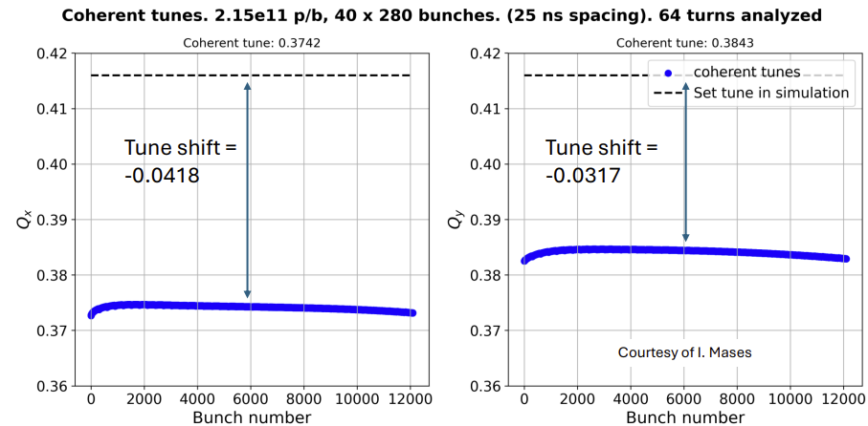
Main rings impedance budget
C. Zannini
FCC-ee is challenging due to the combination of a large beam pipe and short bunches resulting in a crosstalk between different accelerator elements.
Impedance beam induced power has a significant impact on the energy loss per turn from ~4% to ~20% depending on bunch length (in collision or not).
Bunch-by-bunch tune shifts must be taken into account to define the filling strategy and the overall impedance budget.
Stability at nominal working point looks critical due to coupled bunch instability.

Slide 23
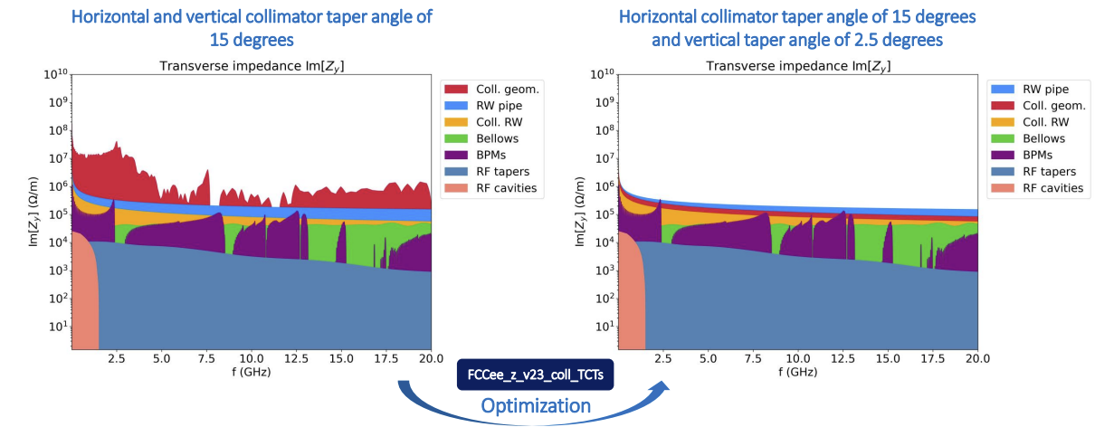
Impact of collimators geometric impedance on beam stability in the FCC-ee
D. Gibellieri
Impedance/Wake model development for critical design decisions:
  Ensured model flexibility to facilitate impedance and wakefield updates in optics, material choices, coating thickness, geometries.
  Enabled impedance assessments for different scenarios.
The design of the collimator system is critical and the taper optimization reduced the geometrical impedance.
The radiative wall impedance linked to optics design favor maximum collimator aperture (particularly vertically).

Slide 24
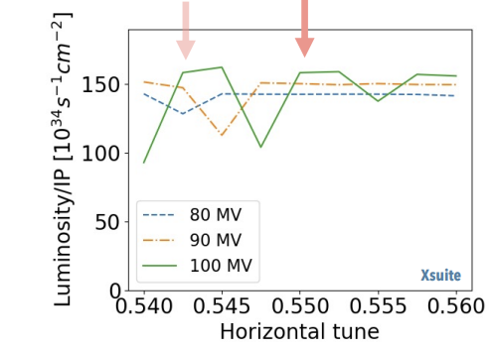
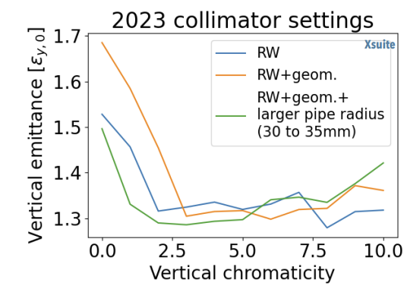
Beam-beam and wakefield-induced collective instabilities and mitigation
R. Soos
The Circulant Matrix Model allows a rapid parameter sensitivity scan of the coherent <x-z> instability. -Chromaticity is a good candidate, but it’s limitation to the lifetime must be established.
Transient beam loading associated with 2cell cavities seems acceptable in terms of <x-z> instability.
Currently no mitigation technique was found to cope with <x-z> instability during non-uniform bootstrap injection.
In the vertical plane, the TMRI is the dominant beam-beam and impedance driven instability, mitigated with chromaticity ~16.
Horizontal plane instability
Vertical plane instability

Slide 25
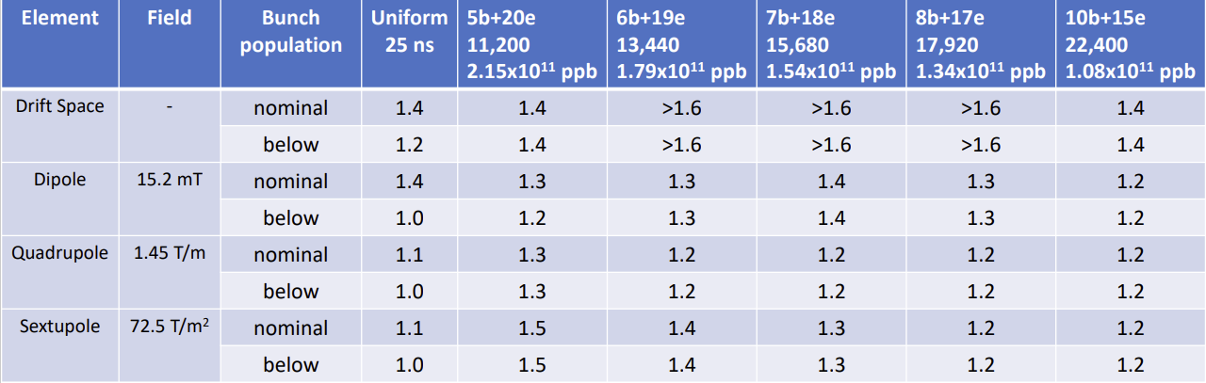
Electron-cloud effects and possible mitigation strategies
L. Sabato
The material constraints in order to avoid e-cloud avalanche multiplication are extremely tight with the baseline parameters.
Using filling schemes with non-uniform bunch spacing the e-cloud formation process could be mitigated,
  the total number of bunches could be increased, to decrease the bunch population, while keeping the surface requirements achievable, reducing the severity of other collective effects (beam-coupling impedance and beam-beam).
SEY requirements for various elements of the lattice, filling pattern and at constant beam current.

Slide 26
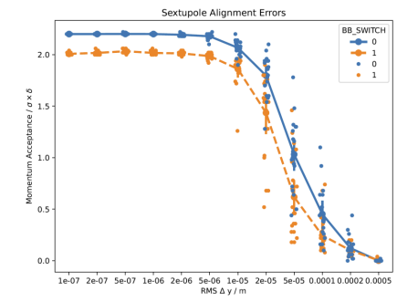
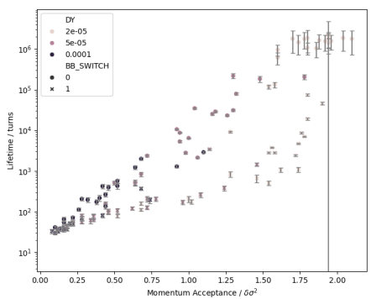
Beam-beam effects in presence of errors
L. Van Riesen-Haupt
Developments in simulation tools and comprehensive benchmarking and testing.
First simulations to probe combined effects:
  Introduction of effects one-by-one to study and understand their individual behaviors
  Misalignments, multipole errors, IP perturbations
  First indications for tolerances and input for tuning teams
Define new and explore established indicators to describe dynamics
First exploration of correlations between figure of merit, with the long term target to add all effects in dedicated tuned lattices.
MOMENTUM ACCEPTANCE AREA
BEAM LIFETIME [turns]
MOMENTUM ACCEPTANCE AREA

Slide 27
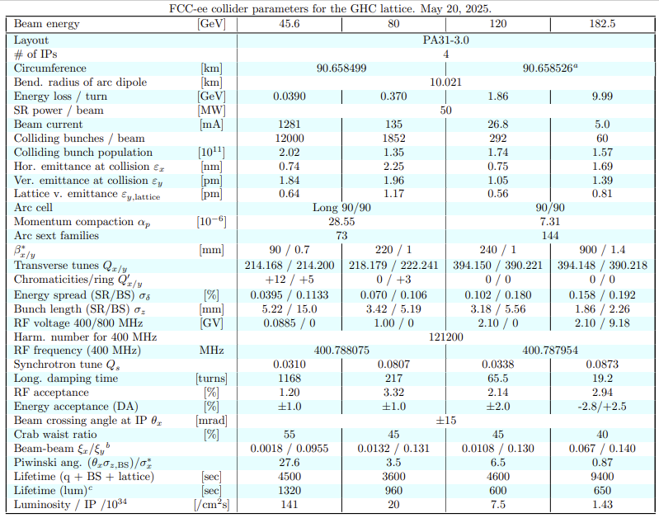
Thanks to all the speakers and thank you for your attention !

