Slide 1
Most material for this presentation is taken from: https://journals.aps.org/prab/abstract/10.1103/PhysRevAccelBeams.28.021002
FCC-ee
Local Chromaticity Correction (LCC) optics
Status and plans
K.André, P.Raimondi, S.Liuzzo, S.White
Many thanks to the the members of FCC-ee design, tuning, integration groups for the constructive and valuable help.

Slide 2
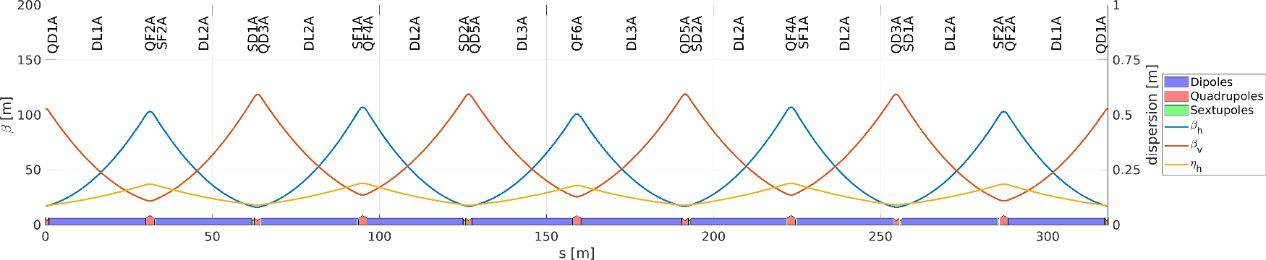
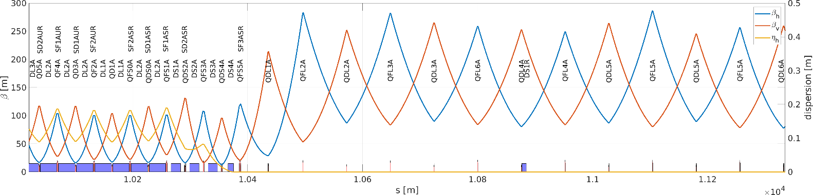
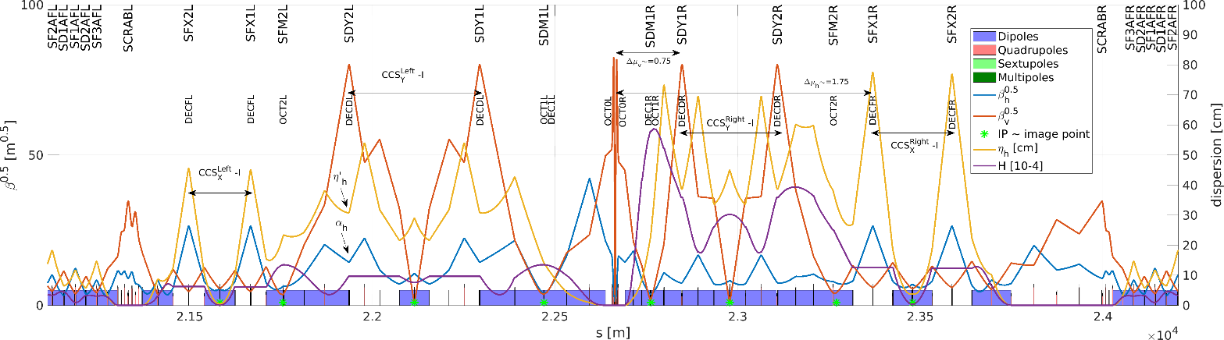
LCC optics
Hybrid Focussing Defocussing (HFD) arcs
Long straight sections (LSS) fulfilling the Transparency Conditions.
https://journals.aps.org/prab/abstract/10.1103/PhysRevAccelBeams.26.021601
Final Focus optics fulfilling the Transparency Conditions and integrating all IP requirements

Slide 3
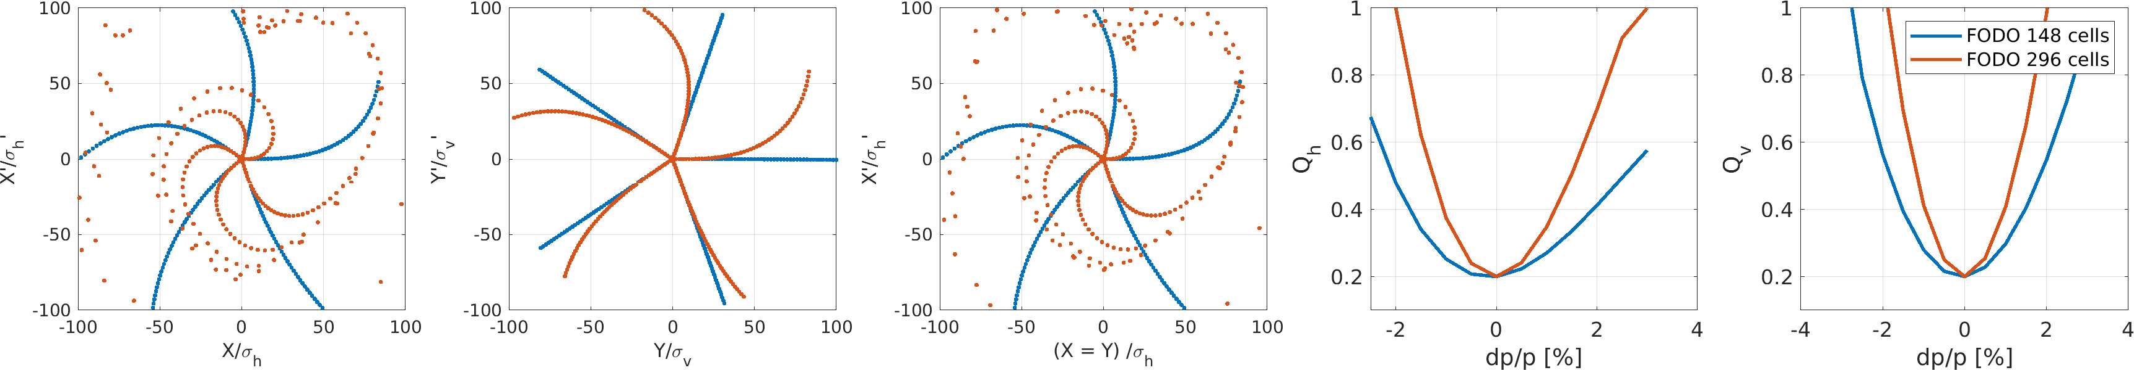
achromaticity and anharmonicity IN a fodo lattice
A lattice is considered achromatic if the variation of the main optics parameters, such as the tunes (Q_{h,v}) and the optics (β, α) at the interaction point (IP), has a small dependency on the variation of energy, ideally above 2% at Z and 3% at ttbar energy
A lattice is considered anharmonic when transverse dynamics scale linearly with respect to x and y actions.
At large amplitude, the nonlinear contributions transform the initial coordinates distributed on a straight line into a curve with nonzero second and higher order polynomial components. The more a lattice is anharmonic, the more the coordinates at each of the five turns will be close to straight lines.

Slide 4
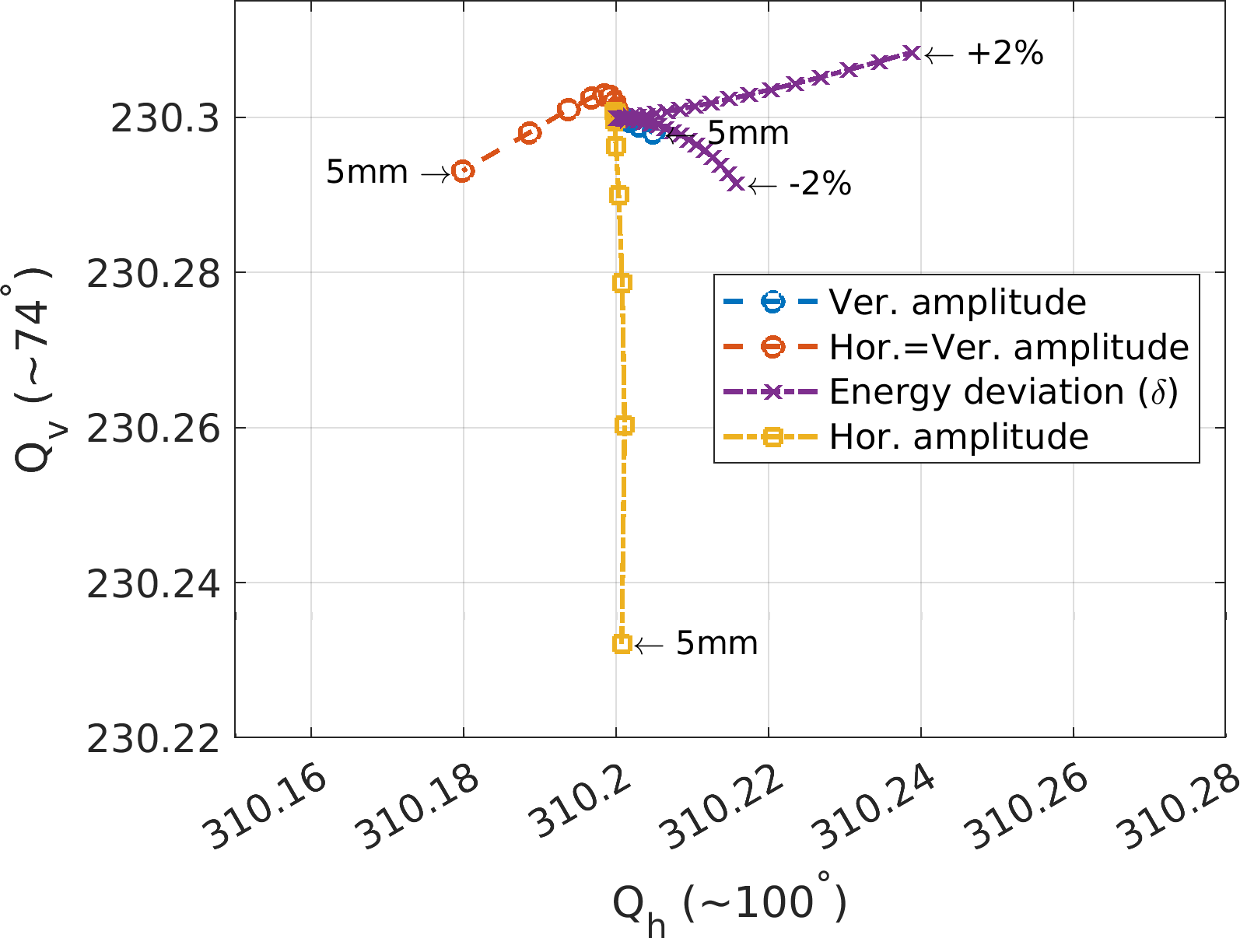
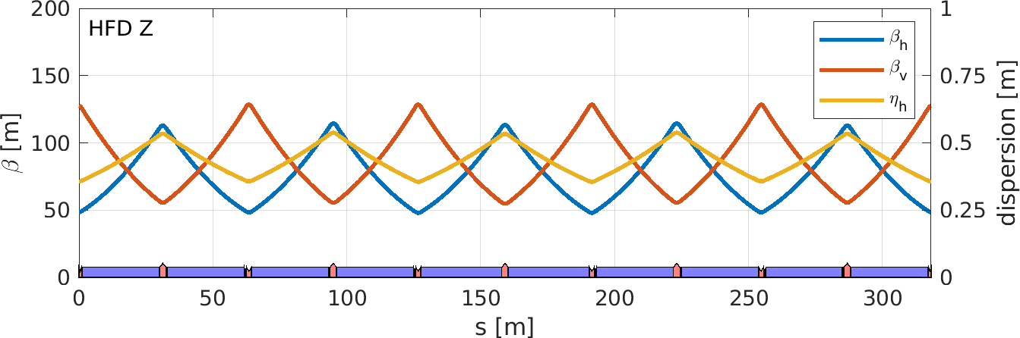
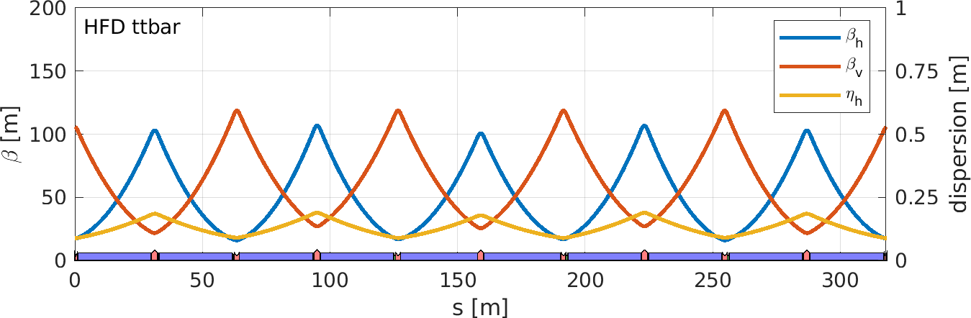
Hybrid focusing defocusing (HFD) ARC cells
Very small tune footprint
Same magnets layout at both energies
ttbar
6 quadrupole families instead of 2 in a FODO cell
3 sextupole families instead of 2 in a FODO cell

Slide 5
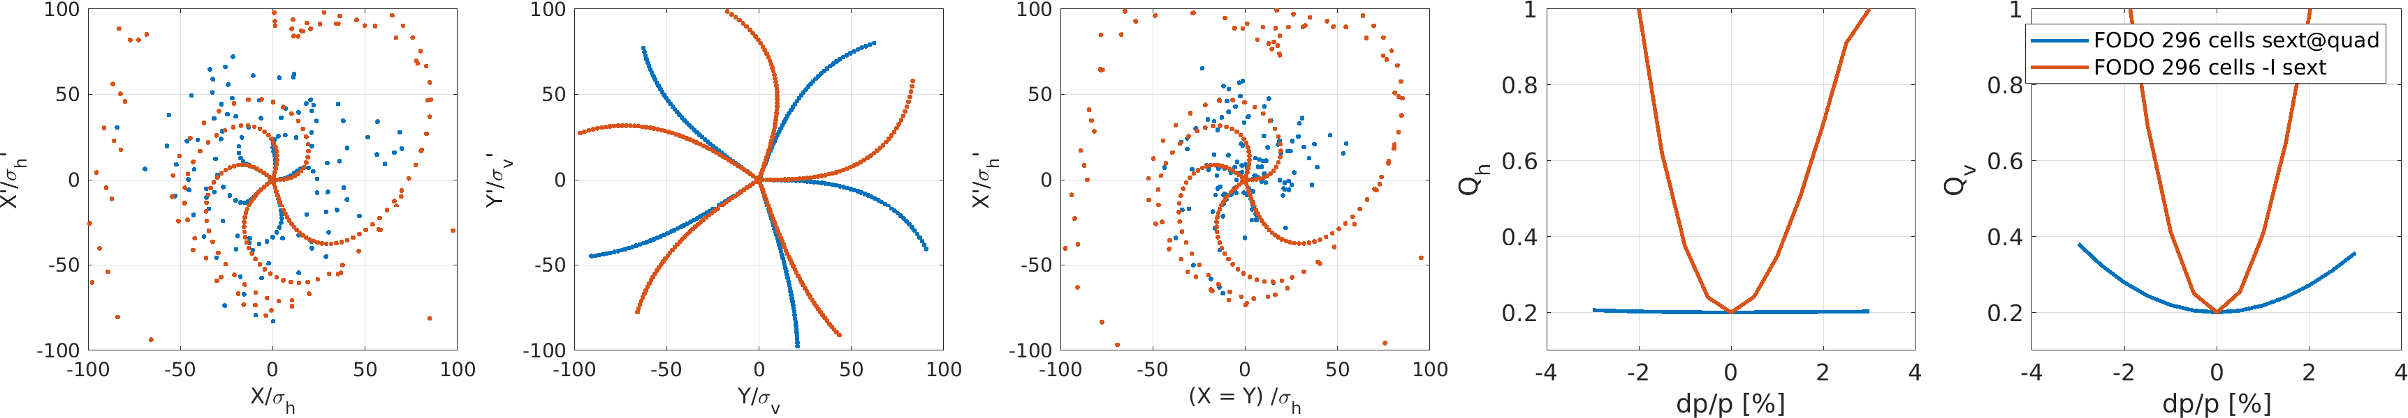
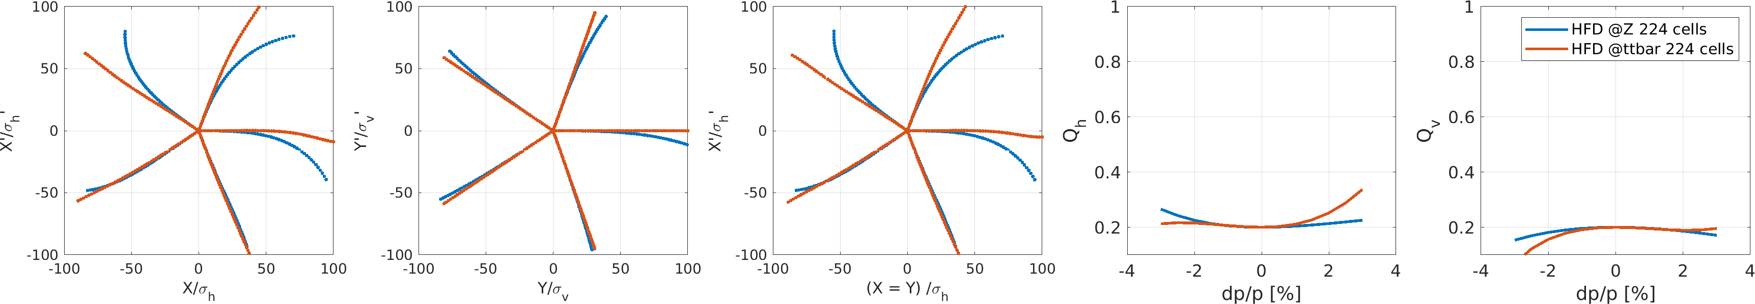
achromaticty and anharmonicty IN THE ARCs OF THE LCC optics
In a FODO arc cell, sextupoles with –I transformation help for anharmonicty, but worsen the achromaticty
In a HFD arc cell, anharmonicty and achromaticty are optimal at both energies and are unaffected by the long straight section insertions following the transparency conditions principles.
Turn 3
Turn 4
Turn 5
Turn 2
Turn 1

Slide 6
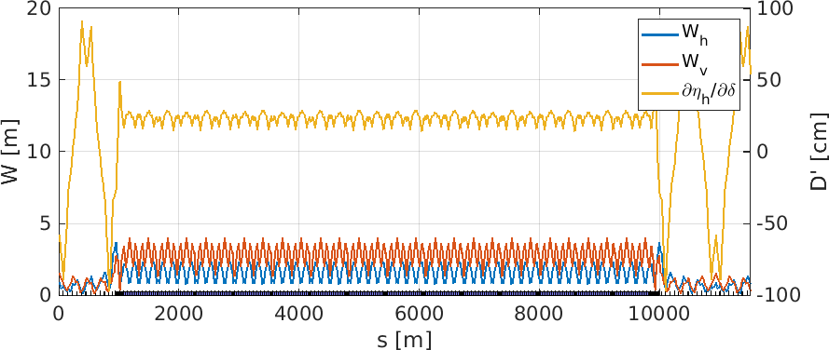
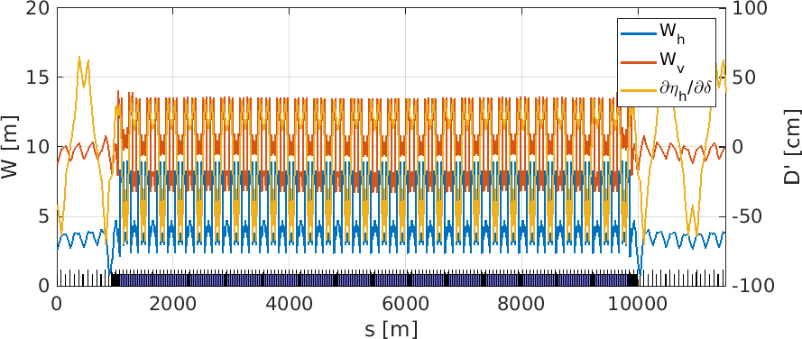
Long stRaight sections and transparency conditions
ARC
Sextupole ON
Transparency conditions are fulfilled when including the Long Straight Section (LSS),
The off-energy optics (W and second order dispersion) remains periodic with sextupoles turned on/off.
Sextupole OFF
LSS
LSS

Slide 7
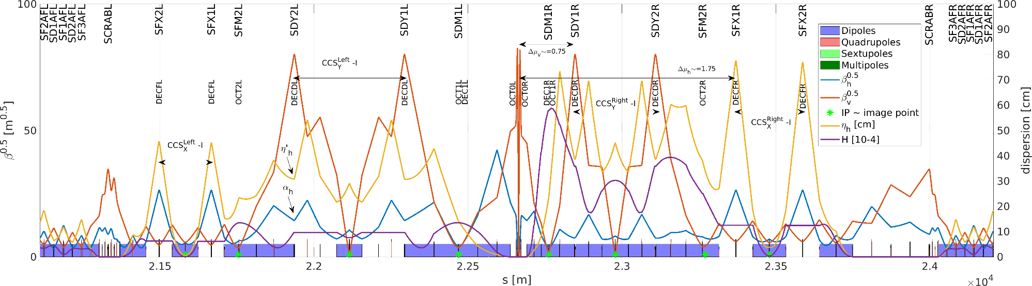
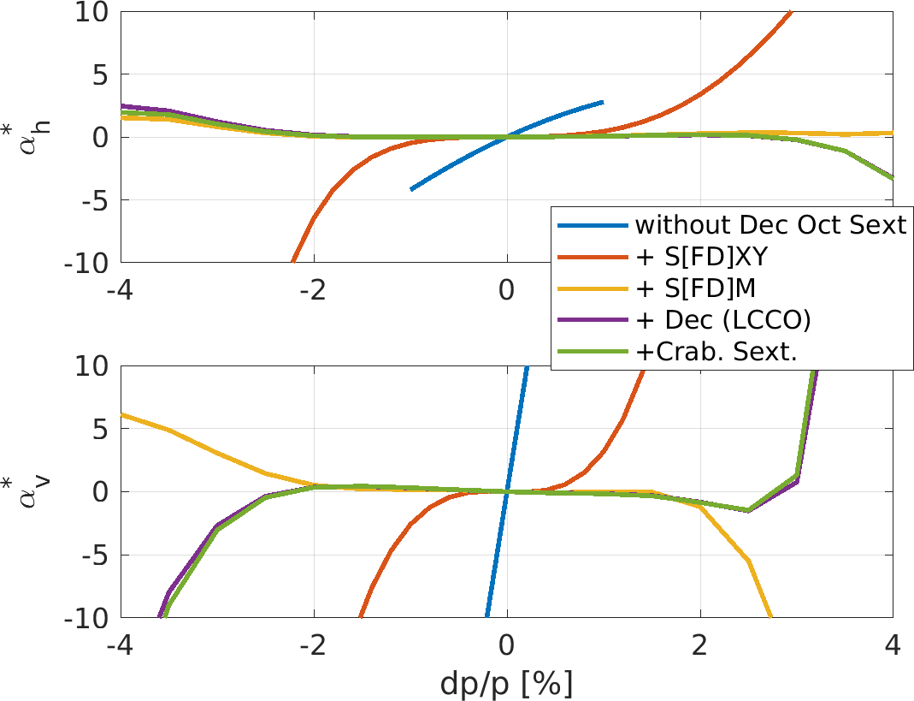
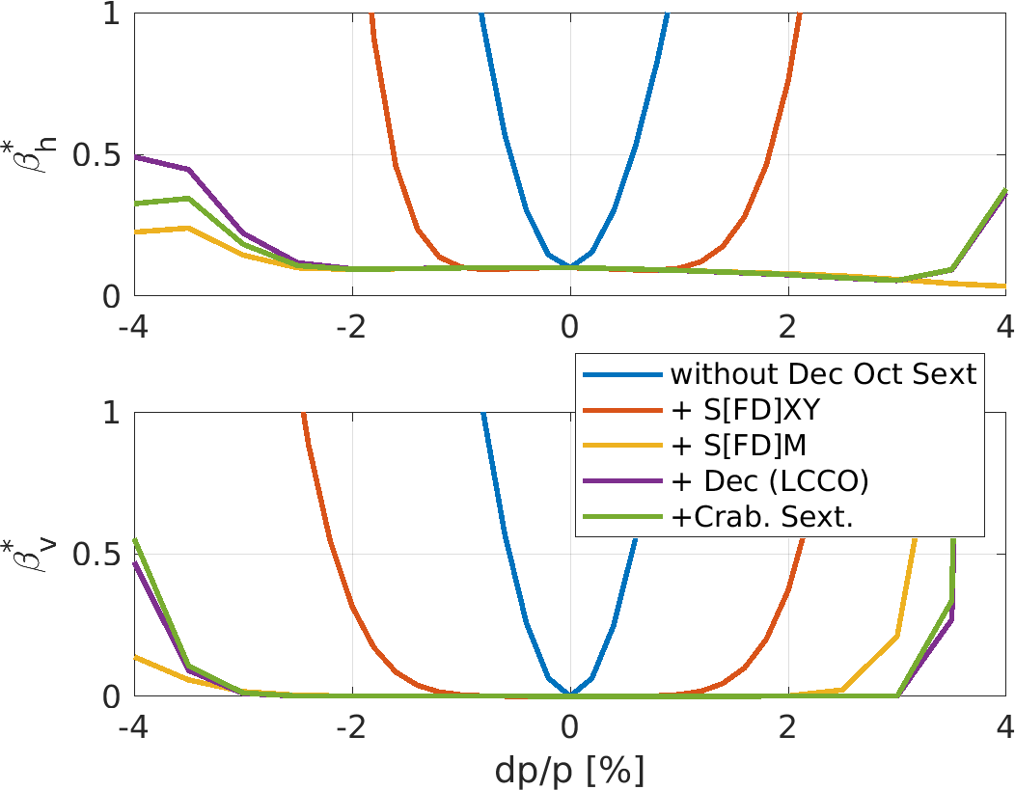
Final Focus
Sextupoles, octupoles and decapoles at IP image point correct third, fourth and fifth order chromaticity at the IP and optimize off-energy optics at the crab sextupoles.
The long sextupole aberrations is mitigated by de-tuning the –I transformation in the chromaticity correction sections (linear optics)

Slide 8
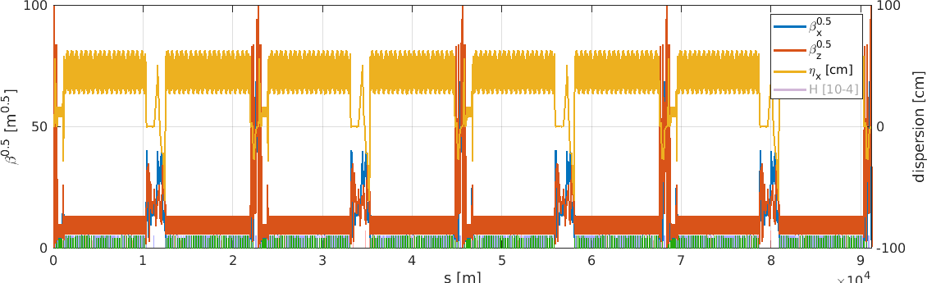
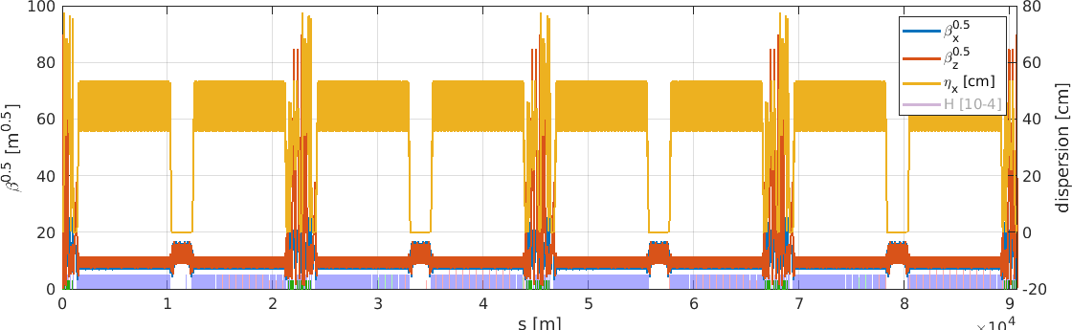
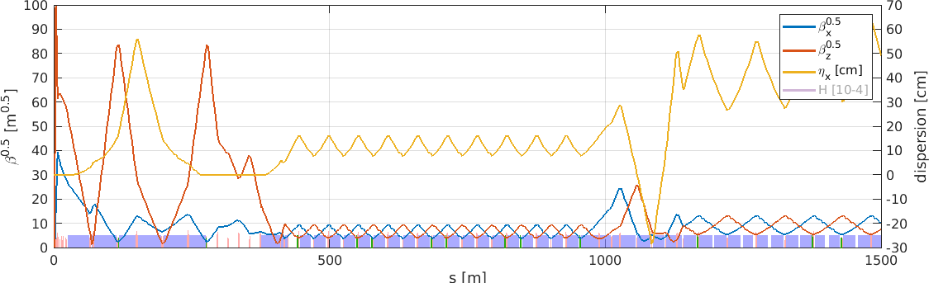
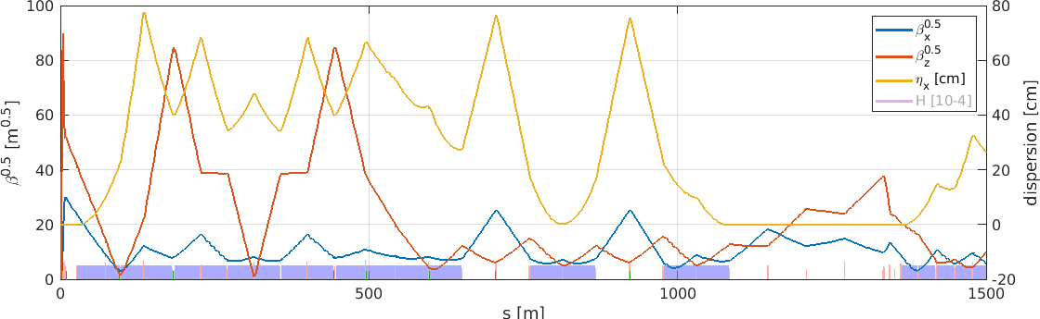
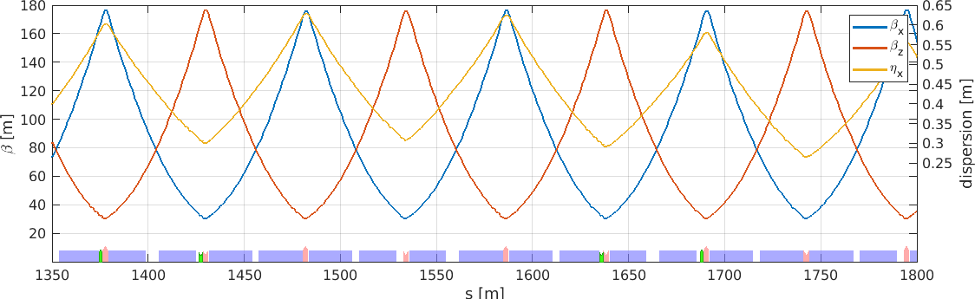
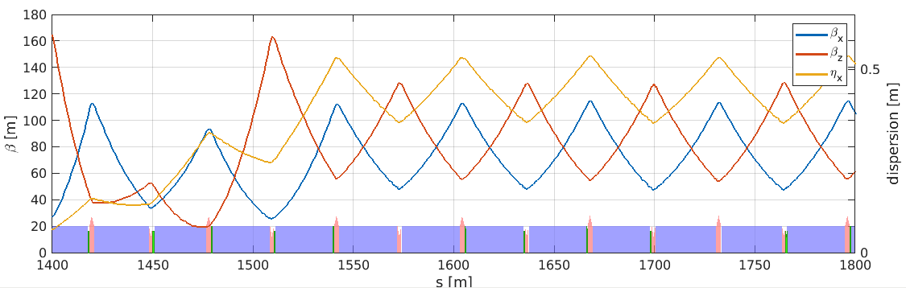
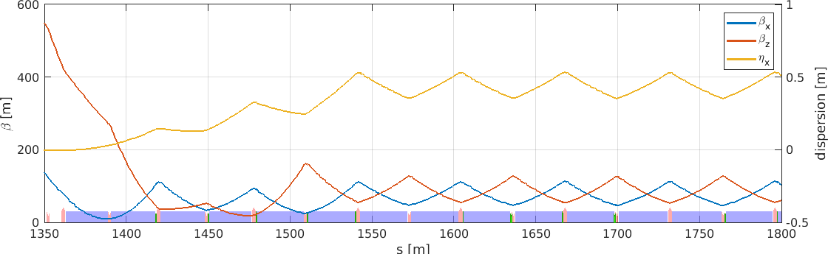
optics for FCC-ee: lattice layout for ARCs and Final Focus
GHC-V22 (K.Oide, https://journals.aps.org/prab/abstract/10.1103/PhysRevAccelBeams.19.111005)
LCC-89 (P.Raimondi, https://indico.cern.ch/event/1326738/timetable/#45-alternative-optics-and-vari)
.
Average betas ~ 105m
Peak betas ~ 175m
Average betas ~ 85m
Peak betas ~ 120m

Slide 9
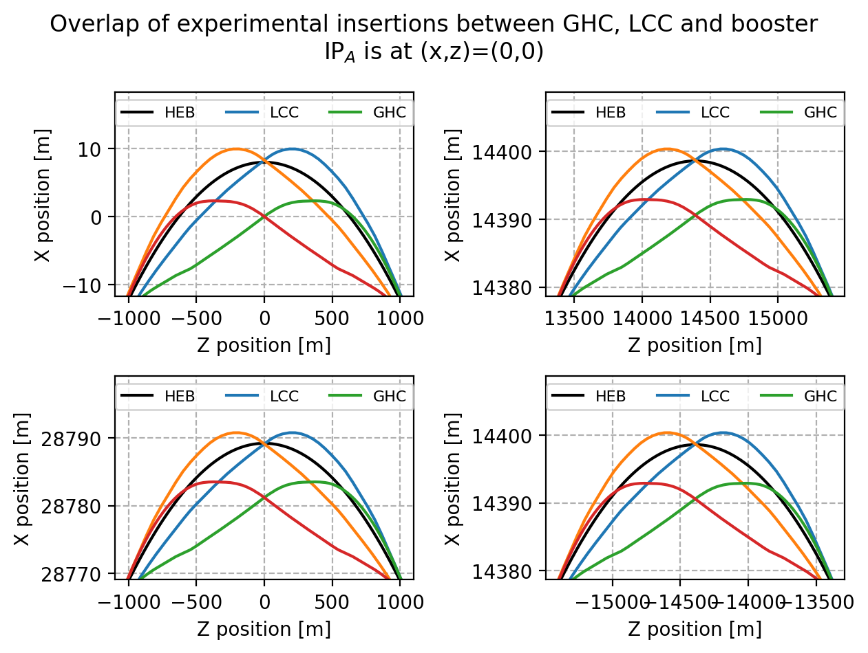
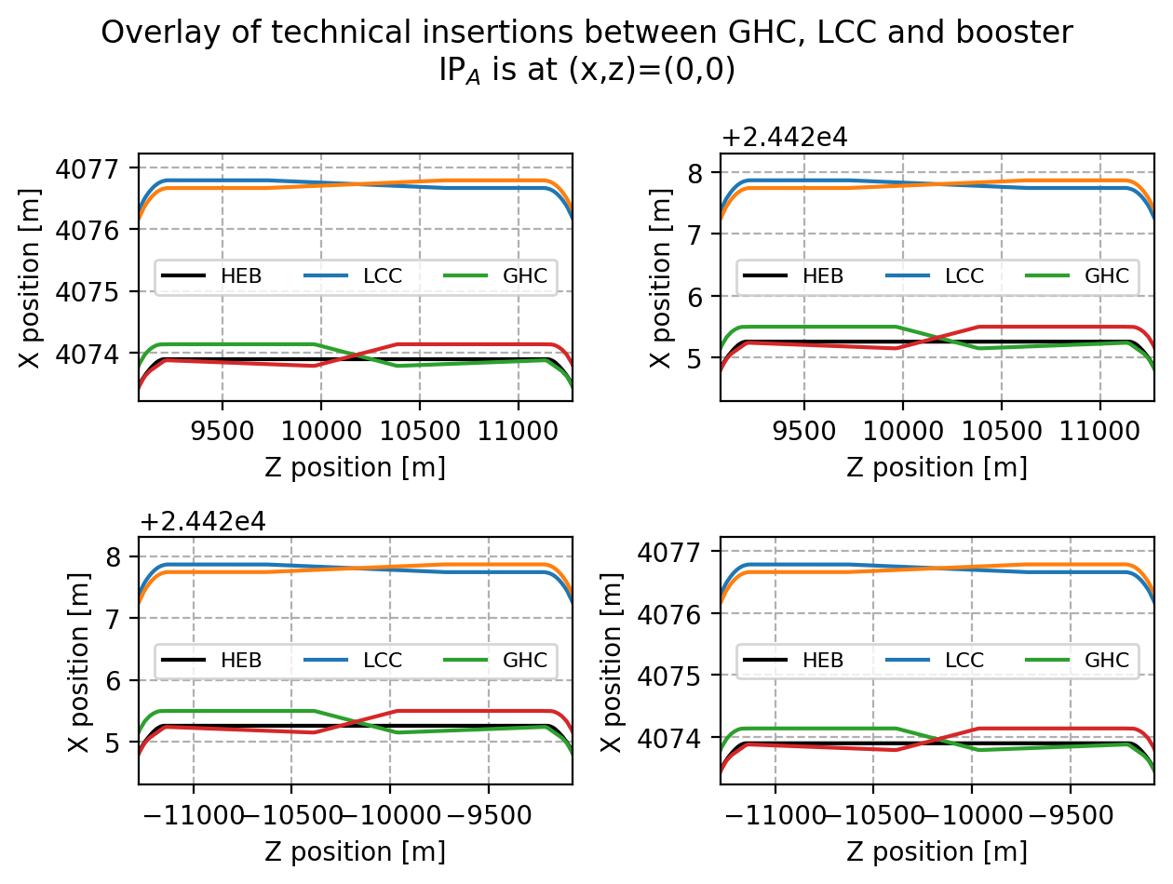
footprints
About 7m offset w.r.t. GHC footprint at each interaction points and 3m in the technical straight sections.

Slide 10
Beam parameters
ll: 9.1174e+04
alpha: 2.8448e-05
fractunes: [0.2602 0.3799]
fulltunes: [214.2602 214.3799]
nuh: 214.2602
nuv: 214.3799
chromaticity: [-0.0183 -0.0782]
dampingtime: [0.7102 0.7117 0.3549]
dampingJ: [1.0003 0.9982 2.0015]
espread: 3.9182e-04
blength: 0.0032
modemittance: [7.0613e-10 4.0822e-32 1.2350e-06]
energy: 4.5600e+10
fs: 168.6472
eloss: 3.9036e+07
synchrophase: 0.1964
momcompact: 2.8448e-05
ll: 9.0659e+04
alpha: 2.8968e-05
fractunes: [0.2000 0.2972]
fulltunes: [198.2000 174.2972]
nuh: 198.2000
nuv: 174.2972
chromaticity: [-0.2942 1.0593]
dampingtime: [0.8037 0.8037 0.4018]
dampingJ: [1.0000 1.0000 2.0000]
espread: 3.7148e-04
blength: 0.0030
modemittance: [6.7642e-10 4.5028e-32 1.1113e-06]
energy: 4.5600e+10
fs: 171.5355
eloss: 3.4295e+07
synchrophase: 0.1723
momcompact: 2.8968e-05
 | units | V22@Z 45.6 GeV | LCC-89@Z 45.6 GeV
circumference | m | 9.1174e+04 | 9.0659e+04
momentum compaction |  | 2.8448e-05 | 2.8968e-05
tunes |  | 214.26 214.38 | 198.20 174.30
chromaticity |  | -0.0183, -0.0782 | -0.2942 1.0593
damping time | seconds | 0.7102 0.7117 0.3549 | 0.8037 0.8037 0.4018
energy spread |  | 3.9182e-04 | 3.7148e-04
bunch length | mm | 3.2 | 3.0
hor. nat. emittance | pm rad | 706 | 676
energy loss / turn | MeV/turn | 39.0 | 34.3 (lower power)
RF voltage | MeV | 200 | 200
harmonic number |  | 135000 | 135000
Outdated
Python Accelerator Toolbox tracking: 6D = including synchrotron radiation and RF
https://github.com/atcollab/at
Quantum diffusion is not included in the following studies (although available).
Fully benchmarked with MADX-PTC

Slide 11
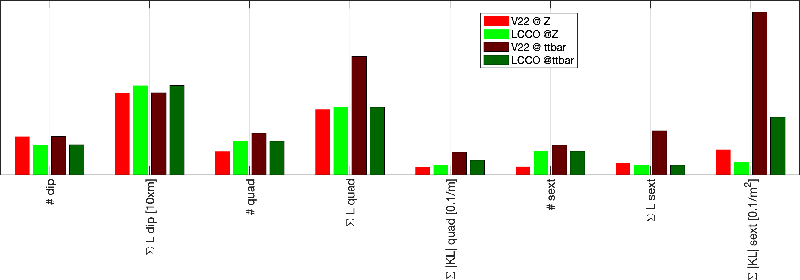
COMPARISON OF the number of magnetic elements and gradients
includes Crab sextupoles
5.2km
9.5km
72km
66km
5.4km
0.9km
3.5km
0.77 km
Number of dipoles
Total length of dipoles
Number of quadrupoles
Total length of quadrupoles
Quadrupole integrated normalised strength
Number of sextupoles
Total length of sextupoles
Sextupole integrated normalised strength
Only the magnet gradients change in LCC between Z and ttbar.
The white boxes for V22 baseline correspond to magnets turned off at Z, which are turned on at ttbar.
LCC’s sextupoles at ttbar have: 1) smaller KL, 2) there are ~500 less and 3) they are shorter.
machfs/liuzzo/FCC/89a2/ANALYSIS/CompareSextupole.m

Slide 12
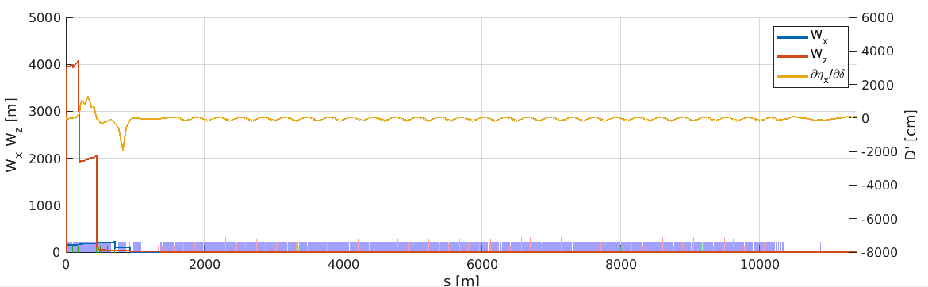
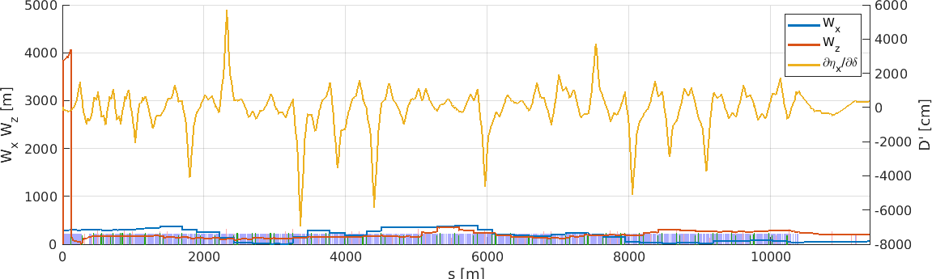
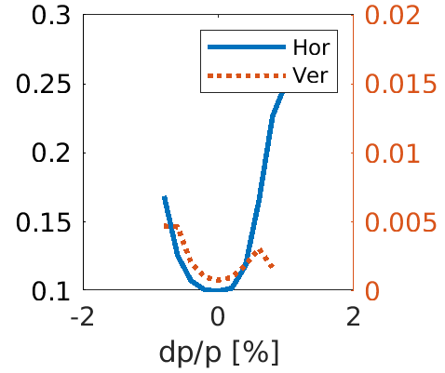
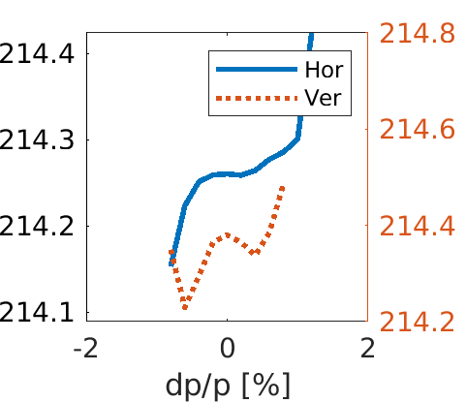
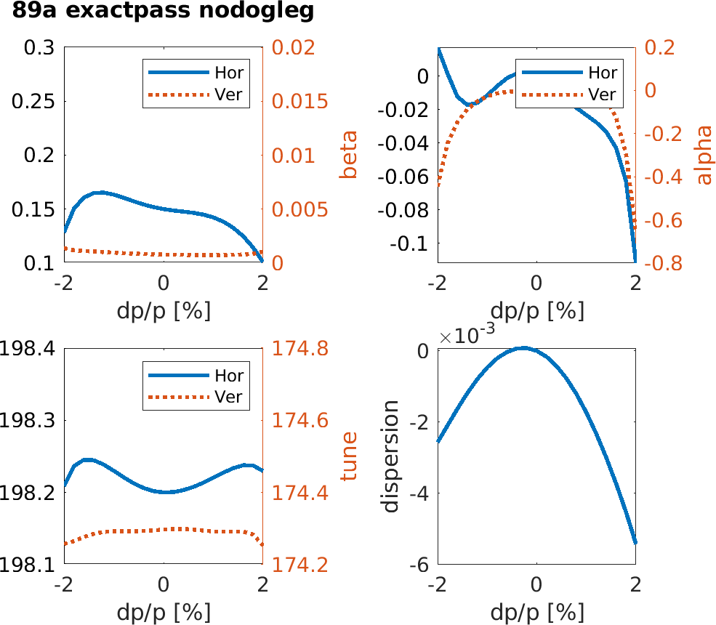
Off energy electron beam optics: W functions, IP optics and phase advance at crab sext.
GHC-V22 (K.Oide, https://journals.aps.org/prab/abstract/10.1103/PhysRevAccelBeams.19.111005)
LCC-89 (P.Raimondi, https://indico.cern.ch/event/1326738/timetable/#45-alternative-optics-and-vari)
.
beta @ IP
tune
beta @ IP
tune
Missing line = Optics computation failed
Negligible luminosity loss due to energy dependent beta

Slide 13
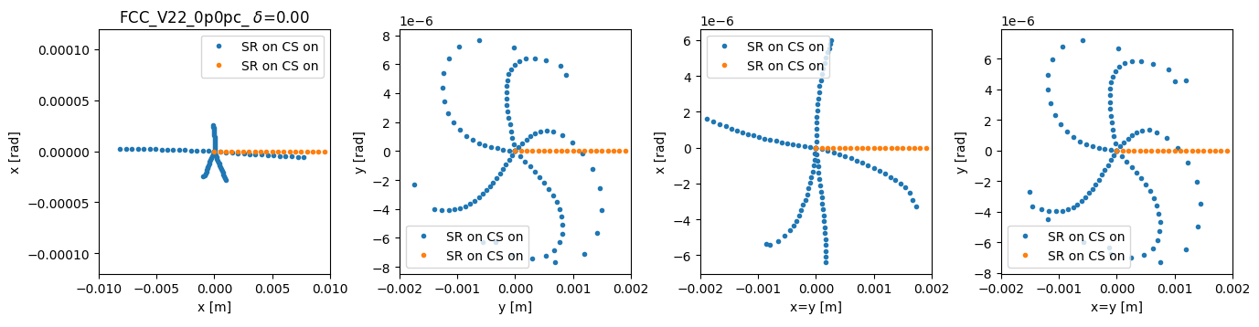
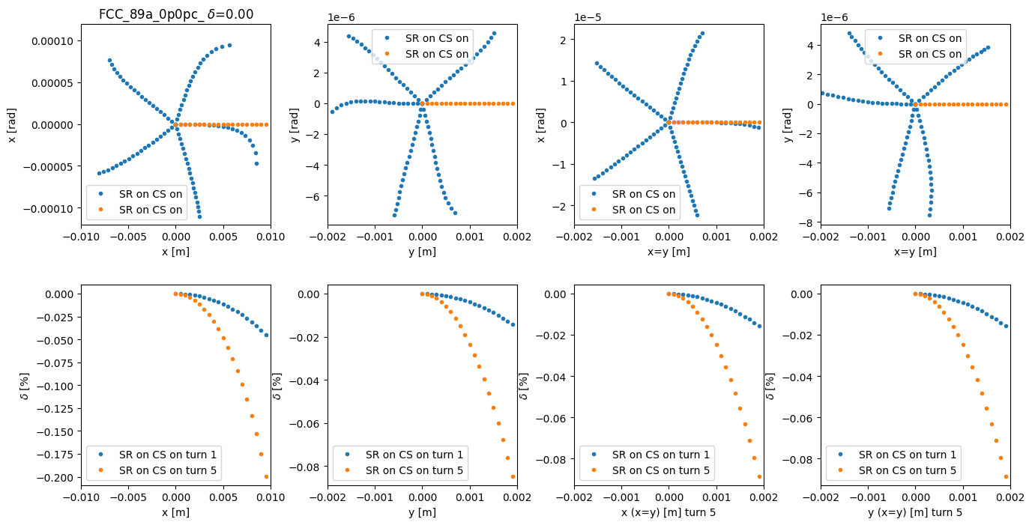
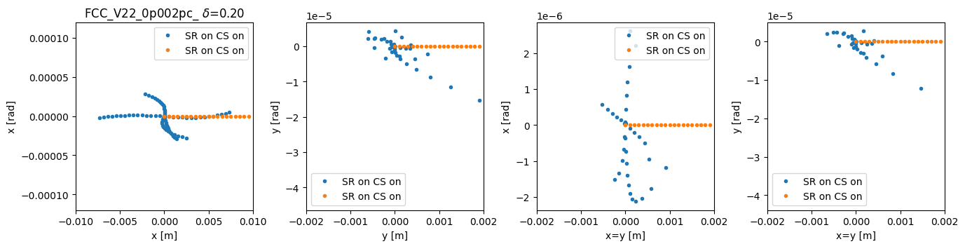
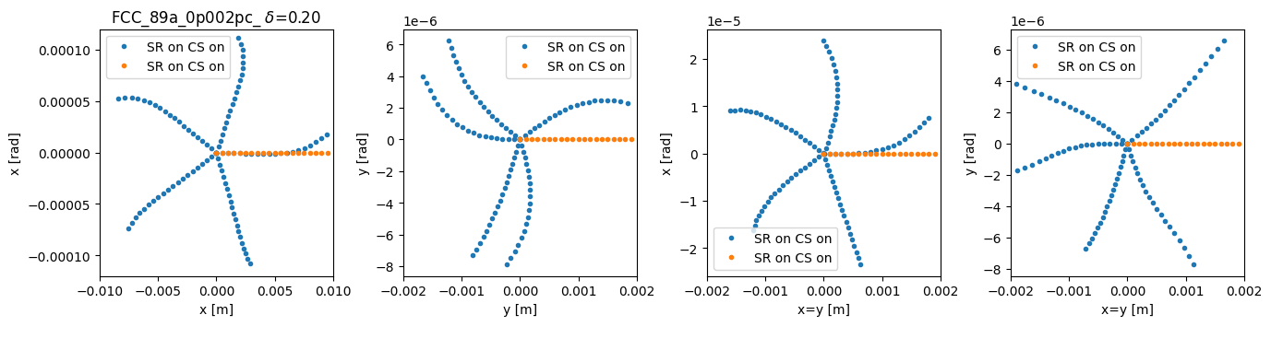
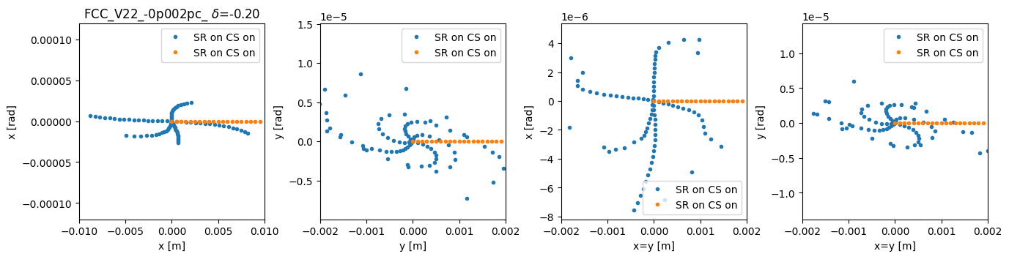
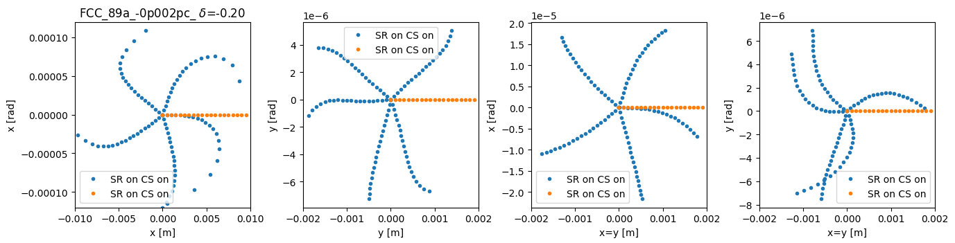
Phase space evolution over 5 turns on and off energy
No SR in dipoles (no effect)
GHC
LCC
δ = 0
δ = +0.2%
δ = -0.2%
Synchrotron radiation and crab sextupoles turned on
The “starfish” plots provide a “quick” overview of the combined effects of all the resonant driving.

Slide 14
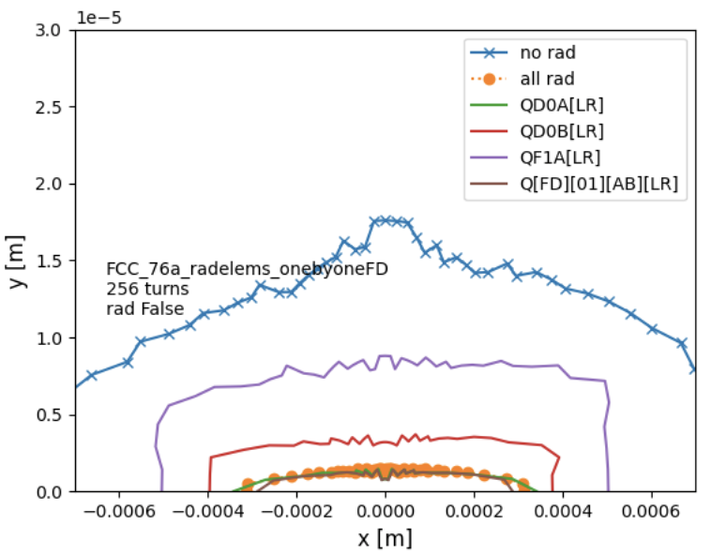
SYNCHROTRON Radiation in Final doublet quadrupoles
LCC76
Magnet | Dip | Qarc | Qff | Qfd | ALL
Q[FD][01][AB][LR] | YES |  |  |  | YES
QD0A[LR] |  | YES |  |  | YES
QD0B[LR] |  |  | YES |  | YES
QF1A[LR] |  |  |  | YES | YES
The dynamic aperture is dominated by synchrotron radiation in the final quadrupole doublet.
Subsequently, the gradient of the FD has been reoptimized to minimize the effect of SR. (~few percent gain).

Slide 15
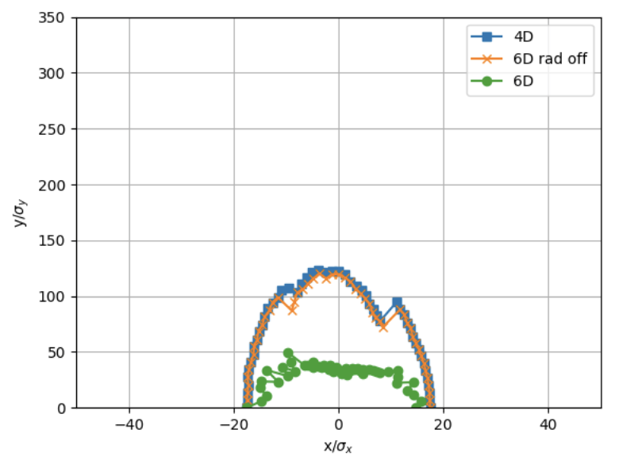
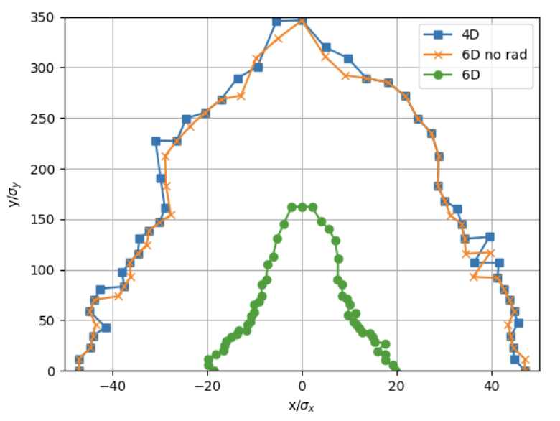
SYNCHROTRON Radiation in Final doublet quadrupoles (QUANTUM DIFFUSION)
6D tracking for 2350 turns, with quantum diffusion (1 seed) starting from straight section, Crab sext. ON, ε_{v} = 0.2% ε_{h}
GHC (V22)
LCC
@CA.1
@SCENTER
β∗_{h} = 15cm
β∗_{v} = 0.8mm
β∗_{h} = 15 cm
β∗_{v} = 0.8 mm
LCC includes countermeasures (decapoles) for synchrotron radiation in Final Doublet.

Slide 16
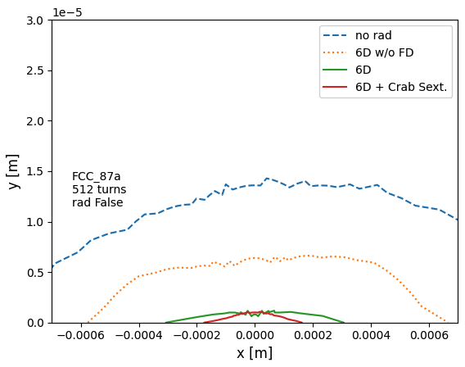
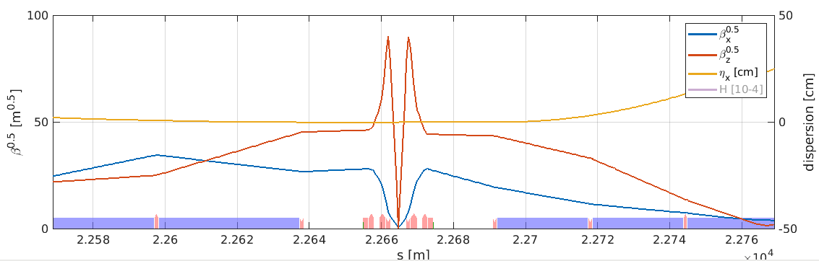
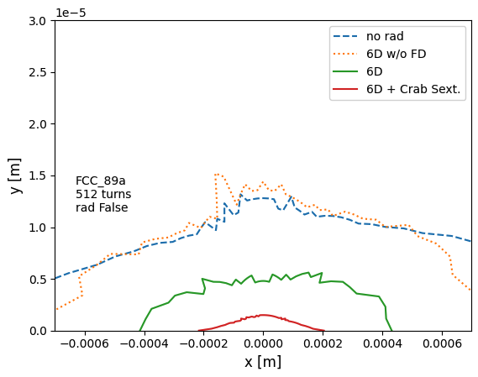
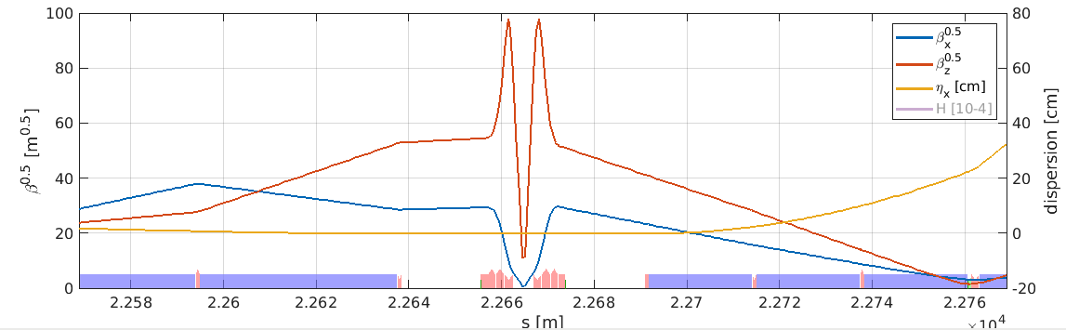
Modified Layout and additional Decapoles to mitigate Final Doublet Synchrotron radiation
LCC 87 = FD optimized to reduce
SR and DA-shrinkage due to SR
LCC 76
LCC 89 = + 3 DECAPOLE pairs in the Final Focus section.
The effectiveness of the DECAPOLES is evident.
This is arguably the first time that the degradation due to the quadrupoles-SR and, in particular, final-doublet-SR is effectively addressed.
including decapoles
including decapoles
LCC 87
More details available here: indico link

Slide 17
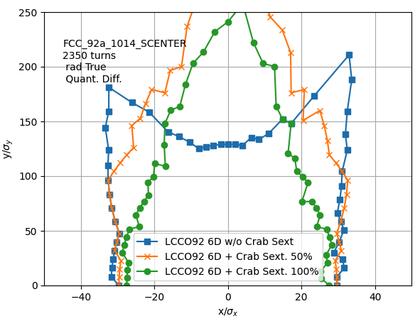
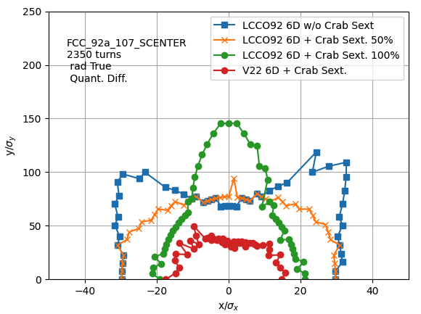
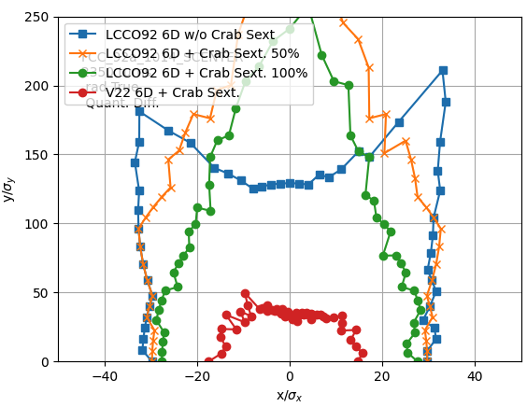
Comparison between nominal and relaxed optics
Nominal β*
β∗_{h}=10cm, β∗_{v}=0.7mm
Relaxed β*
β∗_{h}=10cm, β∗_{v}=1.4mm
β_{x}, β_{y} = 15cm, 0.8mm
→ LCC92 with β∗_{h}=10cm, β∗_{v}=0.7mm gives a DA larger horizontally and vertically with respect to GHC(V22) featuring β∗_{h}=15cm, β∗_{v}=0.8mm.
Relaxed optics obtained by only changing 2x6 quadrupoles in the FF entrance/exit.
Decapoles optimized only for “Crab Sextupoles set to 100%” (80% of geometric value).

Slide 18
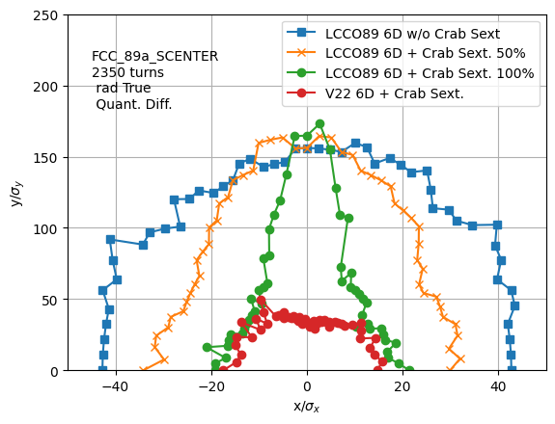
Dynamic aperture at Straight section
Crab 100% = 80% of the geometric value (eq. to GHC)
Commissioning
Tuning with progressive increase of Crab sextupoles strength.
Final configuration for Luminosity production.

Slide 19
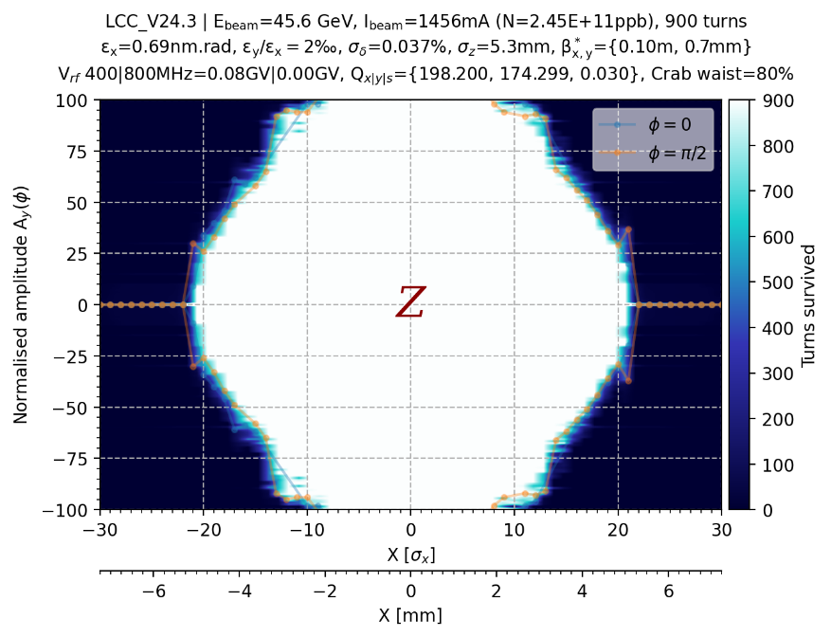
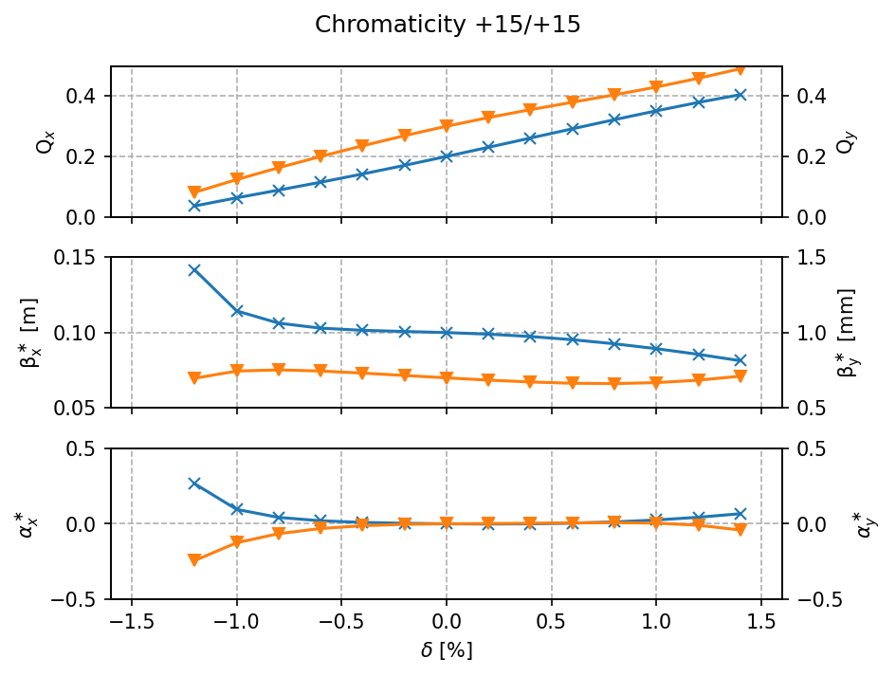
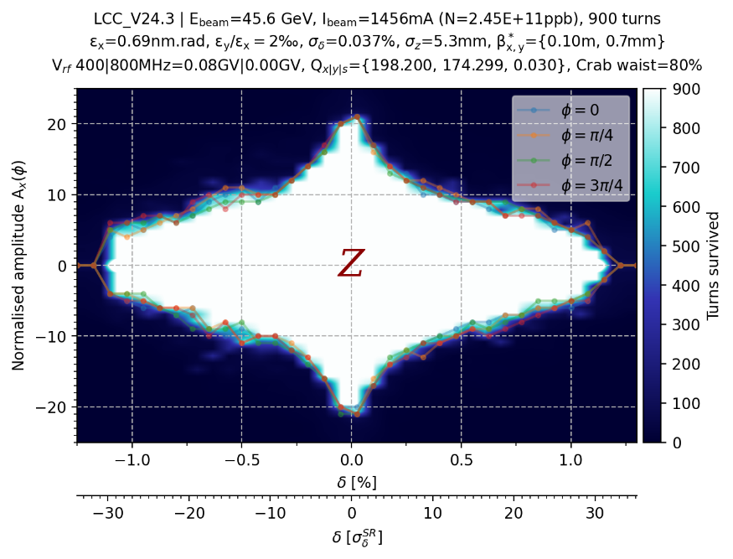
Dynamic aperture with higher chromaticity mitigating collective effects

Slide 20
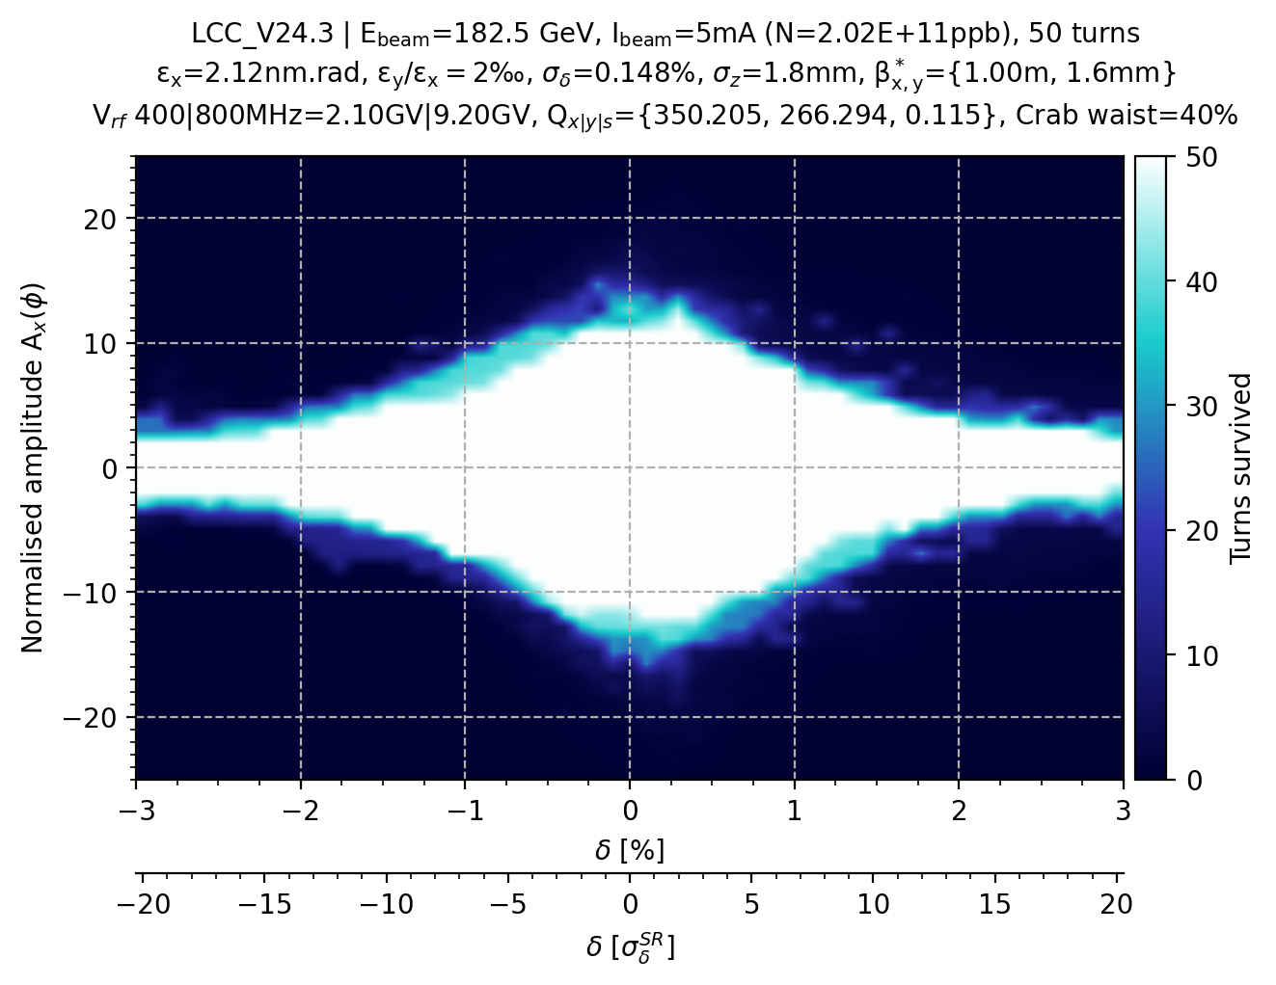


Off-energy dynamic aperture with reduced RF voltage
Single RF section 100% total RF voltage (w.r.t. GHC)
Single RF section 90% total RF voltage (w.r.t. GHC)
Optimization of magnet strengths to be performed,
Reduces the required space for 800MHz RF cavities.

Slide 21


Optics optimizations - I
Multi-objective optimization (DA & MA) with NSGA-II of non-linear elements in LCC.
Pre- and post- optimization magnet strengths for Z (top) and ttbar (bottom).
Pre- and post- optimization DA and MA for Z (left) and ttbar (right).

Slide 22




Optics optimizations - II
Results of initial magnet strengths optimization from S.White performed with pyAT for the Z-pole energy, implemented in Xsuite.
Nominal magnet strengths (v92a)
Optimized magnet strengths (v92a)

Slide 23



Arc alignment sensitivities
The contour plot shows the horizontal beta-beating for:
GHC (top),
LCC (bottom).
2.9
4.5
LCC ARC errors sensitivities are generally better or similar

Slide 24

Final Focus alignment sensitivities
FF quadrupole errors sensitivities are generally better for GHC optics
FF sextupole errors sensitivities are generally better for LCC optics
Orbit in FF sextupoles must be maintained at this level during operation (a fast orbit feedback is needed)
~3x better for LCC

Slide 25
Future work
Detailed commissioning simulations studies to compare with the Feasibility Study Report results featuring the GHC lattice, including alignment and field errors.
Design and optics matching of required technical straight sections.
Study of the impact of tuning knobs and beta squeezing on realistic lattice scenarios (errors and corrections)
Assess the impact of beam-beam effect on tolerances.
Study minimal correction schemes and tuning strategies.
Contribute to the Tuning and Layout & Accelerator Design activities to finalize the optics development in view of a comparison with the baseline.

Slide 26
Conclusions
Large orthogonality of many fundamental quantities, that can be varied separately with no need to retune other quantities: e.g. arc chromaticity, machine tunes, individual IP betas, individual CS pairs, …
The LCC optics include unprecedented solutions to deal with the effect of synchrotron radiation in the Final Focus quadrupole doublet largely benefiting the higher energies operation.
Beam parameters: comparable to GHC, smaller energy loss per turn for LCC.
Number of magnets: at ttbar the LCC optics has less magnets with smaller gradients.
Dynamic Aperture: larger DA on-energy and off-energy for the LCC optics, particularly vertically. It is expected to be larger also for ttbar thanks to much smaller sextupole strengths.
Errors sensitivities: better sextupoles sensitivity for LCC optics (due to lower gradients). Both V22 and LCC optics show issues with long range errors, mostly driven by the Final Focus system.
Random alignment errors: FF and final doublet errors are dominating.

Slide 27
Thank you for your attention !

Slide 28

DIPOLE FIELDS (1 octant)
No negative angle bends for LCCO optics → easier synchrotron radiation absorption scheme

Slide 29


QUADRUPOLE GRADIENTS (1 octant)
Lower gradients for quadrupoles for LCC optics (apart from the final doublet)

Slide 30

Sextupoles gradients (1 octant)
904 m
773 m
3506 m
773 m
Smaller sextupole gradients ➔ Usually better performances.

Slide 31



Stability about Tune working point
Track a 3D grid of 1000 particles of size: 20σ_{x} x 20σ_{y} x 0.002 δp/p for 512 turns for different tunes.
Tune varied using ARC quadrupoles. Chromaticity corrected to initial value after tune change.
Small (10 nm) random errors added to all elements (to emphasize resonance lines).

Slide 32


Local momentum acceptance no synchrotron Radiation (OPTIMISTIC)
6.5h
12.2h
GHC (V22)
LCC (76a)
Small momentum acceptance locations have large impact on final Vacuum and Touschek Lifetime

Slide 33




Error Tolerances: commissioning simulations
Set errors and apply correction sequence: beam threading (first turns), orbit, tunes, optics, coupling, etc…
LMA <1e-4 in this location
@ IP
@ IP
*note larger scales
GHC (V22)
LCC
10um random errors only in the ARCS quadrupoles and sextupoles already impact DA, LMA and optics parameters. Errors larger than 30um seldom make it through first turns beam threading.
Final focus errors are even more demanding (<10um) and dominated by the final doublet errors.
Work in progress to define tolerated errors and commissioning procedures.

Slide 34






Long range errors Tolerances
Errors defined following indications by alignment experts. Presently feasible with state of the art technology.
~10% of these errors already leads to several failing seeds and zero LMA. Final focus errors are the main offenders.
GHC (V22) 1/10 seeds survived
LCCv76 6/10 seeds survived
Same study with relaxed optics should be performed

Slide 35



Dynamic aperture and momentum aperture for Z & ttbar latest version (LCC 92 Jan 2025)
The effects of crab sextupoles is the next effect to be investigated.
Momentum acceptance is in general lower in dispersive or very chromatic regions because off-energy particles will exercise simultaneously betatron and chromatic oscillations.

Slide 36


Off-energy Dynamic aperture
@ SCENTER
@ SCENTER
@ CA.1
@ CA.1

Slide 37
Energy loss due to Final doublet radiation
Energy loss induced by final doublet SR only.
Similar for the two lattices.
After 160 turns the beam loses 2% energy and exceeds the MA.
The RF helps to recover the energy loss and the DA
might improve by optimizing the RF voltage.
Energy loss as function of x
Energy loss as function of y
More details available here: indico link

