Slide 1

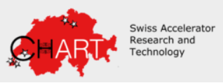
FCC-ee positron source target design, fabrication & updates on P3 integration
Ramiro Mena Andrade, Barbara Humann, Mikkel Daugaard, Jean Louis Grenard, Anton Lechner, Antonio Perillo Marcone and Marco Calviani (SY-STI)
Riccardo Zennaro and Paolo Craievich (PSI), on behalf of the WP3 team (FCC-ee injector update studies)
Date: 21th May 2025

Slide 2
Content
FCC-ee positron source target in the injector complex
Thermo-mechanical studies update
Target prototyping
PSI Positron Production (P3) Experiment update
Conclusions
Questions

Slide 3
1. FCC-ee positron source target in the injector complex

Slide 4
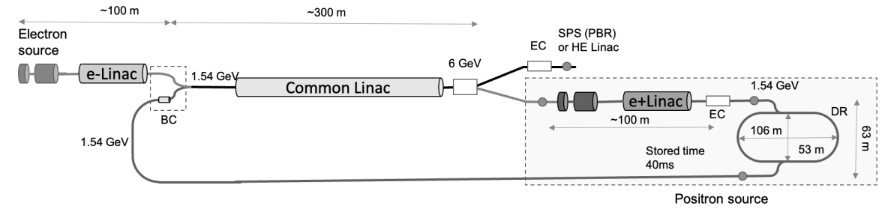
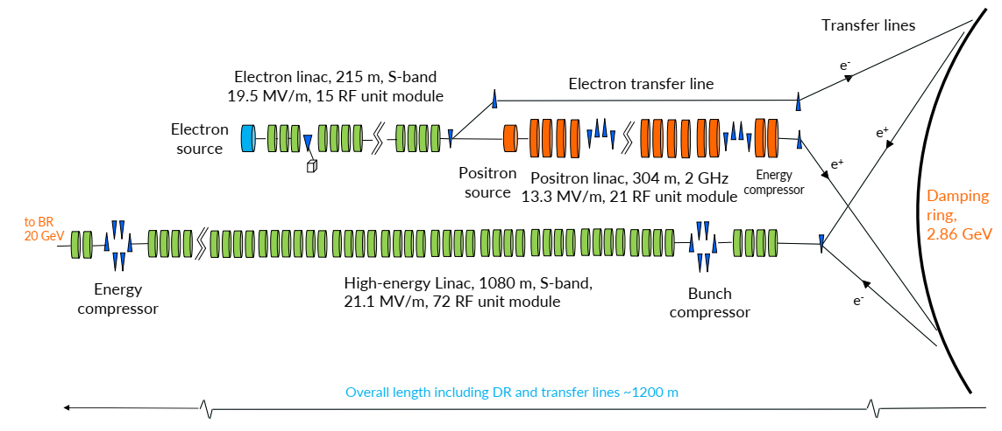
1. FCC-ee positron source target in the injector complex
FCC-ee Injector complex
Going from 6 GeV to 2.86 GeV
improves reliability
eliminates the need for a common linac
more efficient and sustainable solution aligned with performance and operational goals.
This talk is focused on the positron source target:
Thermo-mechanical studies update
Prototype R&D status
P3 experiment update
Fig. 6 GeV previous layout of the FCC-ee injector complex. BC: bunch Compressor. EC: Energy Compressor. [ Craievich et al 2022]
Target
Fig. 2.86 GeV layout of the FCC-ee injector complex [ FCC-Feasibility Study vol 2 2025]
Notes:
The FCC-ee injector complex must provide the e- and e+ bunch trains
This approach allows all linacs to operate at 100 Hz with 4 bunches per pulse
to meet the collider ring filling specification for the most demanding Z running mode.
(-) injector complex is now longer
(+) allows working at 100 Hz
(+) DR operates at higher energy (2.86 GeV)

Slide 5
2. Thermo-mechanical studies update

Slide 6
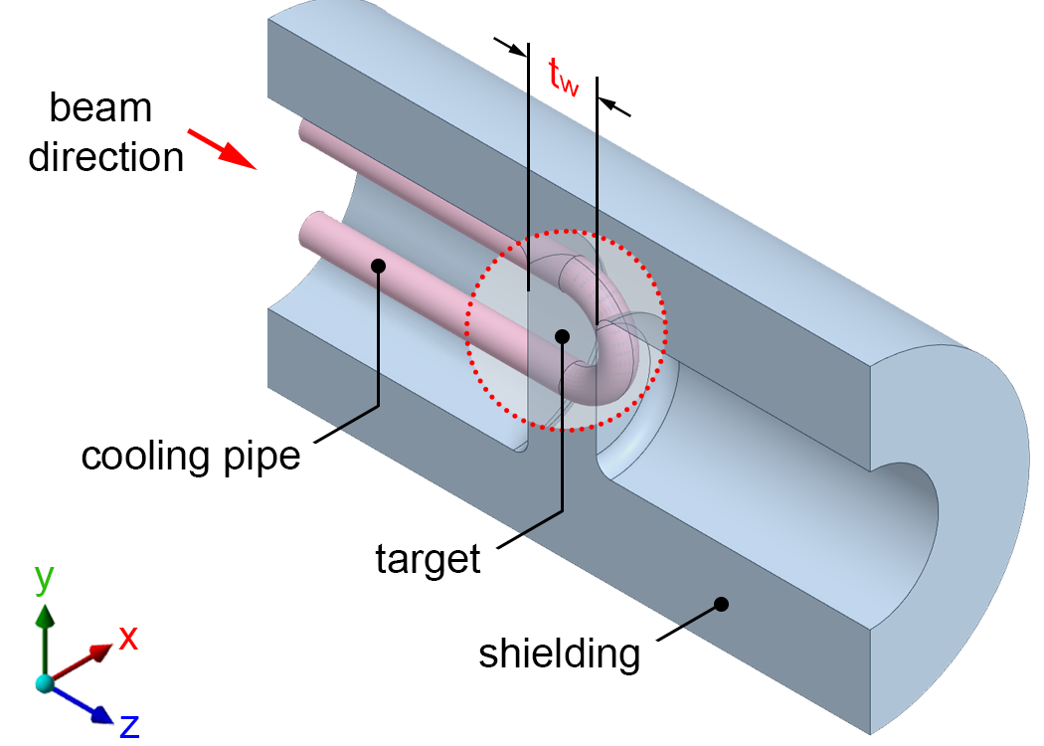
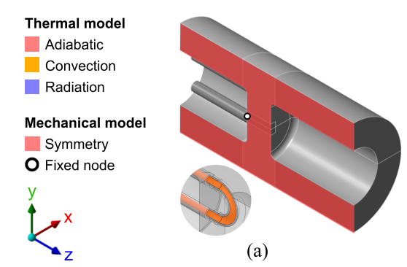
2. Thermo-mechanical studies update (1/4)
Positron source design: Model setup:
Fixed tungsten (W) target
Integrated shielding
Embedded Tantalum (Ta) cooling pipes
Symmetry around x axis (1/2 model)
General dimensions: D70x128.5mm
Parameter | 6 GeV | 2.86 GeV
Beam size RMS (mm) | 1.0 | 1.0
Bunch intensity x e10 (nC) | 1.3 (2.08) | 2.37 (3.8)
Bunches per pulse (-) | 2 | 4
Frequency (Hz) | 200 | 100
Target thickness tw (mm) | 17.5 | 15
Beam power (kW) | 4.99 | 4.3
Beam power on target (kW) | 1.46 | 1.26
Table. Beam and geometry parameters for the simulations
Fig. FCC-ee positron source target half section model
Fig. Thermo-mechanical model setup

Slide 7
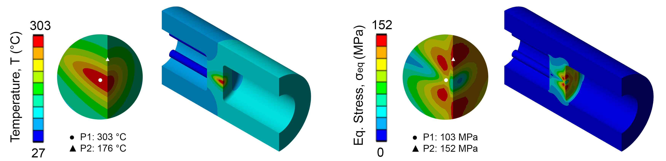
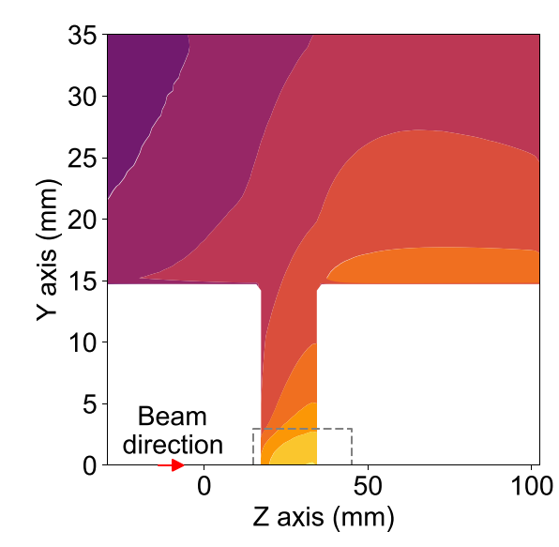
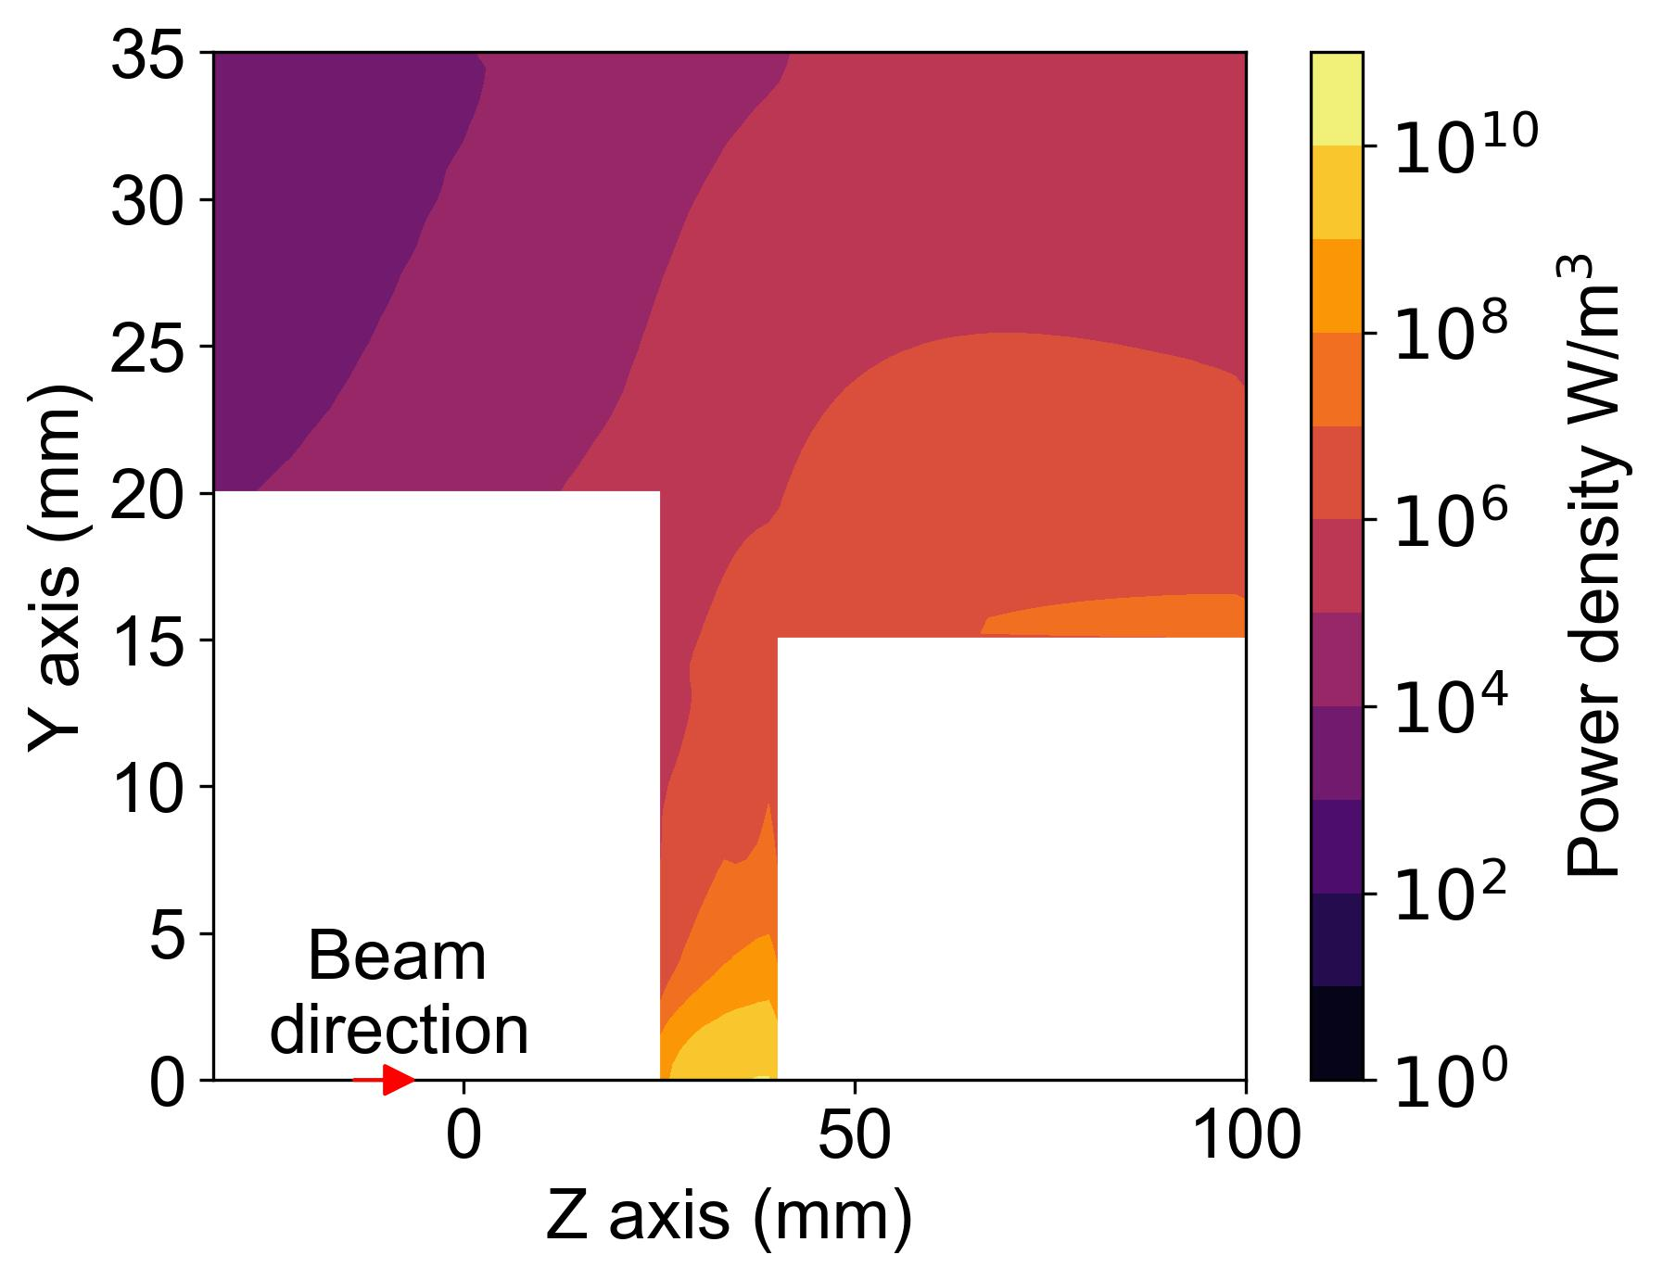
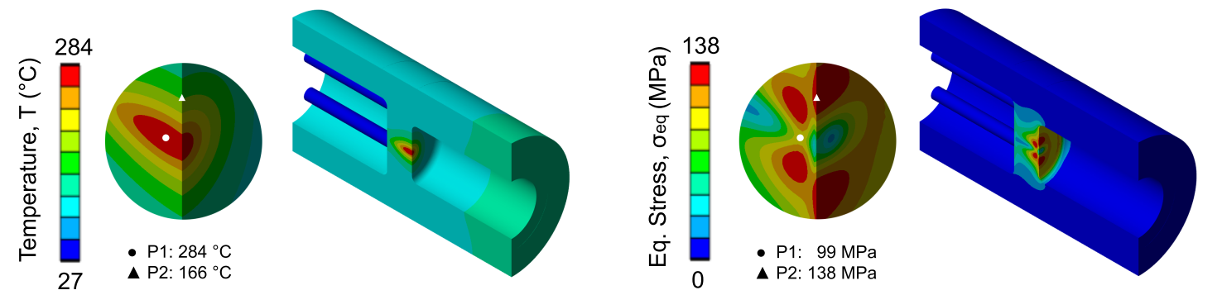
2 Thermo-mechanical studies update (2/4)
Power density deposition:
Main input for the thermomechanical simulations
6 GeV → 2.86 GeV = 4.3% reduction in maximum deposited power density (W/m^3)
Steady-state results:
By reducing the e- beam energy, a thinner target is used. As a result, it gets less power deposited with 9.2% lower thermo-mechanical stresses.
6 GeV
6 GeV
2.86 GeV
2.86 GeV
(c)
Fig. Power density deposition map obtained from FLUKA used as input for the thermo-mechanical simulations for the (left) 6 GeV vs (right) 2.86 GeV W target. [B. Humann and M. Daugaard @CERN SY-STI]
Fig. Temperature (left) and equivalent stress (right) distributions for the (top) 6 GeV vs (bottom) 2.86 GeV W target
Notes:
Comments:
P1: location of maximum temperature
P2: location of maximum thermal stresses
the strong thermal gradient at the external surface causes the maximum stresses at P2 and not at P1.
convection is included in the internal faces of the cooling pipes

Slide 8

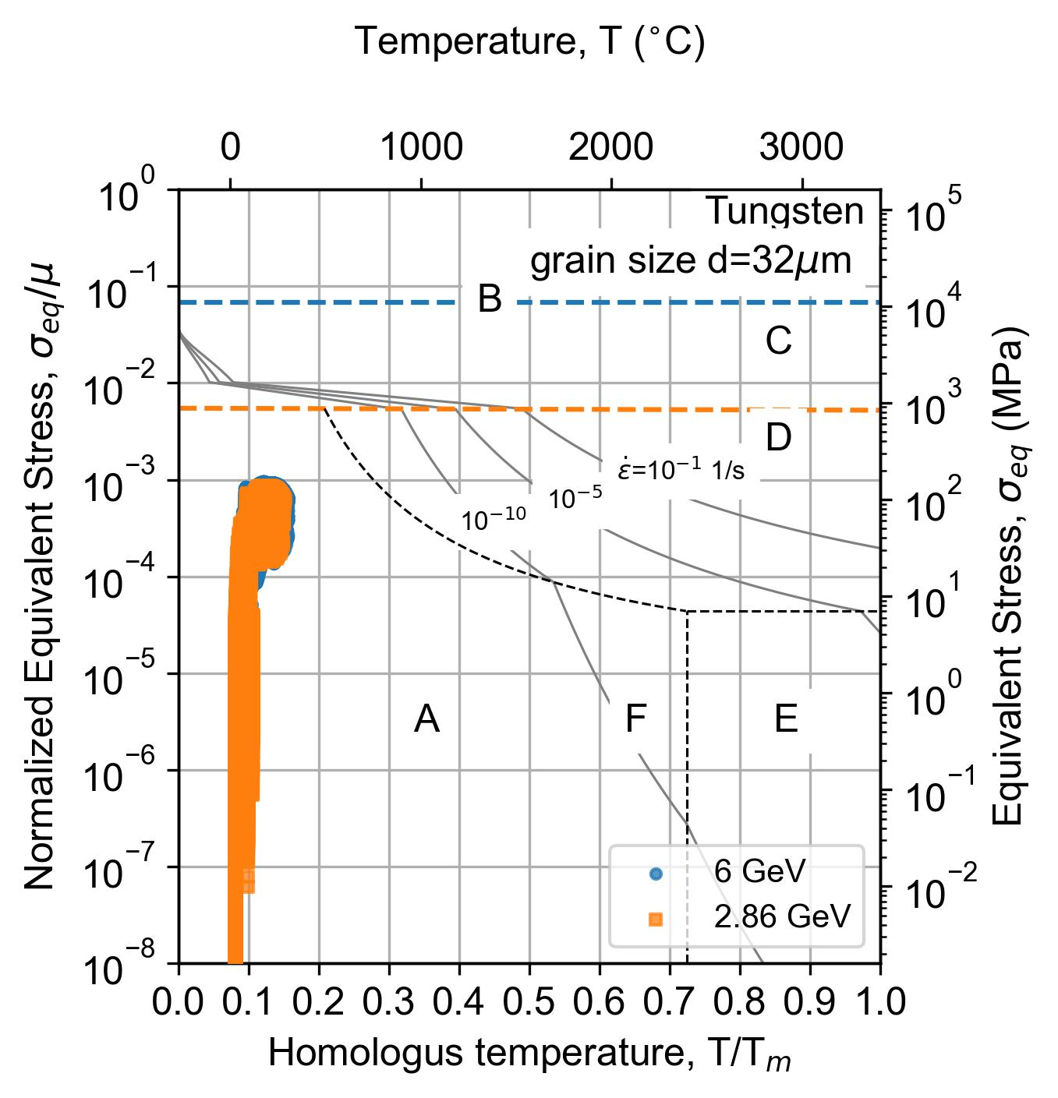
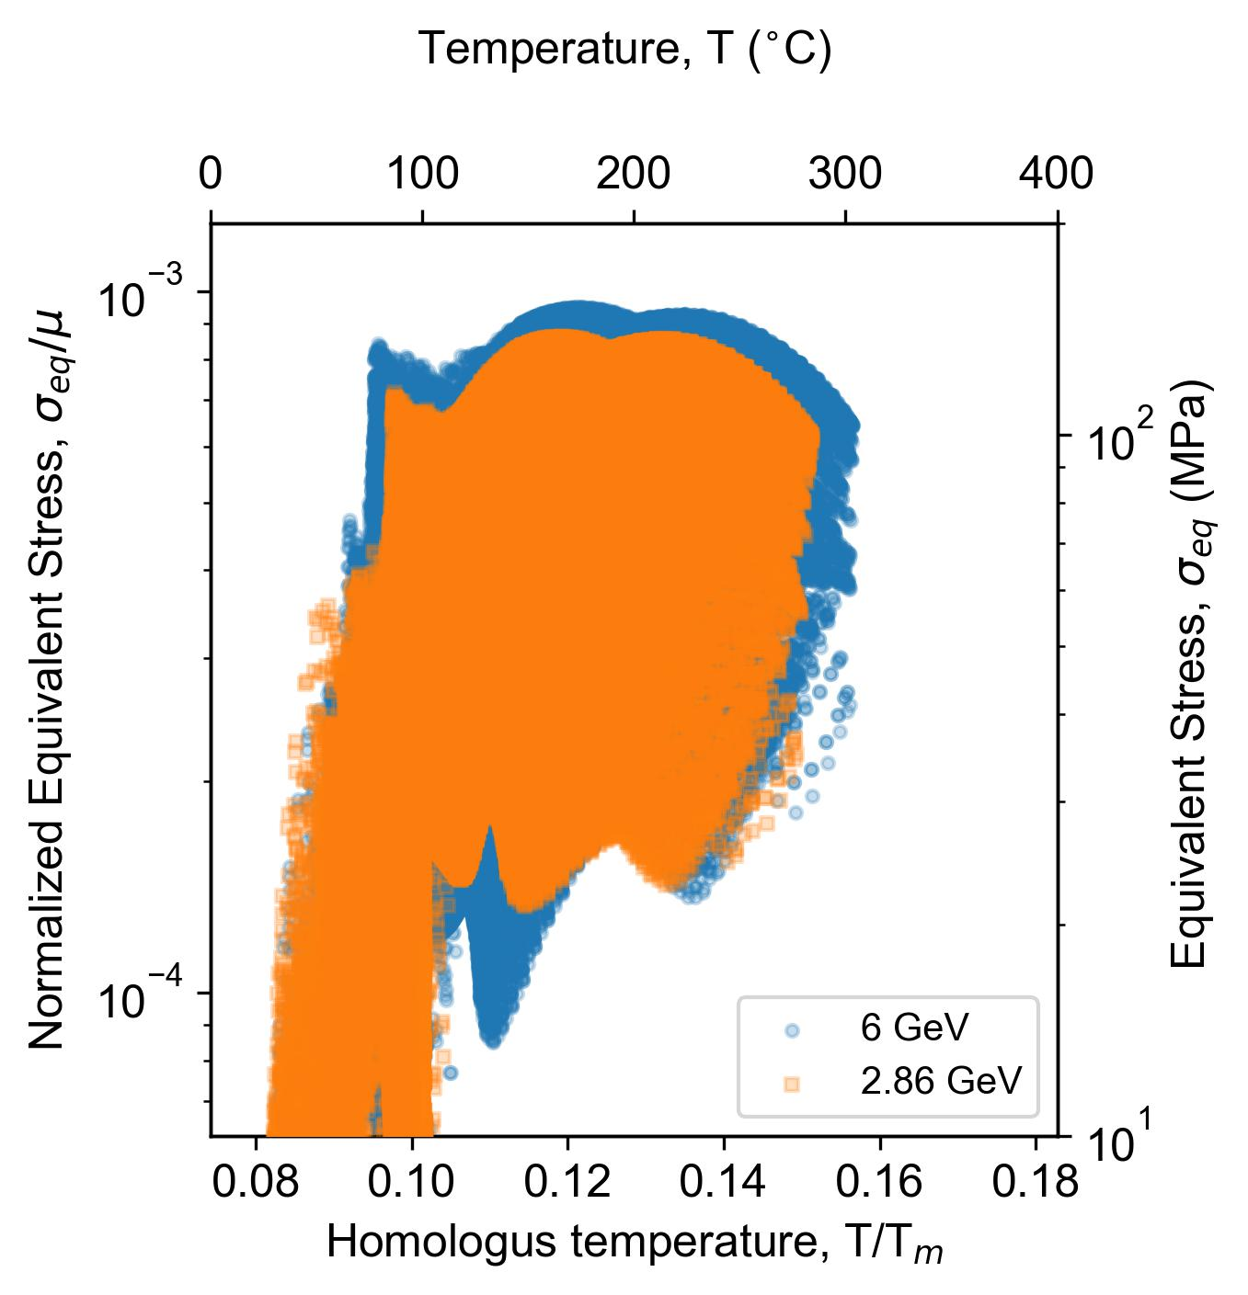
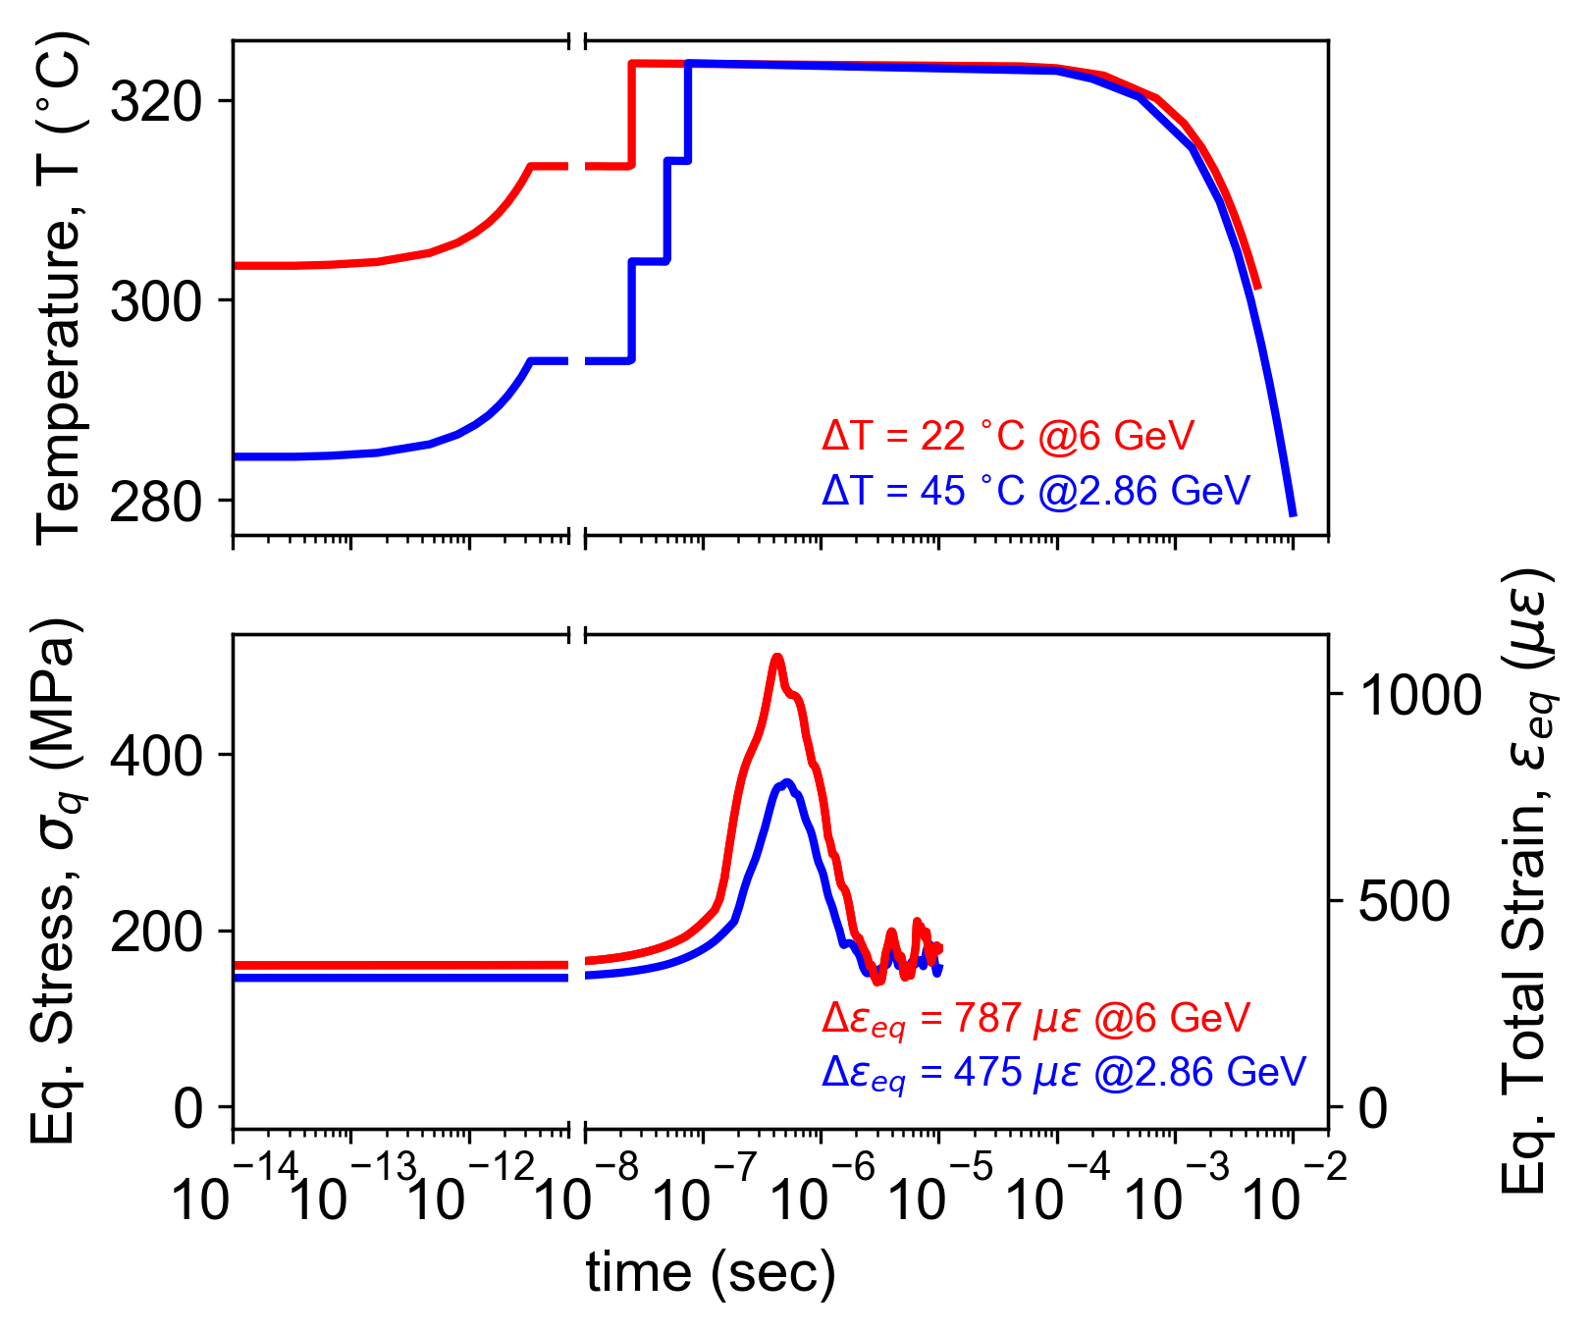
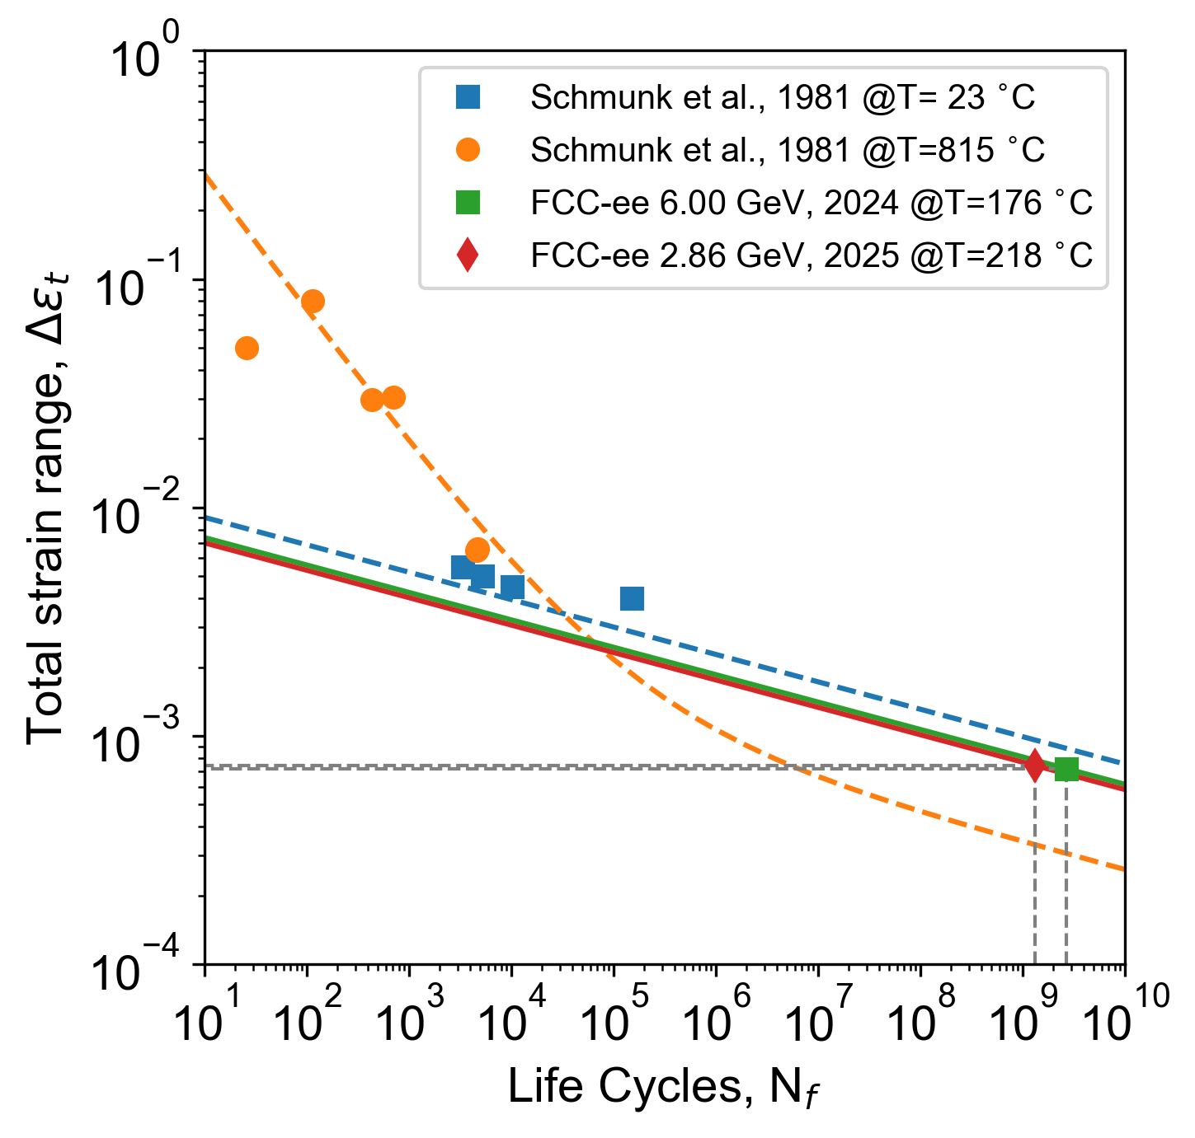
2 Thermo-mechanical studies update (3/4)
Steady state results:
Deformation mechanism maps [Ashby et al. 1972]
Tmax < DBTT [350-400] °C
Transient results:
Thermal fatigue:
Required lifetime = 155.4 [days/year]
Universal slope method [Manson 1964]
Ebeam [GeV] | ΔT [°C] | Δ σeq [MPa] | Δ εeq [με] | Nf x1E9 [cycles] | Δ εlim [με]
6 | 22 | 510 | 787 | 2.7 | 719
2.86 | 45 | 222 | 475 | 1.35 | 741
Table. Thermo-mechanical comparison between 6 vs 2.86 GeV e- beam
D: ductility σu: ultimate tensile strength [MPa]
E: Young’s Modulus [MPa] Nf: number of cycles to failure
Fig. Deformation mechanism maps for polycrystalline tungsten: 6 vs 2.86 GeV. Legend: A: Elastic regime, B: Theoretical shear stress, C: Dislocation glide, D: Dislocation creep, E: Diffusional flow (Nabarro creep) and F: Diffusional flow (Coble creep).
Fig. Transient-state for a single e− beam pulse after reaching steady-state: comparison between the 6 (red) and 2.86GeV (blue) W targets.
Fig. Universal slope method for tungsten [Schmunk et al., 1981]
Notes:
Tool to evaluate the thermo-mechanical performance between configurations
The target lifetime is estimated assuming an operation cycle of 185 days per year [5] with a duty factor of 0.84

Slide 9
2 Thermo-mechanical studies update (4/4)
Summary:
Going from 6 GeV (200 Hz x 2 bunches) to 2.86 GeV (100 Hz x 4 bunches):
  Better thermo-mechanical performance for the W target
  Steady state temperature and thermal stresses are reduced by 6.3 and 9.2 %, respectively.
  Dynamic effects are reduced by a factor of 2.3 (1.7) in terms of equivalent stress (strains).
  The thermal fatigue assessment shows that the required lifetime of 155.4 days/year is feasible.
Next steps:
  Validation of the manufacturing route by producing a prototype
  Radiation damage needs to be re-evaluated. Previous estimation was O(1 DPA/year)

Slide 10
3. Target prototyping

Slide 11
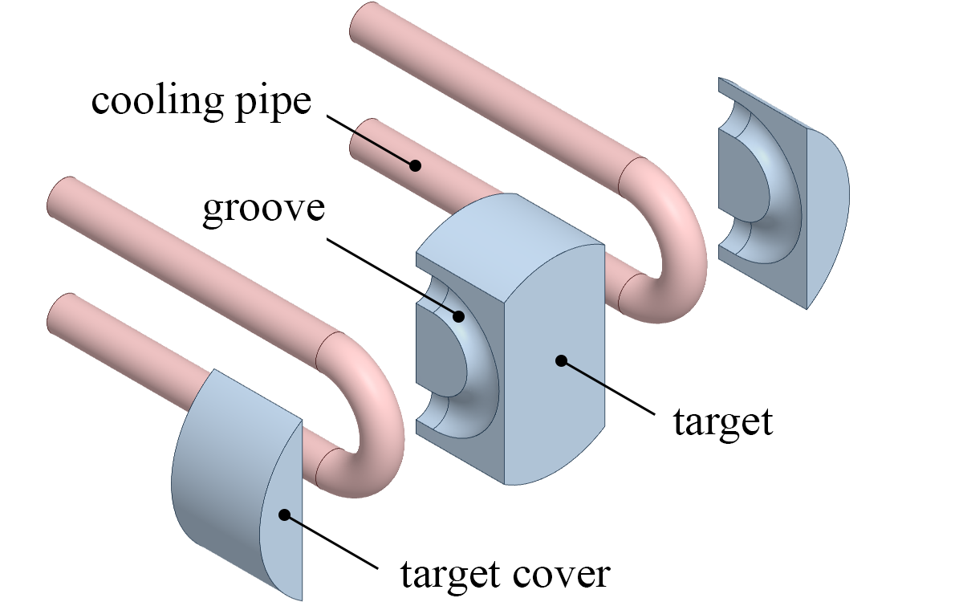
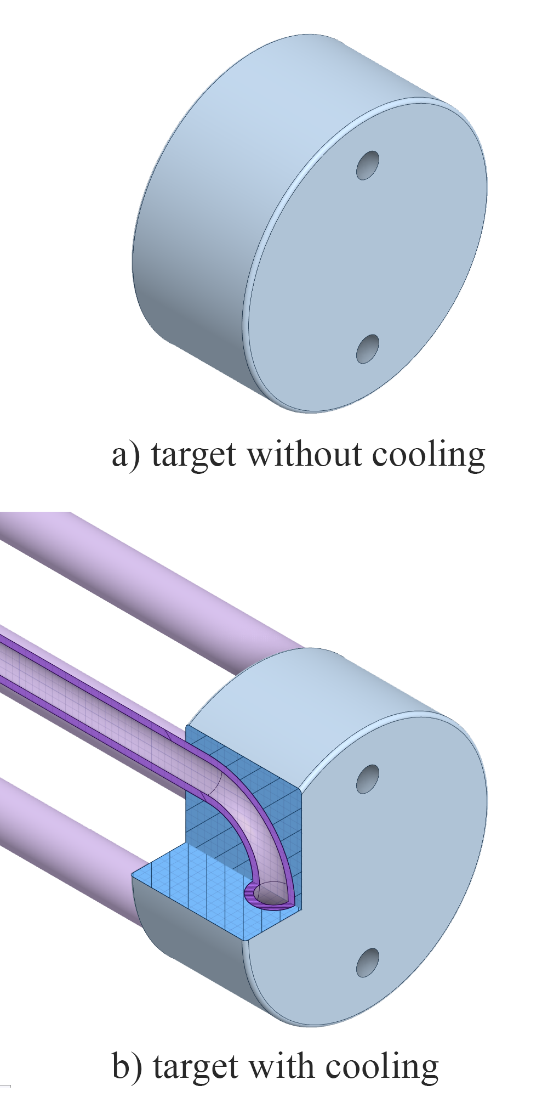
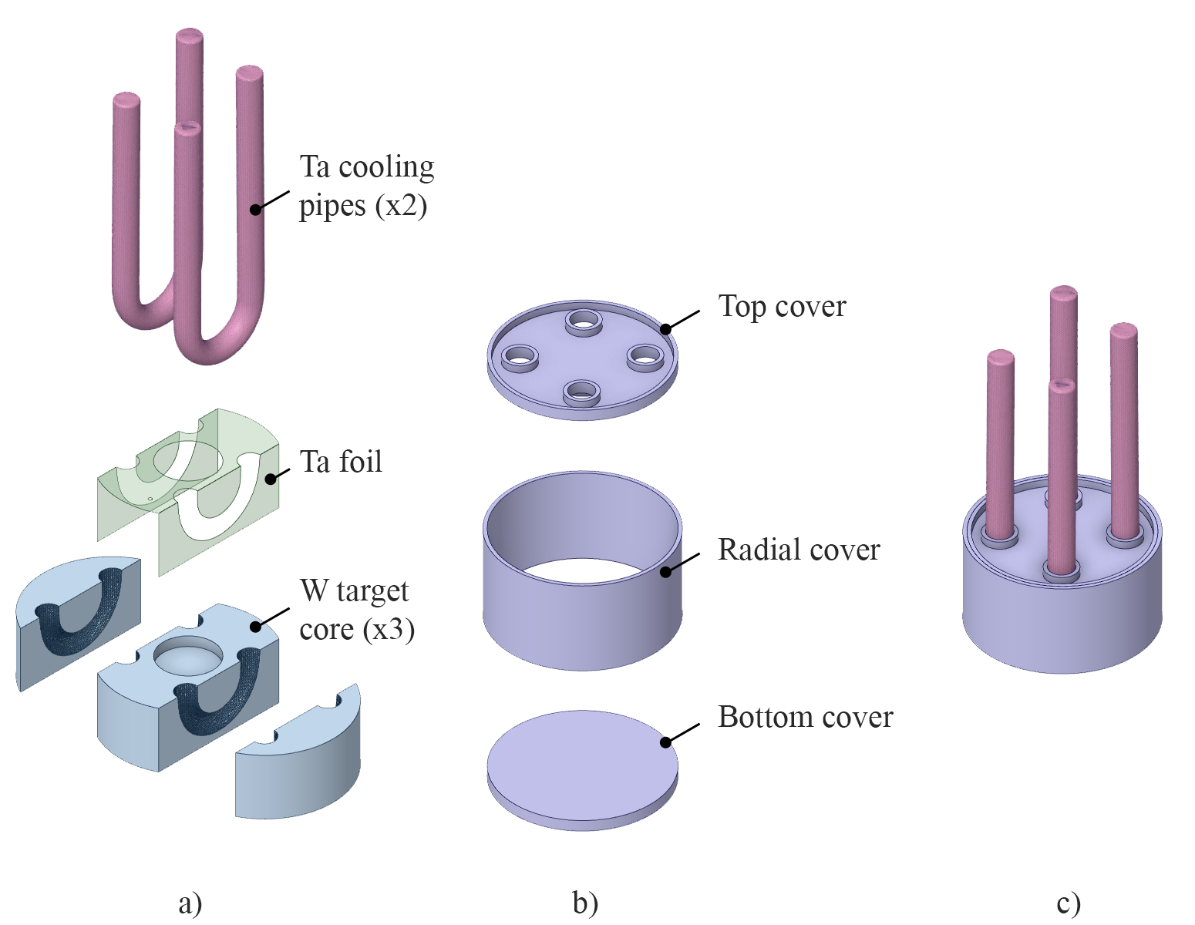
2. Target prototyping: HIP capsule (1/3)
Motivation:
To manufacture a prototype of the positron source target with an embedded cooling system using Hot Isostatic Pressing (HIP) to join both parts by diffusion bonding.
Constraints:
Target thickness: available space to place the cooling pipes
W: 15 mm
Ta: 18 mm
Diameter: 37 mm (for P3)
Fig. P3-target with cooling components
Fig. P3-target prototypes
Fig. P3-target with cooling HIP capsule

Slide 12
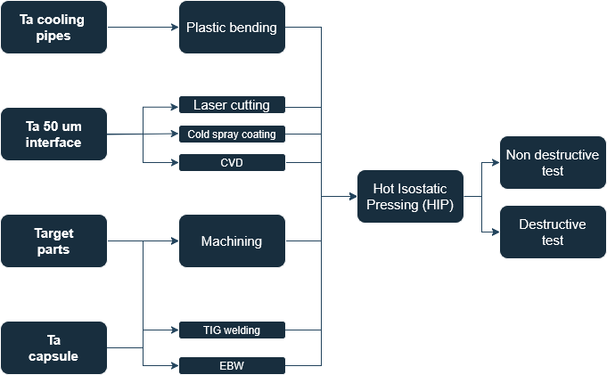
2. Target prototyping: HIP capsule (2/3)
Option 3: W-Ta with inserts
To extend 3mm the target only in a region around the cooling pipes
Target diameter (for the capsule) φ44
To separate the pipes supports to the capsule
Complete
Ongoing
Pending
Fig. P3-target with embedded cooling pipes prototype: a) exploded view of the target components only, b) exploded view of the HIP capsule components only and c) HIP capsule final assembly.
Fig. P3-target with embedded cooling pipes prototype: process diagram

Slide 13
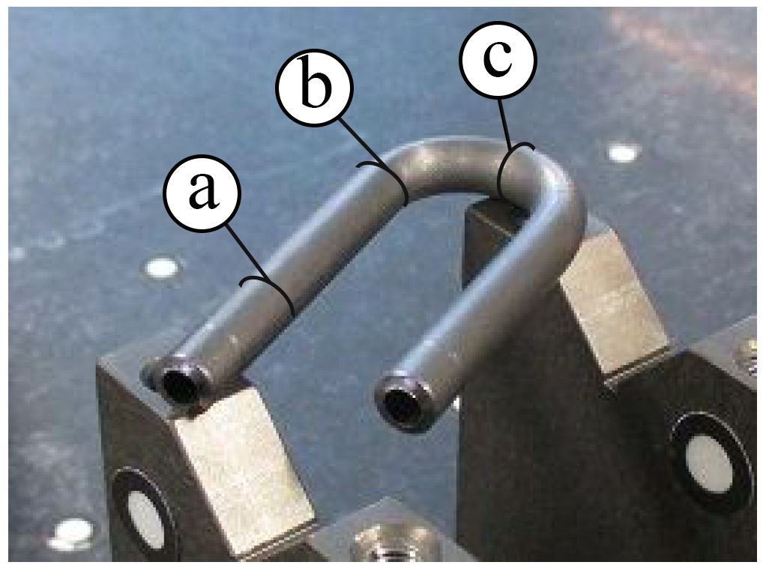
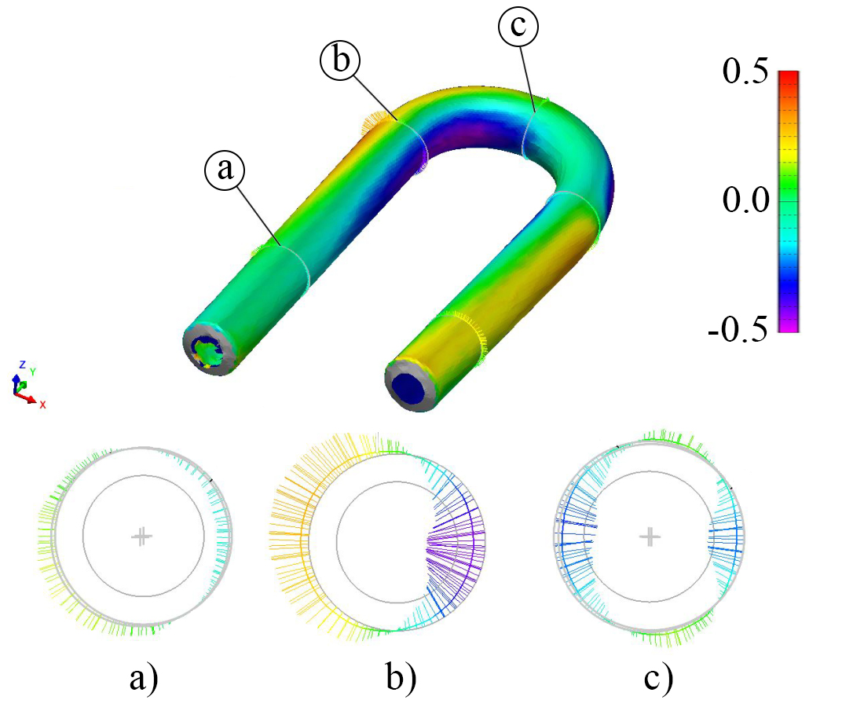
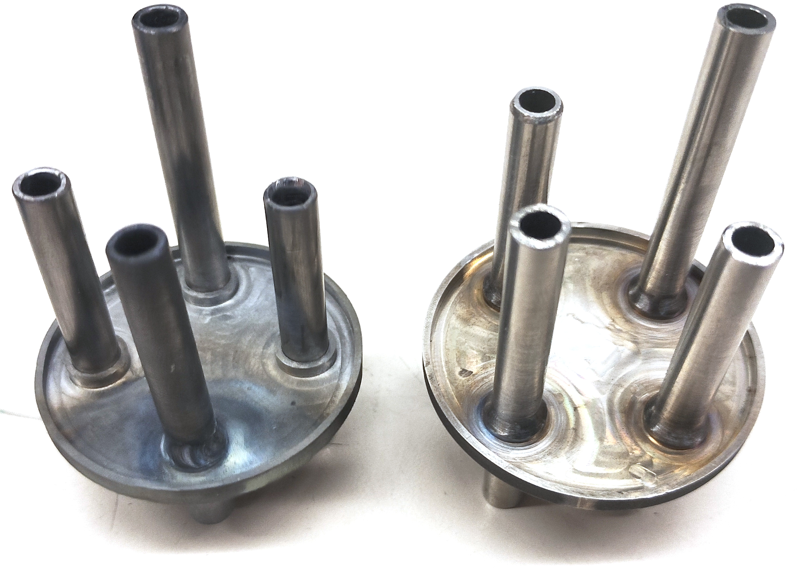
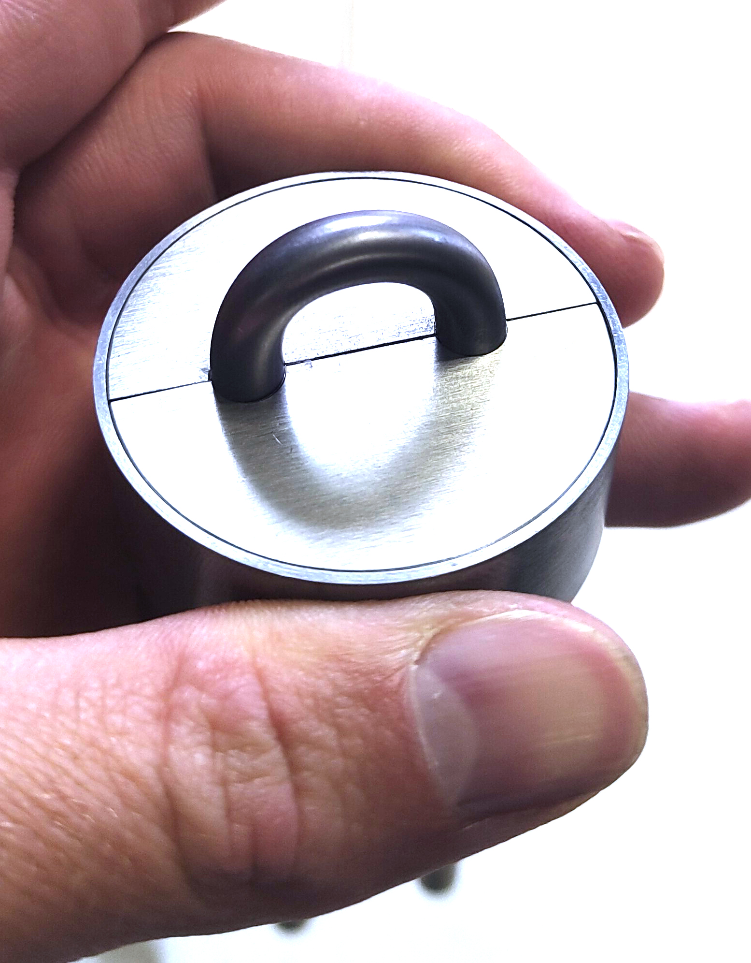
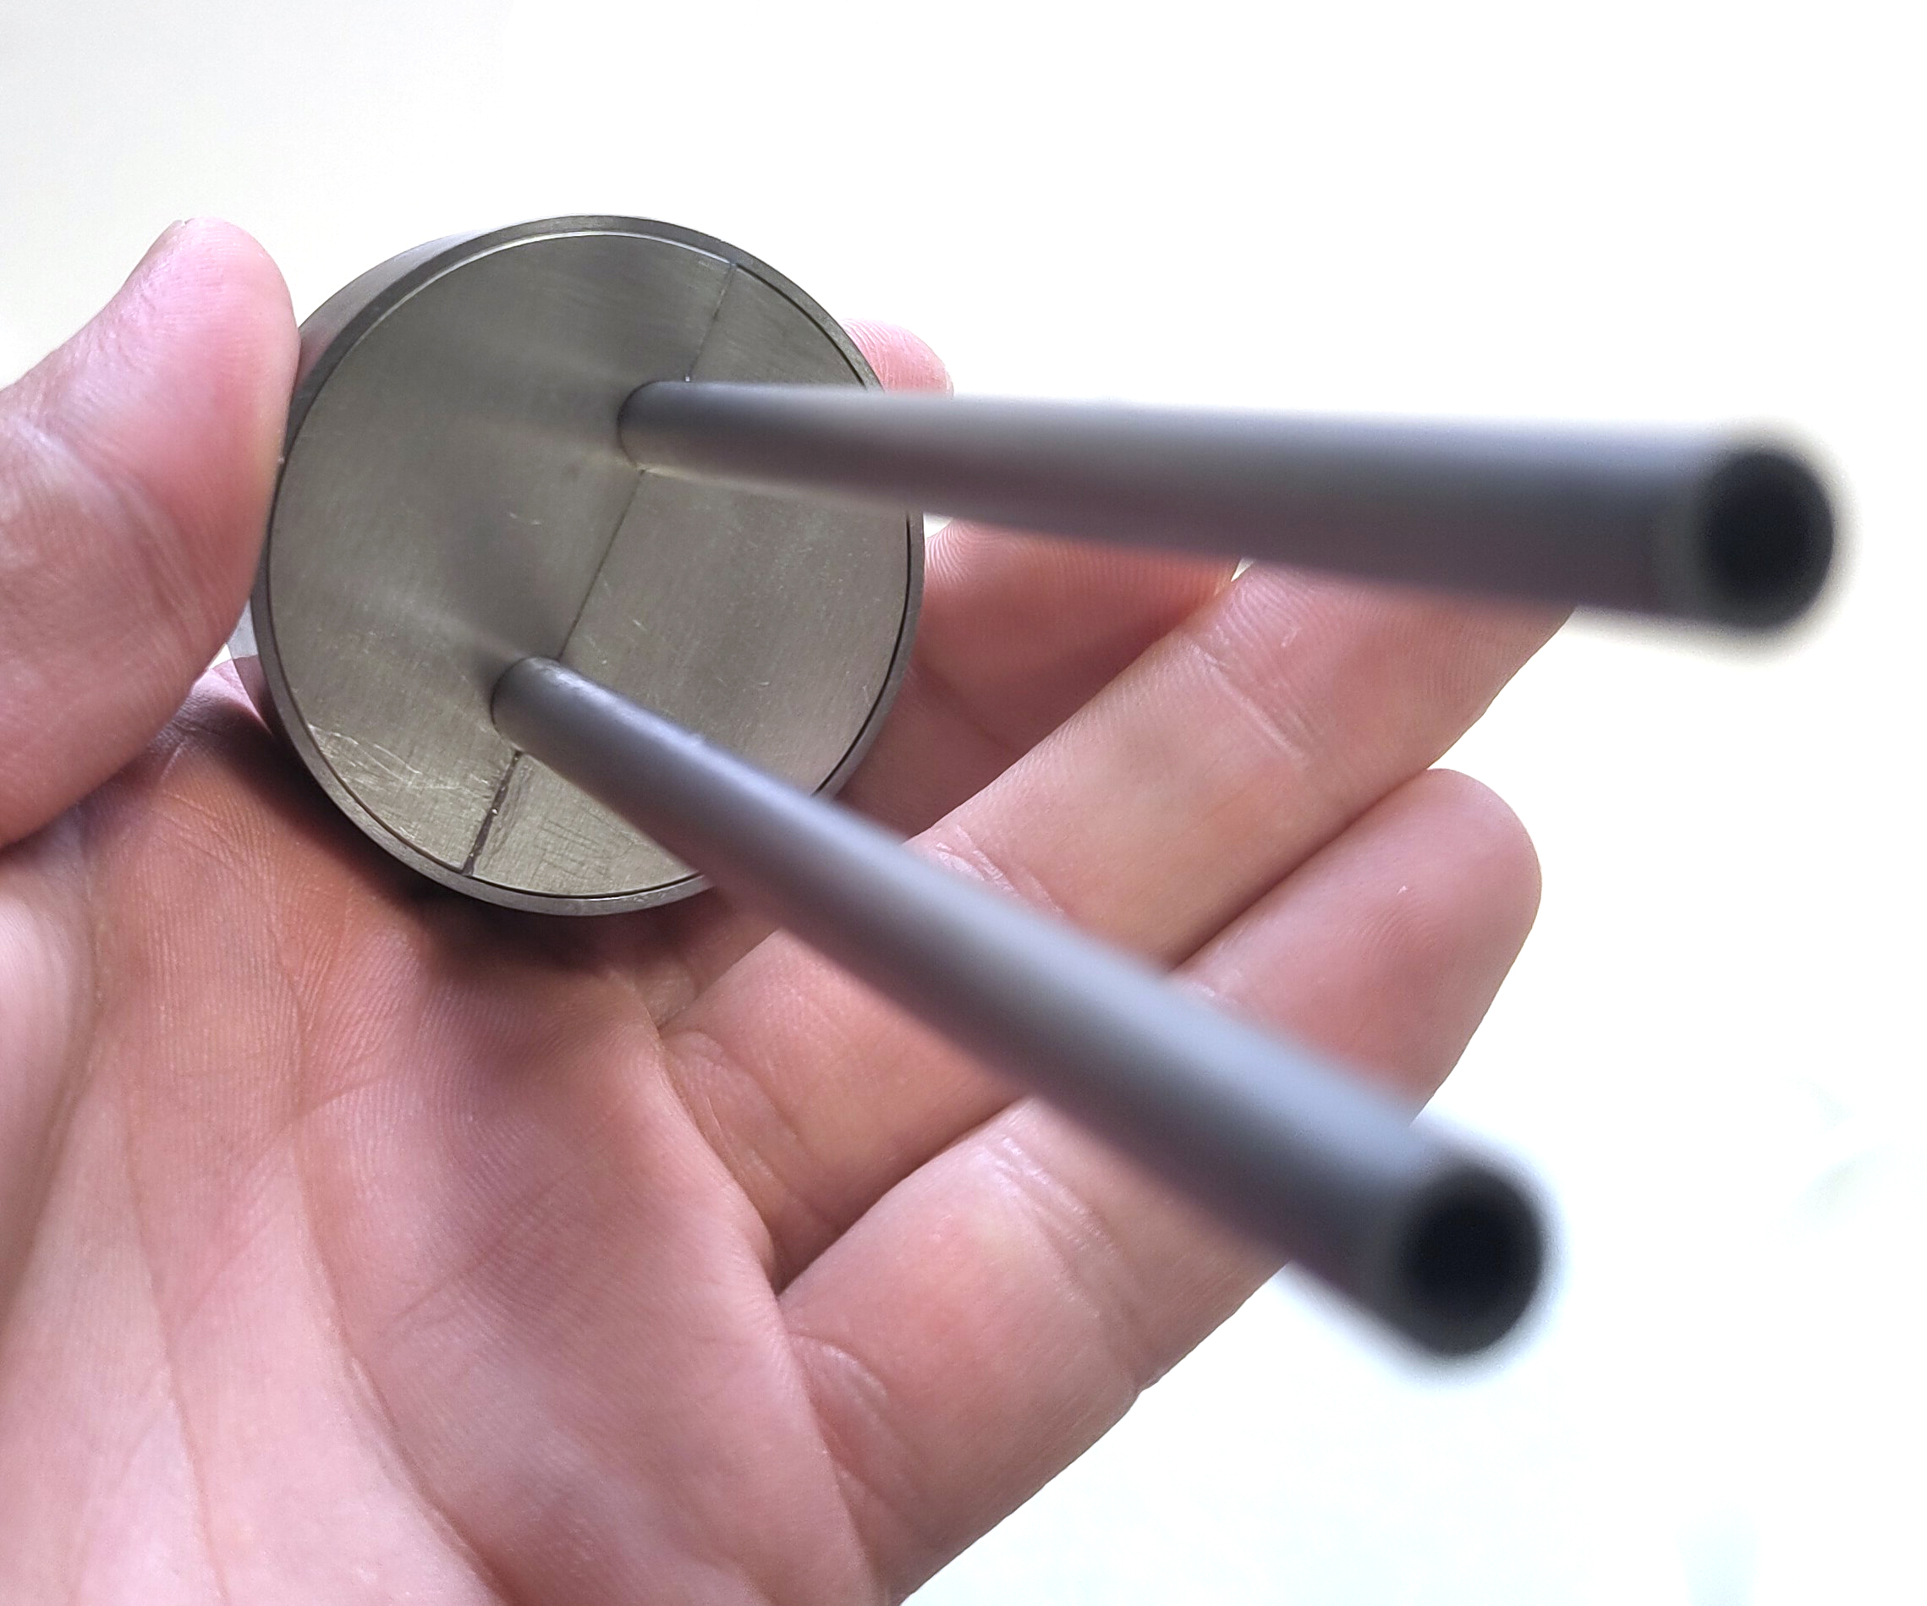
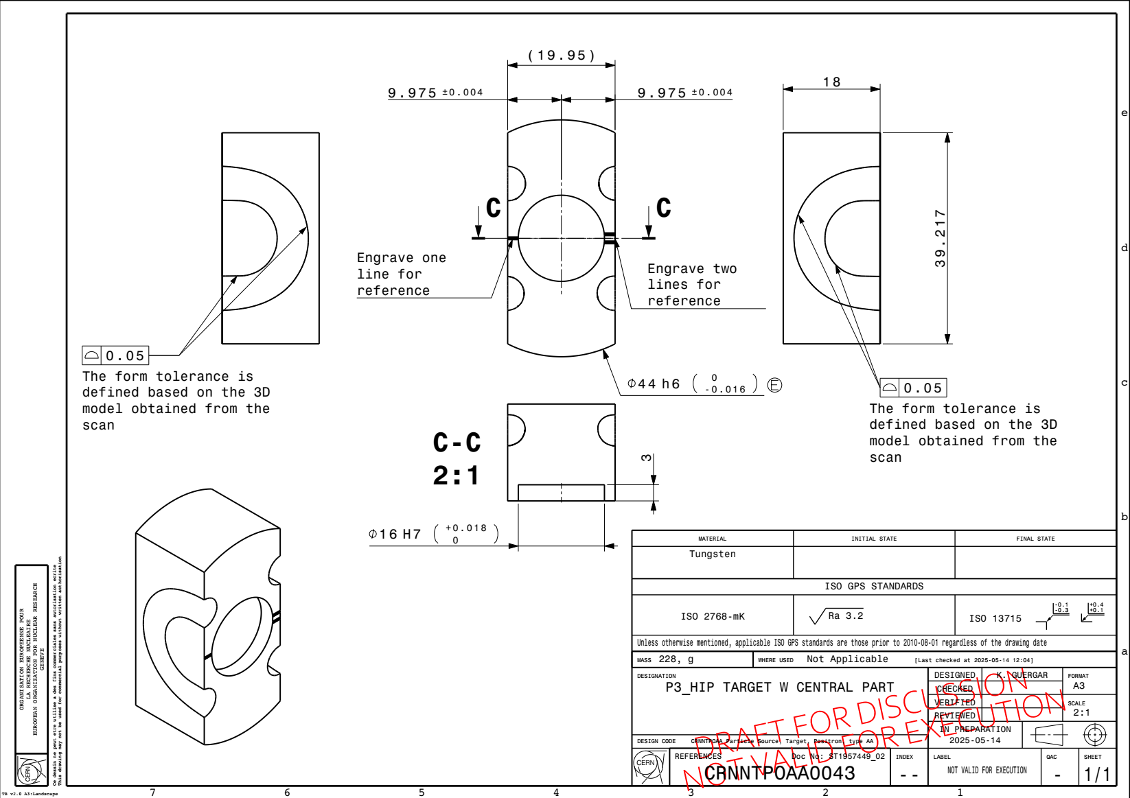
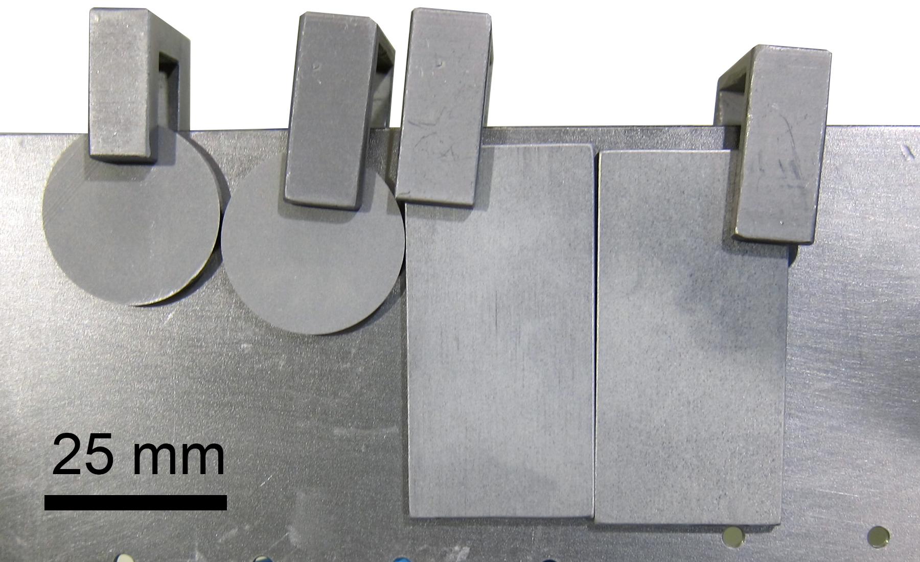
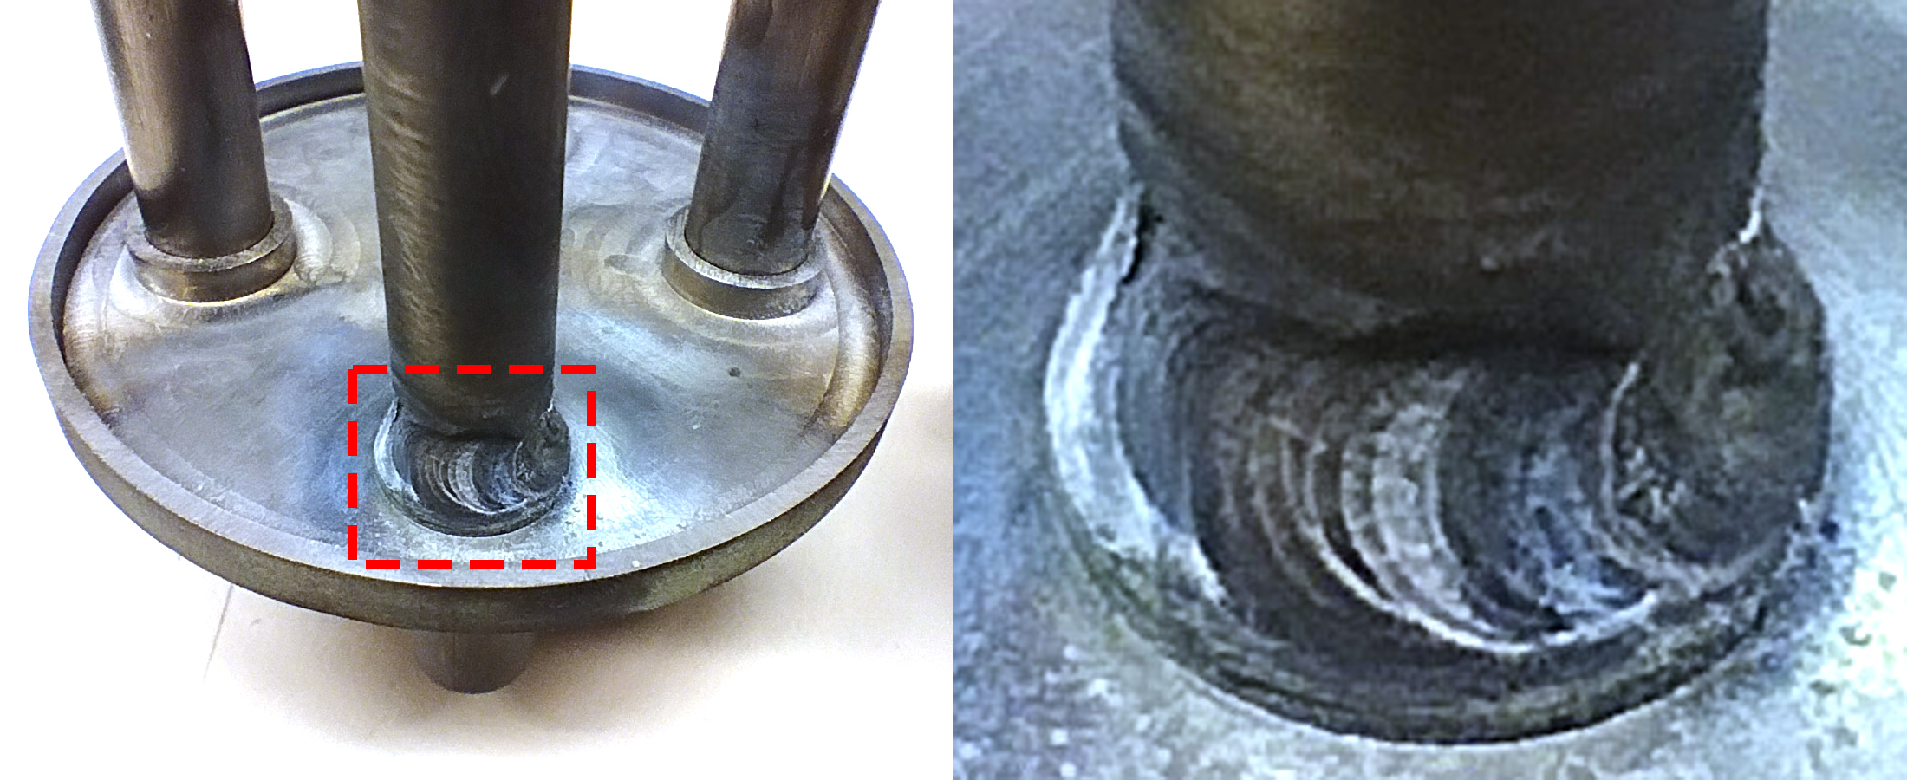
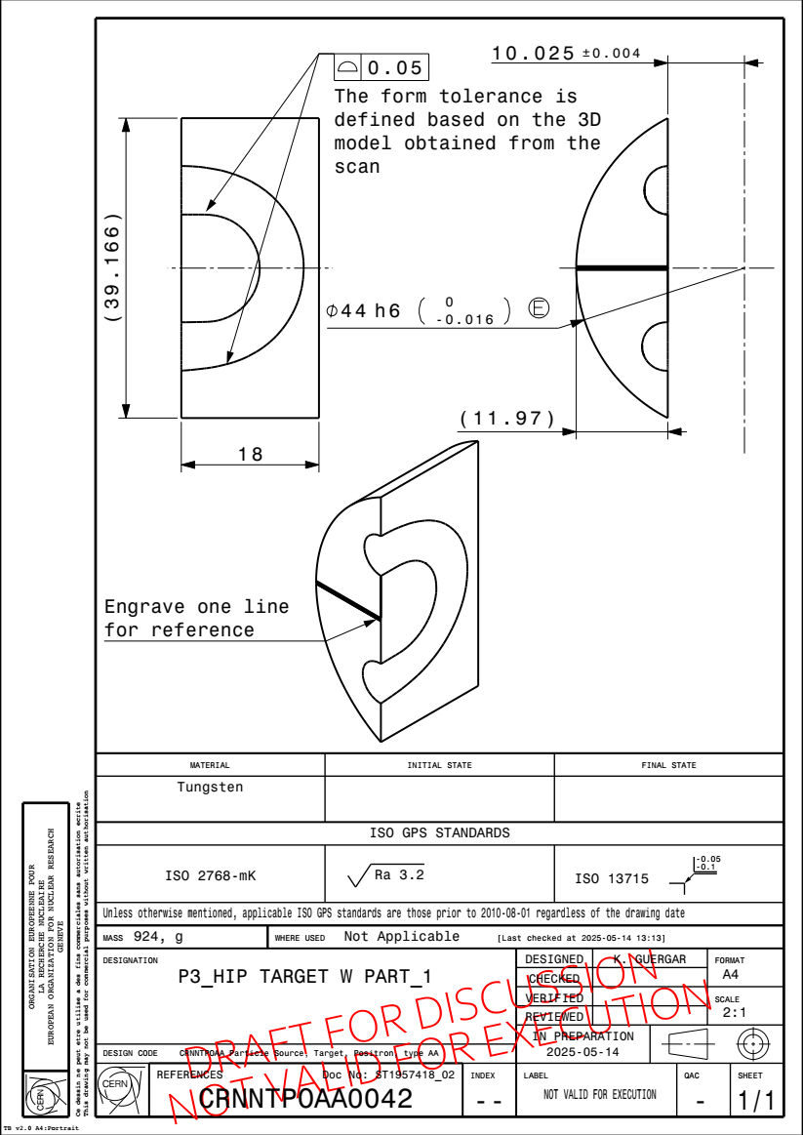
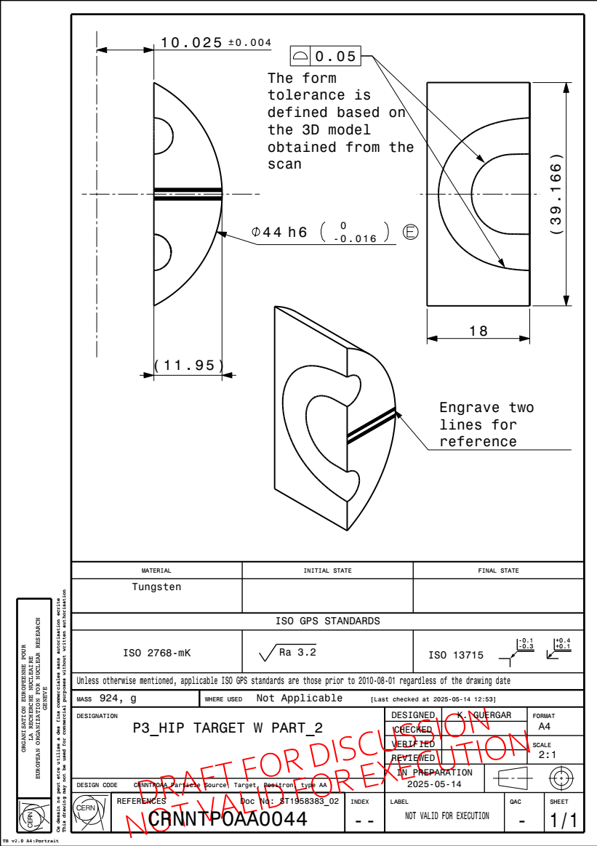
2. Target prototyping: HIP capsule (3/3)
Special thanks for all the technical support to:
[A] T. Coiffet and MME team
[B] K. Guergar and R. Seindebinden (SY-STI-TCD)
[C] W. Vollenberg (TE-VSC)
Fig. Ta cooling pipes prototype: (left) 180° elbow and (right) scanned geometry [A]
Fig. Welding test (left) mock-up of tantalum and (right) stainless steel used for training [A]
Fig. Target prototype (simplified version)
Fig. Welding test for the Ta-Ta joint on the HIPing capsule (left) mock-up and (right) zoom of the resulting joint [A]
Fig. Ta CVD coating in W substrates [C]
Fig. W target parts: 2D drawings [B]

Slide 14
4. PSI Positron Production (P3) Experiment update

Slide 15
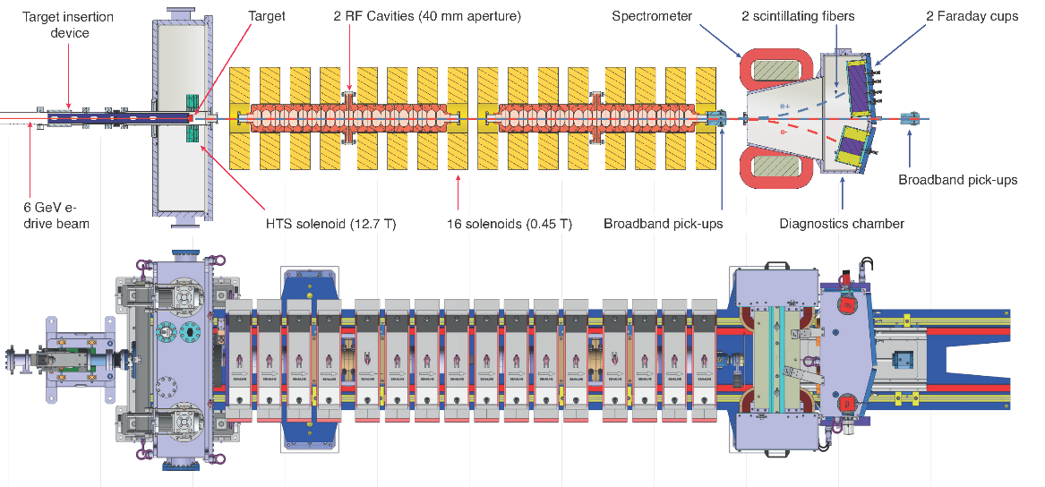
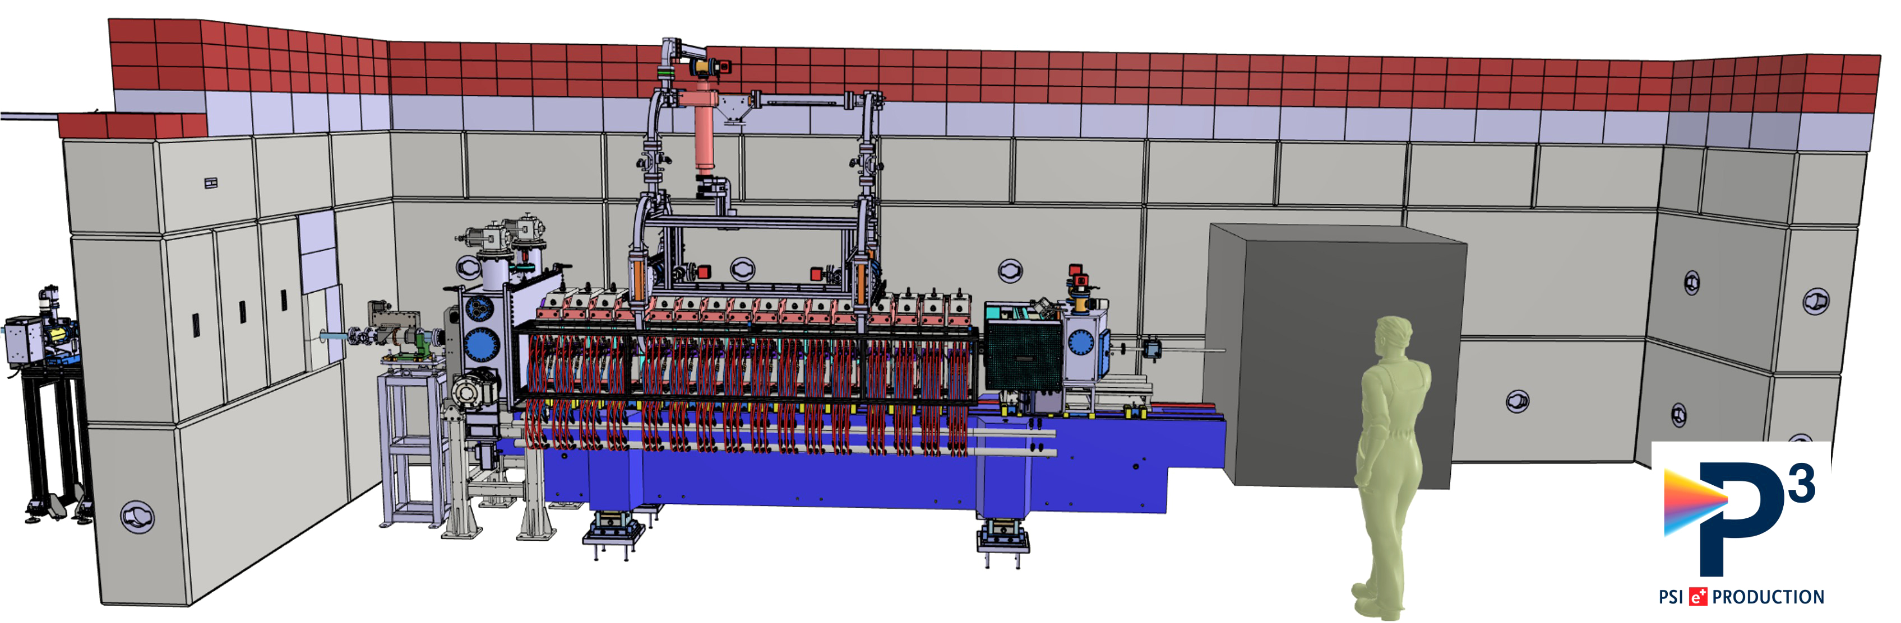
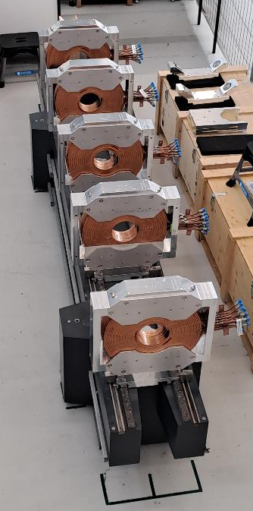
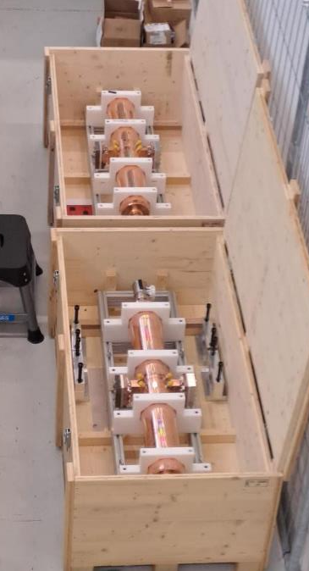
4. P3 Experiment update (1/4)
In a nutshell: e+ source demonstrator for FCC-ee under installation in SwissFEL
Goal: to produce positrons in 2026 using the 3-6 GeV SwissFEL e- beam as drive beam
Status: experiment under assembly, installation in the SwissFEL tunnel in August 2025
Fig. P3 experiment layout [Courtesy: PSI]
Fig. P3-Experiment: (top) cross section with the main components and (bottom) Layout top view [N. Vallis 2024]
Fig. NC solenoids and S-band cavities ready for installation
Notes:
Context: The PSI Positron Production (P3 or P-cubed) experiment is developed inside the CHART Collaboration (PSI-CERN-IJCLab-INFN/LNF)
Goal: to design, build and test different configurations of the positron source.

Slide 16
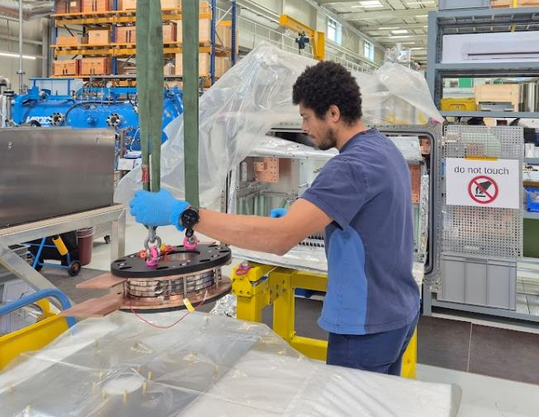
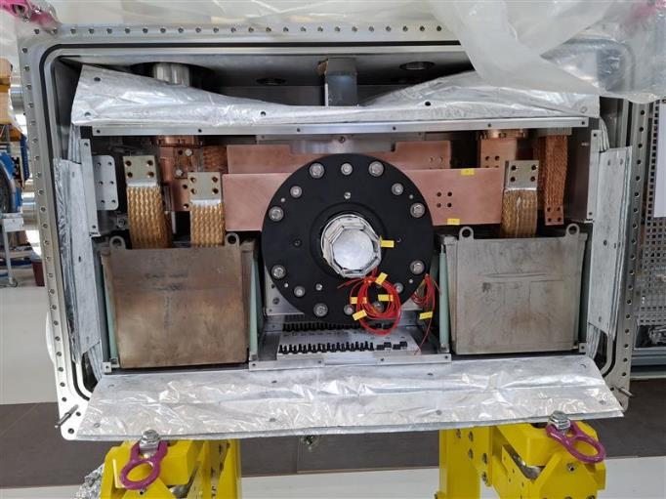
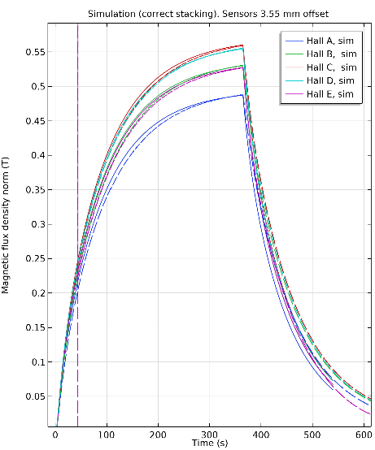
4. P3 Experiment update (2/4)
HTS solenoid
All 5 coils ready and successfully tested in liquid nitrogen
Installation of the coil package in the cryostat under way, should be finished by end of May
Cool-down and power test at 15K in June
Installation of the cryostat in the bunker in summer shutdown
Fig. Coil pack installation
Fig. Coil pack and thermal buffers installed inside cryostat
Fig. Hall sensors measured vs scaled simulated maxima

Slide 17
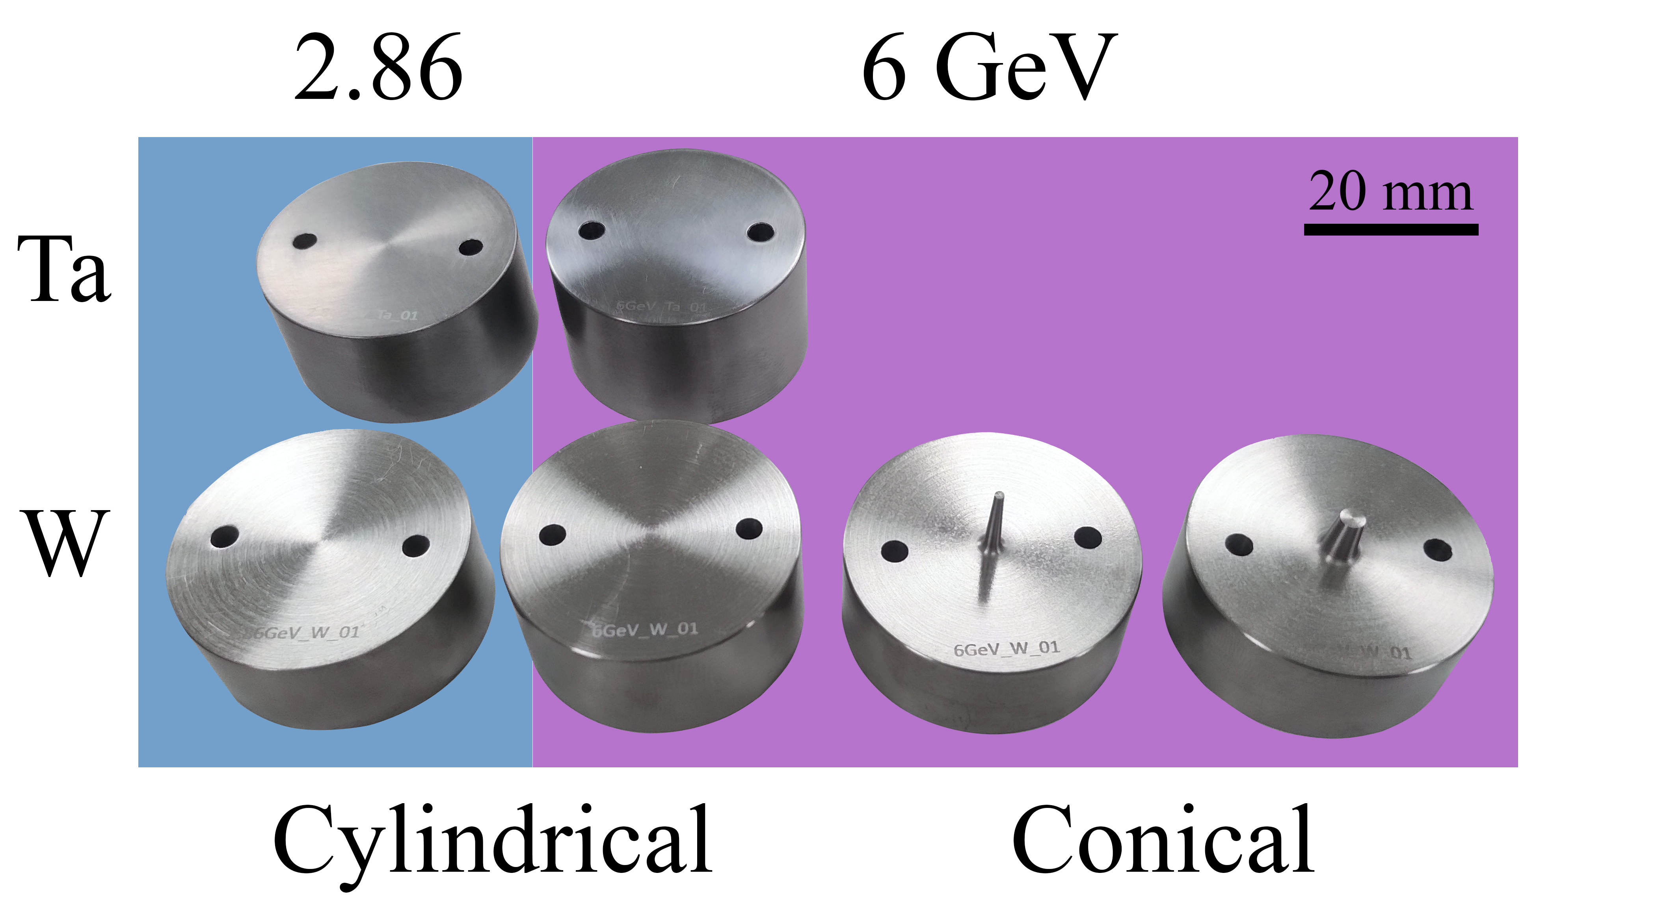
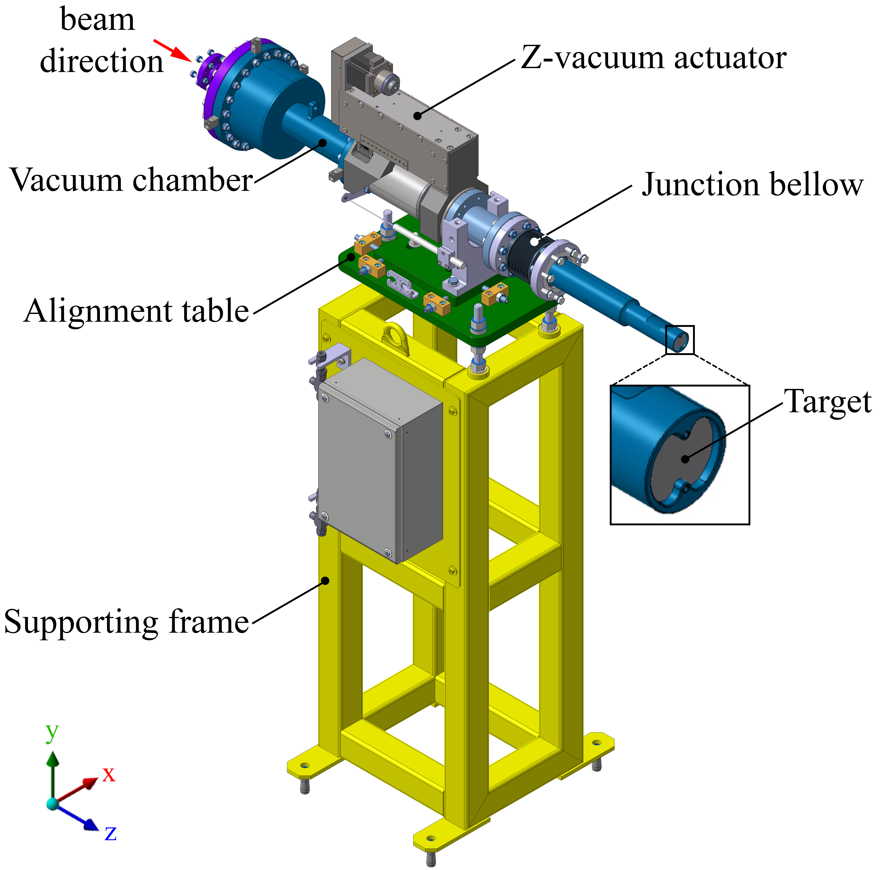
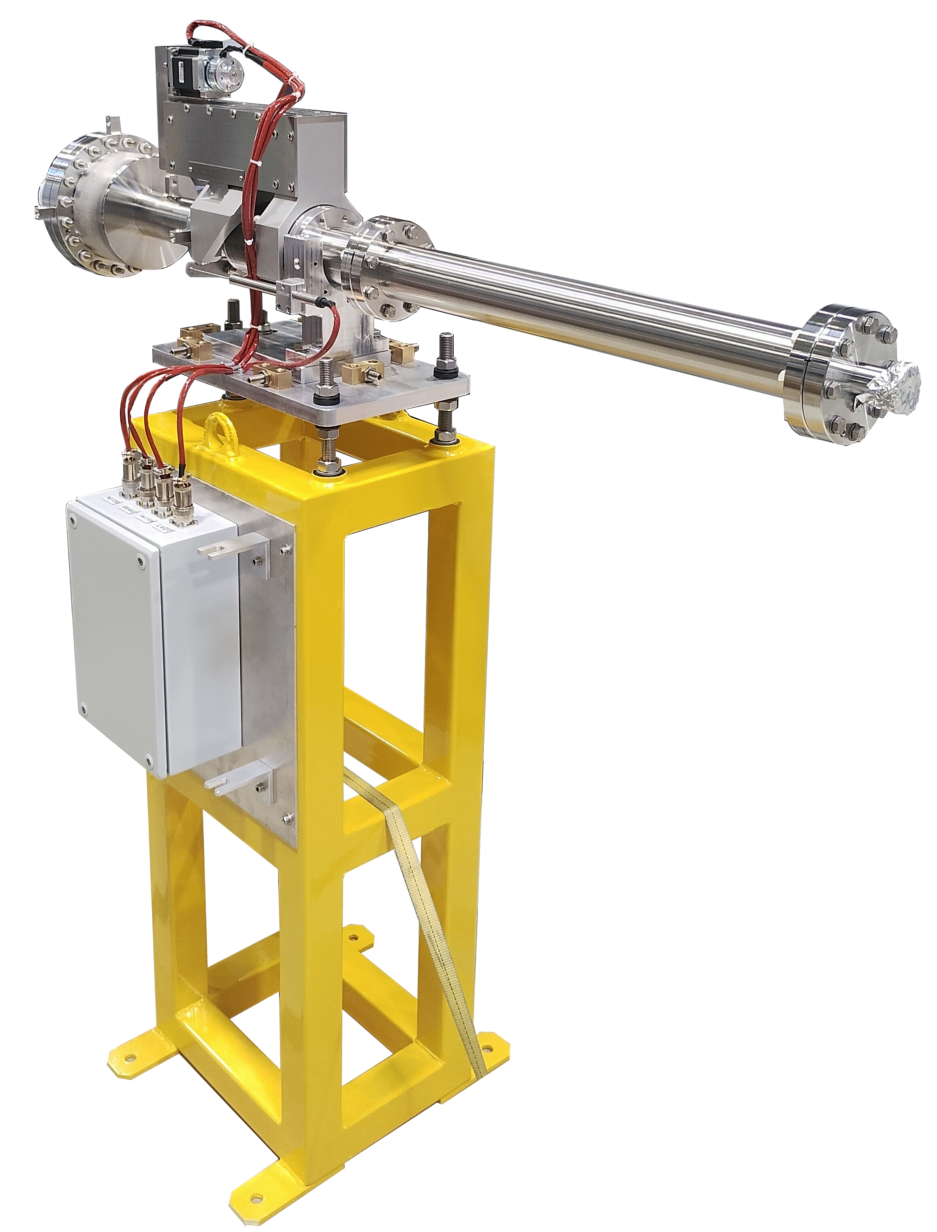
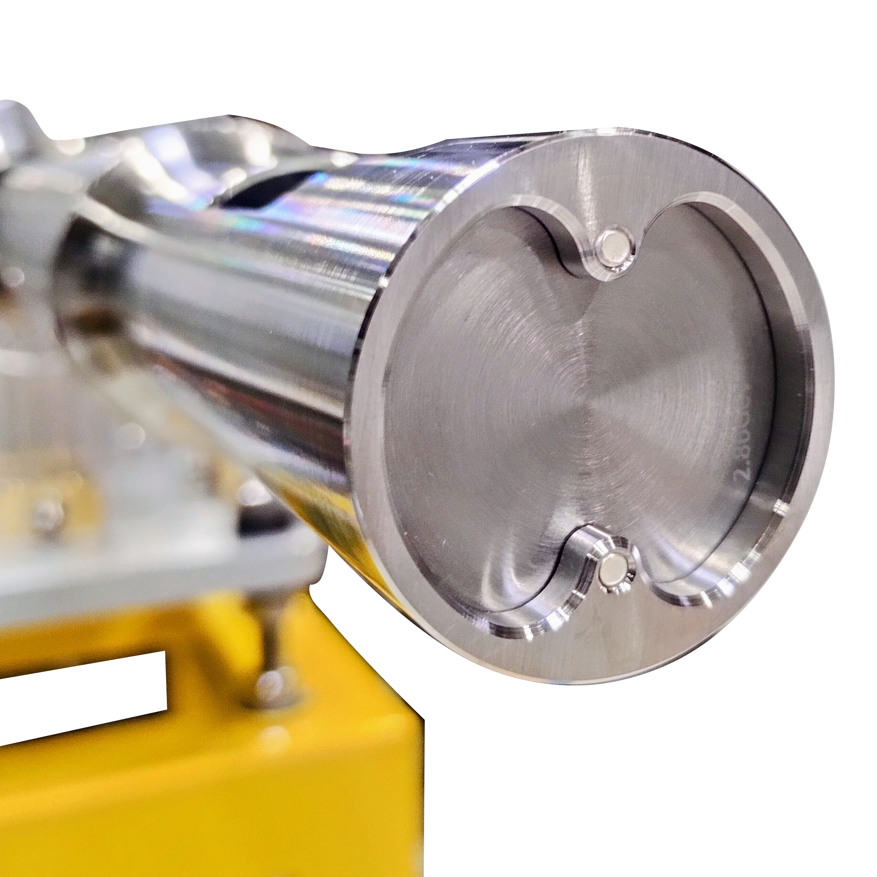
4. P3 Experiment update (3/4)
P3-Target Insertion Device (P3-TID)
Mechanical subsystem in charge to host the fixed target inside of the HTS solenoid
Parameters to explore for e+ yield production:
Geometry (cylindrical vs conical)
Material (Ta and W)
Beam energy (2.86-6 GeV)
Axial position (+/- 50 mm)
Current status:
Ready to be tested at CERN before the planned installation at PSI (Summer 2025)
Fig. P3 available fixed targets. Models without cooling.
Fig. P3-TID subsystem (left) CAD design and (right) mounted assembly.

Slide 18
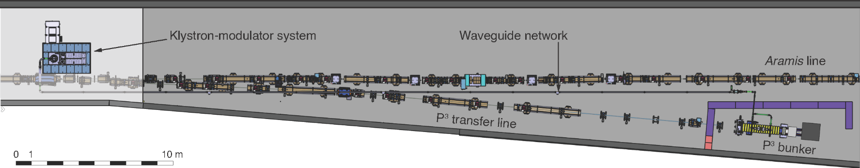
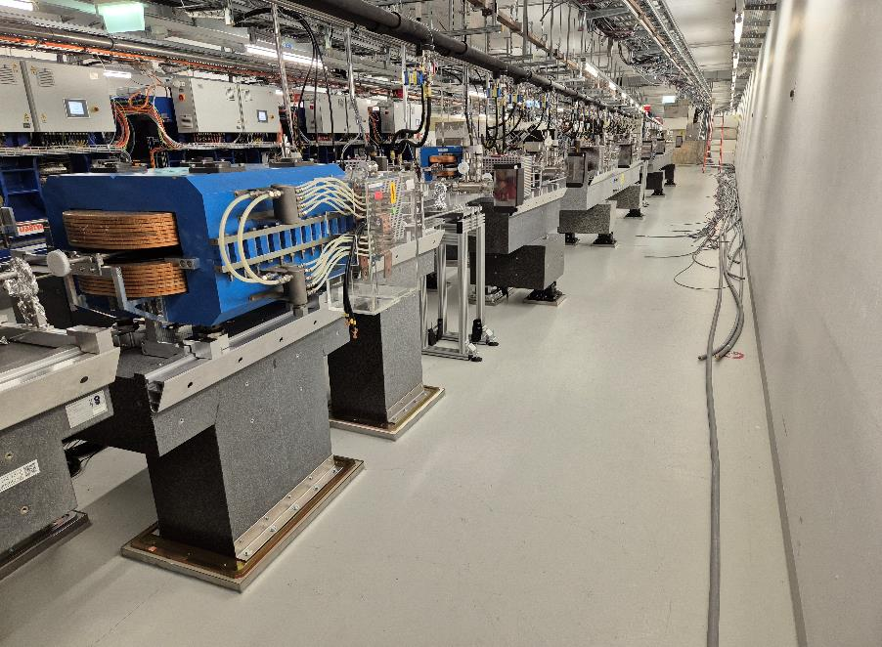
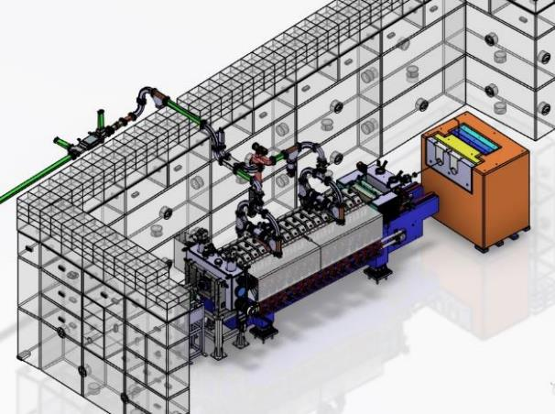
4. P3 Experiment update (4/4)
New
Existing
50 m installed
Dump
Switchyard and beam line installation ~completed
target
Status installation in SwissFEL
Beam line ready
August shutdown
  Installation of the experiment
  Bunker assembly completed
Modulator commissioning end of 2025
e+ beam in 2026
Girder assembly ongoing in WMHA
To be installed in August
Figures credits: M. Schär,
D. Hauenstein and M. Zykova
Front wall assembled
Thanks to M. Schär, D. Hauenstein and M. Zykova

Slide 19
5. Conclusions

Slide 20
5. Conclusions
By moving from 6 GeV to 2.86 GeV, the FCC-ee positron source target (W) improved its thermo-mechanical performance. The obtained reduction in terms of temperature and stresses are beneficial from the operational point of view. However, further work is needed to estimate the impact of radiation damage on the material properties and this information must be included in the numerical model.
The manufacturing of the target with embedded cooling pipes prototypes are ongoing. Extensive R&D efforts are made to validate the processing route.
The status of the P3 experiment was reviewed. All subsystems are ready, and its installation is foreseen at PSI during the August shutdown. The exploitation in 2026 will play a key role for FCC-ee to validate experimentally new design concepts and technologies.

Slide 21
6. Questions?

Slide 22


