Slide 1
Radiation environment in the FCC-ee arcs
B. Humann, A. Lechner
Thanks to F. Valchkova Georgieva, M. Morrone, C. Garion, J. Bauche, L. van Freeden, A. Romero Francia, M. Calviani

Slide 2
Outline
Synchrotron radiation in FCC-ee
  Relevant physical properties
Geometry layout and simulation setup
  Design development
Radiation load in the FCC-ee arcs
  Power dissipation
  Annual ionizing dose levels
  Radiation levels in the electronics bunker
Summary and outlook

Slide 3
Outline
Synchrotron radiation in FCC-ee
  Relevant physical properties
Geometry layout and simulation setup
  Design development
Radiation load in the FCC-ee arcs
  Power dissipation
  Annual ionizing dose levels
  Radiation levels in the electronics bunker
Summary and outlook

Slide 4
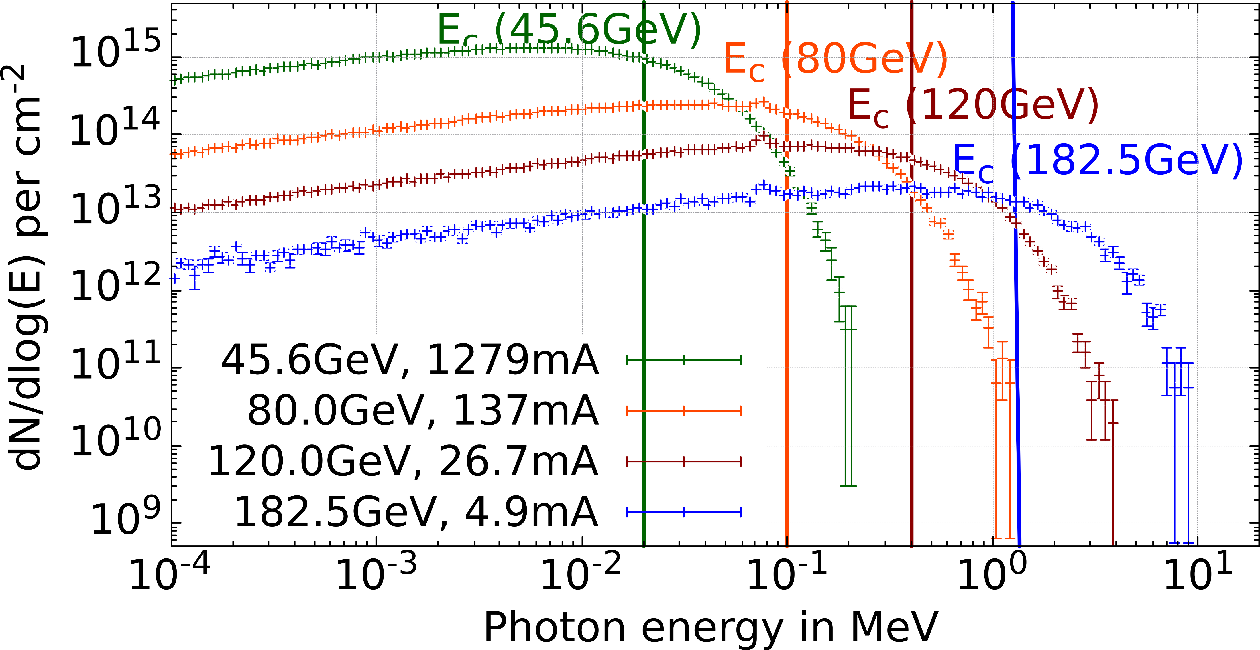
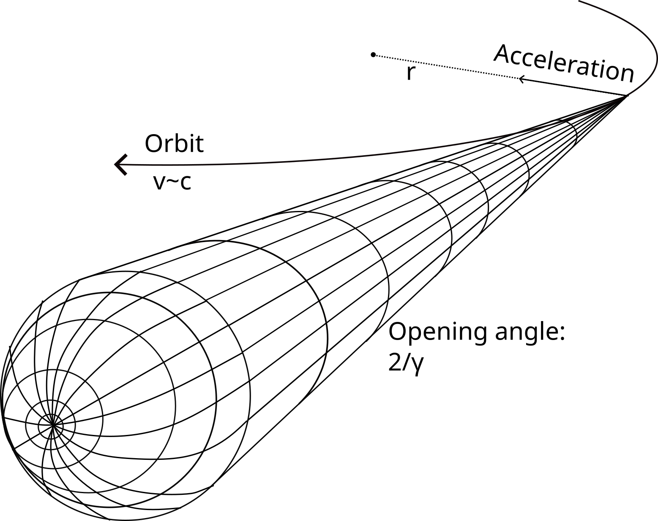
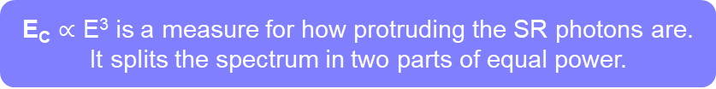
Synchrotron radiation (SR) in FCC-ee
γ of various energy
e-, e+
(45.6 GeV-182.5 GeV)
Electromagnetic radiation emitted by charged particles following a curved trajectory
ρ = 10.021km
E_{C} $∝$ E³ is a measure for how protruding the SR photons are.
It splits the spectrum in two parts of equal power.
P_{SR}=50MW/beam for all operation modes
This presentation provides the results for the ttbar operation mode

Slide 5
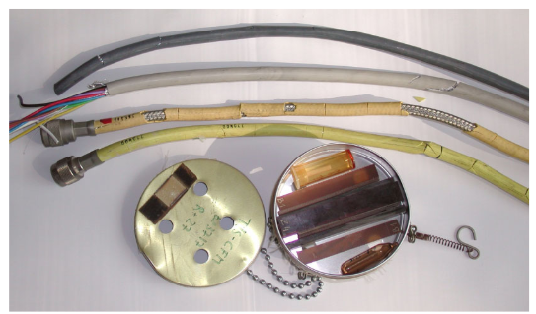



Radiation load challenges
Radiated equipment in LEP
Instantaneous effect: dissipated power
Heat deposition in the accelerator components and tunnel
https://cds.cern.ch/record/1112575/files/cer-002765351.pdf
Cumulative effect: ionizing dose
Cables, optical fibres (for BI)
Organic insulation material in the magnet coils
In this presentation the ionizing dose is normalized to 1 year of operation (1.2x10⁷s)
Radiation to electronics (R2E)
Cumulative effects:
Total ionizing dose
Si-1MeV neutron equivalent fluence
Single event effects:
High energy hadron equiv. fluence
Thermal neutron equiv. fluence

Slide 6
Outline
Synchrotron radiation in FCC-ee
  Relevant physical properties
Geometry layout and simulation setup
  Design development
Radiation load in the FCC-ee arcs
  Power dissipation
  Annual ionizing dose levels
  Radiation levels in the electronics bunker
Summary and outlook

Slide 7
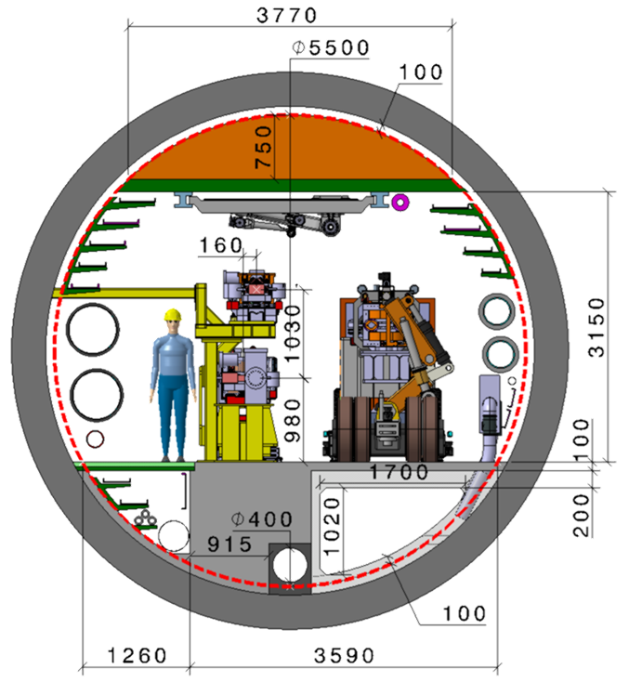
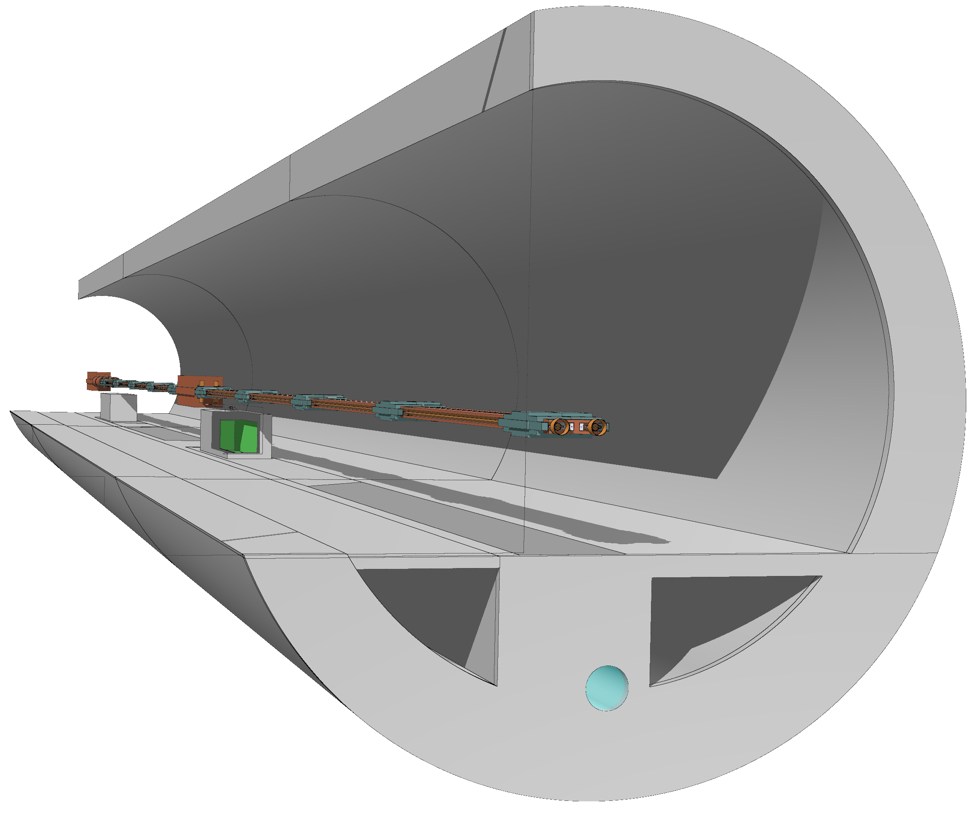
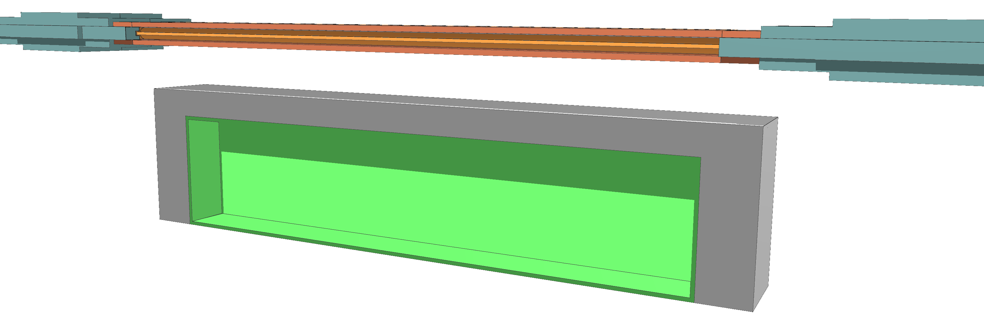
Geometry layout and simulation setup
FODO cell
  2 dipoles (19m, 22m), 2 quadrupoles, 2 sextupoles
  10 photon stoppers (30cm, CuCrZr) per dipole including surrounding shielding (130cm, Pb96Sb4)
  Photon stoppers located upstream w.r.t. center of shielding
Conceptual design
  Electronics bunker below dipole next to quadrupole
  with space for 3 racks (15cm, 25cm walls)
~27cm
Concrete
80cm
300cm
65cm
80cm
350cm
Borated
polyethylene
Tunnel layout: F. Valchkova
Photon stopper design/placement: M. Marrone, R. Ady
Magnet design: J. Bauche, C. Jaemyr Eriksson, L. van Freeden
For more information on the shielding strategy, see A. Lechner's talk this afternoon

Slide 8


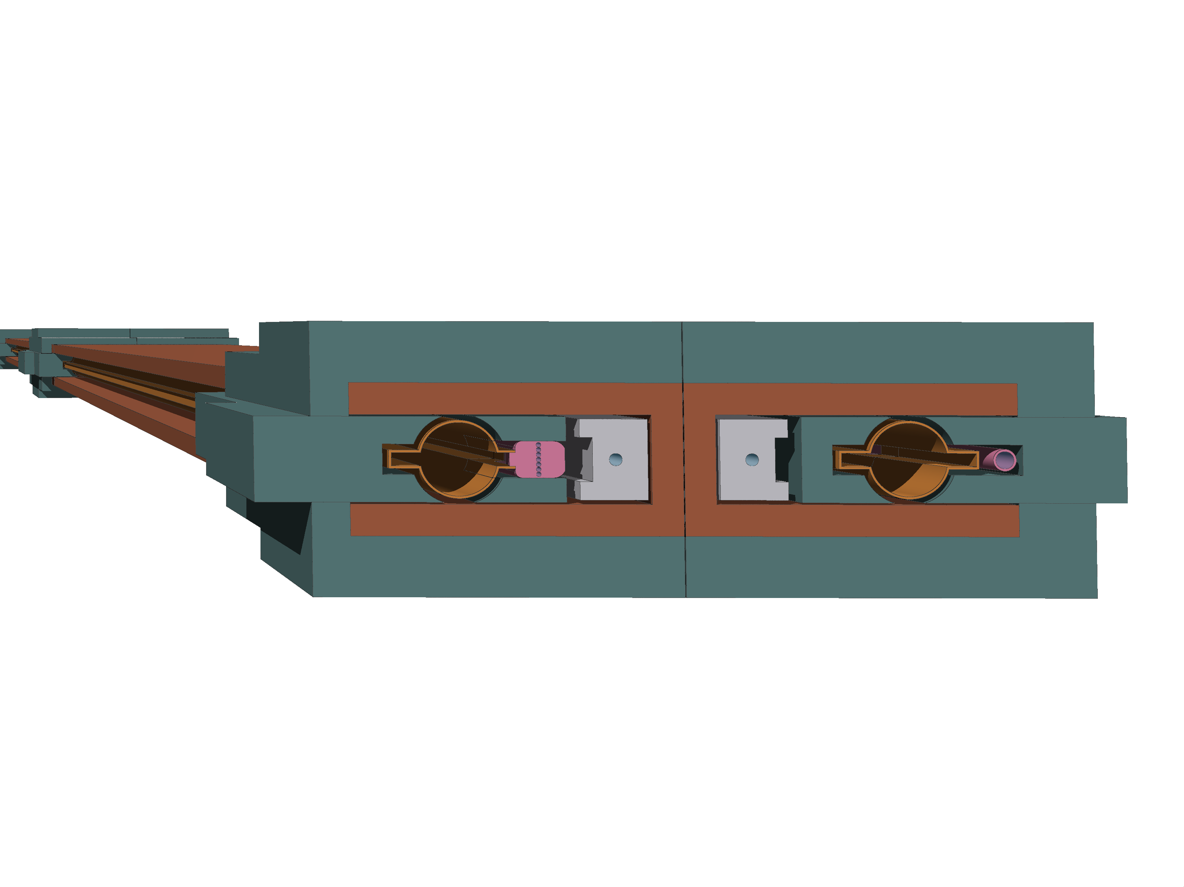
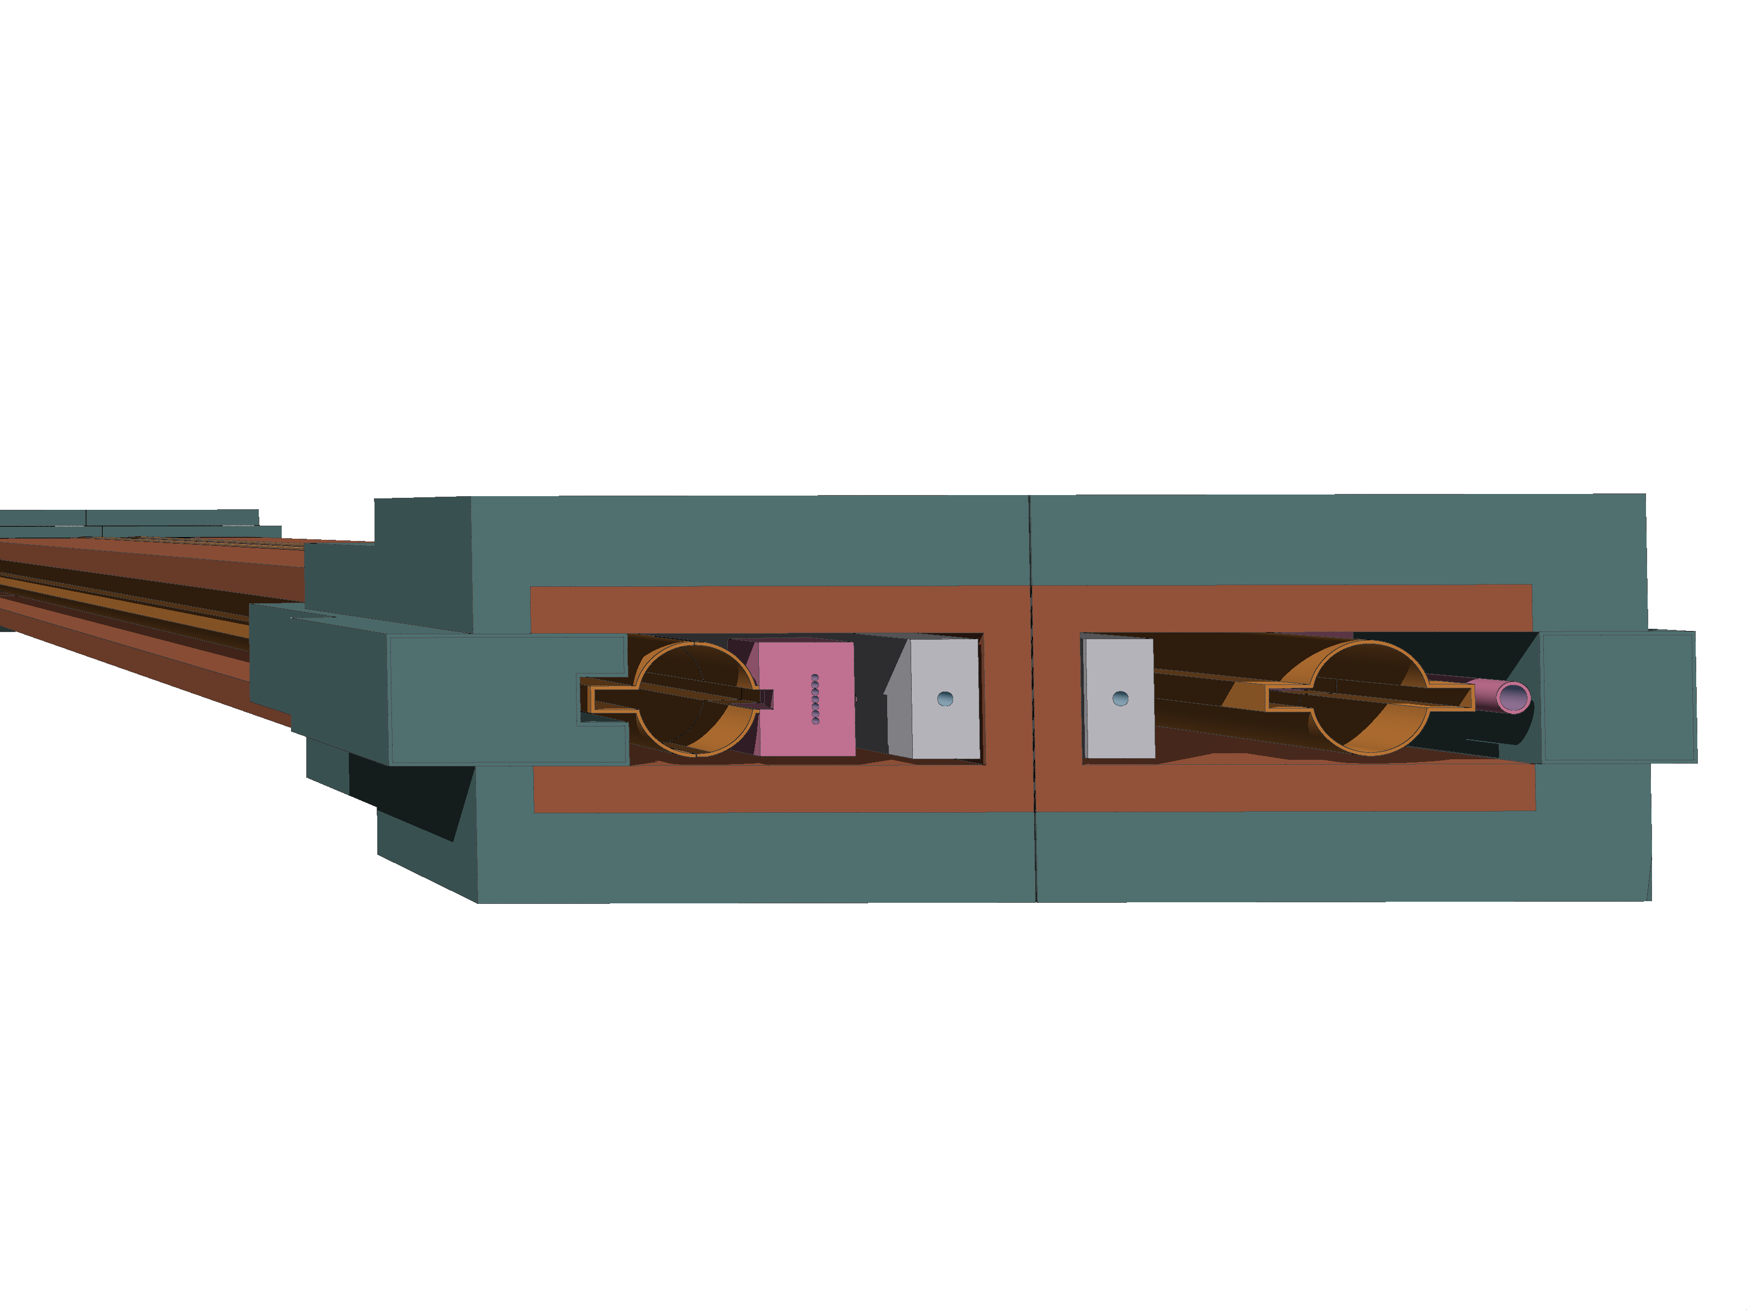
Design development
For more information on the technical implementation, see A. Romero Francia presentation this afternoon
Feasibility Study Report (FSR):
Shielding enclosing the VC with 5mm gap for bakeout but in contact with photon stopper
(Δy = 3cm)
Complex shape around VC
Efficient shielding due to close location of shielding
Weight: ~400kg/shielding
(Total weight: ~10kt for the full machine)
Current conceptual design:
Enlargement of photon stoppers (Δy = 6.3cm)
Removal of shielding next to busbars
Updated busbar dimensions
Volume of plates on top and bottom as well as lateral extension identical
Weight: ~340kg/shielding
2cm
29cm
32cm
Pb94Sb6
Fe
CuCrZr
Al
5cm
e+
e-
12.5cm
8.1cm
130cm
10cm
Collider center
Internal
External
Internal
External

Slide 9
Outline
Synchrotron radiation in FCC-ee
  Relevant physical properties
Geometry layout and simulation setup
  Design development
Radiation load in the FCC-ee arcs
  Power dissipation
  Annual ionizing dose levels
  Radiation levels in the electronics bunker
Summary and outlook

Slide 10
Power dissipation in one FODO cell
Photon stoppers: increase of volume vertically
  Maximum total power per photon stopper:
    FSR: ~3.4kW
    Conceptual: ~4kW
Radiation shielding: removal of material, particularly close to the vacuum chamber
Dipoles: lack of shielding between VC and busbars increases power load
Slight increase in power load in the tunnel environment (= everything that is not accelerator)
 | FSR | Conceptual
Photon stoppers | 68.1% | 80.7%
Radiation shielding | 20.4% | 3.7%
Vacuum chambers | 7.9% | 5.2%
Dipole yokes | 3.4% | 9.6%
Dipoles busbars | 0.1% | 0.5%
Environment | <0.03% | <0.05%

Slide 11
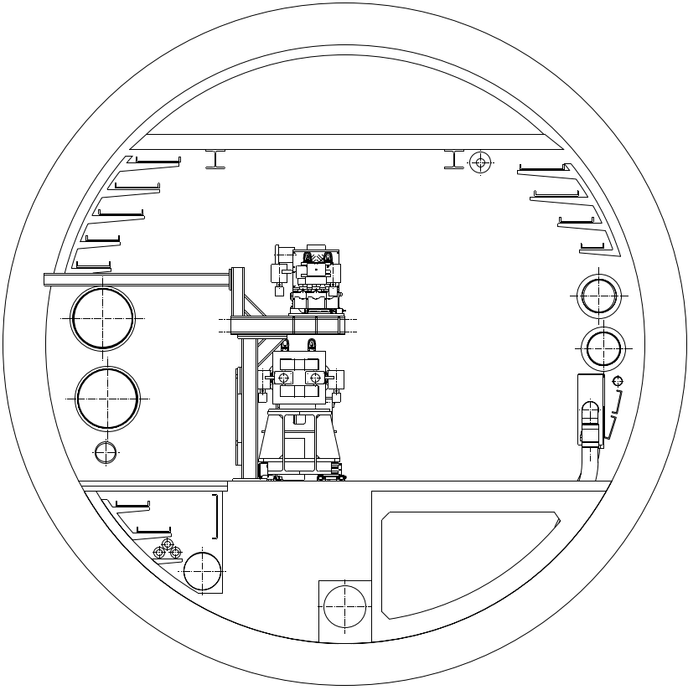

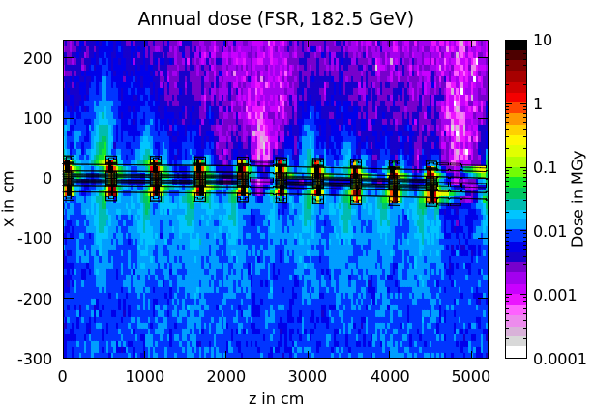
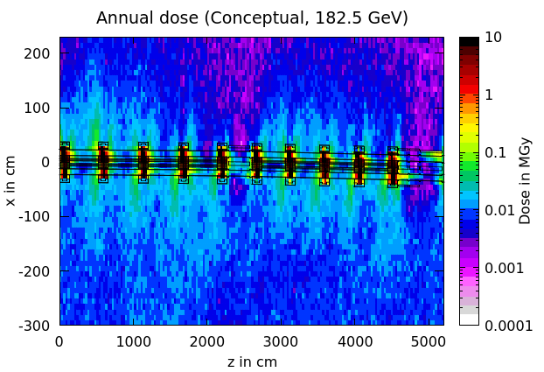
Dose levels in the tunnel
Annual ionizing dose levels at the beam level.
Externally the dose levels increase from <10kGy to ~20kGy at the tunnel walls.
Further optimization of the shielding design possible.

Slide 12
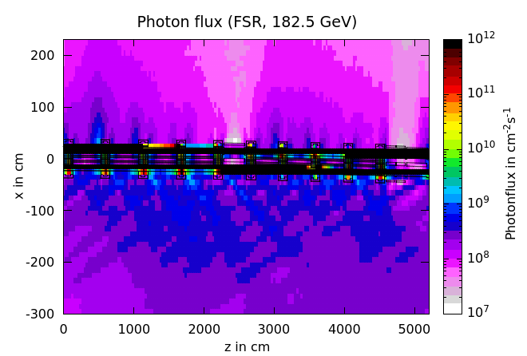
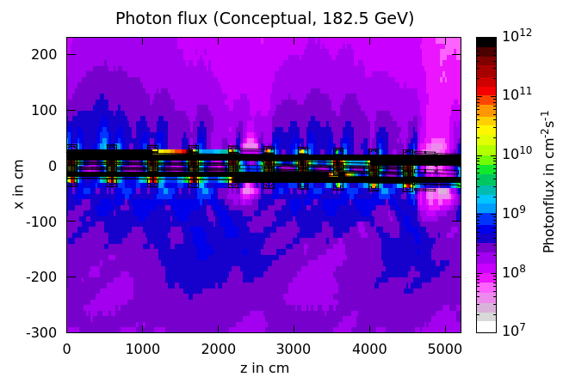
Photon flux in the tunnel
Good indicator helping to understand where the radiation is coming from.
External shielding significantly more effective for the FSR version.
Internally, the C shaped shielding provides good protection with a relatively simple shape.

Slide 13
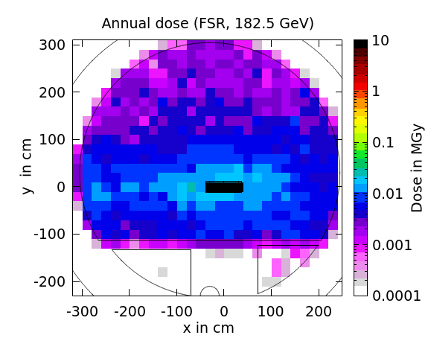
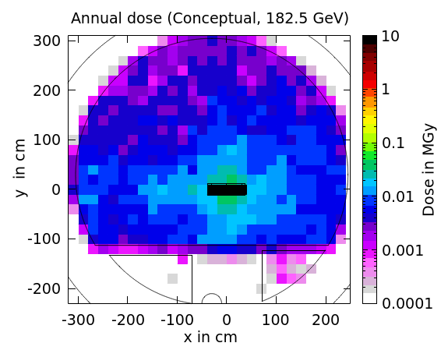
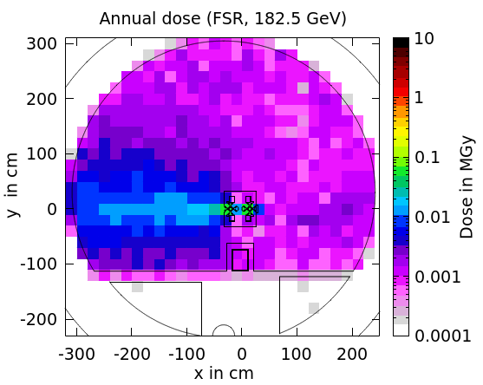
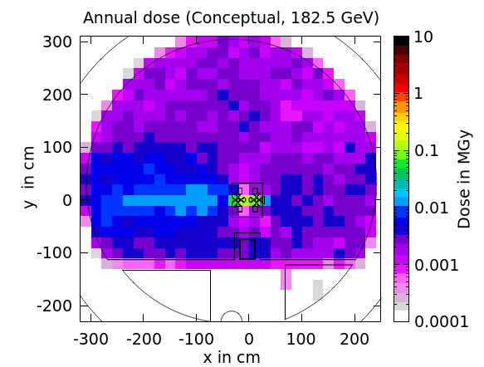
Dose levels in the tunnel – cross section
FSR
Conceptual
<10kGy
~12kGy
Annual ionizing dose levels at the location of the cable trays.
Photon stopper
Slight increase of the dose levels at the cable trays using the conceptual shielding.
Further optimization possible.
<10kGy
<10kGy
Quadrupole
Collider center

Slide 14
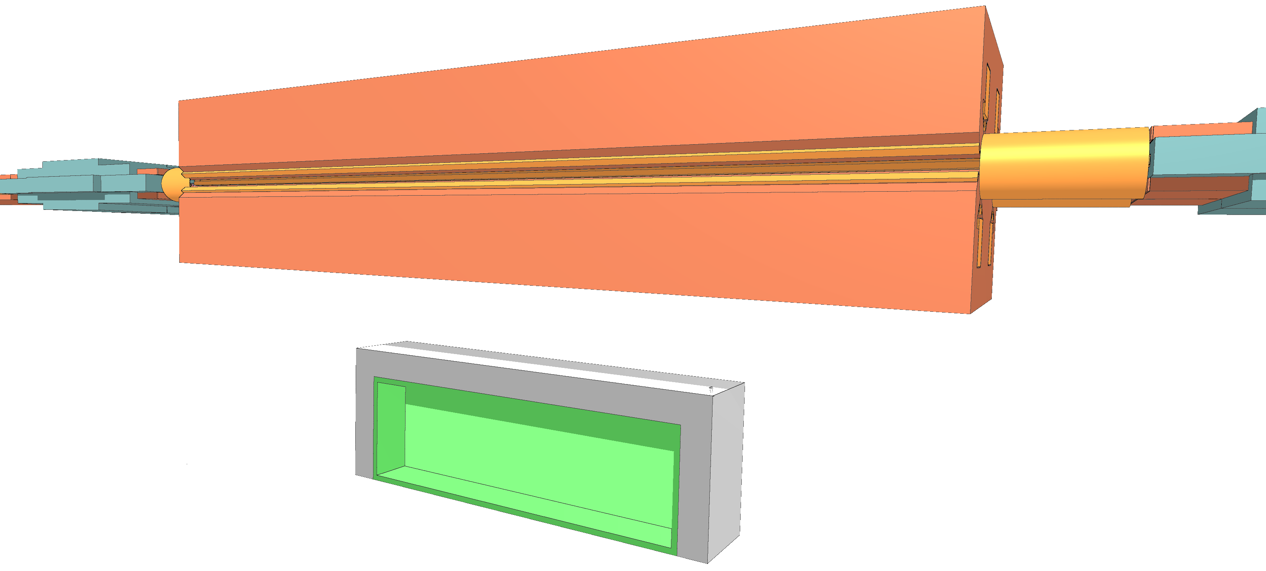
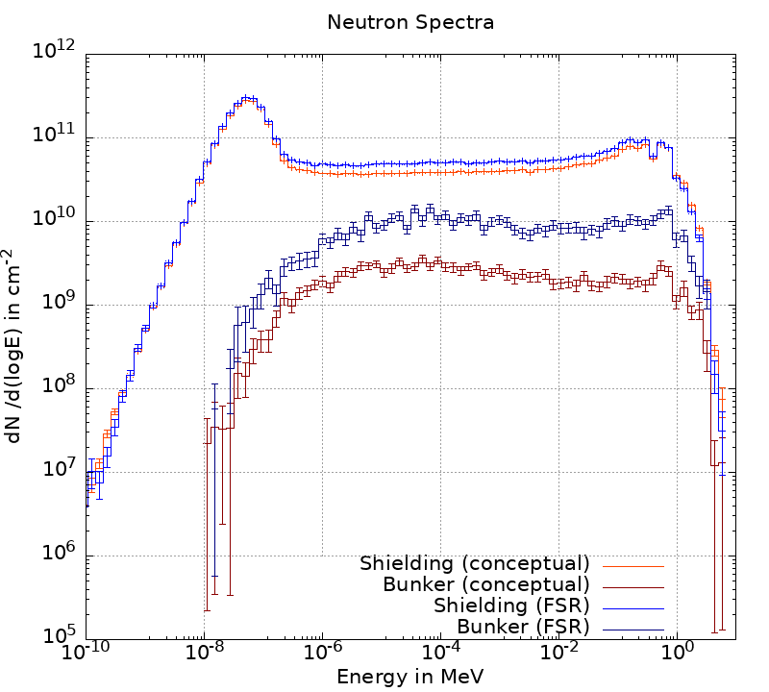
R2E related properties in the electronics bunker
FSR:
below MQ
(10cm wall thickness)
Conceptual:
below MB
(15cm/25cm wall thickness)
 | FSR | Conceptual
Total ionizing dose | <10Gy | ~3Gy
Si 1 MeV neutron equiv. fluence | 2 x 10¹⁰ cm⁻² | 7 x 10⁹ cm⁻²
High Energy Hadron equiv. fluence | 2 x 10⁷ cm⁻² | 1 x 10⁷ cm⁻²
Thermal Neutron equiv. fluence | 4 x 10⁹ cm⁻² | 4 x 10⁹ cm⁻²
More efficient shielding results in smaller neutron contribution in the shielded area over all energy ranges
Current conceptual bunker design is more efficient due to increase of concrete volume

Slide 15
Outline
Synchrotron radiation in FCC-ee
  Relevant physical properties
Geometry layout and simulation setup
  Design development
Radiation load in the FCC-ee arcs
  Power dissipation
  Annual ionizing dose levels
  Radiation levels in the electronics bunker
Summary and outlook

Slide 16
Summary and Outlook
FSR vs conceptual design
Simplification of shielding design increases the radiation levels slightly
Further optimization of shielding design possible
Electronics bunker
Location below the dipoles is promising
Assessment of integration still required
What next?
Implementation of split dipoles and respective photon stopper placement
Comparison between GHC and LCC lattice

Slide 17
Thank you for your attention.
Date / Name of the event
Name of the speaker/author
Space for additional logos
17

