Slide 1

Detector summary
Fabrizio Palla
INFN Pisa and CERN
FCC Week 2025
Vienna (Austria)
23 May 2025

Slide 2
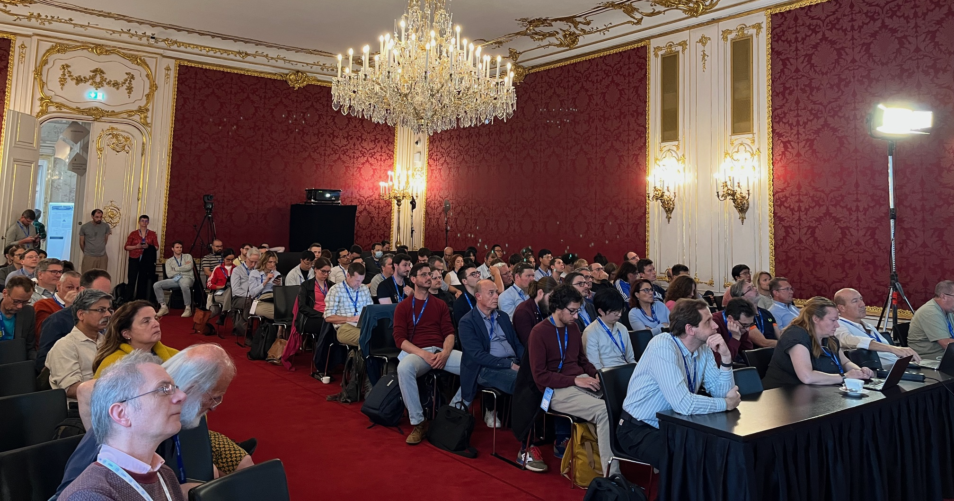
Detector sessions a personally biased selection

Slide 3
Detector Sessions
Tuesday, May 20, 13:30-15:00
chair person: | Mogens Dam | NBI
Overall summary of recent workshop on Tracking Detectors at BNL | Christoph Paus | MIT
Summary of Silicon detectors from recent BNL workshop on Tracking Detectors | Apresyan, Artur | FNAL
Summary of Gaseous and SciFi trackers from recent BNL workshop on Tracking Detectors | Palla, Fabrizio | INFN, Pisa
Muons Systems (technologies and performance studies) | Zhou, Bing | U. Michigan
A 3 T High Temperature Solenoid Design for the IDEA detector project | Mariotto, Samuele | INFN-LASA-Milano
Tuesday, May 20, 15:30-17:00
chair person: | Pleier, Marc-André | BNL
Silicon and SiPM-Scintillator Calorimeters | Boudry, Vincent | LLR
Noble-Liquid Calorimetry | Wu, Zhibo | LAPP
Optical Readout Calorimetry | Hirosky, Bob | U. of Virginia
Status of the ARC | Pezzulo, Serena | U. and INFN Genova
Thursday, May 22, 17:00-18:30
chair person: | Sefkow, Felix | DESY
CLD plans | Sailer, André | CERN
IDEA plans | Giacomelli, Paolo | INFN-BO
ALLEGRO plans | Aleksa, Martin | CERN
ILD plans | Schwan, Victor | DESY
TDAQ plans | Bracinik, Juraj | U. Birmningham
Disclaimer: Not covered here
Detector Requirements (Jan Eysermans)
Detector backgrounds and MDI integration (Manuela Boscolo)

Slide 4
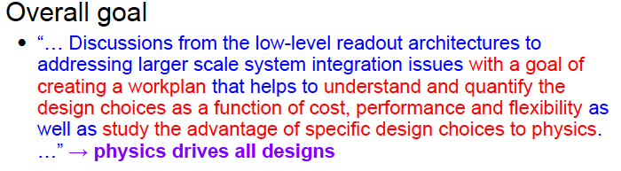
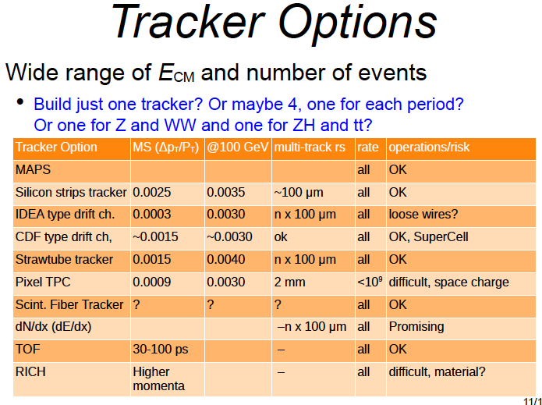
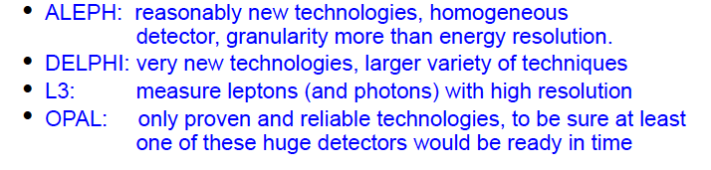
Tracking starts thinking at a system level integration
BNL workshop @beginnig of May
  https://indico.cern.ch/event/1516157/
Christoph Paus
Inspiration from the past

Slide 5
Silicon technologies
Artur Apresyan
Vertex detector, Main Tracker and Silicon Wrapper
  Technology based on MAPS and LGAD
    Profit of DRD3, DRD7 and DRD8
Many synergies with ePIC and ALICE, as well as Calorimetry with MAPS
  Standard and modified process
    Trade off between position resolution, cluster width, timing peformance
  Abuttable or stitching
    To reduced material budget
  Optimisation of
    Position resolution
    Timing resolution
    Power consumption
Beneficial to have multi-processes available and keep a community able to work on several solutions and ‘re-locate’ in case of one will disappear (as happened with TSI-180nm)
    Foundries:
      TPSCo 65nm, LF150, LF110, SkyWater, TSMC65, TSMC28, FBK
    Institutes:
      Berkeley, BNL, Brown, CEA-IRFU, CNRS, CERN, FNAL, IFAE, IN2P3, INFN, KEK, LBNL, Liverpool, Oak Ridge, PSI, Paris-Citè, SLAC, Stony U., UCSC, U. of Tsukuba, U. of Zurich

Slide 6

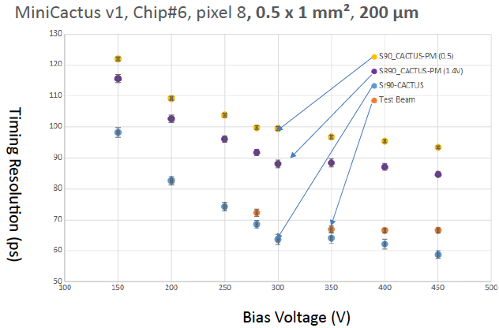

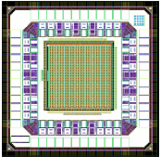
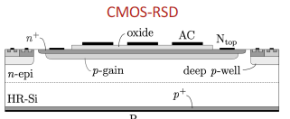
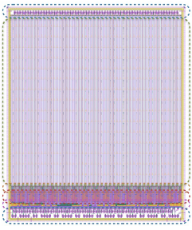

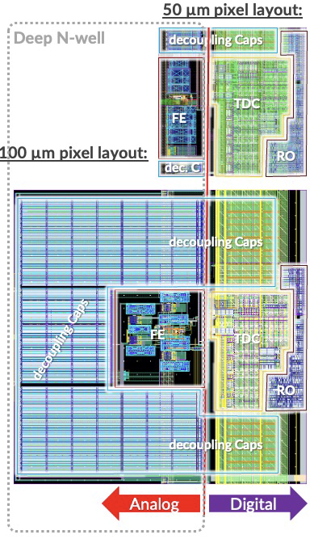
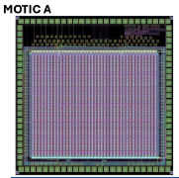
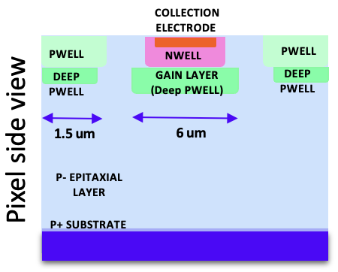
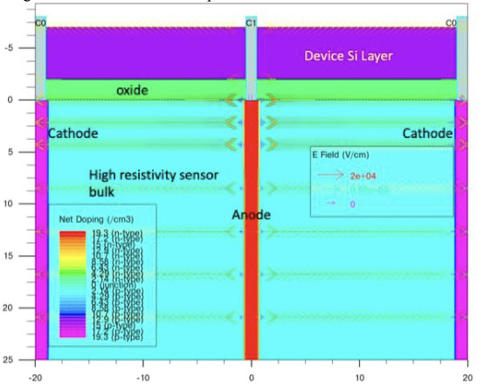




Aim at 10-20 ps & <3 µm resolution @10 mW/cm²
Napa-P2 (TPSCo65) –
Low power TDC for 20 ps time resolution
MD3 (LF110nm) 5 µm & 65 ps resolution
30 mW at 100 kHz
MiniCactusV2 (LF150nm) 65 ps w/o gain – next chip with gain: 20 ps time resolution
MOTIC A (LF110nm) <5 µm & <1.2 ns resolution
APIC (TJ180 nm)
3D sensors and
3D integration

Slide 7
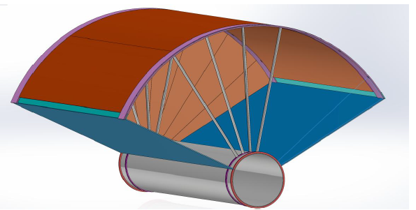
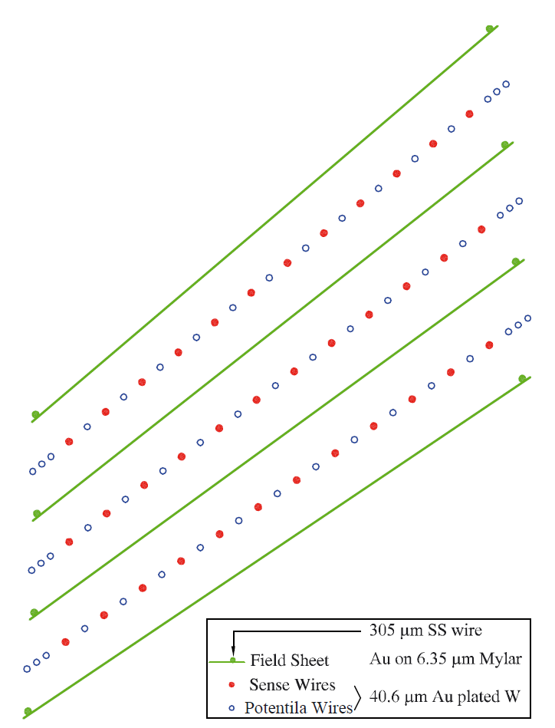
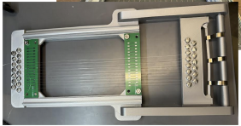
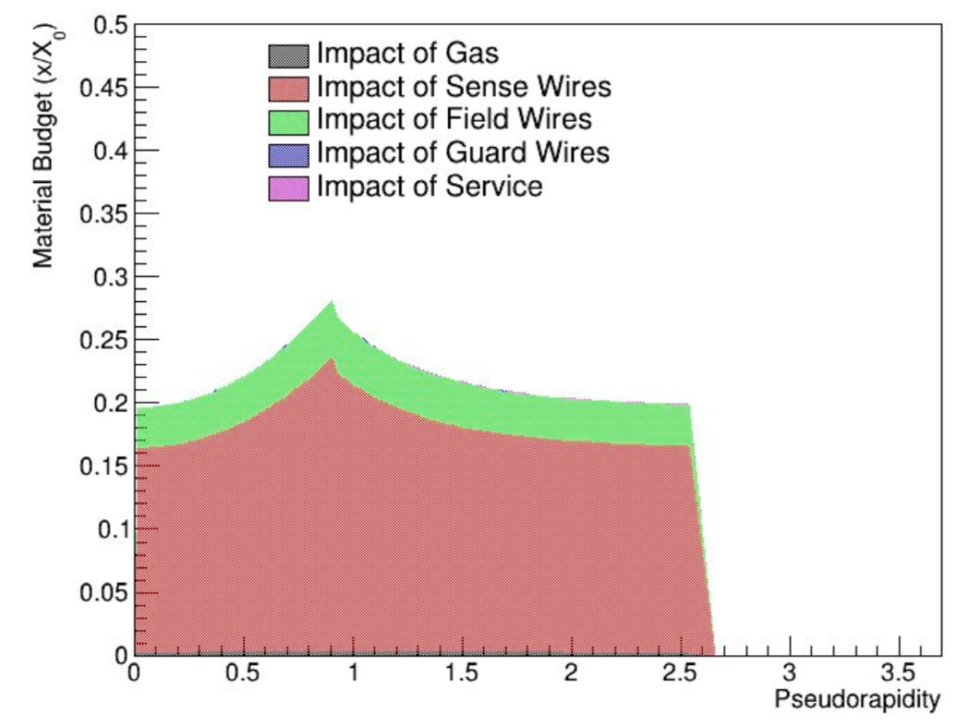
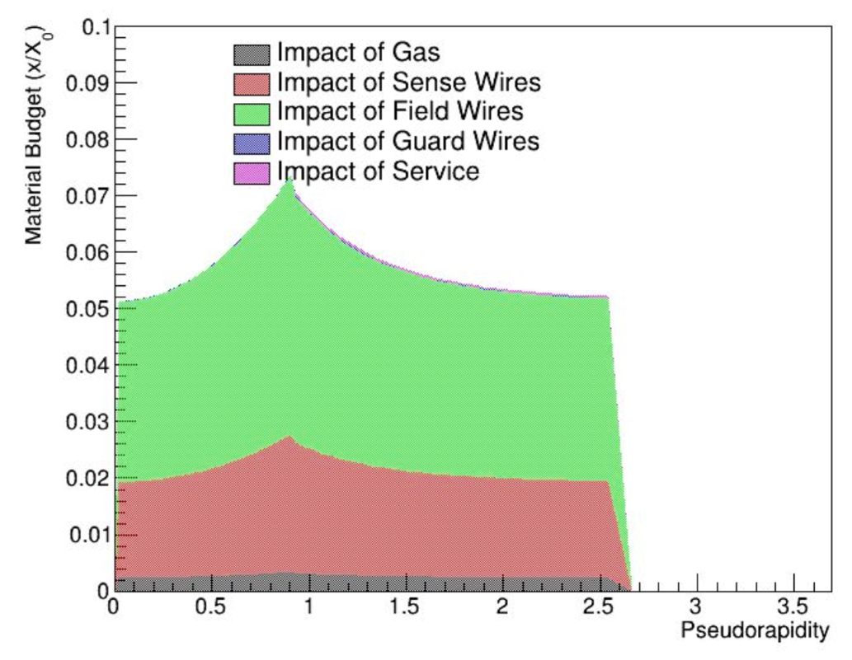
Drift chambers R&D and improved designs
F. Palla
Revisit CDF COT chamber (Jet chamber)?
Lightening material of the wires and gas
Easier to replace broken wires in situ
Homogeneous E field allows 2 track separation
Full length prototype (8 layers) IDEA drift chamber in fabrication INFN
Expect prototype built by early 2028
Carbon fibre wires (Purdue, Stony Brook & INFN)
~4 less material budget
Build 30 cm prototype in Purdue

Slide 8
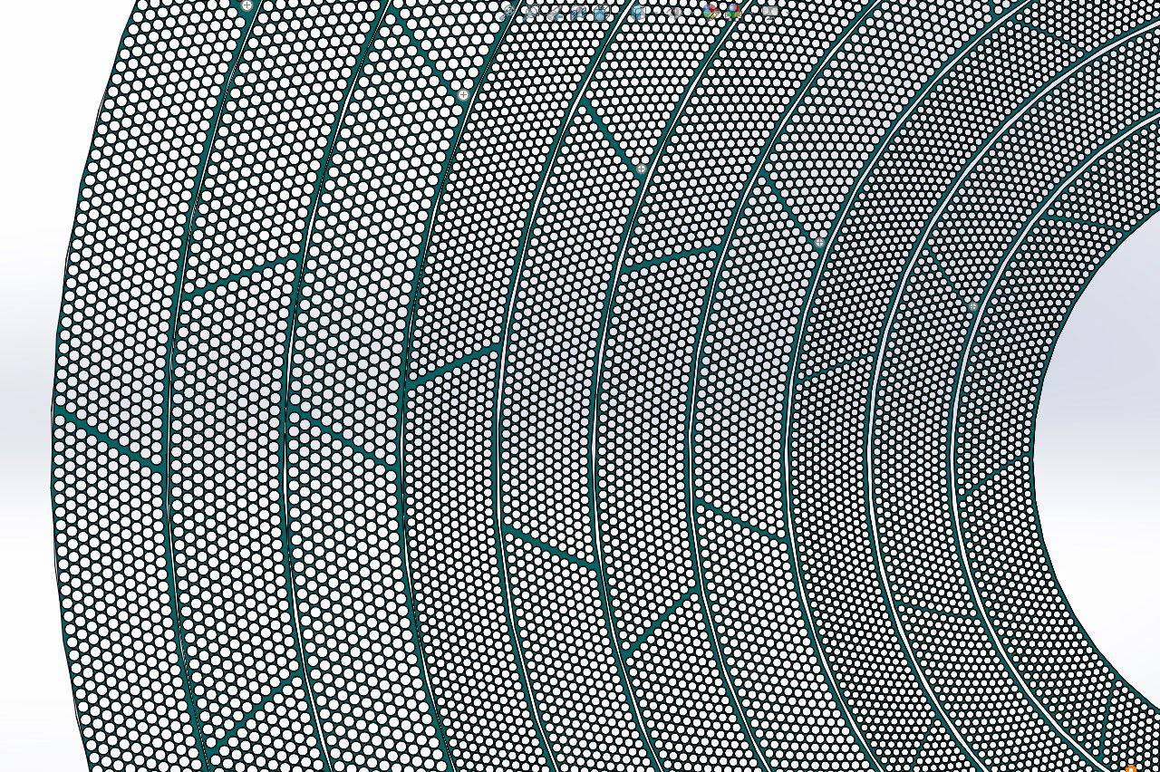
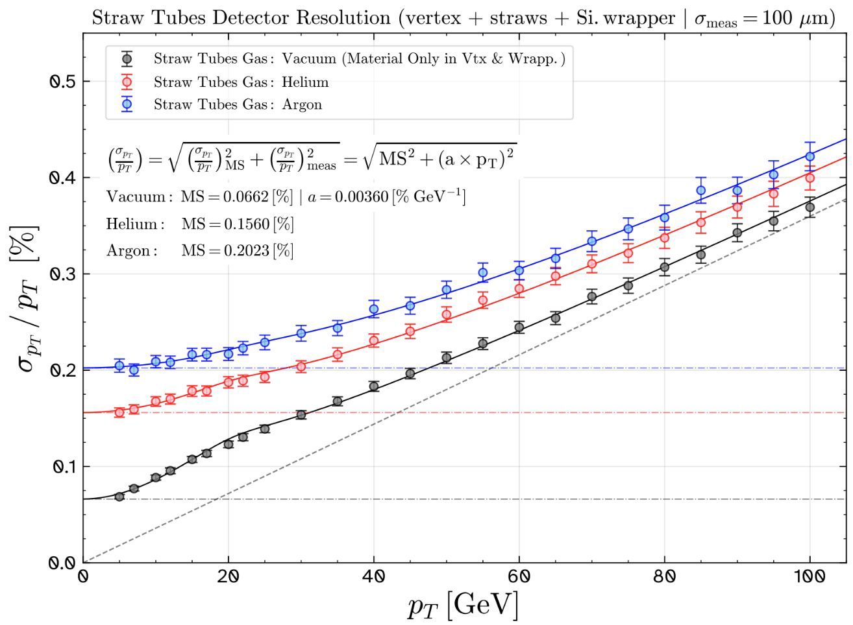
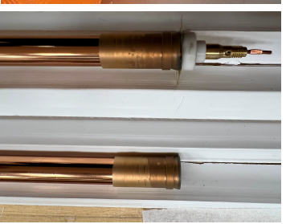
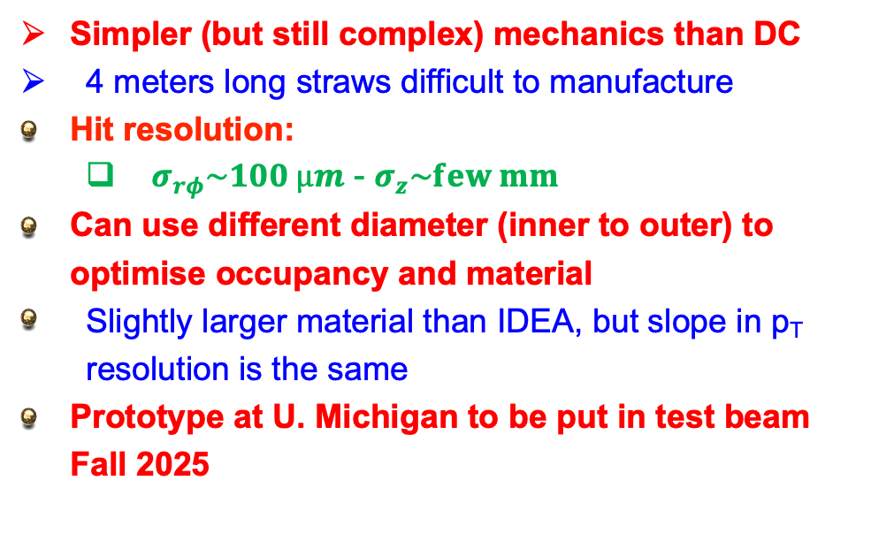
Drift tubes
Simpler (but still complex) mechanics than DC
  4 meters long straws difficult to manufacture
Hit resolution:
    $σ_{rφ}\sim 100 µm$ - $σ_{z}\sim few mm$
Can use different diameter (inner to outer) to optimise occupancy and material
  Slightly larger material than IDEA, but slope in p_{T} resolution is the same
Prototype at U. Michigan to be put in test beam Fall 2025

Slide 9
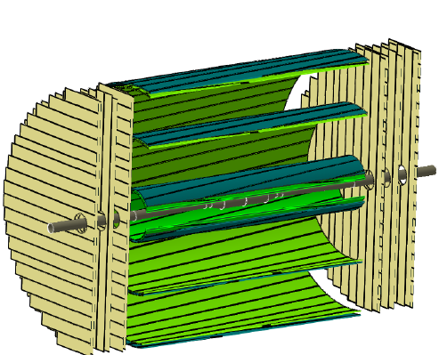
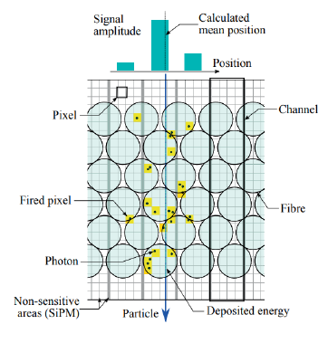
Other options for Trackers
A TPC can be used at WW, ZH and t-tbar energies with GridPix technology
  More challenging to be used at the Z due to large corrections of ion back flow
  Needs adding a dipole field (anti-DID) to suppress backgrounds
Scintillating fibres tracker
  Difficult to have 4 m fibers long with high efficiency
  Need to optimise number of layers and material
  R&D on suppressing electronic noise on SiPM
    Currently Liquid Nitrogen at LHCb

Slide 10

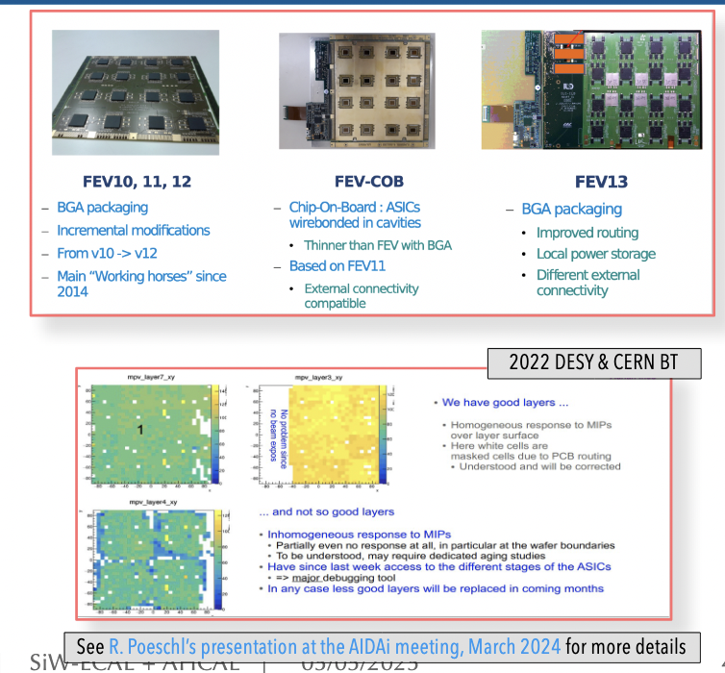
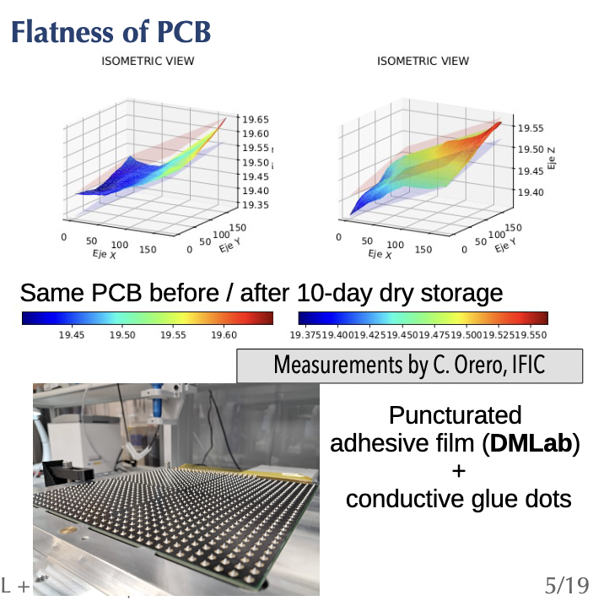
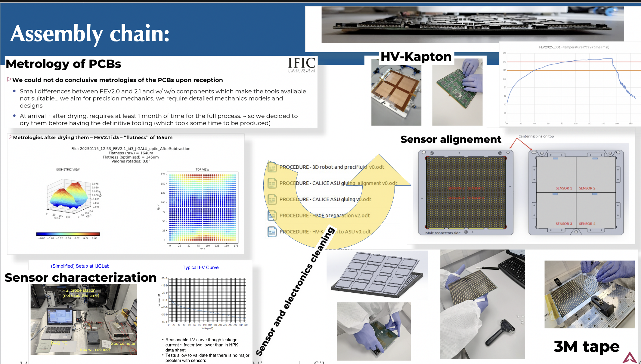
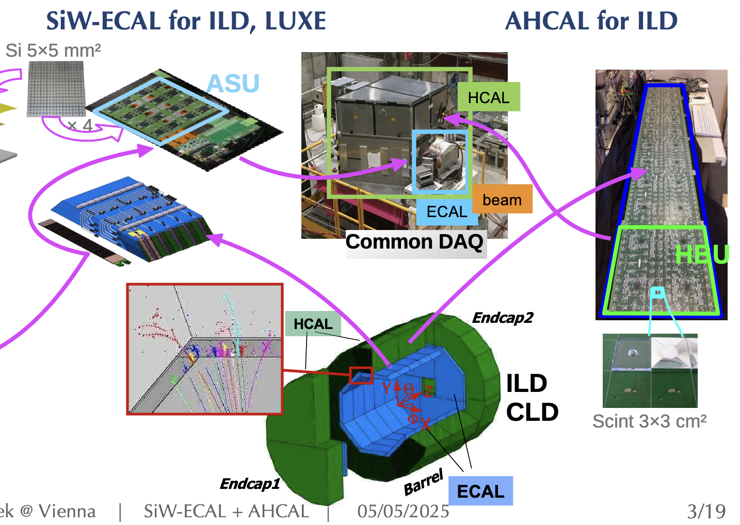
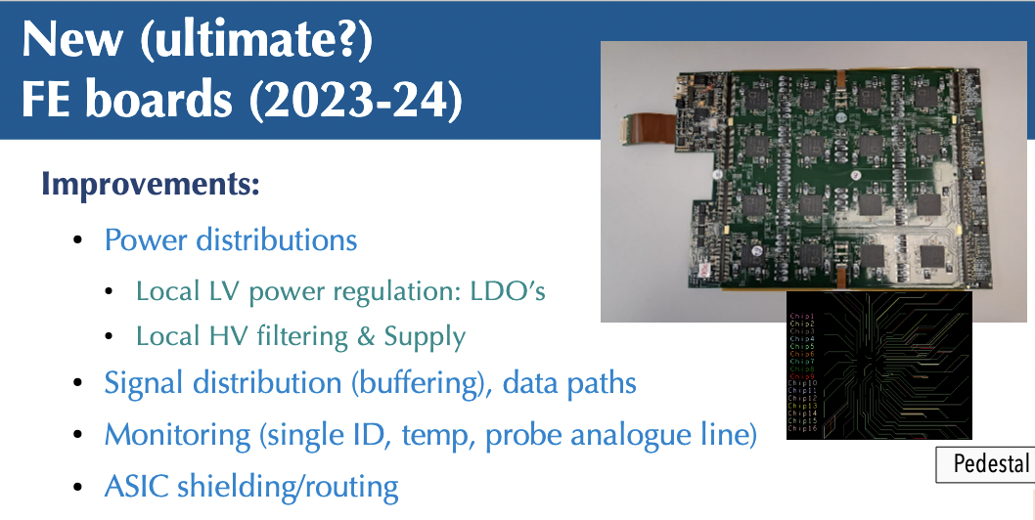
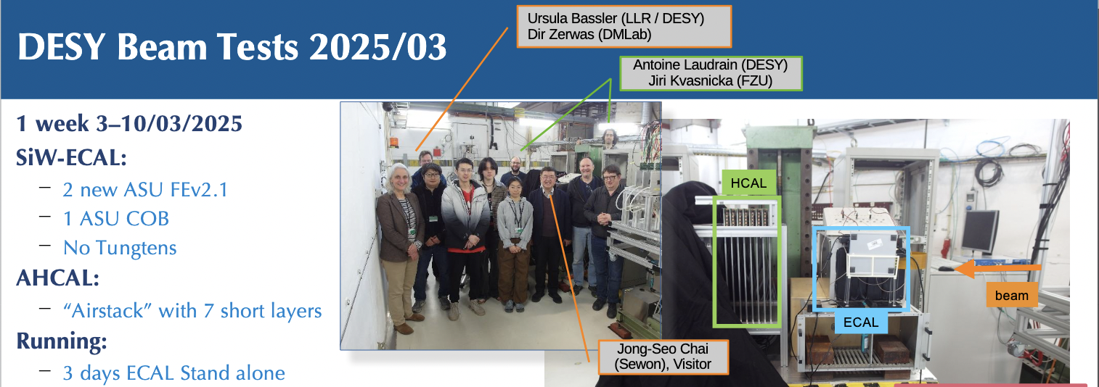
SiW-ECAL + Scint-HCAL
Vincent Boudry
Revised
Hybridization
Procedure
2022 Beam Test
Ultimate* FE version (*on ILC ASICs)
2025 Beam Tests

Slide 11
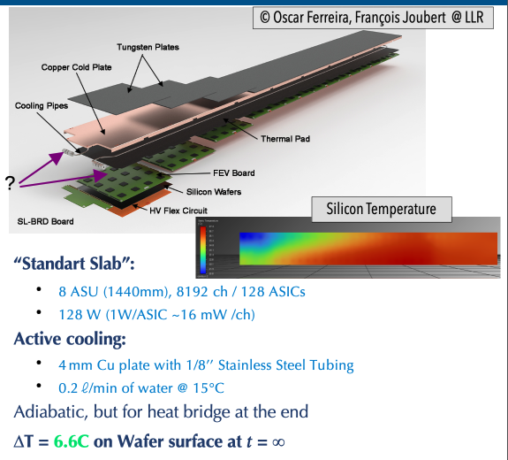
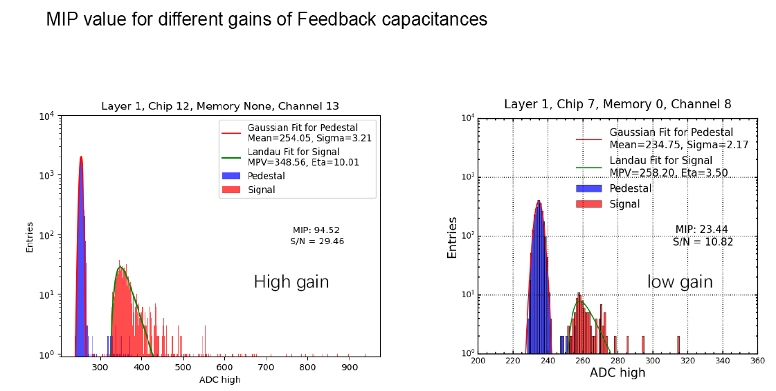
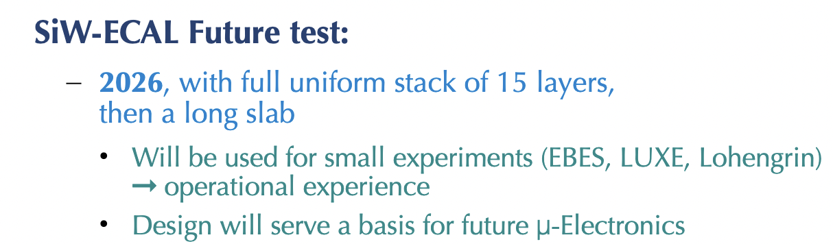
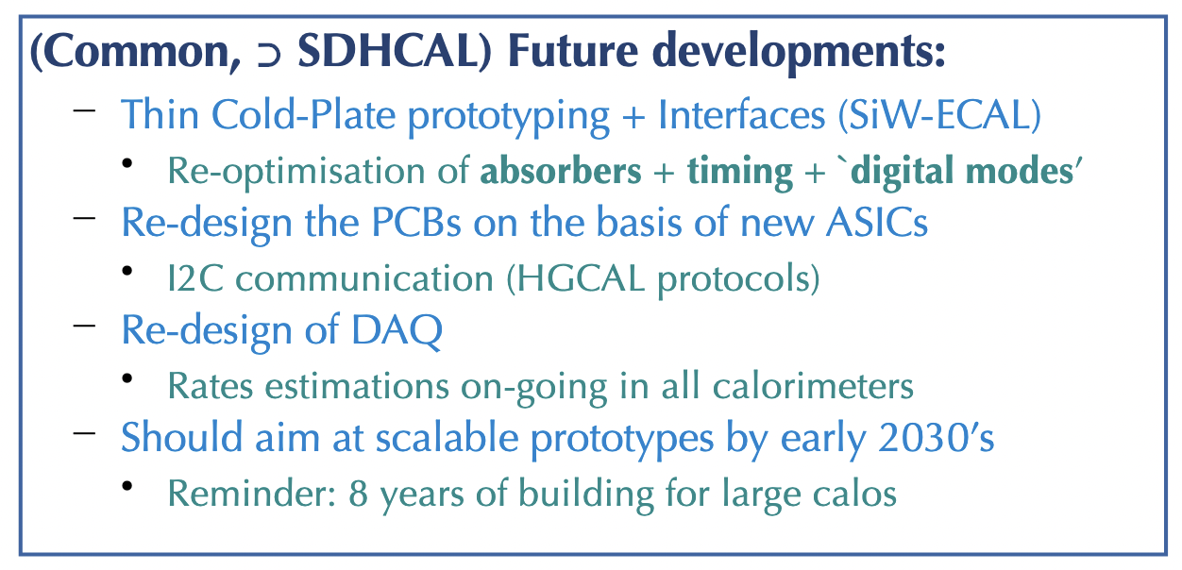
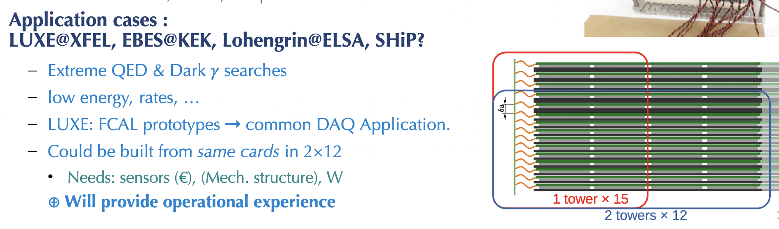
Future Plans
Improved S/N &
Uniformity
➞ Full Test &
Applications
Re-visiting for FCC-ee:

Slide 12
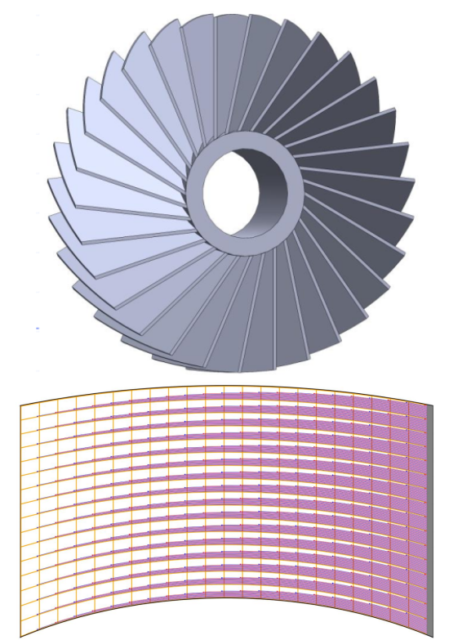
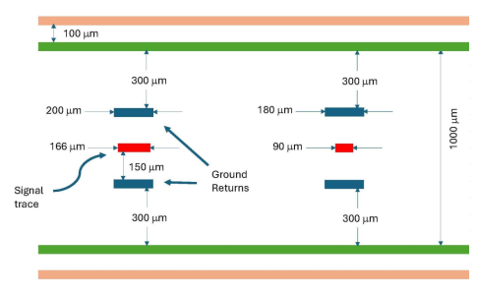
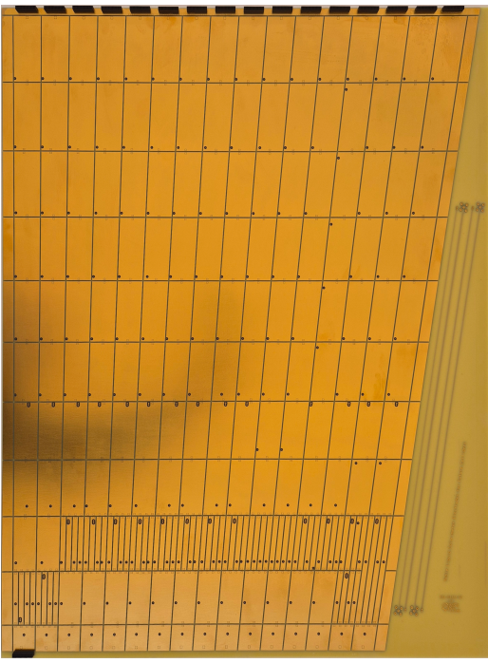
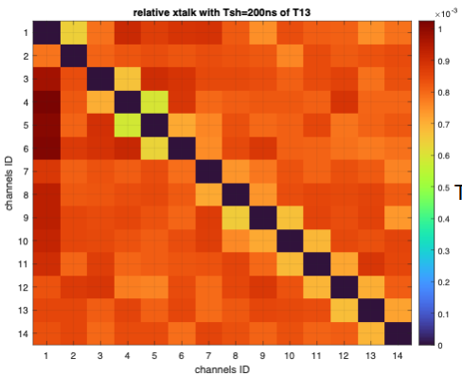
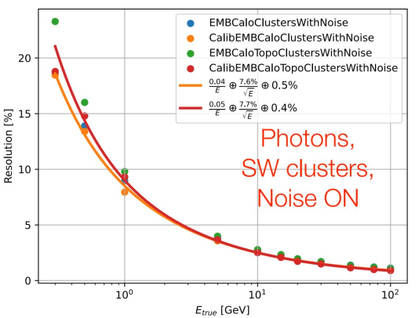
Noble liquid calorimeter R&D
Electrodes for the endcaps ongoing at Arizona
Flat PCB read out at the high |z| edge
Fighting against cross-talk due to smaller signal compared to ATLAS
(10 times smaller granularity)
Cross-talk < 0.1% with 200 ns shaping
(JCLAB and CERN)
Several tools available in dd4hep to help design
Digitization on progress
BDT-regression based calibration
Zhibo Wu

Slide 13

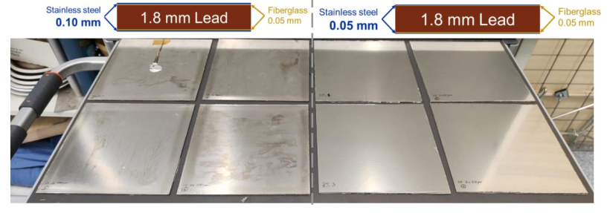
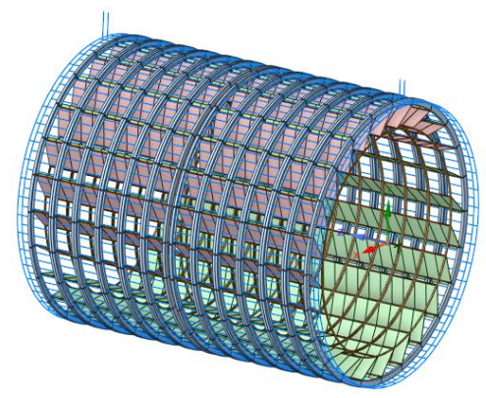
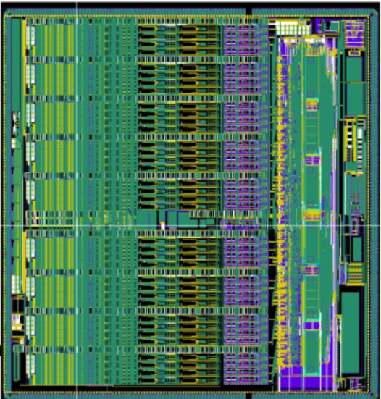
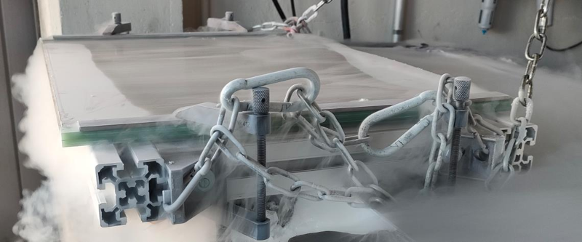
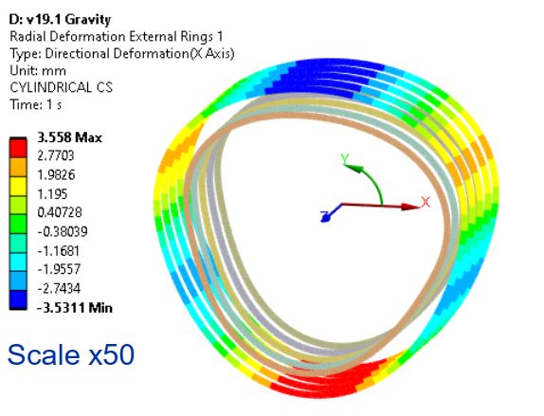
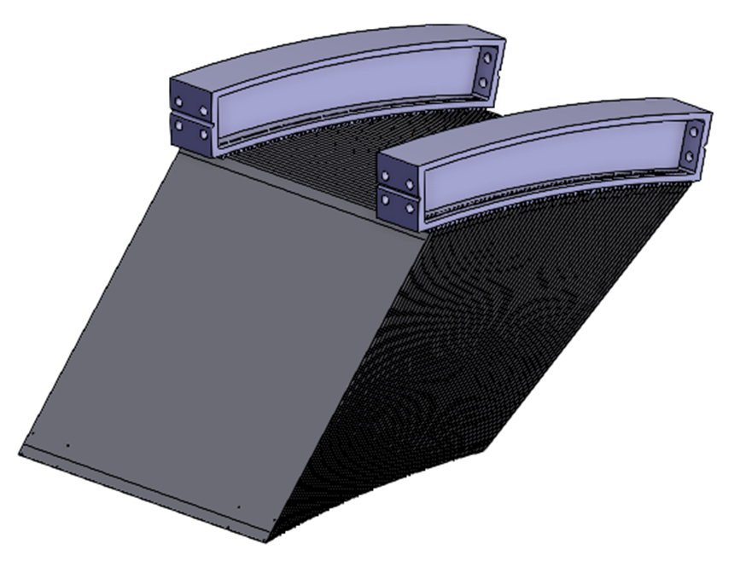
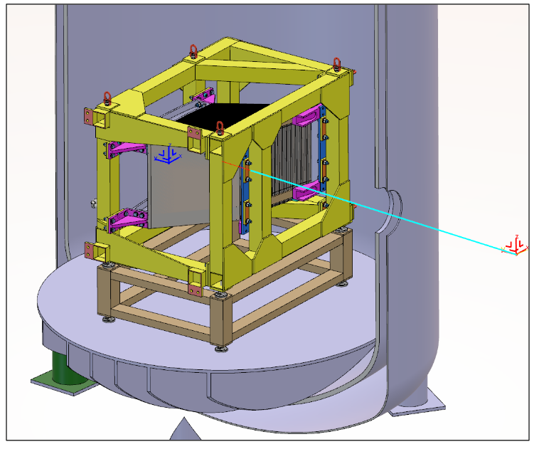
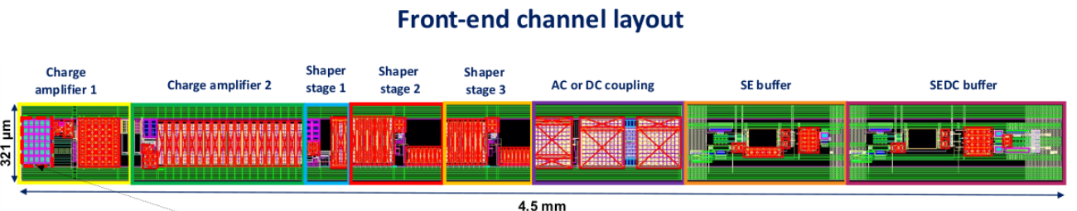

Noble liquid calorimeter mechanical structure and cold electronics
Optimization of absorber prototype design with cold tests
CALOROC1C chip for
Mechanical structure design guided by FEM analysis
CHARMS250 cryogenic analog front-end ASIC
Design of test-beam prototype in progress
Cold electronics candidates from Omega Labs and BNL

Slide 14
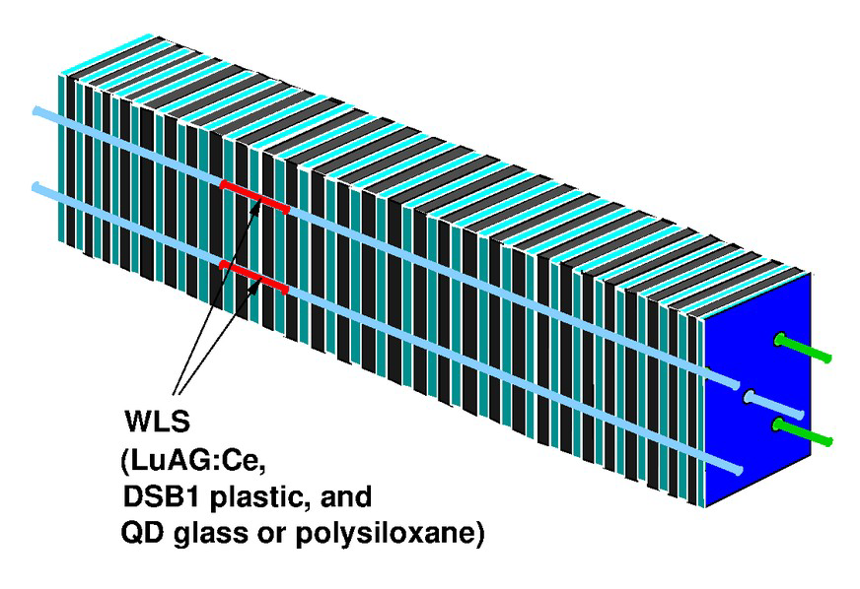
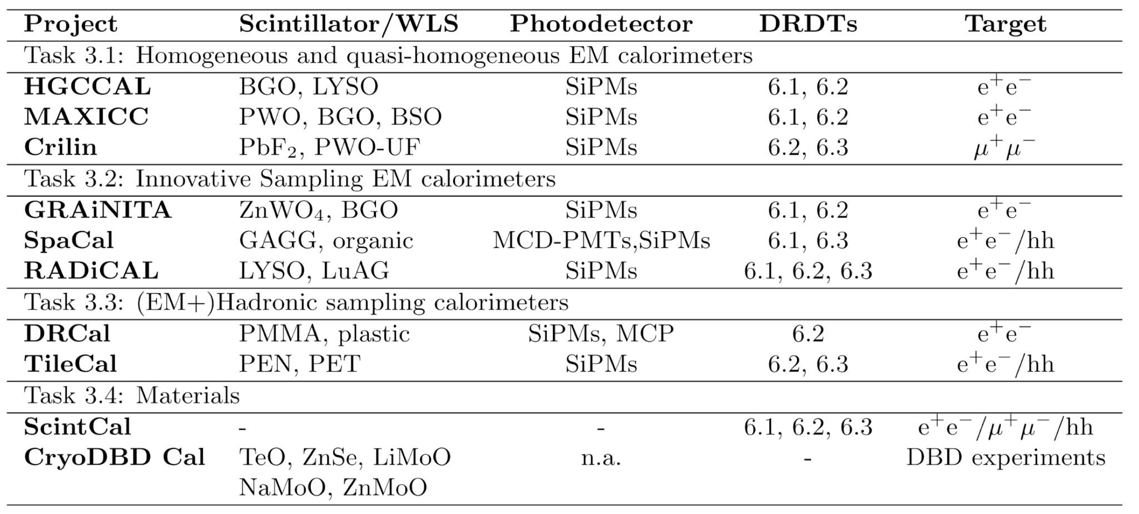
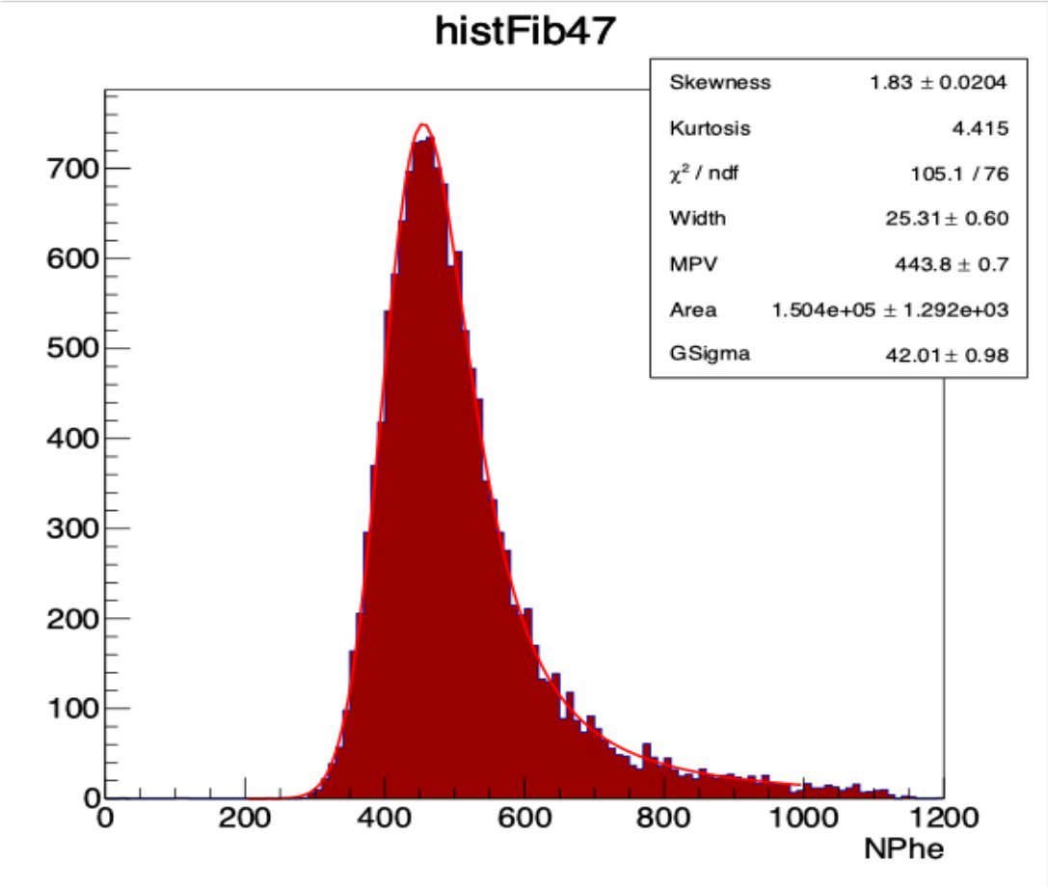


Optical readout calorimetry
RADICAL
W/LYSO:Ce, ~21X₀
20 ps
Bob Hirosky
Grainita test beam: % level stocastic term. 260 µm tracks resolution
“Industrialization” will be key to realize these and other large-scale FCC-ee detectors
DR crystal calorimeter test beams in 2025/26 with EM-scale matrices in PbWO and LYSO @ INFN

Slide 15


Slide 16




Particle ID with RICH
Serena Pezzulo
ARC (Array of Rich Cells)
  Explored resolutions for C₄F₁₀ and aerogel
  Algorithms to deal with multiple tracks in the same cells and magnetic field look OK
  Covers between 2 and 40 GeV

Slide 17





Muon detectors
Bing Zhou
Michigan, MSU, UMass, Harvard, Tufts, UCI, SLAC, INFN Roma 1, Fermilab, BNL, and U. Washington
Cost effective muon detector
  Precision position from drift tubes (100 µm) (track segments and standalone)
    Extruded square tube (x5 cheaper than thin wall tubes from ATLAS)
  Precision timing from scintillators (200 ps) (trigger and TOF)
    Chain R/O electronics to save x2 costs (SiPM)
U. Michigan
FNAL scintillator extruder
Scintillator strips tests in Rome
Cosmic rack @ U. Michigan

Slide 18



IDEA HTM coil
Copper Stabilizer (10 μm)
Samuele Mariotto
Ag Cap Layer (2.5 μm)
HTS ReBCO (2 μm)
REBCO conductors and 3T @20K
  Benefits of ECAL inside the magnet
    Lower X0 requirements
  Radial envelope only 10 cm
  Common geometry implemented in k4geo integrating also antisolenoids, screening solenoid and FFQ magnets
buffer layers stack
Hastelloy (40 μm)
Copper
c
Coil Total Normalized Radiation Length
Material | Total Thickness | X/X0
HTS Tape | 4.0 mm | 0.296
Al2.0%wtNi | 72 mm | 0.862
Insulation | 16 mm | 0.056
Shell | 25 mm | 0.278
TOTAL | 117.3 mm | 1.492

Slide 19


TDAQ challenges
Juraj Bracinik
Basic trigger strategies influences physics and electronics
  Triggerless
    Read at 40 MHz (FE data suppression needed); challenge for offline storage and computing
  Minimally triggered and Maximally triggered
    Define triggers; may stream from FE and then decide? Trigger efficiency
Data to be stored
  only signal $Z→q \overline{q}$ ~19,000 PB/y (90% is MC): x20 HL-LHC
  Detector data rates from machine induced backgrounds and detector noise will be similar (1-15 TB/s)
Define data acquisition architectures
  Sub-detector capabilities to readout at 40 MHz
    Y: can give trigger? N: can buffer data for which latency?
Requires work together with detectors and MDI

Slide 20

Plans for the Detector Concepts
Vertex: SEED MAPS
Tracker: MAPS with smaller material budget
CALICE Calorimeters
PID: ARC
Lots of efforts to redesign the detector using latest developments
MDI and Vertex: MAPS planar or curved – L1 cooled with paraffin
Drift chamber prototype
DR Calo with test beams
3T HTS Solenoid
New ASIC for µRWELL
MDI and Vertex: MAPS planar or curved
Central Tracker: Gaseous/Silicon
PID: ARC/TOF
Calorimeters: Lar/Sci-Iron
Cryostat
Investigate HTS for Solenoid
Studies to integrate TPC with MDI and Z pole operations
Thermal load management in ECAL
Understand DAQ

Slide 21

Conclusions and prospects
Impressive work done since last FCC Week in S. Francisco
  Growing number of teams working on detector developments
    Aggregation of teams to work coherently testified by the large number of EoI, both on detector developments as well as Detector Concepts
  Prototypes, test beams and new designs across all detector areas
Next phase study will address system aspects developments
  Expect more designs and detector concepts

Slide 22

It’s time to start playing together as Johann Strauss orchestra!

Slide 23

Thank you
”With united forces” (Franz Joseph I)

