Slide 1
1
2025 FCC Awards
Frank Zimmermann
FCC Week 2025

Slide 2
2025 FCC Awards
Best Poster awards
FCC Innovation awards – Innovation, Impact, Relevance
Physical Review Accelerators & Beams 2025 FCC Paper Awards

Slide 3
Poster prize committee FCC Week 2025
PED etc.
Freya Blekman
Alain Blondel
Michele Selvaggi
Guy Wilkinson (chair)
Accelerators and others
Paolo Craievich
Mauro Migliorati
Tatiana Pieloni (chair)

Slide 4
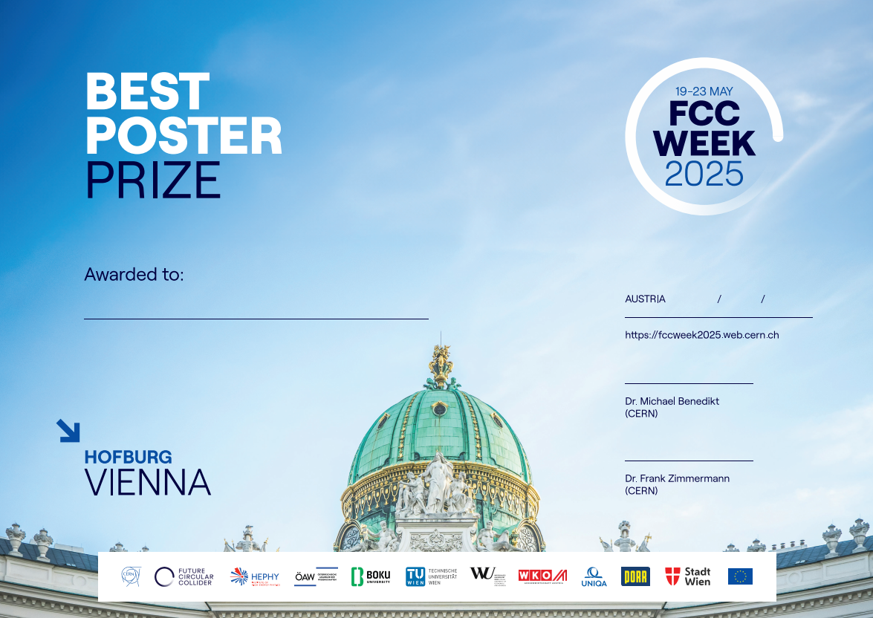

Time-Dependent Precision Measurement of $B_{s}^{0}→φμ^{+}μ^{−}$ Decay at FCC-ee
Tsz Hong Kwok, U Zürich

Slide 5
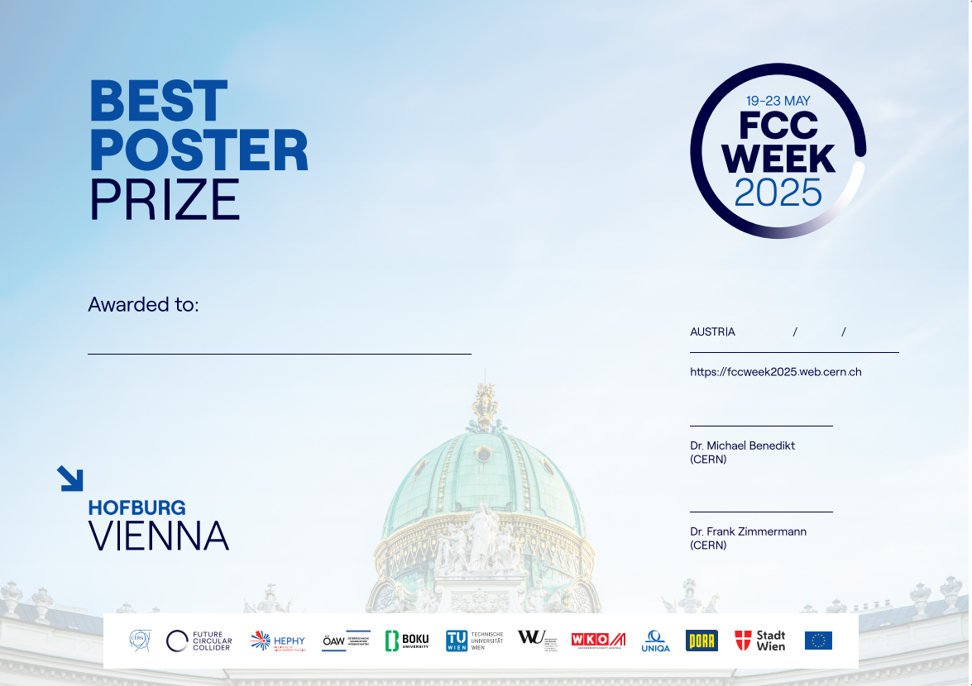
Vibrational study of the booster and collider supporting system
Audrey Piccini, CERN

Slide 6
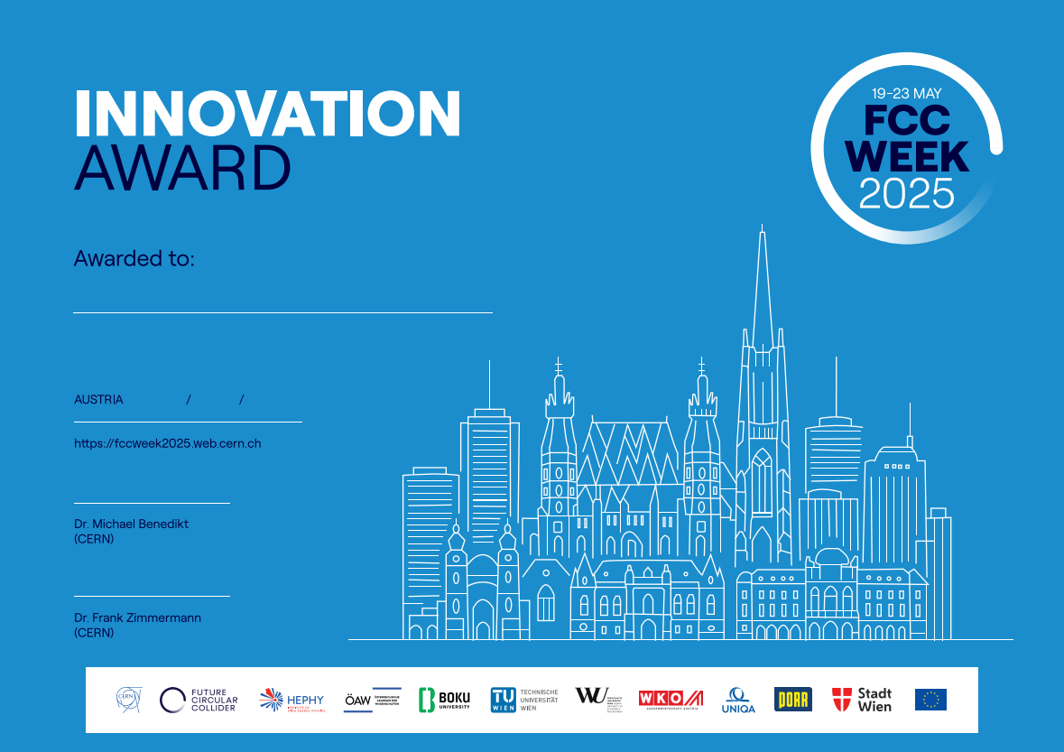
Sara Aumiller, TU München

Slide 7
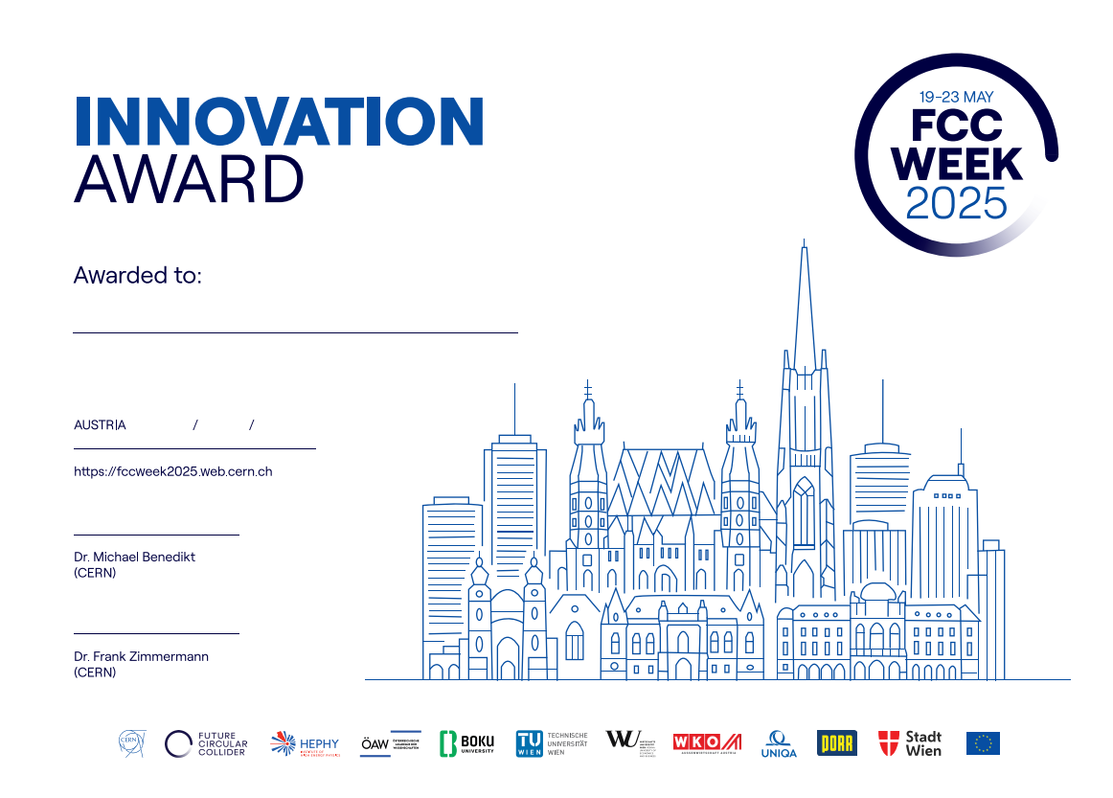
Elaf Musa, DESY

Slide 8
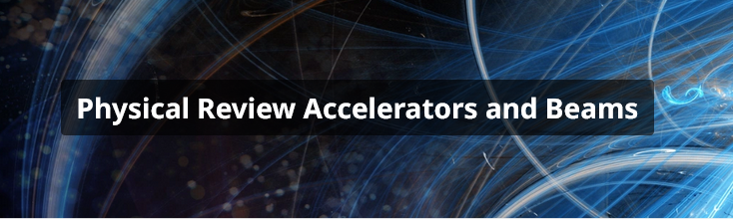

Physical Review Accelerators & Beams 2025 FCC Paper Awards
Two 2025 PRAB FCC Paper Awards for early career researchers, sponsored by PRAB and APS.
The PRAB FCC Paper Awards are meant to recognize the scientific quality of publications related to the Future Circular Collider (FCC) in the journal Physical Review Accel. Beams (PRAB).

Slide 9

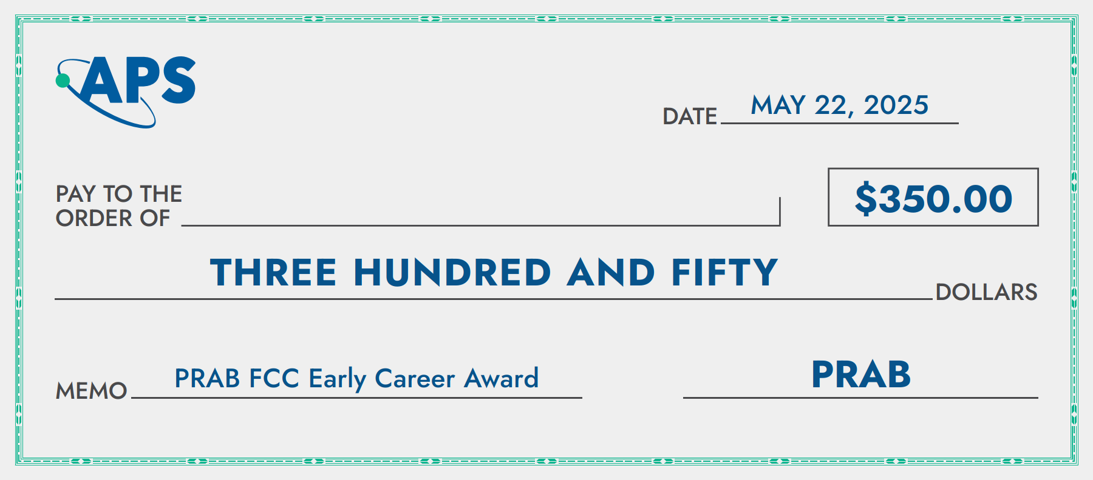
PRAB Early Career Awards
Ivan Karpov, CERN
Transient beam loading and rf power evaluation for future circular colliders
High order mode power loss evaluation in future circular electron-positron collider cavities
Generalized threshold of longitudinal multibunch instability in synchrotrons
…
Nicolas Vallis, PSI
Proof-of-principle 𝑒+ source for future colliders
Editor’s Suggestion

