Slide 2
Radiation Tolerant Design and Testing of Power Systems
CERN Internal Training
Thurel Yves
With inputs from B. Jacquest Sermet, B. Favre & R2E team
CERN, for Basic introduction to radiation effects, 2024 @ CERN
Document source
https://edms.cern.ch/document/3094098/
Meeting link (indico)
https://indico.cern.ch/event/1408522/

Slide 3
Content
Content
What is a Power Converter?
CERN environment and its radiation test facilities
Power Converter operation constraints
Power Converter radiation tolerant design
Sharing lessons learnt and real life example.
Conclusion

Slide 4
Power Converters in CERN Accelerators

Slide 5
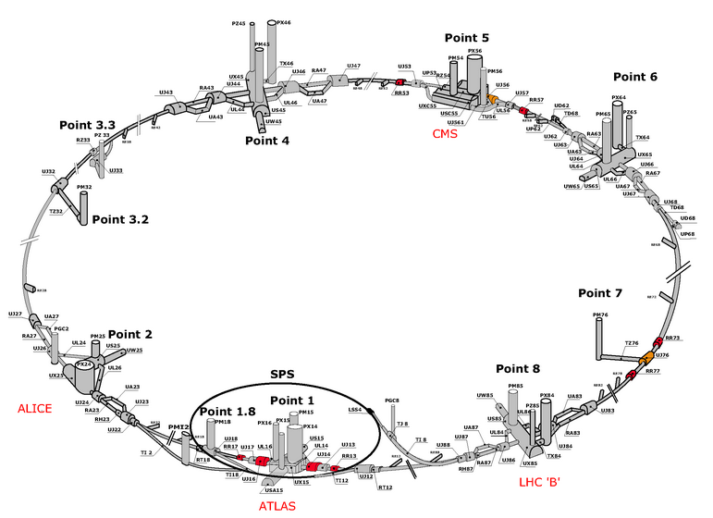
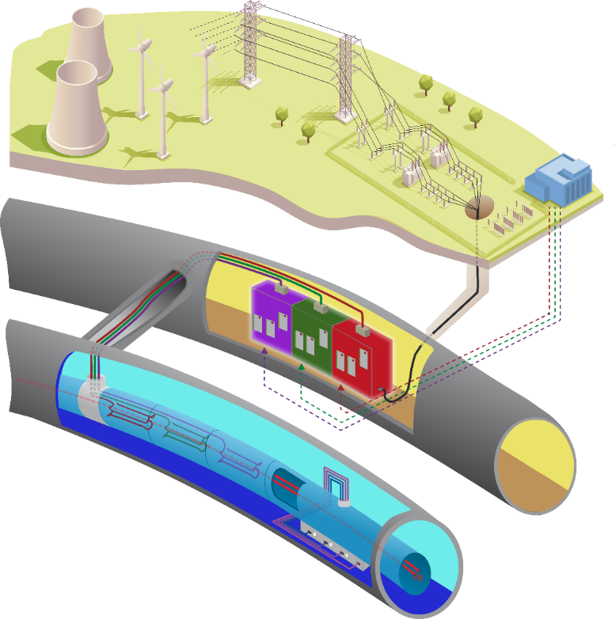
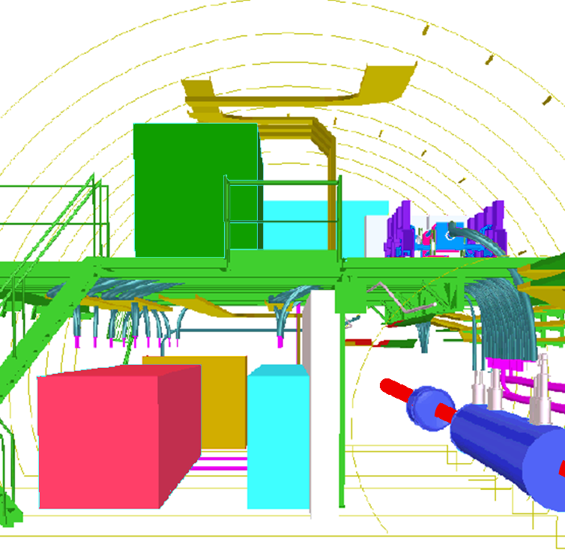

Power Converters in CERN Accelerators | Which use?
F
Power Converters
Beam
1700 units, installed underground over 27 km, guiding beam…
… located in adjacent alcoves, not exposed to radiations for some…
… but others still close enough from beam to suffer from radiations.

Slide 6
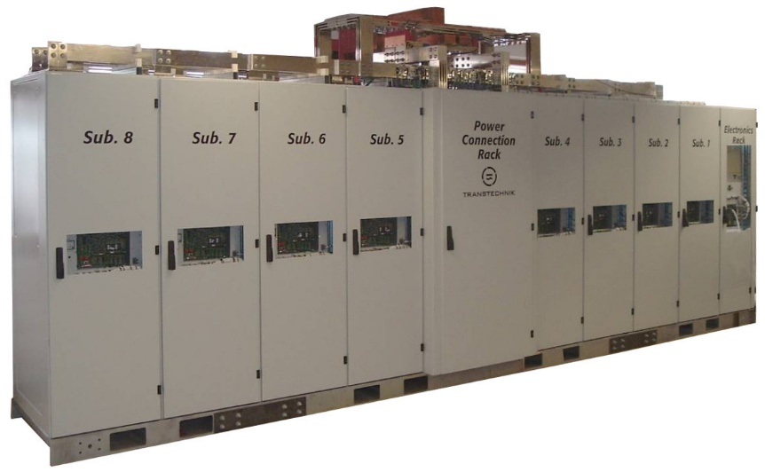
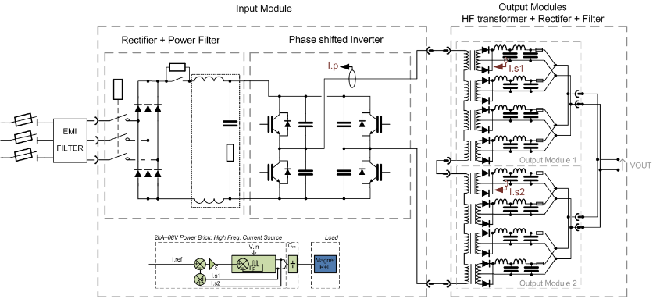

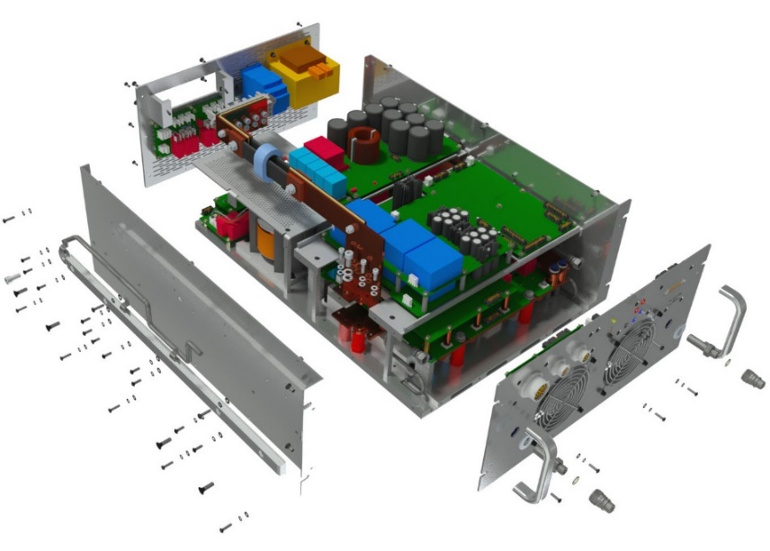
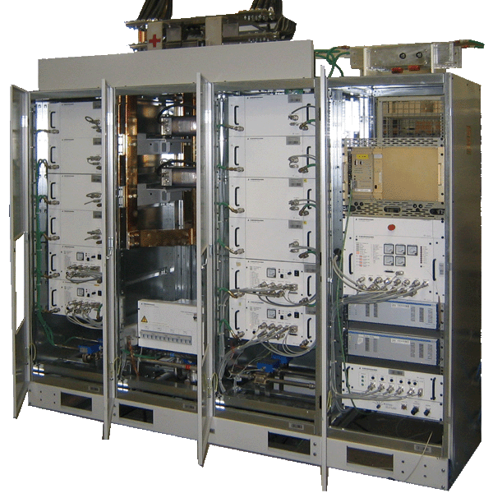
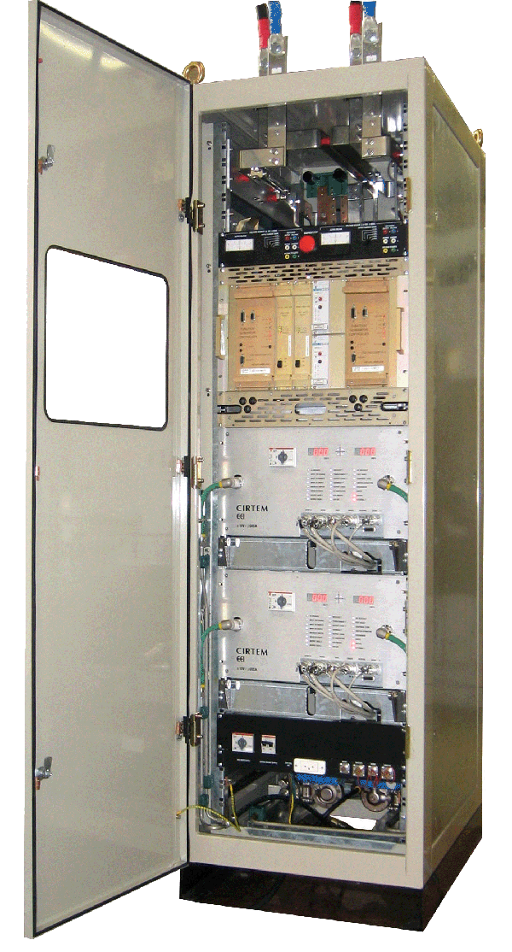
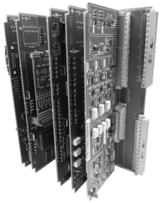
Power Converters in CERN Accelerators | What are they?
AC Mains Supply
Power Converter
3
Iout
Power Part
(Voltage Source)
Vout
L
A
B
Vref
digital .... analog
2
1
120 Units
60 Units
Digital Electronic
Control
Digital loop
Communications
Current Transducers
I.A
I.B
Control (digital):
S. Uznanski
NSREC2017
Few families, with output current in [60; 13 000] A
A power converter needs control but is mainly a …
… power device using only analogue components.

Slide 7
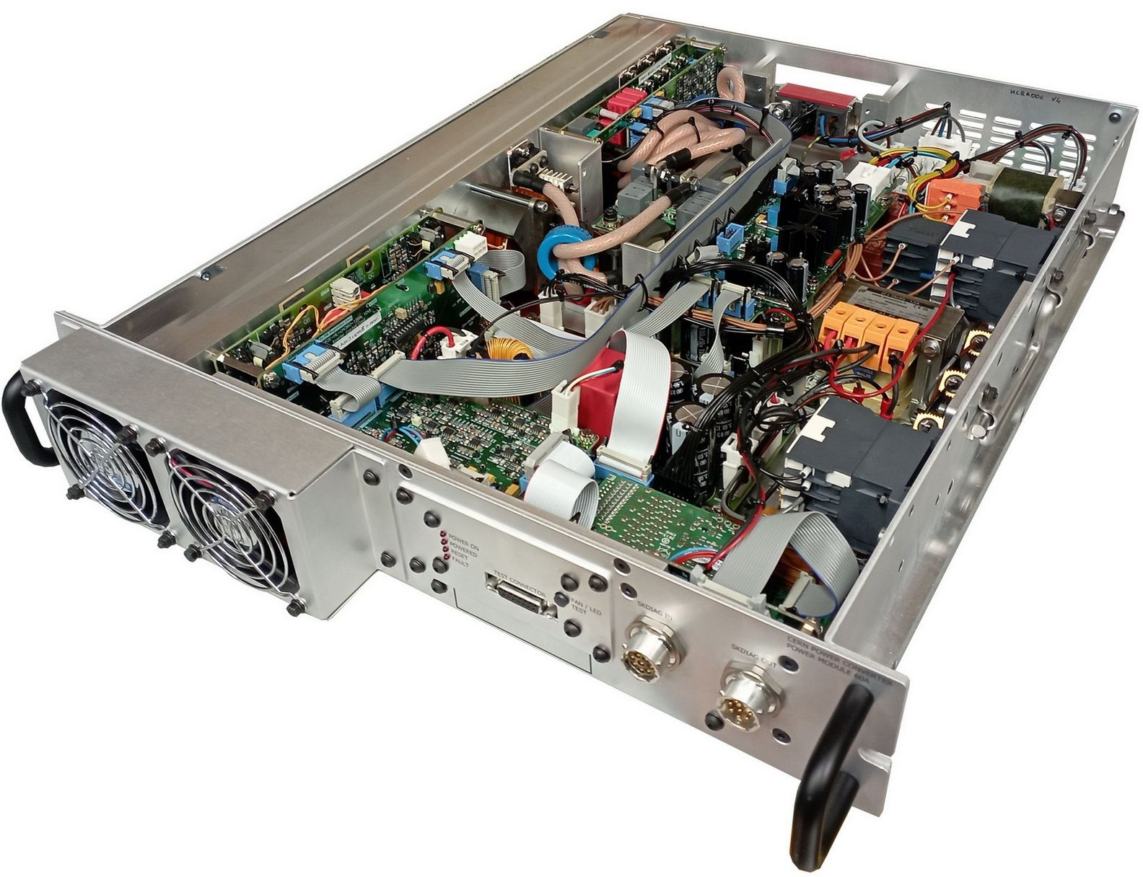
Power Converters in CERN Accelerators | Low Power
 | Power Converter Details
 | Low Power Converter comes with mainly analog (power) components, very specific, like: Power transistors, Diodes, Mosfets, IGBTs Specific sub-system like auxiliary power supplies, IGBT drivers Conventional analog components like: OPA, comparators, low power transistors (mosfet or bipolar, zener, progr. voltage reference...)

Slide 8
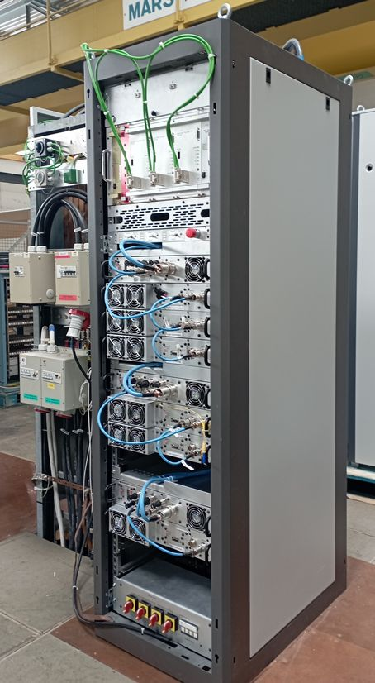
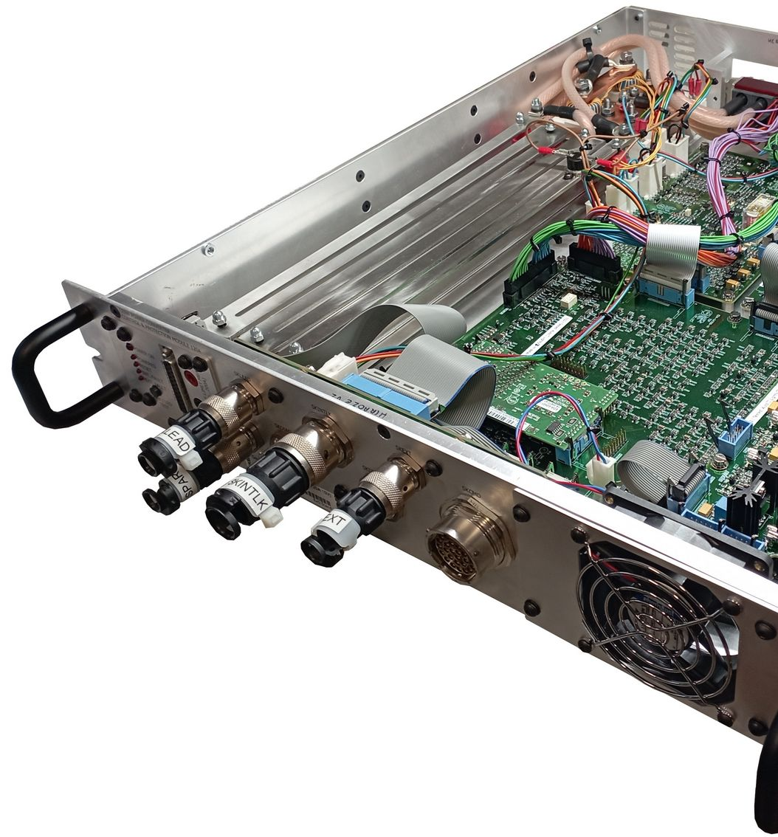
Power Converters in CERN Accelerators | Low Power… High Qty
 | Power Converter Details
 | Very often, converter design is modular, with several power modules (PM) and a control & protection module (CPM) used. One Power Module comes with 800 semiconductors. A standard modular converter can easily use 3 000 semiconductors. For LS3 required converters, 650 000 semiconductors were bought in 2022-2023 for 300 converters.

Slide 9
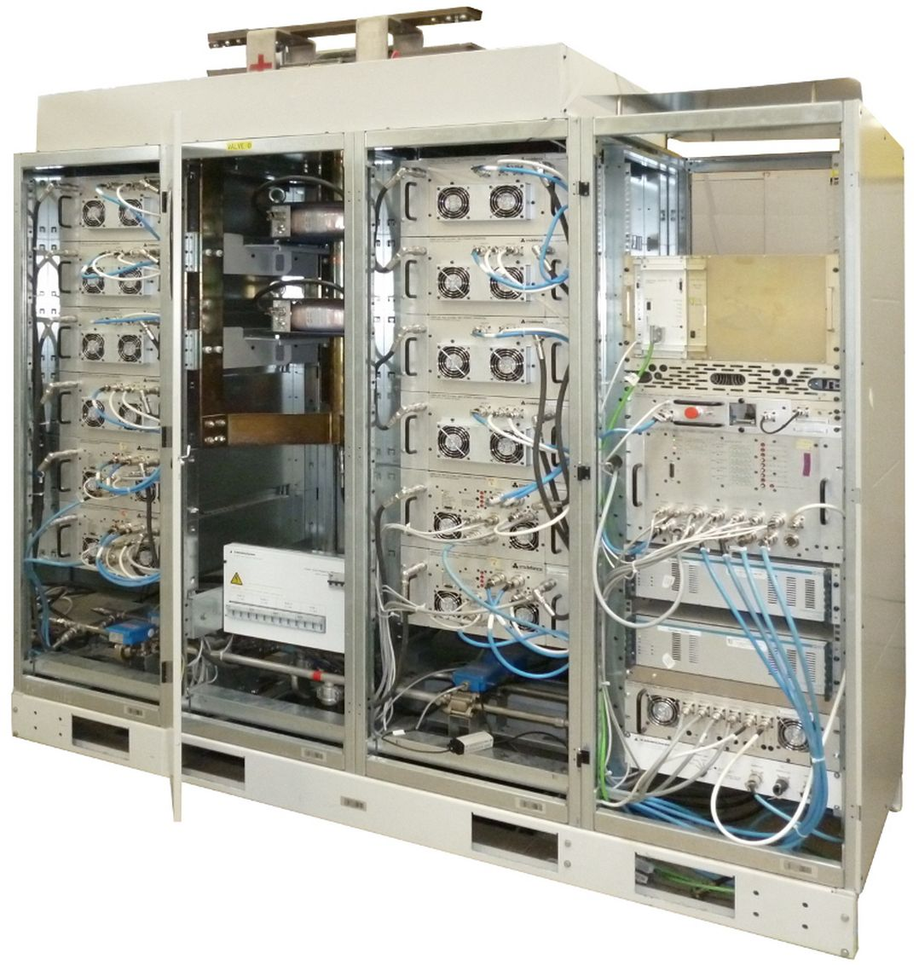
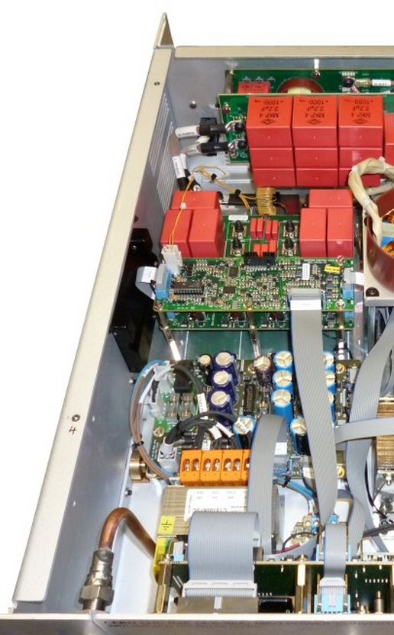
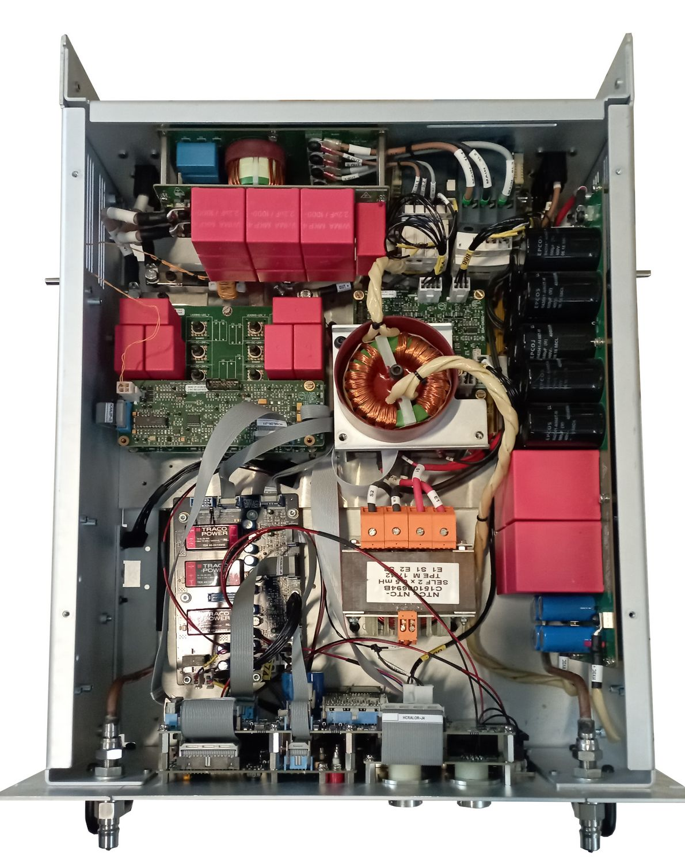
Power Converters in CERN Accelerators | High Power
 | High Power Converter
 | Compared to low power, high power comes with water cooling system, uses bigger components, except in the case of redundant modules.

Slide 10
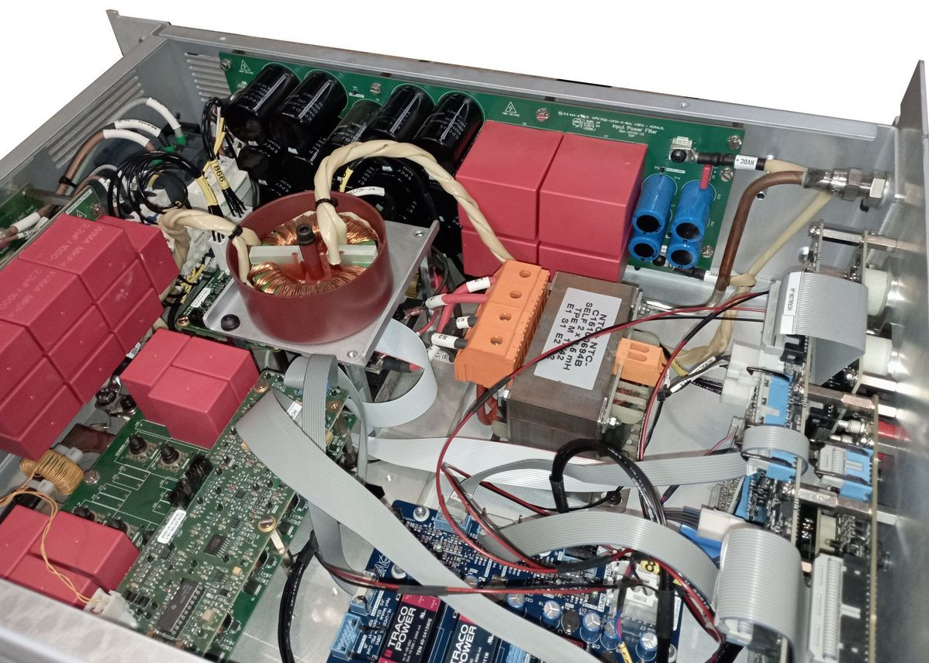
Power Converters in CERN Accelerators | High Power
 | Power Converters
 | Except the size of power components (magnetics and some power semiconductors) and water cooled context, the challenge versus radiation is very similar between low and high power converters.

Slide 11
Power Converters and their radiation environment at CERN

Slide 12
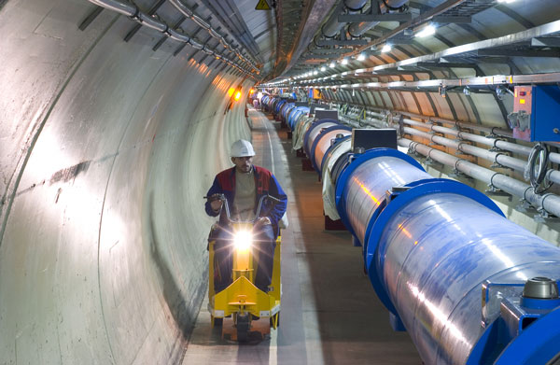
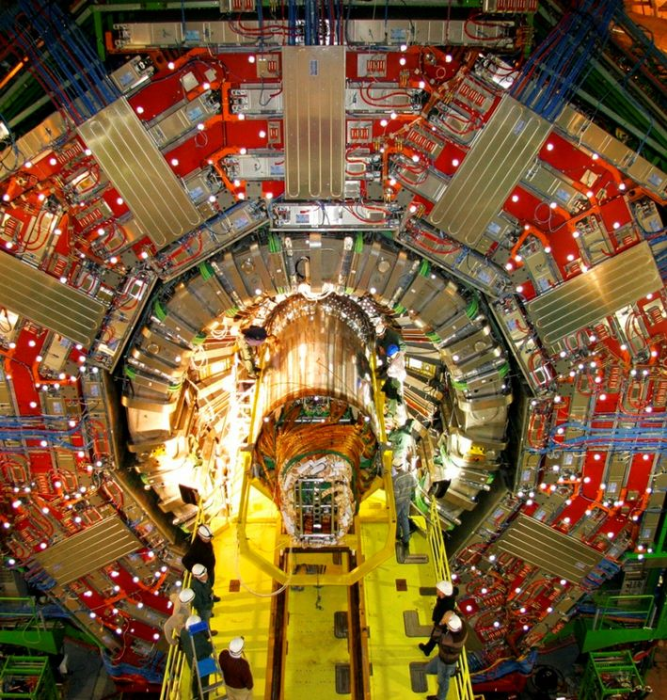
CERN Accelerators | Providing different environments
 | Different radiation cases
 | Accelerator: low to medium radiation environment Experience: high (very) radiation environment

Slide 13
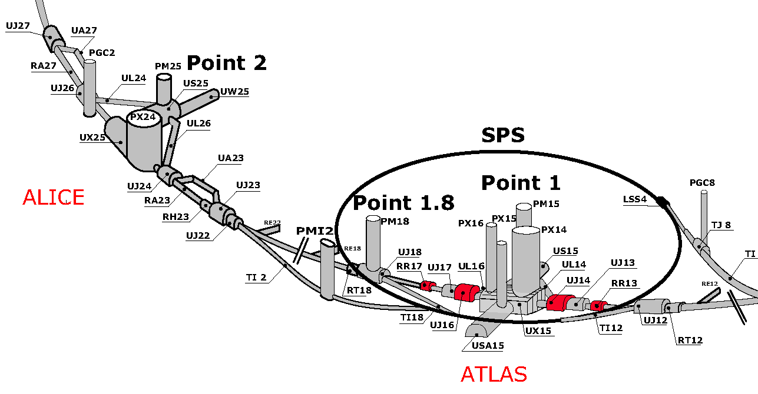
CERN Accelerators | Power Converters locations
 | Tunnel, RR, UJ, UA
 | Installation of power converters can be quite diverse in LHC complex: RR, UA, UJ, or directly in the LHC tunnel, very close to the beam. Proximity with experience debris plays an important role in the radiation levels.

Slide 14
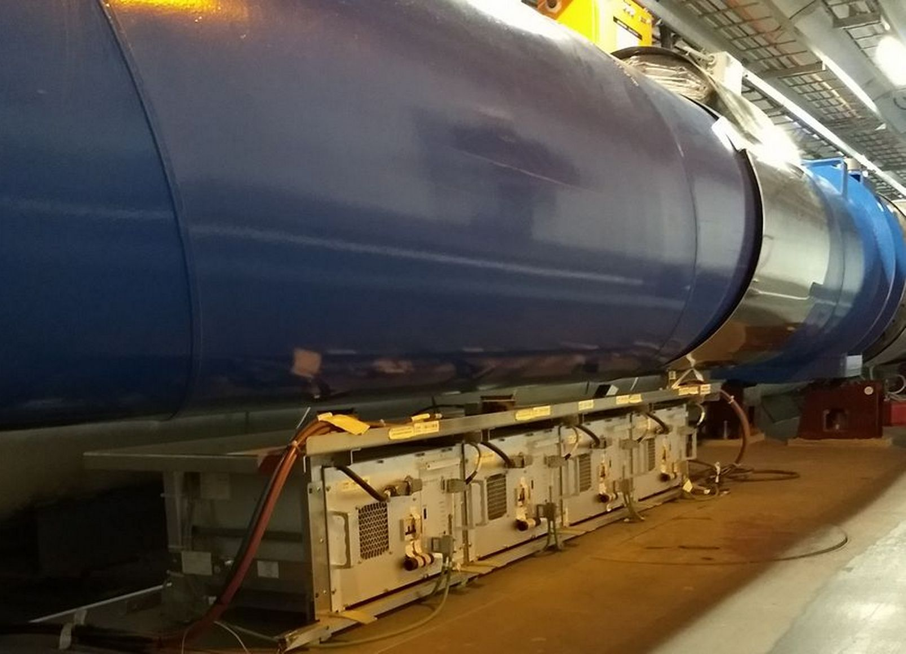
CERN Accelerators | Power Converters locations
 | Orbit correctors in tunnel
 | Some converters (low power orbit correctors) are directly installed below dipoles. Up to 750 units in LHC complex.

Slide 15
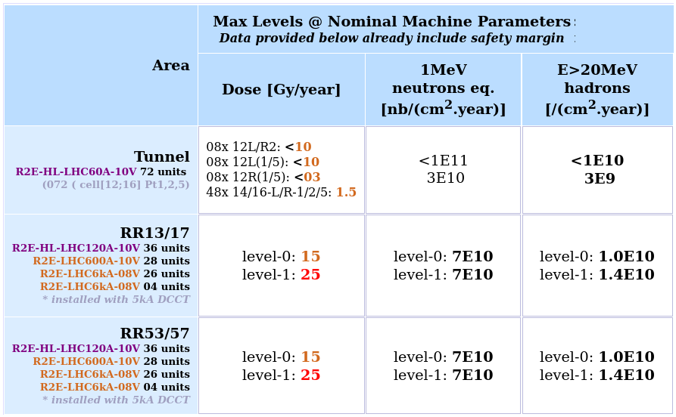
CERN Accelerators | Power Converters locations & Levels
 | Radiation levels
 | Levels can reach up to 350 Gy (25 Gy/year) in some RR location. Having hundreds of systems installed requires low system cross section (E > 20 MeV/cm2), then very low applied to component level and in consequence.

Slide 16
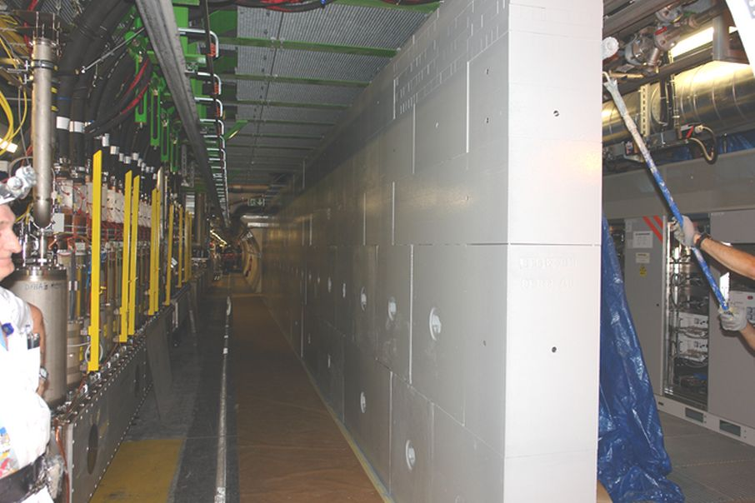
CERN Accelerators | Power Converters locations & Levels
 | Radiation Mitigations
 | Accelerator complexes are not comparable to space environment. Simple and long term efficient mitigations like: Shielding units Relocating units Rotating units Optimizing beam ctrl Should be considered to decrease stress level. Designing / producing radiation tolerant power converters is years of work and heavy effort.
Beam | Concrete Wall | Converters

Slide 17
Radiation Test facilities
Access to these facilities: PSI, CHARM, CO60 change the perspectives of what is possible / realistic

Slide 18
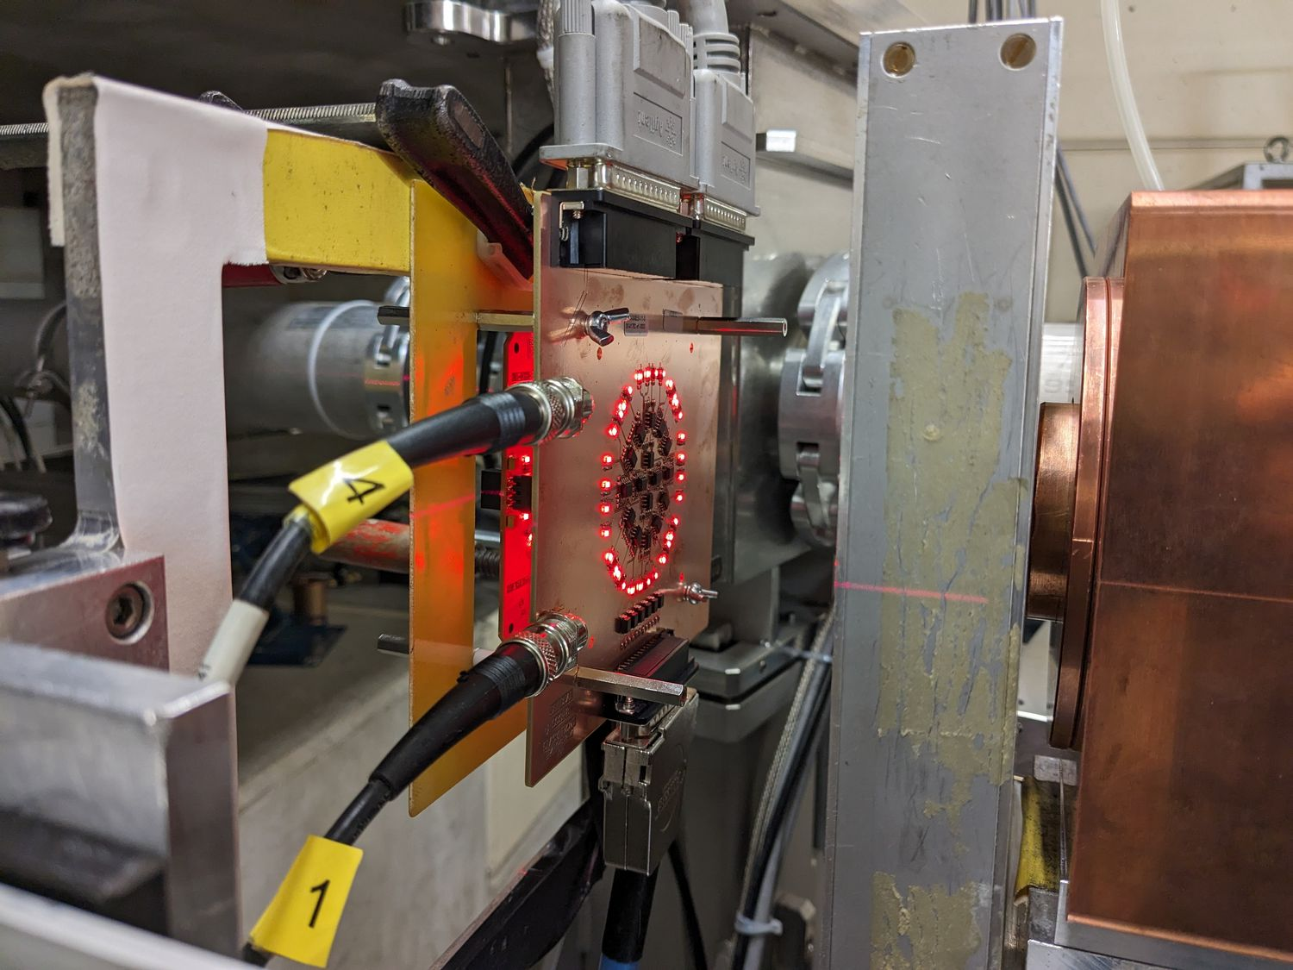
Radiation Qualification | Available facilities
 | PSI Facility
 | CERN gets access to PSI for component level radiation qualification (R2E Team). Test under 60 MeV protons beam. During these campaign, a lot of parameters are measured & checked vs: SET, SEL, SE family... Cumulative dose (DD + TID mixed)

Slide 19
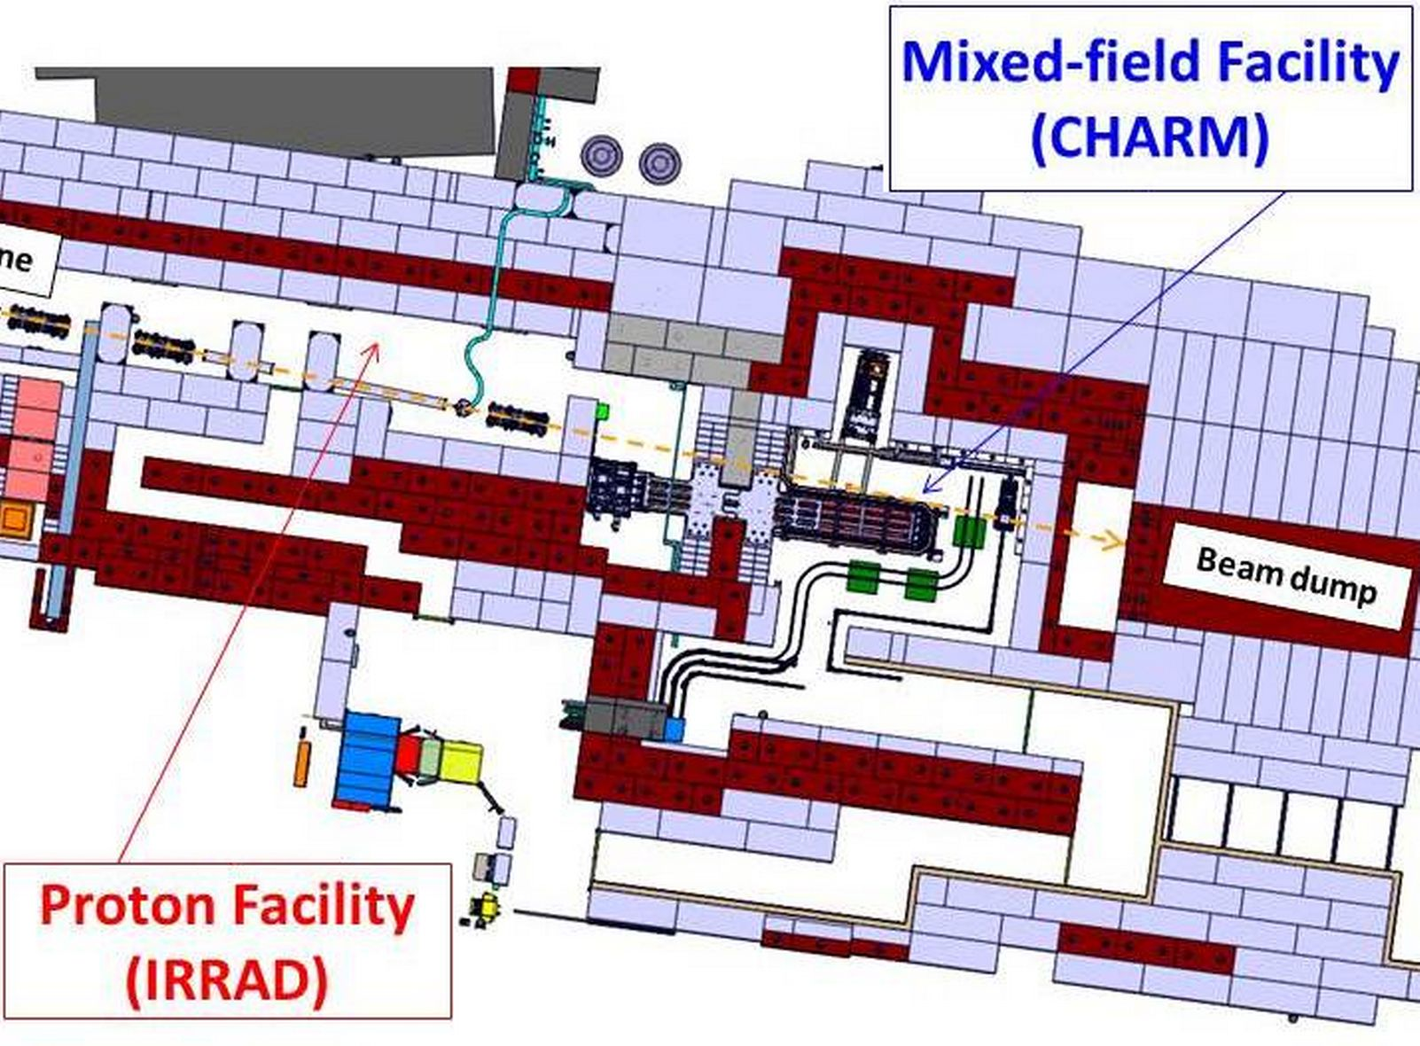
Radiation Qualification | Available facilities
 | CHARM Facility
 | Few days only to qualify component & rack “in one go” for the dose/fluence of interest (HL operation).
Charm: 1-2 days obtained levels
Dose [Gy] | 1 MeV neutrons-eq | E > 20 MeV hadrons
< 60 | < 4 E11 p/(cm²) | < 2 E11 p/(cm²)
HL-LHC (1-year) converter levels
Dose [Gy] | 1 MeV neutrons-eq | E > 20 MeV hadrons
< 25 | < 2 E11 p/(cm²) | < 6 E10 p/(cm²)

Slide 20
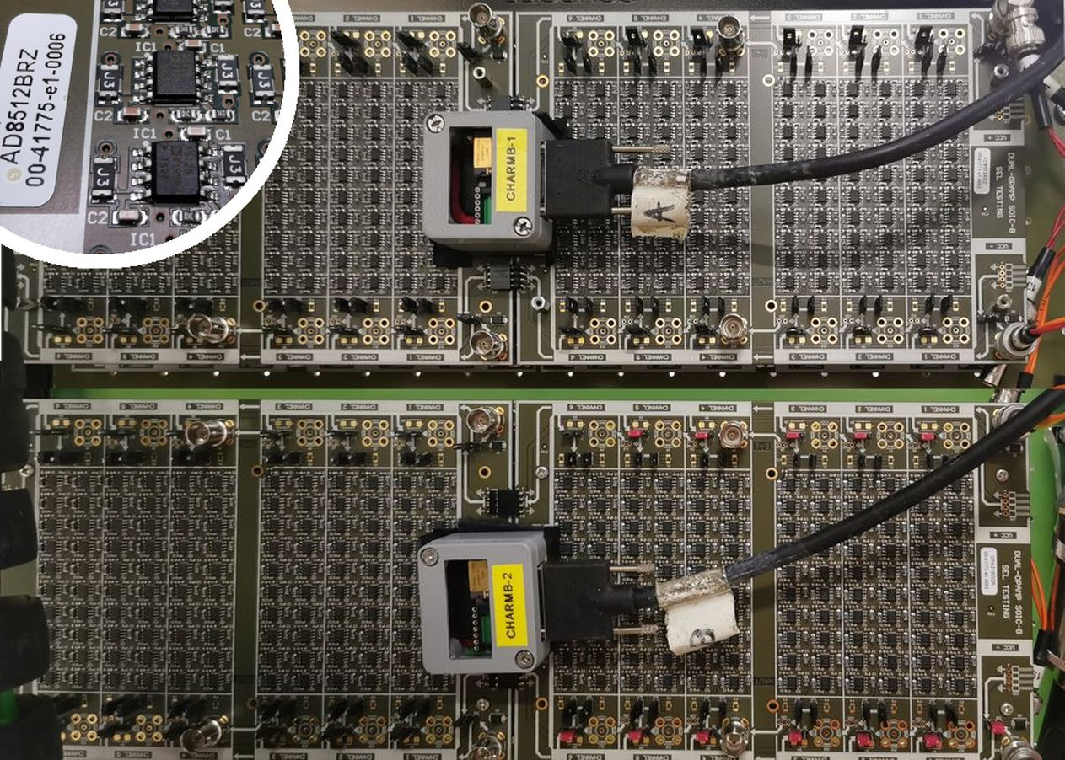
Radiation Qualification | CHARM Testing capacity
 | CHARM, for testing what?
 | Large boards or complete systems can be tested at CHARM. Do not forget: around 30-40 meters exists between DUT and control room. It is possible to repeat PSI type tests, but it is also highly & more interesting to test hundreds of components (not all parameters checked) to ensure dramatic SEL levels...

Slide 21
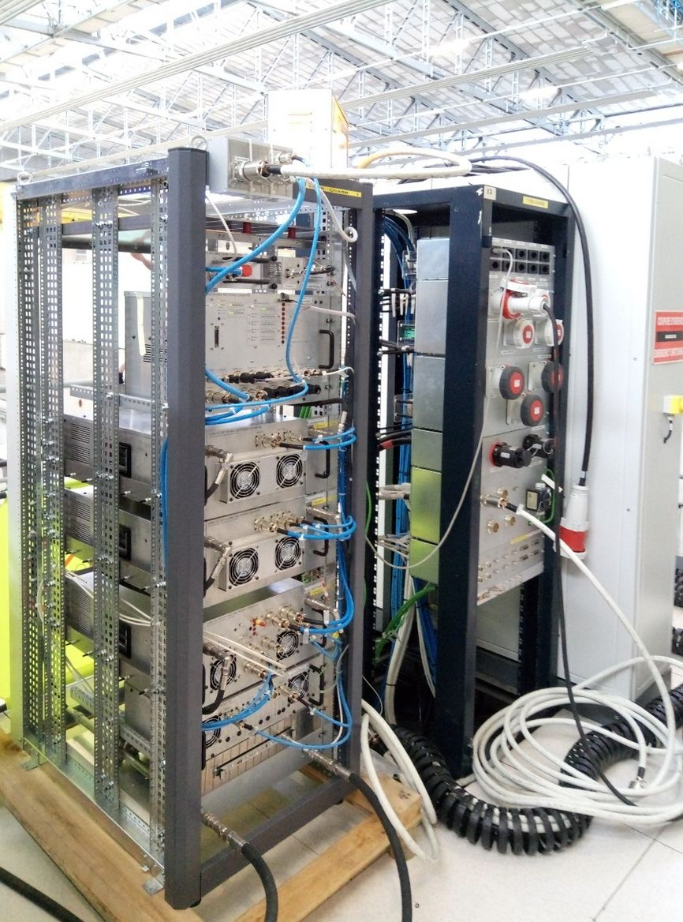
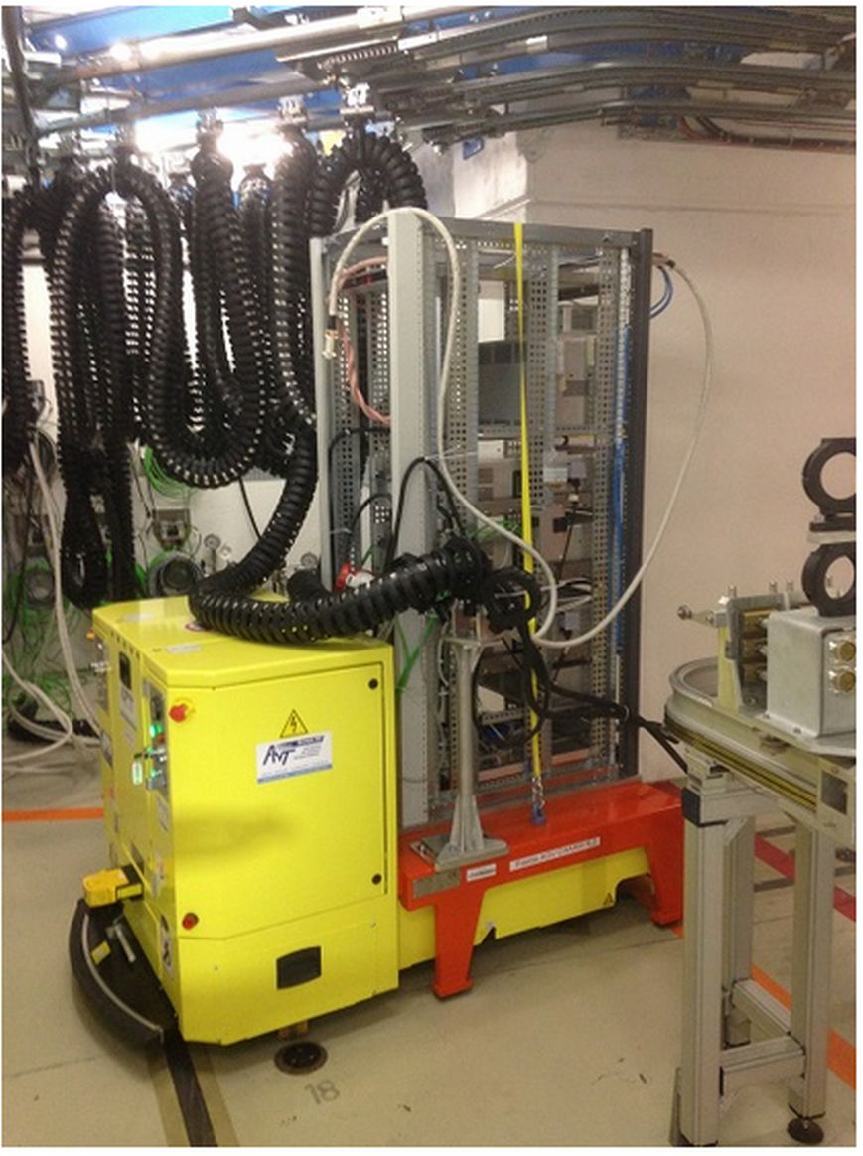
Radiation Qualification | CHARM Testing capacity
 | CHARM, for testing what?
 | … or testing a complete power converter (water cooled included!). Even if not an easy task, it is possible at CHARM.

Slide 22

Radiation Qualification | CHARM in few words
 | CHARM Facility
 | “Nothing beats a CHARM test”. Indeed: CHARM deliver close to operation radiation levels but accelerated CHARM can accept several big complete systems (a full rack!)

Slide 23
Power Converter Operation Context: Which radiation effect tolerable?

Slide 24
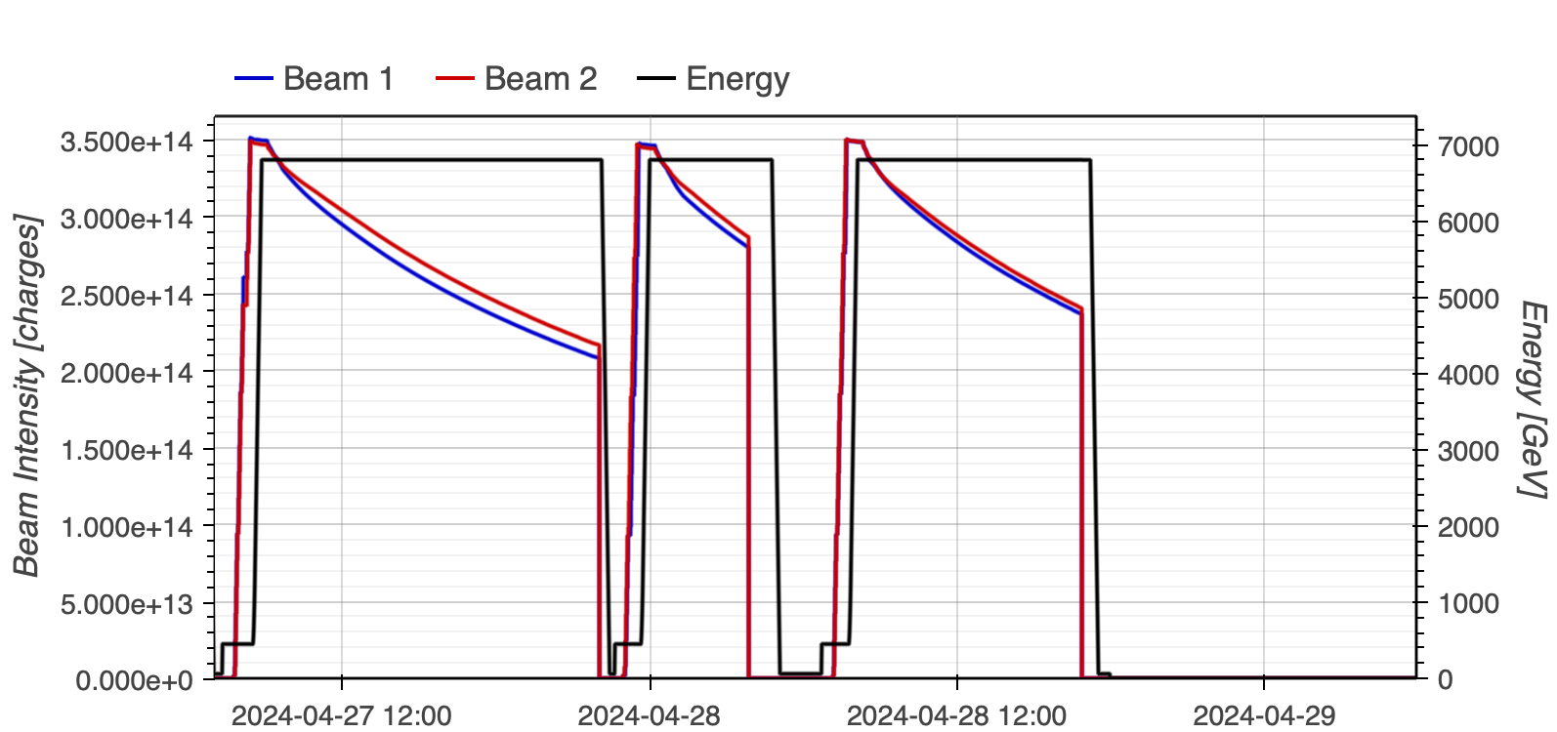
Operation requirements | Radiation = an additional constraint
 | LHC case
 | Around 1000 converters (1700 installed) receive radiations (different level) in LHC accelerator. Any single failure on converter leads to LHC beam dump + hours of downtime (access + repair). Rule: Only Single Event Failure - FREE design should be considered.
MKD power supply
RQT12.R5B1 trip (Converter)

Slide 25
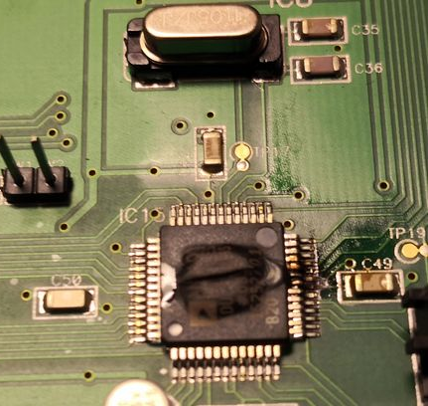
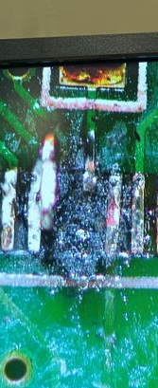
Operation requirements | Radiation in long term perspective
 | SEL (destructive) Impact
 | Impact of a destructive Single Event Latchup can degrade the entire PCB, with no possibility to repair it. SEL or SEB cannot be tolerated. Operation duration is around 20 years min, and being able to repair PCB is essential to last. Re-producing spares COTS is not a credible (acceptable) option.

Slide 26
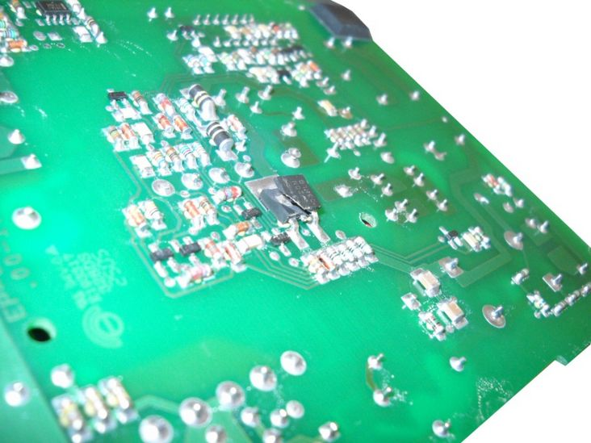
Operation requirements | SEB cost illustrated through experience
Real Life
 | Real-life example - 1/3
 | 400x AC-DC power supply units (same reference) bought at the same time (for a LHC contract). Still, two 800V Mosfets strictly electrically equivalent & used at 500 V references were randomly mounted*. They were tested under 60 MeV protons (PSI): XSmanuf.1 = 1E-9 cm² XSmanuf.2 < 1E-11 cm² ** * this is very common practise. 2x or even 3x sources are often used in a commercial unit (AC-DC, DC-DC etc…). ** no events reported

Slide 27
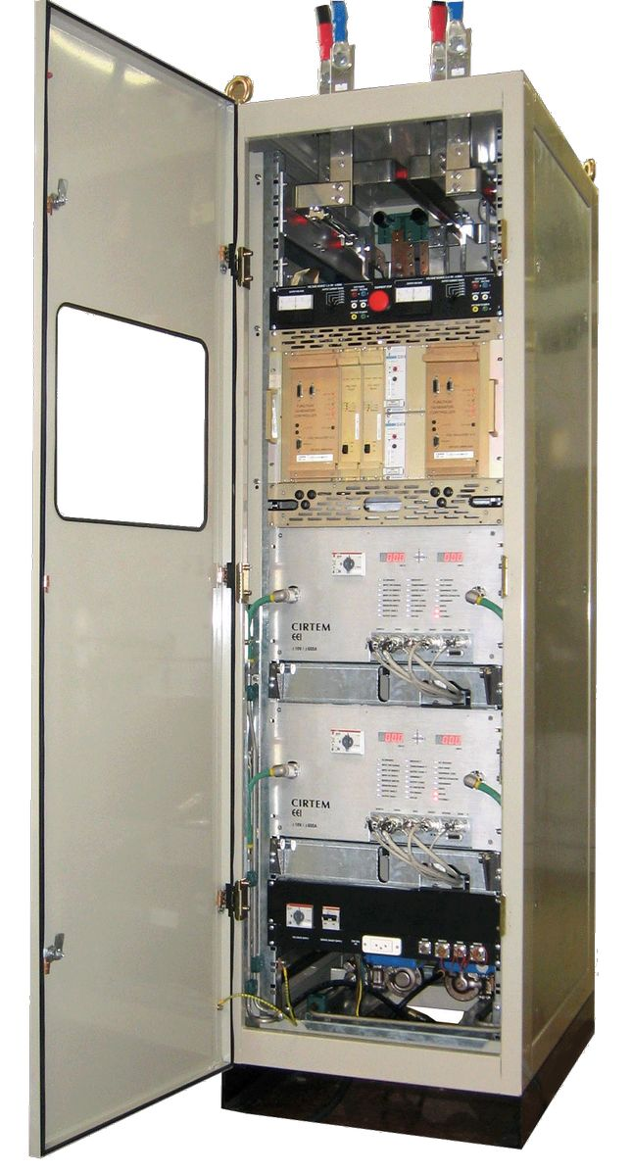
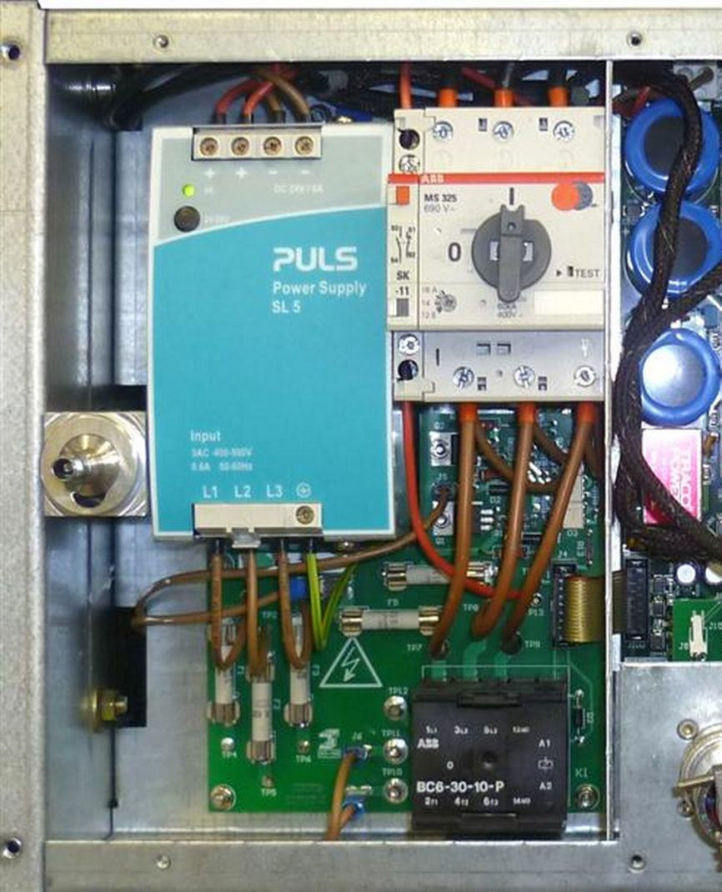
Operation requirements | SEB cost illustrated through experience
Real Life
 | Real-life example - 2/3
 | It was rather complicated to diagnose the issue. Reasons SEB on a component impacts others on PCB Failed AC-DC from operation were ALL using the weak Mosfet, when many others AD-DC units were using the strong ones. Initial radiation tests were strongly inconsistent (using strong Mosfet, by “luck” and not being aware of the dual use).

Slide 28
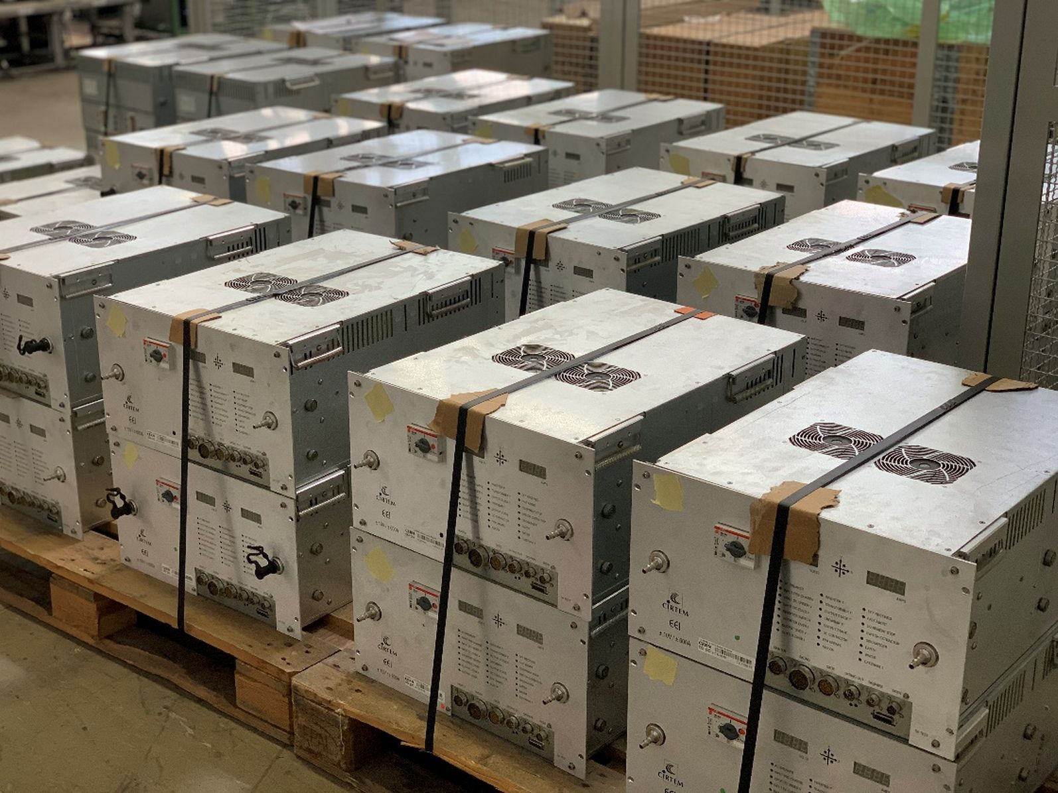
Operation requirements | SEB cost illustrated through experience
Real Life
 | Real-life example - 3/3
 | 400 power modules were removed from LHC machine (distributed over 27 km). All PSU (PULS) module were opened, and sensitive Mosfet was checked (reference) and changed if required. This required a heavy maintenance + a re-test campaign after update.

Slide 29
Power Converter Design: Tools & Information management
Sharing efficient surrounding design paths

Slide 30
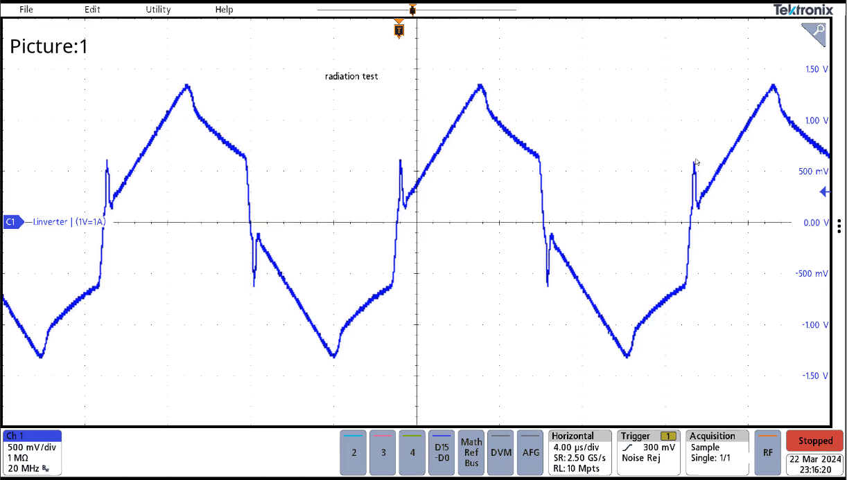
Design tools & info m^{gt} | Intensive use of LTSpice Simulation
 | LTSpice Simulation
 | Any part in operation in the converter was simulated (sometimes through several sub ones) using LTSpice. Simulation average time was required to be less than 20 sec. Simulation had to be as precise and close to reality as possible.

Slide 31
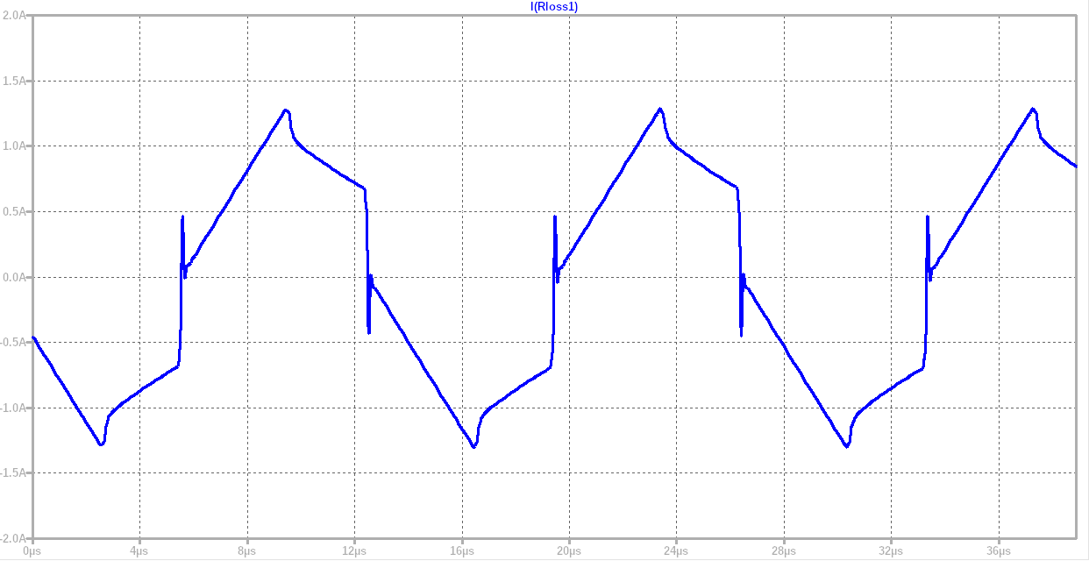
Design tools & info m^{gt} | Intensive use of LTSpice Simulation
 | LTSpice Simulation
 | Response of a 15 sec simulation giving the inverter current of a 70 kHz phase shifted DC-DC, integrating the effect of 50 meters of cable transporting the signal to the final oscilloscope.

Slide 32
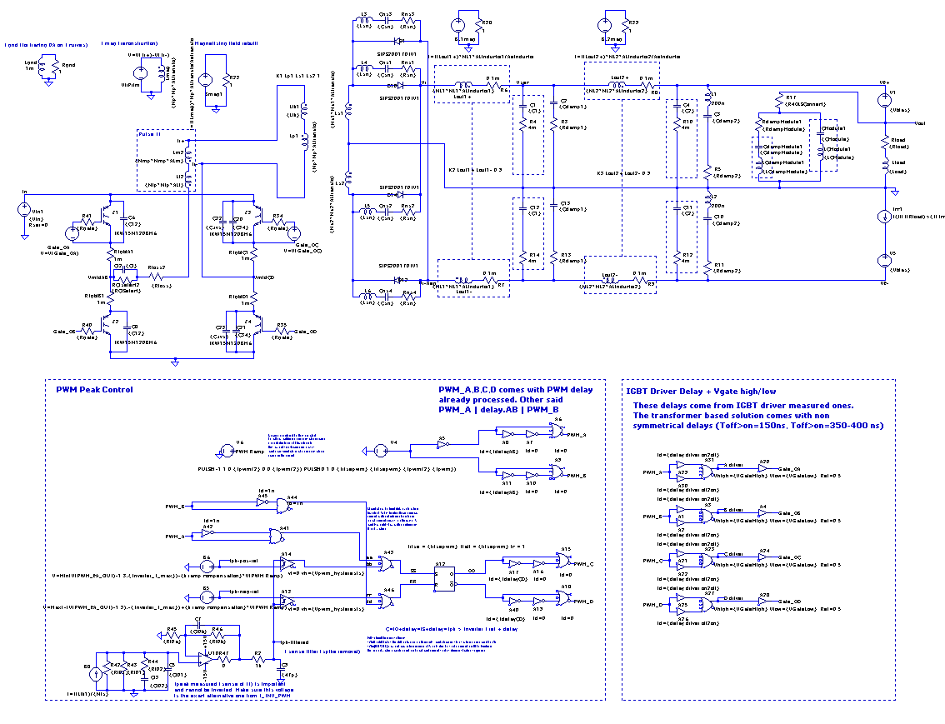
Design tools & info m^{gt} | Efficient LTSpice Simulations
 | LTSpice Simulation
 | Up to 300x periods are generated, in less than 15 sec with access to IGBT power losses, PWM control signals (insert SE, modifying delay times…). Simulation helps to study SE or dose effect through adding SE source, or modifying component models (degradation).

Slide 33
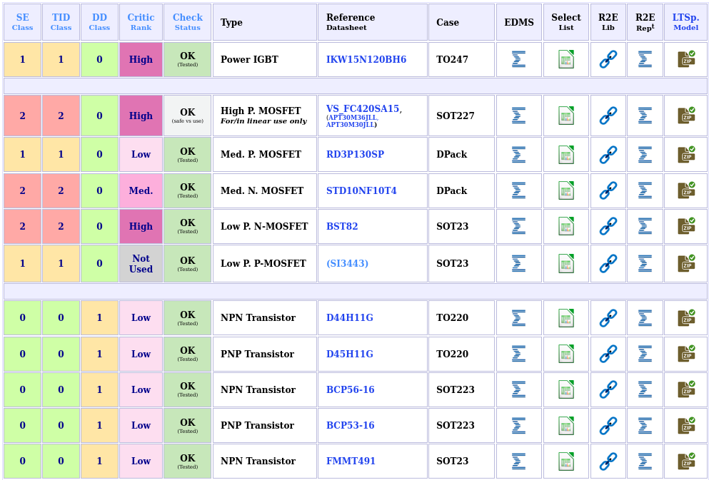
Design tools & info m^{gt} | Information access on component
 | Information easy access
 | All information related to critical semiconductors is easily accessible on webpages Datasheet Selection Matrix Rad-tolerant biblio and test report LTSpice component model

Slide 34
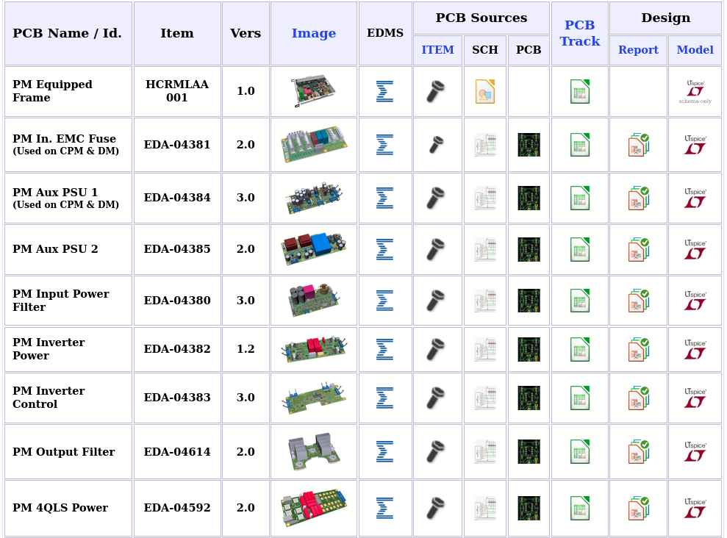
Design tools & info m^{gt} | Information access on PCB cards
 | Information easy access
 | All information related to each PCB is easily accessible on webpages PCB schematics (and layout) PCB Tracking change file (update & bug fixes) Design Report All LTSpice system board models

Slide 35
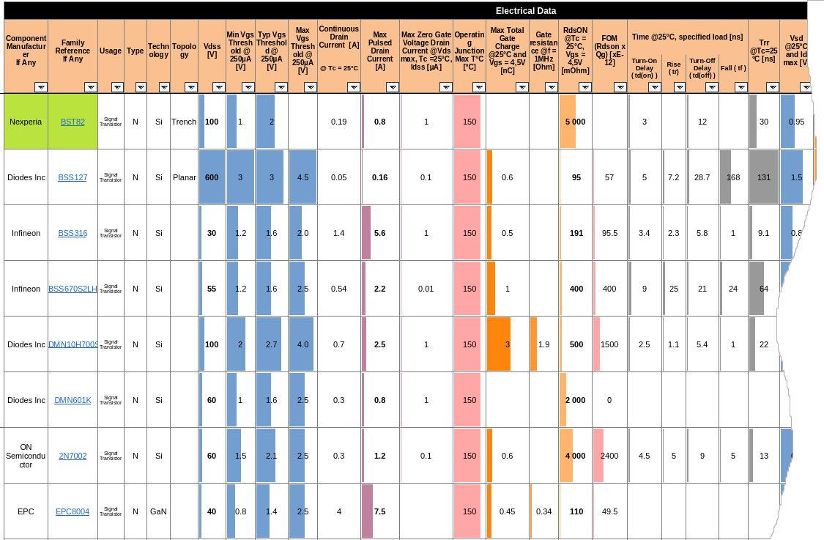
Design tools & info m^{gt} | Documenting cpt selection
 | Information management
 | Any component (mainly semiconductor) comes with a selection matrix (libreoffice calc format). All design criteria are studied, with radiation info put in perspective. Reason for choosing component is clearly stated and documented If a component must be finally changed, it is easy to go to the next one in the list.

Slide 36
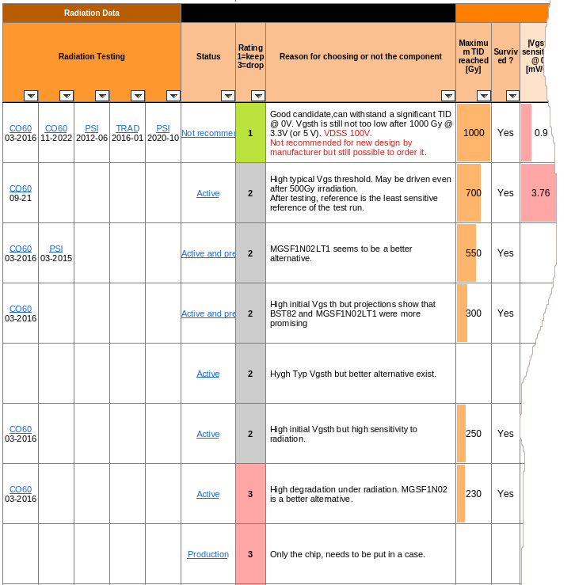
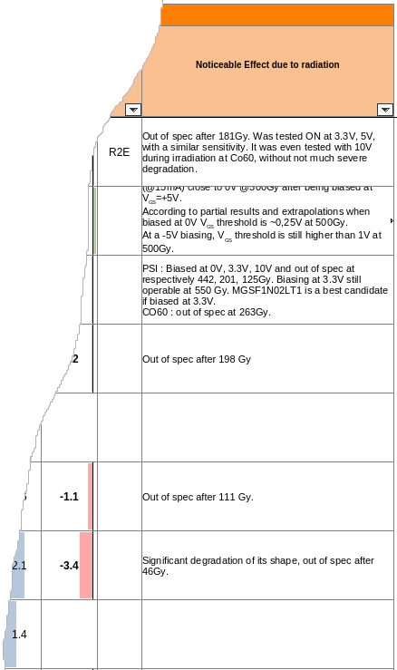
Design tools & info m^{gt} | Documenting cpt selection
 | Information management
 | All possible components (known already vs radiation) is taken in priority. Still, since test level were often not sufficient (towards cross section), hundreds of candidates are often present in these files. OPA, bipolar or mosfet files are of particular interest.

Slide 37
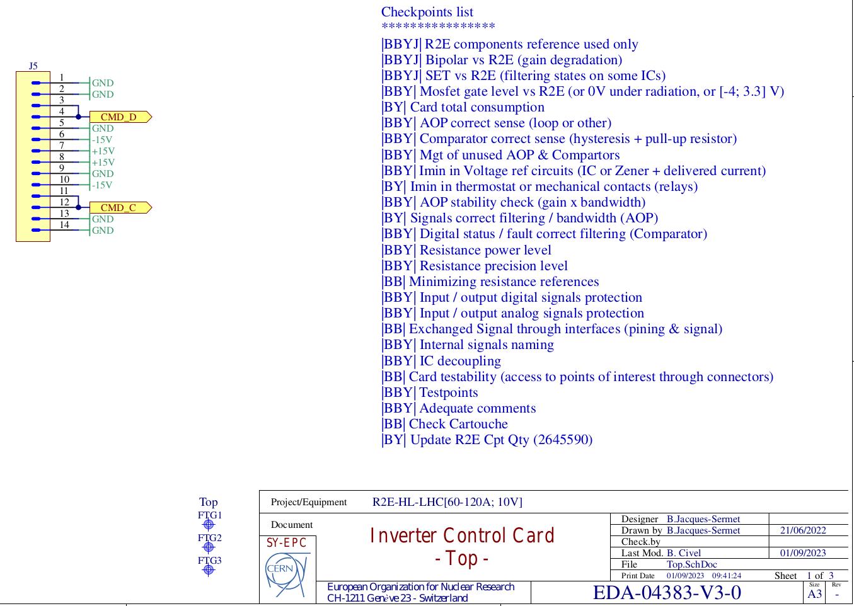
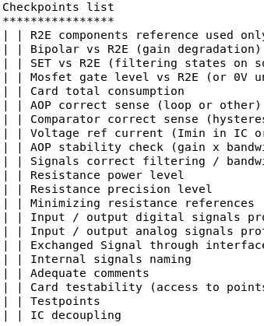
Design tools & info m^{gt} | PCB schematics review
 | Strict rules applied
 | All PCB schematics were verified by 3 designers (BBY), each one giving a stamp on electrical + radiation checkpoints.

Slide 38
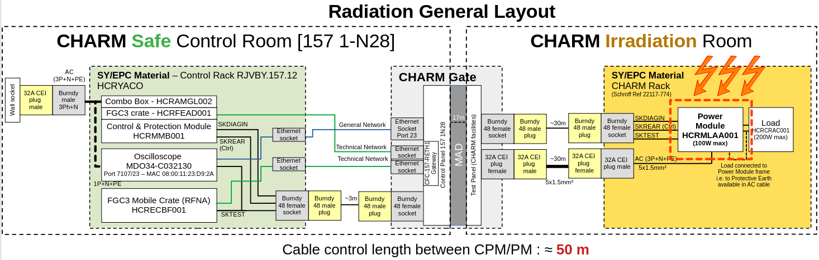
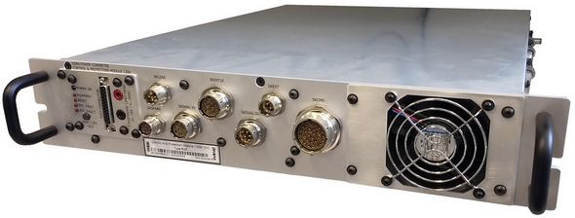
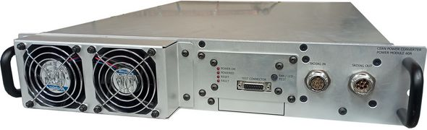
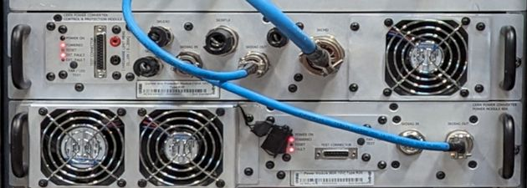
Design tools & info m^{gt} | Testing at CHARM in sight from Day-0
 | CHARM test from day-0
 | The converter was designed to operate in two pieces distant from 50 meters from day-0, as in final test at CHARM.
Control loop, and signal exchange integrity must cope with 50 m of distance @ CHARM !
2-3 meters

Slide 39
Power Converter Design: global key concepts
Starting from overall concepts

Slide 40
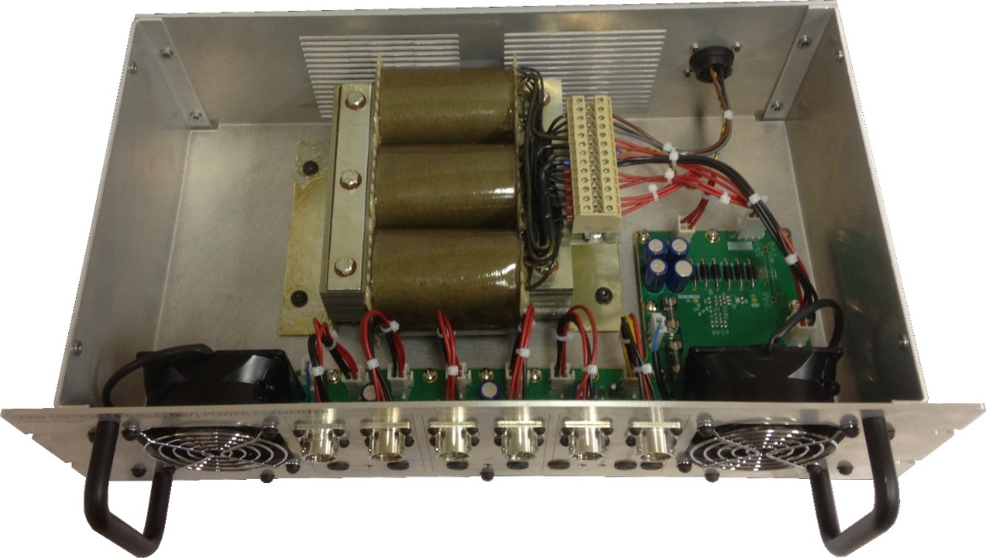
Global key concepts | An accelerator is not that similar to space
 | Accelerator case
 | Heavy (weight) & “low-efficiency” solution can be perfectly “acceptable” solutions, if helping reducing radiation sensitivity.

Slide 41
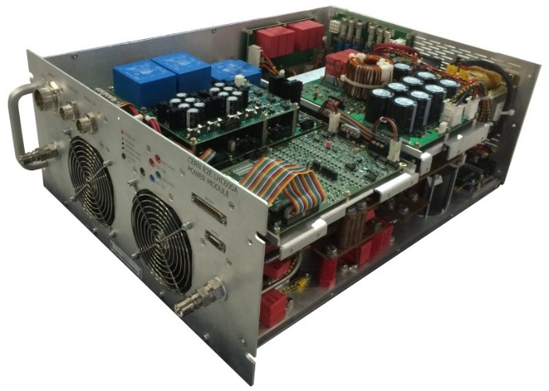
Global key concepts | COTS are appealing and justified
 | COTS use
 | CERN converter designs are all COTS based since: System are complex and use large quantity of components (cost) Radiation-hard qualified components are not really justified vs operation conditions (access to converter, not like in space). CERN has the privilege to dispose from a unique irradiation facility: CHARM (able to test a complete rack).

Slide 42



Global key concepts | Relaxing constraints through redundancy
 | Redundancy
 | Accelerator complexes are not comparable to space environment (size & weight & access). (n+1) redundant converter is an adequate mitigation action, not loosing beam on Single Event case. (n+1) redundancy allows to hugely decrease radiation tolerance level, at least regarding Single Events (not valid for cumulative dose).

Slide 43

Global key concepts | Not “entirely” redundant converter
 | Redundancy
 | Even with redundancy applied at the power module level, the centralized control side (in charge of the global control loop and piloting the power modules) stays the critical unit. Redundancy will simply lower the stress vs single event cross section, but will not entirely remove it.

Slide 44


Global key concepts | Redundancy impact on requirements
 | Redundancy effects
 | Requirement is strongly reduced on redundant part (mainly due to only 3-5 days to restore redundancy = access). Still, and in reality, PM cannot fail that often (too heavy for standby service) especially in SEL (requiring access).

Slide 45
Global key concepts | Large quantity of component impact
 | Overview
 | Calcul the allowed cross section for each sensitive component (SE), in order to determine their required test effort level. Consider the Beam Dump as the most critical criteria, but don’t forget standby service limitation. Redudant units could indicate no beam dump will happen up to 160 failures on PM (power module), but it would not be practically possible to exchange 160 dead units in a year.
Consider a budget of tolerable failures per year impacting operation > 1st concern = Beam dump, with budget dedicated to a number of converters > 2nd concern = Nb of failures (if redundant) compatible with standby service
In case converter is redudant, check the MTTR (mean time to repair) (If redundancy covers the 1st fail, converter is more exposed up to replacement occurs)
Consider a confidence level (margin of error) (90 % comes with a factor of 2.3 on random events (SE))
Count all components in operation potentially stopping the converter (Need to go into detail, to see if a failure really stops the converter – redundancy counts)
Share the budget of acceptable failures between critical components. (Decide if failures should come equally from same component reference vs its occurence)

Slide 46


Global key concepts | Large quantity of component impact
 | Overview
 | With 50-60 components of same type used in a converter, required cross-section are insanely low. Cross section as low as few E-15 are required, which leads to hundreds of components to test (0-fail test targetted). See this file EDMS 2722221.

Slide 47
Design: choosing the right topology
… better not to miss this first step...

Slide 48

Choosing the right topology | Complementary choices
 | Overview
 | Selection of the topology should be focusing on radiation tolerant design to come, digging in detail. This required expert designers or hard selection work, to take all constraints into account, already estimating component level stress and possibility.
Safe vs radiation (safe passive cpts)
Hot vs radiation !
Safe vs radiation
Highly critical vs radiation!

Slide 49
Choosing the right topology | High Frequency DC-DC
 | Overview
 | Selection of the topology should be focusing on radiation tolerant design to come.
Hot vs radiation !
Safe vs radiation
Phase shifted inverter chosen for its IGBT driver design well compatible with pure analog choice, compatible with high TID dose and SEL free performance.
Power diodes if used with voltage derating of 50% can be considered as SE free.

Slide 50


Choosing the right topology | High Freq. DC-DC Components
 | Phase Shifted Inverter
 | Phase Shifted PWM is the utlimate key component used in High Frequency Phase Shifted DC-DC. Preventing Single Event is mainly performed through selection (bipolar technology welcome!) & testing. SET is allowed.

Slide 51

Choosing the right topology | High Freq. DC-DC Components
 | Phase Shifted Inverter
 | Phase Shifted PWM was measured impacted by cumulative dose, modifying its switching frequency (dose) and sometimes missing delay times on IGBT control commands (SE). High Frequency Phase Shifted DC-DC can easily absorbs SE and cumulative dose deviations.

Slide 52



Choosing the right topology | High Freq. DC-DC Components
 | Phase Shifted Inverter
 | IGBT is a key power component used in High Frequency Phase Shifted DC-DC. Preventing Single Event Burnout is usually achieved through limiting to 50 % voltage derating. 1200 V IGBT use at 540 V.

Slide 53

Choosing the right topology | High Freq. DC-DC Components
 | Phase Shifted Inverter
 | SEGR risk (lowered with lower VCE) is even reinforced low through controlled (-3V) VGS only, provided by IGBT driver. Still, do not forget a high degradation to expect on VGE threshold.
220 Gy

Slide 54


Choosing the right topology | High Freq. DC-DC Components
 | Phase Shifted Inverter
 | IGBT VGE threshold is highly impacting by cumulative dose. Chosen topology requires 50 % ON-state on IGBTs. IGBT radiation tolerant driver is a key point of the proposed topology.

Slide 55

Choosing the right topology | High Freq. DC-DC Sub-systems
 | Ph. Shift. Inverter | Driver
 | Highly critical sub-system. CERN designed a purely magnetic-based IGBT driver (rad-tolerant per design), still providing high performance. It is capable to run at frequency in the range: [50; 200] kHz with low or medium power IGBTs, applying ideally - 3 V (tuned) during OFF state to reach higher cumulative dose.

Slide 56

Choosing the right topology | High Freq. DC-DC Sub-systems
 | Ph. Shift. Inverter | Driver
 | A complete simulation model was developped, allowing to foresee (and compensate) dose effect. It was later tested successful SET free and up to 800 Gy at CHARM. Still, since VGE threshold of the IGBT and Mosfet used in driver both change, the applied delay time can vary quite a lot, with design absorbing it.

Slide 57

Choosing the right topology | High Freq. DC-DC Sub-systems
 | Ph. Shift. Inverter | Driver
 | The very precise simulation allows to take into account SET from PWM already at IGBT driver stage, and later at IGBT level (spurious higher current & losses, when losing zero voltage switching conditions).

Slide 58
Choosing the right topology | 4-Quadrant Linear Stage
 | Overview
 | Selection of the topology should be focusing on radiation tolerant design to come.
Highly critical vs radiation!
Output Linear Stage (+ circulating current) selected to control power mosfets gate voltage.

Slide 59

Choosing the right topology | 4-Quadrant Linear Stage
 | Topology choice
 | 4-quadrant linear Stage Permanent control of applied VGS voltage on Power Mosfets thanks to added circultating current. Very fast and able to clean any SET from inverter side
Test of Power Mosfet in Linear Stage | 0 Gy
VGS ≈ 5V
Iref
Imos

Slide 60

Choosing the right topology | 4-Quadrant Linear Stage
 | Topology choice
 | See effect on VGS threshold falling from 5 V to 1 V, but still well managed by chosen control (-10 V possible), maintaining Imos = Iref. See also the minor change on dynamic (OPA & MOSFET degradation, which lead to more stable system).
Test of Power Mosfet in Linear Stage | 1 000 Gy
VGS ≈ 5V
Iref
Imos
VGS ≈ 1V

Slide 61



Choosing the right topology | 4-Quadrant Linear Stage
 | Topology Simulation
 | Expert and highly precise simulation allows the creation of dedicated component models, integrating cumulative dose degradation.

Slide 62

Choosing the right reason to… stop the converter!
 | Operation first!
 | Select and keep only the critical faults stopping the converter. This requires a good understanding of operation requirements, also to correctly evaluate the good trip levels and reason for stop, including redundancy in the decision (it is sometimes better to get one child unit stop earlier, to prevent the global redundant converter to fail).

Slide 63
Design: detailed highlights

Slide 64

Design: detailed highlights | High occurrence of small components
 | High occurrence case
 | Case of Very High Occurrence in the design = SOT23 Low Power Mosfet, widely used. This component can be used up to 50-100 times in a power module (then up to 300 times in a full redundant converter). Apply a solid strategy on how to use it versus its nominal operational state (nominally OFF or ON).

Slide 65


Design: detailed highlights | High occurrence of small components
 | Topology choice
 | Strategy: gate is biased at 3.3 V (not more) if ON all the time and then driving in negative voltage if OFF. If gate is always at 0 V during normal operation, it can handle up to 700-800 Gy easily as it is.
> 400 Gy starts to be challenging

Slide 66

Design: detailed highlights | Filter possible SE at source level
 | Topology choice
 | Adequate filtering to avoid spurious (SET) trip. All signals in the converter were filtered versus their criticity. Simulation allows to ensure converter is always well protected (adding SE source easily).

Slide 67


Design: detailed highlights | Do not forget “Old” robust designs
 | “Old” but reliable design
 | Linear power supply, even if heavy (weight) provides safely high performance simply using a Darlington transistor (gain vs dose) and a rad-tolerant (qualified) adjustable programmable voltage reference. No SE to expect, filtering well AC network as well. It allows to avoid the use of commercial DC-DC (forbidden black box).

Slide 68

Design: detailed highlights | Do not forget “Old” robust designs
 | “Old” but reliable design
 | Radiation cumulative effects (DD + TID) will, clearly impact transistor gain, but in a predictable and manageable way. A darlington stage can help to reach higher dose.

Slide 69


Design: detailed highlights | Old design delivers high performance
 | “Old” but reliable design
 | Performance is directly linked to the programmable voltage reference (SOT23) component. Several references can easily fit strong requirements.
+/- 1 %

Slide 70
COTS use: the gold rules applied
… and classify COTS adequately

Slide 71
COTS General approach SE & Cumulative Dose | Rules
 | Gold rules
 | Stay tune and vigilent! Some components can be perfectly suitable for an application, and not adequate for many reason for other use: Radiation stress level (cross section or dose) Use in electronic schematics (leakage current, Mosfet VGS threshold if use in linear or commutated state, or current level for bipolars)
Minimize the number of references (better choose the good reference component!)
Prefer the robust topologies (limiting stress on critical components)
COTS black boxes (>1 cpt inside) are forbidden (DC-DC, AC-DC, IGBT Drivers...)
Use the component in its known Radiation Safe Operating Area
Test / qualify component as closest as possible to final use
Use only component found in “list of qualified components”
but, in same time ...
Be suspicious about all past conclusions / tests / qualified list
… and ...
Always verify the date, test conditions + read carefully test reports

Slide 72

COTS General approach SE & Cumulative Dose | Rules
 | Gold rules
 | Many semiconductors comes with known good rules when using them under radiation. Simply follow them: 50% derating voltage on Mosfet (SEB) R-C filtering applied (SET) mosfet gate levels (SEGD + TID) minimum gain & optimum current for optocouplers & bipolar (TID), …

Slide 73

COTS General approach SE & Cumulative Dose | Rules
 | Classify components
 | Classify component to put the correct testing and selection effort on.
Select Component Based on Gold Known Rules
Classify Component Radiation versus Criticity
Class-0
Class-1
Class-2
Potentially sensitive
Potentially critical
Highly critical
Unlikely, with a lot of possible references
Mitigating technics known & applicable
Crucial design component, known to be sensitive
TEST
TEST
TEST

Slide 74
COTS qualification

Slide 75
Qualification system under radiation | Do minimum...but well
 | SE: Limiting test effort
 | How to limit testing to the minimum required need? ------------------------------------ Concentrate on 0-FAIL test type + concentrate on operating conditions only. Ensure only that less than maximum cross-section is achieved through a 90% confidence weibaye test. Quantity of qualified component per reference is [5; min required vs XS].
“Area Not allowed!” TESTED
Ignored & NOT TESTED
“XS in this allowed area?”
TESTED
R2E SOA

Slide 76

Component qualification | Very Low Cross Section Goal
 | 0-Fail concept
 | Knowing the distribution of stress applied (randomly spread for Single Event, end of life for dose effect), a 0-failure test is organized. A given level of stress level (dose, E > 20 MeV particles) is applied over a defined quantity of components. If 0-fail test (weibaye) is successful, X-section bound can be claimed (with a confidence level).
[beta=3; eta = 342]

Slide 77

Component qualification | Very Low Cross Section Goal
 | 0-Fail results
 | The majority of components used in our design comes from qualification sessions without any single event / data recorded and it is a good sign! (very different from heavy ion qualification).

Slide 78


Component qualification | Very Low Cross Section Goal
Real Life
 | And when results exist?
 | The most difficult case is certainly when one event happens at the end of the irradiation phase (at high dose). Is it a SE (chosing to happen at end of irradiation?) or start of cumulative dose effect (next ones would just come in mass just after). As soon as events are more than 5, always trace a weibull* graph (to check SE is failure mode). * Open Source solution exists to trace this graph.
Not a “nice” weibull.
Weibull expected : all points in line with random distribution (line, beta = 1)

Slide 79


Component qualification | Very Low Cross Section Goal
Real Life
 | And when results exist?
 | This is the correct graph, removing the latest SE events, which were obtained with drastically modified operating conditions, biasing the results. The resulting correct cross-section is severly modified. X-section false: 6.3E-14 cm² X-section true : 1.5E-13 cm²
Once corrected (taking points belonging to same test conditions), weibull plot is conform to expectation, with beta = 1 (random).

Slide 80

COTS issue | Are same reference identical?
 | COTS testing vs dose
 | Radiation cumulative effects (DD + TID). Degradation rate (VGS threshold, gain) is often high initially and smoother then. A factor of 2-3x is applied to cumulative dose to cover: Lot-Lot variation ELDRS (if applicable)

Slide 81
COTS qualification | “Ideal” process
 | Some leasson learnt
 | COTS = inherent issues to cope with: Identifying correctly the different lots and the representability of the tested samples versus its lot is a difficult task. Do not let too much time between qualification and final purchase (all qty) Radiation hardness insurance requires ideally to test your purchased components
Initial Quantity selection & Purchase
Electrical Validation
Radiation Initial Qualification
Total Quantity Purchase
(Minimizing number of different batches if possible)
Identification of received different batches
Lot-1
Lot-2
Lot-n
…
Radiation Qualification
…
Vs cumulative effects: 5x DUT
Vs SE effects: (5x_{min} + XS_{calc.}) DUT
…
Bought components qualified & ready for production.

Slide 82

COTS qualification | “Ideal” process vs reality
Real Life
 | COTS in real life
 | Purchasing COTS in quantity is one thing, getting them is another… Sometimes, intial quantity cannot be first tested before purchasing phase, since taking too much time.
Observed in 2022

Slide 83


COTS qualification | the dark side of COTS use
Real Life
 | Storing ...COTS
 | Ordering all components in advance, testing batches … means storing and managing thousands of components. In the latest R2E converter projects, around 650 000 components had to be bought & stored.

Slide 84

Qualification system under radiation
 | Huge testing erffort
 | Seet 2022 test campaign. Many components for power converter design, many thanks to R2E team for the testing.

Slide 85
Qualification system under radiation
 | Testing @ PSI
 | CERN R2E team tested many different components. Up to typically 5-20 units were tested at PSI, with many parameters being checked.

Slide 86

Qualification system under radiation
 | Testing @ PSI
 | See test of current sensors from two manufacturers, the only black box considered. Each current sensor was opened, with a quick check on nature of components used. Both manufacturers were contacted for minimizing various component sources. This sensor is not highly critical for the converter to operate.

Slide 87


Component qualification | Very Low Cross Section Goal
Real Life
 | Real-life example - 1/6
 | A first test campaign performed on 23 chip , each under 1.29E12 60 MeV protons / cm2 (for a dose up to 750 Gy). No SEL reported.

Slide 88

Component qualification | Very Low Cross Section Goal
Real Life
 | Real-life example - 2/6
 | Report conclusion: […] Both references OPA192 and OPA2192 were irradiated up to 750Gy. Besides one instance of SET, no other SETs were captured […] A range of SEL cross section can be given, but no estimate (no real value).

Slide 89

Component qualification | Very Low Cross Section Goal
Real Life
 | Real-life example - 3/6
 | How to ENSURE these widely used OPA are sufficiently radiation tolerant, versus stronger requirements? Testing several hundreds of them in a 0-fail oriented test, focusing on SEL only due to practical consideration, but still focusing on the main dramatic event.

Slide 90


Component qualification | Very Low Cross Section Goal
Real Life
 | Real-life example - 4/6
 | OPA was powered in a follower mode, and consumption of the whole board is measured in real time (several OPA units together). Using polyswitch on each SOIC8 (2x OPA) allows to Count the SEL (a Polyswitch is not a fuse, and will consume a step current when activated) Protect the whole setup from dying units.
Not a fuse but a polyswitch

Slide 91

Component qualification | Very Low Cross Section Goal
Real Life
 | Real-life example - 5/6
 | Since many events were found (was not expected), a weibull curve could easily be extracted. Analyse showed events were indeed randomly distributed (as expected for a single event ) Analyse was giving a relatively precise cross section (90 % bounds)

Slide 92

Component qualification | Very Low Cross Section Goal
Real Life
 | Real-life example - 6/6
 | OPA 2192 cross section was found just below threshold (max) initially extracted from previous qualification campaign, and quickly abandonned. Everything fine, isn’t it? ------------------------------------- Well not really. The whole quantity was purchased* (40 000 units) and none will finally be used. * almost 2-years of delivery time announced during covid… “Risk doesn't always pay”

Slide 93
Converter qualification

Slide 94

Converter qualification under radiation
 | Rad. test seq. overview
 | The converter test was built on the basis of sequences generated and repeated, covering 1-2 Gy per sequence. It allows to: Catch SET if impacting the system (inadequate filtering, or topology issue) Measure cumulative dose impact through different measurements
More than 500 sequences | Start – Regulation – Stop
No Single Event | Converter handles 500 Gy | Electronics safe up to 800 Gy

Slide 95

Converter qualification under radiation
 | Radiation test sequences
 | Predefined sequence is envisaged with many different records at specific points of operation, to be comparable with LHC Operation of the converter, well known.

Slide 96

Converter qualification under radiation
 | Radiation test sequences
 | Some specific patterns are played inside the sequence to better evaluate inner performance of the converter (See sinus placed at each plateau’end).

Slide 97

Converter qualification under radiation
 | Radiation test sequences
 | Some relative high sampling capture are taken trying to catch some possible SE events. Signals are captured on Oscillo (40-50 meters of distance). Measured system is operating for 2 weeks under test with switching frequency at 70 kHz, and Single Event likely in the 100 ns max duration time order. Not an easy task, generating a lot of data.
Evaluating Ireg in DC
Capture
Oscillo
Evaluating Vreg in DC
Evaluating Vreg on sine

Slide 98


Converter qualification under radiation
 | Radiation test sequencer
 | Such complex test set up, in terms of control is tunable thanks to specific launcher (python) written on purpose, able to generate and modify easily the generate patterns, in a highly configurabl way. This launcher required weeks of coding work, and is constantly updated to fit with observe data.

Slide 99

Converter qualif. under radiation | testing, collecting, analysing
 | Radiation tests results
 | How radiation results look like in practice? ------------------------------------ Very heavy csv or elaborated spreasheets, hundreds (thousands) of generated files.

Slide 100

Converter qualif. under radiation | testing, collecting, analysing
 | Template importance
 | How to take the good decision, while testing, versus what is observed? ------------------------------------ Templates pre-prepared, ready to receive data on-the-fly (ctrl-C ctrl-V), with extracted graphes ready to give you valid info!

Slide 101

Converter qualif. under radiation | testing, collecting, analysing
 | Radiation tests results
 | How radiation results look like, in practise? ------------------------------------ Hundreds (thousands) of generated files (almost all not-usefull) but computation is required to state it firmly.

Slide 102

Converter qualif. under radiation | testing, collecting, analysing
 | Be smart! Save time
 | It can happen test sequence should be modified during test execution. How to analize, in live thousands of files? ------------------------------------ Use efficient scripts like simple scripts (bash, mencoder, ffmpeg) to sorted images, generating 20 fps videos. Thousands of files studied in few min only. File naming (type) needs care handling...

Slide 103

Converter qualif. under radiation | Reacting live ex. 1
Real Life
 | Using simulations live
 | Single Event Transient on 70kHz inverter during radiation test. Is it required to modify test sequence to reach higher dose? ------------------------------------

Slide 104

Converter qualif. under radiation | Reacting live ex. 1
Real Life
 | Using simulations live
 | Single Event Transient on 70kHz inverter. So What? ------------------------------------ LTSpice simulation gave answer in less than ½ hour (adapting existing). Despite event is severe, no magnetic saturation, nor over power losses to expect. Same case happens with power cooling fan dead… Sequence was not stopped, from 400 Gy, with 800 Gy reached in a safe and controlled way!

Slide 105

Converter qualif. under radiation | Reacting live ex. 2
Real Life
 | Using simulations live
 | This is the recording at 0 Gy of the DC bus (540 Vdc) through a precharge system. ------------------------------------

Slide 106

Converter qualif. under radiation | Reacting live ex. 2
Real Life
 | Using simulations live
 | This is the recording (video) from 0 Gy to 400 Gy, of the DC bus (540 Vdc) through its precharge system. What happened? ------------------------------------ Not an easy question...

Slide 107

Converter qualif. under radiation | Reacting live ex. 2
Real Life
 | Using simulations live
 | What happens to the starting sequence, when DC bus voltage reaches 540 V, around 400 Gy? ------------------------------------ The behaviour was completely unexpected! The complete pre-charge phase is relying on many components and up to 3 different power boards.

Slide 108


Converter qualif. under radiation | Reacting live ex. 2
Real Life
 | Using simulations live
 | Single Event Transient on 70kHz inverter. So What? ------------------------------------ LTSpice simulation gave answer in less than ½ hour (adapting existing). Sequence was not stopped, from 400 Gy, with 800 Gy reached in a safe and controlled way!

Slide 109
Lessons learnt

Slide 110
Lessons learnt from recent R2E project - Radiation
Radiation Event Mitigation / Risks
Single events can be very well managed with gold simple rules
Dose degradation (TID, DD) must be considered very seriously above 50 Gy. There is also, certainly another threshold around 500 Gy to consider.
Component Selection step needs great attention (selection matrix required)
Component Testing effort vs radiation should be focusing on critical components
Whole converter testing effort versus radiation is essential (CHARM)
It is a key point of the project & address some failures mechanism difficult to control / predict
Gives an opportunity to test many components in one go, in their specific use conditions!
Reinforces the trust in design, before installation.
Should not be ideally placed too late, to be able to react!
Simulation can be a key point helping mitigating SE and Dose effect efficiently.

Slide 111
Conclusion

Slide 112
Conclusions
Success in R2E design is & stays based on
Understanding where / what are the threads
Relying on reliable projections of radiation levels in the machine
Gold design rules
Experience and knowledge at CERN is now very high. Rely on / Share it!
Well defined robust & rigid (design & qualification) process
Clear & strong steps are required for a smooth path to success
Focusing on / Choosing / Qualifying the right components at the right level
Co60, CHARM, PSI availability is a key point, as well as component availability
Testing final systems
Preparation is essential
And… … “nothing beats a full system having pass CHARM test!”

