Slide 1
HL-LHC IT String Quality Assurance & Control
N. Heredia García (TE-MPE-SF)
On behalf of WP16

Slide 2
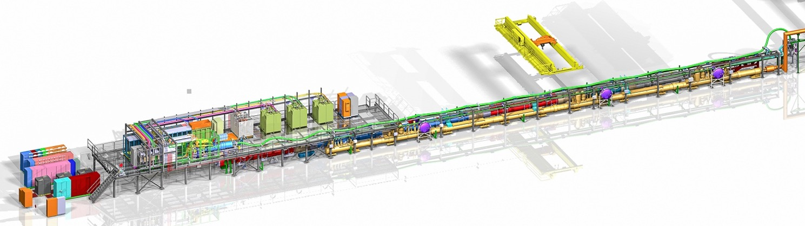
Scope of the talk
Introduction
Quality design
Quality assurance
Quality control
Non-conformities
Lessons learned
Conclusions

Slide 3
Introduction
Careful consideration of quality management driven by the diverse components, constraints and required stakeholders.
Three phases of quality management have been considered, defined by PMI.
the IT String follows the quality standards and processes established for the HL-LHC project within the quality plan.
Phase | Goal | Description
Quality design | Plan quality management | Understand the specific needs and requirements of the project. It involves the definition of processes, tools and performance metrics.
Quality assurance | Manage quality | Ensure that the project meets the defined quality standards and requirements. It involves regular reviews, and continuous improvement.
Quality control | Monitor, record and control quality | Validation of the system to ensure a qualified output. It involves testing and corrective actions.

Slide 4
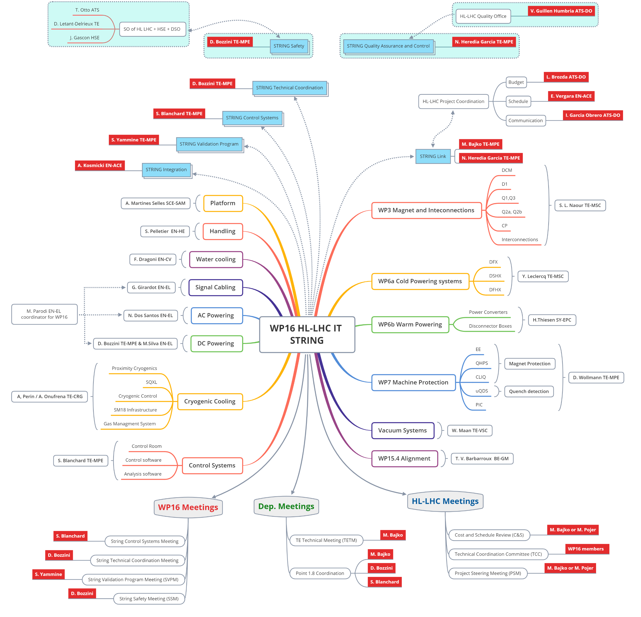
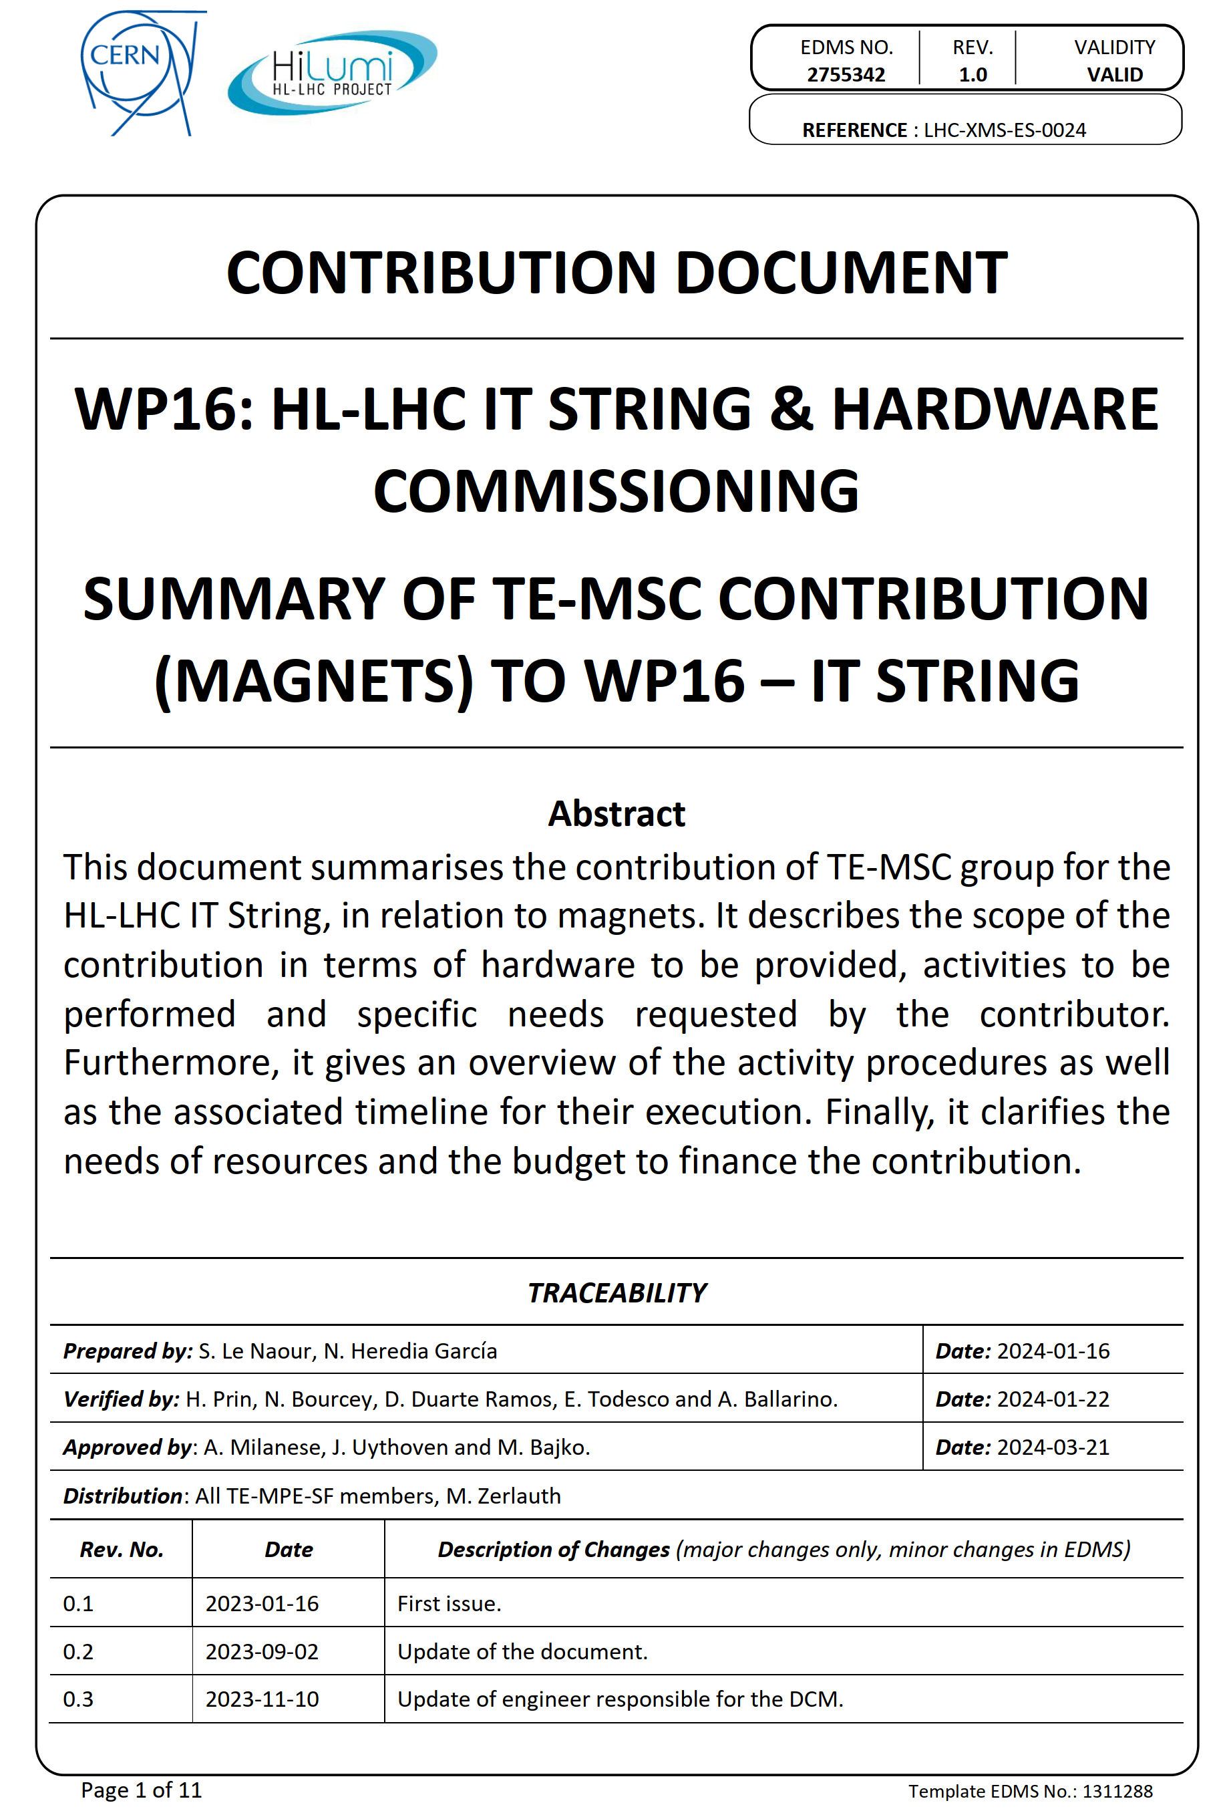
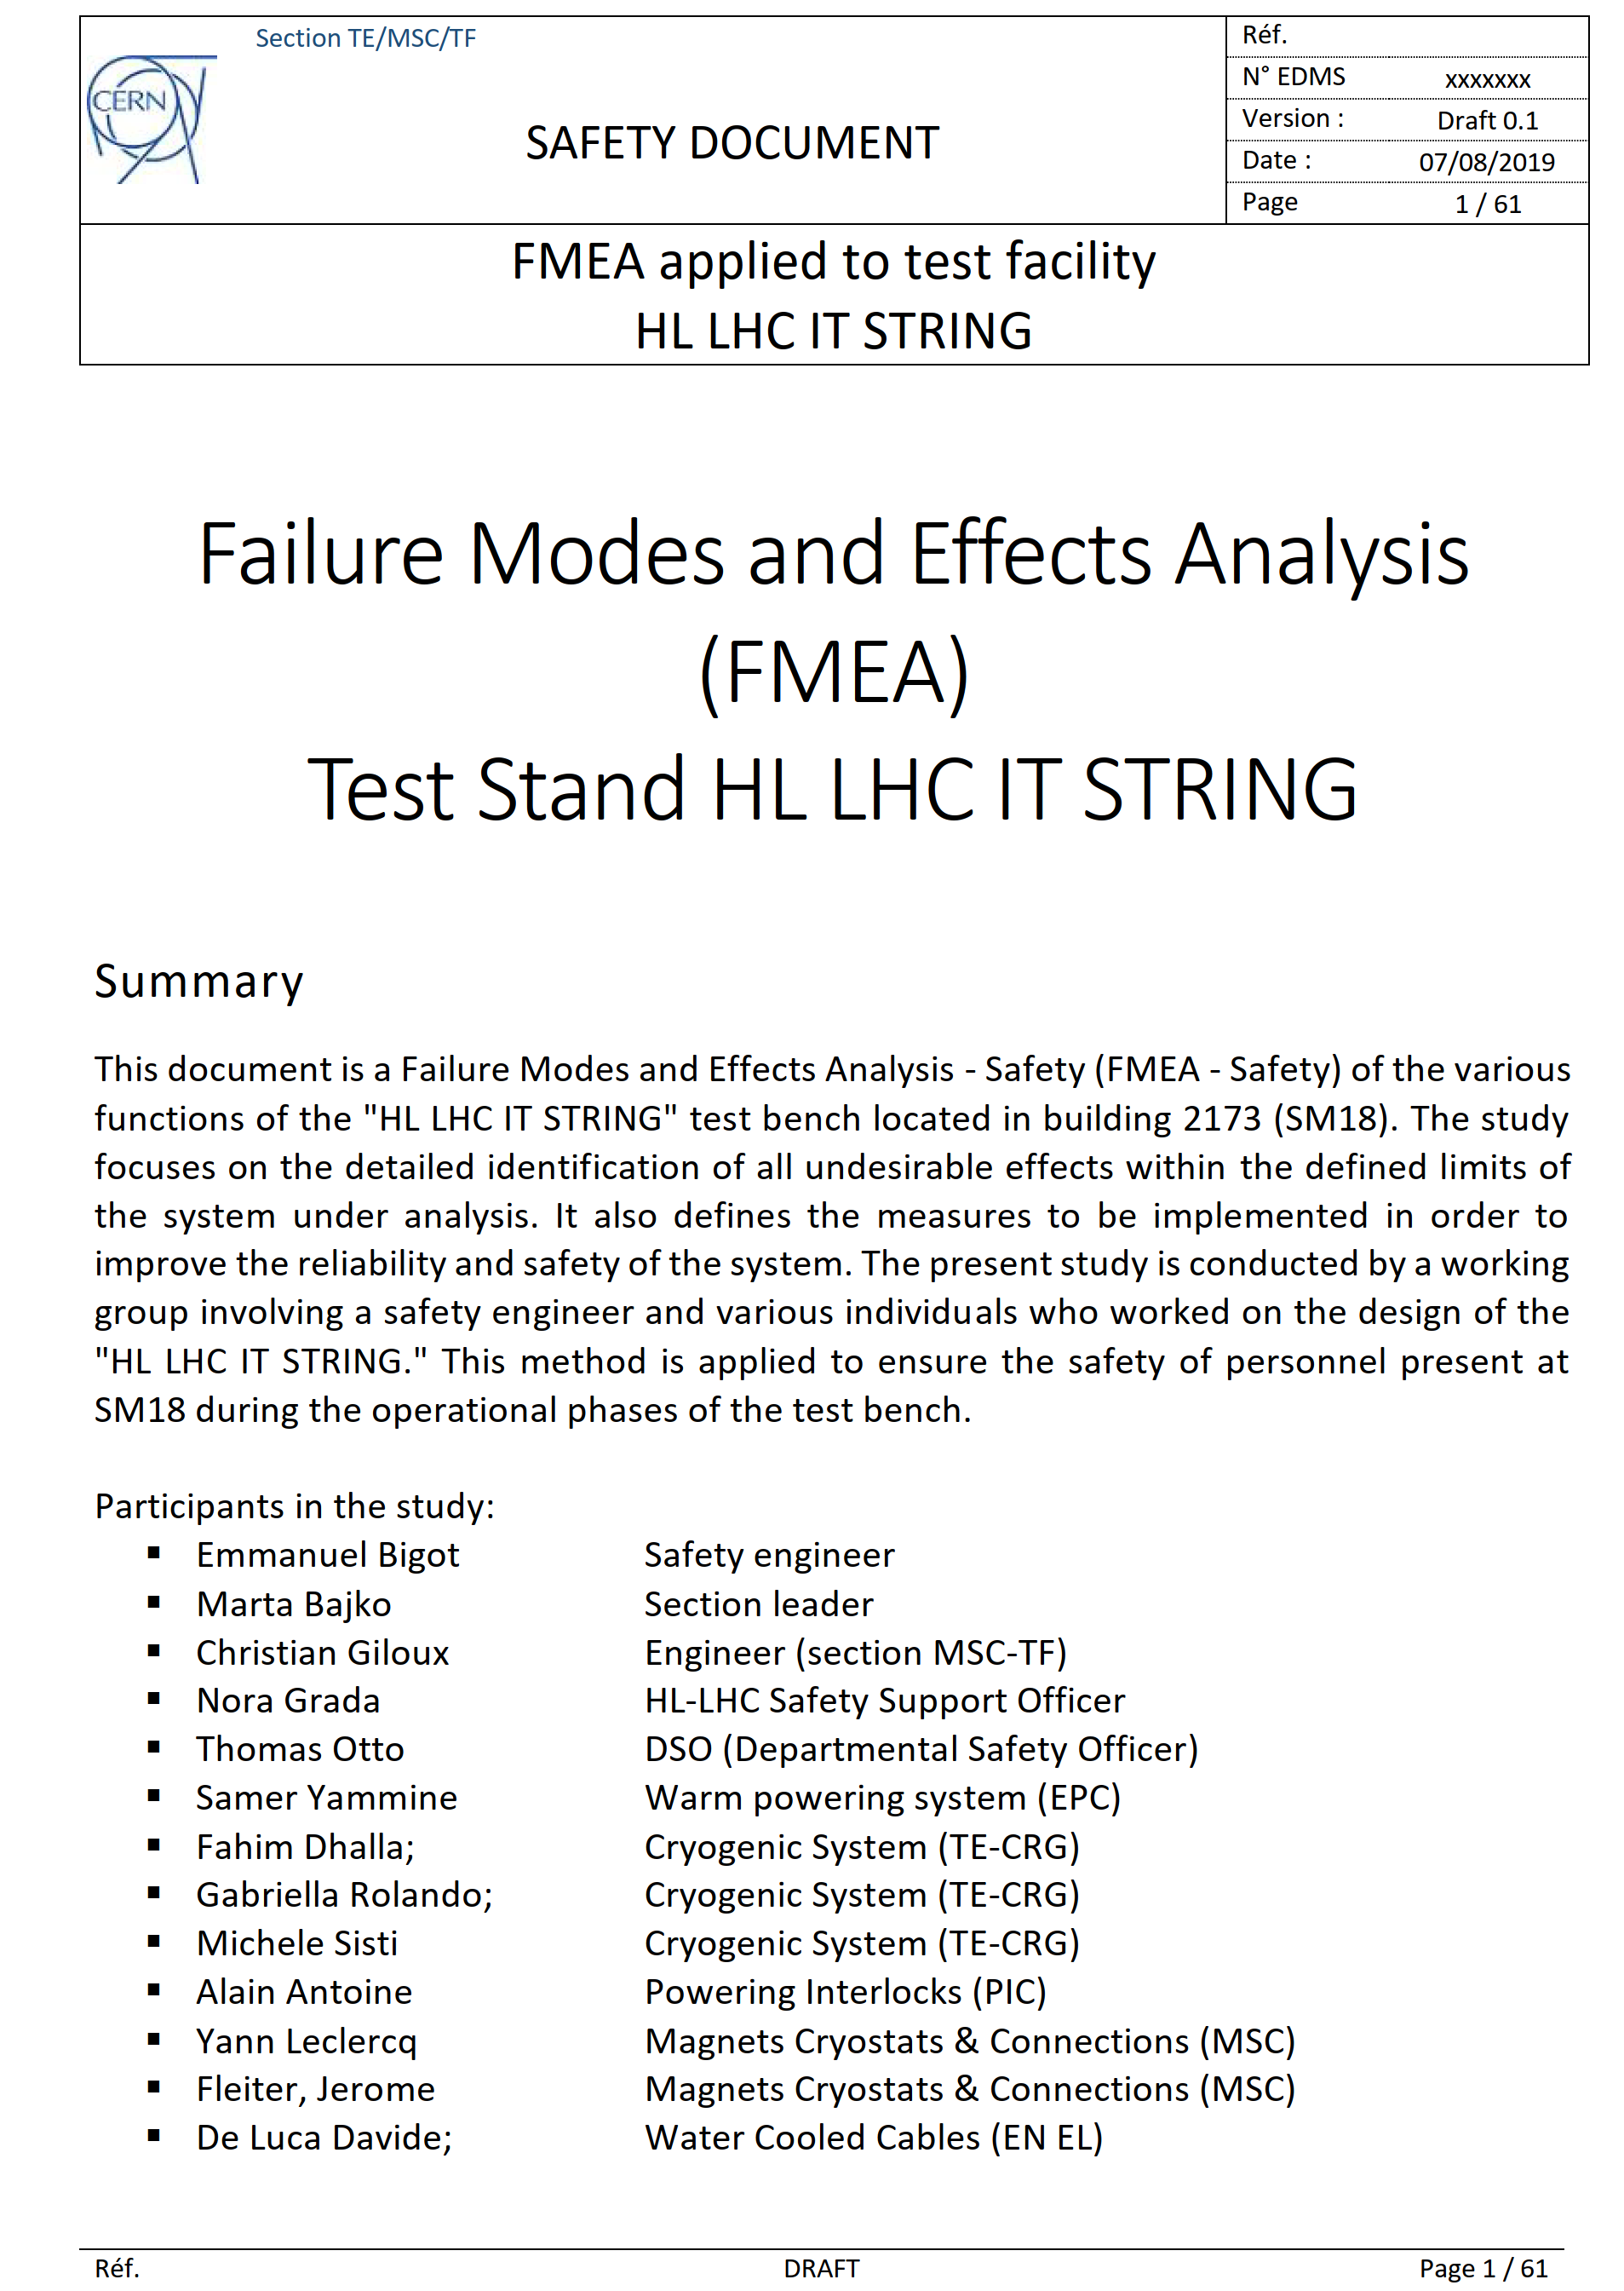
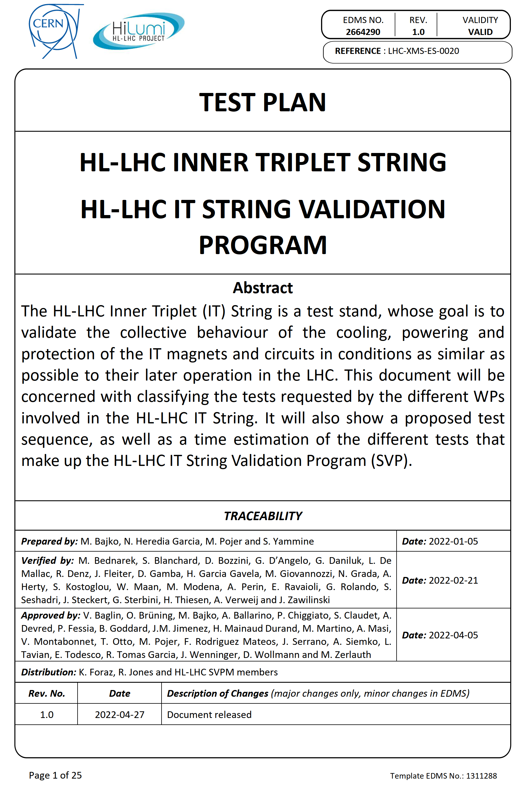
Quality design: Requirements & Expectations
Project organization chart
Scope baseline
Equipment delivery
Activities
Equipment recovery
Cost and resources
Tooling for installation
Infrastructure requests
Safety analysis
Test plan

Slide 5
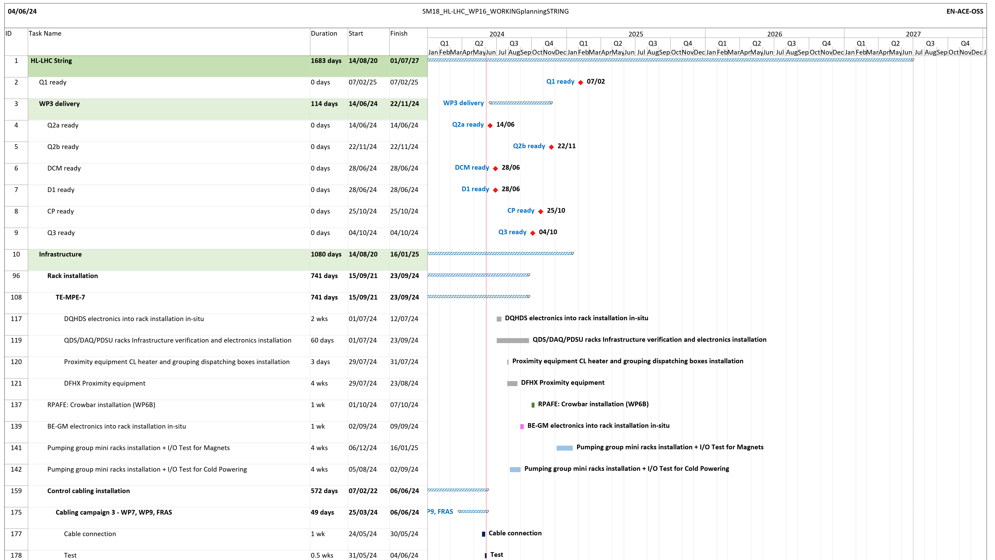
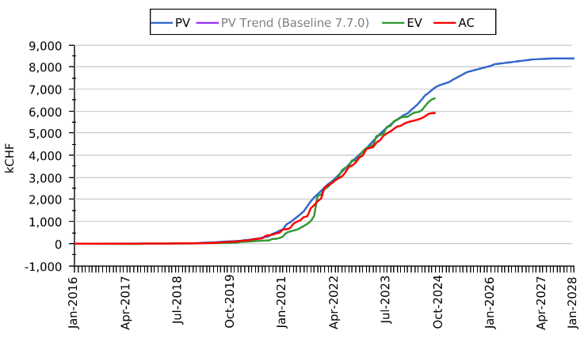
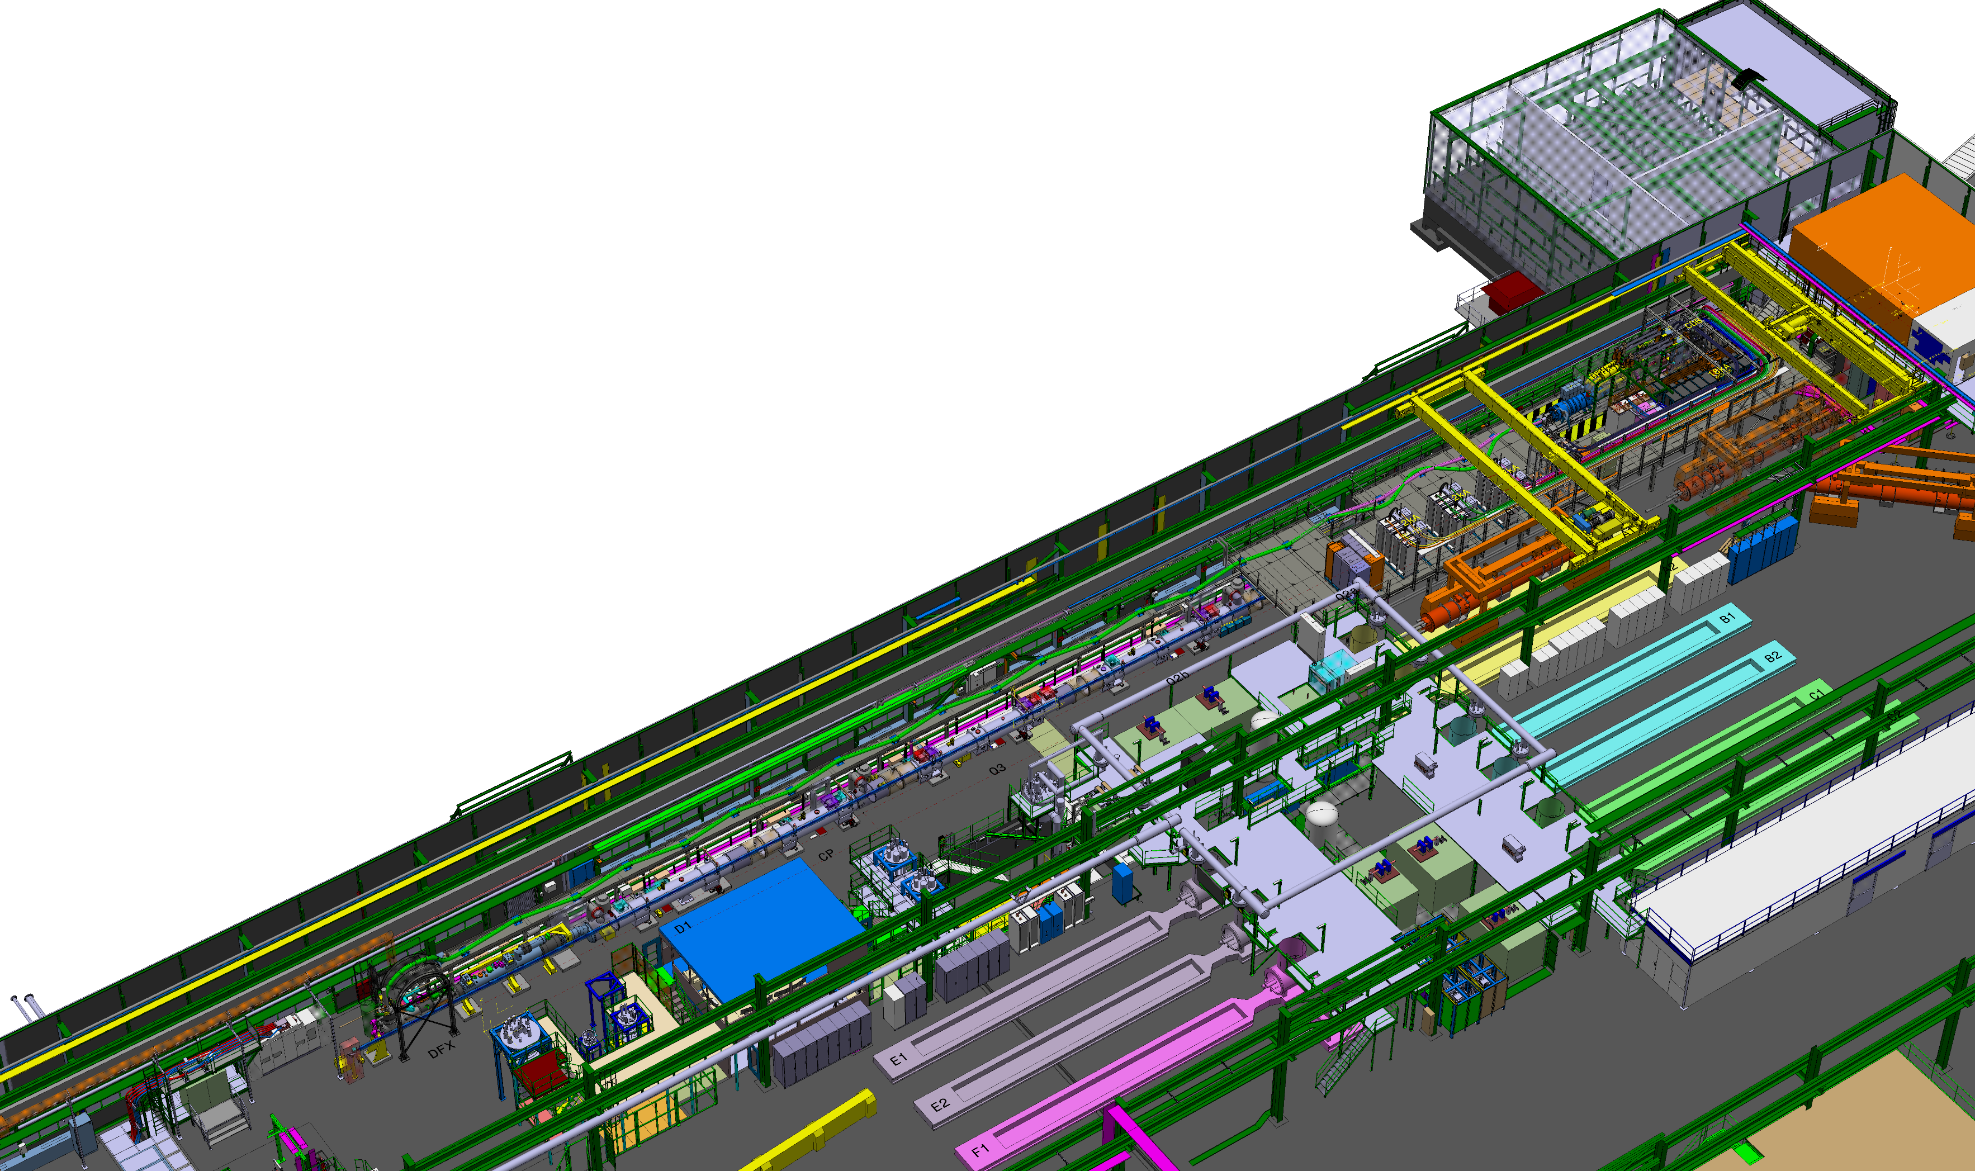
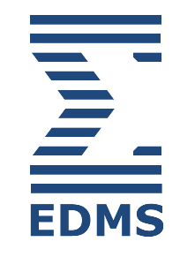



Quality design: Tools
Project planning
Cost tracking
Integration model
Other tools

Slide 6

Quality Assurance: Process
String Technical Coordination Meeting
String Validation Program Meeting
String Controls Meeting
String Quality Meeting
String Day
Project Steering Meeting
Technical Coordination Committee
Cost & Schedule Review
HL-LHC Annual Meeting
The tools developed during the quality design phase have been continually updated.
Project org. chart
Test plan
Planning
EVM
Contribution documents
Safety analysis
Integration model
SharePoint…
The IT String coordination team has organized/participated in multiple meetings to present project updates, discuss next steps, address non-conformities, provide lessons learned…

Slide 7
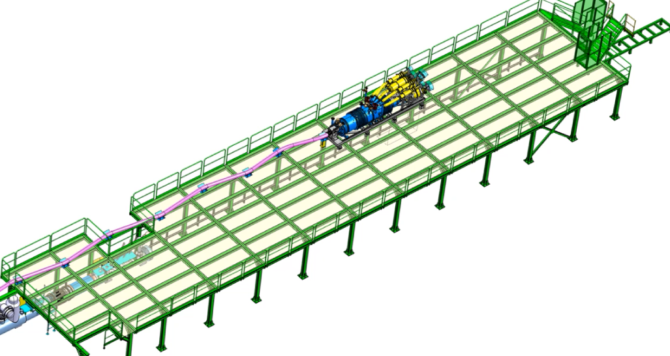
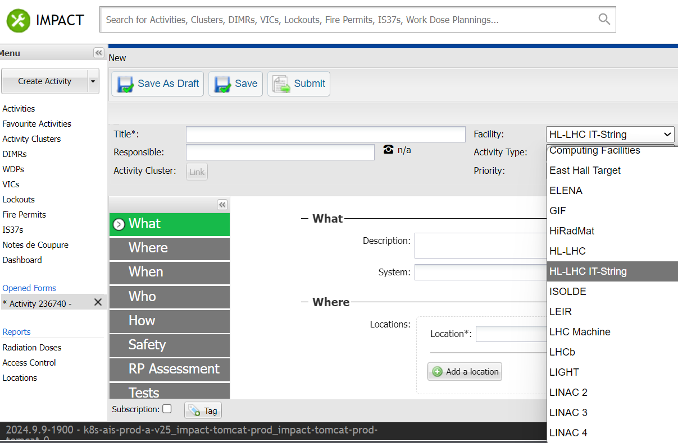
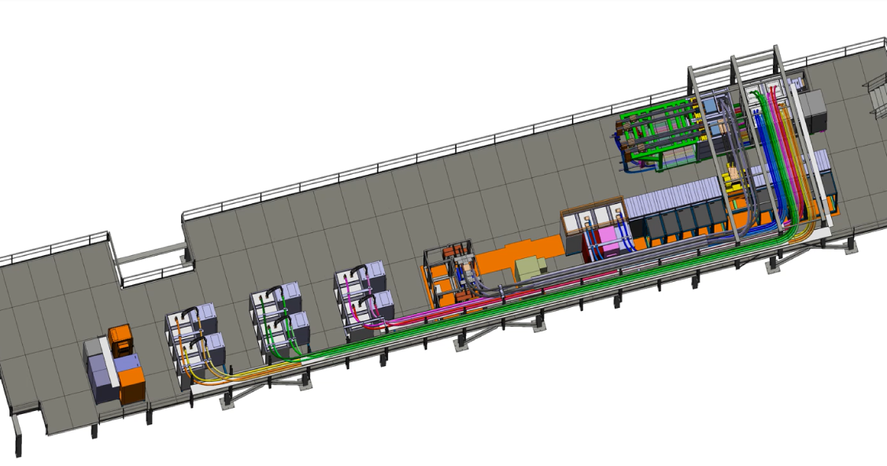
Quality Assurance: Examples
To enhance project execution, various changes, measures, and tools have been implemented, reflecting engagement to continuous improvement:
Installation sequence
Coordination
Access
More info in “HL-LHC IT String Technical Coordination & Safety” by D. Bozzini

Slide 8
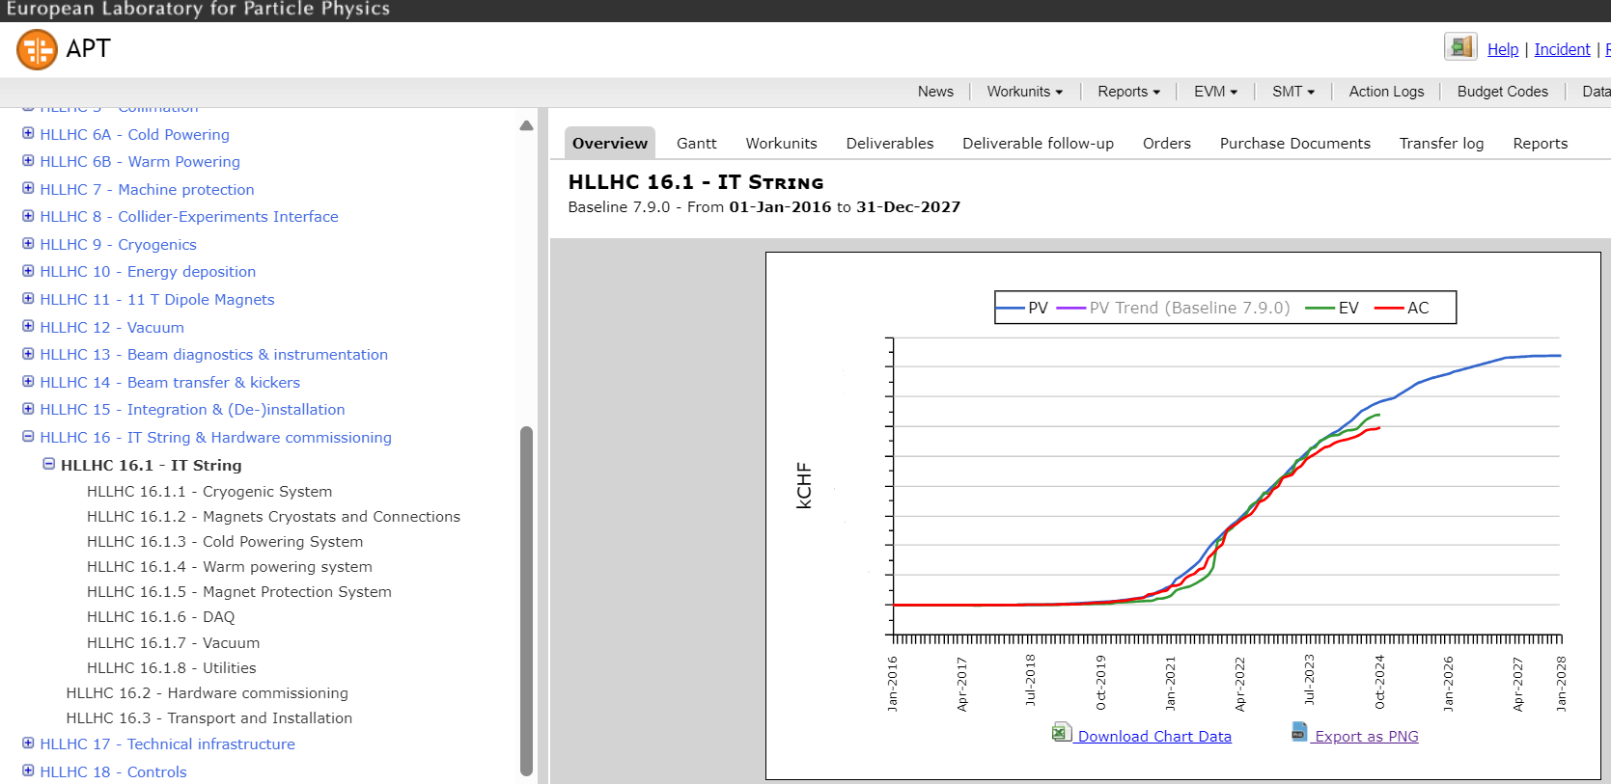
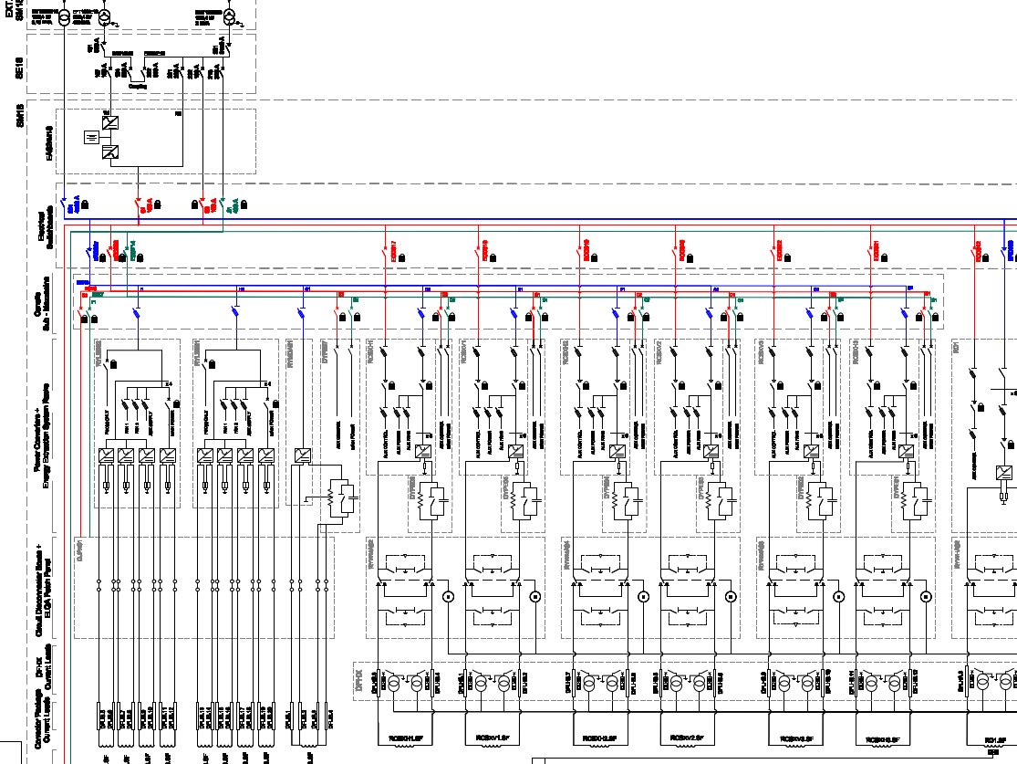
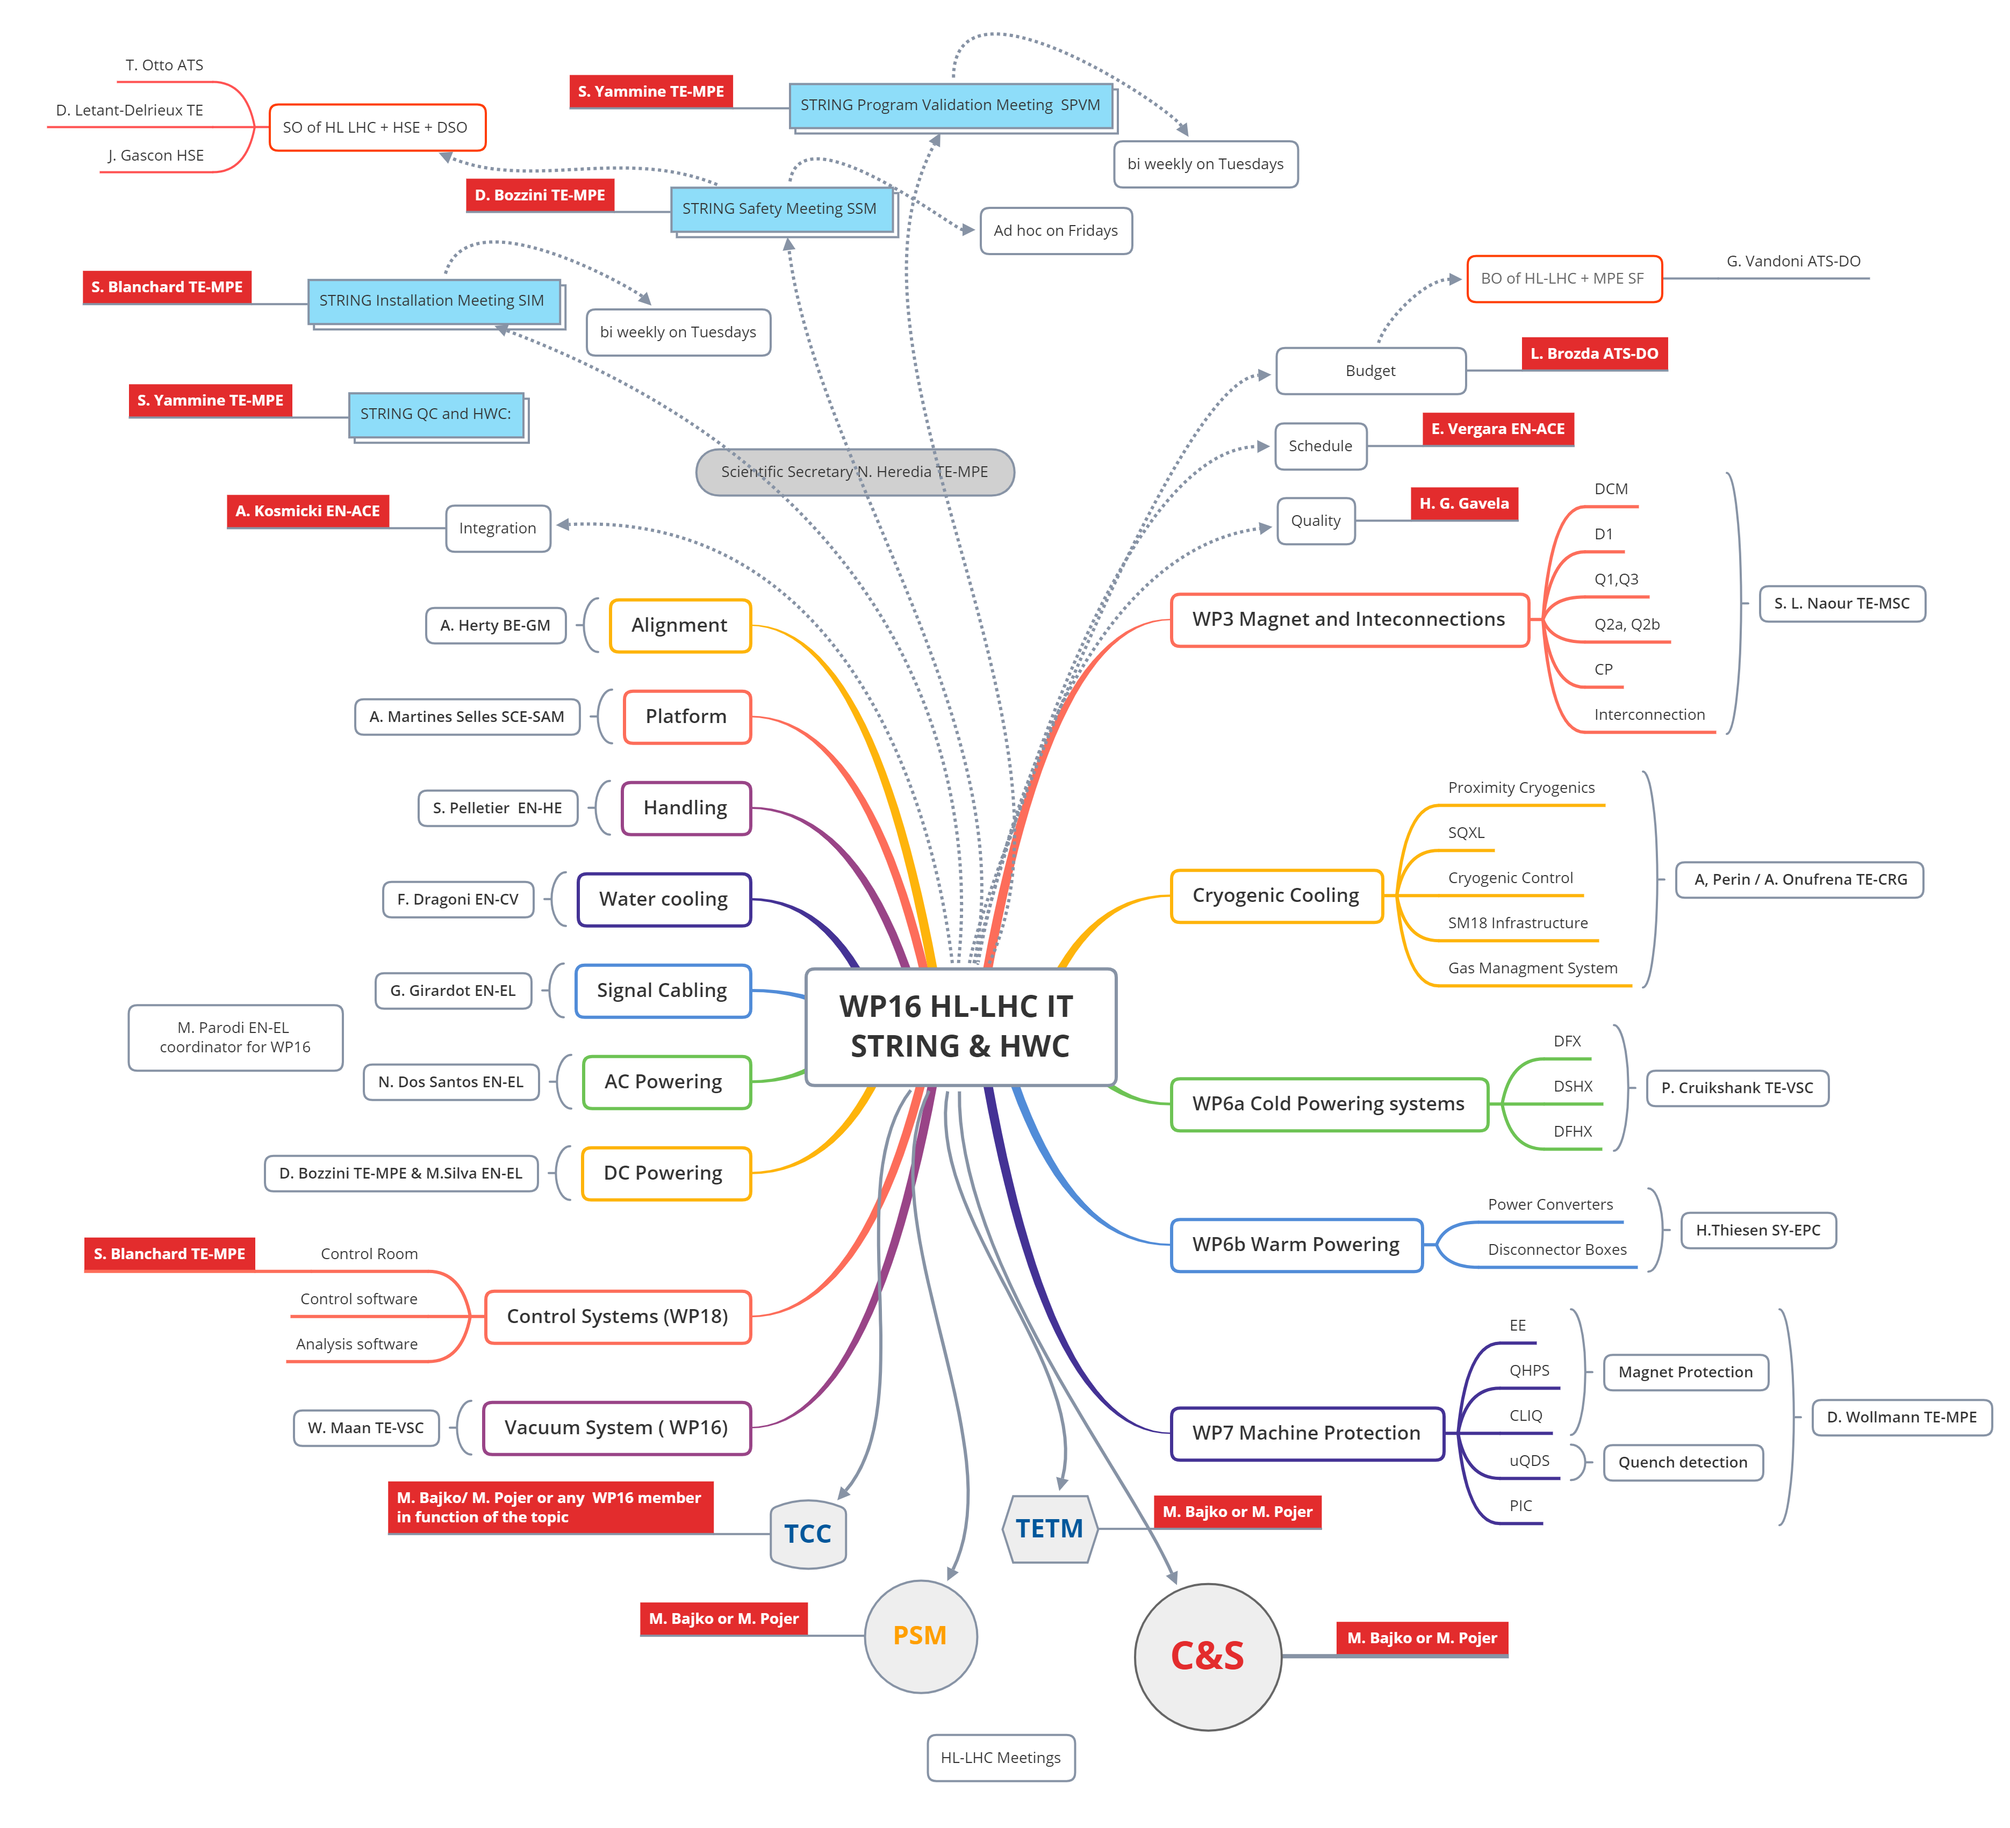
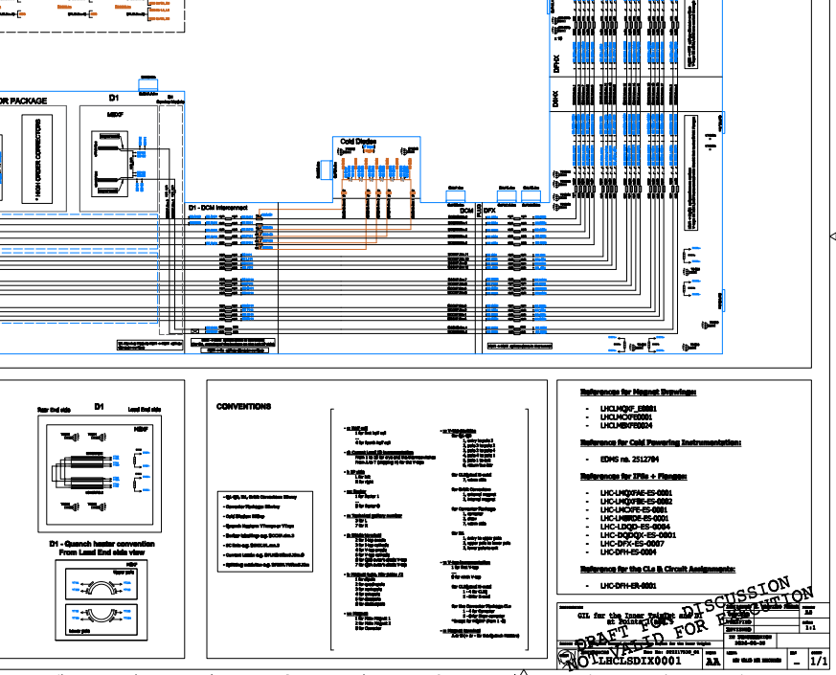
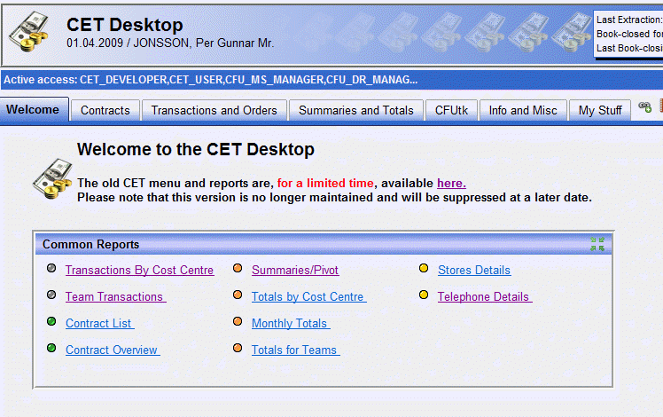
Quality Assurance: Examples
To enhance project execution, various changes, measures, and tools have been implemented, reflecting engagement to continuous improvement:
Roles and responsibilities
Cost monitoring
Operational drawings

Slide 9
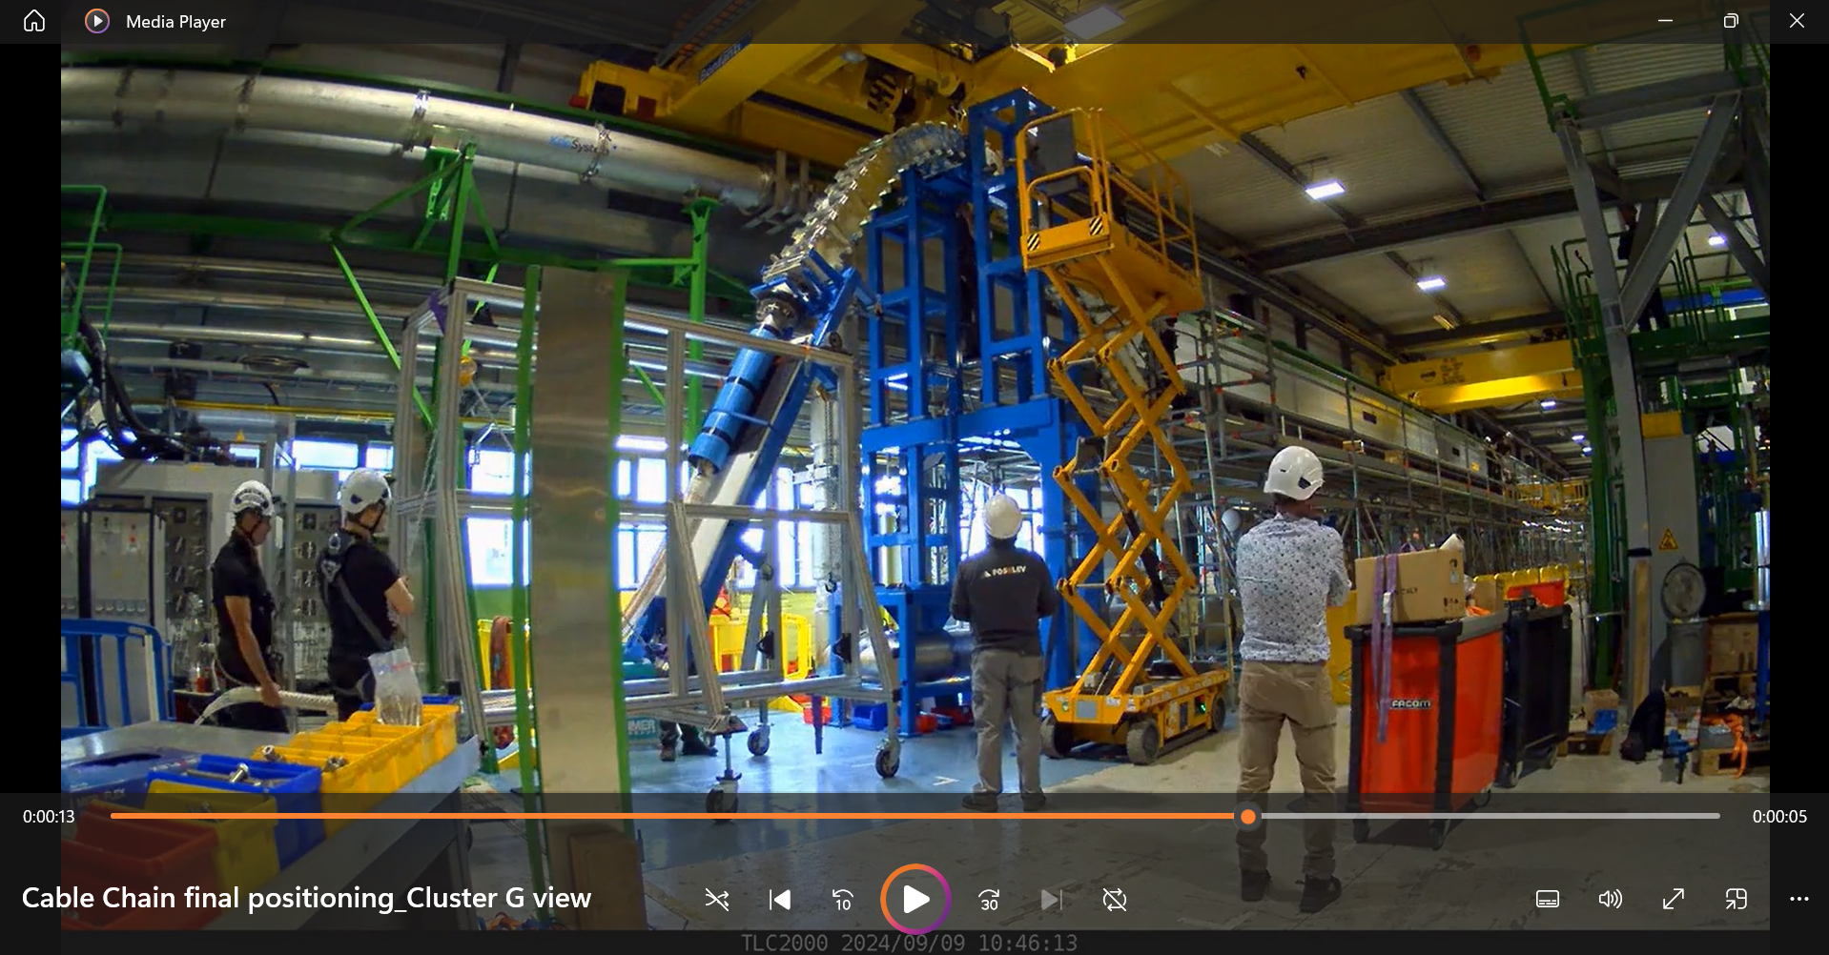
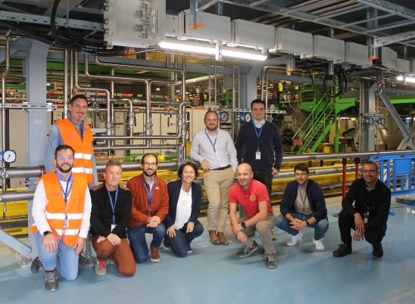
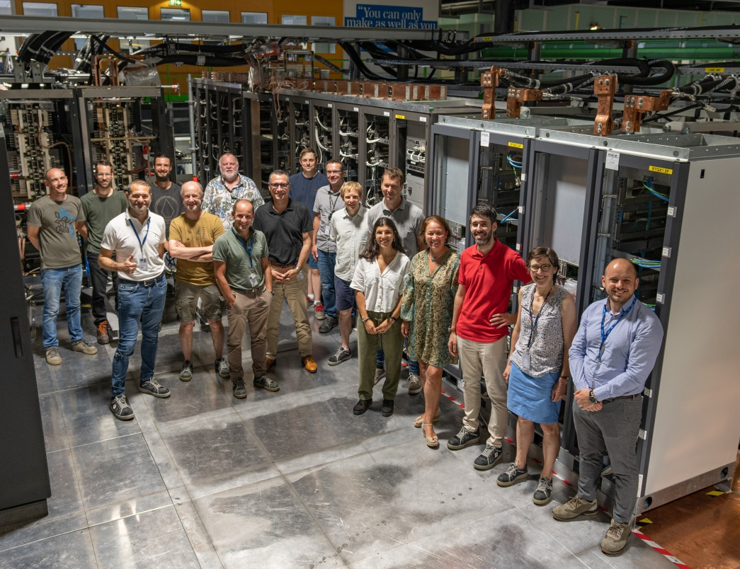
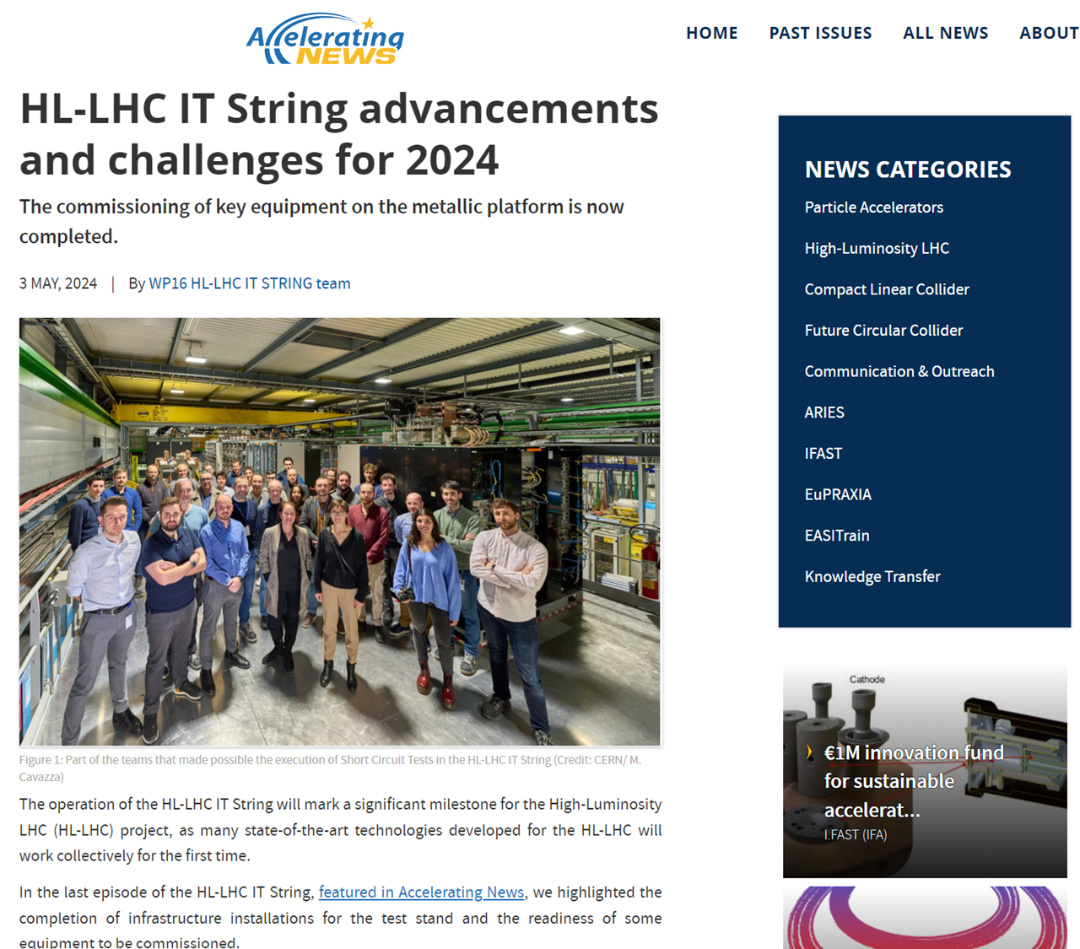
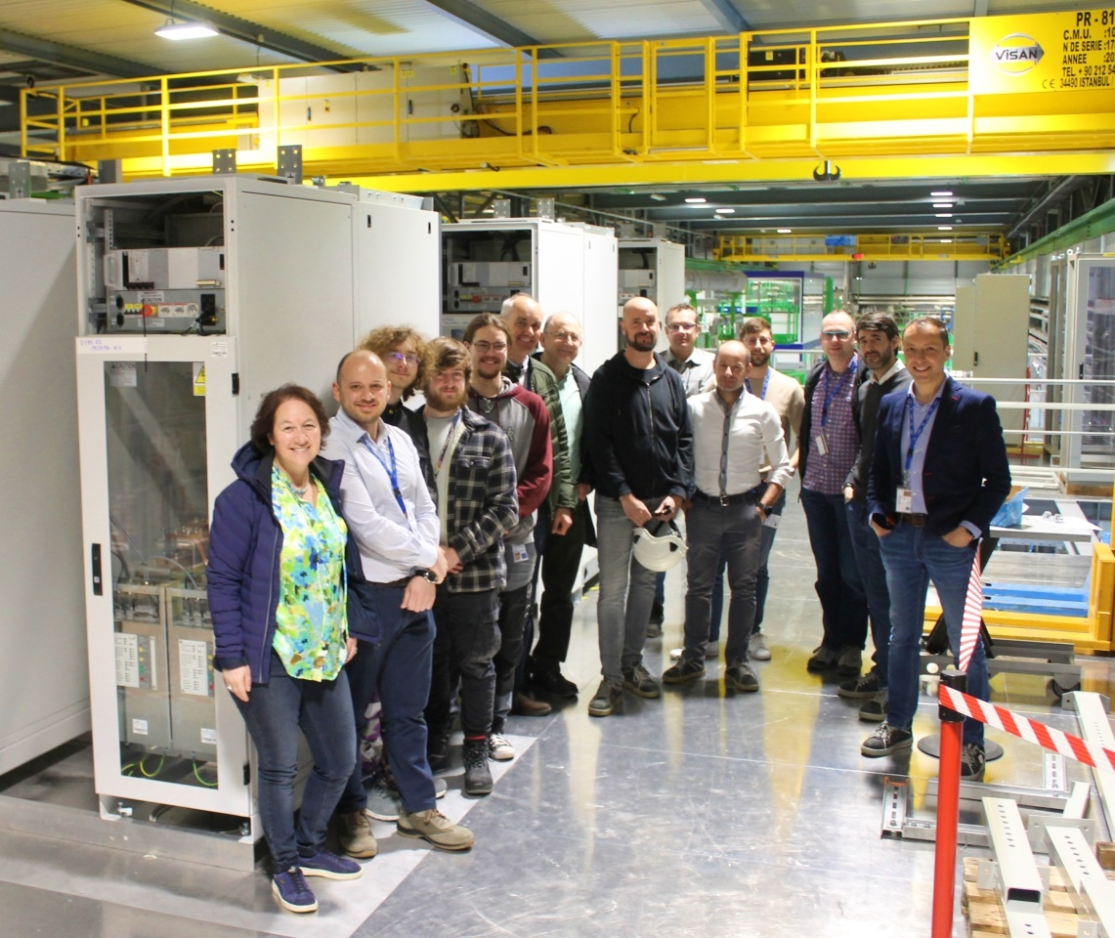
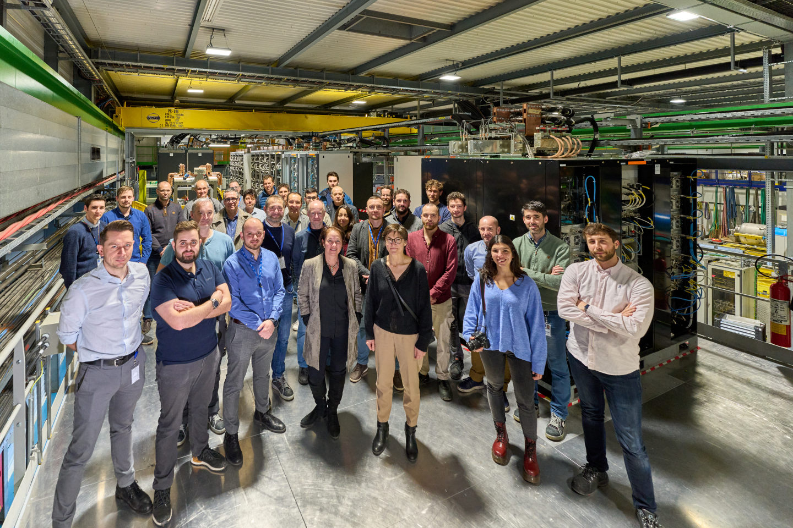
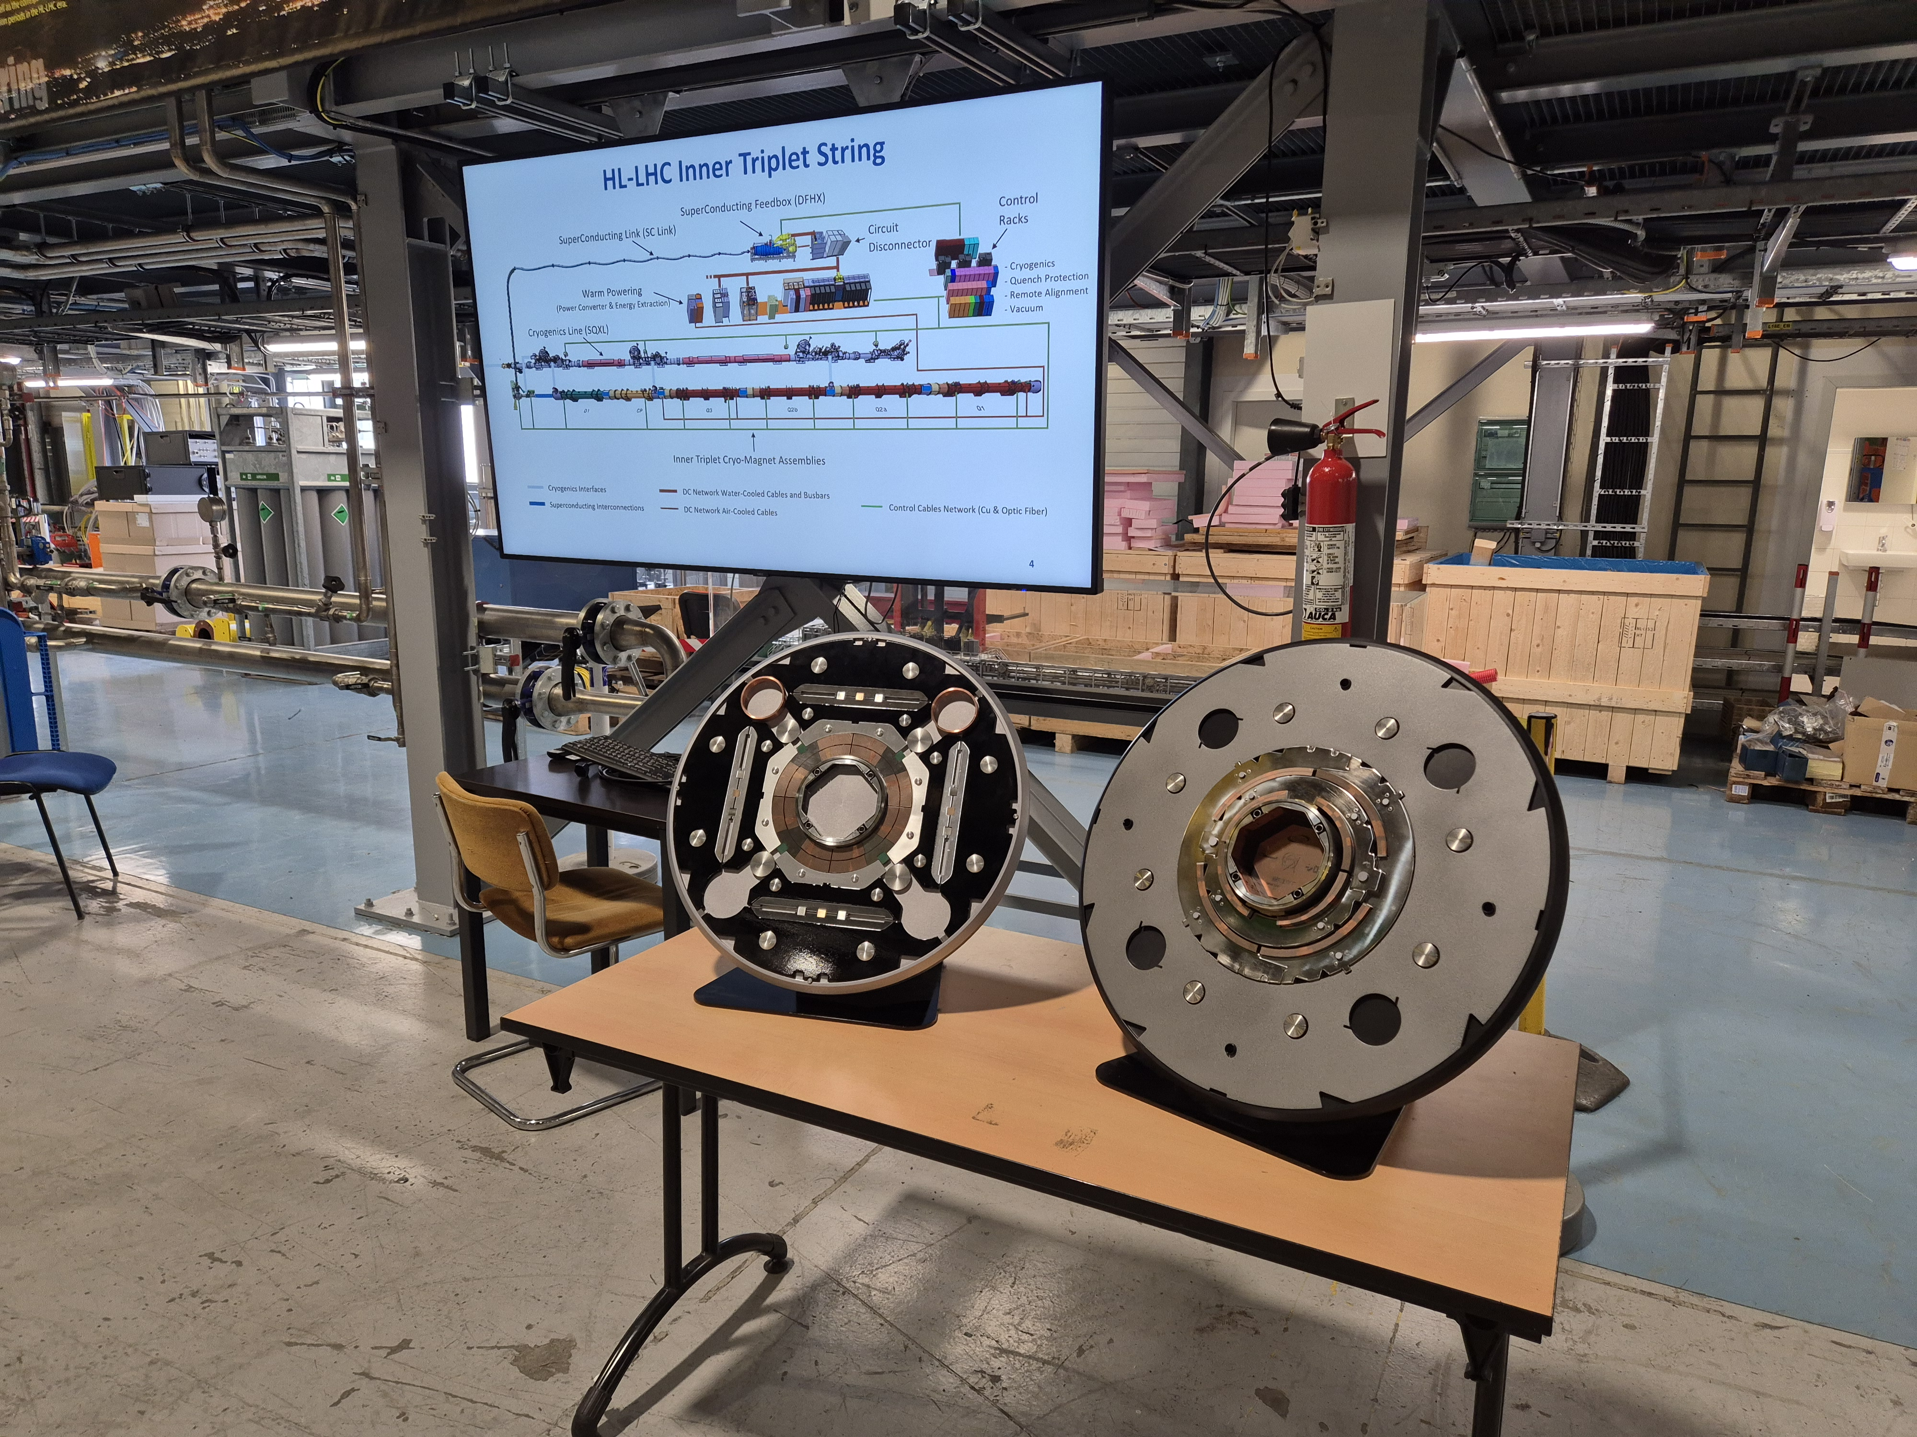
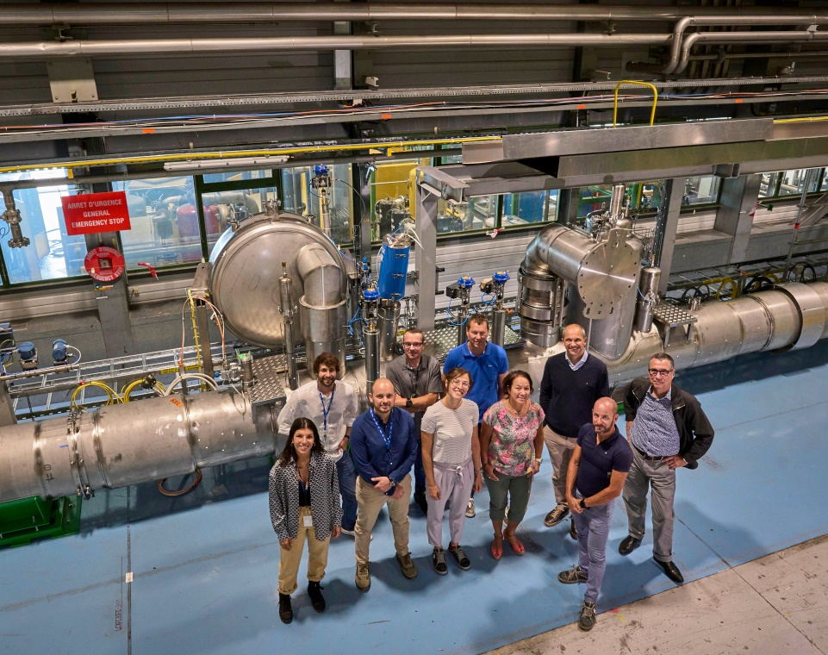
Quality Assurance: Examples
To enhance project execution, various changes, measures, and tools have been implemented, reflecting engagement to continuous improvement:
Communication strategy

Slide 10
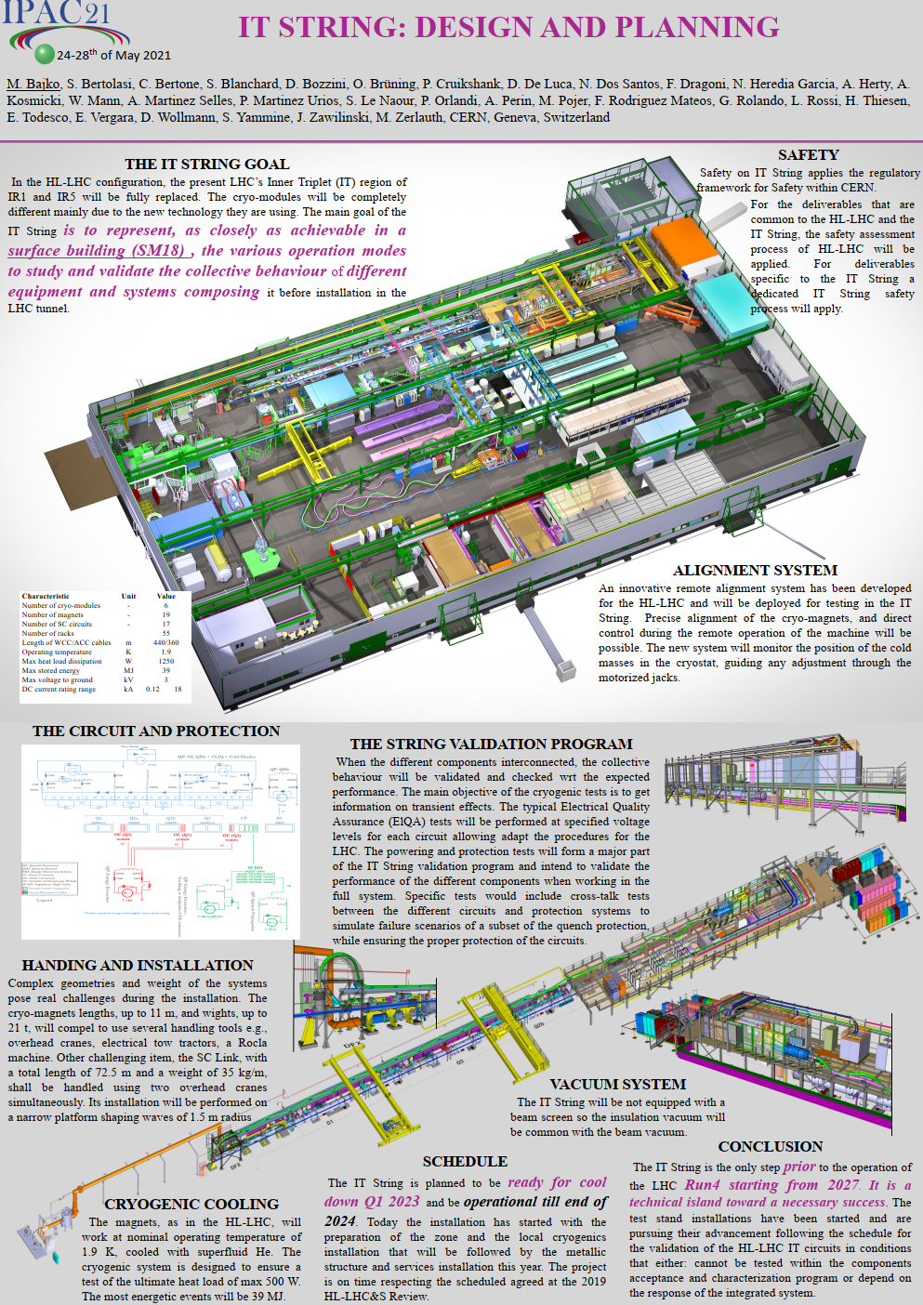
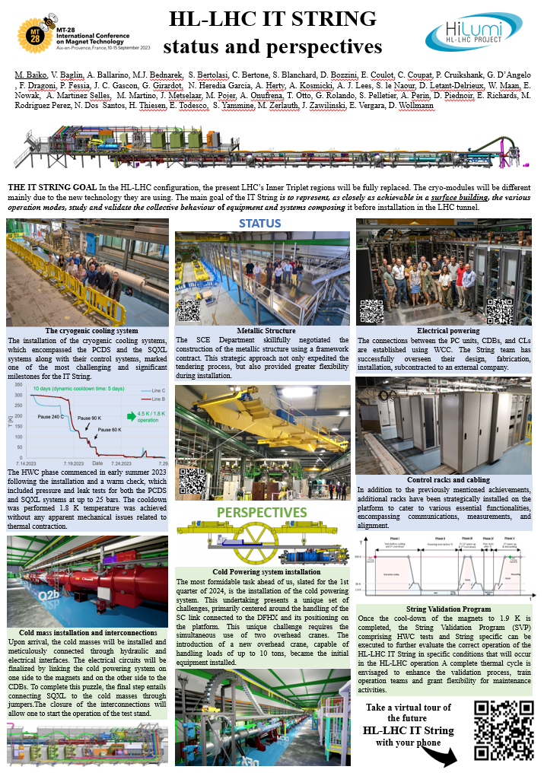
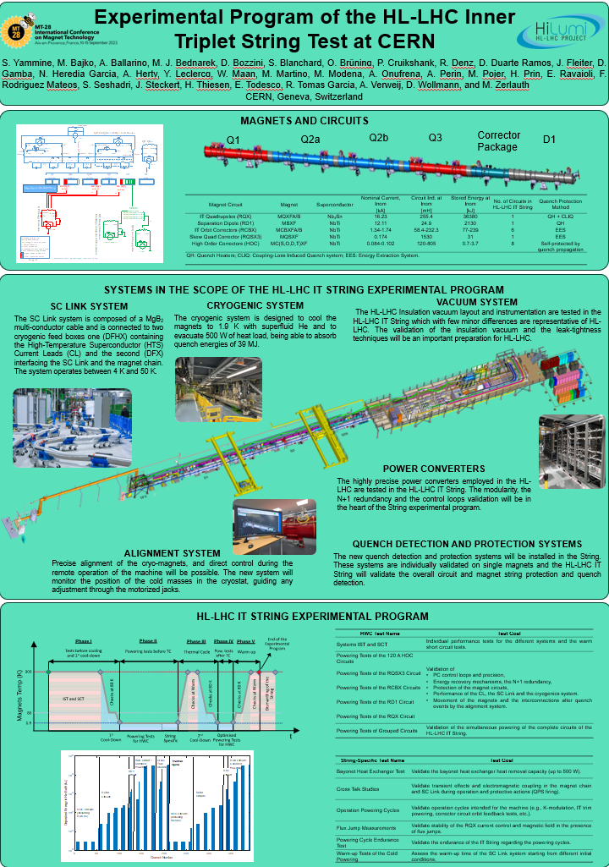
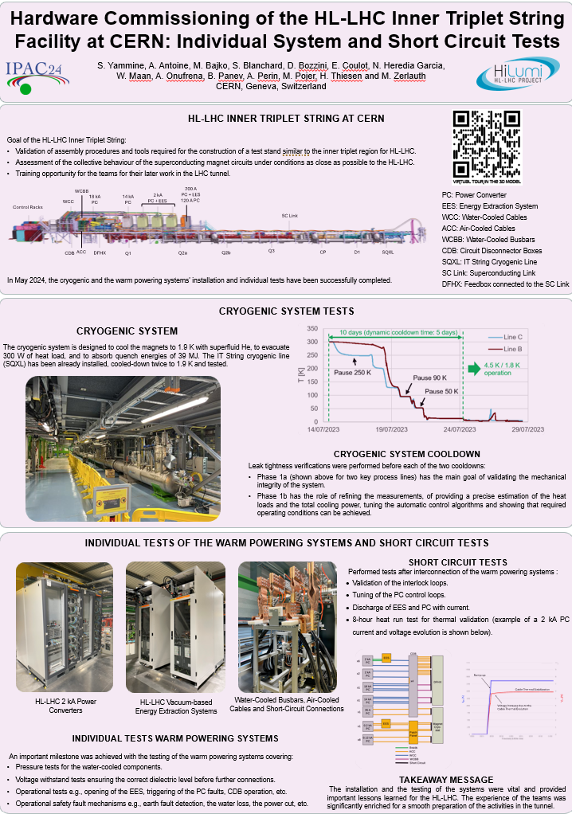
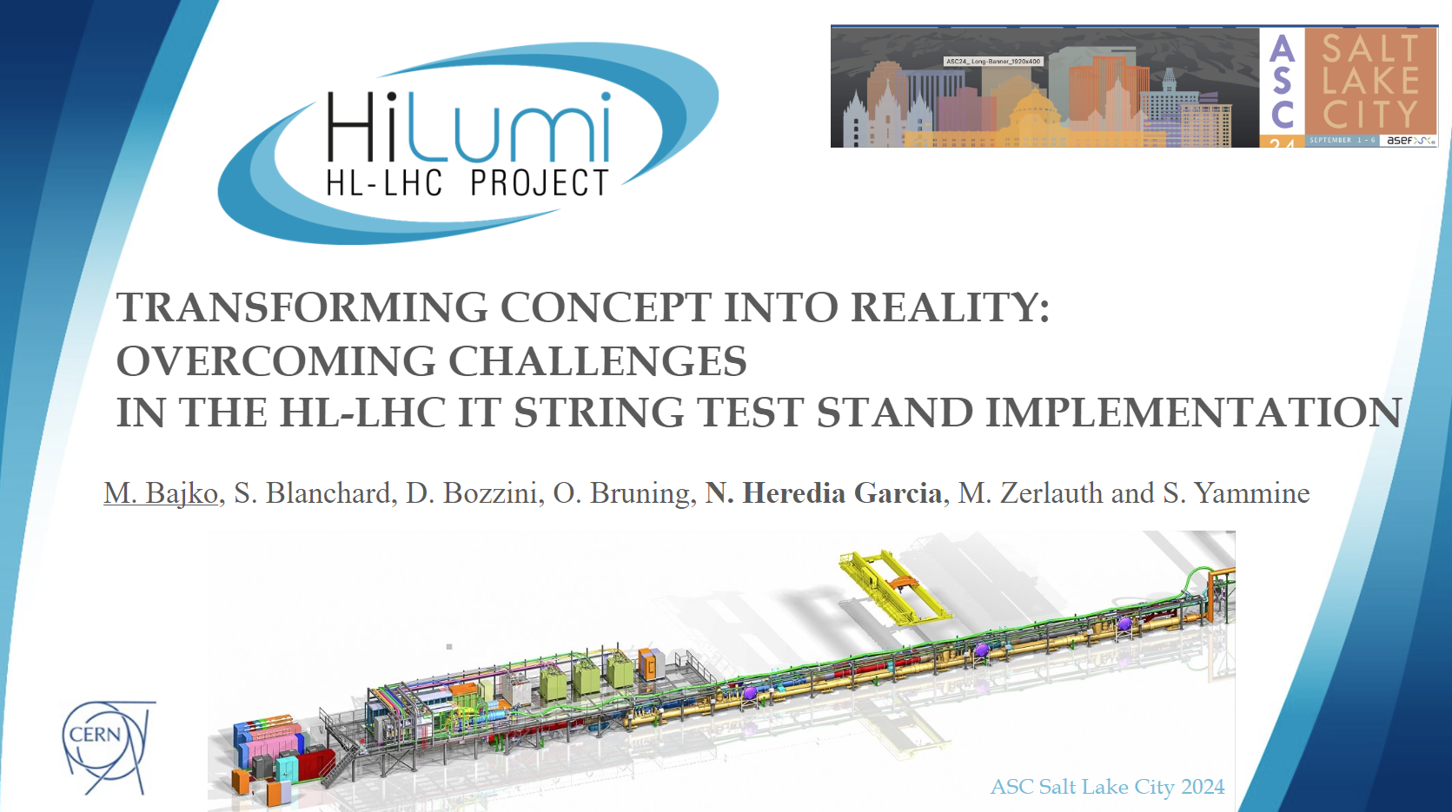
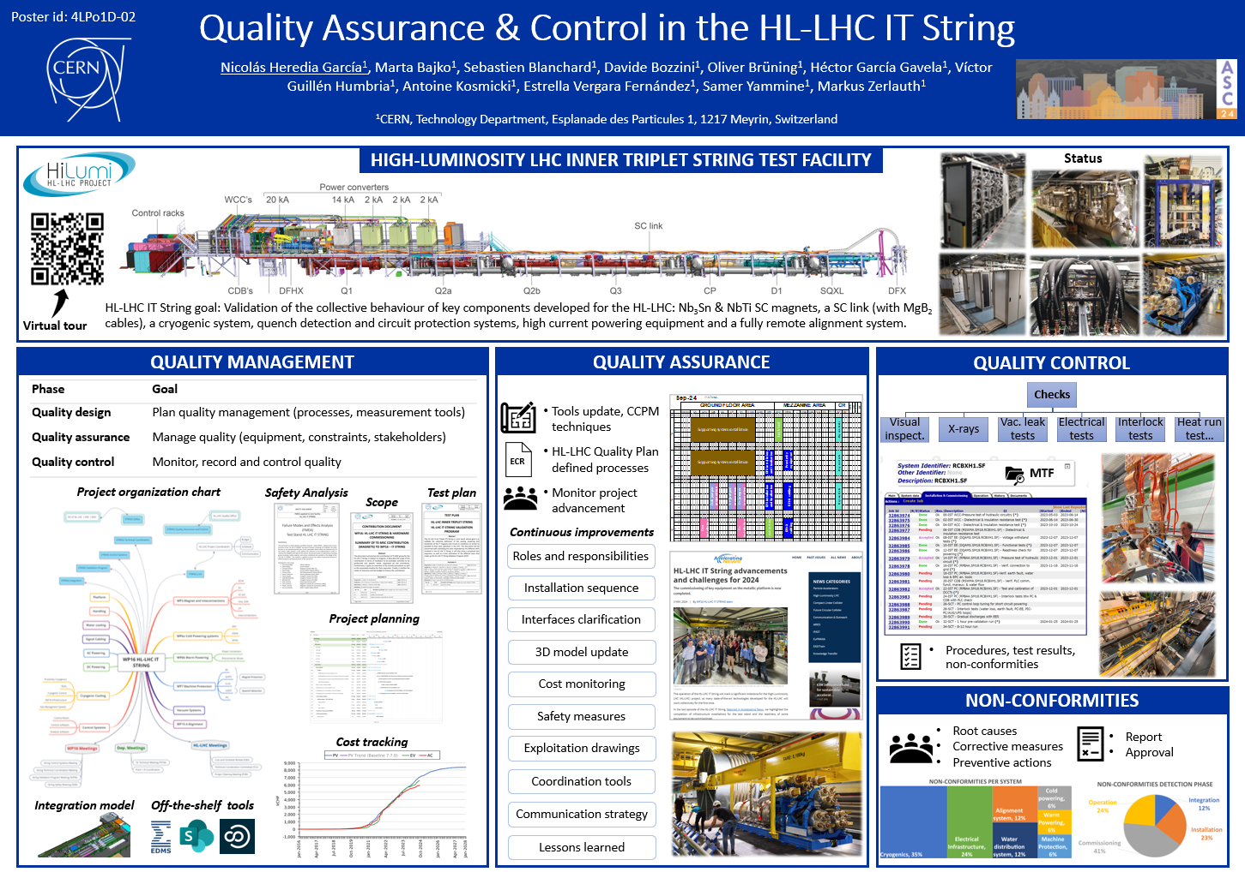
Quality Assurance: Examples
To enhance project execution, various changes, measures, and tools have been implemented, reflecting engagement to continuous improvement:
Communication strategy
IPAC 21
MT 28 (2023)
IPAC 24
ASC 24

Slide 11
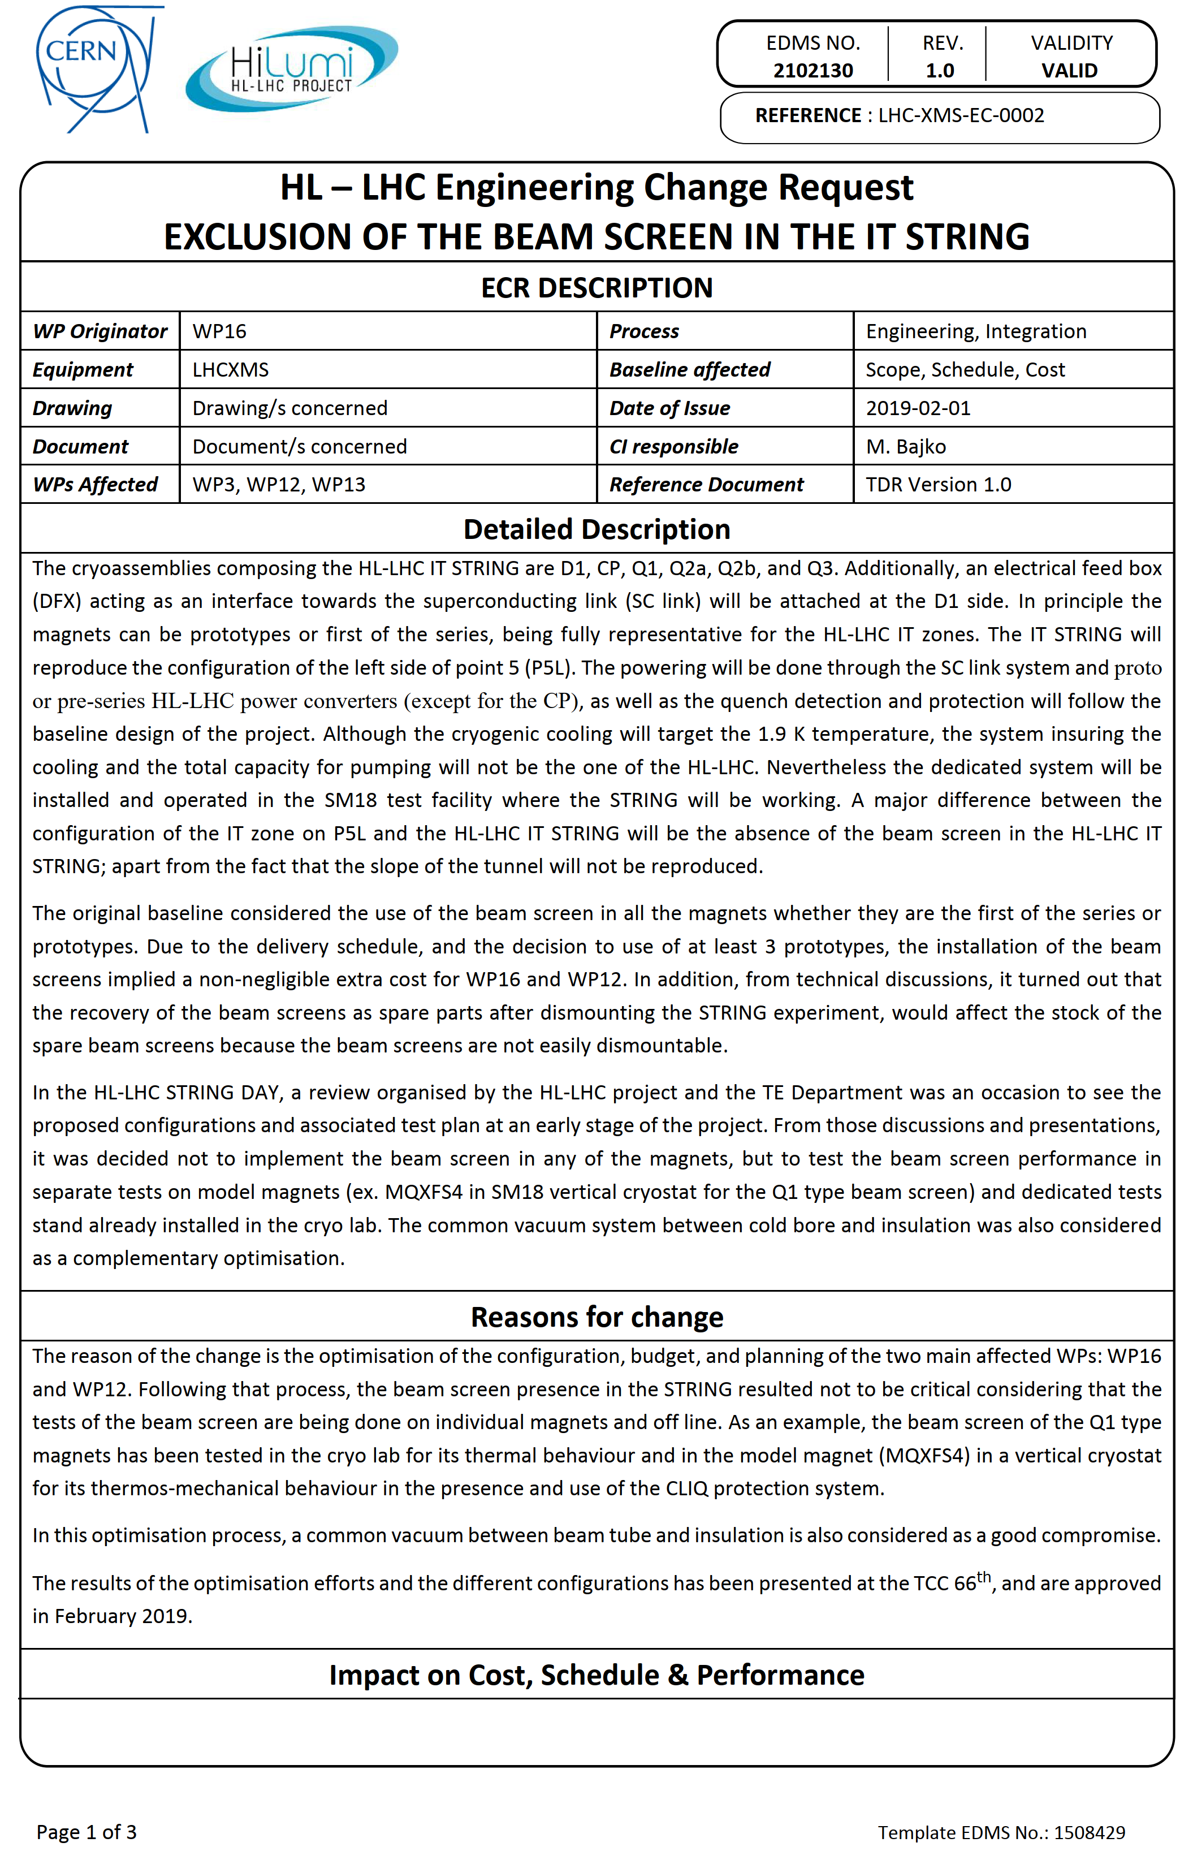
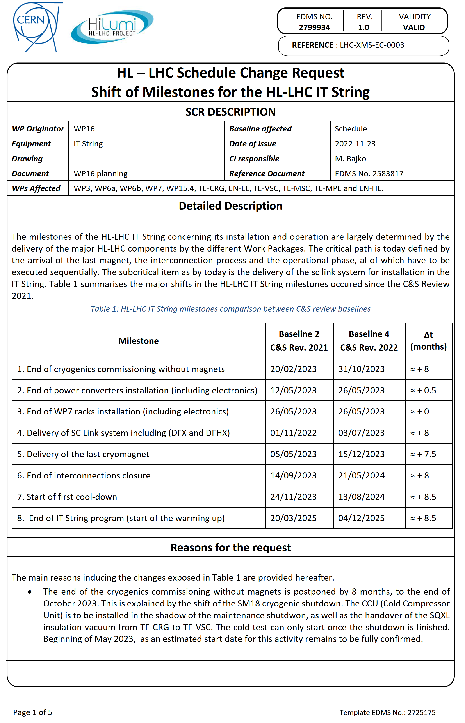
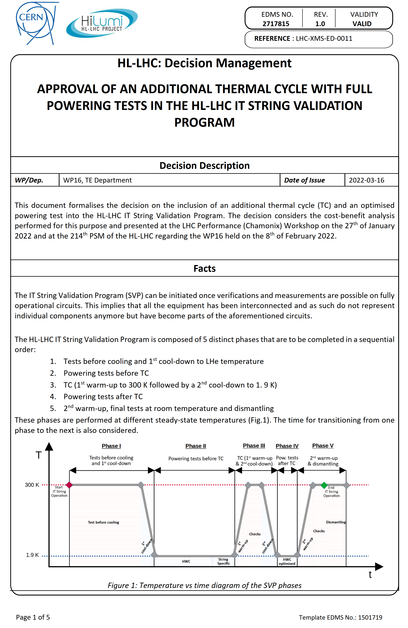
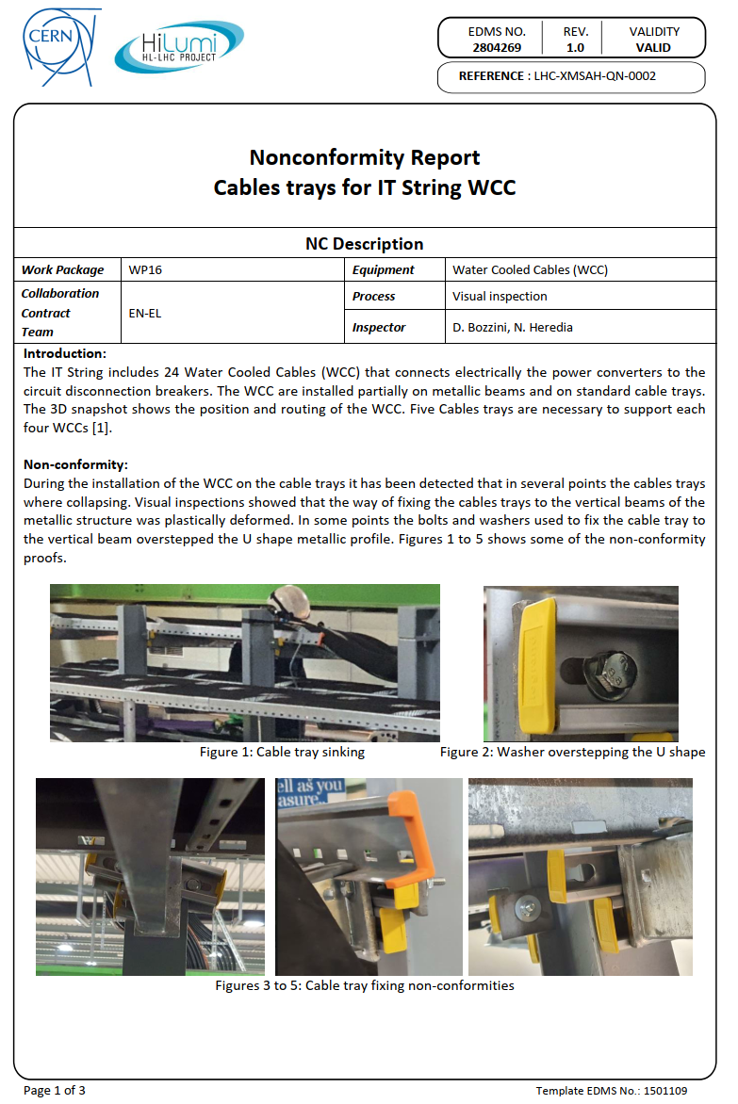
Quality Assurance: HL-LHC
The IT String has adhered to HL-LHC processes for requesting and documenting deviations and/or changes with regards to the baseline scenario during project execution, including:
ECR
SCR
DMR
NCR
Ex: EDMS 2102130
Ex: EDMS 2799934
Ex: EDMS 2717815
Ex: EDMS 3025021

Slide 12
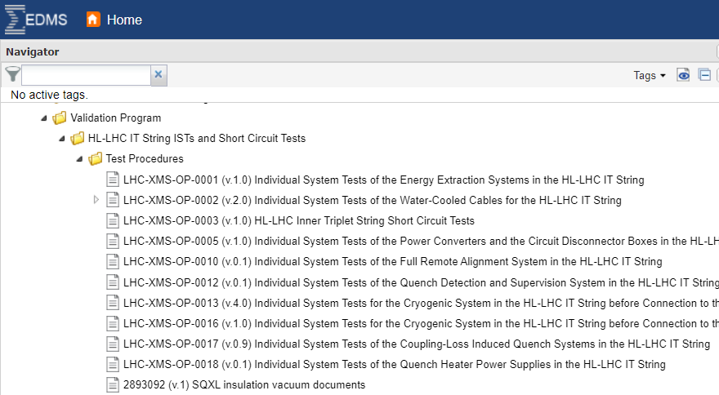
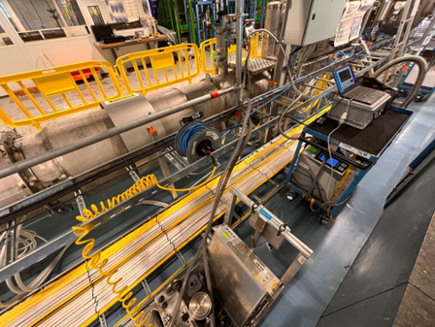
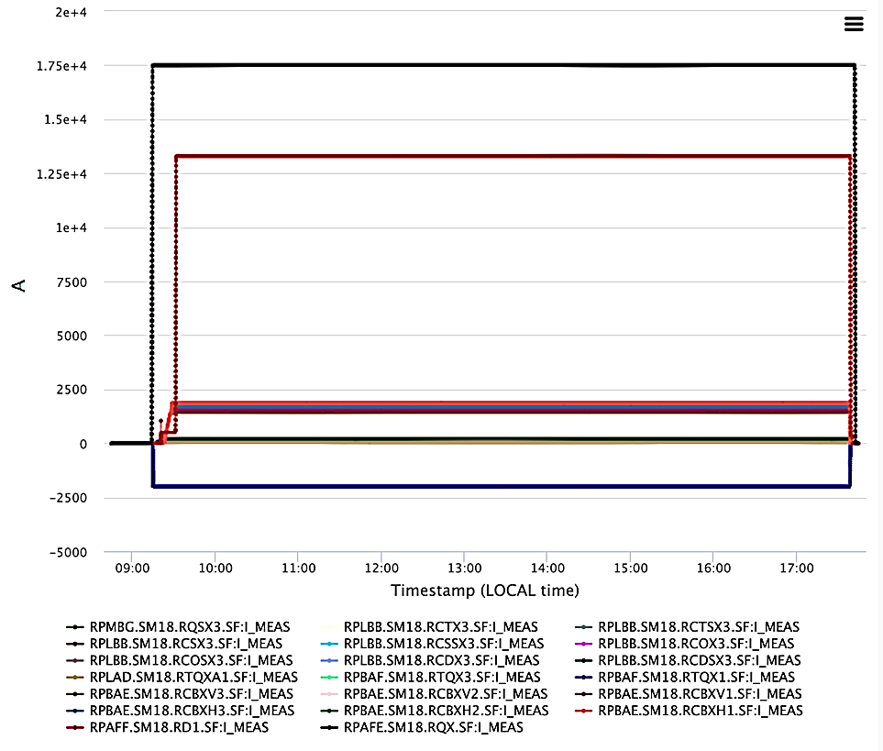
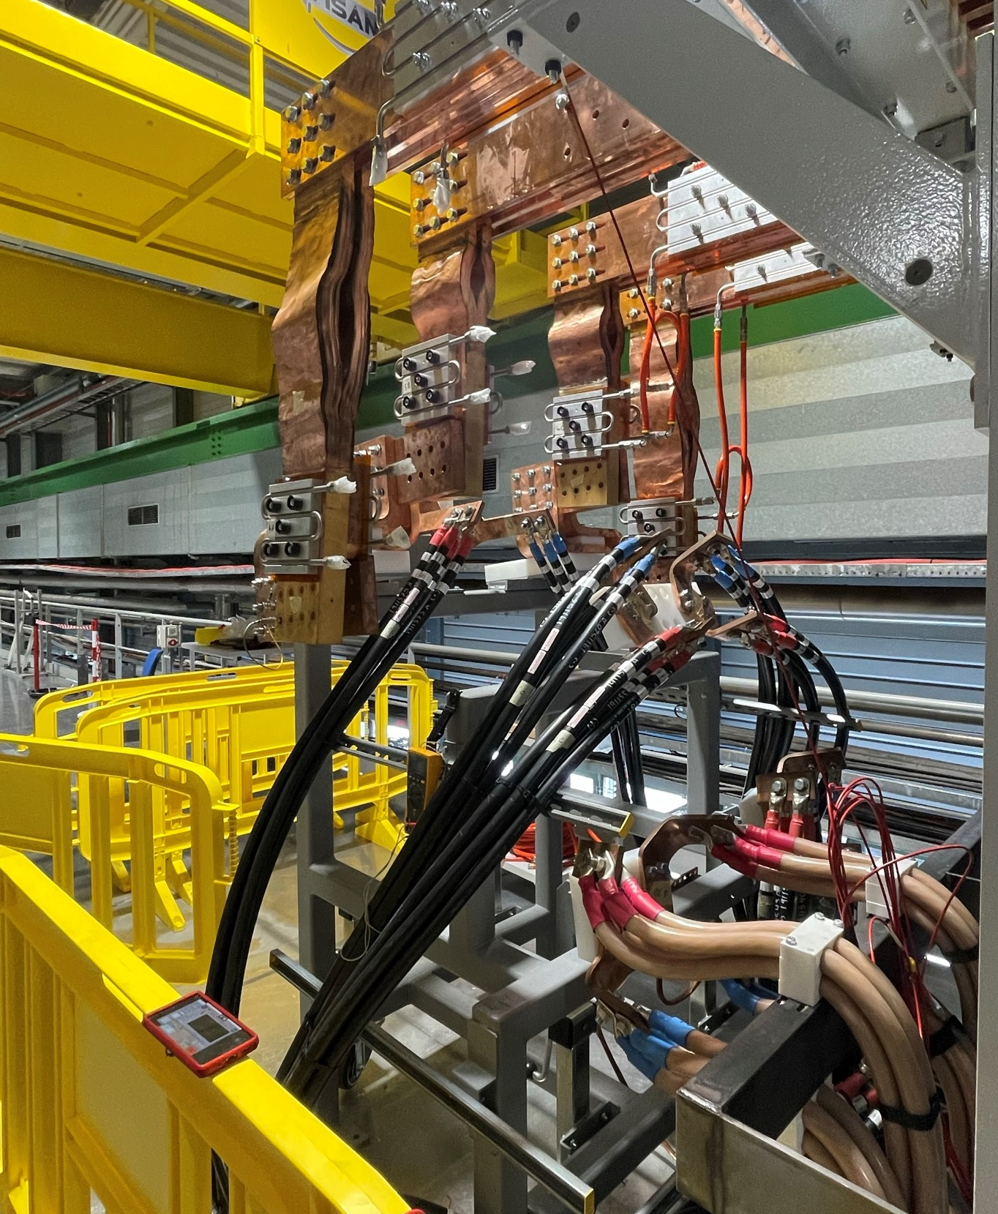
Quality Control: Process
Checks
Visual inspect.
X-rays
Vac. leak tests
ElQA
SCT
…
Quality control tests are managed by the equipment owner.
The String coordination team:
  Ensure proper conditions for the execution of the tests.
  Follow up the activities on-site.
  Check that the test results are documented.
Tests procedures are defined as part of the String Validation Program.
More info in “IST, SCT and Powering Test for the HWC of the HL-LHC IT String” by S. Yammine

Slide 13
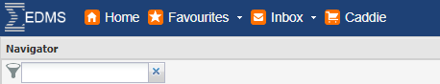
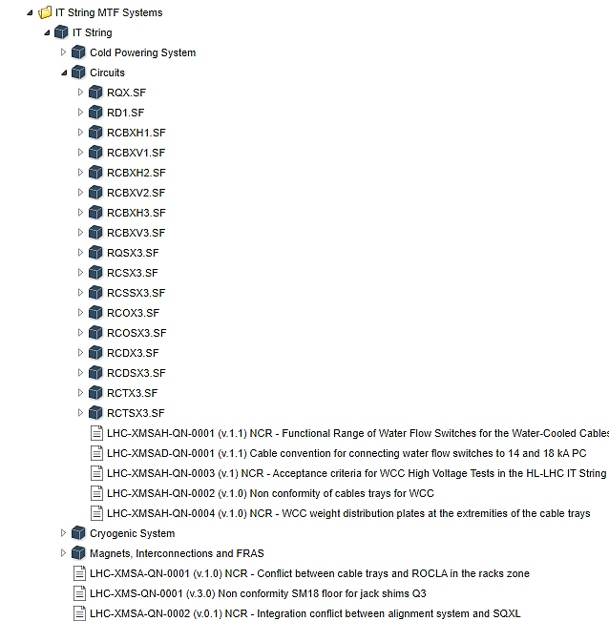
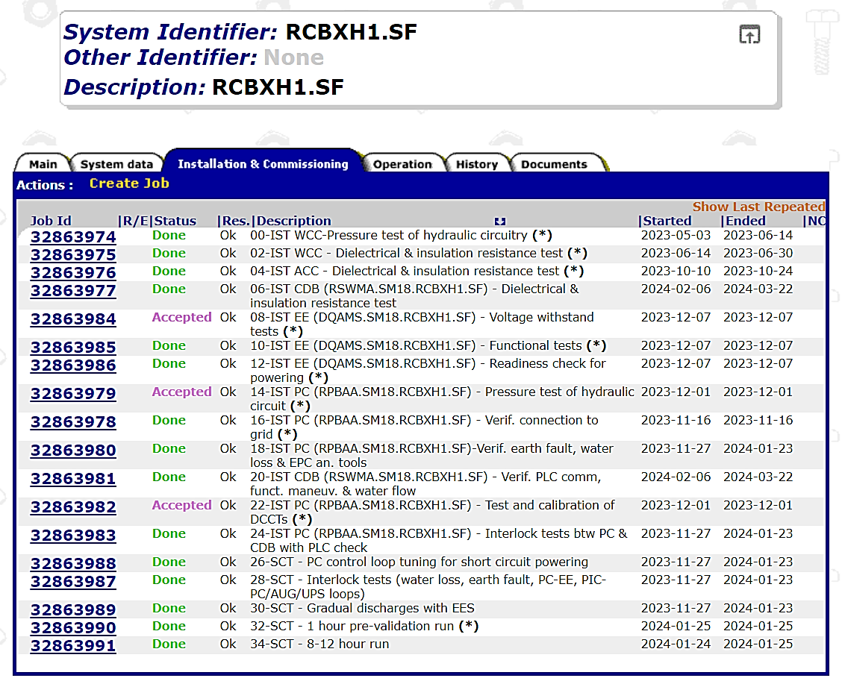
Quality control: MTF
  For the follow up of the quality checks WP16 proposed a MTF structure that was agreed with the HL-LHC Quality Office.
  The structure is divided in several systems, and steps are defined for each of them.
  Steps are extracted from commissioning and operation procedures.

Slide 14
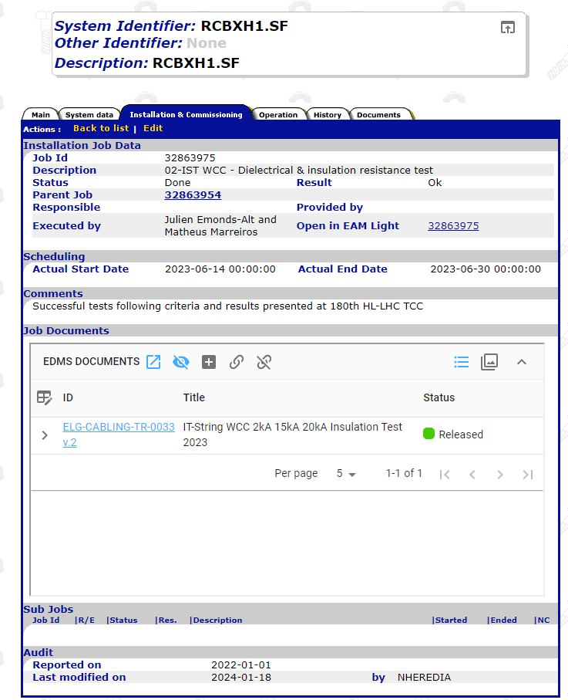
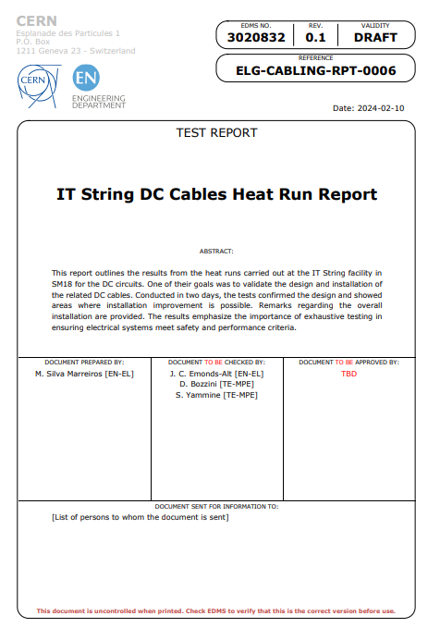
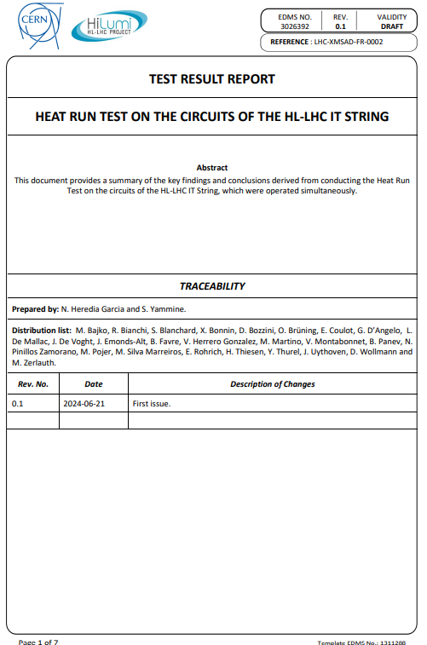
Quality control: Steps
  Information included in a MTF step:
    Description
    Status
    Executor
    Activity start date
    Activity end date
    EDMS docs.: Test result reports, confirmation emails, non-conformities

Slide 15


Non-conformities: Process
  HL-LHC process in place (https://edms.cern.ch/document/1499015):
Detection (QC)
Technical discussions
Decision
Actions ongoing
Closure
Document Draft
EDMS Evaluation
Review STCM
Feedback from IT String Day III:
Addressing non-conformities: It's imperative to document these instances comprehensively, to prevent their recurrence in the HL-LHC tunnel installation ensuring a meticulous follow-up by the entire IT-String / HL-LHC project teams.

Slide 16
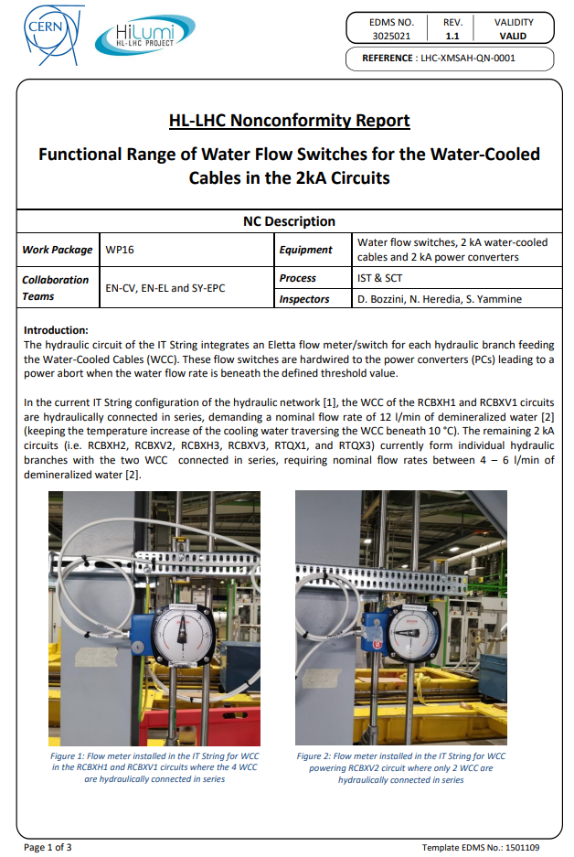
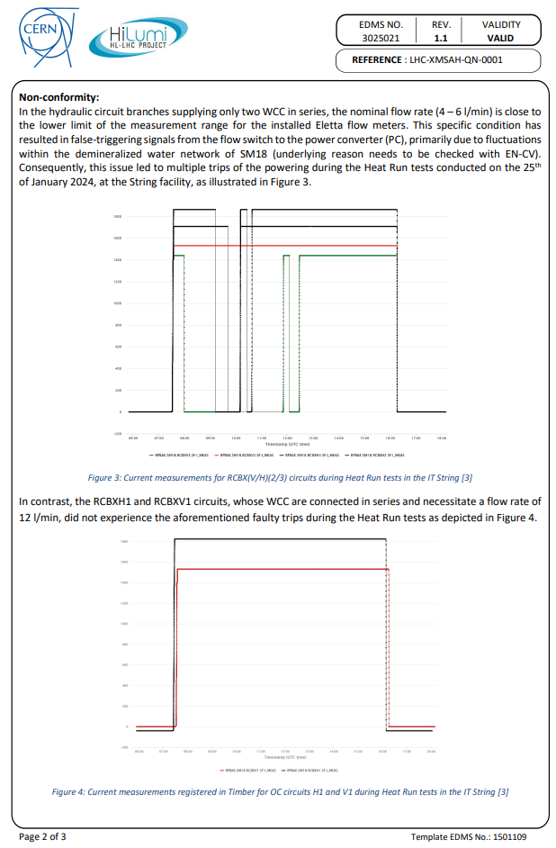
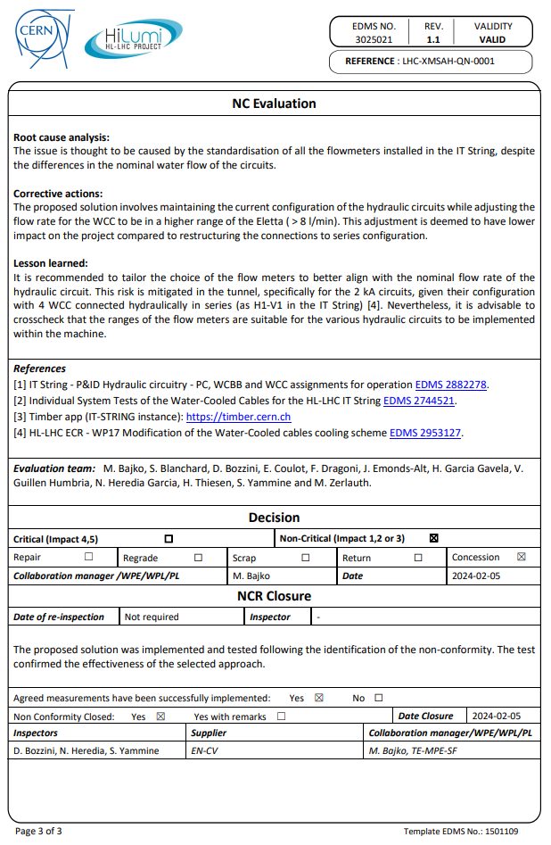
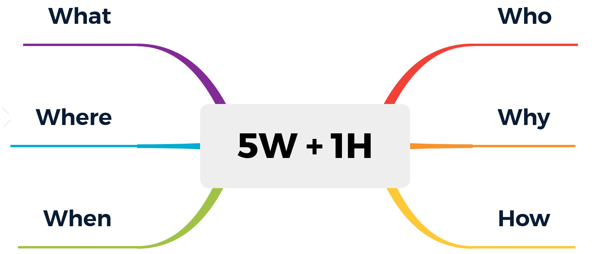
Non-conformities: Template
  Information included in the non-conformity:

Slide 17
Non-conformities: Table
  Table of non-conformities to keep track of documentation status. Reviewed at the String Technical Coordination Meeting.
Ref. | NCR Description | Status | Ap. Date | EDMS | Criticality | Decision | Manag. team | Equipment | Detect. phase | Det. Year | Class
 | NCR of TL02 | 1. To be Opened | TBD | TBD | Non-Critical | Repair | WP16 | Cryogenics | Commissioning | 2024 | Mechanical
LHC-XMSAD-QN-0003 | NCR of water-cooling plates for busbars | 2. In Work | TBD | 3162382 | Non-Critical | Repair | WP16 | Warm powering | Commissioning | 2024 | Manufacturing
LHC-XMSA-QN-0002 | NCR - Integration conflict between alignment system and SQXL | 2. In Work | TBD | 3153667 | Non-Critical | Repair | WP16 | FRAS | Integration | 2024 | Integration
LHC-XMSAH-QN-0003 | NCR - Acceptance criteria for WCC High Voltage Tests in the HL-LHC IT String | 2. In Work | TBD | 3045592 | Non-Critical | Concession | WP16 | Electrical infrastructure | Commissioning | 2023 | Electrical
LHC-XMSAA-QN-0001 | NCR - Excessive Heat Load Detected in Line C within TL01 | 2. In Work | TBD | 3044384 | Non-Critical | Repair | WP16 | Cryogenics | Operation | 2023 | Mechanical
LHC-XMSAA-QN-0005 | NCR - Leak tightness of the SQXL main volume envelope | 2. In Work | TBD | 3075007 | Non-Critical | Repair | WP16 | Cryogenics | Commissioning | 2024 | Vacuum
LHC-XMSAH-QN-0004 | NCR - WCC weight distribution plates at the extremities of the cable trays | 4. Closed | 15/07/2024 | 3117788 | Non-Critical | Repair | WP16 | Electrical infrastructure | Installation | 2024 | Mechanical
LHC-XMSAH-QN-0002 | Non-conformity of cables trays supporting system for WCC | 4. Closed with Warnings | 15/07/2024 | 2804269 | Non-Critical | Repair | WP16 | Electrical infrastructure | Operation | 2022 | Mechanical
LHC-XMSA-QN-0001 | NCR - Conflict between cable trays and ROCLA in the racks zone | 4. Closed | 07/06/2024 | 3093233 | Non-Critical | Repair | WP16 | Electrical infrastructure | Operation | 2024 | Transport
LHC-XMSAC-QN-0001 | Flexible busbars manufacturing for the IT String | 4. Closed | 13/05/2024 | 3045423 | Non-Critical | Repair | WP16 | Cold powering | Installation | 2023 | Manufact. & instal.
LHC-XMSAD-QN-0001 | Cable convention for connecting water flow switches to 14 and 18 kA PC | 4. Closed | 29/04/2024 | 3018444 | Non-Critical | Repair | WP16 | Water distribution system | Commissioning | 2024 | Electrical
LHC-XMSAH-QN-0001 | NCR - Water Flow Switches Functional Range for the Water-Cooled Cables on the 2kA Circuits | 4. Closed | 29/04/2024 | 3025021 | Non-Critical | Concession | WP16 | Water distribution system | Operation | 2024 | Other
LHC-XMSAA-QN-0002 | IT STRING - NCR - SQXL - Shape of service modules | 4. Closed | 22/03/2024 | 2961669 | Non-Critical | Concession | WP16 | Cryogenics | Installation | 2022 | Mechanical
LHC-XMSAA-QN-0003 | IT STRING - NCR - SQXL - Pipe element vacuum vessel reinforcement | 4. Closed | 22/03/2024 | 2961672 | Non-Critical | Repair | WP16 | Cryogenics | Installation | 2023 | Mechanical
LHC-XMSAA-QN-0004 | IT STRING - NCR - SQXL - DN100 Instrumentation Feedthroughs | 4. Closed | 22/03/2024 | 2961678 | Non-Critical | Repair | WP16 | Cryogenics | Commissioning | 2023 | Manufact. & instal.
LHC-XMS-QN-0001 | Non-conformity SM18 floor for jack shims Q3 | 4. Closed | 02/04/2024 | 2872779 | Non-Critical | Concession | WP16 | FRAS | Integration | 2023 | Integration

Slide 18
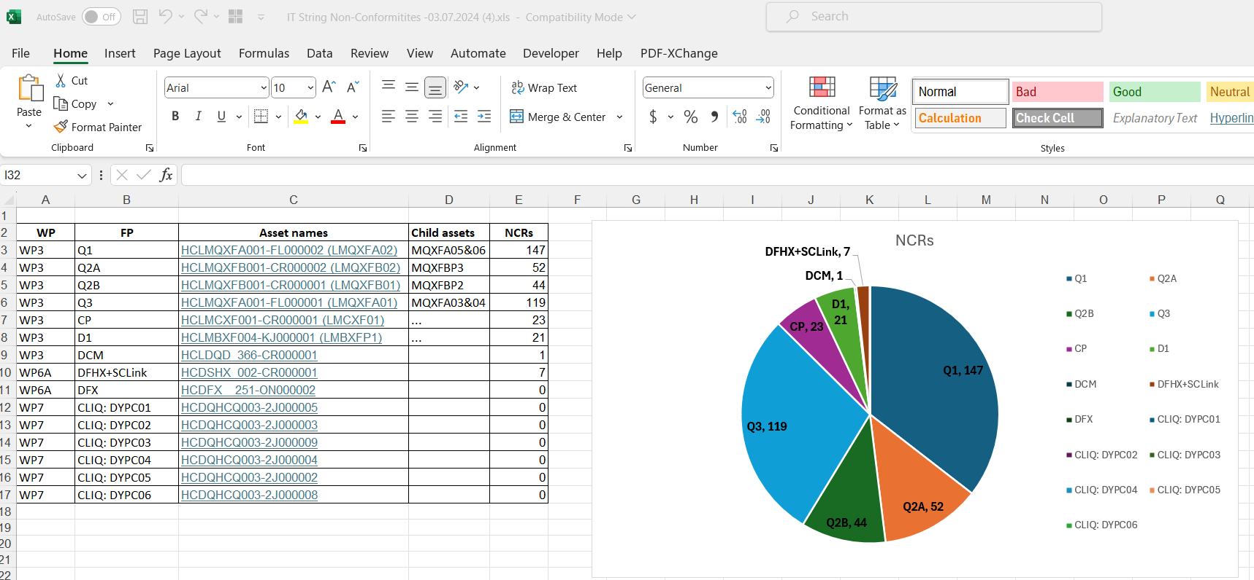
Non-conformities: Quality Meetings
  A series of meeting have been launched with the HL-LHC Quality Office. Assets codes of the equipment coming to the IT String are been identified.
  Using the asset codes, non-conformities have been extracted using Pentaho tool and some of them reviewed. Also, assets will be attached to the String MTF structure to have full traceability of their installation.
  On a weekly basis, the HL-LHC Quality Office informs WP16 via email about the status of open non-conformities in the HL-LHC project.
Feedback from IT String Day III:
Handling Non-Conformities: Identifying non-conformities for the String (out of all non-conformities traced across the project), crucial for HL-LHC, presents a challenge. Discussions focused on methods like tagging these issues in databases or Excel sheets. The focus is on comprehensive documentation and ensuring easy accessibility of these records for future reference is crucial.

Slide 19

Non-conformities: Quality Meetings
  For the equipment non-conformities tagged as “electrical”, an exercise is being initiated in the coordination team to integrate them as part of the general instrumentation layout drawing.
  Deviations from the baseline will also be signaled in this “As-built” drawing.
  This drawing will help to analyse the test results.

Slide 20





Lessons Learned
  Lessons learned have been transmitted to the HL-LHC project in different forums (WP15 integration meeting, TCC, String Day).
  Non-conformity reports contain a chapter dedicated to lessons learned.
  Working meetings have been organised with the intervening teams after completing an installation to discuss areas of improvement.

Slide 21
Conclusions
Sound quality processes are in place in the IT String, with improvements in various aspects.
Effective collaboration and support from the HL-LHC quality office to deal with quality subjects.
Intervening teams are committed to quality, and they count with experience in quality assurance/control methods.
WP16 discovered non-conformities up to now are not critical and corrective measurement have been successfully implemented.
A meeting dedicated to quality is launched to review, among others, equipment non-conformities potentially affecting the IT String.
Lessons learned from the IT String experience have been gathered and communicated.

Slide 22
Thank you for your attention
Special thanks to all the collaborators for their efforts

