Slide 1

Controls and software status for the HL-LHC IT String
S. Blanchard, CERN, TE-MPE-SF
On behalf of the IT String team
The HL-LHC IT String facility includes accelerator systems such as power converters, quench protection, cryogenics, insulation vacuum and alignment. The applications for the system controls and for the operation of the HL-LHC IT String facility compose a three-layer architecture. The front-end layer is composed of Programmable Logic Controllers (PLC) or Front-End Computers (FEC). The systems’ layer is composed of monitoring, control, and supervisory applications. The operation layer is composed of supervisory, sequencer, and magnet circuit test analysis applications. As a preparation of the HL-LHC commissioning phase, the definition of all the required software interfaces, in line with the HL-LHC era, is essential to guarantee the suitable operation of the String facility control system. The readiness status of the controls and software is reported. The Dry Run tests are essential to validate the operation applications and the complete control system before the cooling and the powering test phase of the HL-LHC IT String commissioning program.

Slide 2
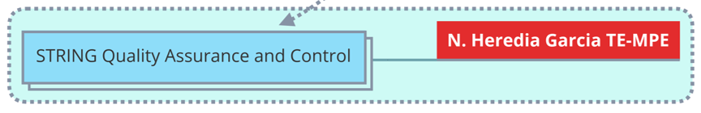
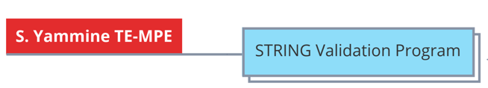
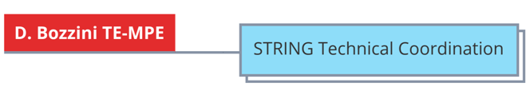
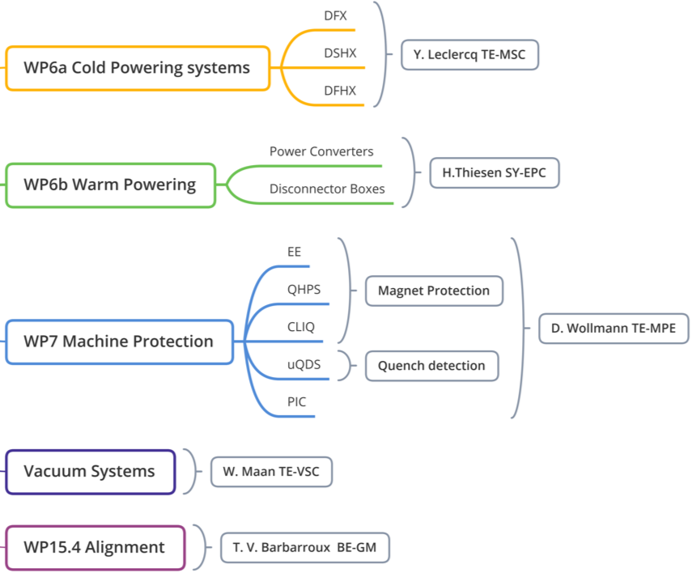
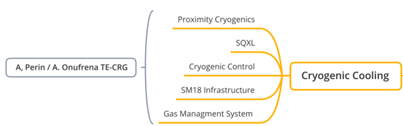
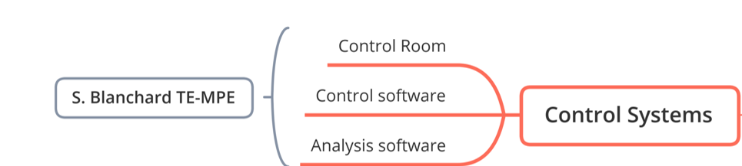
Outline:
  Introduction
  Architecture&Readiness
  Frameworks&Development
  Configuration&Logging
  Access Controls
  Interfaces
  Schedule
  Organization
  Conclusion
This talk

Slide 3
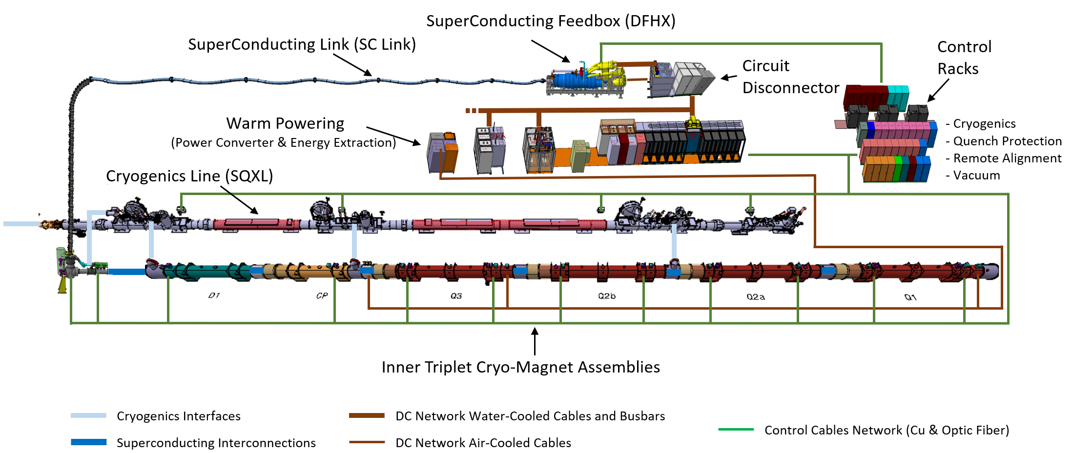
Introduction
The String Facility needs an effective operation software layer to achieve the controls, diagnostics, logging and analysis of the HWC and String specific tests program.
Includes the controls of vacuum (VAC), cryogenics (CRYO), power converters (PC), quench protection (QPS), alignment (FRAS), and all the software required for the OPERATION & ANALYSIS
Highly interconnected with both hardware and software interfaces.

Slide 4
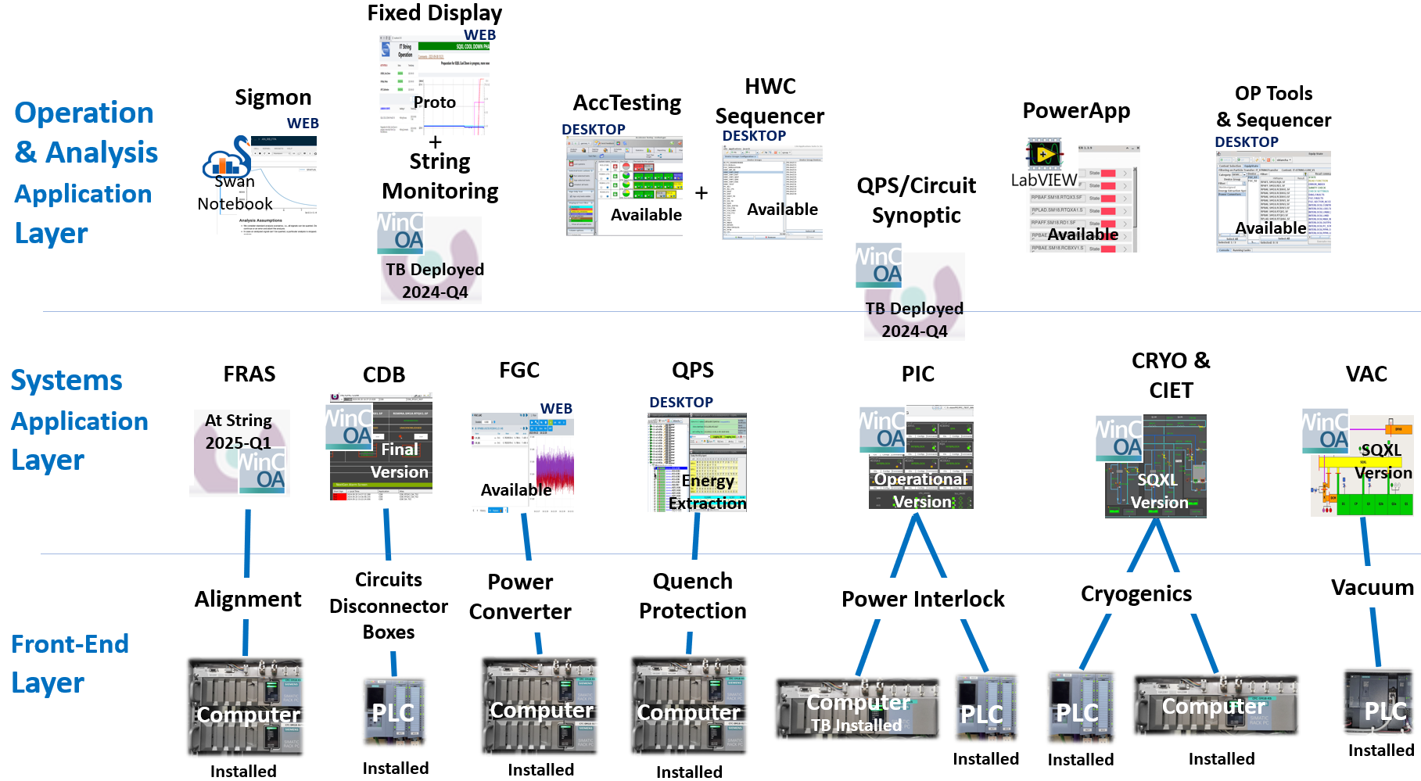
Architecture & Readiness

Slide 5
Frameworks & Development
Based on:
  Industrial control systems (Vacuum, Cryogenics, CDB, PIC)
  FESA accelerator control systems (Power Converter, QPS, FRAS)
  Accelerator standard commissioning, operation and diagnostic software (AccTesting, HWC Sequencer, e-logbook, OP tools, SWAN notebooks)
Use frameworks: FESA, UNICOS/JCOB, LSA/InCA, SWAN notebooks, WebApp framework (Spring, React…)
Use commercial software applications (for Industrial controls): WinCC OA TM
No specific framework development: LHC or HL-LHC developments
Operation software configured with Accelerator Databases (CCDB, LSA DB, Layout DB)

Slide 6
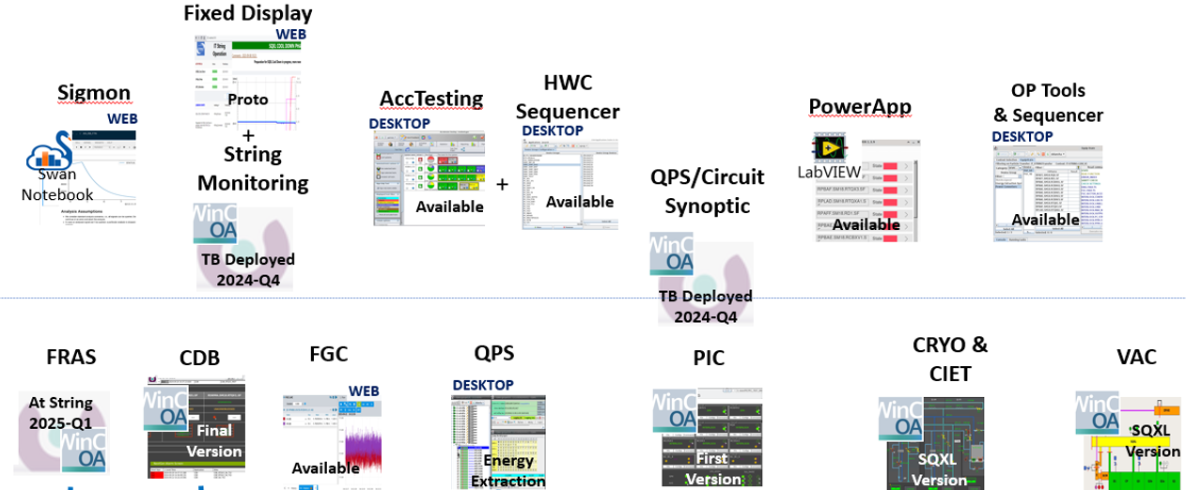
Responsabilities specifications & development
Upgraded
for String
LHC
Framework
LHC
Framework
LHC
Framework
LHC
Framework
New
String Specific
LHC
Framework
Specs:TE-MPE
Dev:TE-MPE
Dev:BE-CSS
Specs:TE-MPE
Dev:BE-CEM
Specs:TE-MPE
Dev:TE-MPE
Scripts:
TE-MPE
Specs:BE-OP
Dev:
BE-CSS/BE-OP
Dev:TE-MPE
Notebooks(HL):
TE-MPE
Specs:TE-MPE
Dev:BE-ICS
3 Departments, 9 Groups
Specs:TE-MPE
Dev:TE-MPE
Specs:TE-MPE
Dev:BE-ICS
Specs:TE-VSC
Dev:TE-VSC
Specs:BE-GM
Dev:BE-ICS
Specs: SY-EPC
Dev:SY-EPC
Specs:TE-CRG
Dev:BE-ICS
New Framework Development
(HL-LHC)
LHC
Framework
LHC
Framework
New Framework Development
(LHC LS3)
LHC
Framework
LHC
Framework
Notes:
Involves 3 Departments, 9 groups

Slide 7
String Controls Configuration & Logging
Configuration:
AccTesting and HWC Sequencer have a unique source for parameters: LSA DB.
All the layout information is populated from Layout DB to LSA DB.
Other parameters, test definitions, sequence attributes are populated from test procedures to LSA DB (See presentation “IST, SCT and Powering Test for the HWC”).
Sequences are coded in HWC sequencer according to test procedures, sequence transition conditions coming from equipment owner.
Logging:
Logging to NxCALS - CERN Accelerator Logging Database
Logging to Post Mortem DB - high-rate logging for post-mortem event analysis.
Supervisory Application logging (SCALAR DB) – better granularity than NxCALS

Slide 8
Access Control and Test Signatory
FESA device: Group of devices with access rules based on RBAC roles and locations
Signatory of tests: Expert RBAC roles
Vacuum/Cryogenics/PIC/FRAS devices: Supervisory Application Specific permissions policy based on Access Domains and LDAP authentication

Slide 9
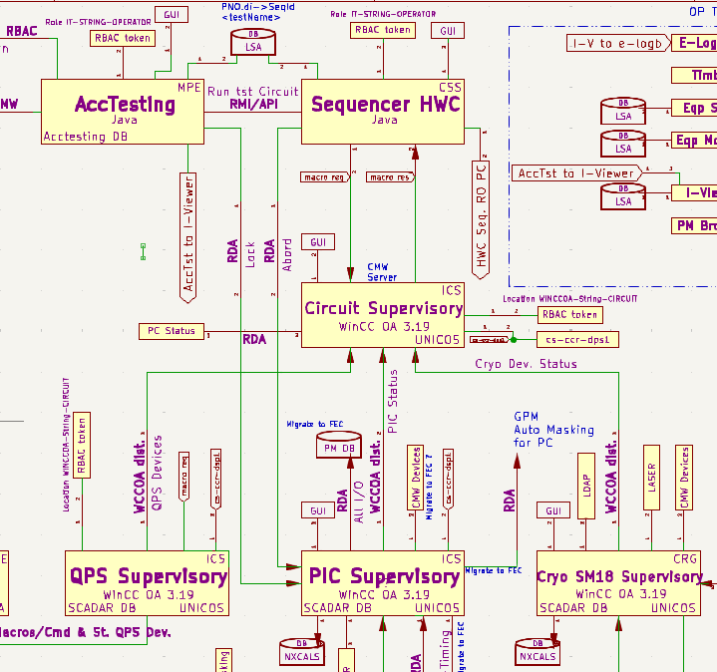
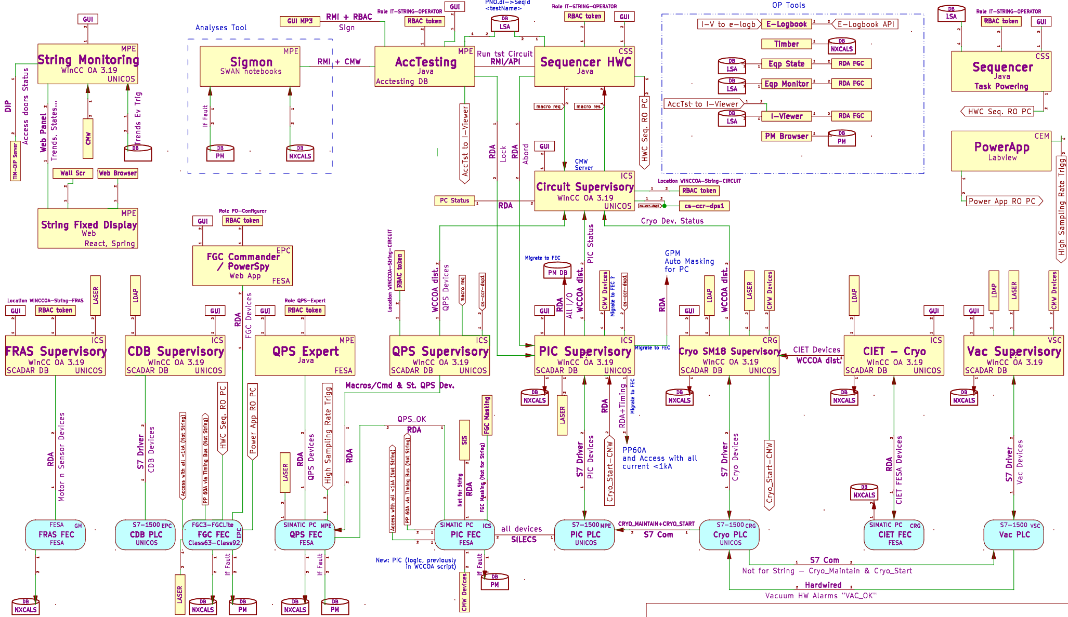
Interfaces

Slide 10
Interfaces
Goal: Not specifications but intends to check that all the required interfaces has been implemented.
Only interfaces between different systems or services are considered:
  HW alarm signals between systems
  HW Central Timing ↔ FEC
  PLC ↔ PLC
  Supervisory application ↔ FESA devices
  AccTesting/HWC Sequencer ↔ Devices/Applications
  Configuration DB (CCDB, LSA DB) ↔ Applications
  Applications ↔ Logging NxCALS/Post Mortem
  Applications ↔ Applications
~60% of the interfaces are available and ~40% tested during commissioning, SCT, Dry Run 1 (estimation not taking into account the weight of interfaces)

Slide 11
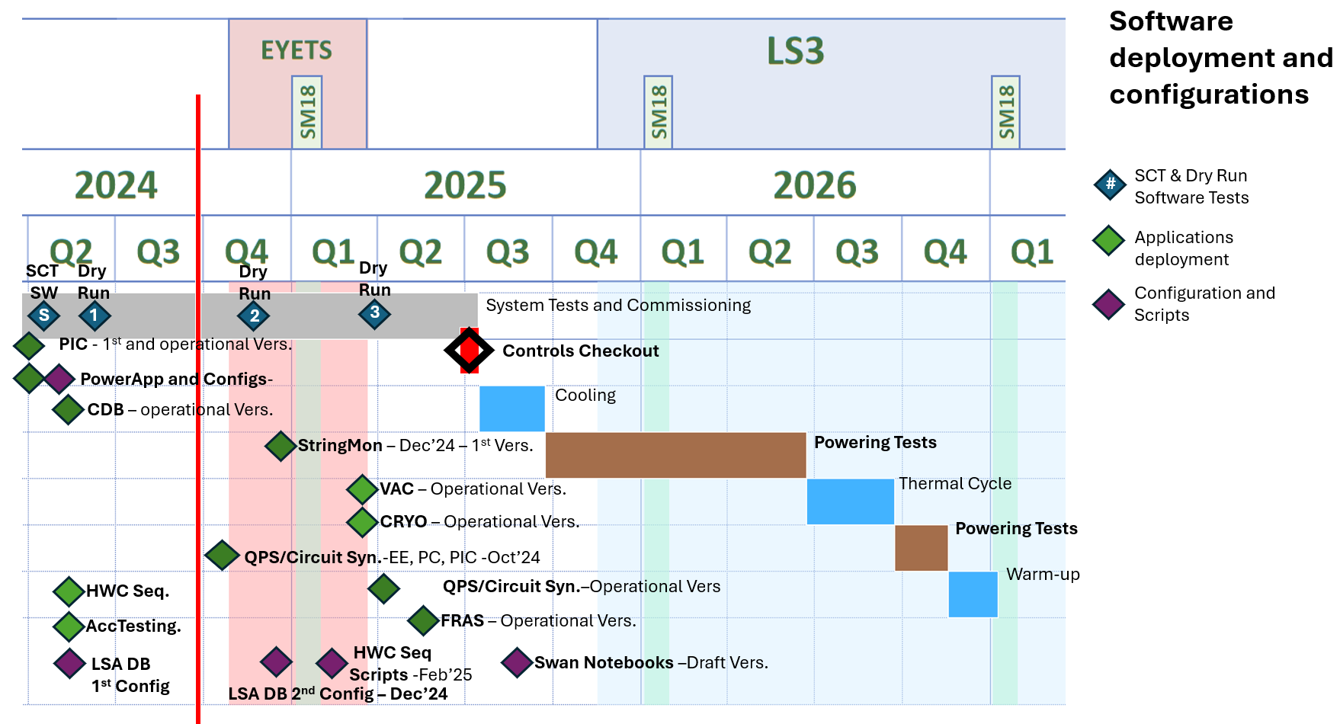
Milestones
YETS
New
LS3 Start

Slide 12
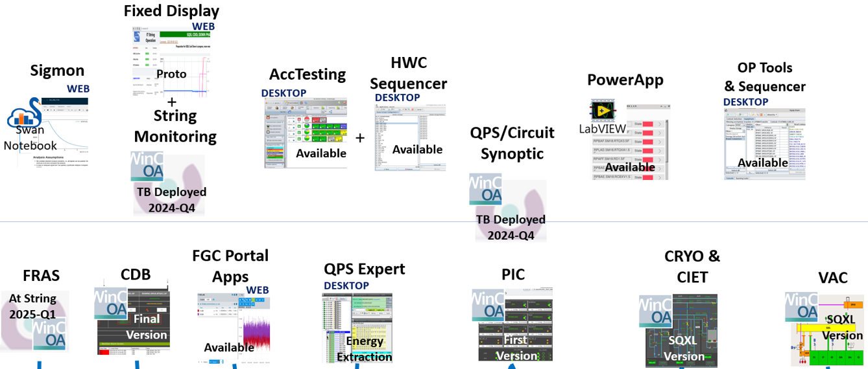
Commissioning and Dry Run1 Checks and Validation
IT String day III
recommendation
Dry Run 1 2024-Q2
Dry Run 1 2024-Q3
SCT 2024-Q1
SCT 2024-Q1
Dry Run 1 2024-Q2
SQXL Cool Down 2023-Q3
SCT 2024-Q1
SQXL Vers.
SQXL Vers.
Energy
Extraction
First Operational
Vers.
DB
Configured

Slide 13
Dry Run 1
IT String day III
recommendation
Environment:
Power Converters are operated in Simulation Mode.
Access RBAC limits the access to IT String devices only.
Configuration Database: LSA DB “NEXT” schema of DEV environment.
LSA DB configured with circuits, power converters, parameters (but not all), and tests definition (TE-MPE, BE-OP, BE-CSS).
Objectives and results:
Validation of PowerApp LabVIEW software
Configuration of LSA DB with the additional information required for the Dry Run tests.
Check String instance AccTesting and HWC Sequencer application.
Interface checks:
  AccTesting ↔ LSA DB
  AccTesting ↔ HWC Sequencer
  HWC Sequencer ↔ LSA DB
  HWC Sequencer ↔ FGC Devices

Slide 14
Next Dry Runs
Dry Run 2 objectives:
Test Interfaces AccTesting/HWC Sequencer with remaining devices: PIC, Energy Extraction,...
Test Post Mortem Triggering.
Check/update HWC sequencer sub-routine
Dry Run 3 objectives and outcome :
The conditions to be able to proceed with the Dry Run depends on the availability of devices.
Test complete sequences involving all connected components.
Test the global behaviour of available circuit devices.
Optimize the HWC sequencer routine/sub-routine for HL-LHC.
Test interfaces with analysis software (SWAN notebooks)
Trigger the coding of the remaining HL-LHC HWC test sequences.

Slide 15
Organization
Coordination and follow-up meetings to address the readiness and availability of applications/functionalities
Topical meetings to address the implementation/availability of interfaces, configuration of DB, and coding of HWC sequences.
Dry Runs and control Checkout to check the operational devices instantiation and functionality of interfaces.
Hardware interfaces tests integrated in Q&A plan (See presentation “Quality Assurance & Control”).
Notes:
3 Departments and 9 Groups

Slide 16
Conclusion
Front End Hardware (FEC, PLC, DIOT), Servers (Supervisory Applications) are installed and available.
An estimated of ~70% of the applications are available and operational (but not necessary with all the functionalities and devices)
~60% of the interfaces are available and 40% tested (during commissioning, SCT, Dry Run 1)
Intensive validation and tests of the software and it interfaces (during Dry Runs)
Positive feedback on the functionalities & performance of the already tested and operational applications (from Commissioning, SCT & Dry Run tests)
Still a lot of work for the configuration, sequences implementation, tests, and learning of operation applications and tools.
Risk not completing the Dry Runs before Magnets ready.
With the Dry Run tests the goal is to test, check, validate, optimize, give feedback, and train team.
The conditions to be able to proceed with the Dry Runs depends on the availability of devices.
LS3 start delay is beneficial (accelerator control services availability) but the impacts during YETS and LS3 (mid-2026-2027) remain a concern and will be addressed.

Slide 17
Spare Slides

Slide 18
Stakeholders…
PIC: Alain Antoine (TE-MPE), Michal Kalinowski (TE-MPE), Jesus Cortes (BE-ICS)
Cryo: Antonio Tovar-Gonzalez (TE-CRG), Thomas Barbe (TE-CRG), Nikolaos Trikoupis (TE-CRG), Alexandros Foivos Kostopoulos (BE-ICS)
Vacuum: Andre Rocha (TE-VSC)
Supervisory QDS, PIC, Circuit: Alexandros Foivos Kostopoulos, Enrique Blanco Vinuela (BE-ICS), Brad Schofield (BE-ICS), Lukasz Goralczyk (BE-ICS)
QPS Expert/AccTesting/Sigmon/Post-Mortem: Daniel Wollmann (TE-MPE), Aleksandra Mnich (TE-MPE), Jean-Christophe Garnier (TE-MPE), Marc-Antoine Galilee (TE-MPE), Gustavo Enrique Sanchez (TE-MPE)
QDS: Reiner Denz (TE-MPE), Tomasz Podzorny (TE-MPE), Jens Steckert (TE-MPE)
FRAS: Mateusz Sosin (BE-GM), Borja Fernandez Adiego (BE-ICS)
HWC Sequencer/LSA/InCA: Michi Hostettler (BE-CO), Lukasz Burdzanowski (BE-CSS), Maciej Peryt (BE-CSS), Roman Gorbonosov (BE-CSS)
PowerApp: Hubert Reymond (BE-CEM), Patryk Dawid Jankowski (BE-CEM), Alvaro Martinez Landete (BE-CEM)
… Apologies for those I have certainly forgotten in this non-exhaustive list

