Slide 1
Status report on high-energy complex
Accelerator design meeting
27 May 2024
Antoine CHANCE CEA Paris-Saclay
On behalf of WP5

Slide 2
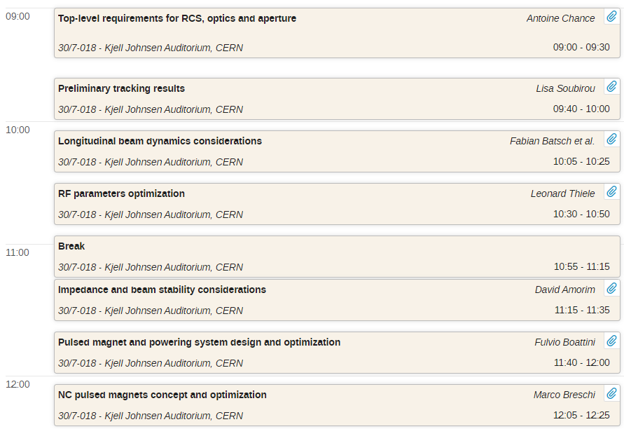
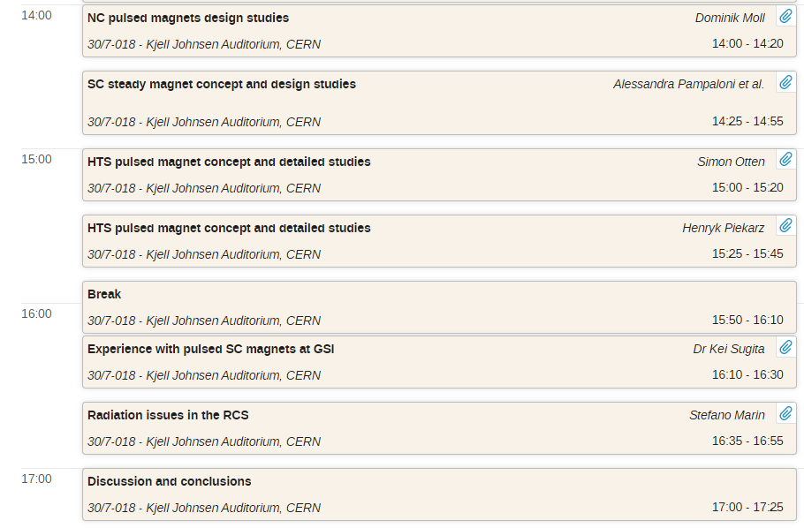
One-day workshop on RCS on Wednesday 22/05/2024
Indico page: https://indico.cern.ch/event/1388830

Slide 3
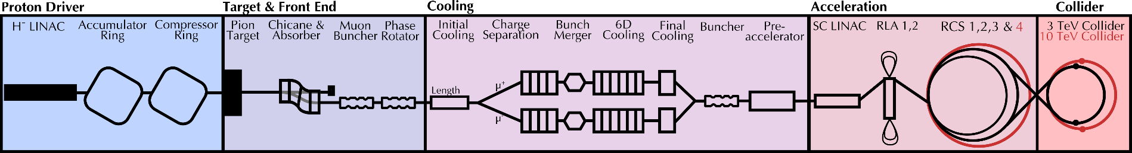
High-energy complex
This meeting was dedicated to the chain of rapid cycling synchrotrons (RCS).
FFA and Recirculating Linacs were not covered in this meeting (can be the topic on a next meeting).
Part of interest for us

Slide 4
Outline
General parameters
Arc cell and tracking
RF parameters
Collective effects
NC magnet parameters
SC magnet parameters
Radiation issues
Summary

Slide 5
Outline
General parameters
Arc cell and tracking
RF parameters
Collective effects
NC magnet parameters
SC magnet parameters
Radiation issues
Summary

Slide 6
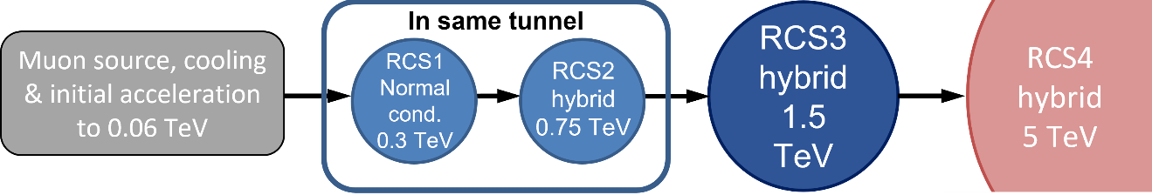
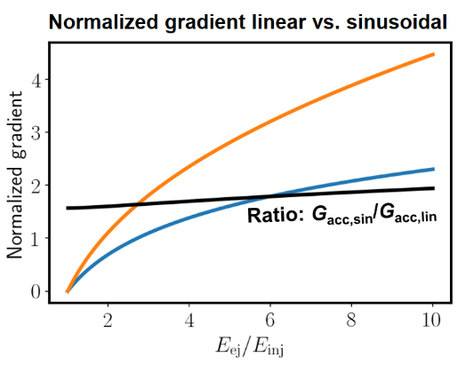
The RCSs ramping
Unchanged RCS chain: 63 GeV → 310 GeV → 750 GeV → 1.5 TeV → 5 TeV
Optimization problem for up-ramp between sinusoidal optimum
for magnet powering and linear optimum for RF
Linear ramping
  constant V_{RF}, simplest RF solution, best for µ
  unfeasible for magnet powering
Non-linear ramping → reduced peak power ≙ magnet powering
costs, but RF efficiency decreases

Slide 7
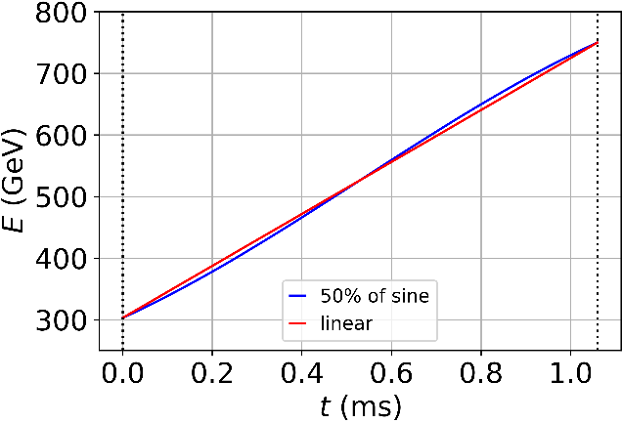
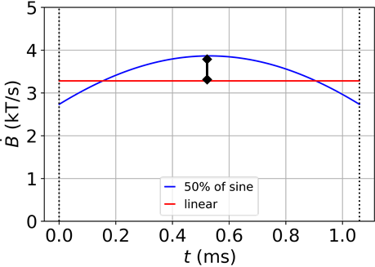
Reminders
Initial focus on RCS2 as test case → highest ramp rate Ḃ of the hybrid RCS
Ramp shape assumption: fraction of sinusoidal
Example of central half of sine → almost 20% extra RF voltage required
That maxima defines the extra costs as the magnet ramp shape defines the voltage shape / RF requirements!
Courtesy: F. Batsch

Slide 8
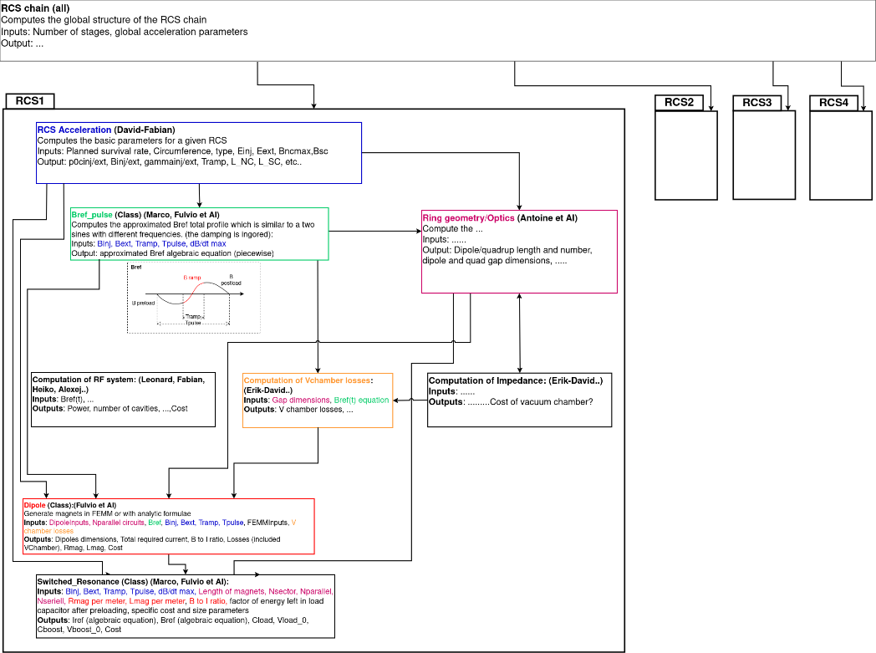
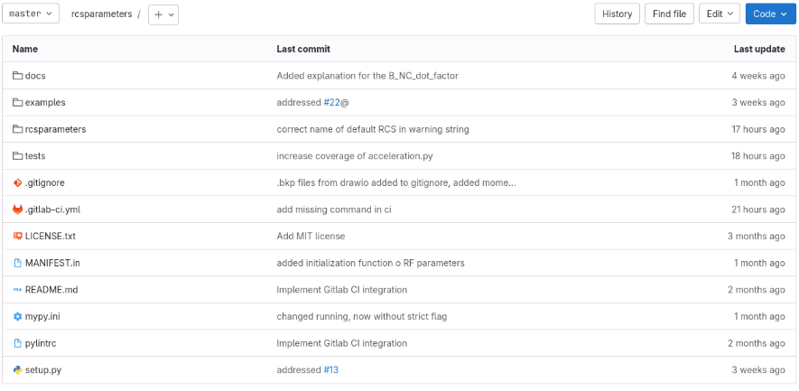
RCS parameter software
The repository is located at https://gitlab.cern.ch/muon-collider-bd/rcsparameters
It is currently “Internal”, accessible to any person with a CERN account
Courtesy: F. Boattini

Slide 9
RCS1/2/3 optimization parameters
 | RCS1→314 GeV | RCS2→750GeV | RCS3→1.5TeV
Circumference, 2πR [m] | 5990 | 5990 | 10700
Bunch population [10¹²] | <2.7 | <2.43 | <2.2
Survival rate per ring [%] | ~90 | ~90 | ~90
Acceleration time, t_{acc} [ms] | 0.34 | 1.04 | 2.37
Number of turns | 17 | 55 | 66
Energy gain per turn [GeV] | 14.8 | 7.9 | 11.4
Avg. acc. gradient [MV/m] | 2.4 | 1.3 | 1.1
Acc. field in RF cavity [MV/m] | 30 (45 optimistically) | 30 | 30
Synchronous phase [°] | 45 | 45 | 45
Minimal bucket area [eVs] | 0.6? | 0.6? | 0.8?
Injection B field [T] (warm m.) | 0.36 | -1.8 | -1.8
Ejection B field [T] (warm m.) | 1.8 | 1.8 | 1.8
Parameters to be optimized:
Circumference
Survival rate and acceleration time
Number of RF stations, n_{RF}
Synchronous phase
Minimal required bucket area
and RF filling factor
Inj. and ejection B fields
Maximum ramp rate, dB/dt?
Courtesy: F. Batsch

Slide 10
Example of optimization with genetic algorithm
Thanks to the class properties of the rcsparameters software, it is easy to change input parameters and see the impact on following properties.
This opens the way to optimization tools: notebook example of an optimization using MOGA → allows to explore a wider range of parameters for our RCS chain
The values shown afterwards are just for example

Slide 11
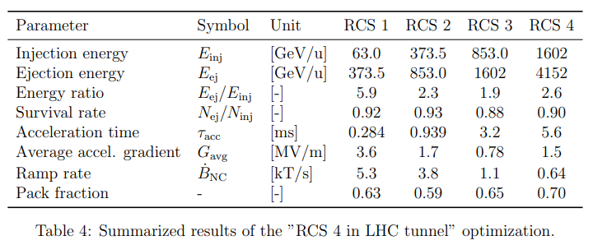
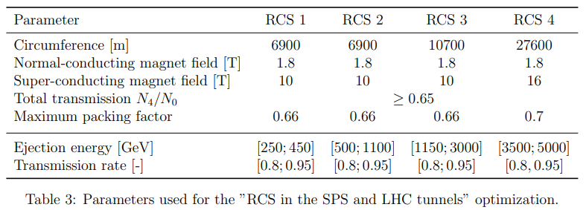
SPS tunnel for RCS 1 and RCS 2, and the LHC tunnel for RCS 4
Objectives: Maximize final energy and minimize average gradient to keep the total number of RF cavities low.
The maximum energy reached is 4.15 TeV, keeping the dipole packing factor in the RCS below the 70 % asked in the simulation parameters The overall muon transmission rate is 0.92×0.93×0.88× 0.90 = 0.68.
Courtesy: D. Amorim

Slide 12
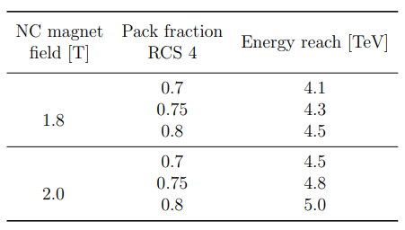
Case 2: SPS tunnel for RCS 1 and RCS 2, and the LHC tunnel for RCS 4
Objectives: Maximize final energy and minimize average gradient to keep the total number of RF cavities low.
The maximum energy can reach 5 TeV if packing factor up to 80% and a peak NC dipole field of 2.0 T instead of 1.8 T.
Courtesy: D. Amorim

Slide 13
Outline
General parameters
Arc cell and tracking
RF parameters
Collective effects
NC magnet parameters
SC magnet parameters
Radiation issues
Summary

Slide 14
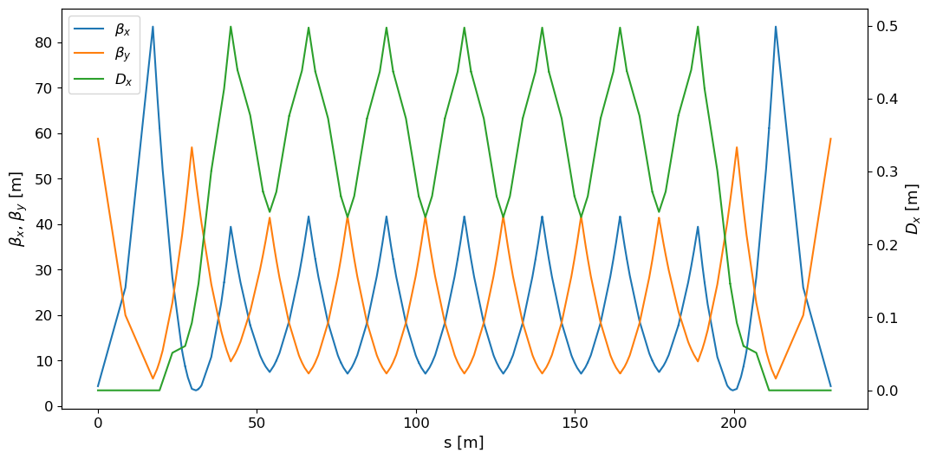
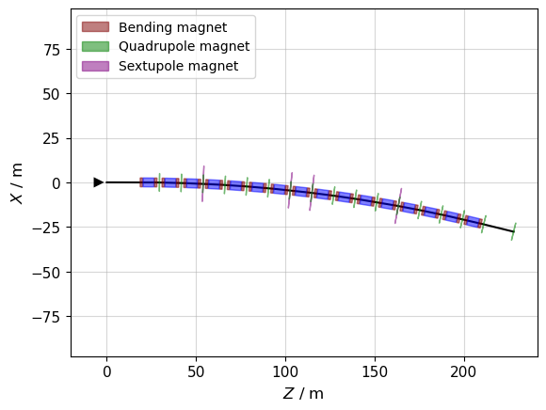
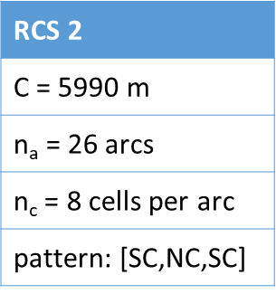
Structure of an arc and optics (RCS2)
FODO structure, base of µ=90°
Dispersion suppressor for RF insertion (cavity + energy kick)
Quad and Sextupoles: thin multipole approximation
Dipoles: thick bend, sliced before tracking
Courtesy: L. Soubirou

Slide 15
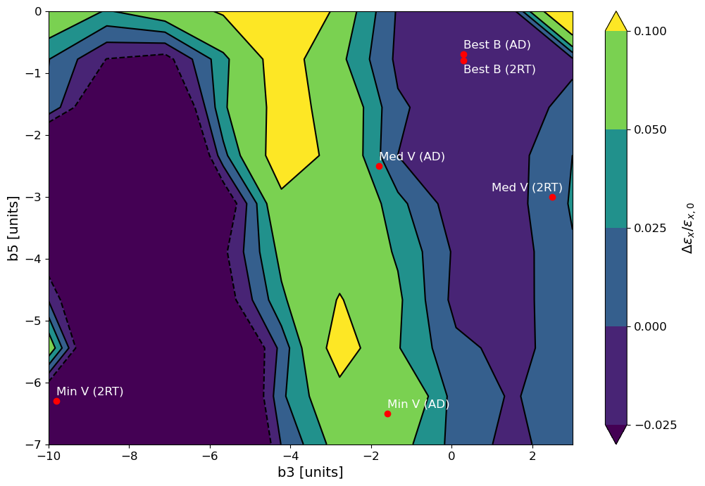
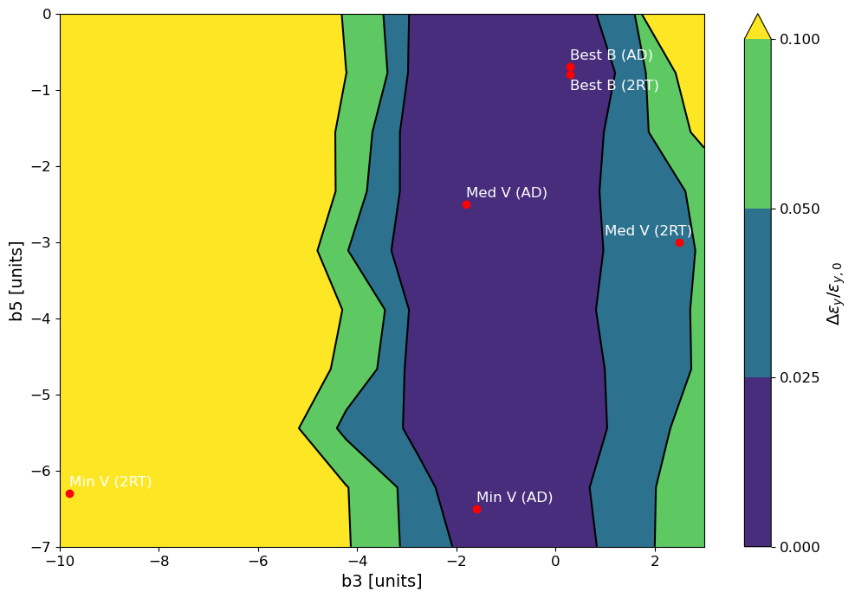
Rough scan of b3/b5 component
Emittance growth
Courtesy: L. Soubirou
Same order of magnitude as without errors : good!
Same order of magnitude as without errors : good!
ε_{x}
ε_{y}
Lose a lot of particles

Slide 16
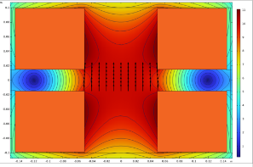
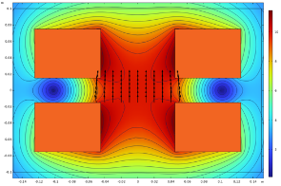
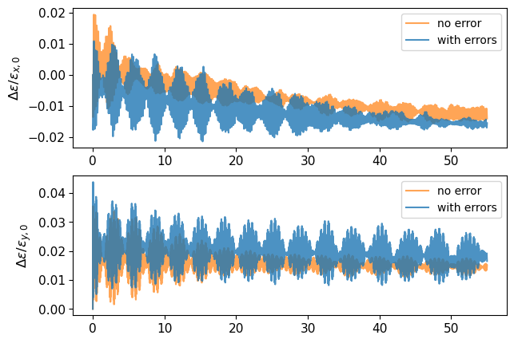
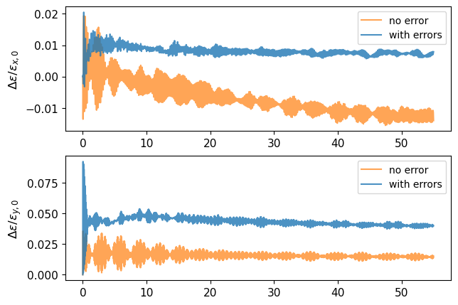
Relative transverse emittance growth with b3 and b5 errors
Courtesy: L. Soubirou
Best Field Quality (2RT)
Median Volume (2RT)
* Initial Magnetic Design of Superconducting Dipoles in Acceleration Stage - Siara Fabbri, Luca Bottura (IMCC-MuCol annual meeting 2024)

Slide 17
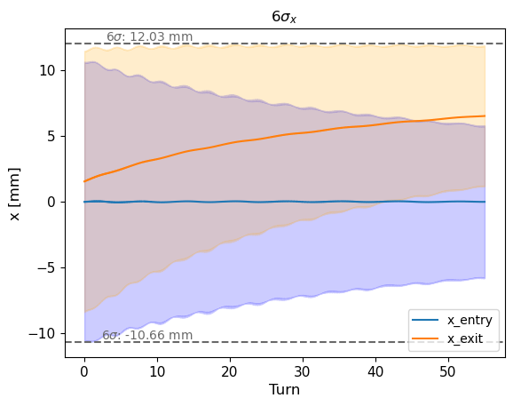
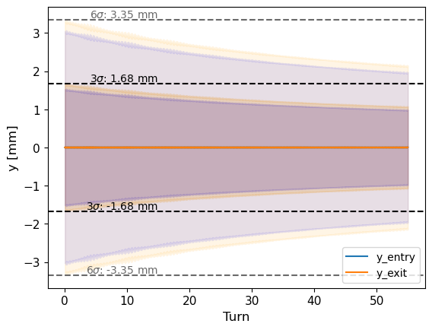
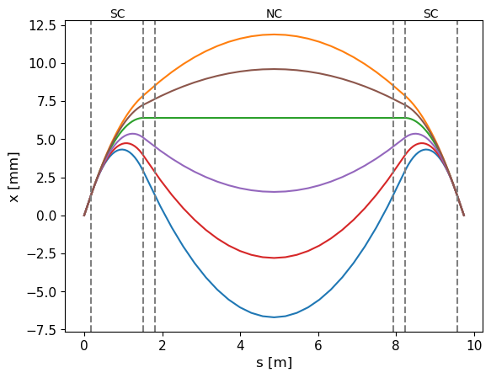
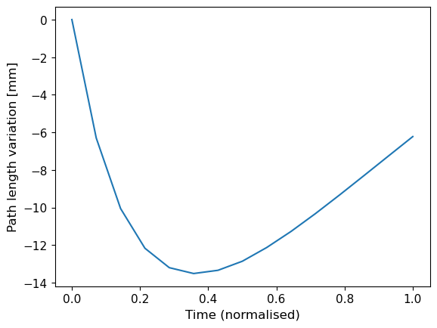
Good field region of SC dipoles
Courtesy: L. Soubirou
Reference traj B_{NC}=0

Slide 18
Outline
General parameters
Arc cell and tracking
RF parameters
Collective effects
NC magnet parameters
SC magnet parameters
Radiation issues
Summary

Slide 19
RF system requirements
Two counter-rotating beams with a single high-intensity bunch
  High transient beam loading
High energy gain to preserve muon lifetime
  High voltage per turn → high cavity gradient & large number of cavities
Short acceleration time
  Cavities will be operated in pulsed mode (duty cycle of a few %)
Beams must be kept stable during acceleration despite large synchrotron tune
  Separation of RF system into multiple stations all around the ring
RF-frequency swing will be required to compensate for changing orbit lengths in hybrid RCSs
  Fast reactive tuners necessary
Non-linear energy gain leads to the requirement for additional cavities
  The maximum number of cavities has to be installed but is not required during the full acceleration time.

Slide 20
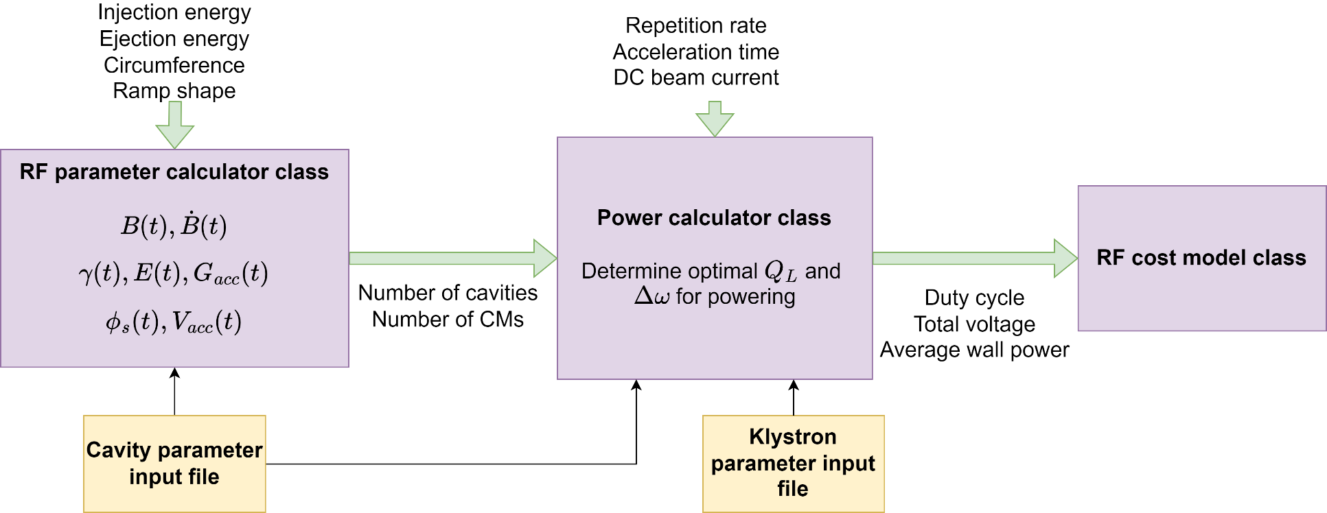
Tools to optimize RF parameters of high-energy acceleration chain
Integrated software package for combined optimization of energy ramp and RF parameters https://gitlab.cern.ch/muon-collider-bd/rcsparameters
Courtesy: L. Thiele
The magnet ramp shape defines the voltage shape / RF requirements!
20

Slide 21
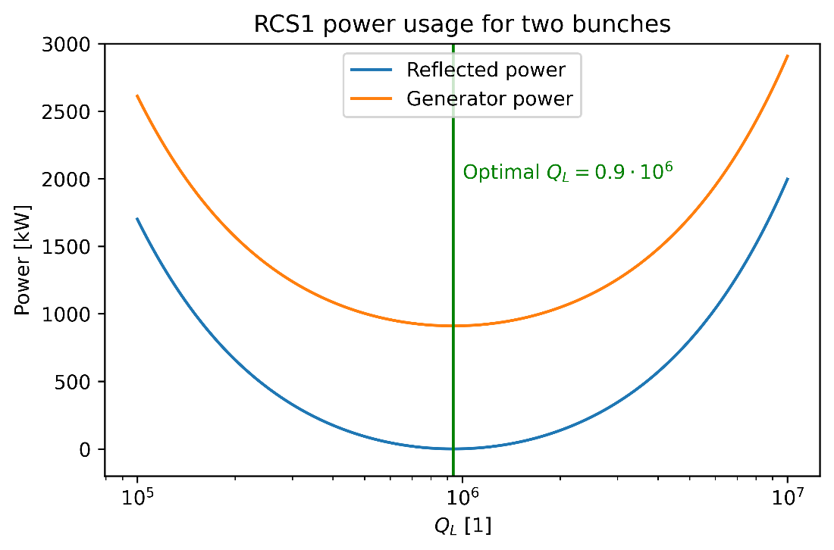
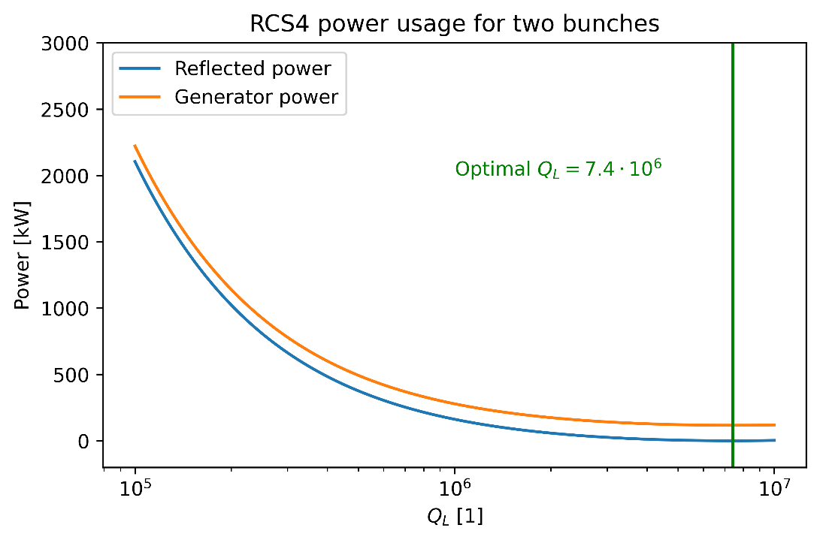
Beam loading compensation
Courtesy: L. Thiele
The power consumption is calculated based on the formulas derived in Cavity-Beam-Transmitter Interaction Formula Collection with Derivation.

Slide 22
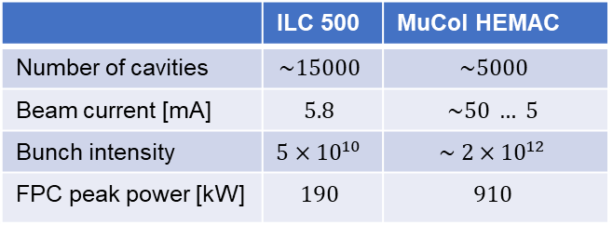
RF parameters
Cavity powering
Assuming optimal quality factor and frequency detuning of the cavity
Assuming ideal, linear energy ramp (sinusoidal ramp will require additional cavities)
 | Unit | RCS1 | RCS2 | RCS3 | RCS4
Beam acceleration time | [ms] | 0.34 | 1.1 | 2.37 | 6.37
Cavity filling time | [ms] | 0.23 | 0.25 | 0.50 | 1.81
RF pulse length | [ms] | 0.57 | 1.35 | 2.87 | 8.18
FPC peak power | [kW] | 911 | 818 | 416 | 297
Total peak RF power | [MW] | 850 | 410 | 300 | 460
Average wall plug power | [MW] | 3.72 | 4.25 | 6.56 | 29.2
Number of klystrons | - | 88 | 42 | 30 | 47
Cavities per klystron | - | 8 | 9 | 18 | 64
Number of cavities | - | 700 | 380 | 540 | 3000
 | ILC 500 | MuCol HEMAC
Number of cavities | $$\sim 15000$$ | $$\sim 5000$$
Beam current [mA] | $$5.8$$ | $$\sim 50 … 5$$
Bunch intensity | $$5×{10}^{10}$$ | $$\sim 2×{10}^{12}$$
FPC peak power [kW] | $$190$$ | $$910$$
Courtesy: L. Thiele

Slide 23
Outline
General parameters
Arc cell and tracking
RF parameters
Collective effects (Only RF impedance, beam-pipe covered in next presentation)
NC magnet parameters
SC magnet parameters
Radiation issues
Summary

Slide 24
RCS parameters
Impedance model for this study: RF cavities
High Order Modes (HOMs) only
  Single cavity: Low Loss TESLA type cavity, all transverse HOMs included.
  Assume all HOMs have Q=10⁵. (see https://accelconf.web.cern.ch/p05/papers/tppt056.pdf)
  Multiply by the number of cavities: there are (700, 380, 540, 3000) cavities in (RCS1, RCS2, RCS3, RCS4)
Main assumptions for the RCS are
  32 RF stations in each machine
  One transverse damper unit, located at RF station 9 (~¼ of the ring)
Scan several parameters
  Chromaticity Q’ from Q’=-20 to Q’=+20
  Damper gain from 4-turn to 100-turn + no damper
  Initial transverse offset of the bunch (in each RCS), from 1 μm to 1 mm

Slide 25
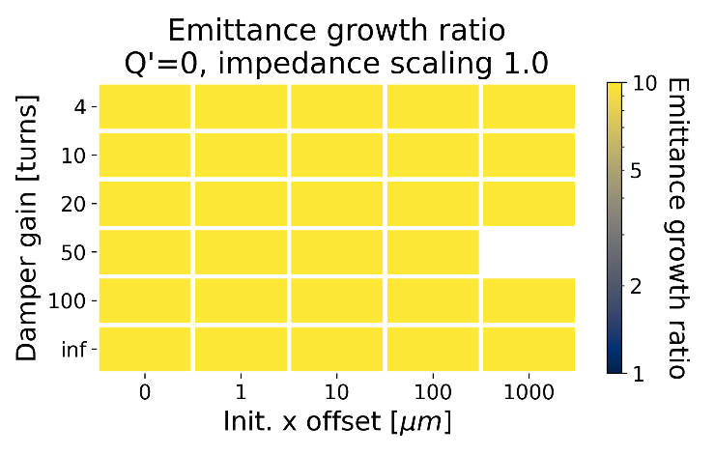
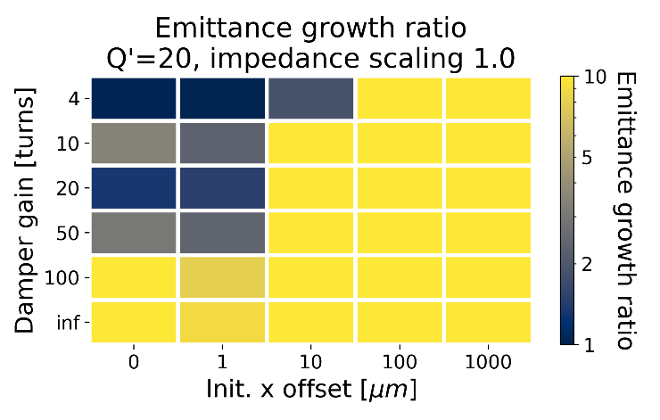
Scans versus positive chromaticity
Chain of 4 RCS (up to 5 TeV)
With the nominal HOMs, a strong damper, 4-turn to 10-turn range, combined with chromaticity Q’=20, are required to stabilize the beam
The admissible offset is reduced to 1 μm level
Courtesy: D. Amorim

Slide 26
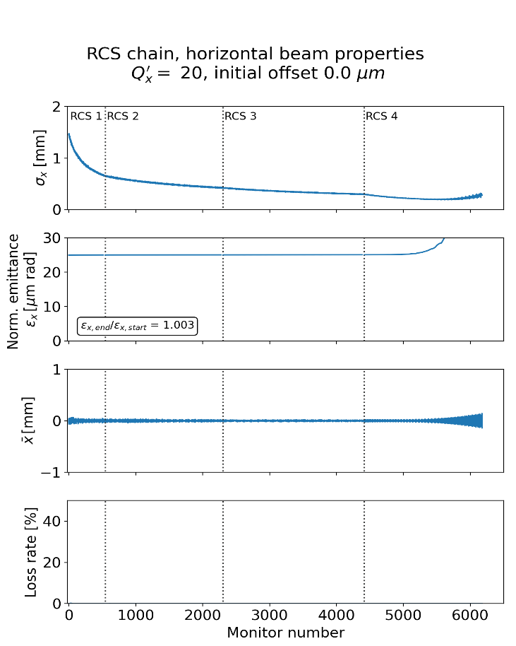
Example of start-to-end simulation with RCS 4
Chromaticity Q’ = 20
No initial transverse offset
A 50-turn transverse damper is included
in each ring (at station #9)
The instability clearly starts in RCS4
Courtesy: D. Amorim

Slide 27
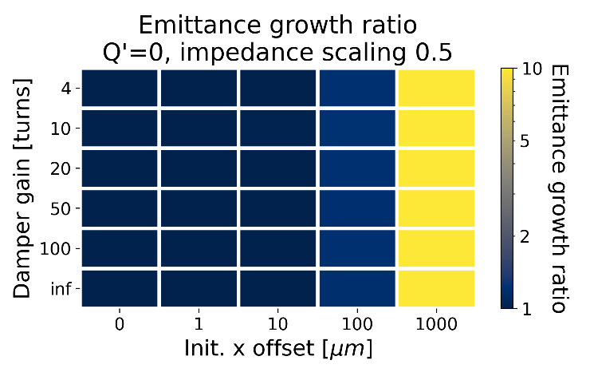
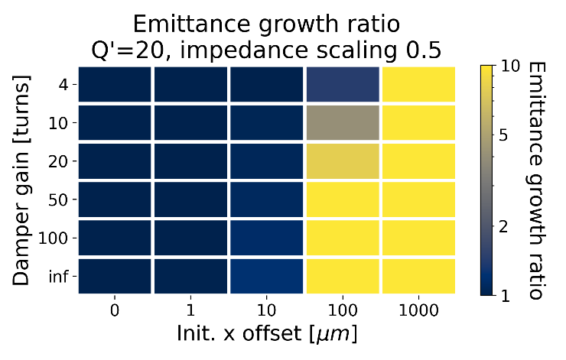
Reducing the R/Q of the modes
Here the full impedance model is scaled by a factor 0.5 → like dividing the R/Q of every mode by 2
We recover transverse coherent stability with larger offset
Courtesy: D. Amorim

Slide 28
Outline
General parameters
Arc cell and tracking
RF parameters
Collective effects
NC magnet parameters
SC magnet parameters
Radiation issues
Summary

Slide 29
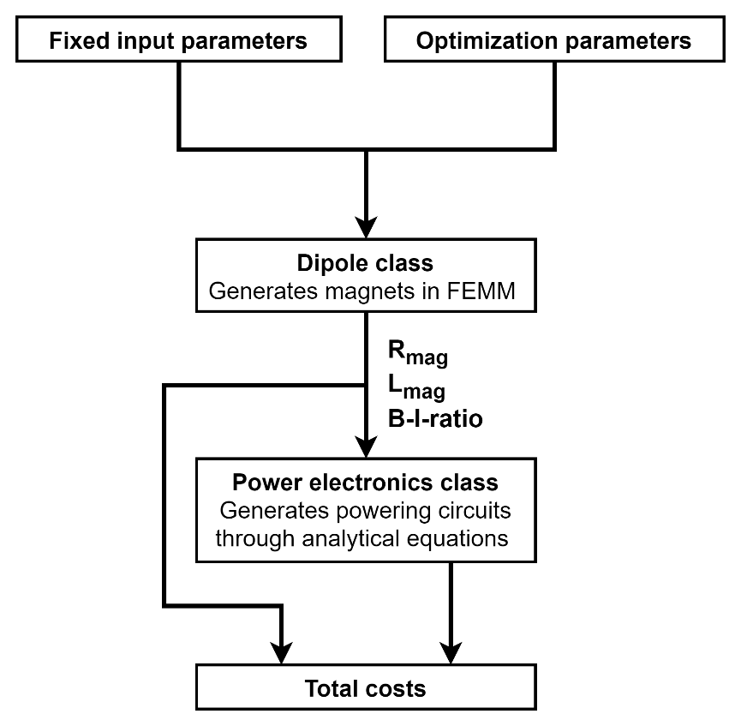
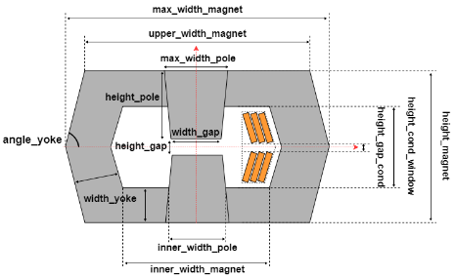
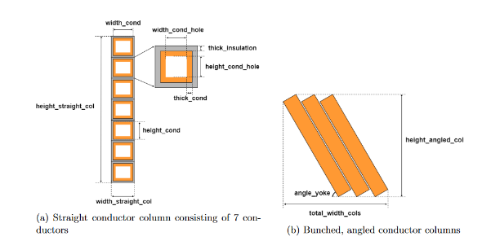
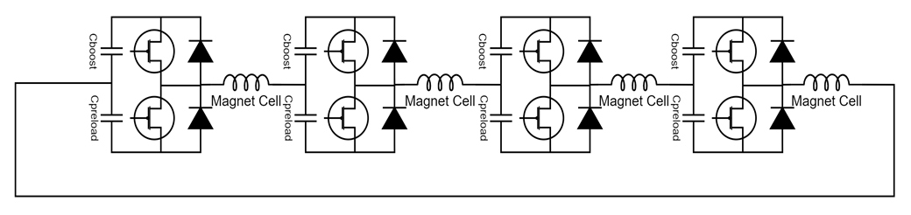
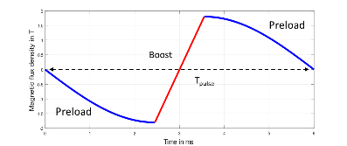
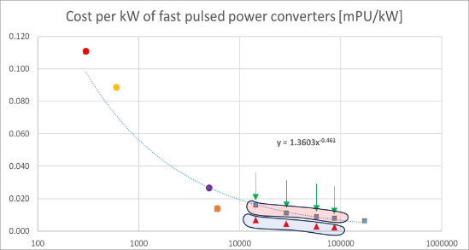
Optimization Process in Python
Some inputs of the Dipole and power converter classes are used as optimization variables. EX: B_max_yoke, B_ratio, pulse_time, height_gap_cond, angle_yoke, sigma_RMS_cycle
Courtesy: F. Boattini
Goal: minimizing the overall costs including:
  Magnet costs (material + manufacturing)
  Capacitor costs including containers
  Power electronics costs
  Operational costs (Losses in magnets and IGBTs, and energy needed for cooling of the coils) for 20 years of operation with 6000h per year
COST MODEL

Slide 30
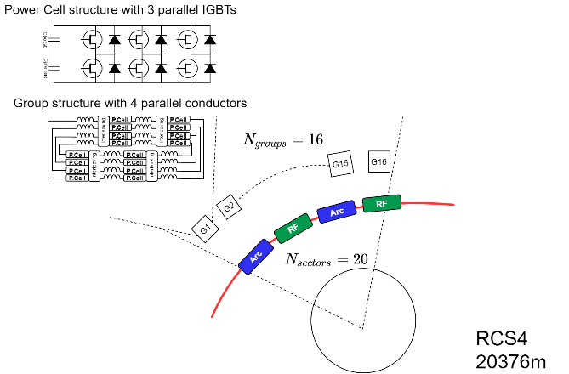
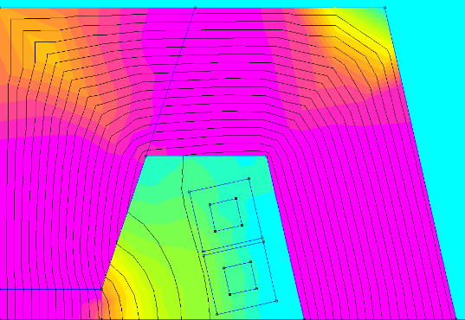

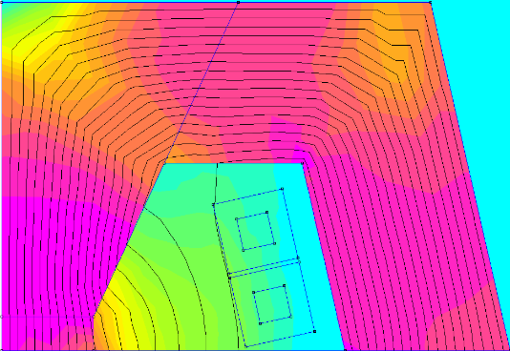
OPTIMIZATION RESULTS: RCS4
224 mm
Courtesy: F. Boattini
Optimization with the new cost model and dipole class
Steel M235-35A
T_{pulse}= 11.0 ms
σ_{rms}= 3.3 A/mm2
mmf = 56562 At
E_{lossIron}= 69 J/m/pulse
E_{losscu}= 588 J/m/pulse
NRG_{stored}= 6393 J/m
153 mm
Steel M235-35A
13 mm
E_{lossMag}= 2615 J/cell/pulse
E_{lossIGBTs}= 233 J/cell/pulse
N_{cells}=5120 → E_{lossTot}=14’581’760 J/pulse
15 mm
50 mm
30 mm
72 mm
221 mm
Optimization with the new cost model and class. Shorter gap 80mm x 30mm
54% of the power cells
T_{pulse}= 20.4 ms
σ_{rms}= 3.9 A/mm2
mmf= 52687 At
E_{lossIron}= 56.6 J/m/pulse
E_{losscu}= 736 J/m/pulse
NRG_{stored}= 5738 J/m
Steel M235-35A
152 mm
Steel M235-35A
14 mm
E_{lossMag}= 5903 J/cell/pulse
E_{lossIGBTs}= 347 J/cell/pulse
N_{cells}=2784 → E_{lossTot}=17’400’000 J/pulse
15 mm
40 mm
31 mm
70 mm

Slide 31
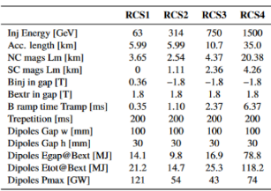
Cost Computation
Using the new cost model for the Power Converters, a new sets of simulations was re-run only for RCS2 and RCS4
 | RCS2(new) | RCS2 (***) | RCS4(new) | RCS4 (***) | RCS4(smaller gap)
NC Magnets cost (*) [pu] | 0.3% | 0.4% | 2.9% | 4.2% | 2.9%
SC Magnets cost [MEu] | 4.0% | 4.0% | 15.5% | 15.5% | < 15.5% (to be updated)
PC cost: power cells [MEu] | 2.5% | 1.3% | 8.8% | 7.4% | 4.8%
PC cost: capacitors [MEu] | 0.1% | 0.1% | 0.8% | 1.3% | 1.0%
Operation cost (losses NC+PC+Cool) (**) [MEu] | 0.8% | 0.5% | 5.3% | 3.4% | 6.3%
Totals | 7.8% | 6.3% | 33.3% (Ncmag+PC 17.8%) | 31.9% | <30.5% (Ncmag+PC 15%)
Courtesy of Siara Fabbri and Luca Bottura
The effect of reducing gap width by 20% brings a reduction in cost of about 16% of the Ncmag + PC costs.
The reduction of SC magnets’ cost is not included here.
(*) to be verified by magnets’ experts
(**) 20years 6000h/year. Cable losses are not included
(***) Old cost model. Presented here: IMCC Annual 2024

Slide 32
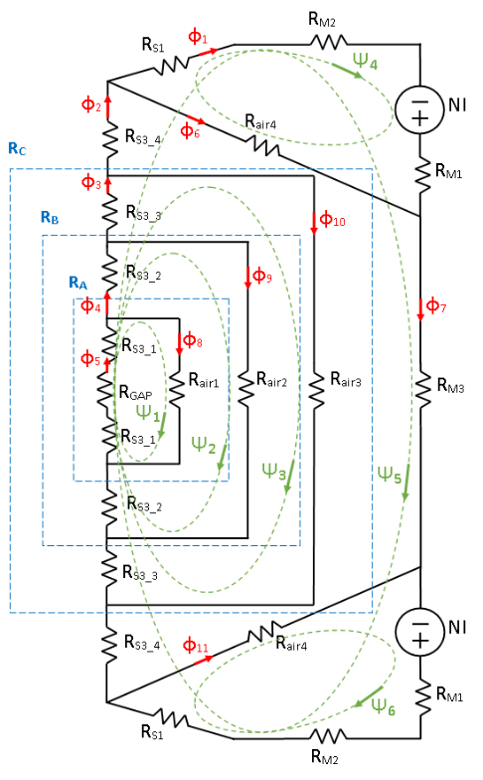
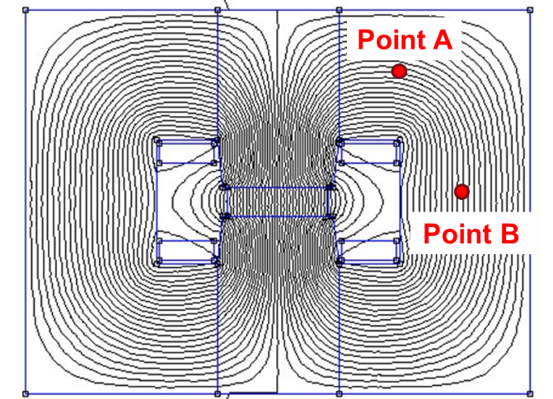
Magnetic circuit model of the H-type magnet
Courtesy: C. Bartoli
To reduce the computation time wrt the FEM model, an equivalent circuit model of the H-type magnet was developed
The circuit was solved with mesh analysis

Slide 33
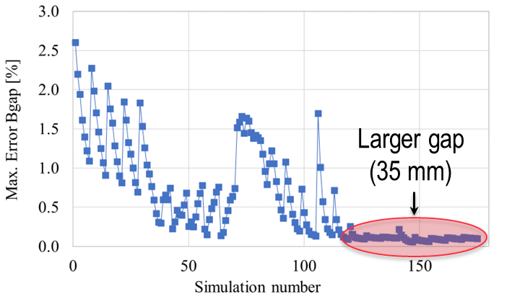
Comparison between magnetic circuit and FEMM
 | Min. (mm) | Max (mm) | Number of values
Gap width | 80 | 120 | 5
Gap height | 25 | 35 | 5
Coil width | 39.5 | 69.5 | 7
A parametric study was launched to compare FEMM and magnetic circuit with different geometries.
175 configurations studied, computing the maximum error with 10 values of transport current on Bgap, Etot, F.
13% peak error on the flux
Computation time is reduced from 177 s to 1.5 s
Courtesy: C. Bartoli

Slide 34
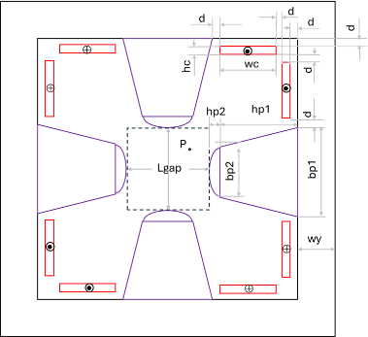
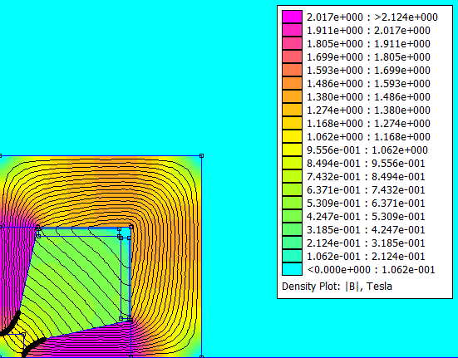
Resistive quadrupole magnet design
Preliminary simulations performed in FEMM
  Material: M235_35A steel
  Lgap: 100 mm
  Jop = 20 A/mm²
At present the field gradient found is 22 T/m
Setup of the optimization procedure ongoing, with the criteria:
  Objective: minimize magnetic energy
  Constraint: field gradient >= 30 T/m
Courtesy: C. Bartoli

Slide 35
Outline
General parameters
Arc cell and tracking
RF parameters
Collective effects
NC magnet parameters
SC magnet parameters (pulsed magnets)
Radiation issues
Summary

Slide 36
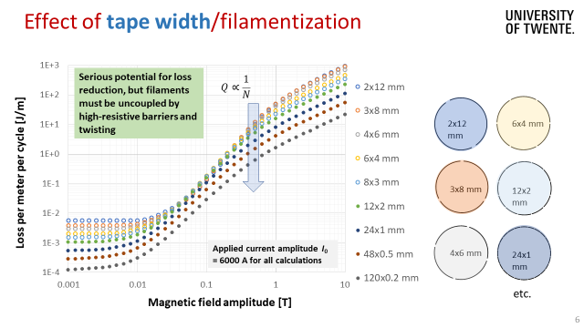

Hysteresis loss in a single single round sub-cable in ReBCO
Courtesy: S. Otten

Slide 37

What level of AC loss acceptable for energy saving?
Courtesy: S. Otten
120x 0.2 mm layout yields AC loss below maximum cryogenic heat load for 15 K < T < 35 K !

Slide 38

HTS pulsed magnet test stand
Courtesy: H. Piekarz

Slide 39


Experience with pulsed SC dipoles at GSI
Courtesy: K. Sugita

Slide 40


Experience with pulsed SC Qpoles at GSI
Courtesy: K. Sugita

Slide 41
Outline
General parameters
Arc cell and tracking
RF parameters
Collective effects
NC magnet parameters
SC magnet parameters (static magnets)
Radiation issues
Summary

Slide 42



Accelerator Superconducting Magnets
Courtesy: S. Fabbri
Parameters
10 T at the center
Rectangular aperture 30 mm x 100 mm
Field quality in good field region TBD (ex. $b_{n}<10$units)
Considerations
Attempt to use uniform technology throughout the collider complex
  HTS windings (for robustness)
  High current density (for cost reasons)
  Operation at high temperature (for energy efficiency)
Parameter | Unit
Minimum central field $B_{0}$ | T | 10
Free aperture (height x width) | mm2 | 30x100
Field Quality limits | units | 10, 50 ( to be iterated with beam physics )
Field quality homogeneity (B1 change) | %
Good Field region (height x width) | mm2 | 10 mm x 20 mm
Operating temperature |  | TBD
HTS tape dimensions |  | 12 mm x ** mm
Magnet length

Slide 43




Numerical Optimization Routine
Courtesy: S. Fabbri
An approach to best optimize field quality and cost
Input constraints:
  Search resolution
  Space the RTs can exist in
  RT constraints (minimum length in x, thickness in y (12 mm))
  Current Density (<700 A/mm2)
Limitations: does not include Iron
30 mm
100 mm
  Racetrack Model 2D and 3D

Slide 44




Numerical Optimization Routine – Example: 3 racetracks
Courtesy: S. Fabbri
To investigate further to understand advantages/disadvantages compared to 2 racetracks, etc.
1.
2.
Goals going forward: finish study considering up to 6 racetracks, considering cost, field quality (*Updated), and engineering complexity $→$Integrate with ROXIE simulations.

Slide 45




Configuration 1 @ 10 T
B [T]
Courtesy: T. Maiello
Block no. | X [mm] right lower corner | Y [mm] right lower corner | No. of conductors | No. of tapes
1 | 142.6 | 20.0 | 40 | 600
2 | 150.0 | 42.2 | 39 | 585
3 | 106.4 | 71.4 | 31 | 465
Iron yoke
Radius [mm] | 300
A [mm] | (170.0; 103.6)
B [mm] | (34.1; 68.4)
Homogeneity (x=25mm) = 0.097%
A
3
B
100 mm
2
Tot. Structure [k€/m] | 25.9
Tot. Assembly [k€/m] | 20.0
Tot. Conductor [k€/m] | 127.1
Tot. Cost [k€/m] | 173.0
1
30 mm
$$B_{0}=10.0370 T$$

Slide 46




Configuration 2 @ 10 T
B [T]
Courtesy: T. Maiello
Block no. | X [mm] right lower corner | Y [mm] right lower corner | No. of conductors | No. of tapes
1 | 146.0 | 20.0 | 40 | 600
2 | 146.0 | 42.2 | 40 | 600
3 | 106.4 | 71.4 | 31 | 465
Iron yoke
Radius [mm] | 300
A [mm] | (170.0; 103.6)
B [mm] | (34.1; 68.4)
Homogeneity (x=25mm) = 0.13%
A
3
B
100 mm
2
Tot. Structure [k€/m] | 25.9
Tot. Assembly [k€/m] | 20.0
Tot. Conductor [k€/m] | 128.3
Tot. Cost [k€/m] | 174.2
1
30 mm
$$B_{0}=10.0002 T$$

Slide 47
Outline
General parameters
Arc cell and tracking
RF parameters
Collective effects
NC magnet parameters
SC magnet parameters
Radiation issues
Summary

Slide 48

Radiation load on magnets – what to consider

Slide 49


Used shielding in the magnets
Courtesy: S. Marin

Slide 50


Radiation to first cell after RF insertion
Courtesy: S. Marin

Slide 51

Residual dose rates
Courtesy: S. Marin
Notes:
X profile

Slide 52
Summary I
A multi-physics tool for the RCS has been developed and includes RF, powering, dipole, and cost considerations.
  We still need some polishing to reach 5 TeV with realistic parameters.
  Next steps are to optimize the transfer energies and the RCS chain.
First tracking studies have been performed. We can already exclude/retain some dipole designs.
  Next steps are to continue optics studies and include additional errors like misalignment errors and jitters on dipoles.
  Correction schemes should be investigated.
The RCS requires a large, distributed RF system on a comparable scale to the ILC.
  The baseline is 1.3 GHz TESLA cavities but an improved design is planned to be developed.
  RF system cost seems to be comparable to NC magnet system.
  We need further optimization to determine the most efficient solution.
Collective effects show that we need a small RF impedance.
  Iterations on coupler/cavity design is mandatory.

Slide 53
Summary II
Resistive dipole designs are quite stable with good numbers for energy and loss.
  We are now well equipped with design and cost algorithms to go to a global cost optimization.
  The cost model of the power converters has been refined but still requires to be consolidated (we need data!) and should include also civil/electric/cooling engineering costs.
Quadrupole design has started. The procedure for the optimized design of the quadrupole is under development. Specifications need to be verified (gradient and aperture).
SC magnets based on racetracks seem to be attractive taking HTS, 20 K and open midplane as a baseline.
We need to progress with the definition of the aperture for the various magnets: resistive, superconducting, quadrupoles. This should include all components and we need to come to a baseline rapidly.

Slide 54
Summary III
HTS pulsed magnets vs NC magnets:
  Hysteresis loss strongly increases with perpendicular field and need to be minimized through optimal conductor placement and yoke design.
  There will be other contributions to the cryogenic heat load: coupling loss, eddy current loss, heat leaks, etc.
  HTS pulsed magnets would be competitive if well above 2 T (especially for RCS 4).
Radiation load to the magnets:
  The ionizing dose to the NC coils remains acceptable deep in the arcs; shielding might be needed for the first cell after the RF insertion.
  The ionizing dose to the SC coils requires shielding of at least 2 cm around the beam pipe and 10 cm of front shielding.
Radiation protection:
  First studies showed that the residual dose levels of the NC magnets are significant.
  At 40 cm from the magnets they are not significantly higher than in the collider ring.
  Further aspects need to be studied in order to give a conclusive answer if such a high cobalt content is acceptable

Slide 55
Required R&D
Lattice design:
  Develop the concept of hybrid synchrotron (correction schemes).
  Operation with very high synchrotron tune.
  Impedance models with a counterpropagative beam.
RF cavities:
  Low-loss cavity design.
  Fast reactive tuners .
  HOM couplers.
Magnets:
  Magnetic materials in kHz frequency range.
  Energy storage and powering components for high number of cycles.
  Pulsed resistive magnet short demonstrator.
  Pulsed system (powering + magnet) demonstrator.
  Racetrack short model dipole
Radiation and shielding.

