Slide 1
Last two months’ chronology
Wed 23/03: first beam to end of TL1
Mon 28/03: beam to CR + factor 4 combination
Thu 31/03: “near miss” incident on MKS02 + gun problems
Fri 29/04: smoke detection installed + tested, restart RF
Mon 02/05: gun high dark current
Tue 03/05: cathode changed
Fri 06/05: cathode changed again
Wed 11/05: first beam to spectrometer girder 4 + 10
Tue 17/05: first beam to TL2
Thu 19/05: problem with MKS11 fixed => higher power setup
status today: optimized beam up to CR injection

Slide 2
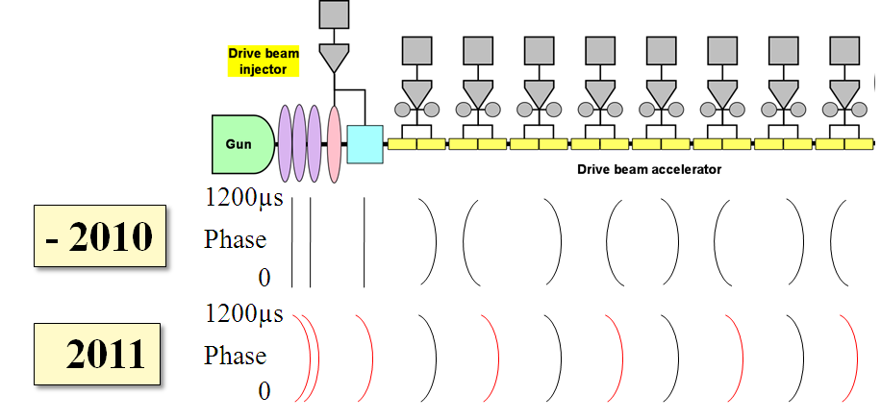
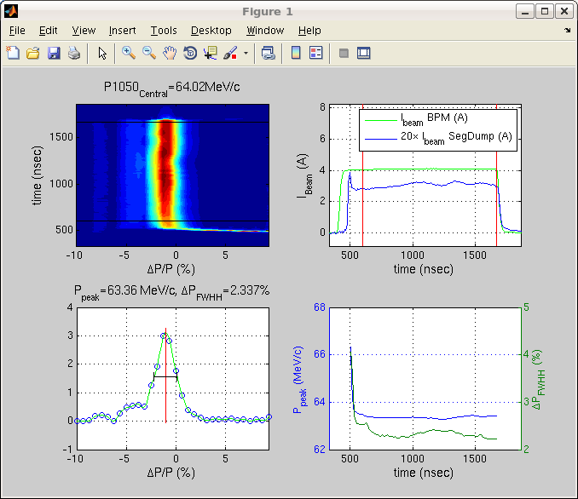
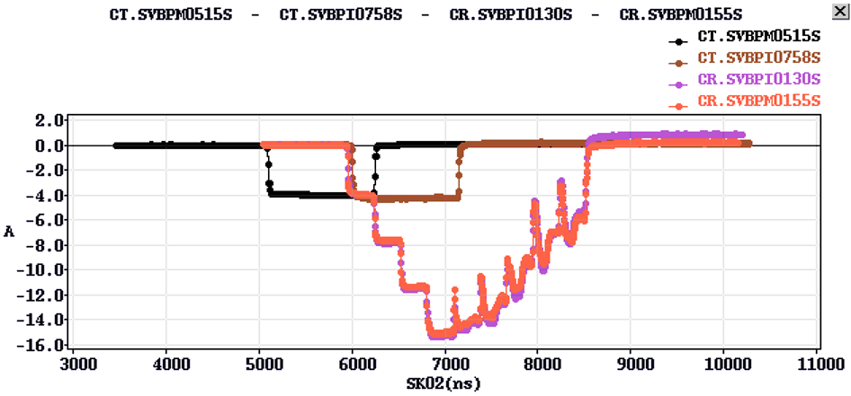
Excellent 3 GHz setup
careful new RF setup
good beam quality
easier and faster set-up
(only one day from end of linac to first factor 4 combination!)

Slide 3

“Near miss” – MKS02 fault 31/03
Smoke from a capacitor bank in MKS02
Quick emergency stop – firemen intervention
Very limited damage
Many capacitors quite old, close to their lifetime limit
Likely mechanism: oil leak > sparking > combustion
Local smoke detectors in place (already planned) > 1 month delay
Other measures: periodic inspections, gradual replacement, software interlock

Slide 4
Selected issues
Controls upgrade of BPMs to ‘virtual samplers’:
  solves problem of overloaded front-ends
  4/05: DCTFUMAL, 13/05: DCTFUMAD, 17.5: DCTFUMAR
  works very well, no connection problems
  issue with signal length to be solved => no multi-turn orbit
MKS02 (rebuilt after PFN damage)
  needed PFN adjustment => gives higher power now
  other PFNs also needed adjustment
  => new beam setup for higher energy
two TWT broken, only one left => no 1.5 GHz beam
  return from repair uncertain (repair has started …)

Slide 5

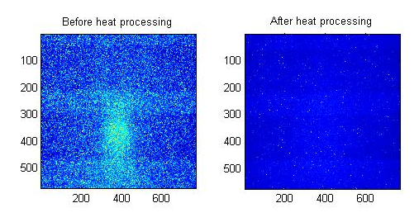
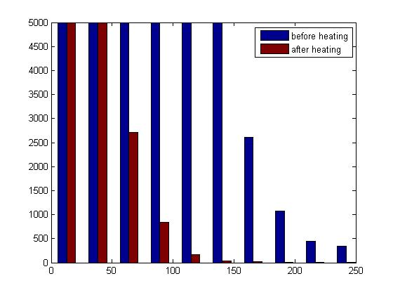
Long shut-down period
From December 14th last year (106 MV/m result)
  MTV’s cameras at the end of Probe and Drive beam lines have been regenerated after irradiation damages. Shielding reinforced (lead and neutron absorber)
  BHB 400 and 800 spectrometer magnets cross checked:
  => no discrepancy found in their magnetic fields
  Thermal control of the ACS tanks water installed
  Much more stable laser beam (no drift in time thanks to the use of optic fibers), automatic resynchronization…
  And of course a lot of work on ACS tank: structure retuned, RF network simplified, pumping improved, RF diagnostics recalibrated…
MTV830 pictures before and after thermal processing
Bright points histogram

Slide 6
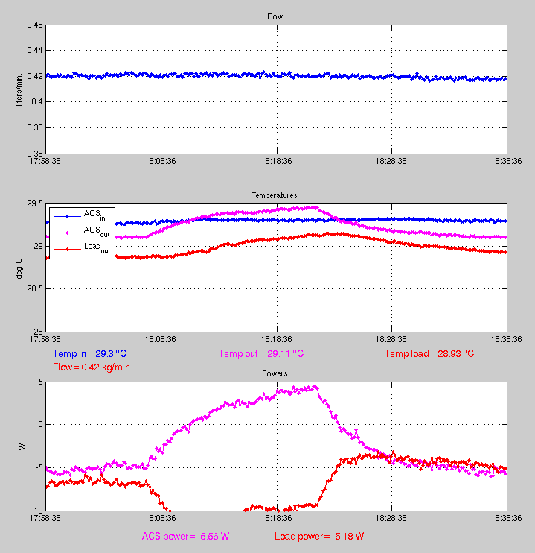
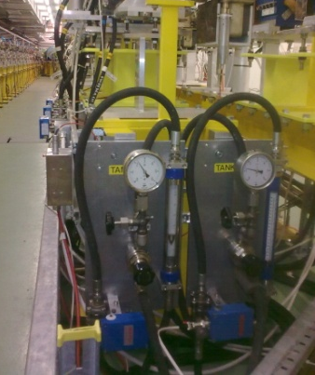
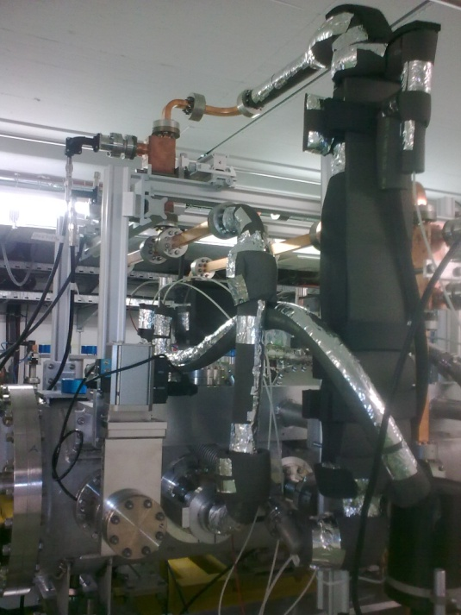
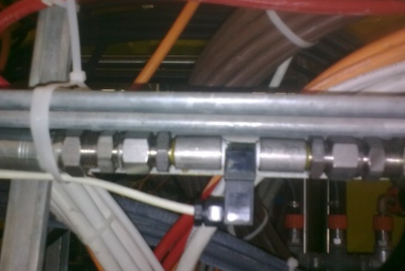
ACS tank water temperature control
Two independent water distributions installed for PETS and ACS tanks
Three PT 100 temperature probes and one flow meter for the ACS
First results obtained by warming the ACS structure with the probe beam are promising (real tests to be done with the RF power)
Water distribution
ACS tank probes and thermal insulation
ACS intercepts the beam
Beam goes through ACS
Turbine flow meter
Beam charge 22 nC - Energy 186 MeV - Repetition rate 5 Hz
Total beam energy 20 W - Energy deposited in ACS = 10.5 W (half !)

Slide 7
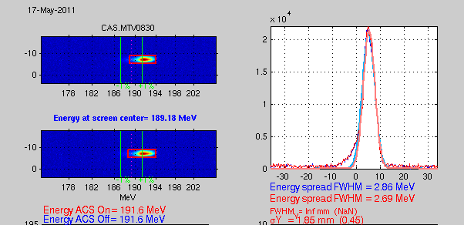
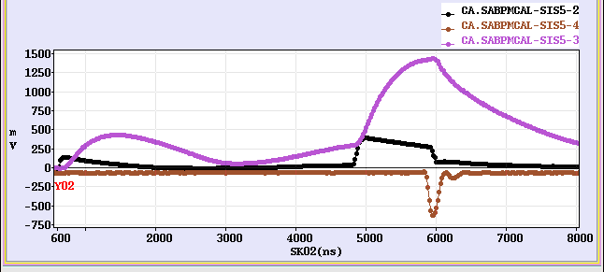
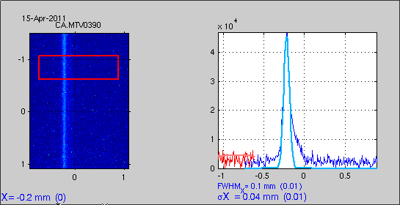
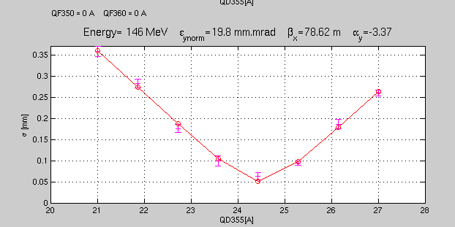
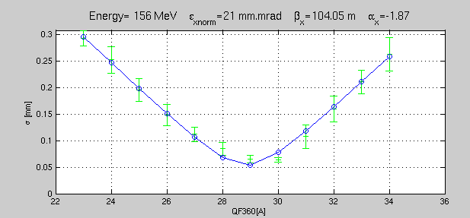
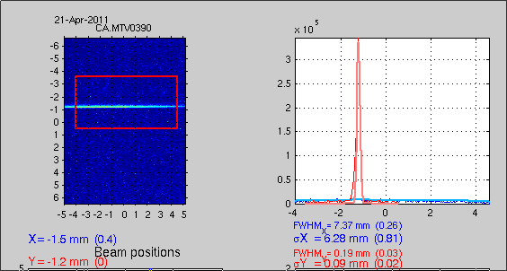
Laser pulse vs. RF pulse timing
Much better QE
(0.5 % instead of 0.3%)
Smaller emittance
Higher energy – 192 MeV
High energy and low energy spread
Gun loop
Compressed RF pulse
Beam
Quad scan results

Slide 8
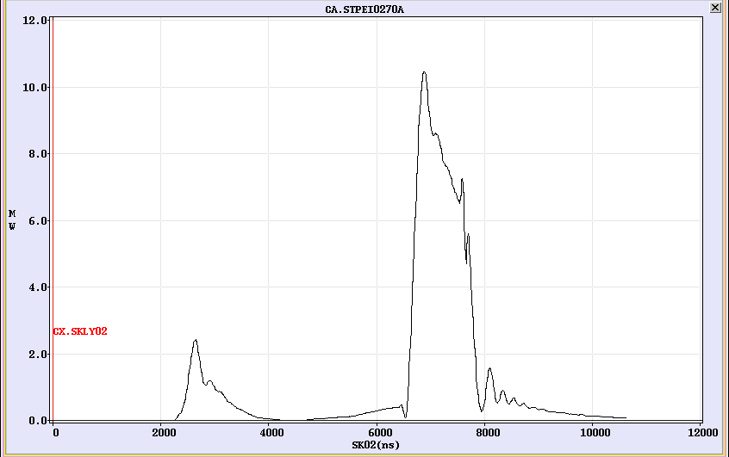
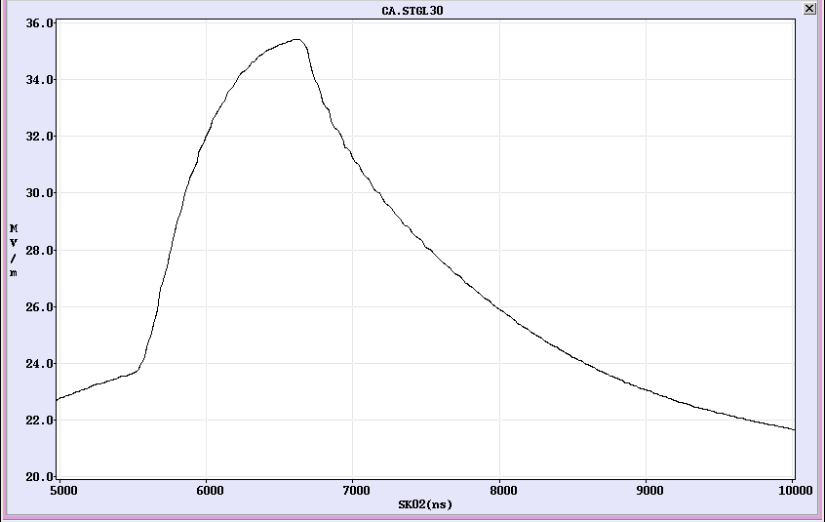
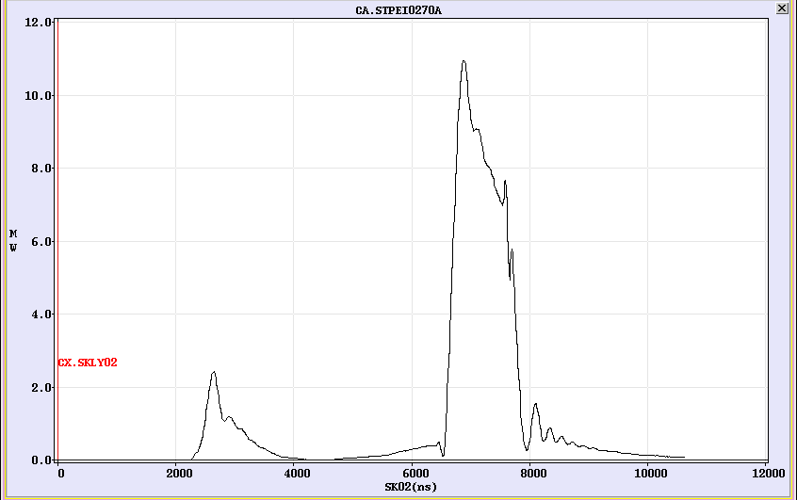
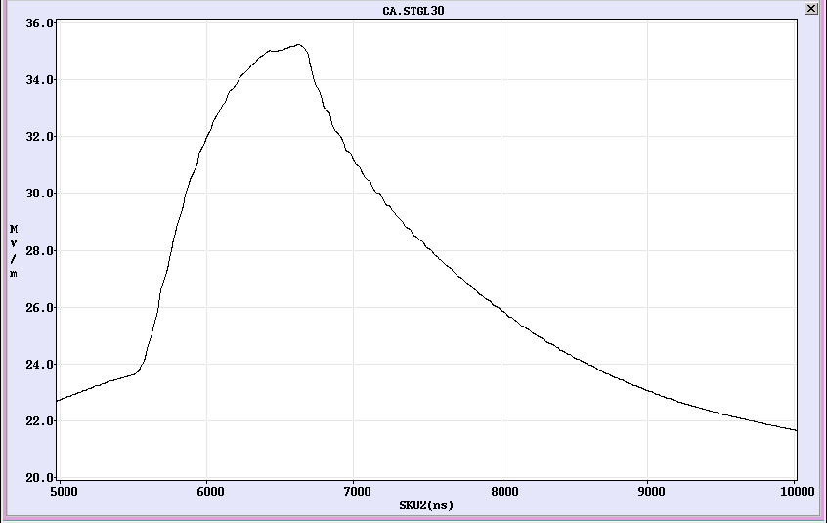
First evidence of beam loading
Obtained with long pulses : 200 ns – 300 bunches – 21 nC
Gun loop loaded
Gun loop unloaded (laser stopped)
RF Structure Output loaded
RF Structure Output unloaded

Slide 9
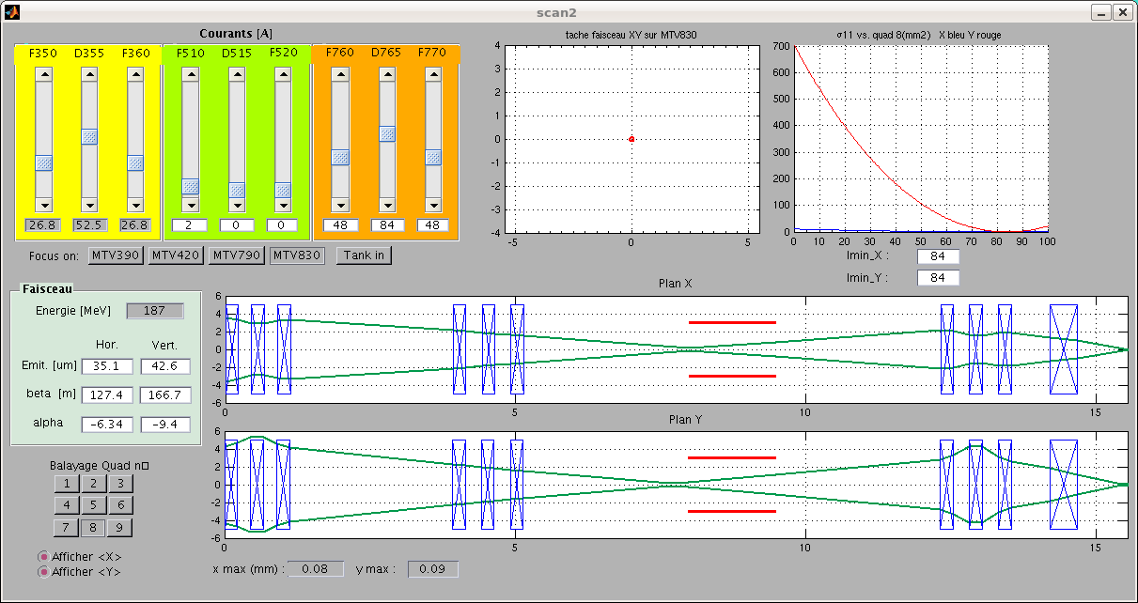
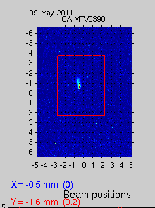
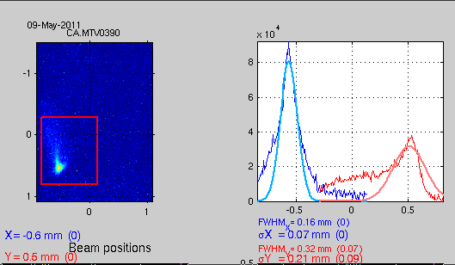
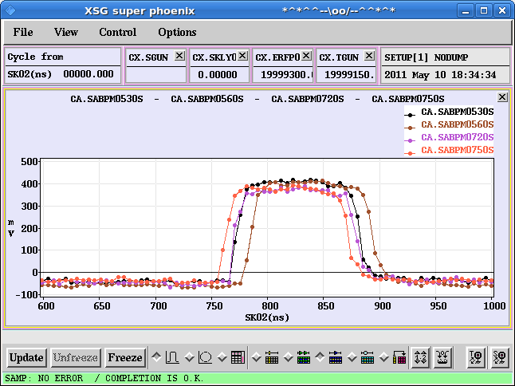
Beam envelope interactive model (flight simulator)
Knowing the Twiss parameters it is easy to draw the beam envelop downstream according
to the quad settings.
Predictions :
Results :
MTV390 with low and with high optical magnification
(very small waist)
TBTS BPMs showing good transport even for long pulses

Slide 10
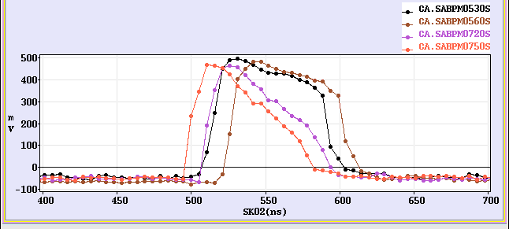
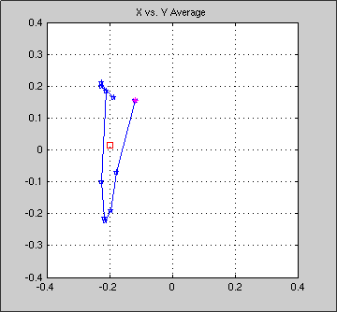
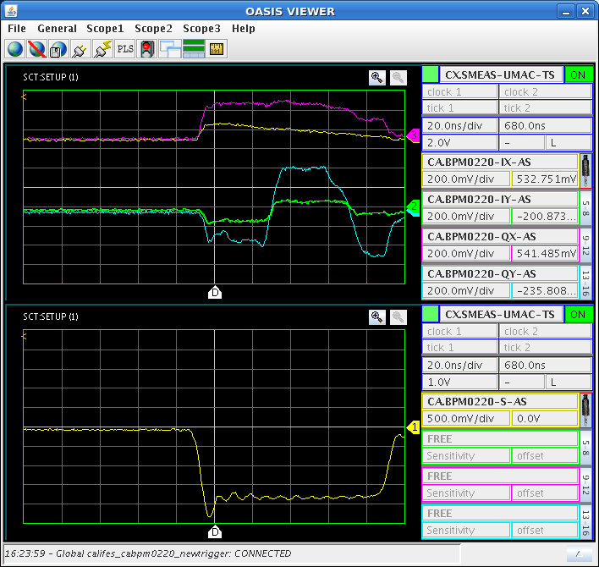
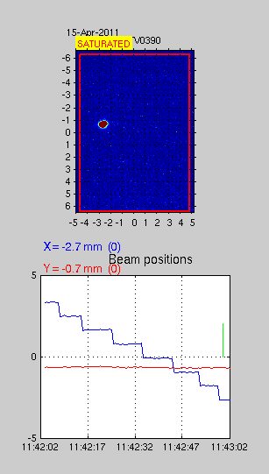
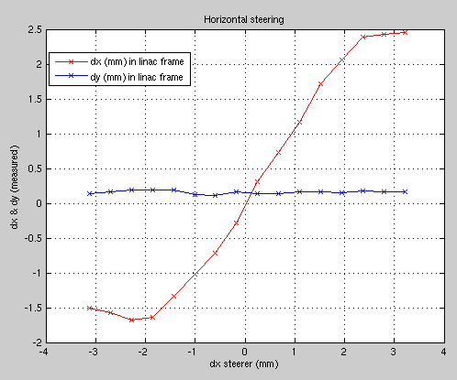
CALIFES BPMs work
BPMs difference signals have been calibrated
Position drift seems to occur during long pulses (>100 ns) or maybe phase
Transport problem during pulse through ACS
Beam position vs. time at the gun output
Raw IQ and Sum signals
BPMs calibration procedure

Slide 11
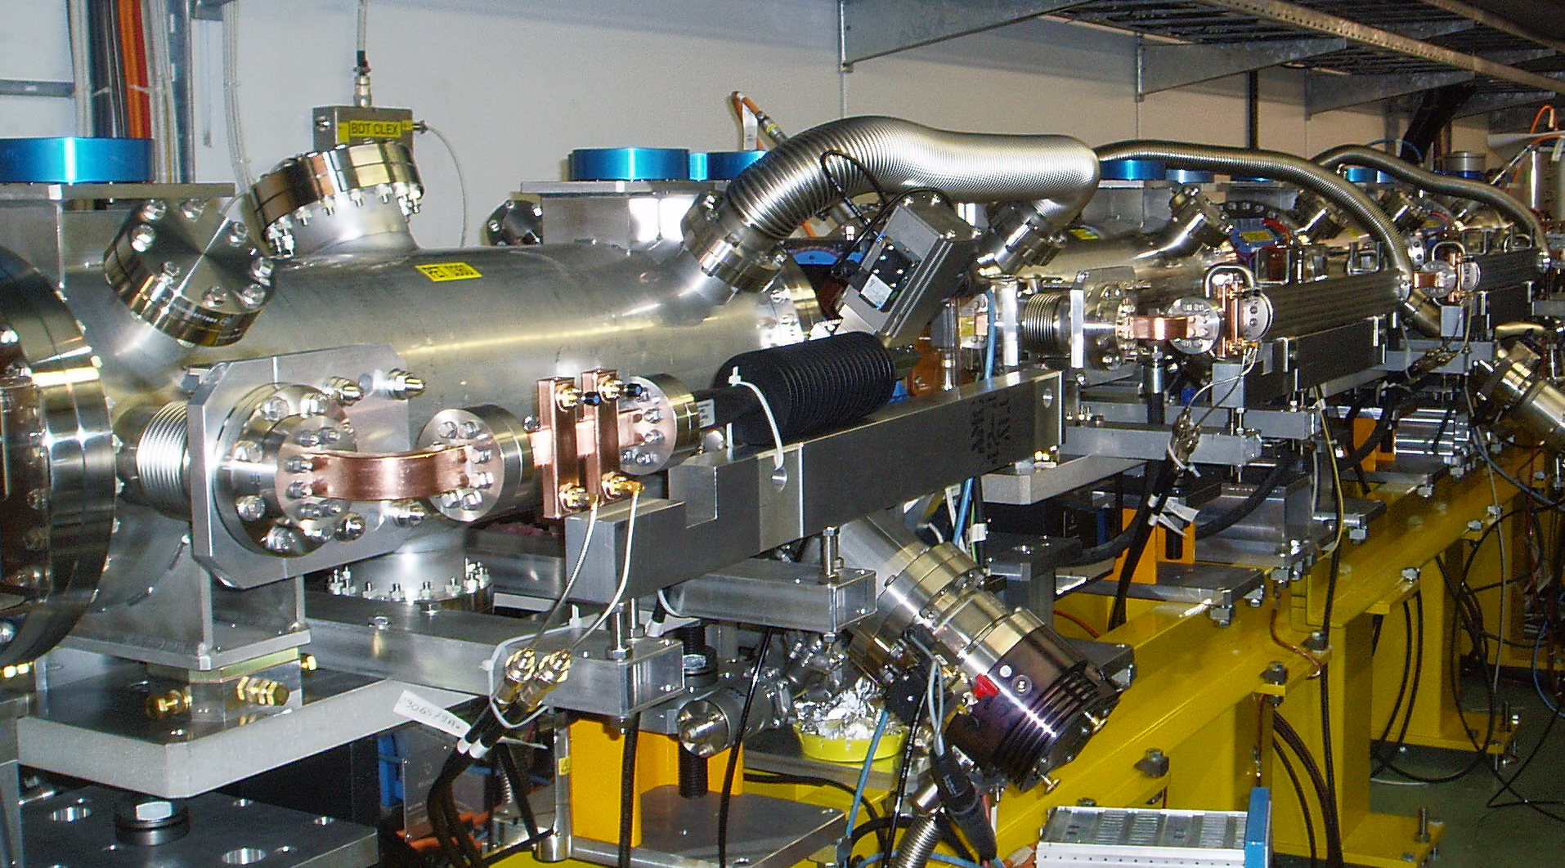
CLEX: TBTS - TBL
TBTS probe beam BPM studies in view of kick measurements
  transverse signals not functioning after gain increase last year
  drive beam amplifiers installed temporarily
  gain not sufficient
  LAPP amplifiers repaired with initial (low) gain
  additional amplifiers to be installed in gallery
  gain improvement is studied
TBL: 3 new PETS installed
– waiting for beam
=> see Steffen’s presentation

Slide 12
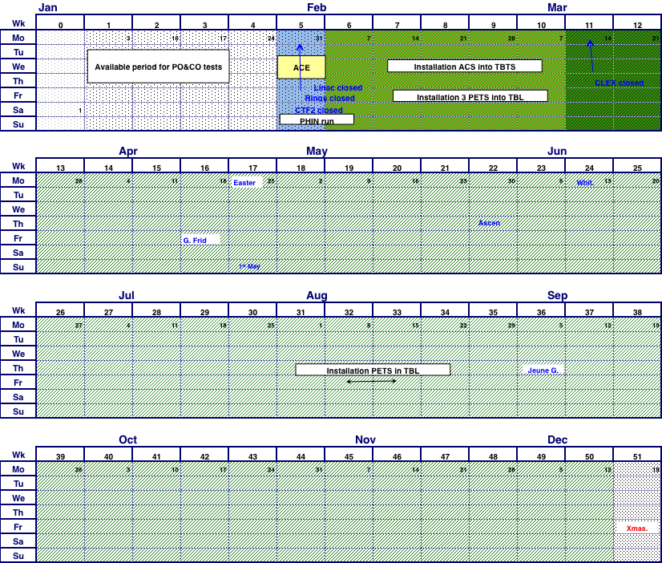
Planning 2011
✔
3 GHz beam setup to CR
initial beam to CLEX
CALIFES setup
1
✔
CR x4 combination
emittance studies
combined beam to CLEX
2
2a
1.5 GHz beam setup
x8 combination
(if TWT is available – only 1 operational)
Smoke in MKS02
One month stop
Gun
2a
3
2
today
3
100 MV/m acceleration
breakdown kicks
TBL deceleration
(1-2 days for DB beam studies)
1
  ε < 150 mm mrad
  longitudinal studies
  stability x8 combination
  (night running for BDR)
INSTALLATION
TBL PETS
PETS on-off
4
4
5
5
    breakdown rate measurements
    PETS / ACS
>
Test of new PETS on-off scheme
TBL deceleration up to 8 PETS
>
Beam phase CSR
rep. rate / losses night supervision

Slide 13
Conclusion
Progress relatively slow due to
  “near miss” on MKS02
  subsequent careful RF setup + adaptation of the beam
  => lost about 2 month (including gun problem)
excellent 3 GHz beam setup
  first 4x combination and beam to TL2 – redoing for present energy
  next: setup combination in CR and send uncombined beam to CLEX
  can profit from the good beam quality for easier setup
1.5 GHz setup will depend on return of TWT
CALIFES was able to operate during the stop, very good set-up, waiting for the drive beam…
Many thanks to all involved, especially to Wilfrid for material!

Slide 14
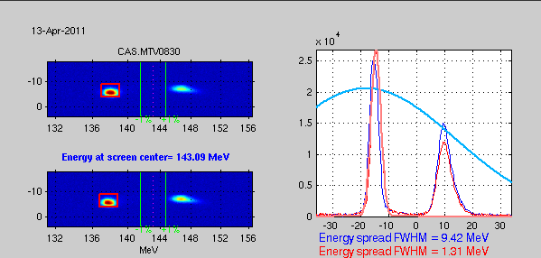
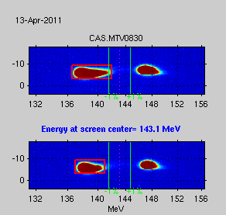
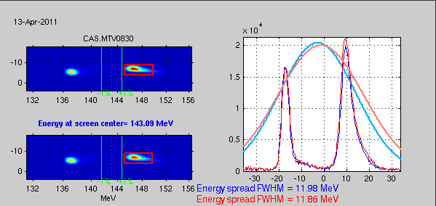
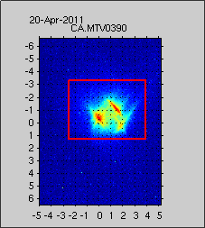
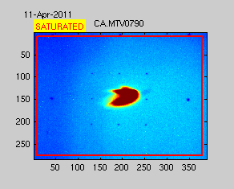
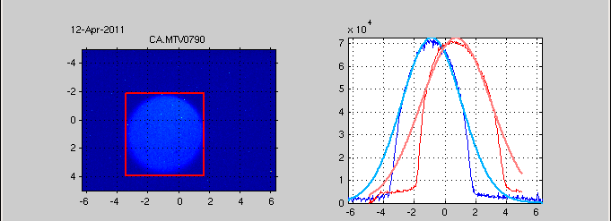
Conclusions - Wilfrid
Ready to resume exciting experiments on Two-Beam Acceleration
And to produce some strange beam pictures
Two different energies in the same beam
ACS shadowing the beam
Three spots in the same beam
Beam and calibration pattern

Slide 15
Spare slides

Slide 16
DB generation – mid 2011
Bunch train recombination
  Consolidate results, routine operation, stability of fully combined beam
Transverse rms emittance
  Complete TL2, TL2’, TBTS commissioning – full transport to CLEX
  < 100 π mm mrad after ring, combined beam
  < 150 π mm mrad in CLEX, combined beam
Bunch length control to < 1 mm rms (combined beam)
  Measurement campaign with different meas. systems
  (RF defl.& screen, fast streak-camera, RF monitors)
  R₅₆ tuning experiments in Frascati chicane and TL2
Beam current stability: improve slow variations, obtain ~0.2 % for combined beam
  Full measurement campaign
  (find correlations, jitter sources)
  Gun pulse flatness, “slow” feedback
  Improve overall klystron stability (at least up to best performing klystrons)
  Slow RF feedback (temp. in pulse compressors)

Slide 17
RF structures – mid 2011
Consolidate RF measurements
Variable power splitter between PETS and ACS taken out
PETS TBTS
  Goal: nominal power / pulse length inside PETS with recirculation
  (135 MW, 250 ns total pulse length, 170 ns flat-top)
  Breakdown rate measurements
  (at high BD rate - extrapolation to lower rates)
  Operation w/out recirculation – may have different breakdown rate…
  Test of new PETS on-off scheme (from summer)
Acc. structure in TBTS
  TD24, initial reconditioning in the shadow of PETS operation
  Goal: nominal power / pulse length delivered to structure
  (65 MW, 250 ns total pulse length, 170 ns flat-top)

Slide 18
Two beam issues – mid 2011
  TBTS
    Two-Beam test – 100 MV/m, with correctly tuned structure
    consistency between power & beam energy gain
    Drive beam, deceleration, power produced
    Probe beam, power delivered to accelerating structure, energy gain
    Beam Loading compensation experiment - by varying fast phase switches – check control of RF pulse shape with probe beam acceleration
    Measurement of breakdown kicks
    Measurement of effect of beam loading on breakdown rate (???)
  TBL
    Measurement of deceleration / produced power
    Measurement of energy spectrum
    Optics, steering algorithm studies

Slide 19
Other issues – mid 2011
CALIFES
  Fully reach nominal parameters (total charge ?)
  Bunch length measurements (RF defl. & screen)
Other
  First measurements of phase stability (PETS output, RF pickups…)
  Operation at 5 Hz
  Control of beam losses
  Coherent Diffraction Radiation (RHUL collaboration)
  …

Slide 20
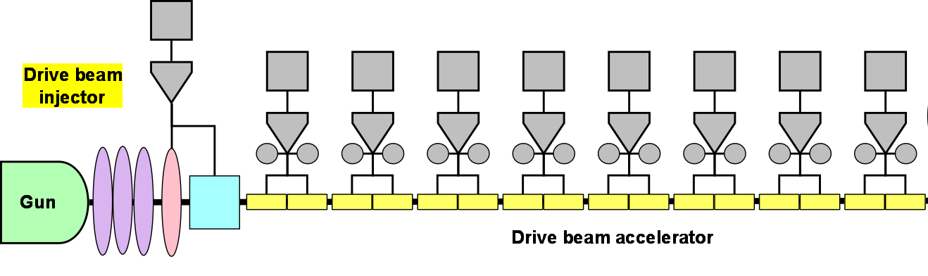
new RF phase setup
1200µs
- 2010
Phase
0
1200µs
2011
Phase
0
same sag for SHBs and pre-/buncher + accelerating structures
=> ∆E/E = 0 along the pulse, no bunch length / energy spread variation
=> tuning all along the pulse identical
still: bunch phase variation – could be compensated in Frascati or TL2 chicane (slight energy shaping along the pulse)
much less sensitive to phase errors [cos(~few deg)]

Slide 21
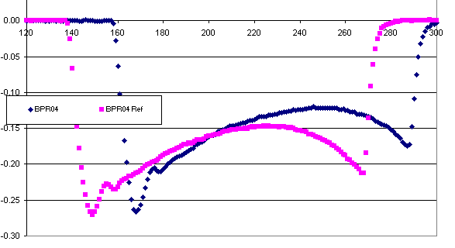
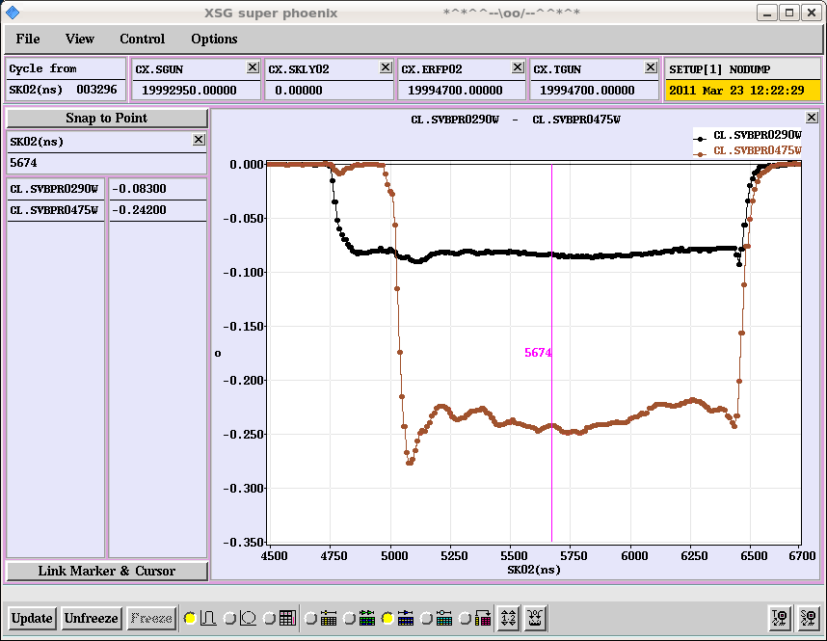
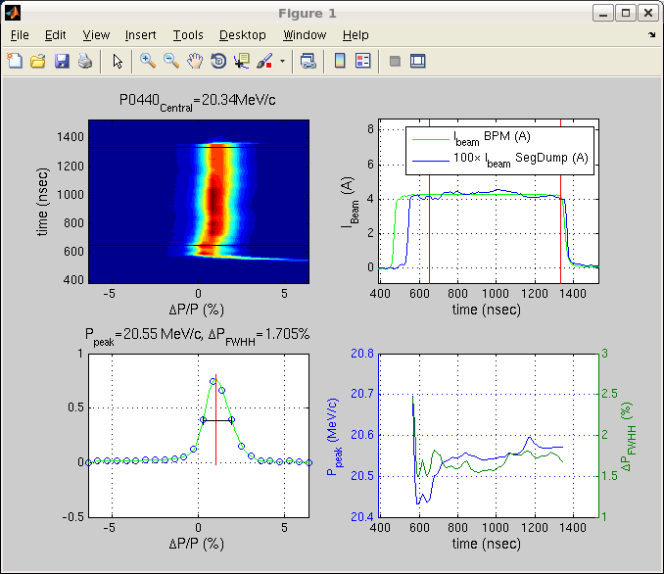
Beam status
~constant BPR signal along the pulse => constant bunch length
2010
2011
=> constant energy + energy spread

Slide 22
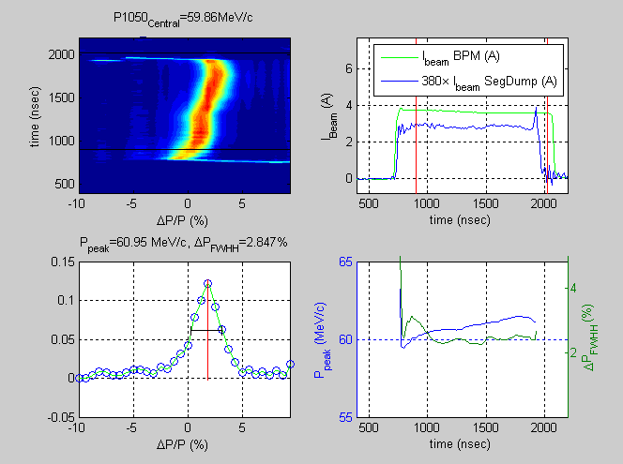
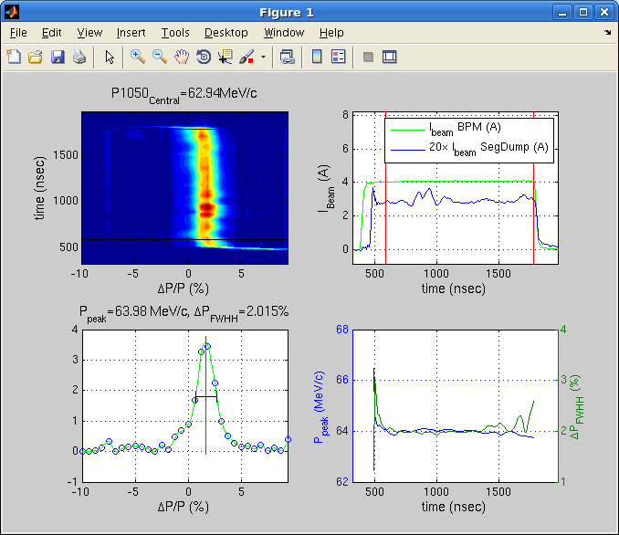
Beam status (cont.)
constant beam energy without special RF shaping
2010
2011

Slide 23
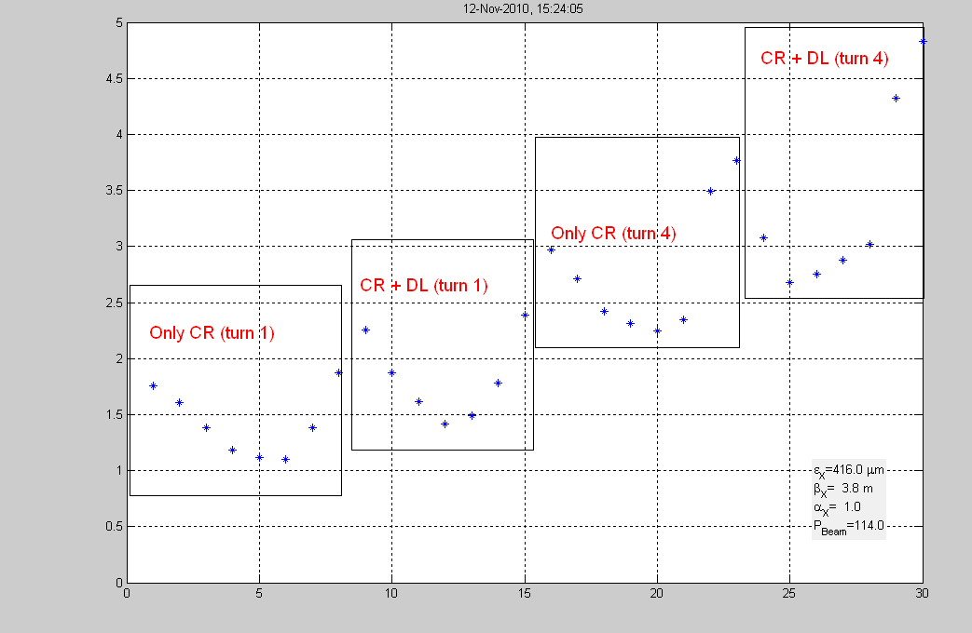
Emittance
measured in H and V for various stages of combination
emittance increase more from CR than from DL
horizontal | CR 1st | DL+CR 1st | CR 4th combined | DL+CR 4th combined
emittance [mm mrad] | 148 | 262 | 532 | 682
beta [m] | 4.8 | 5.0 | 3.7 | 3.6
alpha | 0.9 | 0.9 | 1.0 | 1.2
vertical | CR 1st | DL+CR 1st | CR 4th combined | DL+CR 4th combined
emittance [mm mrad] | 88 | 129 | 152 | 170
beta [m] | 17.2 | 11.0 | 7.3 | 9.9
alpha | -8.1 | -5.1 | -3.1 | -4.3
Simona Bettoni

Slide 24
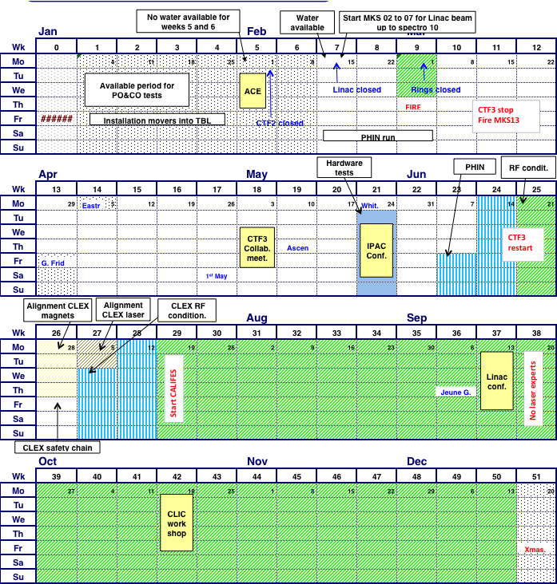
Schedule – restart 31/1/2011
Optics improvements (DL dispersion)
Full transport to CLEX
Bunch length control (first tests)
TBTS initial PETS tests
CALIFES setup
new setup when MKS13 available?
1
2
PETS conditioned to nominal power/pulse length
TBL PETS tests
Accelerating structure conditioned to nominal power/pulse length
  Two-Beam test
  power & energy gain, 100MV/m
3
Beam
1
3
4
  TBL studies
  (limited)
PETS breakdown rate measurements???
2
  Measurement of breakdown kicks
  Beam Loading compensation experiment
5
1
2
3
    Measurement of effect of beam loading on breakdown rate
6
4
5
6
7
Test of new PETS on-off scheme
  TBL studies 30% deceleration ?
8
    Stability studies & improvements
    PETS no recirculation
    Phase stability
    Operation at 5 Hz (or more)
    Control of beam losses
    Coherent Diffraction Radiation …
4
  installTBL PETS
  ??
  <---->
5
6
  2nd TBL PETS installation
  6 weeks PHIN
  phase-coding
  Laser preparation
7
7
8
8

