Slide 1
SR in the FCC-ee arcs – update of the shielding design
B. Humann, A. Lechner
With many thanks to M. Ady, J. Bauche, L. van Freeden, R. Garcia Alìa, M. Hofer, R. Kersevan, M. Hofer, M. Marrone, F. Valchkova-Georgieva
24.04.2024

Slide 2
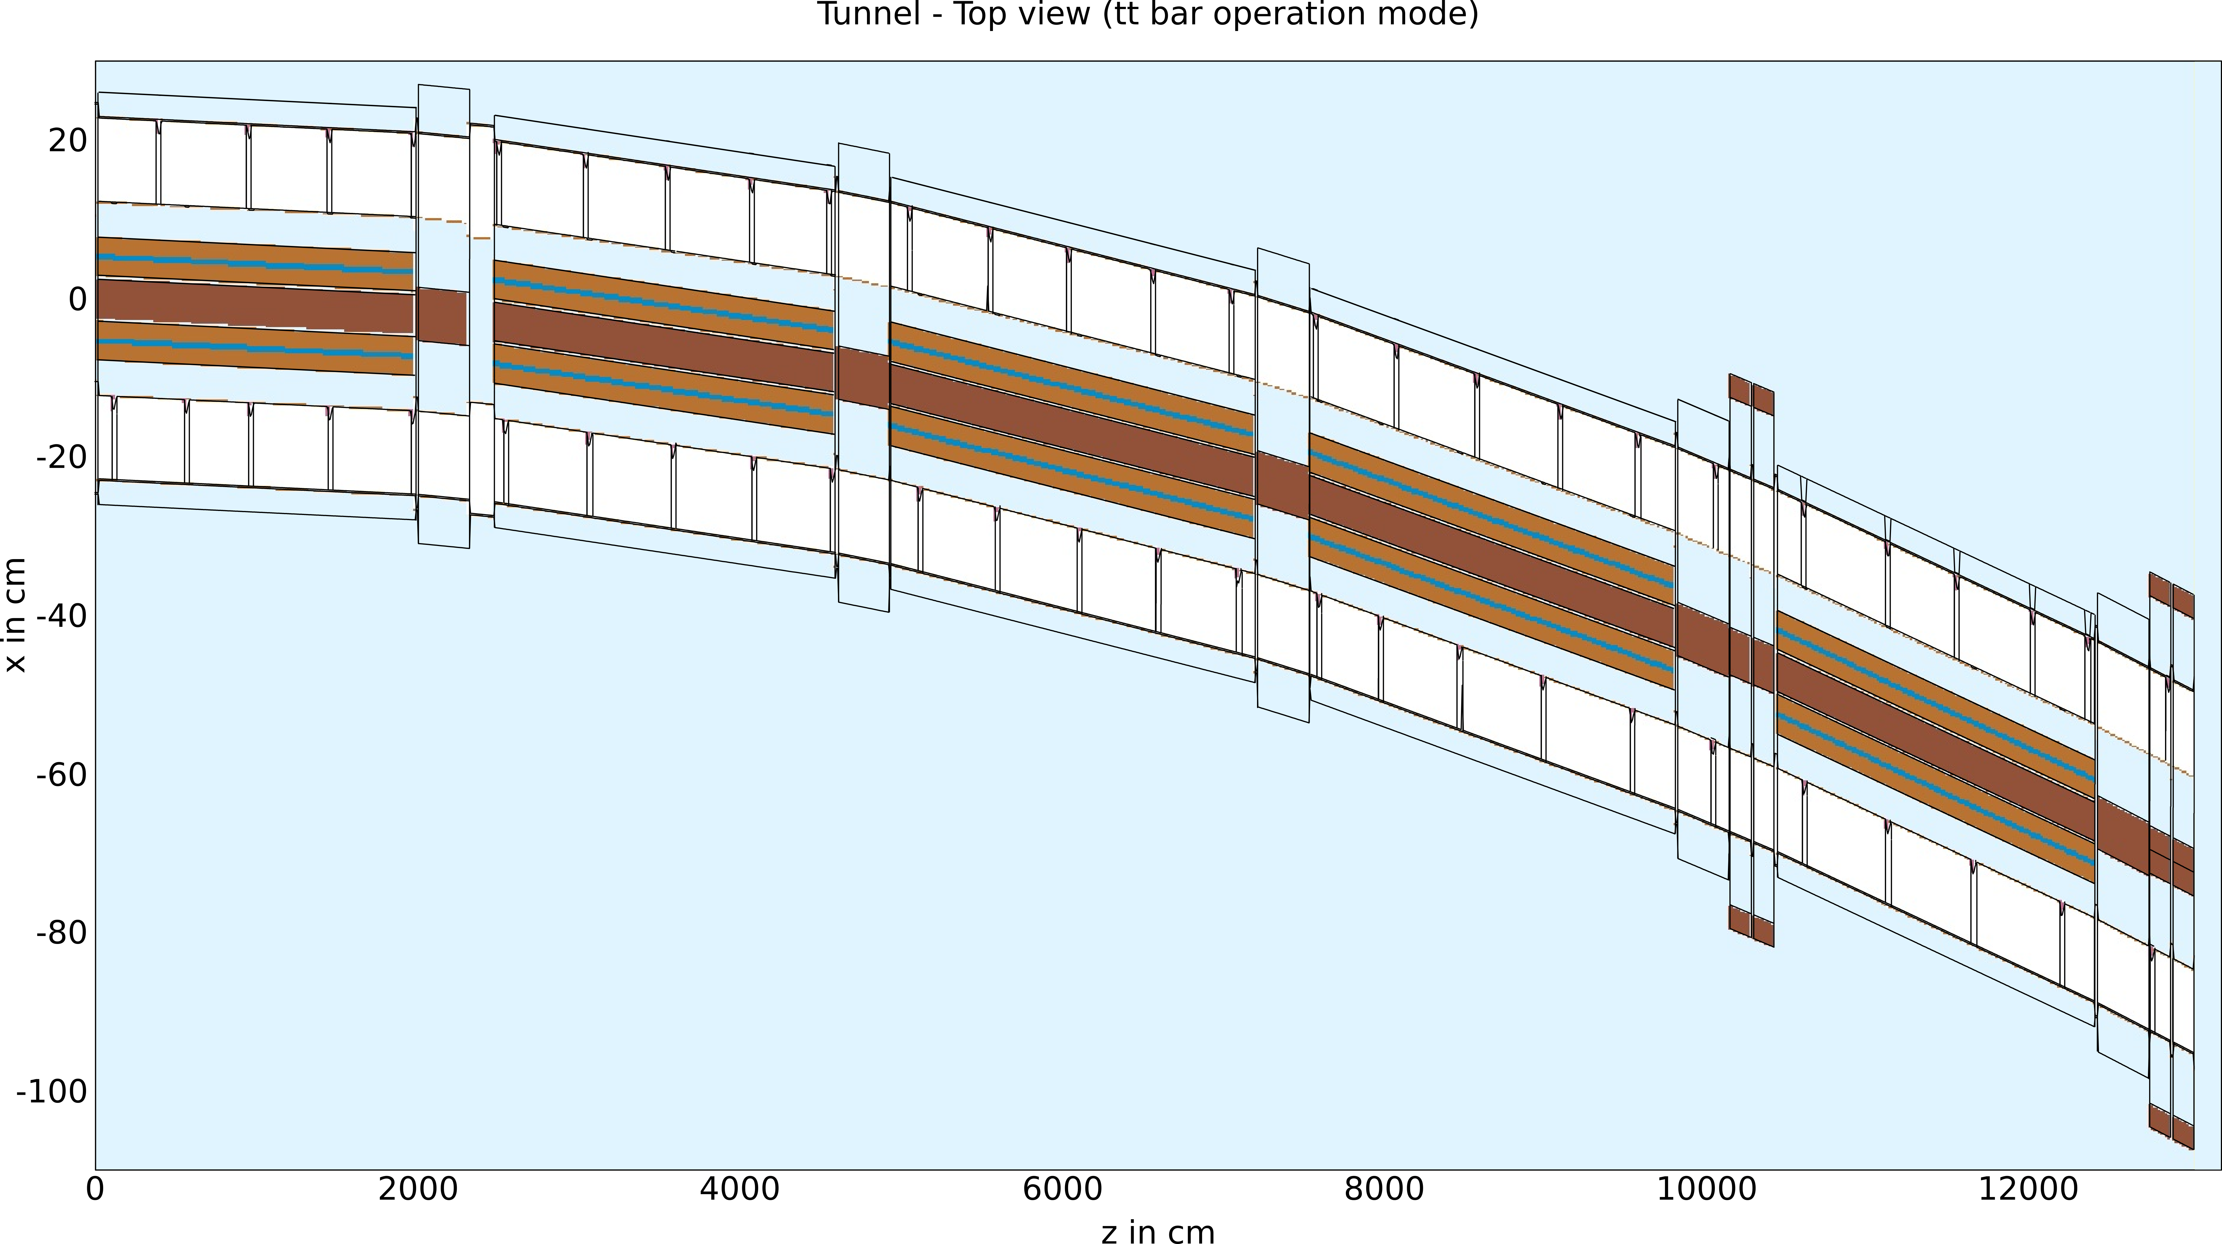
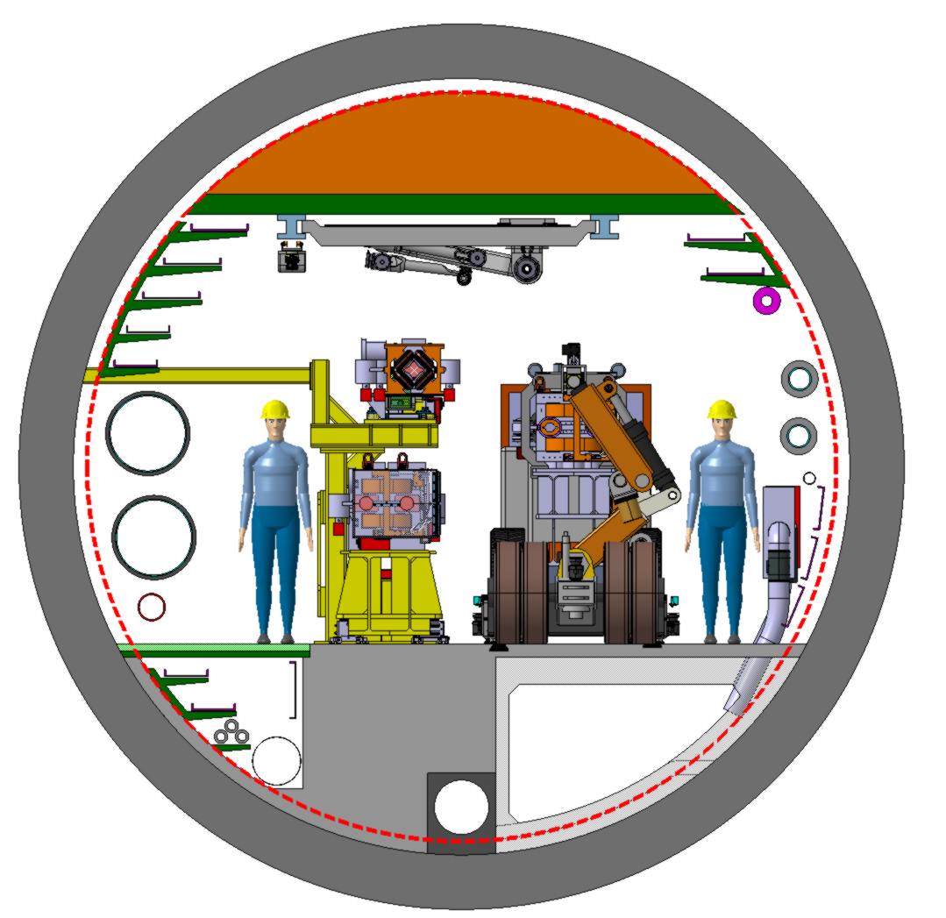
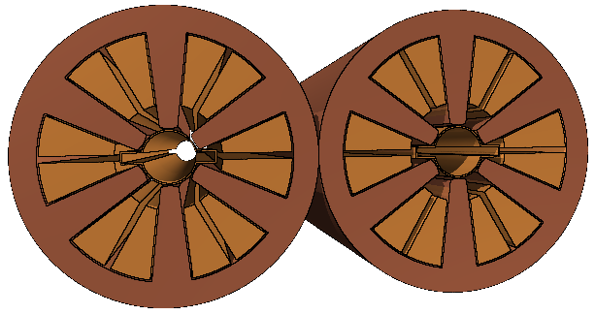
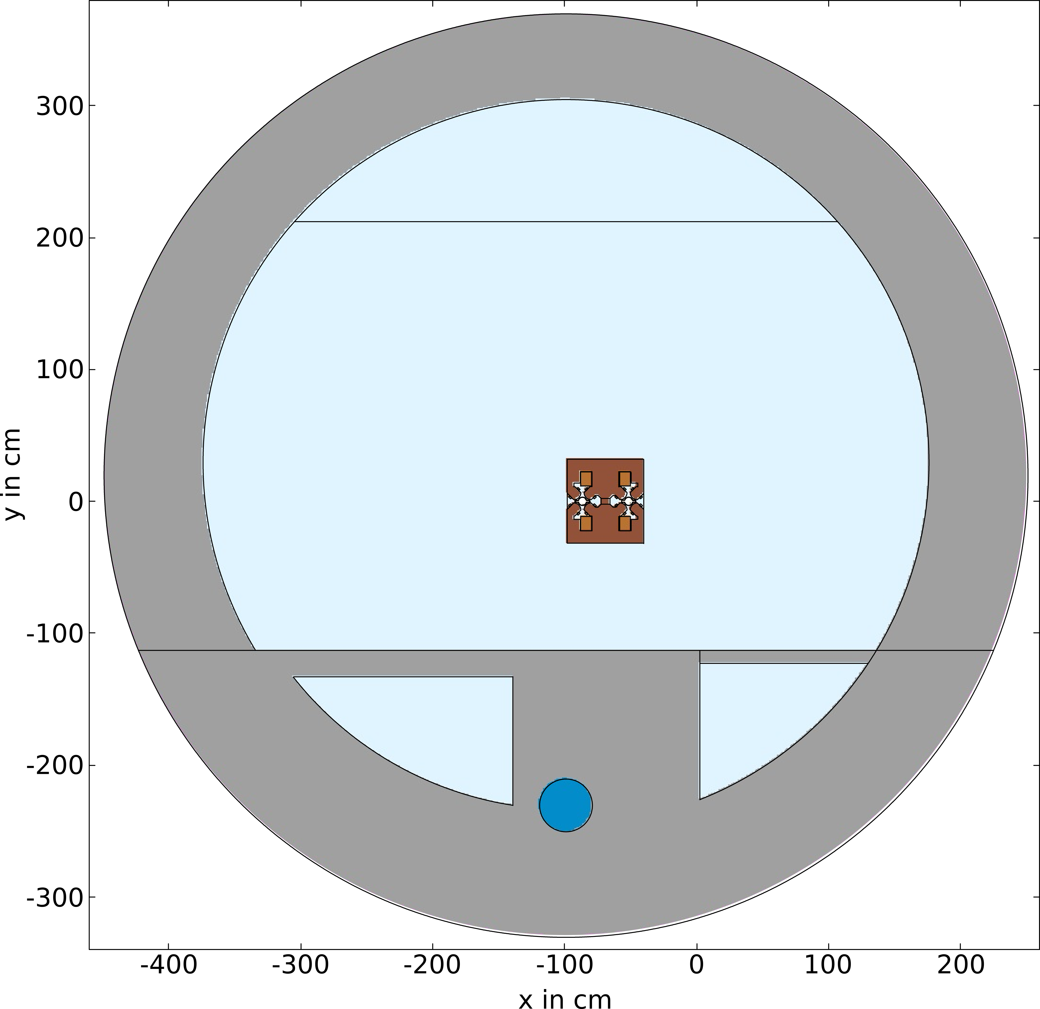
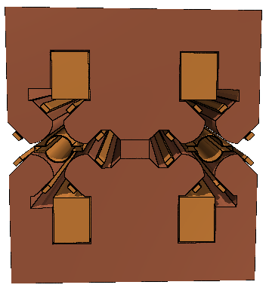
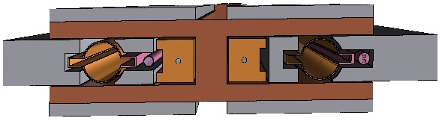
Geometry layout and simulation Setup
Sextupoles
Quadrupole
Dipoles
Collider Center
Collider Center
Latest tunnel cross section
(06/03/2024 Integration Meeting, https://indico.cern.ch/event/1359332/)
Including SR absorbers (pink): 30cm, CuCrZr, cooling pipes included
Additional Pb shielding between the VC and the magnet
This presentation focusses on the setup with additional lead shielding for the ttbar operation mode (182.5GeV, 5mA) as well as for the Higgs operation mode (120GeV, 26.7mA)
Thanks to J. Bauche and L.v. Freeden for the magnet design, M. Marrone for the absorber design and R. Kersevan for the absorber placement

Slide 3
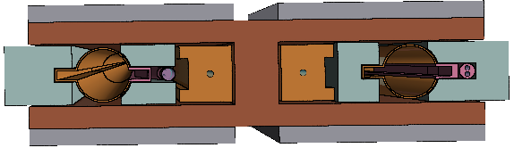
Absorber and shielding design
Shielding Lead + Tungsten (27/03/2024)
Shielding Lead (24/04/2024)
Lead
Lead
Tungsten
Lead
Collider centre
Collider centre
 | Pb + W | Pb
Shielding at VC (60cm long) | W | Pb | Pb due to lower cost but still acceptable absorption properties. The exact alloy needs to be defined.
External extension of shielding | 5cm | 10cm | Increase of the shielding thickness required to achieve the same shielding quality, as the absorption properties of Pb are worse.
Gap between VC & shield. | 1mm | 5mm | Increase of the gap between the VC and the shielding to provide more safety margin for the bake out of the vacuum system.
Pb on top | 60cm x 2 cm |  | Lead plates on top and bottom stayed identical
Additional weight | 1600kg/MB | 2300kg/MB | Substantially more weight for the pure Pb shielding. (Shield: W: 935kg/MB, Pb: 1640kg/MB)
Material densities: Pb: 11.35g/cm³, W: 19.3g/cm³

Slide 4
Power dissipation in the arc cell
Operation mode
Shielding material
Shield
Magnet
(yoke + coils)
VC
Abs.
Shield
Component | H, Pb | ttbar, Pb | ttbar, W
Dipoles | 6.8kW | 7.7kW | 5.3kW
Quadrupoles | 1.4kW | 1.6kW | 1.6kW
Sextupoles | 0.01kW | 0.02kW | 0.02kW
VC | 7.9kW | 8.4kW | 7.8kW
SR Abs. | 116kW | 112kW | 111kW
W Shield | --- | --- | 36.1kW
Pb Shield¹ | 31.2kW | 32.7kW | ---
Tunnel | 1kW | 1.8kW | 1.3kW
Total | 164kW | 164kW | 164kW
VC
Abs.
Dipoles: slightly higher impact for Pb shielding for both operation modes
Quads & Sext.: Absorbed power similar for all versions
VC: substantial absorbed power for all operation modes and shielding options → cooling already foreseen
SR Abs: as expected larger absorption for H operation mode. (71% for H, 68% for ttbar)
W shielding slightly higher power absorption, but Pb solution seems to be promising
Power absorption in the tunnel is around 0.6%-1% of the total power: power relevant to the heating of air in the tunnel. NB: these values are most likely overestimated as the absorber positions are not optimized yet in the half cell (e.g., still one absorber in a MQ)
¹ The Pb Shield data exclusively includes the shielding next to the VC, as the lead plates are so far only installed correctly on one magnet. There around 8-12W per lead plate are absorbed. Right now, this data is included in the Dipole row.

Slide 5
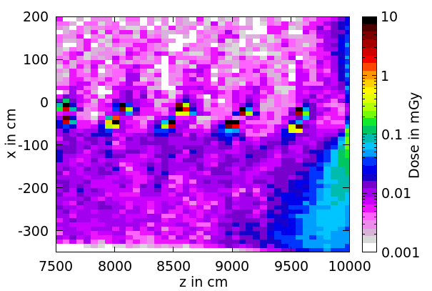
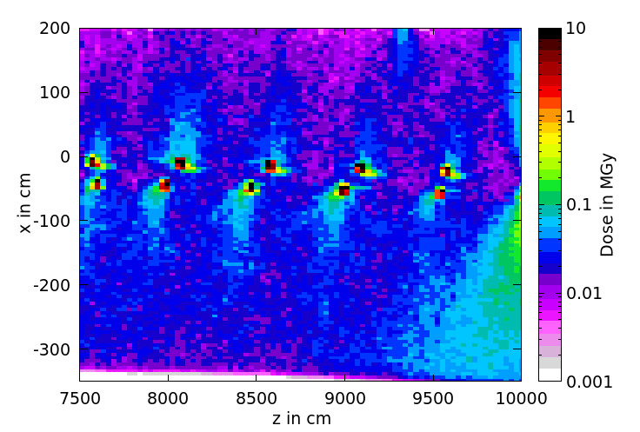
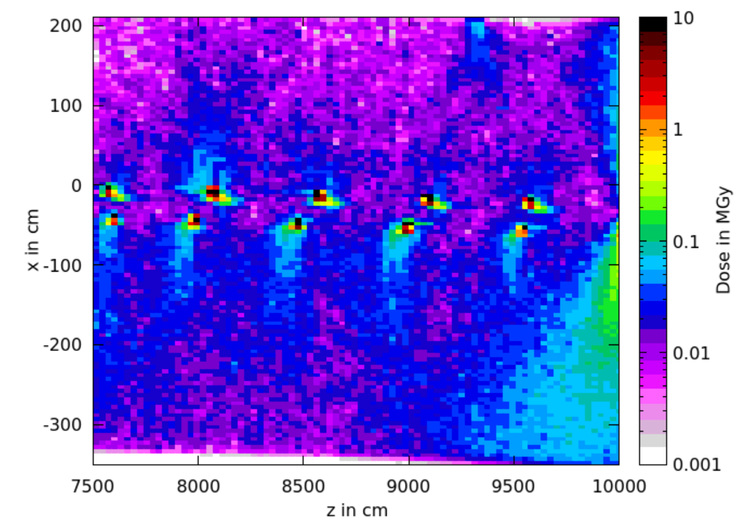
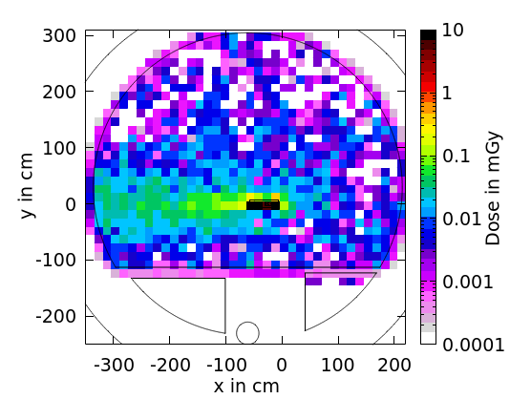
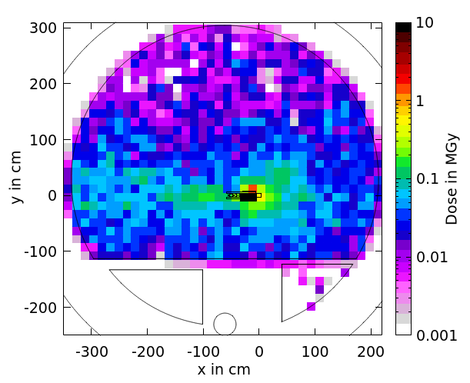
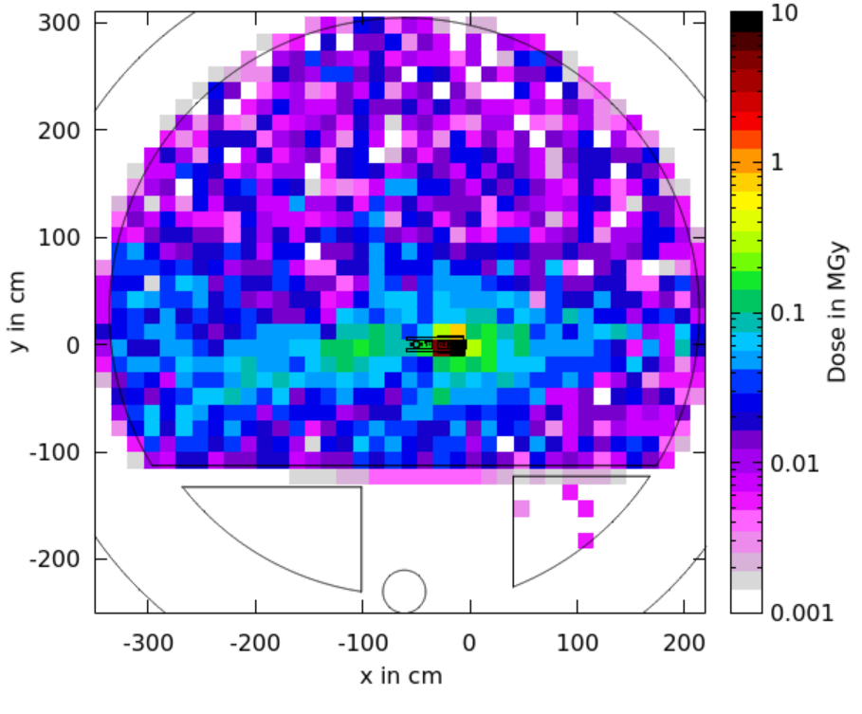
Dose levels in the tunnel
H, Pb
ttbar, Pb
ttbar, W
Shadow
Artefact of ABS in MQ
H, Pb:
Better statistics required to make precise estimation of the dose levels.
Looks promising, but shielding inevitable
NB: different scale for the dose levels
ttbar, Pb (left), W (right):
Similar dose levels in the tunnel environment for both shielding materials. Around 20kGy/year in area of cable trays. A reduction down to 10kGy/year is targeted.
Solution must be found for the absorber shadows of B2.
The dose levels are given for 10⁷s of operation
Issue with absorber in MQ should be resolved soon, so more accurate results can be presented.

Slide 6
Conclusion
Implementing lead as shielding material seems to be feasible from a radiation load point of view. Weight load for the magnets is increased compared to the tungsten shielding, which needs to be investigated.
Dose levels should be reduced by a factor 2 for the ttbar operation mode, while they are acceptable for the Higgs operation mode. Here, higher statistics are needed for more precise estimates.
To come:
  Particle spectra for crucial locations in the tunnel for different particle types (electrons, photons), which will be relevant for the placement of beam instrumentation and electronics.

