Slide 1
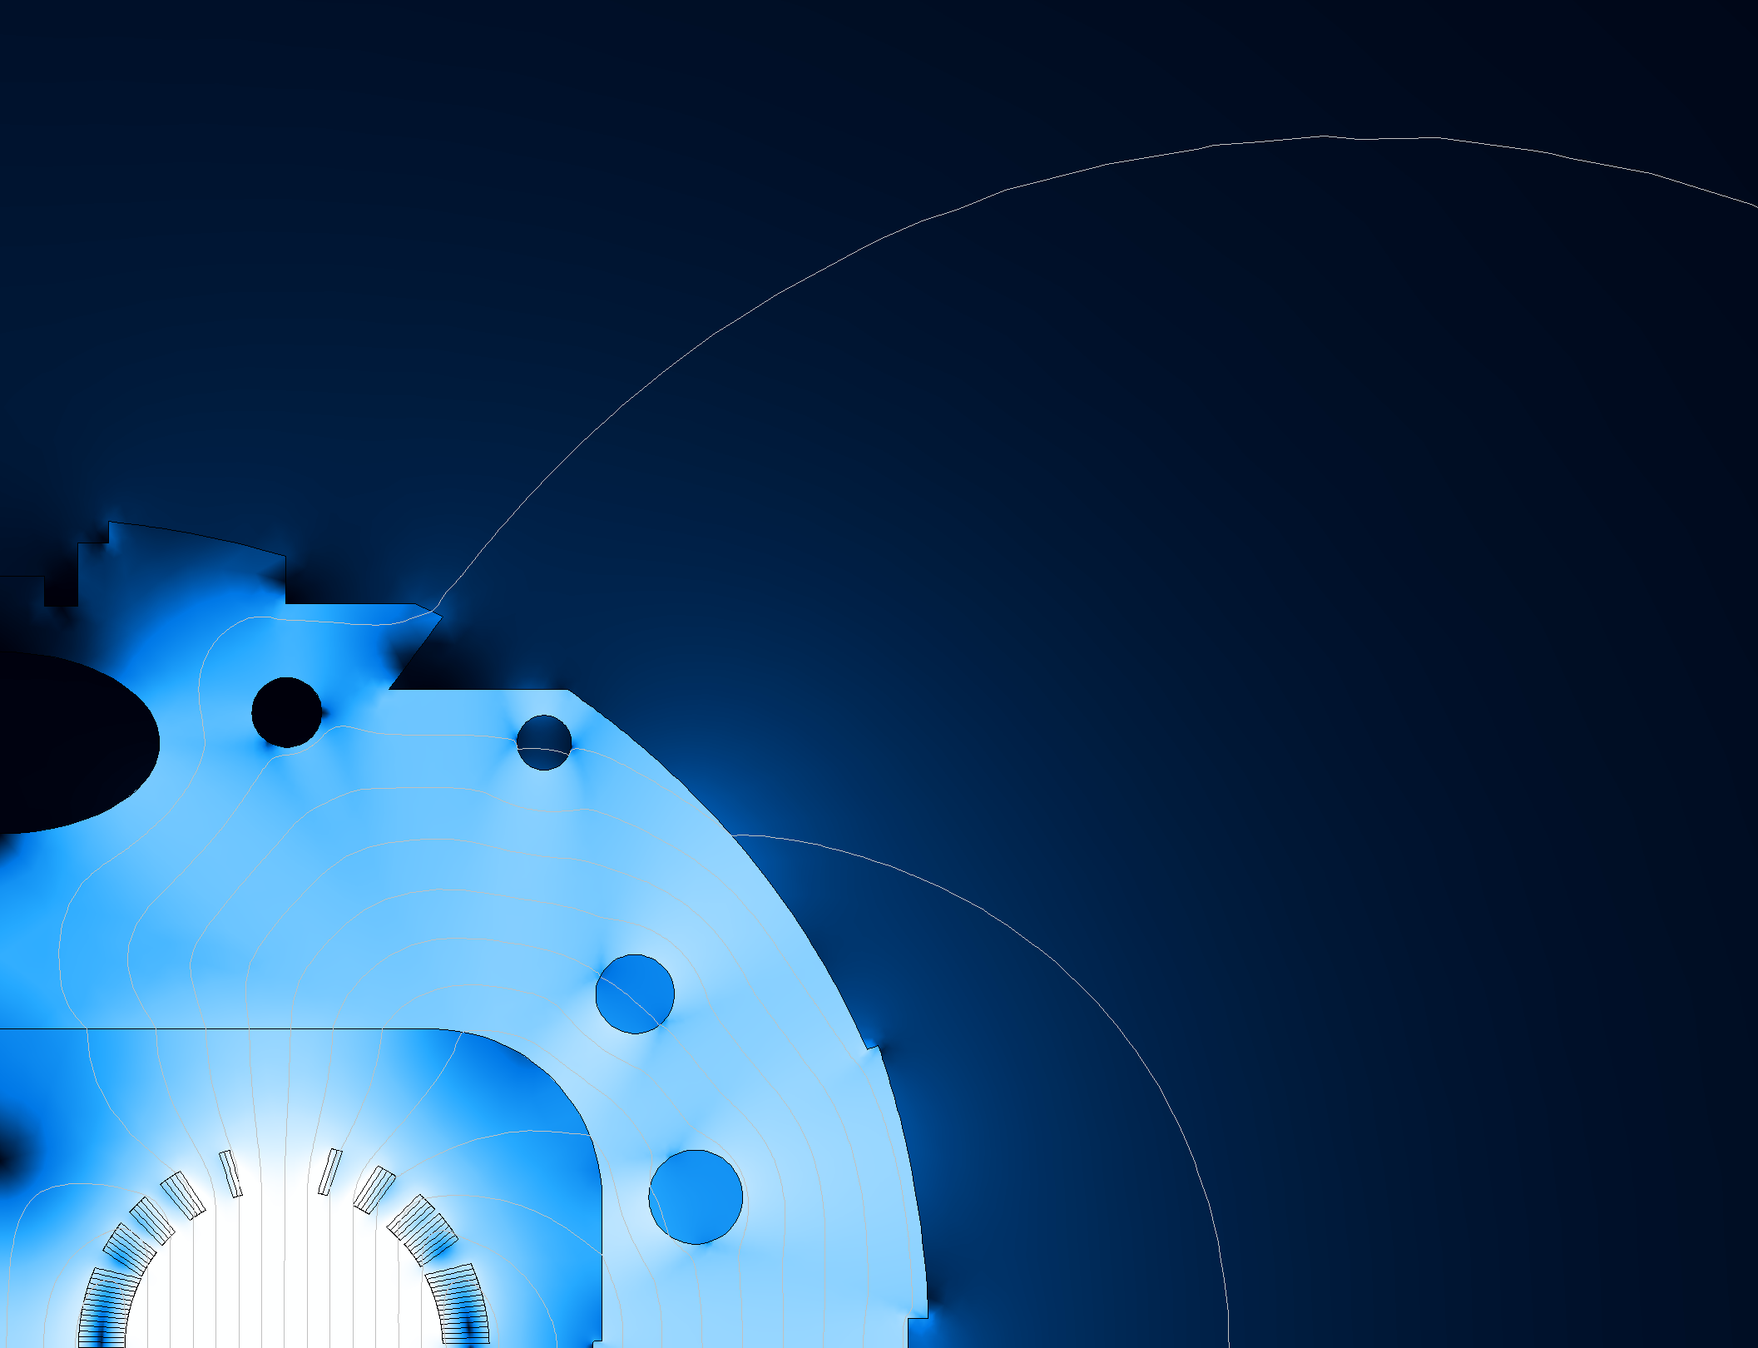





MuCol Meeting
Genova, 22-04-2024
L. Alfonso ¹, A. Bersani ¹, L. Bottura ³, B. Caiffi ¹, S. Farinon ¹, A. Gagno ¹ F. Mariani ⁴, S. Mariotto ⁴, D. Novelli ^{1,2}, A. Pampaloni ¹, T. Salmi ⁵
¹ INFN – Genova
² Sapienza University of Rome
³ CERN
⁴ INFN and University of Milan
⁵ Tampere University

Slide 2
Index
1. Requirements and goals
2. Ansys model (EM)
3. Roxie model
4. Idea of the mechanical structure
5. Open points

Slide 3
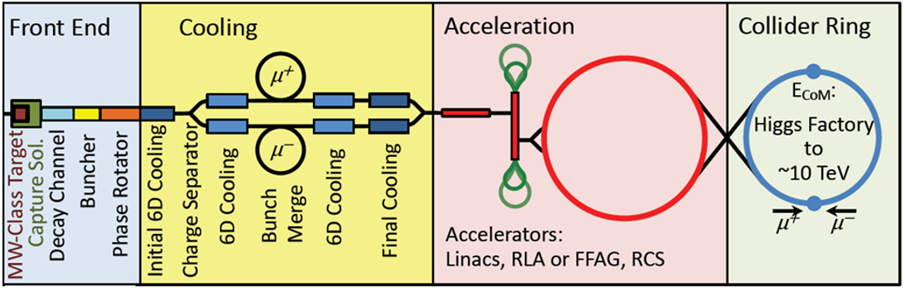
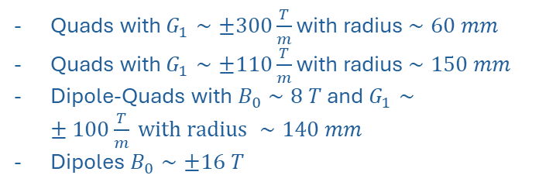
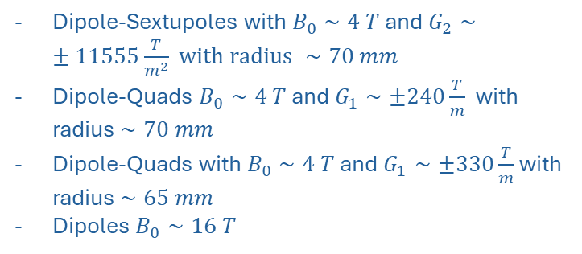
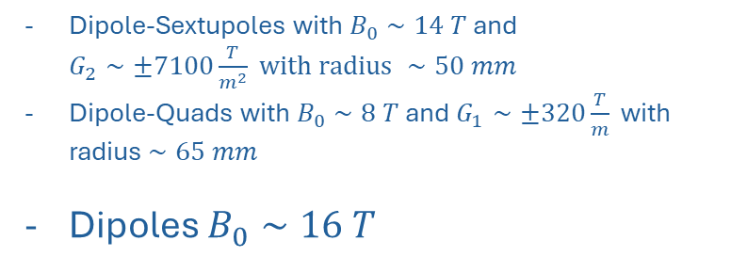
Choice of dipole to study
Final focusing
Quads with $G_{1}∼±300\frac{T}{m}$ with radius $∼60 mm$
Quads with $G_{1}∼±110\frac{T}{m}$ with radius $∼150 mm$
Dipole-Quads with $B_{0}∼8 T$ and $G_{1}∼±100\frac{T}{m} with radius ∼140 mm$
Dipoles $B_{0}∼±16 T$
Chromatic Correction & Matching
Arc
Requirements and goals
Ansys model
Roxie model
Mechanical structure
Open points
Dipole-Sextupoles with $B_{0}∼4 T$ and $G_{2}∼±11555\frac{T}{m^{2}} with radius ∼70 mm$
Dipole-Quads $B_{0}∼4 T$ and $G_{1}∼±240\frac{T}{m}$ with radius $∼70 mm$
Dipole-Quads with $B_{0}∼4 T$ and $G_{1}∼±330\frac{T}{m}$ with radius $∼65 mm$
Dipoles $B_{0}∼16 T$
Dipole-Sextupoles with $B_{0}∼14 T$ and $G_{2}∼±7100\frac{T}{m^{2}} with radius ∼50 mm$
Dipole-Quads with $B_{0}∼8 T$ and $G_{1}∼±320\frac{T}{m}$ with radius $∼65 mm$
Dipoles $B_{0}∼16 T$
[1]
Courtesy of K. Skoufaris, https://indico.cern.ch/event/1351046/

Slide 4
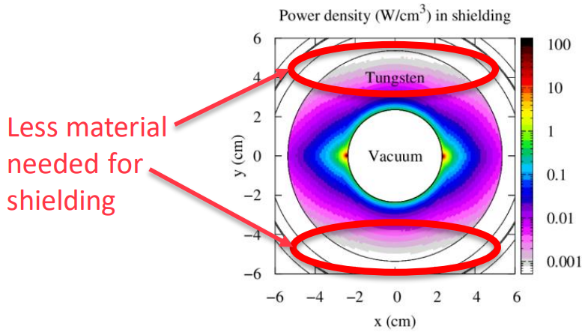
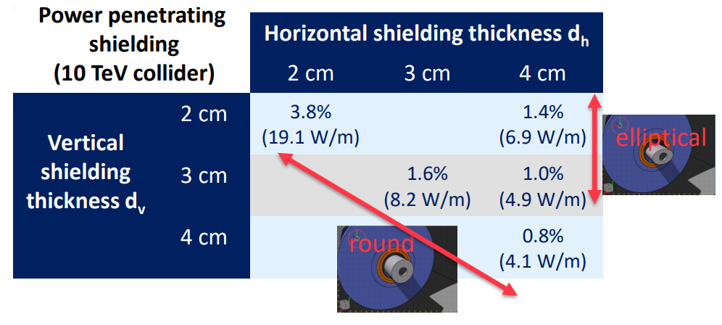




Requirements and goals
1. Elliptical aperture:
120 mm
140 mm
[2]
A. Lechner, D. Calzolari https://indico.cern.ch/event/1250075/contributions/5342853/attachments/2669303/4626606/MUC_collidershielding_20062023.pdf.
2. HTS cable
3. Max budget for the conductors:
$≅$ 300
$$\left(\frac{k€}{m}\right)$$
Requirements and goals
Ansys model
Roxie model
Mechanical structure
Open points
4. Operating temperature:
20
$\left(K\right)$
5. Margin temperature:
2.5
$\left(K\right)$
Max. magnetic field with these requirements ?
Variable parameter: coils width

Slide 5
Block coil VS cos-theta coil
Dipole
Block coil
Cos-theta coil
We think that it is easier to bend the heads with an HTS cable
Requirements and goals
Ansys model
Roxie model
Mechanical structure
Open points
Simpler geometry of the coil

Slide 6
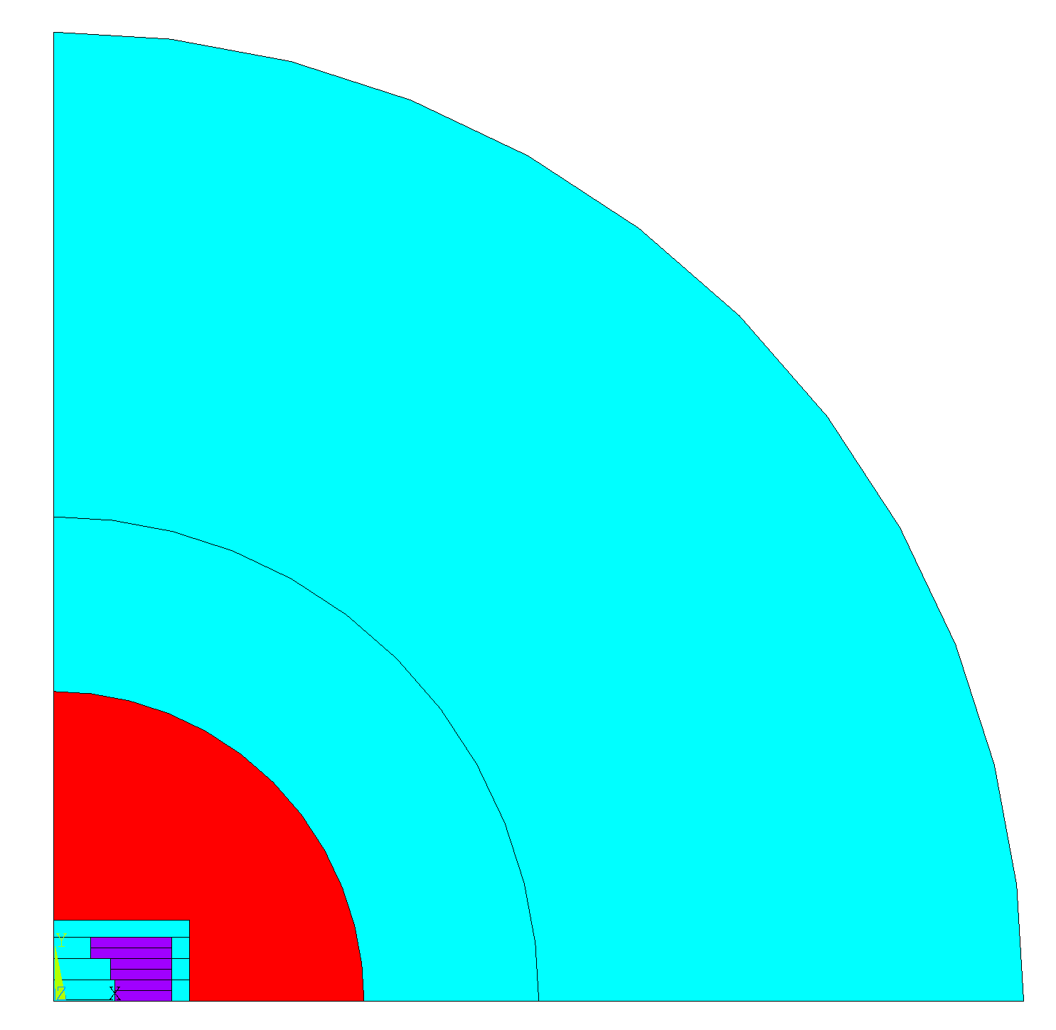
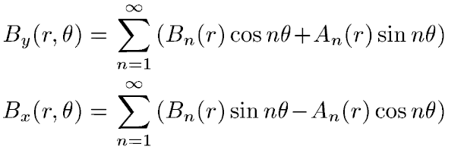


ANSYS model and its validation
Ansys model
Analytical formulas
VS
Requirements and goals
Ansys model
Roxie model
Mechanical structure
Open points
[3]
E. Rochepault, P. Vedrine and F. Bouillault, "2D Analytical Magnetic Optimizations for Accelerator Dipole Block Designs," in IEEE Transactions on Applied Superconductivity, vol. 22, no. 3, pp. 4900804-4900804, June 2012, Art no. 4900804, doi: 10.1109/TASC.2011.2174817.
Air
Infinite elements
Coils
Air
(3 double pancakes configuration)
Iron
(Not considered for the validation of the model)
$${Difference}_{B0}<1 \%$$

Slide 7
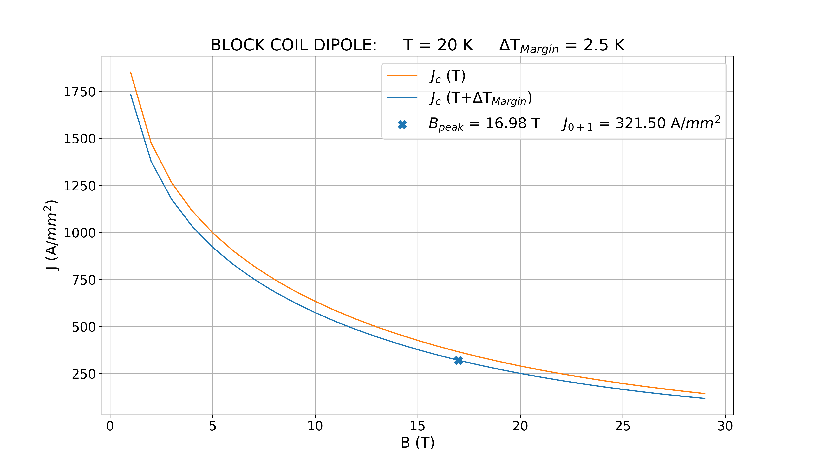




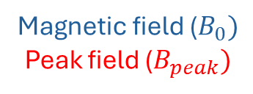



Control over the margin
Input
Method
Output
Magnetic field ($B_{0})$
Peak field ($B_{peak})$
$$J_{0}$$
Ansys EM
If $\frac{J_{0+1}}{J_{0}}<1 → J_{0}=J_{0}∗0.99$
If $\frac{J_{0+1}}{J_{0}}>1 → J_{0}=J_{0}∗1.01$
Requirements and goals
Ansys model
Roxie model
Mechanical structure
Open points
$$J_{0}$$
$$J_{0+1}$$
$$B_{peak}$$
Process finishes when: $0.98<\frac{J_{0+1}}{J_{0}}<1.02$

Slide 8





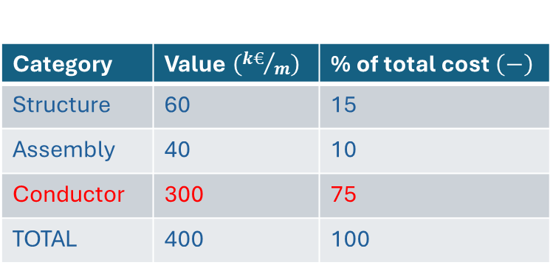

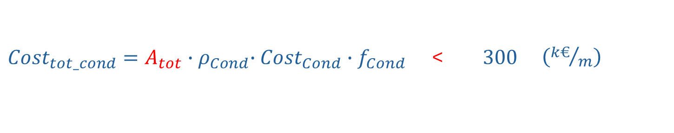






Control over the conductor cost
Category | Value $\left({k€}/m\right)$ | % of total cost $\left(−\right)$
Structure | 60 | 15
Assembly | 40 | 10
Conductor | 300 | 75
TOTAL | 400 | 100
Division of cost
Fixed parameters
$$=$$
$$\left({kg}/{m^{3}}\right)$$
$$ρ_{Cond}$$
$$8000$$
Requirements and goals
Ansys model
Roxie model
Mechanical structure
Open points
$${Cost}_{Cond}$$
$$\left(€/{kg}\right)$$
$$=$$
(Realistic projection)
$$2500$$
$$f_{Cond}$$
$$=$$
$$0.64$$
$$\left(−\right)$$
(Conductor fraction in the cable)
[4]
Courtesy of T. Salmi
${Cost}_{tot_cond}=A_{tot}{∙ρ}_{Cond}∙{Cost}_{Cond}∙f_{Cond}$ < $300 \left({k€}/m\right)$

Slide 9
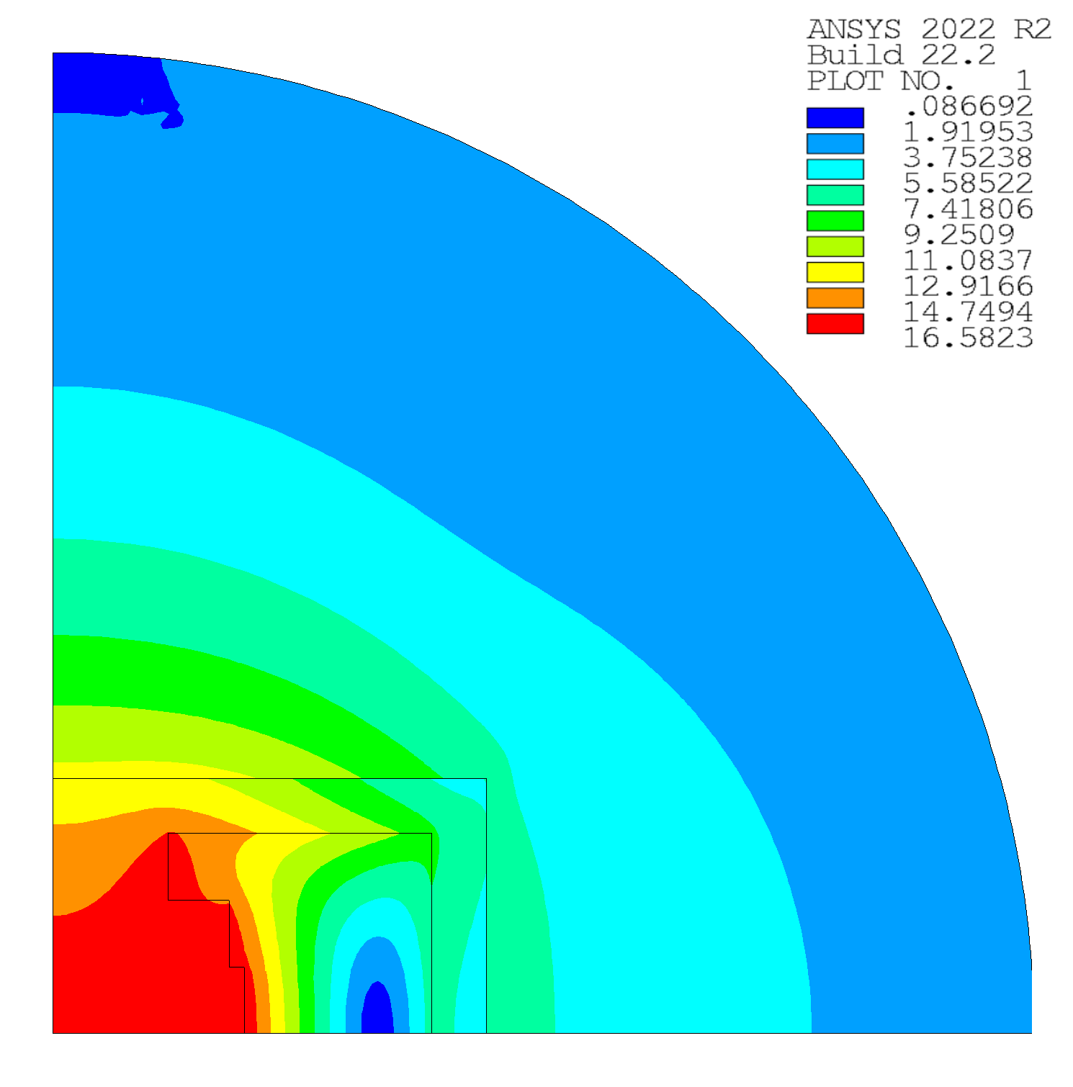

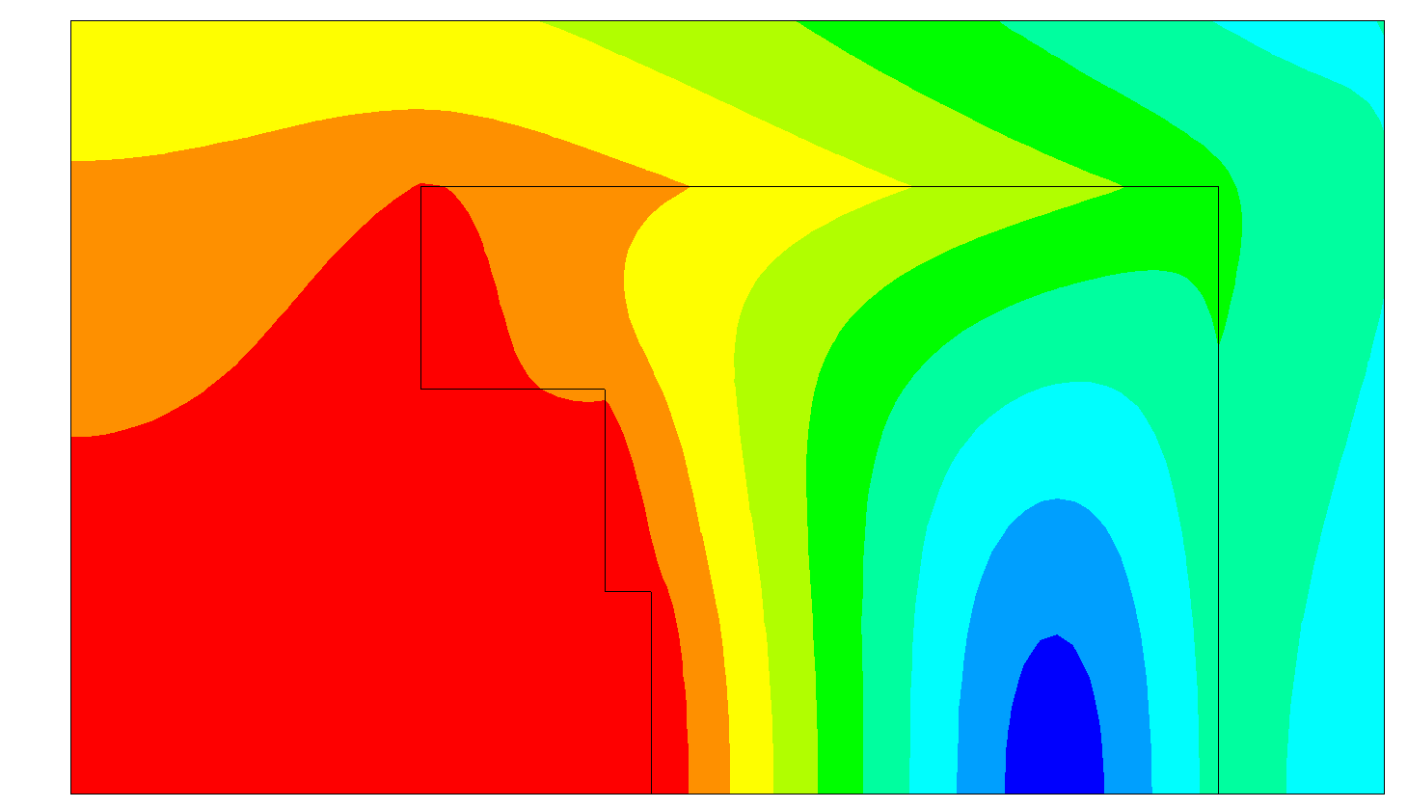
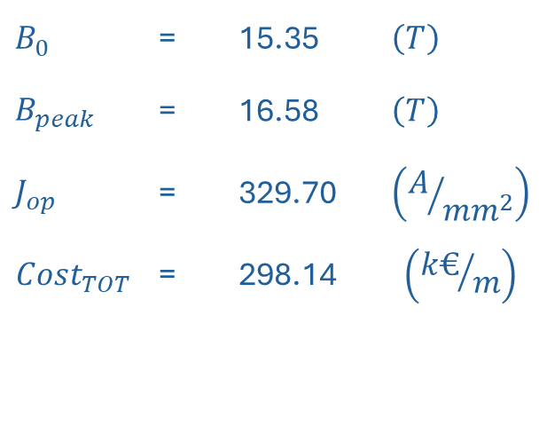
Best configuration obtained in ANSYS with previous limitations
Output:
$$B_{0}$$ | = | 15.35 | $$\left(T\right)$$
$$B_{peak}$$ | = | 16.58 | $$\left(T\right)$$
$$J_{op}$$ | = | 329.70 | $$\left(A/{{mm}^{2}}\right)$$
$${Cost}_{TOT}$$ | = | 298.14 | $$\left({k€}/m\right)$$
Requirements and goals
Ansys model
Roxie model
Mechanical structure
Open points
Field quality still not optimized !
ROXIE

Slide 10
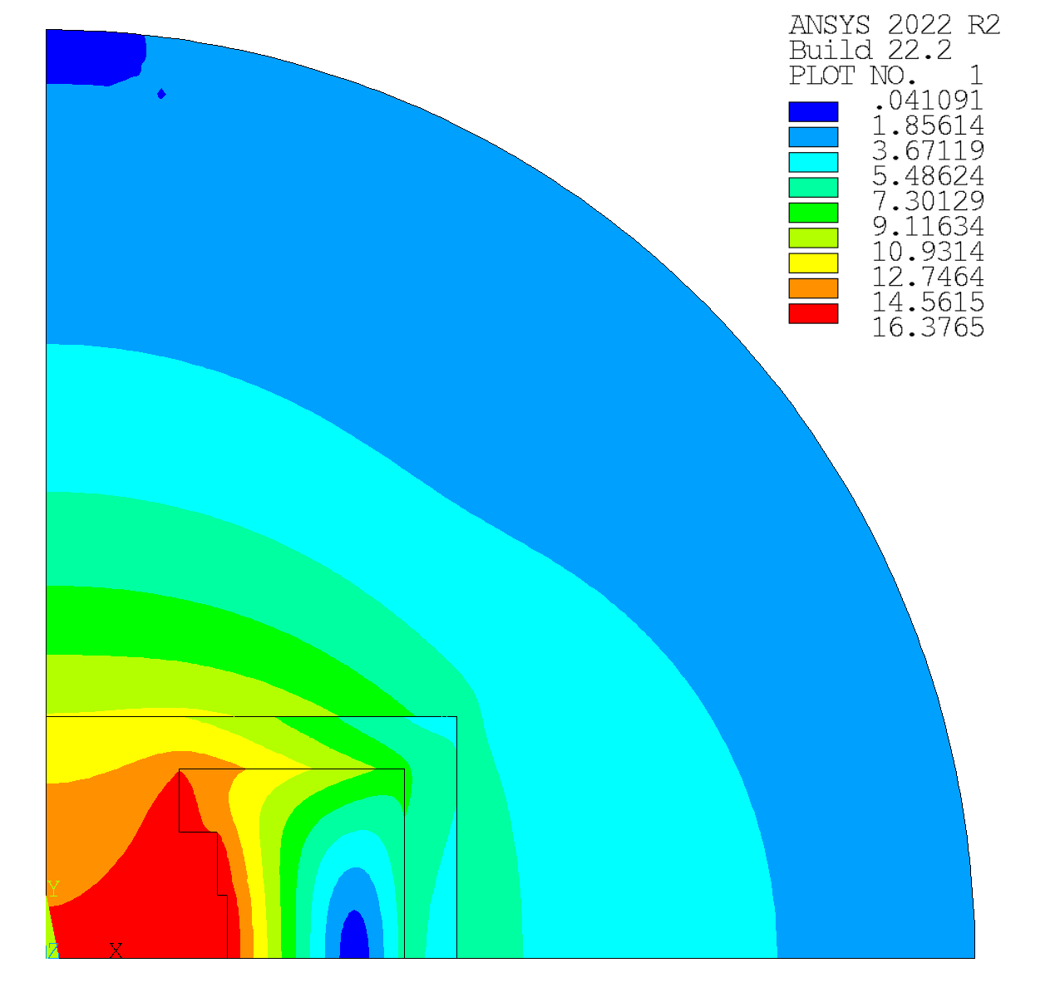



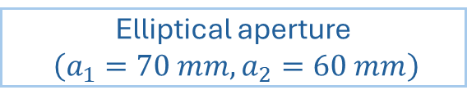
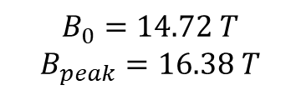



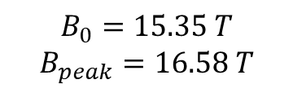








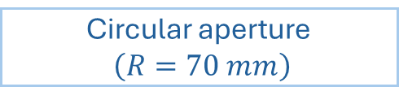


Elliptical aperture VS circular aperture
Elliptical aperture
$\left(a_{1}=70 mm,a_{2}=60 mm\right)$
Circular aperture
$\left(R=70 mm\right)$
$3^{st}$ double pancake
$3^{st}$ double pancake
$$n_{turns}=52$$
VS
$$n_{turns}=47$$
$2^{st}$ double pancake
$2^{st}$ double pancake
$$n_{turns}=40$$
$$n_{turns}=39$$
$1^{st}$ double pancake
$1^{st}$ double pancake
Requirements and goals
Ansys model
Roxie model
Mechanical structure
Open points
$$n_{turns}=37$$
$$n_{turns}=37$$
$$a_{2}$$
$$a_{1}$$
R
$$B_{0}=15.35 T$$
$$B_{peak}=16.58 T$$
$${Difference}_{B_{0}}≅4 \%$$
$$B_{0}=14.72 T$$
$$B_{peak}=16.38 T$$
$$Difference_{Bpeak}≅1, 2 \%$$

Slide 11

Roxie model
Two main “problems”
Roxie works only with Rutherford cable
$J_{c}$ fit
BUT
Bottura’s fit
Succi’s fit
Requirements and goals
Ansys model
Roxie model
Mechanical structure
Open points
We want a tape cable (i.e. Roebel, Cork)
Fleiter – Ballarino’s fit
Not implemented in Roxie
Not implemented in Roxie
Implemented in Roxie

Slide 12
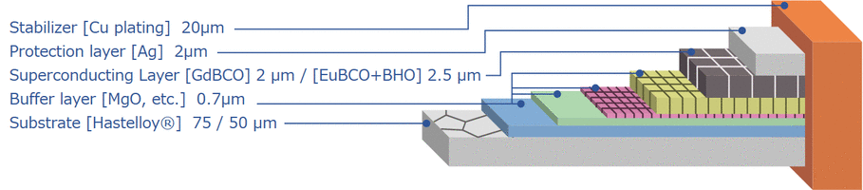
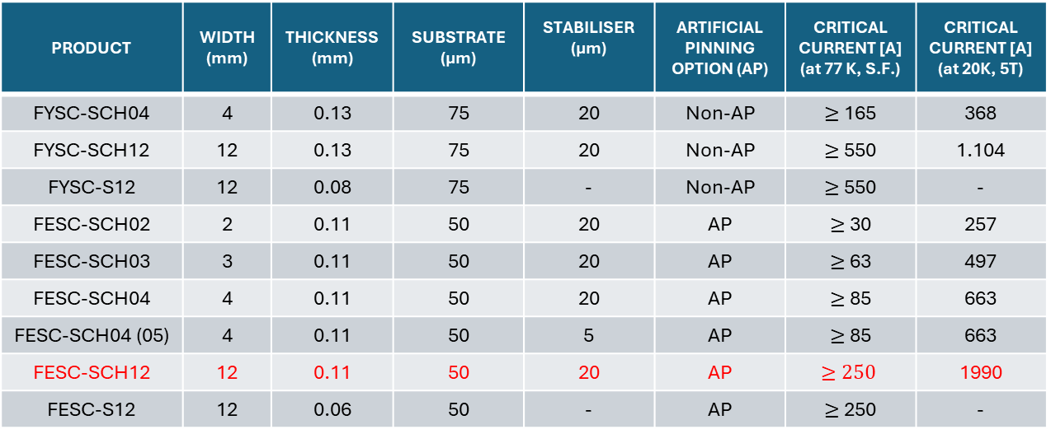
Cable problem
FUJIKURA FESC-SCH12 TAPE
12 mm
0.11 mm
[5]
https://www.fujikura.co.jp/eng/products/newbusiness/superconductors/01/2052504_12808.html
PRODUCT | WIDTH (mm) | THICKNESS (mm) | SUBSTRATE (µm) | STABILISER (µm) | ARTIFICIAL PINNING OPTION (AP) | CRITICAL CURRENT [A] (at 77 K, S.F.) | CRITICAL CURRENT [A] (at 20K, 5T)
FYSC-SCH04 | 4 | 0.13 | 75 | 20 | Non-AP | $≥$ 165 | 368
FYSC-SCH12 | 12 | 0.13 | 75 | 20 | Non-AP | $≥$ 550 | 1.104
FYSC-S12 | 12 | 0.08 | 75 | - | Non-AP | $≥$ 550 | -
FESC-SCH02 | 2 | 0.11 | 50 | 20 | AP | $≥$ 30 | 257
FESC-SCH03 | 3 | 0.11 | 50 | 20 | AP | $≥$ 63 | 497
FESC-SCH04 | 4 | 0.11 | 50 | 20 | AP | $≥$ 85 | 663
FESC-SCH04 (05) | 4 | 0.11 | 50 | 5 | AP | $≥$ 85 | 663
FESC-SCH12 | 12 | 0.11 | 50 | 20 | AP | $$≥250$$ | 1990
FESC-S12 | 12 | 0.06 | 50 | - | AP | $≥$ 250 | -
Requirements and goals
Ansys model
Roxie model
Mechanical structure
Open points

Slide 13


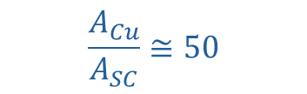

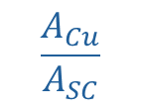
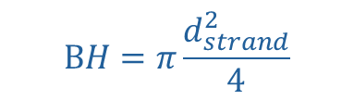

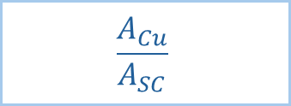
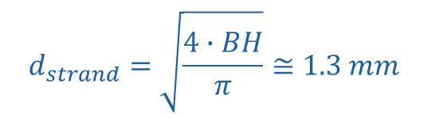
Strand problem
Roxie input
We need to convert this tape to a circular strand !
Tape
Strand
H=0.11 mm
$$d_{strand}$$
$$\frac{A_{Cu}}{A_{SC}}$$
B=12 mm
$$d_{strand}$$
$$BH=π\frac{d_{strand}^{2}}{4}$$
$$d_{strand}=\sqrt{\frac{4∙BH}{π}}≅1.3 mm$$
1)
$$d_{strand}$$
Requirements and goals
Ansys model
Roxie model
Mechanical structure
Open points
$$\frac{A_{Cu}}{A_{SC}}$$
$$\frac{A_{Cu}}{A_{SC}}≅50$$
2)
Superconductor
In Roxie we can edit a strand consisting only of copper and superconductor !
$$2 μm$$
H=0.11 mm
B=12 mm
Copper

Slide 14
Cable geometry
Tape cable
Rutherford cable
0.1 mm
0.1 mm
15
0.1 mm
1.3 mm
14
13
0.1 mm
12
11
1.85 mm
10
1
2
3
4
5
6
7
8
1.85 mm
9
0.11 mm
8
9
10
11
12
1
3
14
15
7
6
Requirements and goals
Ansys model
Roxie model
Mechanical structure
Open points
5
4
3
2
12 mm
1
0.1 mm
12,2 mm
12 mm
Rectangular tape – Circular strand
Copper
12,2 mm
Insulation

Slide 15
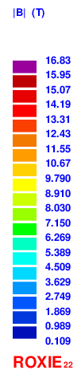
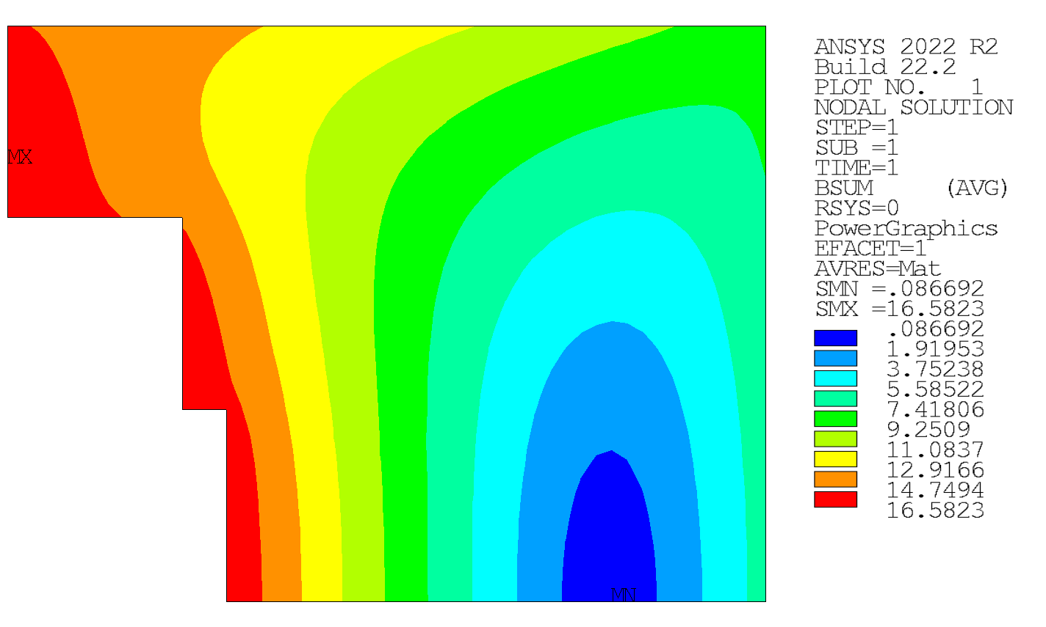
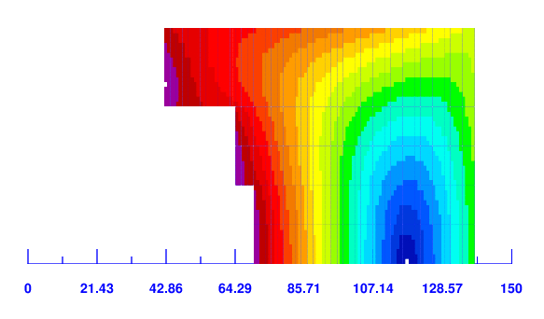
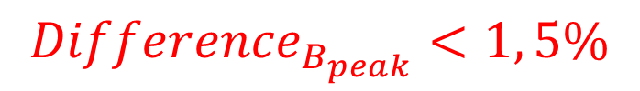

Cable problem
With these geometric assumptions there is a match between Ansys and Roxie
Ansys model
Roxie model
VS
Requirements and goals
Ansys model
Roxie model
Mechanical structure
Open points
$${Differece}_{B0}<1 \%$$
$${Difference}_{B_{peak}}<1, 5\%$$

Slide 16
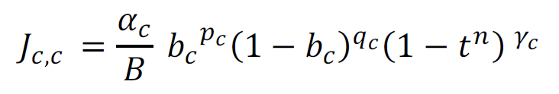
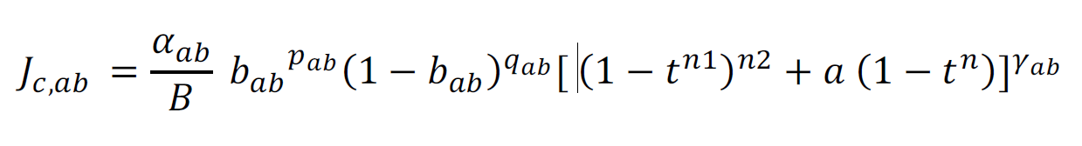
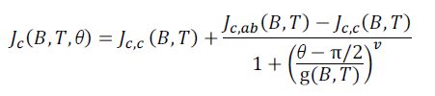




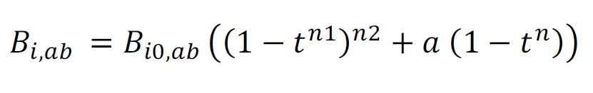



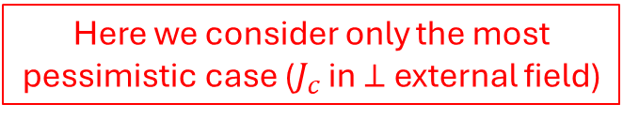







$J_{c}$ fit problem
Bottura’s fit
Fleiter – Ballarino’s fit
- $J_{c}$ in perpendicular external field orientation
- $J_{c}$ in perpendicular external field orientation
$$J_{c,c}=\frac{C_{c}}{B}b_{c}^{p_{c}}{\left(1−b_{c}\right)}^{q_{c}}\left(1−t^{n}\right)\left(1−t^{m}\right)$$
- $J_{c}$ in parallel external field orientation
Where:
$$C_{C}=C_{0}{\left(\frac{p_{c}+q_{c}}{p_{c}∙q_{c}}\right)}^{p_{c}+q_{c}}$$
- $J_{c}\left(B,T,θ\right)$:
VS
Field orientation
$$θ=$$
Reduced field in $⊥$ orientation
Where:
Reduced temperature
Requirements and goals
Ansys model
Roxie model
Mechanical structure
Open points
Reduced field in $⊥$ orientation
Reduced field in $∥$ orientation
Reduced temperature
where $B_{i0,c}$max irreversibility field in $∥$orientation
Here we consider only the most pessimistic case ($J_{c}$ in $⊥$ external field)
where $B_{i0,ab}$max irreversibility field in $⊥$ orientation
where $B_{i0,c}$max irreversibility field in $∥$orientation
[6]
J. Fleiter, A. Ballarino, “Parameterization of the critical surface of REBCO conductors from Fujikura”, Internal note

Slide 17




$J_{c}$ fit problem
Succi’s fit
- $J_{c}$ in perpendicular external field orientation
$$J_{c,c}=I_{C_{0}}{\left(1+b_{0}\right)}^{−α_{G}}{\left(1−b_{irr}\right)}^{q_{G}}$$
Where:
$$I_{c_{0}}=I_{c_{00}}{\left(1−t_{c}\right)}^{γ_{G}}$$
$$b_{0}=B/B_{0}$$
Requirements and goals
Ansys model
Roxie model
Mechanical structure
Open points
$$b_{irr}=B/B_{irr}$$
[7]
G. Succi, https://indico.cern.ch/event/1271361/contributions/5338874/attachments/2840109/4964145/Presentation%20-%20Group%20Seminar.pdf

Slide 18
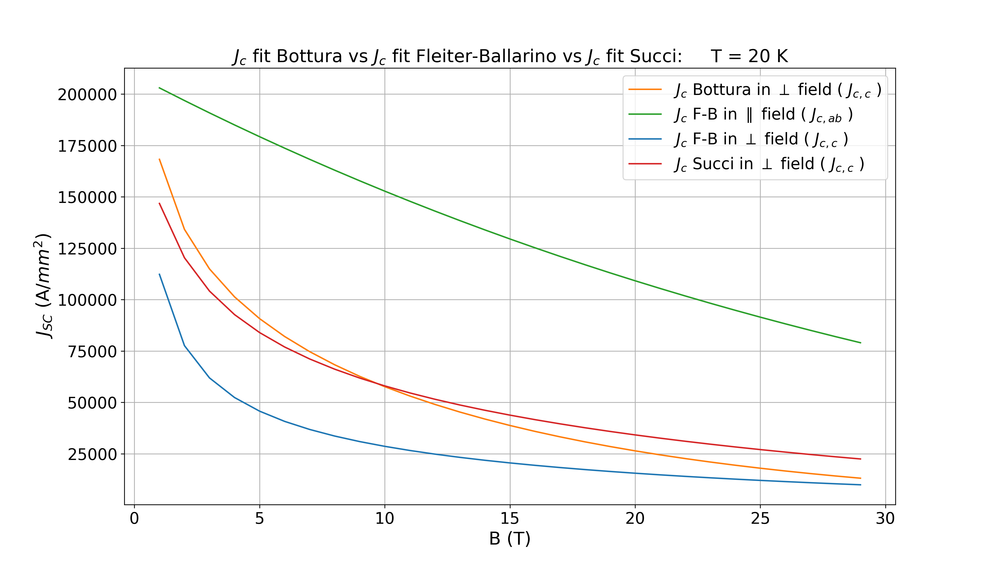
$J_{c}$ fit problem
Requirements and goals
Ansys model
Roxie model
Mechanical structure
Open points

Slide 19
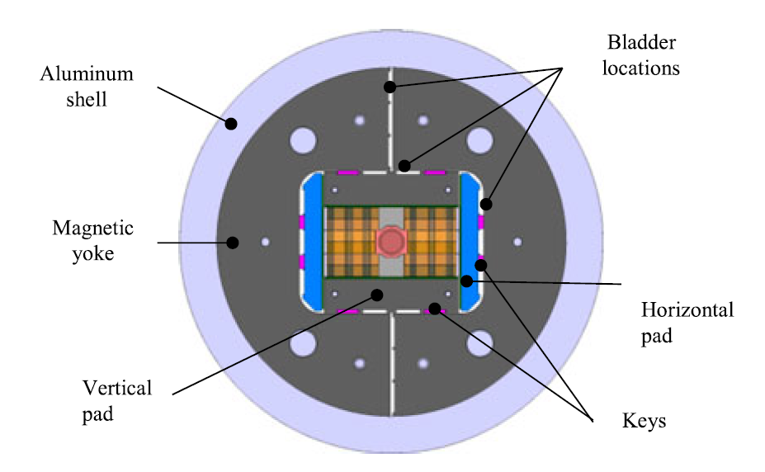
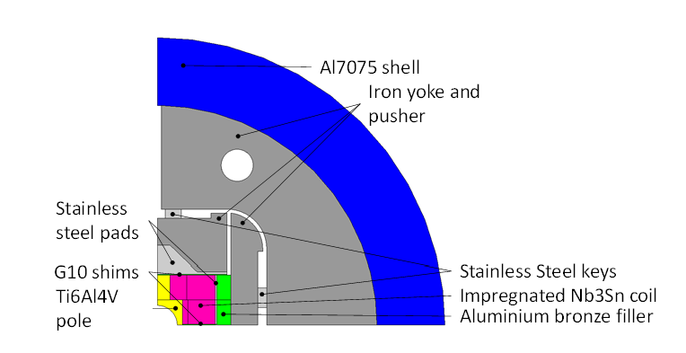
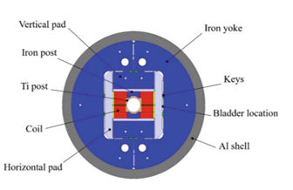
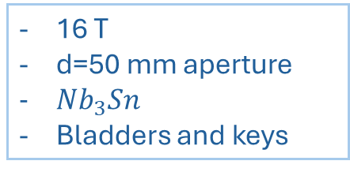
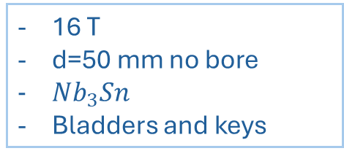
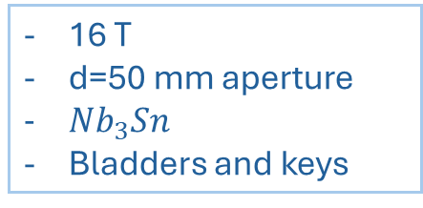
Idea of the mechanical structure
Different block coil references
Racetrack Model Magnet (RMM)
WP5 EuroCirCol
(ECC)
FRESCA 2
16 T
d=50 mm no bore
$Nb_{3}Sn$
Bladders and keys
16 T
d=50 mm aperture
$Nb_{3}Sn$
Bladders and keys
16 T
d=50 mm aperture
$Nb_{3}Sn$
Bladders and keys
Requirements and goals
Ansys model
Roxie model
Mechanical structure
Open points
[8]
S. Izquierdo Bermudez, R. Ortwein, J. C. Perez and E. Rochepault, "Design of ERMC and RMM, the Base of the Nb3Sn 16 T Magnet Development at CERN,“
doi: 10.1109/TASC.2017.2651403
[9]
D. Tommasini, https://cds.cern.ch/record/2226492/files/CERN-ACC-2016-0119.pdf
Schoerling, D., Zlobin, A. (eds) Nb3Sn Accelerator Magnets. Particle Acceleration and Detection. Springer, Cham. https://doi.org/10.1007/978-3-030-16118-7_12
[10]

Slide 20
Bladders and keys solution
Aluminum shell
Bladder
Keys
Horizontal pad
Requirements and goals
Ansys model
Roxie model
Mechanical structure
Open points
Pole
Conductors
Iron yoke
Vertical pad
[11]
E. Rochepault, S. Izquierdo Bermudez, R. Ortwein, J. C. Perez, "Design of ERMC and RMM”

Slide 21
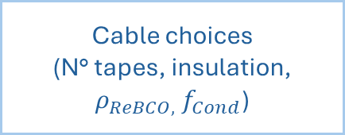
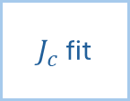
Open points
$J_{c}$ fit
Operating Temperature
+
Temperature Margin
Mechanical structure
Tape choice
+
Its implementation in Roxie
Requirements and goals
Ansys model
Roxie model
Mechanical structure
Open points
Cable choices
(N° tapes, insulation,
$ρ_{ReBCO,}$ $f_{Cond}$)
Elliptical aperture VS
Circular aperture
How important is the magnetic field quality ?

