Slide 1
A – B Plots: margin discussion
Workshop – Genova

Slide 2
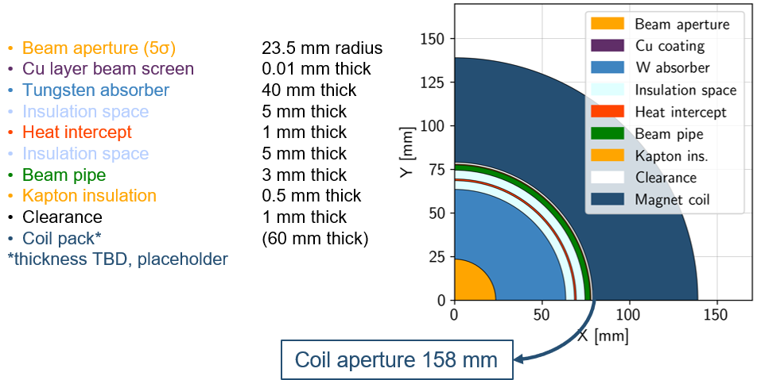

Overview
Assuming 10 TeV machine and coil at 4.5 K
3 TeV collider (5 km ring):
Close to state of the art
$∼$11T/150mm (Nb₃Sn)
600 magnets, 5 m length
Operating temperature: 4.5 K
10+ TeV collider (10 km ring):
HTS magnets, R&D is required
$∼$15T/150mm (ReBCO, hybrid)
1200 magnets, 5 m length
Operating temperature: 4.5…20 K
Courtesy of Patricia Borges de Sousa
https://indico.cern.ch/event/1250075/contributions/5357594/
with HTS @20K the absorber can be thinner
High field dipoles to minimize collider ring size and maximize luminosity.
Beam loss protection
High-energy electrons and positrons arising from muon decay and striking the collider ring magnets can cause radiation damage and unwanted heat load.
Shielding
Large aperture
Courtesy of A. Lechner

Slide 3
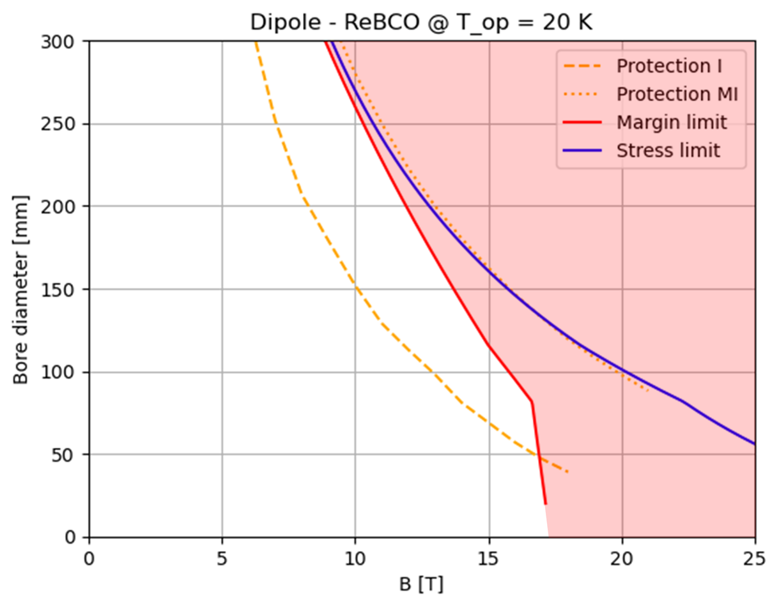
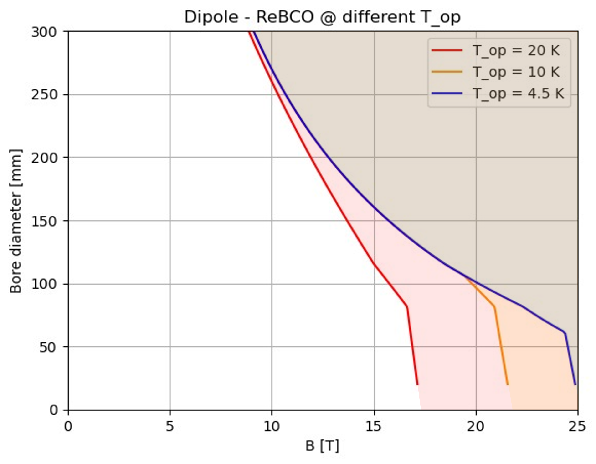

Dipole A-B Plots
$T_{op}$reduction
HTS falls short of the required performance with classical insulated coils. Assuming MI or NI magnets, the protection limit becomes comparable with the other limits.
A reduction of operating temperature will result in a wider design A-B range

Slide 4
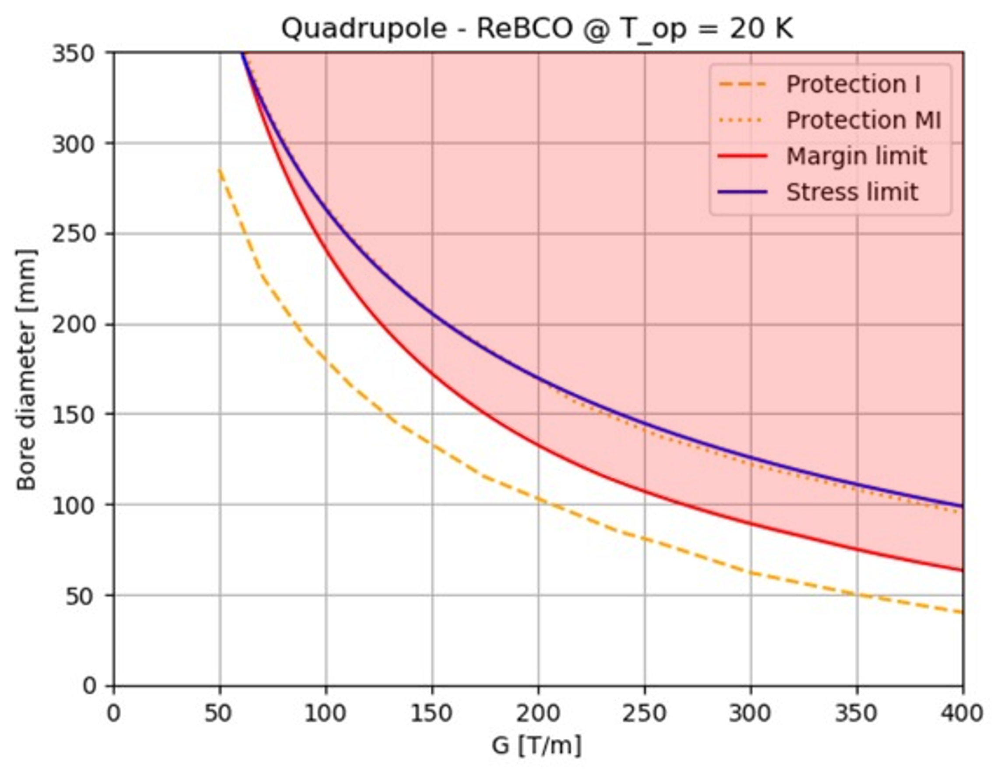
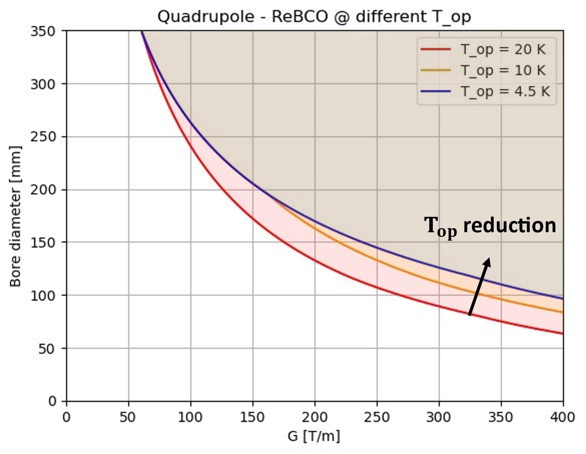
Quadrupole A-B Plots
A reduction of operating temperature will result in a wider design A-B range
HTS is mainly limited by cost production and protection. Working @20K the margin curve is also a limiting factor.

Slide 5
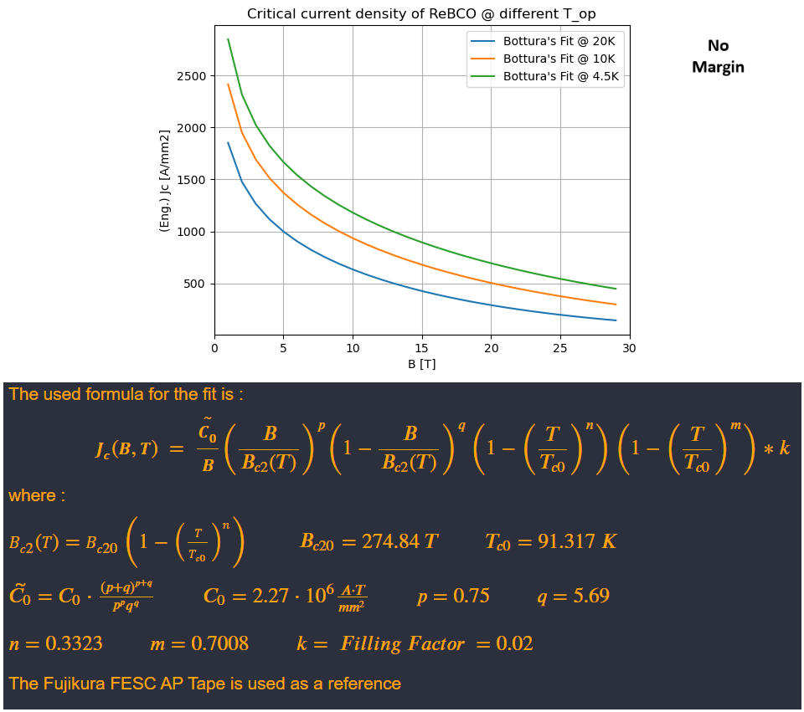

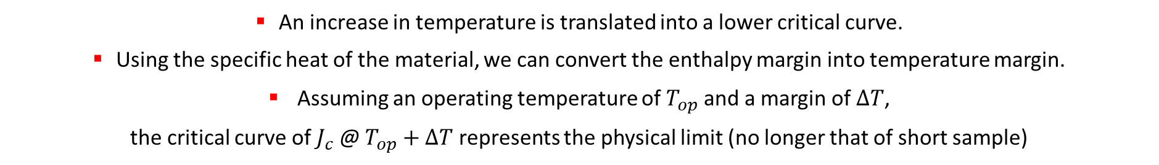
Critical Fit for ReBCO
Short sample values
$T_{ }$reduction
Courtesy of L. Bottura
An increase in temperature is translated into a lower critical curve.
Using the specific heat of the material, we can convert the enthalpy margin into temperature margin.
Assuming an operating temperature of $T_{op}$ and a margin of $ΔT$,
the critical curve of $J_{c}$ @ $T_{op}+ΔT$ represents the physical limit (no longer that of short sample)

Slide 6
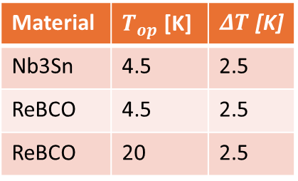
Margin summary
Summarizing the scheme adopted so far:
the stability margin used is calculated under adiabatic assumption, starting from margins in cable enthalpy.
For magnets in Nb3Sn @ 4.5 K we assumed a stability margin in the range of 10...15 mJ/cm**3 (based on HL-LHC experience), which is obtained for a temperature margin of 2.5 K.
For HTS magnets @ 4.5 K, we obtain a stability margin comparable to that of Nb3Sn with a temperature margin of 1.5 K.
For HTS magnets @ 20 K, the same stability margin of 10...15 mJ/cm**3 is obtained for a temperature margin of 0.1 K.
In the last case, we will be dominated by the uniformity in temperature that the cryogenic system can provide.
For this reason, we decided to use the same temperature margin of 2.5 K for both materials and operating temperatures
Material | $T_{op}$ [K] | $ΔT$ [K]
Nb3Sn | 4.5 | 2.5
ReBCO | 4.5 | 2.5
ReBCO | 20 | 2.5
The question raised is the following:
how much does this conservative assumption penalize the ReBCO in the A-B plots?

Slide 7
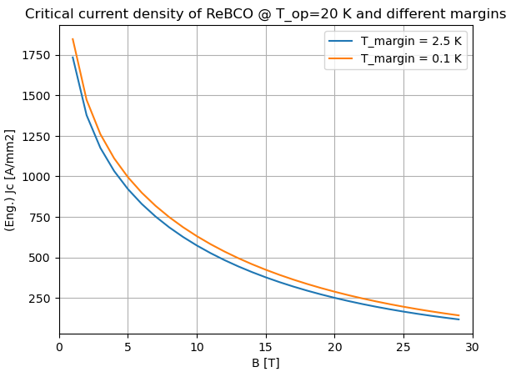
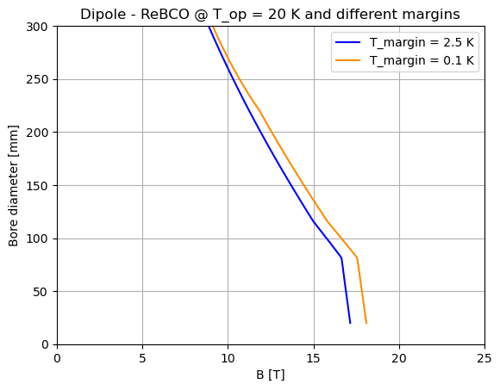
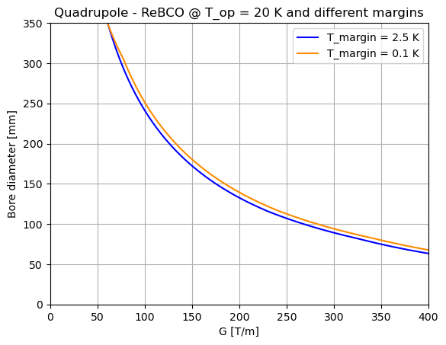
Margin changes
The graphs show that.
In the dipole we lose about 1 T at 50 mm aperture. This loss decreases as aperture increases.
In the quadrupole, we lose about 10 T/m, more or less constant for all apertures.
What might be a good estimate for the margin, also taking into account the limitations given by cryogenics?

