Slide 1
FalconD 12T: versions
Authors: N. Sala on behalf of FalconD collaboration
Date: April 16th, 2024

Slide 2
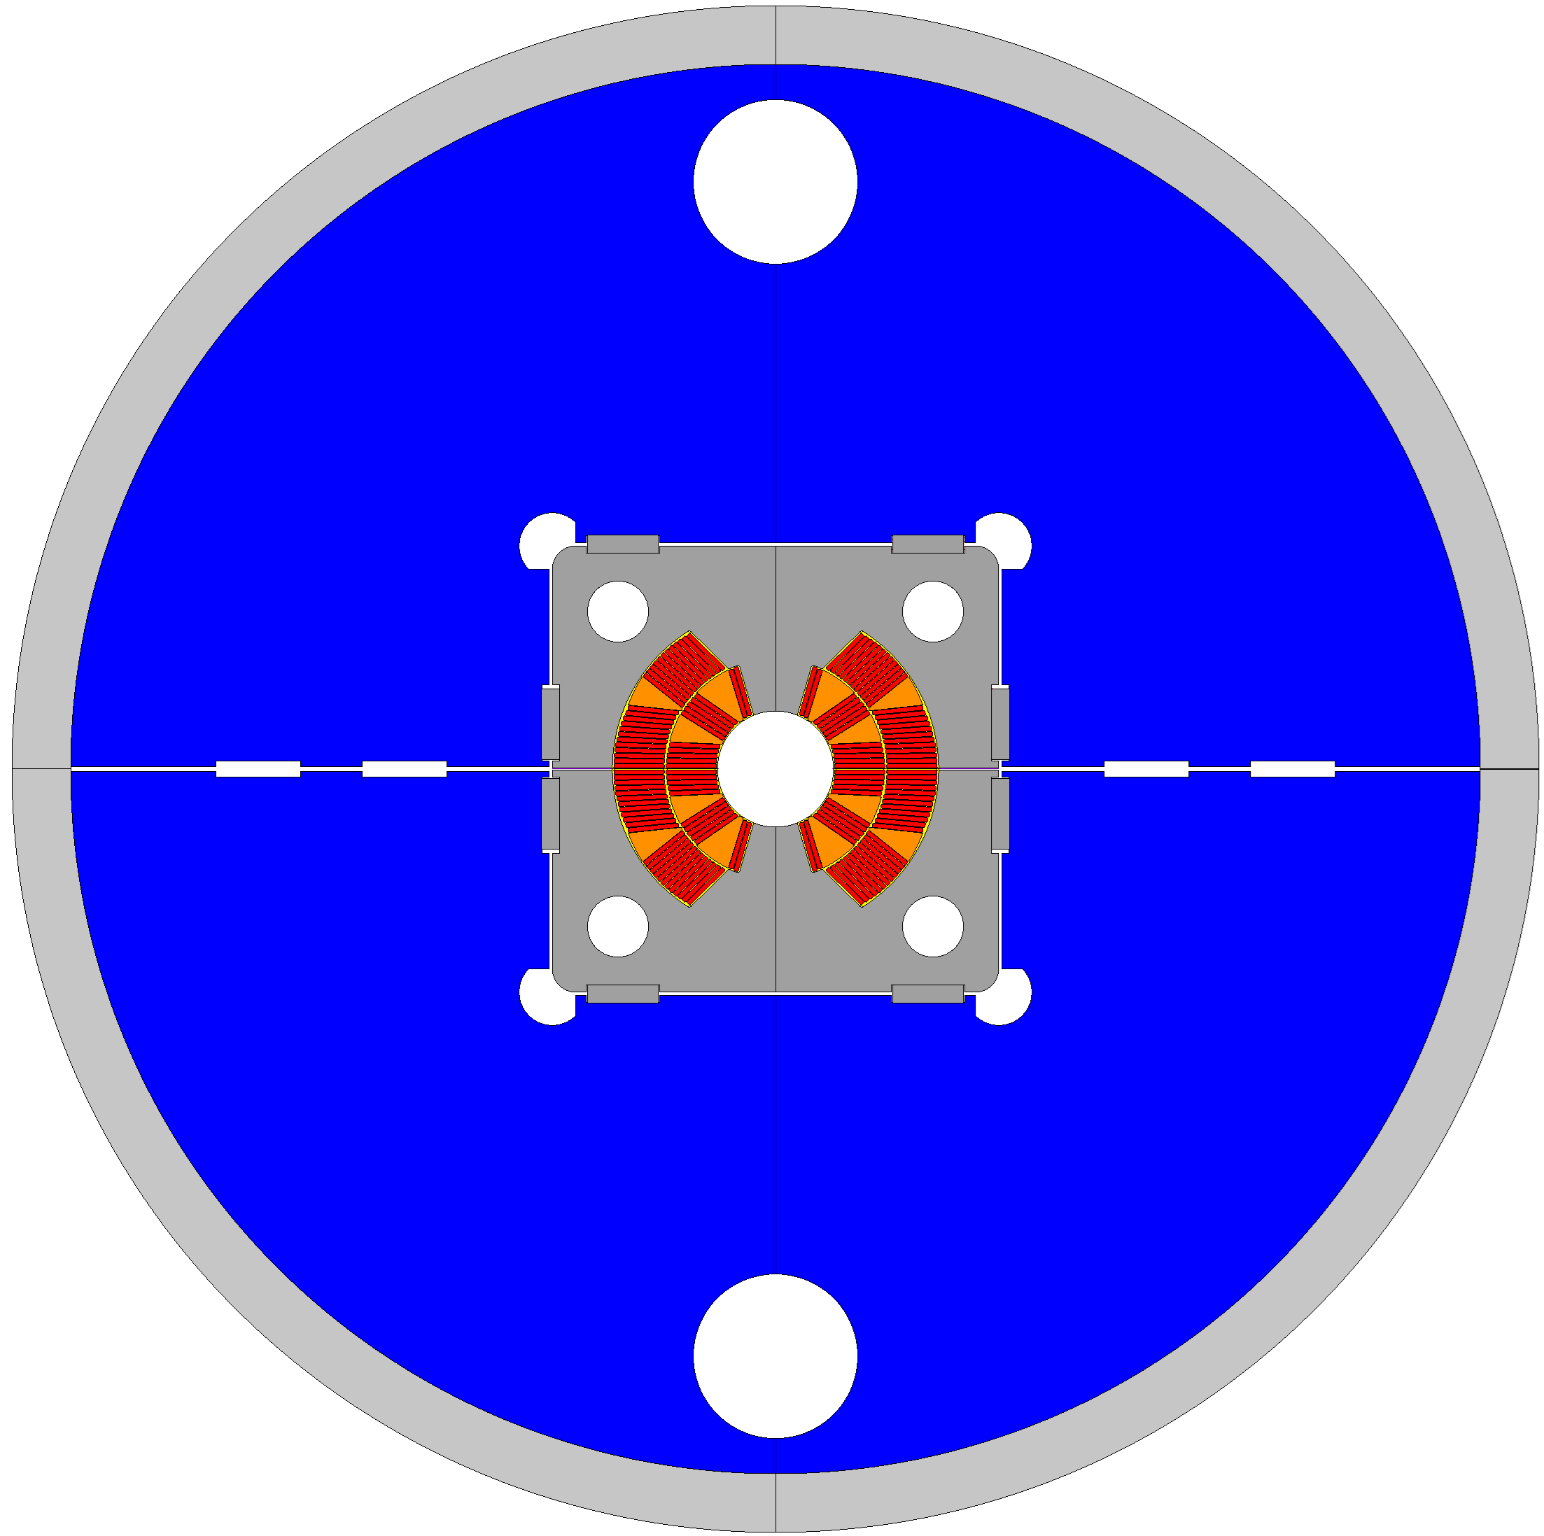
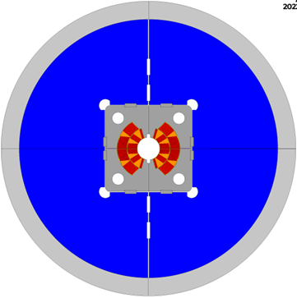
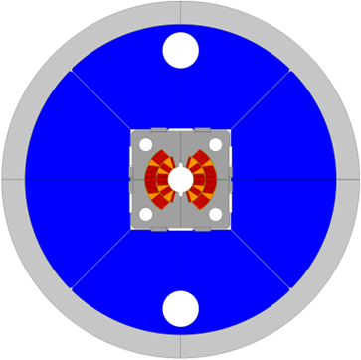
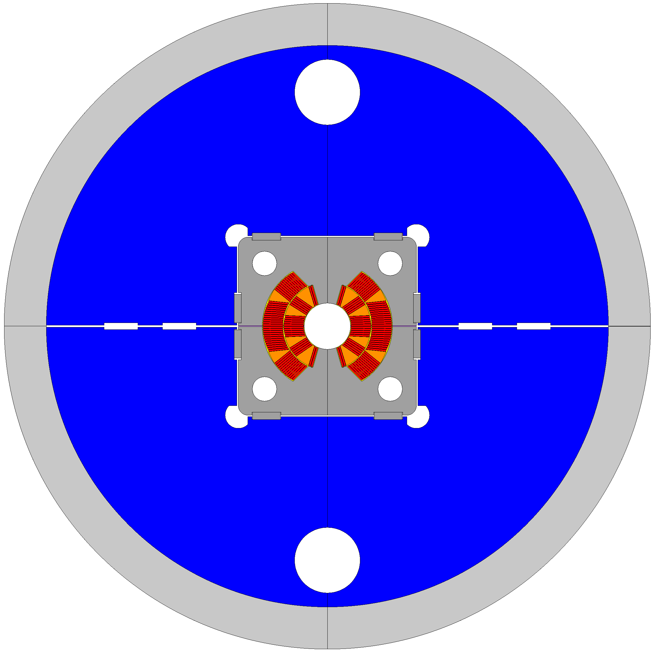
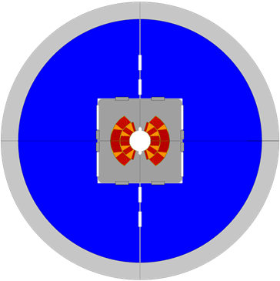
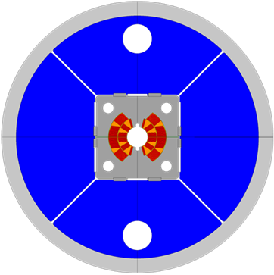
Configurations
Horizontal split yokes
Vertical split yokes
45° splits yokes

Slide 3



Horizontal Split Yokes
High Stiffness
(Structural Yoke)
Low-Medium Thickness
$${th}_{shell}=25 mm$$
Medium Interference
$${int}_{ver}=0.15 mm$$
$${int}_{hor}=0.25 mm$$

Slide 4
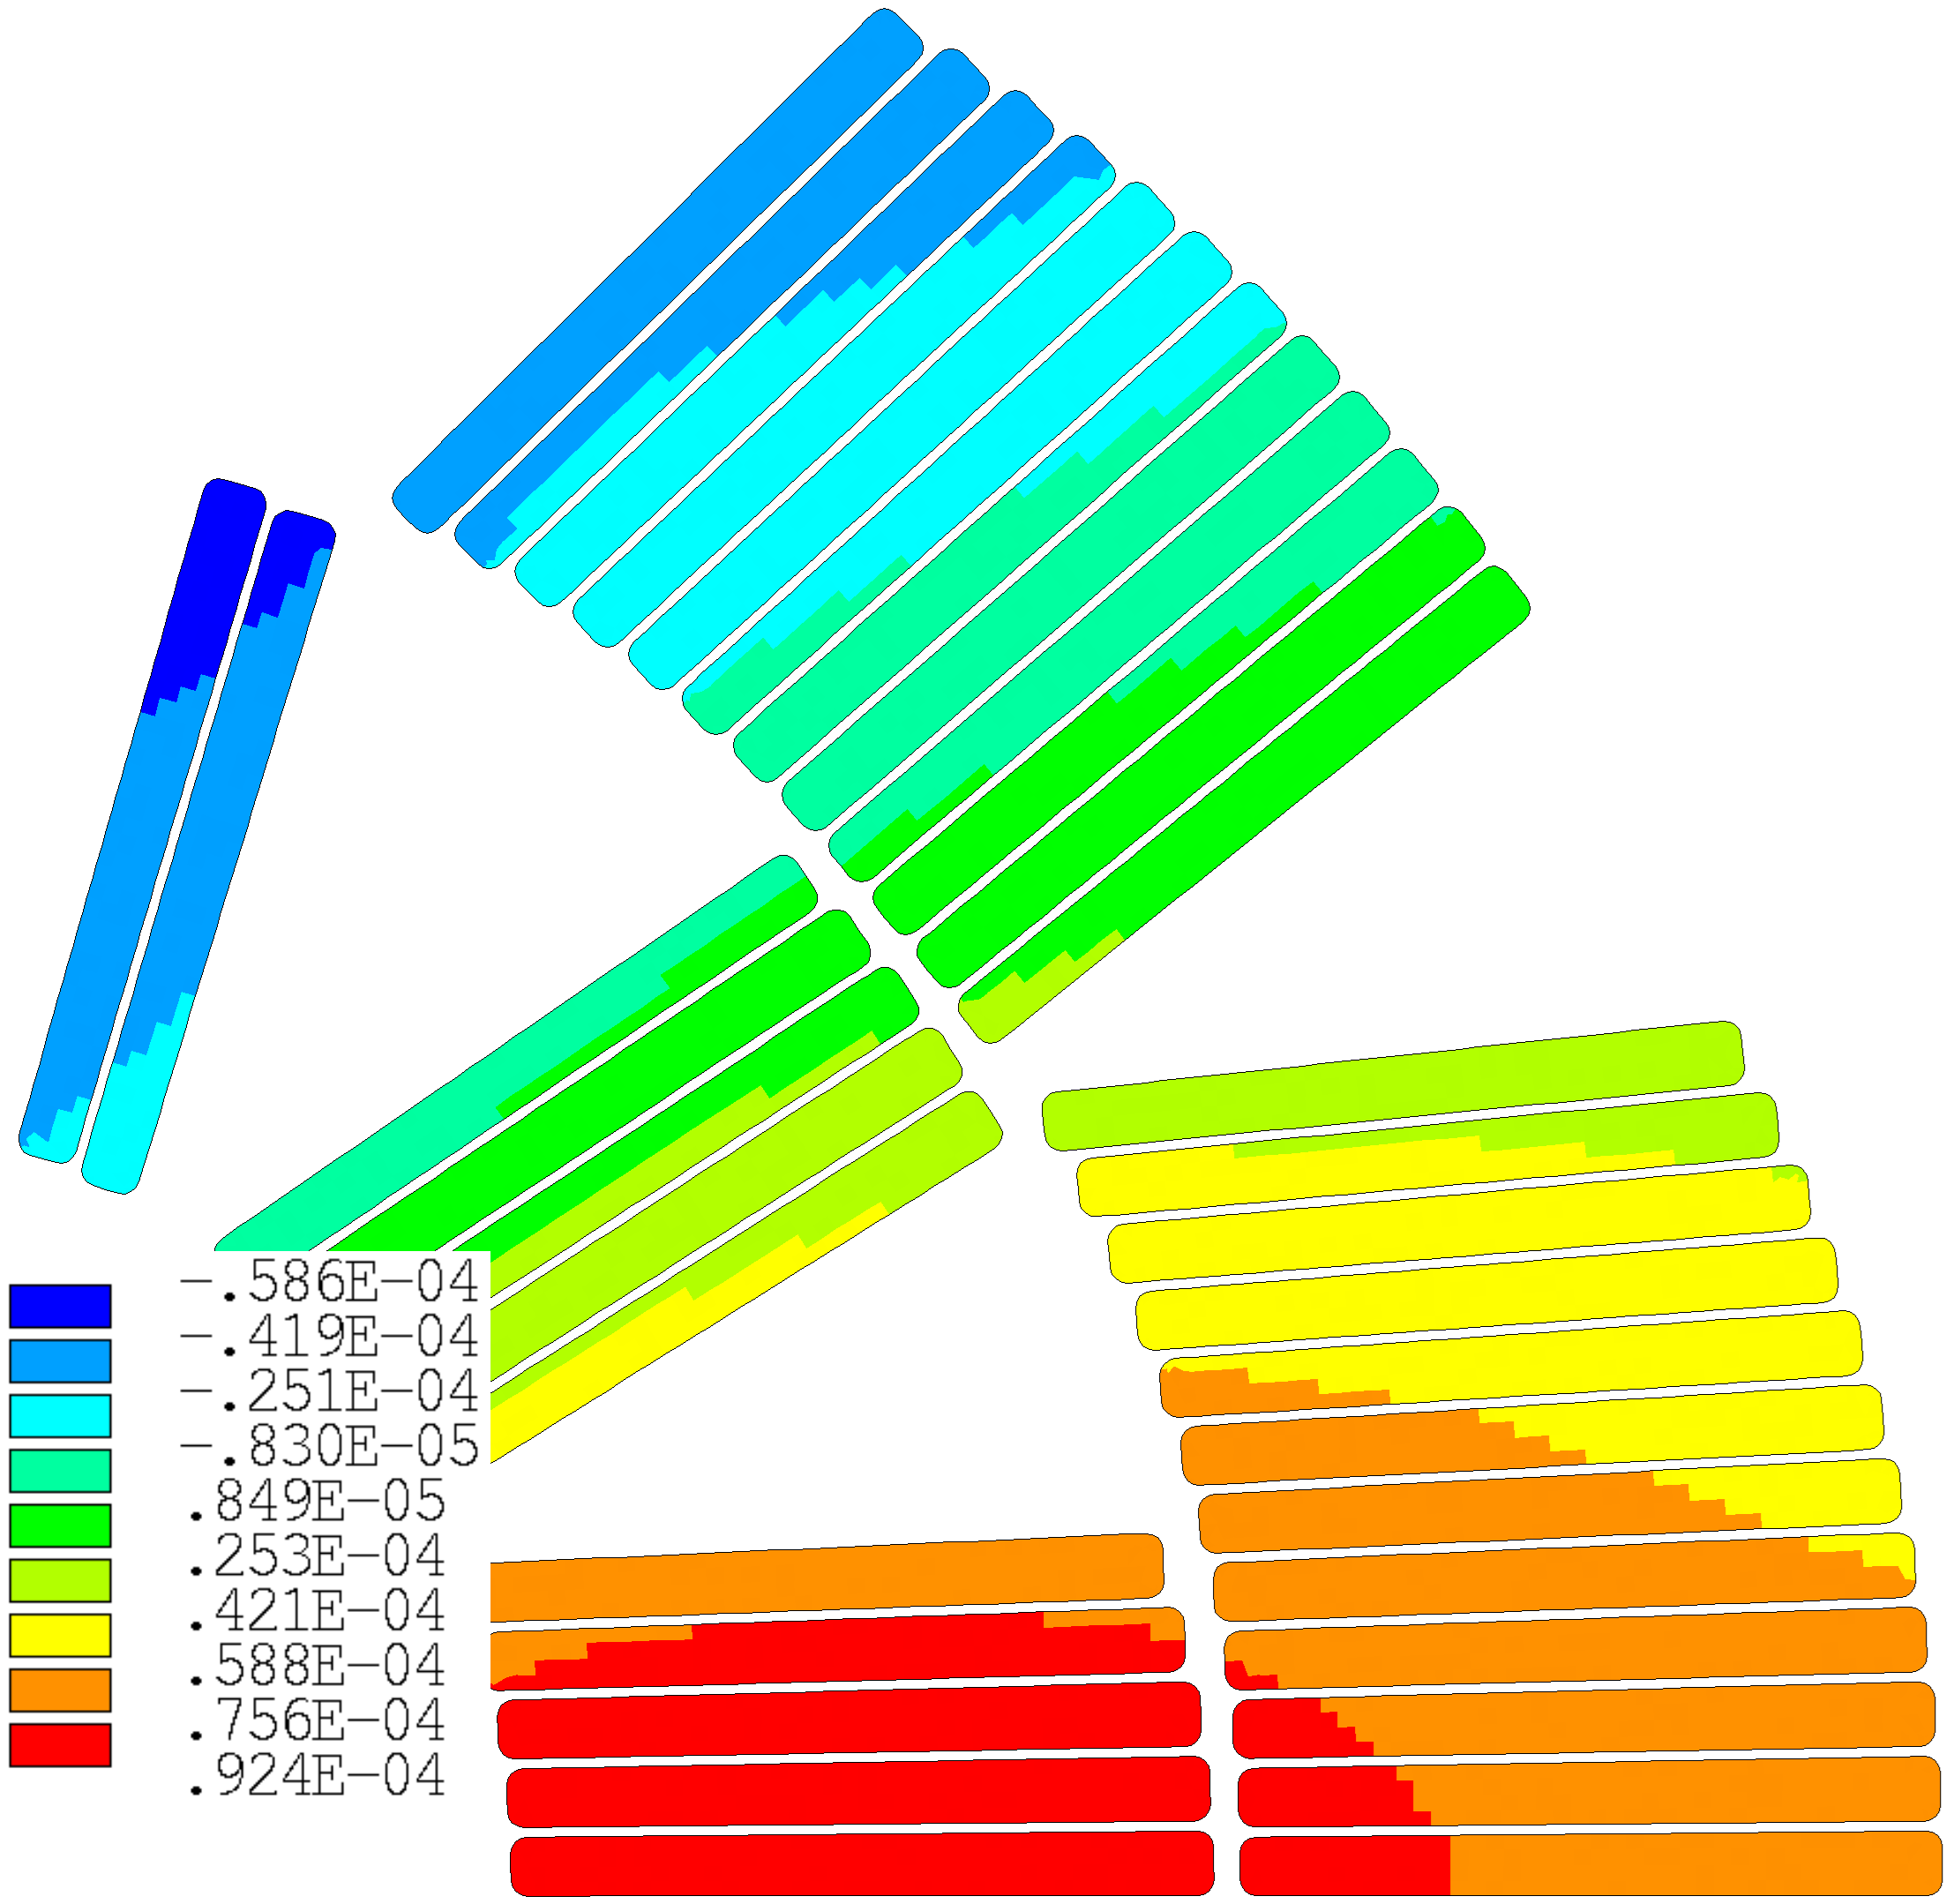
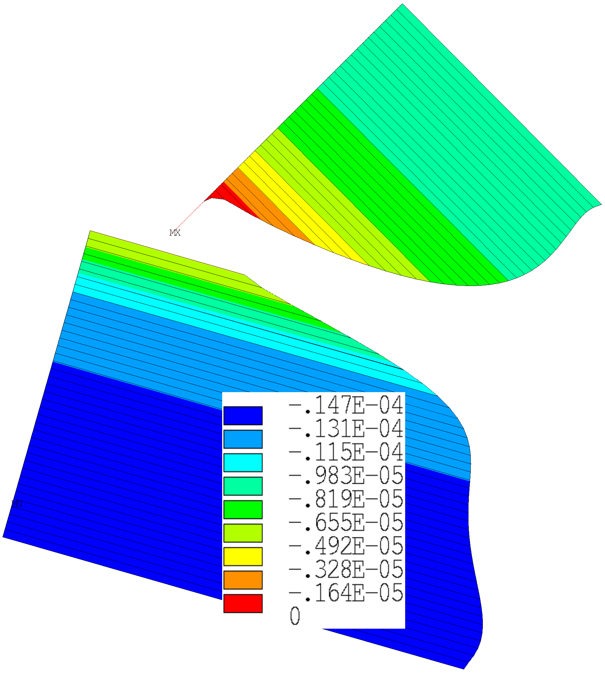





Horizontal Split Yokes: Best
Energization
$$A$$
$$δ_{A,max}=70 μm$$
$$δ_{yoke,max}=45 μm$$
$$δ_{shell,max}=45 μm$$
$${gaps}_{max}=15 μm$$

Slide 5



Horizontal Split Yokes: FEM
High Stiffness
(Structural Yoke)
Medium Thickness
$${th}_{shell}=25 mm$$
Medium Interference
$${int}_{ver}=0.15 mm$$
$${int}_{hor}=0.25 mm$$
$${space}_{opened}<0.2 mm$$

Slide 6
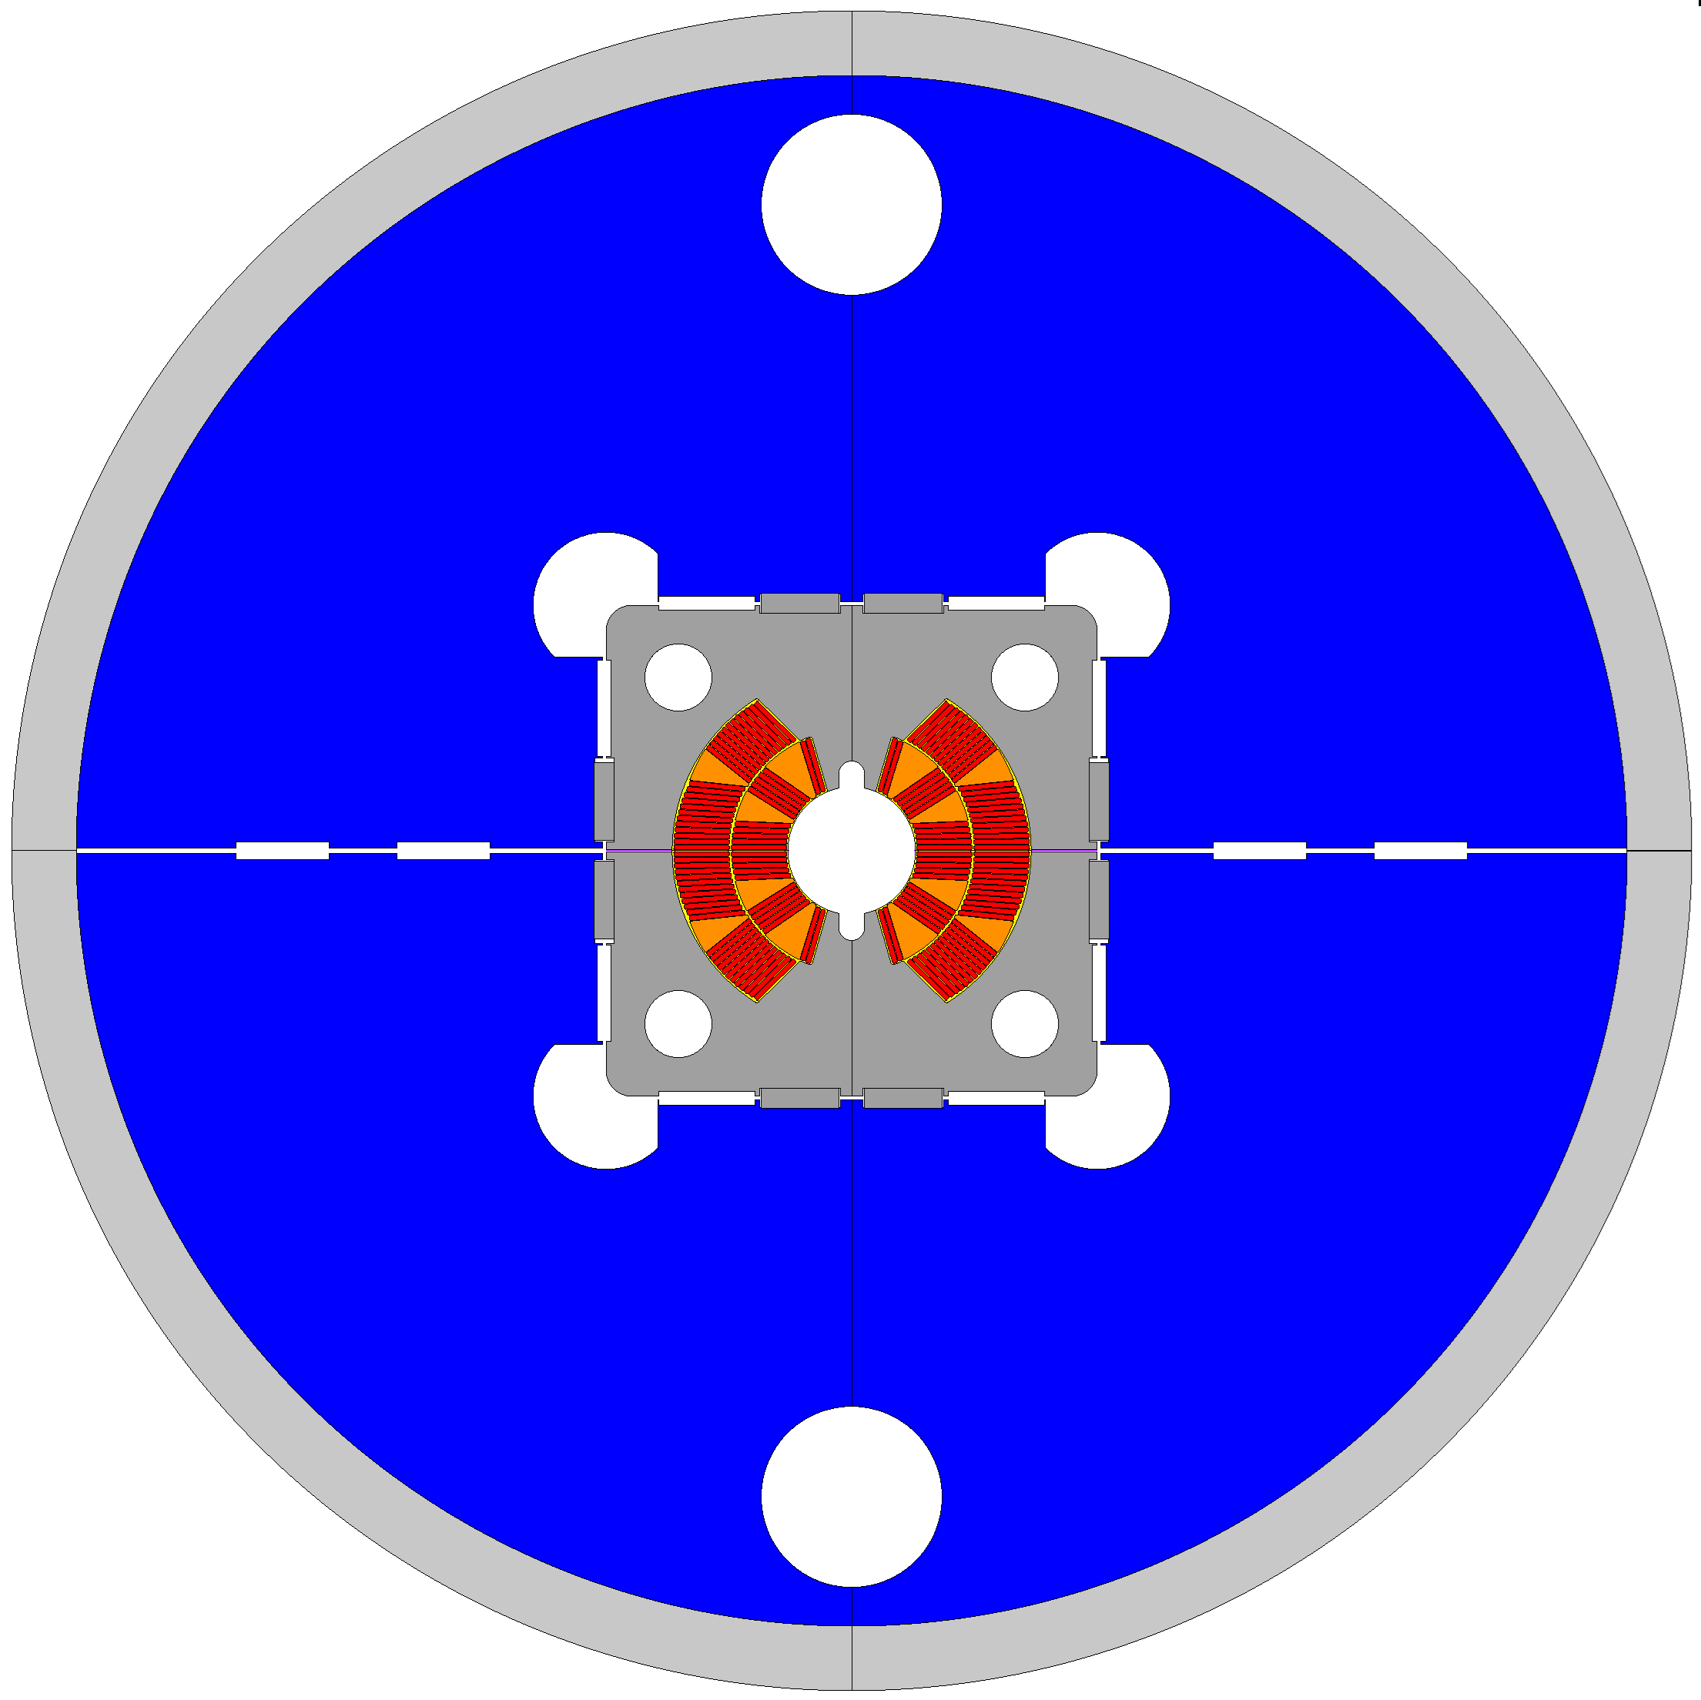








Horizontal Split Yokes
$$To @12T, we need:$$
$${int}_{hor}=0.25 mm$$
$$So we need to open:$$
$${space}_{hor}=0.25+0.25 mm$$
$$→{space}_{needed_hor}>0.5 mm$$
$$So we use 4 bladders:$$
$${pres}_{bla−hor}=35 MPa$$
$$→{space}_{open_hor}<0.2 mm$$

Slide 7



Horizontal Split Yokes: feasible
High Stiffness
(Structural Yoke)
High Thickness
$${th}_{shell}=45 mm$$
Interference
$${int}_{ver}=0.4 mm$$
$${int}_{hor}=0.0 mm$$

Slide 8
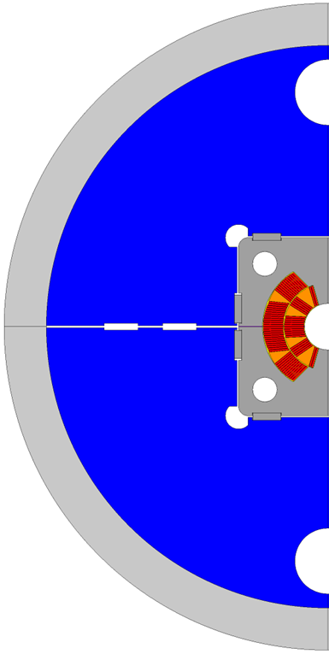
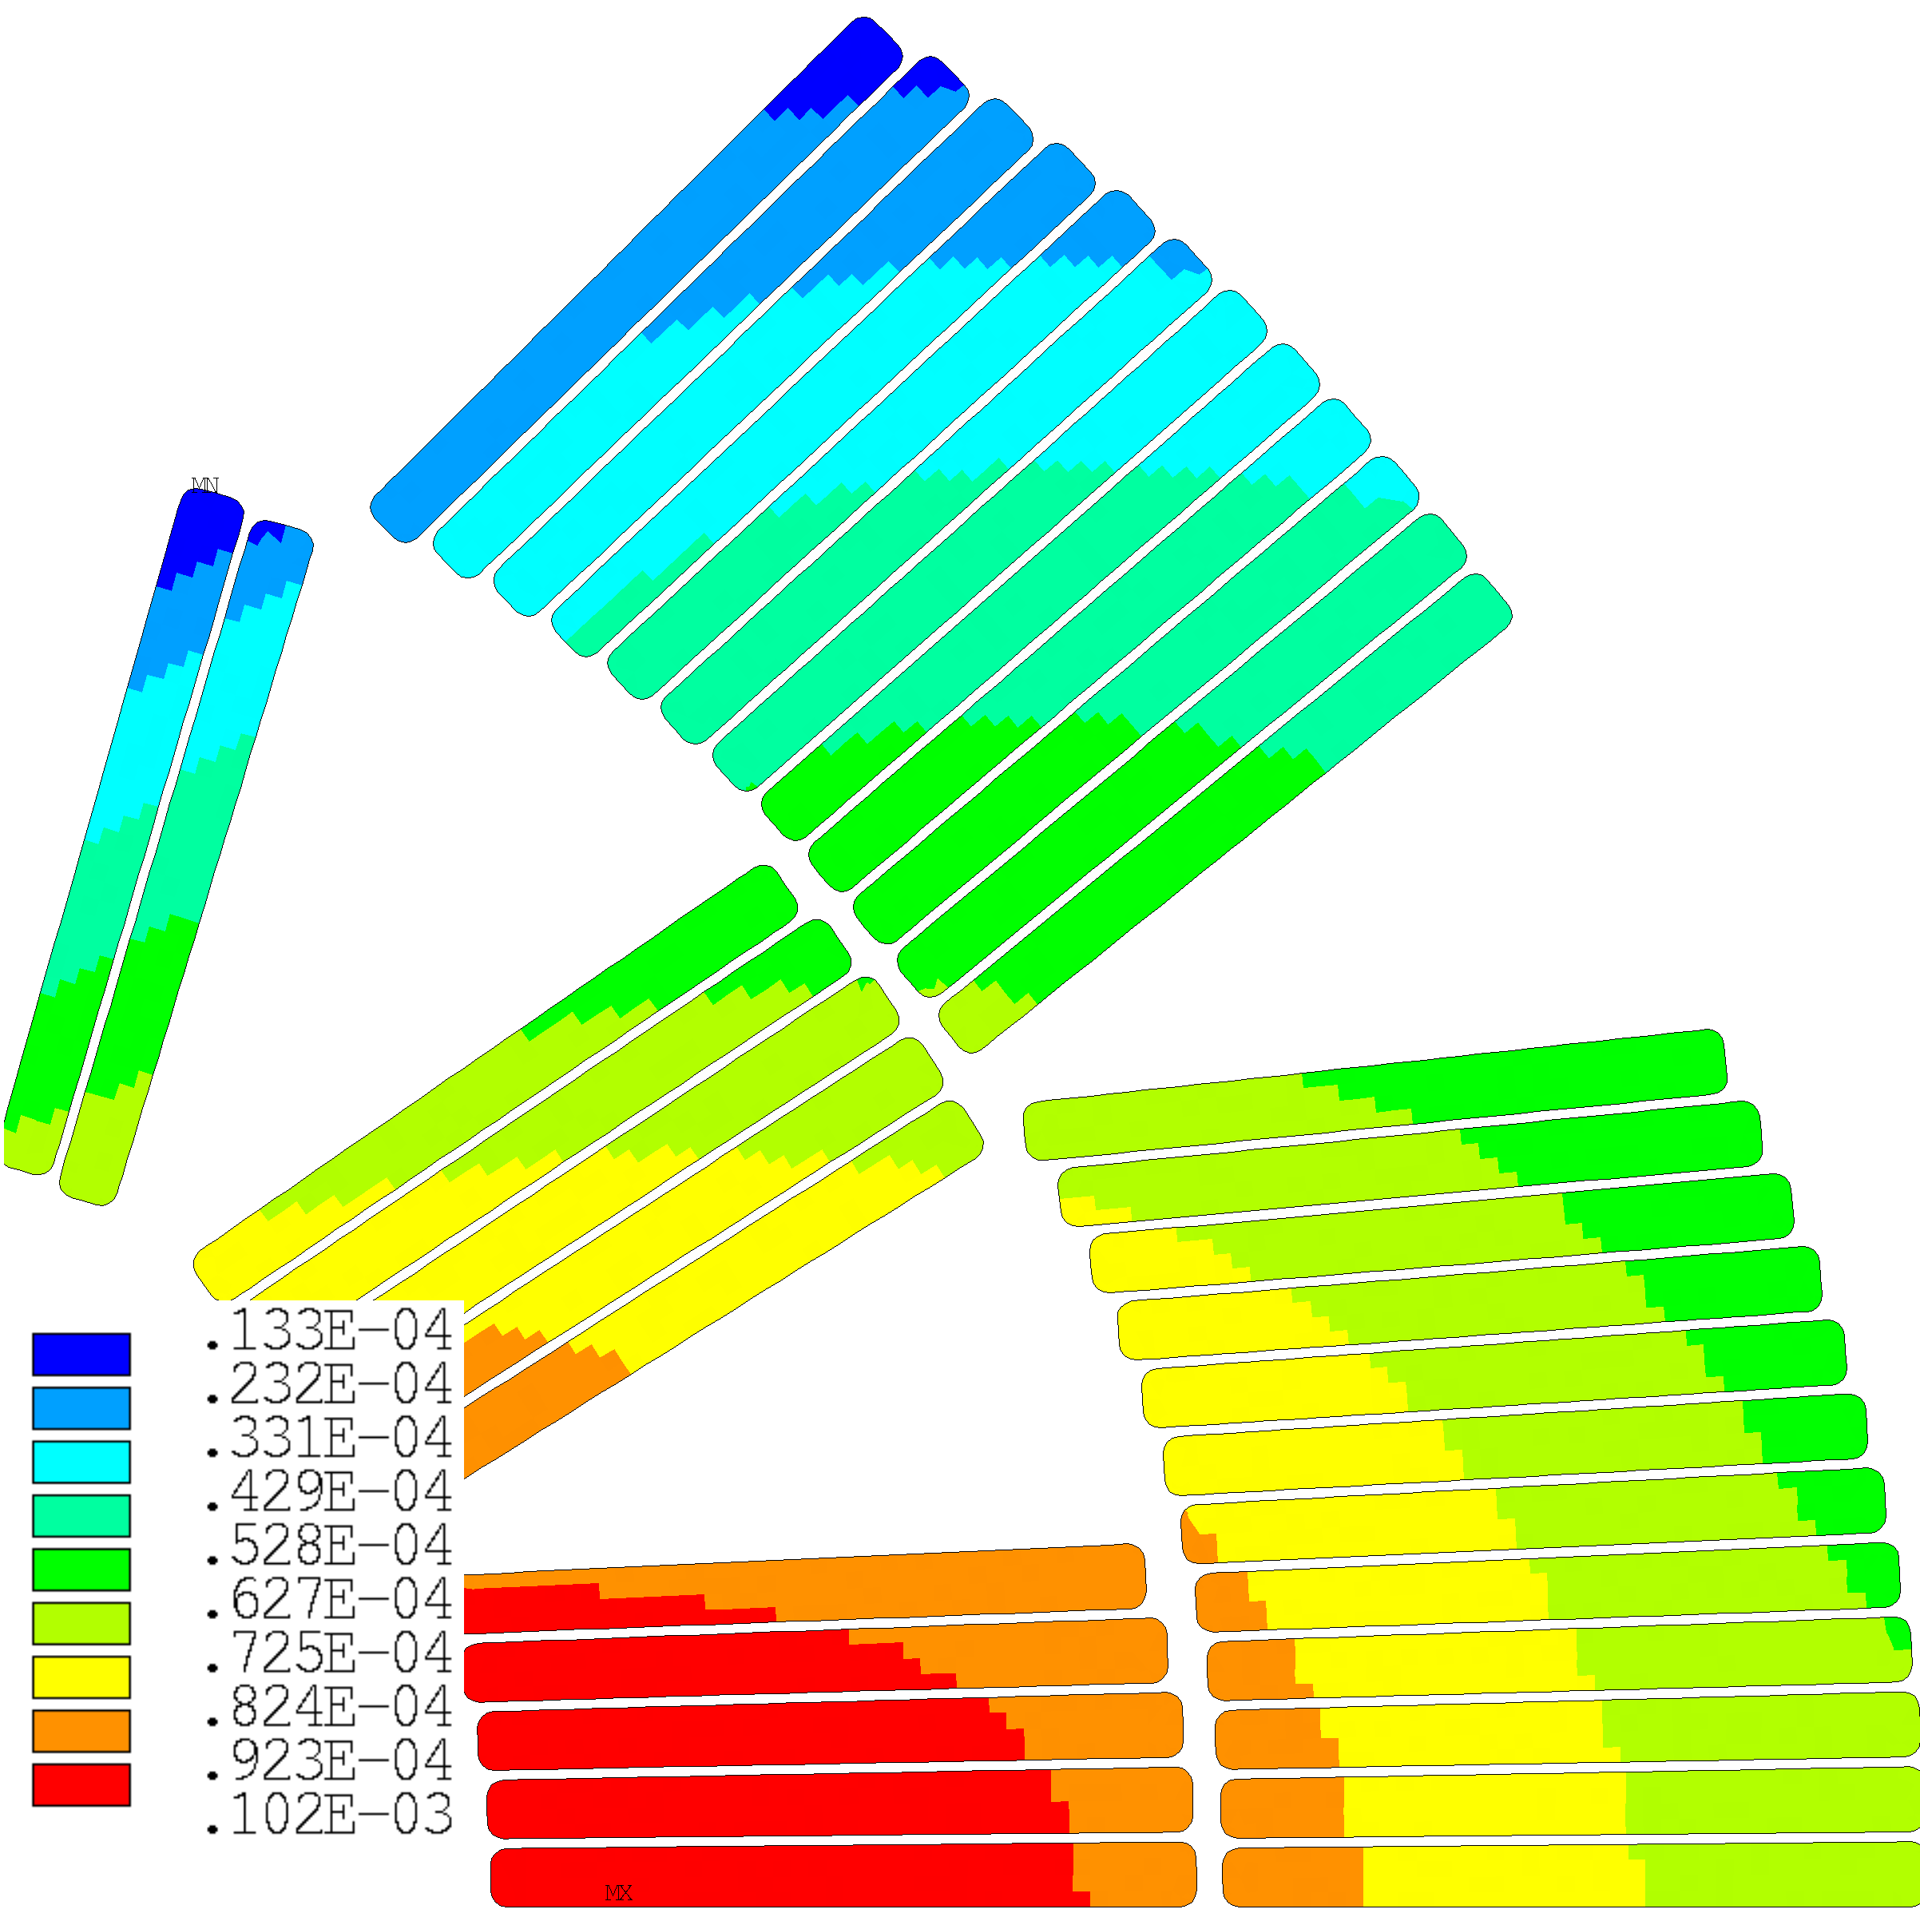
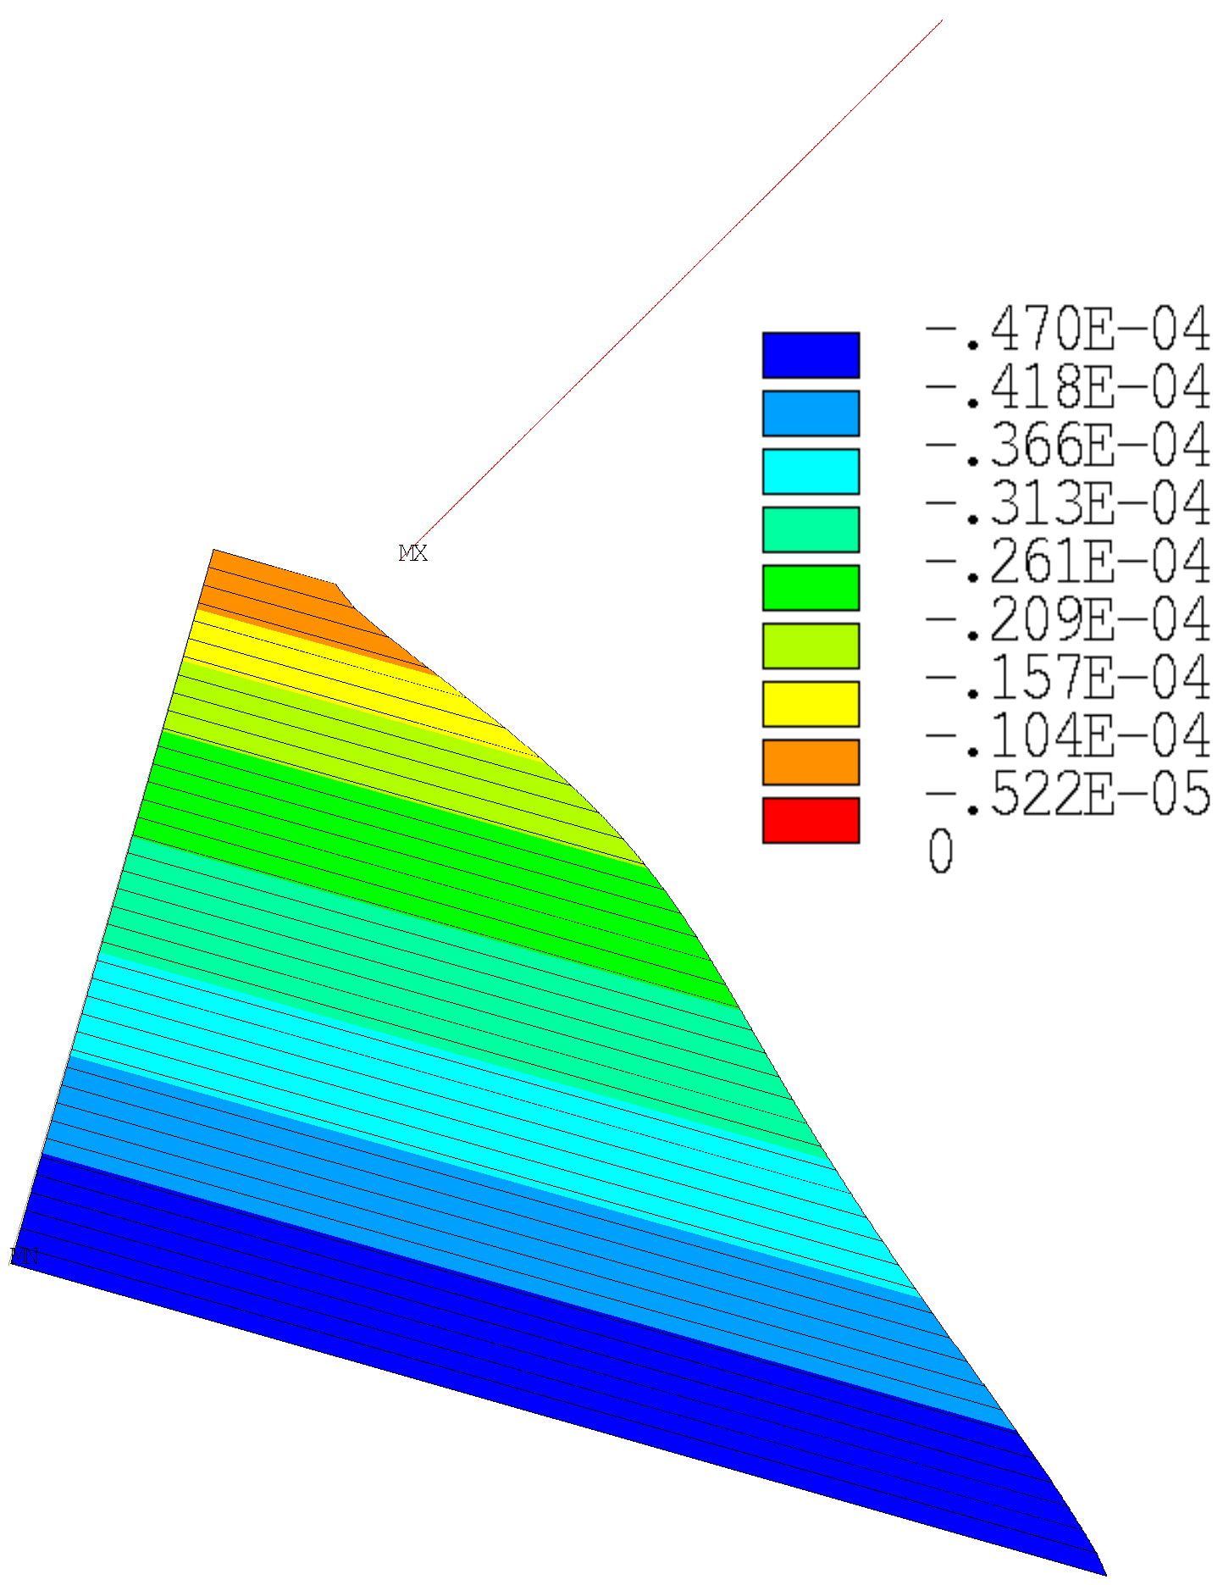




Horizontal Split Yokes: Best
Energization
$$A$$
$$δ_{A,max}=68 μm$$
$$δ_{yoke,max}=43 μm$$
$$δ_{shell,max}=41 μm$$
$${gaps}_{max}=47 μm$$

Slide 9
Horizontal Split Yokes
Since we cannot include high horizontal interference (due to the high stiffness of iron with respect to maximum bladder pressure), the pre-stress is attributed only to the outer aluminum shell.
We do not have pre-stress distributed between the assembly and cool-down steps; it is provided only at 1.9K.
Despite high shell thicknesses (up to 45/50 mm), we are unable to obtain adequate pre-stress figures.

Slide 10
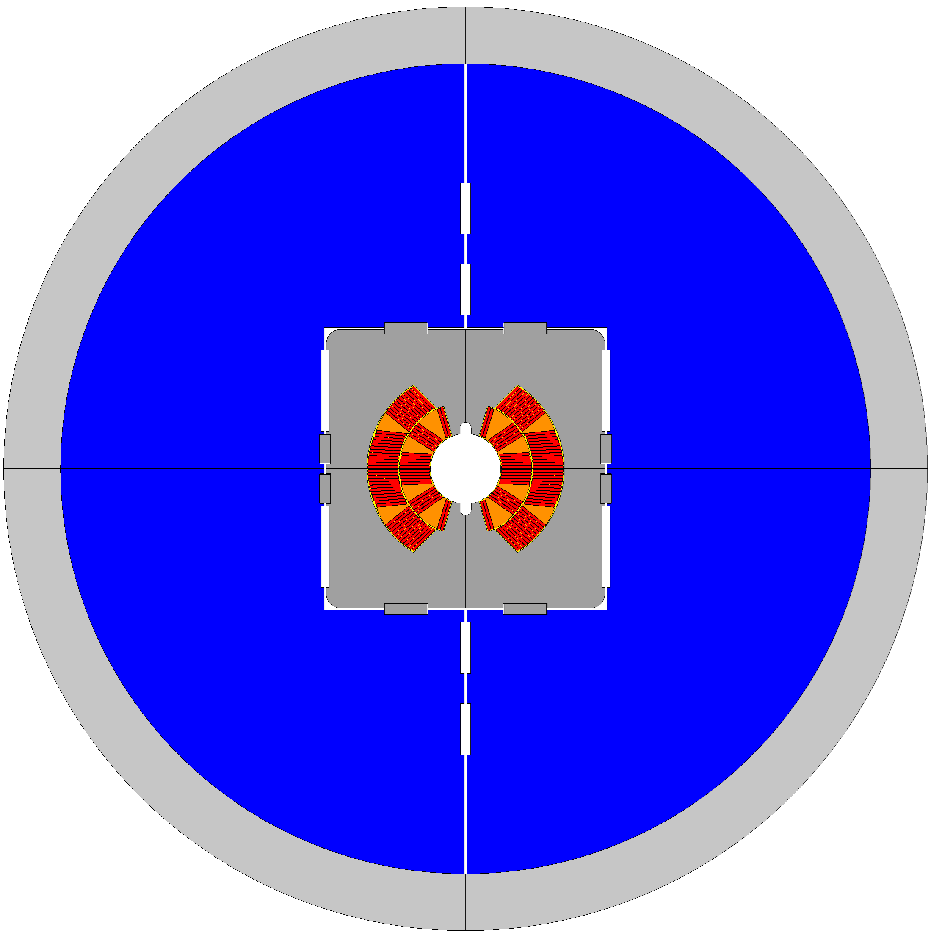



Vertical Split Yokes
Medium Stiffness
(Yoke only loads shell)
High Thickness
$${th}_{shell}=40 mm$$
Medium Interference
$${int}_{ver}=0.1 mm$$
$${int}_{hor}=0.5 mm$$

Slide 11
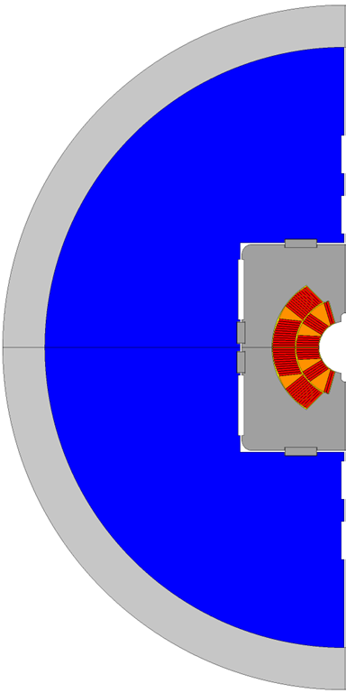
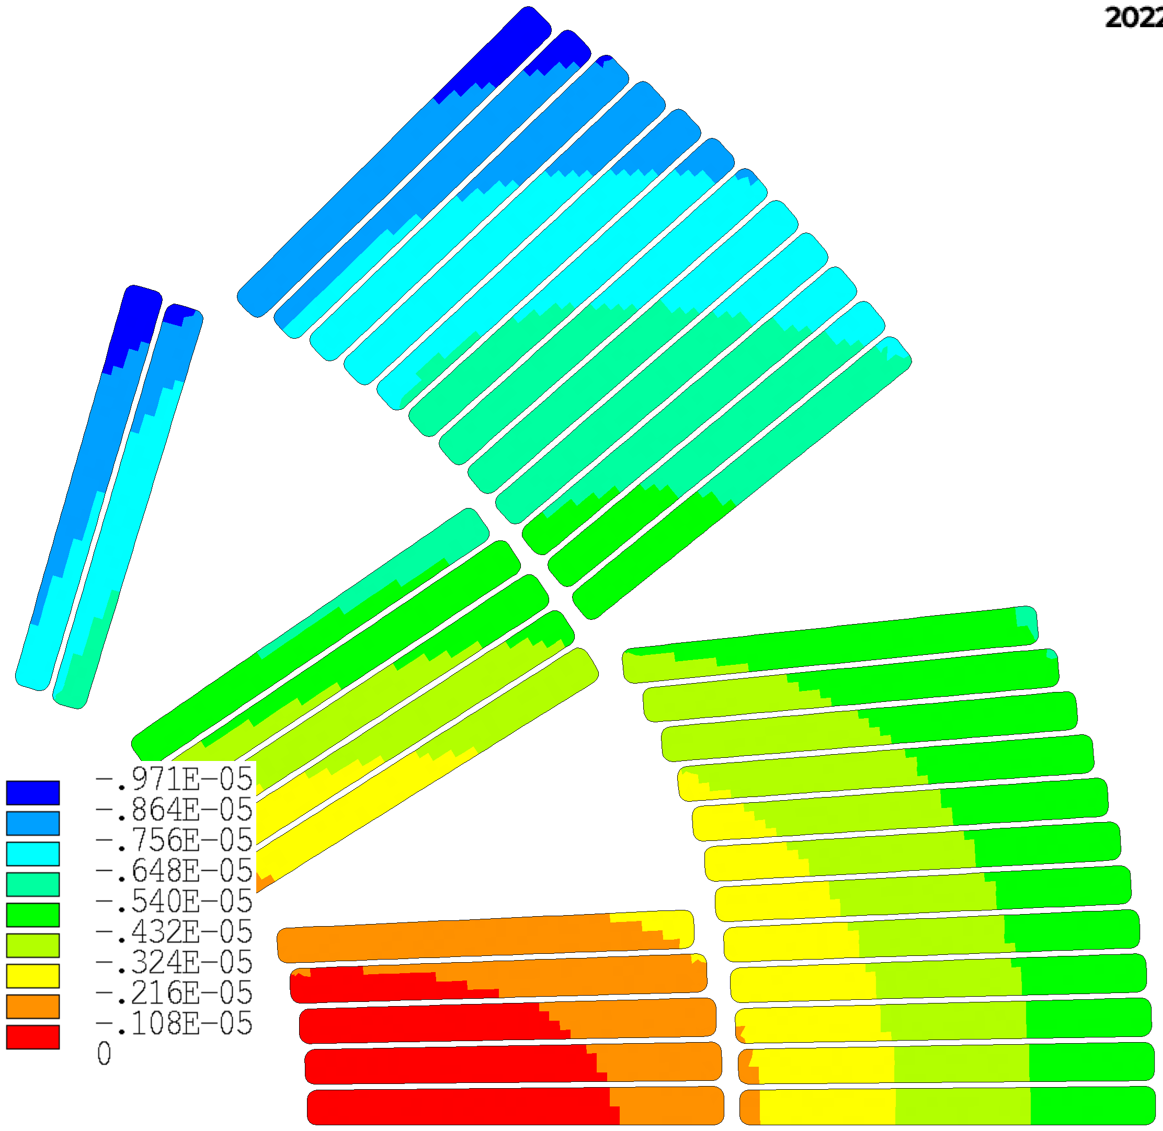
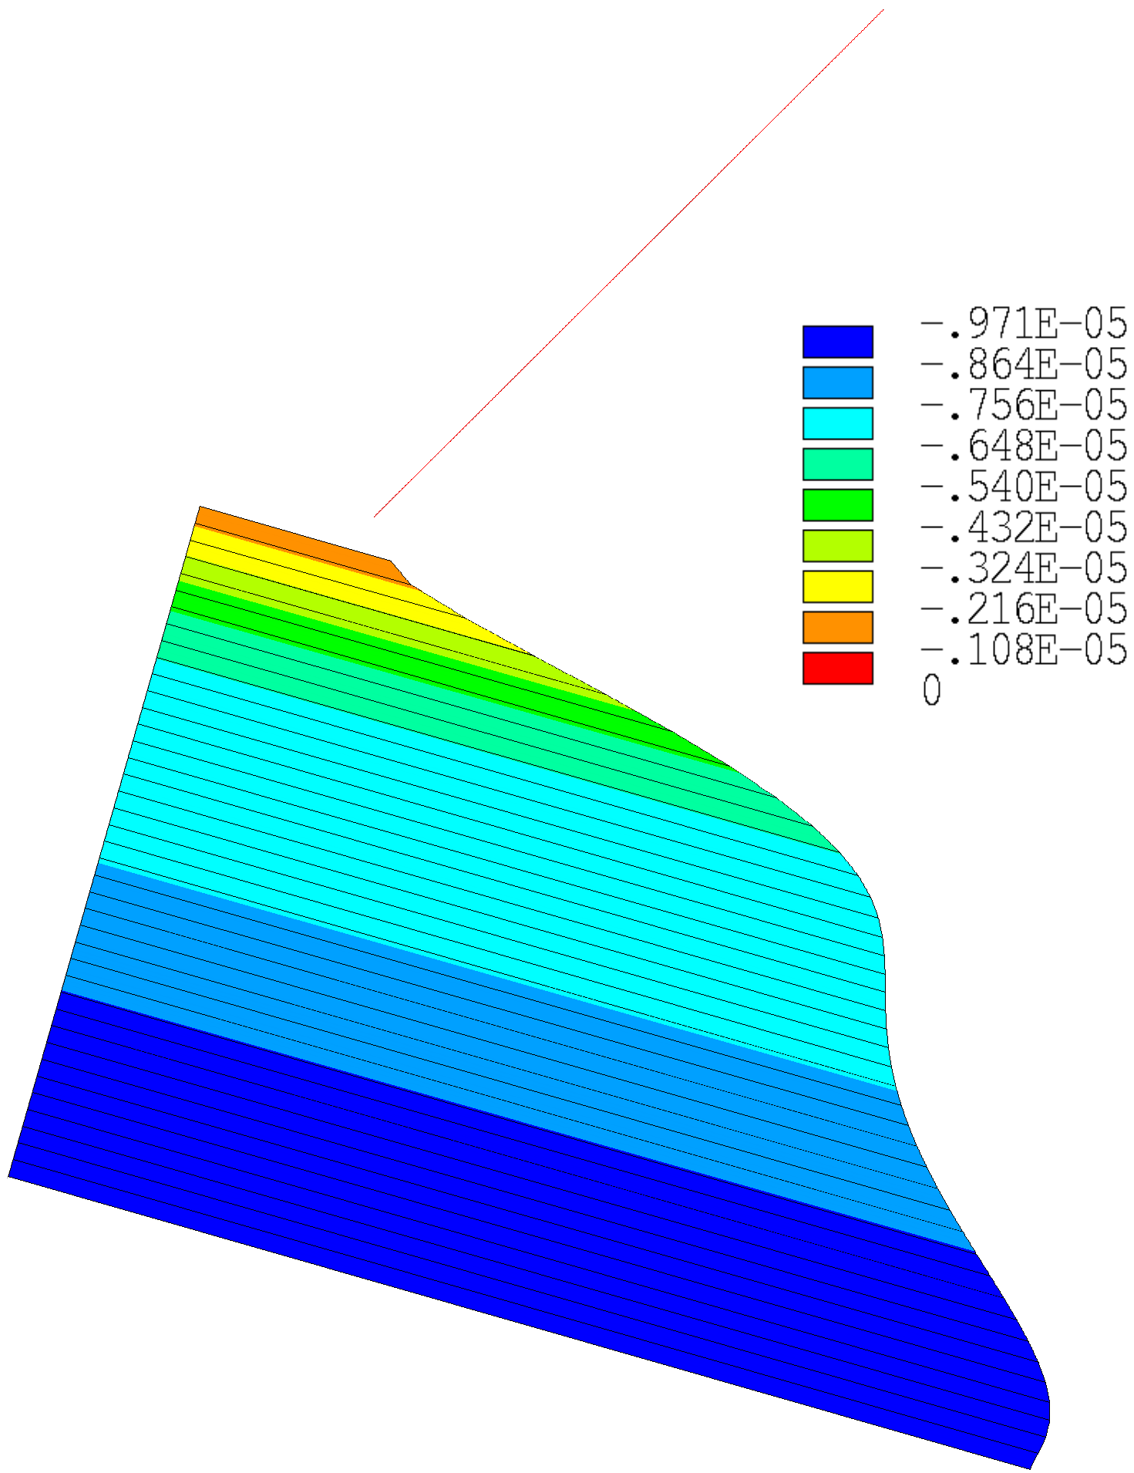




Vertical Split Yokes: best results
Energization
$$A$$
$$δ_{A,max}=45 μm$$
$$δ_{yoke,max}=30 μm$$
$$δ_{shell,max}=30 μm$$
$${gaps}_{max}=8 μm$$

Slide 12
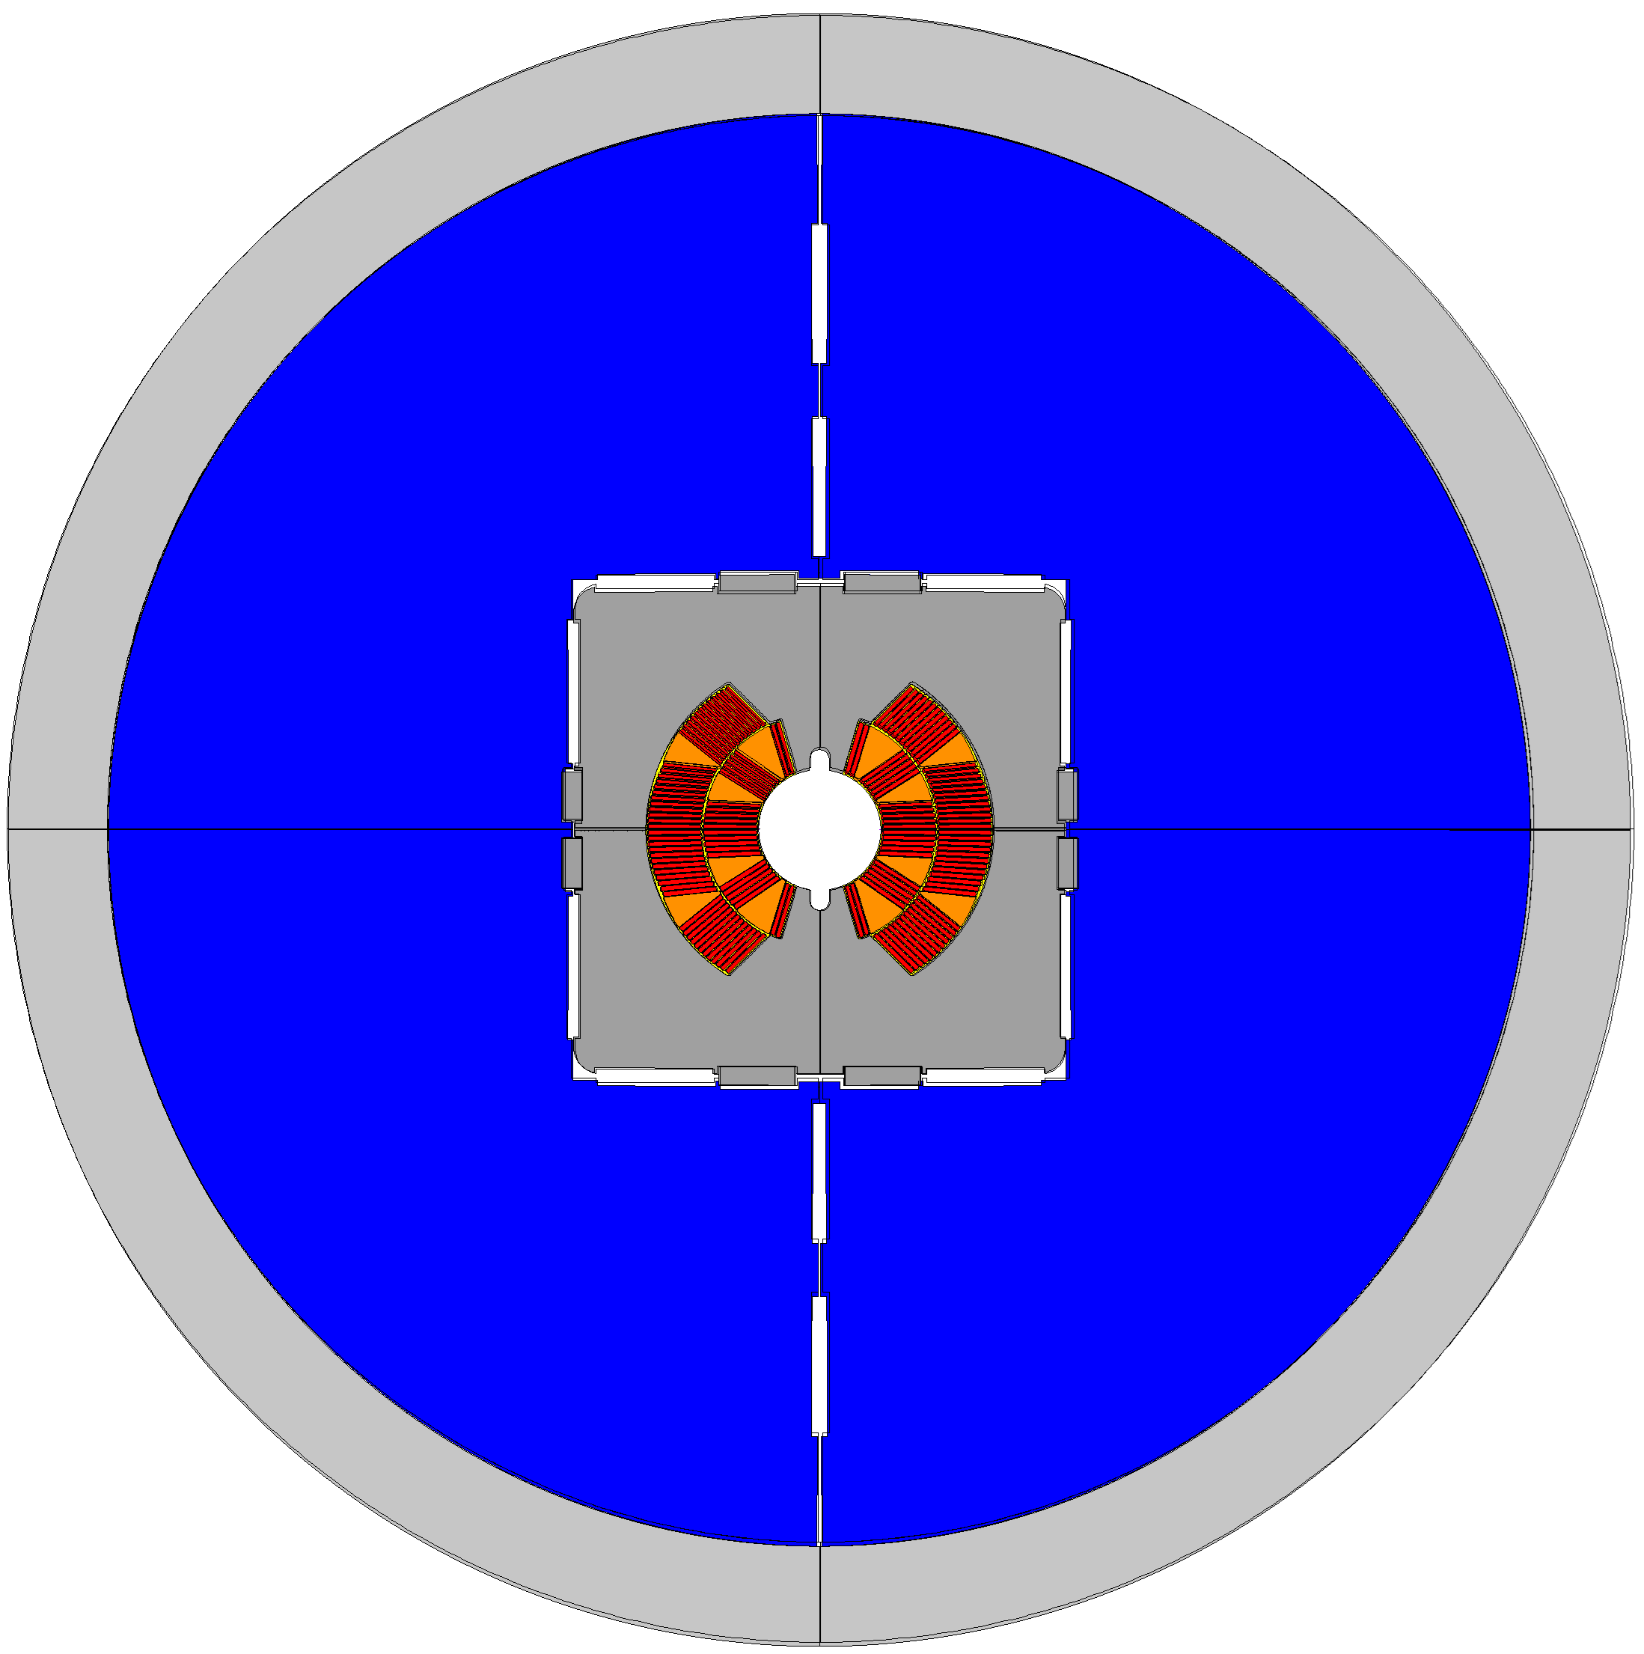








Vertical Split Yokes
$$To @12T, we need:$$
$${int}_{ver}=0.1 mm$$
$$So we need to open:$$
$$→{space}_{needed_hor}>0.3 mm$$
$$Using bladders:$$
${size}_{bla−hor}=46$mm
$${pres}_{bla−hor}=45 MPa$$
$$→{space}_{open_hor}<0.2 mm$$
(* See slides 13,14)

Slide 13
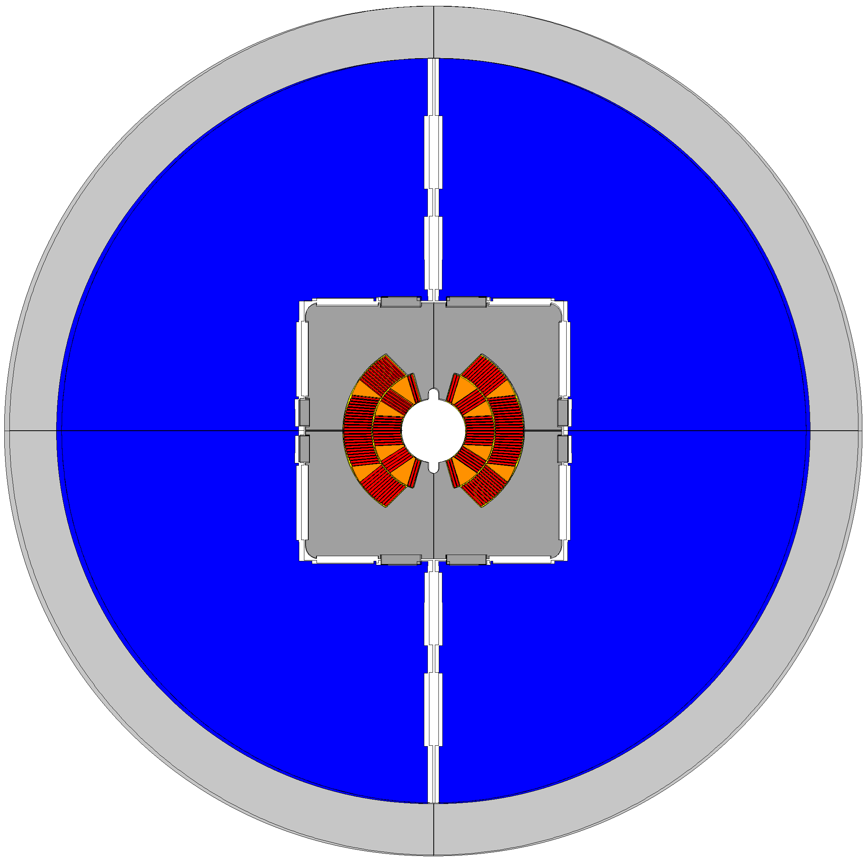








Vertical Split Yokes
$$To @12T, we need:$$
$${int}_{hor}=0.5 mm$$
$$So we need to open:$$
$$→{space}_{needed_hor}>0.75 mm$$
$$Using also V.S. bladders:$$
${size}_{bla−ver,hor,VS}=56$mm
$${pres}_{bla−ver,hor,VS}=45 MPa$$
$$→{space}_{open_ver}>0.8 mm$$

Slide 14
Vertical Split Yokes
Since we cannot include enough vertical interference (to be verified because in eRMC and RMM ...), the pre-stress is attributed only to the horizontal interference key (@R.T.) and shell shrinking (1.9 K).
Despite high shell thicknesses (up to 45/50 mm), we need at least 100 microm of horizontal interference in ordert to obtain adequate pre-stress figures (close to 5/10 microns gaps).

Slide 15
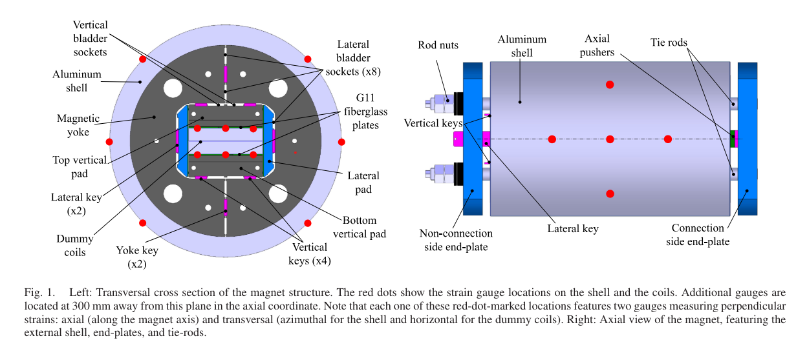



Vertical Split Yokes: eRMC, RMM
$${int}_{ver}=0.05 mm$$
$${int}_{hor}=0.55 mm$$
$$(up to 0.85 mm)$$
(temporary keys)
“Mechanical Tests, Analysis, and Validation of the Support Structure
of the eRMC and RMM Magnets of the FCC R&D at CERN” by M. G. Perez (2020)

Slide 16
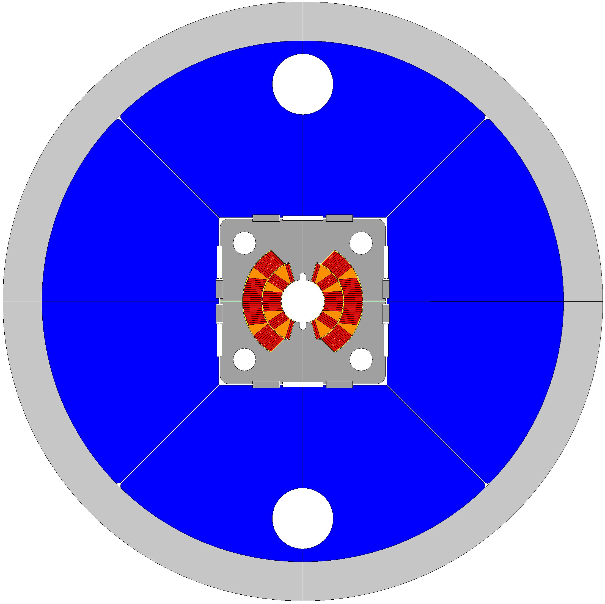



45° splits Yokes
Medium Stiffness
(not structural yokes)
Med-High Thickness
$${th}_{shell}=35÷45 mm$$
Medium-High Interference
$${int}_{ver}=0.2÷0.4 mm$$
$${int}_{hor}=0.2÷0.4 mm$$

Slide 17
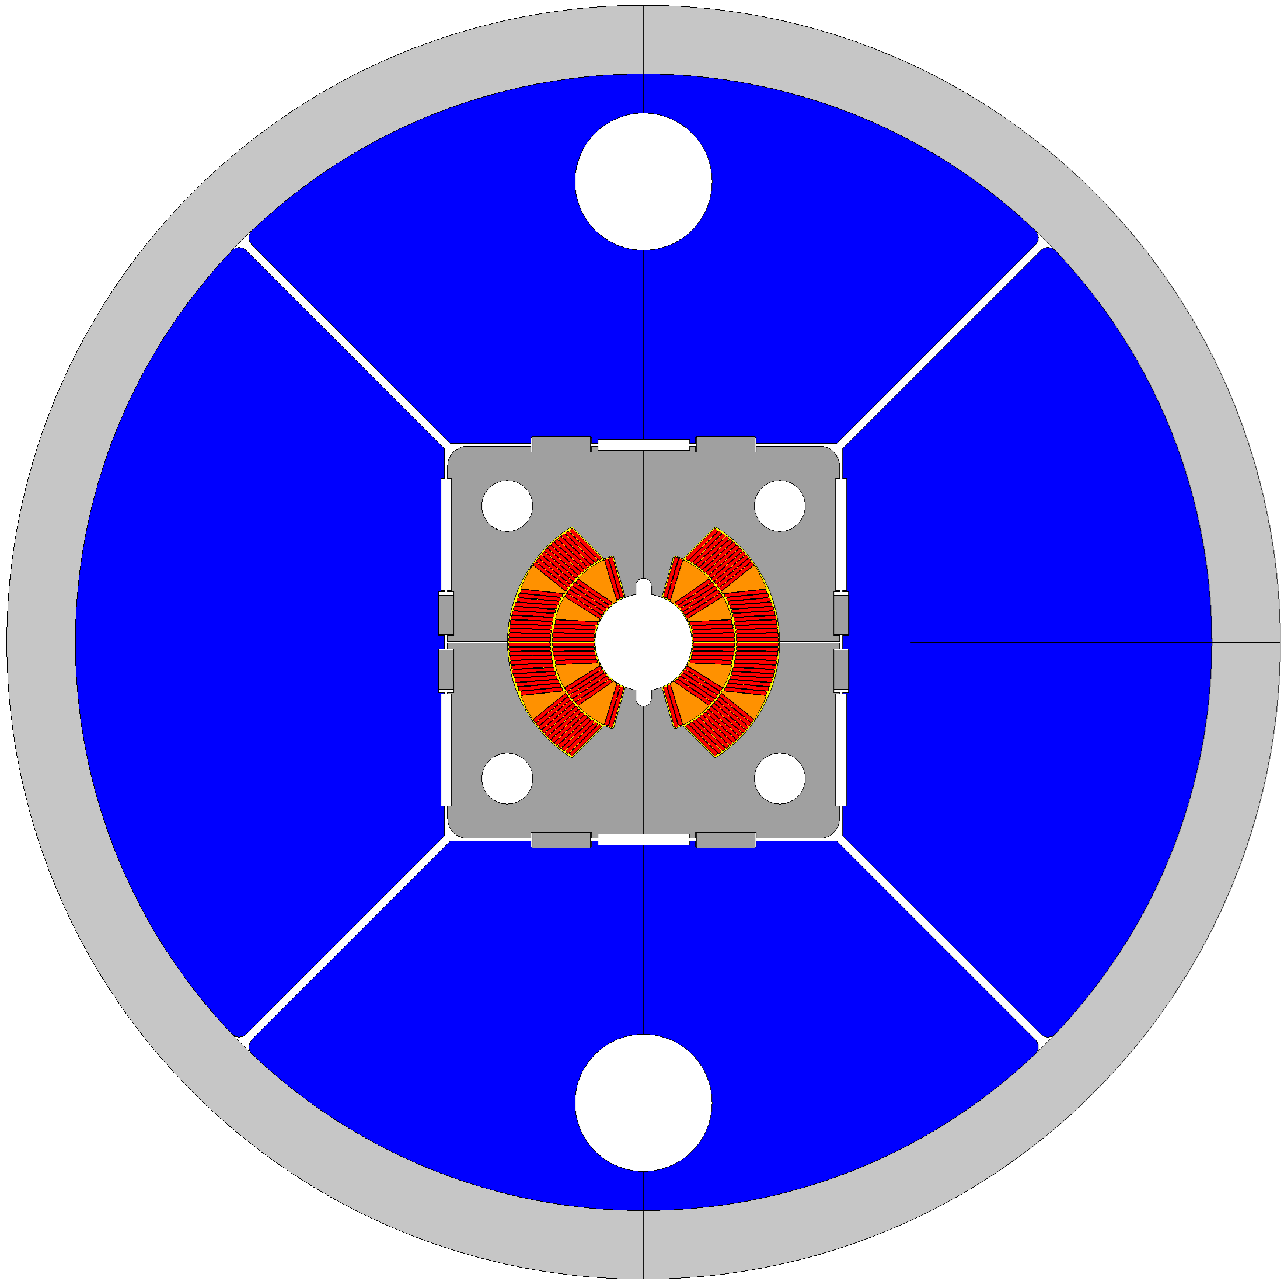
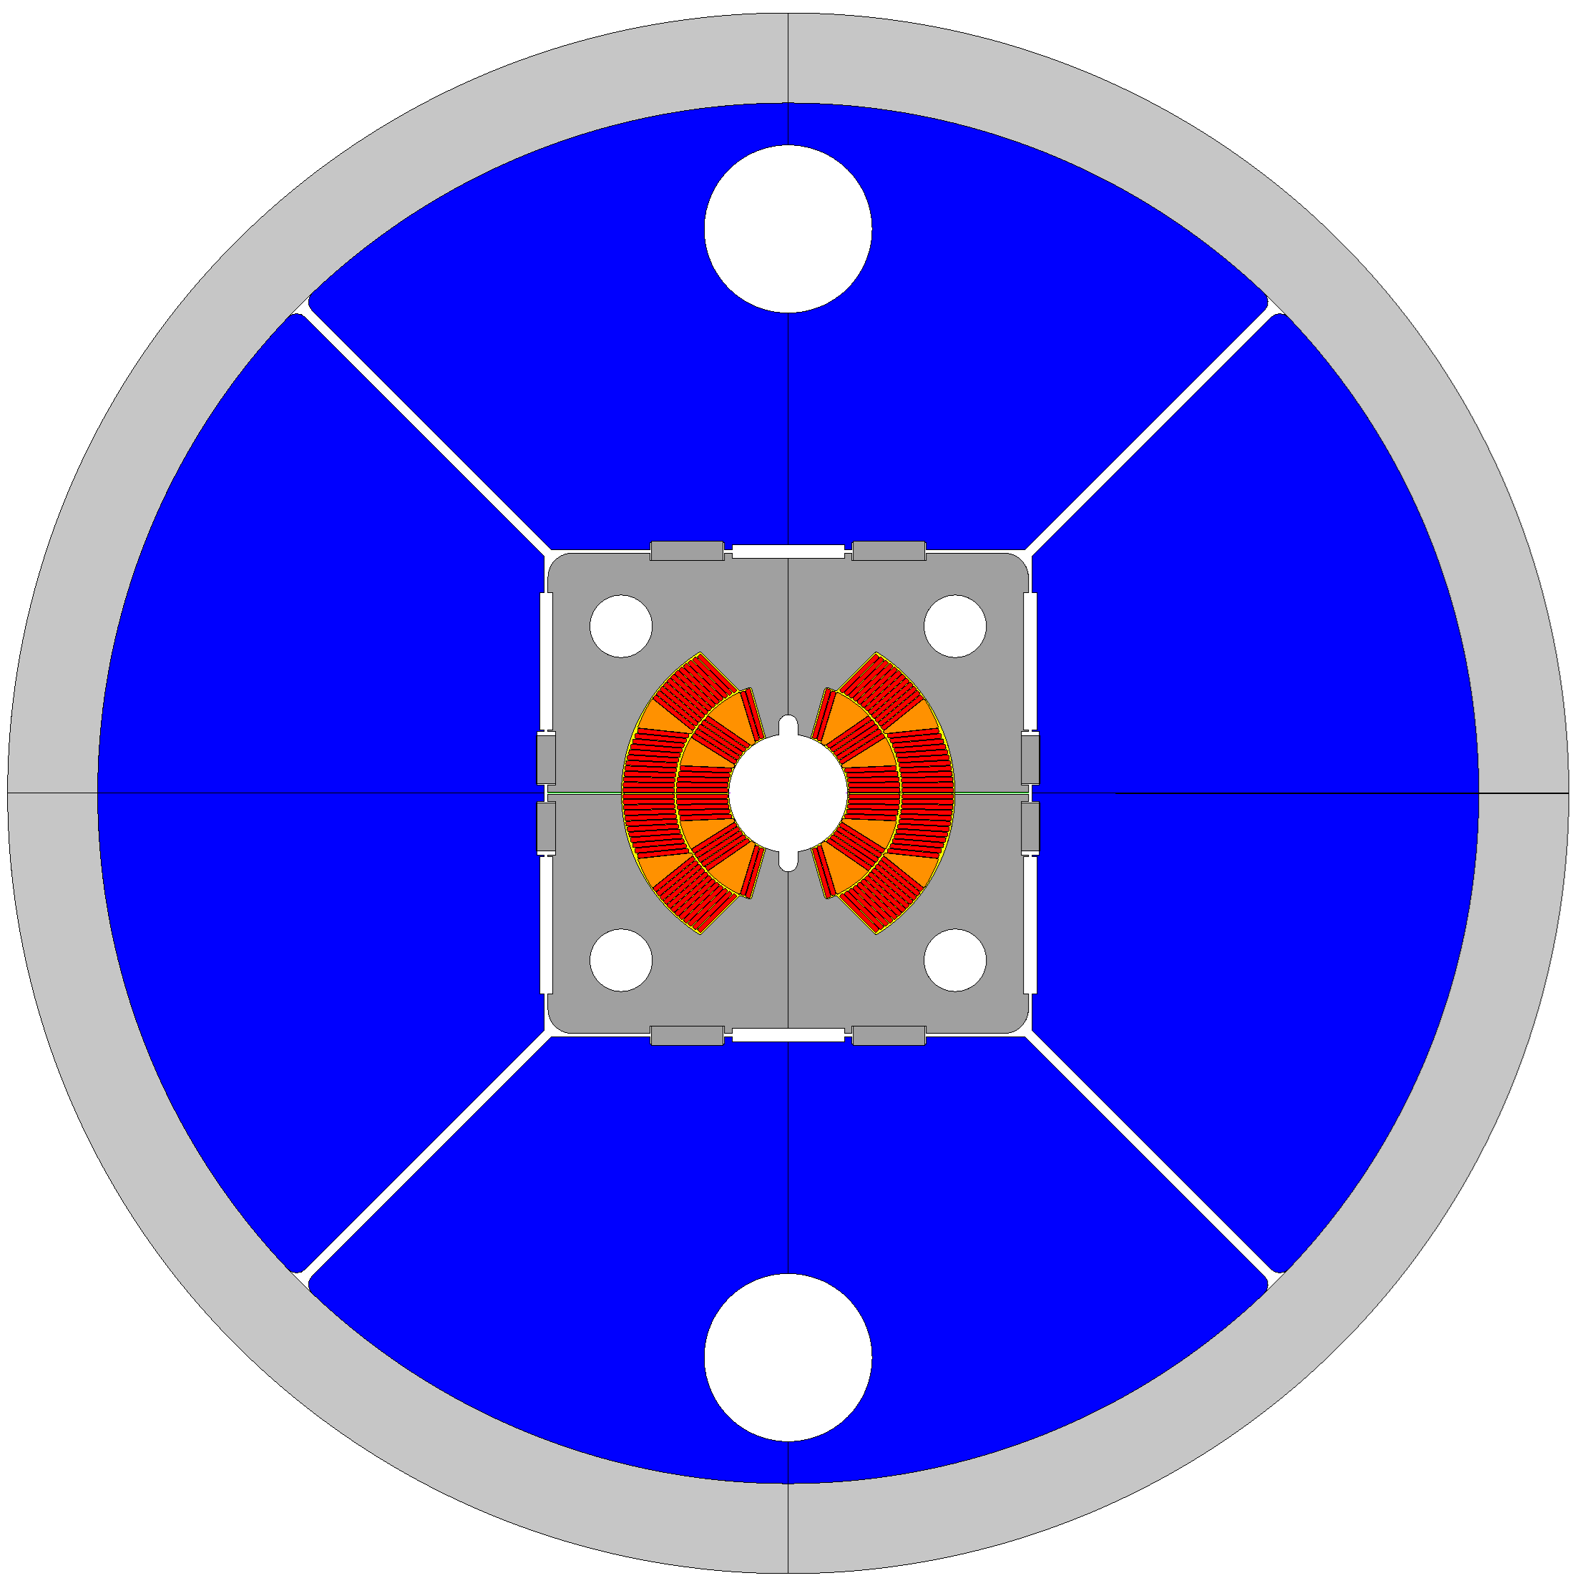
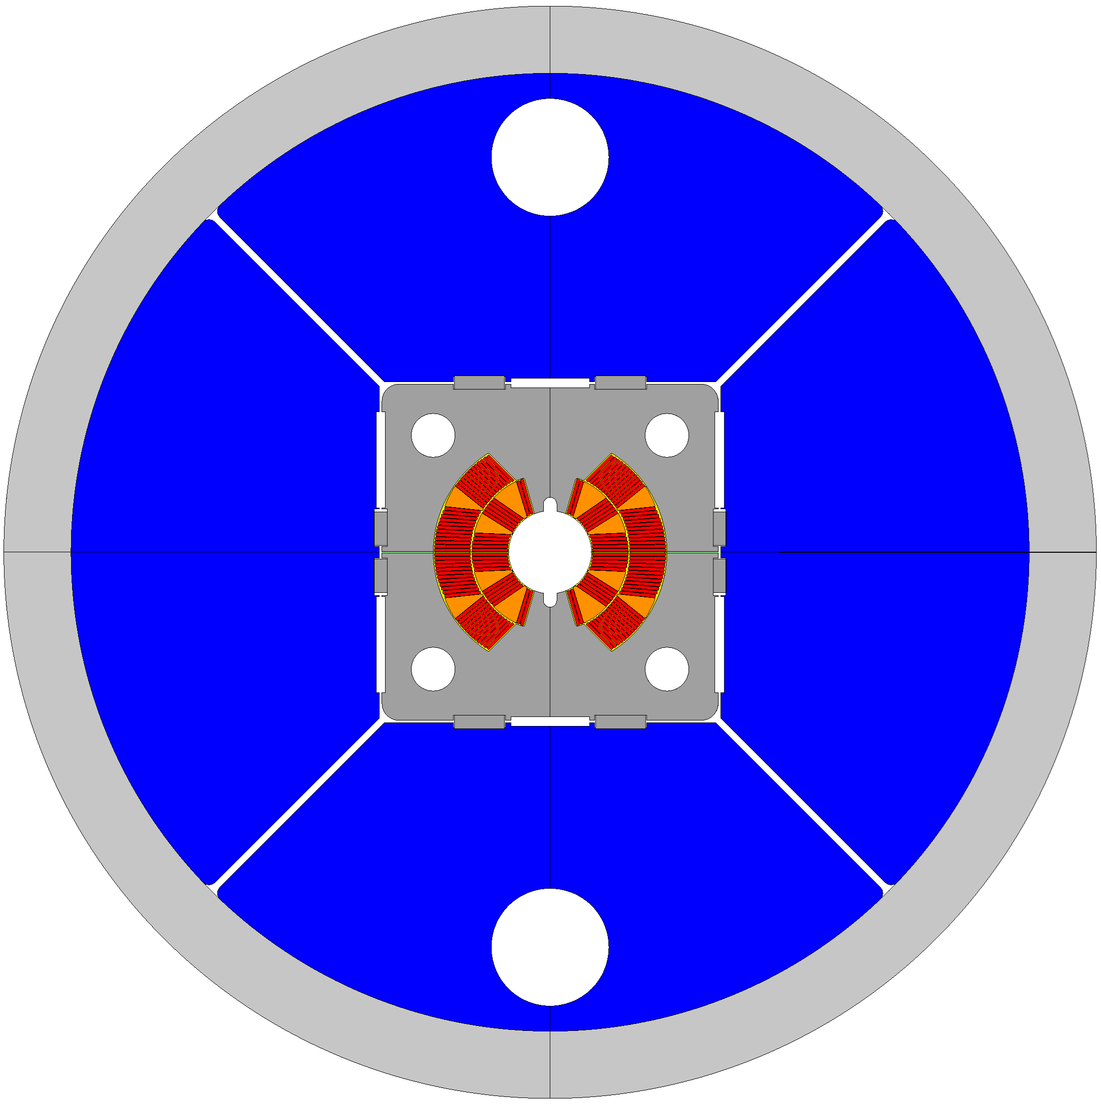
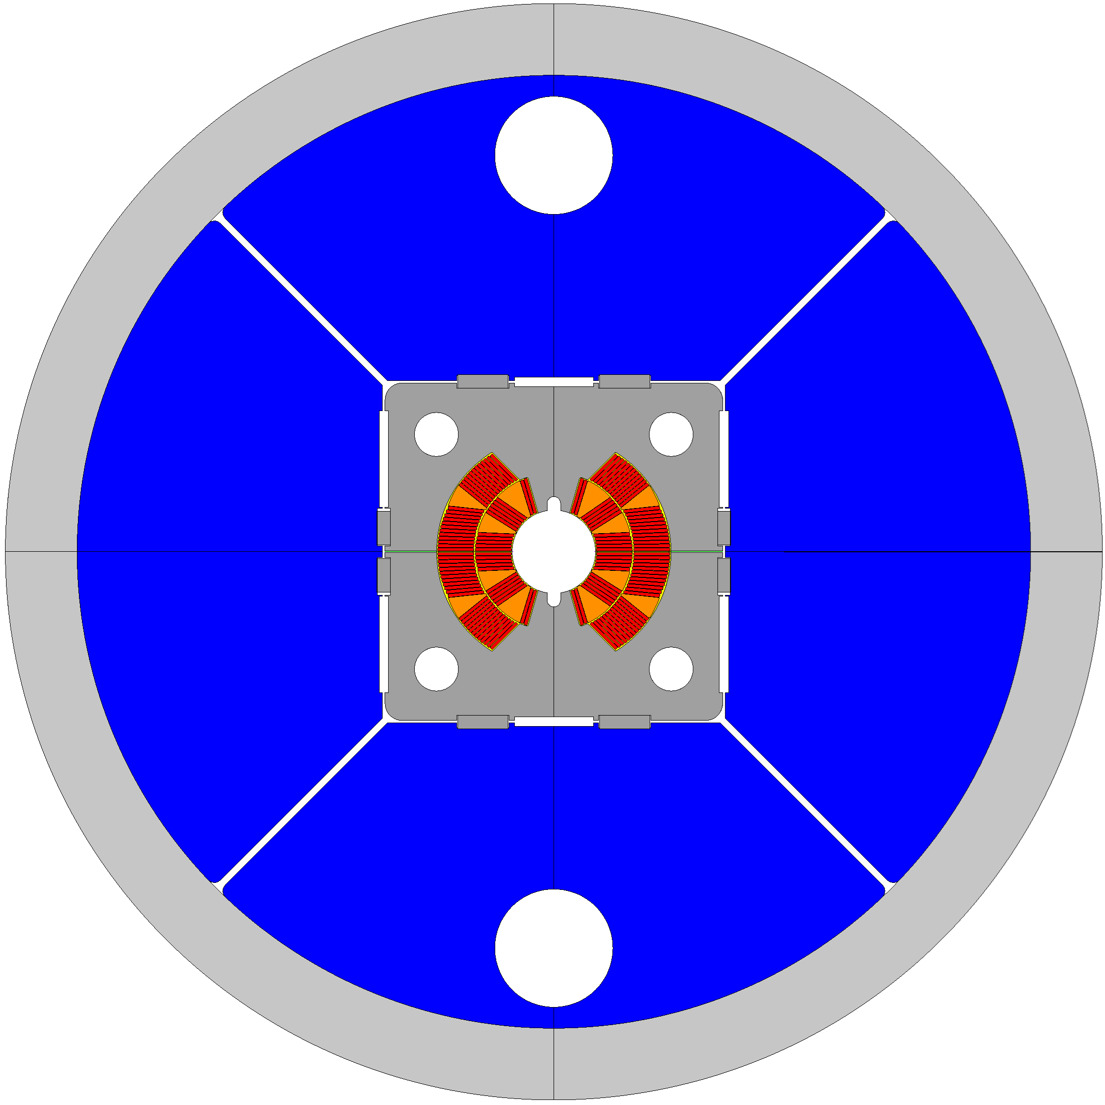









45° splits Yokes
$${th}_{Shell}=35 mm$$
$${th}_{Shell}=45 mm$$
$$\{$$
$$similar results$$
$$\{$$
$${int}_{ver}=0.4 mm$$
$${int}_{ver}=0.2 mm$$
$${int}_{hor}=0.4 mm$$
$${int}_{hor}=0.2 mm$$

Slide 18
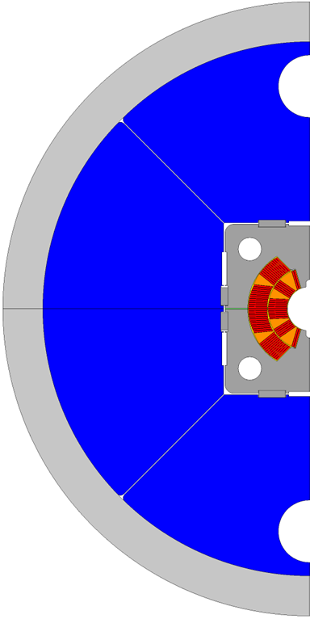
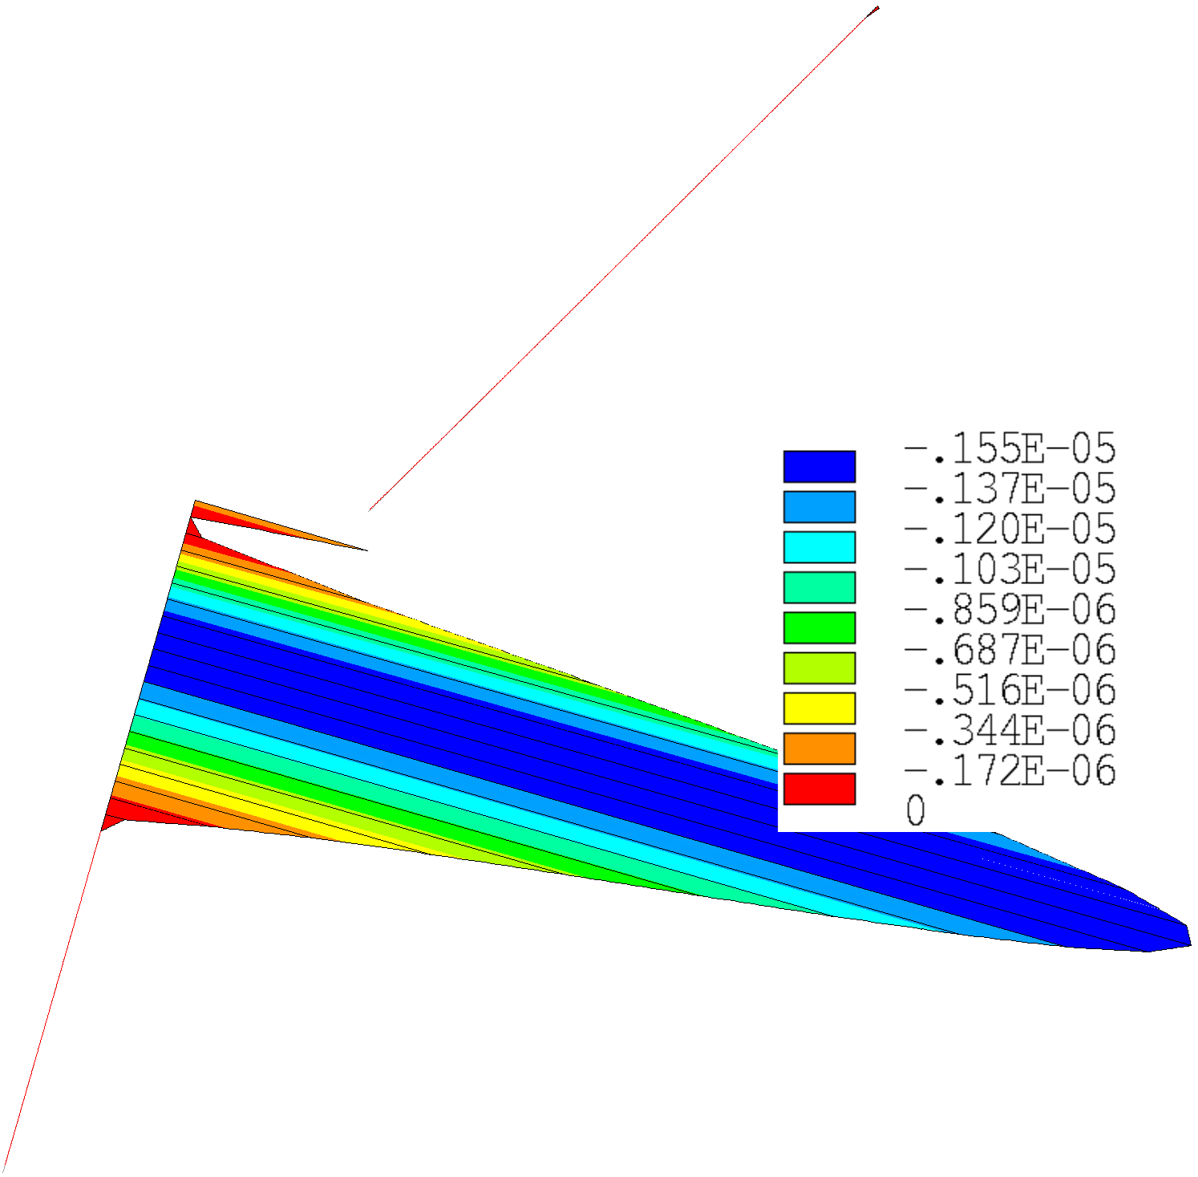




45° splits Yokes: best results
Energization
$$A$$
$$δ_{A,max}=67 μm$$
$$δ_{yoke,max}=54 μm$$
$$δ_{shell,max}=55 μm$$
$${gaps}_{max}=2 μm$$

Slide 19
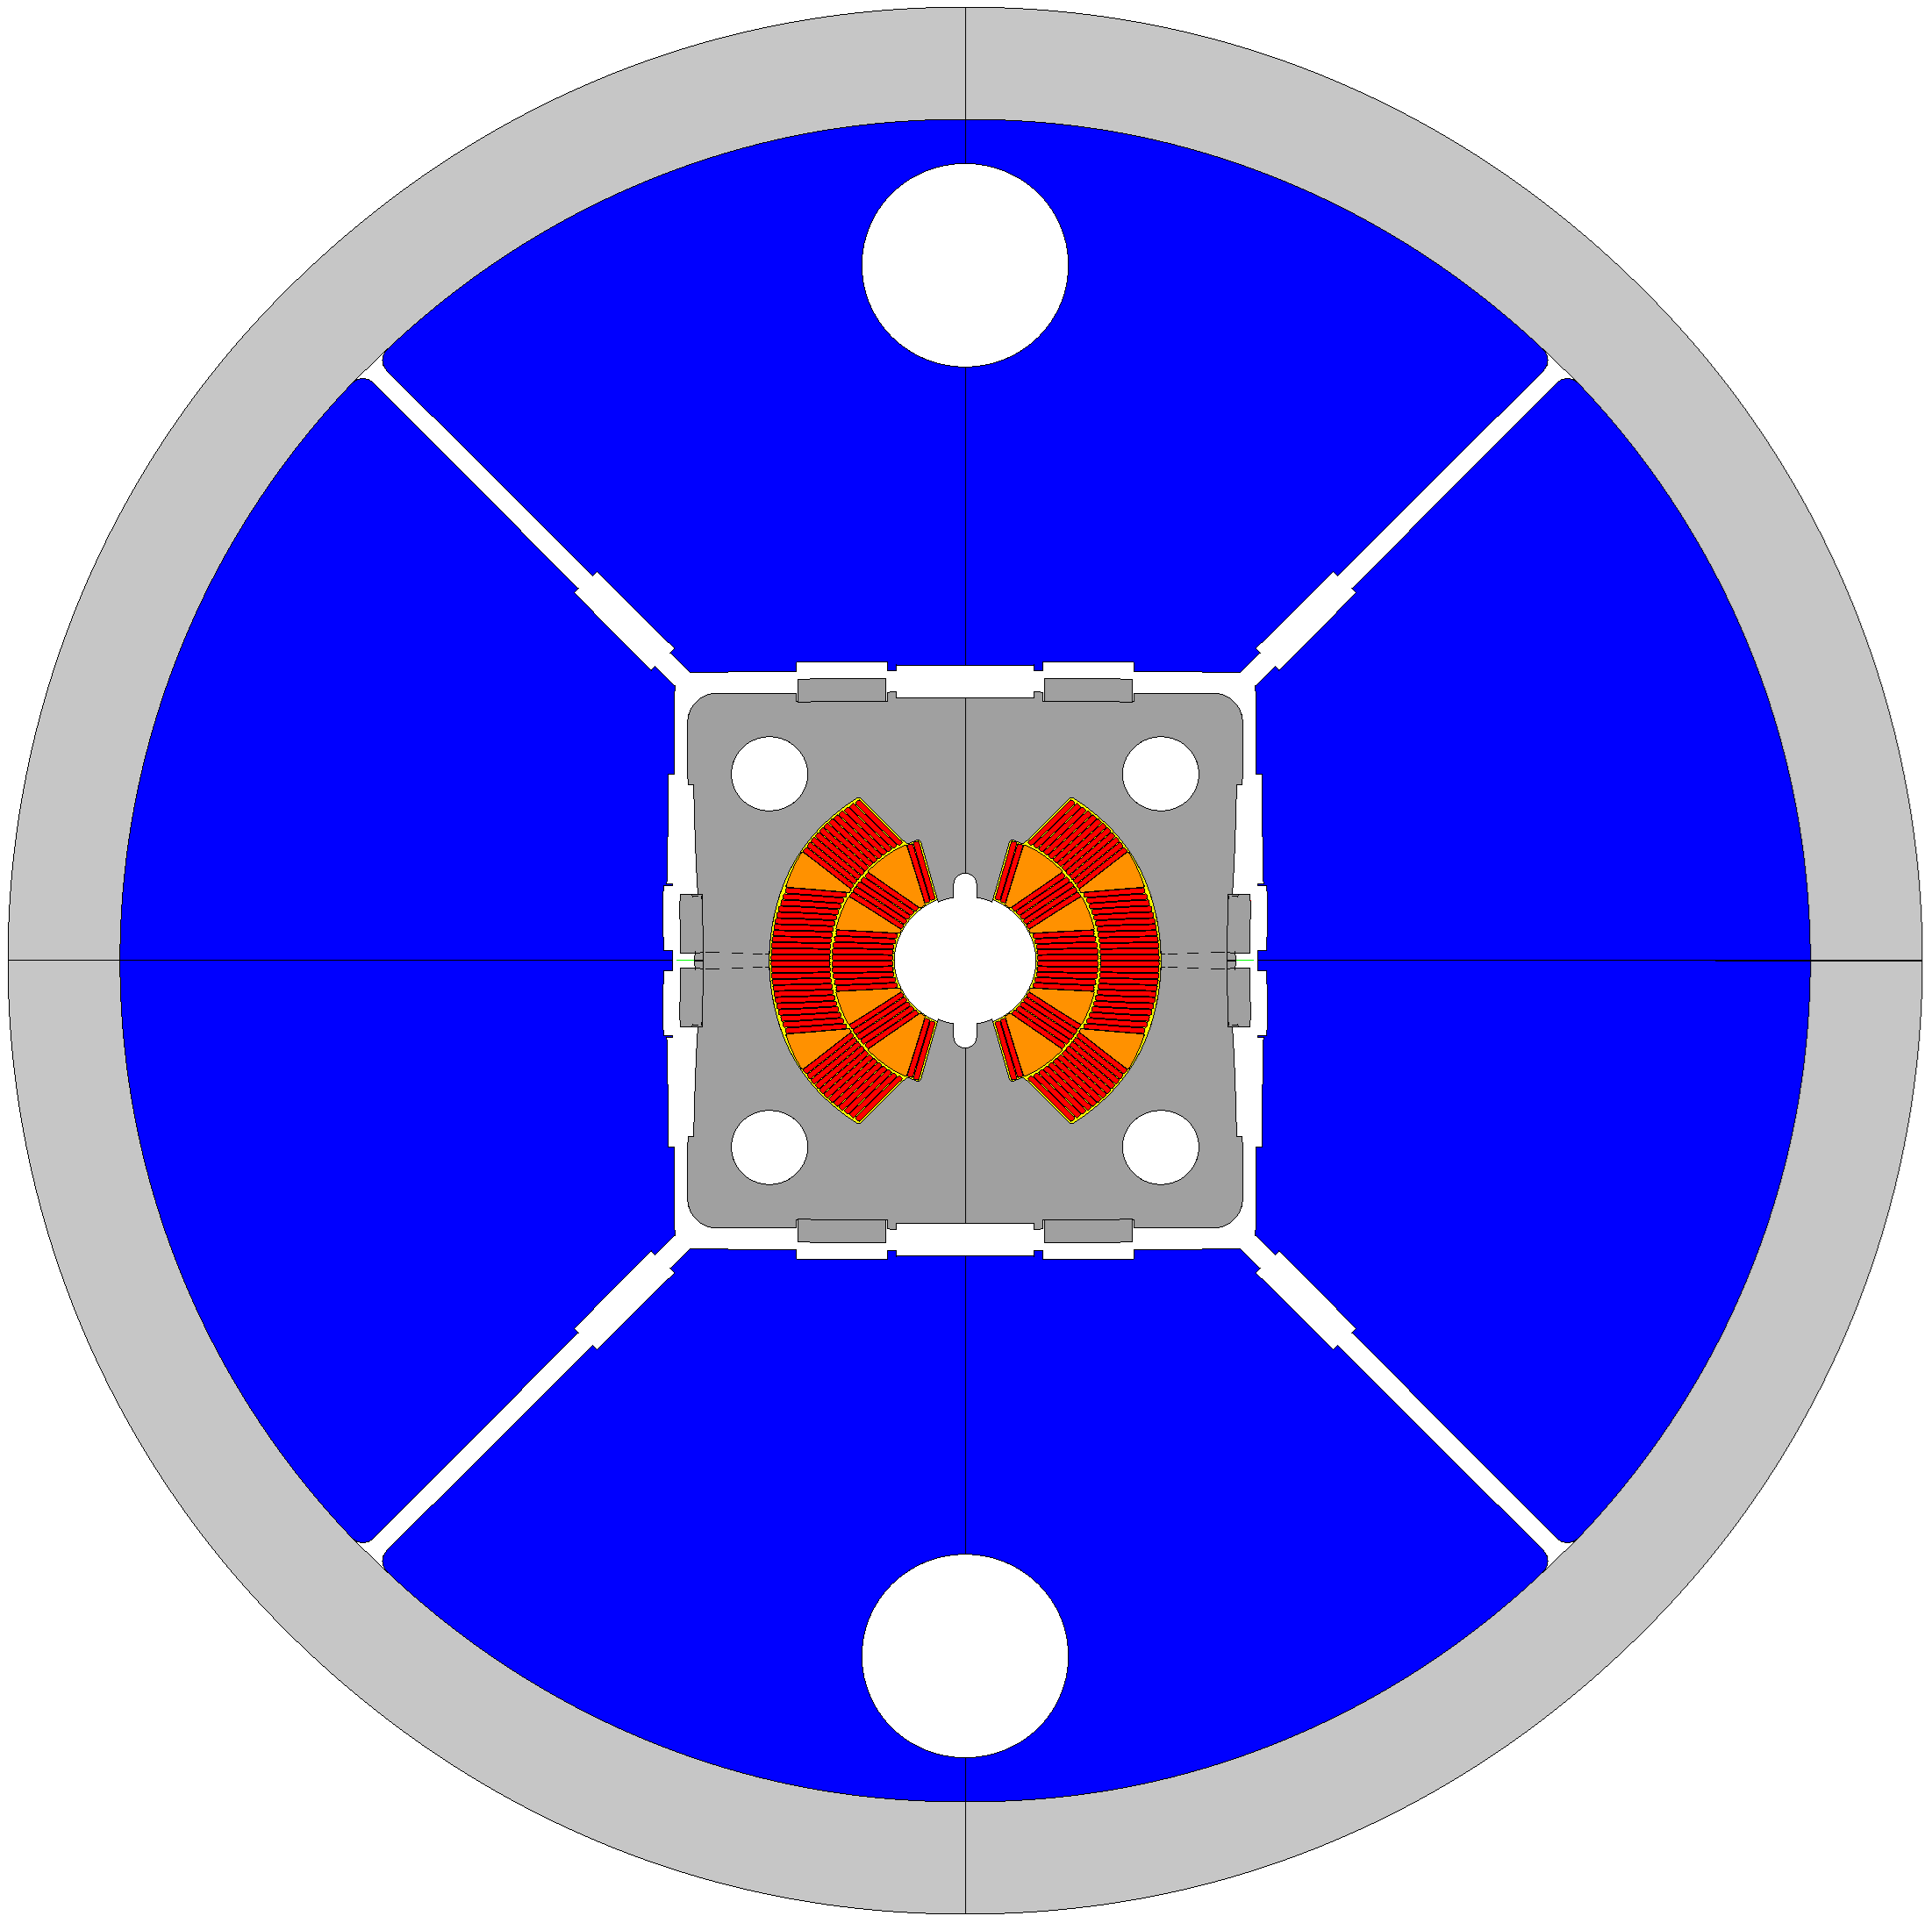








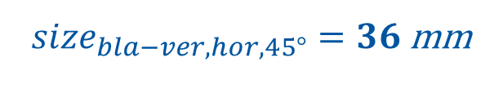


45° splits Yokes : assembly
$$To @12T, we need:$$
$${int}_{ver}=0.2 mm$$
$${int}_{hor}=0.2 mm$$
$$So we need to open:$$
$$→{space}_{needed_ver}>0.5 mm$$
$$→{space}_{needed_hor}>0.5 mm$$
$$So we use also 45° bladders:$$
${size}_{bla−ver,hor,45°}=36$mm
$${pres}_{bla−ver,hor,45°}=35 MPa$$
$$→{space}_{open_ver}<0.40 mm$$
$$→{space}_{open_hor}<0.30 mm$$

Slide 20
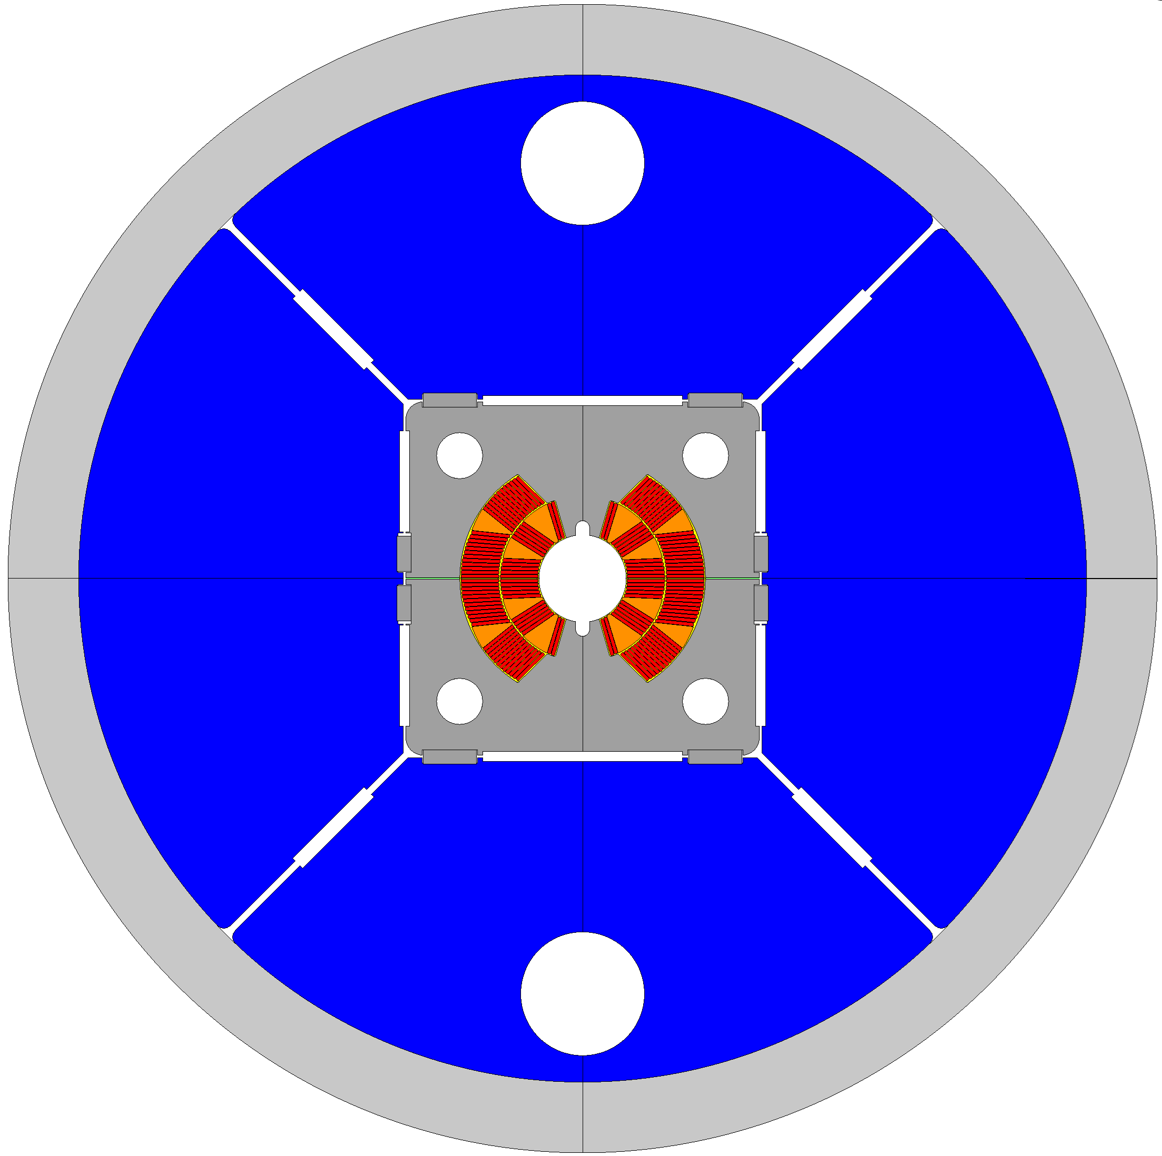




45° splits Yokes : assembly
$$To @12T, we need:$$
$${int}_{ver}=0.2 mm$$
$${int}_{hor}=0.2 mm$$
$$So we need to open:$$
$$→{space}_{needed_ver}>0.5 mm$$
$$→{space}_{needed_hor}>0.5 mm$$
$$So we use also 45° bladders:$$
${size}_{bla−ver,hor,45°}=46 \& 56$mm
$${pres}_{bla−ver,hor,45°}=40 MPa$$
$$→{space}_{open_ver}>0.50 mm$$
$$→{space}_{open_hor}>0.60 mm$$

Slide 21
Thank you For your attention!

Slide 22
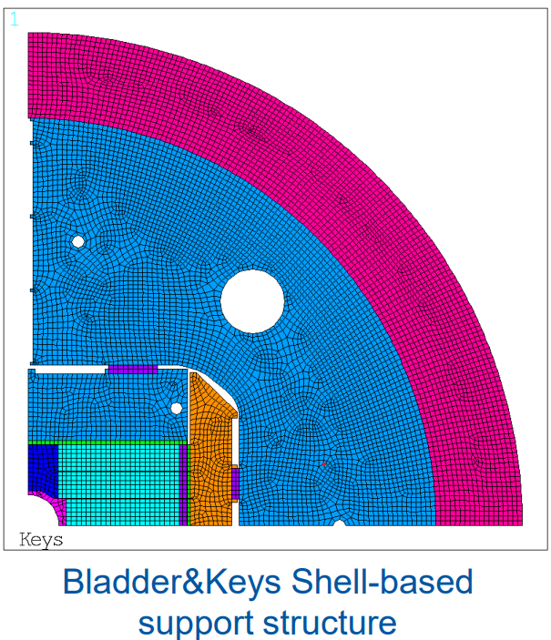
Design of ERMC-RMM by E.Rochepault

Slide 23



45° splits Yokes : FEM
$$To @12T, we need:$$
$${int}_{hor}=0.2 mm$$
$$So we need to open:$$
$${space}_{hor}=0.2+0.3 mm$$
$$→{space}_{needed_hor}>0.5 mm$$
$$So we use 4 bladders:$$
$${pres}_{bla−hor}=35 MPa$$
$$→{space}_{open_hor}<0.25 mm$$

Slide 24
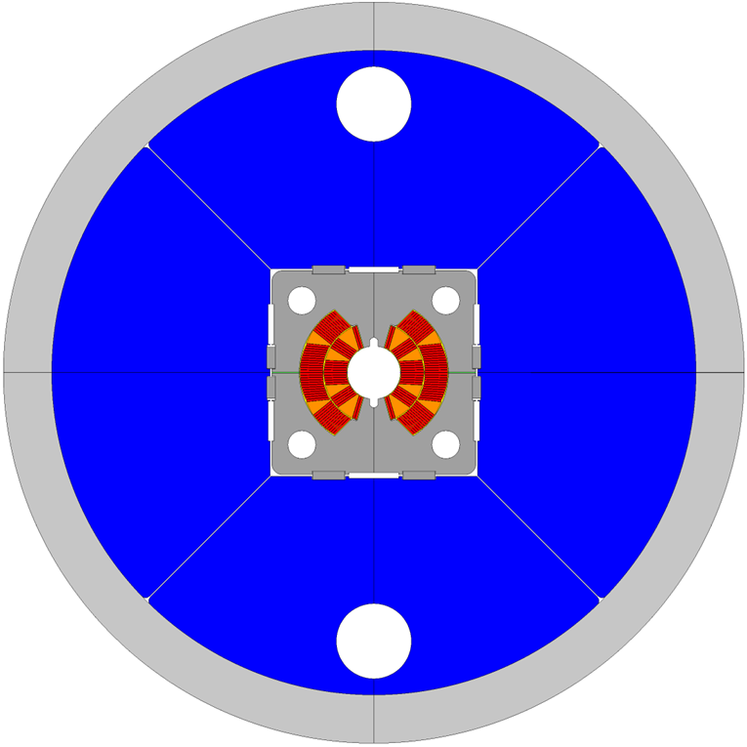






45° splits Yokes : FEM
$$To @12T, we need:$$
$${int}_{ver}=0.2 mm$$
$$So we need to open:$$
$${space}_{ver}=0.2+0.3 mm$$
$$→{space}_{needed_ver}>0.5 mm$$
$$So we use bladders:$$
$${pres}_{bla−ver}=35 MPa$$
$$→{space}_{open_ver}<0.15 mm$$

Slide 25
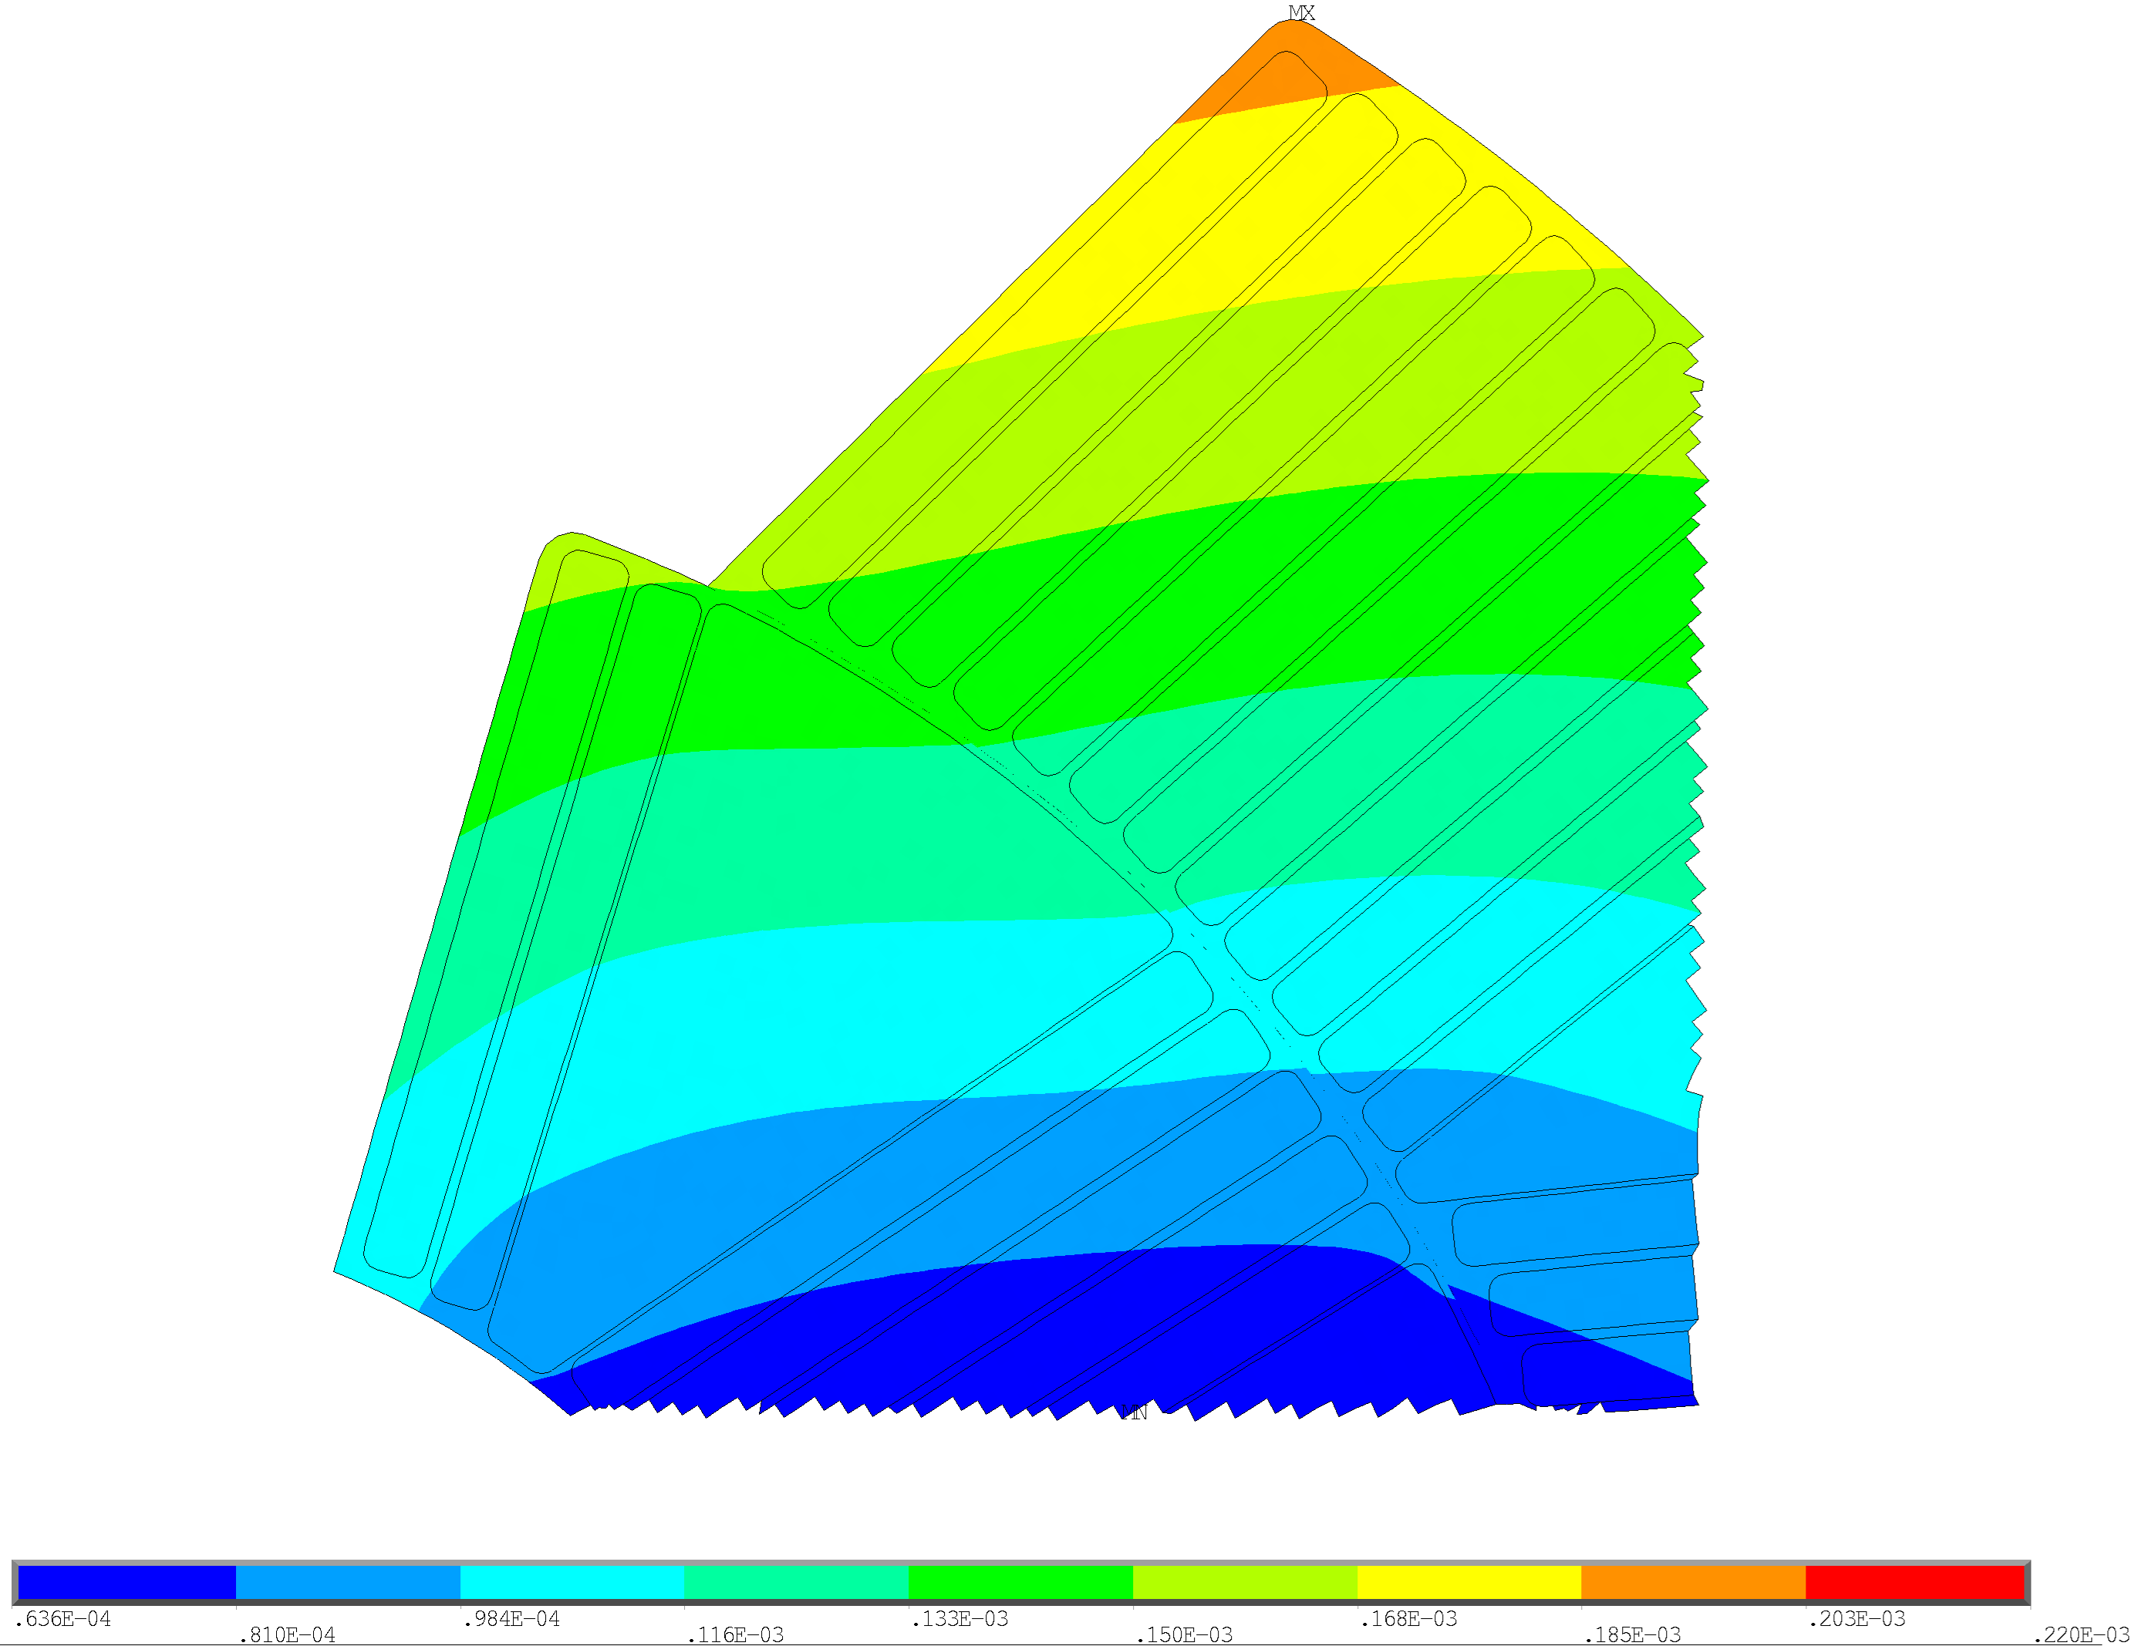
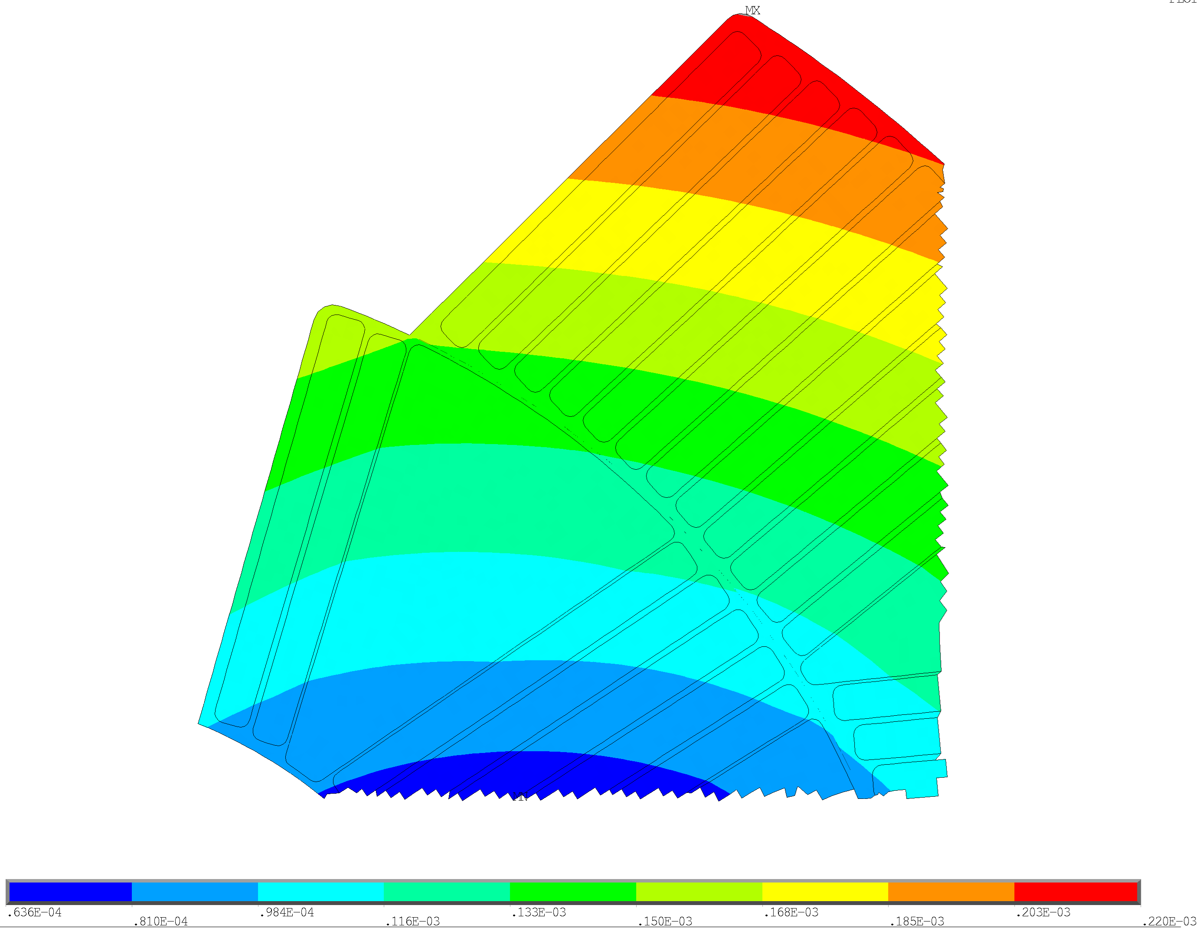

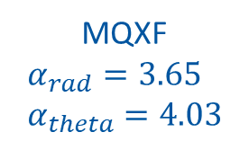
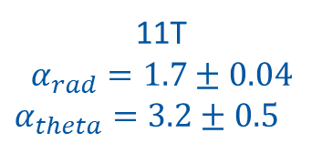

Thermal contraction values
11T
$$α_{rad}=1.7±0.04$$
$α_{theta}=3.2±0.5$
MQXF
$$α_{rad}=3.65 \\ α_{theta}=4.03$$
$${u_sum}_{max}=190 μm$$
$${u_sum}_{max}=220 μm$$

Slide 26
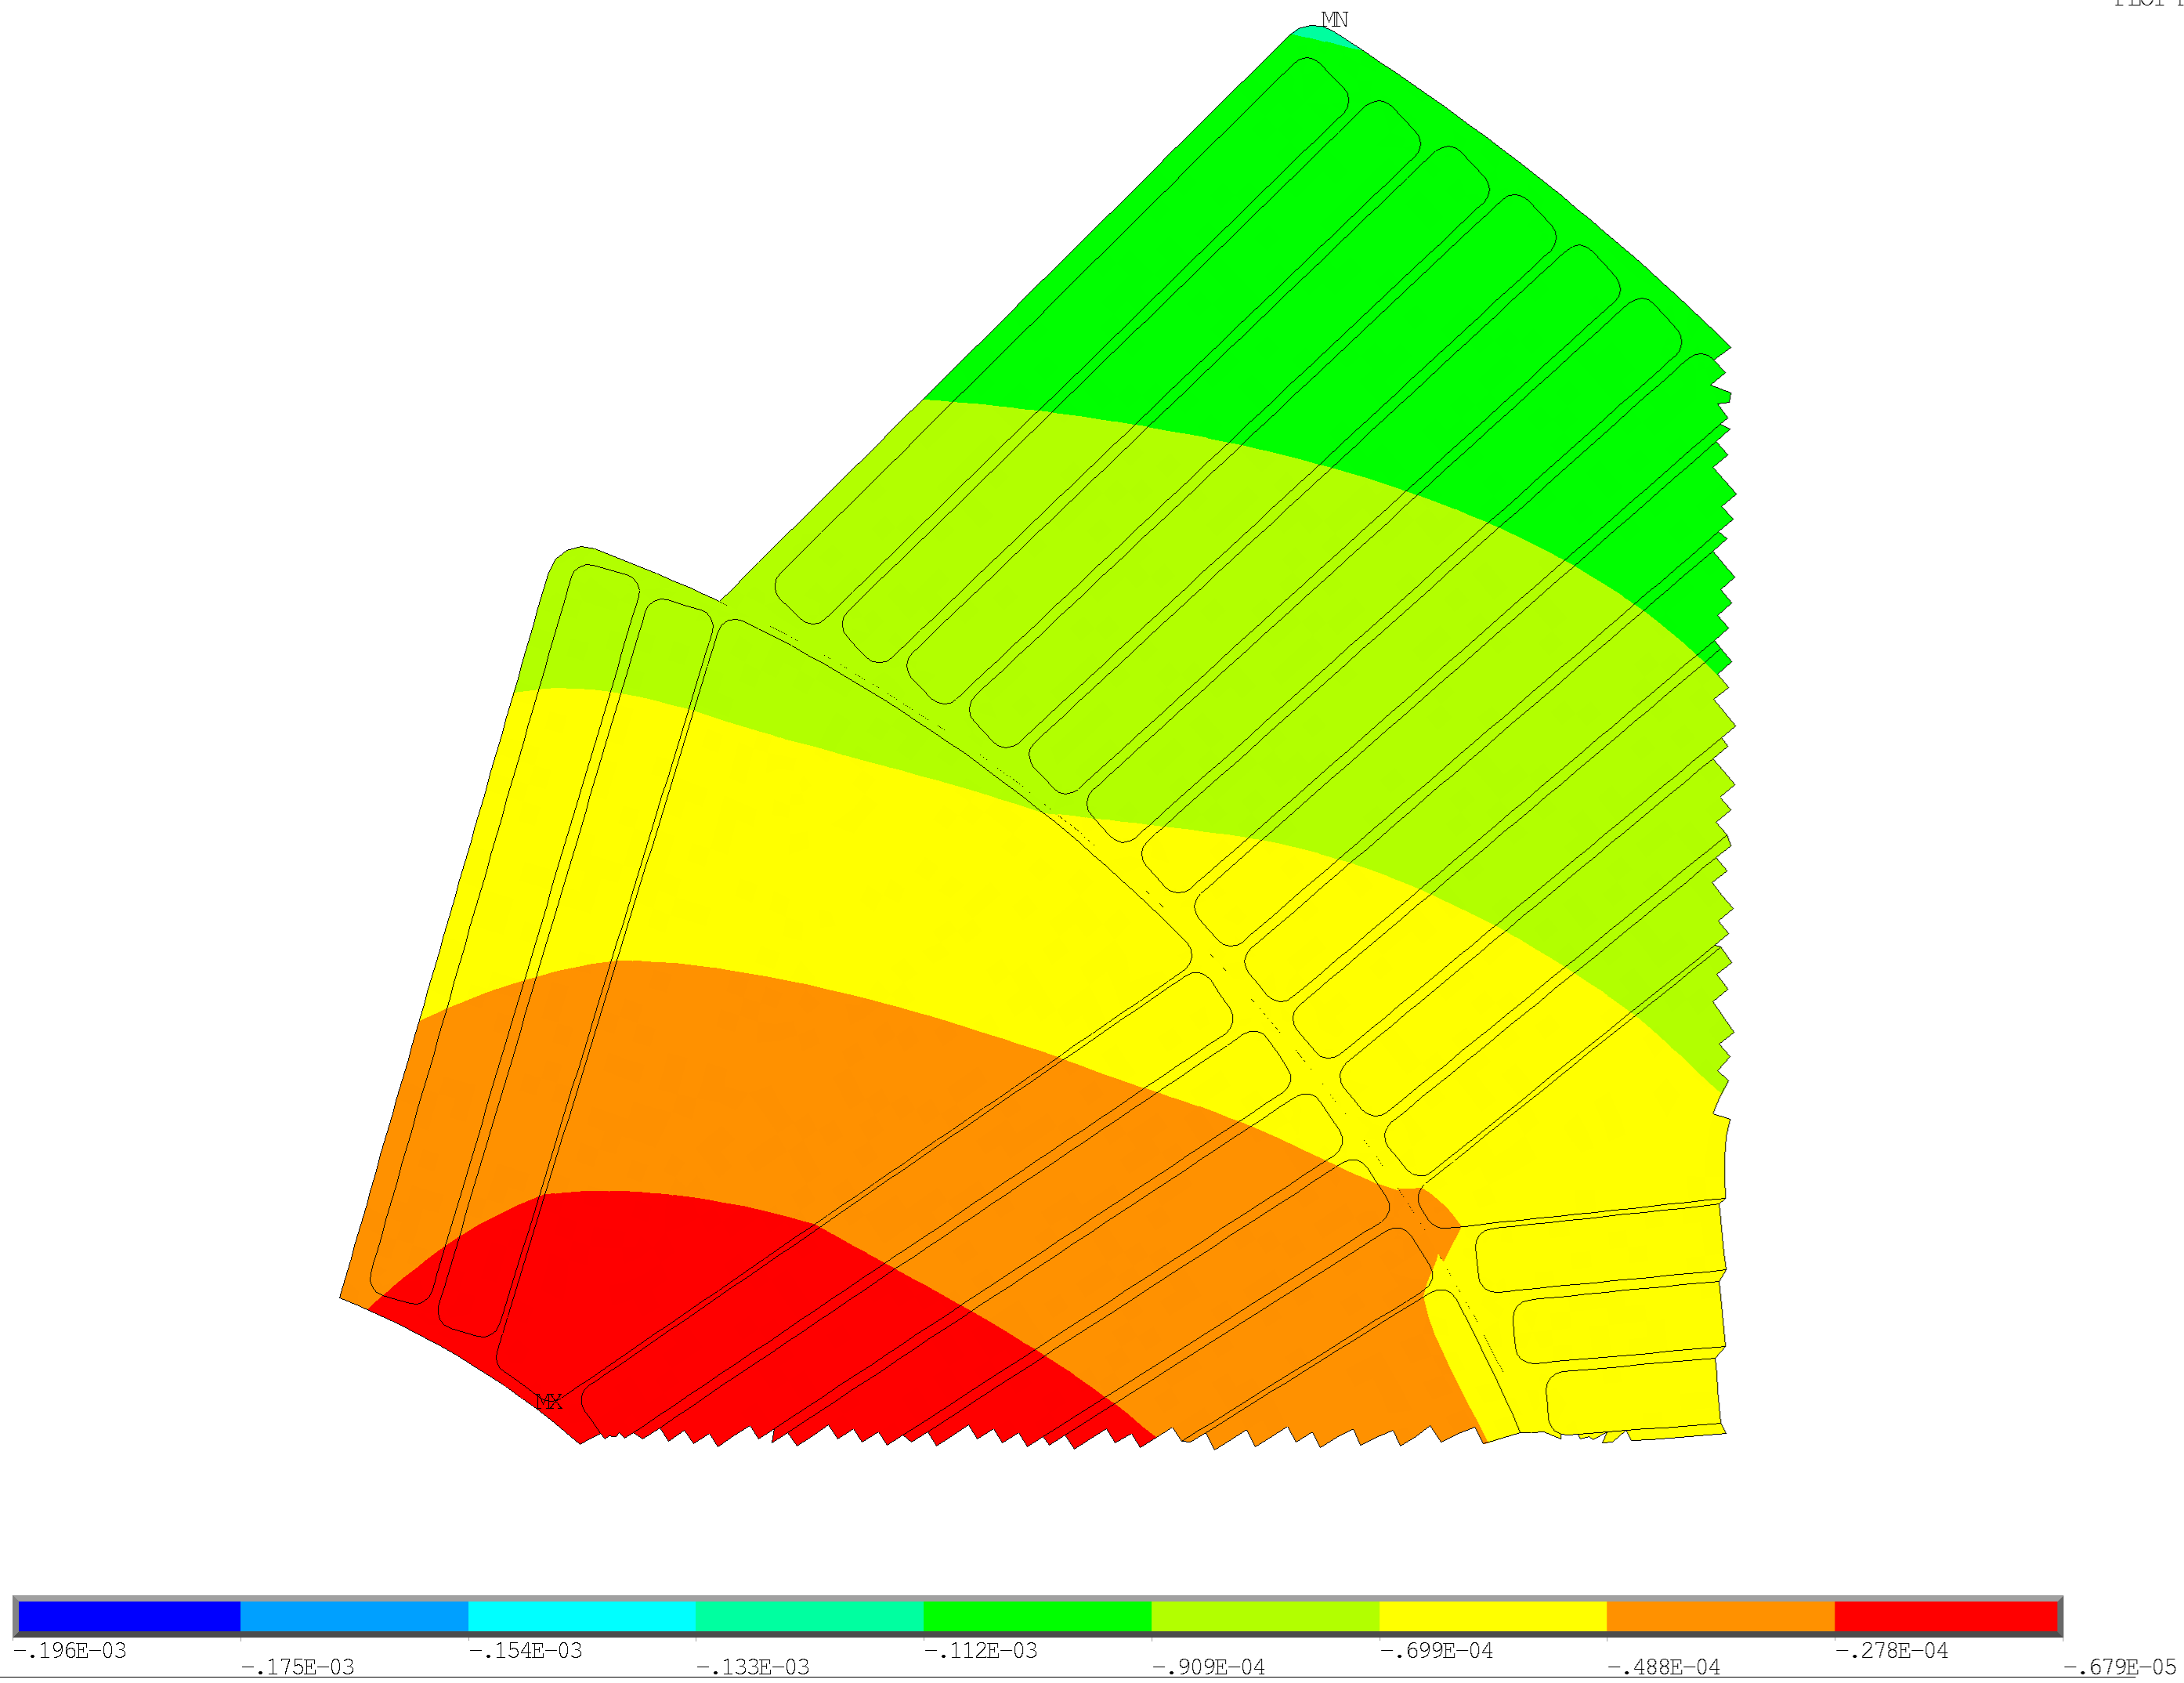
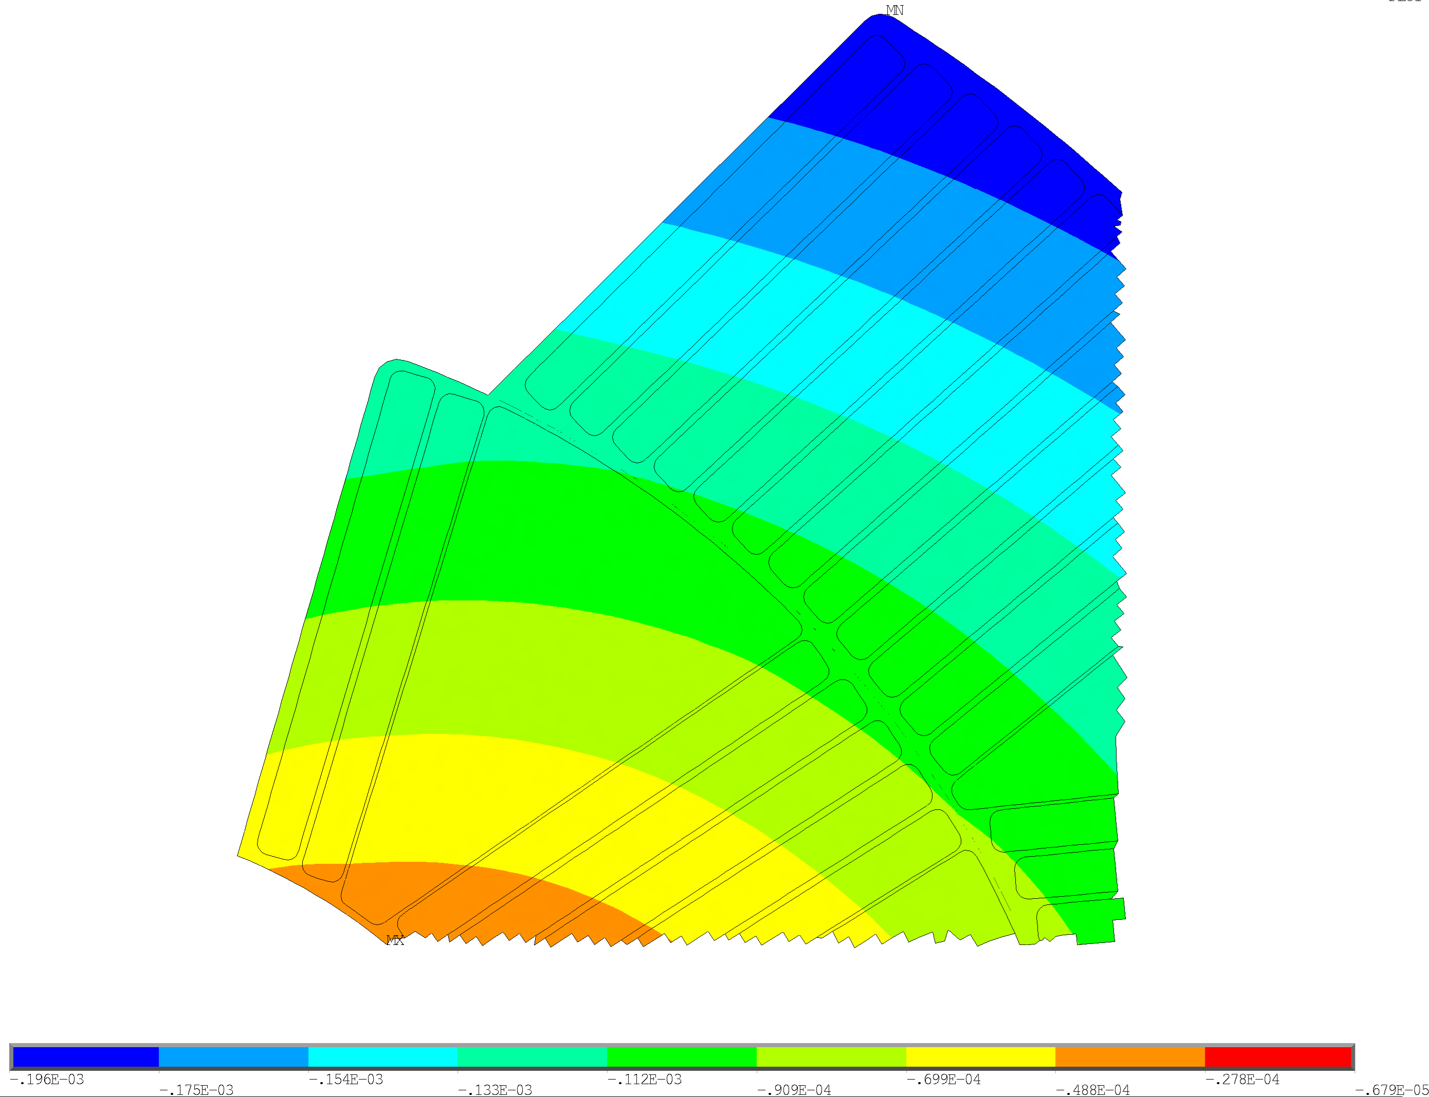


Thermal contraction values
11T
$$α_{rad}=1.7±0.04$$
$α_{theta}=3.2±0.5$
MQXF
$$α_{rad}=3.65 \\ α_{theta}=4.03$$
$${u_rad}_{max}=−113 μm$$
$${u_rad}_{max}=−196 μm$$

Slide 27
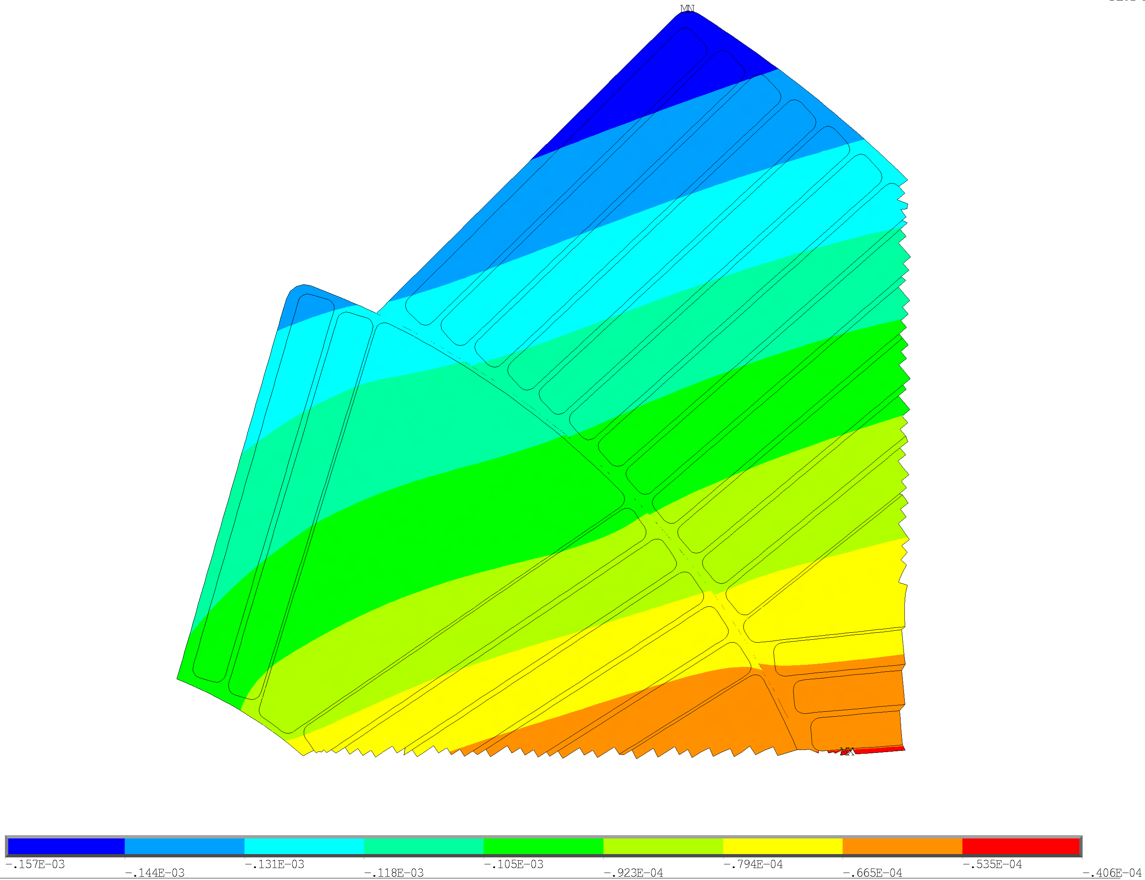
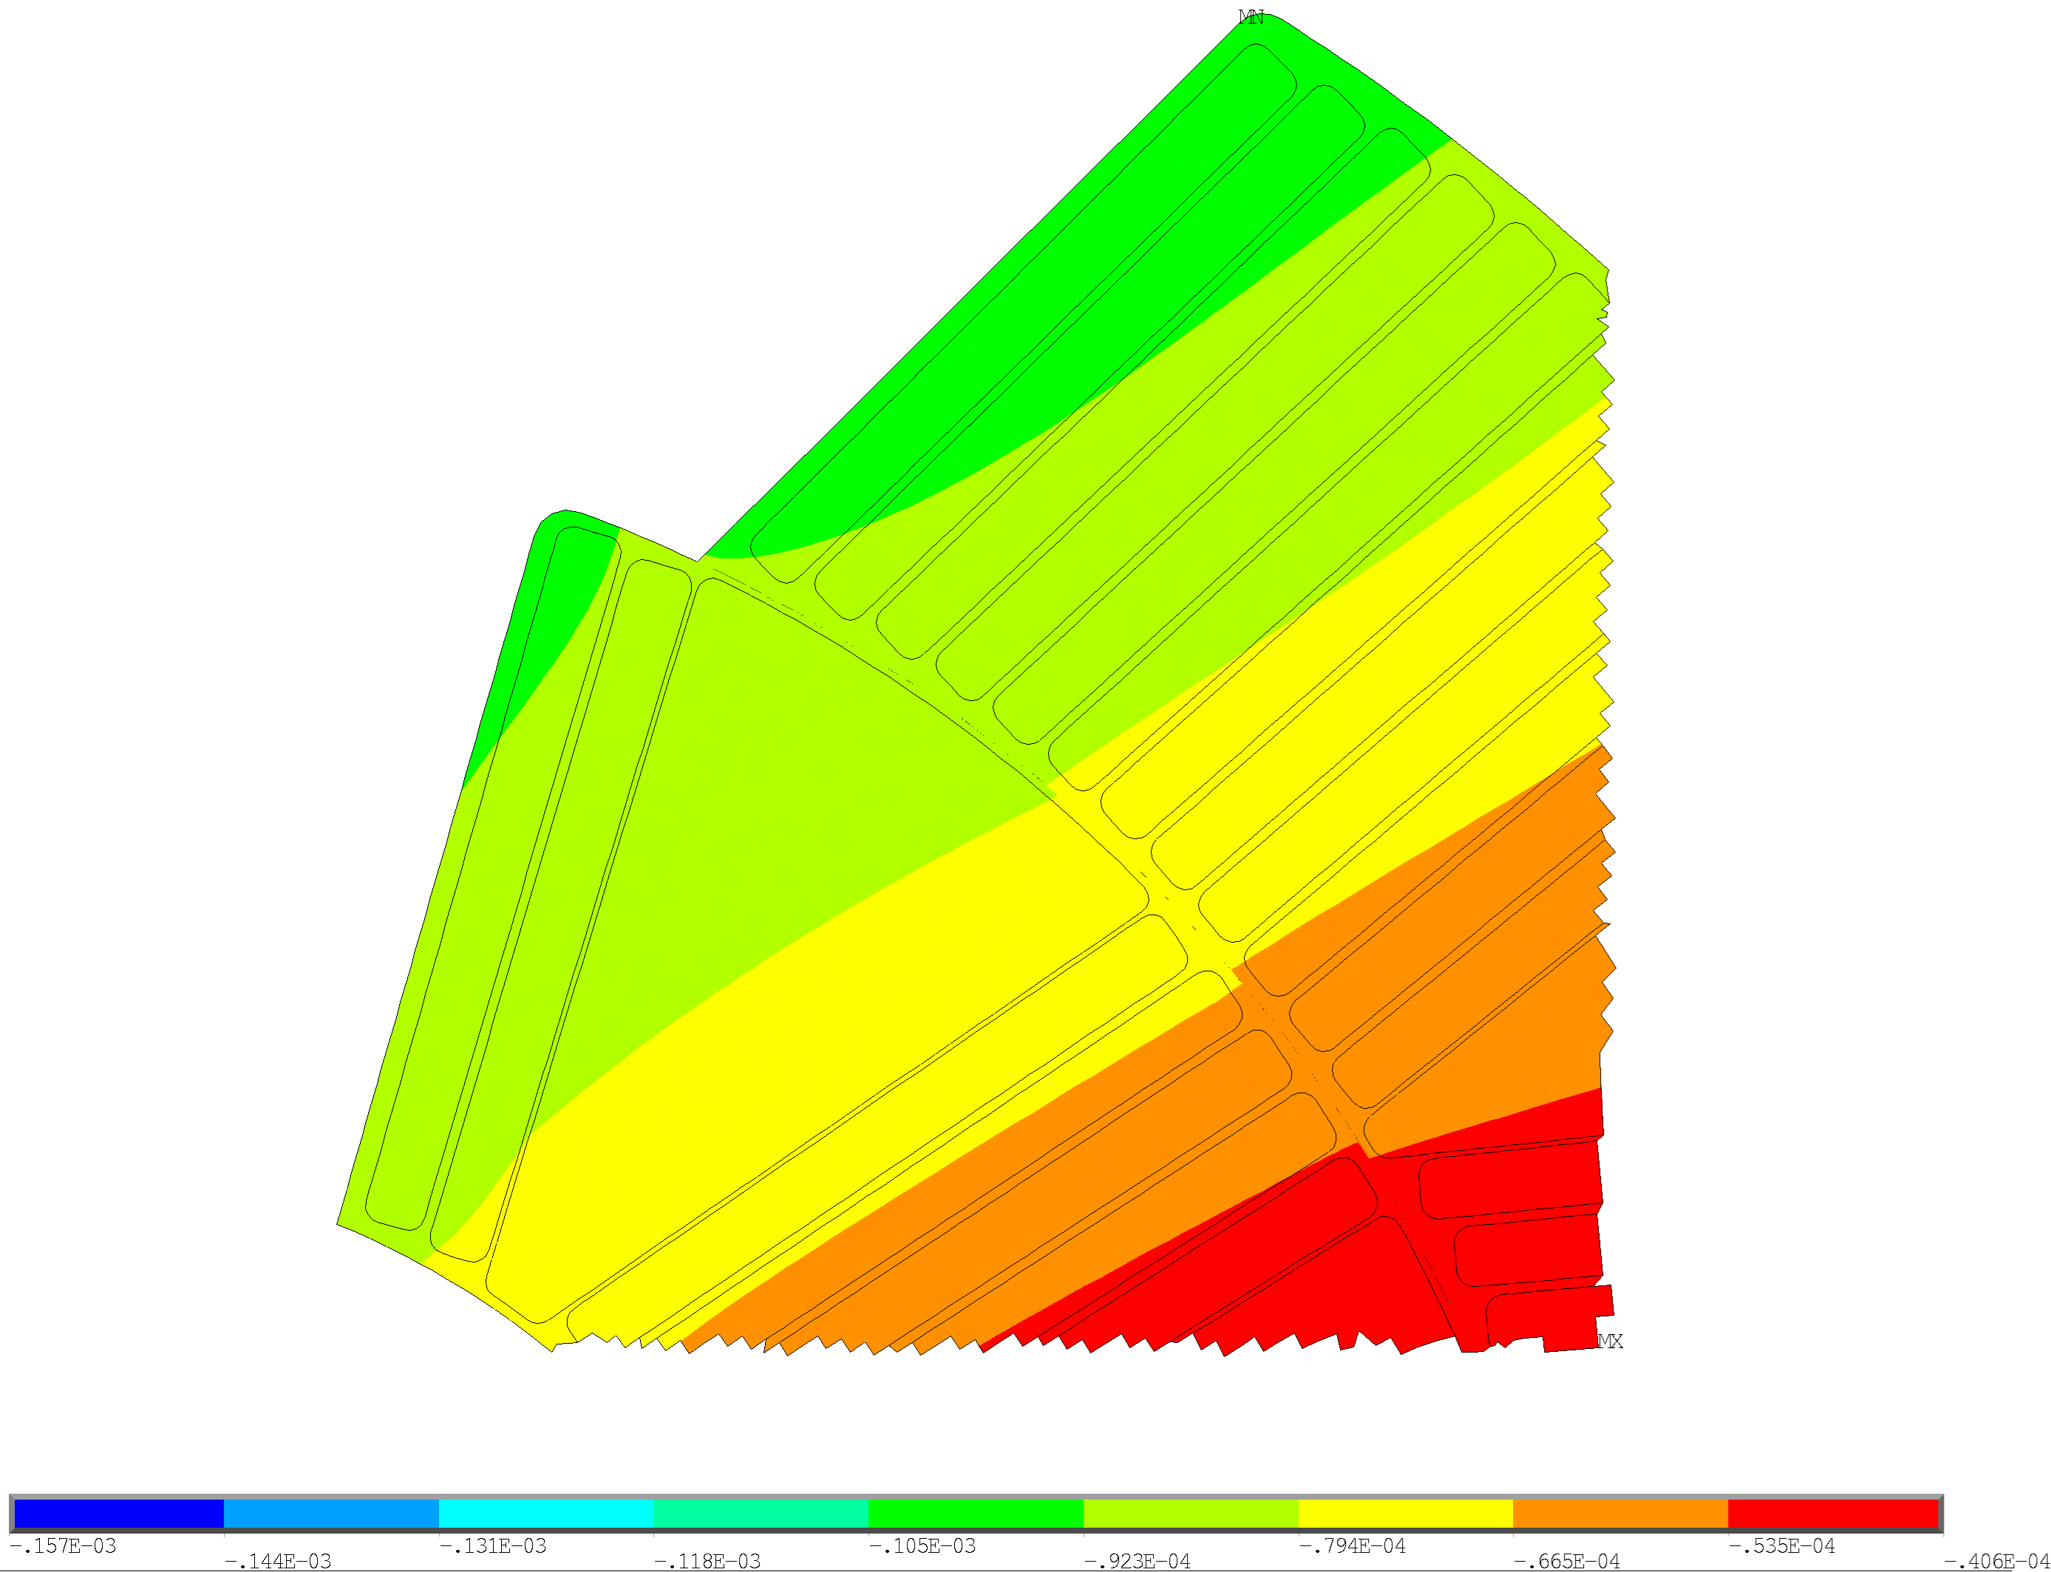



Thermal contraction values
11T
$$α_{rad}=1.7±0.04$$
$α_{theta}=3.2±0.5$
MQXF
$$α_{rad}=3.65 \\ α_{theta}=4.03$$
$${u_the}_{max}=−157 μm$$
$${u_the}_{max}=−101 μm$$

