Slide 1
Second Project Review meeting
June 20th, 2024
WP 6
Hybrid Pixel Sensors for 4D Tracking and Interconnection Technologies
Claudia Gemme (INFN Genova), Anna Macchiolo (UZH Zurich)

Slide 2
Objectives
The primary goal of this WP is to add precise timing measurements to the spatial information in silicon pixel sensors to provide 4-dimensional tracking for the future detectors for High Energy Physics.
This feature will help to disentangle tracks and vertices of spatially overlapping particles and improve event reconstruction in the high occupancy environment of experiments at HL-LHC and beyond.
Only hybrid sensors in connection with high-performance ASICs can at the moment fulfil the extreme timing requirements of 4D tracking and therefore advanced interconnect technologies are required for the hybridisation in large areas and at small pixel sizes.
For this reason, Anisotropic Conductive Films (ACF) and Wafer-to-Wafer (W2W) interconnection, such as Metal-Oxide Hybrid Bonding or Metal-Metal-Fusion Bonding are being developed in this WP.

Slide 3
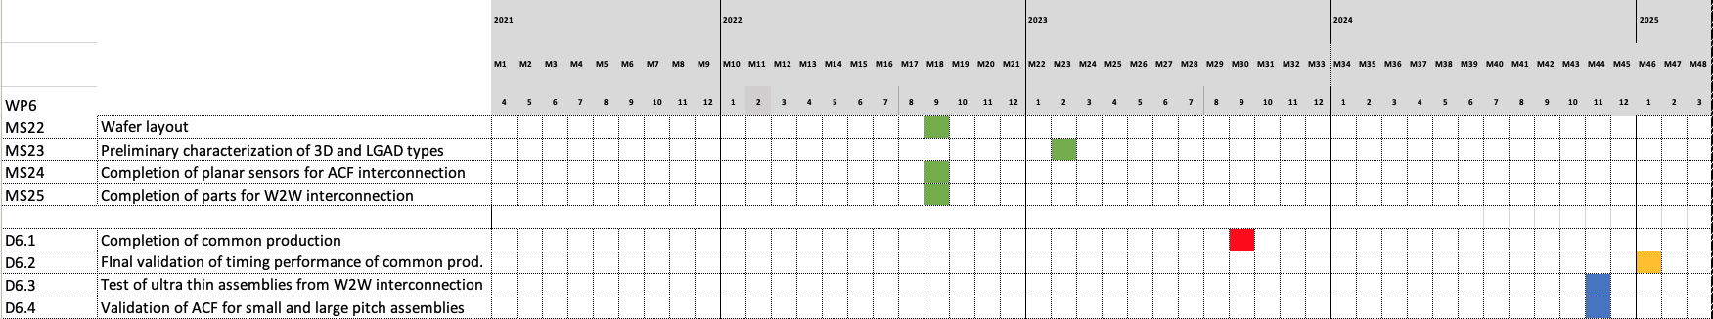
Organization,
Deliverables and Milestones
WP 6.2
  Design and production of sensors with small pitch and excellent timing performance in FBK and CNM, using 3D and LGAD technologies (four productions in total).
  Simulation to support the design and evaluate the performance.
WP 6.3
  Validation of the production devices, in laboratory and tests on beam.
WP 6.4
  Development of suitable ACFs material and die-to-die bonding process flows for small pixel pitches: production of structures to optimize the trials
  Wafer-to-Wafer bonding: optimize the procedure with test structures, Production and test of ultra-thin assemblies interconnected with W2W technique.
First Deliverable D6.1 was due in October 2023 → both productions still to start at one of the two foundries, see next slides.

Slide 4
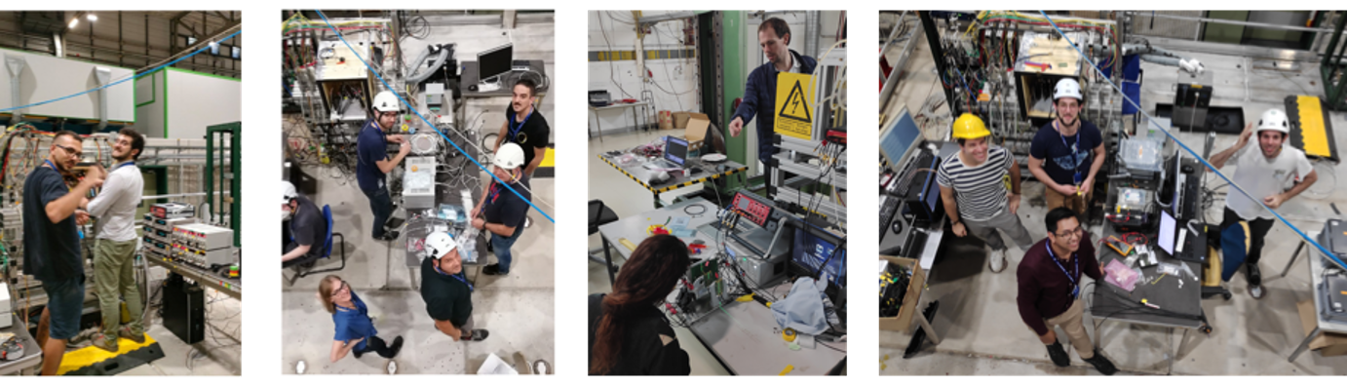
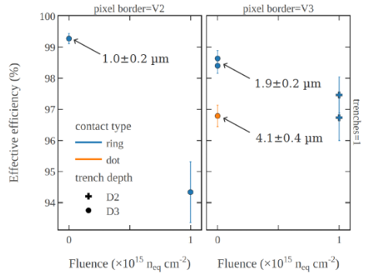
Highlights
Establishment of an innovative Test-beam set-up for sensors for 4D Tracking
Comparison of the performance of different timing sensors
Participation of several groups from different experiments, very useful to spread experiences, technological solutions and for community build-up
TI-LGAD efficiency in TB
coordinators: Gregor Kramberger and Ivan Vila
4

Slide 5
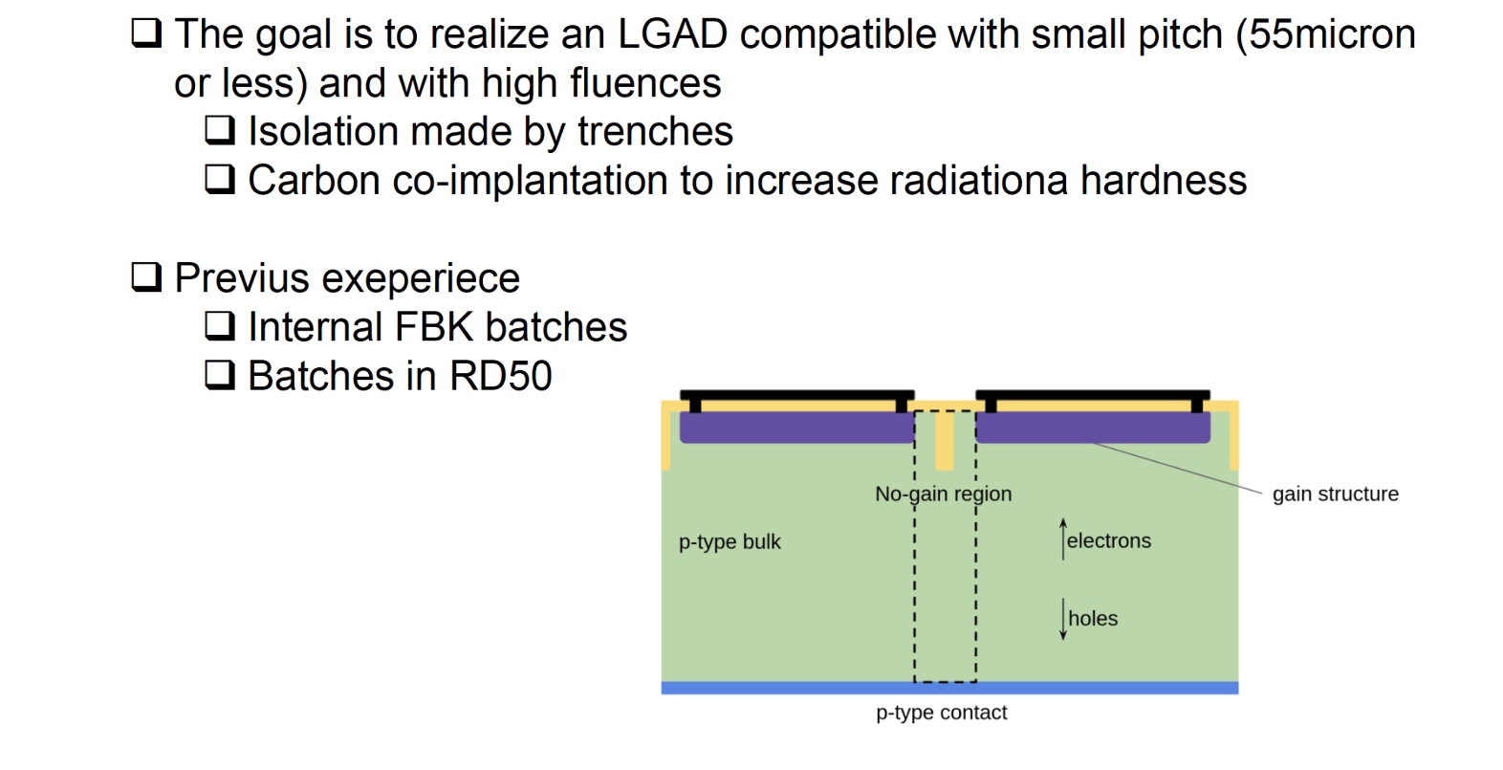
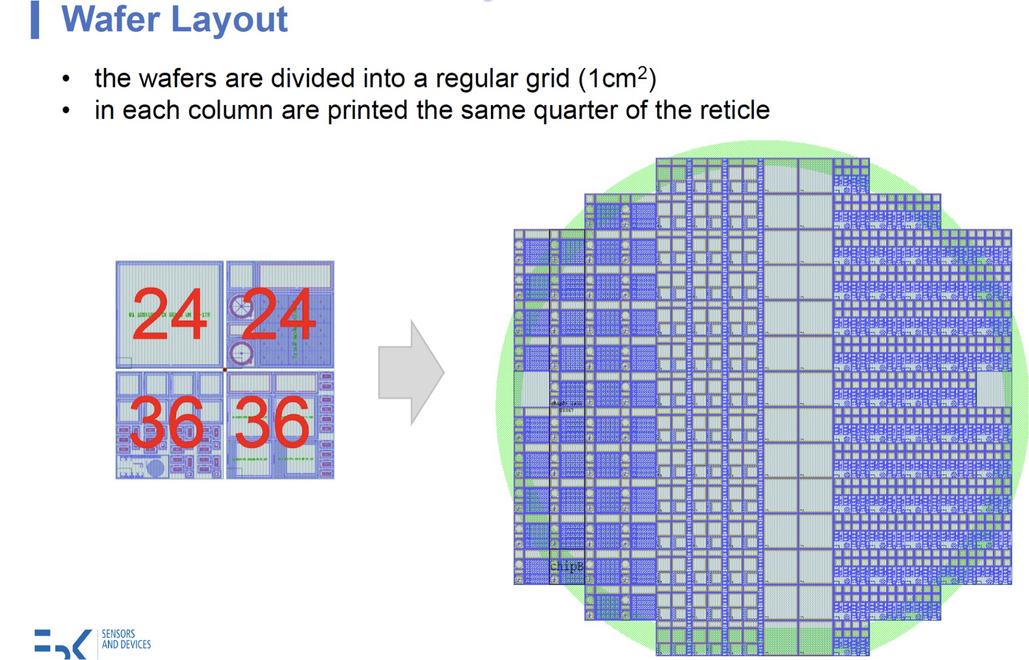
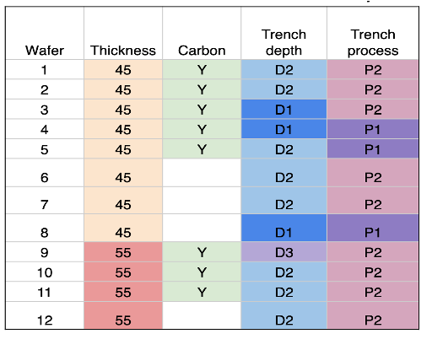
Towards D6.1:
LGAD production at FBK
Status: Fabrication completed, devices distributed, irradiated and tested in lab and TB
Trench-isolated (TI) LGADs
reticule structure
Process split in the 12 wafers
baseline
One full reticle (about 2x2 cm²) in 4 quarters
• Pixel & Strip
• PCM FBK
• 2x1 Test devices
In order to explore
• Pitch
• Border: 4 versions
• Number of trenches : 1 or 2

Slide 6
Towards D6.1:
LGAD production at FBK
Status: Fabrication completed, devices distributed, irradiated and tested in lab and TB
Trench-isolated (TI) LGADs
Production completed in October. Several tests run at wafer level in FBK to qualify the wafers, see example in next slides:
Extremely high yield for small sensors, >60% for large sensors; well above 95% on small structures.
Wafers 1, 6 and 10 diced
parts being distributed to Institutes and JSI for irradiation.
Large sensors sent to be interconnected via ACF to Timepix3 chips
Parts (not irradiated and irradiated up to 2.5e15) tested at DESY and SPS on beam in Feb.
All the other wafers have temporary metal layer removed. Next:
Send these wafers to IZM for UBM and hybridization

Slide 7
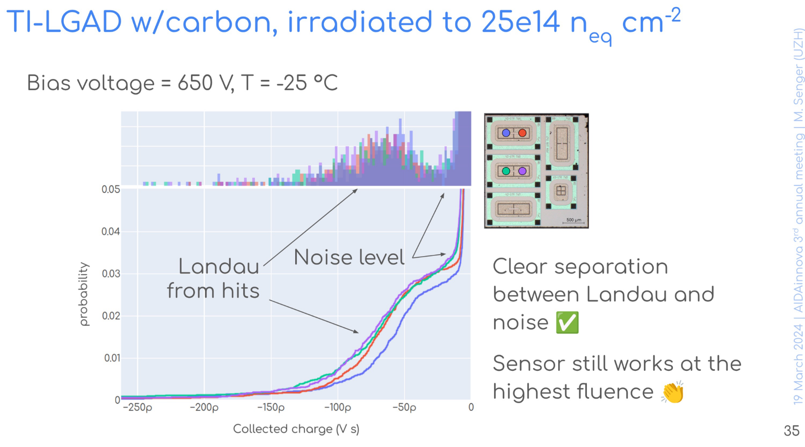
Towards D6.1:
LGAD production at FBK
First glance at February TB results:
7

Slide 8
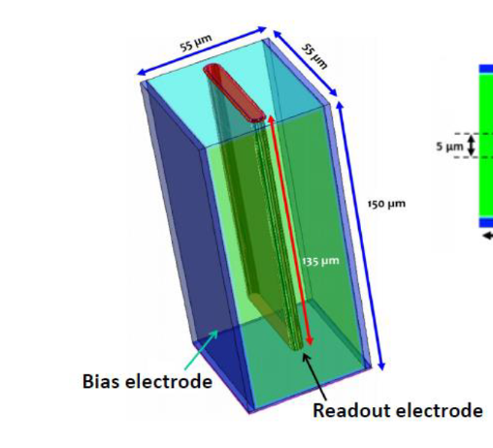
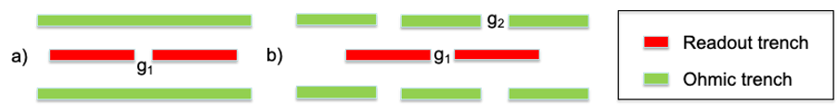
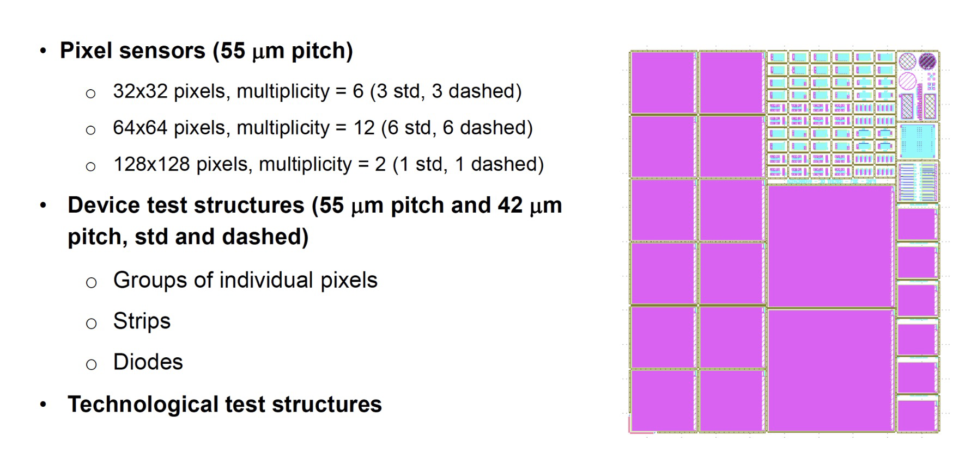
Towards D6.1:
3D production at FBK
Status: Fabrication just completed, running tests on wafers at FBK with temporary metal
std
dashed
Mainly 55x55 um² pixel cell devices compatible with existing or in design readout chips (Timespot, IGNITE, Timepix ASICs )
6” Wafers with photolitography on a reticule

Slide 9
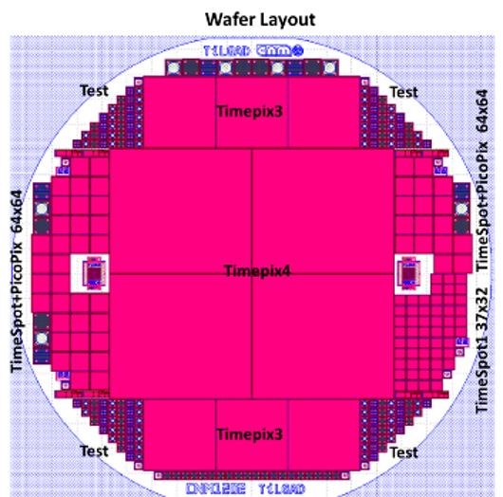
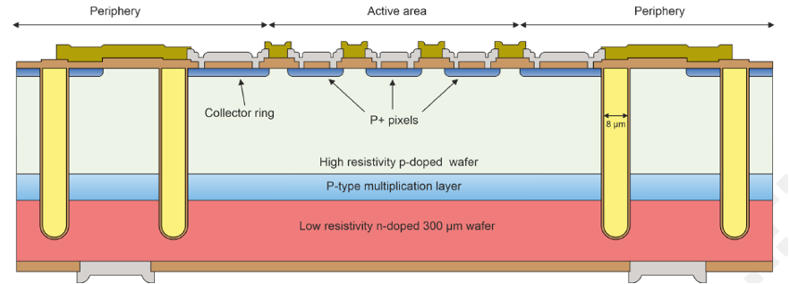
MS22: iLGAD at CNM
Status: Prototyping production at CNM suffered from a too high doping of the multiplication layer in Epi wafers→ APD behaviour
AidaInnova layout ready to be produced on Si-Si 4” wafers with Timepix4 and Timepix3 structures, plus smaller matrices→ end of the production foreseen in October-November
•Trenches to isolate the active area
✓ Multiplication region is fully isolated.
✓ Simpler single-side process and 50% less fabrication steps.
✓ Devices are able to sustain higher voltages.
✓ Slim-edge technology.
✓ Optimization of the multiplication layer is independent of charge collection and cross-talk at the electrodes.
Deliverable D6.1 was due in October 2023 → even considering only ¾ of the productions, it has to be moved to October 2024

Slide 10
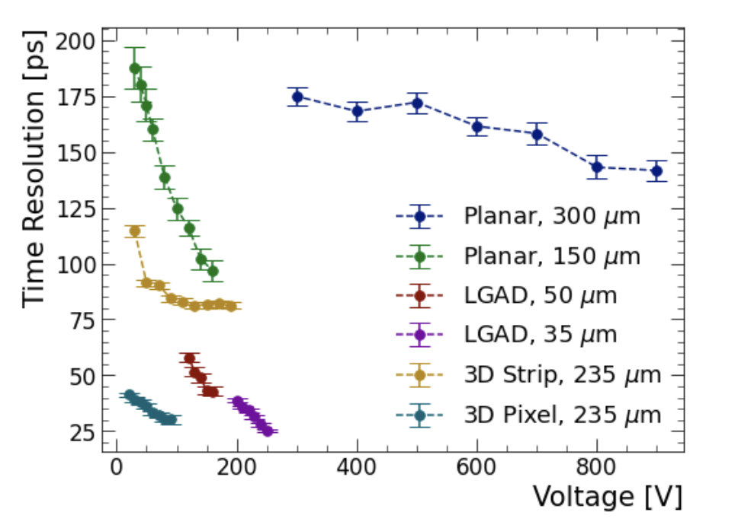
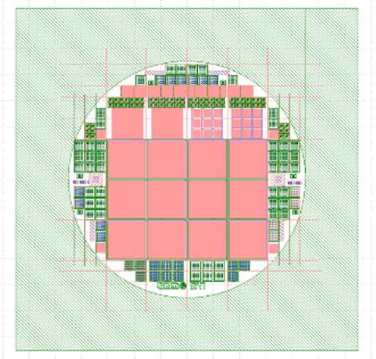
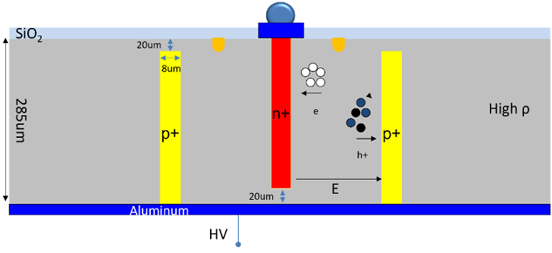
MS22: 3D sensors at CNM
Status: Prototyping production (RD50) completed with promising results.
L. Deel, DRD3 week, June 2024
Mask design of AIDAinnova 3D production to be completed within July with test-structures requested by LHCb and production should be starting on 4” wafers in September → one year to be completed
Sensor structures compatible with Timepix3, PicoPix and Ignite chips

Slide 11
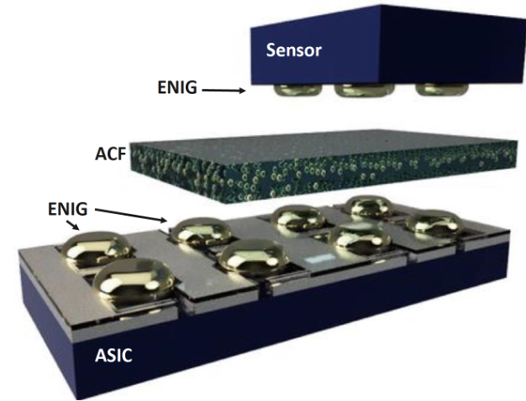
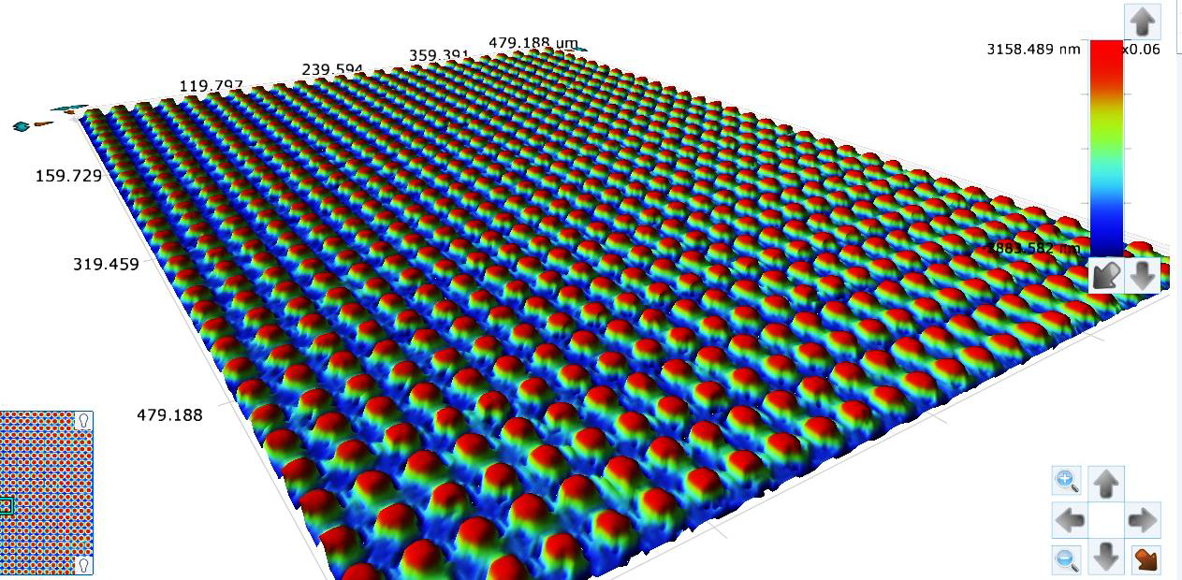
MS24: Interconnection with Anisotropic Conductive Films and Adhesives
Status: ENIG deposition has been optimized
New equipment available at Campus Biotech for characterizing all nickel bumps on a chip, allows for quick identification of problematic areas, if any.
High bump height 10.5µm for large pitches and 4.5 m for small pitches
Good ENIG homogeneity with a variation of only 0.5µm
Very few defects, with good results for pitches down to 20-25 microns
Optical profilometry after ENIG plating of CLICpix2 like daisy-chains with 20 um pitch
Systematically improving the ACA bonding process for a variety of hybrid pixel detector assemblies (Timepix3, ESRF-SPHIRD, ALTIROC, Timespot), as well as for dedicated daisy-chain test structures produced within the AIDAinnova collaboration
More stability testing of assemblies (temperature, radiation hardness)
Expanding the number of projects profiting by the technology

Slide 12
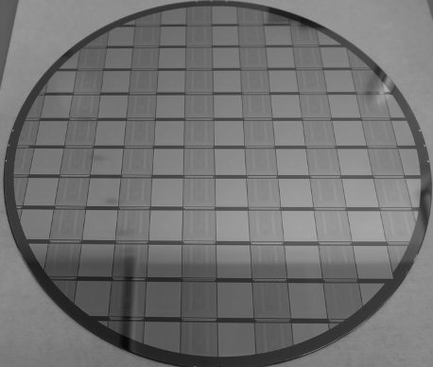
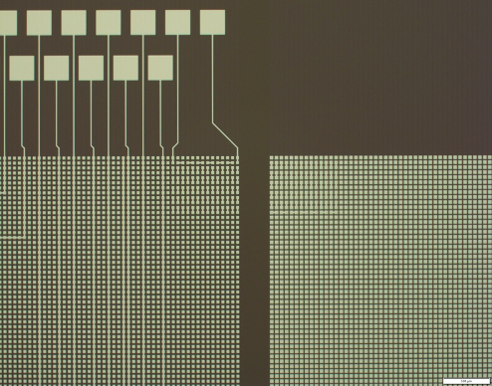
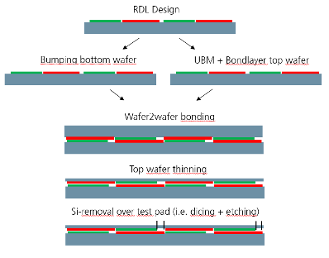
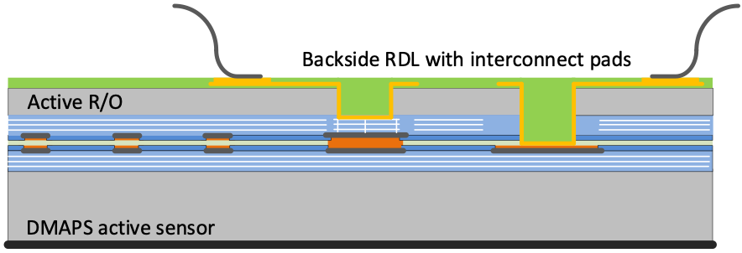
MS25: Wafer to Wafer interconnection
Status: Timepix3 wafers in hands; passive CMOS sensors wafers in fabrication at Lfoundry on 8” wafers (ready by end of summer); optimizing W2W process with daisy chains wafers.
Concept is to simplify the hybridization by joining device at wafer level rather than on dice level
  Combined polymer-metal-bond process flow selected for the project
  Timepix3 wafers are at IZM. Final sensors being produced with passive CMOS technology at LF.
  W2W bonding process setup with daisy chain at IZM well advanced but still some optimizations

Slide 13
Conclusions/Achievements
MS22+D6.1:
So far finalized three sensors wafer layouts out of four planned.
  Production completed in two cases at FBK
  One production starting now at CNM and should be completed in October - November
  Last production (3D sensors) to be started in September at CNM
MS24 (ACF interconnection):
Dummy chains produced, used for the optimization of the ACF interconnection technique.
MS25 (W2W interconnection):
Dummy chains produced, passive CMOS sensors being produced at LFoundry, procedure for wafer-to-wafer bonding agreed and technological tests achieved with daisy chains
Others:
Improved simulation to estimate LGAD sensors performance and gain layer degradation. 3D simulations progressing
Test-beam activities allowed to gain important information on LGAD performance

Slide 14
Backup

Slide 15
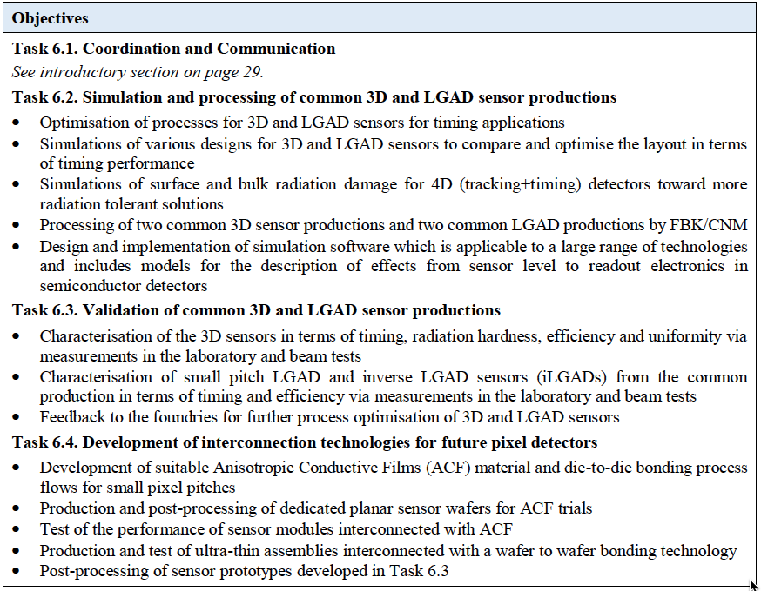
WP6 Tasks and
Task Leaders
Task Leaders
T6.2
Gian Franco Dalla Betta
Giulio Pellegrini
T6.3
Gregor Kramberger
Ivan Vila
T6.4
Dominik Dannheim
Fabian Hügging

Slide 16
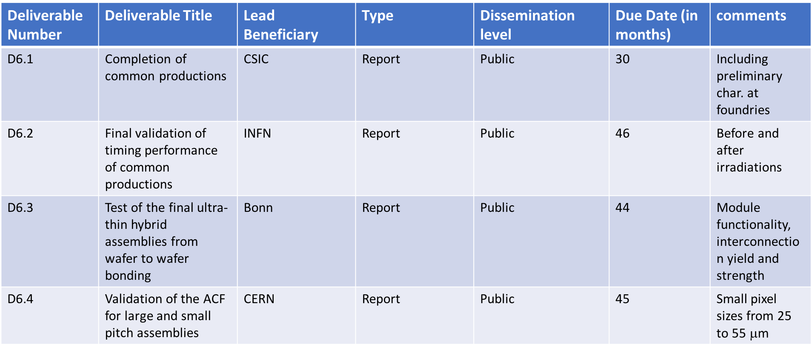
WP6 Deliverables

Slide 17
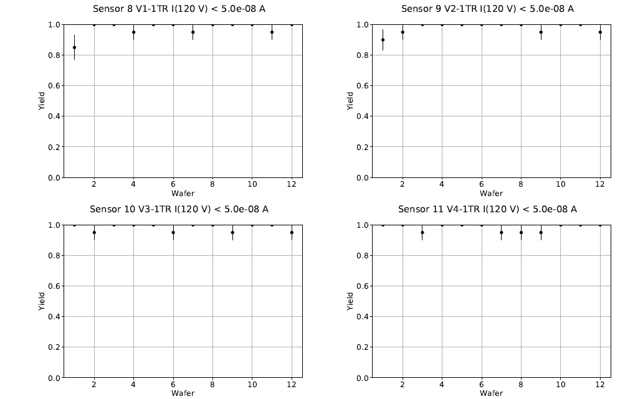
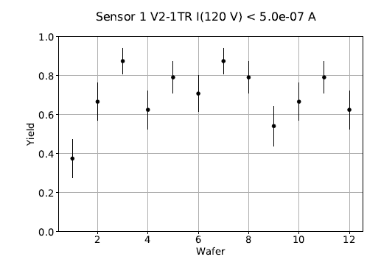
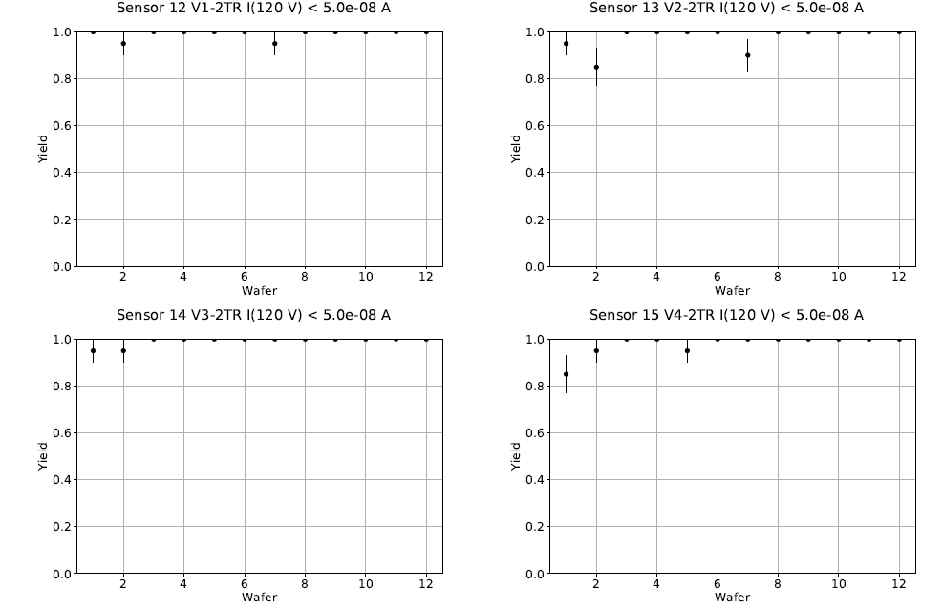
Towards D6.1:
LGAD production at FBK
Some examples of Wafer level measurements:
The yield calculation includes only sensors with gain:
Extremely high for small sensors, >60% for large sensors
Back-up
Small Sensors
Large Sensors
17

Slide 18
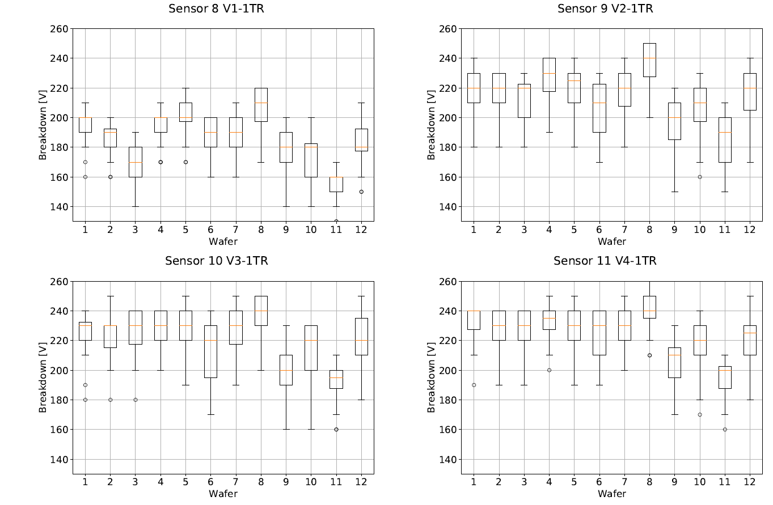
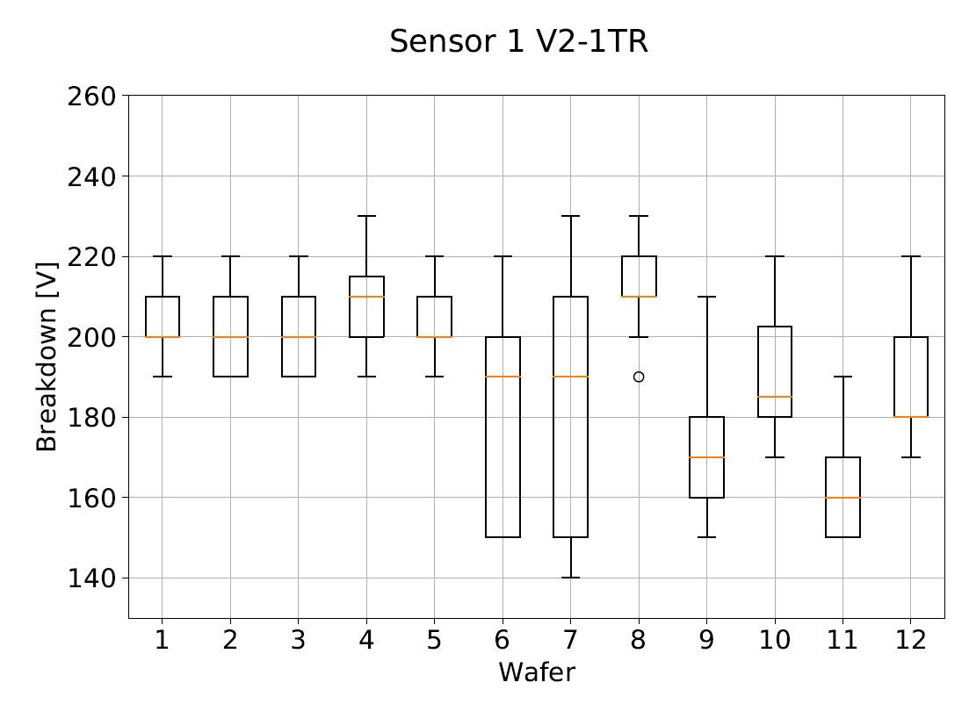
Towards D6.1:
LGAD production at FBK
Some examples of Wafer level measurements:
Breakdown voltage as expected
Back-up
Small Sensors
Large Sensors
18

Slide 19
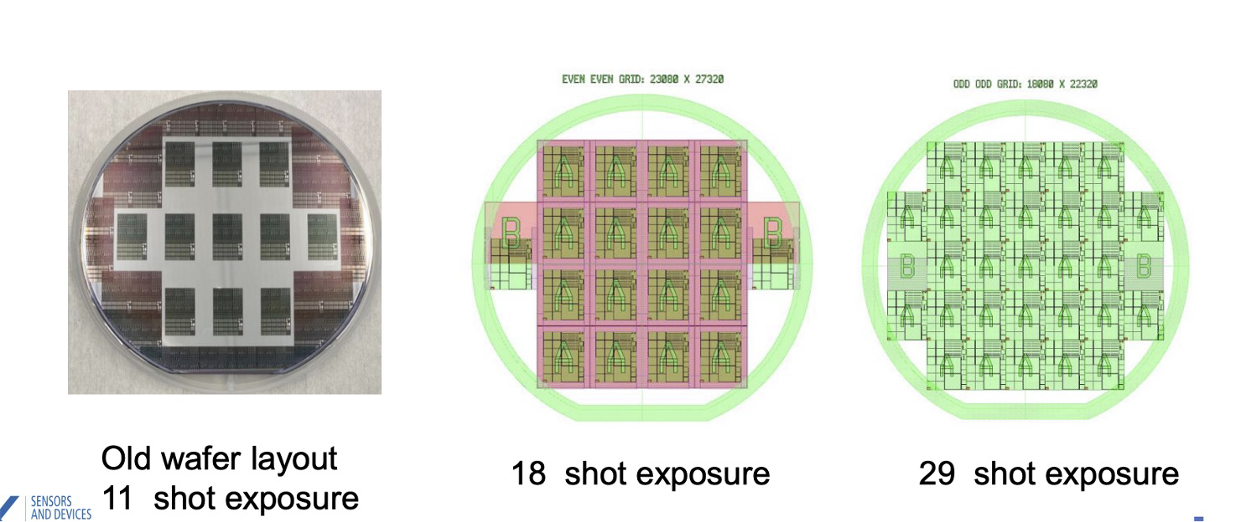
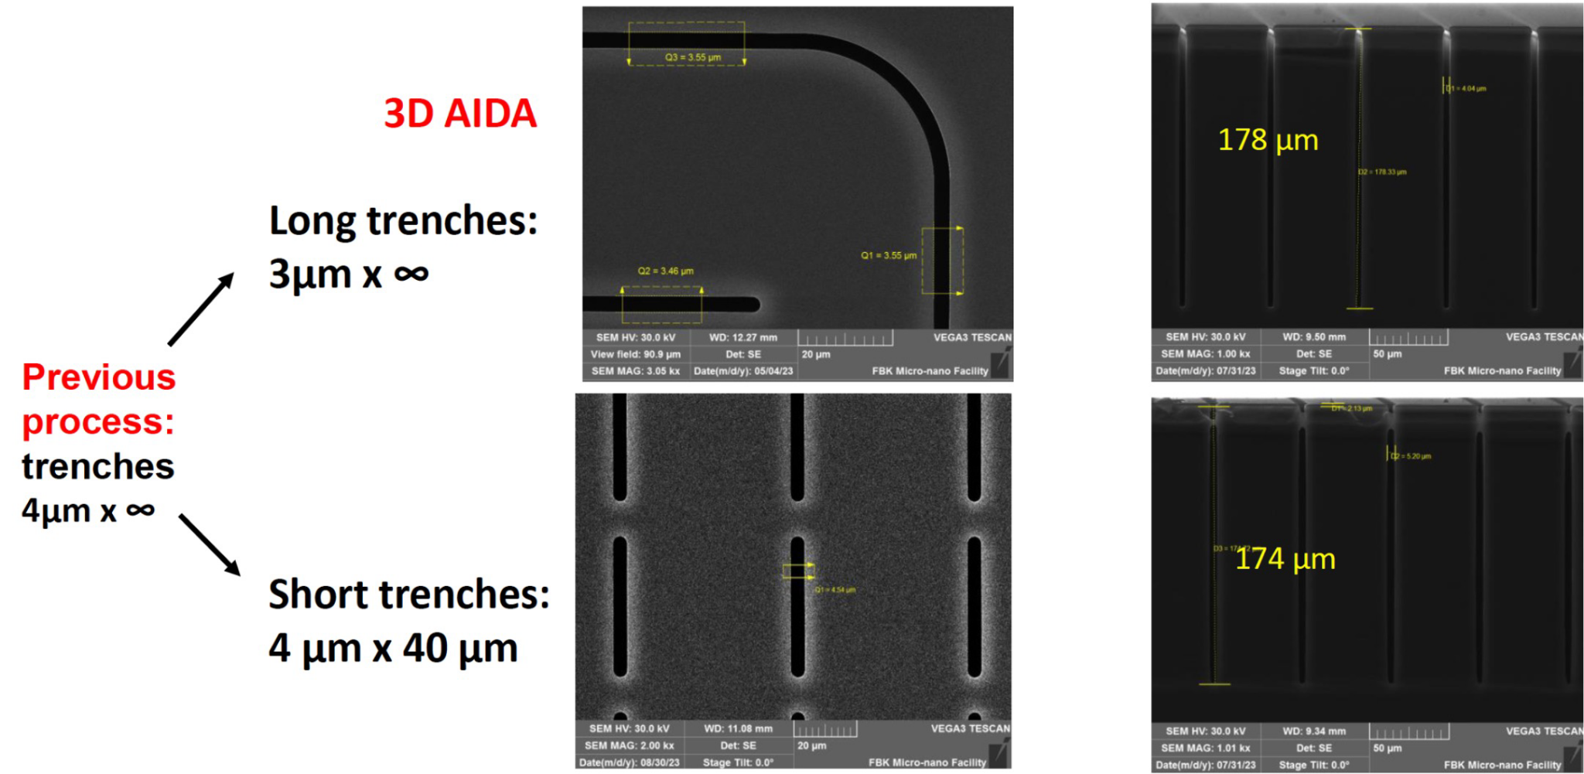
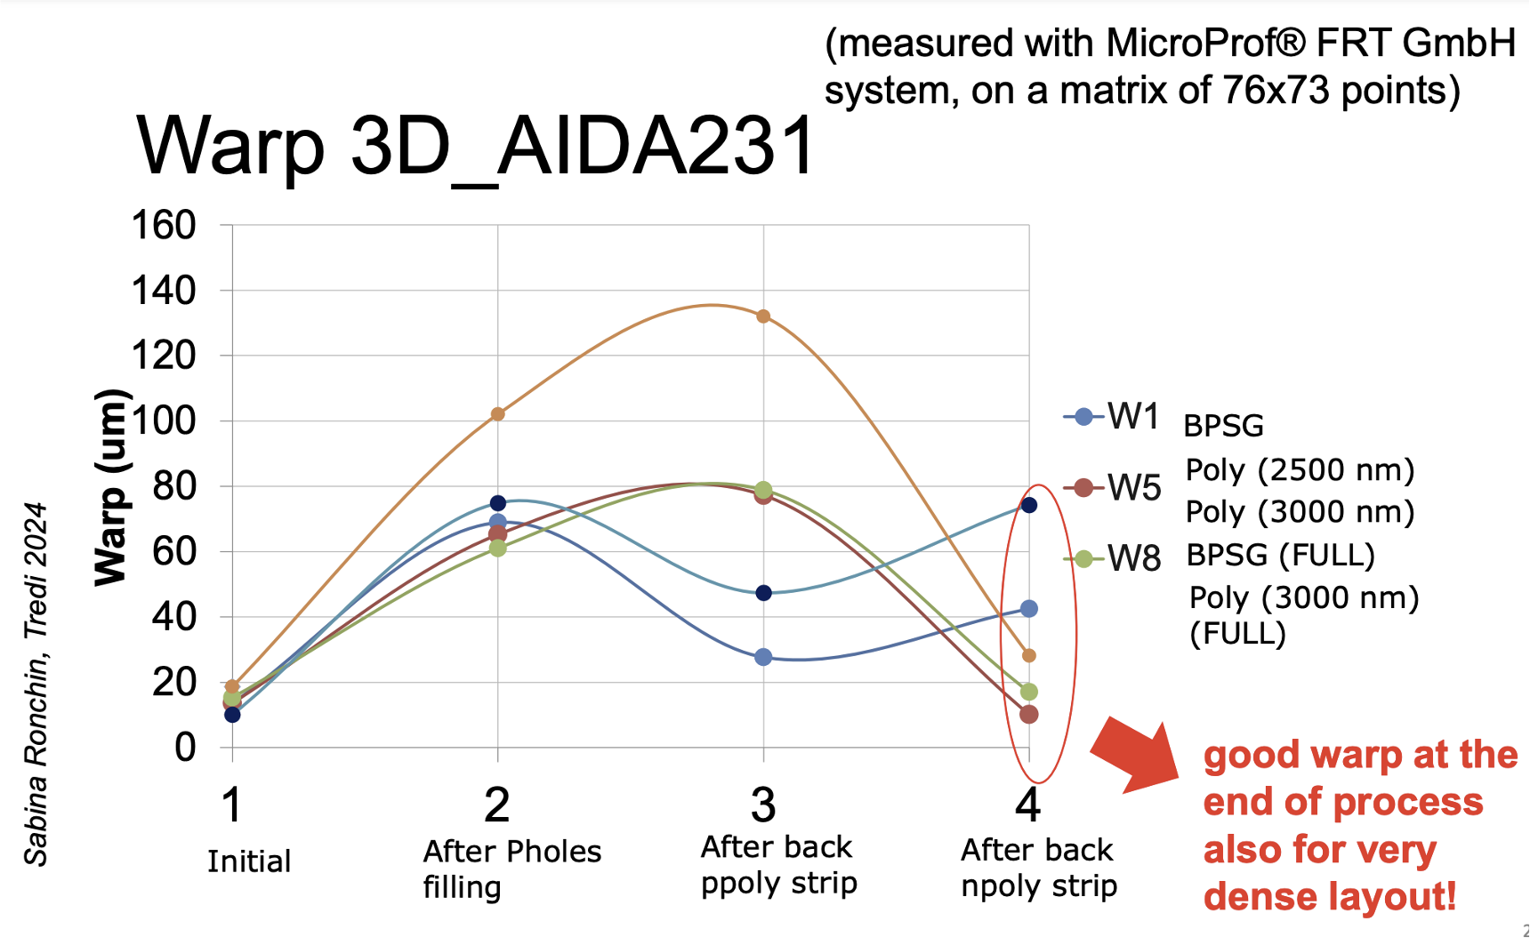
Towards D6.1:
3D production at FBK
Status: 18 wafers fabrication jus completed, running tests on wafers at FBK.
Wafer Layout:
• 14 wafers with 18 DIE on wafer
• 4 wafers with 29 DIE to test high density yield.
Process Split:
• 12 poly filling
• 6 BPSG filling
Short and narrow trenches
to improve subsequent
photolitographic process
Wafers warp under control!

Slide 20
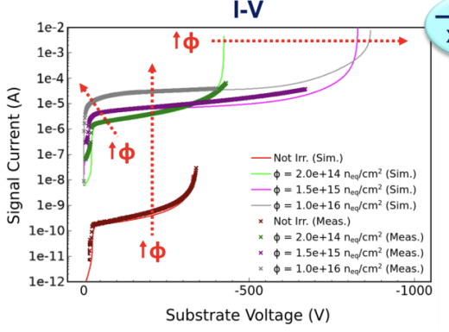
Task 6.2 Simulations supporting
3D and LGAD productions
Simulations have been developed to predict the LGAD behaviour up large fluences.
  The radiation damage model used in the simulation framework is the “New University of Perugia TCAD model” scheme, which allows to model the comprehensive surface and bulk radiation damage effects in Si by means of a limited set of physically meaningful deep-level radiation-induced traps.
    I-V and C-V simulated curves have been compared with experimental data, allowing to fine tune parameters for predictive results that have guided the design.
    3D sensors applications started.
The Allpix Squared Monte-Carlo simulation framework has been extended by modules to simulate the sensor response of LGAD sensors as well as by the possibility to define a flexible geometry for 3D sensor implants in different shapes from frontside and backside. A first implementation of radiation-induced trapping has been implemented.

Slide 21
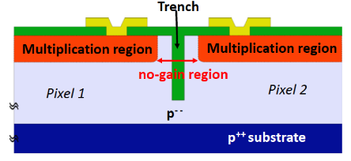
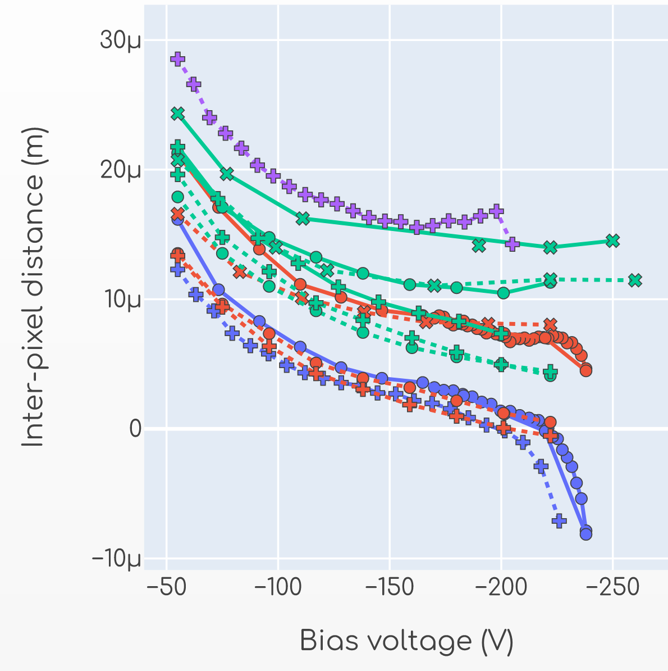
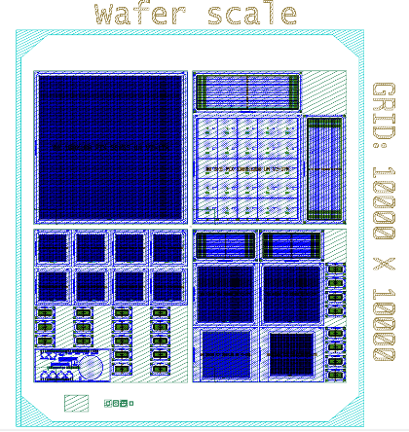
Towards D6.1:
LGAD production at FBK
Fabrication details
Trench-isolated (TI) LGADs
Inter-pixel distance measured on proto-production
reticule structure
Process split

Slide 22
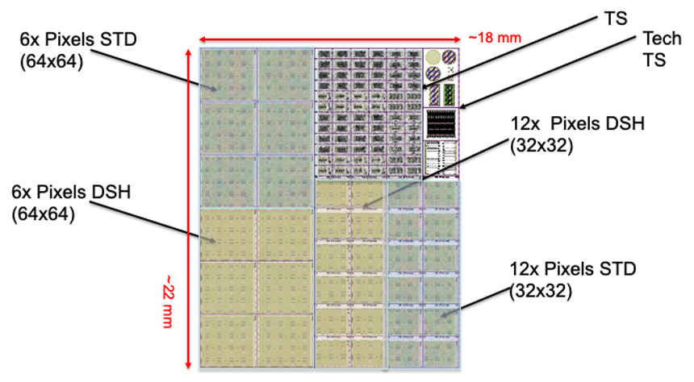
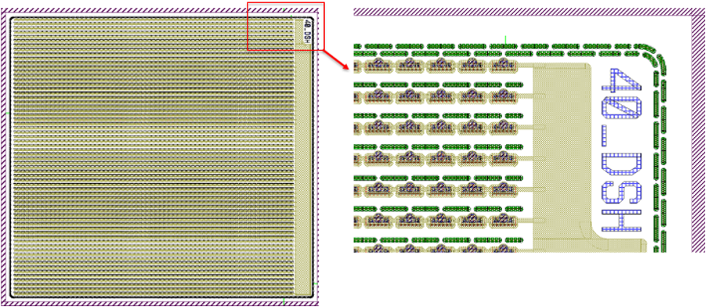
Towards D6.1:
3D production at FBK
Fabrication details
Mainly 55x55 um² pixel cell devices compatible with existing or in design readout chips (Timespot, Picopix, Timepix ASICs )
6” Wafers with photolitography on a reticule
Example of a 64x64 matrix with dashed trenches

