Slide 1
AIDAinnova Second Project Review Meeting
Thursday 20th June 2024
WP4
Upgrade of Irradiation and Characterization Facilities
Federico Ravotti (CERN), Fernando Arteche (ITAINNOVA)

Slide 2
Objectives
Irradiation and characterization tests required for the R&D on next generation of particle detectors demand more accurate and reliable procedures, as well as a higher efficiency in their execution
The main goal of WP4 is to develop & standardize common tools for testing infrastructure to better support the next detector generation
  Improve facilities, systems and methods
The activities are covered by different partners:
  Academia
  Industry
  Research and Technology Organizations (RTOs)
Good collaboration between partners ensures the readiness of the detector support infrastructure for AIDAinnova’s TRLs

Slide 3
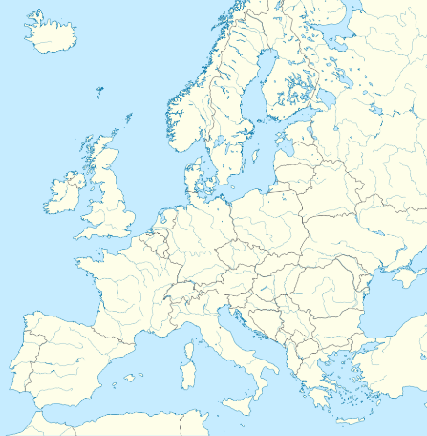


Tasks
Task 4.1: Task Coordination (CERN, ITAINNOVA ⁽⁺⁾)
Task 4.2: Micro-beam Upgrade at RBI Accelerator Facility (RBI-AF)
Task 4.3: Common Tools for Irradiation Facilities QC: Data Management, Traceability, Dosimetry and Activation Measurements (CERN, MINES^{(*)}, INFN, ENEA^{(*)}, CAEN)
Task 4.4: Design & Development of a New Sensor Characterization System based on TPA-TCT Technique (CERN, CSIC-IFCA, FYLA)
Task 4.5: Design & Development of a New Electronics Characterization System for EMC Control (ITAINNOVA⁽⁺⁾, CNRS-IPHC)
IRRAD/GIF⁺⁺
CERN Switzerland
Partner
Company Facility
MINES
ParisTech
France
CNRS-IPHC
France
CSIC-IFCA
Spain
CAEN
Italy
RBI-AF
Croatia
ENEA-FNG
INFN
Italy
FYLA
Spain
ITAINNOVA
Spain
^{(*)} Collaborating Institute
⁽⁺⁾ RTO

Slide 4
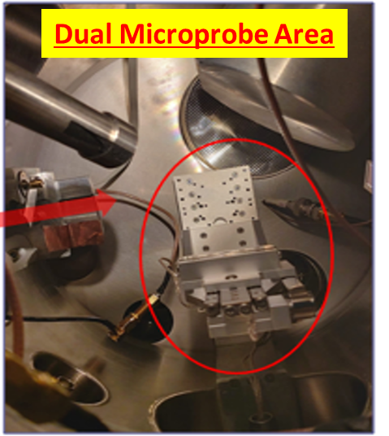
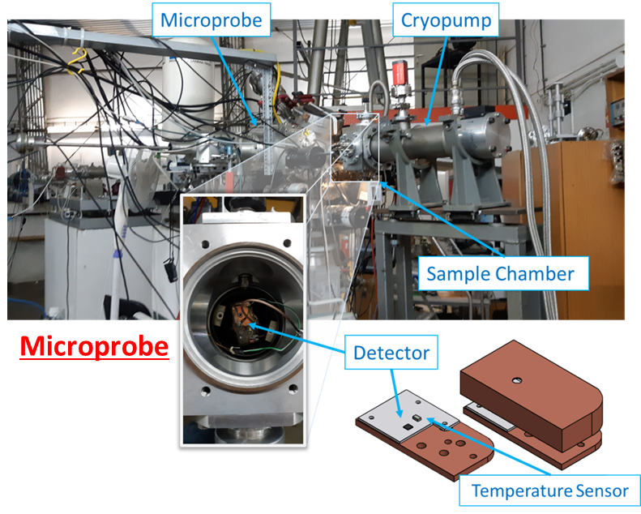

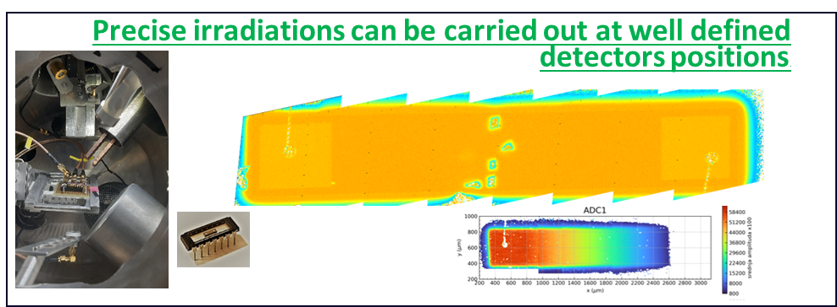
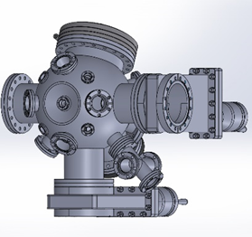
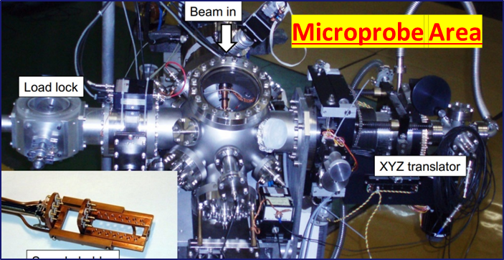
Task 4.2: Micro-beam Upgrade at RBI Accelerator Facility - Results/highlights
New precise and monitored sample positioning system (1nm to tenths nm) & software control –SPECTOR upgrade.
Sample cooling system ( low Temp)
  The present setup for low temperatures can achieve temperatures ~ 40-50 K
Upgrades are already very useful
  Time for sample precise positioning and micro-analyses on areas of interest is significantly decreased
Additional work
  New XYZ piezo stage has been designed
    It will deliver soon and control system will be integrated in SPECTOR
    Activity covered with RBI funds
MS12
D4.1

Slide 5
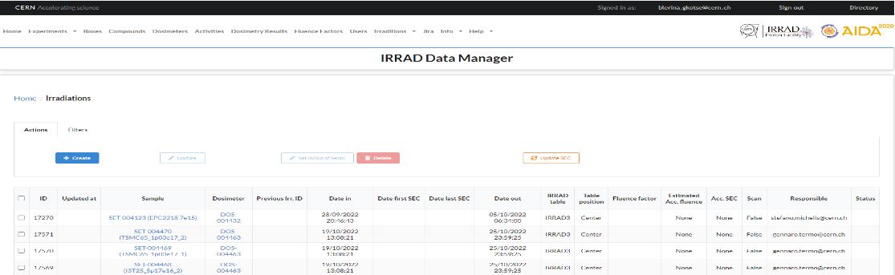
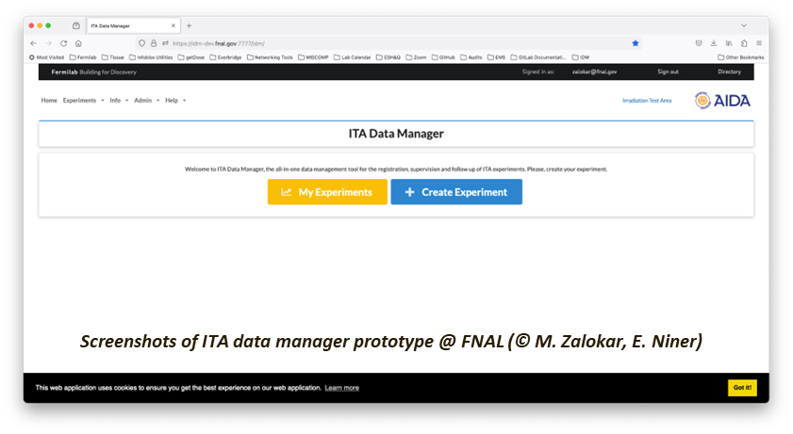

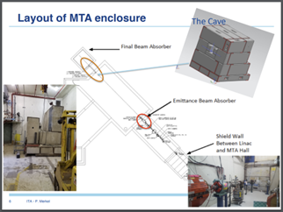
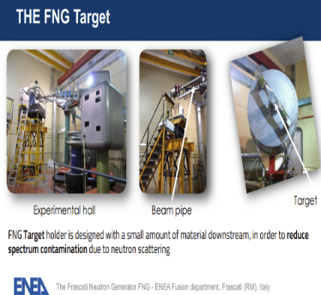
Task 4.3: Common Tools for Irradiation Facilities QC: Data Management, Traceability, Dosimetry and Activation Measurements: Results/highlights
  For irradiation run 2024, new version of generalize IDM deployed implementing the recommendations gathered during the usability session:
  The goal of ENEA-FNG's contribution to D4.3 is to demonstrate IDM's applicability in facilities beyond CERN, highlighting the software's generalization capabilities.
  The extension of the IDM to CERN-GIF++ is complete, but the departure of key staff at ENEA-FNG in Rome halted the software deployment work required for D4.3.
IDM CERN IRRAD
  Change of target facility for D4.3
IDM FNAL IRRAD
IDM specifications for deployment to new facilities finalized
Deployment @ GIF++ finalized
Deployment @ FNAL ongoing
  Due to the challenges at ENEA-FNG, it's proposed to shift the software deployment from ENEA-FNG to the Fermilab-ITA proton irradiation facility in the USA, with the change not affecting the original scope or objectives of D4.3
MS13

Slide 6
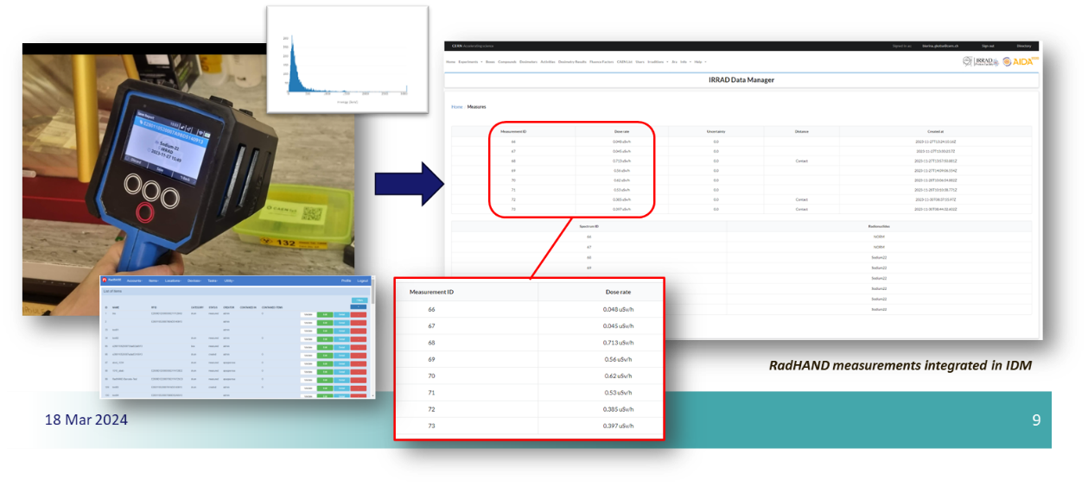
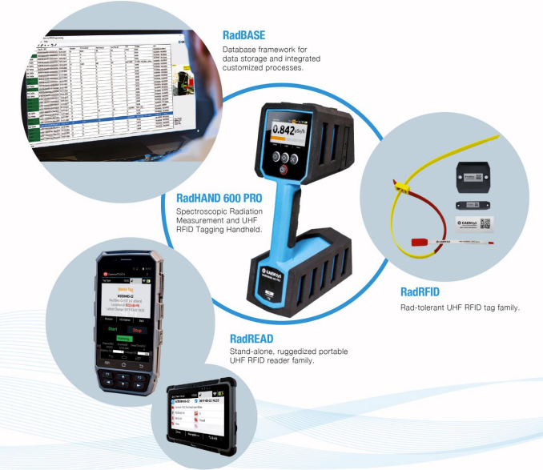
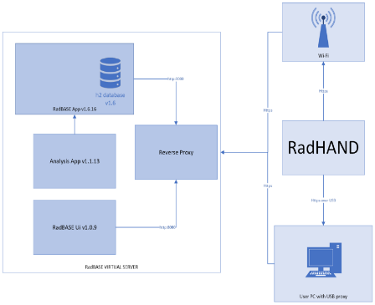
Task 4.3: Common Tools for Irradiation Facilities QC: Data Management, Traceability, Dosimetry and Activation Measurements: Results/highlights
Sample tracking control system
  A new integrated RFID-based system (DigiWaste platform from CAEN), which combines spectroscopic radiation measurements and RFID tagging, has been evaluated.
Data from the CAEN RadHAND tool and CANBERRA APEX-Gamma spectrometry system have been integrated into IDM.
  Complete workflow tested
Milestone MS14 completed and released
  Including a Video
Last Irradiation campaign is ongoing to test the radiation tolerance of RFID tags
MS14
DigiWaste platform
MS15

Slide 7
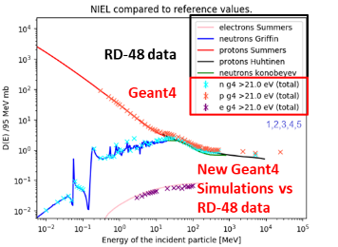
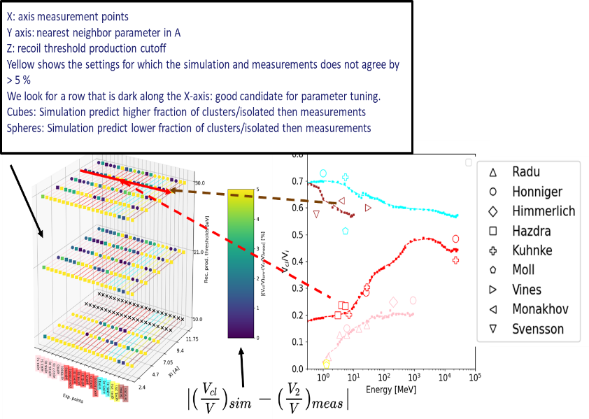
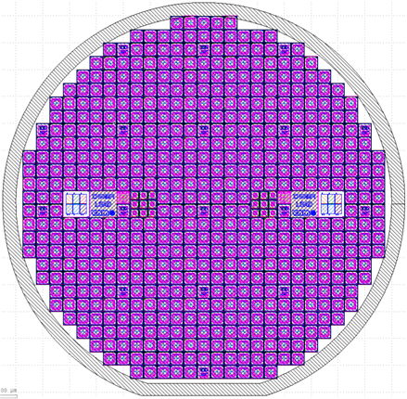
Task 4.3: Common Tools for Irradiation Facilities QC: Data Management, Traceability, Dosimetry and Activation Measurements: Results/highlights
Produce a common dosimetry calibration set for cross-comparison of irradiation facilities by evaluating, with dedicated dosimeter structures, the Non-Ionizing Energy Loss (NIEL) of their particle beam
Geant4 and FLUKA simulations for NIEL curves successfully reproduced and algorithm for identifying clustered vs point defect damage implemented
  Tuning of algorithm parameters is ongoing
    It will benefit of Benchmarking simulations with measurements data
    A set of Silicon Sensors (n-in-p) are in production at CNM, Barcelona
D4.2

Slide 8
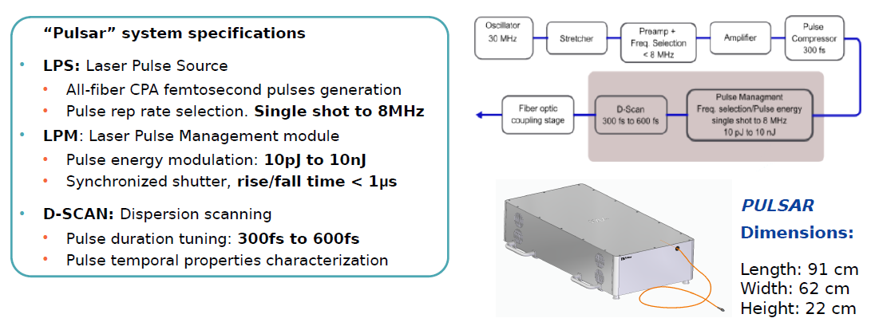
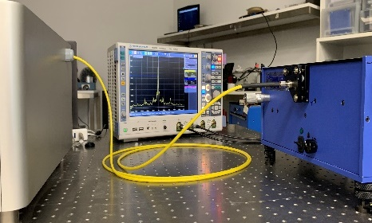
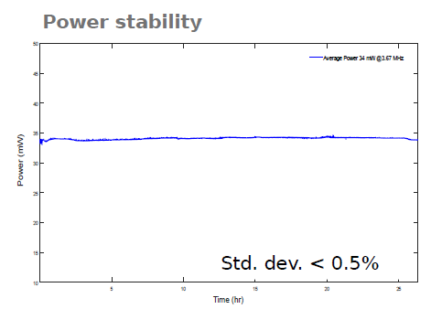
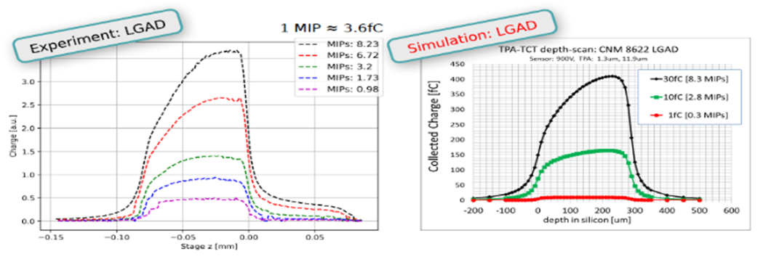
Task 4.4: TPA-TCT System Development: Results/highlights
Since 2023 Re-designed Laser system at Fyla
  The new “Pulsar” laser system was manufactured
  The system fully integrates the laser pulse source (LPS), the pulse management module (LPM) and the dispersion compensation module (D-scan) in a single box component with fiber optic beam delivery.
  The system “Pulsar” presents robustness and great stability in optical and temporal properties.
D4.4
(5+1) TPA-TCT laser systems have been installed within the user community, utilizing the Fyla laser model LFC1500X.
  Many tests have been already performed
  A new TPA-TCT system with the Fyla laser model Pulsar is being set up at the University of Oxford.
MS16
Gain suppression measured with TPA-TCT in LGADs. Reproduce in TCAD simulations
8

Slide 9
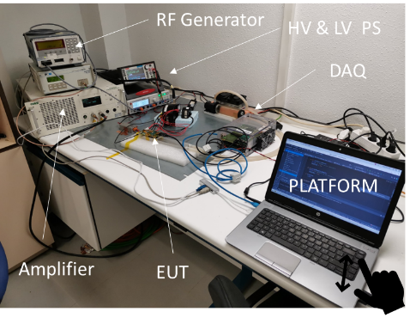
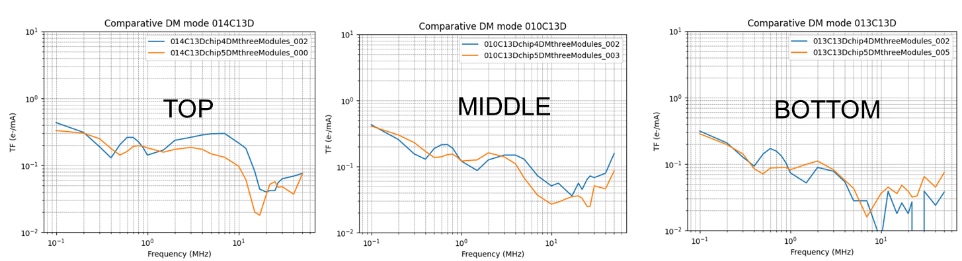
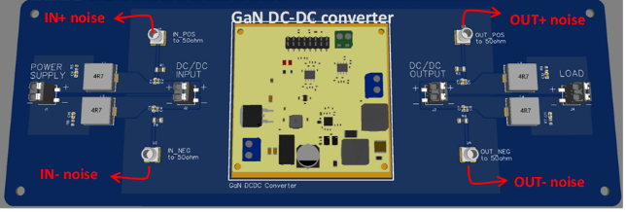
Task 4.5: Design & Development of a New Electronics Characterization System for EMC Control: Results/highlights
EMC Transfer Functions (TF) measurement system development has been completed.
  System is fully operational - already used in EUROLABs project
MS17
Noise studies at system level
CMS-ITK –phase II
A portable test bench is being developed for conducting EMC emission measurements of PS in IRRAD facilities
  It will be tested and validated at IPHC-Strasbourg facilities,
During P2 a dedicated PCB has been designed
  Data acquisition will use a high-resolution, 14-bit, four-channel oscilloscope (Transient capabilities)
A Python-based software layer is being developed.
D4.5

Slide 10
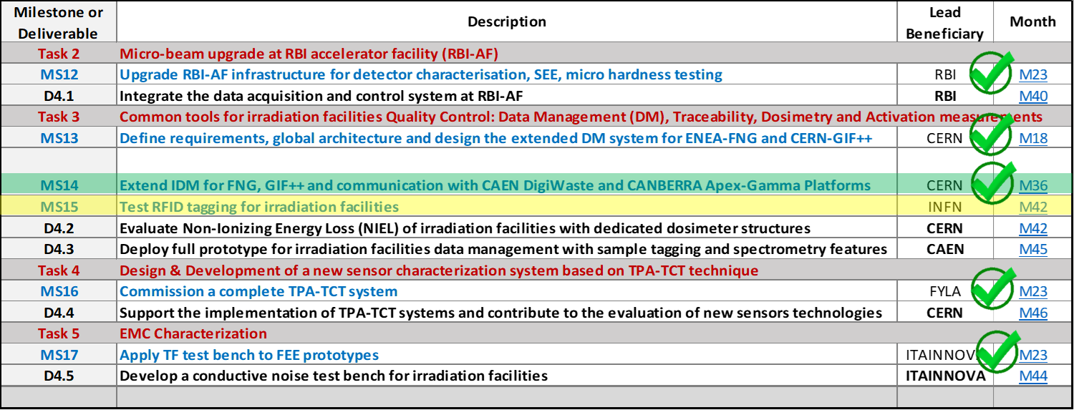
WP4 Deliverables/Milestones & Resources
6 Milestones (MS): M18 – M42: 5/6 completed
  M36: MS14 achieved during the last year (March 2024)
  M42: MS15 is the last one (September 2024)
5 Deliverables (D): M40 – M46
Resources
  Budget – 1.04 M€ (69 %)

Slide 11
Back up slides

Slide 12
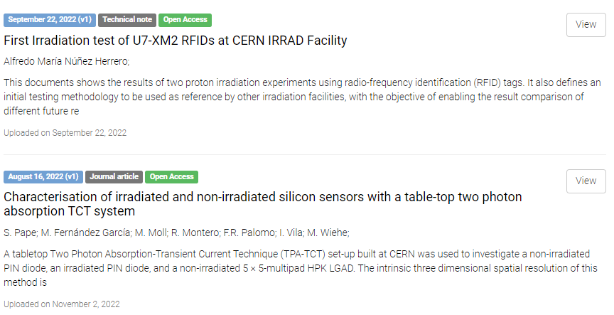
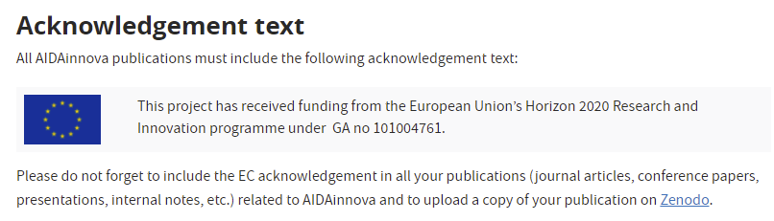
Task 4.1: WP Coordination - Results/highlights
https://aidainnova.web.cern.ch/publications
12 publication records for WP4 in Zenodo
  7 other than MS reports (articles, notes, presentations, etc.)
  1 in the pipeline for task 4.3, other 7 still pending to be uploaded in Zenodo
e-groups to communicate with TLs and WP4 members
INDICO category to host WP- and Task-related meetings:
  https://indico.cern.ch/category/13502/ (14 events)

Slide 13
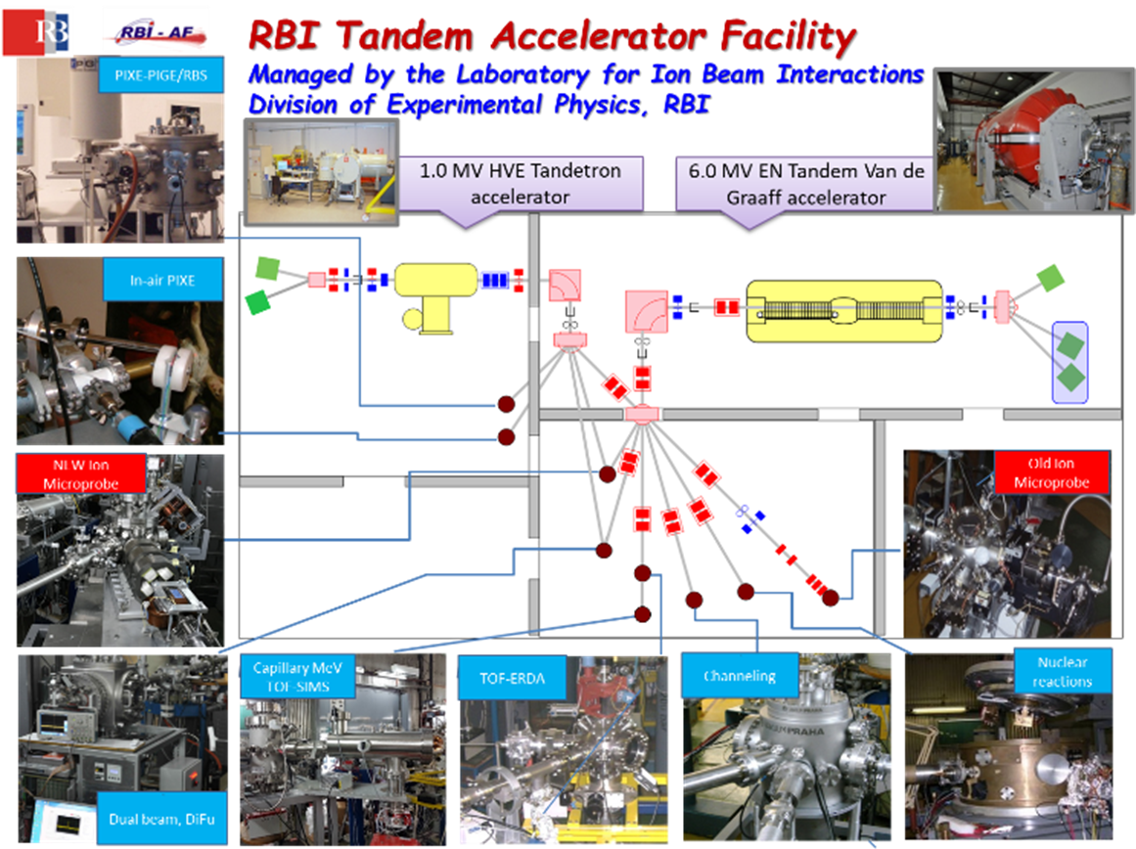
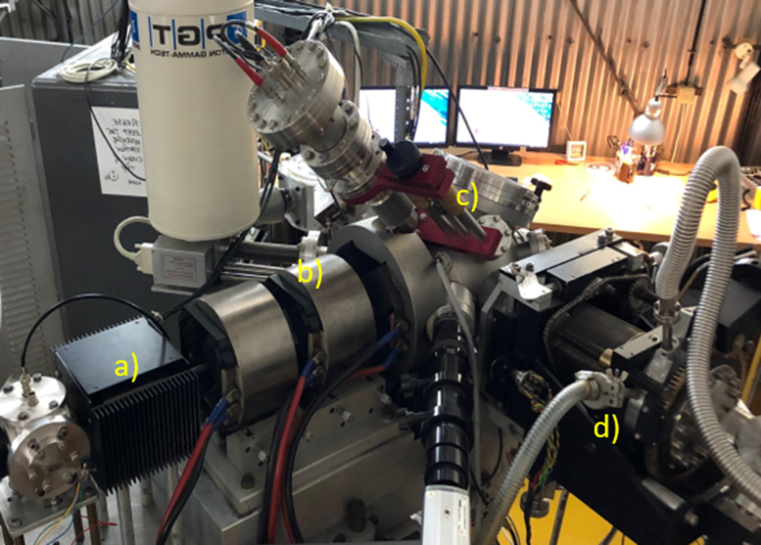
Task 4.2: Micro-beam Upgrade at RBI Accelerator Facility
Upgrade of the RBI Tandem Accelerator Facility (RBI-AF) infrastructure for detector characterization and radiation hardness studies at micron-scales

Slide 14





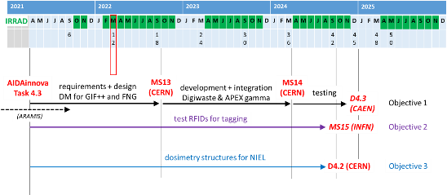


Task 4.3: Common Tools for Irradiation Facilities QC: Data Management, Traceability, Dosimetry and Activation Measurements
Objective 1: Generalization of the IRRAD Data Manager (IDM) to include new facilities and improve the data sharing
Objective 2: Design and development of an integrated system prototype for induced activation and traceability data management
Objective 3: Produce a common NIEL dosimetry calibration set for facilities cross-comparison
Detector development, irradiation, characterization (CH)
Irradiation/testing of electronics (IT)
Electronic Instrumentation for Nuclear and PP (IT)
7 task meetings organized during the first year to review the progress in the three objectives …
Data management SW, ontologies and ML (FR)

Slide 15
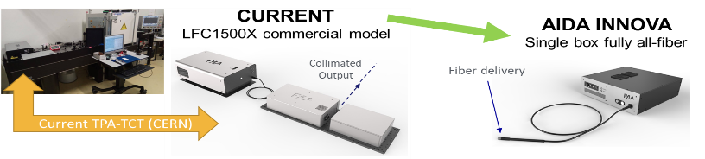


Task 4.4: TPA-TCT System Development
Development of a customizable and user friendly Two Photon Absorption – Transient Current Technique (TPA-TCT) system for the characterization and test of silicon devices.
Two activities are planned in task 4.4:
  System upgrade
  Promote the use of this technique within detector community
LPS: Laser Pulse Source
  All-fiber CPA femtosecond pulses generation
  Pulse rep rate selection. Single shot to 8 MHz
LPM: Laser Pulse Management module
  Pulse energy modulation: <10 pJ to > 10 nJ
  Synchronized shutter. rise/fall time < 1 us
D-SCAN: Dispersion scanning
  Pulse duration tuning: 300 fs to 600 fs
  Pulse temporal properties characterization
LPS + LPM + D-SCAN in single box fully all-fiber
  Pulse duration goal < 100 fs
  Fiber-based tunable dispersion compensation:
  < 100 fs to 1 ps
  Fiber-pigtailed AOM functionalites:
    Energy modulation
    Pulse rep rate selection
    Sync shutter
    Dispersion-less fiber output delivery to TPA-TCT optical sub- system

Slide 16
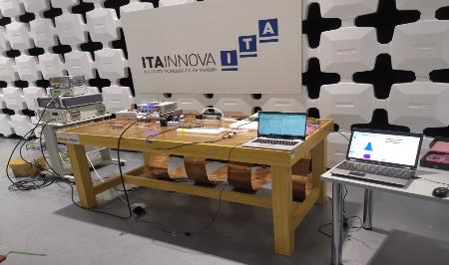

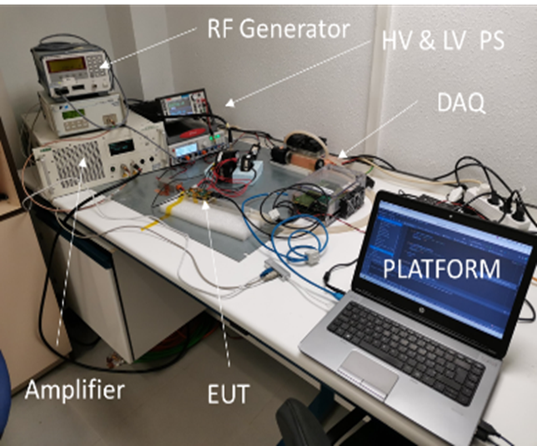

Task 4.5: Design & Development of a New Electronics Characterization System for EMC Control
This task plans to upgrade Electromagnetic Compatibility (EMC) tests in order to improve the support for detector electronics designers.
Activities:
  Design and develop an automatic EMC test bench to measure the noise transfer functions (TF) of physics detectors.
  Design and develop a portable test bench to perform in-situ EMC conducted emission measurements of power units in irradiation facilities.
> 1 week → a few hours …
Previous EMC TF measurement system
EMC TF measurement system upgraded

