Slide 1
Engineering Development of the DarkSide 20k AAr Cryogenic System
Tiziano Baroncelli (TE-CRG-CL)
29 May 2024

Slide 2
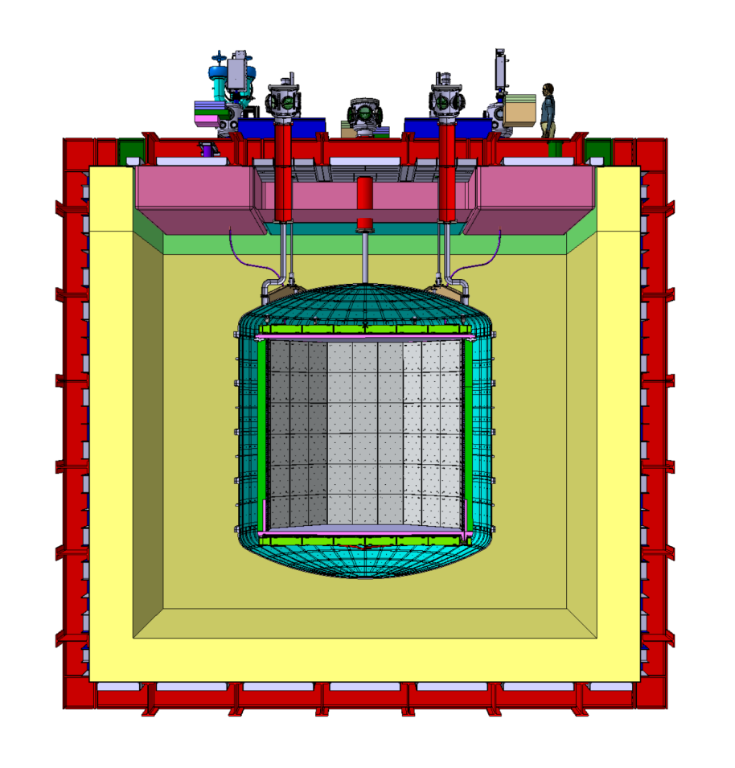
1. Overview of the DarkSide 20k experiment
Warm structure
Time Projection Chamber (TPC) filled with 51 ton of liquid underground Ar (UAr).
Cryostat filled with 700 ton of liquid atmospheric Ar (AAr).
Inner neutron veto between TPC and inner vessel.
Outer muon veto between outer membrane and inner vessel.
Inner (UAr) vessel
Liquid UAr
TPC
Liquid AAr
Cryostat membrane (cold structure)
Fig. 1.1 - DarkSide 20k cryostat

Slide 3
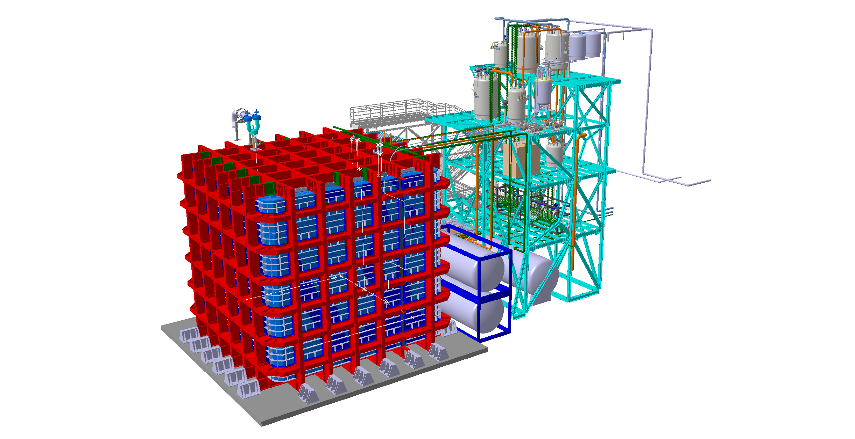
1. Overview of the DarkSide 20k experiment
Cryogenic fluid handling system composed of 9 valve boxes (VB), 16 cold + 18 warm transfer lines (TL), and two warm skids (WP)
DS-20k proximity cryogenics
DS-20k cryostat
Fig. 1.2 – Full 3D CAD model of the DarkSide 20k experiment.

Slide 4
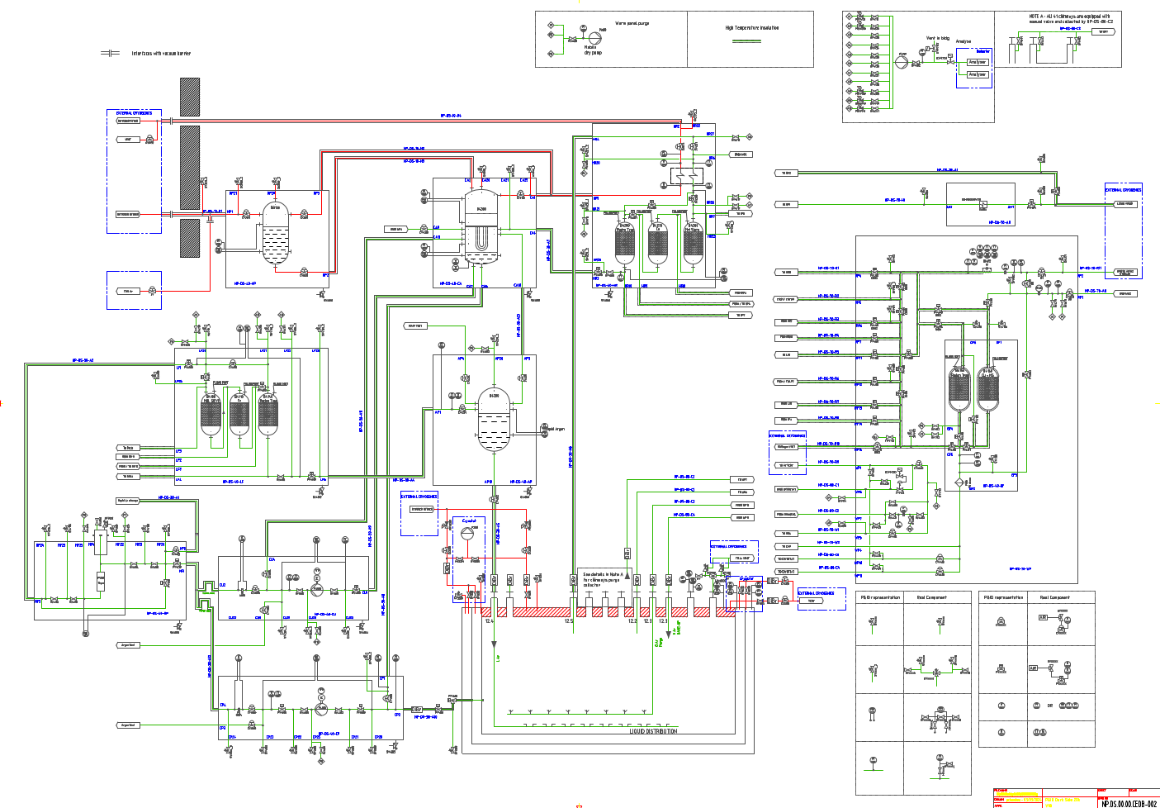

2. Overview of the DarkSide 20k AAr system
LAr recirculation (liquid filtering, thermal convection)
Warm chimneys GAr recirculation (gas filtering)
Boil-off recovery & recondensation (pressure control)
Cooling (N2)
1.06 bara
87.7 K
Fig. 2.2 – DarkSide 20k AAr P&ID (steady state operations).
10 kW

Slide 5
2. Overview of the DarkSide 20k AAr system
Pump VB (2 off)
Mech. filter
Liquid filter
Argon phase separator
Condenser
Cold gas filter
Warm gas filter
N₂ phase separator
16 cold transfer lines
AAr cryogenics Contractor
Warm panel
Cryostat safety valves
Cryostat membrane purge system
18 warm TL
CERN
Fig. 2.3 – DarkSide 20k AAr P&ID (PBS).
DS20k cryostat

Slide 6



3. AAr cryogenics – project development
 | CRIOTEC’s RESPONSIBILITY
 | SHARED RESPONSIBILITY
 | CERN's RESPONSIBILITY
Activities breakdown
CONTRACTS | WORK BREAKDOWN STRUCTURE (WORKING PACKAGES)
 | PROJECT DEVELOPMENT |  |  |  |  |  |  |  | CONFIGURATION MANAGEMENT
 | PROCESS | INSTRUM. | ELECTR. / CONTROL | ASSEMBLY, INTEGRATION, TESTS | OPERATIONS | MANAGEMENT | COMMUNIC. | SAFETY | MECHANICAL, CALCS | CAD DESIGN (2D, 3D) | PFD, P&ID | TECHNICAL SPECS
CRIOTEC CONTRACT
WARM PANEL
CRYOSTAT MEMBRANE VALVES
CRYOSTAT SAFETY VALVES
Tab. 3.1 – DS 20k activities breakdown.

Slide 7
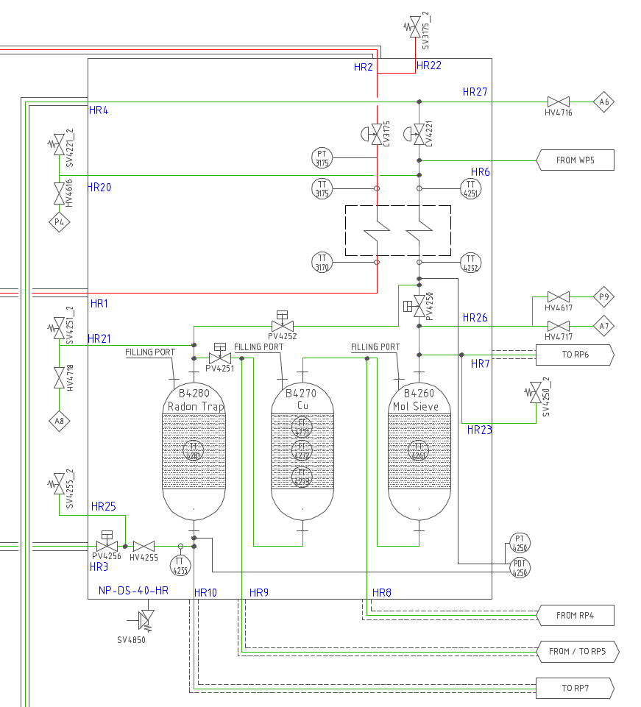
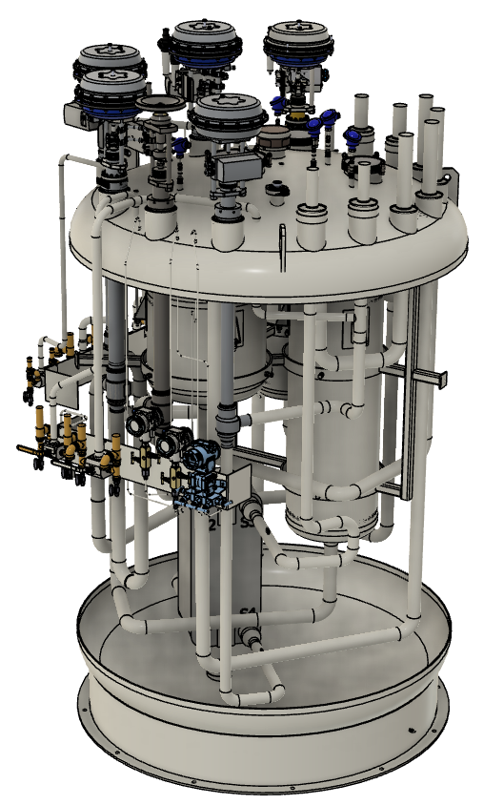
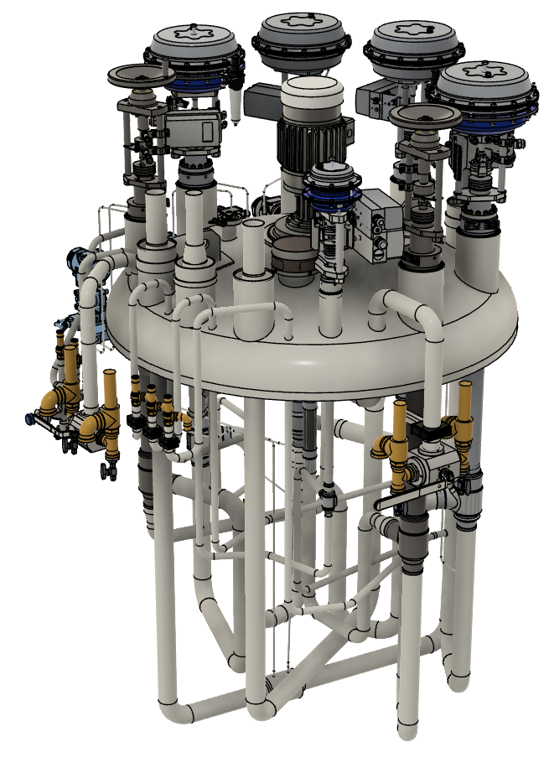
3. AAr cryogenics – project development
How to get from this…
…to this?
P&ID
Interface control document (ICD)
3.4.1.1 The NP.DS.40.HR Cold gas argon radon trap valve box
“The liquid argon used in the detection process needs to have a purity level in the parts per billion (ppb) oxygen equivalent and shall also be cleaned from radon. In order to achieve this purity inside the detector cryostat, the liquid and the gas must be purified during the system filling and in normal operation. One of the main functions of this valve vox is to circulate the boil-off gas of the cryostat through the chemical filters of the NP.DS.40.HR to guarantee the purity level during normal
operation. The second main function is to cool-down the gas coming from the cryostat and the chimneys through the heat exchanger. The NP.DS.40.HR box shall contain an Aluminum Plate-Fin Heat Exchanger. The Plate-Fin heat exchanger shall be designed, fabricated and inspected in accordance with the PED. The design shall conform to the latest ALPEMA edition of the Standards of the Brazed Aluminium Plate-Fin Heat Exchanger Manufacturers’ Association. Brazed Aluminium plate-fin Heat Exchangers (BAHX) shall be vacuum brazed. The Contractor shall review with the heat exchanger manufacturer all operation scenarios (including Warm-up and Cool-down). The heat exchanger manufacturer shall officially certify that the heat exchangers are suitable for safe and long-term operation at all temperature differences necessary to ensure operation. The necessary process parameters to size the heat exchanger are given in Annex § 9.4, a particular attention shall be paid in regard to the pressure drop across the argon branch which shall not exceed 10mbar at nominal flow […]”.
CP valve box
LF valve box
Technical specifications

Slide 8


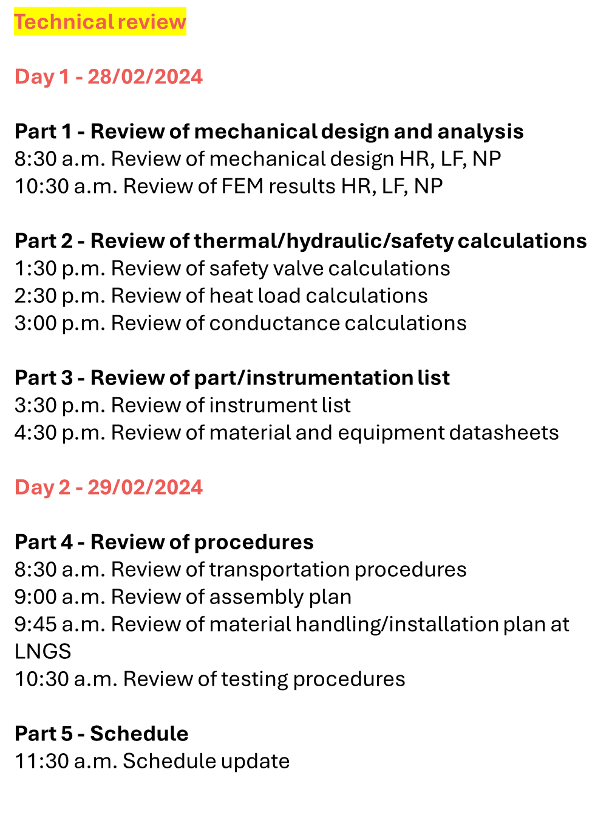





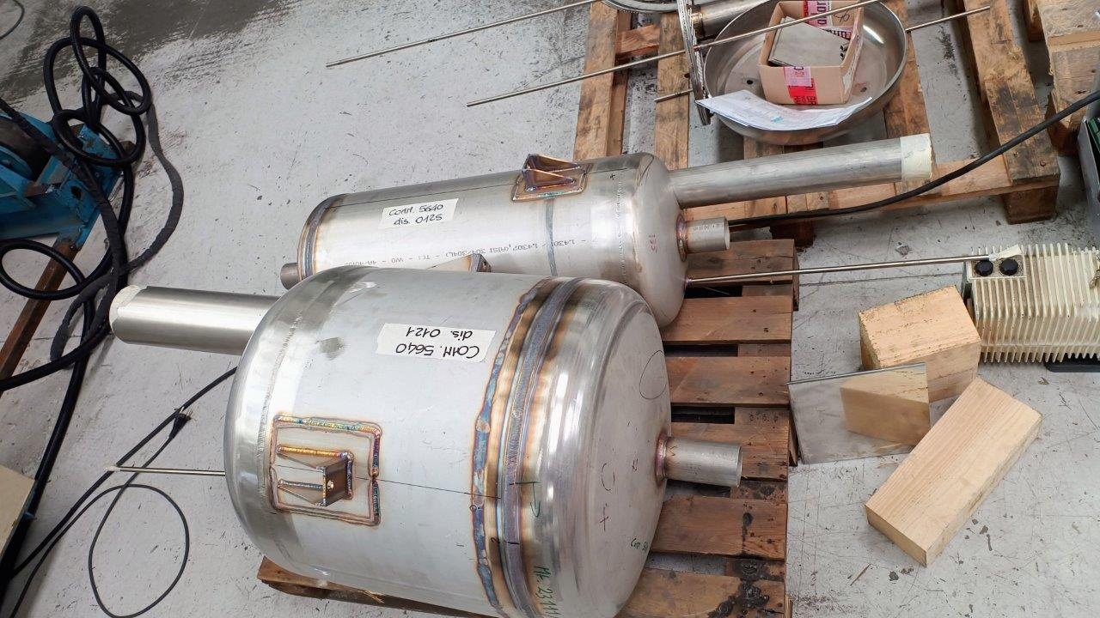
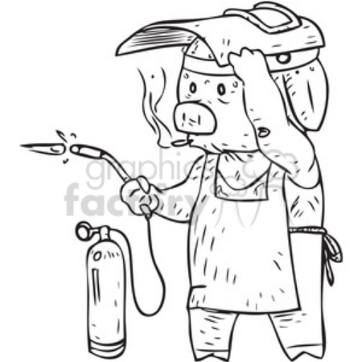
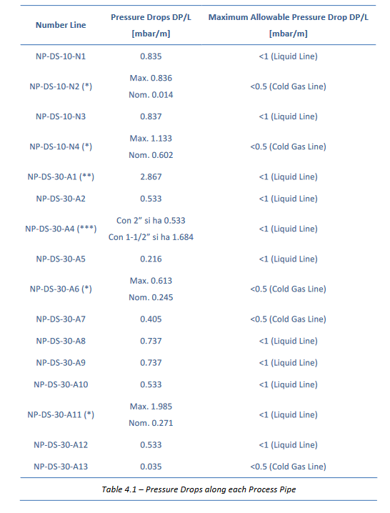
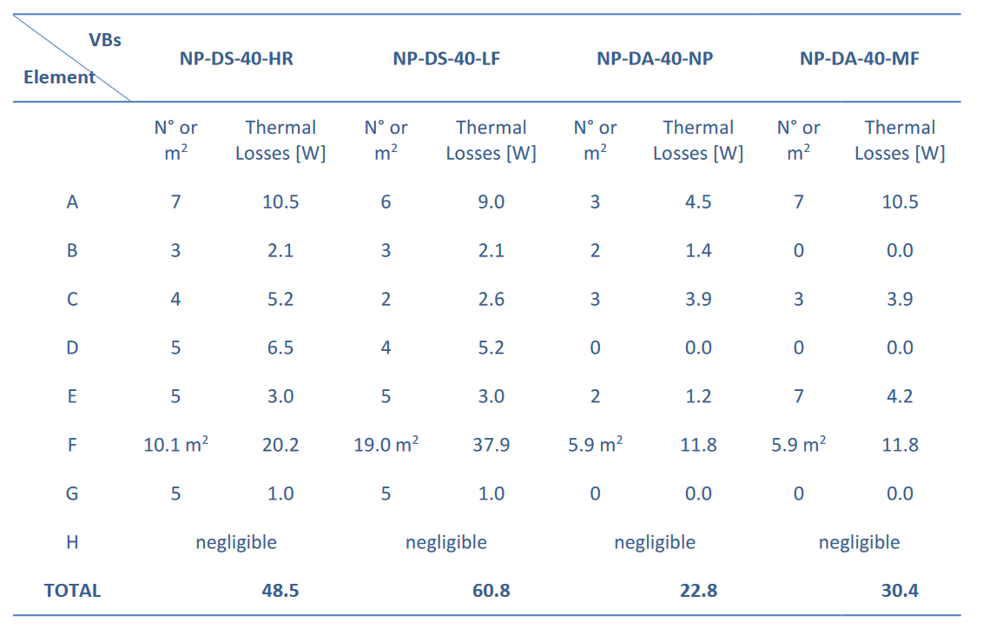
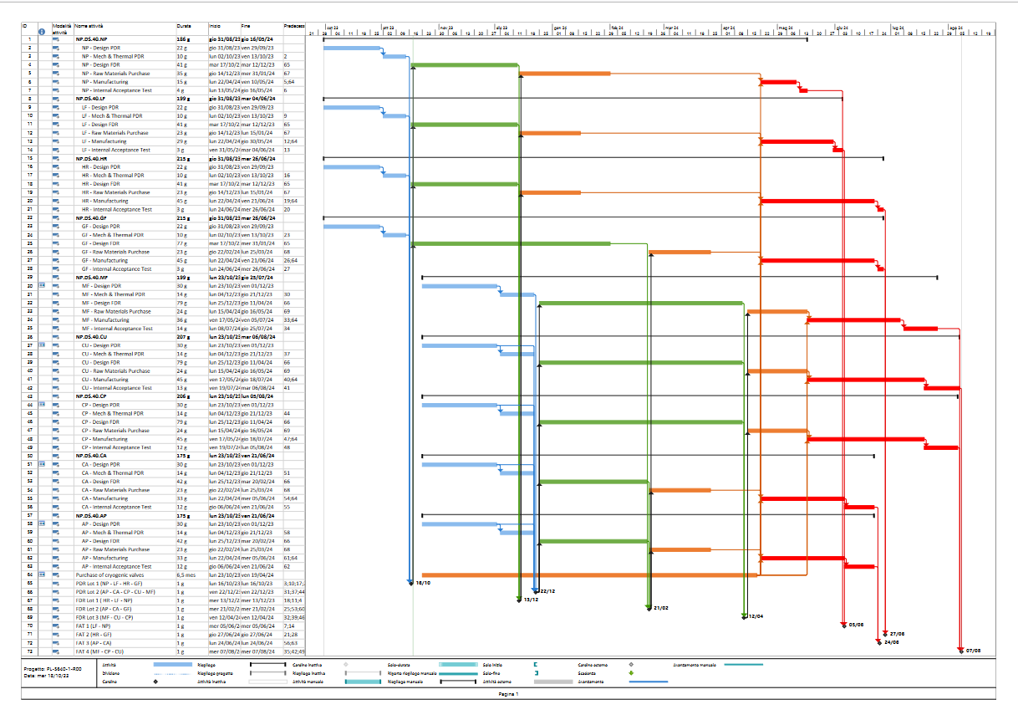
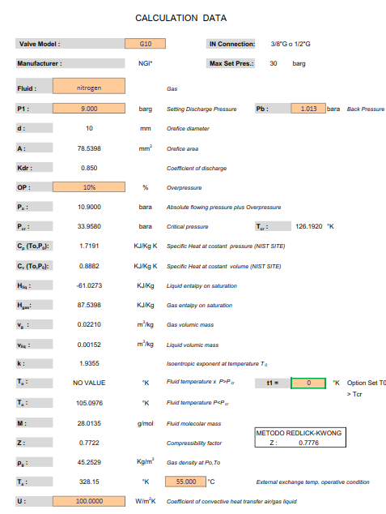
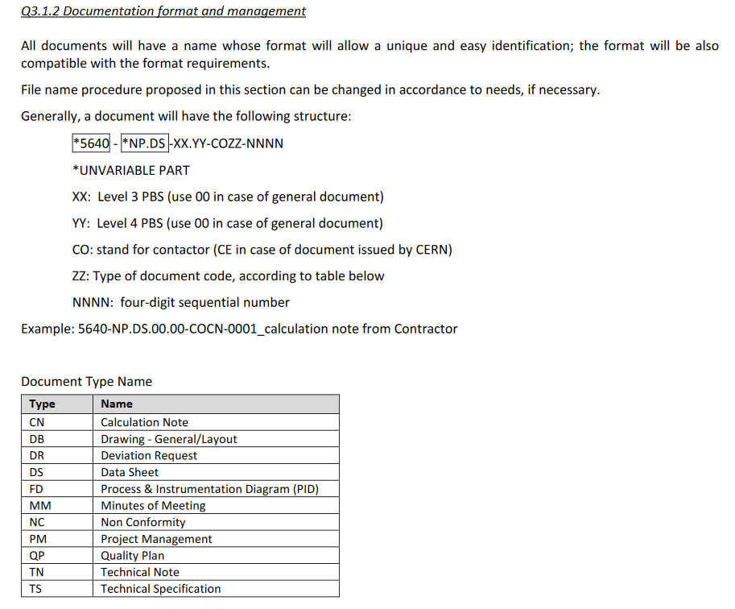
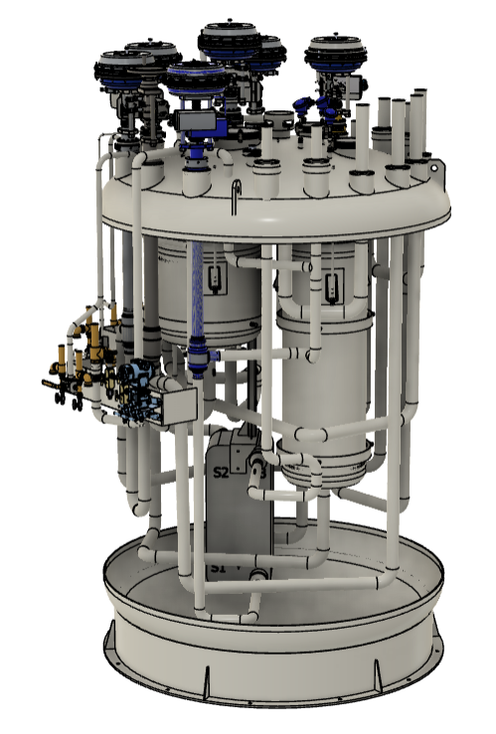
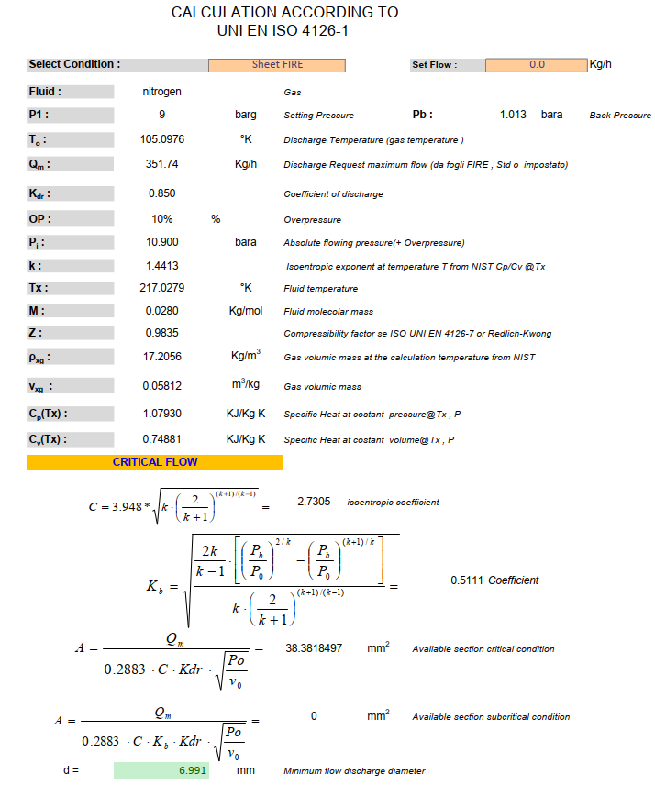
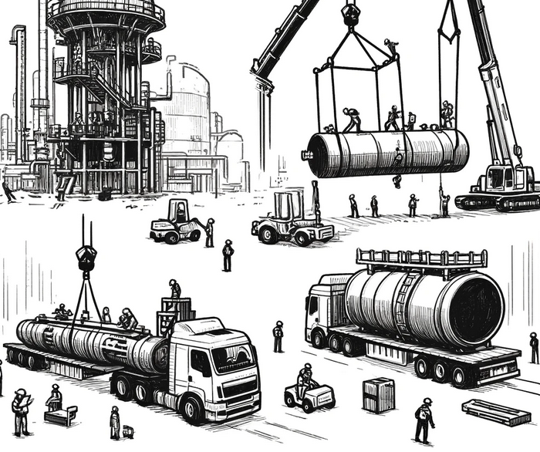
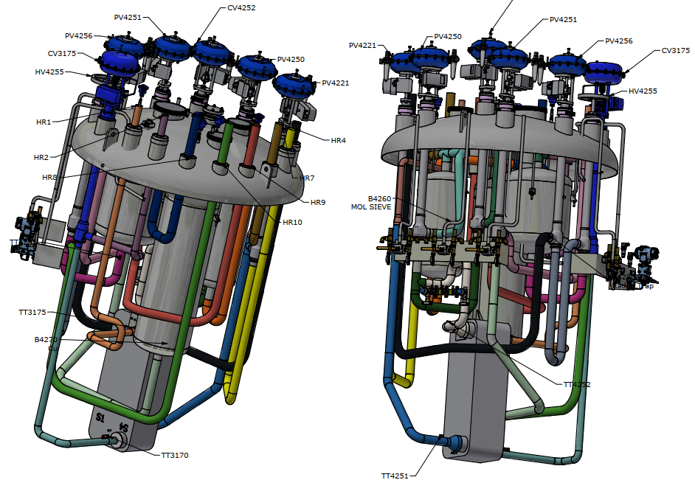
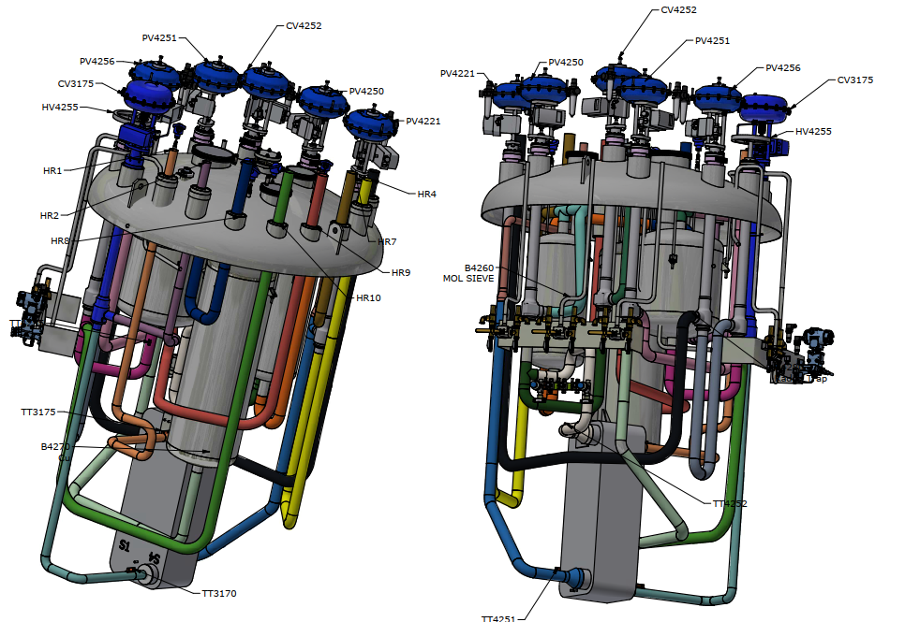
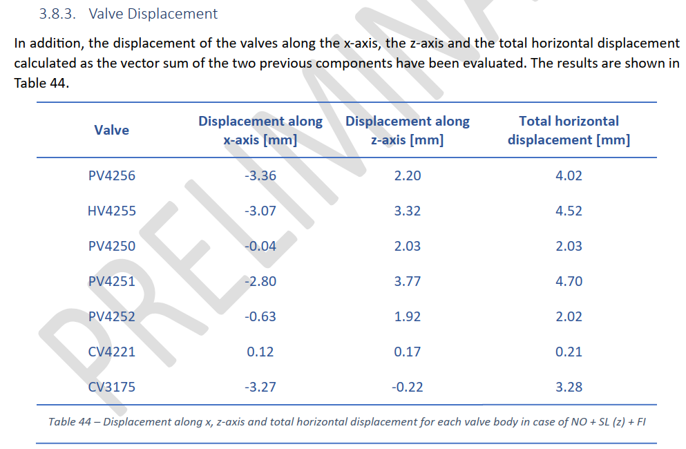
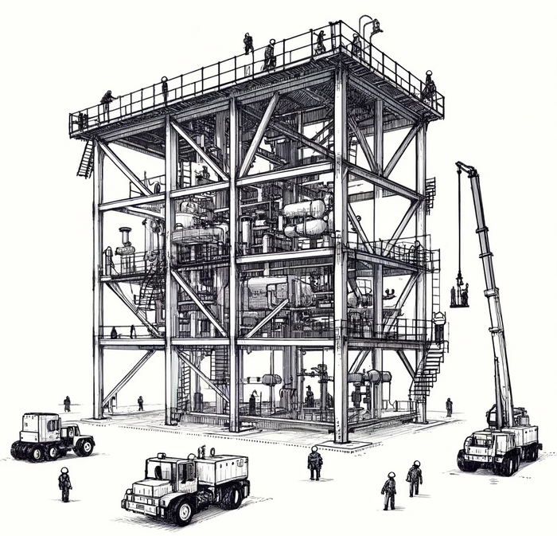
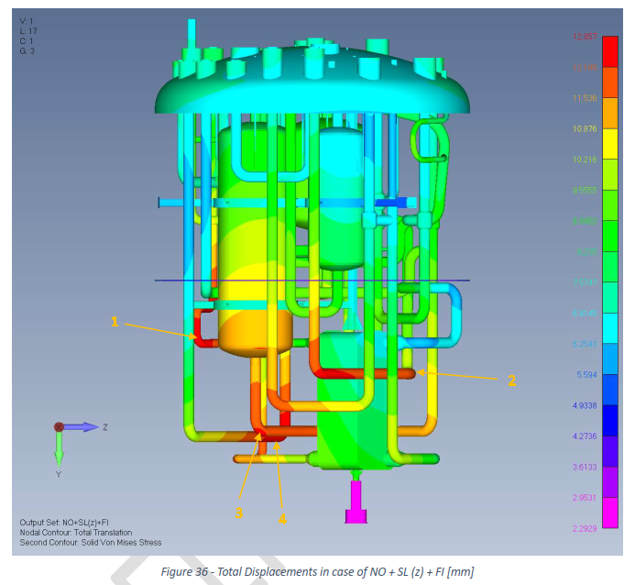
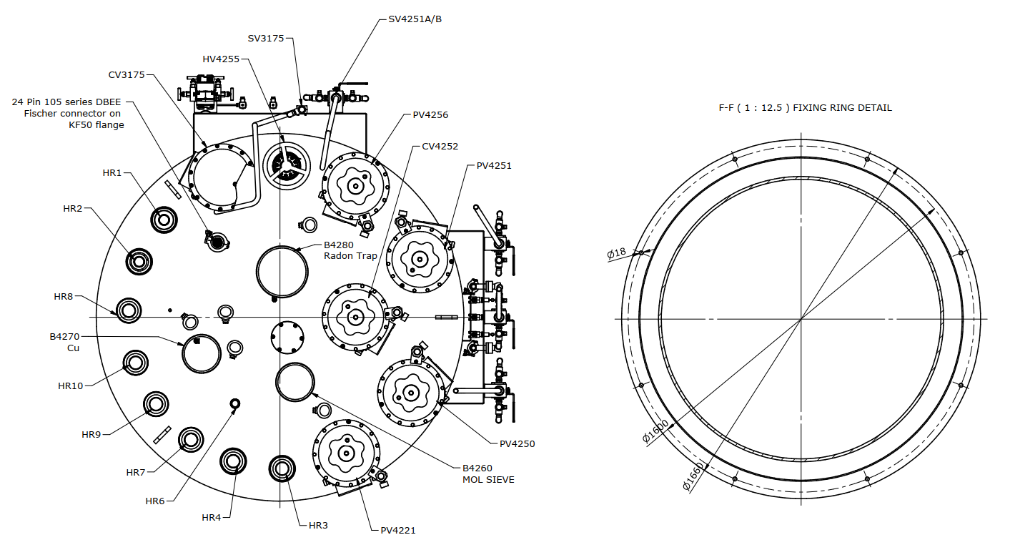
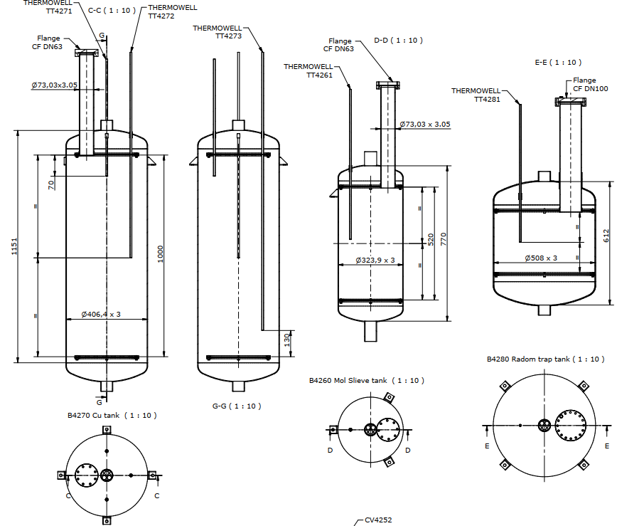
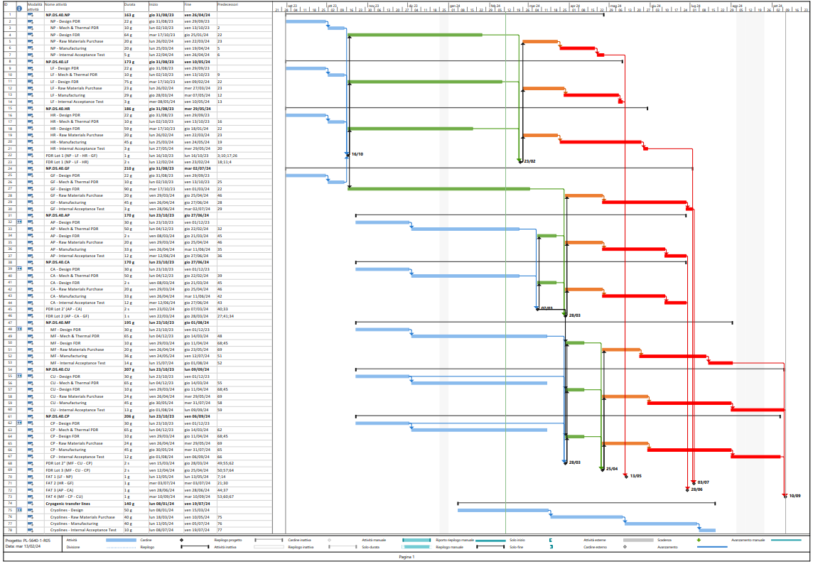
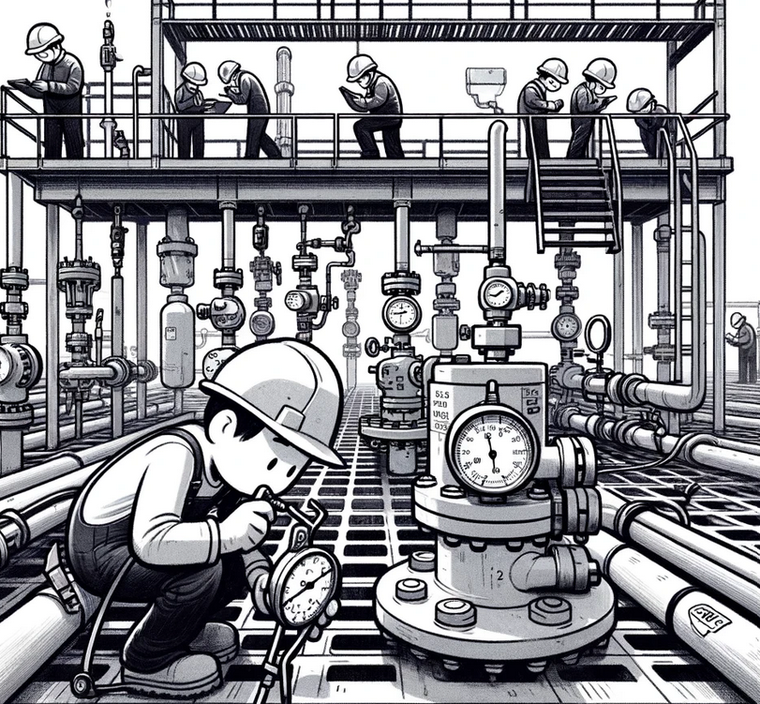
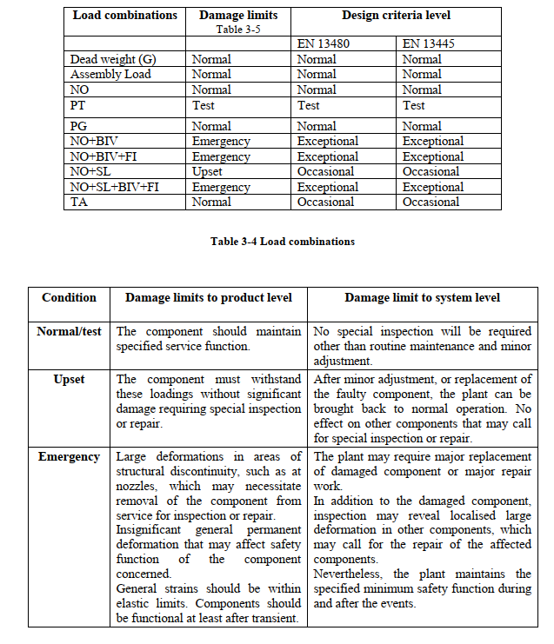
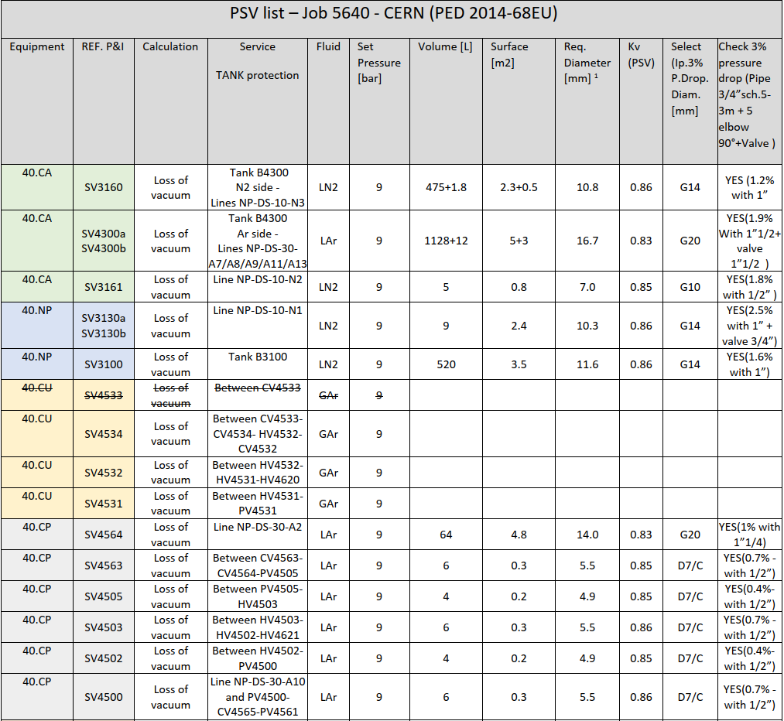
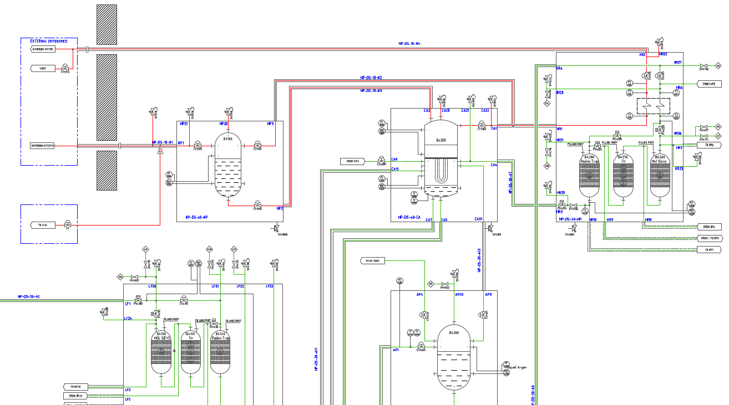
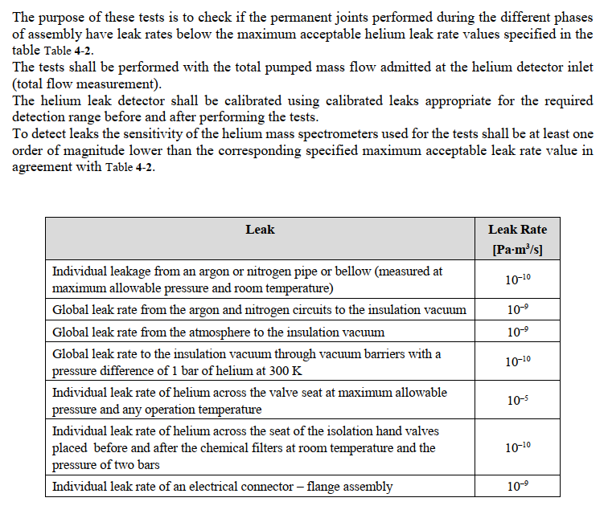
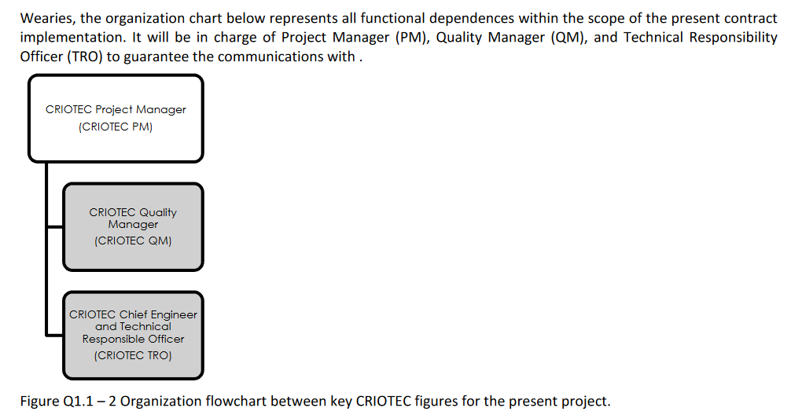
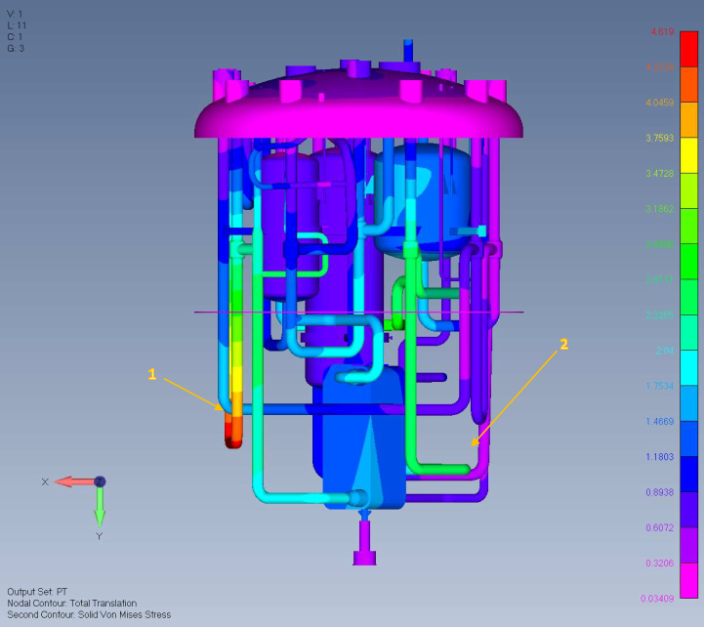
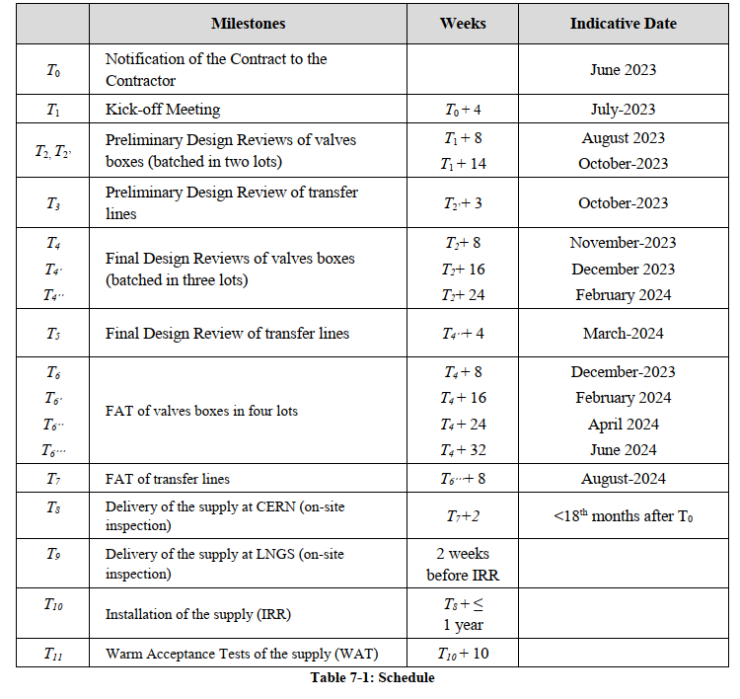
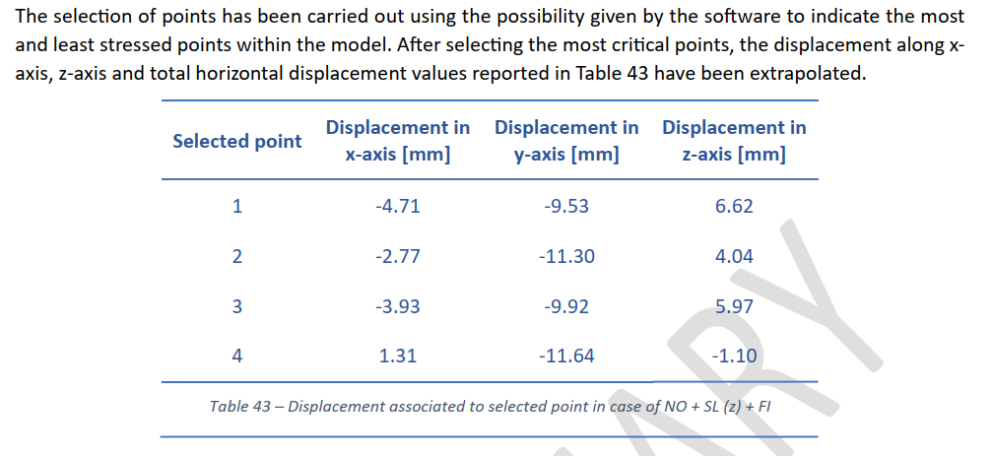
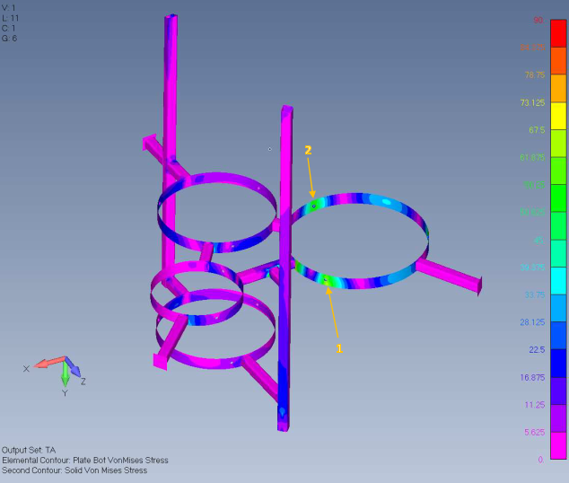
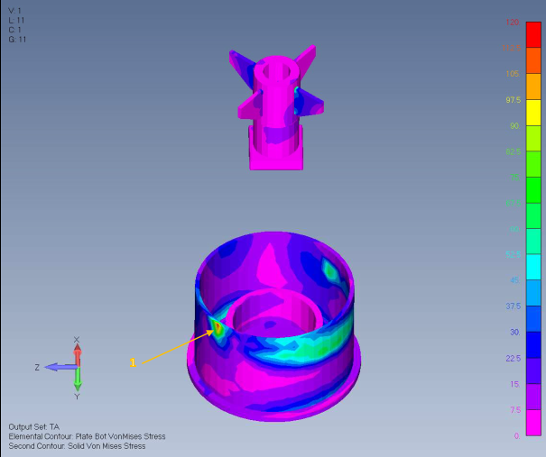

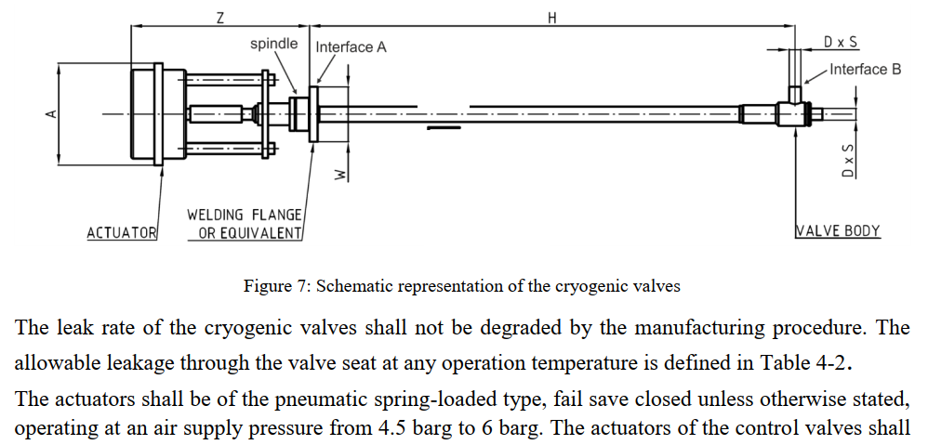
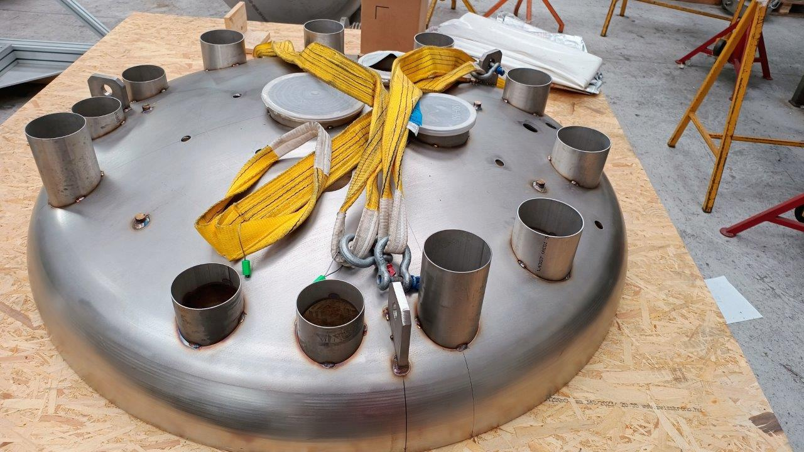

3. AAr cryogenics – project development
CERN
Contractor
CERN + Contractor
CERN + Contractor
CERN
CERN
Contractor
Contractor
AAr contract
Contractor
Kick-off meeting
Review of all PDR deliverables:
2D, 3D CAD files
FEM, structural reports
Hydraulic, thermal, safety calculations
List of procedures, tests
List of materials, standards, etc.
Updated execution schedule
Review of all FDR deliverables:
Final 2D, 3D CAD files
Final FEM, structural reports
Final Hydraulic, thermal, safety calculations
Final instrument/part list
Updated execution schedule
Technical specifications
ICD
P&ID
Risk plan
Quality plan
Execution schedule
As built 3D model
Installation, inspection, control procedures
Cleanliness work plan
MIP for installation
Welding plan for installation
Helium leak test (from atm. to vacuum)
Purge/flushing of pipes
Helium leak test + pressure test (from process side to vacuum @ MAWP, T_{amb})
Review and approval of IRR deliverables
Equipment conditioning, sealing, protection
Material handling, rigging/loading
Installation of accelerometers
Witness installation
Site preparation
Equipment inspection
Installation of external supports
Final positioning and connection of VB
Final positioning and connection of TL
Continuity control
Witness WAT
Witness tests
Review of FAT report
Formal approval of FAT report
Testing
  NDE of welds
  Leak testing
  Pressure testing
Inspection & control
  Cleanliness control
  Dimensional control
Reporting
  FAT report
Materials, parts procurement
Fabrication
Manufacturing file
Final CAD design (3D, 2D)
Final calculations (thermal, safety, hydraulic)
Final FEM analyses
Final instrument/part list
Updated execution schedule
CAD design (3D, 2D)
Calculations (thermal, safety, hydraulic)
FEM analyses
Project requirements
Preliminary design
NO
PDR
YES
Final design
NO
FDR
YES
Manufacturing
NO
FAT
YES
Preparation for shipment & installation
NO
IRR
YES
Installation
WAT

Slide 9
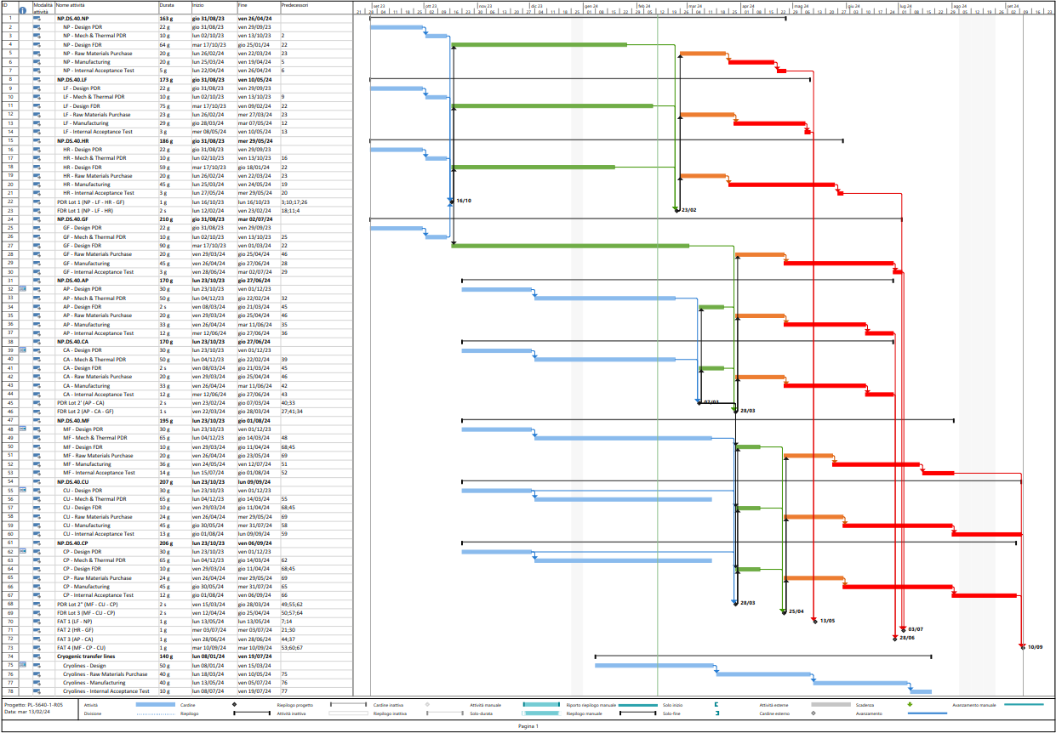
3. AAr cryogenics – status
TODAY
Preliminary design
VALVE BOXES LOT 1
Final
design
Material procurement
Fabrication activities
VALVE BOXES LOT 2
VALVE BOXES LOT 3
TRANSFER LINES
Fig. 3.1 – AAr system contract – Gantt chart

Slide 10
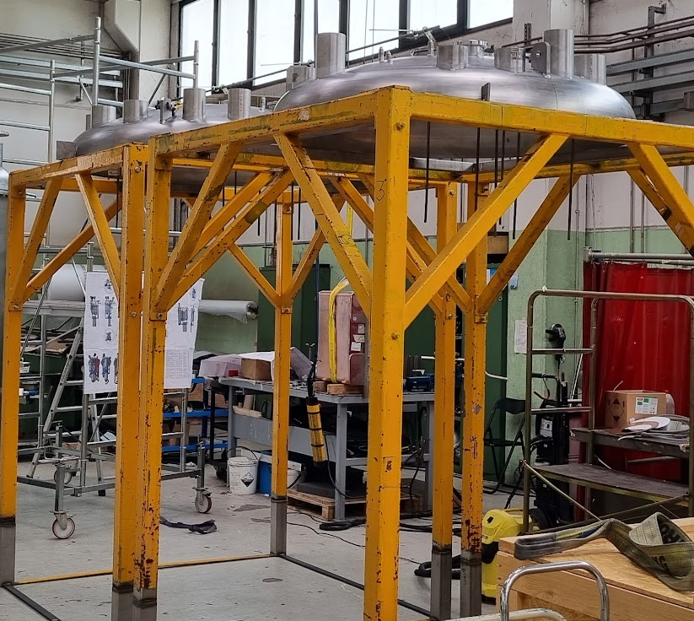
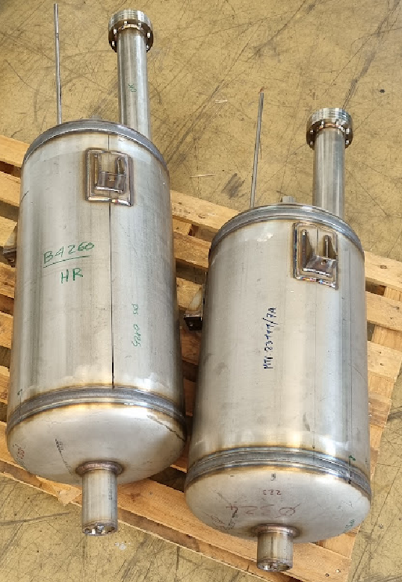
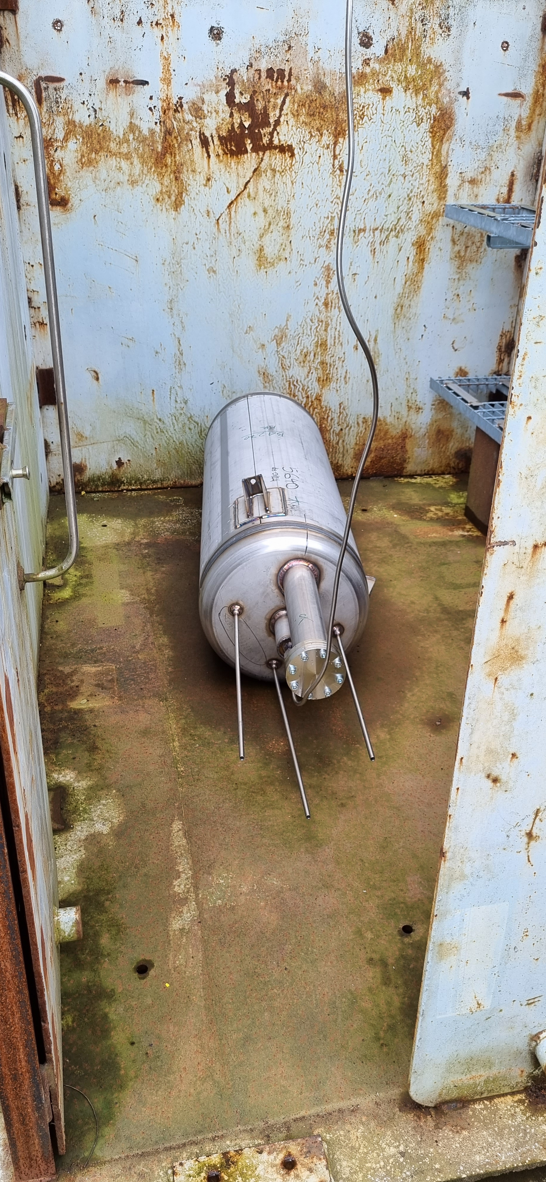
3. AAr cryogenics – project development
Fig. 3.2a, 3.2b, 3.2c – Manufacturing activities on VB lot 1: machined top caps for LF, HR (left); HR inner filters (mol. Sieve, Cu filter) after pressure testing (middle); LF inner filter (mol. Sieve) during pressure testing.

Slide 11
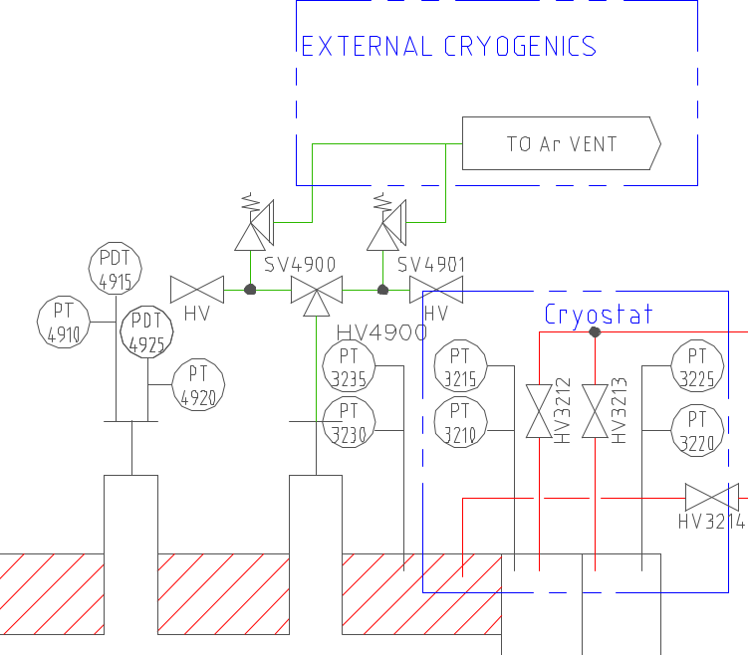
4. Overview of the DarkSide 20k AAr system (cryostat SV)
Cryostat safety valves

Slide 12



4. Cryostat safety relief equipment
 | CRIOTEC’s RESPONSIBILITY
 | SHARED RESPONSIBILITY
 | CERN's RESPONSIBILITY
Activities breakdown
CONTRACTS | WORK BREAKDOWN STRUCTURE (WORKING PACKAGES)
 | PROJECT DEVELOPMENT |  |  |  |  |  |  |  | CONFIGURATION MANAGEMENT
 | PROCESS | INSTRUM. | ELECTR. / CONTROL | ASSEMBLY, INTEGRATION, TESTS | OPERATIONS | MANAGEMENT | COMMUNIC. | SAFETY | MECHANICAL, CALCS | CAD DESIGN (2D, 3D) | PFD, P&ID | TECHNICAL SPECS
CRIOTEC CONTRACT
WARM PANEL
CRYOSTAT MEMBRANE VALVES
CRYOSTAT SAFETY VALVES
Tab. 4.1 – DS 20k activities breakdown.

Slide 13
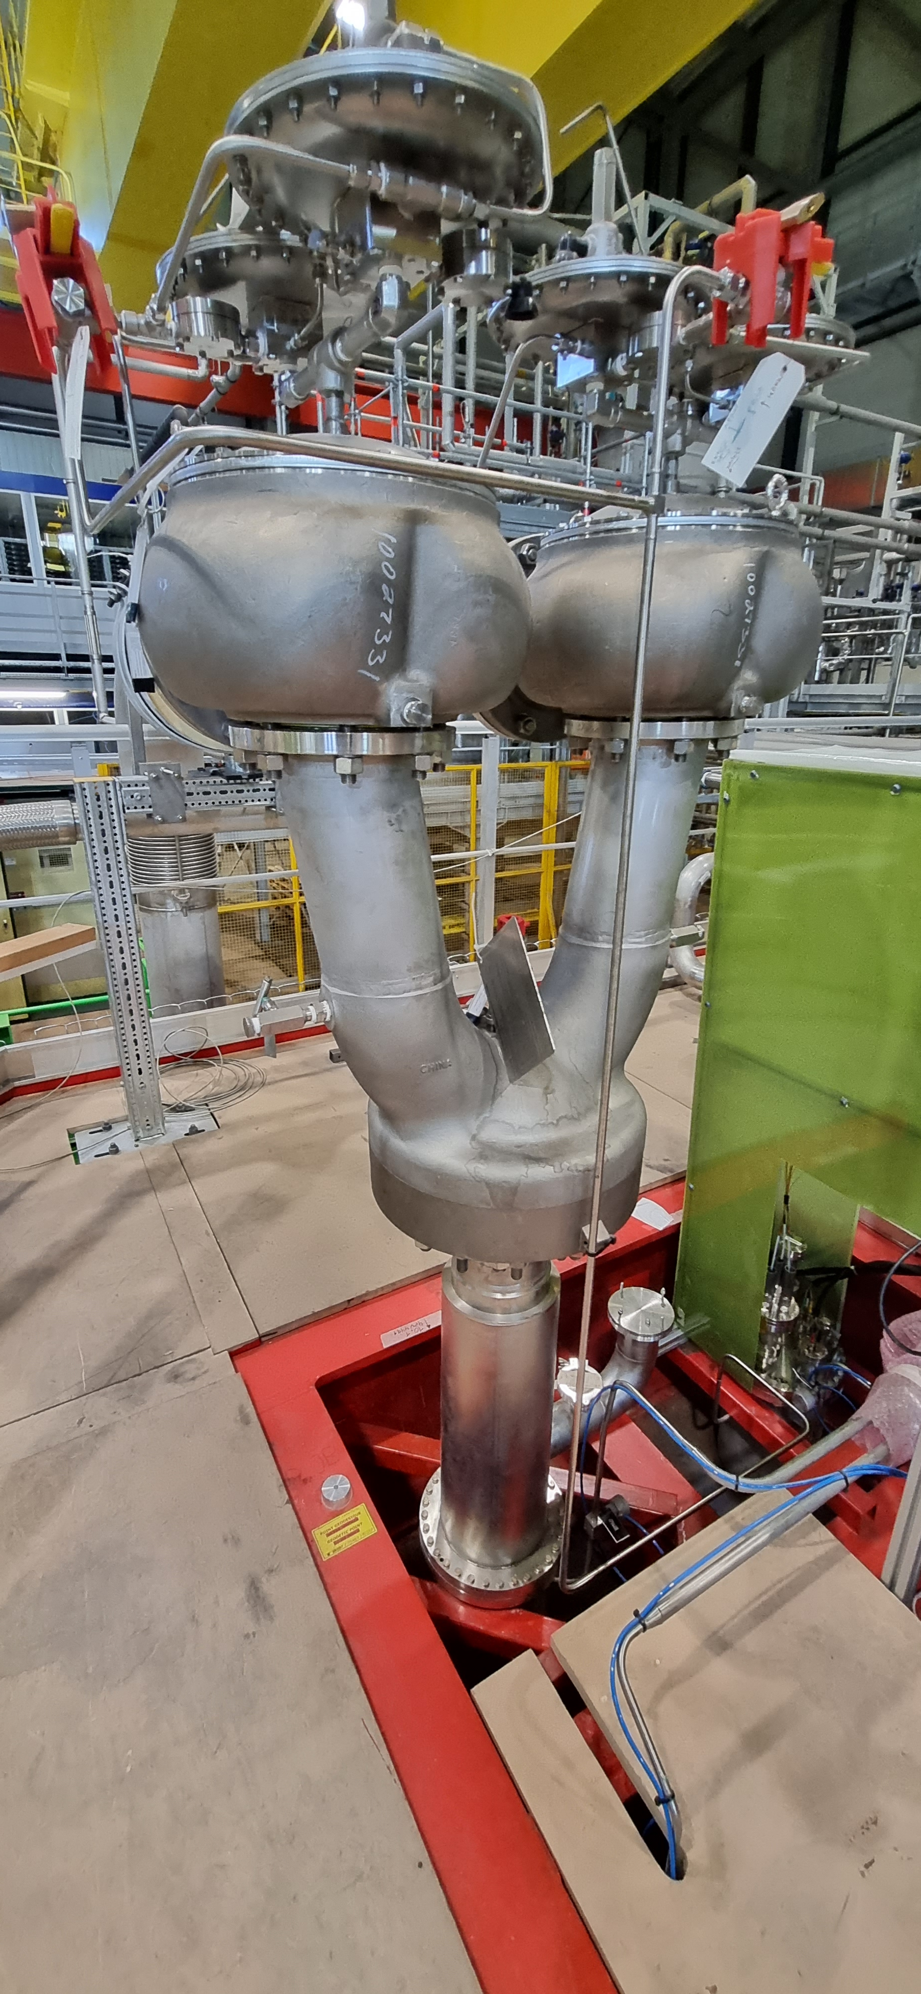
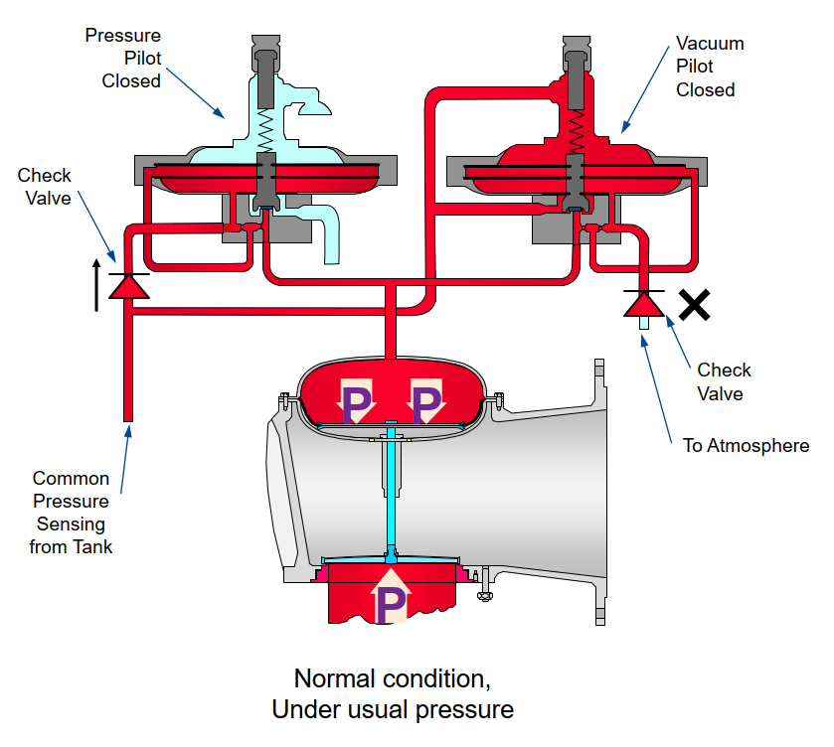
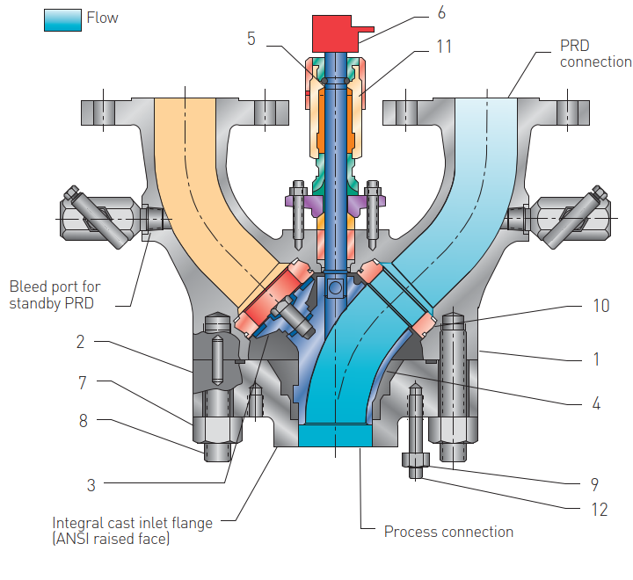
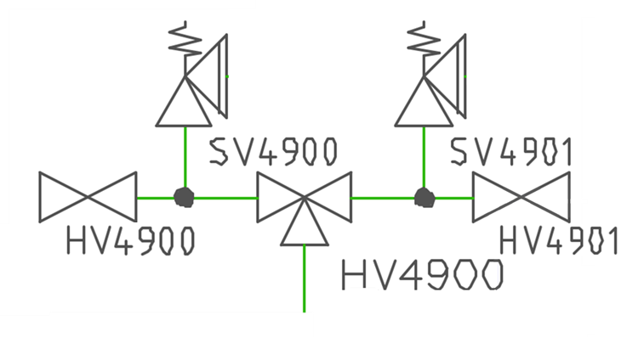












4. Cryostat safety relief equipment
Cryostat safety valves overview
  Double pilot-operated safety relief valves + 1 diverter valve
  Two independent pilots for overpressure and under-pressure relief
  Safety valves and diverter valves to be sized according to ISO 21013-3
PORV #1
PORV #2
Tab. 4.2 – DS 20k pressure scales.
DIVERTER VALVE
Vacuum safety relief
Steady-state operations
Overpressure safety relief

Slide 14
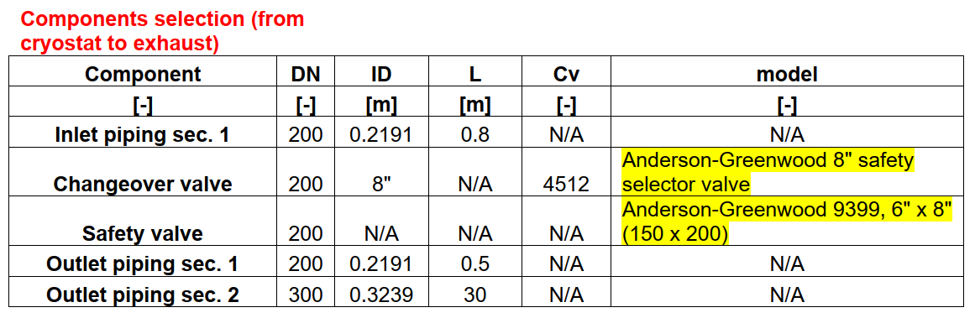
4. Cryostat safety relief equipment
Step 2 - upstream flow resistance
Step 1 - process parameters, mass flow to be relieved
Step 3 - downstream flow resistance
Step 4 - SV back-pressure and exit conditions
Step 6 - determination of equivalent vol. flowrate in std conditions
Step 5 - determination of min. required discharge area
Cryostat safety valves sizing
    Risk assessment (based on work done for ProtoDUNE)
    Hydraulic/safety calculations (ISO 21013-3)
    Calculation note
    Technical specifications for PE
Scenario FC (overpressure) – heat input from 10% fire case*;
Scenario ST (overpressure) – mass input from split tube in the condenser;
Scenario VP (under-pressure) – mass output from vacuum pumping units; and
Scenario OC (under-pressure) – heat output from condenser overcooling.
Temperature at location X (end of outlet section 2)
Up | 105 | [W/m2-K] | overall HTC
cp | 0.521 | [kJ/kg-K] | specific heat at mean temperature between saturation and 922 K
Tx = Texit10 | 453.691 | [K] | temperature at location x (system exit) corresponding to SV limit back-pressure
Pexit | 0.91 | [bara] | system exit pressure
νexit10(Pexit,Texit10) | 1.03777 | [m3/kg] | specific volume corresponding to exit pressure and temperature at location x
vd10 | 0.790169 | [m3/kg] | average specific volume between valve outlet and system exit, SV limit back-pressure
Resistance coefficients - downstream piping
AFd | 0.079473 | [m2] | min. cross-sectional area, downstream network
K1 | 1 |  | resistance coefficient - exit
ft | 0.013 |  | Darcy's friction factor
K2 | 1.22603 |  | resistance coefficient - pipe friction
nelbows | 4 |  | number of elbows (90°)
nbends | 1 |  | number of bends (< 90°)
K3' | 0.728 |  | resistance coefficient - elbows
K3" | 0.208 |  | resistance coefficient - bends
K3 | 0.936 |  | resistance coefficient - elbows + bends
Cv | 0 |  | flow coefficient (imperial)
K4 | 0 |  | resistance coefficient - valve
AR | 0.45725 |  | area ratio - gradual expansion
K5 | 0.04 |  | resistance coefficient - gradual expansion
KRd | 3.42203 |  | total upstream resistance coefficient
νdmax | 3.271856 | [m3/kg] | max. specific volume
check | OK |  | specific volume check (vdmax > vd10)
Relief valve back pressure
F | 0.00535 | [kg-bara/m3] | multiplication factor, eqn. (40) ISO 21013-3
Pb,test | 0.918487 | [bara] | initial value of back-pressure (then iterated)
hr | 128.0858 | [kJ/kg] | SV outlet specific enthalpy
νb,Pb(Pb,hr) | 0.558218 | [m3/kg] | SV outlet specific volume corresponding to back-pressure and specific enthalpy
Tb,Pb(Pb,hr) | 246.6572 | [K] | SV outlet temperature corresponding to back-pressure and specific enthalpy
Safety valve inlet piping
DN | DN200 (219.1 OD x 2) |  | pipe DN
OD | 0.2191 | [m] | pipe OD
tw | 0.002 | [m] | pipe wall thickness
ID | 0.2151 | [m] | pipe ID
AFu | 0.036339 | [m2] | pipe cross-sectional area
L | 0.8 | [m] | pipe length
Aj | 0 | [m2] | pipe outer surface between inner vessel and vacuum jacket
Ae | 0.550658 | [m2] | pipe outer surface outside vacuum jacket
Temperature at location X
Up | 105 | [W/m2-K] | overall HTC
cp | 0.521 | [kJ/kg-K] | specific heat at mean temperature between saturation and 922 K
Tx = Ti | 246.8497 | [K] | temperature at location x (valve inlet)
ν(Ti) | 0.396022 | [m3/kg] | specific volume at location x
ν_{u} | 0.267158 | [m3/kg] | average specific volume between saturated and location x
Resistance coefficients - upstream piping
K1 | 0.5 |  | resistance coefficient - entrance
ft | 0.014 |  | Darcy's friction factor
K2 | 0.052069 |  | resistance coefficient - pipe friction
nelbows | 0 |  | number of elbows (90°)
K3 | 0 |  | resistance coefficient - elbows
Cv | 4512 |  | flow coefficient (imperial)
K4 | 0.224962 |  | resistance coefficient - valve
KRu | 0.77703 |  | total resistance coefficient
Pi | 1.291896 | [bara] | SV inlet pressure
ΔPup | 0.003104 | [bar] | total upstream pressure loss
ΔPup% | 0.89 | [%] | total upstream pressure loss [%]
Fire case scenario
Pressure setting |  |  | Description
Pexit = Patm | 0.91 | [bara] | nominal atmospheric pressure
PSg | 0.35 | [barg] | set pressure (relative)
PSa | 1.26 | [bara] | set pressure (absolute)
PMAA = 110% PS | 1.295 | [bara] | max allowable accumulated pressure
Heat load
Fire factor | 0.1 |  | fire reduction factor
W6 | 309926.2 | [W] | heat load - fire case
Wtot,NO | 8333.083 | [W] | heat load - normal operations
WT | 318259.3 | [W] | total heat load
Mass flow rate
Valve | SV4900 | [tag] | valve tag
Fluid | argon |  | fluid
Tn | 88 | [K] | fluid temperature (normal operations)
Ta | 328 | [K] | ambient temperature
Tf | 463.15 | [K] | fire temperature
PSa | 1.26 | [bara] | set pressure (absolute)
P0 = PMAA | 1.295 | [bara] | relieving pressure
T | 89.69329 | [K] | sat. temperature @ P0
νg | 0.138293 | [m3/kg] | specific volume, vapor phase (saturated @ P0)
νL | 0.000724 | [m3/kg] | specific volume, liquid phase (saturated @ P0)
ΔHvap | 159.2999 | [kJ/kg] | latent heat of vaporization @ P0
Qm | 7154.635 | [kg/h] | mass flow rate to be relieved
Qm | 1.987399 | [kg/s] | mass flow rate to be relieved
nom_1 | 4.993755 |  | subcritical flow coefficient, multiplier 1
nom_2 | 0.084833 |  | subcritical flow coefficient, multiplier 2
den_1 | 0.527633 |  | subcritical flow coefficient, multiplier 3
Kb | 0.896047 |  | subcritical flow coefficient
Kdr | 0.732182 |  | derated discharge coefficient
C | 2.867897 |  | coefficient = f(κ) for subcritical flow
R | 8.314 | [J/mol-K] | universal gas constant
Amin | 7310.335 | [mm2] | minimum orifice area
Dmin | 96.47698 | [mm] | minimum orifice diameter
Conversion to standard conditions, air (60 °F, P = 1 atm)
Wfl | 7154.635 | [kg/hr] | mass flow rate, reference fluid
fluid | air |  | converted fluid (air)
Pair | 1.01325 | [bara] | pressure, standard conditions (1 atm)
Tair | 273.15 | [K] | temperature, standard conditions (60 ºF)
gc | 1 | [kg-m/N-s2] | gravitational constant
Mair | 28.9586 | [g/mol] | molar mass of converted fluid
k | 1.402758 |  | specific heat ratio of converted fluid
r | 0.710961 |  | outlet/inlet pressure ratio
fluid | argon |  | reference fluid
Pi | 1.291896 |  | SV inlet pressure
Ti | 254.0958 | [K] | SV inlet temperature
Mi | 39.948 | [g/mol] | molar mass of reference fluid
Zi | 0.998387 |  | compressibility factor of reference fluid
n | 1.668057 |  | isentropic expansion coefficient of reference fluid
Wair | 5701.588 | [kg/hr] | equivalent mass flow rate, converted fluid
ρair | 1.223 | [kg/m3] | density, standard conditions
Vdot,air | 4662.517 | [Nm3/h] | equivalent volumetric flow rate, converted fluid (metric)
Wair | 2900.536 | [SCFM] | equivalent volumetric flow rate, converted fluid (imperial)
Sizing summary
Risk scenario | type | fluid through valve | mass flow | converted vol. flow
 |  |  | W | V_{dot,air}
[-] | [-] | [-] | [kg/hr] | [Nm3/h] | [SCFM]
10% fire case | overpressure | argon | 7154.6 | 4662.5 | 2900.5
split tube | overpressure | nitrogen | 10310.7 | 7139.3 | 4441.3
vacuum pumps | under pressure | air | 88.0 | 78.9 | 49.1
overcooling | under pressure | air | 165.4 | 148.2 | 92.2
Relief valve inlet conditions
νi(Pi,Ti) | 0.396976 | [m3/kg] | SV inlet specific volume
hr(Pi,Ti) | 128.0858 | [kJ/kg] | SV inlet specific enthalpy
Relief valve outlet conditions
Pb10 | 0.945 | [bara] | SV limit back-pressure (10%)
νb10(Pb10,hr) | 0.542567 | [m3/kg] | specific volume corresponding to SV limit back-pressure and isenthalpic expansion
Tb10(Pb10,hr) | 246.6709 | [K] | temperature corresponding to SV limit back-pressure and isenthalpic expansion
Safety valve outlet piping
Section 1
DN | DN200 (219.1 OD x 2) |  | pipe DN
OD | 0.2191 | [m] | pipe OD
tw | 0.002 | [m] | pipe wall thickness
ID | 0.2151 | [m] | pipe ID
AFd,1 | 0.036339 | [m2] | pipe cross-sectional area
L | 0.5 | [m] | pipe length
Aj | 0 | [m2] | pipe outer surface between inner vessel and vacuum jacket
Ae | 0.344161 | [m2] | pipe outer surface outside vacuum jacket
Temperature at location X (end of outlet section 1)
Up | 105 | [W/m2-K] | overall HTC
cp | 0.521 |  | specific heat at mean temperature between saturation and 922 K
Tx = Tb,1 | 254.0958 | [K] | temperature at location x (end of downstream network - section 1)
Section 2
DN | DN300 (323.9 OD x 2.9) |  | pipe DN
OD | 0.3239 | m | pipe OD
tw | 0.0029 | m | pipe wall thickness
ID | 0.3181 |  | pipe ID
AFd,2 | 0.079473 | m2 | pipe cross-sectional area
L | 30 | m | pipe length
Aj | 0 | m2 | pipe outer surface between inner vessel and vacuum jacket
Ae | 30.52686 | m2 | pipe outer surface outside vacuum jacket
Temperature at location X (end of outlet section 1)
Up | 105 | [W/m2-K] | overall HTC
cp | 0.521 | [kJ/kg-K] | specific heat at mean temperature between saturation and 922 K
Tx = Tx1 | 254.0825 | [K] | temperature at location x (end of downstream network - section 1)
Temperature at location X (end of outlet section 2)
Up | 105 | [W/m2-K] | overall HTC
cp | 0.521 | [kJ/kg-K] | specific heat at mean temperature between saturation and 922 K
Tx = Texit,Pb | 453.6904 | [K] | temperature at location x (system exit)
Exit process parameters
vexit,Pb(Pexit,Texit,Pb) | 1.02818 | [m3/kg] | specific volume at system exit
vb,Pb + vexit,Pb | 1.586399 | [m3/kg] | multiplication factor, eqn. (40) ISO 21013-3
Pb,actual | 0.918487 | [bara] | iterated value of SV back-pressure
divergence % | 0.00 | [%] | check on iterated value
check | OK |  | check on iterated value
ΔPdown% | 2.42 | [%] | total downstream pressure drop [%]
Relief flow conditions
Pi | 1.291896 | [bara] | SV inlet pressure
Ti | 254.0958 | [K] | SV inlet temperature
νi(Pi,Ti) | 0.396976 | [m3/kg] | SV inlet specific volume
Pb | 0.918487 | [bara] | SV outlet pressure
Tb | 246.6572 | [K] | SV outlet temperature
κ(Pi,Ti) | 1.668057 |  | SV inlet isentropic expansion coefficient
r = Pb/Pi | 0.710961 |  | outlet/inlet pressure ratio
r* = (2/(κ+1))^(κ/(κ-1)) | 0.486943 |  | coefficient = f(κ) for sonic flow check
flow | subcritical |  | sonic flow condition
inlet conditions |  | outlet conditions |  | pressure drops
P_{i} | T_{i} | P_{o} | T_{o} | ΔP_{up%} | ΔP_{down%}
[bara] | [K] | [bara] | [K] | [%] | [%]
1.292 | 254.1 | 0.918 | 246.7 | 0.89 | 2.42
1.288 | 190.0 | 0.926 | 189.4 | 2.09 | 4.46
0.910 | 328.0 | 0.880 | 328.0 | 0.01 | 0.01
0.910 | 328.0 | 0.880 | 328.0 | 0.02 | 0.02
Risk scenario | orifice min. size |  | vol. flow capacity |  | orifice area | Check | Margin on V_{dot,air}
 | A_{min} | D_{min} | V_{dot,air,eff} |  | A_{eff}
[-] | [mm2] | [mm] | [Nm3/h] | [SCFM] | [mm2] | [-] | [%]
10% fire case | 7310 | 96.5 | 11650 | 7050 | 18639 | YES | 149.9
split tube | 11517 | 121.1 | 11650 | 7050 | 18639 | YES | 63.2
vacuum pumps | 595 | 27.5 | 1650 | 995 | 18639 | YES | 1991.3
overcooling | 1117 | 37.7 | 1650 | 995 | 18639 | YES | 1013.0

Slide 15
4. Cryostat safety relief equipment (status)
Cryostat safety equipment procurement
  DR approved (est. price: 140k CHF)
  Technical specifications for PE will be sent out for bids around mid-June 2024
  Manufacturing, testing & delivery: 36 – 42 weeks approximately
  Installation foreseen in April 2025.

Slide 16
5. Conclusions
  Project complexities to be addressed by a strict, consistent project management and quality control framework
  AAr cryogenics contract with Criotec:
    VB design phase completed (9 VB approved); PDR of TL on 27/05/24
    Manufacturing of first 3 VB to be completed between 1st and 2nd week of June; manufacturing and FAT of all VB before mid-August 2024
    Manufacturing and FAT of TL in September 2024
  Other activities
    Warm panel fabrication to be completed beginning of June (1st skid ready for testing)
    Cryostat SV: sizing & calculation note completed; TS ready for Price Enquiry
  Project progressing well, despite initial delays!
  Final installation and WAT foreseen in October-November 2024 (AAr cryogenics + warm panel)

Slide 17
Thanks for your attention!

Slide 18
BACK-UP SLIDES

Slide 19
4. Overview of the DarkSide 20k AAr system (warm panel)
Warm panel
Fig. 4.1 – DarkSide 20k AAr P&ID (warm panel detail).

Slide 20

4. Warm panel – project development
 | CRIOTEC’s RESPONSIBILITY
 | SHARED RESPONSIBILITY
 | CERN's RESPONSIBILITY
Activities breakdown
CONTRACTS | WORK BREAKDOWN STRUCTURE (WORKING PACKAGES)
 | PROJECT DEVELOPMENT |  |  |  |  |  |  |  | CONFIGURATION MANAGEMENT
 | PROCESS | INSTRUM. | ELECTR. / CONTROL | ASSEMBLY, INTEGRATION, TESTS | OPERATIONS | MANAGEMENT | COMMUNIC. | SAFETY | MECHANICAL, CALCS | CAD DESIGN (2D, 3D) | PFD, P&ID | TECHNICAL SPECS
CRIOTEC CONTRACT
WARM PANEL
CRYOSTAT MEMBRANE VALVES
CRYOSTAT SAFETY VALVES
Tab. 4.1 – DS 20k activities breakdown.

Slide 21
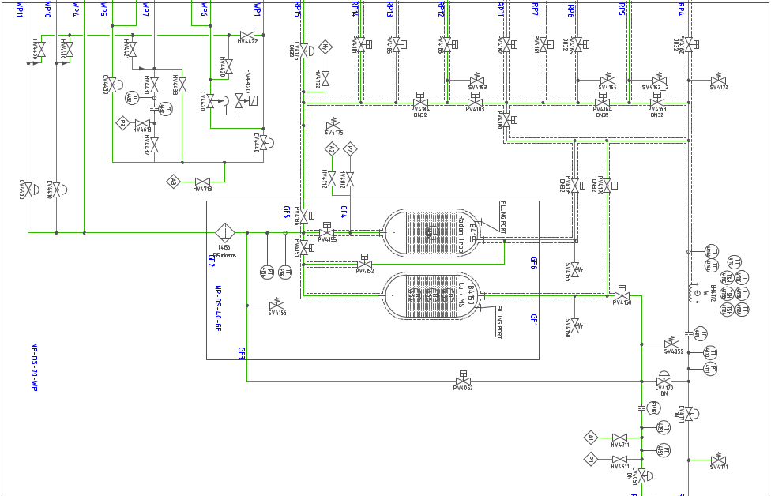







4. AAr cryogenics – Warm panel
Warm panel overview
  Distribution gas argon* at ambient temperature (300 K) and regeneration temperature (500 K)
  Four operating modes (chimneys flow, cryostat overpressure, purge, regeneration)
  *98% argon + 2% hydrogen mixture from bottles for activation of Cu filters; vaporized argon for all other modes
  29 bellow-sealed valves to be sized:
    10 x control valves (CV)
    16 x pneumatic on/off valves (PV)
    3 x manual on/off valves (HV)
Fig. 4.2 – DarkSide 20k AAr P&ID (warm panel detail).
98% Ar / 2% H₂ (from gas storage)
vaporized argon (from liquid storage)

Slide 22
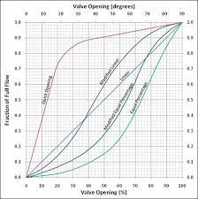



4. AAr cryogenics – Warm panel
Warm valves sizing
  Kv (or Cv) to be determined for all 29 valves
    All valves (CV + PV + HV): guarantee max flow at max opening $→\dot{m}\left(K_{v,max}\right)≥\dot{m_{max}}$
    Control valves (CV): operate around 35% Kv_{max} at nominal flow (best control) $→\dot{m}\left({0.35 K}_{v,max}\right) \sim \dot{{ m}_{nom}}$
  Development of VBA code coupled with REFPROP to automate calculations
  Step 1) analysis of all operating modes & valve activation sequences
  Step 2) preliminary sizing (Kv) based on selected reference modes
  Step 3) additional performance check on CV

Slide 23

4. AAr cryogenics – Warm panel (status)
  2 x skids fully developed under CERN’s responsibility
  1st skid completed (photo), 2nd will be completed next week
  WP testing in first half of June 2024 (Leak testing, pressure testing, NDE of welds)
  WP will be delivered together with AAr cryogenic system (end of September 2024)
Fig. 4.3 – DarkSide 20k AAr warm panel – skid 1 fully fabricated.

Slide 24







2. Overview of the DarkSide 20k AAr system
Cryogenic fluid handling system composed of 9 valve boxes (VB), 16 cold + 18 warm transfer lines (TL), and two warm skids (WP)
Complex engineering system stemming from broad functional analysis and previous experience (ProtoDUNE):
  Requirements (purity, thermodynamic, safety)
  Constraints (operational modes, mechanical performance, compliance with standards, etc.)
Purity requirements
  Contamination levels (222Rn < 0.01 Bq/kg; N₂ < 1 ppm; O₂ < 0.1 ppm; H₂0 < 0.1 ppm)
  Recirculation rate (700 ton / 4.5 days)
  Purification system (liquid filter VB, 2 x gas filter VB, each with 3 internal filters)
Thermodynamic stability
  Stable pressure and temperature inside cryostat
  Stable liquid level & gas phase inside cryostat
  Uniform temperature across cryostat
Operational modes
  Purge (gas Argon)
  Cool-down and filling (liquid Argon)
  Filter activation/regeneration
  Steady state (cooling, recirculation, filtering, etc.)
  Emptying
Fig. 2.1 – DarkSide 20k proximity cryogenics system

Slide 25
3. AAr cryogenics – project development
1.5m CHF contract for AAr cryogenics (9 VB + 16 TL)
Contract awarded to Criotec Impianti (Italy) in July 2023
~ 0.2m CHF for AAr warm panel (2 skids, 18 warm TL), internal @ CERN
Other contracts:
  Cryostat safety relief equipment (~ 150k CHF)
  Protego valve (147k CHF)
  Internal lines (to be manufactured @ CERN)
  Cryogenic pumps (212k CHF)
AAr cryogenic system will be installed in LNGS be in October/November 2024
AAr cryogenics Contractor
CERN

Slide 26
3. AAr cryogenics – project development
Complexities stemming from:
Intrinsic complexity of engineering system
Scope of supply, responsibilities, interfaces
Project & collaboration layout, external constraints
Such complexities need to be addressed by means of a strict, consistent project management and quality control framework:
Project structure (WBS, PBS)
Technical and other specifications
Milestone & project reviews, deliverables, schedule
Project status
Design phase of VB completed (mid-May 2024), design phase of TL to be completed before end of June 2024
Manufacturing of first 3 VB almost completed, manufacturing of all VB to be completed before end of July 2024
FAT: June/July 2024 for VB, September for TL
Beginning of final installation foreseen for 1st week of October

Slide 27
Detection principle
Features:
  Argon dual-phase TPC, constant el. drift field of 200 V/cm
  Drift volume topped by gas pocket (GAr)
Objective:
  Direct DM search, WIMP particles
Principle:
  Charged particles interact in LAr producing scintillation photons (UV range) + ionization electrons
  Standard LAr TPC:
    Primary photons detected (S1)
    Electrons collected on the anode
  Dual-phase LAr TPC:
    Primary photons detected (S1)
    Electrons produce light signal in gas phase, so signal (S2) detected
  Shape of S1 pulse and S2/S1 ratio allows for background discrimination

Slide 28

Detection principle

Slide 29

Detection principle
Detector vetoing:
  Volume between octagonal barrel and vessel also sensitive
  Acts as inner veto (15 cm thick gadolinium-doped PMMA); Gd enhances neutron interactions (which produce photons)
  Thin plastic layer (passive shielding) will be installed on inner SS vessel outer surface
  700t AAr used as outer veto, 32 photo-detectors installed on the outer face of the plastic shielding (to detect muons)

Slide 30


1. Overview of the DarkSide 20k experiment
Steel
Fig. 1.2 – Detail of the DarkSide 20k inner vessel.
Fig. 1.3 – Detail of the DarkSide 20k inner vessel photosensitive devices.

Slide 31


Purification principle
Molecular Sieve
Cu-226 ( Cu coated Al₂O₃ )
Moisture adsorption
Oxidation – 87K
$$Cu^{2+}+{\frac{1}{2}O}_{2}→CuO$$
Regeneration – 420K
$$CuO+H_{2}→H_{2}O+Cu^{2+}$$
Activation
“Controlled reduction of atmosphere exposed Cu-226”
“very” exothermal, 0.5 % hydrogen
Regeneration
“Controlled reduction of Cu-226 oxidised in purity conditions”
exothermal, 2.5% hydrogen

Slide 32


Cryostat membrane
  Same membrane technology as ProtoDUNE, SBND (FNAL)
  Licensed technology by GTT
  Modular technology
  From outside to inside:
  External support structure in steel (I-beams)
  SS “tertiary” membrane
  Outer layer of polyurethane foam insulation
  SS “secondary” membrane (in case of leaks)
  Inner layer of polyurethane foam insulation
  Corrugated SS “primary” membrane (1.2 mm)

Slide 33



Cryostat membrane
Inner PU insulation layer
Intermediate/outer PU insulation + 10 mm SS tertiary plate
Outer warm structure

Slide 34


Cryostat membrane
Fig. 1.4 – Detail of DarkSide 20k cryostat insulation system.
Fig. 1.5 – Detail of DarkSide 20k photodetection units.
Fig. 1.6 – Internal view of NP04 cryostat.

Slide 35
UAr procurement
Overview:
  Atmospheric argon detectors, one of main issues is presence of ³⁹Ar (beta-decaying isotope of Ar)
  Concentration produces about 1 Bq/kg
  Spectrum can overlap with region of interest for DM searches
  Dedicated Urania plant in Colorado (US) being constructed to produce UAr @ 250 kg/d (420 days to obtain 100t+!)
Objective:
  Direct DM search, WIMP particles
Principle:
  Charged particles interact in LAr producing scintillation photons (UV range) + ionization electrons
  Standard LAr TPC:
    Primary photons detected (S1)
    Electrons collected on the anode
  Dual-phase LAr TPC:
    Primary photons detected (S1)
    Electrons produce light signal in gas phase, so signal (S2) detected
  Shape of S1 pulse and S2/S1 ratio allows for background discrimination

Slide 36

UAr procurement
Overview:
  Atmospheric argon detectors, one of main issues is presence of ³⁹Ar (beta-decaying isotope of Ar)
  Concentration produces about 1 Bq/kg
  Spectrum can overlap with region of interest for DM searches
  Dedicated Urania plant in Colorado (US) being constructed to produce UAr @ 250 kg/d (420 days to obtain 100t+!)
  Further purification (distillation) in ARIA, Sardinia

Slide 37





Sintered steel filters

Slide 38
Sintered steel filters
Sintered stainless steel is a type of material produced through a process called sintering, where fine stainless steel powders are compacted and then heated to a temperature below their melting point. This process causes the particles to bond together, creating a solid piece of metal.
High Strength and Durability
Porosity Control
Complex Shapes and Precision
Uniform Properties
Customization
Sintering Process Overview
Powder Preparation: Stainless steel powders are carefully prepared and mixed to achieve the desired composition.
Compaction: The powders are compacted into a mold under high pressure to form a "green" (unsintered) part.
Sintering: The compacted part is heated in a controlled atmosphere furnace to a temperature below the melting point of the base metal, causing the particles to bond.
Post-Sintering Operations: Depending on the application, additional processes such as machining, heat treatment, or surface finishing may be applied to achieve the final specifications.

Slide 39






AAr cryogenics – Warm panel
Warm valves sizing & procurement
  Hydraulic calculations (VBA + REFDROP)
  TS for PE + DR (final price: 133k EUR)
  Contract follow-up
VALVE | Location P₀ | Sizing scenario | Q_{max} | P₀ | ΔP_{LOCAL} | P_{in,VALVE} | ΔP_{VALVE} (Qmax) | P_{out,VALVE} | K_{v,max} | C_{v,max} | DN Velan | Φ_{seat} Velan | C_{v} Velan
[tag] | [name] | [name] | [kg/s] | [MPa] | [bar] | [MPa] | [bar] | [MPa] | [-] | [-] | [mm] | [mm] | [-]
CV4420 | cryostat | GAr from cryostat | 0.1 | 0.1070 | 2.622E-04 | 0.1070 | 0.067 | 0.1003 | 35.97 | 41.59 | DN50 | 45 | 70.0
HV4431 | cryostat | GAr from cryostat | 0.01 | 0.1070 | 0.0010 | 0.1069 | 0.0012 | 0.1068 | 25.95 | 30.00 | DN32 | 28 | 30.0
HV4432 | HV4421 outlet | GAr from cryostat | 0.01 | 0.1068 | 0.0209 | 0.1047 | 0.0012 | 0.1046 | 25.95 | 30.00 | DN32 | 28 | 30.0
HV4433 | cryostat | GAr from cryostat | 0.01 | 0.1070 | 0.0010 | 0.1069 | 0.0012 | 0.1068 | 25.95 | 30.00 | DN32 | 28 | 30.0
CV4430 | HV4422 outlet | GAr from cryostat | 0.01 | 0.1046 | 0.000 | 0.1046 | 0.010 | 0.1035 | 8.83 | 10.20 | DN32 | 28 | 18.0
CV4440 | HV4422 outlet | GAr from cryostat | 0.01 | 0.1046 | 0.000 | 0.1046 | 0.043 | 0.1003 | 4.47 | 5.16 | DN32 | 20 | 11.0
CV4171 | GAr/H2 storage | Regeneration | 0.075 | 0.4 | 0.000 | 0.400 | 0.800 | 0.3200 | 4.37 | 5.06 | DN32 | 20 | 11.0
CV4051 | Atm. HEX | Regeneration | 0.075 | 0.4 | 0.000 | 0.400 | 0.800 | 0.3200 | 4.37 | 5.06 | DN32 | 20 | 11.0
CV4170 | CV4051 outlet | Regeneration | 0.075 | 0.320 | 0.034 | 0.317 | 0.800 | 0.2366 | 5.08 | 5.88 | DN32 | 20 | 11.0
PV4162 | CV4170 outlet | Regeneration | 0.075 | 0.2366 | 0.026 | 0.2340 | 0.053 | 0.2288 | 25.95 | 30.00 | DN32 | 28 | 30.0
PV4163 | PV4160 outlet | Regeneration | 0.075 | 0.2366 | 0.026 | 0.2340 | 0.053 | 0.2288 | 25.95 | 30.00 | DN32 | 28 | 30.0
PV4164 | PV4162 outlet | Regeneration | 0.075 | 0.2288 | 0.005 | 0.2283 | 0.054 | 0.2228 | 25.95 | 30.00 | DN32 | 28 | 30.0
PV4165 | PV4162 outlet | Regeneration | 0.075 | 0.2288 | 0.002 | 0.2286 | 0.054 | 0.2231 | 25.95 | 30.00 | DN32 | 28 | 30.0
PV4161 | PV4163 outlet | Regeneration | 0.075 | 0.2288 | 0.002 | 0.2286 | 0.054 | 0.2231 | 25.95 | 30.00 | DN32 | 28 | 30.0
PV4180 | CV4170 outlet | Regeneration | 0.075 | 0.2366 | 0.026 | 0.2340 | 0.053 | 0.2288 | 25.95 | 30.00 | DN32 | 28 | 30.0
PV4182 | PV4180 outlet | Regeneration | 0.075 | 0.2288 | 0.000 | 0.2288 | 0.054 | 0.2233 | 25.95 | 30.00 | DN32 | 28 | 30.0
PV4186 | PV4182 outlet | Regeneration | 0.075 | 0.2233 | 0.076 | 0.2157 | 0.058 | 0.2100 | 25.95 | 30.00 | DN32 | 28 | 30.0
PV4183 | PV4164 outlet | Regeneration | 0.075 | 0.2228 | 0.000 | 0.2228 | 0.056 | 0.2173 | 25.95 | 30.00 | DN32 | 28 | 30.0
PV4184 | PV4183 outlet | Regeneration | 0.075 | 0.2100 | 0.000 | 0.2100 | 0.059 | 0.2041 | 25.95 | 30.00 | DN32 | 28 | 30.0
PV4185 | PV4182 outlet | Regeneration | 0.075 | 0.2233 | 0.051 | 0.2182 | 0.057 | 0.2125 | 25.95 | 30.00 | DN32 | 28 | 30.0
PV4181 | PV4183 outlet | Regeneration | 0.075 | 0.2173 | 0.035 | 0.2138 | 0.058 | 0.2079 | 25.95 | 30.00 | DN32 | 28 | 30.0
PV4190 | CV4170 outlet | Regeneration | 0.075 | 0.2366 | 0.026 | 0.2340 | 0.053 | 0.2288 | 25.95 | 30.00 | DN32 | 28 | 30.0
PV4191 | PV4190 outlet | Regeneration | 0.075 | 0.2288 | 0.003 | 0.2285 | 0.017 | 0.2268 | 45.85 | 53.00 | DN40 | 40 | 53.0
PV4196 | PV4191 outlet | Regeneration | 0.075 | 0.2256 | 0.000 | 0.2256 | 0.017 | 0.2239 | 45.85 | 53.00 | DN40 | 40 | 53.0
PV4195 | CV4170 outlet | Regeneration | 0.075 | 0.2366 | 0.026 | 0.2340 | 0.053 | 0.2288 | 25.95 | 30.00 | DN32 | 28 | 30.0
PV4155 | PV4152 outlet | Regeneration | 0.075 | 0.2288 | 0.014 | 0.2274 | 0.017 | 0.2256 | 45.85 | 53.00 | DN40 | 40 | 53.0
CV4175 | PV4184 outlet | Regeneration | 0.075 | 0.2041 | 0.000 | 0.2041 | 1.038 | 0.1003 | 8.84 | 10.22 | DN32 | 28 | 18.0
CV4051 | Atm. HEX | Purge / make-up | 0.075 | 0.28 | 0.000 | 0.280 | 1.000 | 0.1800 | 5.22 | 6.03 | DN32 | 20 | 11.0
PV4150 | CV4051 outlet | Purge / make-up | 0.075 | 0.1800 | 0.034 | 0.1766 | 0.042 | 0.1724 | 25.95 | 30.00 | DN32 | 28 | 30.0
PV4152 | PV4190 outlet | Purge / make-up | 0.075 | 0.1724 | 0.003 | 0.1721 | 0.014 | 0.1708 | 45.85 | 53.00 | DN40 | 40 | 53.0
PV4155 | PV4152 outlet | Purge / make-up | 0.075 | 0.1708 | 0.014 | 0.1694 | 0.014 | 0.1680 | 45.85 | 53.00 | DN40 | 40 | 53.0
PV4052 | CV4051 outlet | Purge | 0.075 | 0.1800 | 0.034 | 0.1766 | 0.042 | 0.1724 | 25.95 | 30.00 | DN32 | 28 | 30.0
CV4410 | PV4052 outlet | Purge / make-up | 0.075 | 0.1680 | 0.000 | 0.1680 | 0.607 | 0.1073 | 8.65 | 10.00 | DN32 | 25 | 15.0
CV4400 | PV4156 outlet | Make-up | 0.075 | 0.1680 | 0.000 | 0.1680 | 0.607 | 0.1073 | 8.65 | 10.00 | DN32 | 25 | 15.0
CV4051 | Atm. HEX | GAr to condenser | 0.02 | 0.28 | 0.000 | 0.280 | 1.000 | 0.1800 | 1.39 | 1.61 | DN32 | 20 | 11.0
PV4150 | CV4051 outlet | GAr to condenser | 0.02 | 0.1800 | 0.034 | 0.1766 | 0.003 | 0.1763 | 25.95 | 30.00 | DN32 | 28 | 30.0
PV4152 | PV4190 outlet | GAr to condenser | 0.02 | 0.1763 | 0.003 | 0.1760 | 0.001 | 0.1759 | 45.85 | 53.00 | DN40 | 40 | 53.0
PV4155 | PV4152 outlet | GAr to condenser | 0.02 | 0.1759 | 0.014 | 0.1745 | 0.001 | 0.1744 | 45.85 | 53.00 | DN40 | 40 | 53.0
CV4300 | PV4156 outlet | GAr to condenser | 0.02 | 0.1744 | 0.000 | 0.1744 | 0.763 | 0.0981 | 2.15 | 2.49 | DN15 | 13 | 3.75
Step 3 – Cross-check of CV performances, tuning of process inputs
Step 5 – Technical specifications for PE
Step 4 – List of valves for PE
Step 2 – valve sizing
Step 1 – Process analysis

Slide 40



AAr cryogenics – Warm panel
Flow element sizing, design & procurement
  Hydraulic calculations (VBA + REFDROP) as per ISO 5167
  Mechanical design development
  TS for PE (final price: 7.2k EUR)
  Contract follow-up
Step 1 – Orifice pressure drop calculations (ISO 5167-2)
Step 2 – Development of flow element mech. design

Slide 41




AAr cryogenics – Warm panel
SUMMARY TABLE - min. diameters according to ISO 21013-3 [mm] |  |  |  |  | ΦSV min
Valve | AH-1 | EH | FC | PR-G | [mm]
SV4052 |  |  | 6 |  | 6
SV4171 |  |  | 7 | 10 | 10
SV4150 |  |  | 5 |  | 5
SV4155 |  |  | 4 |  | 4
SV4172 |  | 7 | 7 |  | 7
SV4163A |  |  | 7 |  | 7
SV4163B |  |  | 7 |  | 7
SV4164 |  |  | 5 |  | 5
SV4183 |  |  | 3 |  | 3
SV4175 |  |  | 5 |  | 5
SV4004 | 8 |  | 5 |  | 8
SUMMARY TABLE - min. SV pipe sizes according to ISO 21013-3 |  |  |  |  | ISO pipe - min size
Valve | AH-1 | EH | FC | PR-G | [mm]
SV4052 |  |  | 10 OD x 1 |  | 10 OD x 1
SV4171 |  |  | 12 OD x 1 | 14 OD x 1 | 14 OD x 1
SV4150 |  |  | 10 OD x 1 |  | 10 OD x 1
SV4155 |  |  | 8 OD x 1 |  | 8 OD x 1
SV4172 |  | 14 OD x 1 | 12 OD x 1 |  | 14 OD x 1
SV4163A |  |  | 12 OD x 1 |  | 12 OD x 1
SV4163B |  |  | 12 OD x 1 |  | 12 OD x 1
SV4164 |  |  | 10 OD x 1 |  | 10 OD x 1
SV4183 |  |  | 6 OD x 0.5 |  | 6 OD x 0.5
SV4175 |  |  | 10 OD x 1 |  | 10 OD x 1
SV4004 | DN15 (21.3 OD x 1.6) |  | 10 OD x 1 |  | DN15 (21.3 OD x 1.6)
Safety valves sizing & procurement
  Risk assessment, hydraulic calculations (VBA + REFDROP)
  per ISO 21013-3, calculation report
  Direct purchase (final price: 1k EUR)
Nuova General Instruments, Model D10/S, G1/2”, free discharge
- d₀ = 10 mm, K_{dr} = 0.77 → discharge capacity = +17.8 % on min. capacity (PR-G)
- Materials: inlet body 1.4571 (316Ti); bonnet: 1.4301 (304)
- Seal: FKM (Viton)
- CE certification
Step 1 – Risk assessment & overpressure scenarios
Step 2 – Safety valve calculations (left) & sizing summary (right)
Step 3 – Safety valve selection

Slide 42



8. Valve selection
Option 2: Nuova General Instruments, Type D10, G1/2”, free discharge
- d₀ = 10 mm, K_{dr} = 0.77 → discharge capacity = +17.8 % on min. capacity (PR-G)
- Materials: inlet body 1.4571 (316Ti); bonnet: 1.4301 (304)
- Seal: FFKM (Kalrez), FKM (Viton) or PTFE (Teflon)
- CE certification

Slide 43

2. ISO 21013-3 SV sizing procedure - overview
EXAMPLE
Step 1 – determination of process condition and overpressure scenario
Loss of insulation vacuum with air, nitrogen condensation, P < Pcr
Step 2 – determination of heat loads [W] for each condition
Eqn. 7) W₄ = (w₁ + w₂ + …) * (T_{a} – T) (supports/piping)
Eqn. 12) W_{3a} = U_{3a} * A_{i} (LIV)
Step 3 – heat load combinations [W]
Eqn. 19) W_{T3a} = W_{3a} + W₄
Step 4 – determination of mass flow to be relieved
Eqn. 24) Q_{m} = 3.6 * ((v_{g} – v_{l}) / v_{g}) * (W_{T3a} / L)
Step 5.1 – calculation of ‘adjusted’ relieving temperature (required for LIV and fire case) and relative flow orifice size
Eqn. 32)
Step 5.2 – calculation of pressure drops (3% upstream limit; 7% downstream limit).
Sec. 7.2.5.1) (P – P_{i}) ≤ 3% (P_{s} – P_{atm})

Slide 44


AAr cryogenics – Warm panel
Mechanical design & integration, fabrication, and testing
  Supervision and approval of mechanical design and integration

Slide 45
Pilot-operated relief valves
Overview of pilot-operated PRD
  Variable back-pressure or elevated pressure within the header system can prevent conventional spring-loaded relief valves from performing correctly (additional forces to overcome)
  Balance bellows design: another option, but also not ideal in case of high back-pressure
  Pilot operated (PORV): the main valve is sealed using system pressure regulated by a separate valve/control called the ‘pilot’. The set point and relieve conditions are controlled by the pilot, which is isolated from back pressure → generally unaffected by back-pressure
  PORV also allow to optimize production pressure as close to set point as possible, to minimize waste and fugitive emissions
  Smaller footprint

Slide 46


Pilot-operated relief valves
Benefits of pilot operated PRD
  Soft seat design (bubble-tight performance through relief cycles)
  Increased seating forces as system approaches set pressure
  Balanced design (against effect of back-pressure)
  Available in pop or modulating action (reduce product waste/emissions)

Slide 47
Pilot-operated relief valves - operations
PORV operations – normal operations (main seat closed)
  System pressure acting simultaneously on:
    bottom of the mail valve seat
    Top of the mail valve diagram
    Pilot diaphragms (boost cavity + sense cavity)
  Main valve seat held closed tightly by system pressure x unbalanced area
  Pilot soft seat held closed by pilot spring load > upwards forces on sense diaphragm (boost diaphragm has pressure both on top/bottom)
PORV operations – pilot open
  Process pressure increases to the point where force on sense diaphragm > spring load*
  Pilot seat lifts slightly, producing small flow in pilot sense line and across blowdown adjustment orifice
    Reduction of pressure downstream in adjustment orifice
    Reduction in pressure in the sense cavity
  Small reduction in pressure creates large force difference which snaps the pilot full open
*Note: this point is varied by changing the pressure drop across variable blowdown adjustment orifice:
  Smaller adjustment makes the valve close at lower system pressure (longer blowdown)
  Larger adjustment makes it open in proportional/modulating mode
  In a sense, the variable orifice size regulates the ‘delay’ between main seat and pilot seat, both in opening and closing conditions.

Slide 48

Pilot-operated relief valves - operations
PORV operations – open and flowing
  When pilot is fully open
    Large reduction in pressure on top of main valve diaphragm (inside dome) resulting in full lift of main seat
    Discharge through main valve continues until system pressure is reduced to the point where spring force can overcome lifting force from sense and boost diaphragm (in this case pressure above/below this diaphragm is slightly different)
  When pilot begins to close
    Flow (and relative pressure drop) across fixed and adjustment orifices decreases
    Sense cavity pressure increases relatively to boost cavity pressure → accelerated pilot closing
  When pilot fully closed
    Full pressure loads dome area and valve seat closes

Slide 49
3. AAr cryogenics – project development
 | CRIOTEC’s RESPONSIBILITY
 | SHARED RESPONSIBILITY
 | CERN's RESPONSIBILITY
Activities breakdown
CONTRACTS | WORK BREAKDOWN STRUCTURE (WORKING PACKAGES)
 | PROJECT DEVELOPMENT |  |  |  |  |  |  |  | CONFIGURATION MANAGEMENT
 | PROCESS | INSTRUM. | ELECTR. / CONTROL | ASSEMBLY, INTEGRATION, TESTS | OPERATIONS | MANAGEMENT | COMMUNIC. | SAFETY | MECHANICAL, CALCS | CAD DESIGN (2D, 3D) | PFD, P&ID | TECHNICAL SPECS
CRIOTEC CONTRACT
WARM PANEL
CRYOSTAT MEMBRANE VALVES
CRYOSTAT SAFETY VALVES

Slide 50

6. Cryostat membrane equipment
Overview of membrane N2 purge system
Vol. 1 – walls/floor, external
P₃
P₁
P₂
Vol. 2 – walls/floor, internal
P_{int}
P_{atm}
Vol. 3 – top-cap

Slide 51


6. Cryostat membrane equipment
Requirements of membrane N2 purge system
  Protection of cryostat membrane by constant, slight differential pressure over atmospheric pressure
  2 operating modes: intermitting purge (standard) or continuous purge
  Three completely independent volumes and relative pressure sensors & purge circuits
  Flow requirements coming from: i) Pressure changes in NO (leaks, P_{atm}); ii) Vol. exchange rate during continuous purge; iii) Pressure changes during cool-down, filling.

Slide 52
6. Cryostat membrane equipment
P&ID revision; equipment definition, sizing & procurement
  P&ID revision (processes, equipment)
  Equipment sizing (PRR, CV, HV)
    Hydraulic calculations (VBA + REFDROP)
  Equipment procurement
    PRR, HV and pressure sensors: direct purchase
    CV: TS for PE w/o procurement office (TBC)
Legend | P [mbarg] | P [mbara]
P = Pmin | -50 | 860
P = Pavg | 0 | 910
P = Pmax | 50 | 910
 |  |  |  |  | P = Pmin | P = Pmax | P = Pavg | P = Pavg | P = Pavg | P = Pmin | P = Pmax | P = Pmin | P = Pmax
valve | side | volume | model | Kv | K_{v}/K_{v,max} | K_{v}/K_{v,max} | K_{v}/K_{v,max,avg} | opening | mdot | mdot | mdot | δmdot% | δmdot%
[-] | [-] | [-] | [-] | [-] | [-] | [-] | [-] | [%] | [g/s] | [g/s] | [g/s] | [%] | [%]
CV3200 | inlet | walls | Kämmer SmallFlow™ - 385000 | 0.40 | 0.334 | 0.316 | 0.325 | 62.4 | 0.70 | 0.68 | 0.72 | -2.66 | 2.81
CV3220 | inlet | topcap | Kämmer SmallFlow™ - 385000 | 0.063 | 0.328 | 0.311 | 0.320 | 61.9 | 0.11 | 0.11 | 0.11 | -2.66 | 2.81
CV3210 | outlet | walls | Kämmer SmallFlow™ - 385000 | 2.50 | 0.414 | 0.392 | 0.403 | 69.7 | 0.70 | 0.68 | 0.72 | -2.40 | 3.10
CV3230 | outlet | topcap | Kämmer SmallFlow™ - 385000 | 0.40 | 0.414 | 0.392 | 0.403 | 69.7 | 0.11 | 0.11 | 0.12 | -2.40 | 3.10

Slide 53
6. Cryostat membrane equipment
Conclusions
  Calculations show great system stability over wide pressure variations
  Flow capacities largely covering purge requirements
Component | Proposed model | Kv or Cv
PRV3200 | Swagelok KPR series, Cv = 1, 0-50 psig | Cv = 1
PRV3201 | Swagelok KPR series, Cv = 0.02, 0-10 psig | Cv = 0.02
CV3200 | Kämmer SmallFlow™ - 385000 | Kv = 0.4
CV3210 | Kämmer SmallFlow™ - 385000 | Kv = 2.5
CV3220 | Kämmer SmallFlow™ - 385000 | Kv = 0.074
CV3230 | Kämmer SmallFlow™ - 385000 | Kv = 0.4
HV3202 | Swagelok Stainless Steel 40 Series Ball Valve, 3/8” | Cv = 6
HV3203 | Swagelok Stainless Steel 40 Series Ball Valve, 3/8” | Cv = 6
HV3204 | Swagelok Stainless Steel 40 Series Ball Valve, 3/8” | Cv = 6
HV3205 | Swagelok Stainless Steel 40 Series Ball Valve, 3/8” | Cv = 6
HV3206 | Swagelok Stainless Steel 40 Series Ball Valve, ¼” | Cv = 1.4
HV3212 | Swagelok Stainless Steel 40 Series Ball Valve, 3/8” | Cv = 6
HV3213 | Swagelok Stainless Steel 40 Series Ball Valve, 3/8” | Cv = 6
HV3214 | Swagelok Stainless Steel 40 Series Ball Valve, ¼” | Cv = 1.4

Slide 54
3. AAr cryogenics – project development
Lot 1:
Cold gas filter (HR)
N2 phase separator (NP)
Liquid filter (LF)
Lot 2:
Ar phase separator (AP)
Condenser (CA)
Warm gas filter (GF)
Lot 3:
Cryostat pump (CP)
Condenser pump (CU)
Mechanical filter (MF)
Lot 4:
16 x cold TL

Slide 55
3. AAr cryogenics – project development
System concept & development
  Functional analysis (objectives, requirements, procedures, etc.)
  Process definition (fluids, parameters, equipment, etc.)
  Equipment definition (VB, TL, valves, instruments, etc.)
2a. Phases and activities (contract development)
  Design phase → preliminary and final design activities
  Manufacturing → manufacturing, handling, and transportation activities
  Installation phase → assembly and mechanical acceptance activities
  Final acceptance
2b. Milestones (project quality control)
  Design phase → kick-off meeting, preliminary design reviews (PDR, 4 off), final design reviews (FDR, 4 off)
  Manufacturing phase → factory acceptance test (FAT, 5 off), delivery readiness review (DRR)
  Installation phase → installation readiness review (IRR), warm acceptance test (WAT)
  Final acceptance
CERN
contract
Contractor
(+ CERN supervision)
…16 milestones, 10 project reviews!!

Slide 56
3. AAr cryogenics – project development
System specifications
  Technical specifications
  Process specifications (ICD, P&ID, PFD, procedures)
  Project management (WBS, schedule)
Contract deliverables (pt. 1 – supply)
  KoM → list of standards
  PDR (4 off) → list of matl., parts, and instruments; preliminary 2D/3D CAD files; preliminary FEM reports; heat load calcs; pressure drop calcs; conductance report; SV sizing; etc.
  FDR (4 off) → final list of standards, matl. specs, parts & instruments; final 2D/3D files; final FEM reports; final location & size of SV; conceptual assembly plan; tools for transport & installation; test procedures
  FAT (5 off) → FAT report, list of fabrication standards; fabrication/assembly drawings; control procedures (fabrication, FAT, inspection, etc.), manufacturing/inspection plans (MIP); welding plan; cleanliness plan
  IRR → list of installation standards, as built 3D models, P&IDs, control procedures (installation, inspection, etc.), MIP for installation, welding plan, prevention plan, risk assessment, etc.
  WAT & test review → WAT report, acceptance procedures, control reports & certificates (installation, inspection), etc.
CERN to Contractor
Contractor to CERN

Slide 57
3. AAr cryogenics – project development
System specifications
  Technical specifications
  Process specifications (ICD, P&ID, PFD, procedures)
  Project management (WBS, schedule)
Contract deliverables (pt. 2 – performance of contract)
  KoM → quality plan, execution schedule, risk management plan
  PDR (4 off) → quality plan (incl. subcontractors), updated execution schedule, deviation requests
  FDR (4 off) → updated execution schedule, deviation requests, non-conformities
  MRR → manufacturing quality plan, updated execution schedule, hazard analysis/risk assessment
  FAT (5 off) → deviation requests, non-conformities
  DRR → packing list, release note, transport schedule
  IRR → installation quality plan, execution schedule, H&S protection plan
  WAT → WAT release note, deviation requests, non-conformities
  CAT → CAT release note, guarantee/warranty certificate, final QP, execution schedule, H&S protection plan, deviation requests & non-conformities
CERN to Contractor
Contractor to CERN

Slide 58
Warm panel
Parts & instruments overview
  29 x warm valves (TS for PE + DR)
  11 x safety valves (direct purchase) + 1 x diverter valve (direct purchase)
    9 x single SV
    1 x double SV + 1 x diverter valve
  3 x flow elements (TS for PE w/o procurement office)
  1 x electric heater (TS for PE w/o procurement office)
  14* x pressure transmitters (TS for PE)
    2 x gauge
    7 x absolute
    5 x differential
  8 x temperature sensors
    8 x PT100 sensors (direct purchase)
    4 x copper supports (manufactured @ CERN)
  12 x bellow-sealed hand valves (all direct purchases)
    5 x Swagelok SS-8BG (outgassing ports)
    5 x Swagelok SS-6BG-MM (analysis ports)
    2 x Rotarex K320 LP (purge ports)
* Only 5 sensors for DS WP; 8 sensors for DS cryostat; 1 sensor for mobile pumping station.

Slide 59


Determination of flow coefficient
3.3 Standard test conditions
The standard conditions referred to in definitions of flow coefficients (Kv, Cv) are the following:
flow in turbulent condition;
no cavitation and vaporisation phenomena;
valve diameter equal to pipe diameter;
static pressure drop measured between upstream and downstream pressure taps located as in Figure 1;
straight pipe lengths upstream and downstream the valve as per Figure 1;
Newtonian fluid.

Slide 60


Determination of flow coefficient

Slide 61


Determination of flow coefficient
Warm valves sizing & procurement
  Determination of flow coefficient Cv

