Slide 1
Design and implementation of model-based control for cryogenics process
Author : Keanu Buch
Supervisors : Thomas Barbe & Marco Pezzetti
Date : 29/05/2024

Slide 2
Table of content
Introduction on CCU Cryogenics process
  CCU constraints
  Delay constraints
Control objectives
Control Models for cryogenic processes
  PI controller
  Smith Predictor
Cryogenic PI controller
Smith Predictor
  System identification
  Dynamic delay estimation
  Simulation
  Robustness
Controller performance comparison
PLC implementation
Conclusion

Slide 3


1. CCU Cryogenics process
P = 2 [Bar]
T = 300 [k]
gas
↓
Cold compression unit
COLD BOX
PT210
$$\dot{Q_{out}}$$
WPU
CV971
PT220
HE970 : heater
TT210
TT971
CV970
LINE B :Approx 120 m
$$\dot{Q_{in}}$$
P = 3 [Bar]
T = 5 [k]
→ Liquid
LINE C
HL-LHC Magnets

Slide 4
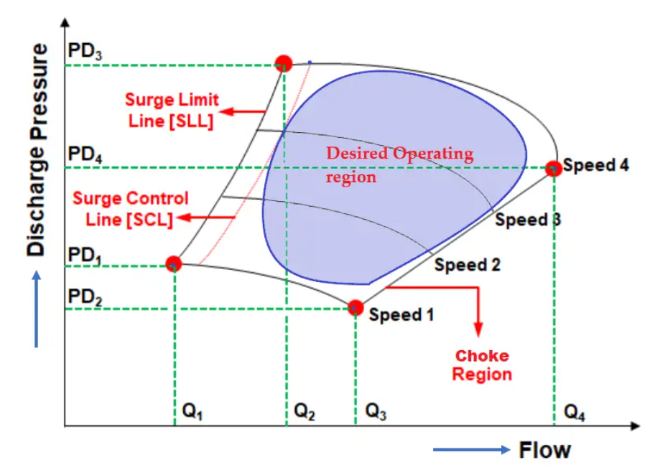
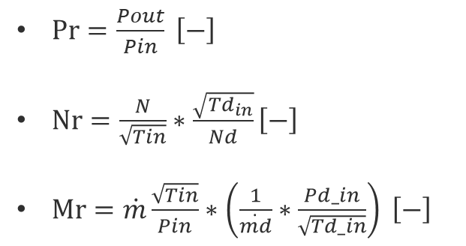
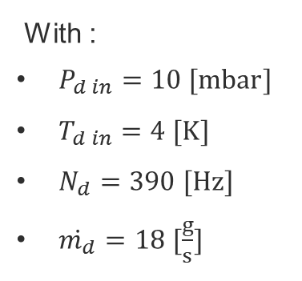
CCU constraints
Desired trajectory
$\operatorname{Pr}{=\frac{Pout}{Pin}} \left[−\right]$
$\operatorname{Nr}{=\frac{N}{\sqrt{Tin}}∗\frac{\sqrt{Td_{in}}}{Nd}}\left[−\right]$
$\left.\operatorname{Mr}{=\dot{m}\frac{\sqrt{Tin}}{Pin}∗\left(\frac{1}{\dot{md}}∗\frac{Pd_in}{\sqrt{Td_in}}\right.}\right) \left[−\right]$
With :
  $P_{d in}=10 [mbar]$
  $T_{d in}=4 [K]$
  $N_{d}=390 [Hz]$
  $\dot{m_{d}}=18 [\frac{g}{s}]$

Slide 5
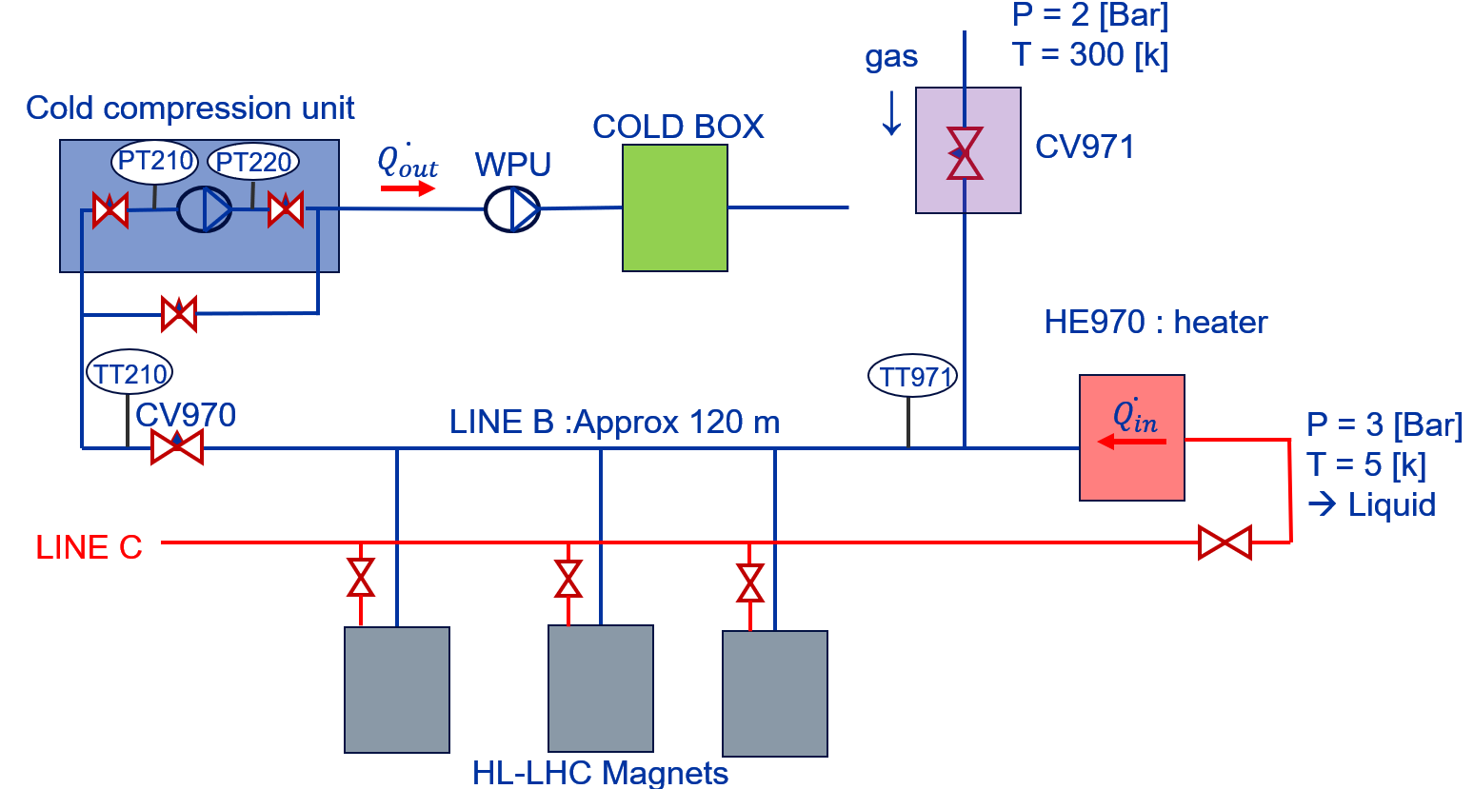
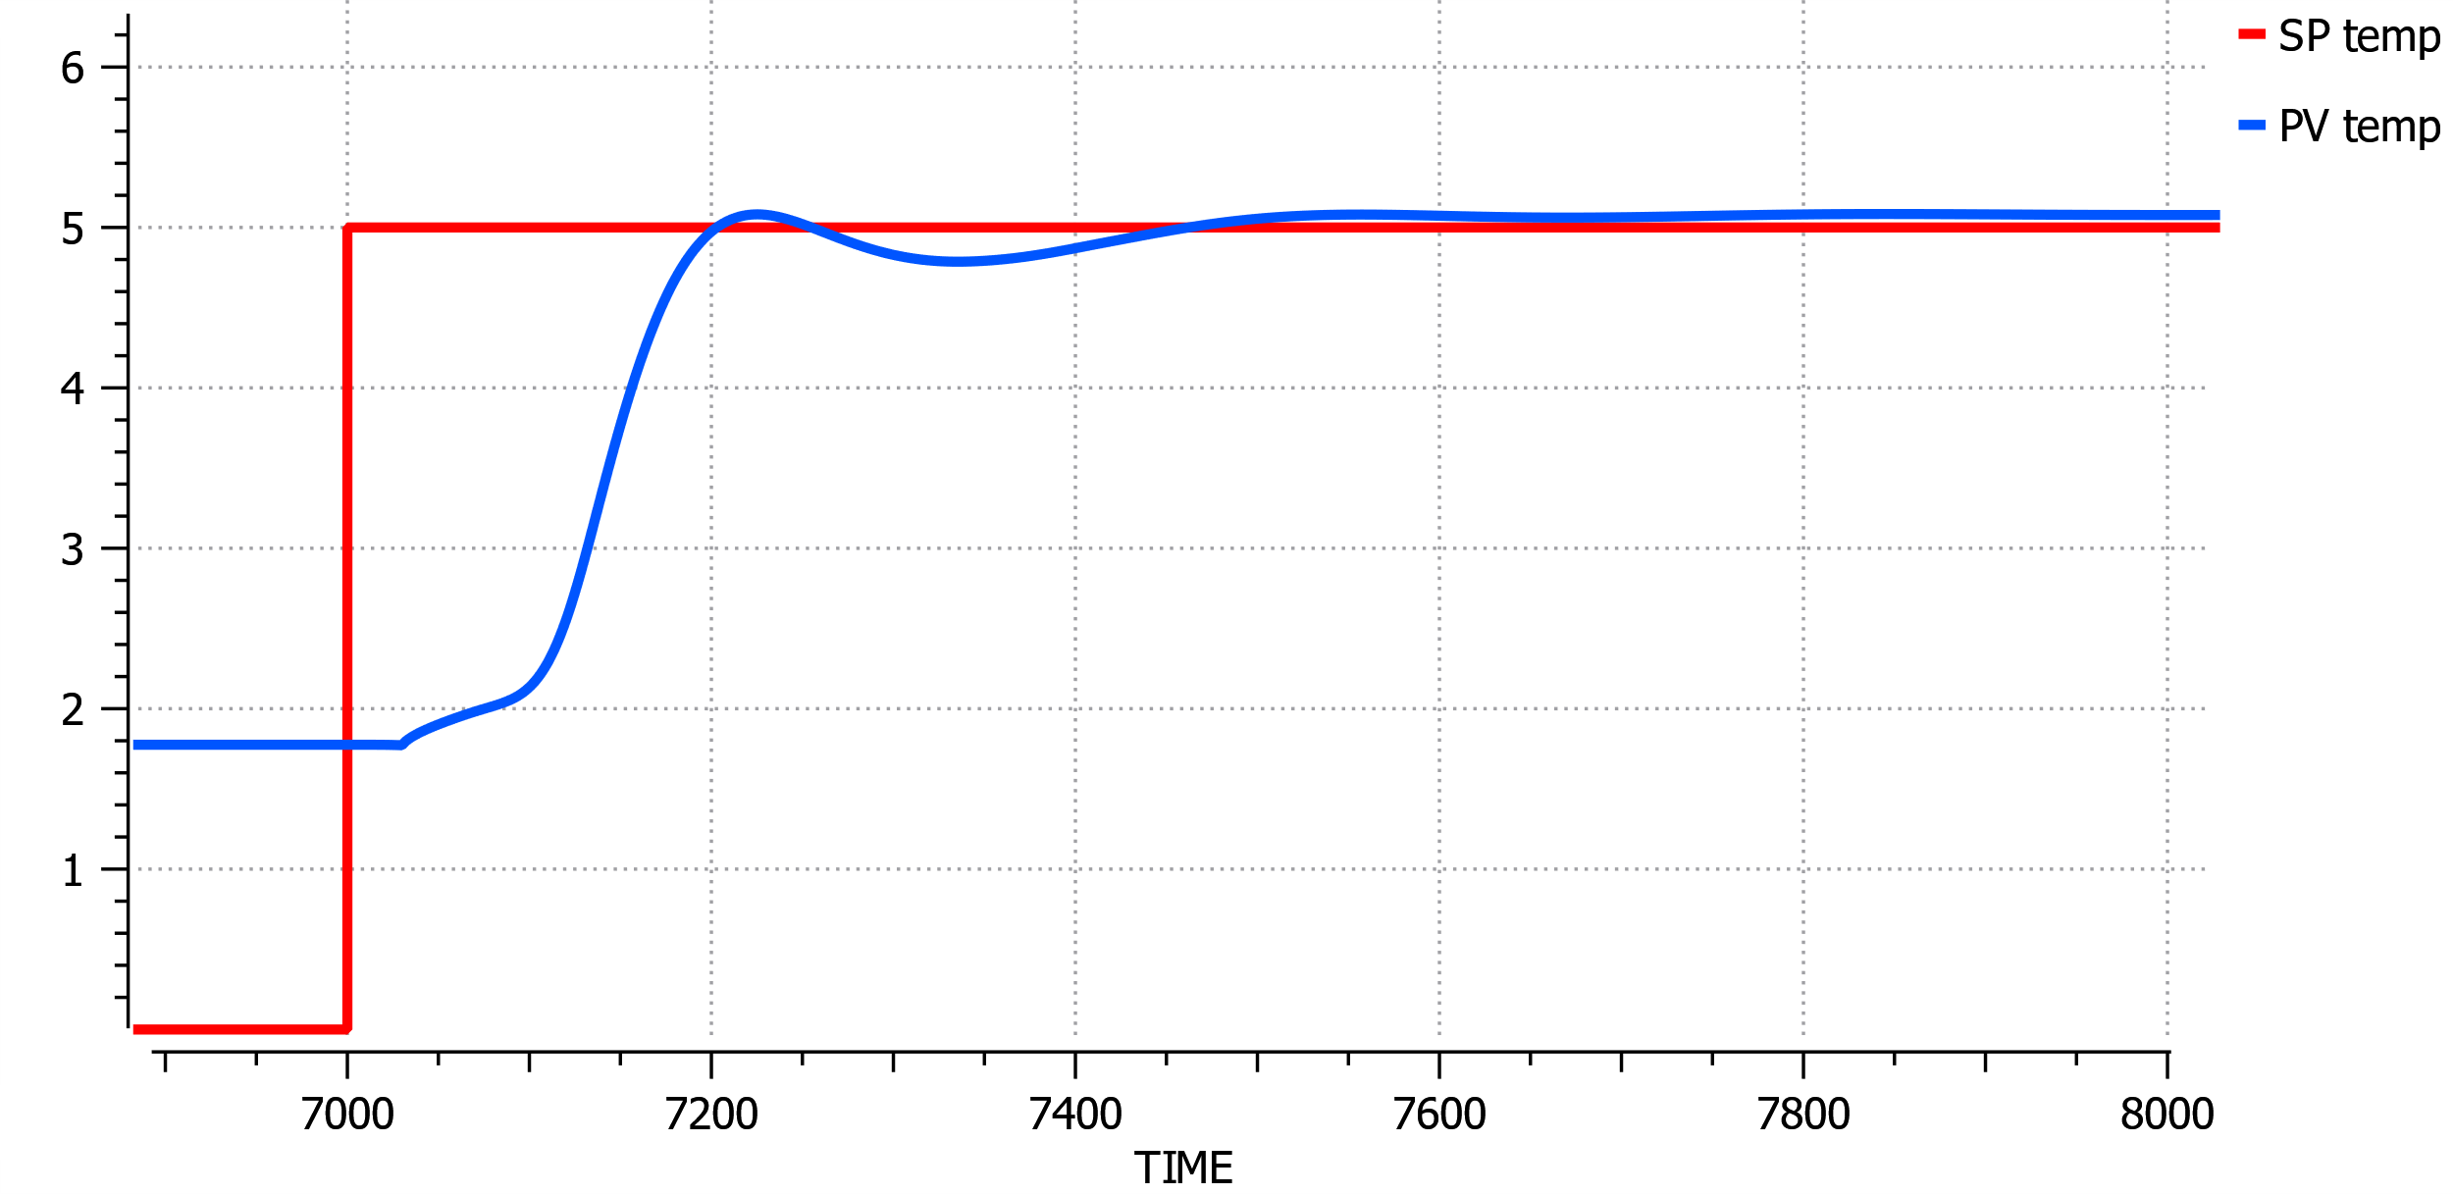
Delay Analysis
Delay effect after manual step on CV971 and temperature

Slide 6
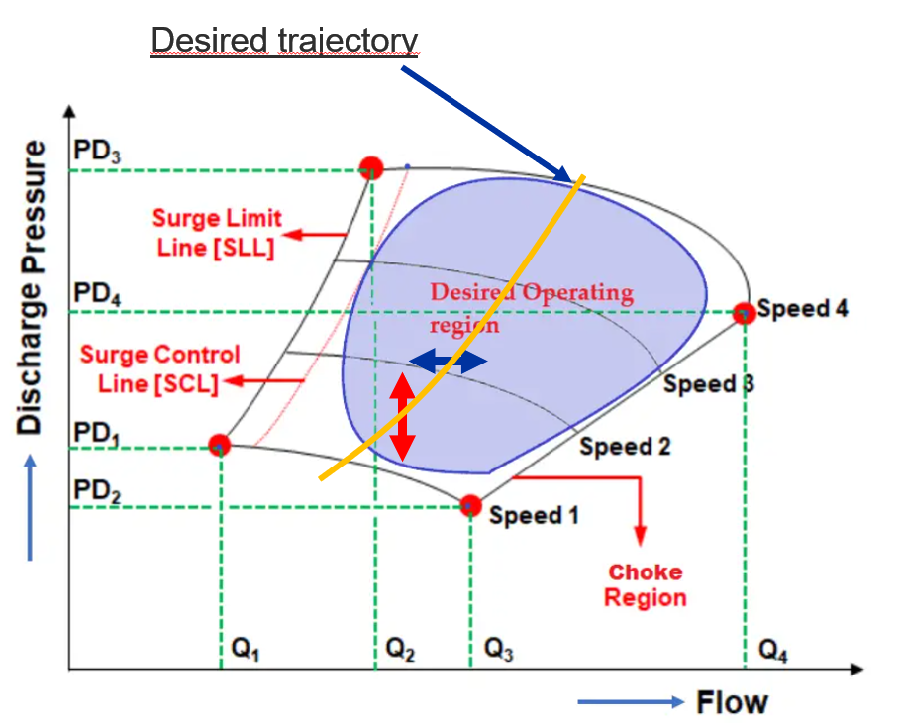
2. Cryogenic Control objective
Control objectives :
  Pv1 = Pressure in LINE B
  Pv2 = Temperature at inlet of CCU
Manipulated actuators :
  CV971 Valve opening
  motor speed [Hz]
Disturbances ?
  Magnet Quench
Constraints
  Surge line
  Choke line
  Max speed
  Speed rate limitation
  Valve opening
  Min/Max pressure
  Min/Max temperature
  Computing power
CCU

Slide 7
3. Control Models for cryogenic process
IMC :
  Model based or MIMO controller
  Easy to implement
  Can handle constraints
  Easier tuning
Smith Predictor:
  Model-based
  2 controllers → temperature and CCU speed
  Requires temperature SP for CCU constraints handling
  Best known for dead time compensation
  Dynamic delay calculation
  Simplest solution
MPC or NLMPC
  Model Based : SISO or MIMO controller
  Single controller for both CCU and CV971 valve
  Can handle constraints
  Predict behavior and control it i.e. Pr trajectory
  Hard to implement → “Bazooka”
  PI controller :
  No model required
  Limitation with long dead time and complex systems

Slide 8
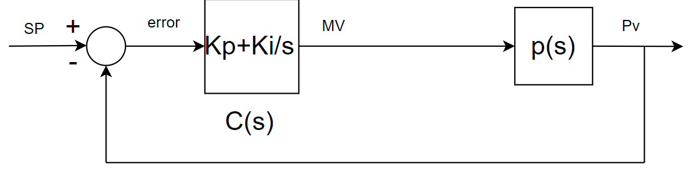

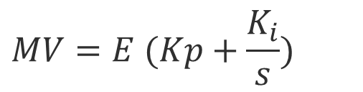
Cryo typical PI controller :
No model required, PI controller work by correcting the error E with the feedback loop
$$E=SP−PV$$
$$MV=E (Kp+\frac{K_{i}}{s})$$

Slide 9
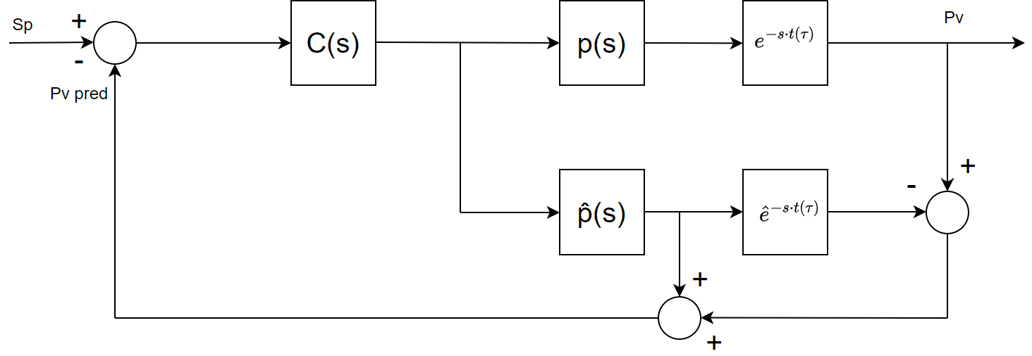
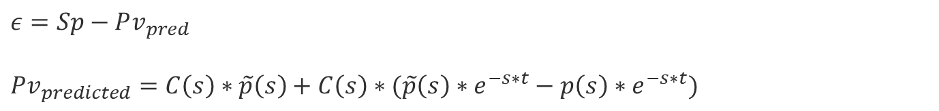
Smith predictor controller
$$ε=Sp−Pv_{pred}$$
$Pv_{predicted}=C\left(s\right)∗\tilde{p}\left(s\right)+C\left(s\right)∗(\tilde{p}\left(s\right)∗e^{−s∗t}−p\left(s\right)∗e^{−s∗t})$
Controller is often time associated with a PI, but lead/lag, RST controllers can be used depending on the application requirement
= Modelling error

Slide 10
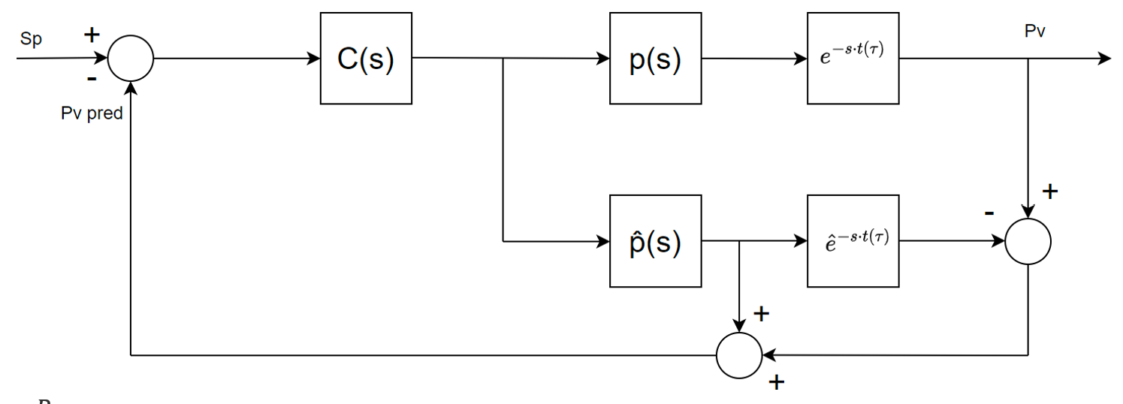
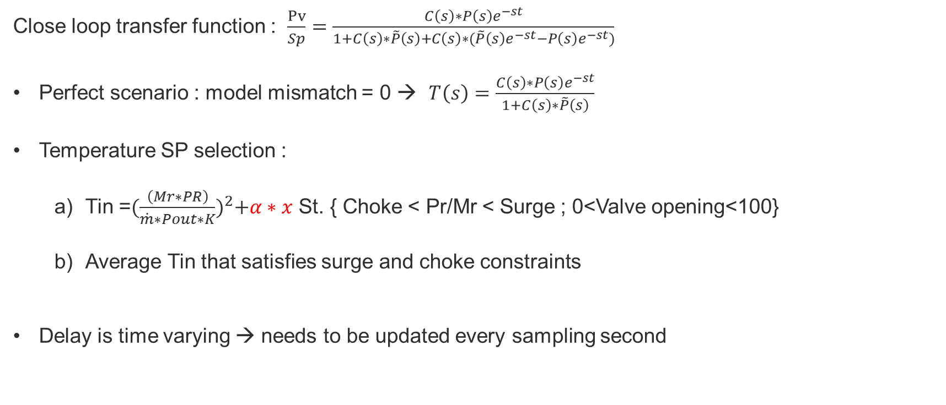
Smith Predictor controller
Close loop transfer function : $\frac{Pv}{Sp}=\frac{C\left(s\right)∗P\left(s\right)e^{−st}}{1+C\left(s\right)∗\tilde{P}\left(s\right)+C\left(s\right)∗(\tilde{P}\left(s\right)e^{−st}−P\left(s\right)e^{−st})}$
Perfect scenario : model mismatch = 0 → $T\left(s\right)=\frac{C\left(s\right)∗P\left(s\right)e^{−st}}{1+C\left(s\right)∗\tilde{P}\left(s\right)}$
Temperature SP selection :
  Tin =${(\frac{\left(Mr∗PR\right)}{\dot{m}∗Pout∗K})}^{2}+α∗x$ St. { Choke < Pr/Mr < Surge ; 0<Valve opening<100}
  Average Tin that satisfies surge and choke constraints
Delay is time varying → needs to be updated every sampling second

Slide 11
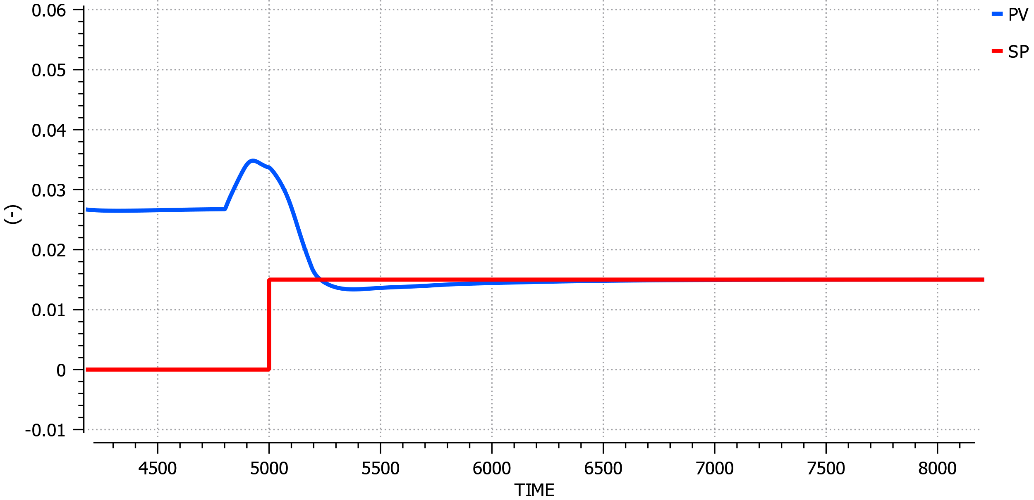
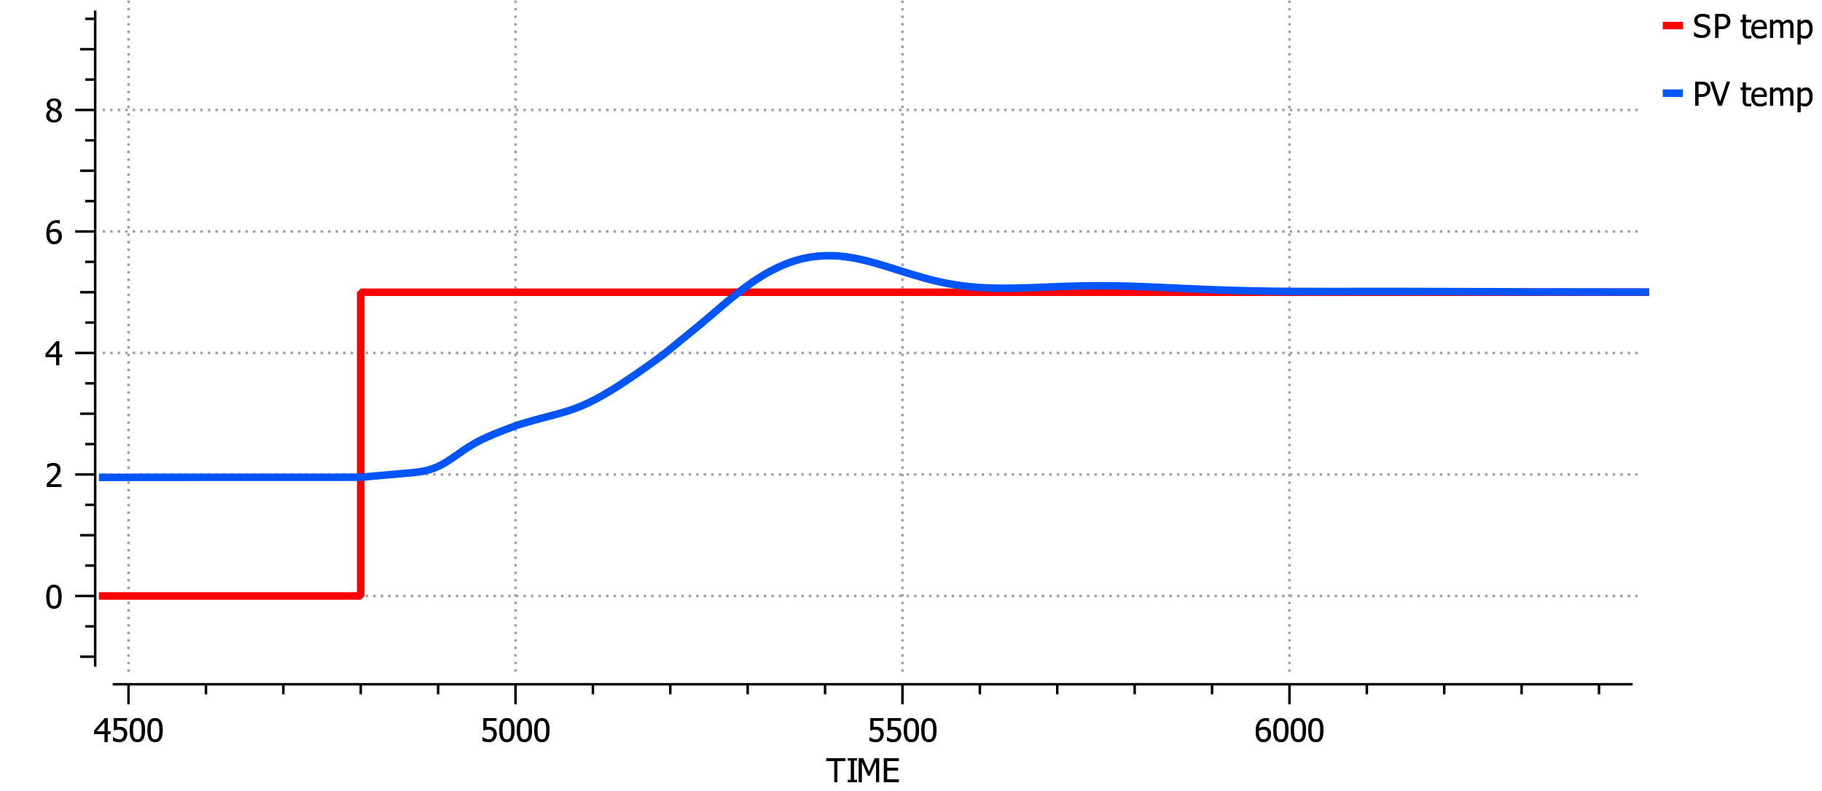

4. Cryogenic PI controller 1/2
“performance in simulation”
PI tuning with Ziegler-Nichols and Trial error :
CCU-PV evolution
CCU $T_{Inlet}$ evolution
Kp = 7; Ti = 90 [s]
Kp = 3; Ti = 50 [s]

Slide 12
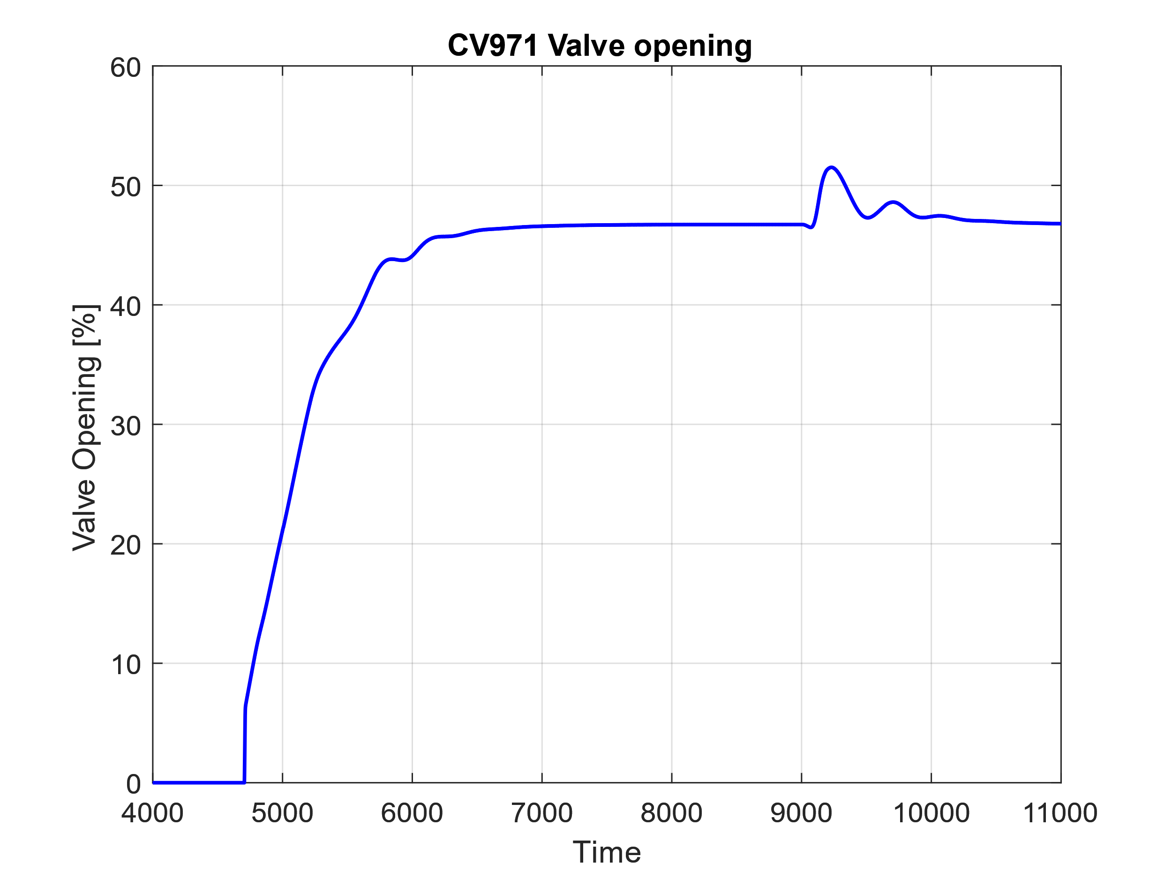
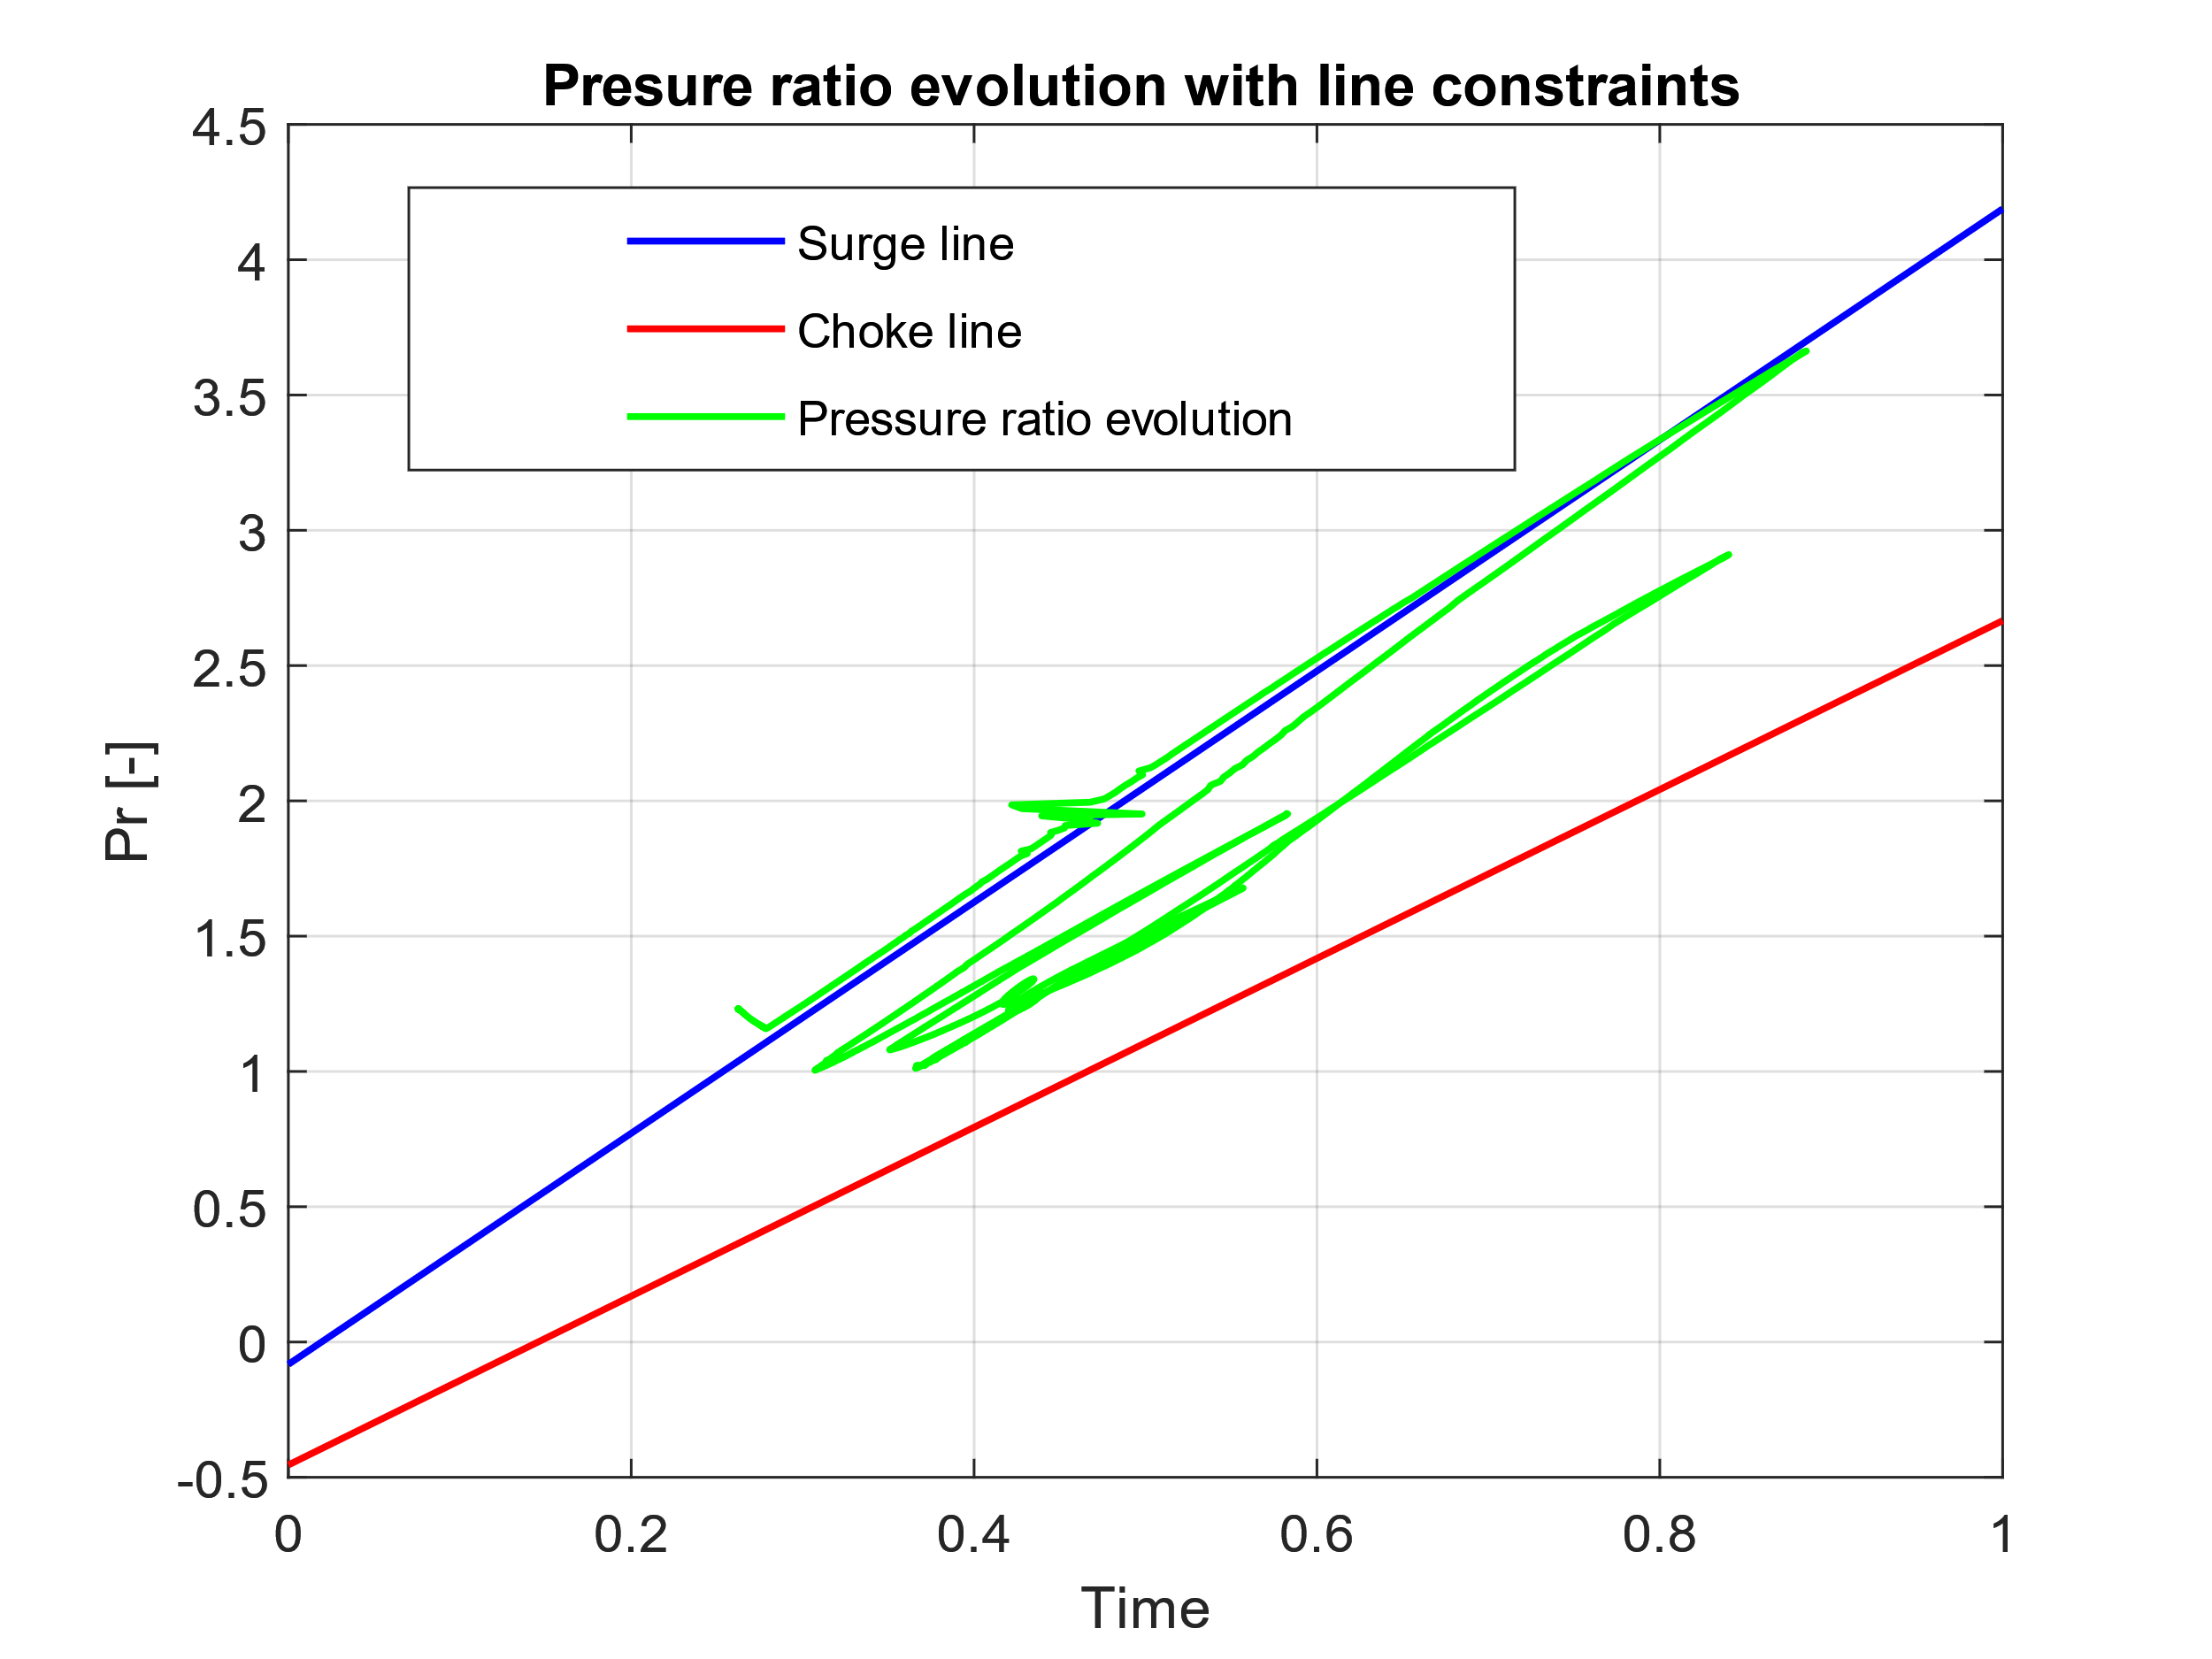
Existant cryogenic PI controller 2/2
“performance in simulation”
PI tuning effect on Surge/Choke:
SURGE

Slide 13
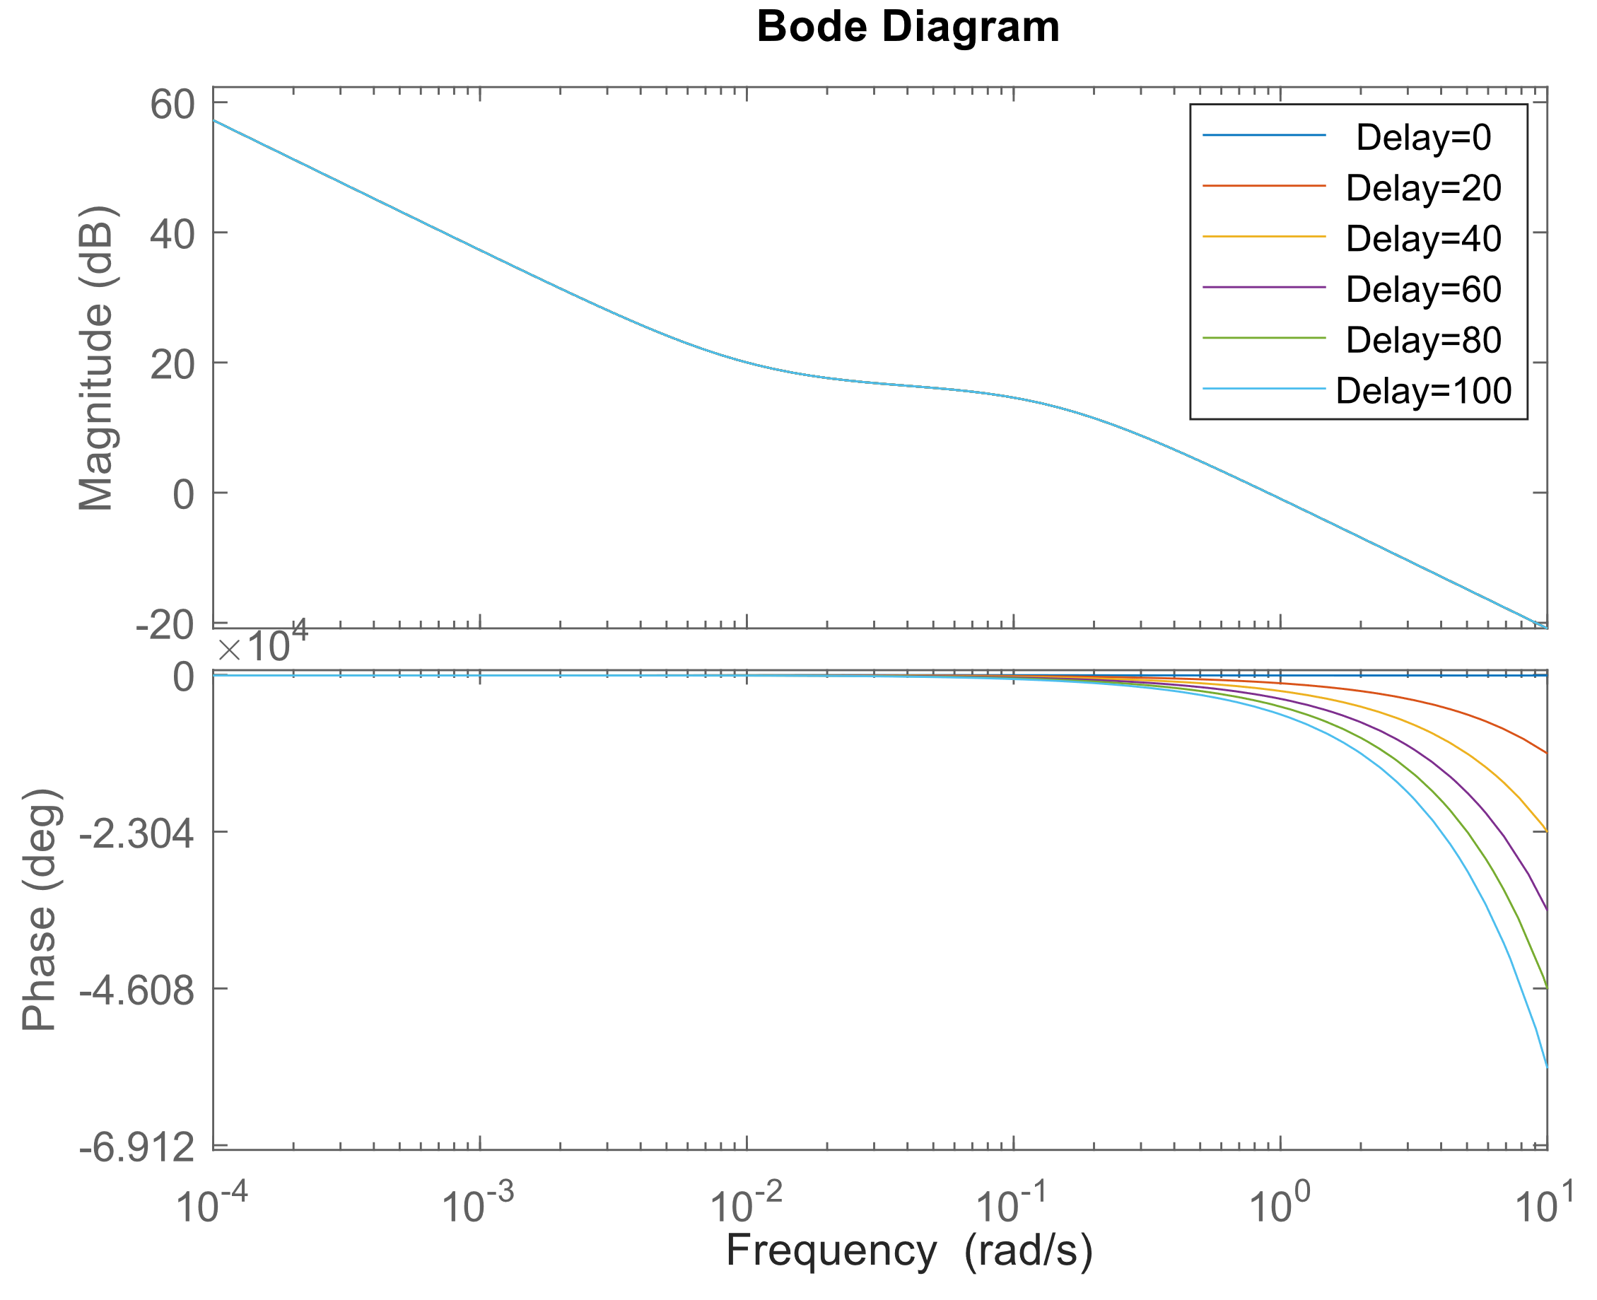
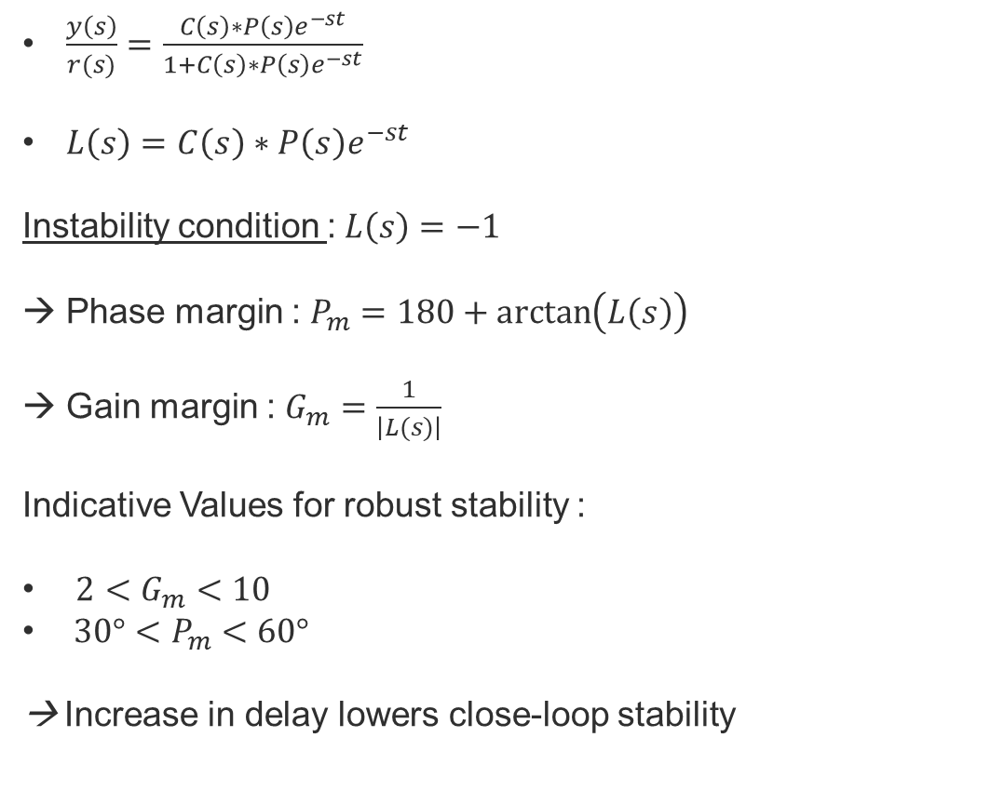
Delay effects on close loop stability
$\frac{y\left(s\right)}{r(s)}=\frac{C\left(s\right)∗P\left(s\right)e^{−st}}{1+C\left(s\right)∗P\left(s\right)e^{−st}}$
$L\left(s\right)=C\left(s\right)∗P\left(s\right)e^{−st}$
Instability condition :$L\left(s\right)=−1$
Phase margin : $P_{m}=180+\arctan\left(L\left(s\right)\right)$
Gain margin : $G_{m}=\frac{1}{\left|L(s)\right|}$
Indicative Values for robust stability :
${2<G}_{m}<10$
${30°<P}_{m}<60°$
→ Increase in delay lowers close-loop stability

Slide 14
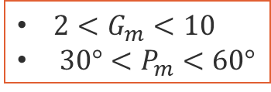
Delay effect on close loop stability
${2<G}_{m}<10$
${30°<P}_{m}<60°$
Kp = 3; Ti = 50 [s]
Kp = 8; Ti = 50 [s]
Delay | Gain margin | Phase margin | Max delay
0 | 65535.00 | 76.89 | 0.00
20 | 16.09 | 71.00 | 4.18
40 | 7.67 | 65.11 | 6.85
60 | 4.80 | 59.21 | 8.94
80 | 3.45 | 53.32 | 10.38
100 | 2.69 | 47.43 | 11.21
Delay | Gain margin | Phase margin | Max delay
0 | 65535.00 | 67.37 | 0.00
20 | 6.03 | 53.98 | 3.18
40 | 2.87 | 40.59 | 4.27
60 | 1.80 | 27.20 | 4.11
80 | 1.29 | 13.82 | 2.69
100 | 1.01 | 0.43 | 0.10
Stable but not robust !

Slide 15
5. Smith predictor system identification 1/2
  First principle Modelling → Complex process, potential difficult → Conservation of masse/energy
  Transfer function models
    Broida
    Vander Grinden
    Higher order transfer models
  statistical models
    ARX
    ARMAX
    CARIMA
    Box-Jenkins
  State-Space Models
  Neural network models (CNN, GNN, etc)
Models depends on process dynamics such as non-linearities, noise, inverse responses etc

Slide 16
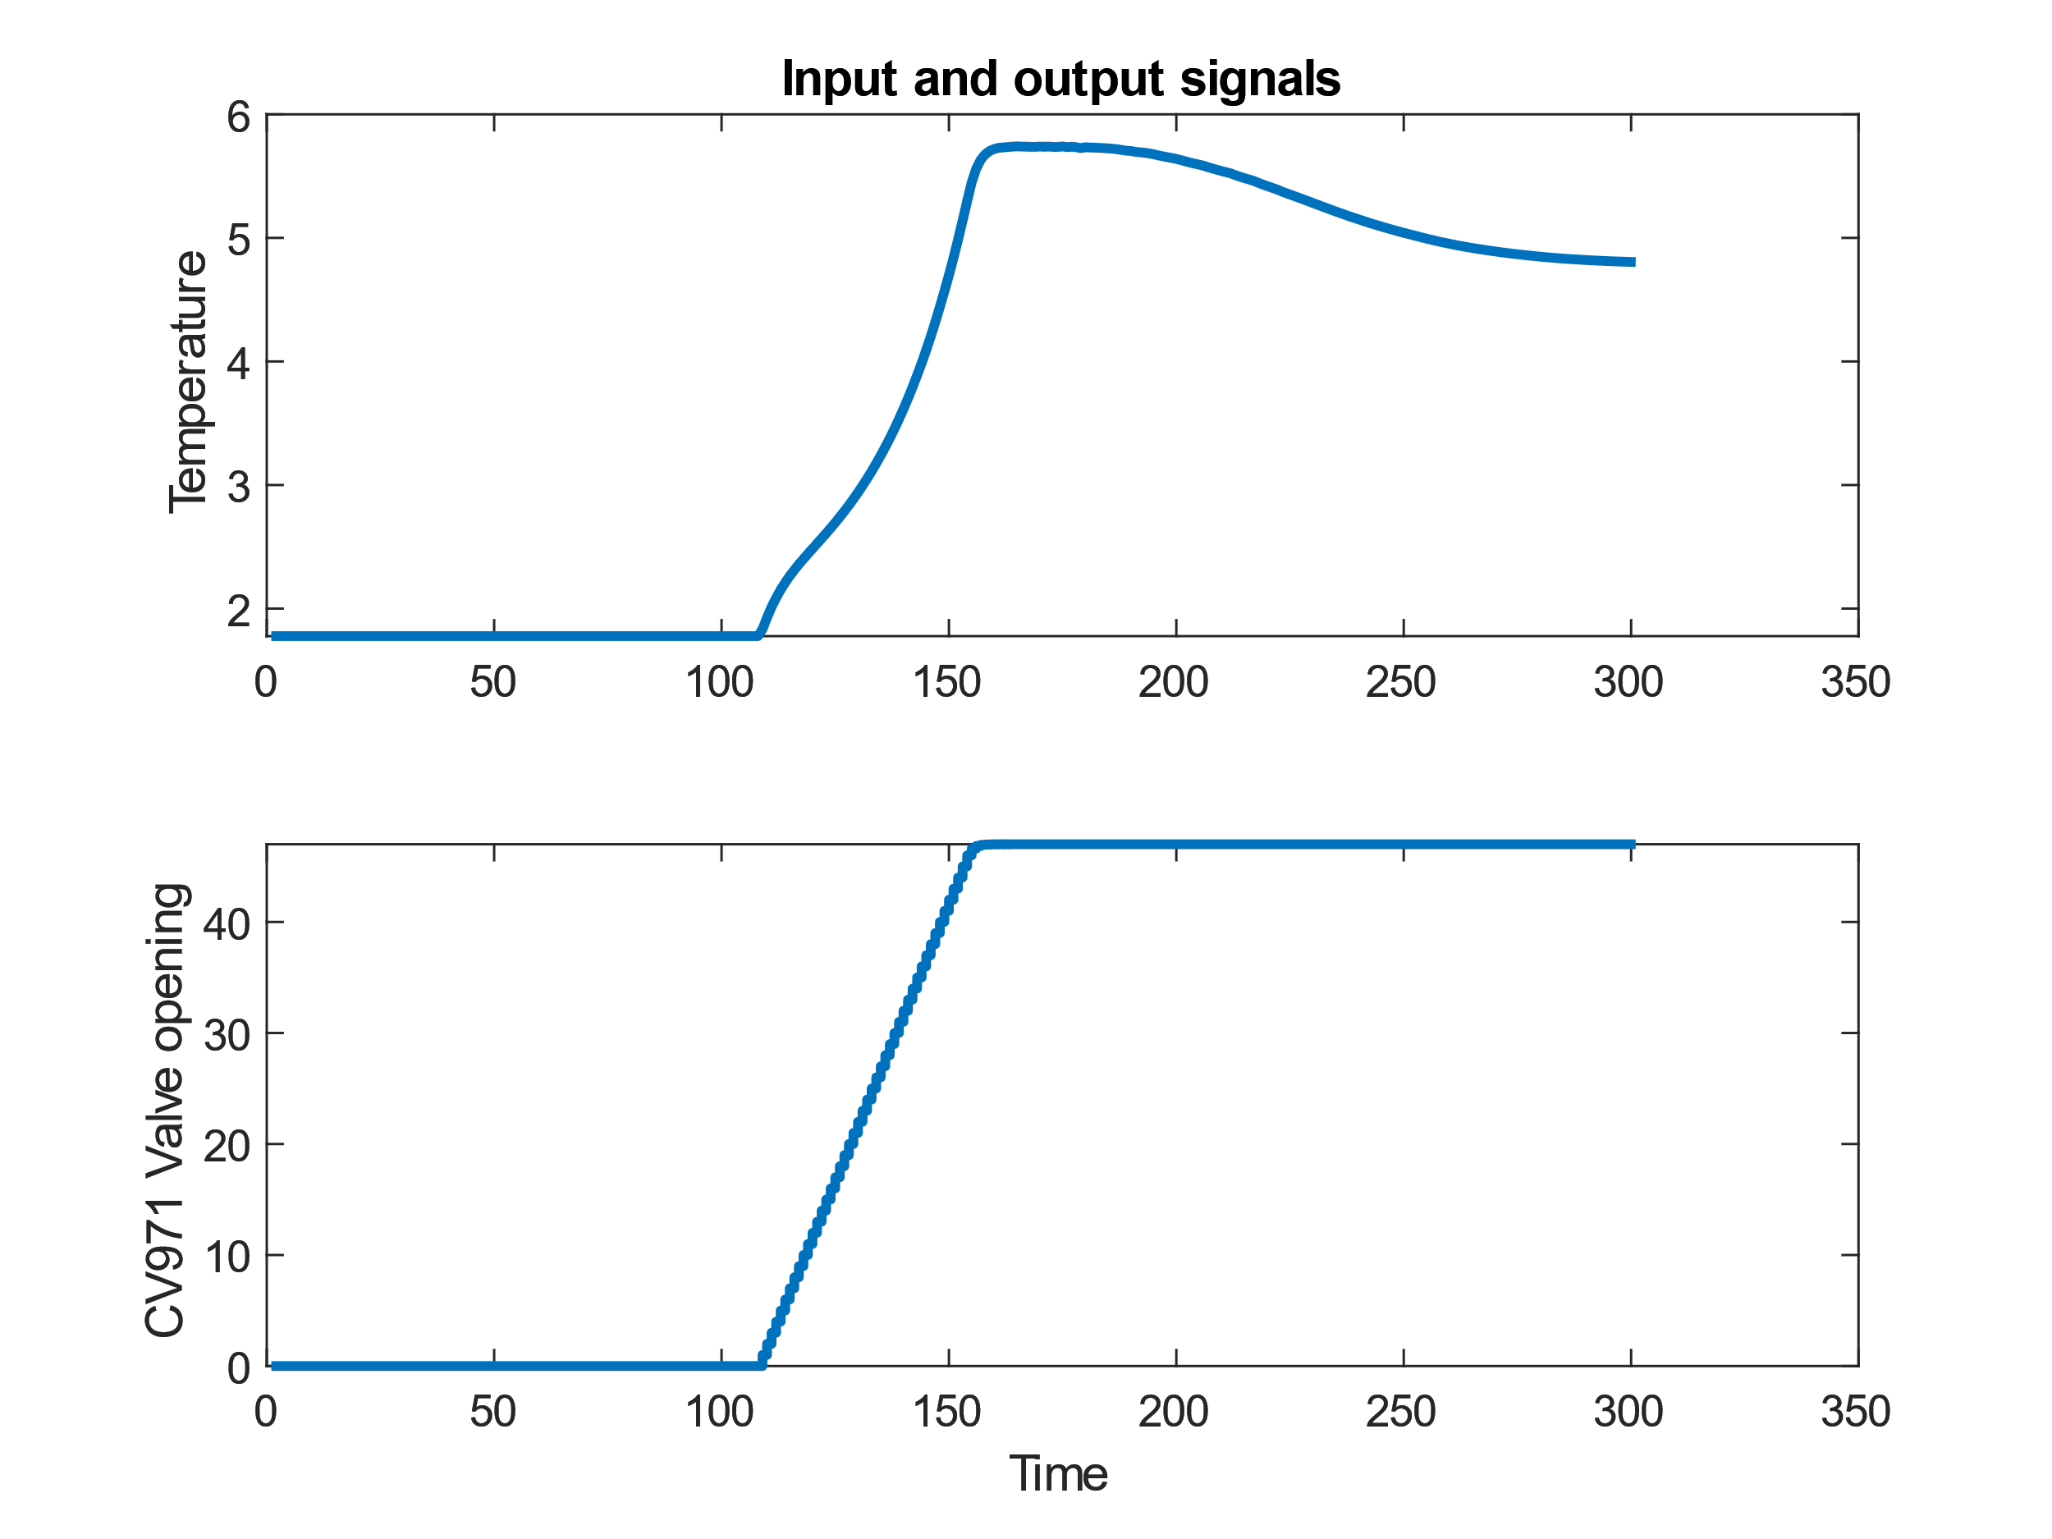
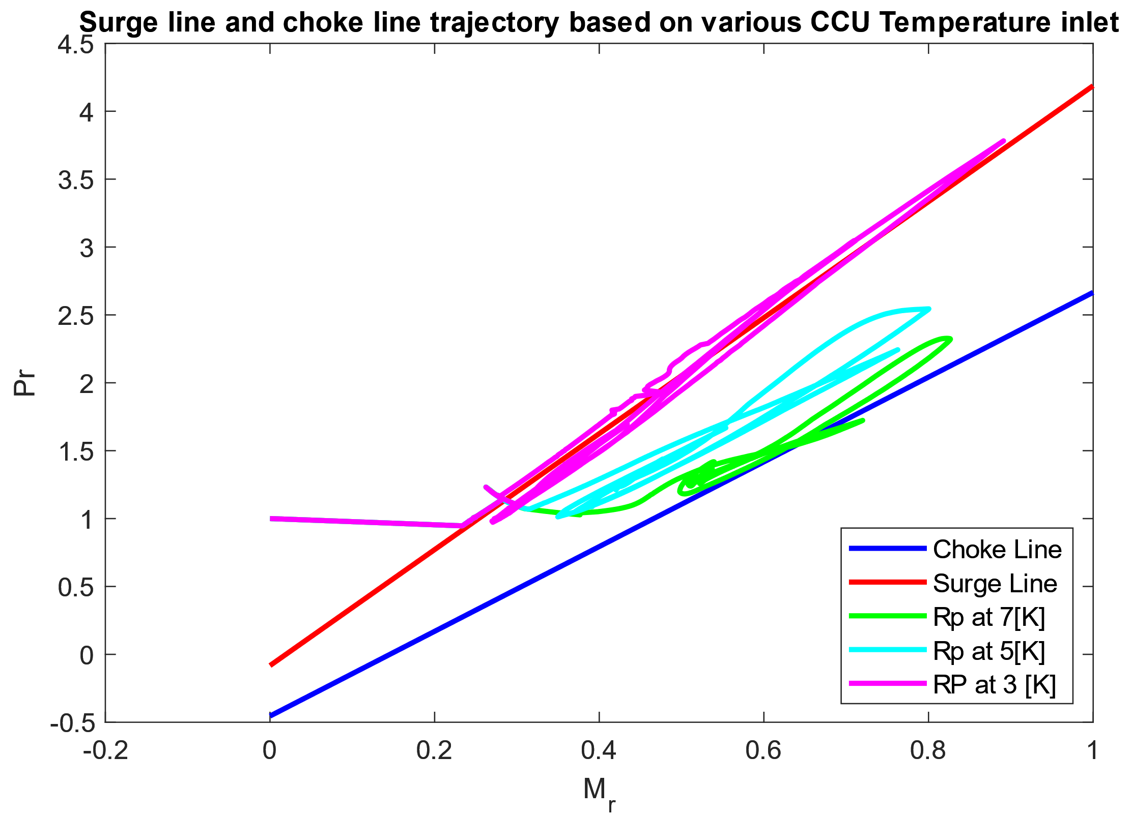
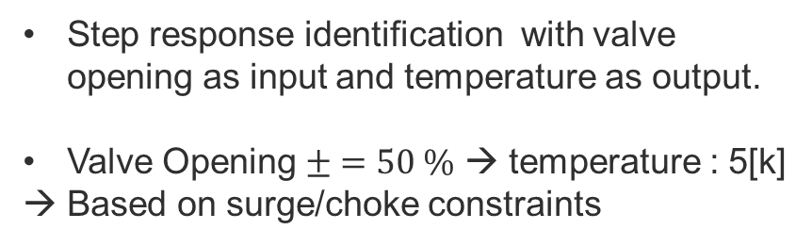
Smith predictor system identification 2/3
Step response identification with valve opening as input and temperature as output.
Valve Opening $± =50 \%$ → temperature : 5[k]
→ Based on surge/choke constraints

Slide 17
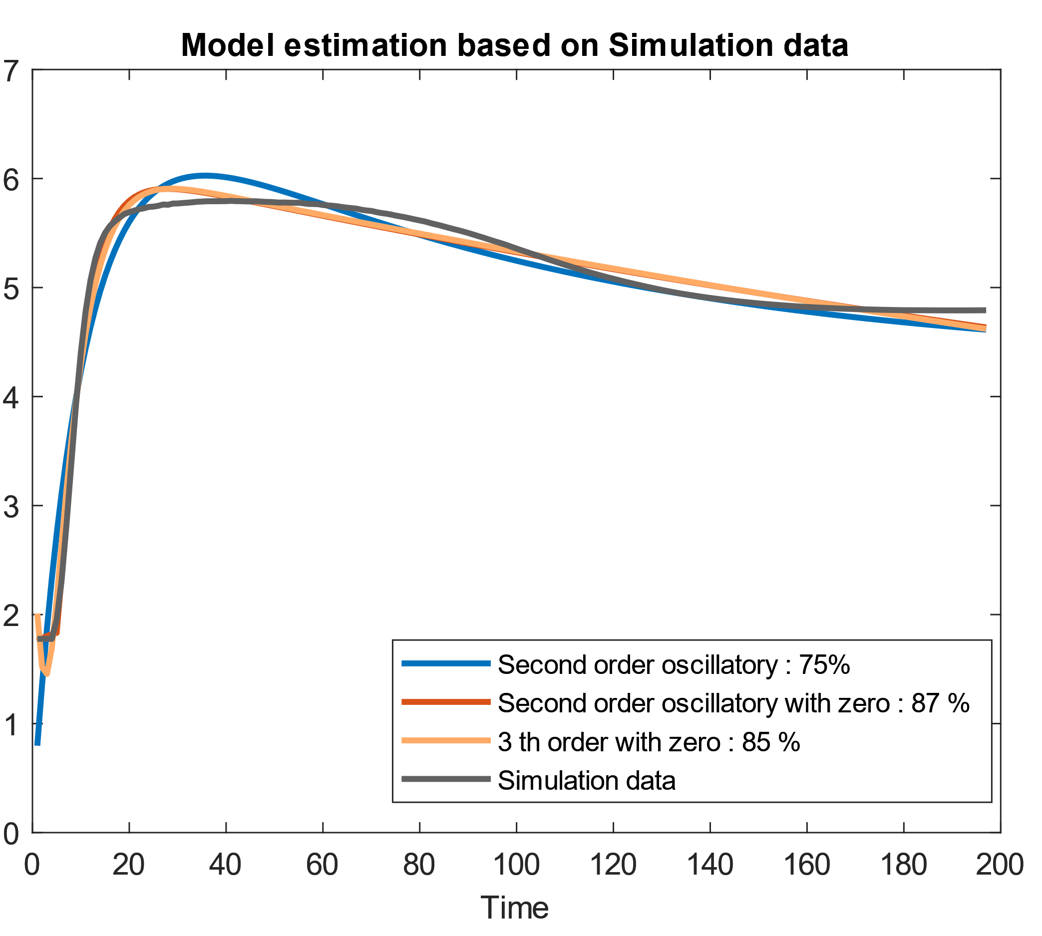
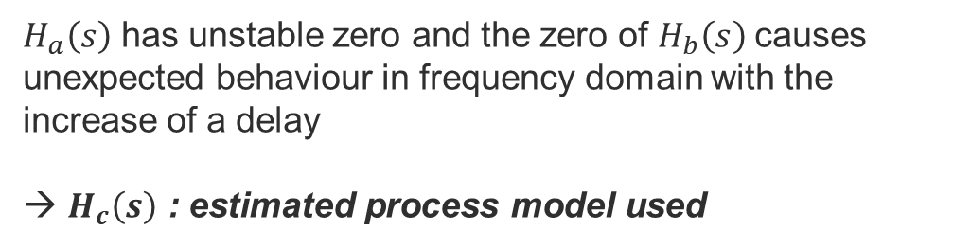
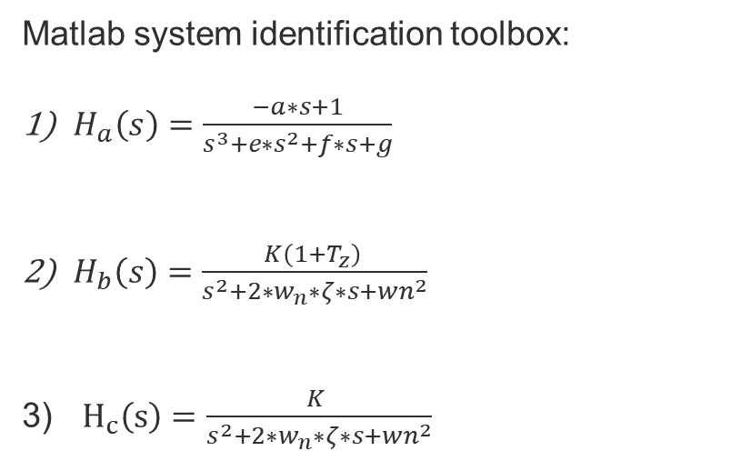
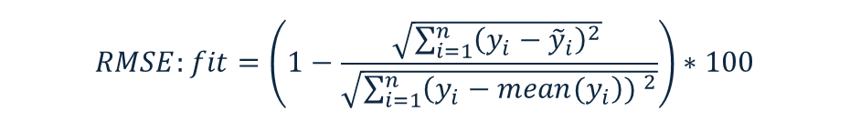
Smith predictor system identification 3/3
Matlab system identification toolbox:
$H_{a}\left(s\right)=\frac{−a∗s+1}{s^{3}+e∗s^{2}+f∗s+g}$
$H_{b}\left(s\right)=\frac{K\left(1+T_{z}\right) }{s^{2}+2∗w_{n}∗ζ∗s+wn^{2}}$
$H_{c}\left(s\right)=\frac{K }{s^{2}+2∗w_{n}∗ζ∗s+wn^{2}}$
$H_{a}\left(s\right)$ has unstable zero and the zero of $H_{b}\left(s\right)$causes unexpected behaviour in frequency domain with the increase of a delay
→ $H_{c}\left(s\right)$ : estimated process model used
$$RMSE:fit=\left(1−\frac{\sqrt{\sum_{i=1}^{n}{{\left(y_{i}−{\tilde{y}}_{i}\right)}^{2}}}​}{\sqrt{\sum_{i=1}^{n}{{\left(y_{i}−mean(y_{i}\right)) }^{2}}}}\right)∗100$$

Slide 18
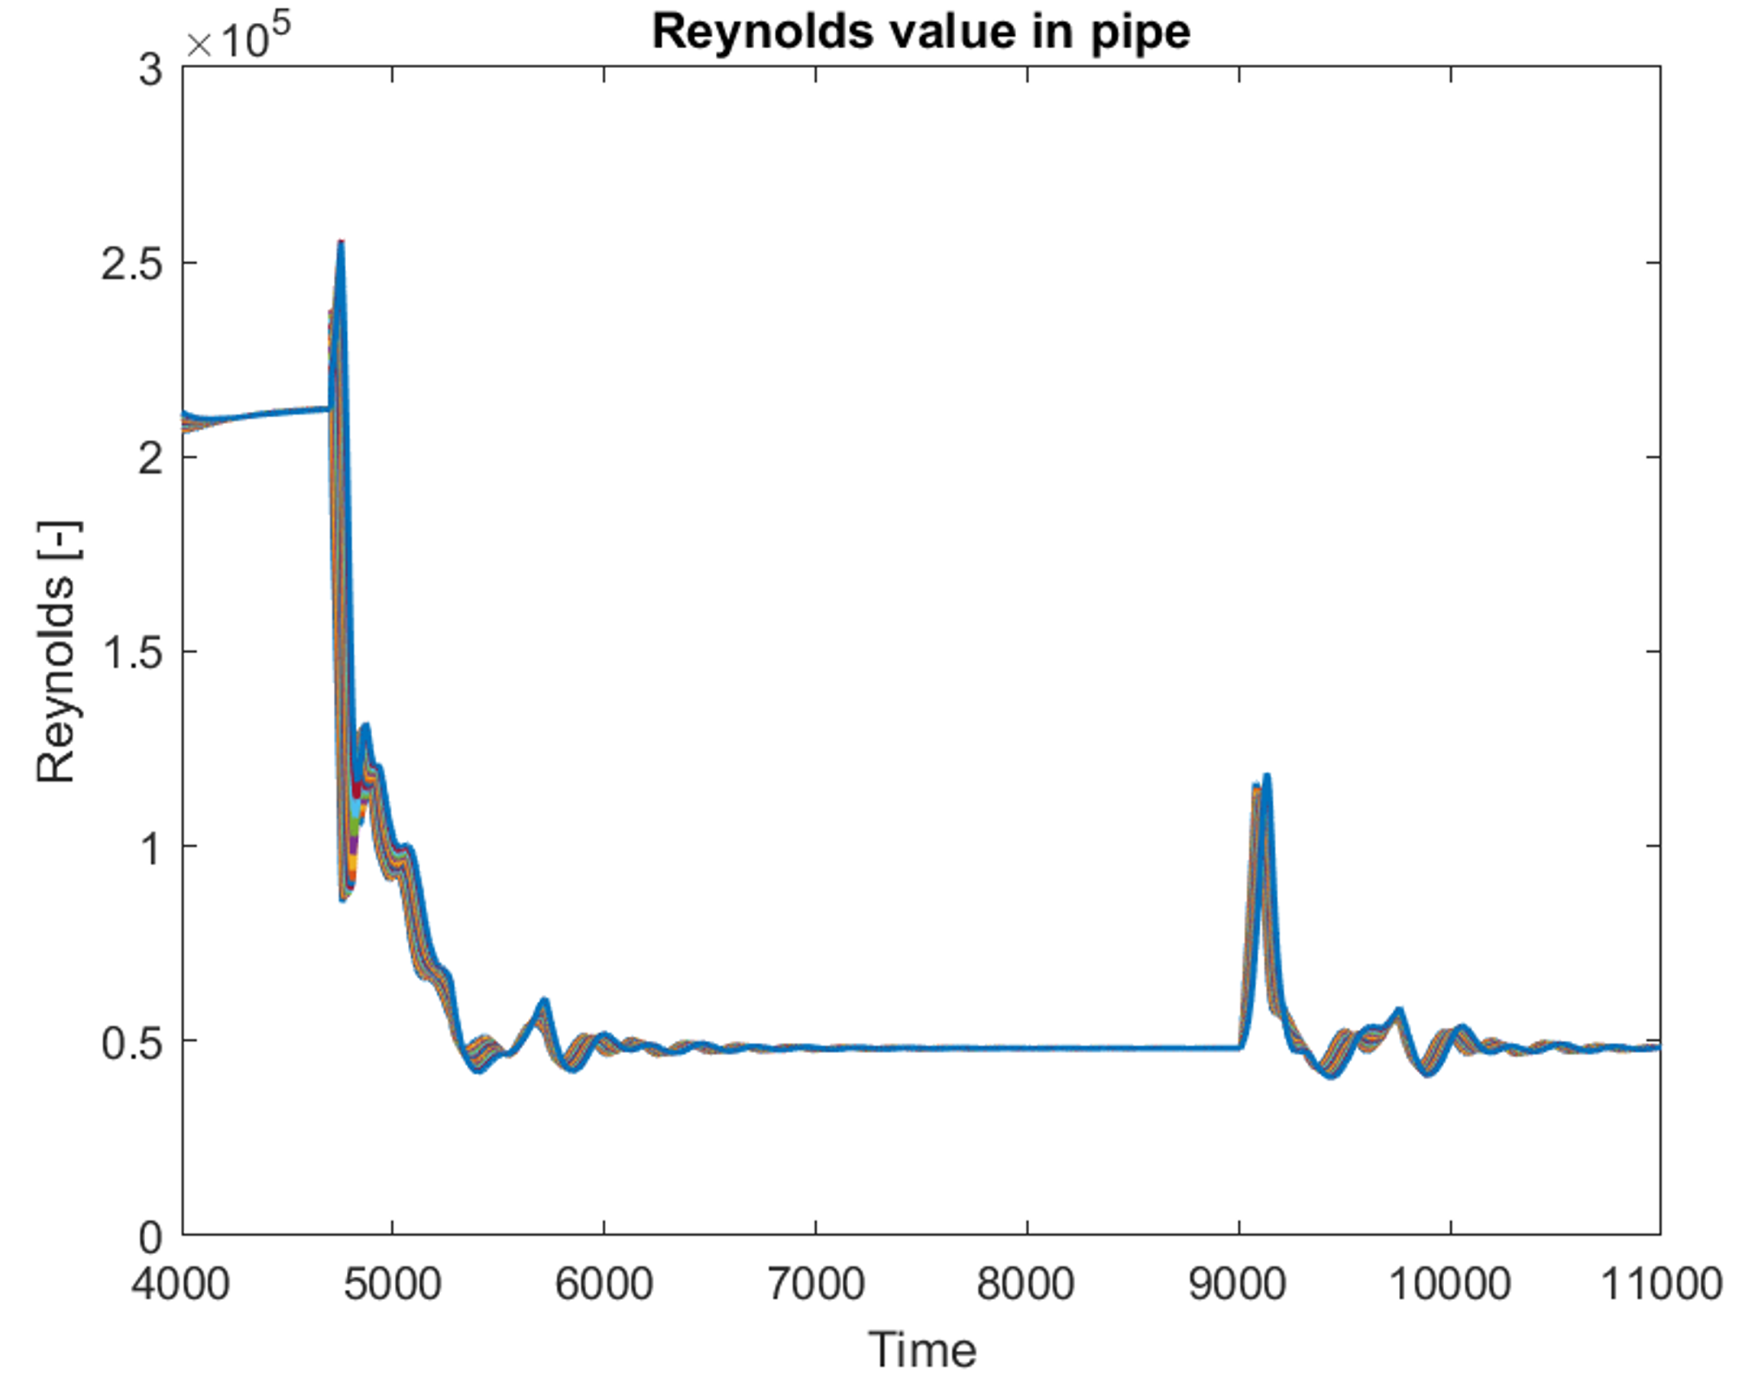

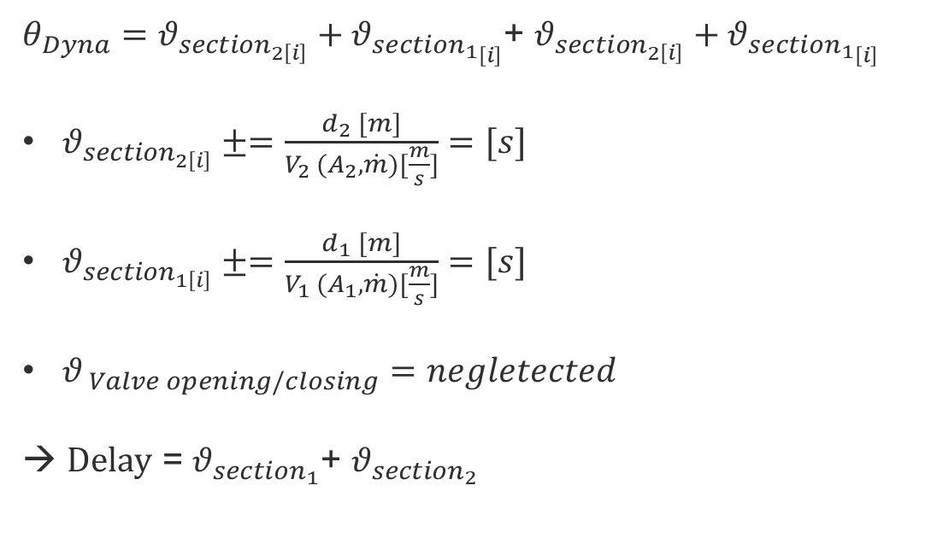

Dynamic Delay estimation
$${θ_{section}}_{2 } (±60 m,DN125)$$
$${θ_{section}}_{1} (±60m,DN200)$$
TT210
TT970
TT971
Flow
LINE B PIPE
$θ_{Dyna}=θ_{section_{2\left[i\right]}}+θ_{sectio{n_{1}}_{\left[i\right]}}$+ $θ_{section_{2\left[i\right]}}+θ_{sectio{n_{1}}_{\left[i\right]}}$
$θ_{section_{2\left[i\right]}}±=\frac{d_{2} [m]}{V_{2 }(A_{2},\dot{m})[\frac{m}{s}]}=[s]$
$θ_{section_{1\left[i\right]}}±=\frac{d_{1} [m]}{V_{1 }(A_{1},\dot{m})[\frac{m}{s}]}=[s]$
$θ_{ Valve opening/closing}=negletected$
→ Delay = $θ_{section_{1}}$+ $θ_{section_{2}}$
Re>4000 → Turbulent flow

Slide 19
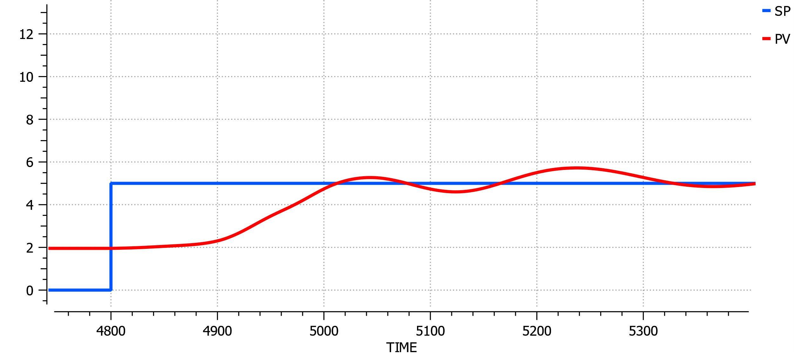
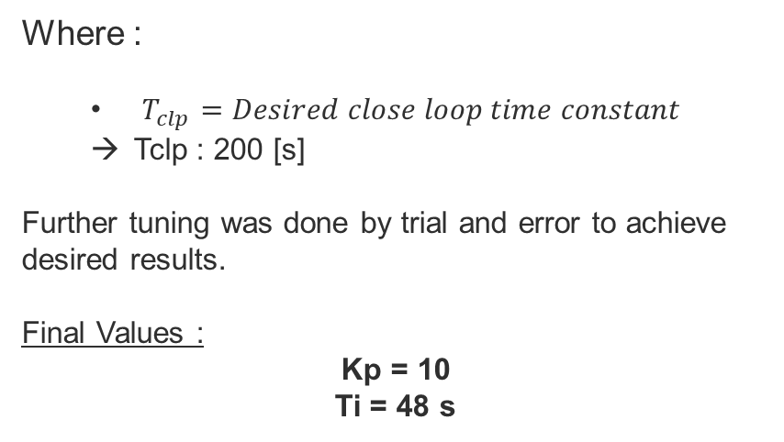
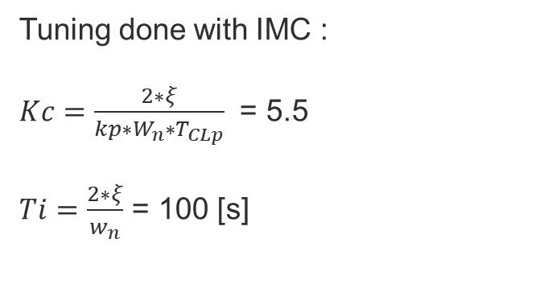
Smith predictor simulation
Tuning done with IMC :
$Kc=\frac{2∗ξ}{kp∗W_{n}∗T_{CLp}}$ = 5.5
$Ti=\frac{2∗ξ}{w_{n}}$ = 100 [s]
Temperature SP and PV evolution
Where :
  $T_{clp}=Desired close loop time constant$
  Tclp : 200 [s]
Further tuning was done by trial and error to achieve desired results.
Final Values :
Kp = 10
Ti = 48 s

Slide 20
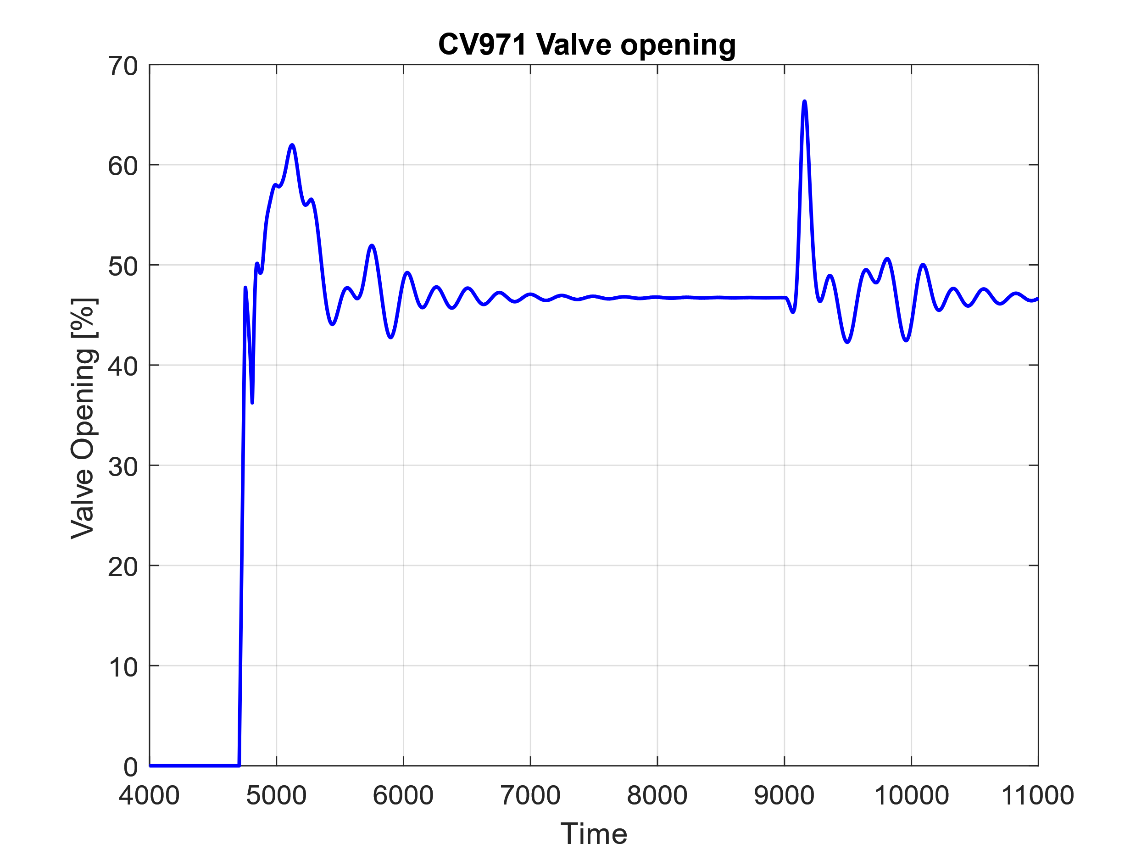
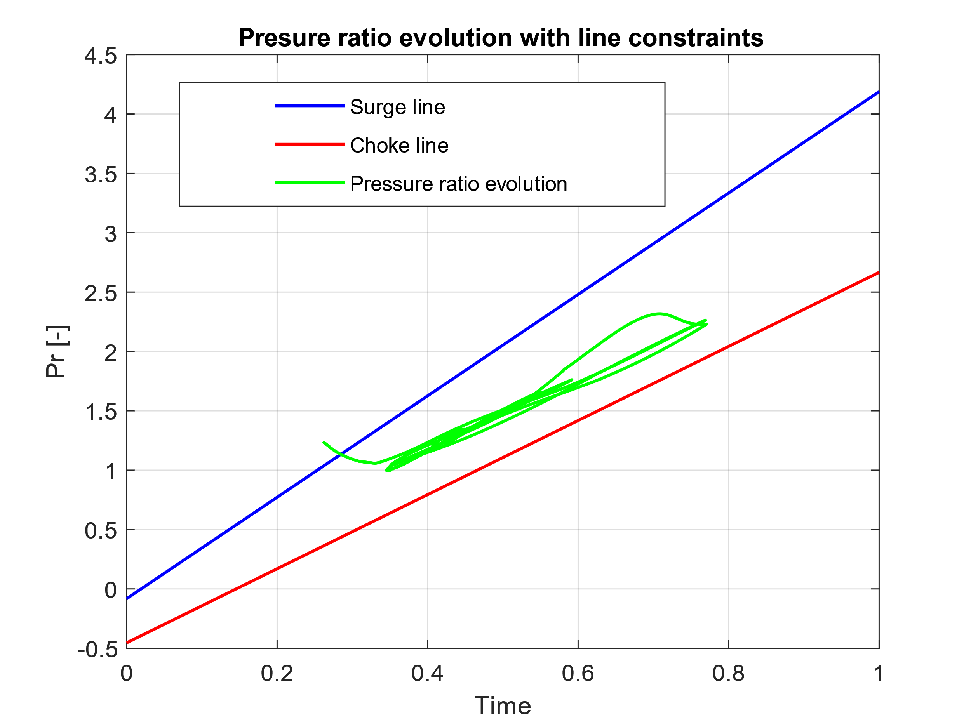
Smith predictor simulation

Slide 21
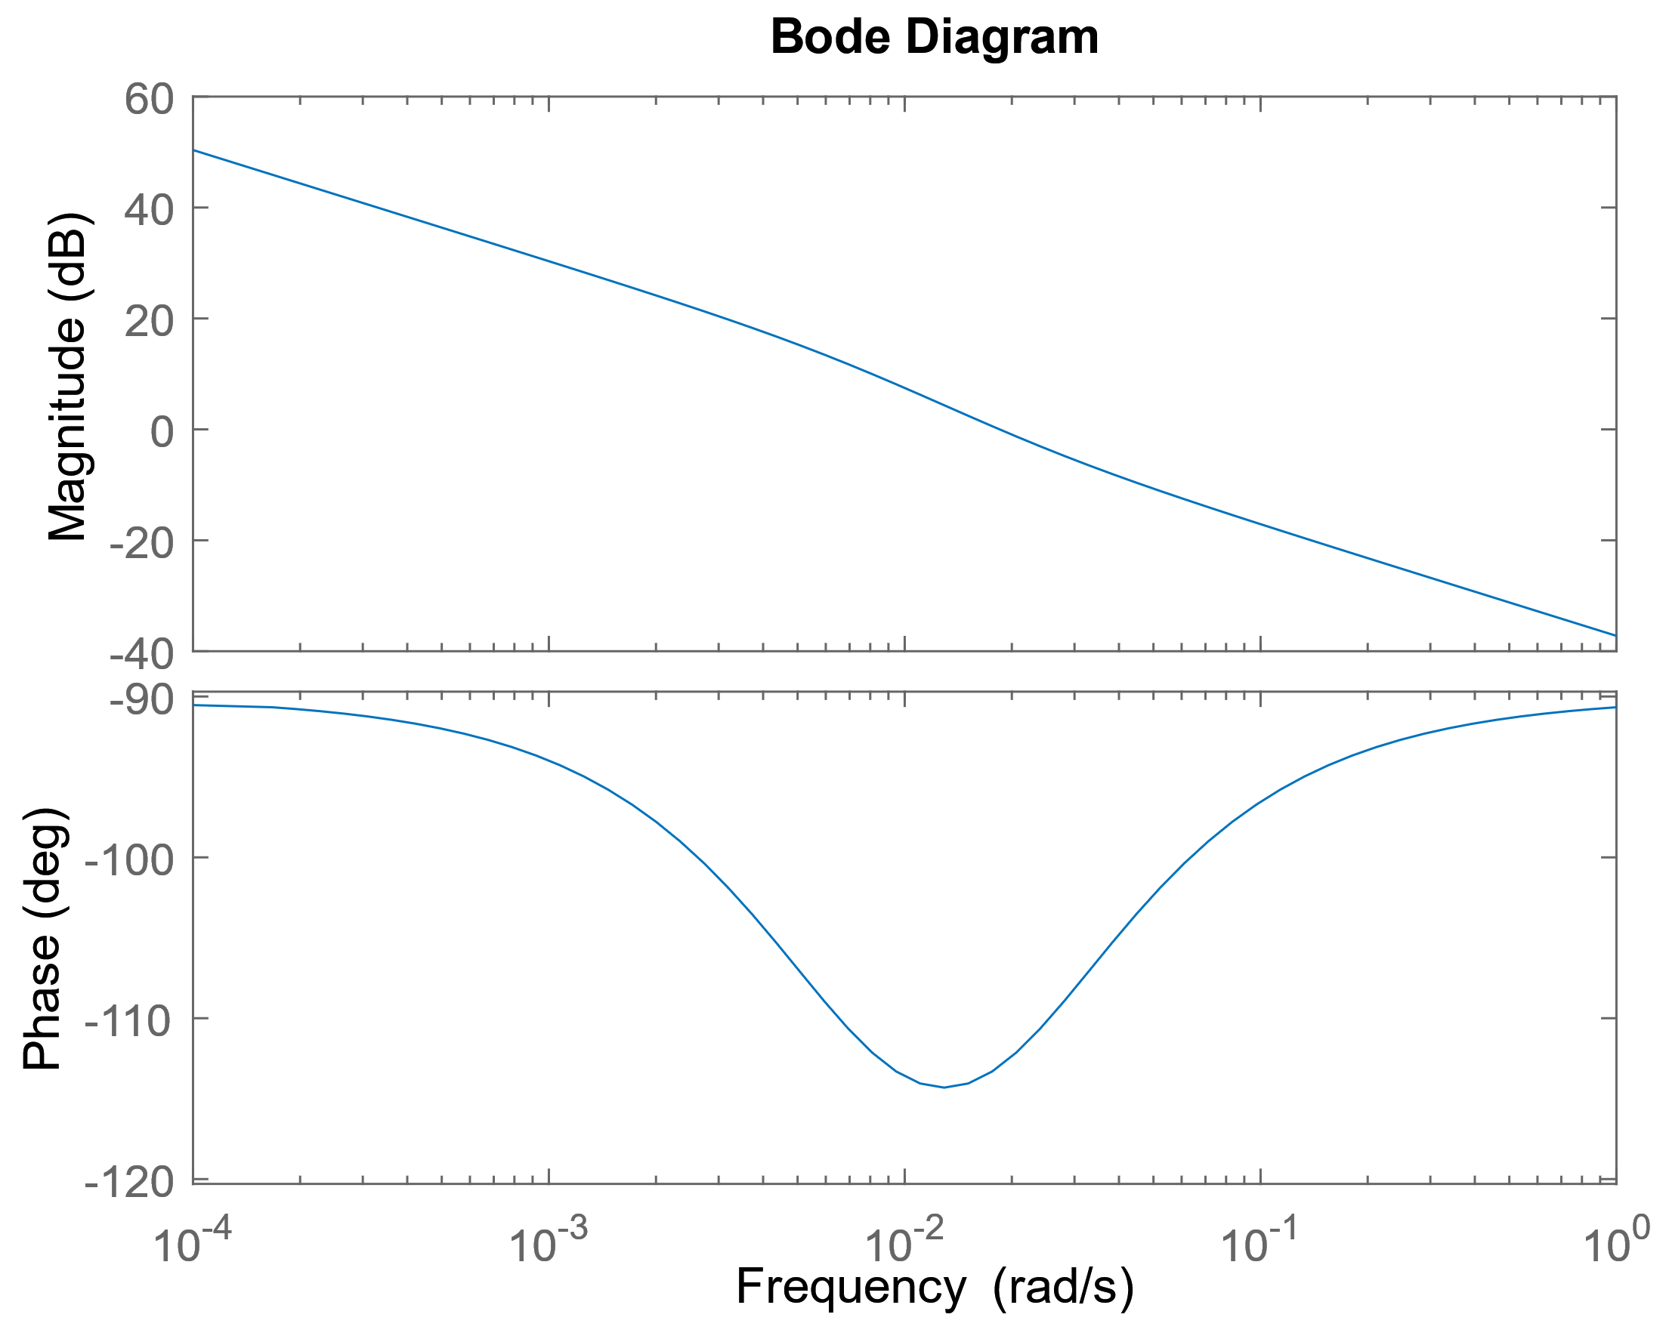
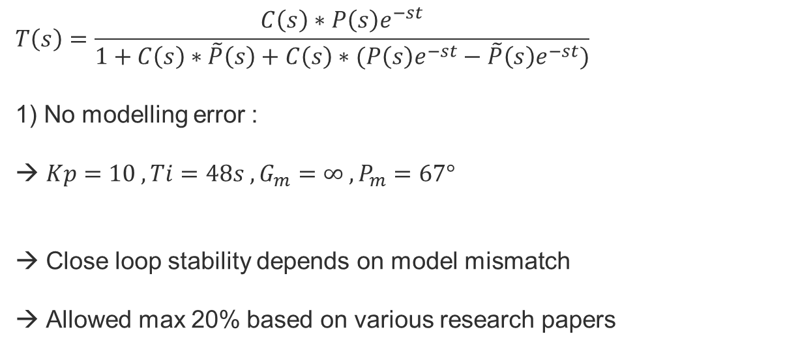
Smith predictor close loop stability
$$T\left(s\right)=\frac{C\left(s\right)∗P\left(s\right)e^{−st}}{1+C\left(s\right)∗\tilde{P}\left(s\right)+C\left(s\right)∗(P\left(s\right)e^{−st}−\tilde{P}\left(s\right)e^{−st})}$$
1) No modelling error :
$Kp=10 , Ti=48s , G_{m}=∞ , P_{m}=67°$
Close loop stability depends on model mismatch
Allowed max 20% based on various research papers

Slide 22
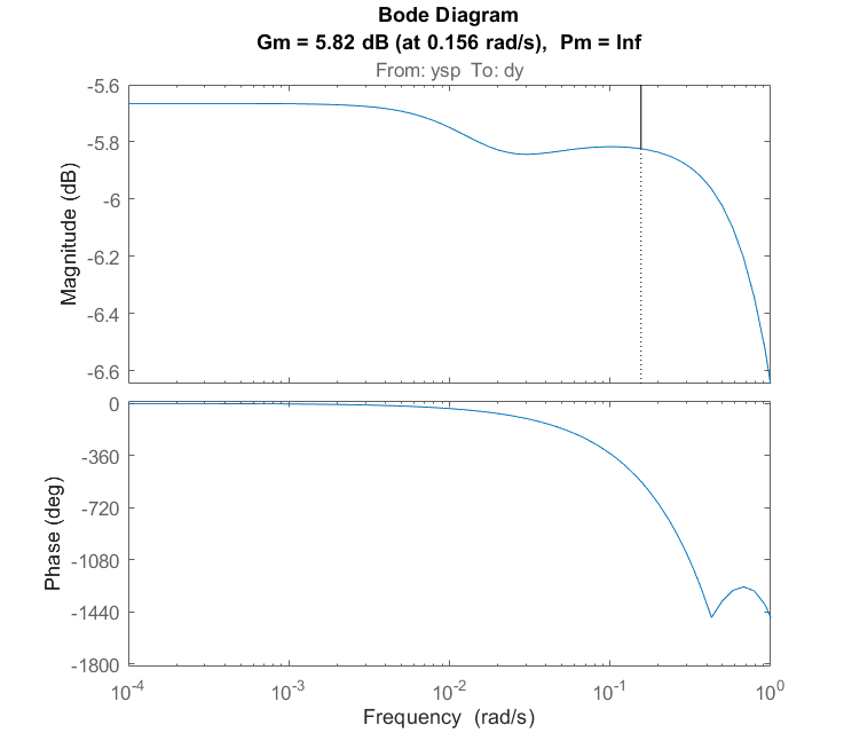
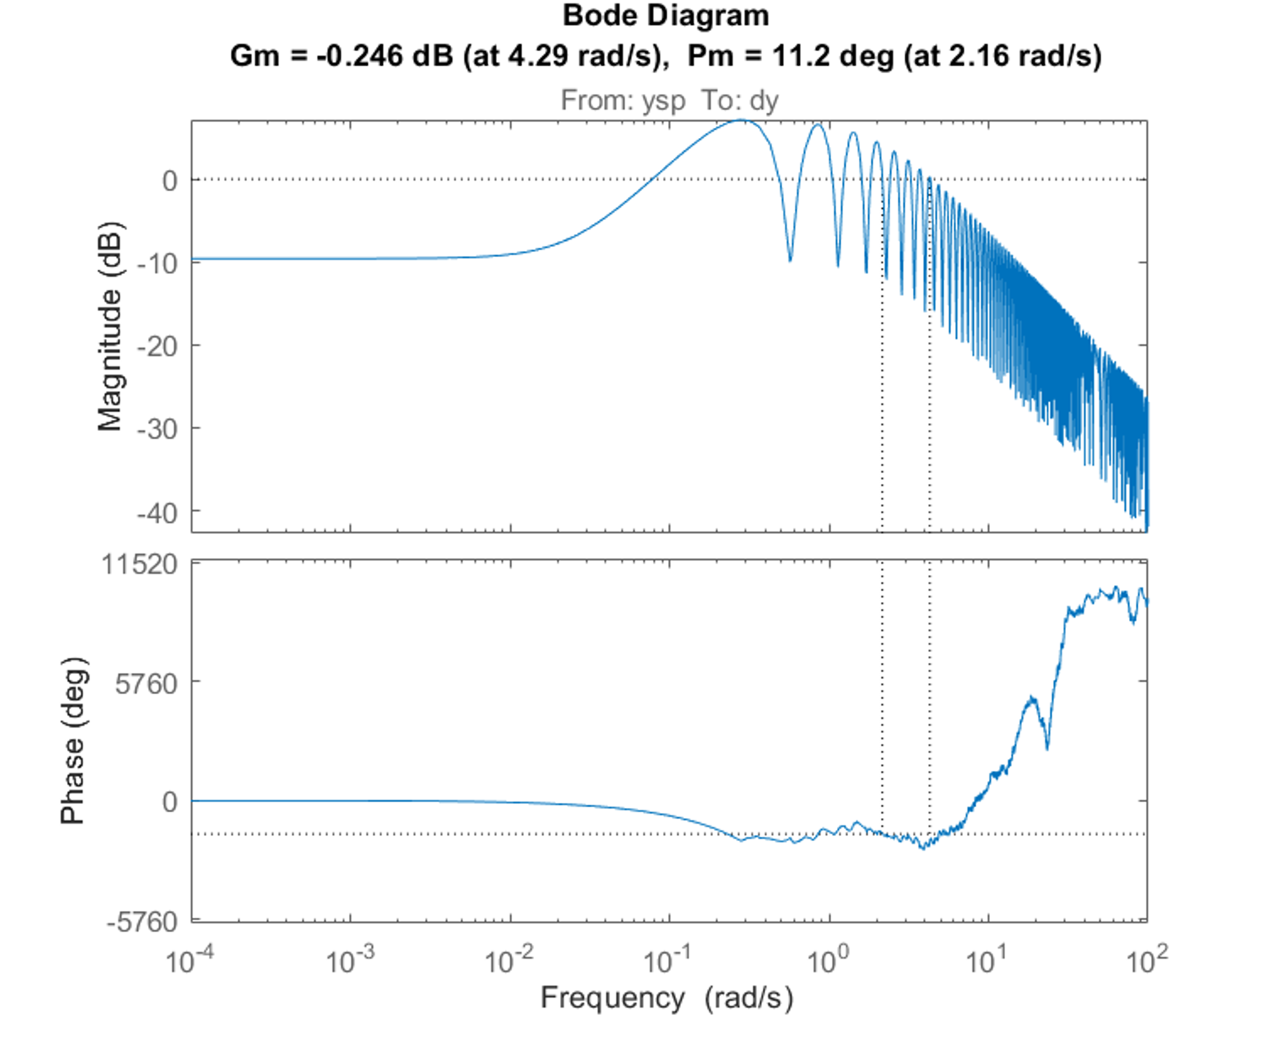


Smith predictor robustness
Modelling errors on delay and process model:
$$\tilde{p}\left(s\right)≠p(s)$$
$$e^{−s\tilde{θ}}\left(s\right)≠e^{−s\tilde{θ}}$$
Model error = 15%
Delay = 50 s + 15% error

Slide 23
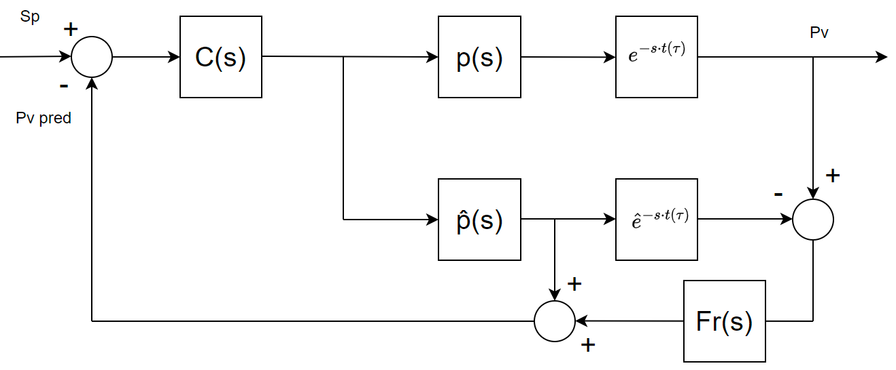
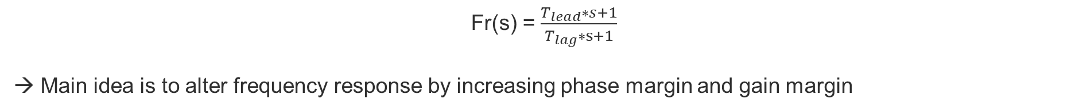
Filtered Smith predictor
Fr(s) = $\frac{T_{lead}∗s+1}{T_{lag}∗s+1}$
→ Main idea is to alter frequency response by increasing phase margin and gain margin

Slide 24
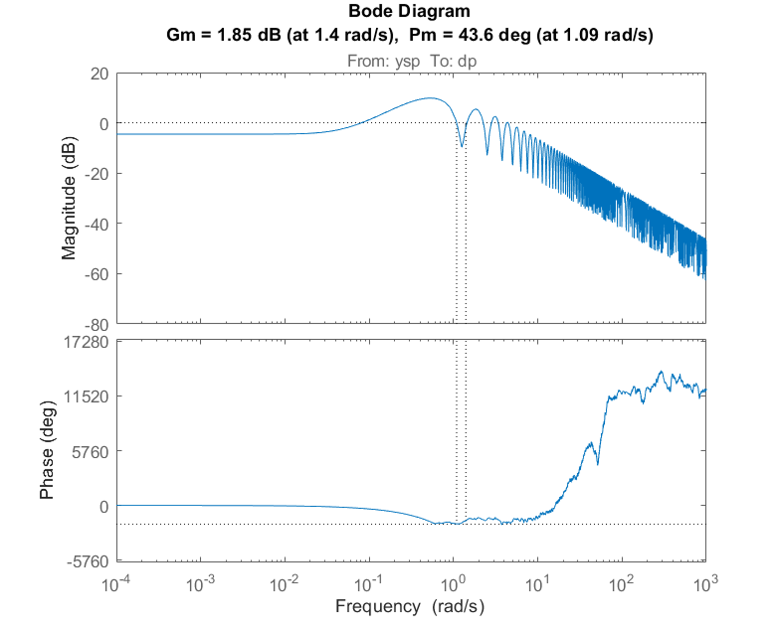
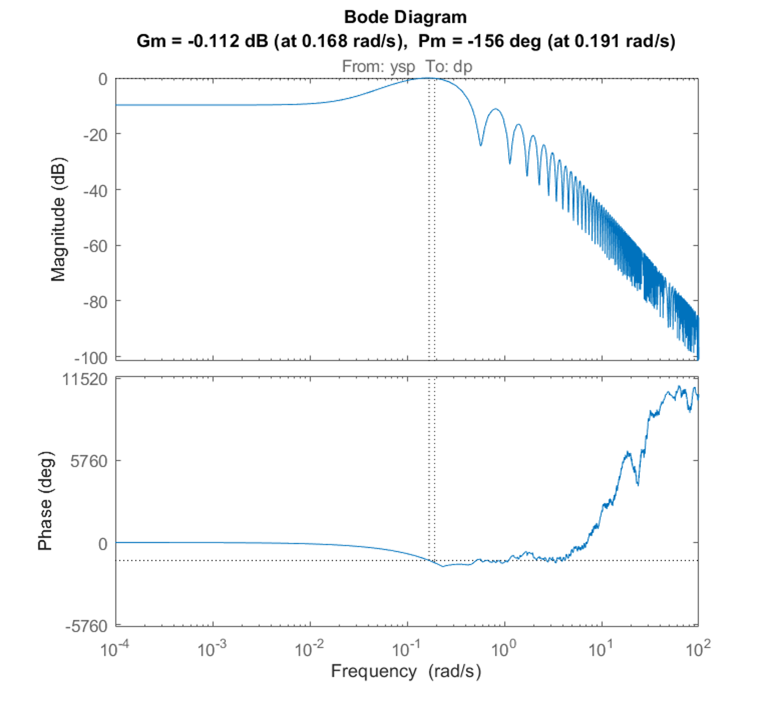
Filtered Smith predictor
Adaptive filter needed
Delay = 45 s + 15% error
Delay = 110 s + 15% error

Slide 25
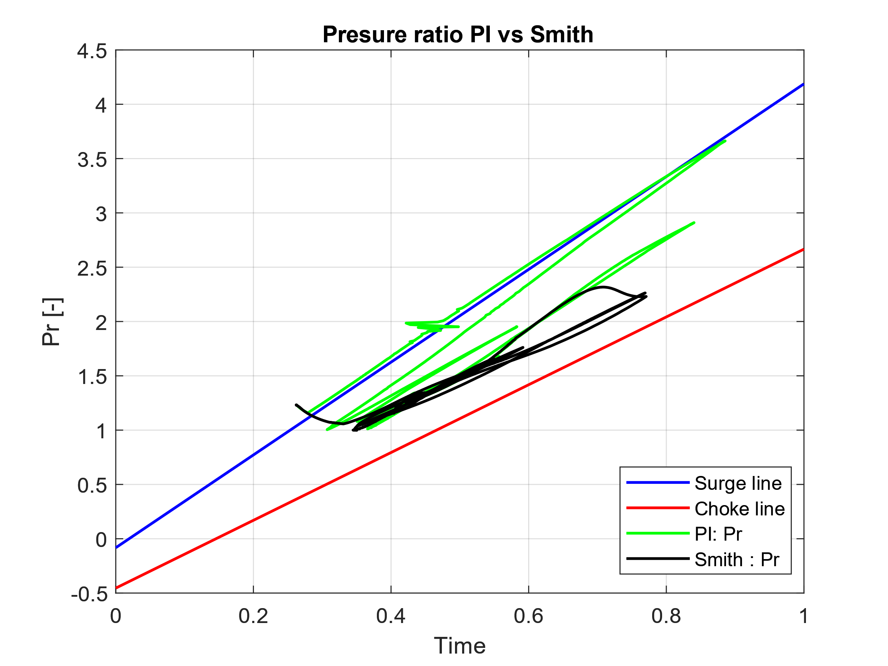
6. Controller comparison
PI controller doesn’t respect CCU constraints, slower and less table
SP controller handles CCU constraints, is faster but is susceptible to modelling errors

Slide 26
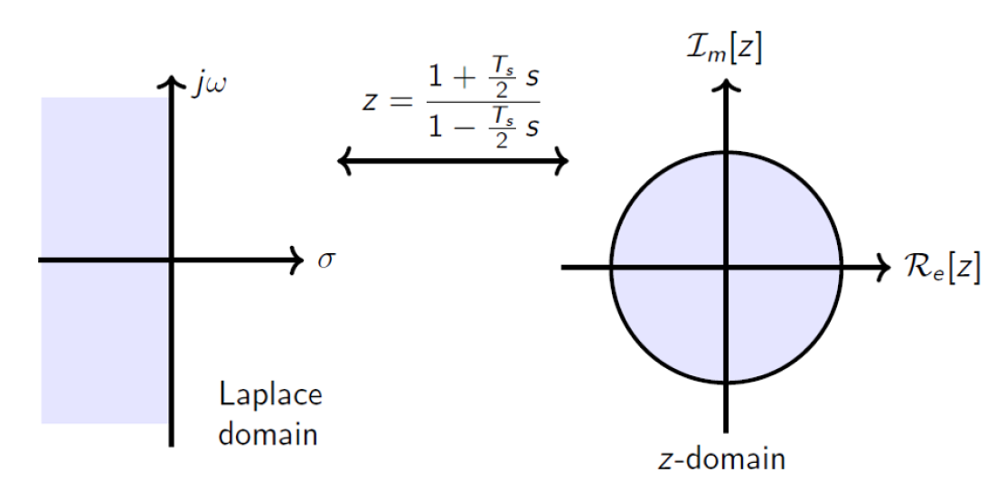
7. PLC implementation
Transfer functions are in continuous time → need to be discretized for PLC implementation.
Numerical integration methods to discretize model, bilinear (Tustin) transform.
Stable
→Continuous stable transfer functions remain stable after discretization
Stable

Slide 27
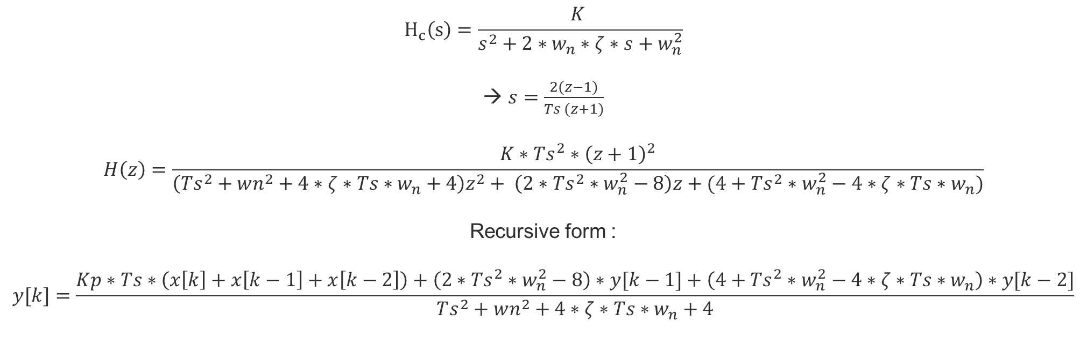
PLC implementation
The more complex a transfer function is, the more complex the discreet form is
$$H_{c}\left(s\right)=\frac{K }{s^{2}+2∗w_{n}∗ζ∗s+w_{n}^{2}}$$
$s=\frac{2(z−1)}{Ts (z+1)}$
$$H\left(z\right)=\frac{K∗Ts^{2}∗{\left(z+1\right)}^{2}}{\left(Ts^{2}+wn^{2}+4∗ζ∗Ts∗w_{n}+4\right)z^{2}+ \left(2∗Ts^{2}∗w_{n}^{2}−8\right)z+(4+Ts^{2}∗w_{n}^{2}−4∗ζ∗Ts∗w_{n})}$$
Recursive form :
$$y[k]=\frac{Kp∗Ts∗\left(x\left[k\right]+x\left[k−1\right]+x\left[k−2\right]\right)+\left(2∗Ts^{2}∗w_{n}^{2}−8\right)∗y[k−1]+\left(4+Ts^{2}∗w_{n}^{2}−4∗ζ∗Ts∗w_{n}\right)∗y[k−2]}{Ts^{2}+wn^{2}+4∗ζ∗Ts∗w_{n}+4}$$

Slide 28
8. Conclusion
PI performance is not robust due to delay effect on instability and constraints of the CCU
Smith Predictor achieved desired results based on stability and CCU constraints
  Modelling errors on the plant have less influence on stability
  Modelling errors on the delay require adaptive filter or max 15 % error as they cause instability
Imperative to limit delay modelling errors !
Next phase : test the smith predictor on the real process :
  Dead time comparison with measured data and calculation to ensure error <15 %
  New system identification to limit modelling error from simulation
  Compare PI and Smith predictor performance
  Validate the SP controller or improve the SP controller or propose a different design for robust dead time compensation

Slide 29
References
​Introduction to cryogenics for accelerators (2017) – Serge Claudet, CERN
​Cryogenics centrifugal compressors and circulators (2020) – Guy Gistau-Baguer, CERN
​Refrigeration – U. Wagner, CERN
​Cryogénie – Bernard Hébral, Grenoble
​Tutorial Modelling of Cryogenic systems in EcosimPro (2011) – Benjamin Bradu, CERN
​Digital control theory (2022) – De Bruyne Francky, ECAM Brussels Engineering School
​Practical process control (2023) - De Bruyne Francky, ECAM Brussels Engineering School
​System identification, linear theory (2023) - De Bruyne Francky, ECAM Brussels Engineering School
The control handbook (1996) - Editor – Williams S.Levine, IEEE press

Slide 30
Thank you!

