Slide 1






HIGHEST: high-gradient, high-temperature superconductors
This project has received funding from the European Union’s Horizon 2020 Research and Innovation programme under GA No 101004730.
Sergio Calatroni, on behalf of the Collaboration.

Slide 2
A view on Linear Colliders

Slide 3
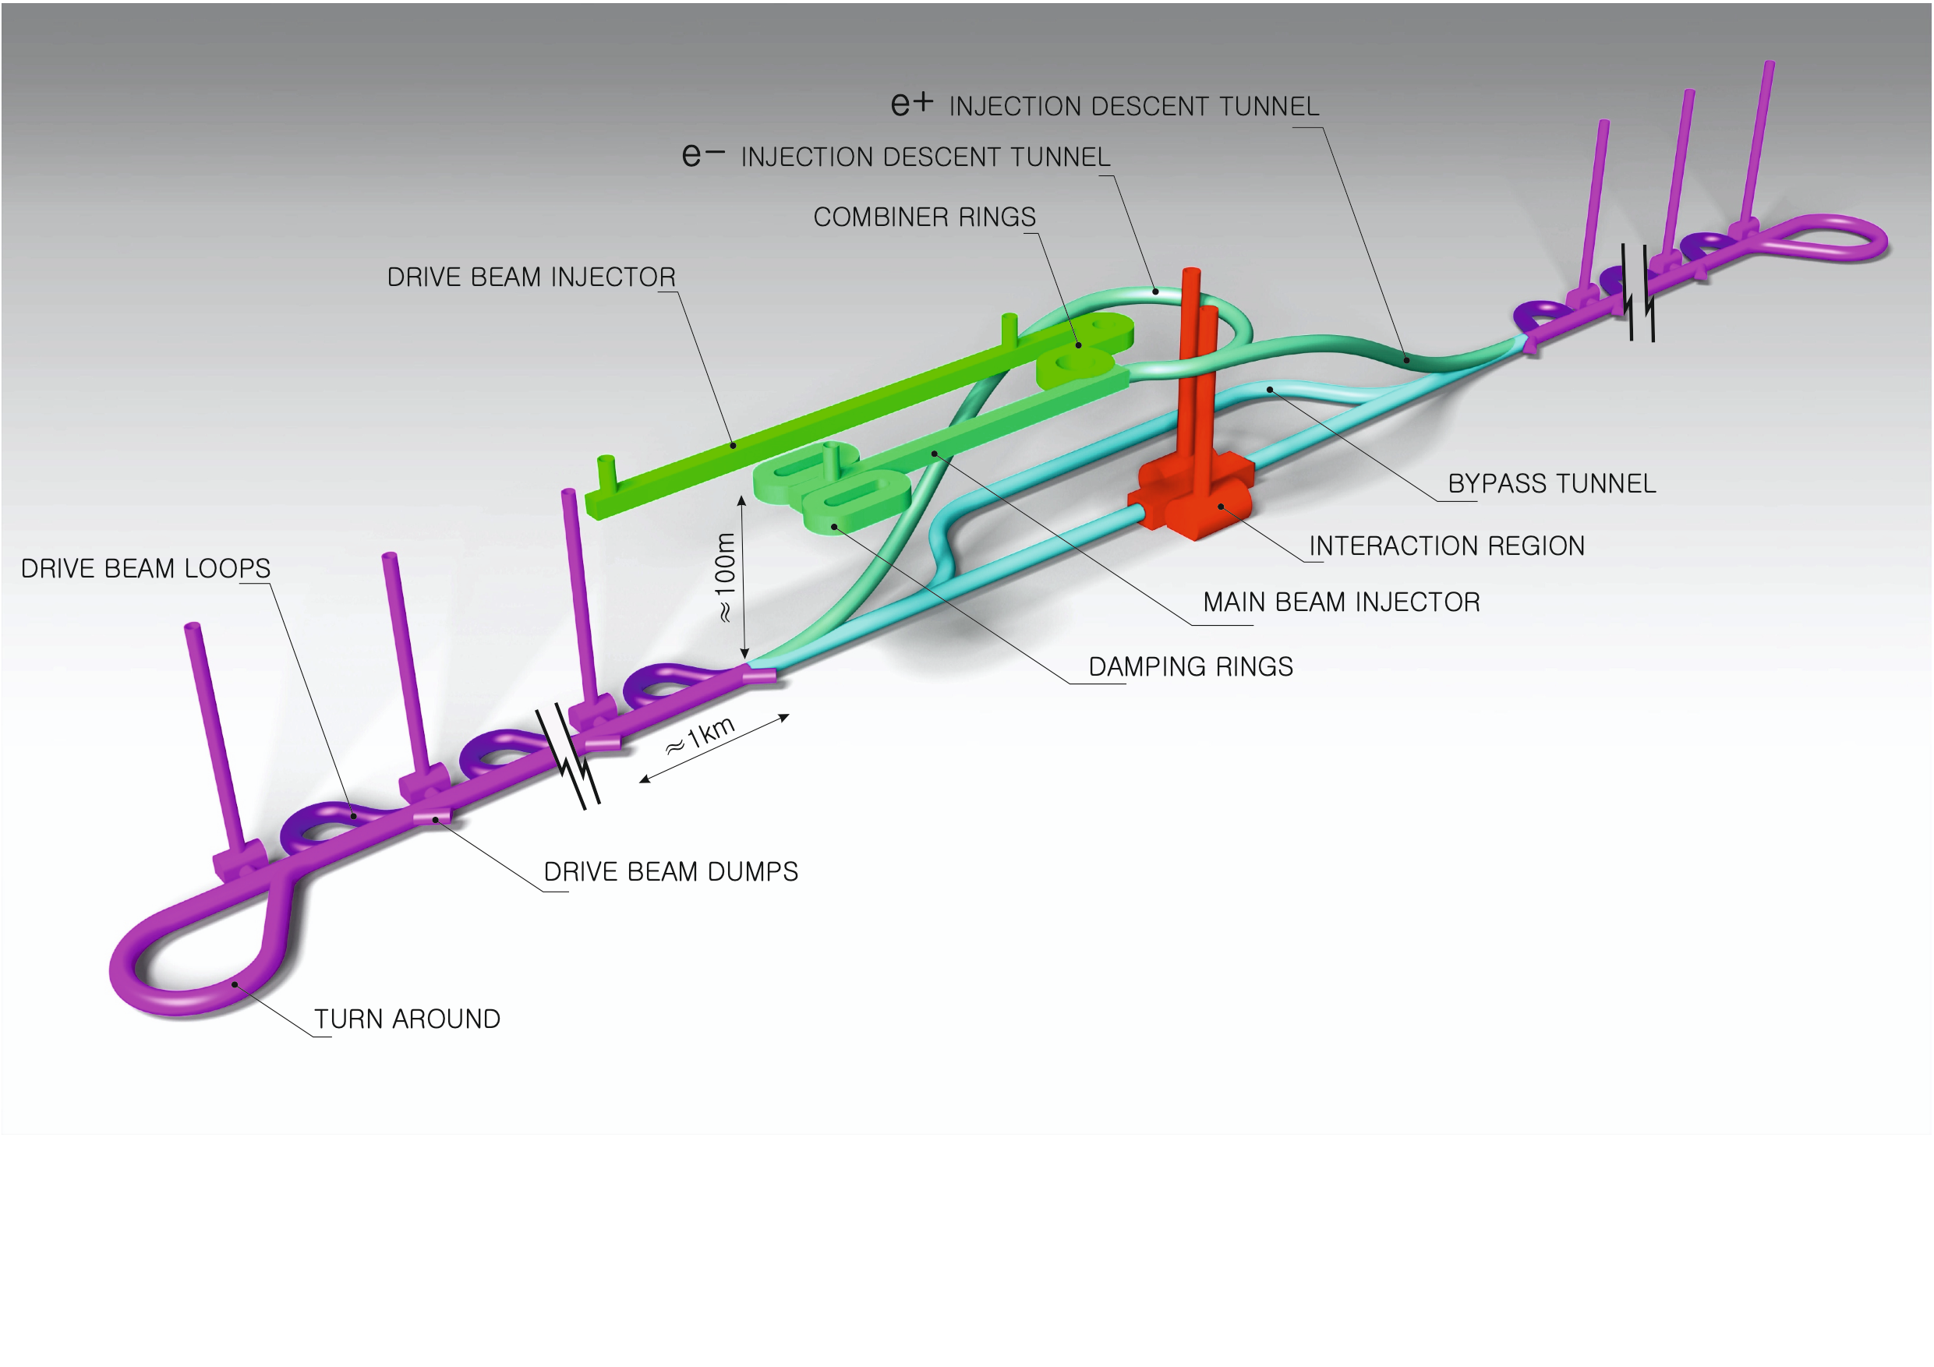
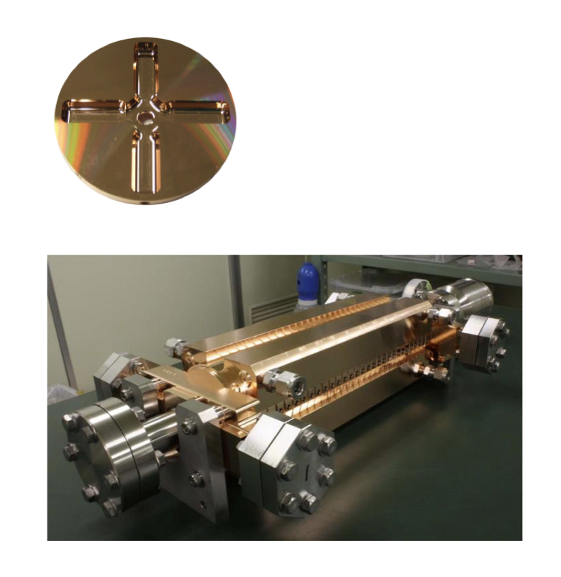
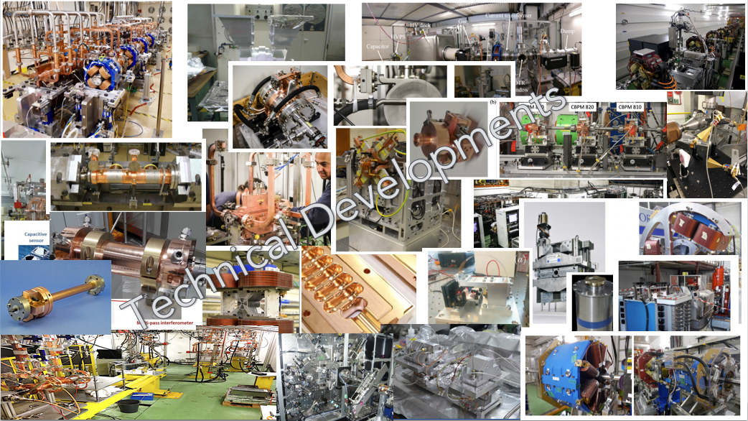
The Compact Linear Collider (CLIC)
  Recent talks: eeFACT-I1 and eeFACTI2
  Timeline: Electron-positron linear collider at CERN for the era beyond HL-LHC
  Compact: Novel and unique two-beam accelerating technique with high-gradient room temperature RF cavities (~20’500 structures at 380 GeV), ~11km in its initial phase
  Expandable: Staged programme with collision energies from 380 GeV (Higgs/top) up to 3 TeV (Energy Frontier)
  CDR in 2012 with focus on 3 TeV. Updated project overview documents in 2018 (Project Implementation Plan) with focus 380 GeV for Higgs and top.
Accelerating structure prototype for CLIC: 12 GHz (L~25 cm)
The CLIC accelerator studies are mature:
Optimised design for cost and power
Many tests in CTF3, FELs, light-sources and test-stands
Technical developments of “all” key elements
From: Steinar Stapnes

Slide 4
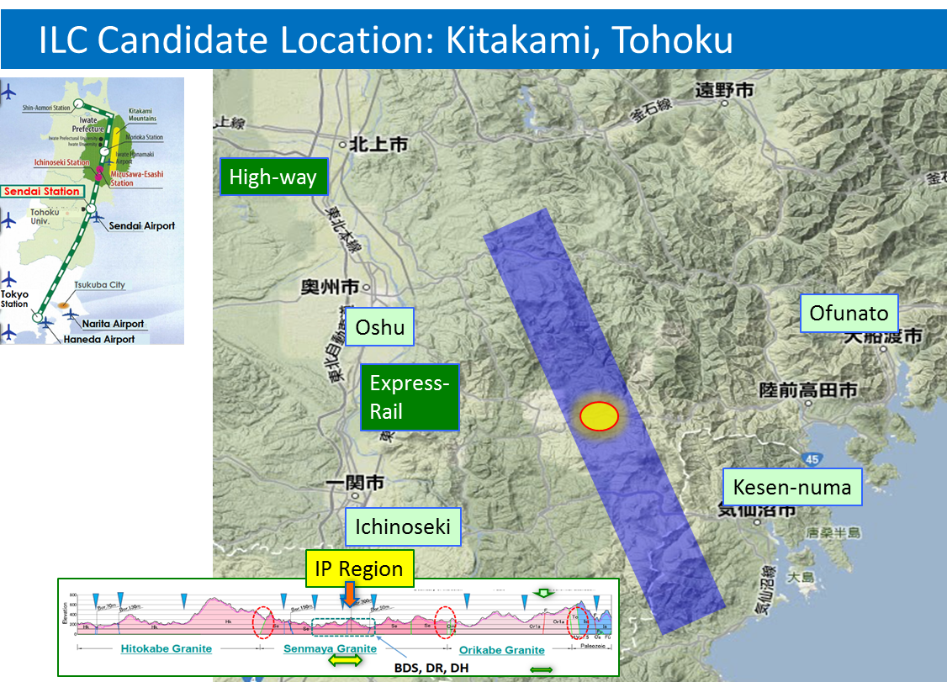
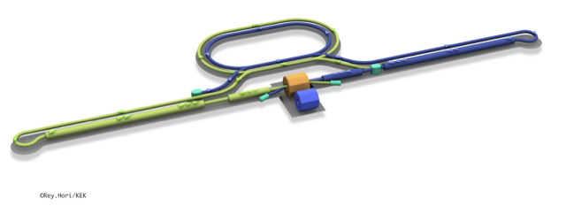
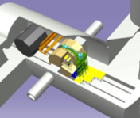
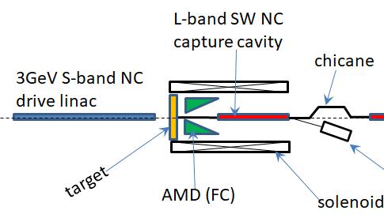
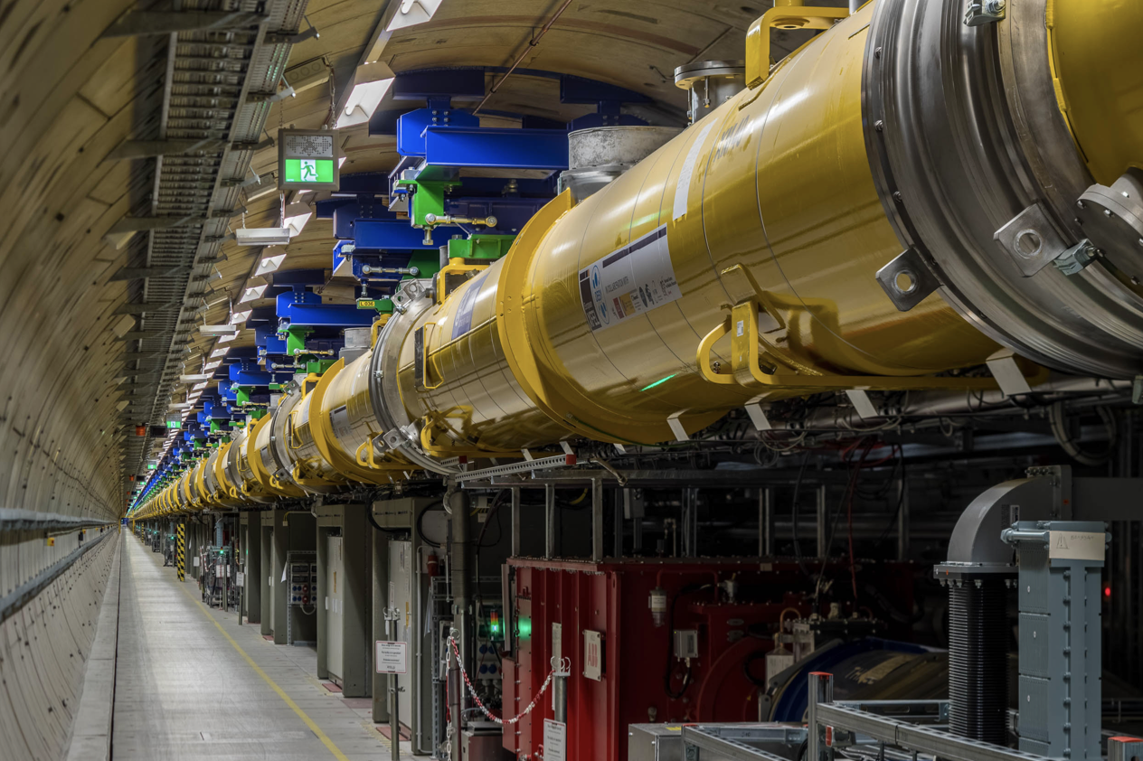
The ILC250 accelerator facility
  Recent talks: eeFACT-I1 and eeFACTI2
Interaction point
Damping Ring
e+ Source
e- Source
e- Main Linac
Beam dump
Physics Detectors
e+ Main Liinac
Bunches of ~10¹⁰ e+/e-
Undulator positron source
Creating particles Sources
  polarized elections/positrons
High quality beam Damping ring
  low emittance beams
Acceleration Main linac
  superconducting radio frequency (SRF)
Collide them Final focus
  nano-meter beams
Go to Beam dumps
Electron driven positron source
From: Steinar Stapnes

Slide 5
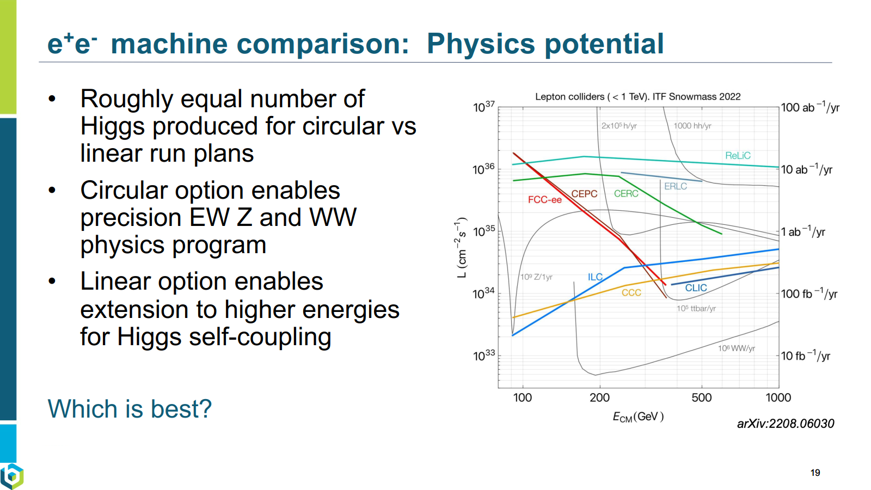
From JoAnne Hewett, FCC week 2024

Slide 6
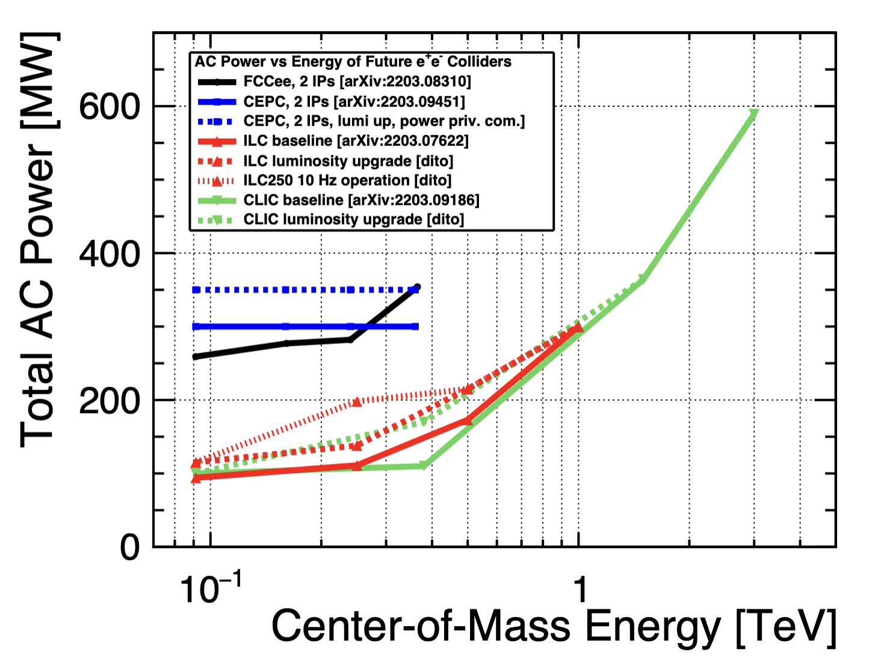
Power and energy: future colliders
Linear collider studies predict roughly similar power consumption for equivalent machines (ILC vs CLIC)
From: Steinar Stapnes

Slide 7
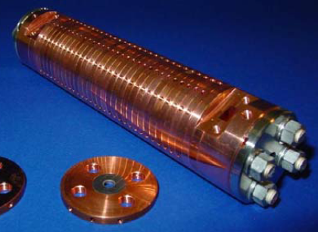
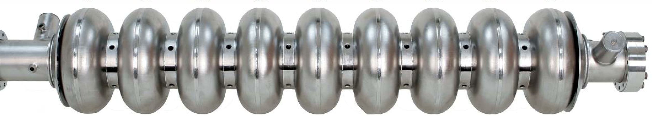

How can SC and NC have the same power consumption?
Linear collider RF systems fall in two categories
Despite the ~10⁶ difference in quality factor, (~10³ considering cryo efficiency), pulsing at low duty factor allows reducing the average consumption for NC accelerating structures down to the SC level – which cannot be effectively be pulsed
We want to verify whether HTS in pulsed RF mode allows a further power gain compared to both Nb and Cu
SC niobium, Q₀≈10¹⁰, 35 MV/m, CW
$R_{s}∝{1/Q}_{0}$ $P=\frac{1}{2}R_{s}H^{2}$
NC copper, Q₀≈10⁴, 100 MV/m, pulsed

Slide 8
C3, a new kid on the block?
More info on C³ here
Improvements in Q factor compared to copper could pave the way for energy savings
From: Emilio Nanni

Slide 9
Background of HIGHEST

Slide 10
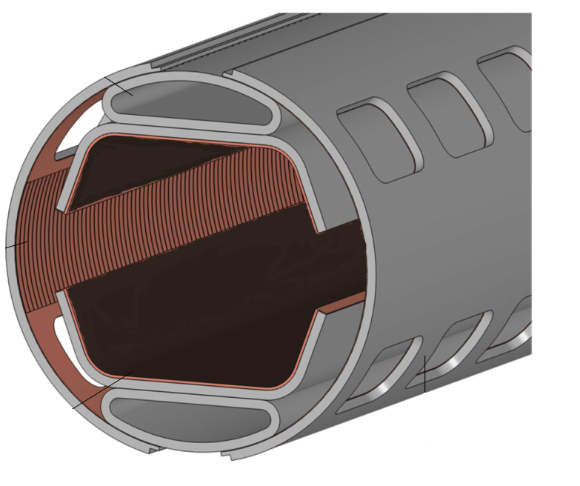
HTS for the FCC-hh beam screen
FCC-hh, a proposed 100 TeV p-p collider at CERN, with 16 T dipoles operated at 1.9 K
A beam screen held at 50 K, to protect the dipoles from synchrotron radiation ~30 W/m/beam (LHC < 0.2 W/m)
HTS materials instead of copper in the FCC-hh beam screen,
to improve beam stability (-> impedance) at 50 K
Bunched particle beams produces RF fields, up to ~1 GHz
Extremely challenging requirements:
  HTS must operate at 50 K and 16 T
  Critical fields Hc₂ , H_{irr} >> 16T
  J_{c} > 25 kA/cm² (2.5x10⁸ A/m²)
  Surface resistance R_{s} better than for copper
Compatible with accelerator environment
  Minimize dipole field distortion due to persistent currents
  UHV compatible, low SEY, lifecycle assessment, etc..
16 Tesla !
Calatroni, IEEE TAS 26, 3500204 (2016)
Calatroni et al, SuST 30, 075002 (2017)

Slide 11
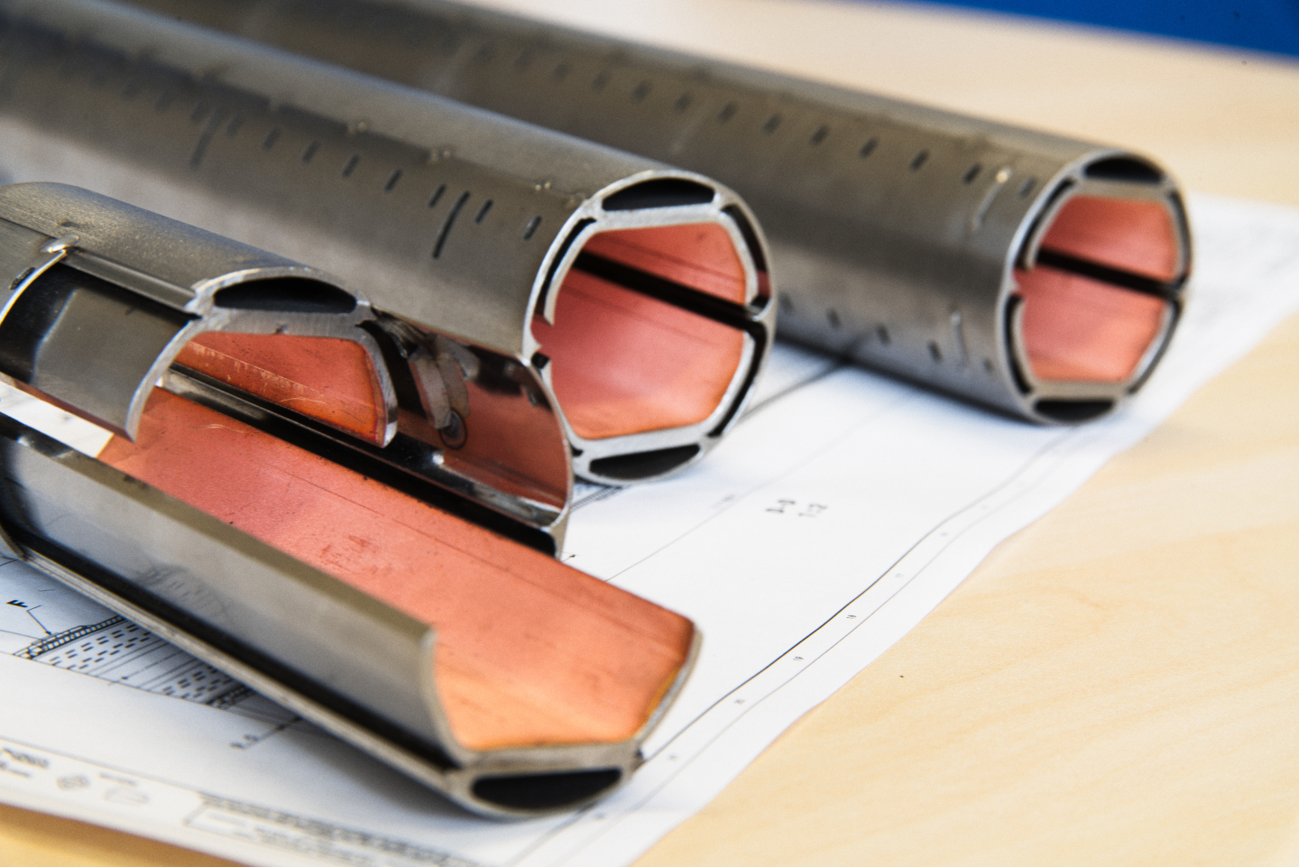












Two material choices
Manufacture the screen using REBCO tapes soldered to the screen
Coat the inside of the screen
with Tl-1223 films

Slide 12
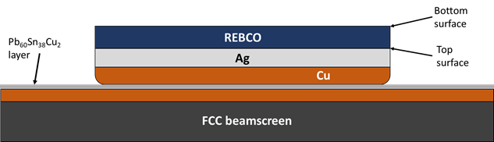
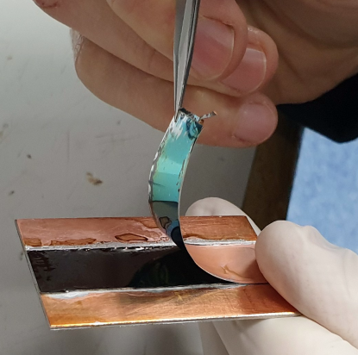
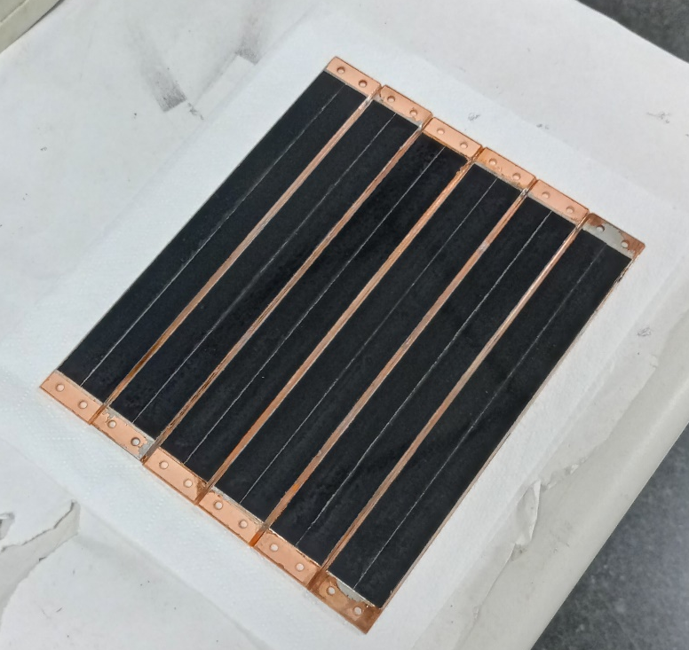
Development of soldering technology
Solder
HTS tapes
Solders based on
Sn / Pb / Cu / Bi & In
temperatures < 220ºC
CC
Beamscreen
2x80 km of beam screens to be coated with HTS

Slide 13
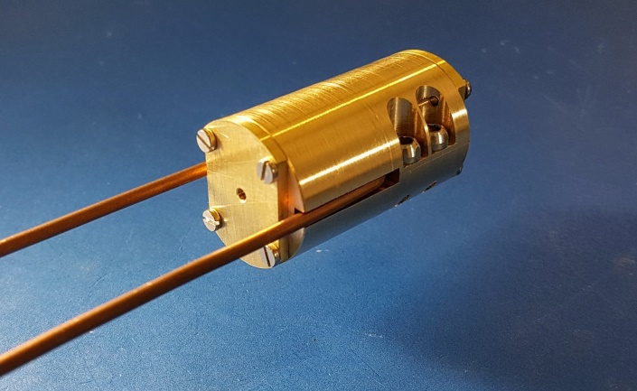
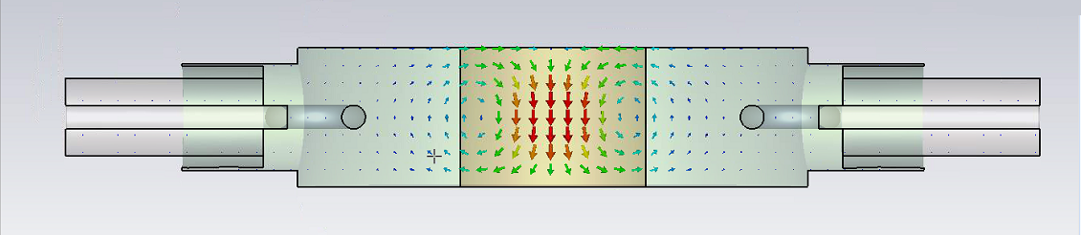
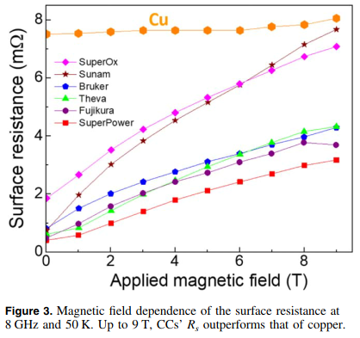
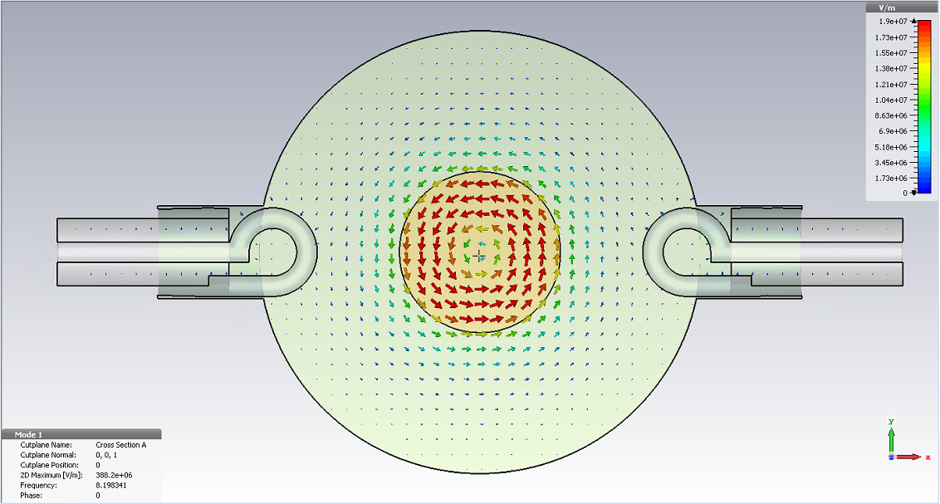

Validation of RF performance (UPC - ICMAB)
In house developed 8.05 GHz cavity resonator compatible with 25mm bore 9 T magnet at ICMAB
REBCO CCs outperform Cu at 50K and up to 9T
R_{S} is microstructure dependent
Surface currents equivalent to 0.1 MV/m of a typical accelerating cavity
Puig et al, SuST 32, 094006 (2019)

Slide 14
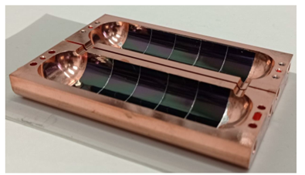
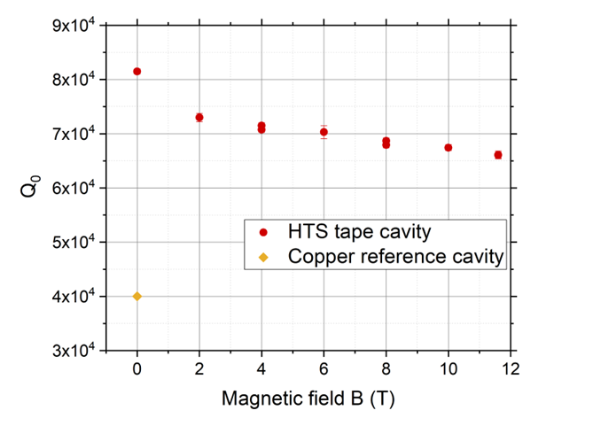
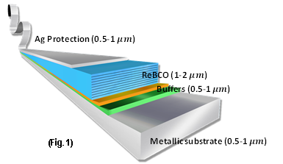
First real cavity, f≈9 GHz
We have developed a technology for applying 2D HTS tapes to 3D RF “RADES” cavities demonstrating the potential of HTS for RF applications J. Golm et al., IEEE TAS, Vol. 32, No. 4, (2022) 1500605
2x improvement of RF quality factor compared to copper
(newer prototype 5x improvement)
12 mm-wide HTS tapes
RADES cavity for axion searches

Slide 15
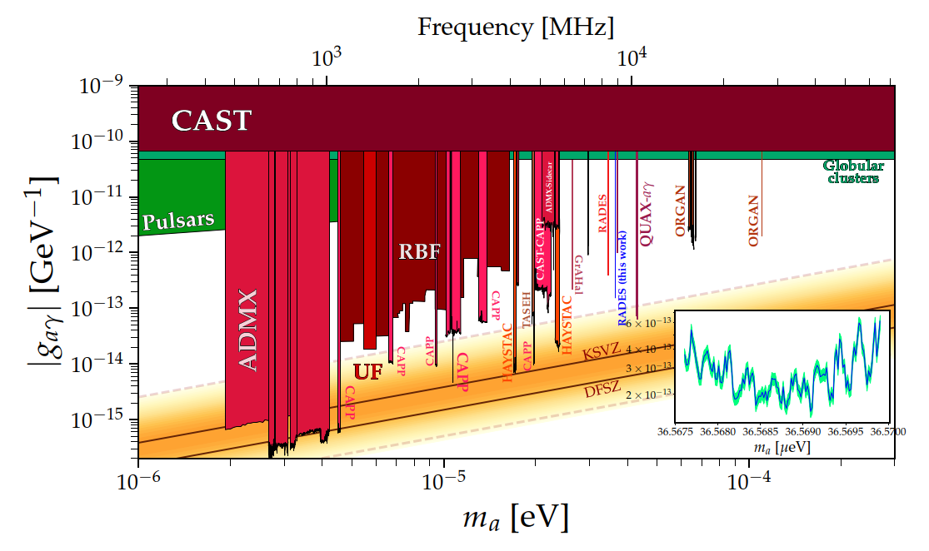
First published physics results with an HTS coated cavity
arXiv:2403.07790

Slide 16
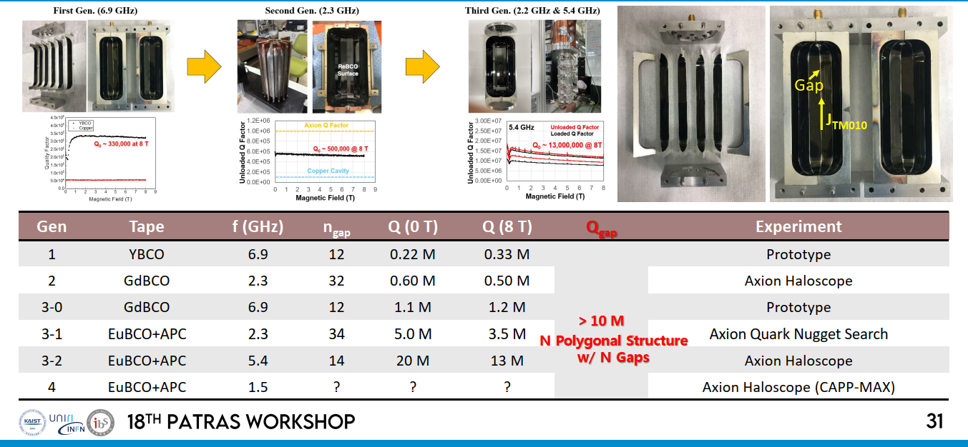
Other results from CAPP
3.5x10⁻⁵ Ω
2.2x10⁻⁵ Ω
From: D. Ahn, CAPP. More info at Patras Workshop

Slide 17
Goals of HIGHEST

Slide 18
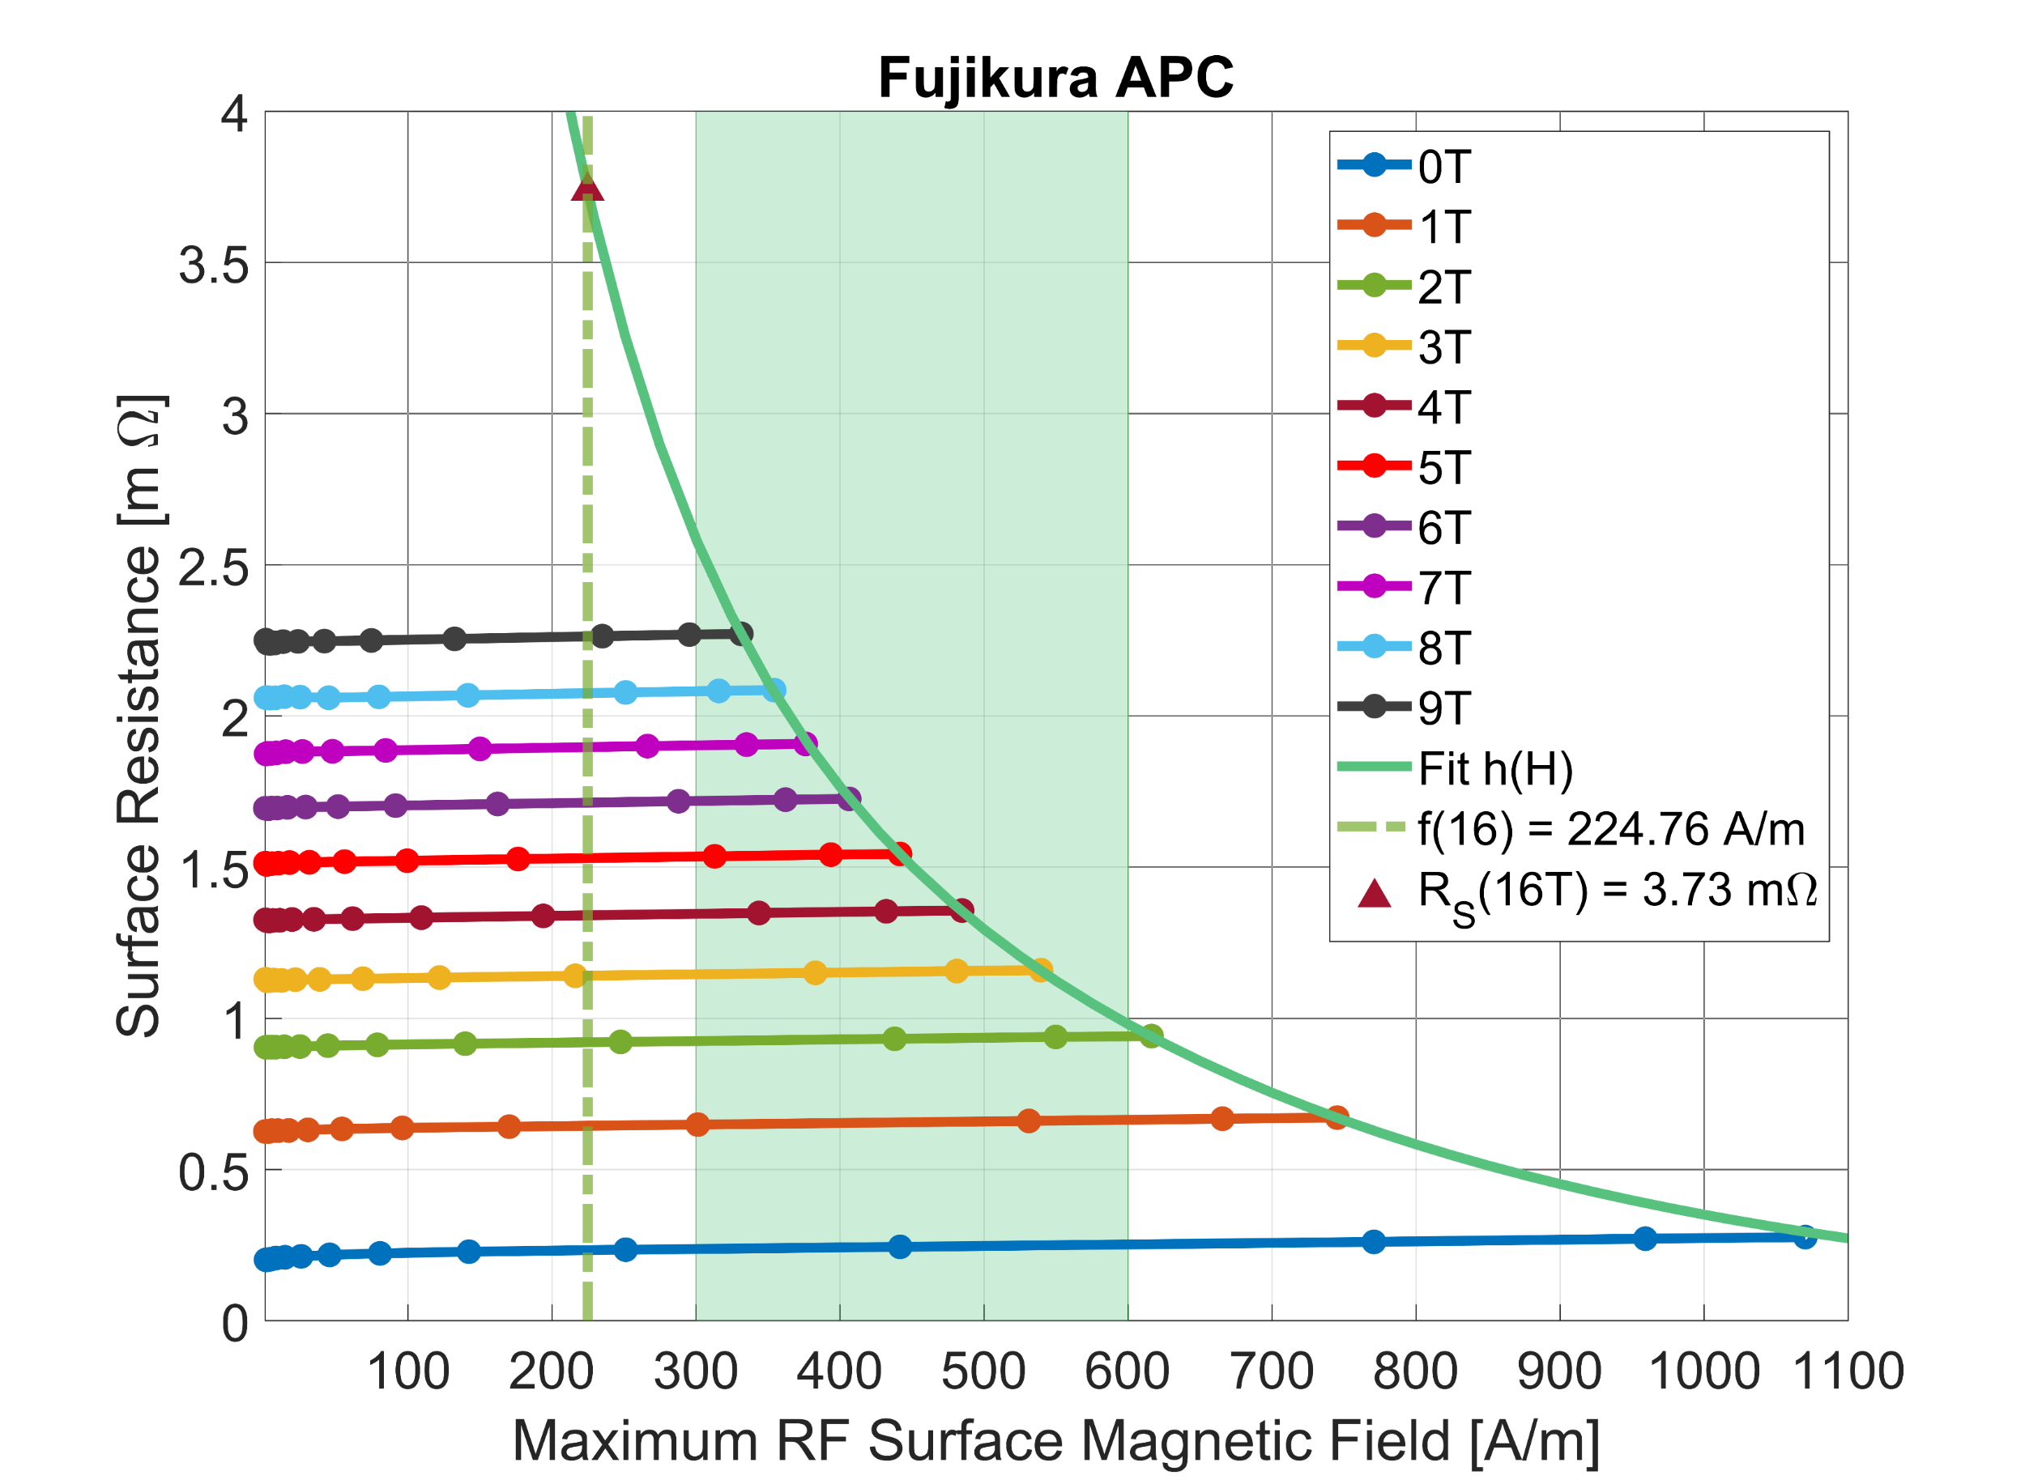
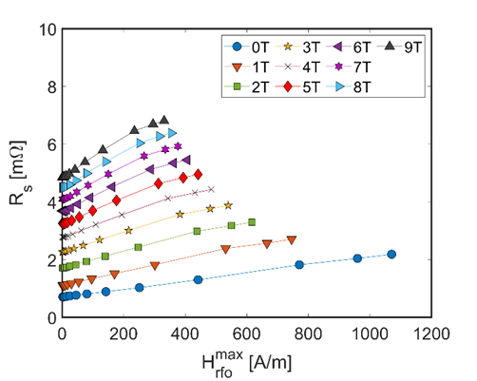
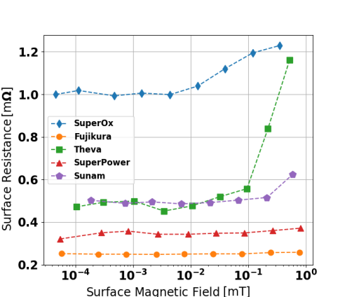
ICMAB – UPC: testing at higher RF power
THEVA inclined deposition
0 T external field
HTS coated conductors at 8 GHz (dielectric resonator) and 50 K
Patrick Krkotic, PhD dissertation, UPC Barcelona 2022

Slide 19
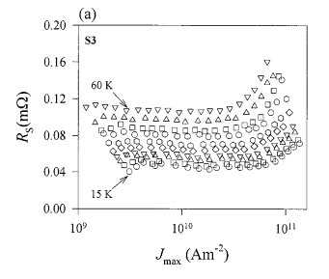
Literature review
There are very few measurements on HTS at high RF currents (mostly microstrip resonators). But physics is proven.
~10¹¹ A/m² RF current (microstrip resonator, 200 µm, 350 nm thick, 8 GHz)
Powell et al. Journal of Applied Physics 86, 2137 (1999)
For 1 µm thickness this is equivalent to 10⁵ A/m (≅ 0.1 T ≅ 25 MV/m)
Entering the “high-gradient” range

Slide 20
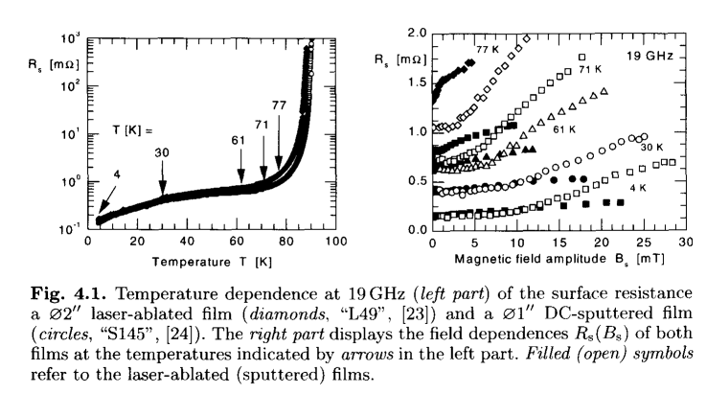
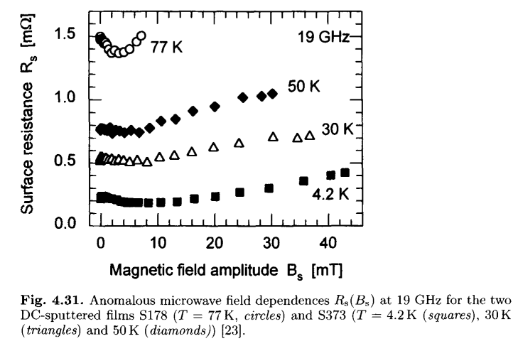
Literature review - II
From: M. Hein, “High-Temperature-Superconductor Thin Films at Microwave Frequencies” (Springer Tracts in Modern Physics, 155)

Slide 21
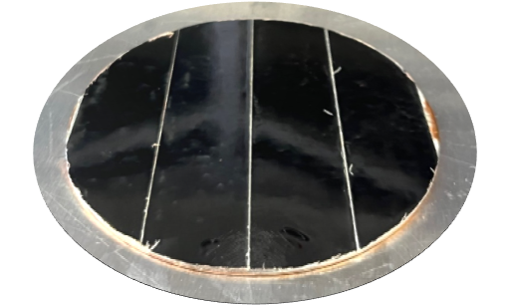
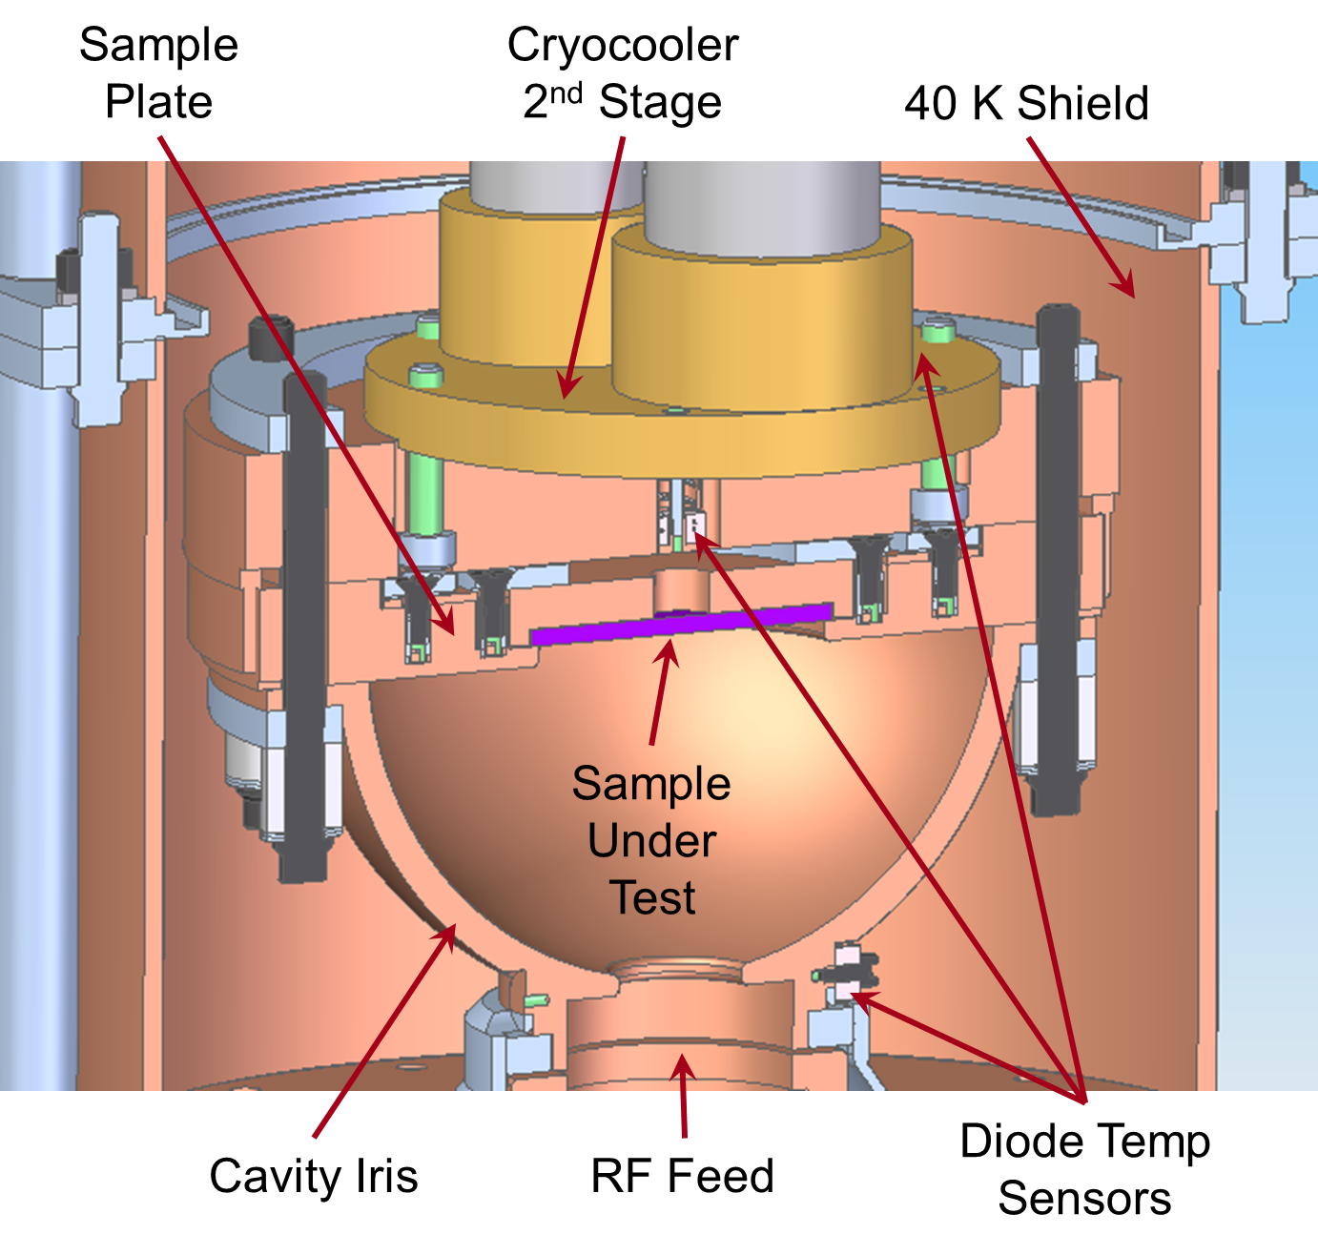
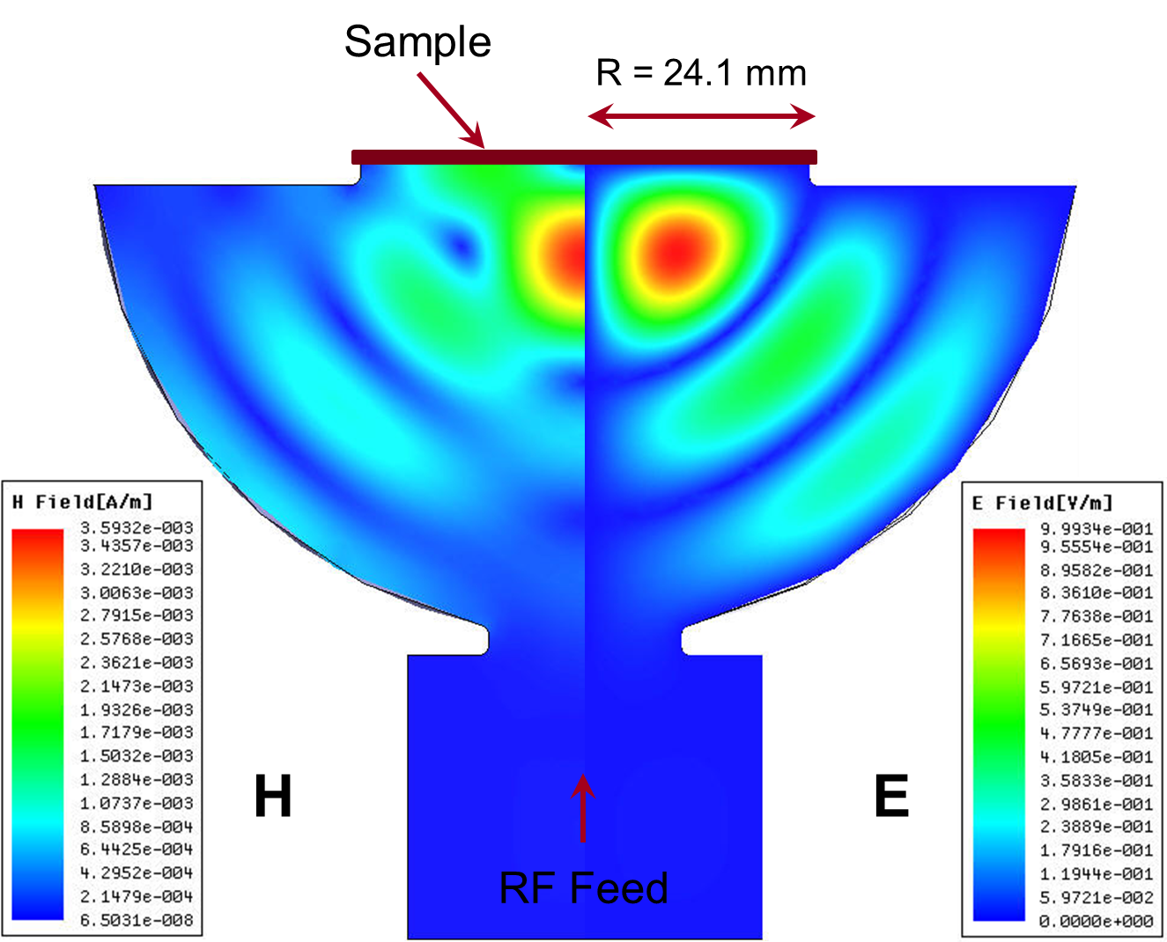
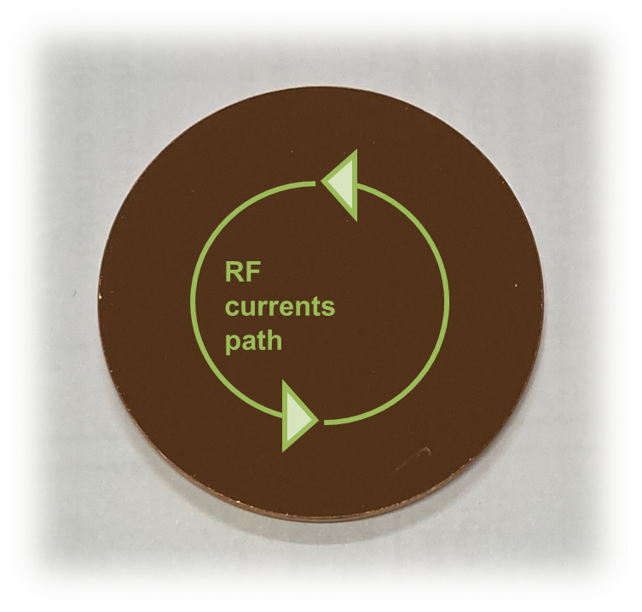
High-gradient testing at SLAC – supported by I.FAST IIF
“Mushroom” cavity. Can achieve H_{peak} of about 360 mT – 2.9x10⁵ A/m (equivalent to ~80 MV/m in a standard accelerating cavity) using 50 MW XL-4 Klystron at 11.4 GHz.
Zero E-field on the sample
Maximum H-field on the sample
Sample accounts for ⅓ of total cavity loss
Goal: demonstrate and qualify high-gradient pulsed operation of HTS, at cryo-temperatures

Slide 22
Work plan from 4/2023 to 4/2025

Slide 23
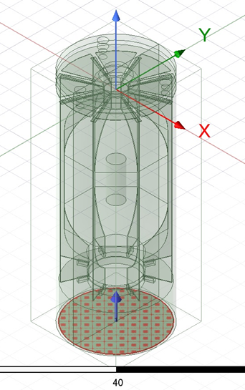
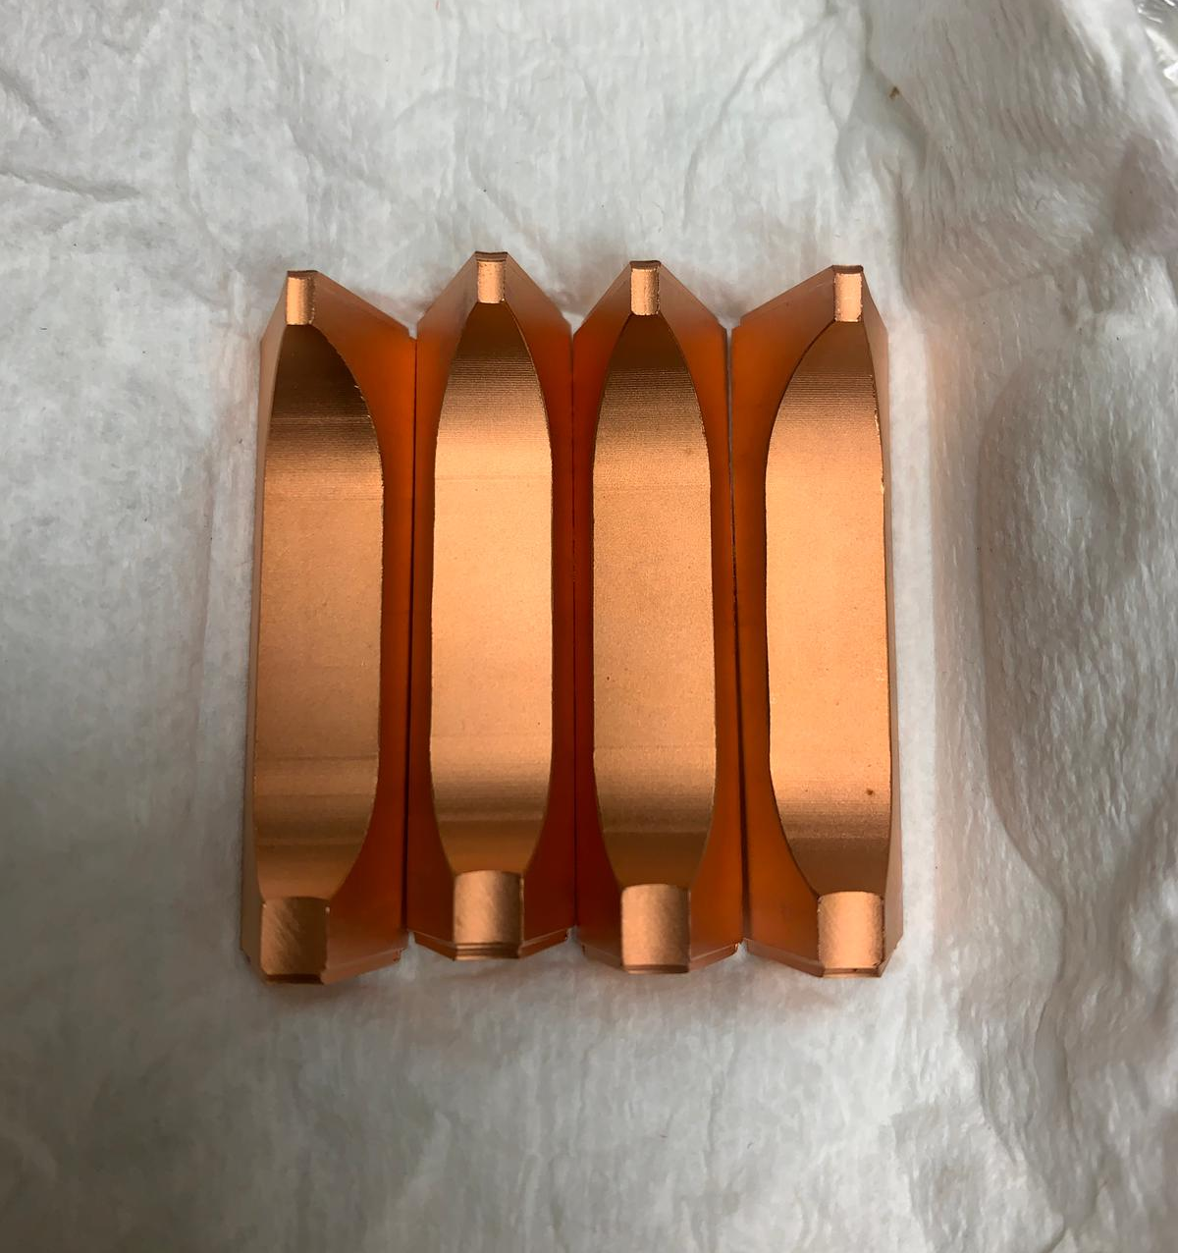
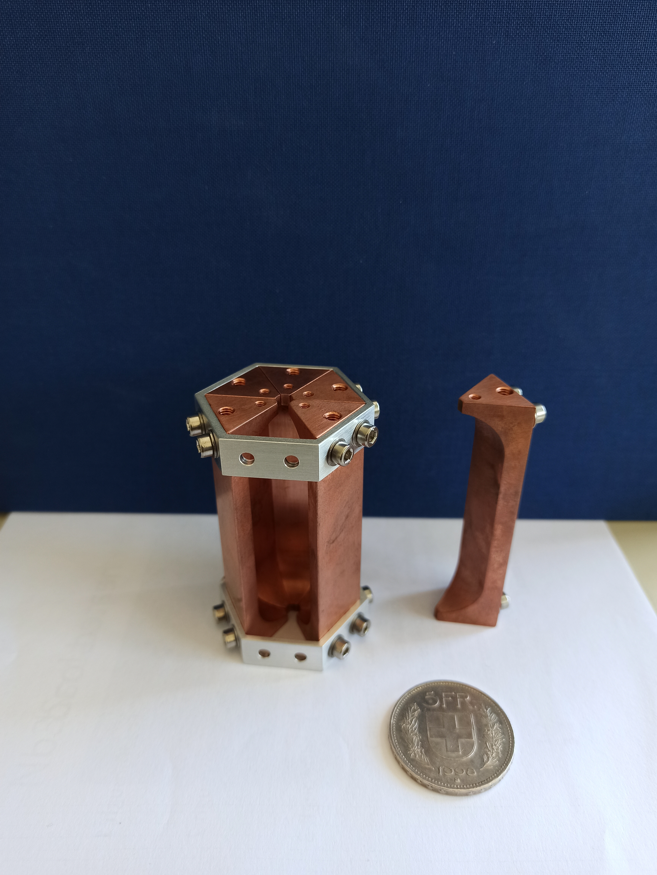
Segmented cavities
CERN
Segmented
cavity for
axion
detection
SLAC
Segmented
cavity for
RF pulse
compressor

Slide 24
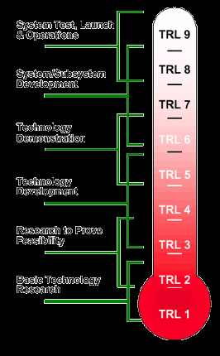
Industrial application prospect
At the end of this study, we aim at consolidating TRL4.
Prototype pulse compressor with SLAC will demonstrate TRL6.
  Timescale: 2-3 years after completion of this study
  Need a further round of funding
  This will include the design, fabrication and coating, and its validation in a high-power RF bench test bench.
Future accelerator projects will drive achieving further TRLs and drive commercialization.
  Industry will be involved for construction of devices
  Other companies may be involved for hardware manufacturing

Slide 25

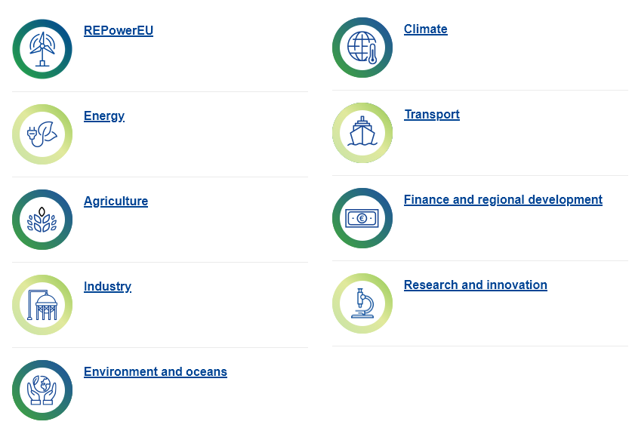
Addressing the European Green Deal
New-generation collider linacs are expected to use hundreds of MW of electricity
Energy savings from HTS are in line with current policies of societal impact minimization
Benefits
Actions

Slide 26
Resources and budget
CERN:
  Provided resources: two senior physicist (scientific coordination, 0.2 FTE) and one senior Fellow (follow up, measurements, 0.5 FTE)
  Requested resources: 10 kEUR (sample manufacturing)
KCT:
  Provided resources: one senior scientist (design, procurement, coating, 1 FTE)
  Requested resources: 100 kEUR (80 kEUR manpower for coating operations, 20 kEUR sample holder manufacturing)
CSIC-ICMAB:
  Provided resources: one senior scientist (0.2 FTE), and one PhD student (0.5 FTE)
  Requested resources: 50 kEUR (40 kEUR PhD student and manpower for coating and characterization work, 10 kEUR consumable)
Ratio for the requested IIF funds: 120 kEUR personnel and labour / 40 kEUR material
Final deliverable is a report on the demonstrated achieved performance, and on the prospects for scalability to accelerator-scale RF devices.

Slide 27
Budget table
 | Manpower | Materials | Total
CERN |  | 10 kEUR | 10 kEUR
KCT | 80 kEUR | 20 kEUR | 100 kEUR
CSIC-ICMAB | 40 kEUR | 10 kEUR | 50 kEUR
 |  |  | 160 kEUR

Slide 28
A possible future ?

Slide 29

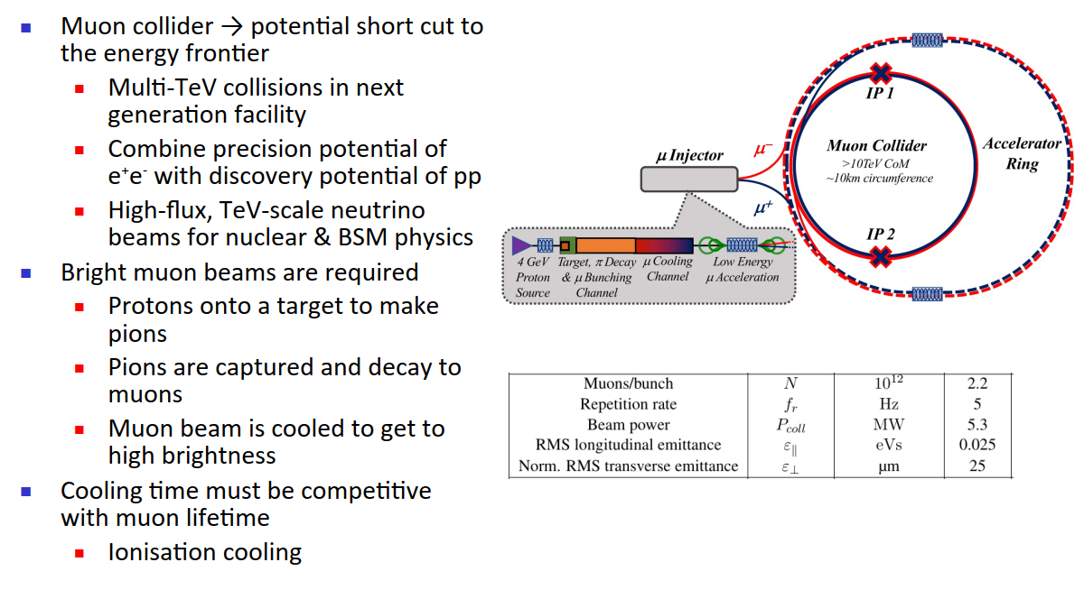

Muon Collider
From: Chris Rogers

Slide 30
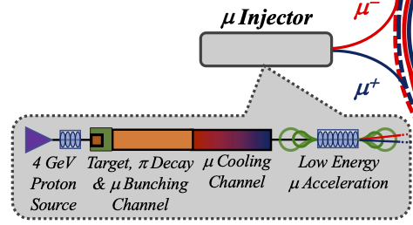
Muon collider
Muon cooling system requires RF cavities operating at high-gradient AND in a strong magnetic field.
Normal conducting copper, possibly cryo: baseline option
A dream: High-Temperature Superconductors ?

Slide 31
Final remarks
No data exist for modern HTS at high-gradient RF (either samples or cavities): experiments needed
Fabrication technologies for real cavities must be developed:
wider soldered tapes within the iFAST collaboration “HIGHEST”
Eventually, develop a direct HTS coating technique on copper

Slide 33
High-temperature Superconductors

Slide 34
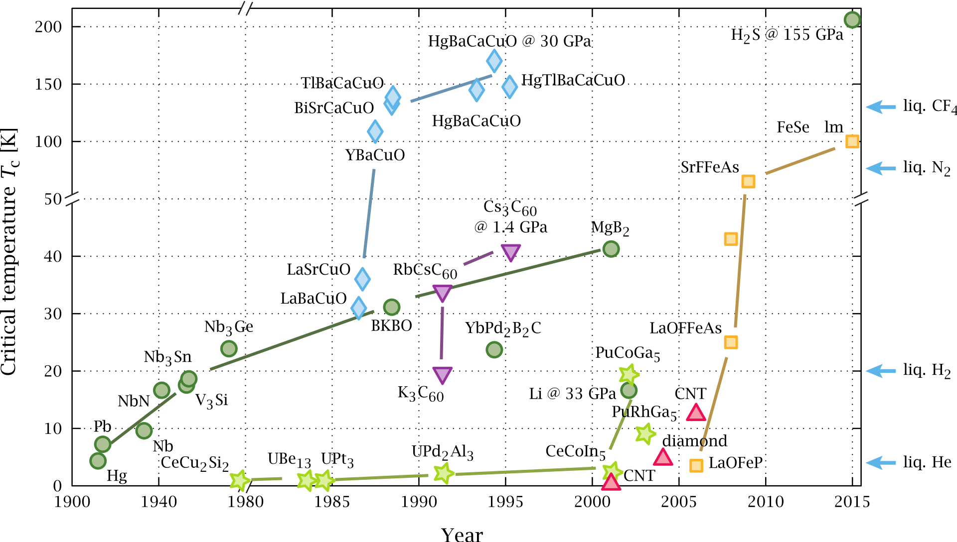
Superconductors zoo
By PJRay - Own work, CC BY-SA 4.0, https://commons.wikimedia.org/w/index.php?curid=46193149

Slide 35
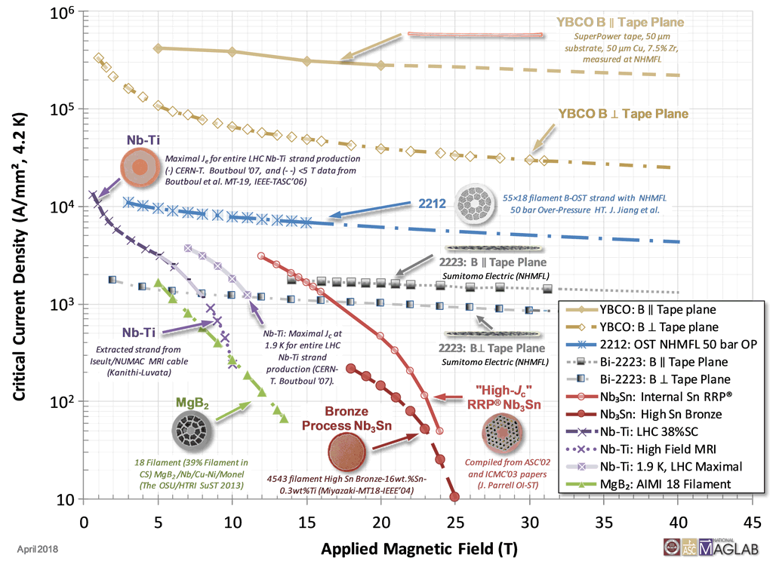
Zoo of superconductors
J_{c} may vary of orders of magnitude.
H_{c2} has much smaller variation.
YBCO most promising candidate
NbTi – NbTiN possible candidates at B < 10T
Nb₃Sn for B < 15 T
https://nationalmaglab.org/magnet-development/applied-superconductivity-center/plots

Slide 36
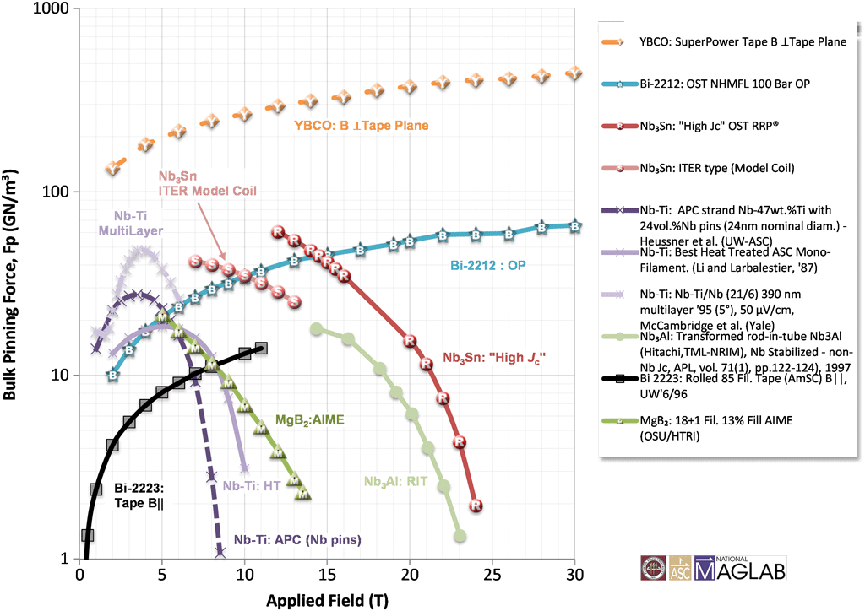
Zoo of superconductors
Pinning force
https://nationalmaglab.org/magnet-development/applied-superconductivity-center/plots

Slide 37
First: a caveat
HiPIMS +DC Bias
J_{C} decrease is guiding the development of Nb/Cu films
Rationale:
Results from HIE-ISOLDE and bulk Nb
Modelling of losses as hysteretic losses from RF fluxons penetration
Existing HTS Coated Conductors might not be the best choice at high-gradient RF, being optimized for flux pinning
Nb/Cu samples
HIE-ISOLDE
Bulk Nb
4K, 250mT
From: Carlota Pereira Carlos

Slide 38
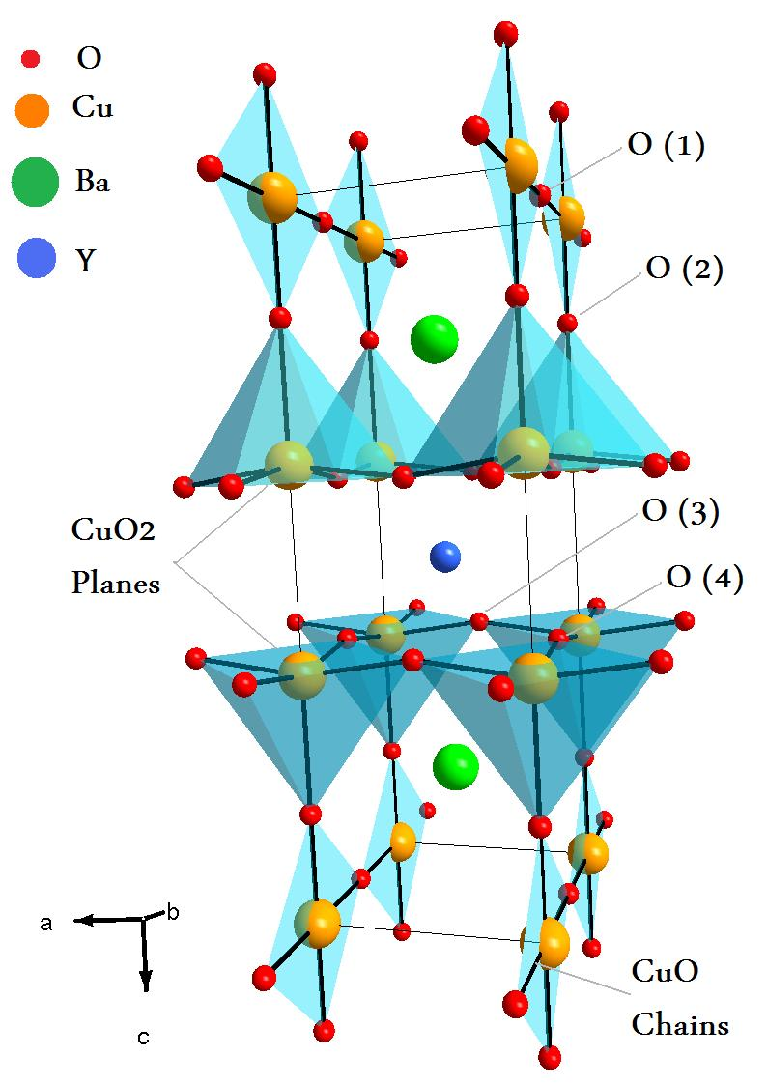
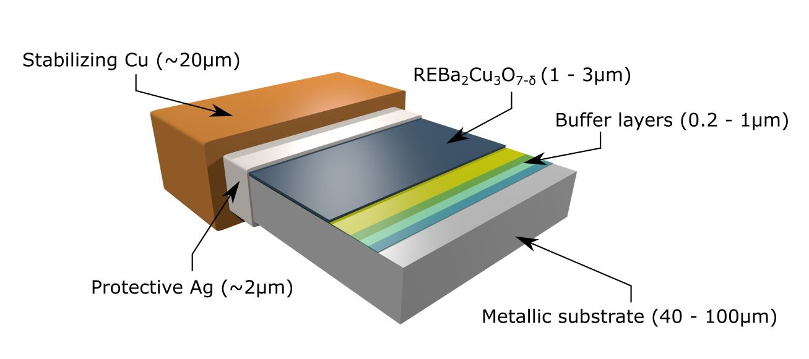
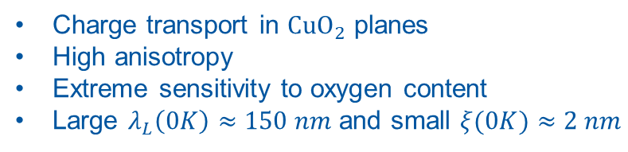
REBCO coated conductors
REBCO crystal structure
Scheme of Coated Conductor (CC)
Electronic features:
Buffer layers allow biaxial epitaxial REBCO growth
Metallic substrate makes tape ductile
Charge transport in $CuO_{2}$ planes
High anisotropy
Extreme sensitivity to oxygen content
Large $λ_{L}\left(0K\right)≈150 nm$ and small $ξ(0K)≈2 nm$
Artur Romanov, PhD dissertation, UA Barcelona 2022

Slide 39
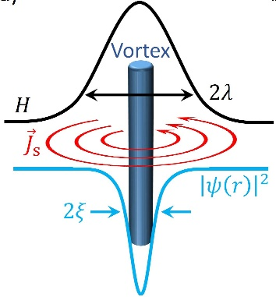



Type II superconductors
Vortex in type II SC
Magnetic phase diagram
for type II SC
Abrikosov lattice
Vortex length scales:
$λ_{L}≐$ Distance upon which magnetic field decays.
$ξ≐$ Distance upon which the order parameter decays.
Characterized by mixed phase
with vortex penetration.
Distribution into hexagonal lattice in homogenous material.
Artur Romanov, PhD dissertation, UA Barcelona 2022

Slide 40







Vortex pinning
Lorentz-like force provokes vortex movement
Defects: Strategy to pin vortices
Scales with current density and magnetic field$:$
$${\overset{⃑}{F}}_{L}=\overset{⃑}{J}×\overset{⃑}{B}$$
Critical current density ${\overset{⃑}{J}}_{c}:$
Defect landscape:
0D: Impurity atoms, interchanged atoms
1D: Dislocations, columnar defects
2D: Twin boundaries, grain boundaries
3D: Nanoparticles, associated strained regions
$${\overset{⃑}{F}}_{P}={\overset{⃑}{J}}_{c}×\overset{⃑}{B}$$
The maximum value of $J$ without moving the lattice, without presenting resistance.
Artur Romanov, PhD dissertation, UA Barcelona 2022

Slide 41











Various producers of CCs
Bruker
Fujikura APC
SuNAM
SuperOx 2
YBCO (1.6 $μm$) + BZO nanorods
EuBCO (2.5 $μm$) + BHO nanorods
GdBCO (1.5 $μm$)
YBCO (3 $μm$) + Y₂O₃ nanodots
CCs differ in architecture and REBCO microstructure.
Artur Romanov, PhD dissertation, UA Barcelona 2022

Slide 42

HTS coating technologies
Patrick Krkotic, PhD dissertation, UPC Barcelona 2022

Slide 43


Some theory background: fluxon motion in RF
The motion of the rigid fluxon lattice behaves as a harmonic damped oscillator
(neglecting thermal creep)
d
Pinning centers
B field is normal to surface: worst case
The “depinning frequency”
Surface resistance
Gittleman and Rosenblum: Phys Rev. Lett. 16, 734 (1966)
Calatroni and Vaglio, IEEE Trans. Appl. Supercond. 27 (2017) 3500506
Coffey, Clem PRL 67, 386 (1991)
Brandt PRL 67 2219 (1991)
Silva et al, PRB 78, 094503 (2008)

Slide 44





RF when an external magnetic field is present
Vortex lattice
  cylindrical normal conducting regions
  $≈$tens of nm diameter
  Each vortex carries one flux quantum
Apply RF Current
  Motion of vortices → dissipation
  $$m\ddot{x}+η\dot{x}+kx=J_{RF}Φ_{o}$$
    The motion of the rigid vortex lattice behaves as an harmonic damped oscillator with quadratic potential
Gittleman and Rosenblum: Phys Rev. Lett. 16, 734 (1966)
Calatroni and Vaglio, IEEE Trans. Appl. Supercond. 27 (2017) 3500506
Coffey, Clem PRL 67, 386 (1991)
Brandt PRL 67 2219 (1991)
Silva et al, PRB 78, 094503 (2008)
$$B_{DC}$$
$$J_{RF}$$
Vortex pinning
  Artificial pinning centres
$$HTS$$
Simplified model valid for estimates and scaling
Patrick Krkotic, PhD dissertation, UPC Barcelona 2022

Slide 45





Coating process I
1) Pre-tinning
2) Edge removal
Solder
Solder
Ag
Ag
REBCO
REBCO
Buffer layers
Buffer layers
Substrate
Substrate
Ag
Ag
Cu
Cu
Developed in the context of FCC-hh impedance reduction by coating the beam screen with HTS tapes

Slide 46
Coating process II
3) Soldering
4) Substrate extraction
Solder
Ag
Cu
REBCO
Cu
Buffer layers
Ag
Substrate
Substrate
Cu
Ag
Substrate
Buffer layers
Ag
Cu
REBCO
Buffer layers
Ag
REBCO
Cu
Ag
Solder
Cu
Cu
Surface to coat
Solder
Cu
Surface to coat
N. Lamas et al., to be published

Slide 47







Scaling to lower frequency
REBCO scaled to 1 GHz at 50 K
A parallel-plate resonator is being commissioned to test samples at ~1 GHz
x100 improvement over Cu at 50 K
GHz
38x12 mm samples
50 mm bore
16 T
$X_{s}(T)$ at all frequencies
Romanov et al, SciRep 10:12325 (2020)
For HTS Rs scales as $f^{2}$
For Cu Rs scales as $f^{1/2}$
Will demonstrate real experimental frequency scaling on samples

Slide 48


Surface impedance: the key
τ Risetime of beam instabilities
$$\left|Δω\right|$$
Z_{T} Transverse impedance (property of the beam)
R_{S} Surface resistance (property of the surface)
τ: instabilities rise-time
Δω: betatron tune-shift
I_{b}: bunch current
M: number of bunches
E: beam energy
L: bunch length
R: accelerator radius
c: speed of light
b: vacuum chamber radius
f: wakefields frequency
ρ: electrical resistivity
What could be better than copper at 50 K?
High-Temperature Superconductors (HTS)

Slide 49



New kid on the blocks: the C3 study @ SLAC
More info here
8 km footprint for 250/550 GeV CoM ⟹ 70/120 MeV/m
Large portions of accelerator complex compatible between LC technologies
Beam delivery / IP modified from ILC (1.5 km for 550 GeV CoM), compatible w/ ILC-like detector
Damping rings and injectors to be optimized with CLIC as baseline
Cryogenically cooled – 77 K (liquid nitrogen)
C³ Parameters
C³ - 8 km Footprint for 250/550 GeV (to scale)
Cooling allows for increase in accelerating gradient, and savings in RF power infrastructure
From: Emilio Nanni

Slide 50

Flux pinnining
Typical SRF accelerator cavities are made of niobium
Effect of external magnetic field on SRF accelerating cavities is mostly due to flux pinning, weak pinning in bulk Nb and strong in Nb/Cu
Earth magnetic field should not be an issue for HTS (to be verified)
Strong magnetic shielding needed
Limited or no magnetic shielding

Slide 51


HTS tape at 8 GHz (dielectric resonator) and 50 K
Patrick Krkotic, PhD dissertation, UPC Barcelona 2022

Slide 52

Effect of magnetic field: fluxon losses in RF
Surface resistance, reactance due to vortex motion
“safe” zone
“unsafe” zone
To maximize f₀ and minimize fluxon losses we need high J_{c} materials

Slide 53


Predicted surface resistance of HTS in 16 T field
YBCO | T_{c}=92K | T=50K | B₀=16T | J_{c}(50,16)=7.5x10⁹Am⁻² | B_{c2}(50)=40T | ρ_{n}=60μΩcm | f₀=10GHz
Tl-1223 | T_{c}=125K | T=50K | B₀=16T | J_{c}(50,16)=1x10¹⁰Am⁻² | B_{c2}(50)=80T | ρ_{n}=80μΩcm | f₀=14GHz
For HTS the Rs scales as $f^{2}$
For Cu the Rs scales as $f^{1/2}$

Slide 54


Cryogenic losses: SRF aimed at energy saving compared to NRF
Carnot efficiency
Cryoplant efficiency
30%
Power consumption for 1 W @ 77 K | 13 W
Power consumption for 1 W @ 20 K | 50 W
Power consumption for 1 W @ 4.2 K | 230 W
Power consumption for 1 W @ 1.9 K | 920 W
Thanks to T. Koettig, CERN

Slide 55


Low-power RF measurements
An improvement larger than x10 compared to copper (Rs=8mΩ) has been measured on samples of tapes (8 GHz) at low RF power
Cu
Adapted from Romanov et al, Sci. Rep. (2020) 10:12325

Slide 56

HTS for axion searches
Motivation:
Axion haloscope
$$ℱ \sim { g}_{Aγ}^{4}{ Q T}_{sys}^{−2}{V^{2}G}^{4}m_{A}^{2} B^{4}$$
Increase Q
copper coating → superconducting coating
Requirement: High quality factor in a high magnetic field

Slide 57



First results at SLAC, at low gradient
Two HTS measurements, after calibration measurements with Cu and Nb
Soldered REBCO-CCs on copper (Fujikura by CSIC-ICMAB)
Directly grown REBCO on MgO and on copper+MgO (CERACO)
R_{s} Cu ≅ 17 mΩ
R_{s} REBCO tapes ≅ 1.7 mΩ
R_{s} REBCO PVD ≅ 1.0 mΩ

Slide 58
Preliminary SLAC results at high-gradient I
From: Mitch Schneider

Slide 59
Preliminary SLAC results at high-gradient II
Shaded area: change from 100 W to 1.6 kW of forward power
From: Ankur Dhar

Slide 60




First device validation – supported by I.FAST Innovation Fund
Next goals: develop large-size tapes (50 mm wide) in collaboration with KCT, to be first tested on discs at SLAC. Two-years plan funded by IIF
(Ideally: REBCO coating directly on 3D objects)
Device validation: X-band pulse compressor (SLAC) as first “real” RF device
Coating will be performed by CSIC-ICMAB
Courtesy Greg LeSage, SLAC
Pulse compressor

Slide 61







Axion cavity as earlier demonstrator
Approach being validated also for axion detection cavities in RADES collaboration having a similar geometry
Copper body manufactured at Mainz University, adapted to 12 mm wide coated conductors, coated by CSIC-ICMAB
    f= 9.3 GHz
Q₀ = 356 070
    Surface currents
Axion cavity
    E-field
Q₀ = 268 520 (75%)

Slide 62


Summary of milestones and deliverables: WP2 KCT
M1 - Design and fabrication of sample holder system (due 3/2024). Achieved well in advance
D1 - HTS coating of large samples (due 3/2025). On track and well under way, first 40 mm wide tape already coated (final goal is 50 mm, but 40 mm is enough for our final goal)
KCT confidential
Do not disclose
Roll to roll coater
for HTS tapes
40 mm wide
HTS tape

Slide 63



Summary of milestones and deliverables: WP3 CSIC
D1 - Coating on discs and segmented cavities for benchmarking (small tapes) (due 3/2024). Achieved for discs, already high-power tested at SLAC (presented at EUCAS 2023 / IPAC 2024) waiting for readiness of segmented cavity
D2 - Measurement of superconducting properties of large size tapes (due 3/2025). On track and well under way, first 40 mm wide tape already characterized
First tests of 40 mm tape
Copper disc coated with 12 mm tapes
CSIC confidential
Preliminary results
Do not disclose

Slide 64





Possible practical implementation of HTS tape-coated cavities
How could a future cavity look like? Bimetallic cavities
B
SC
NC
J. Haimson, WEPMS085, PAC07 (s.steel inserts)
CLIC Mo-iris prototype
P. McIntyre et al., IEEE TAS 19 (2009) 1380
Composite cavities exist and have been demonstrated.
Joints at low-current regions are standard practice even in SRF cavities (ie QWRs)
Segmentation at zero-current region is possible, see device being designed at SLAC

