Slide 1



HTS soldering & preliminary characterization
HIGHEST” High-Temperature High-Gradient Superconductors
2024 – 07 – 05 CERN

Slide 2
Outline
1 – Alternatives to commercial CC
D-Nano 40 mm-wide CC tape “batch #1”
Jena YBCO thin film
2 – Coating a RADES cavity
3 – R&D and lessons learned
Solder thickness
Pressure homogeneity
4 – Plan of action

Slide 3
Outline
1 – Alternatives to commercial CC
D-Nano 40 mm-wide CC tape “batch #1”
Jena YBCO thin film
2 – Coating a RADES cavity
3 – R&D and lessons learned
Solder thickness
Pressure homogeneity
4 – Plan of action

Slide 4
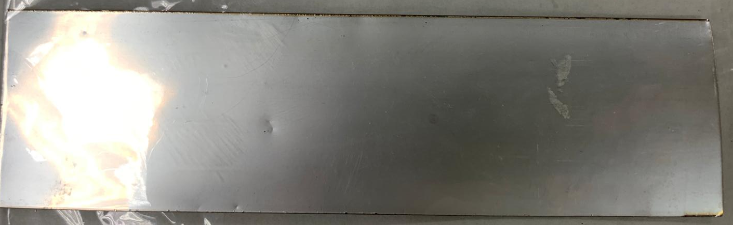
3D HTS coatings will benefit from having wider tapes
40mm-wide D-Nano tape from batch #1

Slide 5
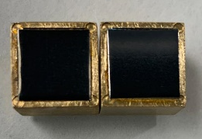
3D HTS coatings will benefit from having wider tapes
40mm-wide D-Nano tape from batch #1

Slide 6
40mm-wide D-Nano tape from batch #1 is unsuitable as low R_{s} coating
& ν = 8 GHz
40mm-wide D-Nano tape from batch #1
40mm-wide D-Nano tape from batch #1 shows rather high R_{s} values

Slide 7
40mm-wide D-Nano tape from batch #1 is unsuitable as low R_{s} coating
& ν = 8 GHz
40mm-wide D-Nano tape from batch #1
40mm-wide D-Nano tape from batch #1 shows rather high R_{s} values
Based on previously reported low J_{c} values, the high R_{s} (H=0) could arise from “high-angle” grain boundaries

Slide 8
Outline
1 – Alternatives to commercial CC
D-Nano 40 mm-wide CC tape “batch #1”
Jena YBCO thin film
2 – Coating a RADES cavity
3 – R&D and lessons learned
Solder thickness
Pressure homogeneity
4 – Plan of action

Slide 9

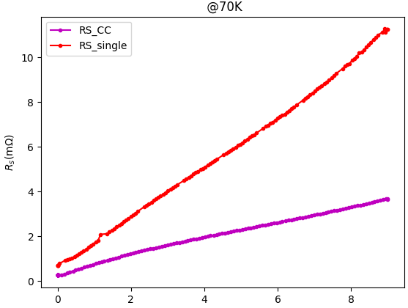
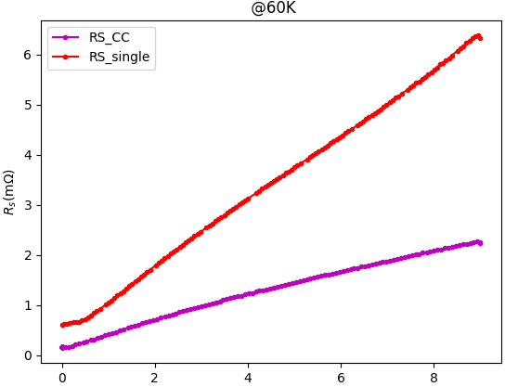
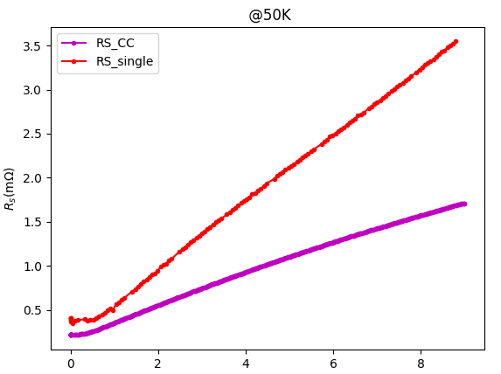
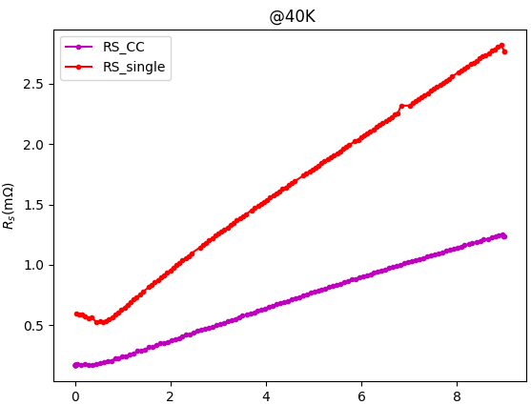
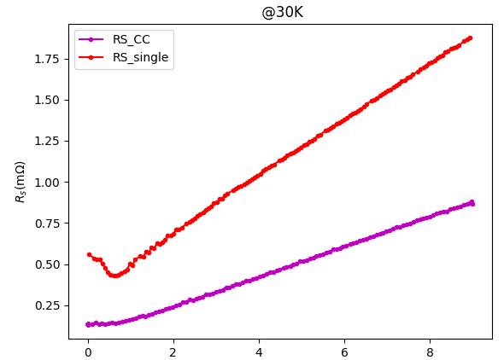
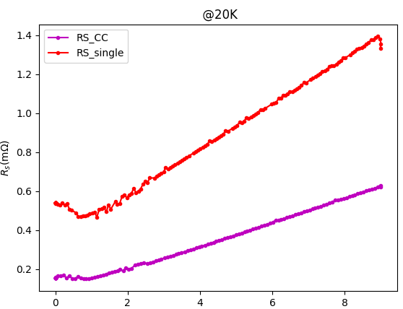
YBCO thin film* shows encouraging results…
& ν = 8 GHz
& ν = 8 GHz
& ν = 8 GHz
μ₀H(T)
μ₀H(T)
μ₀H(T)
& ν = 8 GHz
& ν = 8 GHz
& ν = 8 GHz
μ₀H(T)
μ₀H(T)
μ₀H(T)
…when compared to best CC
*MgO^{SC} /YBCO^{15nm} /STO^{20nm} /YBCO^{400nm}

Slide 10
YBCO thin film* shows encouraging results…
@20K & 8GHz
RRR10 Cu
RRR50 Cu
YBCO^{SC}
EuBCO^{CC}
…when compared to Cu
*MgO^{SC} /YBCO^{15nm} /STO^{20nm} /YBCO^{400nm}

Slide 11
Outline
1 – Alternatives to commercial CC
D-Nano 40 mm-wide CC tape “batch #1”
Jena YBCO thin film
2 – Coating a RADES cavity
3 – R&D and lessons learned
Solder thickness
Pressure homogeneity
4 – Plan of action

Slide 12
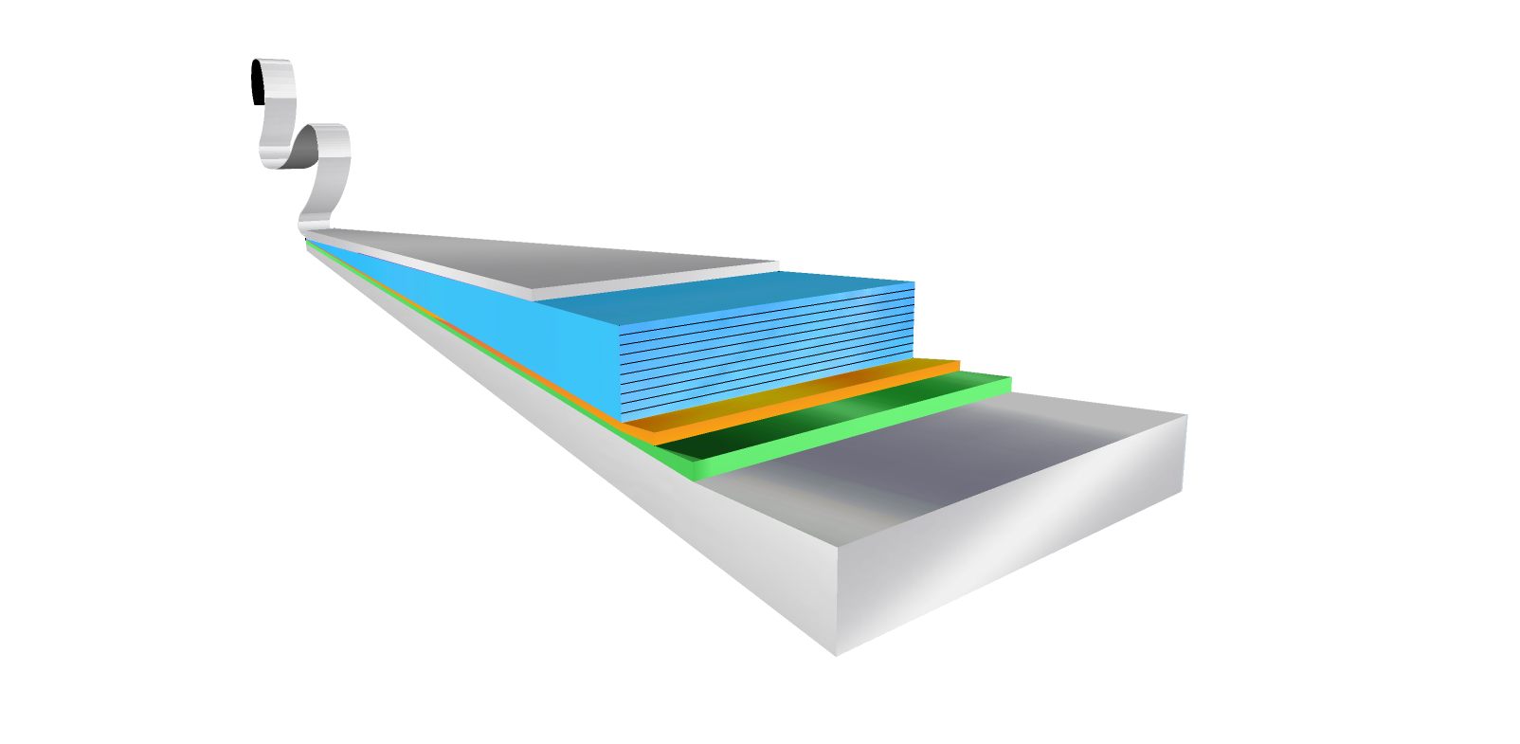
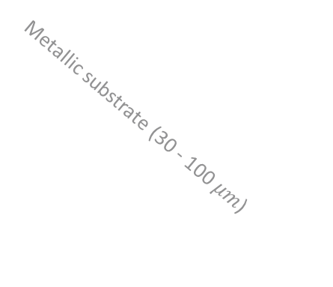


Coating process overview
Scheme of Coated Conductor (CC)
1) Pre-tinning
2) Edge removal
Protective layer
REBCO (1 – 3$μm$)
Solder
Buffers (0.2 – 1 $μm$)
Solder
Ag
Ag
REBCO
REBCO
Metallic substrate (30 - 100 $μm$)
Buffer layers
Buffer layers
Substrate
Substrate
Ag
Ag
Cu
Cu

Slide 13
Coating process overview
3) Soldering
4) Substrate extraction
Solder
Ag
Cu
REBCO
Cu
Buffer layers
Ag
Substrate
Substrate
Cu
Ag
Substrate
Buffer layers
Ag
Cu
REBCO
Buffer layers
Ag
REBCO
Cu
Ag
Solder
Cu
Cu
Surface to coat
Solder
Cu
Surface to coat

Slide 14
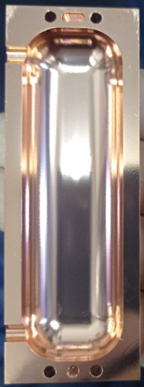
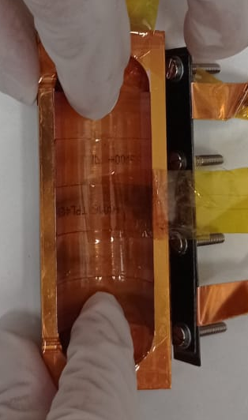
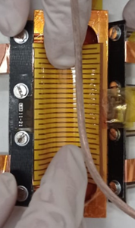
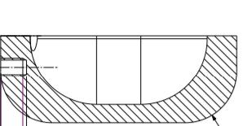
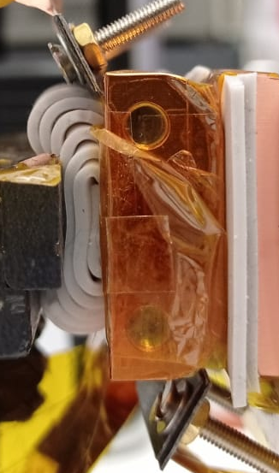
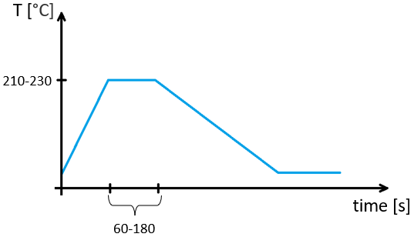
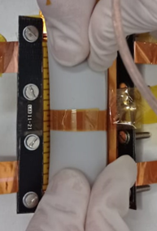
RADES cavity coating in detail
Pressure Homogenizer
Coating the Axion Cavity – May 2021– Guilherme Telles and Neil Lamas

Slide 15
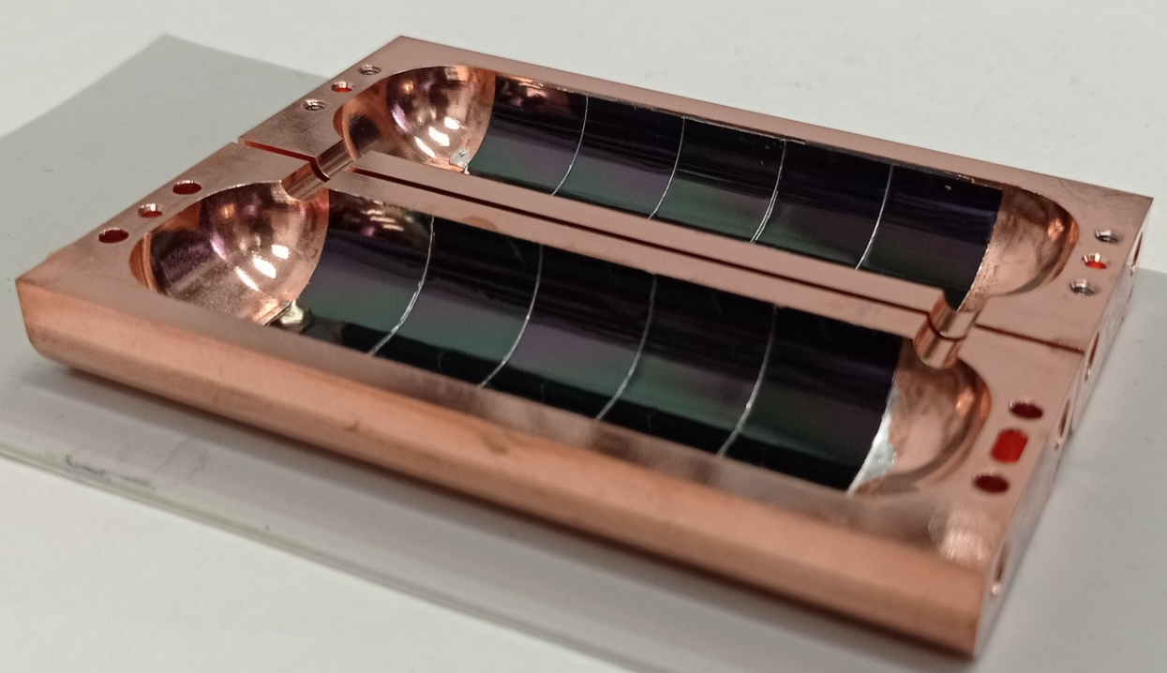
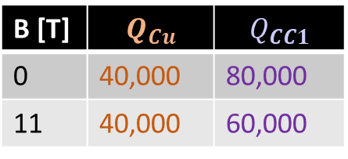
1st coating: Outperformed 100% Cu cavity
Q-factor measurements
B [T] | $$Q_{Cu}$$ | $$Q_{CC1}$$
0 | 40,000 | 80,000
11 | 40,000 | 60,000
$$T=4.2 K$$
$$ν≈9 GHz$$
Coating performed slightly worse than expected

Slide 16
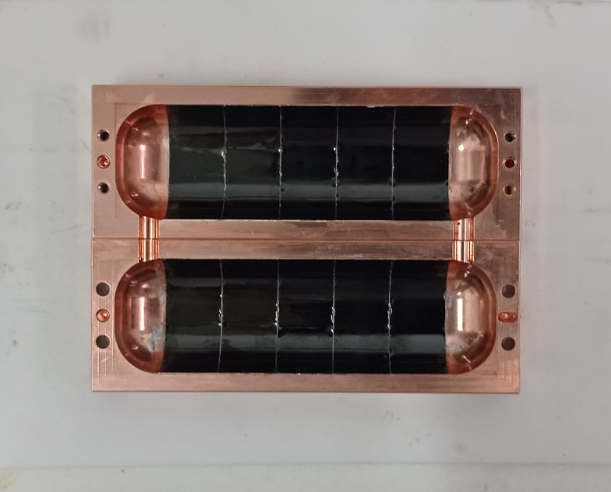
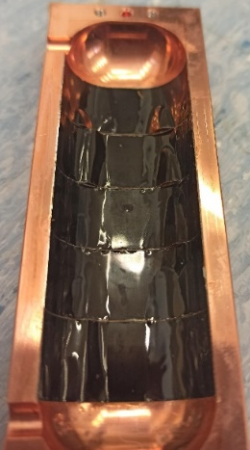
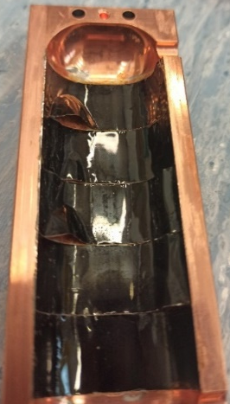
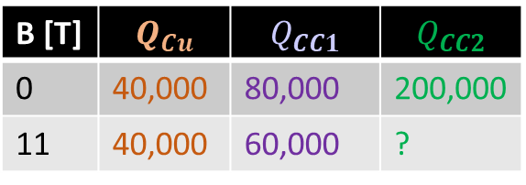
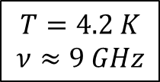
2nd coating: The coating failed under external magnetic field
$$T=4.2 K$$
$$ν≈9 GHz$$
B [T] | $$Q_{Cu}$$ | $$Q_{CC1}$$ | $$Q_{CC2}$$
0 | 40,000 | 80,000 | 200,000
11 | 40,000 | 60,000 | ?
Promising Q values!
Coated with Fujikura
Used less solder to reduce solder overflow

Slide 17
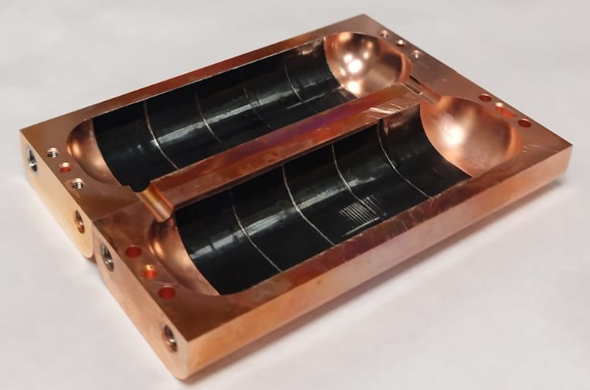
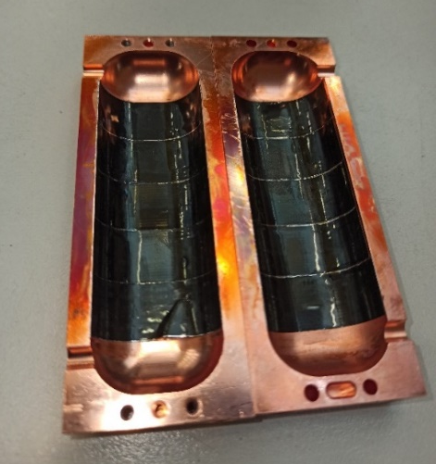
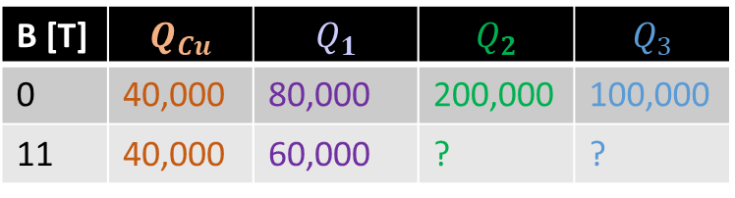
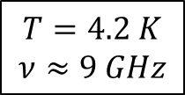
3rd coating: The coating failed under external magnetic field
$$T=4.2 K$$
$$ν≈9 GHz$$
B [T] | $$Q_{Cu}$$ | $$Q_{1}$$ | $$Q_{2}$$ | $$Q_{3}$$
0 | 40,000 | 80,000 | 200,000 | 100,000
11 | 40,000 | 60,000 | ? | ?
How to prevent detachment?

Slide 18
Outline
1 – Alternatives to commercial CC
D-Nano 40 mm-wide CC tape “batch #1”
Jena YBCO thin film
2 – Coating a RADES cavity
3 – R&D and lessons learned
Solder thickness
Pressure homogeneity
4 – Plan of action

Slide 19
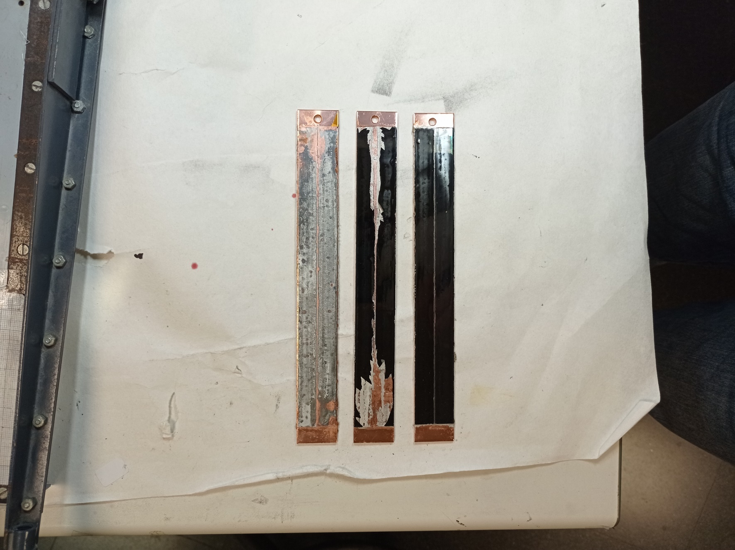
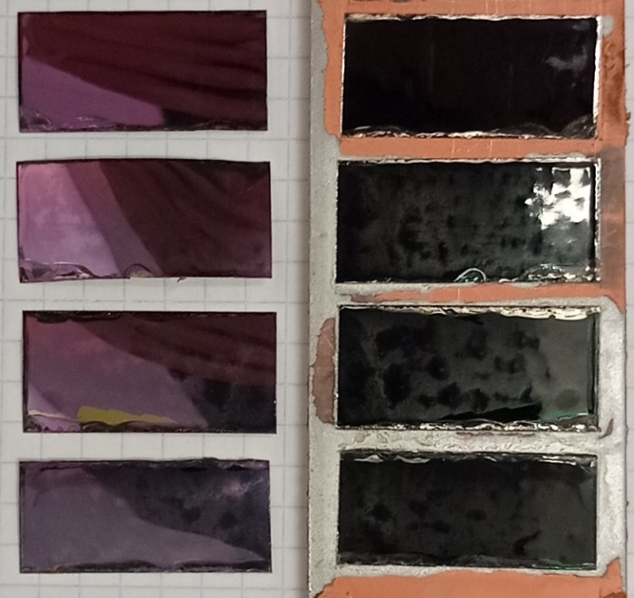
Right amount of solder
Amount of solder
Not enough solder
→ no adherence
Right amount of solder
Too much solder
REBCO deformation
+ solder leak

Slide 20

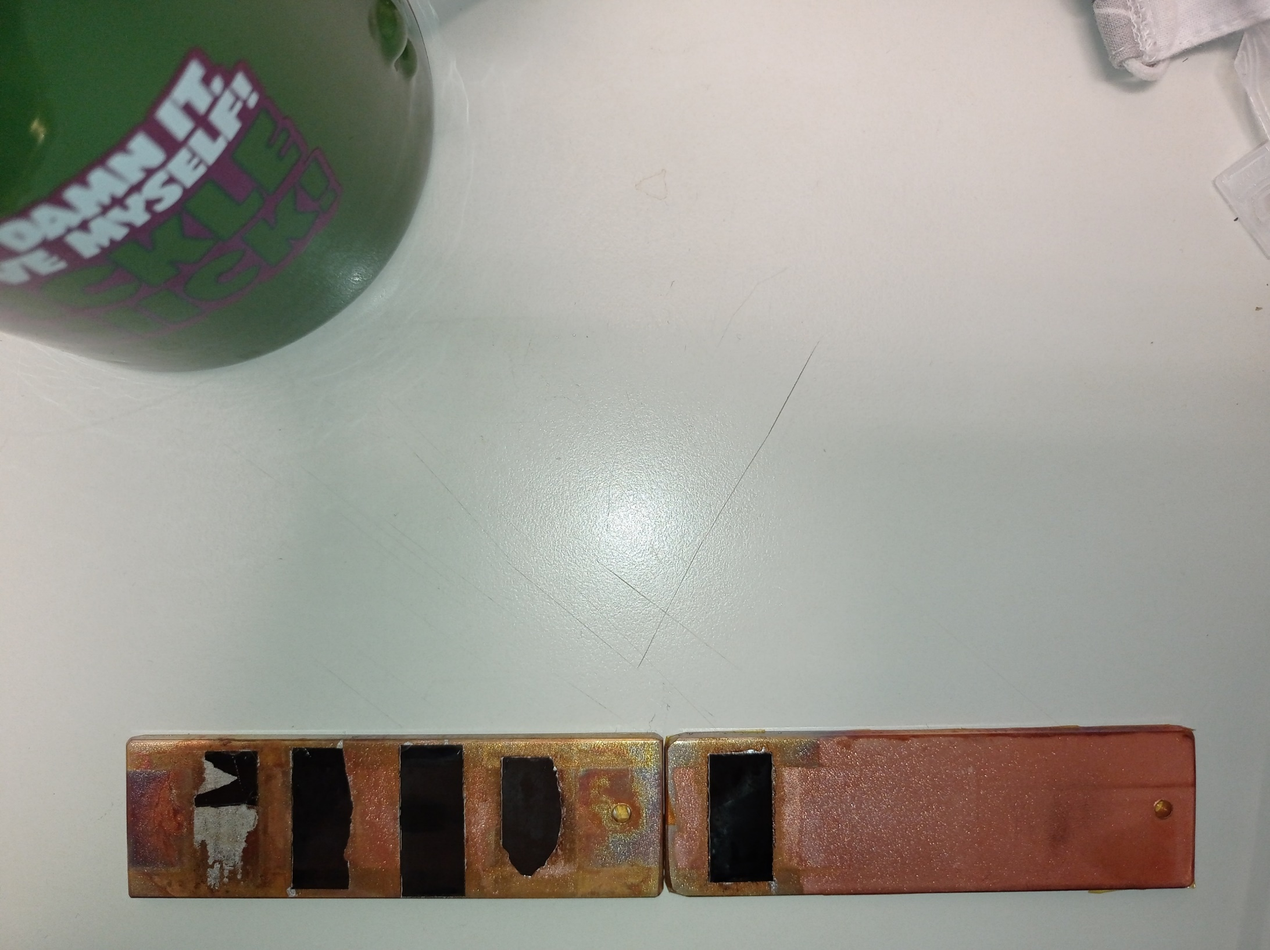

At least 10 μm of solder thickness are needed
Sample ID | Solder thickness | Pressure [kg/3e-3m^2] | Kapton test | Intrusive test
1 | 6.5 | 50
2 | 6.5 | 100
3 | 10.3 | 50
4 | 10.3 | 10
5 | 10.3 | 25
1 bar (corresponds to 30 kg) of pressure applied on 10 μm of solder
withstands at least 11 bar of pulling pressure

Slide 21
Outline
1 – Alternatives to commercial CC
D-Nano 40 mm-wide CC tape “batch #1”
Jena YBCO thin film
2 – Coating a RADES cavity
3 – R&D and lessons learned
Solder thickness
Pressure homogeneity
4 – Plan of action

Slide 22
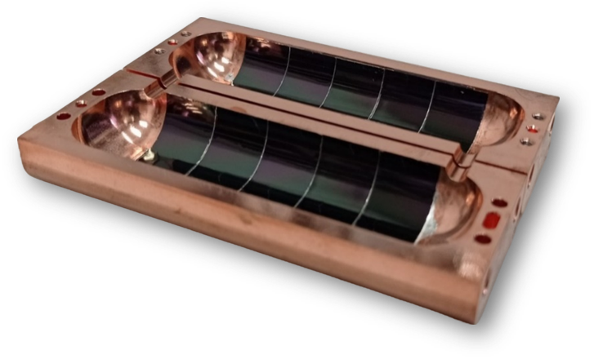
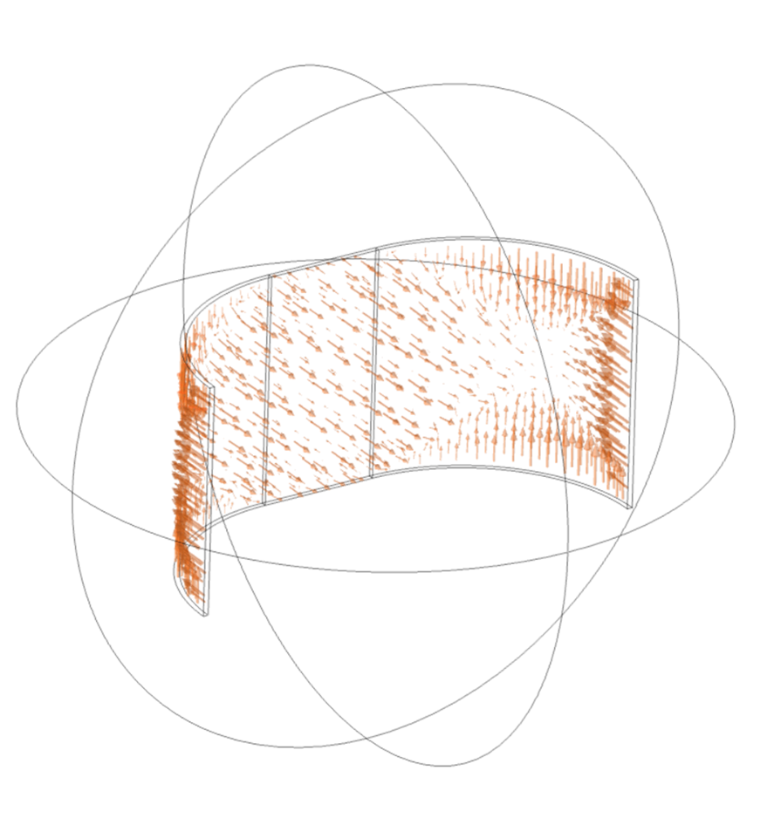
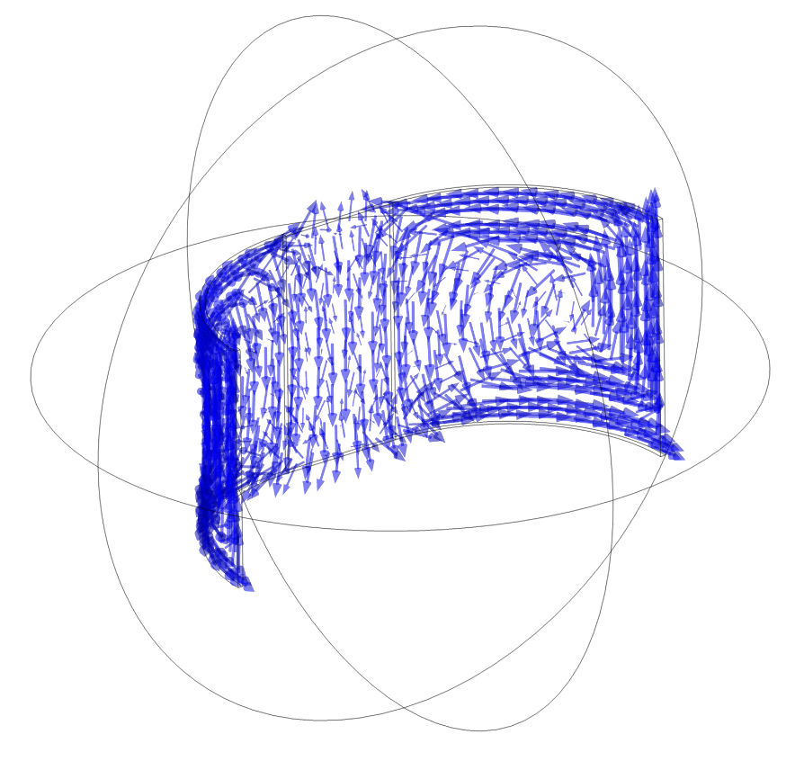
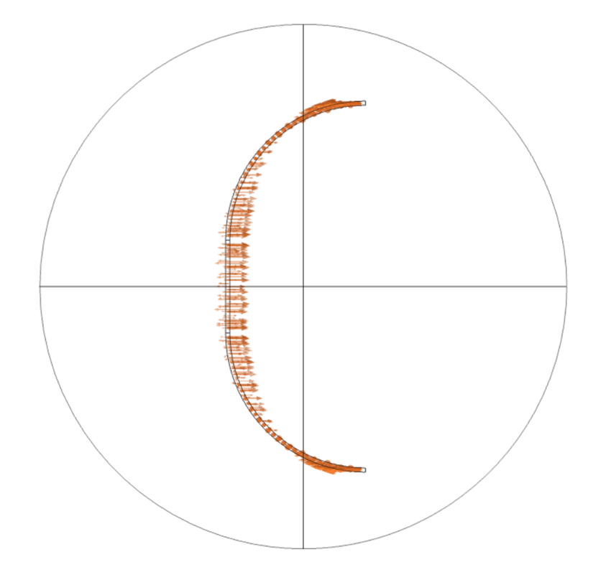






Simulations of the RADES Cavity show a pulling pressure ≤ 110 bar
$$B$$
DC Field-induced currents
Lorentz forces
$$B$$
$c$-axis
$B∥ab$-plane $→$ maximum $J_{c}$
$F_{v}∥c$-axis $→$ max pull-off force
$$B=11 T →P≤110 bar$$
5

Slide 23




Critical region is around the central flat portion of the cavity
$$B$$
$c$-axis
$B∥ab$-plane $→$ maximum $J_{c}$
$F_{v}∥c$-axis $→$ max pull-off force
We need to better homogenize the applied pressure during soldering
Lorentz Forces in REBCO-coated Cavities for Dark Matter Search – Guilherme Telles

Slide 24
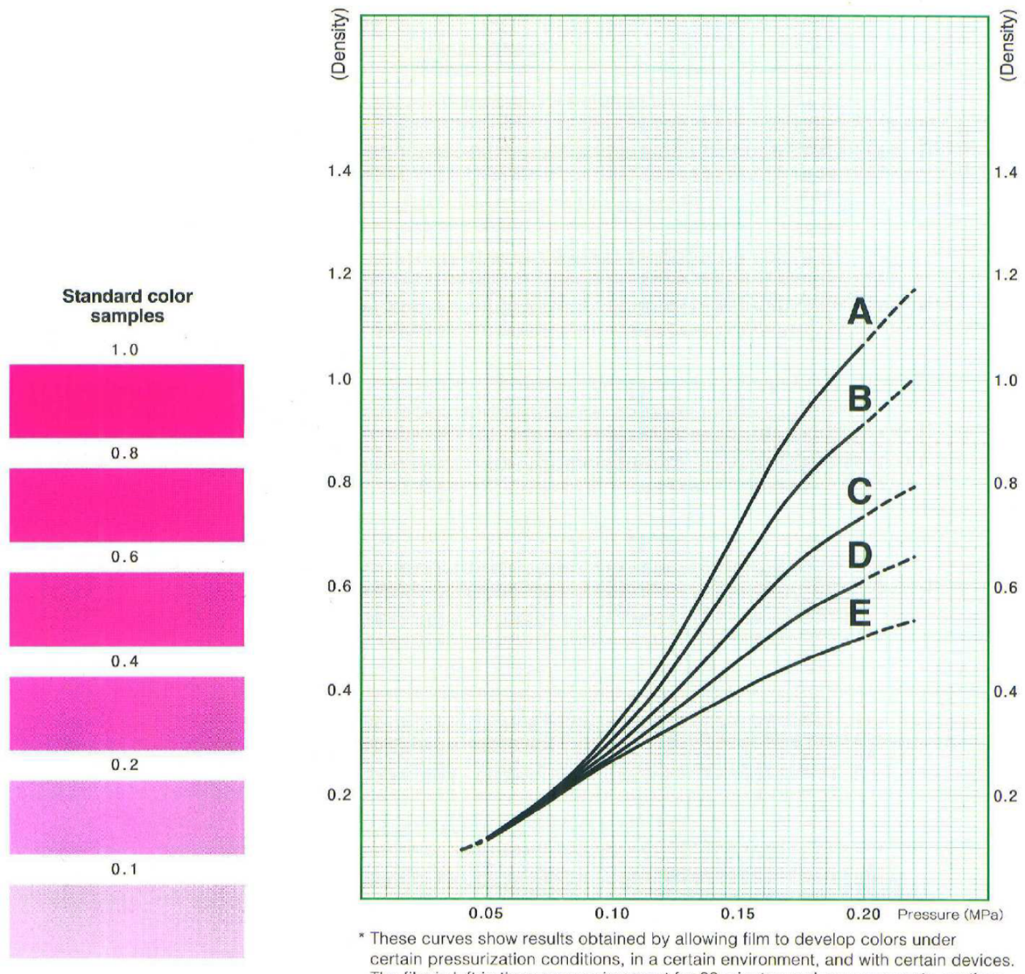
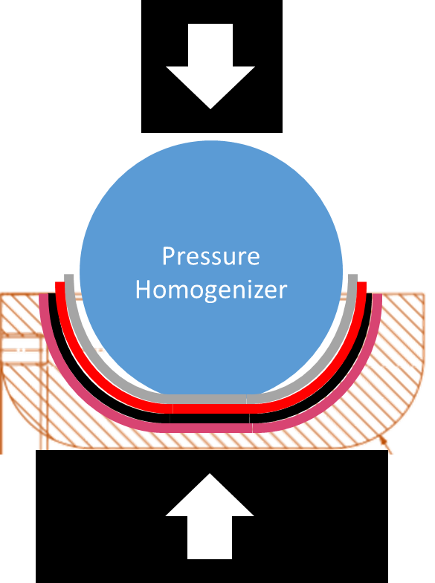
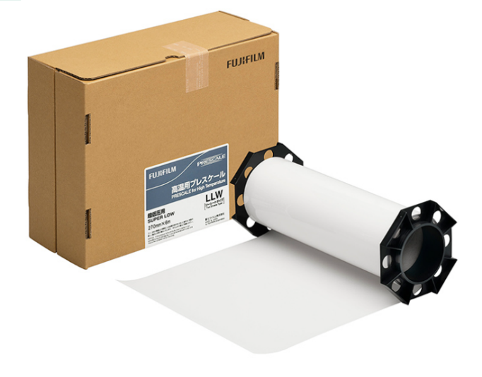
We can quantify the pressure & its homogeneity
Pressure sensitive sheet

Slide 25
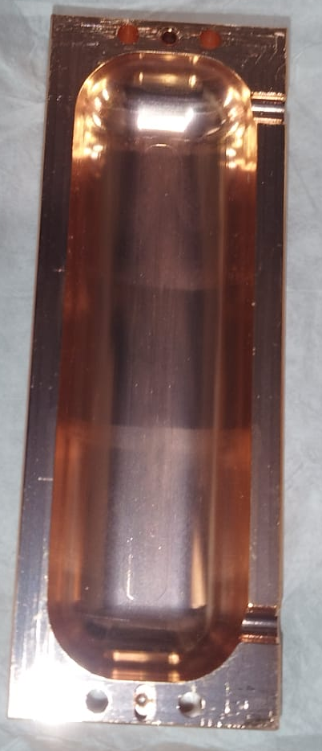
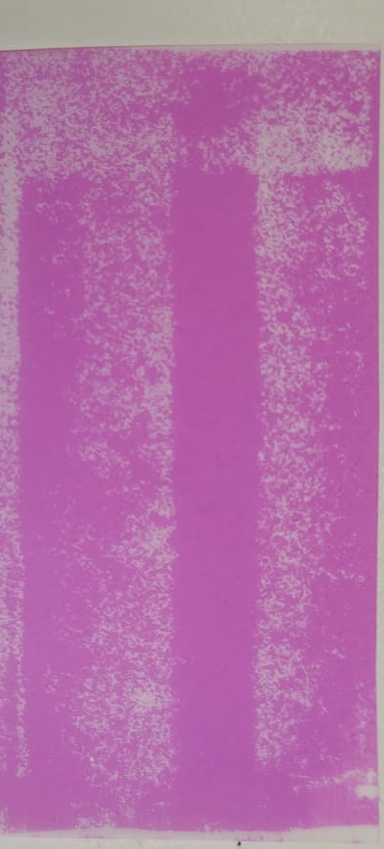
We are not achieving an homogeneous pressure in the cavity
0.8 - 1.2 bar
1.5 - 2.5 bar
Low-pressure areas
There seems to be a correlation between locally low pressure and detachment
Transversally: start of curvature
Longitudinally: one side of the cavity

Slide 26
What do we need to improve homogeneity?
Softer pressure homogenizer without air bubbles
New high precision press
Custom negative piece

Slide 27
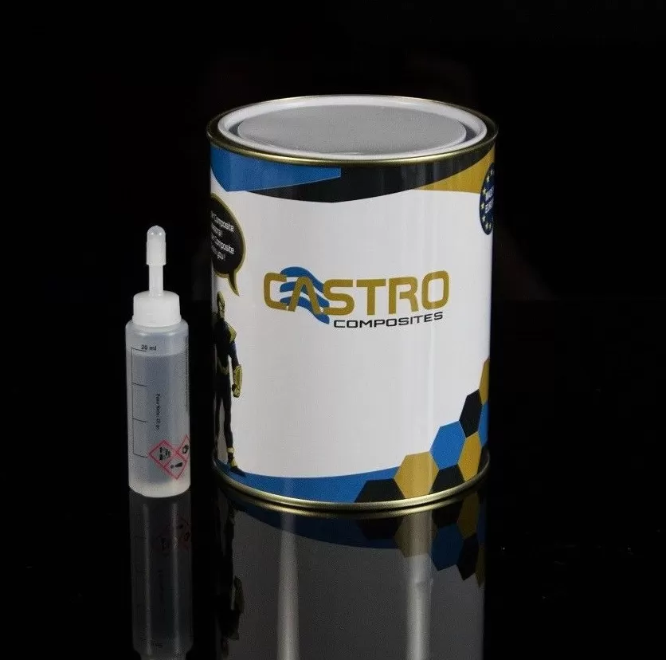
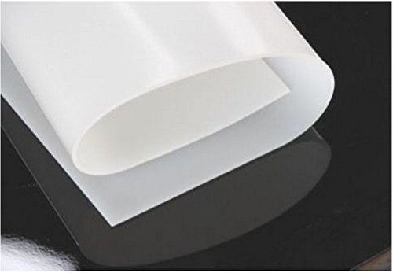
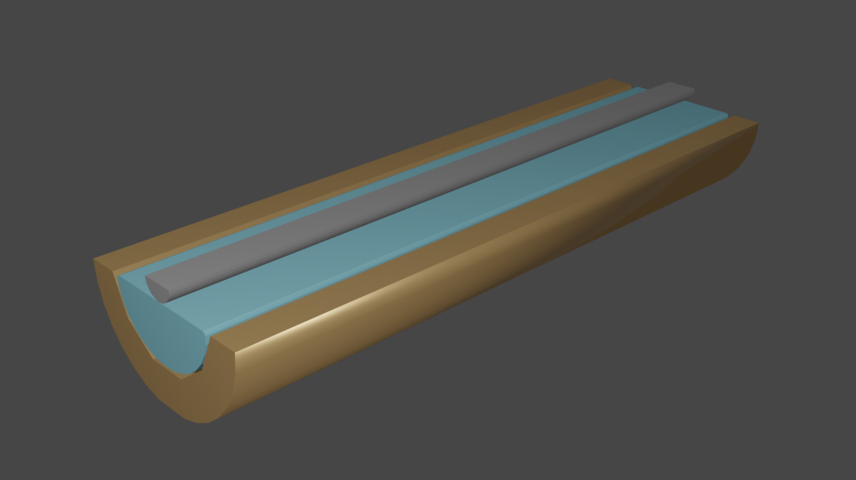
What do we need to improve homogeneity?
Silicone rubber cast
Silicone rubber sheet
Softer pressure homogenizer without air bubbles (to be tested)
New high precision press
Custom negative piece
Hardness Shore A 20
Elastosil M 4601 A/B Silicone
Hardness Shore A 28
Custom negative piece
Silicon rubber sheet
Facet to be coated
For open geometries
(flux compressor, polyhedral cavity….)
For semi-closed geometries
(RADES, KEK…)

Slide 28
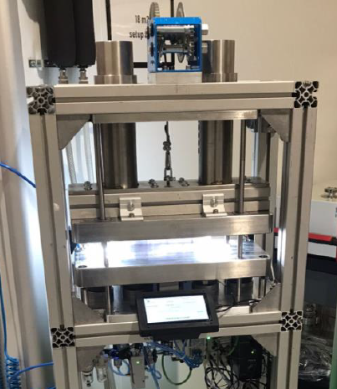
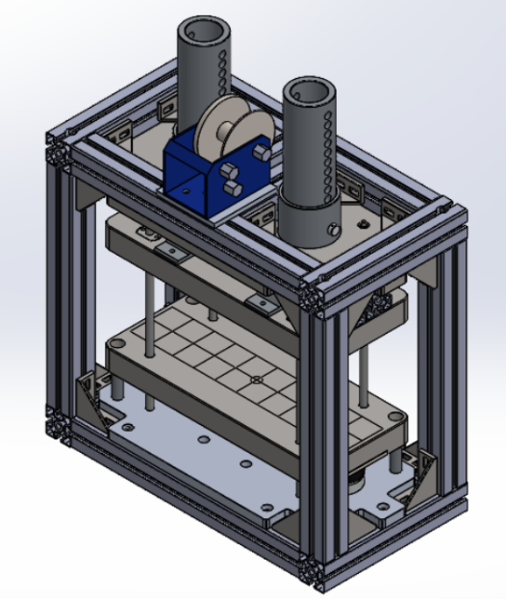
What do we need to improve homogeneity?
Softer pressure homogenizer without air bubbles
New high precision press (Implemented)
Custom negative piece
Automatic pressure control

Slide 29
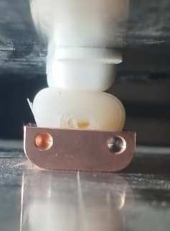
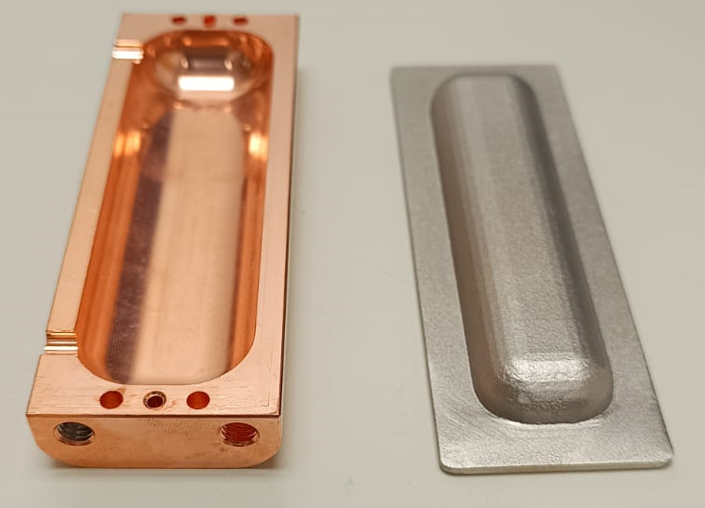
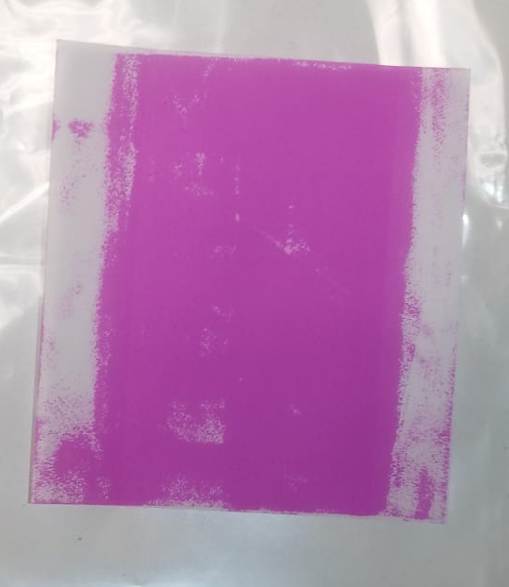
What do we need to improve homogeneity?
Softer pressure homogenizer without air bubbles
New high precision press
Custom negative piece (tested successfully)
We use FEM simulations to determine best negative piece geometry for a given surface

Slide 30
Outline
1 – Alternatives to commercial CC
D-Nano 40 mm-wide CC tape “batch #1”
Jena YBCO thin film
2 – Coating a RADES cavity
3 – R&D and lessons learned
Solder thickness
Pressure homogeneity
4 – Plan of action

Slide 31
Plan of Action
– Design negative piece(s) for SLAC’s flux compressor based on COMSOL simulations
– Run pressure homogeneity experiments to find best configuration
– Wait for results on the new RADES cavity and re-coat if needed using a silicone cast
– Push R&D on pre-delaminated coatings

