Slide 1
To increase the visibility and recognisability of the CBG !
  Development of the visual identity;
  Creation of social media channels (linkedin, etc.);
  Creation of a motto / slogan / tagline.

Slide 2


WE NEED A VISUAL IDENTITY
Logo concept
For web
For print
CERN
Baltic
Group
CERN
Baltic
Group
We are using
Maybe?
CERN
Baltic
Group
CERN
Baltic
Group
CERN
Baltic
Group
CERN
Baltic
Group

Slide 3
WE NEED A VISUAL IDENTITY
Slogan
Now there is no tagline / slogan
Maybe?
Accelerating Knowledge – Connecting Regions
Sparking Collaboration – Catalyzing Progress
Catalyzing Change – Inspiring Collaboration
More ideas?

Slide 4



WE NEED A VISUAL IDENTITY
Colours
Colours that fit with logo.

Slide 5




WE NEED A VISUAL IDENTITY
Social Media

Slide 6
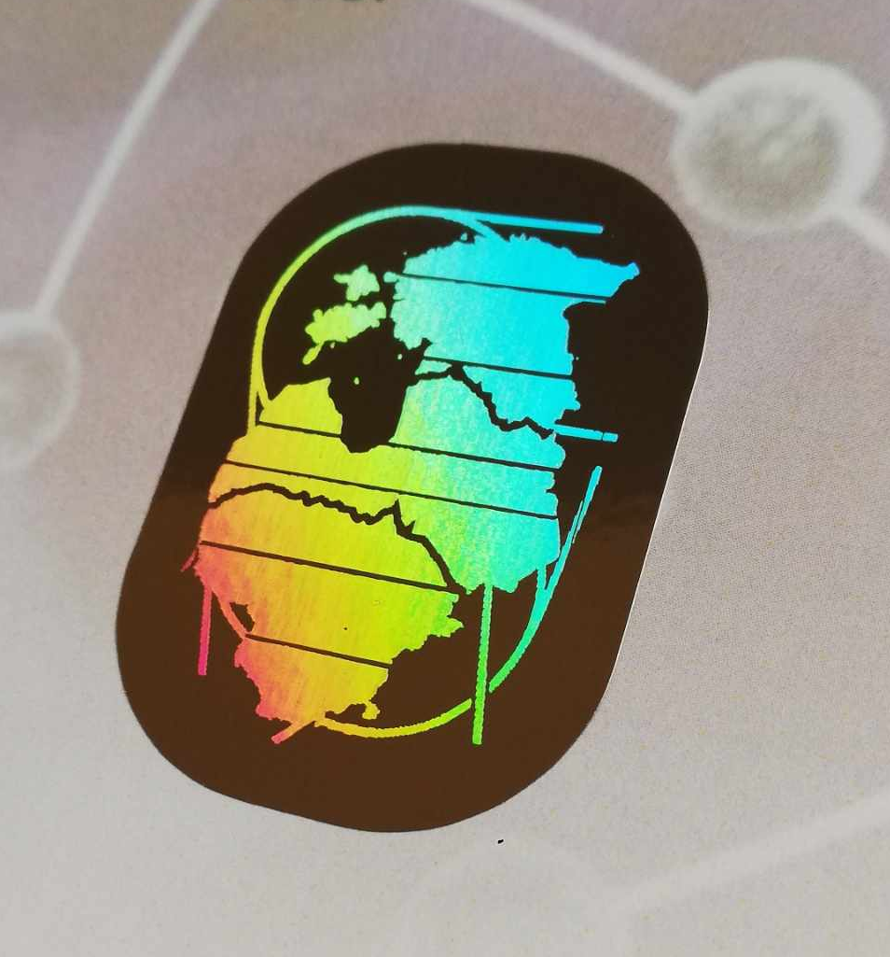
For the sertificates of CBG events (School and Conference 2024)

