Slide 1
Conceptual design for horizontal insertion of FLArE TPC modules
L. Bartoszek
BARTOSZEK ENGINEERING
4/22/24

Slide 2
Overview
There isn’t enough room in the current tunnel for a vertical insertion of FLArE TPC modules
Horizontal insertion of TPC modules has been done before—EXO
  EXO was a vacuum insulated cryostat with two copper vessels made from ultra radiopure copper
  The inner cryostat (surrounding the LXe TPC,) was full of HFE, a heat transfer hydrocarbon liquid
  I designed a custom machine supported from the room crane rails in the clean room at WIPP to do the insertion
EXO is also where I got the idea to use Jetseals to seal the TPC modules against the vessel
The insulation scheme is similar to MicroBooNE

Slide 3
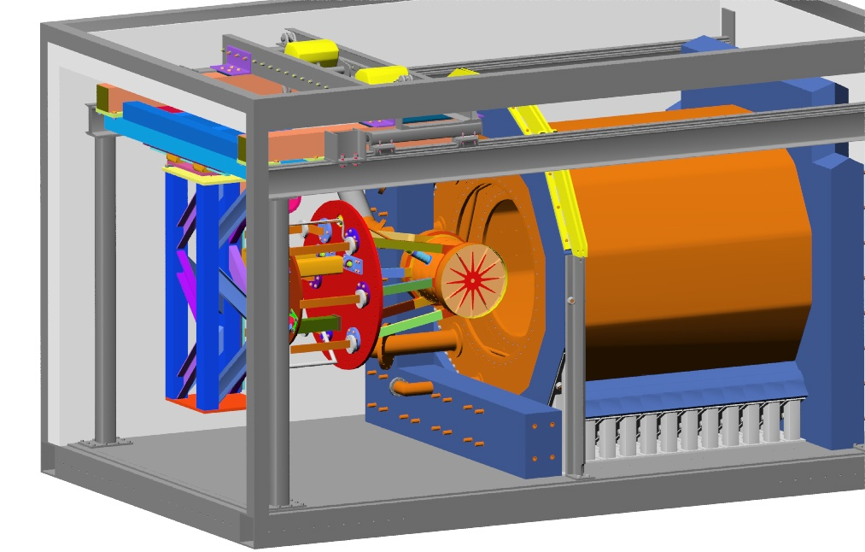
From a talk I gave at EXO Week in 2009:
The TPC was supported by a custom horizontal insertion mechanism

Slide 4
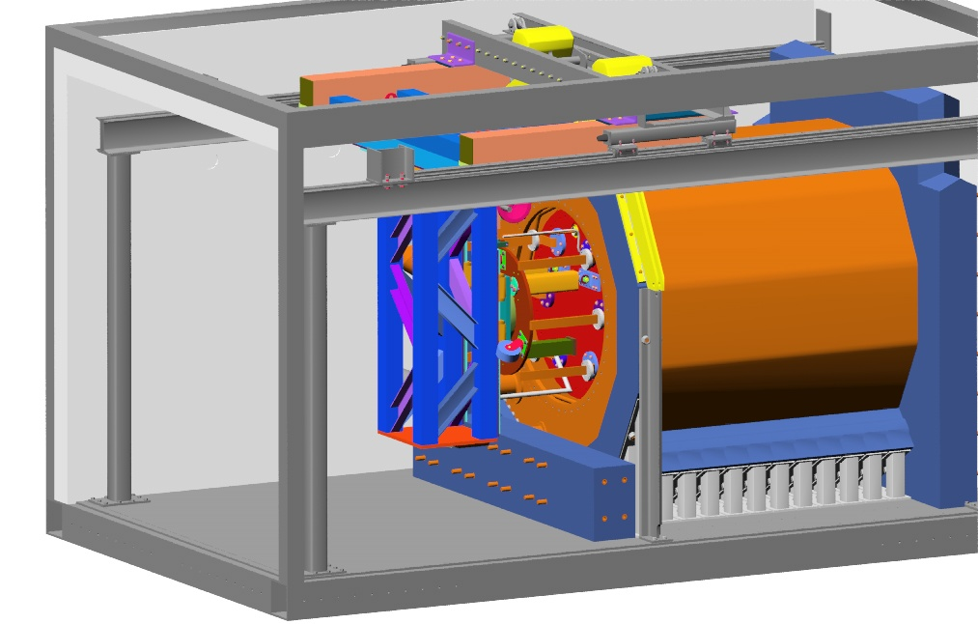
The cold door mated against the inner cryostat

Slide 5
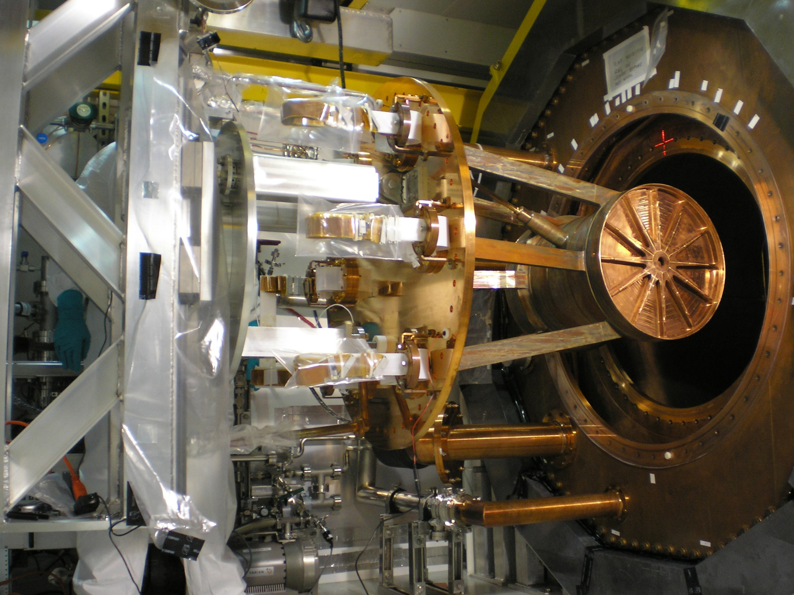
The TPC and the cold door supported from the installation machine

Slide 6
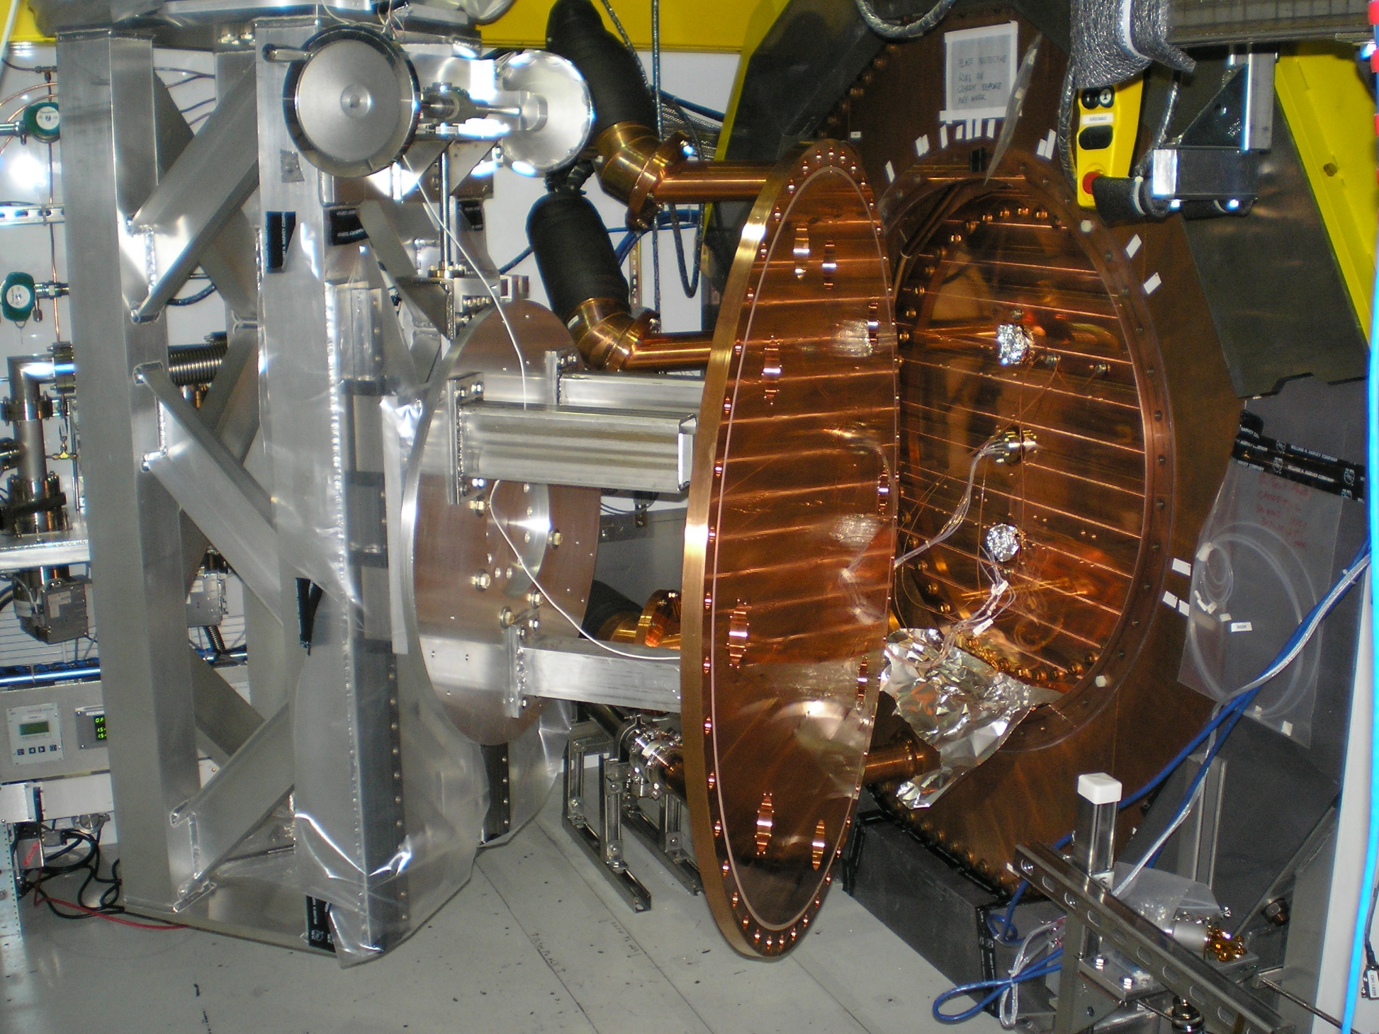
The installation machine holding the outer warm door

Slide 7
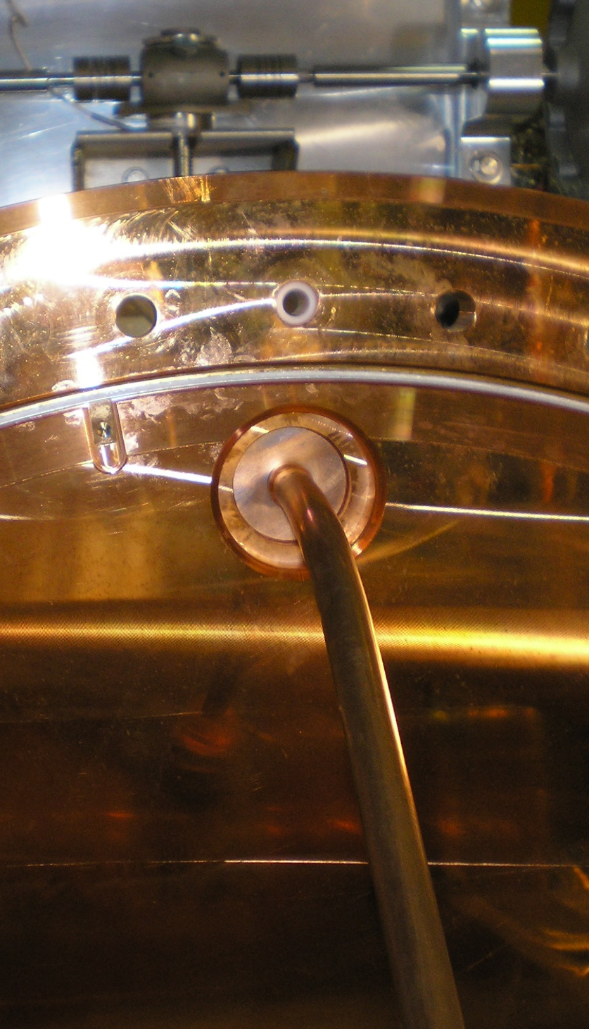
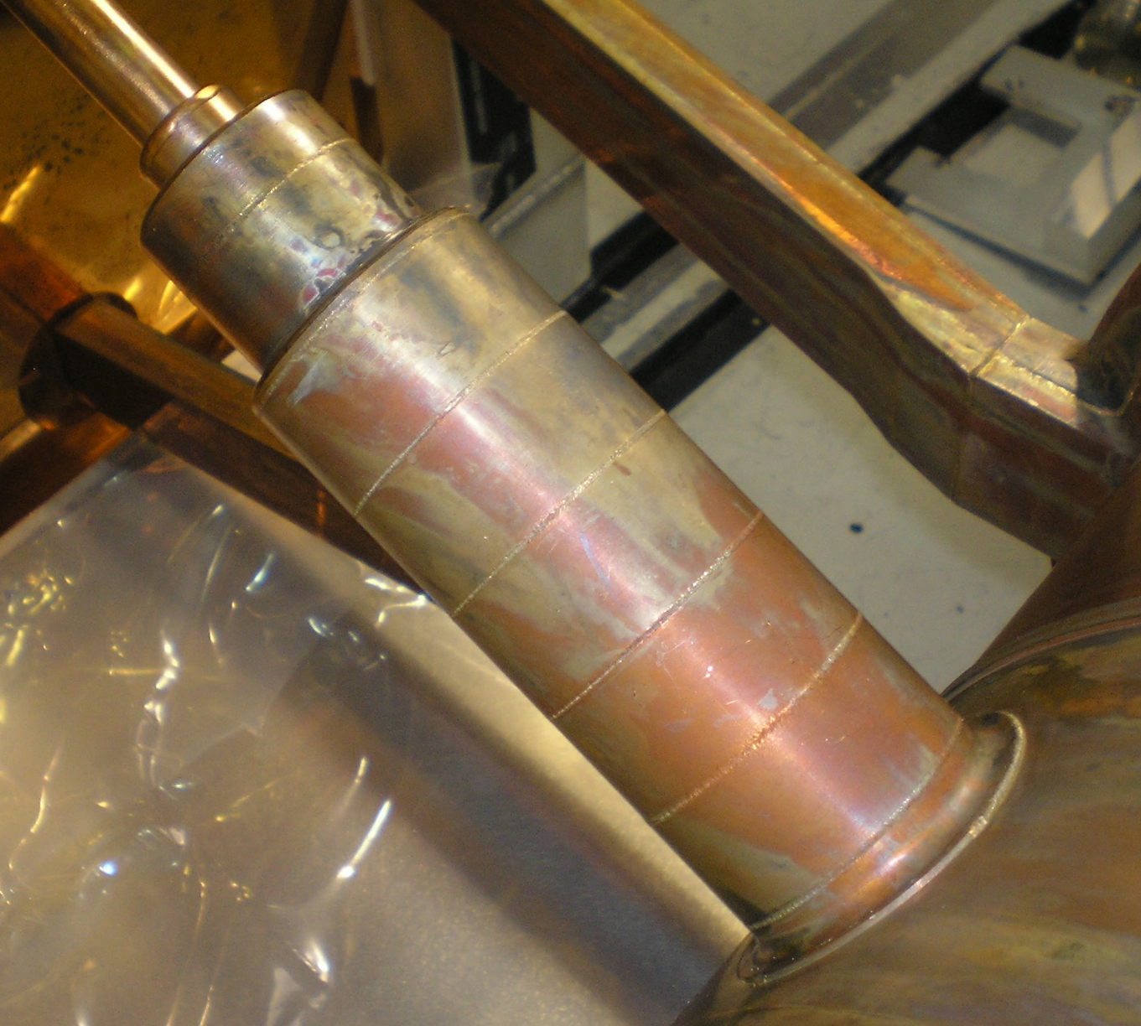
Two views of the HV feedthrough through the cold door

Slide 8
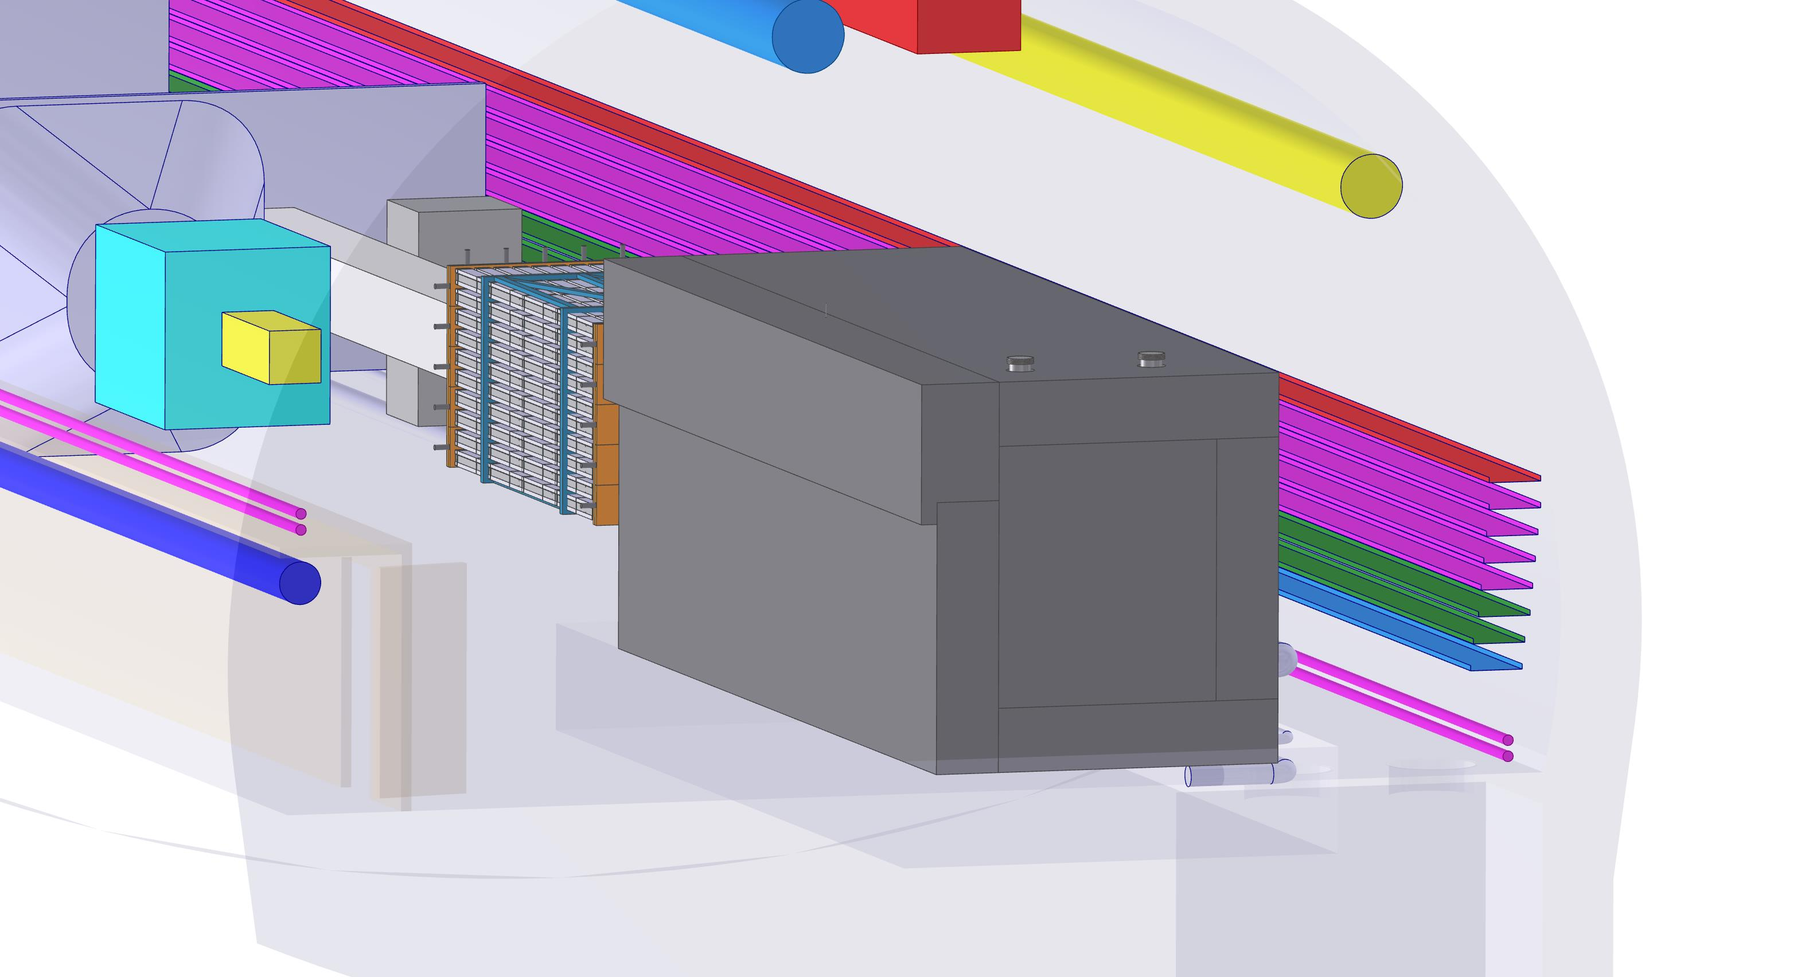
The fully insulated detector in the tunnel at CERN

Slide 9
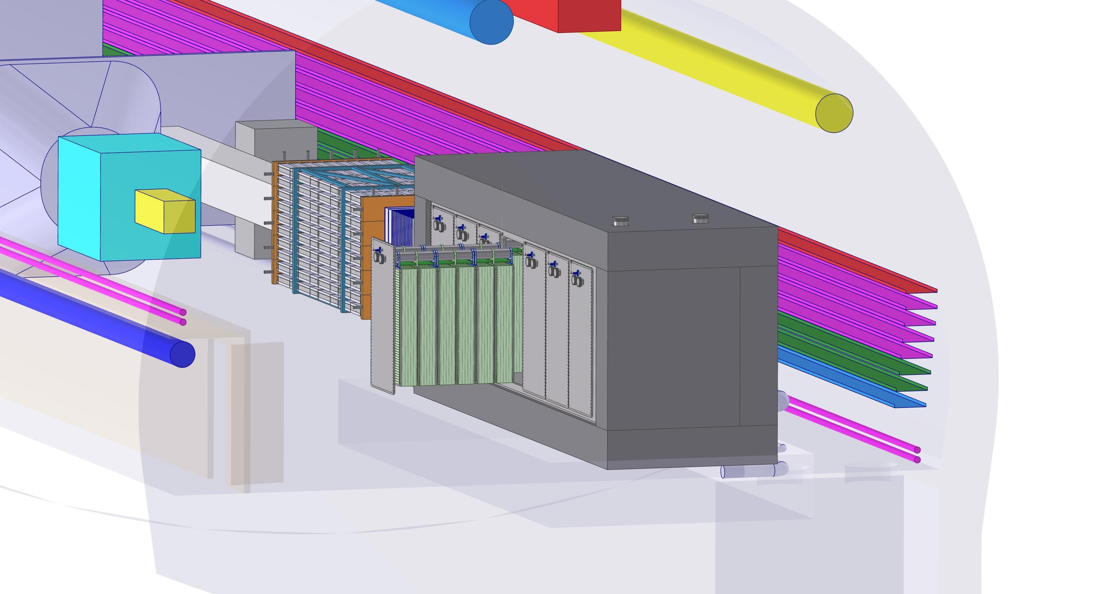
Removing the front face foam to expose the cold doors of the detector

Slide 10
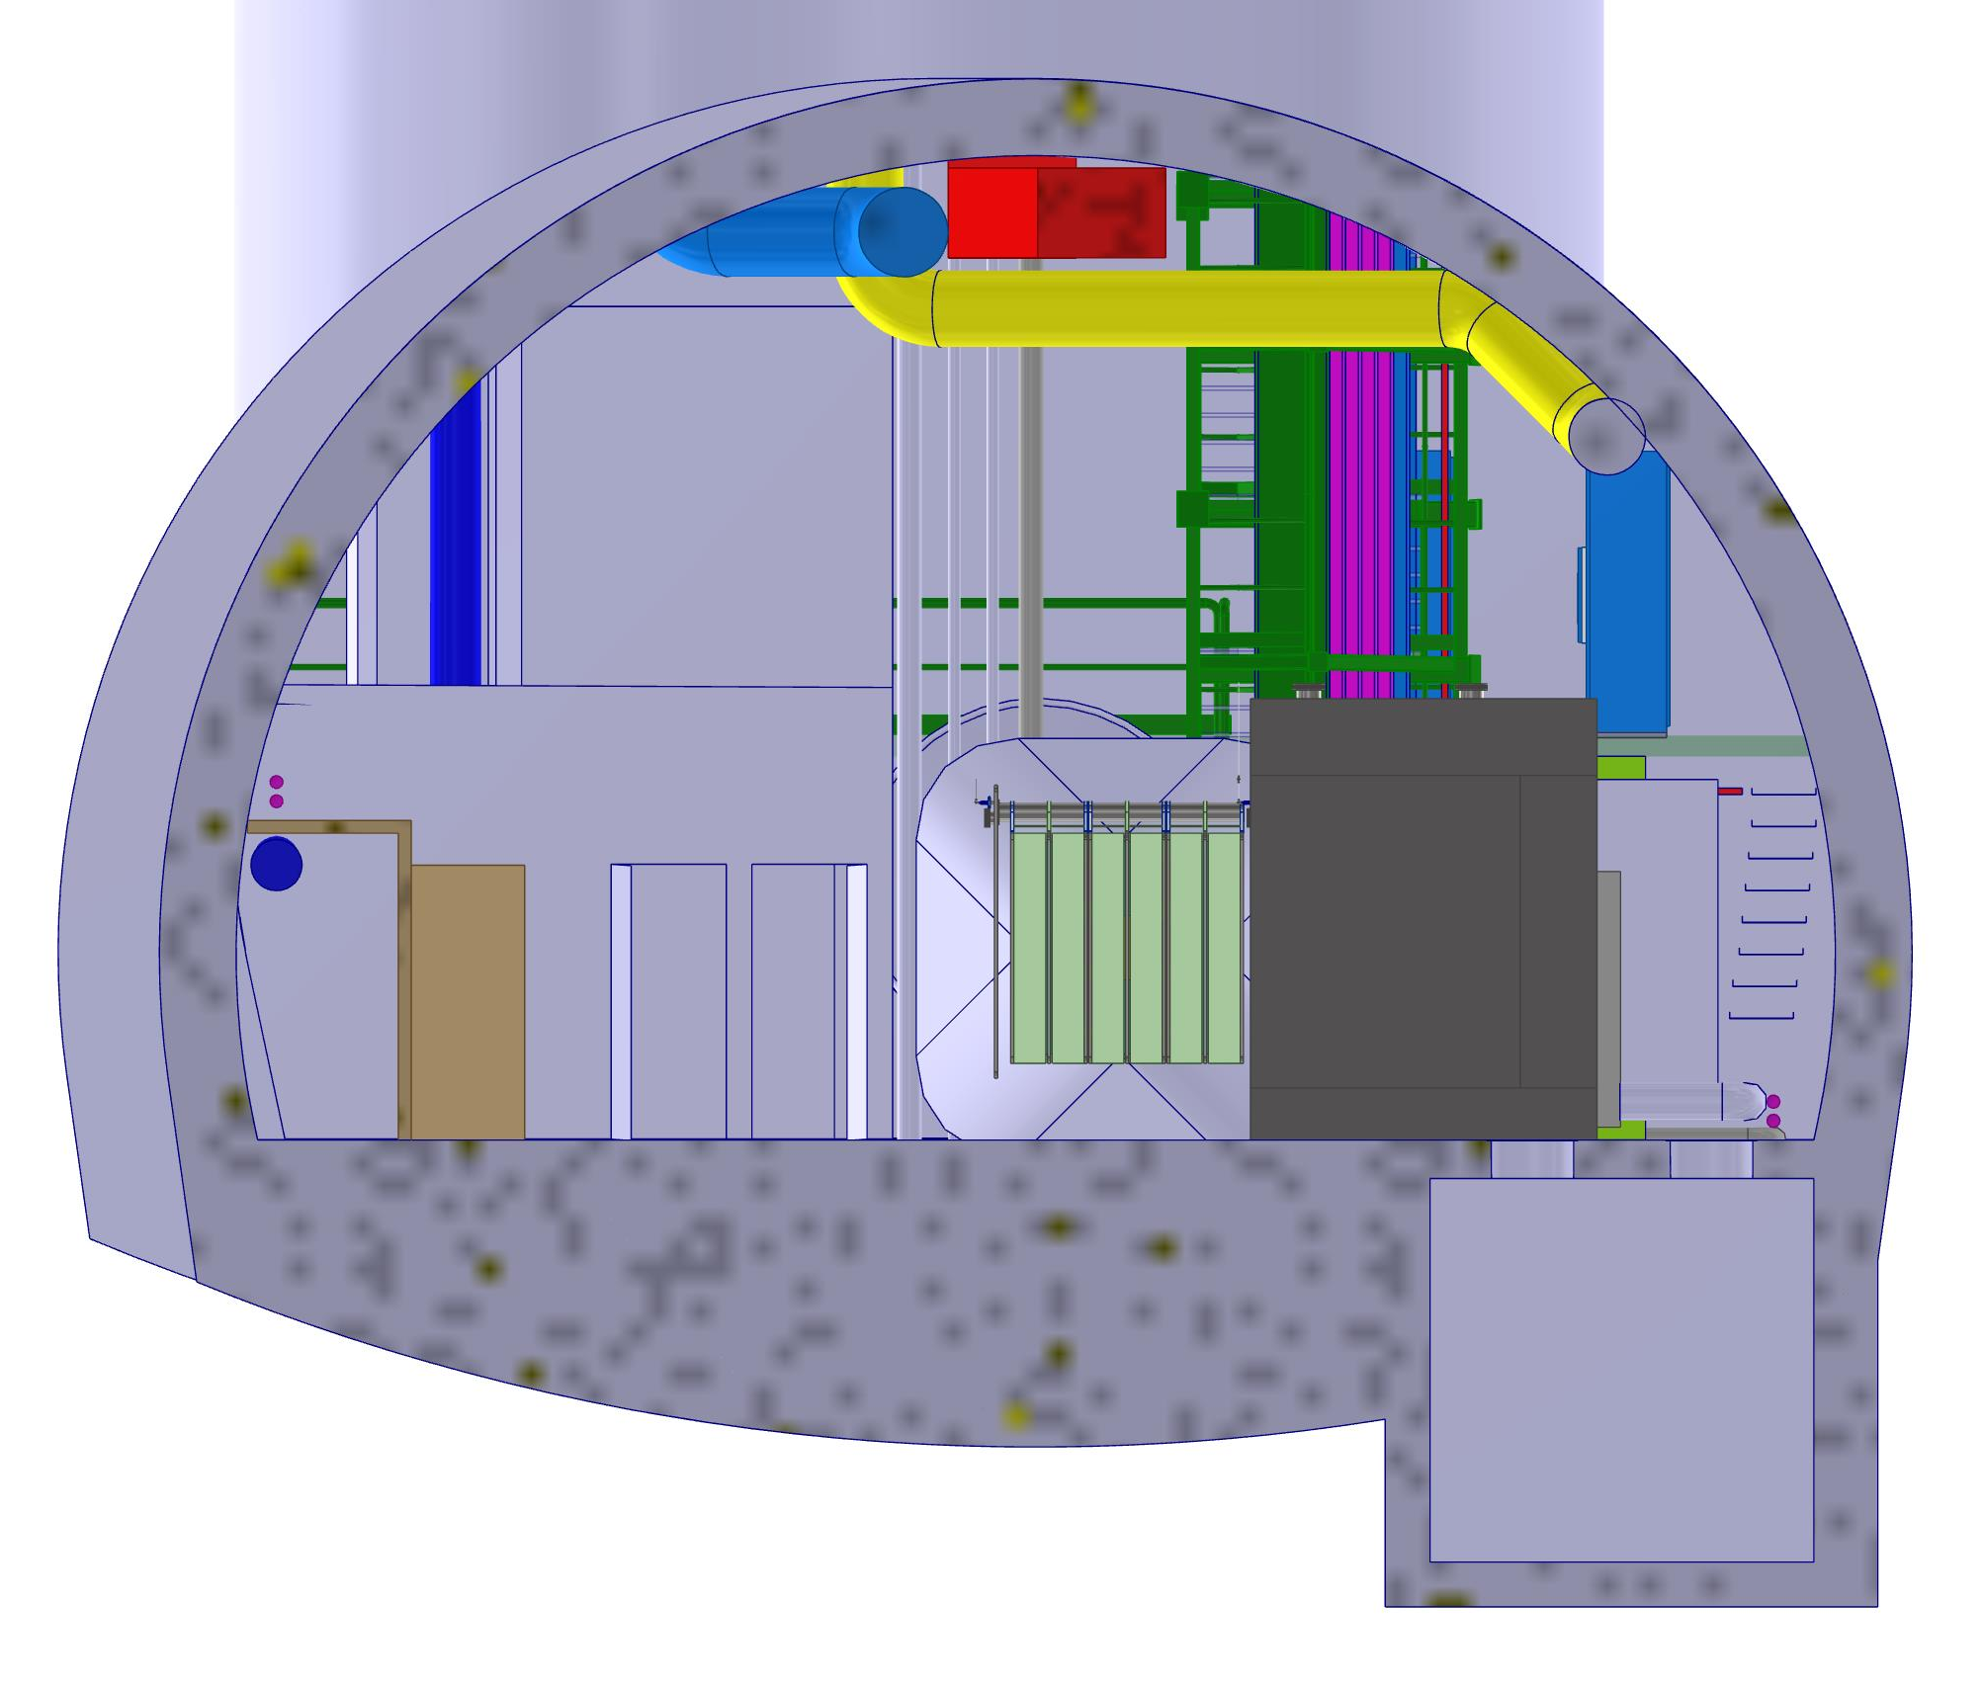
End view showing ample room for a TPC module insertion machine

Slide 11
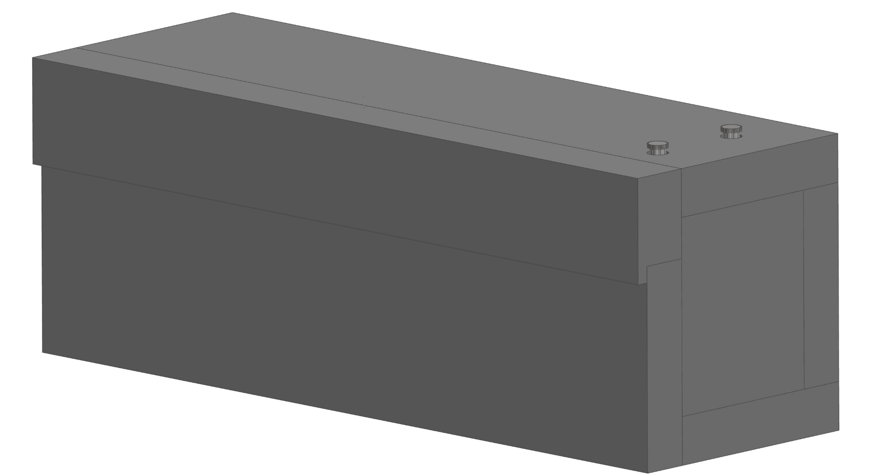
Cryostat surrounded by rigid foam

Slide 12
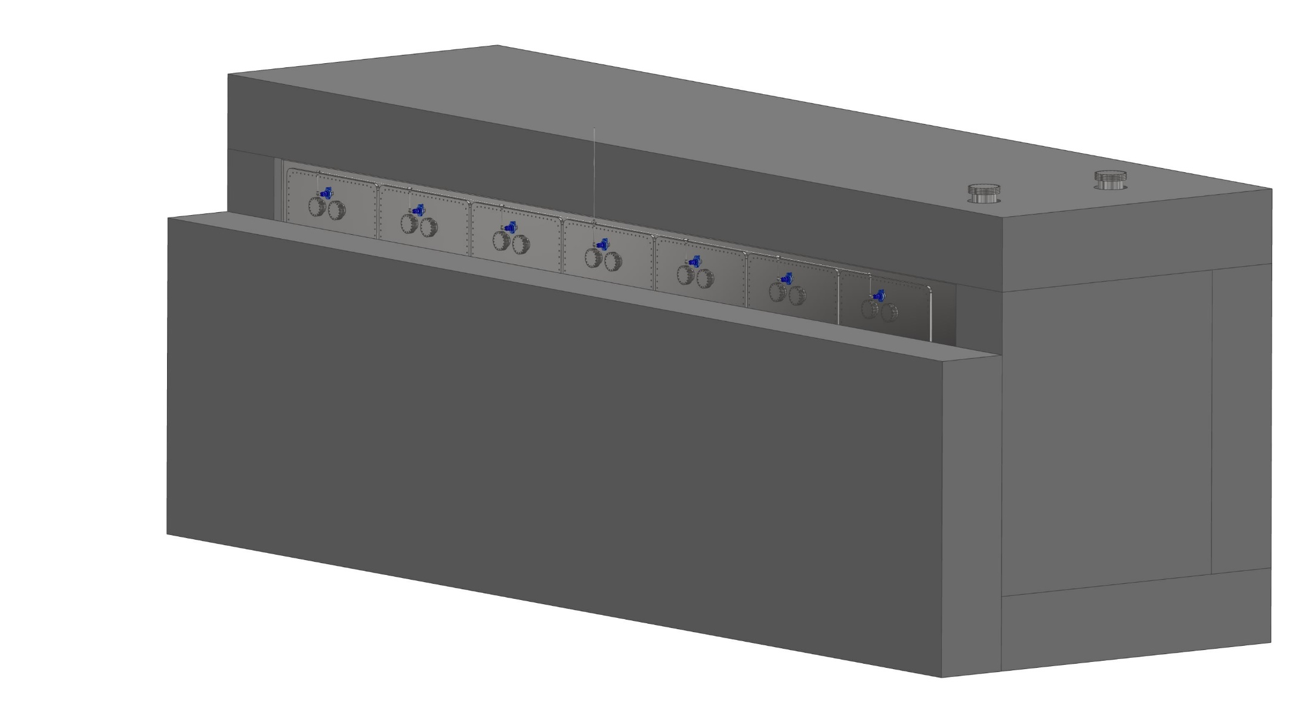
First piece of foam removed exposing the feedthroughs

Slide 13
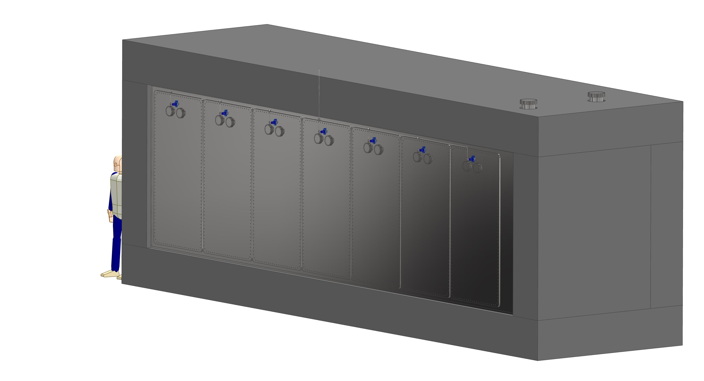
Front face foam removed in preparation for module extraction

Slide 14
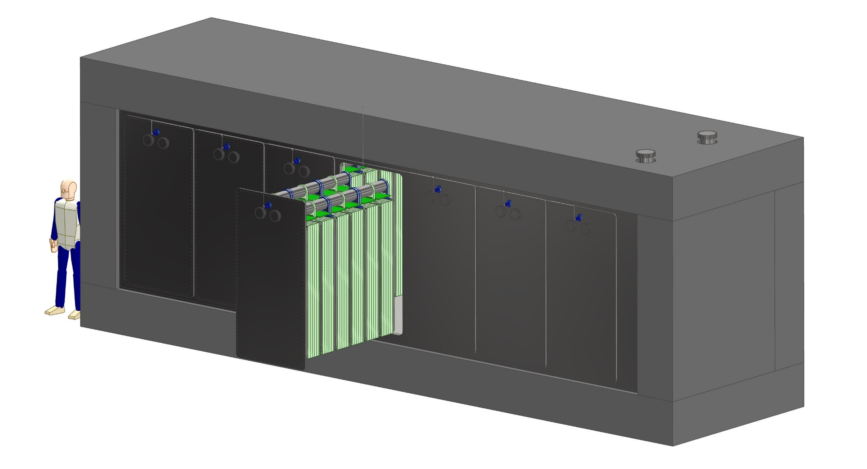
A TPC module withdrawn horizontally from the cryostat

Slide 15
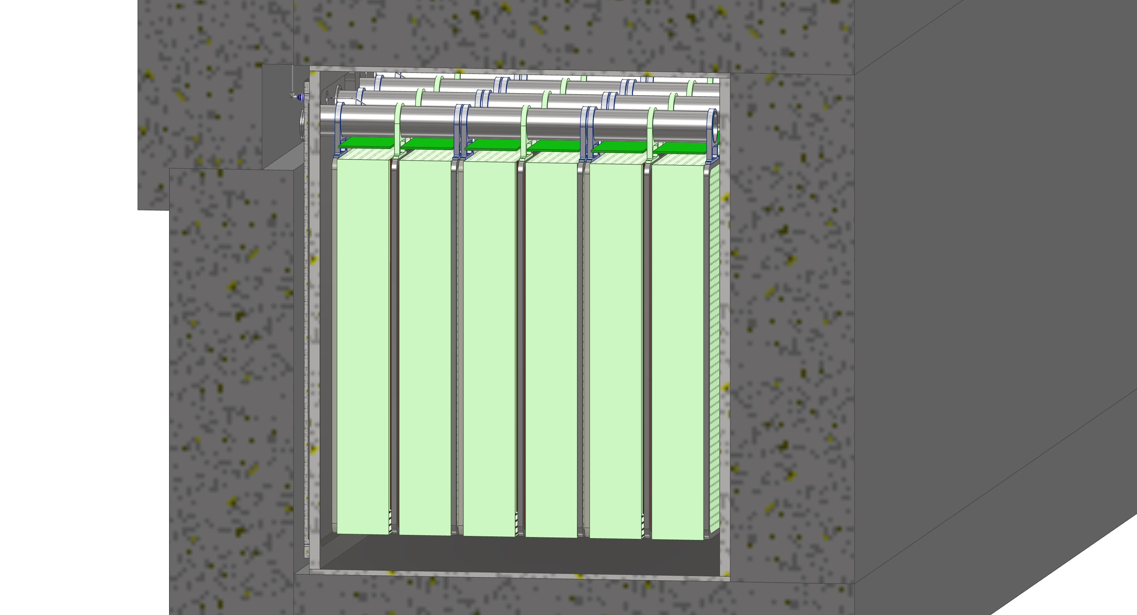
Section view showing the space inside the foam enclosure for services

Slide 16
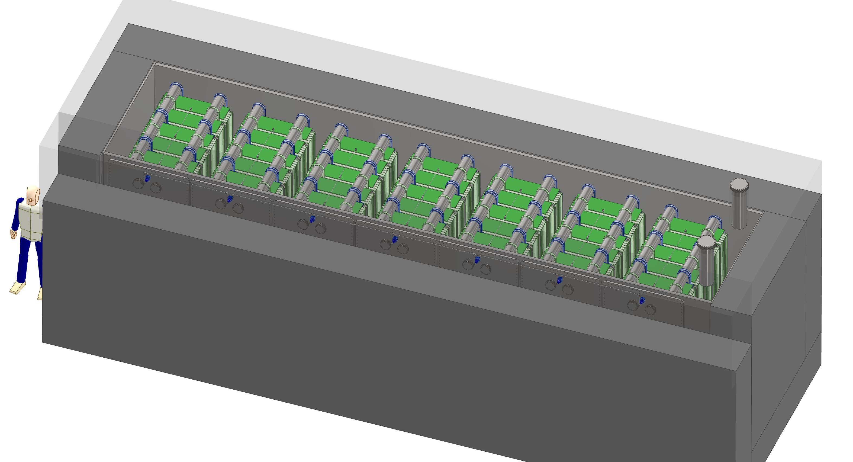
Top foam and plates made transparent

Slide 17
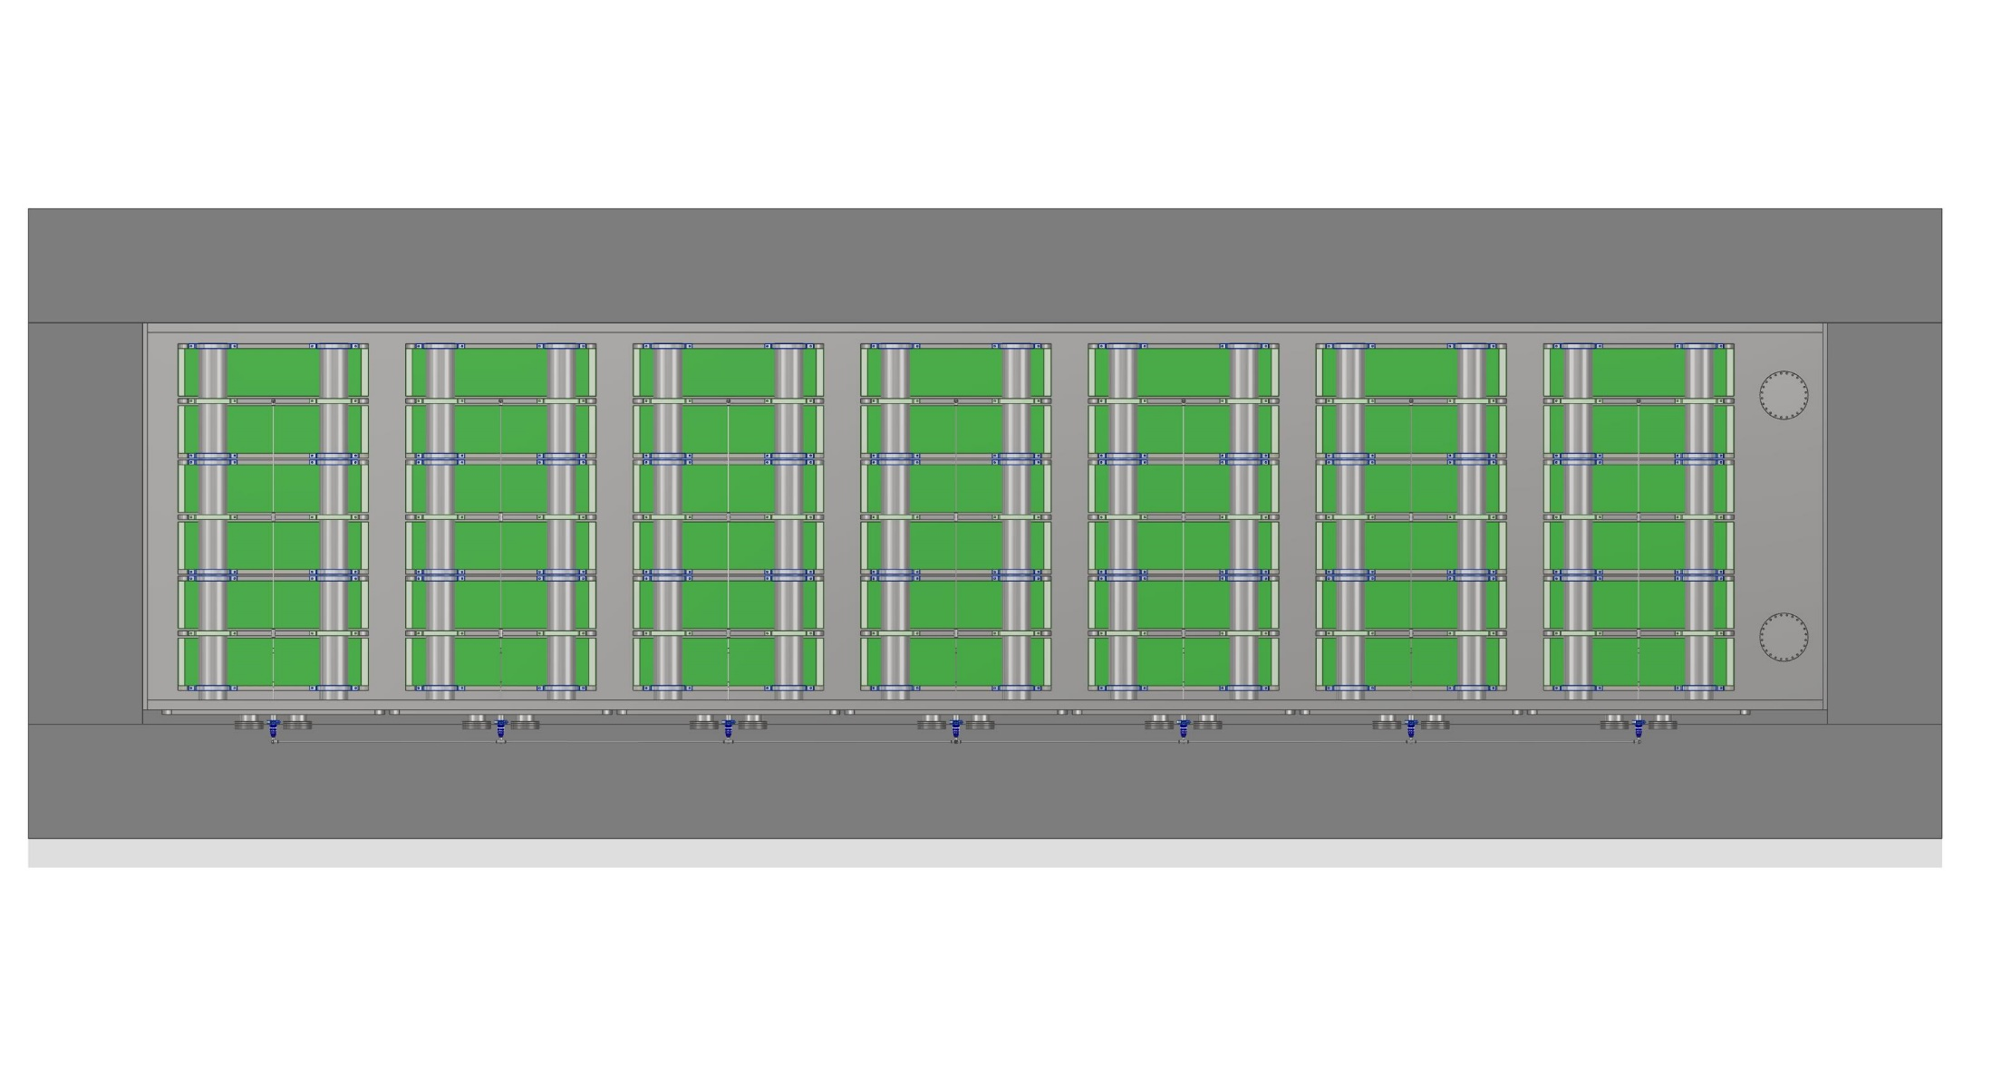
Plan view through the transparent top of the cryostat

Slide 18
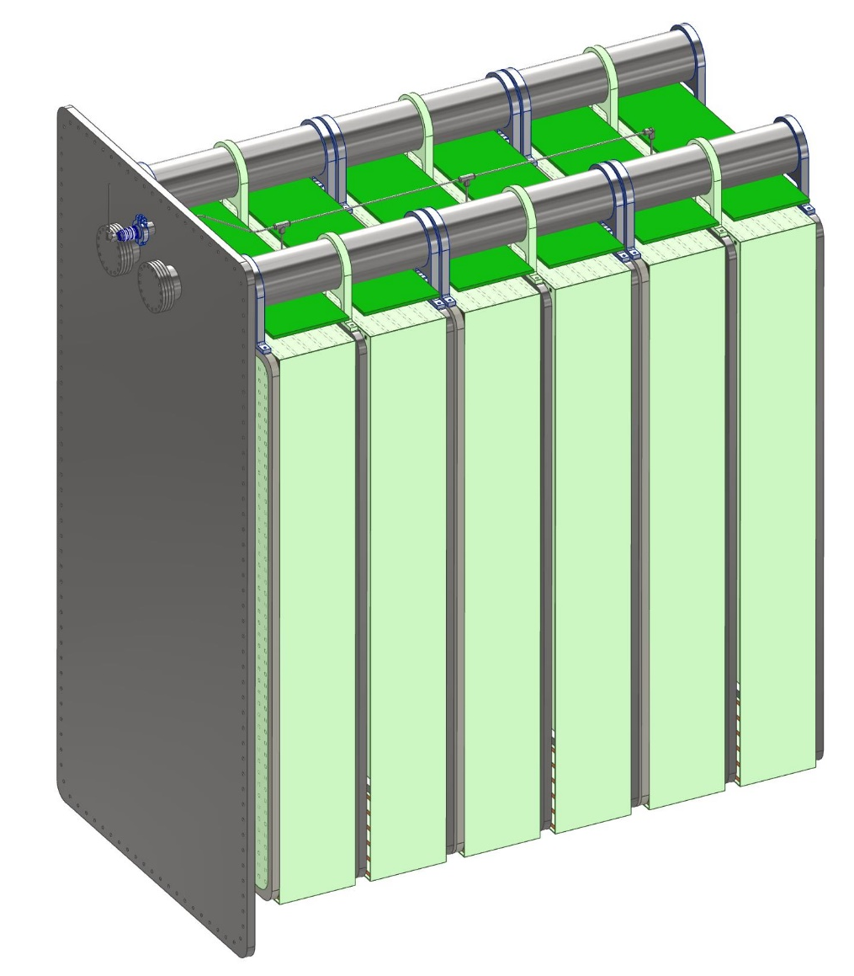
A TPC Module with three TPC cells hanging from cantilevered beams
This is a 20kV feedthrough mounted on an NW40 flange from Lesker, with an aluminum EVAC seal. It is a placeholder since it is not a cryo HV feedthrough.
6 inch OD x .250 inch wall stainless tubing is the cantilevered beam that holds the TPCs up. The tubes are welded to flanges bolted to the inside of the cold door.
These are 6 inch conflat flanges with 4” OD tube to get power in and signals out. We’ll have to see if this aperture is adequate.

Slide 19
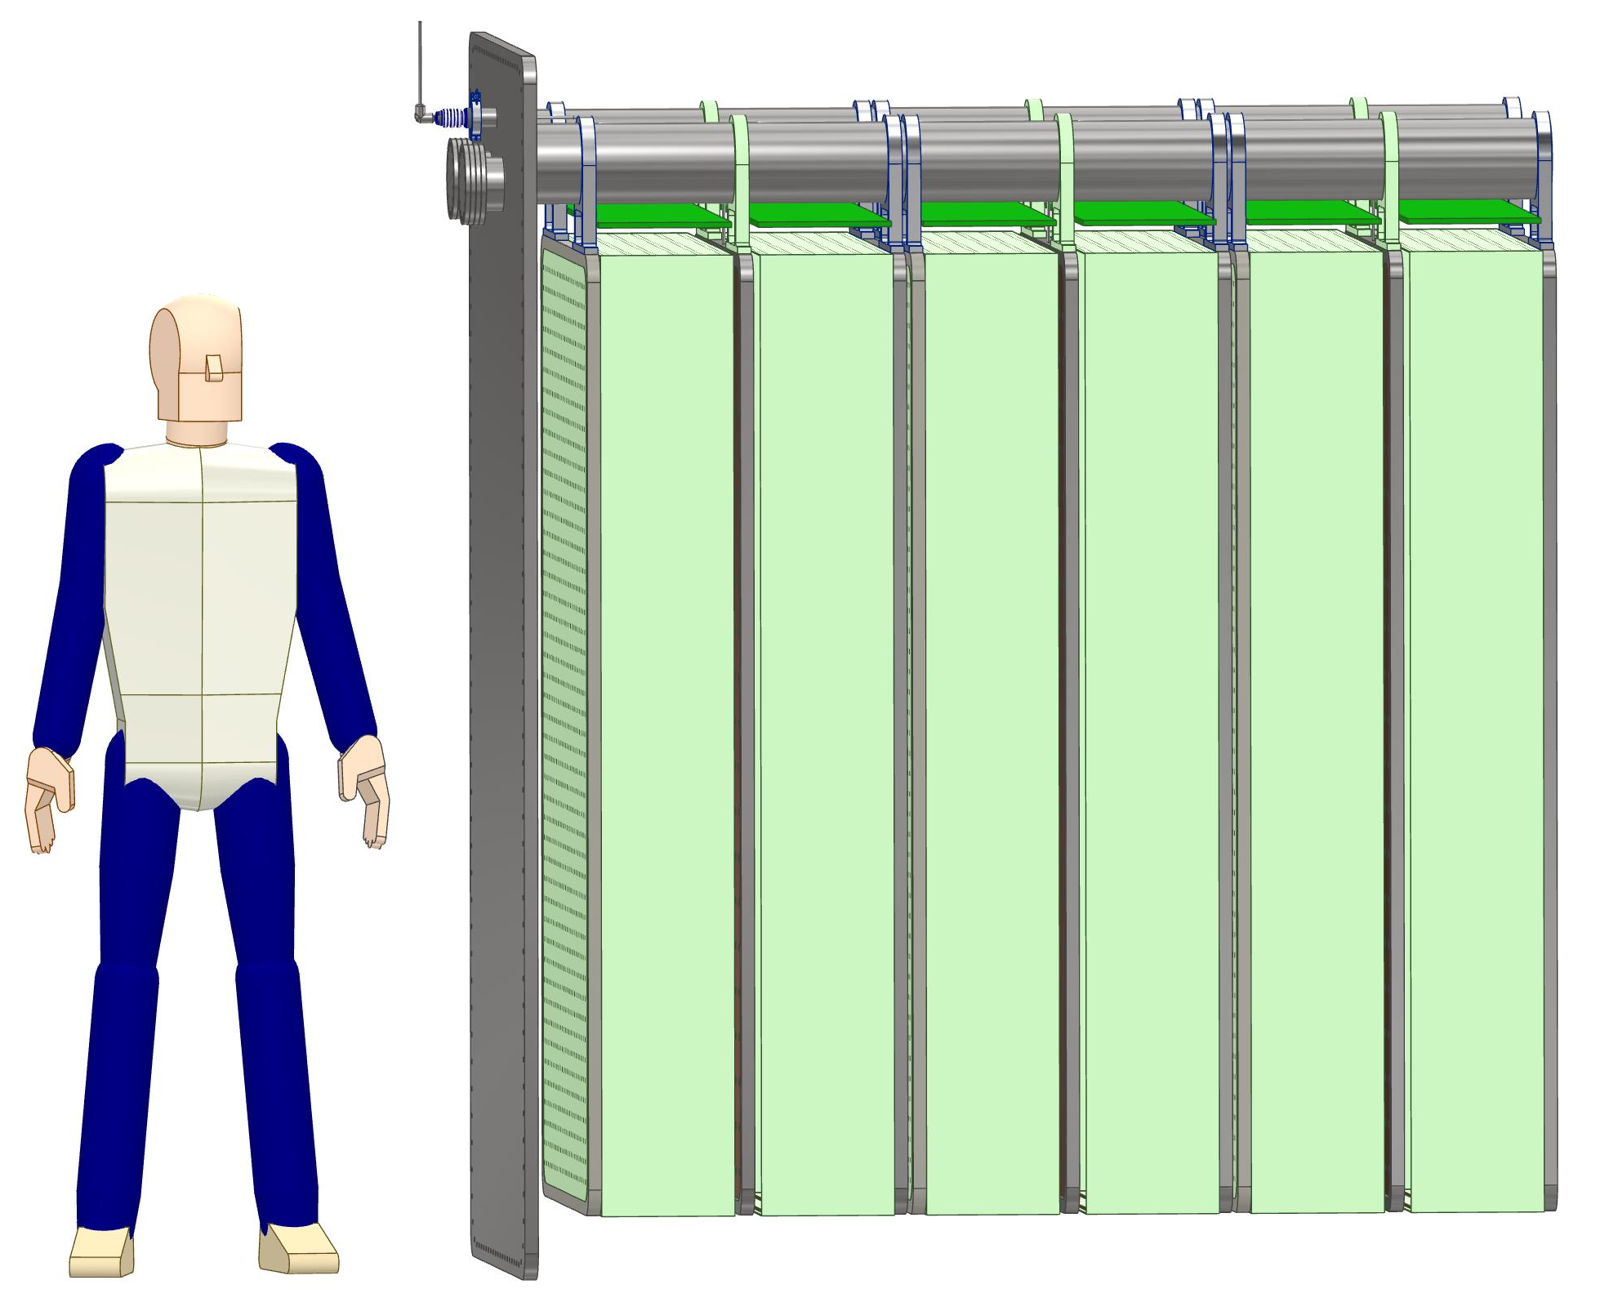
A TPC Module with 6 foot man next to it for scale
The TPC module weighs 2,400 lbs (1,088.4 kg) as shown.

Slide 20
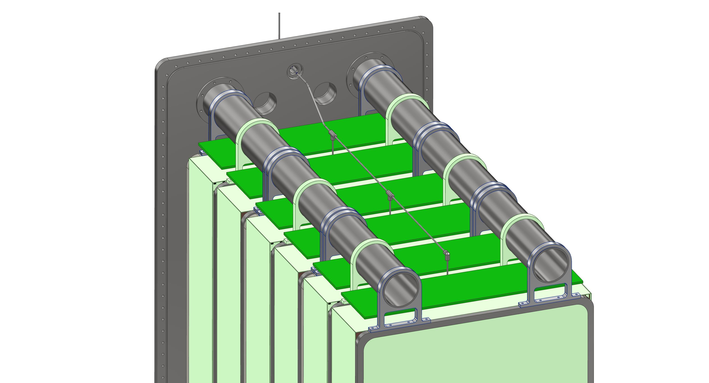
Another view showing a conceptual HV connection scheme to the cathode planes

Slide 21
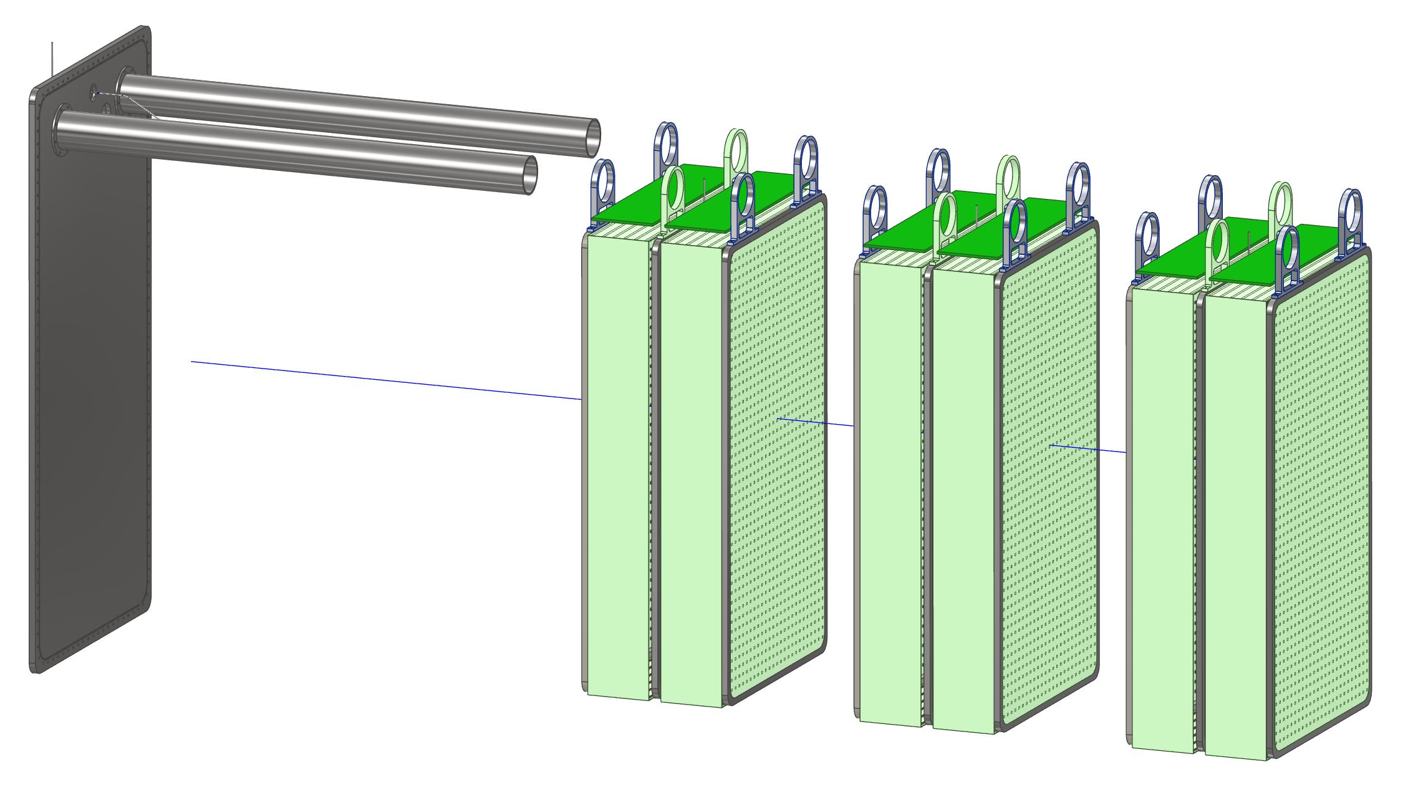
Exploded view of a module showing separate TPCs

Slide 22
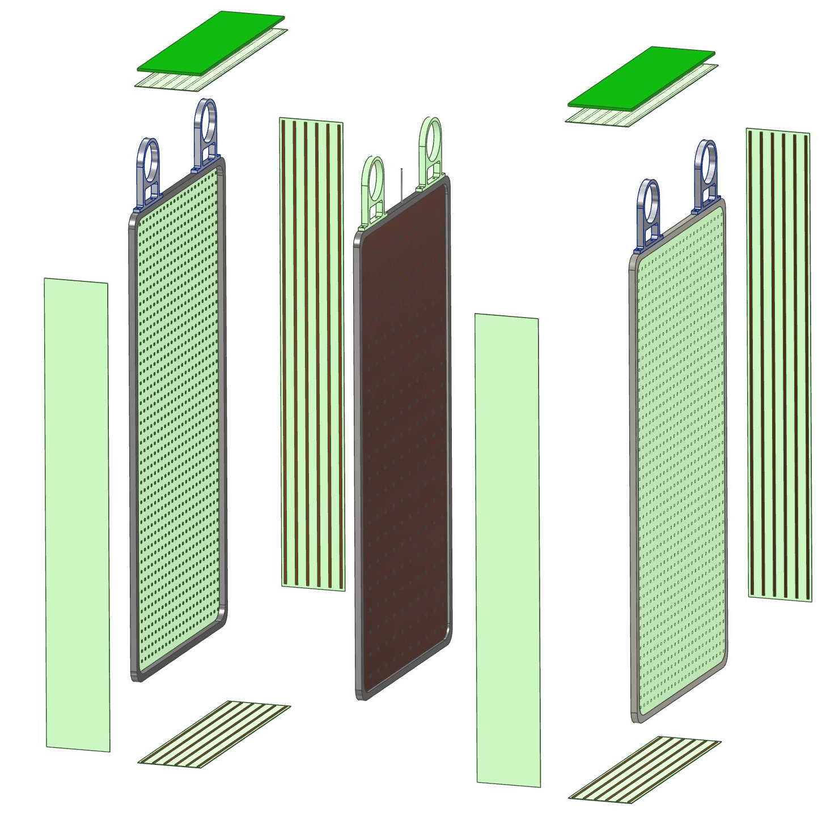
Exploded view of a single TPC cell
Electronic board
Cathode plane
Field cage plates
Anode plane
Hanger brackets
Anode plane
Field cage plates

Slide 23
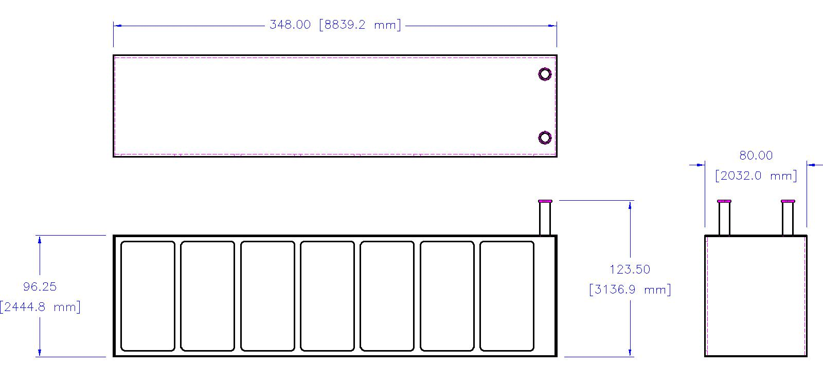
Overall dimensions of the TPC “filing cabinet” cryostat
This object weighs 43,546 lbs, 21.8 tons. (19,749 kg) Can it be brought down the tunnel shaft in one piece?

Slide 24
Preliminary FEA of vessel and TPC
I did very basic checks of plate thickness and beam size to verify the feasibility of the design
Much more sophisticated analyses need to be done yet

Slide 25
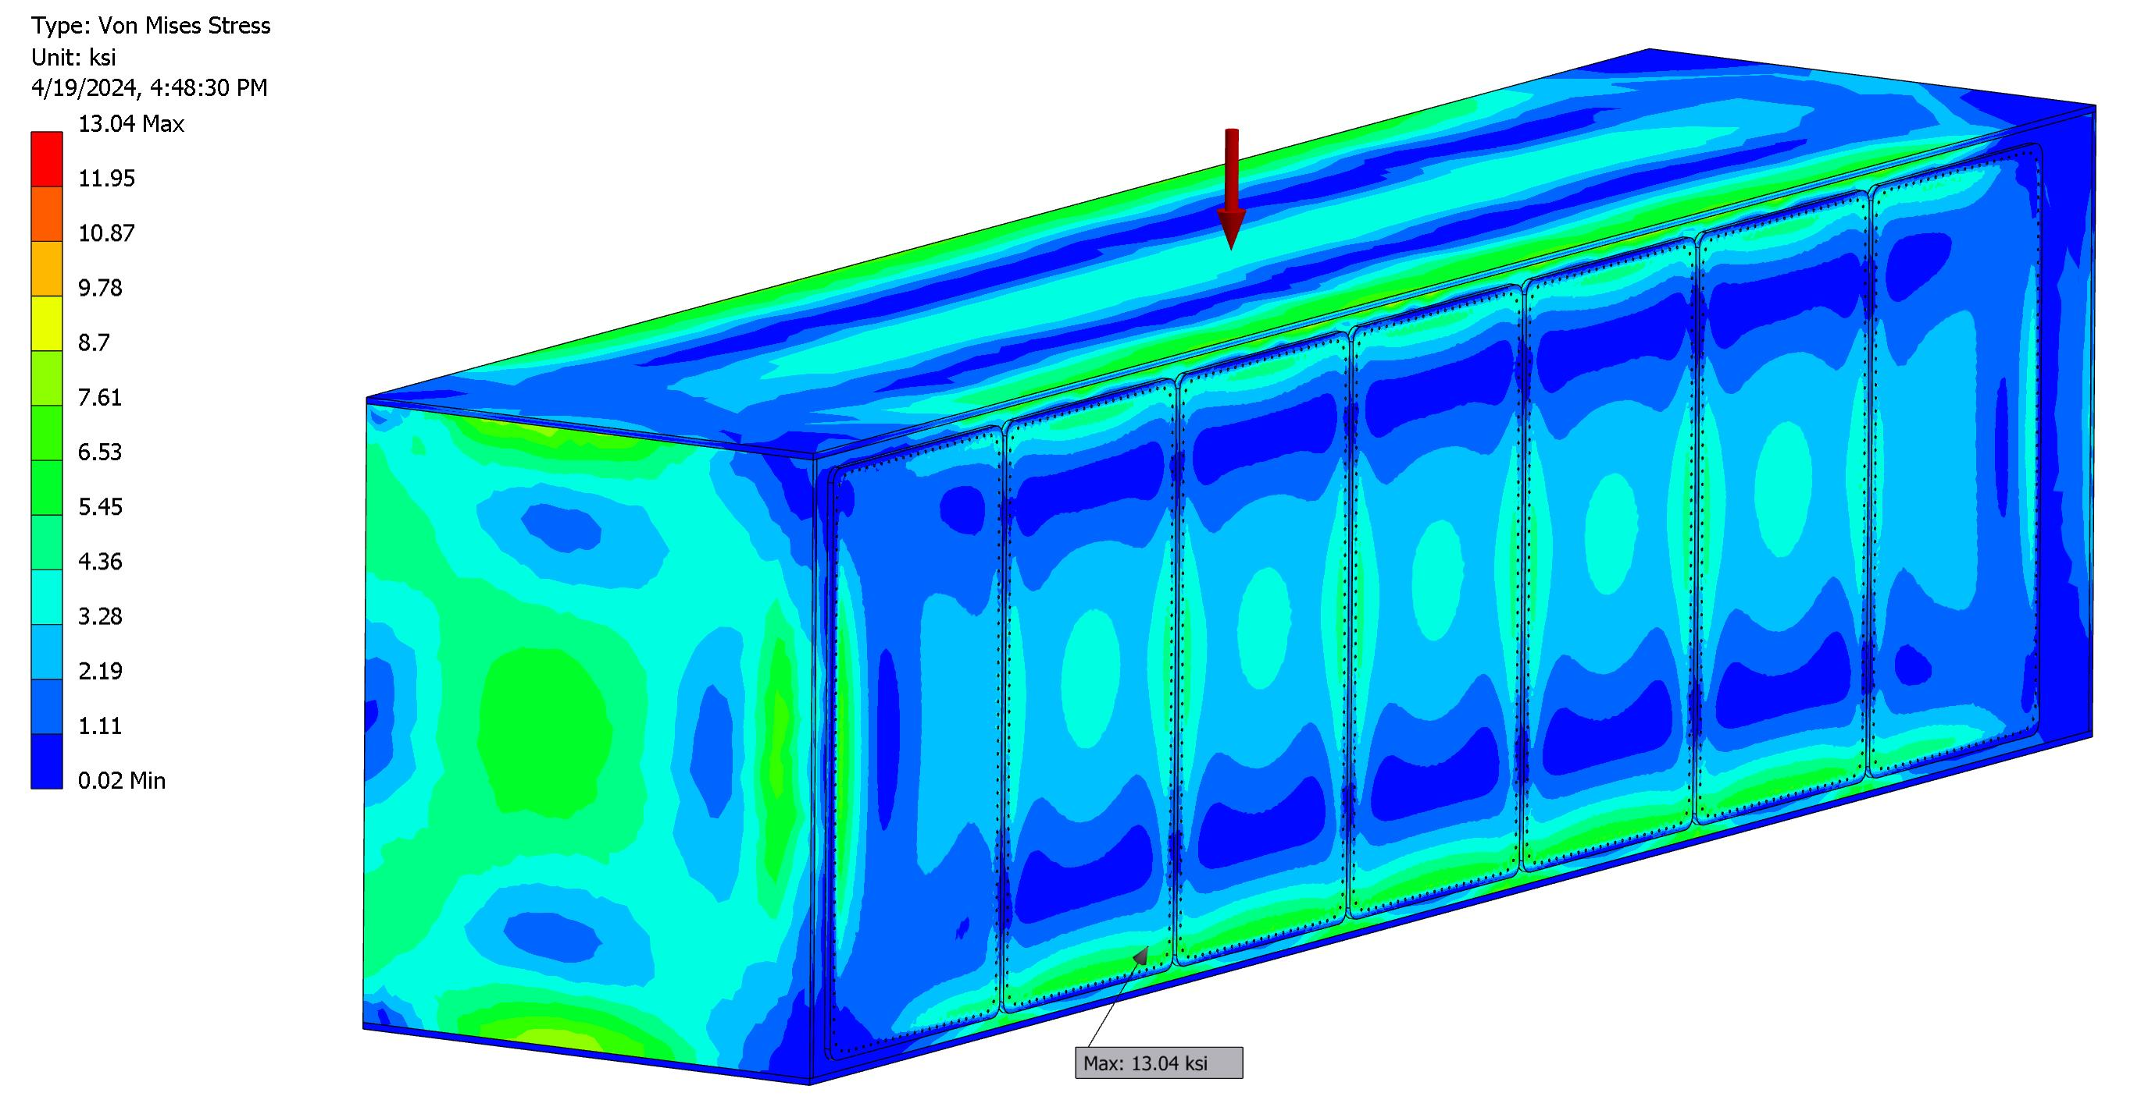
Von Mises stress plot, 5 psi internal pressure, 2 inch thick back wall
Maximum stress is on the inside radius of the opening in the cryostat wall. Stresses everywhere else are significantly lower.

Slide 26
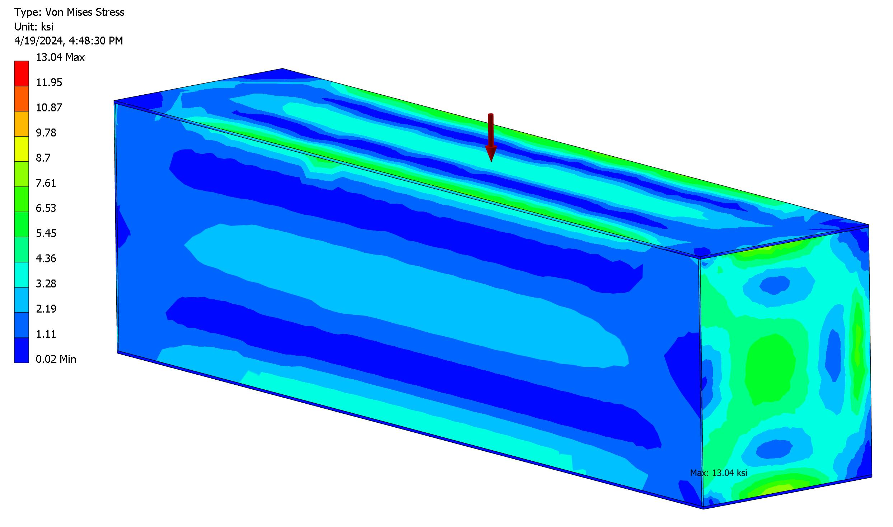
Von Mises stress plot, 5 psi internal pressure, 2 inch thick back wall
This is a back side view. I increased the wall thickness of the back to 2 inches after seeing very large displacements from moderate internal pressure. Stresses everywhere are now very low and acceptable.

Slide 27
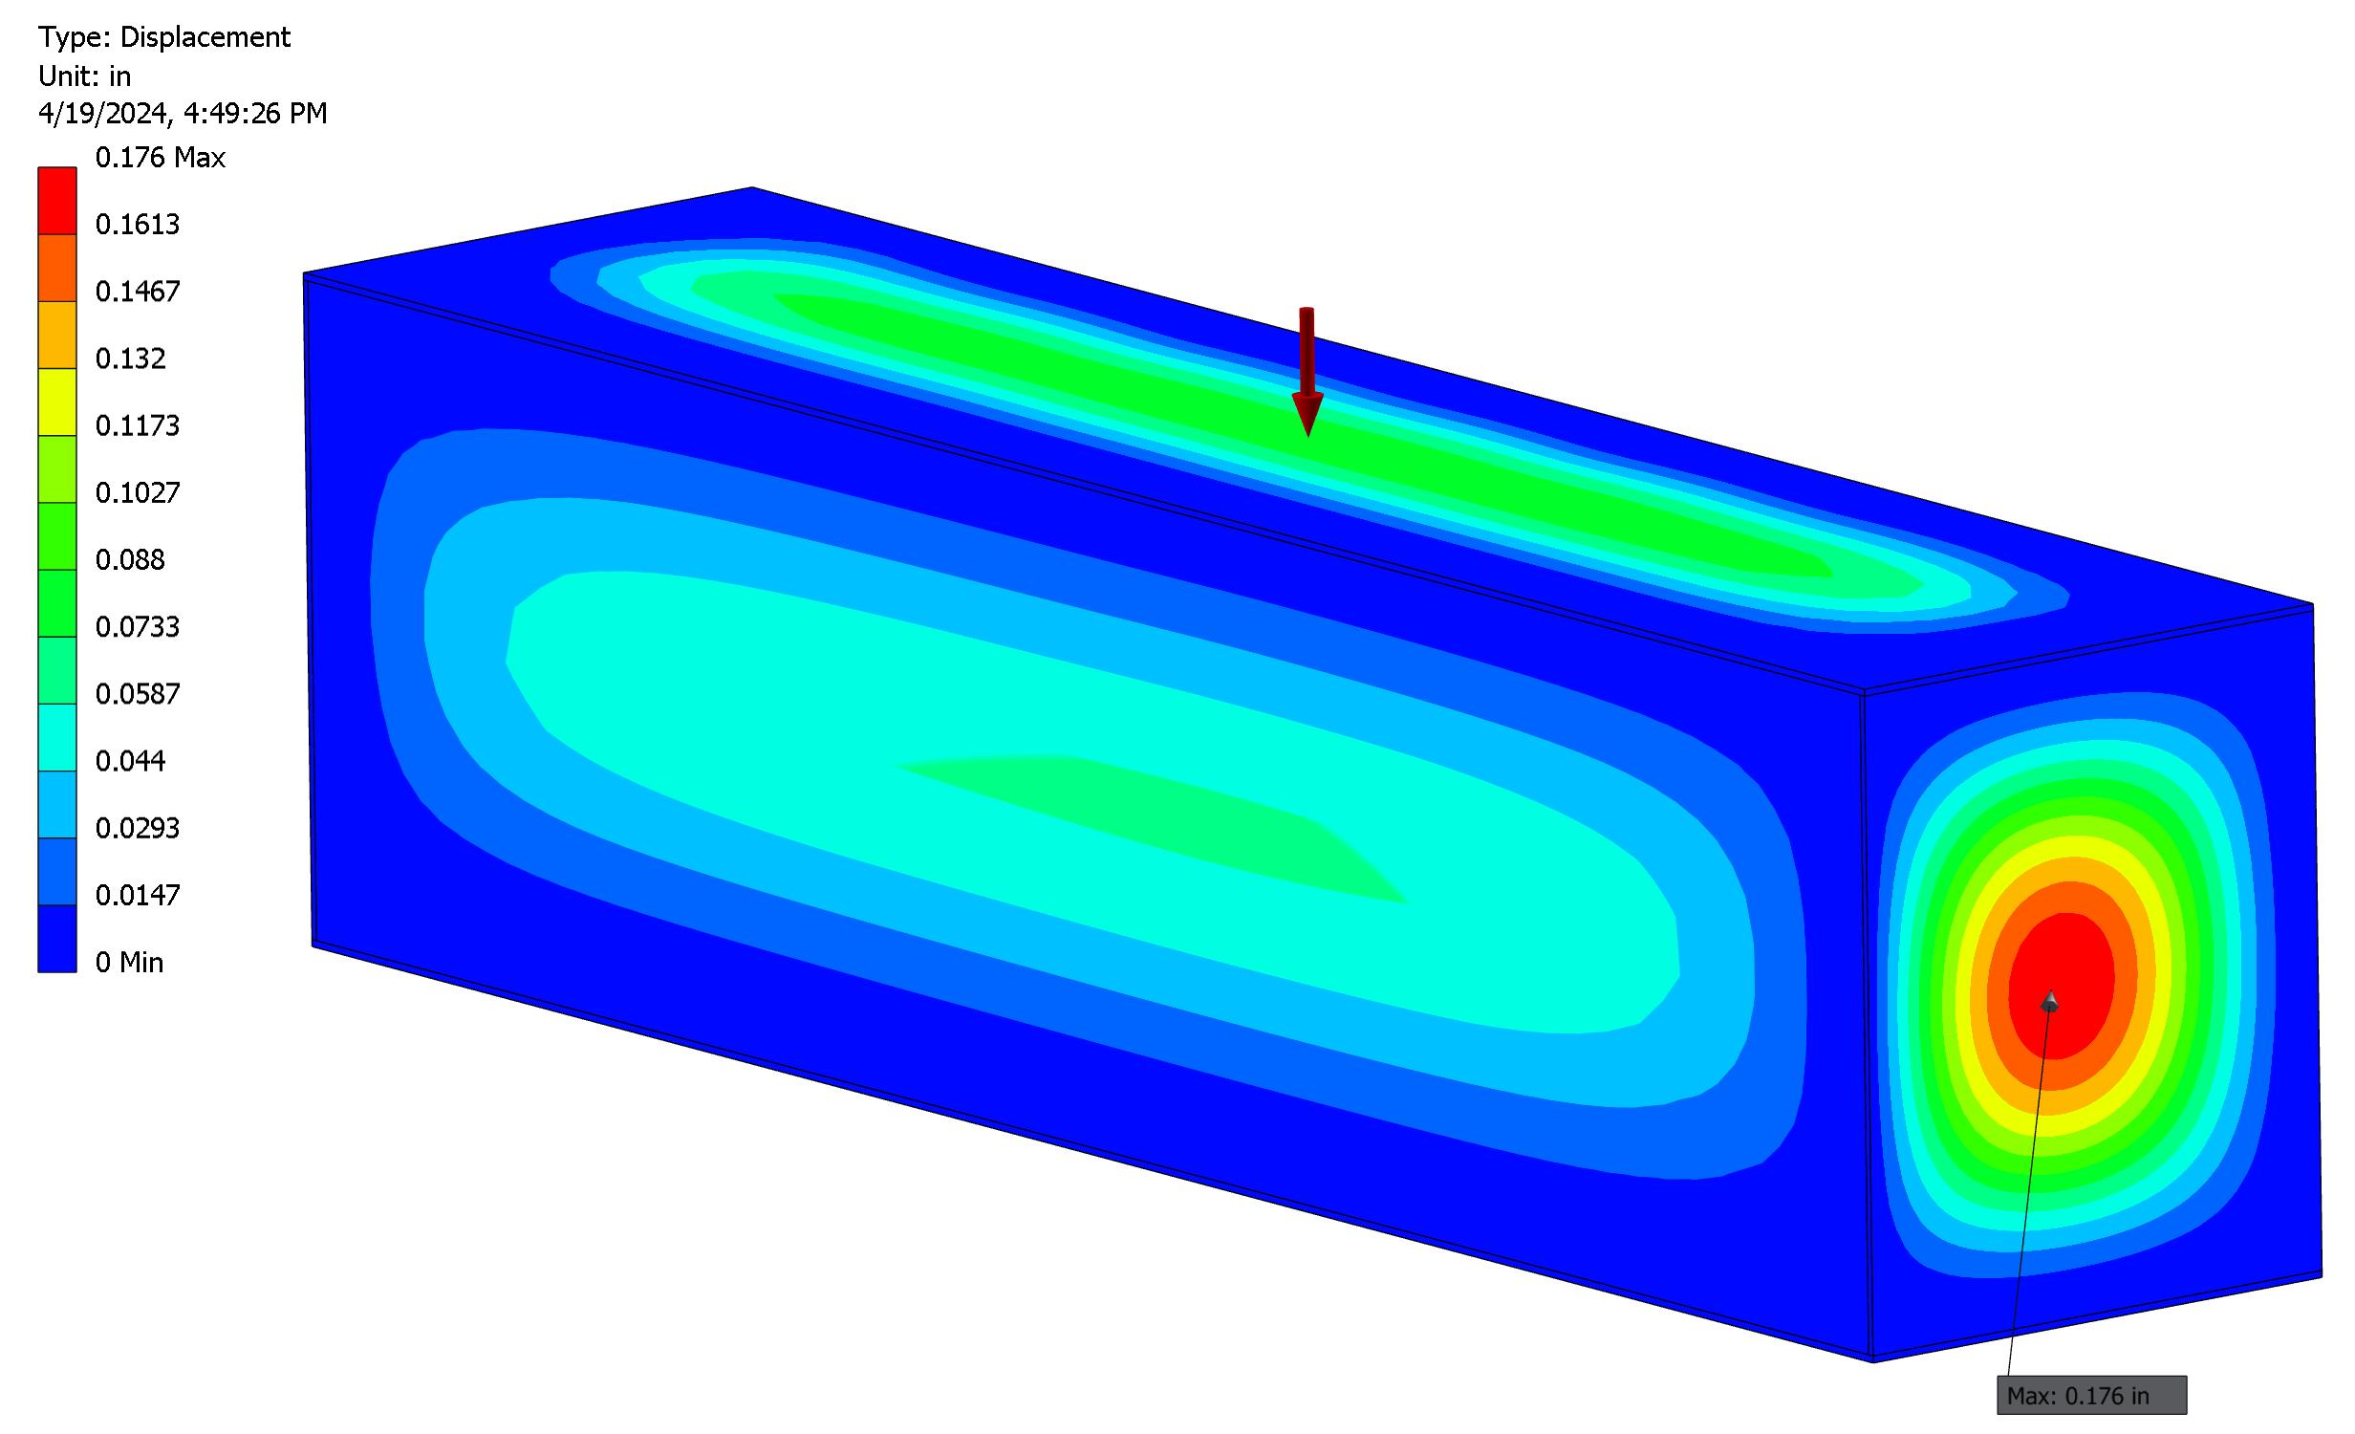
Deflection plot, 5 psi internal pressure, 2 inch thick back wall
The back side now deflects by ~2 mm from 5 psi internal pressure. End walls deflect outward by 4.5 mm.

Slide 28
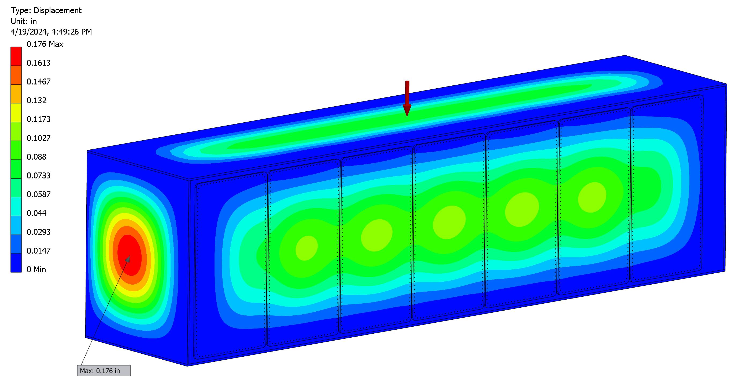
Deflection plot, 5 psi internal pressure, 2 inch thick back wall
The doors deflect by ~3 mm. This analysis is for uniform internal pressure loading. The hydraulic pressure gradient from the LAr is not included here.

Slide 29
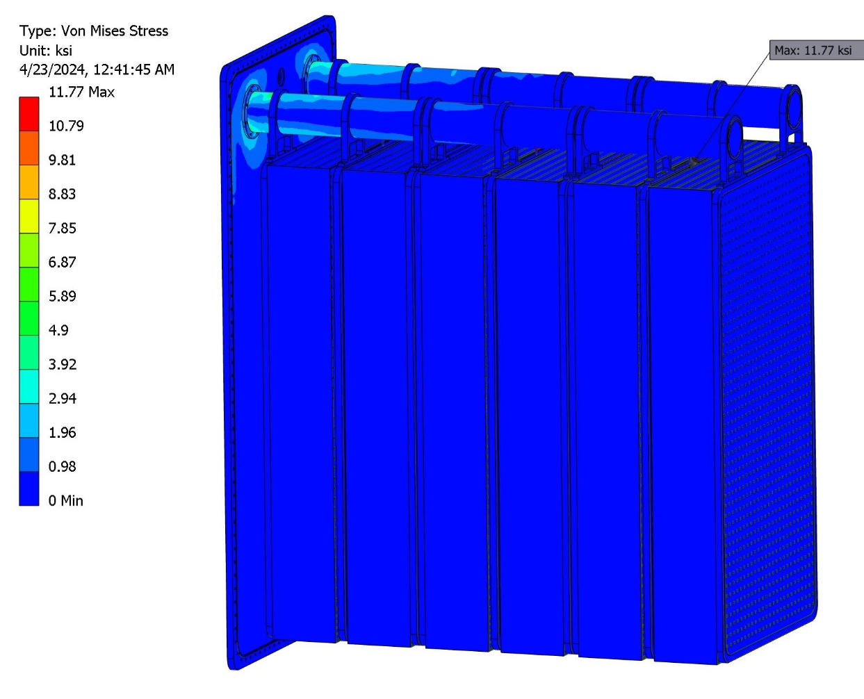
Von Mises stress plot of TPC Module with 1 G load vertical
The stress concentration is a weird artifact at the HV connection to one of the cathodes. Stresses everywhere else are very low. (Typical of a deflection driven design.)
I fixed the area where the bolt holes are for the support BC.

Slide 30
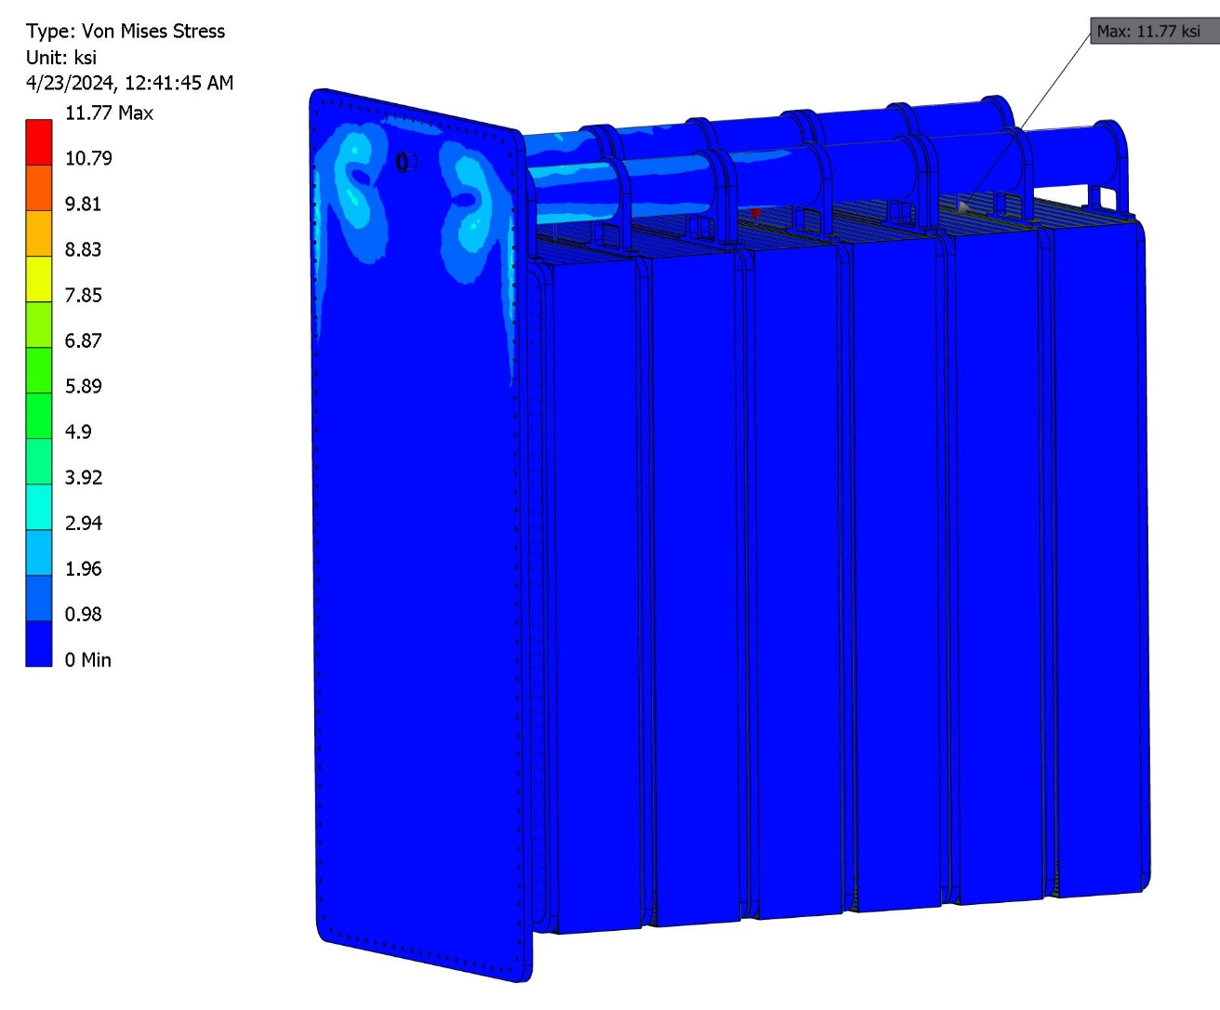
Another view of Von Mises stress with 1 G load
Stresses may be unrealistically low because all of the parts are bonded together in this model. I do not include any sliding freedom.

Slide 31
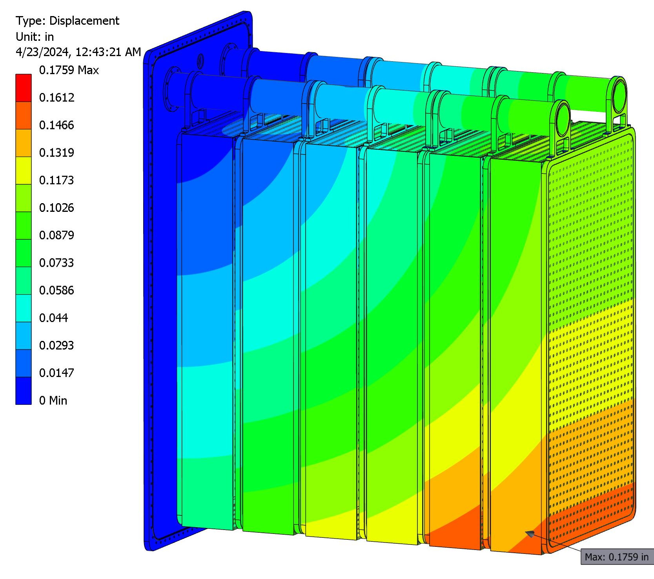
Total displacement plot of TPC module with 1 G loading
The cantilevered supports appear to be adequate for 1 G loading of the TPC modules.

Slide 32
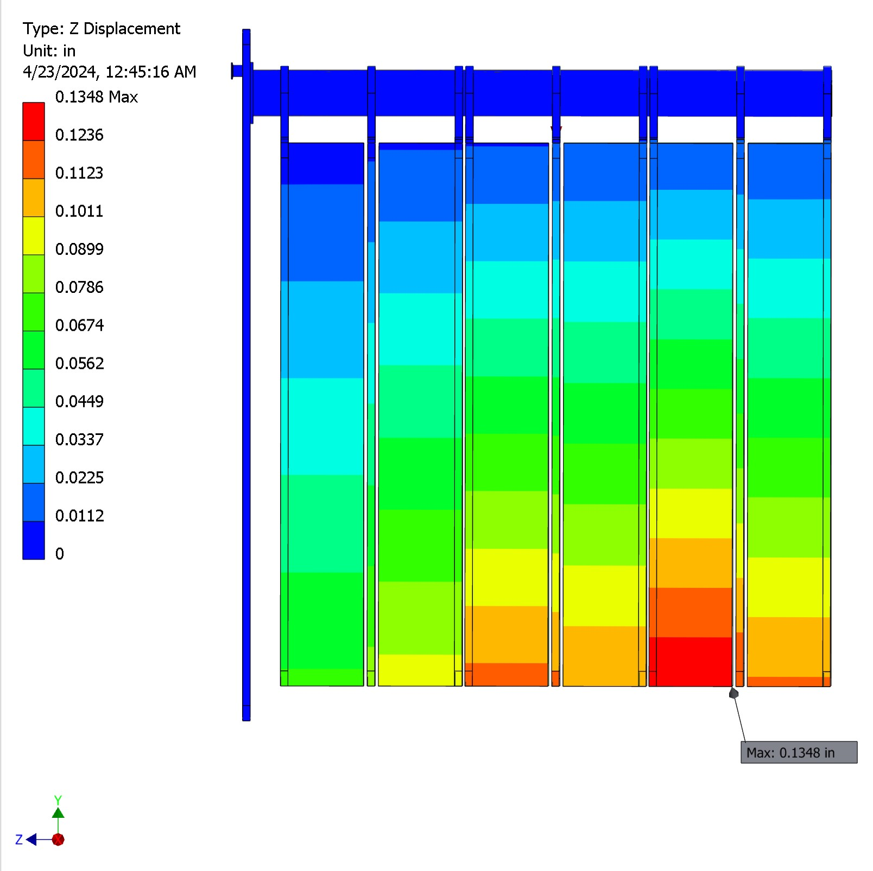
Z deflection plot of TPC Module with 1 G loading
The vertical sag causes a horizontal shifting of the bottoms of the TPCs of about 3.5 mm.

Slide 33
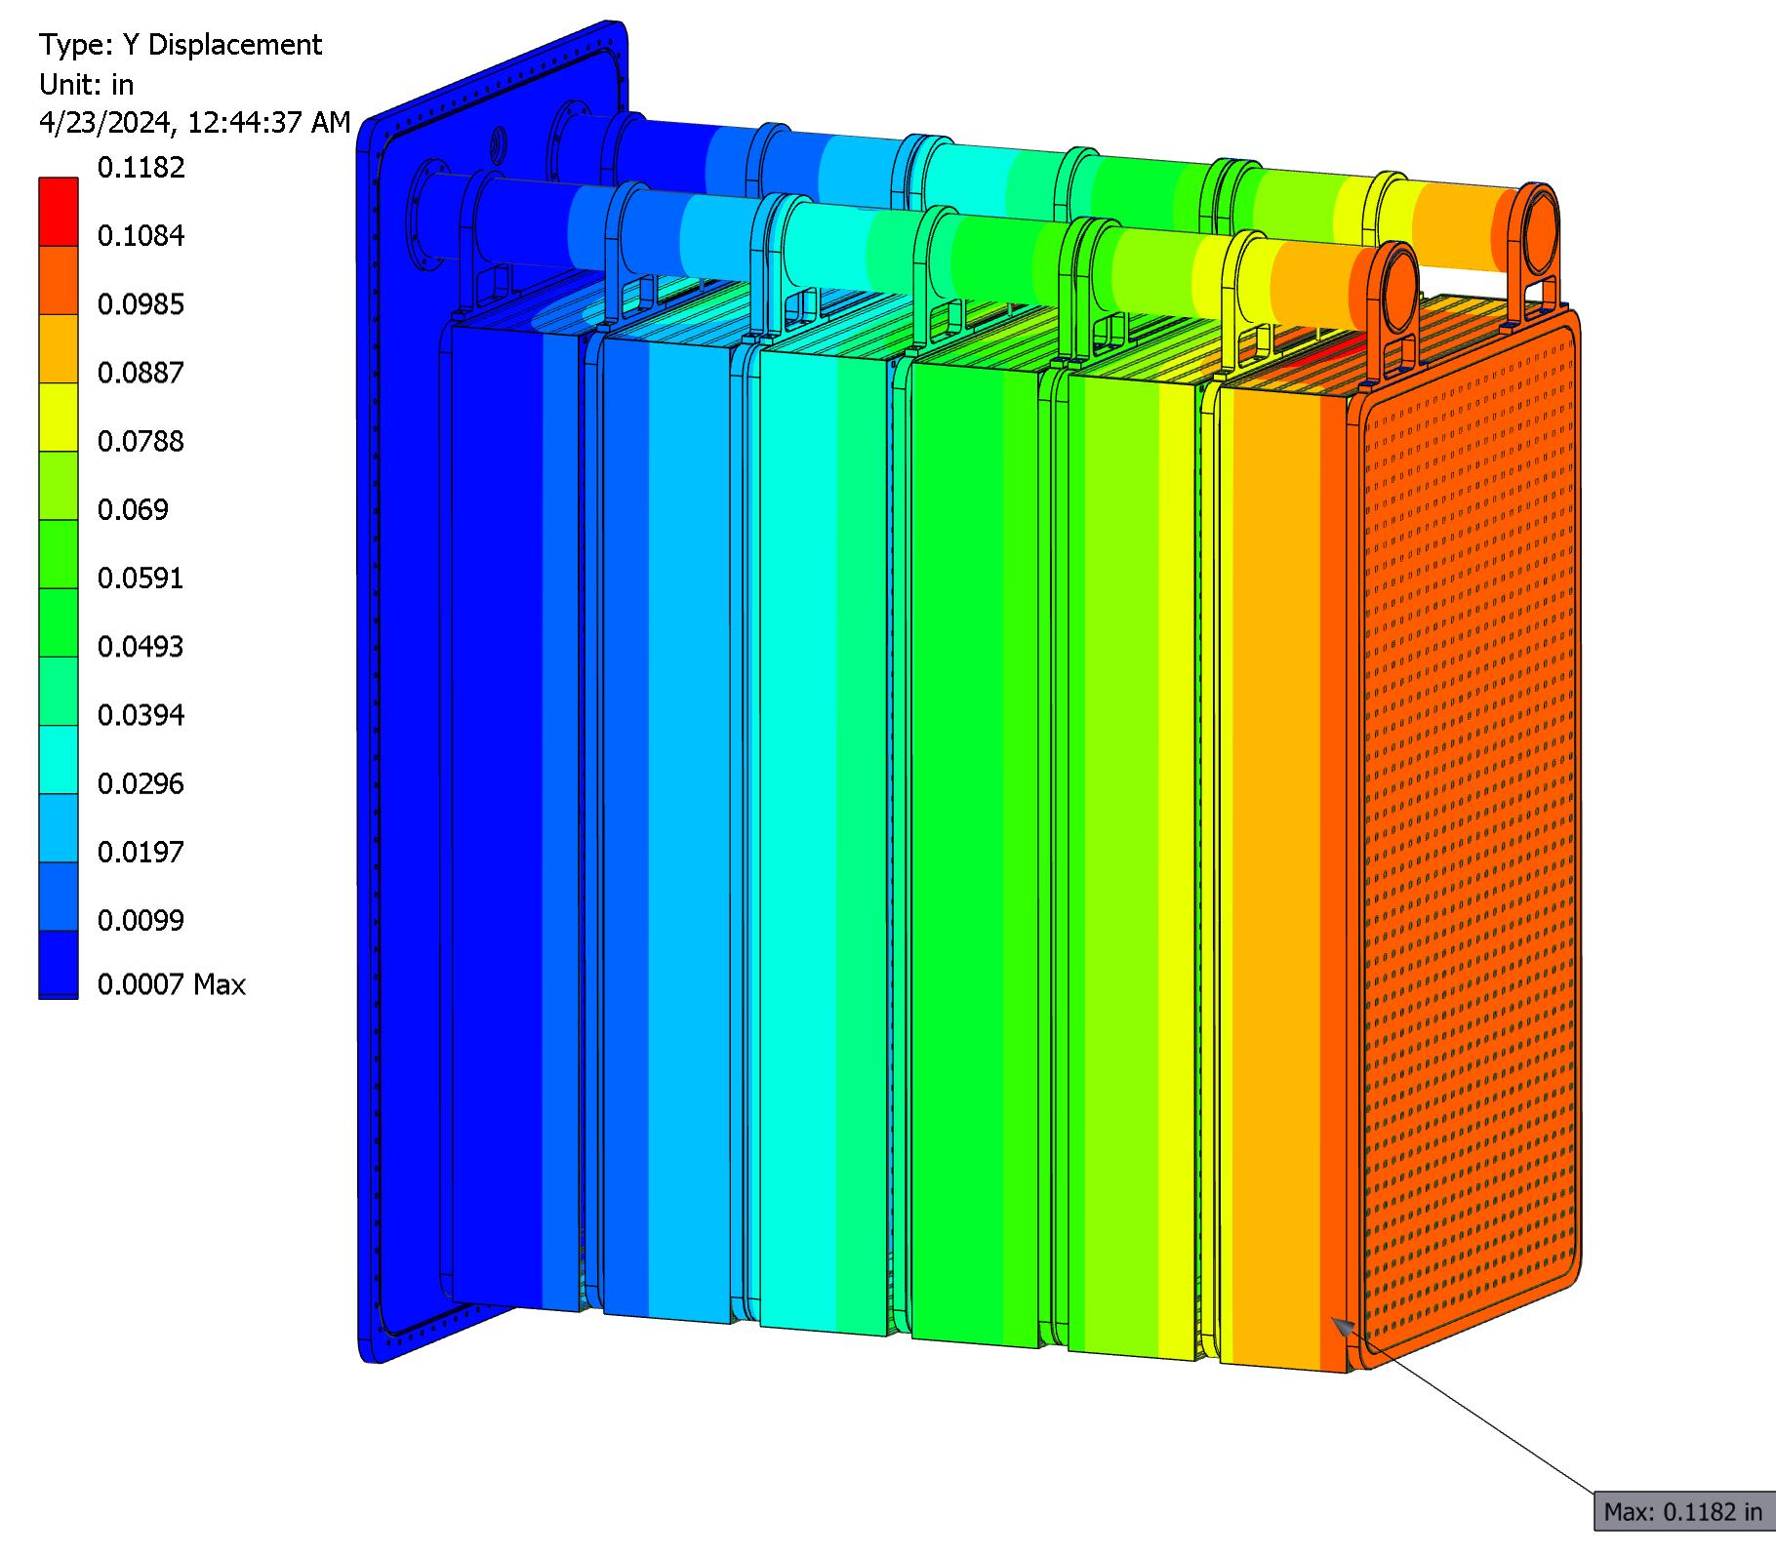
Y (vertical) deflection plot of TPC module with 1 G loading
Vertical sag from gravity at the end of the cantilevers is 3 mm.

Slide 34
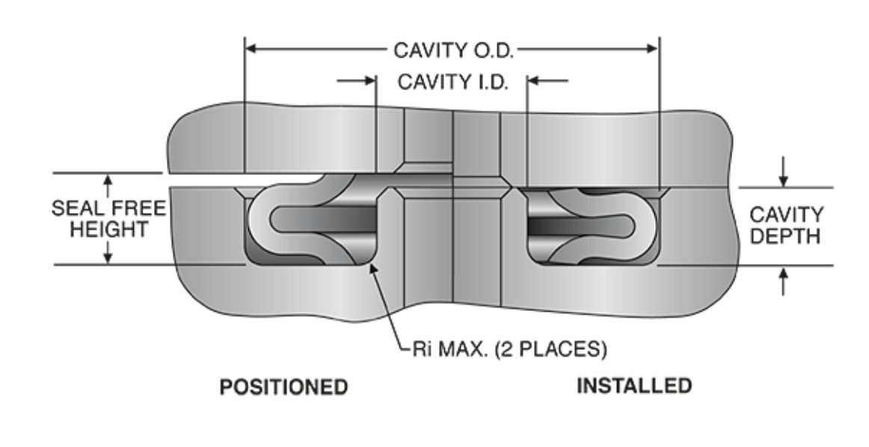
Seal concept for the large rectangular cold doors
From https://jetseal.com/ . We used Jetseals in EXO for the cold door on the cryostat.
I am currently working with Jetseal to make sure they can make seals as large as ours.

Slide 35
Summary
What is presented here is a conceptual design to see if the horizontal support of the TPCs, horizontal insertion and extraction are feasible
The concept of horizontal assembly was used in EXO
The single wall, foam insulated cryostat is similar in concept to MicroBooNE
Much work needs to go into insulation and sealing the insulation from moist air to prevent ice build-up and heat leak

