Slide 1
LC issues for the European Strategy
Status (as documented in the CDR volume 1 and 2):
  Accelerator
  Detector/Physics
Implementation studies (CDR volume 3 for the Strategy – July 2012)
Program 2012-16
International context (CERN in ILC and LC development)
Timeline overall and phase 2016+
Summary

Slide 2

The CLIC CDRs
Vol 1: The CLIC accelerator and site facilities (H.Schmickler)
- CLIC concept with exploration over multi-TeV energy range up to 3 TeV
- Feasibility study of CLIC parameters optimized at 3 TeV (most demanding)
- Consider also 500 GeV, and intermediate energy range
- Complete, final editing ongoing, presented in the SPC In March 2012 (Daniel Schulte)
http://project-clic-cdr.web.cern.ch/project-CLIC-CDR/
Vol 2: Physics and detectors at CLIC (L.Linssen)
- Physics at a multi-TeV CLIC machine can be measured with high precision, despite challenging background conditions
- External review procedure in October 2011
- Completed and ready for print end 2011, presented in SPC in December 2011 (Lucie Linssen)
http://lcd.web.cern.ch/LCD/CDR/CDR.html#Overview
Vol 3: “CLIC study summary” (S.Stapnes)
- Summary and available for the European Strategy process, including possible implementation stages for a CLIC machine as well as costing and cost-drives
- Proposing objectives and work plan of post CDR phase (2012-16)
- Summer 2012: Ready for the European Strategy Open Meeting
Main information page:http://clic-study.org/accelerator/CLIC-ConceptDesignRep.php

Slide 3
CLIC Layout at 3 TeV
Drive Beam Generation Complex
Main Beam Generation Complex

Slide 4
Key Design Issues
Main linac gradient
Accelerating structure
Drive beam scheme
Drive beam generation
PETS (power extraction and transfer structures)
Two beam acceleration
Drive beam deceleration
Luminosity
Main beam emittance generation, preservation and focusing
Alignment and stabilisation
Operation and Machine Protection System (robustness)
Detector (experimental conditions)

Slide 5
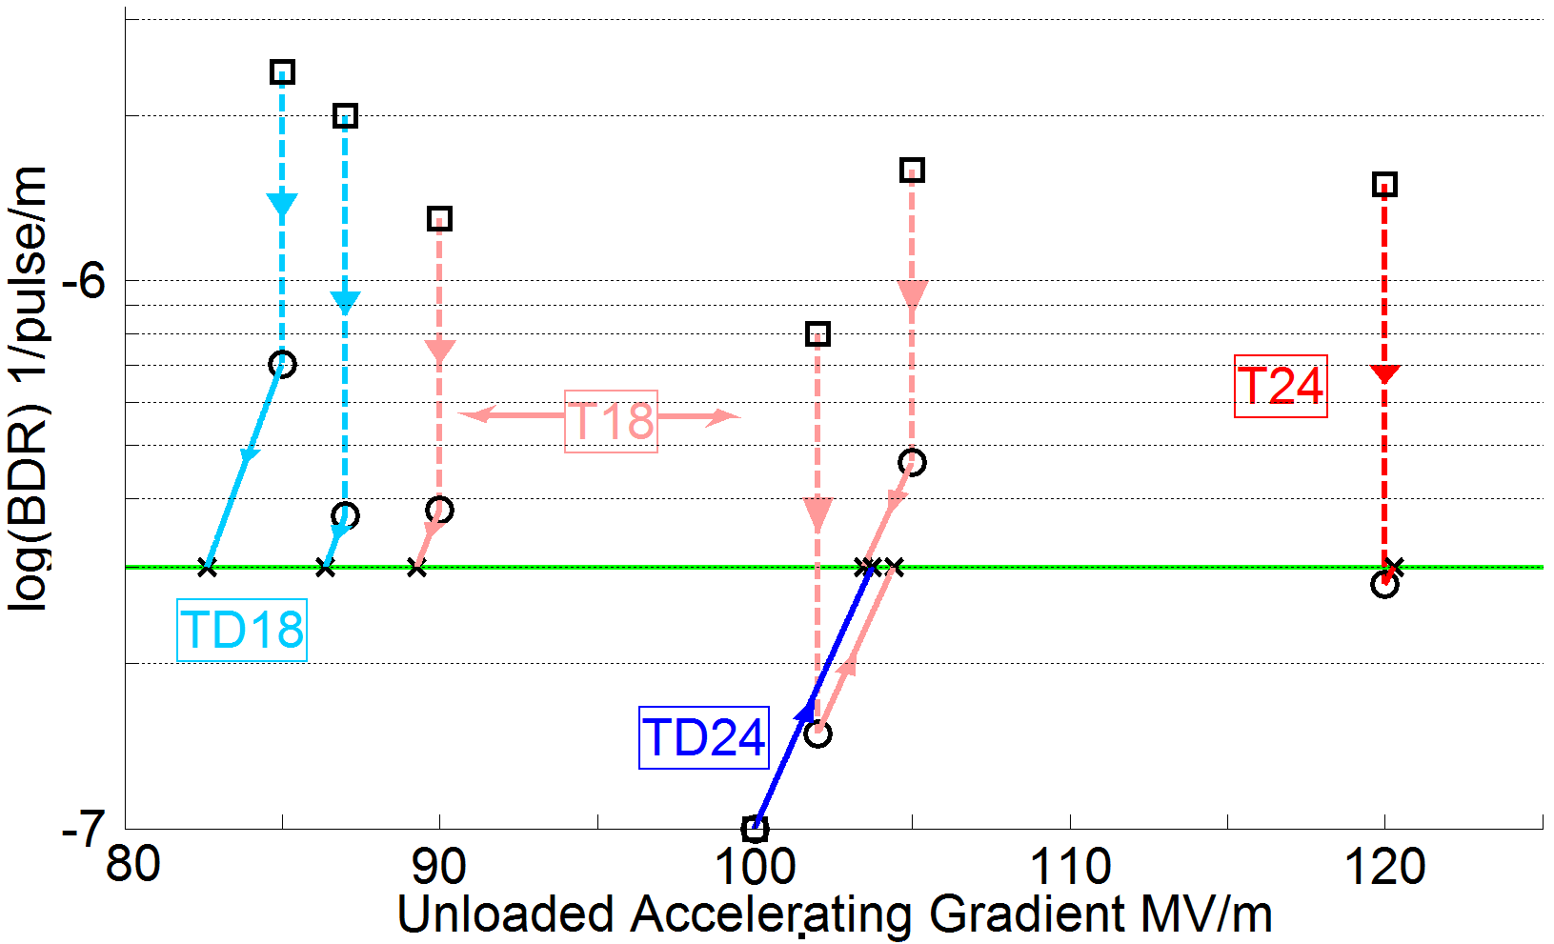
Achieved Gradient
Tests at KEK and SLAC
Measurements scaled according to
 | Simple early design to get started | More efficient fully optimised structure
No damping waveguides | T18 | T24
Damping waveguides | TD18 | TD24 = CLIC goal
Unloaded 103MV/m
Expected with beam loading 86-103 MV/m

Slide 6
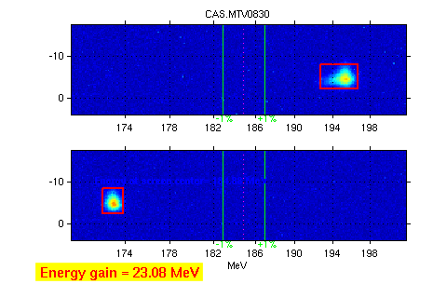
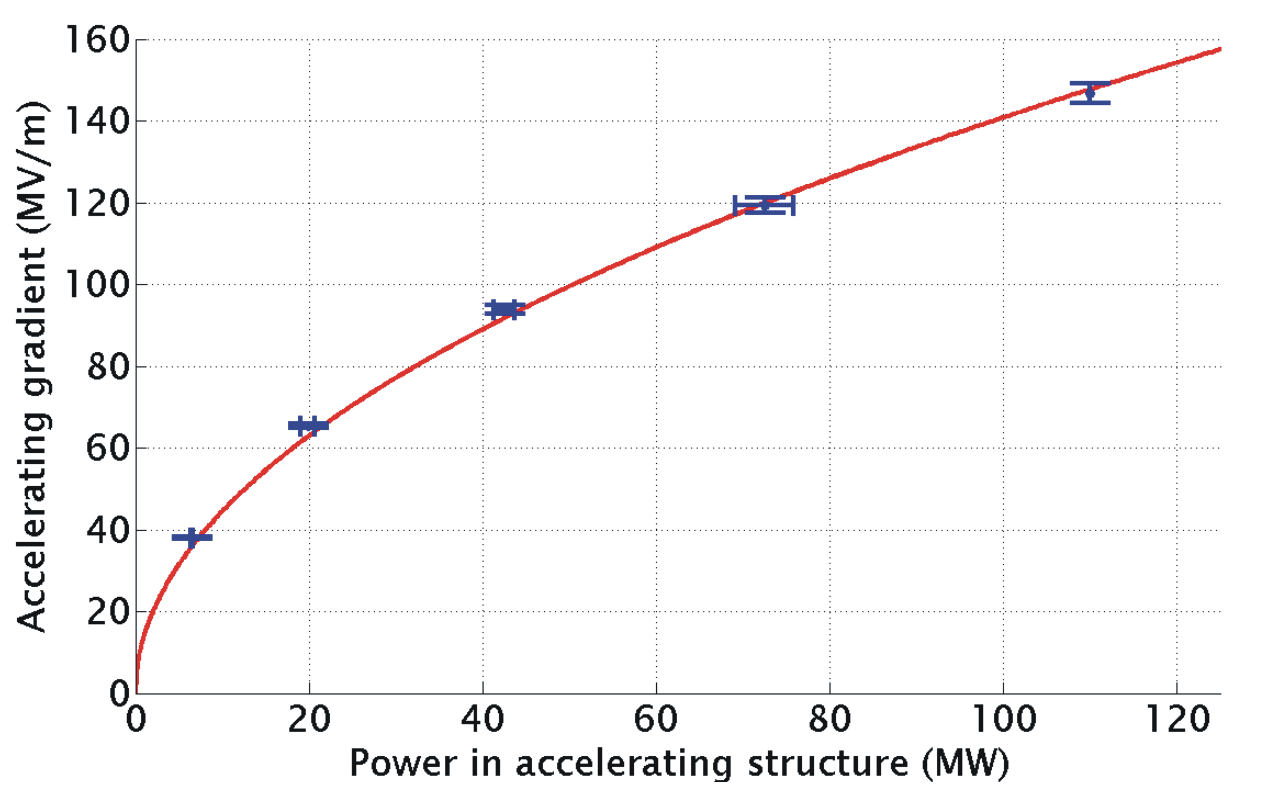
TBTS: Two Beam Acceleration
Measured accelerating gradient
Maximum gradient 145 MV/m
Consistency between
produced power
drive beam current
test beam acceleration

Slide 7
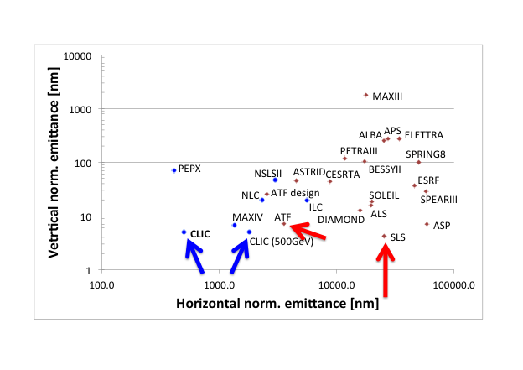
Emittance Generation
Many design issues addressed
lattice design
dynamic aperture
tolerances
intra-beam scattering
space charge
wigglers
RF system
vacuum
electron cloud
kickers
CLIC @3 TeV would achieve 1/3 of luminosity with ATF performance
(3800nm/15nm@4e9)
Damping ring design is consistent with target performance

Slide 8
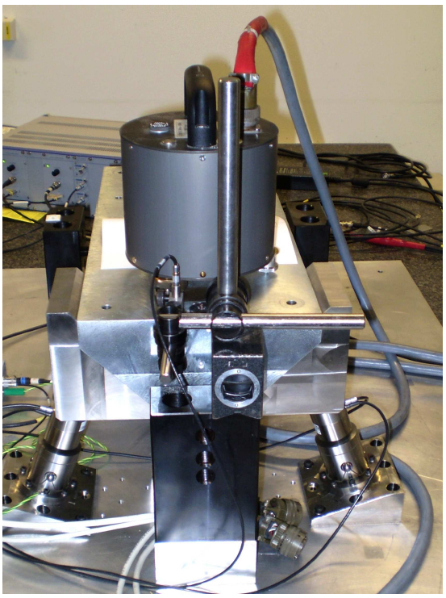
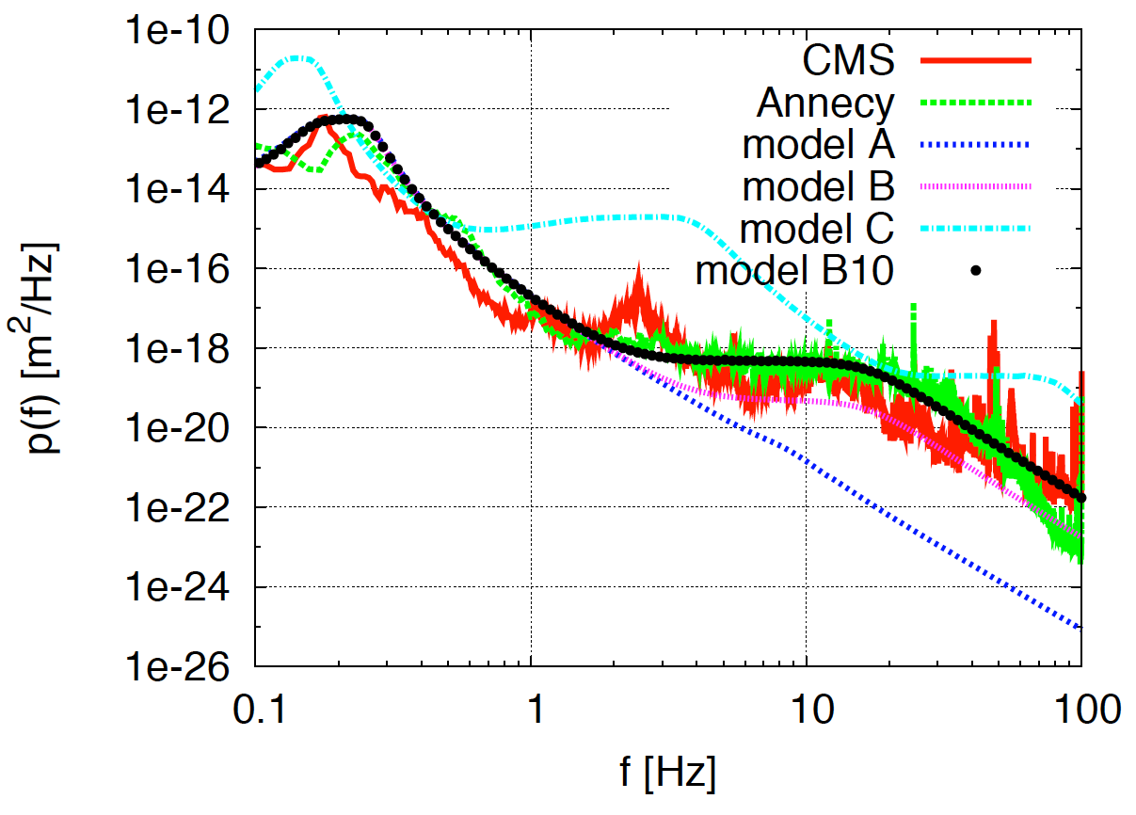
Active Stabilisation Results
Luminosity achieved/lost [%]
 | B10
No stab. | 53%/68%
Current stab. | 108%/13%
Future stab. | 118%/3%
Code
Machine model
Beam-based feedback
Close to/better than target

Slide 9
CLIC Main Parameters

Slide 10
Energy Flexibility
Need to operate at
Lower than nominal energy
Concept developed
based on reduced main and drive beam current but longer pulses
can cover factor 3 in energy

Slide 11
The CLIC CDRs
Vol 1: The CLIC accelerator and site facilities (H.Schmickler)
- CLIC concept with exploration over multi-TeV energy range up to 3 TeV
- Feasibility study of CLIC parameters optimized at 3 TeV (most demanding)
- Consider also 500 GeV, and intermediate energy range
- Complete, final editing ongoing, presented in the SPC In March 2012
http://project-clic-cdr.web.cern.ch/project-CLIC-CDR/
Vol 2: Physics and detectors at CLIC (L.Linssen)
- Physics at a multi-TeV CLIC machine can be measured with high precision, despite challenging background conditions
- External review procedure in October 2011
- Completed and ready for print end 2011, presented in SPC in December 2011 (Lucie Linssen)
http://lcd.web.cern.ch/LCD/CDR/CDR.html#Overview
Vol 3: “CLIC study summary” (S.Stapnes)
- Summary and available for the European Strategy process, including possible implementation stages for a CLIC machine as well as costing and cost-drives
- Proposing objectives and work plan of post CDR phase (2012-16)
- Summer 2012: Ready for the European Strategy Open Meeting
Main information page:http://clic-study.org/accelerator/CLIC-ConceptDesignRep.php

Slide 12
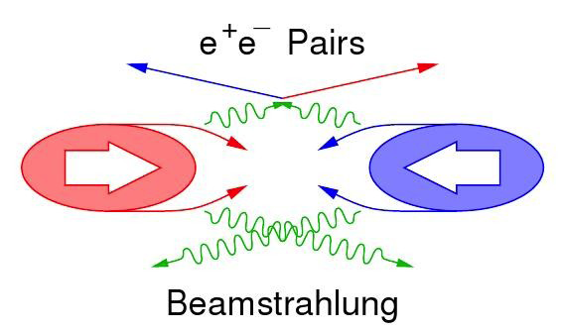
CLIC machine environment (1)
 | CLIC at 500 GeV | CLIC at 3 TeV
L (cm⁻²s⁻¹) | 2.3×10³⁴ | 5.9×10³⁴
BX separation | 0.5 ns | 0.5 ns
#BX / train | 354 | 312
Train duration (ns) | 177 | 156
Rep. rate | 50 Hz | 50 Hz
σ_{x} / σ_{y} (nm) | ≈ 200 / 2.3 | ≈ 45 / 1
σ_{z} (μm) | 72 | 44
Drives timing
requirements
for CLIC detector
Simplified view:
Pair background
Design issue
γγ → hadrons
Impacts on the physics
Needs suppression in data
Beam related background:
Small beam profile at IP leads to very
high E-field
  Beamsstrahlung
    Pair-background
    γγ to hadrons

Slide 13
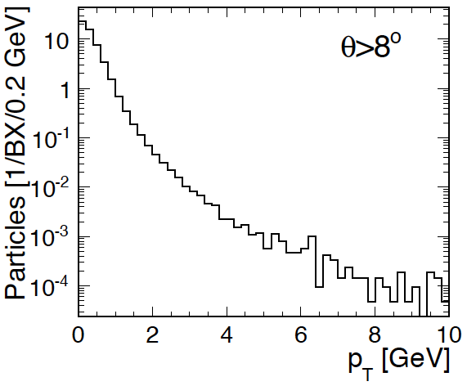
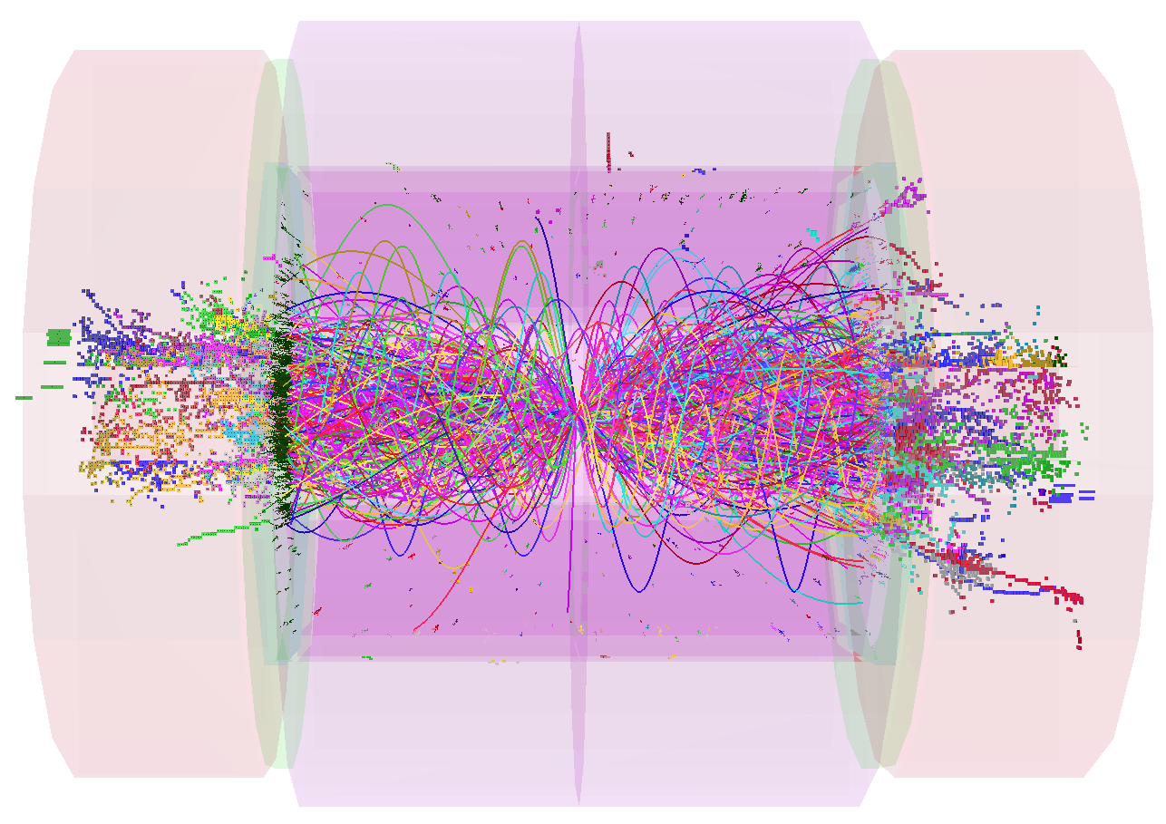
impact of γγ → hadrons
Dominating background in calorimeters and central tracker, “mini-jets”
At 3 TeV, average 3.2 events per BX (approximately 5 tracks per event)
For entire bunch-train (312 BXs)
  5000 tracks giving total track momentum : 7.3 TeV
  Total calorimetric energy (ECAL + HCAL) : 19 TeV
Mostly low p_{T} particles
20 BXs
P_{T} spectrum
particles
γγ => hadrons

Slide 14
background suppression at CLIC
Triggerless readout of full train
 t₀ physics event (offline)
Full event reconstruction + PFA analysis with background overlaid
  => physics objects with precise p_{T} and cluster time information
  Time corrected for shower development and TOF
Then apply cluster-based timing cuts
  Cuts depend on particle-type, p_{T} and detector region
  Allows to protect high-p_{T} physics objects
tCluster
+
Use well-adapted jet clustering algorithms
  Making use of LHC experience (FastJet)

Slide 15
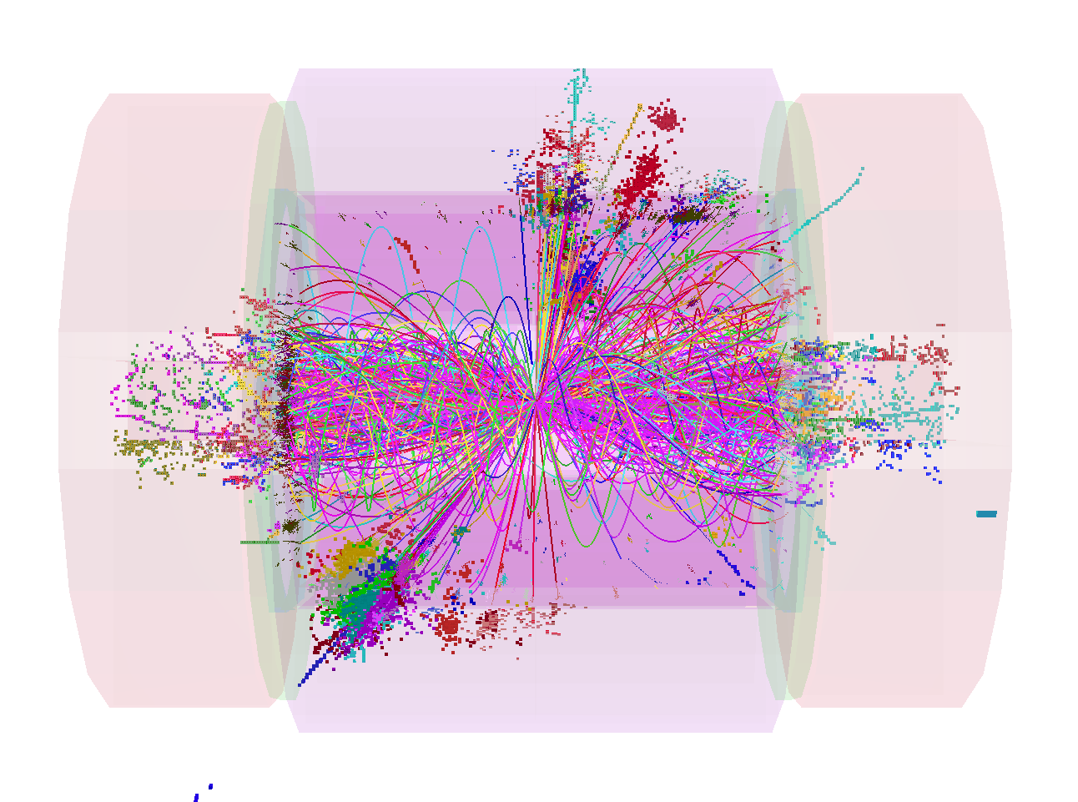
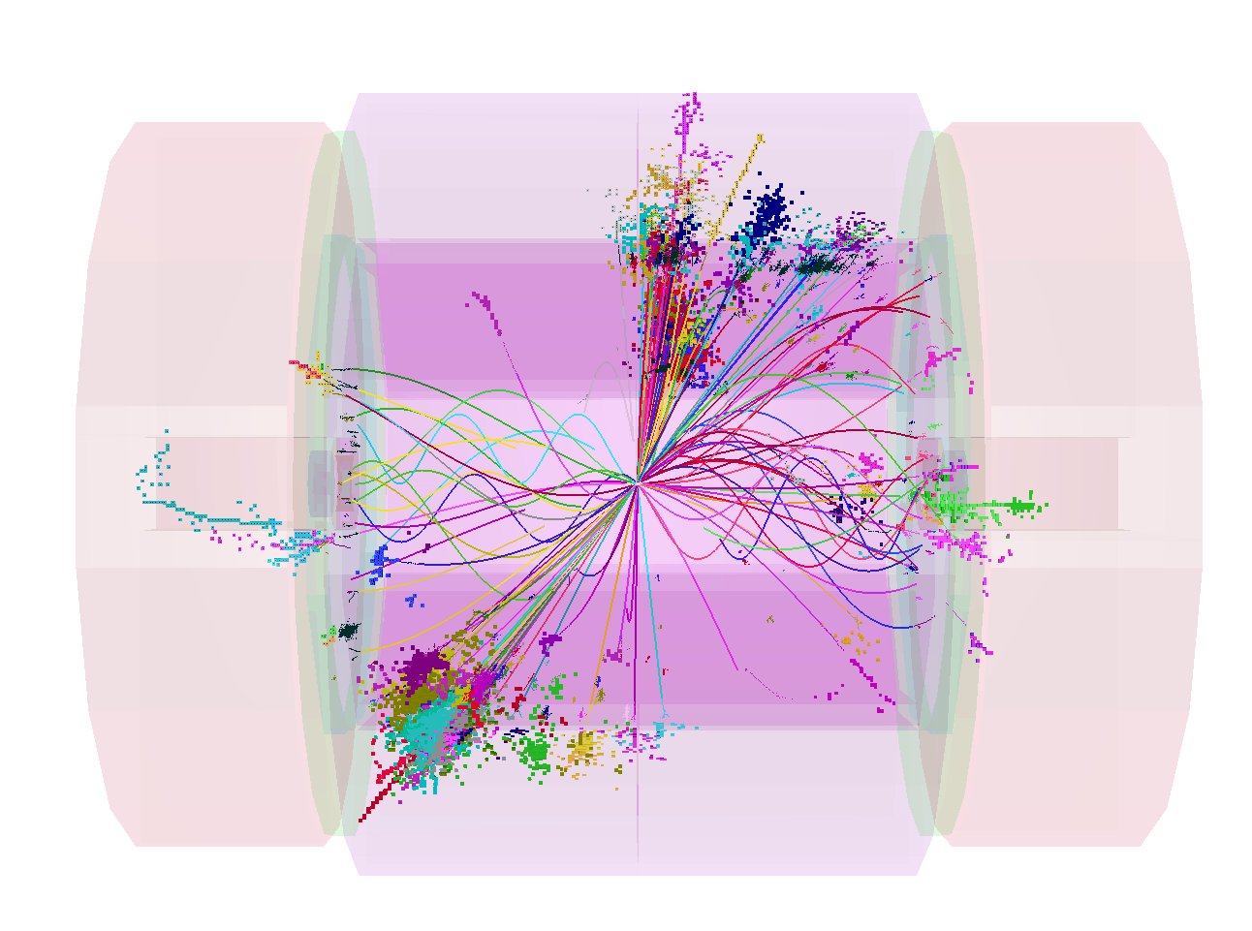
combined p_{T} and timing cuts
1.2 TeV
100 GeV
1.2 TeV background in reconstruction time window
100 GeV background after tight cuts

Slide 16
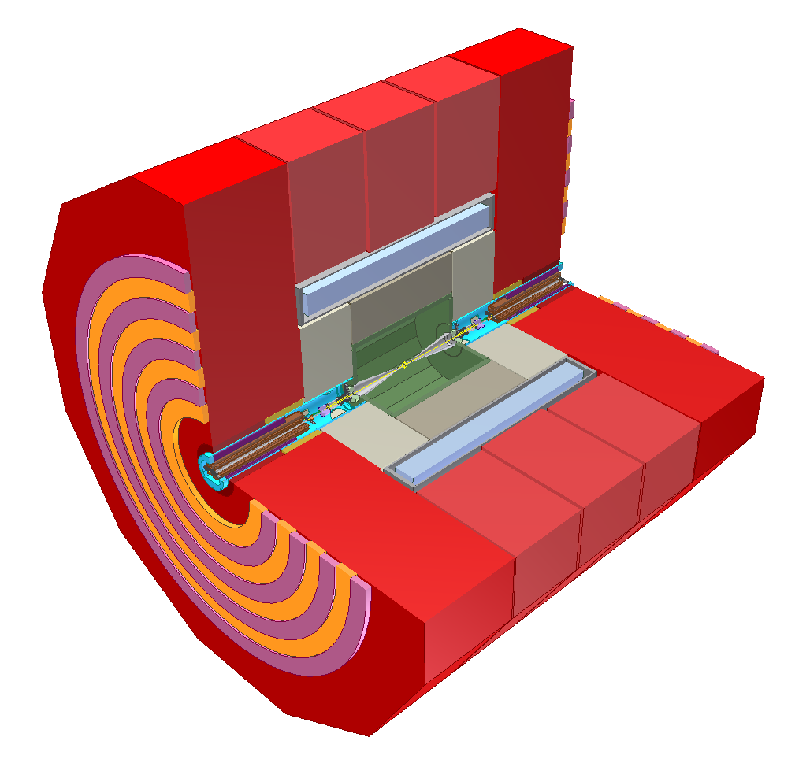
detector concepts
… in a few words …
return yoke with
Instrumentation
for muon ID
complex forward region with final beam focusing
strong solenoids
4 T and 5 T
fine grained (PFA) calorimetry, 1 + 7.5 Λ_{i},
6.5 m
main trackers:
TPC+silicon (CLIC_ILD)
all-silicon (CLIC_SiD)
ultra low-mass
vertex detector
With 20 μm pixels

Slide 17
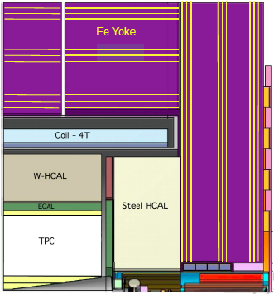
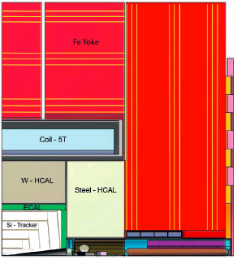
CLIC_ILD and CLIC_SiD
Two general-purpose CLIC detector concepts
Based in initial ILC concepts (ILD and SiD)
Optimised and adapted to CLIC conditions
CLIC_ILD
CLIC_SiD
7 m

Slide 18
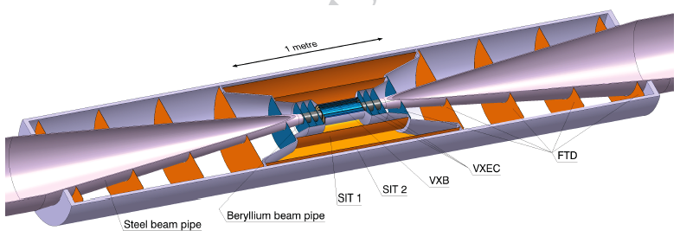
vertex detector
Vertex + forward tracking
CLIC_ILD
20×20 μm pixel size
0.2% X₀ material par layer <= very thin !
  Very thin materials/sensors
  Low-power design, power pulsing, air cooling
Time stamping 10 ns
Triggerless readout for 156 ns bunch train
Radiation level <10¹¹ n_{eq}cm⁻²year⁻¹ <= 10⁴ lower than LHC
Challenging R&D project

Slide 19
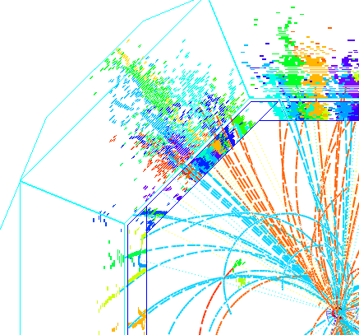


calorimetry and PFA
Jet energy resolution and background rejection drive the overall detector design
=> => fine-grained calorimetry + Particle Flow Analysis (PFA)
What is PFA?
Typical jet composition:
60% charged particles
30% photons
10% neutrons
⬇
Always use the best info you have:
60% => tracker
30% => ECAL
10% => HCAL
Hardware + software !

Slide 20
The CLIC CDRs
Vol 1: The CLIC accelerator and site facilities (H.Schmickler)
- CLIC concept with exploration over multi-TeV energy range up to 3 TeV
- Feasibility study of CLIC parameters optimized at 3 TeV (most demanding)
- Consider also 500 GeV, and intermediate energy range
- Complete, final editing ongoing, presented in the SPC In March 2012
http://project-clic-cdr.web.cern.ch/project-CLIC-CDR/
Vol 2: Physics and detectors at CLIC (L.Linssen)
- Physics at a multi-TeV CLIC machine can be measured with high precision, despite challenging background conditions
- External review procedure in October 2011
- Completed and ready for print end 2011, presented in SPC in December 2011 (Lucie Linssen)
http://lcd.web.cern.ch/LCD/CDR/CDR.html#Overview
Vol 3: “CLIC study summary” (S.Stapnes)
- Summary and available for the European Strategy process, including possible implementation stages for a CLIC machine as well as costing and cost-drives
- Proposing objectives and work plan of post CDR phase (2012-16)
- Summer 2012: Ready for the European Strategy Open Meeting
Main information page:http://clic-study.org/accelerator/CLIC-ConceptDesignRep.php

Slide 21
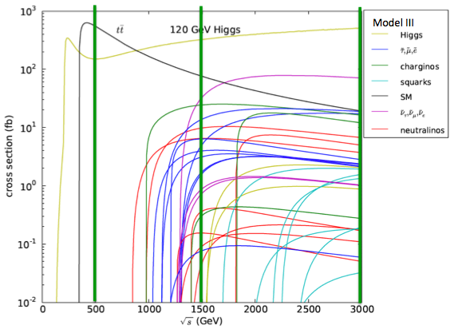
CLIC physics potential
CLIC physics potential is complementary to LHC
Beyond LHC discovery reach:
e+e- collisions give access to additional physics processes
  weakly interacting states (e.g. slepton, chargino, neutralino searches)
  more clean conditions than in LHC
Defined initial state + more precise measurements
^{σ(fb)}
Examples highlighted in the CDR
Higgs physics (SM and non-SM)
Top
SUSY
Higgs strong interactions
New Z’ sector
Contact interactions
Extra dimensions
….
^{√s (GeV)}

Slide 22
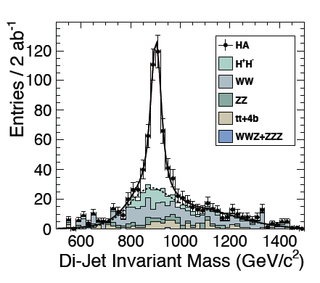
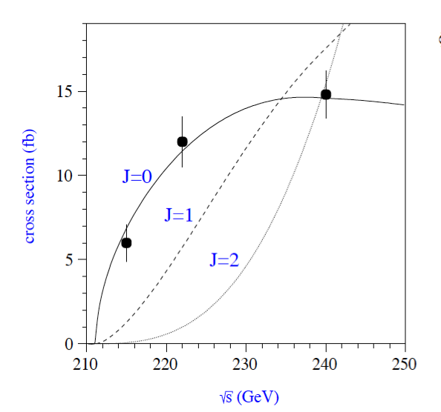
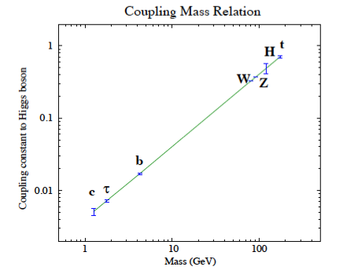
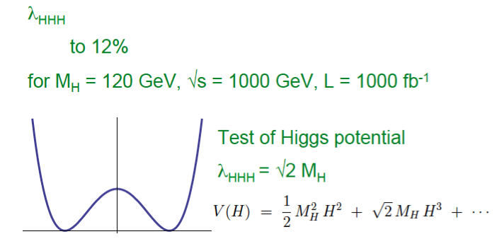
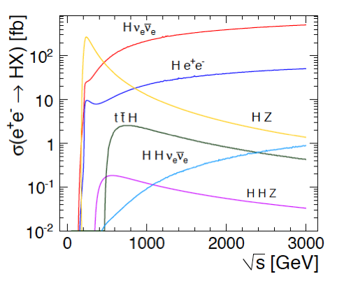
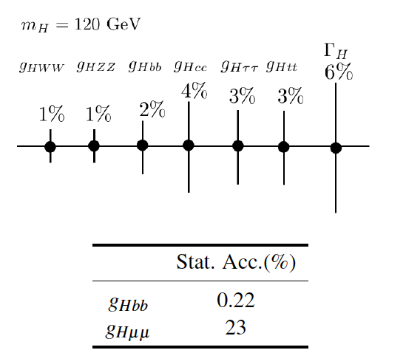
Higgs – 120 GeV in this case
Precision measurements from ILC RDR and CLIC CDR (volume 2 in both cases)
20 fb⁻¹ per point for spin measurements
Couplings (in this plot): 300 GeV and 500 fb⁻¹ for b, τ, e, W, Z and 500 GeV for H (self-coupling), 700 GeV for top
Higgs self coupling error reduced to 12% if running at 1 TeV (1 ab⁻¹)
CLIC studies compatible, has focused on running at 3 TeV (large WW fusion cross-section) and 2 ab⁻¹ leading to reduced statistical errors and access to difficult cases as coupling to muons (23% error)
Note that these measurements are “not theory dependent” and provide an absolute measure (important for BSM scenarios)
To be compared – at some point - to LHC at 1-2 ab⁻¹ and dedicated triggers, analyses and upgrades, which can cover some of the same measurements
Notes:
20 fb-1 at three points

Slide 23
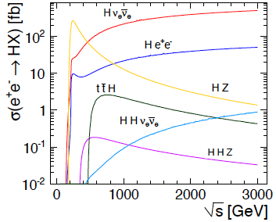
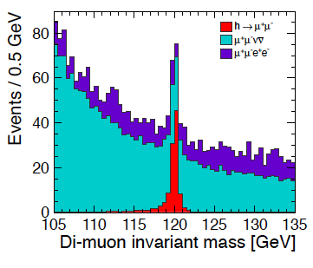
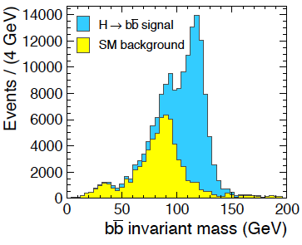
SM Higgs
Standard model Higgs (example 120 GeV)
CLIC √s range give access to a wealth of Higgs studies
σ(h ➔ μ⁺μ⁻) ➔ ±15%
σ(h ➔ bb) ➔ ±0.2%
3 TeV
3 TeV

Slide 24
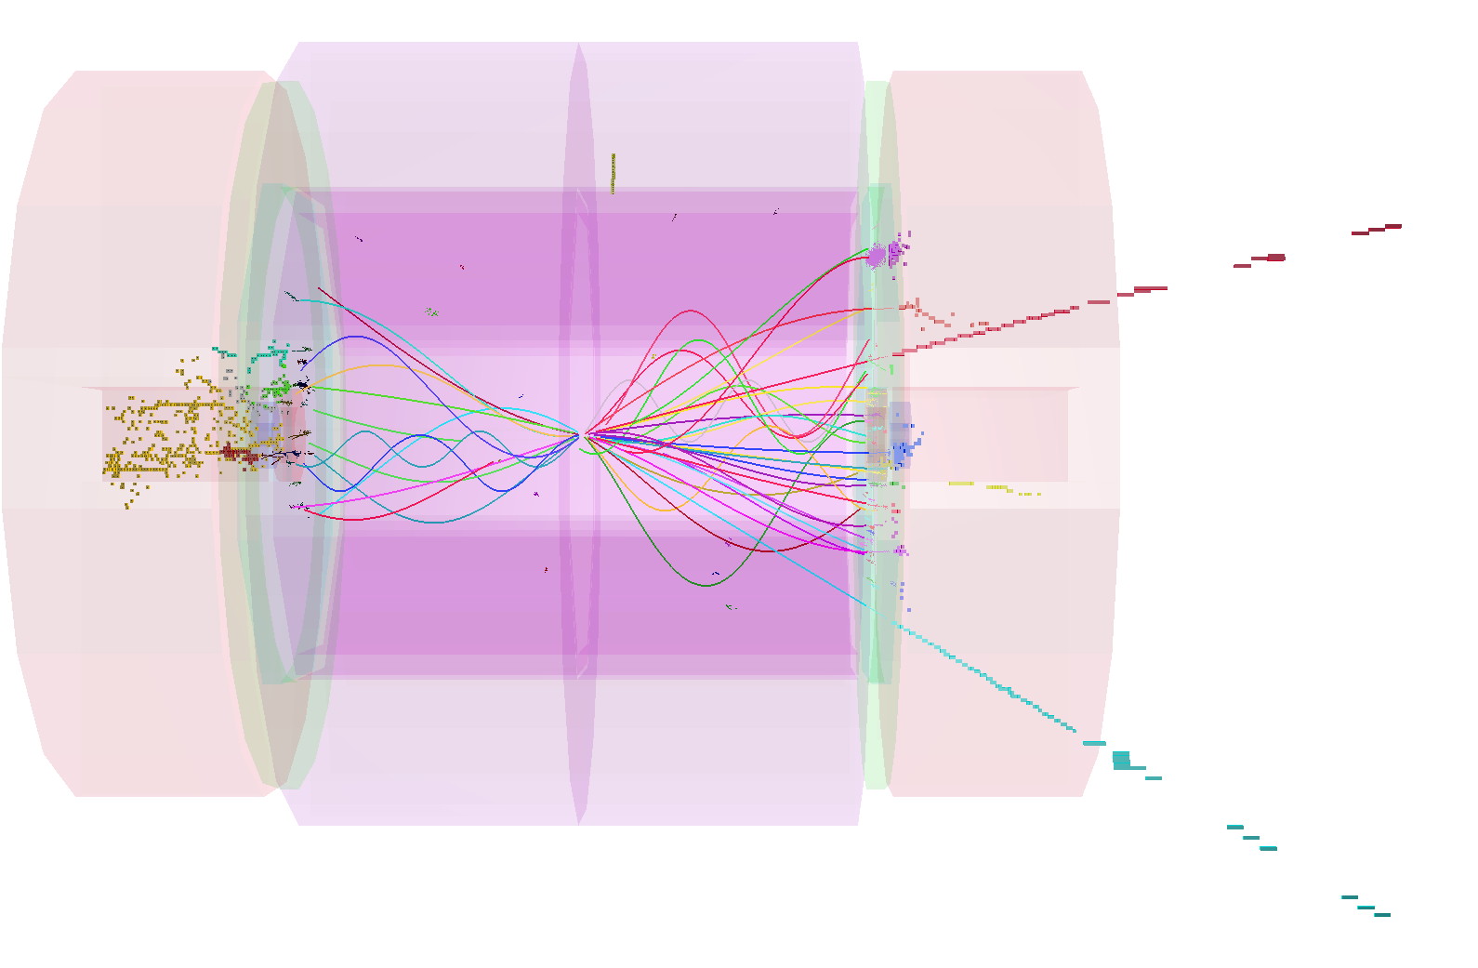
slepton production
Slepton production at CLIC very clean
SUSY “model II”: slepton masses ~ 1 TeV
Channels studied include
Leptons and missing energy
Masses from analysis of endpoints of energy spectra
All channels
combined
e.g. smuon
production

Slide 25
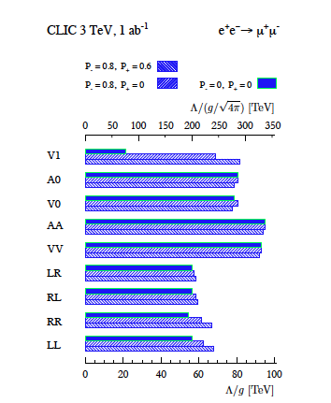
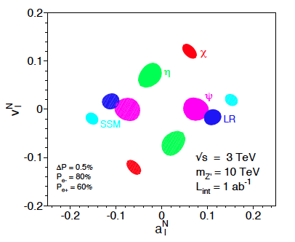
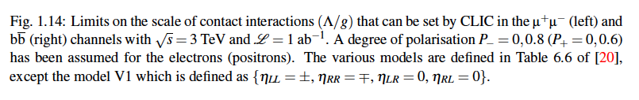
Other physics
A wealth of other physics related to top and SM precision tests, new forces, extra dimensions, little Higgs, strong interaction models …
And a LC can have reach way beyond its beam energies (illustrated in the plots below)
.. but beyond the scope of this talk …

Slide 26
CLIC Implementation – in stages?
CLIC two-beam scheme compatible with energy staging to provide the optimal machine for a large energy range
Lower energy machine can run most of the time during the construction of the next stage.
Physics results will determine the energies of the stages
Linac 1
I.P.
Linac 2
0.5 TeV Stage
Injector
Complex
4 km
4 km
~14 km
Linac 1
I.P.
Linac 2
1-2 TeV Stage
Injector
Complex
7.0-14 km
7.0-14 km
~20-34 km
Linac 1
3 TeV Stage
I.P.
Linac 2
Injector
Complex
20.8 km
3 km
3 km
20.8 km
48.2 km

Slide 27
Implementation issues
Physics - how do we build the optimal machine given a physics scenario (partly seen at LHC ?):
Understand the benefits of running close to thresholds versus at highest energy, and distribution of luminosities as function of energy
Construction scenario (and approval scenario):
Explore how we in practice will do the tunneling and productions/installation/movement of parts in a multistage approach ? Environmental impact study
Costs - Initial machine plus energy upgrade: External cost review 21-22.2.2012, costs will be discussed in volume 3 of the CDR
Power and energy development.
Have started to work on energy estimates (not only max power at max luminosity and the highest energy) based on running scenarios and power on/off/standby estimates
Timescale/lifecycle for project re-defined: Buildup of drive beam (CLIC zero), stage one – physics, more stages/extensions
Parameters: energy steps and scans, inst. and int. luminosities, commissioning and lum. ramp up times.

Slide 28
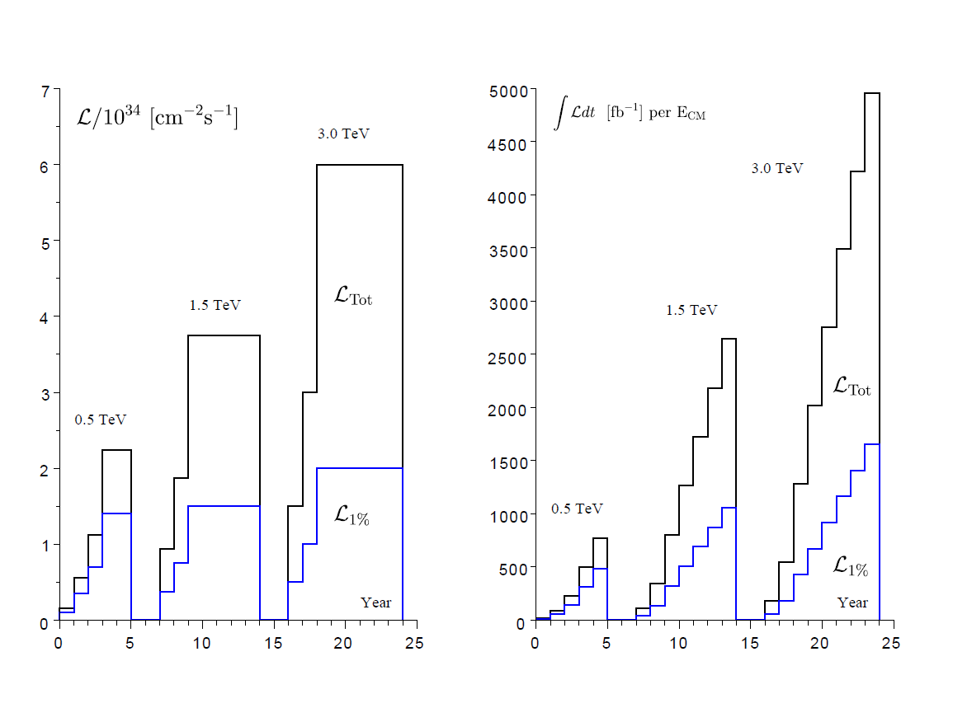
A possible energy/luminosity scenario
With a model (see figure for one example) for energies and luminosities, and assumptions about running scenarios (see below), one can extract power and energy estimates as function of time (next slide).
For each value of CM energy:
177 days/year of beam time
188 days/year of scheduled and fault stops
First year
  59 days of injector and one-by-one sector commissioning
  59 days of main linac commissioning, one linac at a time
  59 days of luminosity operation
  Quoted power : average over the three periods
  All along : 50% of downtime
Second year
  88 days with one linac at a time and 30 % of downtime
  88 days without downtime
  Quoted power : average over the two periods
Third year
  Still only one e+ target at 0.5 TeV, like for years 1 & 2
  Nominal at 1.5 and 3 TeV
Power during stops (scheduled, fault, downtime) :
  (40 MW, 45 MW, 60 MW) at (0.5, 1.5, 3) TeV, respectively

Slide 29
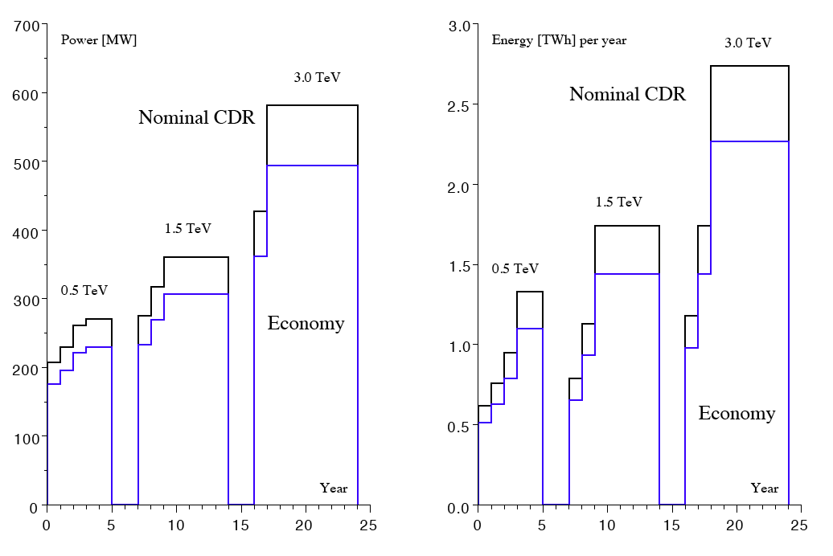
Power/energy
Other models can be envisaged (this is one out of many), and one should also keep in mind that reducing the instantaneous luminosity at the highest energies reduced both power and yearly energy, and finer energy scans might well be needed within one stage
The possible « economy » (see blue curves):
Sobriety
  Reduced current density in normal-conducting magnets
  Reduction of heat loads to HVAC
  Re-optimization of accelerating gradient with different objective function
Efficiency
  Grid-to-RF power conversion
  Permanent or super-ferric superconducting magnets
Energy management
  Low-power configurations in case of beam interruption
  Modulation of scheduled operation to match electricity demand: Seasonal and Daily
  Power quality specifications
Waste heat recovery
  Possibilities of heat rejection at higher temperature
  Waste heat valorization by concomitant needs, e.g. residential heating, absorption cooling

Slide 30
Costing review 21-22.2 2012
Extract from summary slide:
The Panel was impressed by the quality of the presentations and degree of detail to which the value estimate has been studied
No major omissions were found
The Panel endorses the methodology used to make the value estimates
There is a lack of coherence between the two stages (500, 1500 GeV) that must be resolved when the numbers are presented
  Luminosity factor 2 higher than achieveable with nominal bunch charge
  Justification for such high luminosity should be re-examined (since it has a significant cost impact)
The Panel recommends more work on prototyping & collaboration with industry in order to refine value estimates
  More confidence in scaling laws
  Bring precision below the 30 % level
  Inconsistency in costing the 500 GeV stage since component costs are estimated using learning curves corresponding to quantities of 1.5 TeV stage
  Scope for further optimization, e.g. length of TBM girders
Rough comparison with ILC cost data shows no major discrepancy, except in ventilation costs
Clearly state what the claimed uncertainty means (1 sigma, 2 sigma, 90 % ?)

Slide 31
Review of CLIC costing review
- The PANEL -
  C. Adolphsen, SLAC
  W. Bialowons, DESY
  H. Braun, PSI
  G. Dugan, Cornell University
  L. Evans, Imperial College (chair)
  P. Garbincius, Fermilab
  K. Peach, JAI (ex officio)
  T. Shidara, KEK
  M. Vretenar, CERN
  M. Yoshioka, KEK

Slide 32
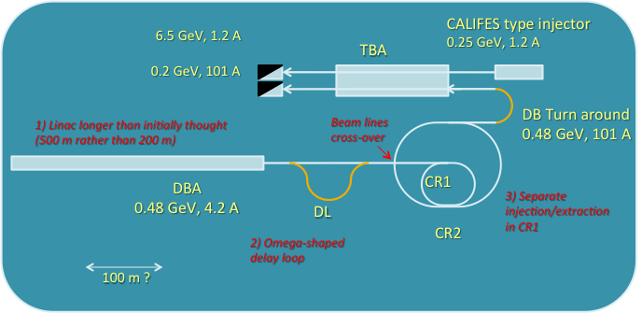
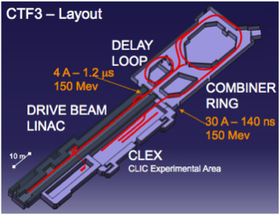
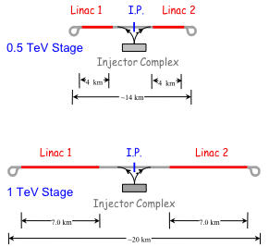
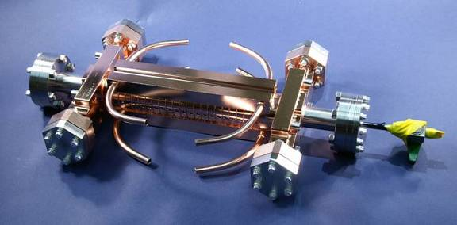
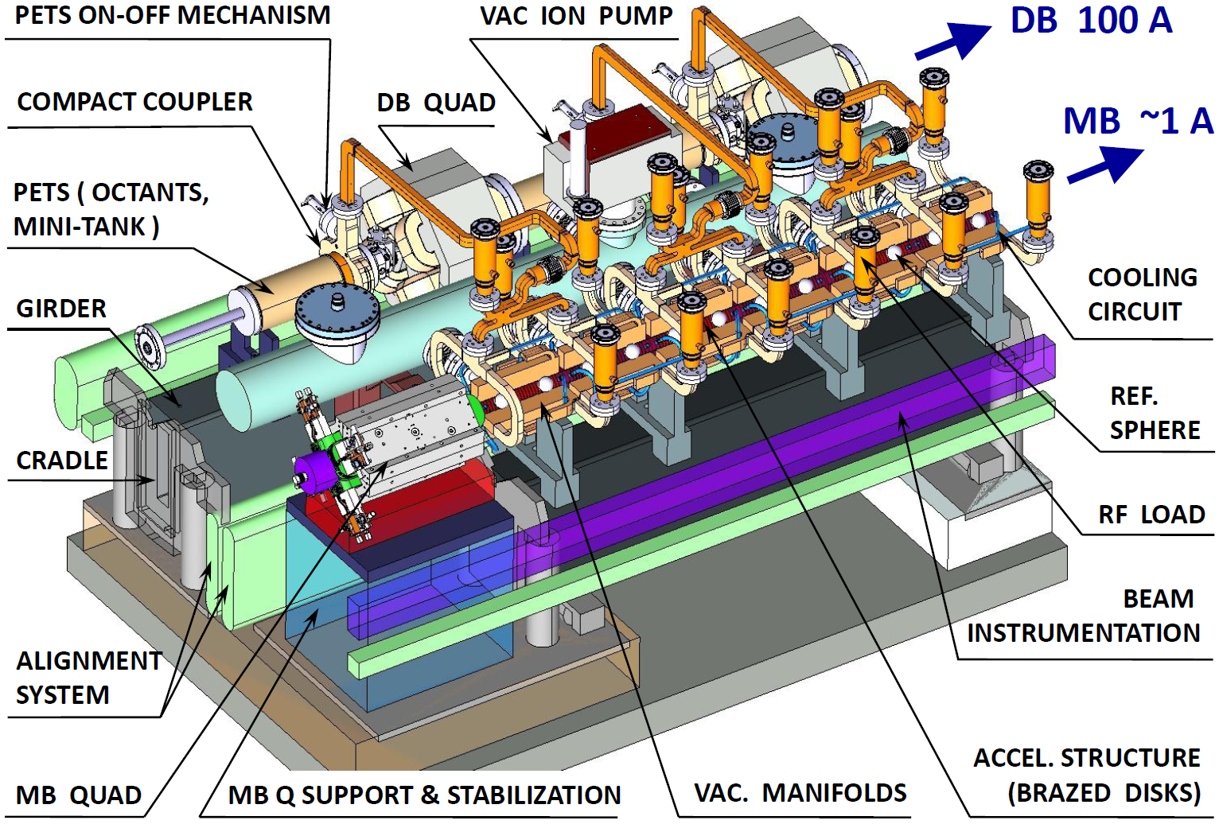

CLIC project time-line
From 2016 – Project Implementation phase, including an initial project to lay the
grounds for full construction:
CLIC 0 – a significant part of the drive beam facility: prototypes of hardware components at real frequency, final validation of drive beam quality/main beam emittance preservation, facility for reception tests – and part of the final project)
Finalization of the CLIC technical design, taking into account the results of technical studies done in the previous phase, and final energy staging scenario based on the LHC Physics results, which should be fully available by the time
Further industrialization and pre-series production of large series components with validation facilities
Environmental Impact Study
Final CLIC CDR and
feasibility established, also input for the Eur. Strategy Update
2004 - 2012
2012 - 2016
2016 – 2022
~ 2020 onwards
2011-2016 – Goal: Develop a project implementation plan for a Linear Collider:
Addressing the key physics goals as emerging from the LHC data
With a well-defined scope (i.e. technical implementation and operation model,
energy and luminosity), cost and schedule
With a solid technical basis for the key elements of the machine and detector
Including the necessary preparation for siting the machine
Within a project governance structure as defined with international partners
CLIC project construction – in stages, making use of CLIC 0

Slide 33
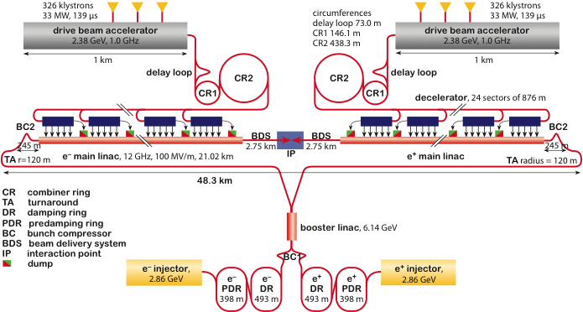
The objectives and plans for 2012-16
In order to achieve the overall goal for 2016 the follow four primary objectives for 2012—16 can defined:
    These are to be addressed by activities (studies, working groups, task forces) or work-packages (technical developments, prototyping and tests of single components or larger systems at various places)
Define the scope, strategy and cost of the project implementation.
Main input:
The evolution of the physics findings at LHC and other relevant data
Findings from the CDR and further studies, in particular concerning minimization of the technical risks, cost, power as well as the site implementation.
A Governance Model as developed with partners.
Define and keep an up-to-date optimized overall baseline design that can achieve the scope within a reasonable schedule, budget and risk.
Beyond beam line design, the energy and luminosity of the machine, key studies will address stability and alignment, timing and phasing, stray fields and dynamic vacuum including collective effects.
Other studies will address failure modes and operation issues.

Slide 34
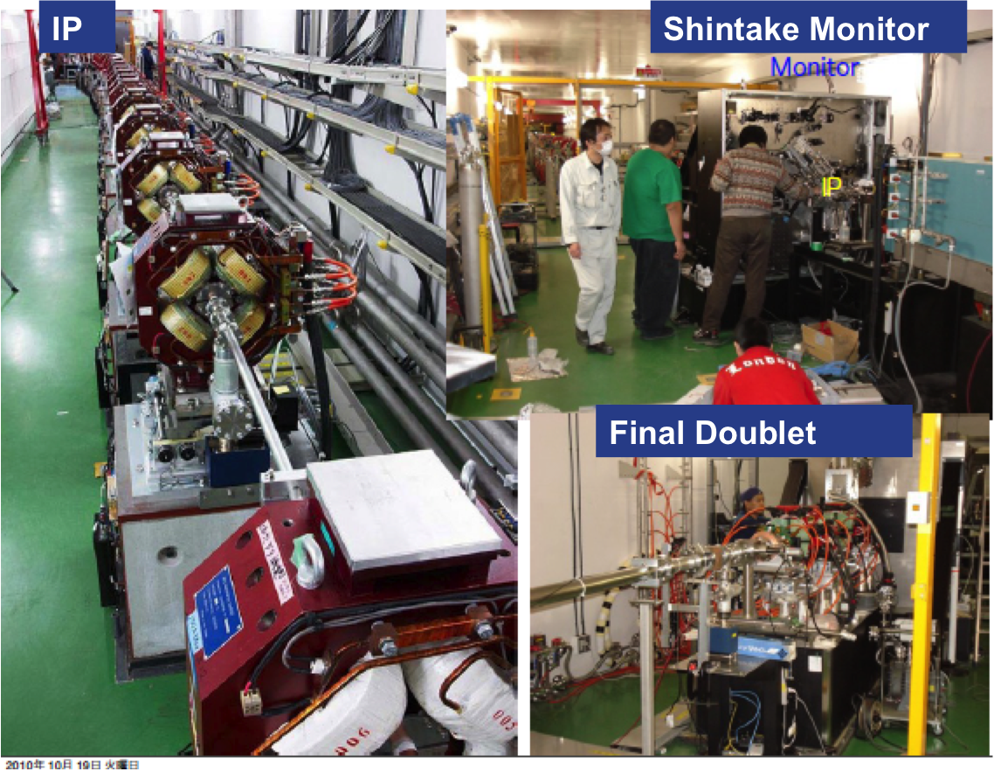
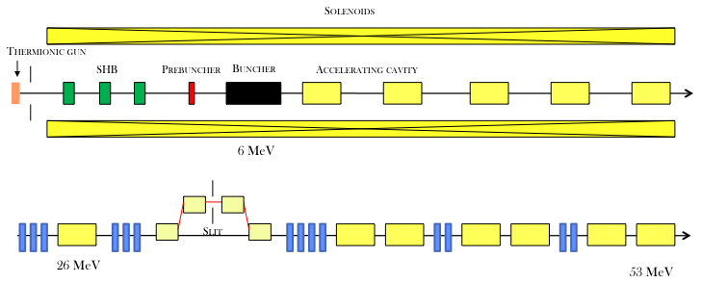
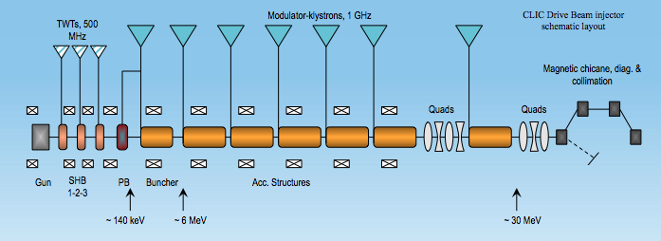
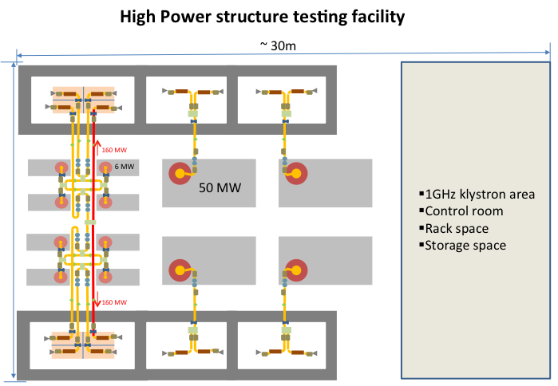
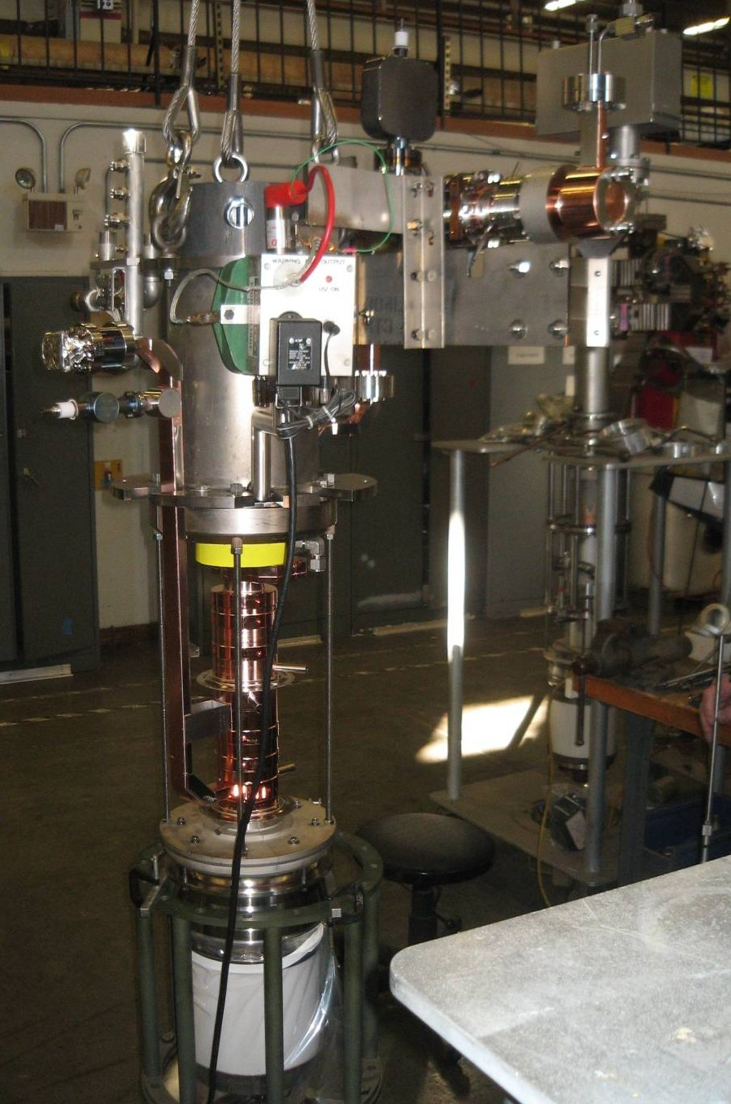
The objectives and plans for 2012-16
Develop the technical design basis. i.e. move toward a technical design for crucial items of the machine and detectors, the MD interface, and the site.
Priorities are the modulators/klystrons, module/structure development including testing facilities, and site studies.
Technical work-packages providing input and interacting with all points above
Identify and carry out system tests and programs to address the key performance and operation goals and mitigate risks associated to the project implementation.
The priorities are the measurements in: CTF3+, ATF and related to the CLIC Zero Injector addressing the issues of drive-beam stability, RF power generation and two beam acceleration, as well as the beam delivery system.
Technical work-packages and studies addressing system performance parameters
Notes:
Add some info about space at CERN

Slide 35
























Current CLIC&CTF3 Collaboration
CLIC multi-lateral collaboration - 44 Institutes from 22 countries
ACAS (Australia)
Aarhus University (Denmark)
Ankara University (Turkey)
Argonne National Laboratory (USA)
Athens University (Greece)
BINP (Russia)
CERN
CIEMAT (Spain)
Cockcroft Institute (UK)
ETH Zurich (Switzerland)
FNAL (USA)
Gazi Universities (Turkey)
Helsinki Institute of Physics (Finland)
IAP (Russia)
IAP NASU (Ukraine)
IHEP (China)
INFN / LNF (Italy)
Instituto de Fisica Corpuscular (Spain)
IRFU / Saclay (France)
Jefferson Lab (USA)
John Adams Institute/Oxford (UK)
Joint Institute for Power and Nuclear Research SOSNY /Minsk (Belarus)
John Adams Institute/RHUL (UK)
JINR (Russia)
Karlsruhe University (Germany)
KEK (Japan)
LAL / Orsay (France)
LAPP / ESIA (France)
NIKHEF/Amsterdam (Netherland)
NCP (Pakistan)
North-West. Univ. Illinois (USA)
Patras University (Greece)
Polytech. Univ. of Catalonia (Spain)
PSI (Switzerland)
RAL (UK)
RRCAT / Indore (India)
SLAC (USA)
Sincrotrone Trieste/ELETTRA (Italy)
Thrace University (Greece)
Tsinghua University (China)
University of Oslo (Norway)
University of Vigo (Spain)
Uppsala University (Sweden)
UCSC SCIPP (USA)

Slide 36
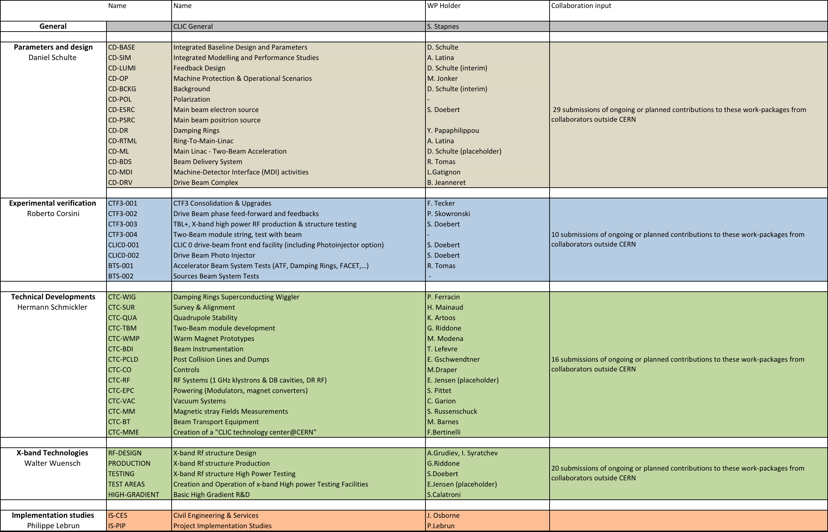
Work-packages and responsibilities
The programme combines the resources of collaborators inside the current collaboration, plus several new ones – and also involves around 20 CERN groups:
Have ~75 submitted descriptions of ongoing or planned efforts linked to these work-packages 2012-16 from groups outside CERN (result of CLIC working meeting 3-4.11: https://indico.cern.ch/conferenceOtherViews.py?view=standard&confId=156004 (still open for more interests)
Description of contributions, link-persons, planned personnel and material resources at home and at CERN for the period

Slide 37
Detector and Physics activities in the next project phase
Challenging detector technologies, considered feasible in a 5-year R&D program
Physics studies
  CLIC at various energies, follow up on LHC results
Simulation studies and Detector optimisation
  General detector optimisation
  Simulation studies in close relation with detector R&D
Detector R&D and engineering
  Vertex detector
    Ultra-thin (0.2 X₀/layer), very small pixels (20 μm), 10 ns hit time-stamping
  Tracking detectors
    Very thin integrated designs (TPC and Silicon)
  Calorimetry
    High-grained, very compact active layers, 1 ns hit time resolution
  Electronics
    High readout functionality, precise timing
    Low power, power delivery and power pulsing (=> air cooling)
  Engineering and magnet R&D
    Reinforced superconductor, moveable services
    Forward region integration, detector movements, calorimetry, alignment…

Slide 38
CERN and ILC
Site studies and conv. facilities (Osborne and others) – main contribution to ILC TDR (workshop next three days at CERN)
Cryo-module assembly cost study being launched (with Babcock Noell) – also to provide data for the ILC TDR
Common working groups with ILC (next slide)
Participate in ILC GDE (weekly and in person meeting)
Machine/Detector interface studies
Substantial contributions to detector and physics studies including software
GDE and ILCSC mandate “expires” next year, three developments:
  Japan more vocal about the possibility to host an ILC
  US funding for ILC accelerator zero from 2013 (but some funding in more general SC programme) – some recovery possible(?)
  Move towards a common LC framework (in ILCSC and ICFA meetings)

Slide 39
LC common studies
Many common problems and solutions even though the basic core acceleration methods differ, and the parameters to be achieved by the systems below differ – in some cases leading to different solutions
  In addition common working groups on: Cost and Schedule, Civil Engineering and Conventional Facilities – and a General Issues Working Group
Sources (common working group on positron generation)
Machine Detector Interfaces
Damping rings
Beam dynamics (covers along entire machine)
Beam delivery systems
Physics and detectors

Slide 40
Summary so far
Technical progress on accelerator and detectors good (CDRs will be substantial documents addressing most of the key issues for the project – at the level possible at this time)
ILC TDRs/DBSs will also be done with CERN involvement
Plans for 2012-16 well underway for CLIC, and organization also ok (with some challenges):
  Inside CERN and with collaborators (not always an obvious balance)
  For accelerator (collaboration) and detectors & physics (less formal document and organization with set of institutes), with common Steering Group
  Visibility at strategy/council level would help (in particular collaborators) …..
but let us look longer term

Slide 41
CLIC project time-line
From 2016 – Project Implementation phase, including an initial project to lay the grounds for full construction:
CLIC 0 – a significant part of the drive beam facility: prototypes of hardware components at real frequency, final validation of drive beam quality/main beam emittance preservation, facility for reception tests – and part of the final project)
Finalization of the CLIC technical design, taking into account the results of technical studies done in the previous phase, and final energy staging scenario based on the LHC Physics results, which should be fully available by the time
Further industrialization and pre-series production of large series components for validation facilities
Other system studies addressing luminosity issues (emittance conservation) …
Environmental Impact Study
Final CLIC CDR and
feasibility established, also input for the Eur. Strategy Update
2004 - 2012
2012 - 2016
2016 – 2022
~ 2020 onwards
2011-2016 – Goal: Develop a project implementation plan for a Linear Collider:
Addressing the key physics goals as emerging from the LHC data
With a well-defined scope (i.e. technical implementation and operation model,
energy and luminosity), cost and schedule
With a solid technical basis for the key elements of the machine and detector
Including the necessary preparation for siting the machine
Within a project governance structure as defined with international partners
CLIC project construction – in stages, making use of CLIC 0

Slide 42
System test and initial step for CLIC
Objectives beyond 2016:
Final components at some scale
Full currents
Needed for initial phase of project (receptions and conditioning of final modules before installation)
Other users of such a facility ?
Expensive wrt to current LC funding at CERN (~390 MCHf)

Slide 43
Tentative beam parameters
Drive beam (TBA entrance)
Energy 480 MeV
Emittance, norm. rms ≤ 150 um
Energy spread, rms ~ 1 %
Bunch length, rms 1 mm (3.6 ps)
Bunch charge 8.4 nC
Pulse Current 101 A (4.2 A in DBA)
Pulse length 244 ns (~ 6 us in DBA, option for full pulse length – 140 us)
Rep. Rate 50 Hz
Probe beam (end of TBA)
Energy 6.5 – 6.75 GeV (250 to 500 MeV injector exit, 6.25 GeV acceleration)
Emittance, norm. rms 1 – 20 um (both horizontal and vertical)
Energy spread, rms 0.1 – 1 %
Bunch length, rms ~ 0.5 mm (1.8 ps – may changed by adding a bunch compressor)
Bunch charge 0.2 - 1 nC
Pulse Current 0.4 – 2 A
Pulse length up to 156 ns (possibility of single bunch)
Rep. Rate up to 50 Hz

Slide 44
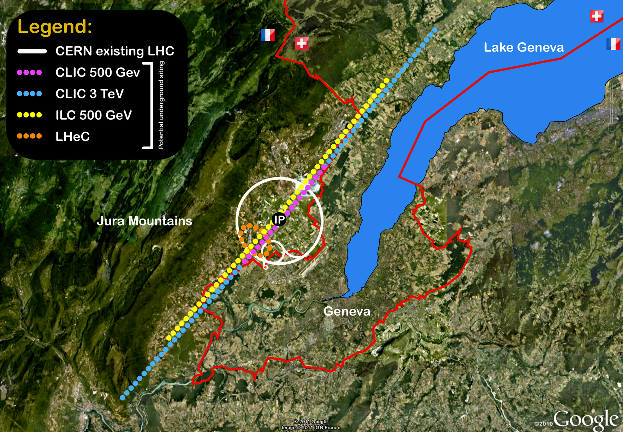
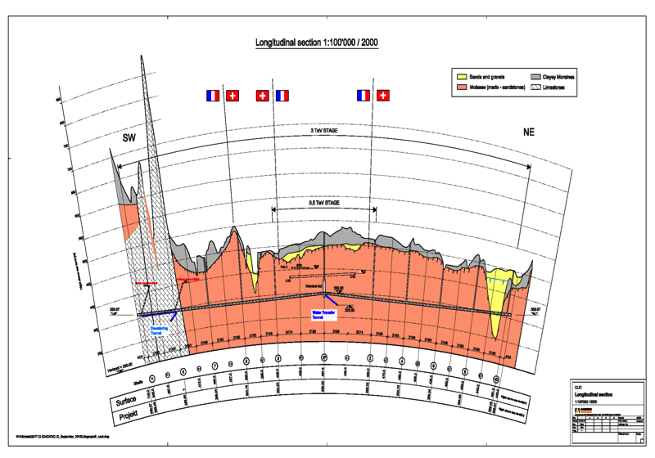
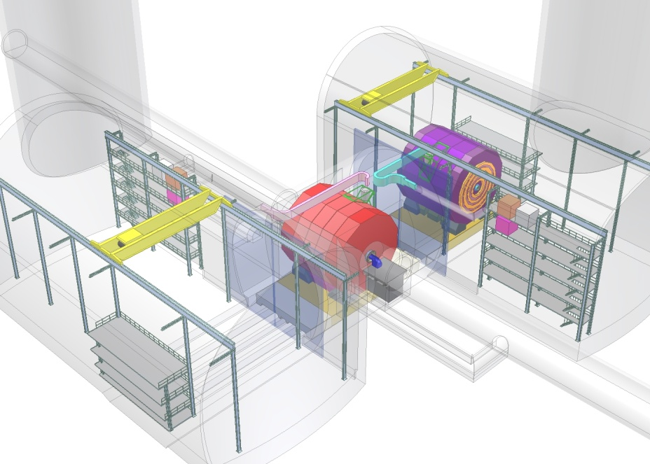
Tunnel implementations (laser straight)
Central MDI & Interaction Region

Slide 45
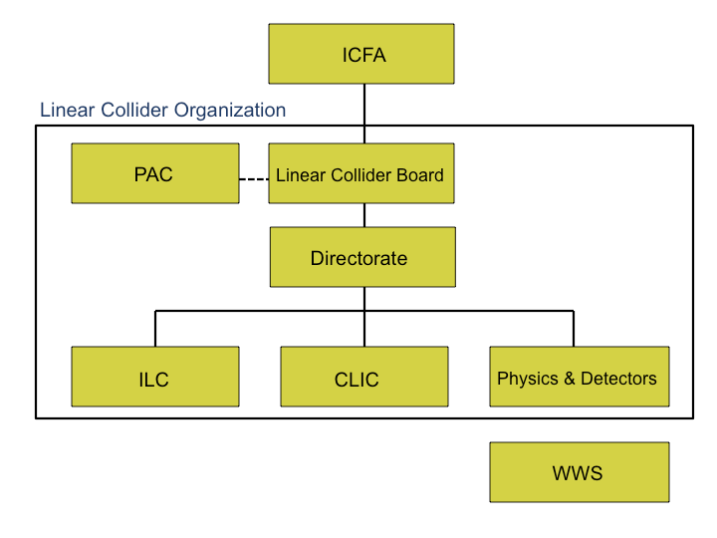
Figure extracted from Bagger’s talk

Slide 46
LC global organization issues for CERN
(in blue the more difficult ones)
CLIC Coll. Board – “no problem”, continue as before
  As for LHC experiments (RRB and CB are separate bodies with limited overlap)
Representation in the LCB (to be discussed between ICFA, ECFA, Council, other relevant bodies elsewhere).
  In Europe: have had feedback from some European CB members that representation should be suggested or endorsed by Council ?
  Or at Strategy Secretariat level, being reported to Council ?
Representation in LC “Directorate” – CLIC spokesperson or LC study leader, decide later
Work on strengthening the combined working group (several can be CERN lead)
ILC SC work (very limited – but follow (CERN as European hub, or Grab cavity work .. others )
Organization of Detector and Physics (including WWS)
  Detector concepts, R&D, CDRs and TDRs, physics studies
  Assume/insist on containing the entire community
  Leadership of this “box” ?
  Institute representation
Should note that the new LC organization is not in contradiction with the Council Paper on Global Projects (hosted by CERN or elsewhere)
  with some extrapolations to the future

Slide 47
Summary continued
Technical progress on accelerator and detectors good (CDRs will be substantial documents)
ILC TDRs/DBSs will also be done with CERN involvement (see later)
Plans for 2012-16 well underway for CLIC, and organization also ok (with some challenges)
    Inside CERN and with collaborators (not obvious balance)
    For accelerator (collaboration) and detectors & physics (less formal document and organization with set of institutes), with common Steering Group
    Visibility at strategy/council level would help (in particular collaborators)
Plans 2016-2020(2) require more resources (CLIC zero face value is ~390 MCHF)
  Relatively easy to plan in isolation but uncertainties from LC international development, and other possible priorities for CERN
  Significantly more work is needed to define an optimal programme beyond the one now covering to 2016 (examples: review CLIC zero scope, possible other uses of the facility, other key tests – at CERN or elsewhere)
We can integrate into the future LC organization (in agreement with CERN Council documents for global projects)
  With some challenges in some areas as indicated (European position should be better defined – but not always a clear opinion)

Slide 48
Strategy for the strategy
What is needed to conserve a leading European role in a future LC project (purely my view):
  Funding at MTP level as a minimum for next phase + “moral” boost to potential collaborators in the next 2-4 years (flag in Strategy/Council as strategically important) …. but have clear potential to involve collaborators better and improve project substantially with more resources
  Planning beyond 2016 at an increased level (at CERN and partners), with four elements:
    CLIC larger systemtest(s)
    ILC hub at CERN – prepare/study
    Lead European LC Detector and Physics activities (establish much better links to HL and HE LHC physics studies and strengthen all)
    Increased strategic involvement by Council (read CERN management/strategy secretariat) in the European LC activities (it is now beyond RECFAs role)
Results:
  Keep the LC options open the next 5-7 years at least if needed, it is an ambitious programme that attract partners (existing and new) inside the CERN organisation and outside, we conserve the CLIC development (at least in this period and with a planned next phase), we conserve/improve physics/detector studies for our future programme, and will allow us to react to international LC developments and LHC physics at the right time (hosting a LC or participating or none of them)
Perspective (at stake):
  A LC (CLIC certainly but also ILC) is likely to be the future “world machine” as LHC is today, provided LHC (including HL LHC) unveils some of the new physics believed to be within reach
  It will extend any labs programme (and certainly CERNs) VERY substantially in time and scope as an LC extendable in both length and acceleration technique/technology
  It can support a very large user community as its physics programme is wide
  HeLHC has some of the same potential but here CERN is “the host” so the short term strategy is easy

Slide 49
Input to Strategy currently planned
Volume 3 (need a short version less than 15 pages) - will refer to volumes 1 and 2 of course
  Make case for what is needed short term (towards 2020 – next step beyond CTF3)
Have agreement with ILC to provide a document with the physics case for a linear collider (international committee led by F. Le Diberder)
  agreed in ILCSC/IFCA meeting in Mumbai, discussed more in LCWS2011 in Granada
  James Wells CERN is in the committee
A document about a low energy machine - klystron powered with CLIC type of structures (will not be a CLIC input but we could participate) … debated and not concluded in most recent CLIC Steering Committee
CERN will prepare documents about medical use of accelerators and general accelerator R&D (input from us)

Slide 50
Reserve

Slide 51
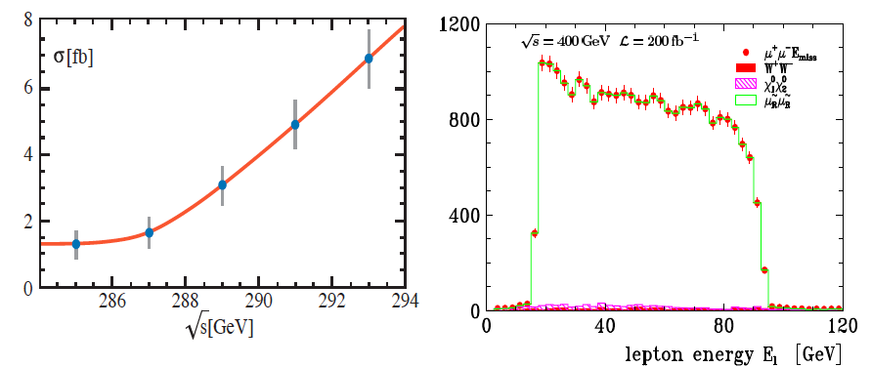
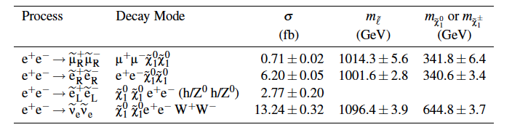

Supersymmetry
Complex and exiting arena for a LC where high precision and energy flexibility will be paramount
Energies determined from threshold scans, or edges of lepton energy spectrum in decays of for example slepton -> lepton + neutralino
See example from CLIC CDR study 3 TeV, 2 ab⁻¹
Precision important in order to understand a complex spectrum, to be able to disentangle various models and to extrapolate towards high energies, as well as addressing key questions – e.g. as if the theory provides a suitable Dark Mark Matter candidate.

Slide 52

gaugino pair production
SUSY “model II”:
Pair production and decay:
Separation using di-jet
invariant masses (test of PFA)
82 %
17 %
use slepton study result

Slide 53

heavy Higgs searches
CLIC access to SUSY heavy Higgs searches

Slide 54

physics reach, short overview
Discovery reach (indicative) for new physics:

Slide 55

Two-beam Concept
2m

Slide 56


Accelerating Structure
Require <1% probability of even a single break down in any structure
  p ≤ 3x10⁻⁷m⁻¹pulse⁻¹
Design based on empirical constraints

Slide 57
CLIC Power Source Concept
Delay Loop × 2
gap creation, pulse compression & frequency multiplication
Drive Beam Accelerator
efficient acceleration in fully loaded linac
RF Transverse Deflectors
Combiner Ring × 3
pulse compression &
frequency multiplication
Combiner Ring × 4
pulse compression &
frequency multiplication
CLIC RF POWER SOURCE LAYOUT
Drive Beam Decelerator Section (2 × 24 in total)
Power Extraction
Drive beam time structure - initial
Drive beam time structure - final
240 ns
240 ns
5.8 μs
140 μs train length - 24 × 24 sub-pulses
4.2 A - 2.4 GeV – 60 cm between bunches
24 pulses – 101 A – 2.5 cm between bunches

Slide 58

CLIC Test Facility (CTF3)
Delay Loop
Combiner ring
150 MeV e-linac
3.5 A – 1200 ns
Thermionic source
Experimental area
28 A - 140 ns
Recycled infrastructure
made it affordable
causes lots of headache

Slide 59


Drive Beam Linac
95.3% RF to beam efficiency
No instabilities
Phase switch works OK
Pulse current measurement
10 m
Power
Parameter | CLIC goal | CTF3 measured at end of linac
Transverse emittance | 100μm | 50-60μm
Pulse current | 7.5e-4 | 5.4e-4

Slide 60
Potential Staged Parameters

Slide 61

Drive Beam Combination
29 A reached, routinely 25A
Current measurement in CTF3
  Significant increase of transverse emittance
  Current jitter increases to O(0.1%-1%)
Focus has been on current
will now further improve beam quality
CTF3 specific issues need to be addressed and limits identified
RF pulse compression
Beam energy in combiner ring is
5% of that in CLIC
Geometric emittance 20 times larger
…
…
Delay loop
After delay loop
End of linac
In combiner ring

Slide 62

Drive Beam Deceleration and Module: CLEX
TBTS (two-beam test stand)
power transfer to main beam
module design
TBL (test beam line)
drive beam stability during deceleration
Main beam injector

Slide 63
PETS
Designed with more margin than accelerating structures
P_{out}≈130MW
Pulse used for measurement
and nominal pulse (blue)
0.25m
Measurements at SLAC:
No breakdown last O(8 10⁶ pulses)
-> P consistent with p≤10⁻⁷/m/pulse

Slide 64
Decelerator Design
≈ 900m (900 quadrupoles)
100A, 2.4-0.24GeV beam
aperture ≈ 10σ
large energy spread
significant wakefields
Simulation of 3σ-envelope along decelerator w. imperfections
Simulation of final energy along train
Simulations show that design is OK

Slide 65

TBL: Drive Beam Deceleration
9 out of 16 PETS installed
Rest will come this year
~26% deceleration
Final goal is 50% deceleration
Measurend in TBL:
Up to 21A current
optics understood
no losses in TBL
Good agreement
power production
beam current
beam deceleration

Slide 66
Main Beam Emittances
Beam power
Luminosity
spectrum
Beam Quality
(+bunch length)

Slide 67

Main Linac
Wakefields limit efficiency
(beam break-up)
Damping
(long-range wakefields)
Strong lattice
-> tight tolerances
Short bunches (short-range wakefield)
Trade-off for aperture (short-range wakefields)

Slide 68
Main Linac Tolerances
Stabilise quadrupole
O(1nm) @ 1Hz
Pre-align BPMs+quads
accuracy O(10μm)
3) Use wakefield monitors accuracy O(3.5μm)
2) Beam-based alignment

Slide 69



Pre-alignment System
Required accuracy of reference point is 10μm
Test of prototype shows
  vertical RMS error of 11μm
  i.e. accuracy is approx. 13.5μm
Improvement path identified

Slide 70
BDS Design and Alignment
Probability to achieve more than L/L₀ [%]
Main design issues
chromaticity
non-linear effects
synchrotron radiation
tuning
stability
Goal
Static imperfections:
Goal is L ≥ 110% L₀
with probability of 90%
Convergence is slow
faster method is being developed
Simulated full tuning performance
Need more complete imperfection modelling
independent sides
field errors
dynamic imperfections during tuning
realistic signals
Design is OK
Imperfection mitigation comes close to target
Test programme at ATF2 at KEK

Slide 71

Ground Motion and Its Mitigation
Natural ground motion can impact the luminosity
typical quadrupole jitter tolerance O(1nm) in main linac and O(0.1nm) in final doublet
-> develop stabilisation for beam guiding magnets

Slide 72
Machine Protection/Operation
Machine protection concept
inherently robust against fast failures
detect slow failures (next pulse permit)
Most important example BDS collimation
energy collimators supposed to take a pulse
betatron collimators not
Concept for start-up developed
based on CTF3/LHC experience

Slide 73
Conclusion
Main linac gradient
Ongoing test close to or on target
Uncertainty from beam loading
Drive beam scheme
Generation tested, used to accelerate test beam, deceleration as expected
Improvements on operation, reliability, losses, more deceleration (more PETS) to come
We are ready for the next phase
Luminosity
Damping ring like an ambitious light source, no show stopper
Alignment system principle demonstrated
Stabilisation system developed, benchmarked, better system in pipeline
Simulations seem on or close to the target
Operation
Machine Protection
Start-up sequence defined
Most critical failure studied
First reliability studies
Low energy operation developed

Slide 74
Thanks
Thanks to the CLIC collaboration in general
Thanks in particular to:
N. Shipman, I Syratchev, A. Grudiev, W. Wuensch, G. Riddone
M. Csatari
T. Persson, G. Sterbini, P. Skowronski, F. Tecker, R. Corsini,
S. Doebert, A. Dubrovski, W. Farabolini, R. Ruber
H. Meinaud Durand, K. Artoos, J. Snuverink, J. Pfingstner,
R. Tomas, Y. Papaphilippou, A. Latina, B. Dalena, B. Jeanneret
J.-P. Delahaye, S. Stapnes

Slide 75
Concept First Stage
Concept! Not to scale

Slide 76
Parameter and Structure Choice
Potential structures designs
Beam physics constraints
RF limitations
Parameter set
Physics requirements
Structure chosen to work for beam physics
Will tell the story as if we had a structure given
Cost model
Design choice

Slide 77
Main Linac Alignment and Emittance Growth
Target is achieved:
90% likely hood of less than 5nm vertical emittance growth

Slide 78
Drive Beam Requirements
Emittance ε_{x,y} ≤ 150μm
Transverse jitter ≤ 0.3σ
Current stability 0.75 •10⁻³
Phase stability 0.2° @ 12GHz
Bunch length stability 1%
RF power stability 0.2%
RF phase stability 0.05°
Phase stability 2.5° @ 12GHz
0.2° @ 1GHz

Slide 79

RF Stability
Cannot yet measure beam phase jitter accurately enough
monitor being built (Frascati)
Have specifications for RF
compare to CTF3
Good CTF3 klystron
pulse-to-pulse
10ns time slices
with respect to local phase reference
 | Tolerance | Measured
RF Power | 0.2% | 0.21%
RF Phase | 0.05° | 0.07° (0.035°)

Slide 80
PETS On-Off Mechanism
On-off mechanism is essential for operation
Switch off bad structures/PETS
Successfully tested in CTF3
Power to acc. structure
0N
Forward power in PETS
0FF

Slide 81
The CLIC Damping Rings CDR Parameters
Parameters | 1GHz | 2GHz
Energy [GeV] | 2.86
Circumference [m] | 427.5
Energy loss/turn [MeV] | 4.0
RF voltage [MV] | 5.1 | 4.5
Stationary phase [°] | 51 | 62
Natural chromaticity x / y | -115/-85
Momentum compaction factor | 1.3e-4
Damping time x / s [ms] | 2.0/1.0
Number of dipoles/wigglers | 100/52
Cell /dipole length [m] | 2.51 / 0.58
Dipole/Wiggler field [T] | 1.0/2.5
Bend gradient [1/m2] | -1.1
Phase advance x / z | 0.408/0.05
Bunch population, [e9] | 4.1
IBS growth factor x/z/s | 1.5/1.4/1.2
Hor./ Ver Norm. Emittance [nm.rad] | 456/4.8 | 472/4.8
Bunch length [mm] | 1.8 | 1.6
Longitudinal emittance [keVm] | 6.0 | 5.3
Space charge tune shift | -0.10 | -0.11
The latest DR lattice parameters (CDR version)
  2 RF options at 1 and 2 GHz with the 1 GHz option as the baseline
Main problems of the previous lattice
  Large space charge tune shift (~-0.2) ➔ warning by ACE
    Larger longitudinal emittance needed
  Large RF stable phase (70º) → warning by Alexej
    Larger RF voltage needed (goes to the opposite direction for longitudinal emittance)
  Stay always within the requirements for the transverse emittances

