Slide 1
Application of the moderate peak power (6 MW) X-band klystron’s cluster for the CLIC accelerating structures testing program.
I. Syratchev

Slide 2
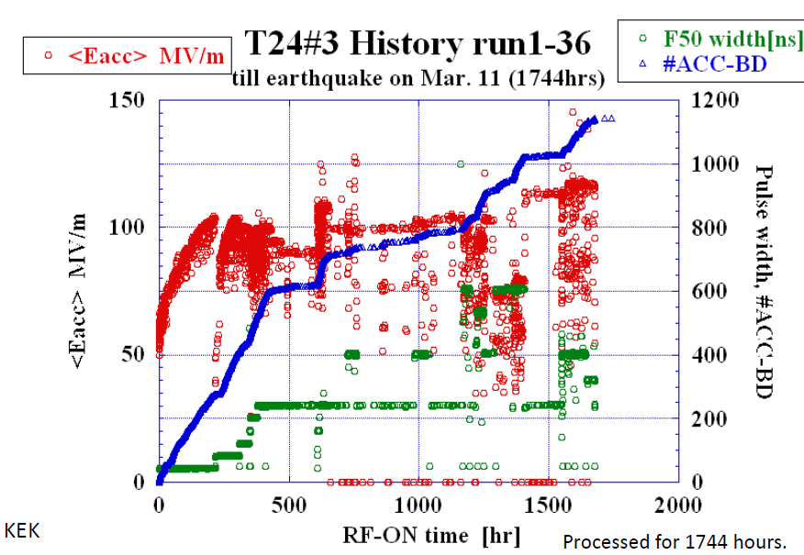
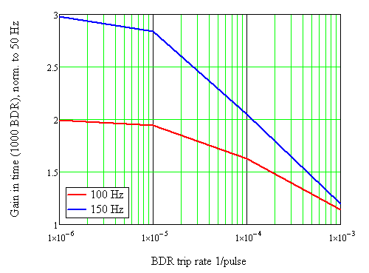
Could the testing period be reduced by increasing the repetition rate?
50 MW klystron. The XL-4 klystron was tested at 120 Hz and reduced pulse length - 1000 ns. To make it to operate reliably at a full spec some modification of the RF window and collector will be needed?
Accelerating structure cooling circuit is designed for 50 Hz, increasing average power by factor 2-3 (100-150 Hz) is feasible (under investigation).
Operation. Currently the processing is conducted at ~ 10⁻⁵-10⁻⁴ BRD trip rate. With 2 structures running in parallel the after-BRD down time will slow down processing progress. Longer term tests (at a low BRD trip rate) will profit from the higher repetition rate.
1 min after-BRD-down-time was assumed
Processing zone
With a single source, the repetition rate and processing time are not correlated linearly
Running: BDR TR ~10⁻⁶
Processing: BDR TR ~10⁻⁵

Slide 3
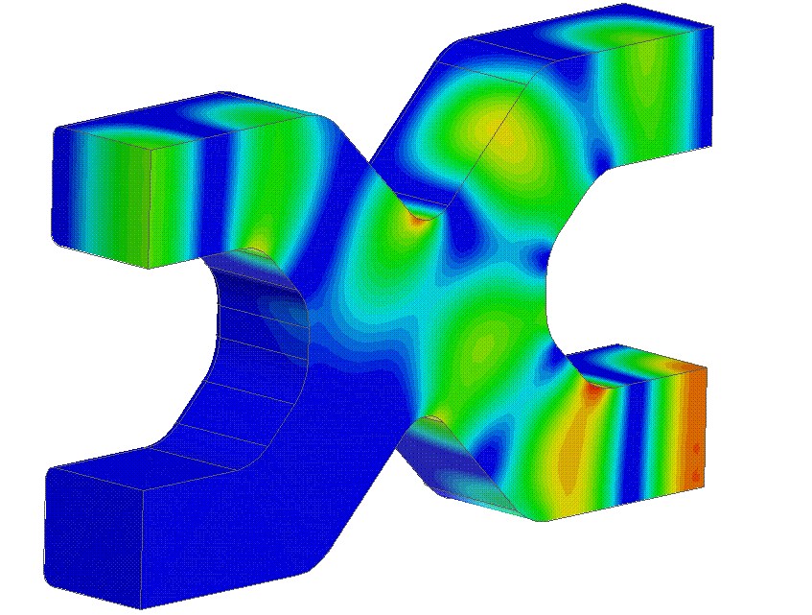
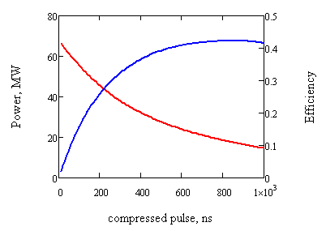
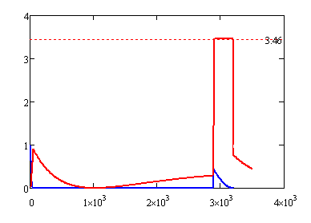
Can we go even higher (above 100 Hz) in a repetition rate?
40 MW x few hundred ns, X-band klystrons cluster power station + Pulse compressor.
ϕ_{0+π/2}⇒ ϕ_{0 +π/2} -90
ϕ₀⇒ ϕ₀+90
2xPhM
2x5.5 MW
400 Hz
V1
ϕ1
AM
Load
V2
ϕ2
Amplitude: 1⇒0
Constant phase
PC, Q₀=1.8x10⁵
To structures ~ 40 MW
Example: T_{in}=3.2μs, T_{out}=300 ns
P_{in}=2 x 5.5 MW, P_{out}=38 MW
Peak power vs. pulse length
T_{in}=3.2μs, β=4.75
Structures
β=4.75
Power, norm.
Combining the two stations we get an accesses to 80 MW peak power kHz range test facility!
Drawback: The efficiency goes down to ~ 14% for 240 ns pulses.
Load
Time, ns

Slide 4
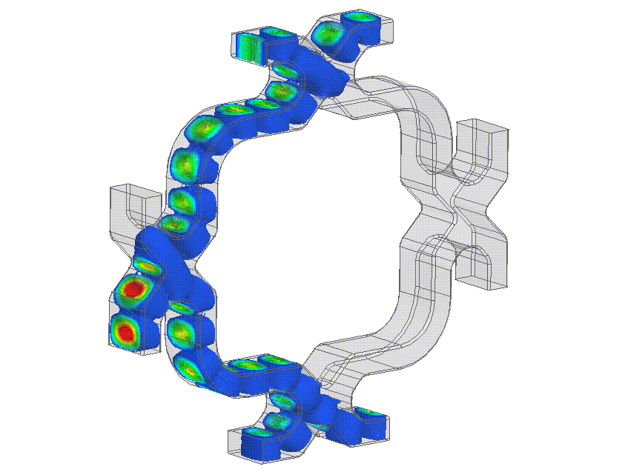
High power 4 port commutation with a phase manipulation
12 GHz (5.5 MW x 4.6 μsec x 400 Hz) x 4
PhM
PhM
AM
P_{av}/Kl.=10 kW
AM
100 Hz x 4
400 Hz x 1
133 Hz x 3
82 MW x 240 ns
(61 MW x 400 ns)
200 Hz x 2
By RF phase manipulation of klystrons pairs (0- π), we can established 4 testing slots running at 100 Hz each. In the case of a single/few structure/s breakdown/s, the missing pulse can be send to any other testing channel, thus maintaining the overall repetition rate available for the tests.

Slide 5
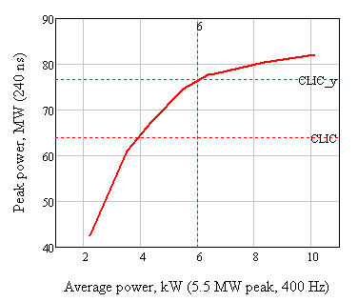
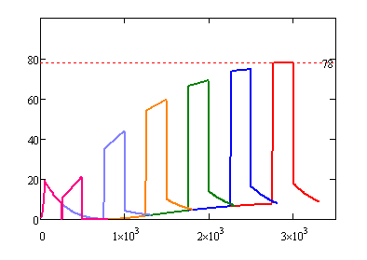
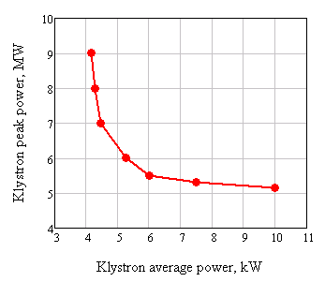
Single klystron peak and average power issues
5.5MW-6.5MW peak power klystron looks like an optimal choice to provide efficient generation of the pulses for CLIC accelerating structures testing.
+20% for RF components losses
Single klystron parameters (for 78 MW x 240ns compressed pulse)
Power, MW
400 Hz/Kl. example
Time, ns
Operation issues:
After breakdown, the accelerating structure needs to be re-processed. This is normally done by gradual increasing both the peak power and pulse length. In our case it can be done in a simple way by changing only the klystron pulse length without re-programming klystron phase modulation. In a similar way the peak power can be balanced between the channels

Slide 6
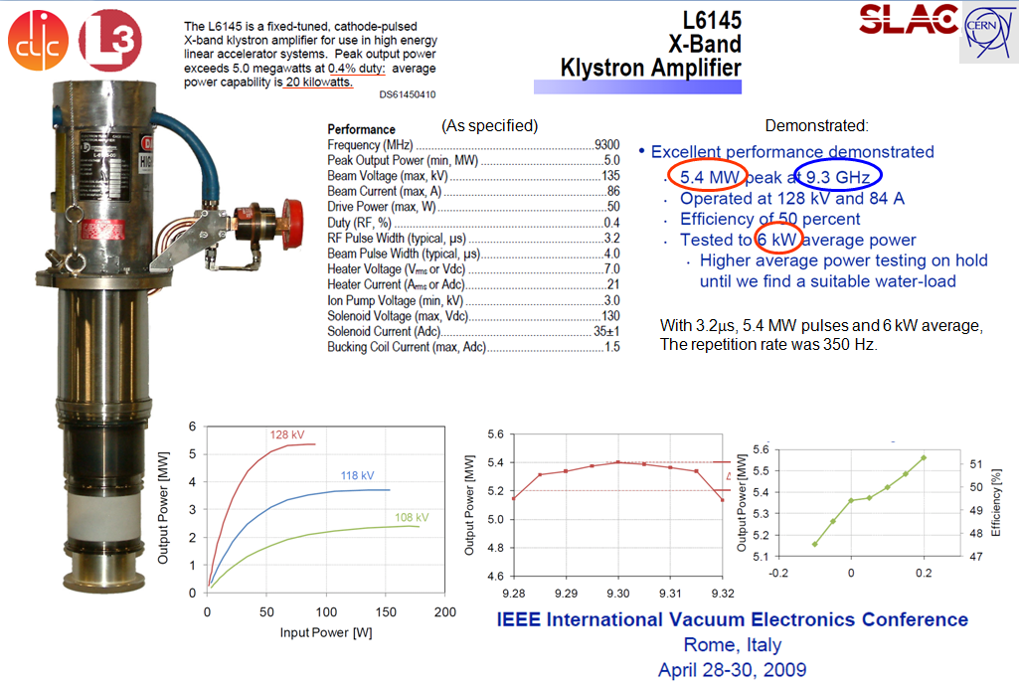
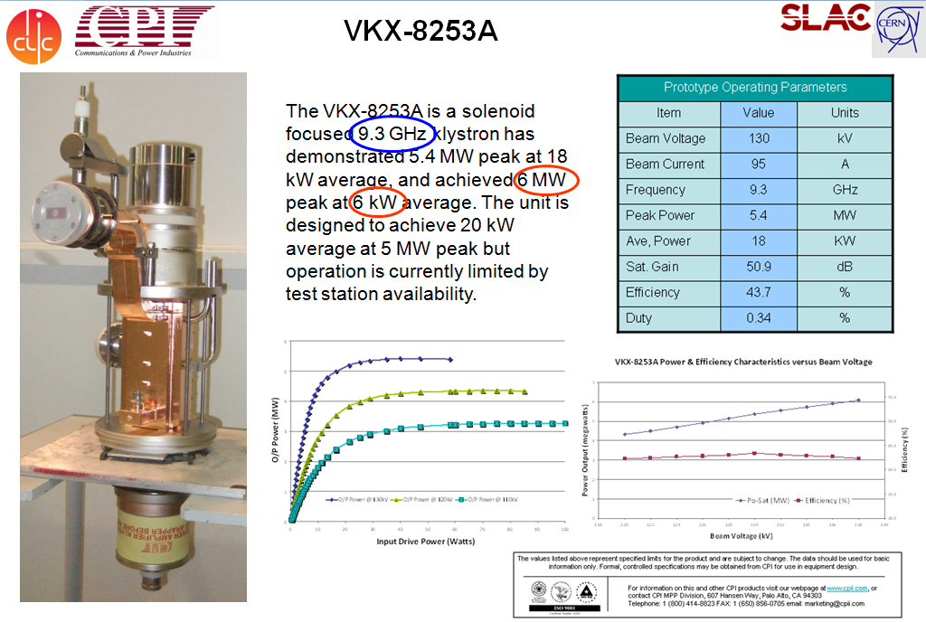
The 9.3 GHz version of such a tube is available on the market. At least two companies (CPI and L3 in US) have developed industrial prototypes and Thales (Europe) has a paper design.
All these companies were contacted and expressed their interests in scaling the existing 9.3 GHz devices to 12 GHz
L3
CPI
Thales

Slide 7
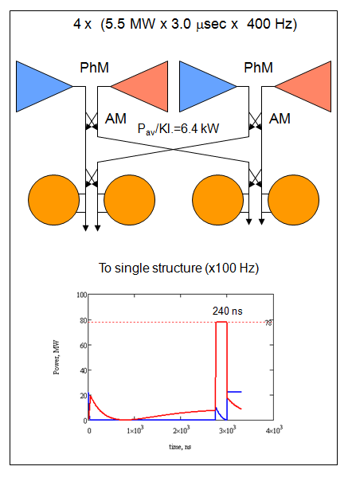
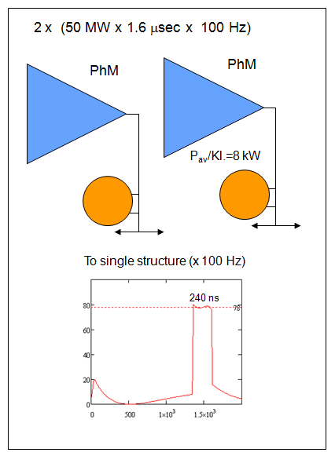
High peak power klystron vs. medium power klystrons cluster.
Performance issues.
Equivalent in terms of delivered number of pulses

Slide 8

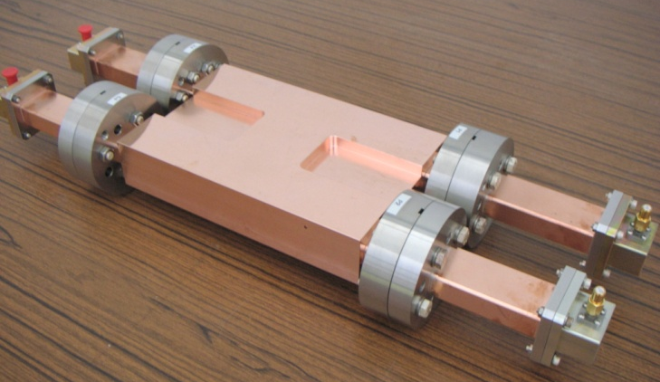
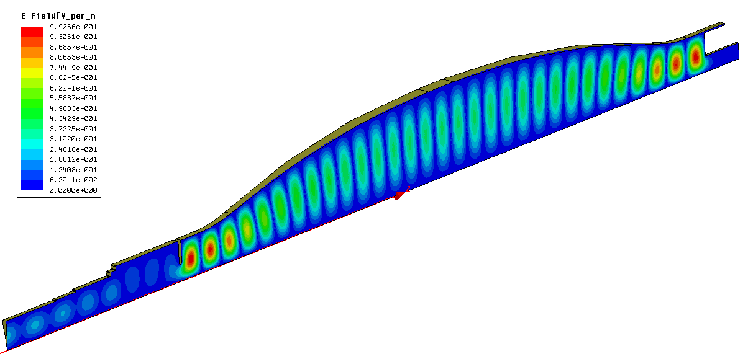
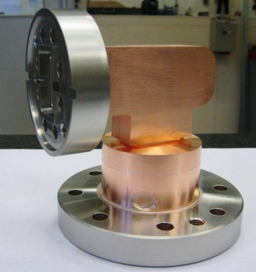
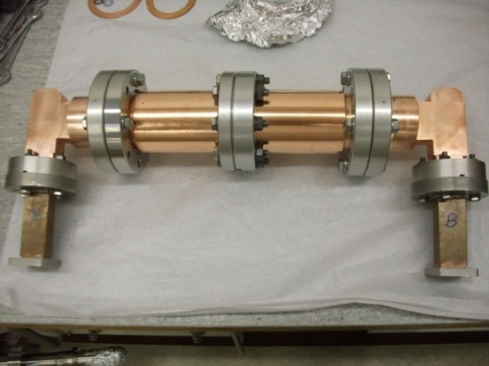
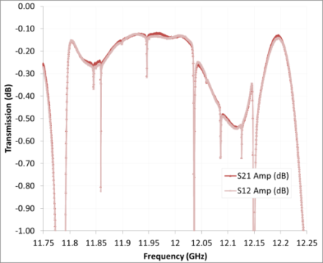
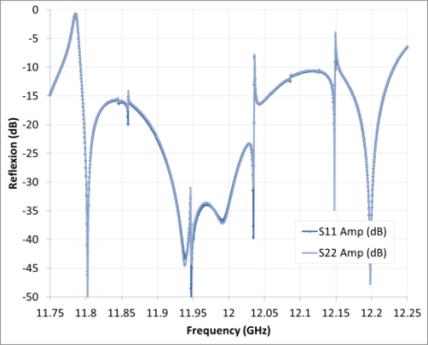
Compact SLED-type X-band pulse compressor.
Design & components by F. Peauger, CEA.
From Klystron
Hybrid
H₀₁ Mode Converter Φ36mm
H₀ ₁ ₃₁ Cavity
Short circuit + pumping port
Iris
To Accelerating Structure
H₀₁ Circular Taper (Φ36mm→ Φ50mm)
SLAC-type Double height 3 dB hybrid
H01M ‘rugby’ cavity
Mode: H_{0,1,31}
Length: 420mm
Max. ∅: 110 mm
Q₀: 1.82x10⁵ (HFSS)
KEK-type compact H10-H01 mode converter
H01 tapers (∅36->∅50)
The mode converters are used to pre-fabricate H₀₁ mode in a circular waveguide (∅ 50 m). The coupling iris and tuning piston are also placed in the same diameter to avoid diffraction coupling to the modes with higher radial number (H_{0,N>1,M}).
The cavity shape is optimized to provide required Q₀ (1.8x10⁵). The internal tapers are designed to minimize modes conversions of the operating mode.
The fixed tuning pistons will be used as a separate (not the part of vacuum system) pieces to balance the cavities frequencies. Final frequency tuning will be done with the cooling water temperature control.
These components were designed and fabricated by CEA as a French in-kind contribution to the 12 GHz klystron station waveguide network at CERN

Slide 9
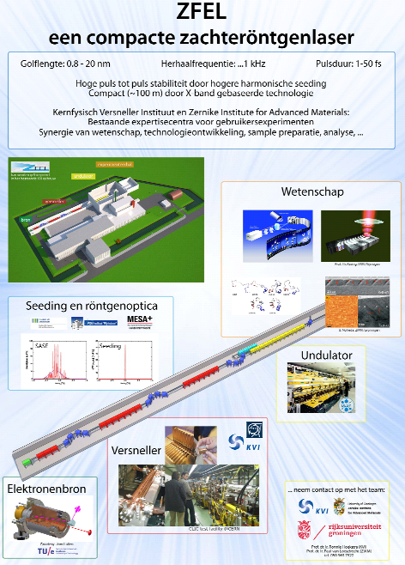
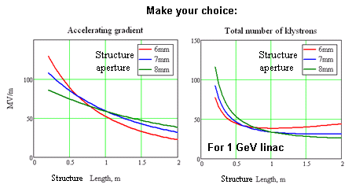
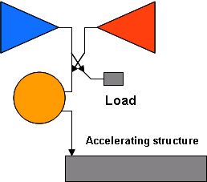
Other applications
The new collaboration between CLIC/CERN and KVI/GRONINGEN (Netherlands) has been recently established. The subject is the development of high gradient electron linac based on CLIC (12 GHz) accelerating structure technology capable to operate at ~1 kHz repetition rate.
X-band linac module
The moderate peak power klystron cluster plus pulse compressor is the most economic way to deliver high peak RF power and high repetition rate.

