Slide 1
RF Facilities Update
X band order with CPI for 2 Klystrons
  Modulator price enquiry in November once CPI confirm klystron spec
Market survey will go out before end of year for Igor’s low power klystron solution

Slide 2
Conditioning progress of the 12GHz klystron power source
10MW, 1500ns
50 Hz
Max rf power levels at 50Hz repetition rate.
20/10/2011: 20MW, 500ns, 50Hz
Klystron HV conditioning, no rf.
Most time needed for voltage and current calibration (not yet finished!).
LCWS11 / CAS
break

Slide 3
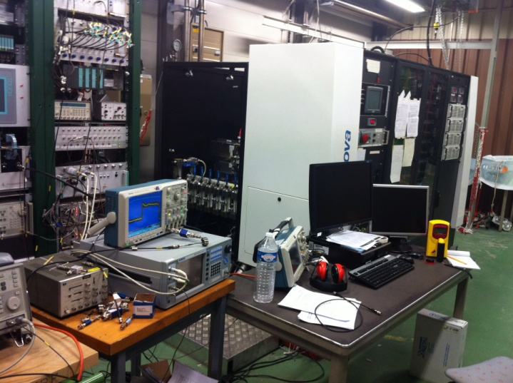
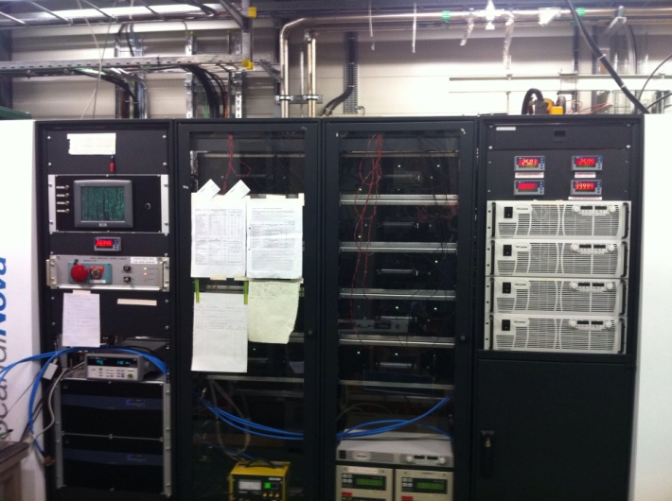
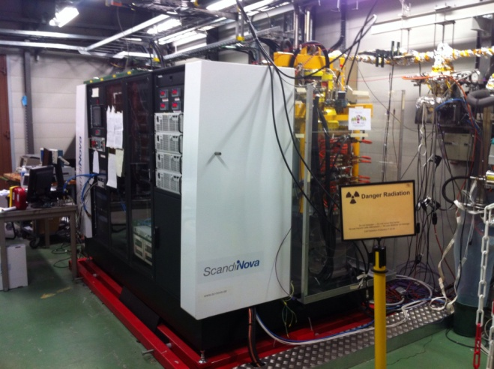
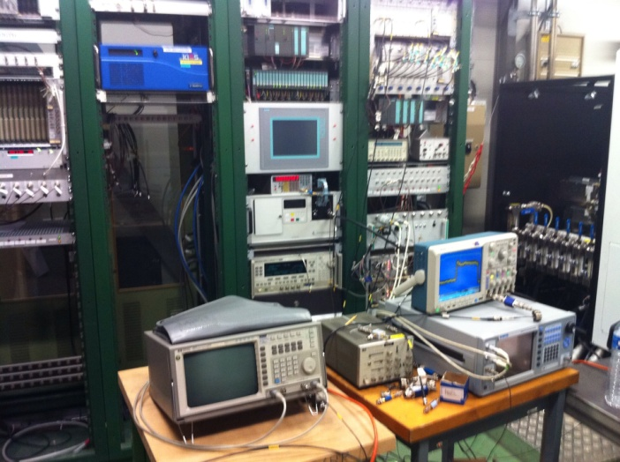
Scandinova Modulator running very well with
1kV on IGBT’s giving us about 360 kV on Klystron
at full pulse width and 50Hz rep rate
Continue RF conditioning of klystron and RF network
When saturation is reached (expect 28 to 30MW) will
compare to SLAC power curves to confirm modulator
calibration.
Increase klystron to nominal voltage and finish high
power conditioning hopefully before end of year
Install complete RF network during shutdown to start putting RF into
CTF2 when shutdown is finished

