Slide 1
CLIC power consumption
B. Jeanneret
CLIC Project meeting, Oct 2011

Slide 2
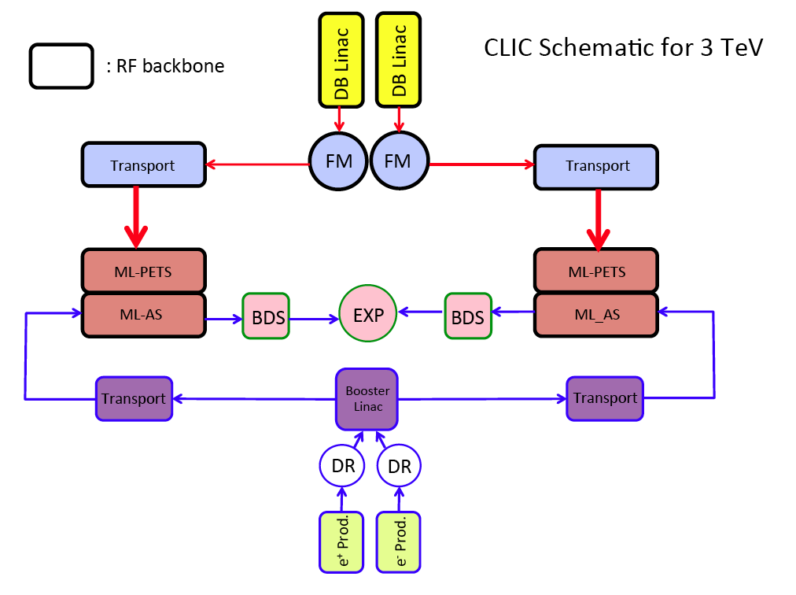

Slide 3
Detailed power map nominal luminosity all data in MW
E_CM [TeV] | 0.5 | 1.5 | 3
MB injectors magnets | 1 | 1 | 1
MB injectors RF | 24.3 | 16.5 | 16.5
MB PDR+DR magnets | 5.1 | 5.1 | 5.1
MB PDR+DR RF | 17.6 | 17.2 | 17.2
MB Transport | 16.5 | 16.5 | 16.5
MB Long Transport Line | 0.1 | 0.3 | 0.5
DB injectors Sol+Mag | 3.4 | 3.4 | 6.8
DB injectors RF | 66.8 | 127.6 | 255.2
DB FM | 9.3 | 9.3 | 18.5
DB transport to tunnel | 0.1 | 0.1 | 3.0
DB transport in tunnel | 8.1 | 19.6 | 39.1
DB Long Delay Line | 2.0 | 2.3 | 0.0
TBM MB | 1.0 | 2.5 | 4.9
TBM DB | 2.8 | 6.7 | 13.3
Post Decel | 2.2 | 5.3 | 10.6
BDS | 0.9 | 1.2 | 1.6
Interaction area | 16.3 | 16.3 | 16.3
Dump Line | 1.1 | 1.7 | 3.3
Experiment | 15.0 | 15.0 | 15.0
Instrum. Main tunnel | 2.1 | 5.0 | 10.0
Instrum. other | 3.0 | 3.0 | 4.0
Control Main tunnel | 0.4 | 1.0 | 2.0
Control other | 0.8 | 0.8 | 1.0
Cooling & Ventilation | 58.0 | 67.0 | 93.0
Network Losses | 13.0 | 17.0 | 28.0
TOTAL | 271 | 361 | 582
Detailed and precise evaluation
made for most systems
RF – DB Linac, E. Jensen, R. Wegner, G. McMonagle,D. Nisbet, S.Pittet
RF – Main Linac, A. Grudiev, G. Riddone, I. Syratchev
Magnet & rectifiers, M. Modena, A. Vorozhtsov, D. Siemaszko, S.Pittet
Cooling and ventilation, M. Nonis
Many others on less power-demanding systems

Slide 4
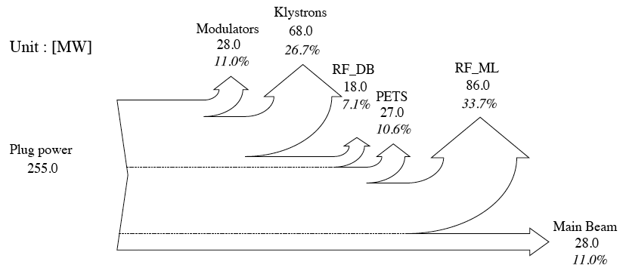
RF : from Drive Beam Linac to Main Beam - 3TeV
Auxiliaries not included here
(in particular CV)
Modulator yield : η = 0.89 : quite challenging (see talk S. Pittet)
Klystron yield : η = 0.70 a bit beyond today’s standards
PETS : nearly perfect transformer (η = 0.98) , but 17% of drive beam power goes to dump
Main Linac structure yield : compromize with total linac length and low-emittance preservation
← Keep with ?

Slide 5
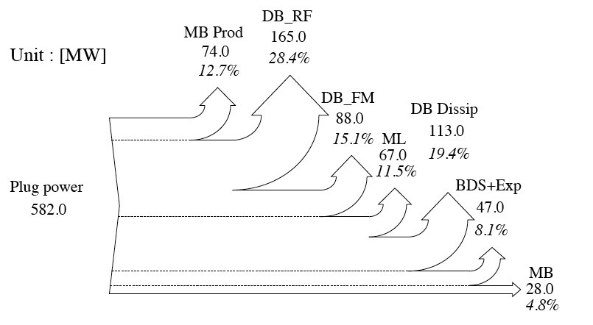
Overall power efficiency map - 3 TeV
RF alone will not produce luminosity. Need in addition
  FM 1GHz→12 GHz + transport
  MB production, BDS & Experiment
  Auxiliaries are not marginal, see below
Overall power efficiency is 5% ← indicator of relative value
Luminosity/power is better estimator

Slide 6
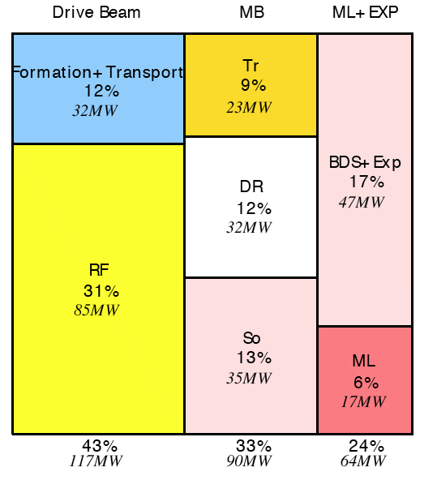
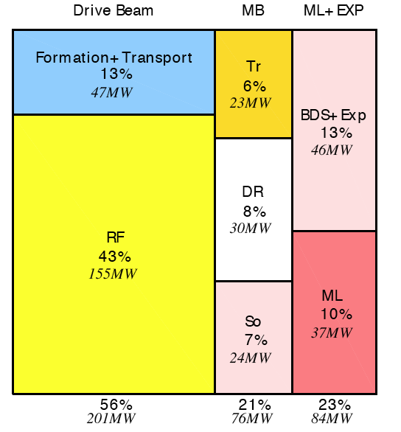
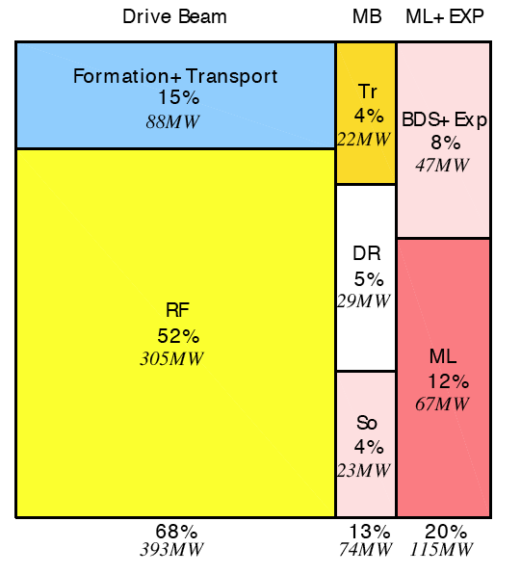
Power by system at 3 CM-energies
0.5 TeV , 271 MW
1.5 TeV , 361 MW
3 TeV , 582 MW
CLIC is efficient at high CM energy (RF dominated : RF+ML 64% @ 3 TeV, 53% @ 1.5 TeV)
Optimization effort was put on DB Linac up to now
500 GeV : requires further optimization on all other systems (mostly MB production and BDS+Exp)

Slide 7
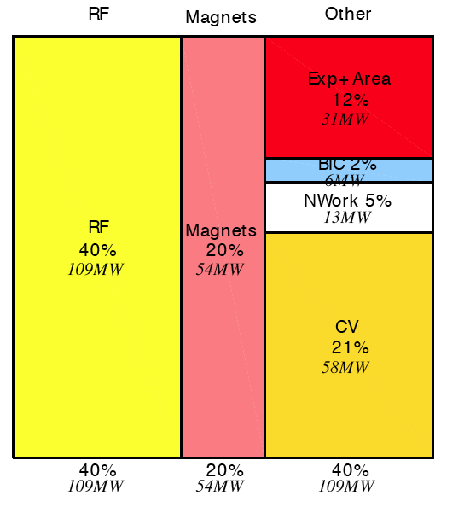
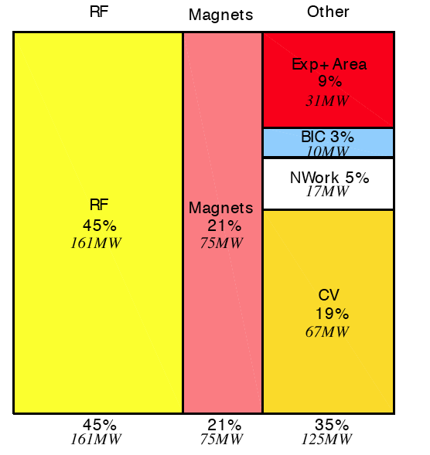
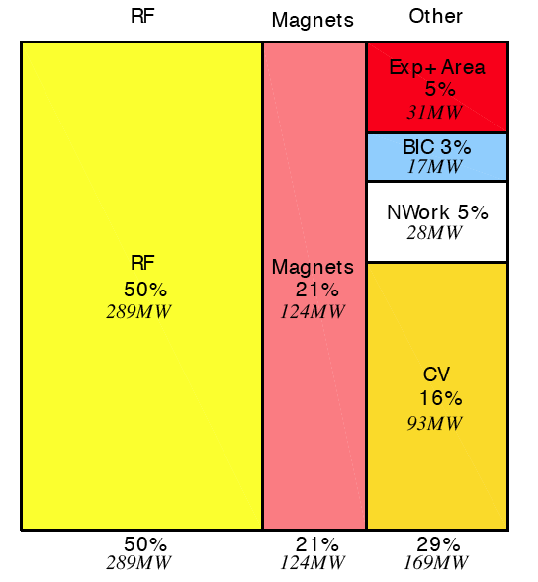
Power by components
0.5 TeV , 271 MW
1.5 TeV , 361 MW
3 TeV , 582 MW
Large contribution of cooling and ventilation at 500 GeV
  Mostly related to the large size of the surface beam complex
  (20 km of beam line vs 10km for the 2 Main Linacs)

Slide 8
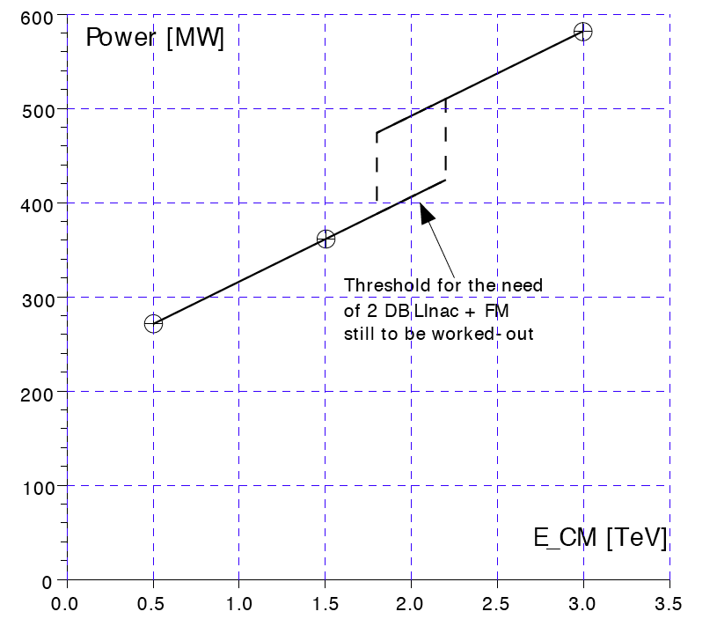
Total power consumption = f(E_{CM})
E _{CM} [TeV] | Luminosity 1% [cm⁻²s⁻¹] | P_{MB}/P_{TOT}
0.5 | 1.40 × 10³⁴ | 3.6%
1.5 | 1.45 × 10³⁴ | 3.9%
3.0 | 2.0 × 10³⁴ | 4.8%
If physics favours E_{CM}>1.5 TeV
→ need to determine the threshold 1→2 DB linac
Maybe, rework a specific optimized case in the 1.5 TeV range

Slide 9
Mitigation of power budget - I
RF already optimized/optimistic/challenging (DB modulators and klystrons, Main Linac)
Magnets : may consider Permanent or Super-conducting/super-ferric
  But not everywhere (SR issues, too large fields, reduced field quality/tunability)
  Assume 50% power reduction
Cooling & ventilation
  Consider better buildings (air re-circulation, use heated cooling water for heating buildings, etc, …)
  Expensive but may afford 30% reduction of ventilation power (60 MW at 3 TeV)
Main beam production ? Detailed studies needed, keep as is.
 | 0.5 Tev | 1.5 TeV | 3 TeV
0.5 × P_{mag} | 27 | 37 | 62
0.3 × P_{CV-air} | 12 | 14 | 18
ΔP | 39 | 51 | 80
P-ΔP | 232 | 310 | 502
P | 271 | 361 | 582
Cannot be ‘sold’ as is,
ΔP must be balanced with ΔCost
But incentive for further iterations

Slide 10
Energy consumption at 3 TeV
Consider : programmed stops
  90 days of ‘winter shut-down’
  2 days of short tech stop / 2 weeks + 7 days of tech stop / 2 months → 54 days
  T = 365 – 90 – 54 = 221 days of operation
  20% of down-time because of faults (LHC 2010) : 44 days
  Remains : beam days / full power : 177
 | CDR |  |  | ECONOMY
 | Power [MW] | Days | Energy [TWh] | Power [MW] | Days | Energy [TWh]
Nominal peak power | 582 | 177 | 2.47 | 500 | 177 | 2.12
Fault induced down-time | 60 | 44 | 0.06 | 40 | 44 | 0.04
Programmed stops | 60 | 144 | 0.21 | 40 | 144 | 0.14
Energy spent /year |  |  | 2.74 |  |  | 2.30

Slide 11
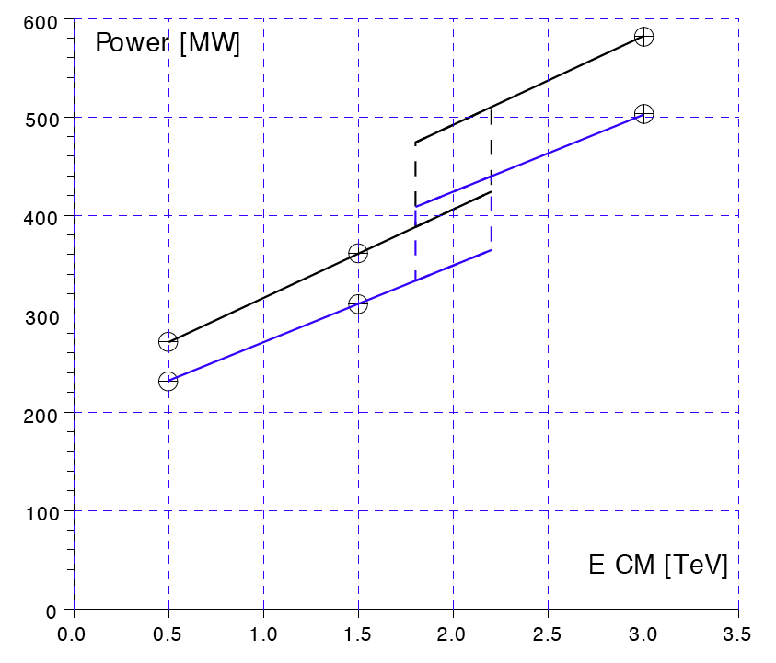
Mitigation of power budget - II
There is a potential of improvement with power
But
  Performance shall not be degraded (magnets)
  Cost impact may be important
Cannot be integrated to CDR without further detailed work
CDR-nominal
‘Eco’

Slide 12
Producing part of our energy needs
Physicists encouraged to consider carbon footprint
By e-EPS. Published on 18 October 2011 in News, Physics World
… consider the impact of large scientific facilities – such as ground-based telescopes and particle accelerators, which can often have considerable energy demands – but also the effects on an individual scale. Marshall’s research shows that – in the field of astrophysics alone – researchers themselves average 23,000 air miles each year to attend meetings and visit observatories, and use around 130 KWh of extra energy daily, compared to the average US citizen.
Marshall proposes … : future experiments are built to be carbon neutral; …physicists might opt to take part in overseas meetings through video conferencing, rather than flying there in person.
The article comes just before the First Joint Workshop on Energy Management for Large Scale Research Infrastructures, which is being at held in Lund, Sweden on 13-14 this month
They gave an
Exemple …
CLIC will not escape agressive requests

Slide 13
Eolian energy
CLIC 3 TeV , P_{nom}=500 MW, E_{year} = 2.3 TWh
Consider p = 5 MW eolian unit
  Average capacity factor c = 0.2
  e_{year} = 8760pc = 0.86e-2 TWh
N = E_{year}/e_{year =} 270 units
120 m
Around CERN ?
180m
40 m

Slide 14
Solar energy
Photovolatic cells on top of the DB Linac building :
  Surface of the roof : S = L×W = 2500 × 30 = 7.5 e4 m2
  P_{solar,max} ≈ 1KW/m² at 12h00 in June
  S×P_{solar,max} = 75 MW
  Averaged over year & wheater fluctuations:
    p ≈ P_{solar,max}/12
  Optimistic electric yield : η = 0.3
<P_{electric,tot}> = 0.3SP_{solar,max} / 12 ≈ 2 MW
→ … Cosmetics …

Slide 15
Going further
RF power already optimized
Magnets : going beyond 50% reduction ?
Reduce the ventilation power to ≈ 0
Reduce the water cooling
Less magnets
Cool & Vent power, nominal | .5 TEV | 1.5 TeV | 3 TeV
Water | 11 | 14 | 23
Chilled water | 6 | 7 | 10
Air | 41 | 46 | 60
TOTAL | 58 | 67 | 93

Slide 16
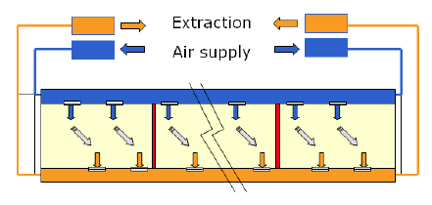
Ventilation in tunnels
Main tunnel : 2500 m
Scheme imposed by safety issues (smoke extraction)
Very poor conductance → high power
Difficult to do better with the present constaints
CERN site : Few surface points allowed – busy area

Slide 17
Another location for CLIC
(CLIC is claimed to be a world-wide project)
Flat, empty area
  Allows for any density of surface points
  May allow for natural ventilation
  Improve water distribution
  Rectifiers, electronics, etc : on surface (cooling much more easy)
Windy and sunny
  Own clean energy production
Water nearby
Empty area - II
  May reconsider the main beam production
  One site at each main linac entry
    No surface loop (1.5 km)
    No turn-around (2 x 3 km of tunnels)
    Booster Linac still needed (or combined with ML) ?
Power economy : CV & beam lines
As well : cost reduction (less deep, more on surface, optimization of surface complex

Slide 18
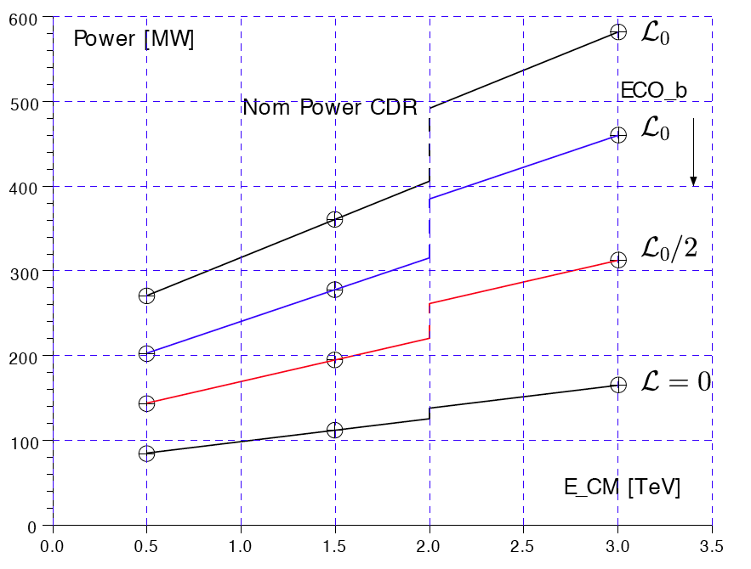
‘Eco’-b
P_{magnet} ➘50% like above
P_{air} = 0
No change for water, no discount for MB loops
Still margin for improvement
A Starting point …
P/2 → L/4

Slide 19
Summary for power
Not 100% precise, a bit rounded
Power [MW] | .5 TeV | 1.5 TeV | 3 TeV
CDR nominal | 270 | 360 | 580
Eco – a | 230 | 310 | 500
Eco - b | 200 | 280 | 460
Eco - c | 180 | 250 | 410
Better magnets, bld insulation
New, easier site :
P_{air} = 0 , 50% P_{magnet}
P_{air} = 0 , 50 % P_{water} , 70% P_{magnet}
Moving MB prod
Gain : 1/3
Power become a critical item, like nm, fs, RF modules, cost …
  Requires more collaboration with Civil.Eng and CV
  Freedom for the site allows for
    Option Eco-c
    Own clean energy production
    Cost reductions

