Slide 1
CTF3 Status
R. Corsini for the CTF3 Team
Talk Outline:
News since last Project Meeting
Status of feasibility benchmarks in CTF3
      Drive beam generation
      PETS & RF Structures
      Two-beam issues
1

Slide 2
Program for the rest of the year - I
PHIN run
☺
  Completed, good measurements on cathode lifetime
TERA experiment
☺
  Done within schedule, other 3 weeks planned at the beginning of 2012
Improve 1.5 GHz factor 8 beam
😐
  Delayed by manpower (LCWS 11 Granada), gun & klystron troubles, TWT availability
  Good improvements on beam current flatness from gun, compensation of phase switches, injector set-up
  Optics studies to increase acceptance under way. Improvements in DL &CR optics, CR closed orbit

Slide 3
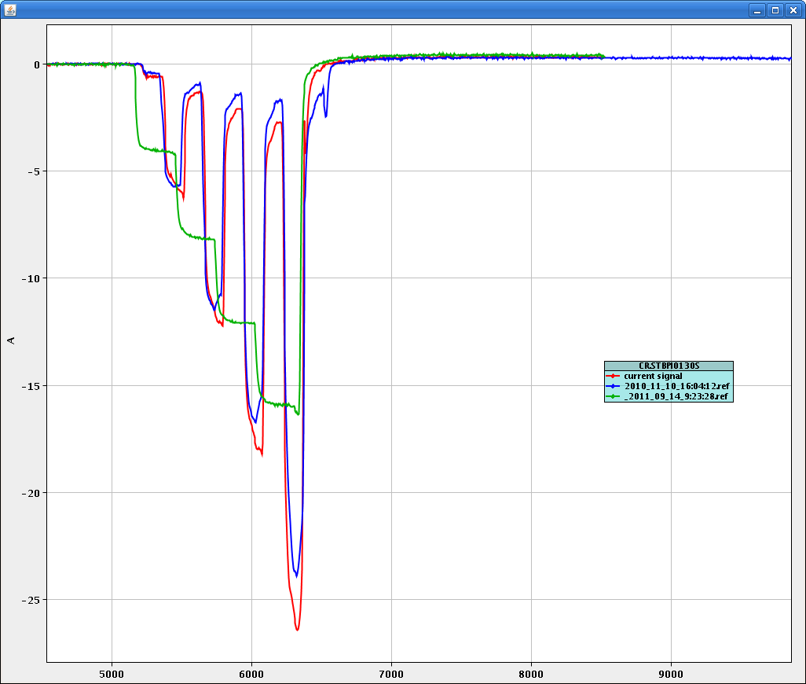
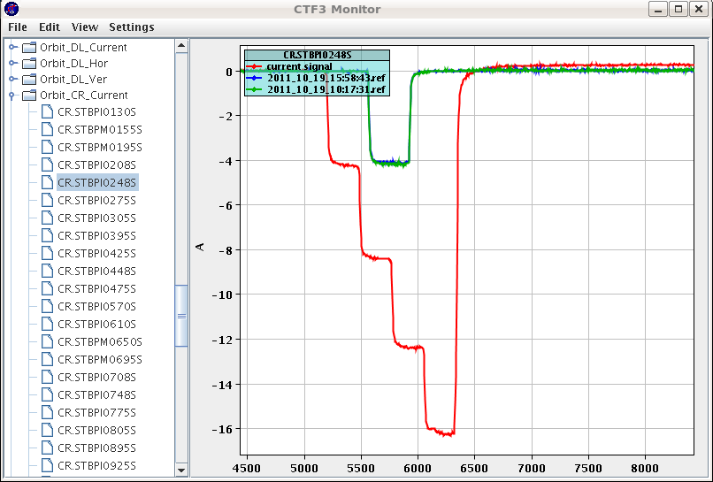
Beam Recombination
Factor 8
Factor 4

Slide 4
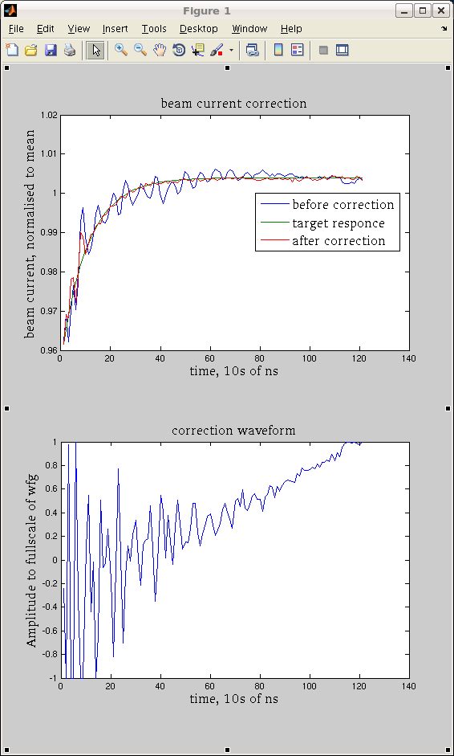
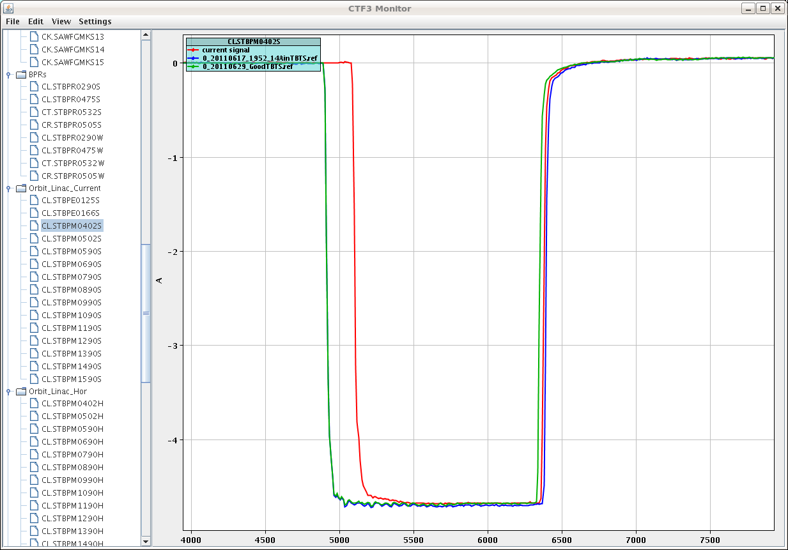
Gun current Correction
Alexandra Andersson

Slide 5
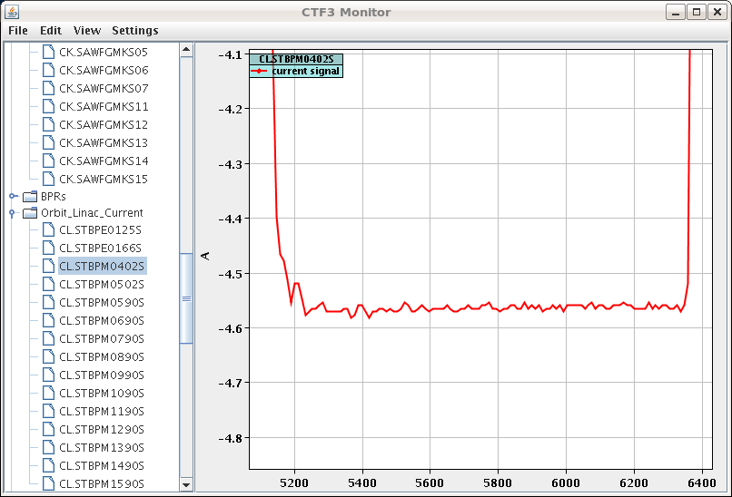

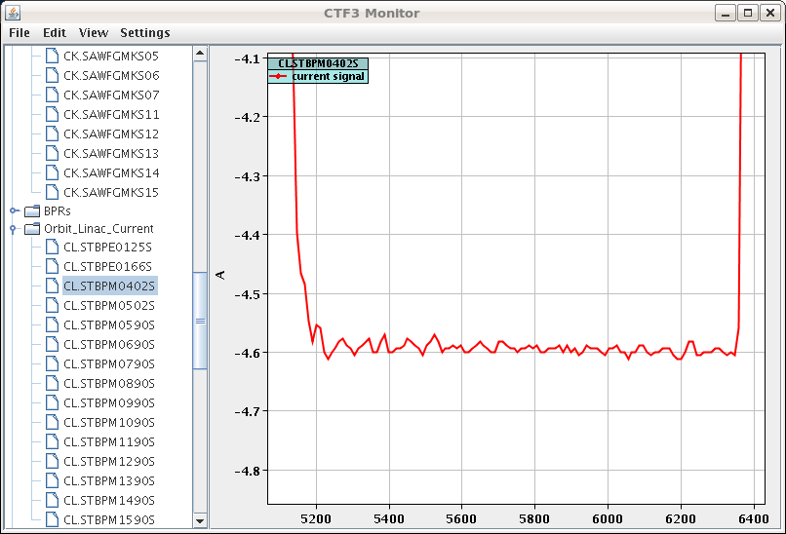
Compensation of phase switches
Gun adjusted, no switches
Switches, gun re-adjusted
Switches introduced
Alexandra Andersson, Frank Tecker, Piotr Skowronski

Slide 6
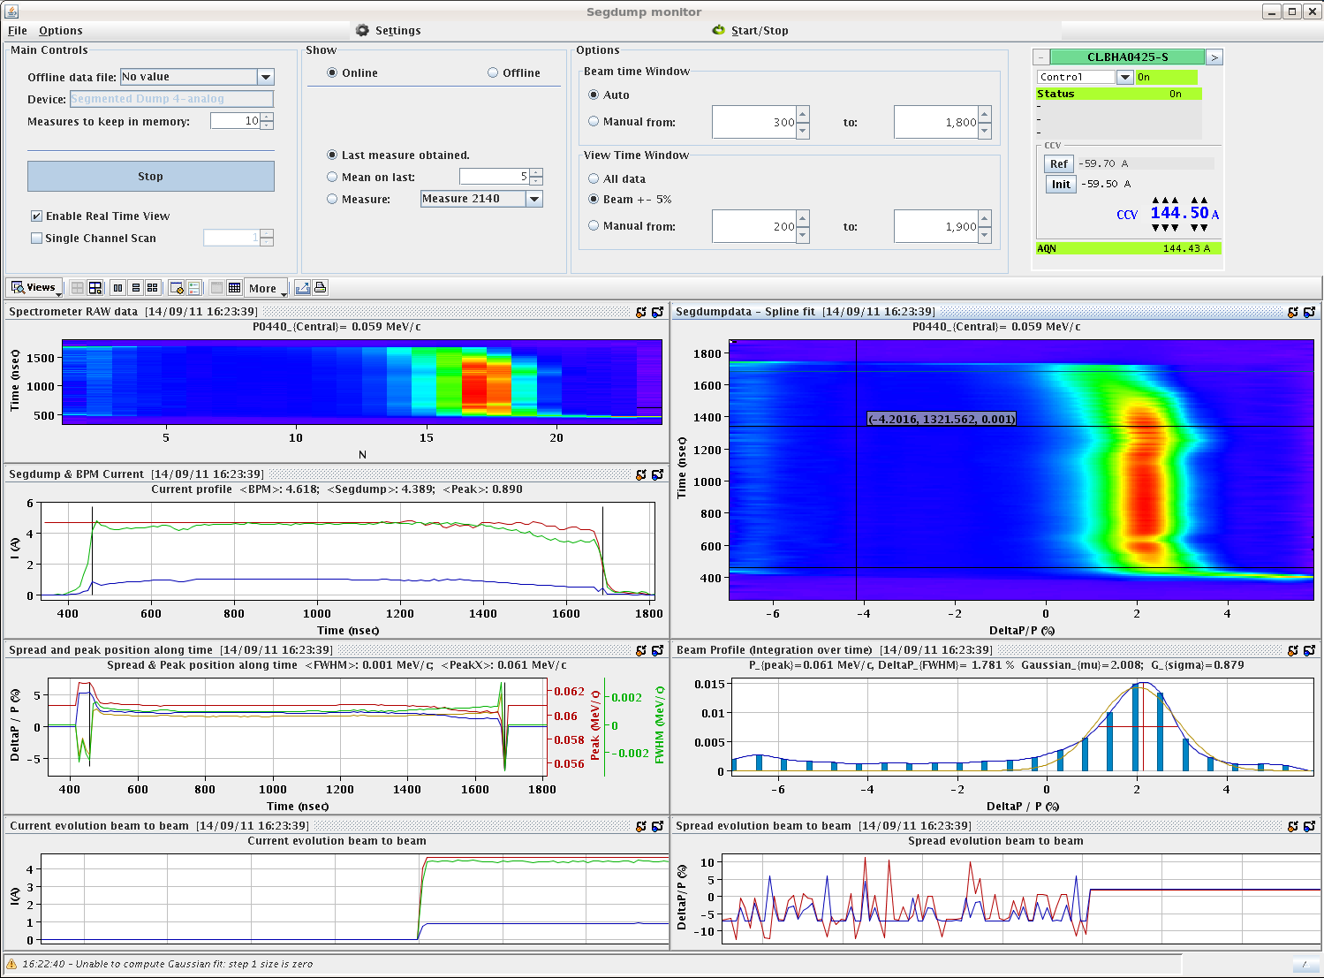
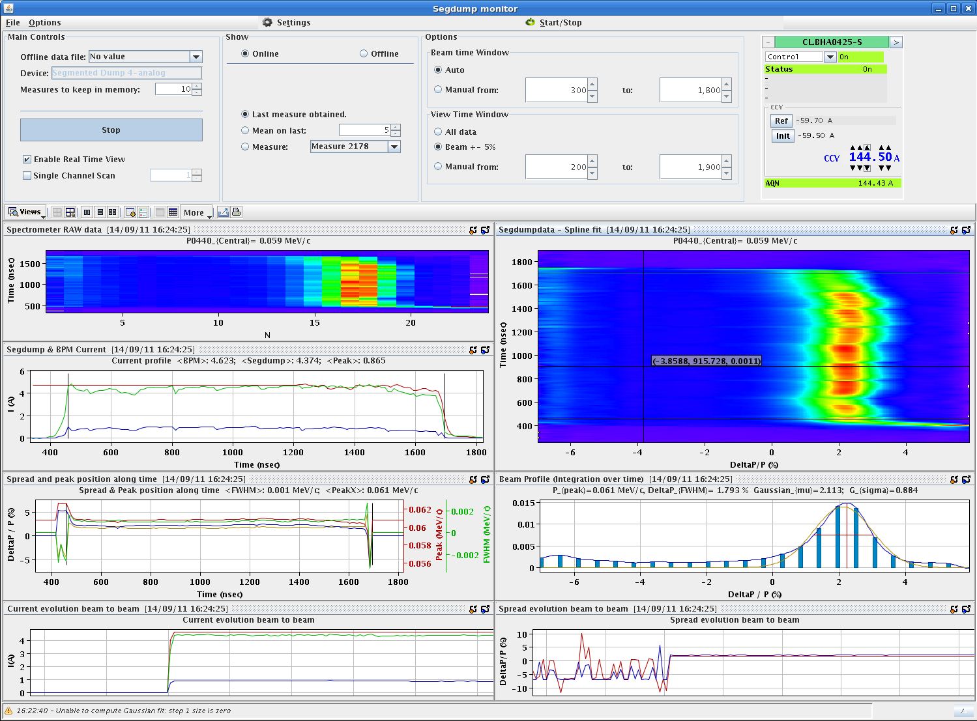
Compensation of phase switches
Switches
No switches
Frank Tecker, Piotr Skowronski

Slide 7
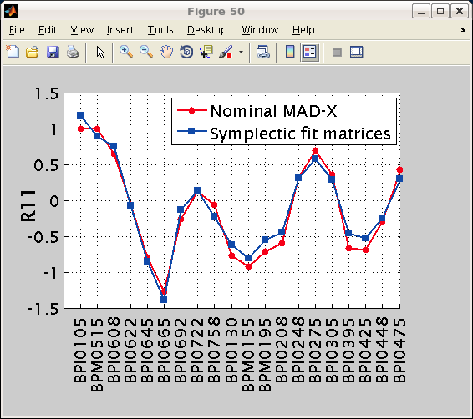
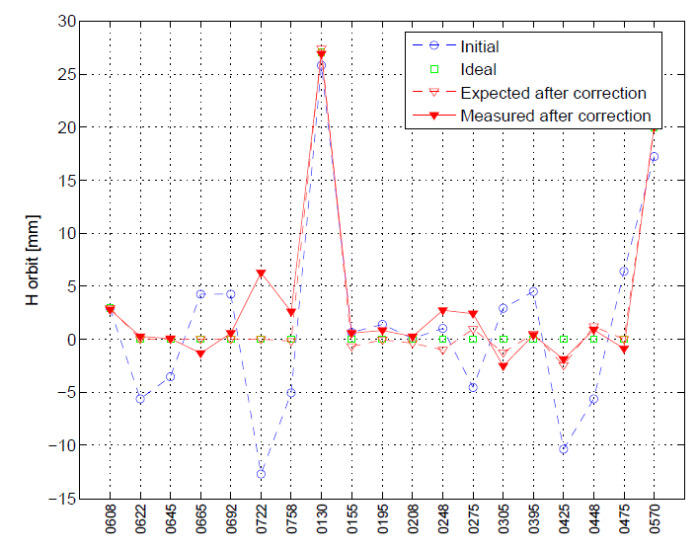
Optics studies, orbit correction
Model checks in CR
Guido Sterbini,
Ben Constance
Orbit correction in TL1 - CR
Ben Constance

Slide 8
Program for the rest of the year - I
PHIN run
☺
  Completed, good measurements on cathode lifetime
TERA experiment
☺
  Done within schedule, other 3 weeks planned at the beginning of 2012
Improve 1.5 GHz factor 8 beam
😐
  Delayed by manpower (LCWS 11 Granada), gun & klystron troubles, TWT availability
  Good improvements on beam current flatness from gun, compensation of phase switches, injector set-up
  Optics studies to increase acceptance under way. Improvements in DL &CR optics, CR closed orbit
TBL deceleration with 8 PETS for CDR
☺
  9 PETS installed instead of 8, first beam (3-4 A) transported – no major issues – start higher current tests today.
PETS On-Off ☺
  Installed – first tests (low current) positive, work as recirculation, fast conditioning > more later

Slide 9
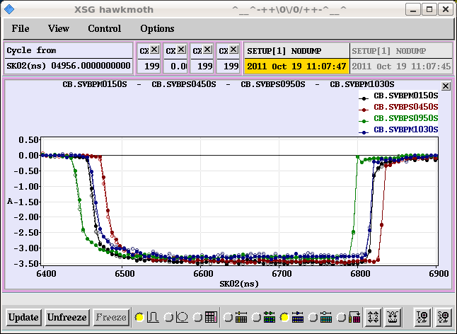
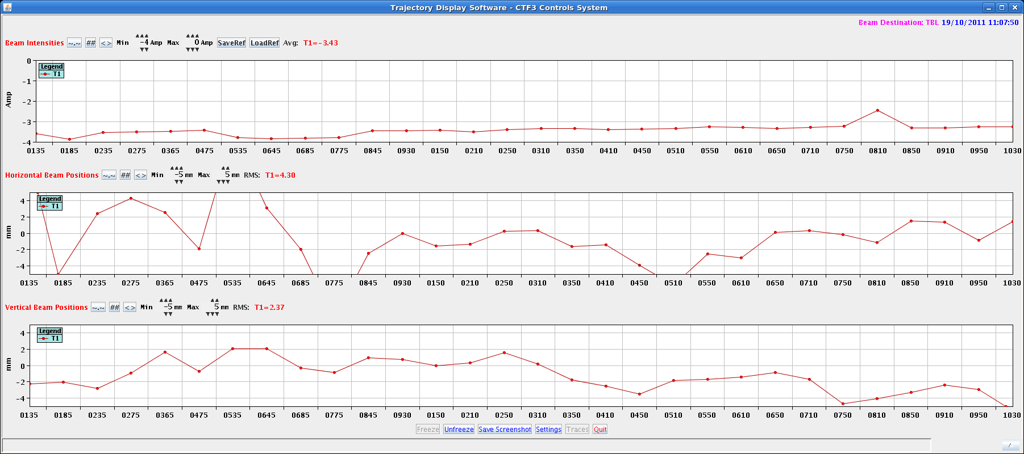
TBL with 9 PETS tanks
Steffen Doebert, Reidar Lillestol

Slide 10
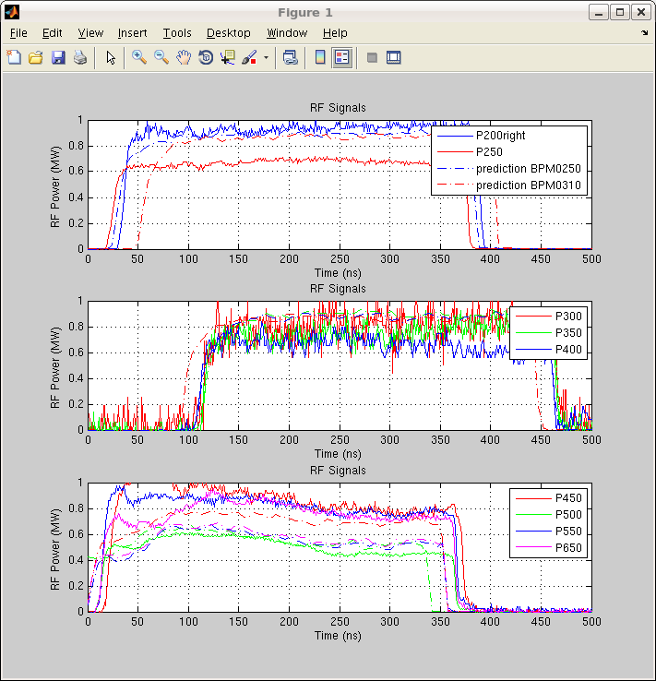
TBL with 9 PETS tanks
Reidar Lillestol

Slide 11
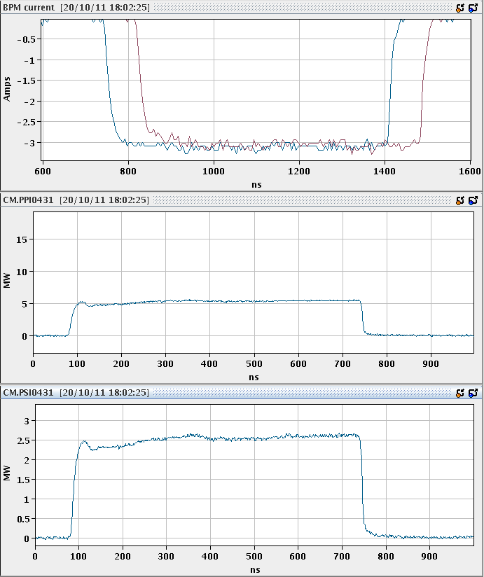
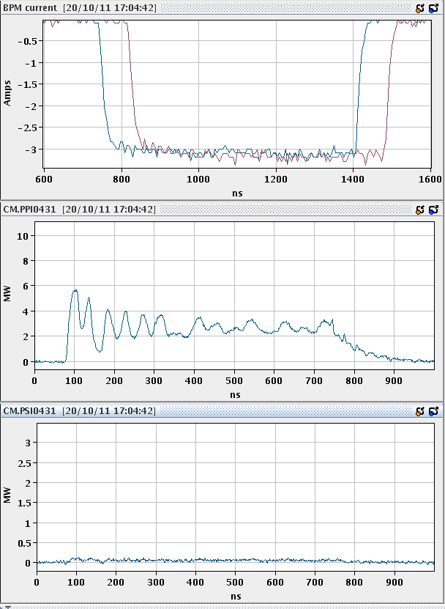
TBTS first operation with Petsonov
PETS On
PETS Off
Igor Syratchev, Alexei Dubrowski

Slide 12
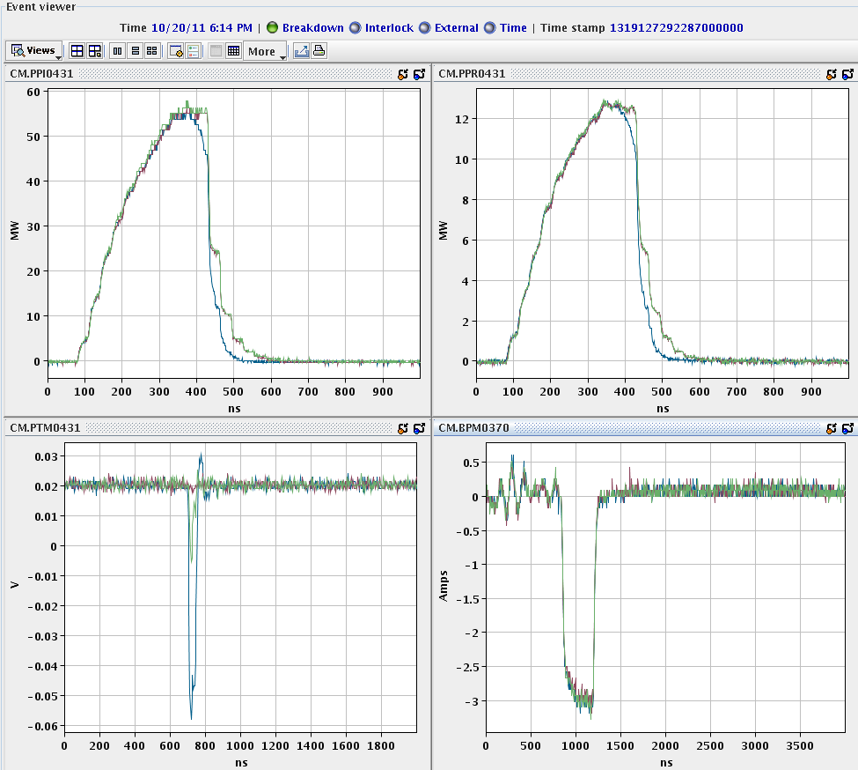
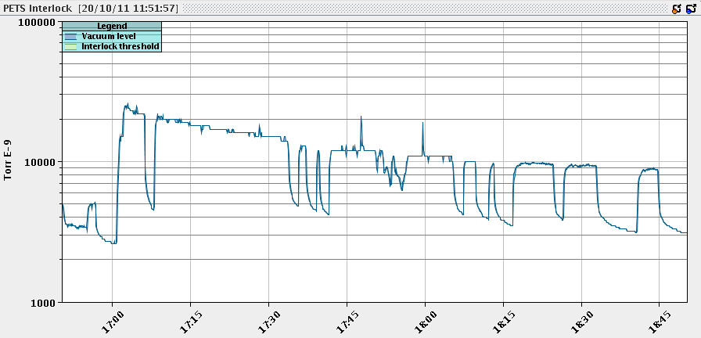
TBTS first operation with Petsonov
Igor Syratchev, Alexei Dubrowski
Petsonov used in recirculating mode
Conditioning - vacuum

Slide 13
Program for the rest of the year - II
Beam stability measurements at 3 GHz and 1.5 GHz 😐
  Several improvements in “slow” feed-backs, some more under way
  Still miss factor 8
Emittance and bunch length control 😐
  Will profit from optics/operational improvements, measurements still to be performed (December?)
Breakdown kick measurements 😐
  Preliminary results based on screen, BPM upgrade needed (measurements in December – continued in 2012)
Beam loading compensation for main beam ☹
  First tests, need good set-up before real tests

Slide 14
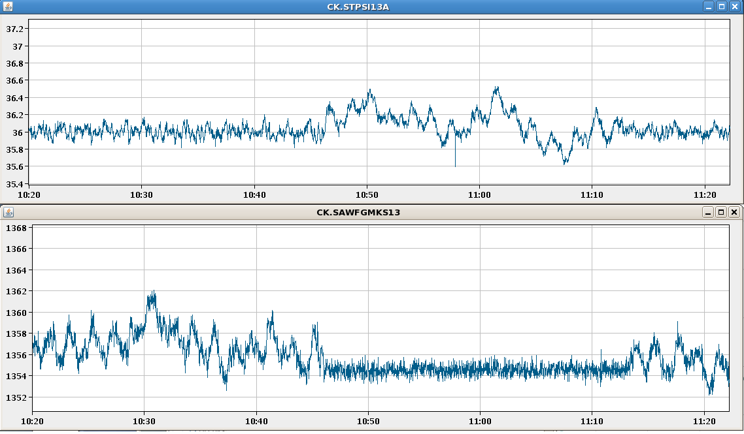
Feed-backs, stability
RF power feedback, MKS 13
[MW]
[arb]
Tobia Persson, Piotr Skowronski

Slide 15
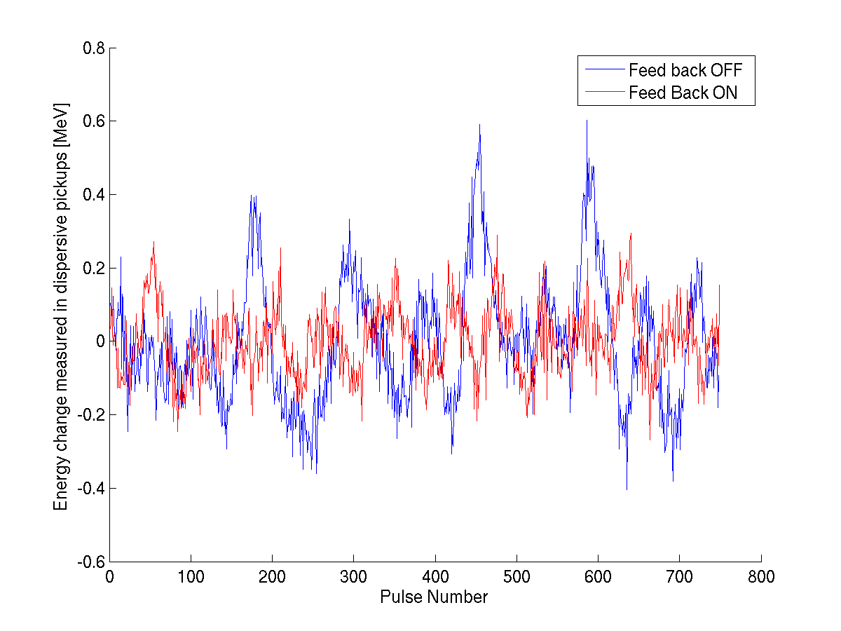
Feed-backs, stability
RF power feedback, effect on beam
Tobia Persson, Piotr Skowronski

Slide 16
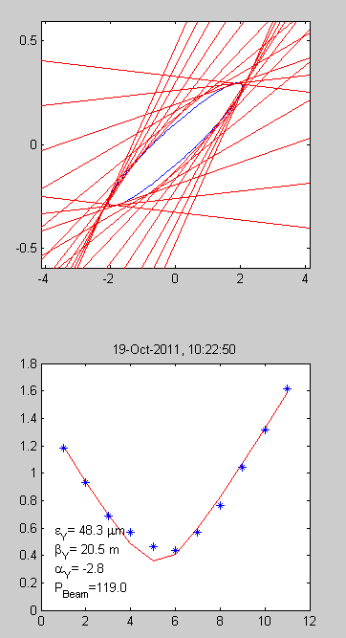
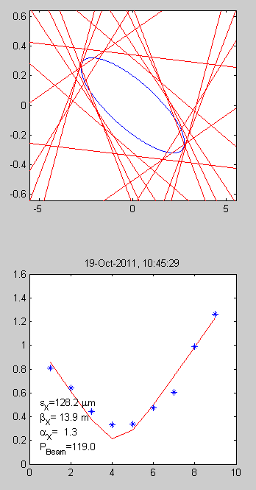
Emittance at TBL entry
Reidar Lillestol

Slide 17
Break-down kicks
Measured on OTR screen CA.MTV0790 (~4.9 m from the accelerating structure).
kick angle = 340 µrad
kick angle = 400 µrad
Andrea Palaia, Wilfrid Farabolini, Javier Barranco

Slide 18
CLIC Feasibility Benchmarks
CTF3
RF Test Stands
SLAC – KEK -CERN
Technical system tests and simulations
18

Slide 19
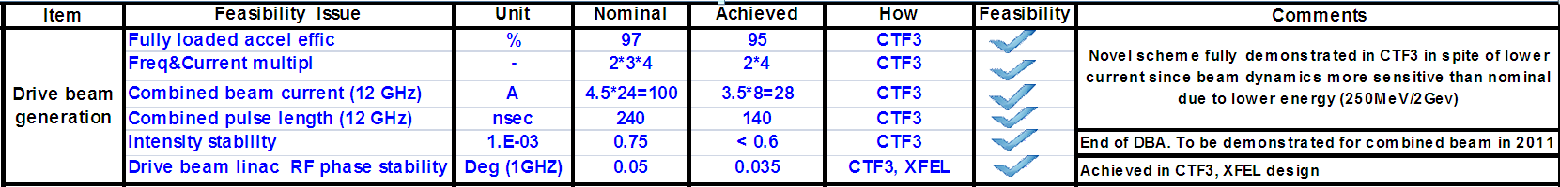
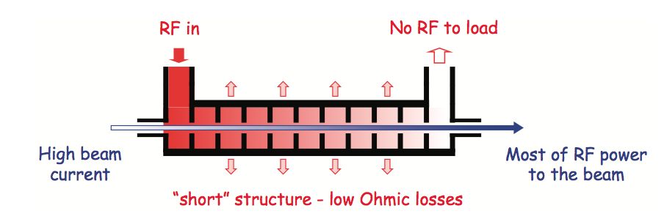
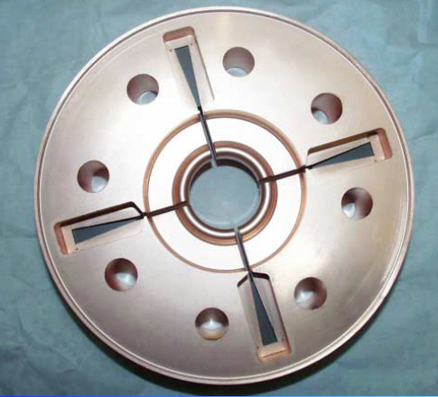
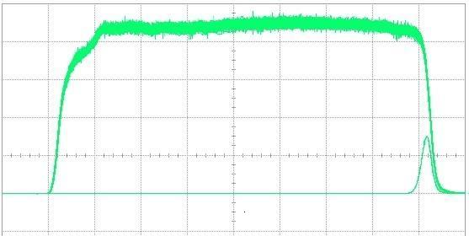
CTF3 Achievements – Drive Beam Generation
Dipole modes suppressed by slotted iris damping (first dipole’s Q factor < 20)
and HOM frequency detuning
damping
slot
MKS03
MKS05
MKS06
MKS07
Spectrometer 4
Spectrometer 10
SiC load
High current, full-loaded linac operation
95 % RF to beam efficiency measured
No instabilities
RF pulse at structure input
1.5 µs beam pulse
10 m
RF pulse at output

Slide 20
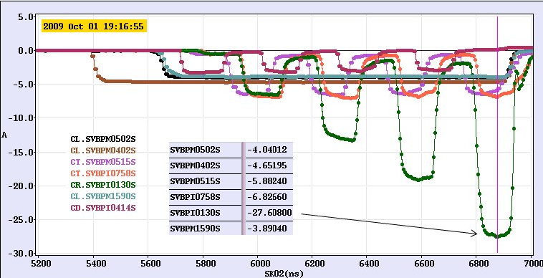
CTF3 Achievements – Drive Beam Generation
P
,
n
0
0
Transverse
Beam recombination
Factor 8 recombination by RF deflector injection
RF Deflector,
f
0
2
P
, 2
×
0
×
f
0
P
,
f
0
0
Deflecting
Field
November 2011

Slide 21
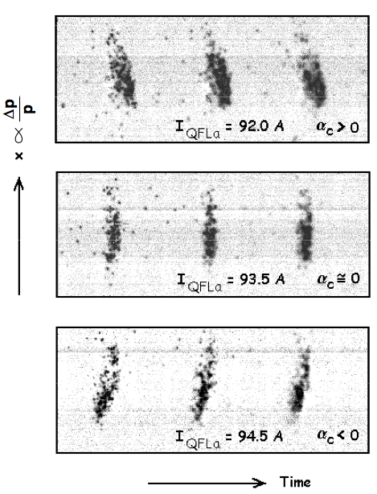
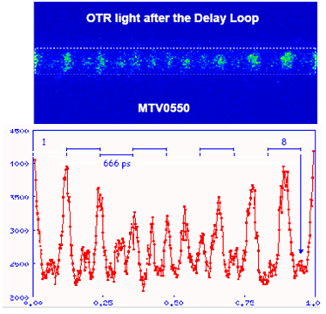
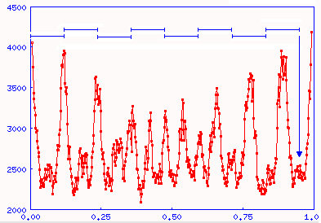
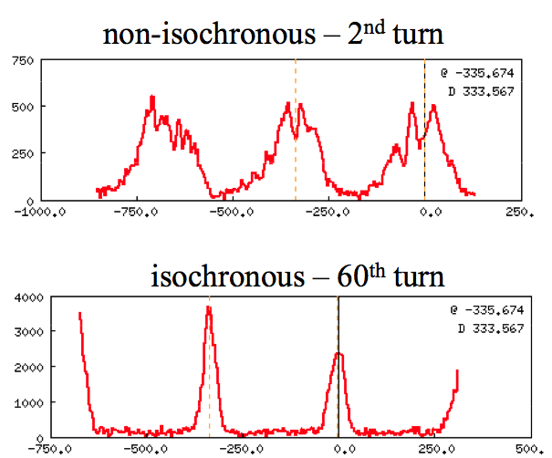
CTF3 Achievements – Drive Beam Generation
Beam recombination
Fast bunch phase switch in SHB system
Operation of isochronous rings and beam lines

Slide 22
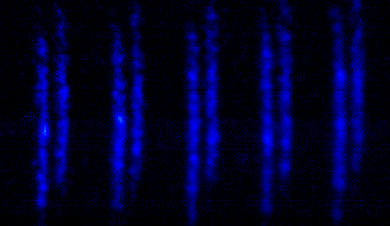
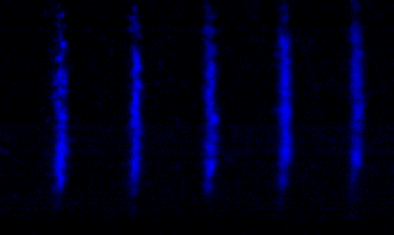
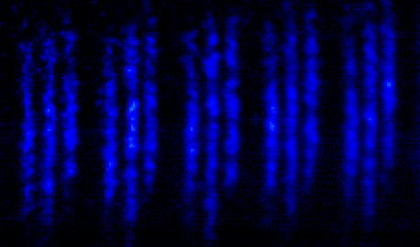
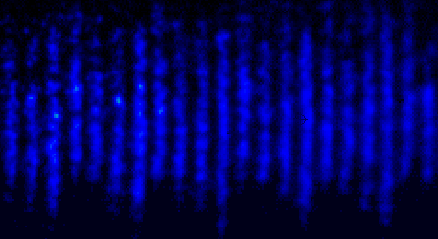
CTF3 Achievements – Drive Beam Generation
x
333 ps
83 ps
Streak camera image of the beam, illustrating the bunch combination process
t

Slide 23
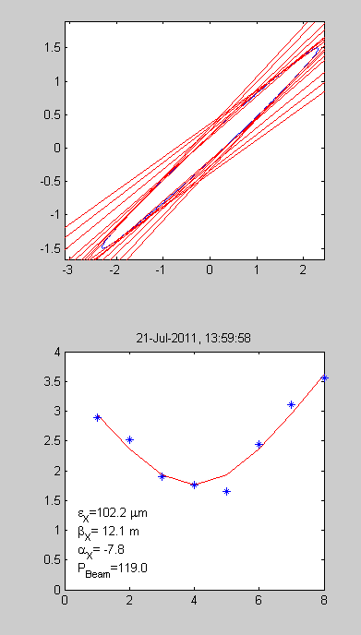
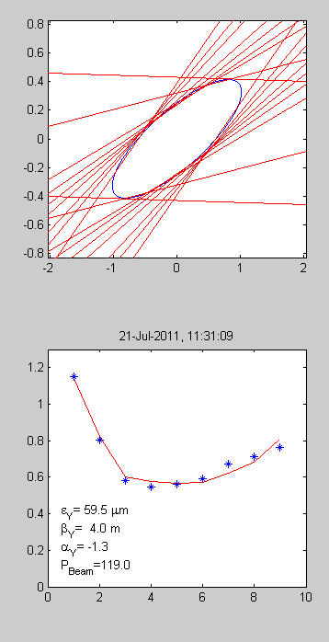
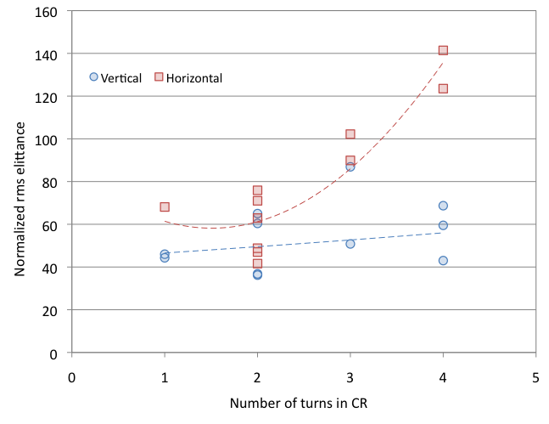
CTF3 Achievements – Drive Beam Generation
Beam recombination - Emittance
Different turns are ~ ok, no unknown effects
Some emittance increase due to non perfect combination
Best results in CLEX
for factor 4: ε_{Η}= 250 um ε_{V}= 150 um
for factor 8: ε_{Η}= 250 um ε_{V}= 150 um
Improve measurements
Correct dispersion (linear, nonlinear)
Correct multi-turn orbit
Control beta-beating
End 2011 ?

Slide 24
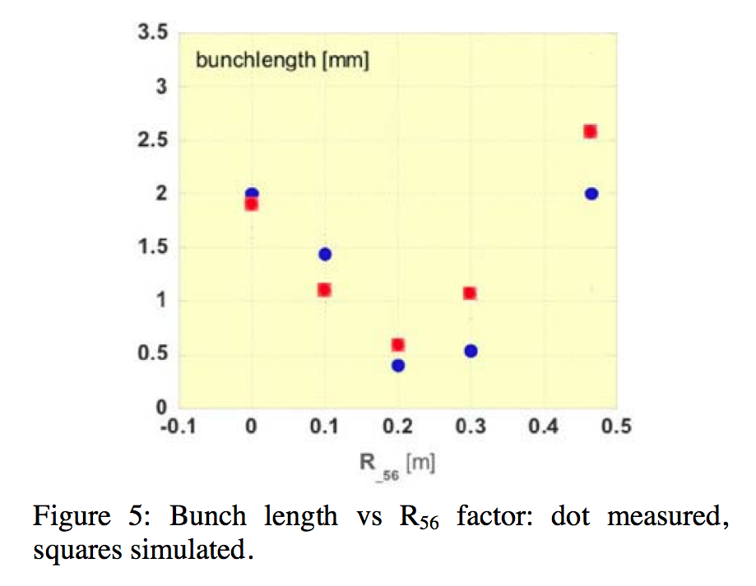
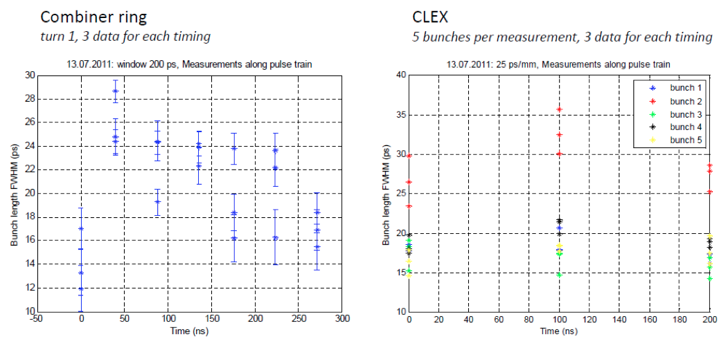
CTF3 Achievements – Drive Beam Generation
Beam recombination – Bunch lenght
nominal in CLEX 1 mm sigma
In the past, well below 1 mm sigma measured at the end of the linac (tuned chicane)
Recent results (preliminary): 1.5 to 4 mm sigma for CR and CLEX (natural chicane)
Improve measurements
Tune chicane to small R56
Measurements in CLEX
End 2011 ? Improve in 2012

Slide 25
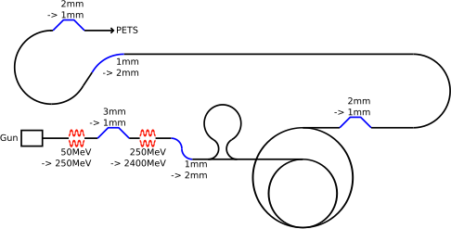
CTF3 Achievements – Drive Beam Generation
CLIC Drive Beam requirements
Emittance ε_{x,y} ≤ 150μm
Transverse jitter ≤ 0.3σ
Current stability 0.75 •10⁻³
Phase stability 0.2° @ 12GHz
Bunch length stability 1%
RF power stability 0.2%
RF phase stability 0.05°
Current stability 0.1%
Phase stability 2.5° @ 12GHz
0.2° @ 1GHz

Slide 26
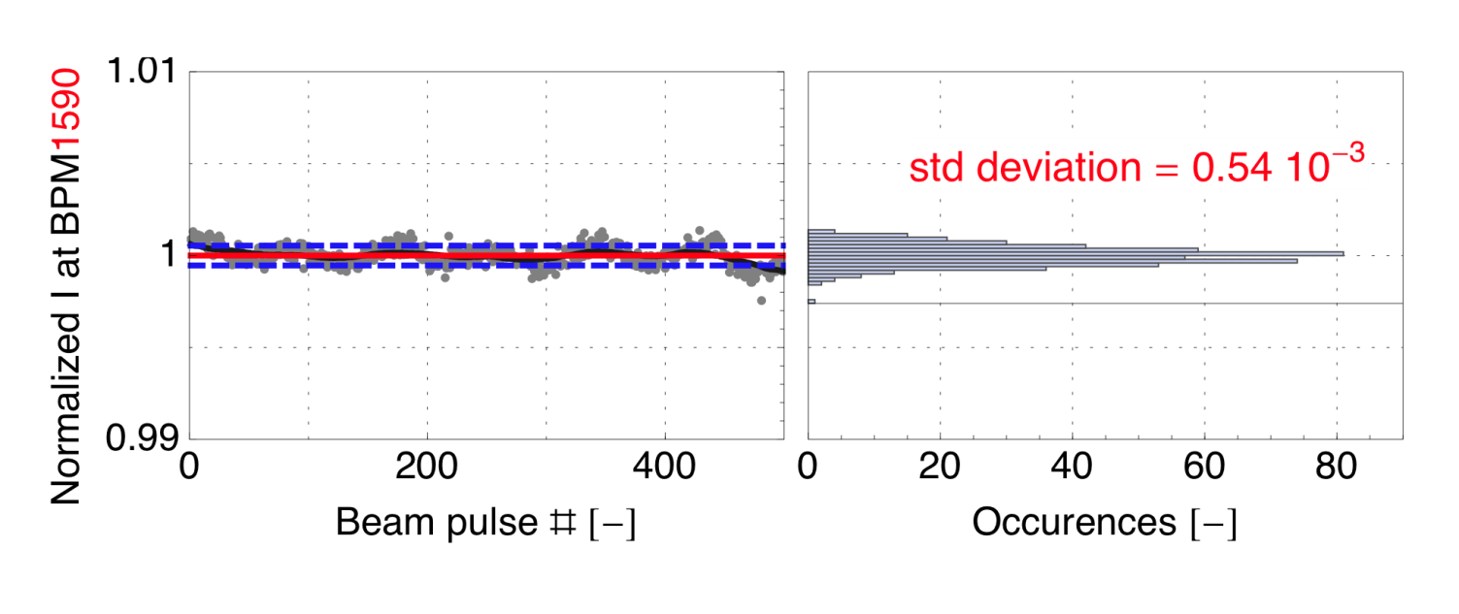
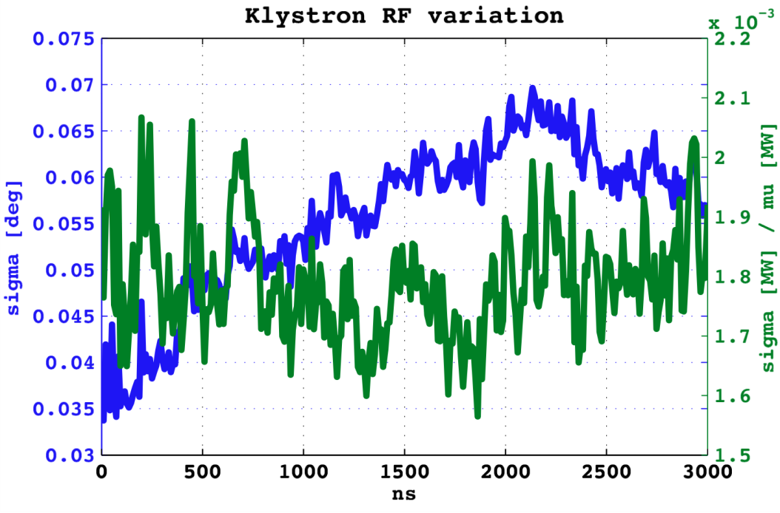
CTF3 Achievements – Drive Beam Generation
Pulse charge measured at end of the linac
After factor 8 combination
~ 1% jitter
“Good” CTF3 klystron
pulse-to-pulse jitter
10 ns time slices along the RF pulse
with respect to local phase reference
Improve and document current stability for combination factor 4
Improve stability for combination factor 8 – at the permil level
Means: improve acceptance (dispersion, orbit, beta-beating)
Reduce energy spread – bunch length
End 2011 – Mid 2012
 | Tolerance | Measured
Beam current | 0.075% | 0.054%
RF Power | 0.2% | 0.16% - 0.21%
RF Phase | 0.05° | 0.035° - 0.07°

Slide 27
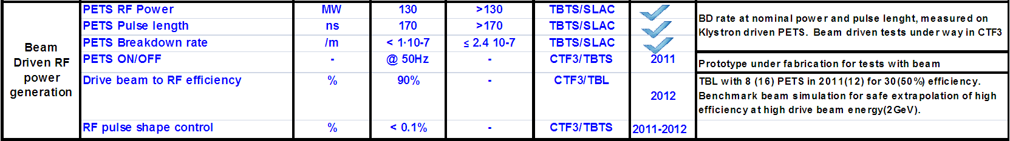
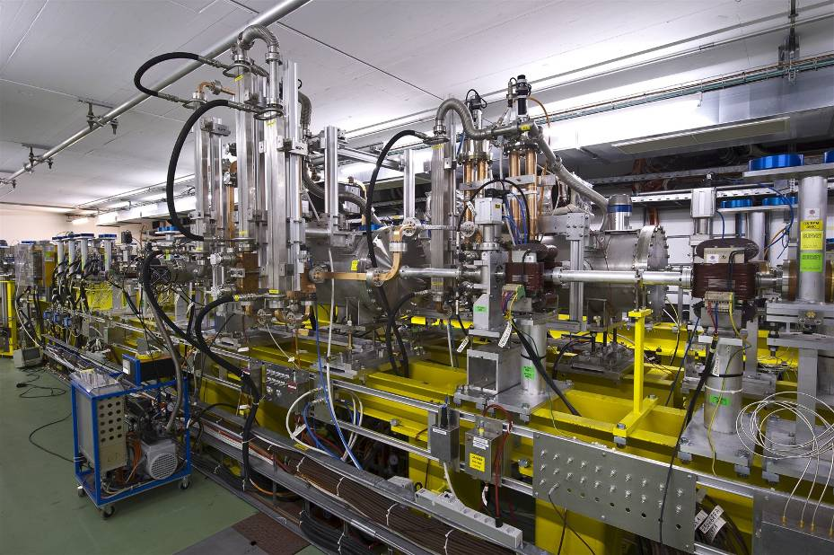
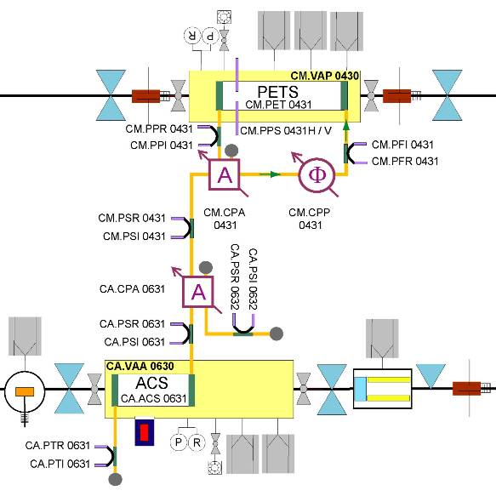
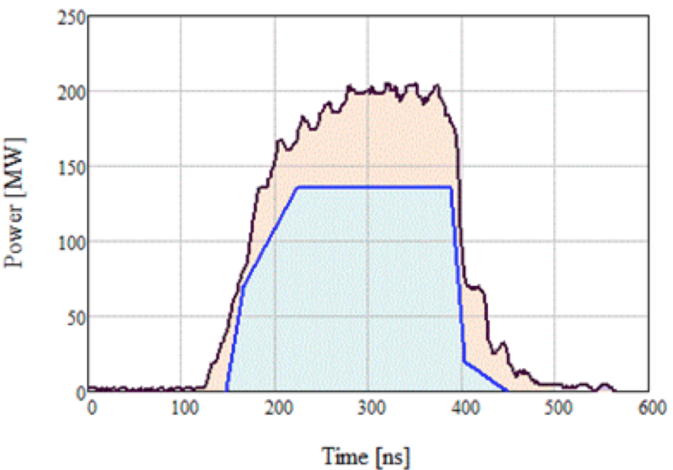
CTF3 Achievements – Beam driven RF power generation
Analyze data for evaluation of present break-down rate
Dedicated measurement at high powers – increased rep rate
Document
End 2011 – Mid 2012
PETS rapidly (~ 3 x 10⁵ pulses) reached record
>200 MW peak RF power level,
providing reliably pulses ~ 1o0 MW peak to accelerating structure.
About twice the power needed to demonstrate 100 MV/m acceleration in a two-beam experiment with TD24 structure.
Breakdown rate ?
CLIC target pulse
27

Slide 28
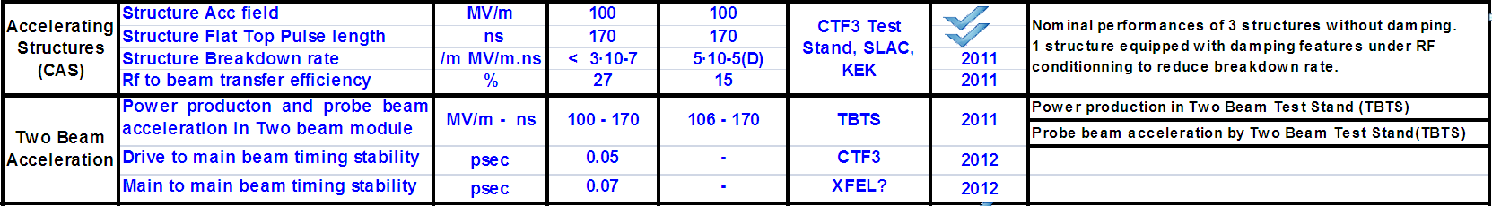
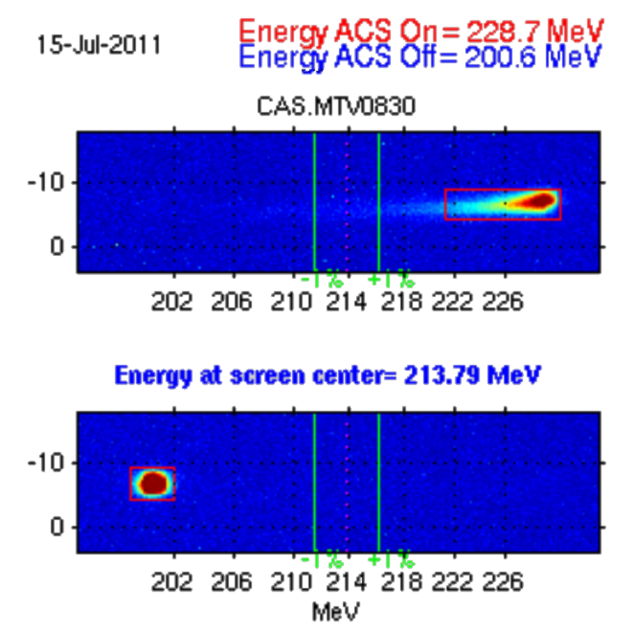
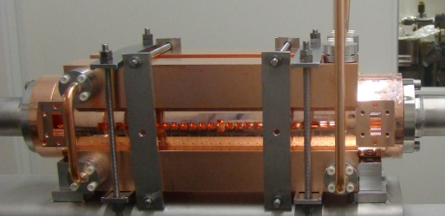
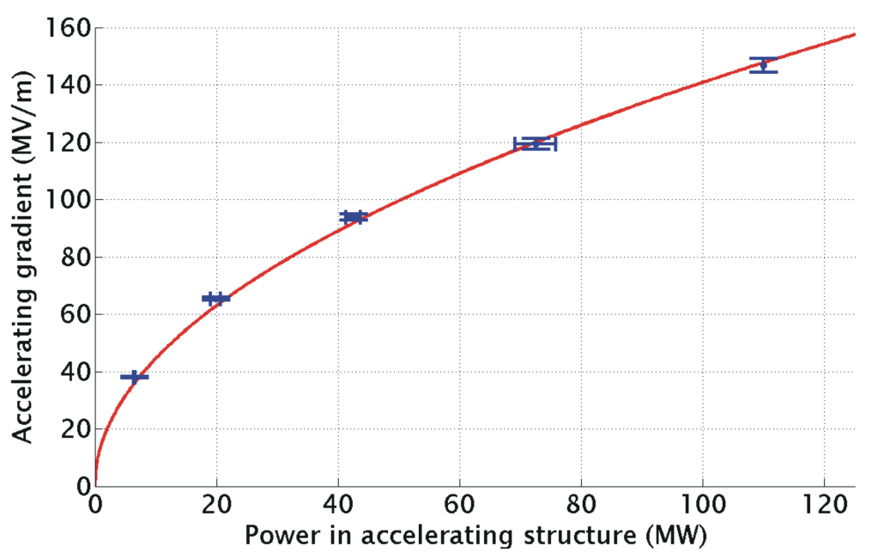
CTF3 Achievements – Two-Beam Acceleration
Two-Beam Acceleration demonstration in CTF3 Two-Beam Test Stand
TD24
Drive beam ON
Drive beam OFF
Maximum probe beam acceleration measured: 31 MeV
⇒ Corresponding to a gradient of 145 MV/m
28

Slide 29


CTF3 Achievements – Beam driven RF power generation
Issues:
Reliable power production
Ability to control output power
9 PETS – 20 A
November 2011
Conditioning
Initial test – no structure connected
Connect structure
Full test, including use as recirculation loop
End 2011 ?
On-off mechanism
Installation in CTF3 TBTS under way now.
Test starting from next week.
29

Slide 30

CTF3 Achievements – Beam driven RF power generation
Deceleration with 9 PETS, 20 A (end 2011)
Deceleration with 12 PETS, > 20 A (mid 2012)
Final test, 16 PETS (end 2012)
9 PETS – 20 A
November 2011
16 PETS maximum
4 PETS installed and tested
4 5 being installed in September
12 to 16 next year
Up to 19 A current
optics understood
no losses in TBL
Good agreement
power production
beam current
beam deceleration
30

Slide 31
CTF3 Achievements – Beam driven RF power generation
Beam loading compensation ramp
Create precise ramp by fine tuning of phase switches timing
Show control of ramp to the desired degree (limited by number of free parameters)
Eventually test acceleration with probe beam (short pulse, scan method)
CLIC target pulse
2012
Initial tests, end 2011
Eventual improvements/upgrades, shut down 2011/2012
Full test, including probe beam acceleration, mid/end 2012
31

Slide 33


CTF3 Achievements – Accelerating Structures
33

Slide 34




Accelerating Structure - Experimental results
Breakdown rate at 100 MV/m (unloaded) accelerating gradient and scaled to 180 ns pulse length
Measurements scaled according to
Damped
SLAC Tests
CTF3
Two-Beam
1st generation, moderate efficiency
2nd generation,
high efficiency
CERN built,
old procedure
Undamped
34

Slide 35
CTF3 Achievements – Accelerating Structures
Continue conditioning/BDR measurements of TD24 in the shadow of other experiments
Profit to improve power production stability/availability/rep rate
Continue BD kick measurements
Install couple of new structures, TD24 with wake-field monitors in winter shut-down 2011-2012
First module should go in during winter shut-down 2012-2013

Slide 36
CTF3 Achievements – Two-Beam Acceleration
See the previous WG session
(common AWG6-AWG8)
36

Slide 37
CTF3 achievements – Drive Beam
CTF3 Achievements – What is still missing for feasibility – Drive Beam Generation
Transverse rms emittance
100 π mm mrad (end of linac)
Ring isochronicity α_{p} < 10⁻⁴
Bunch length control
< 1 mm rms (end of linac)
Factor 2 combination
in Delay Loop
(from 3.5 to 7 A)
Control of ring length to better than 0.5 mm
Beam current stability
~ 0.1 % end-of-linac,
~ 0.2 % combiner ring
~ 0.05 % end-of-linac !
Bunch train recombination factor 4 in Combiner Ring (from 3 to 12 A)
Full beam loading (95% transfer)
high current acceleration (up to 5 A)
Bunch train recombination 2 x 4 in DL and CR (from 3.5 to 28 A)
Transverse rms emittance
< 150 π mm mrad (combined beam)
Bunch length control
< 1 mm rms (combined beam)
Beam current stability
~ 0.2 % for combined beam
Sub-Harmonic bunching with
fast (< 6ns) 180° phase switch
(8.5% satellites)
37

Slide 38
CTF3 achievements – Two-Beam issues
CTF3 Achievements – What is still missing for feasibility – TBL / TBTS / CALIFES
8 (12 > 16) PETS + spectrometer installed to verify transport of a 28 A beam with up to 30% of energy extracted.
Probe beam acceleration to 100 MV/m.
(up to 145 MV/m measured)
Beam-powered test of a PETS to nominal parameters (135 MW, 240 ns) with external recirculation (10 A) and without (20 A) – including probe beam
Improved power & drive beam energy loss measurements
Break-down kick measurements
PETS On-off mechanism demonstration
Drive beam phase
Beam-powered test of a PETS with external recirculation to 170 MW, <200 ns - ~10 A beam current
Power & drive beam energy loss measurements.
38

Slide 39




Two-Beam RF components
Two-Beam RF layout
Waveguide network
high power
precise phase length
PETS
high-power
as short as possible
low longitudinal and transverse impedance
Choke mode flange
independent alignment of main and drive beam
ON/OFF mechanism
Accelerating structure
high-gradient
as long as possible
micron precision
transverse wake-field suppression
On/ramp/off
necessary (?) to react to breakdown and/or failure
39

Slide 40



Power Extraction and Transfer Structure (PETS)
High power tests of the full PETS prototype (with damping material ) at ASTA/SLAC
PETS installed into the ASTA test area at SLAC
Typical RF pulse shape in ASTA during the last 125 hours of operation
SiC load
No breakdown during the last 80 hours
BDR <2.4 10-7/pulse/m
CLIC target pulse
August 2010
133 ns
266 ns
PETS/ASTA processing period
BD statistics accumulation period
(fixed power level)
CLIC target
Peak power
Avg power
Energy
BD
40

Slide 41
Key Design Issues
Main linac gradient
Accelerating structure
Drive beam scheme
Drive beam generation
Power extraction and drive beam deceleration
Two beam module
Luminosity
Main beam emittance generation and preservation
Focusing to nanometer size
Alignment and stabilisation
Operation and Machine Protection System (robustness)
Detector (experimental conditions)
Design and feasibility issues will be covered in
CLIC Conceptual Design Report
In time for European strategy group
Volume 1: Accelerator
Volume 2: Physics and experiments
Volume 3: Executive summary
41

Slide 42
The CLIC RF Power Source Concept
CLIC RF Power Source Layout
Delay Loop × 2
gap creation, pulse compression & frequency multiplication
Drive Beam Accelerator
efficient acceleration in fully loaded linac
RF Transverse Deflectors
Combiner Ring × 3
pulse compression &
frequency multiplication
Combiner Ring × 4
pulse compression &
frequency multiplication
Drive Beam Decelerator Section (2 × 24 in total)
Power Extraction
Drive beam time structure - initial
Drive beam time structure - final
240 ns
240 ns
5.8 μs
140 μs train length - 24 × 24 sub-pulses
4.2 A - 2.4 GeV – 60 cm between bunches
24 pulses – 101 A – 2.5 cm between bunches
42

Slide 43


CLIC Test Facility (CTF3)
CTF3 – Layout
DELAY
LOOP
4 A – 1.2 μs
150 Mev
COMBINER
RING
DRIVE BEAM
LINAC
28 A – 140 ns
150 Mev
10 m
CLEX
CLIC EXperimental Area
Two-Beam Test Stand (TBTS)
Test Beam Line (TBL)
Scaled model of CLIC RF power source - built partly re-using existing infrastructure
Made it affordable
Different parameters – in some cases issues more difficult than in CLIC
43

Slide 44
CLIC Test Facility (CTF3)
What do we learn in CTF3, relevant for the CLIC RF power source ?
A non-exhaustive list ☺ easier ☹ more difficult
System quantity/issue CTF3 CLIC
Injector/linac bunch charge 2-3 nC 7.7 nC
current 3.5 - 4.5 A 4.2 A
pulse length 1.4 μs 140 μs
phase coding same
frequency 3 GHz 1 GHz
transverse stability about the same - CTF3 ``too stable ´´
Delay loop/ring final current 30 A 110 A
beam energy 150 MeV 2.4 GeV
combination 2 - 4 2 - 3, 4
CSR, wakes worse in CTF3 (lower energy)
Deflector instability about the same
Power production (PETS) Aperture 23 mm 23 mm
Length ≈ 1 m 23 cm
Power > 135 MW 135 MW
Pulse length 140 ns (240 with recirculation) 240 ns
Decelerator Fractional loss 50-60 % 90%
Final energy 70 MeV 240 MeV
wakes, stability somehow ``masked´´ in CTF3
beam envelope much larger in CTF3
In general, most of unwanted effects are equivalent or worse in CTF3 because of the low energy, however in CLIC the beam power is much larger (heating, activation, machine protection)
Needed tolerances on the final drive beam parameters (phase, current, energy stability...) are more stringent in CLIC – some could be demonstrated in CTF3 as well

