Slide 1
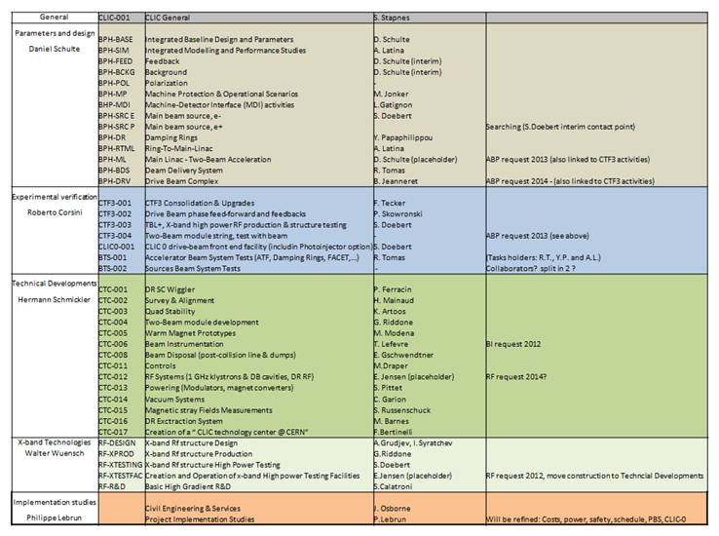
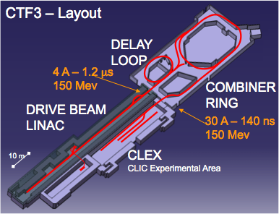
CLIC space requirements
We use many facilities but the main one at CERN is CTF3:
Today we look for space for key activities (in terms of resources 30-40% of the program )

Slide 2
High Power structure testing facility
~ 30m
160 MW
6 MW
50 MW
1GHz klystron area
Control room
Rack space
Storage space
~ 25 m
160 MW

Slide 3
High Power structure testing facility
Aim to perform a large number of structure high power tests per year to enable CLIC structure optimization and industrialization
Space needed: 25 x 30 x5 m Height needed ~5 m,
Crane for klystron manipulation would be desirable
Temperature controlled demineralized cooling water for klystrons and structures
Shielding enclosures for structures, radiation area (klystrons)
Electrical power, 400 V, ~ several 100 kW ?
Schedule: Area preparation 2012, first test stand 2012/2013
Similar installations exists already in SM18 for example
Possible options: SM18, 175,156, 112,185

Slide 4
CLIC DB injector
schematics
Solenoids
Thermionic gun
SHB
Prebuncher
Buncher
Accelerating cavity
6 MeV
Slit
26 MeV
53 MeV
Documented in the CDR; a scaled version of CTF3

Slide 5
CLIC DB injector test facility
~ 10 m
MOD
MOD
MOD
MOD
KLY
KLY
KLY
KLY
~ 10 m
Bunker ~3m concrete
~ 4 m
~ 50/80 m
Access system
Rack space for electronics and power supplies
Rack space for electronics and power supplies
~ 6 m
CLIC 0: ~ 400 m

Slide 6
CLIC DB injector test facility
Aim to develop and test realistic CLIC hardware and perform beam stability studies at nominal beam power
Space needed: 50 x 30 x10 m if possible extendible to ~80 m length Height needed ~10 m
Option: Tunnel with equipment gallery
Crane for manipulation of heavy equipment, concrete blocs, klystrons, accelerating structures
Temperature controlled demineralized cooling water for klystrons, structures and magnets
Shielding enclosures for linac with access control, radiation area (tunnel, klystrons)
Electrical power, 400 V, ~ 1-2 MW for full installation ?
Schedule: Area preparation 2012, first installation 2013, more space needed >2016
How about some space around the ISR, TT1 tunnel

Slide 7
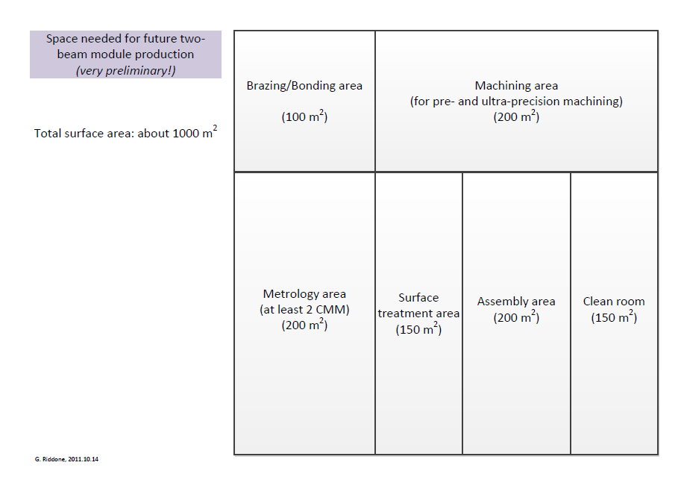
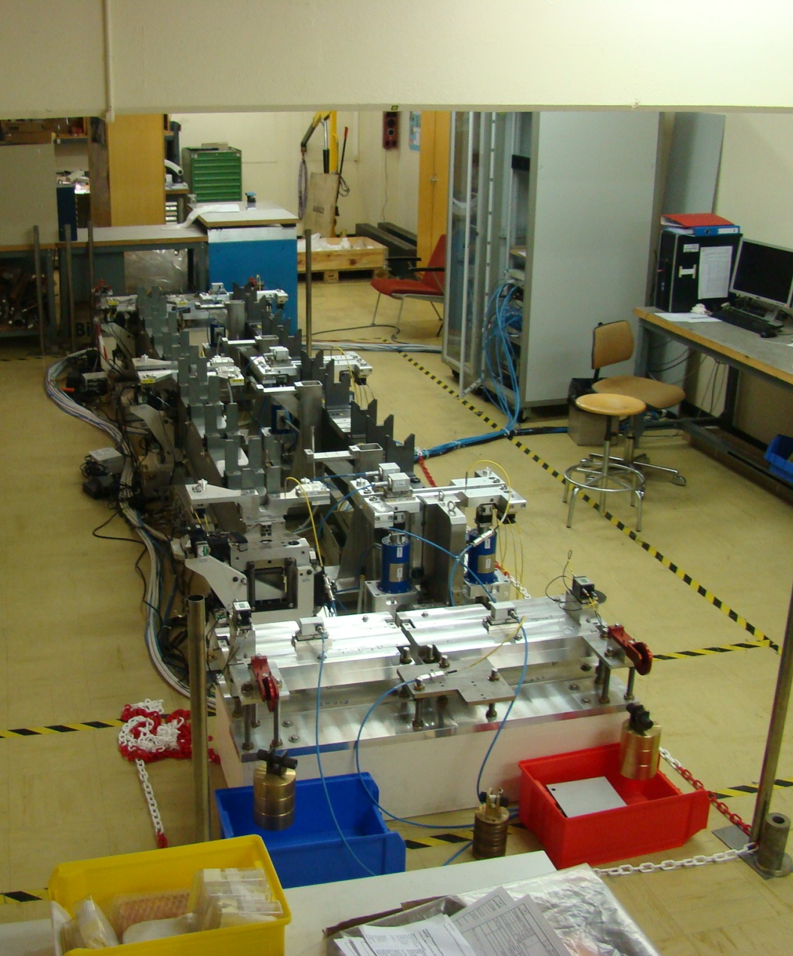
Space needs for future two-beam module production

Slide 8
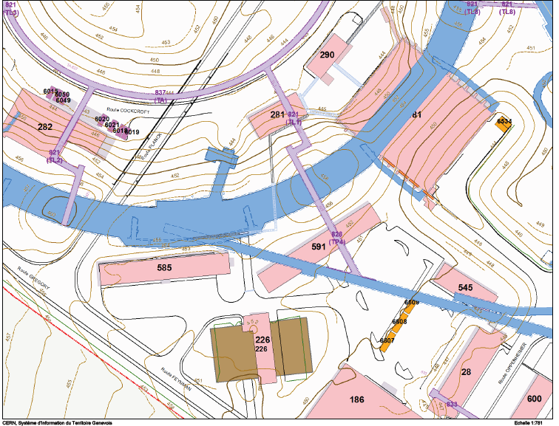
Option for the CLLIC DB injector in the TT1 tunnel

Slide 9
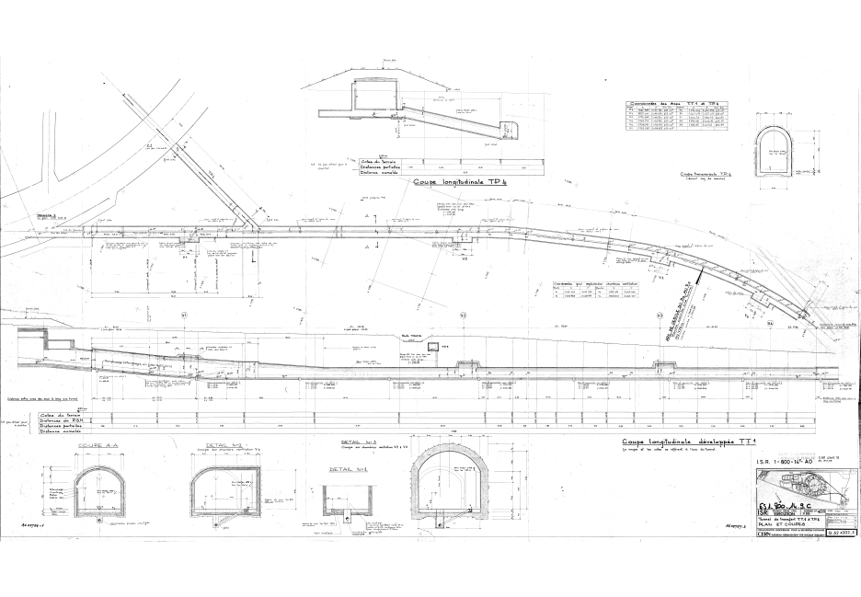
Option for the CLLIC DB injector in the TT1 tunnel

Slide 10
Conclusion
Space need identified and active research started
Department space officers involved
No concrete results so far, closer look into TT1 and Bldg 185

