Slide 1
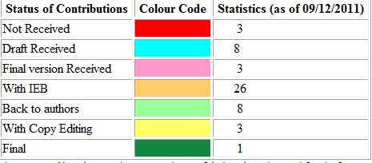
CDR Status information
9.12.2011
http://project-clic-cdr.web.cern.ch/project-CLIC-CDR

Slide 2
Issues/Observations
- increased editorial board (IEB)..actively working
- extra help organized for final copy editing...can start on first documents
→ Quality of figures in many cases not sufficient...will need extra effort
- try to use project meeting this Friday to chase missing contributions
- provided the authors play the game, we can meet the March deadline, but big competition with “5 years plan” and cost review
- will need one more person for text processing (= need another Texpert)
- trying to get yellow report numbers assigned for both volumes 2 and 1
- cover layout with be mostly “standard yellow” with a centre rectangle on the front cover for free styling
- author list effort handled by editors of volume 2
- question came up: Executive summary (5-8 pages) of volume 1?

