Slide 1
CLIC project (accelerator) work-packages
Status 9-12-2011
Very active process presently...collides with efforts on CDR (same people)
Workflow as follows:
Workpackages defined, responsible people nominated, first “top-down” resources estimates done until October 2011
3./4. November: Collaboration workshop at CERN: got a global picture on what resources can be expected from outside CERN
Workflow presented in A&T group leader meetings
Matrix: WPs-A&T groups defined; one responsible for each group defined:
mandate: a) understand and document all requests of resources for group
b) get a refined resource estimate and resource planning for GLs.
→ a) large fraction done; b) will have to wait for January 2012
expect in the course of January feedback from GLs (in an APT compatible format)
- will organize a final prioritization and planning event within the CLIC study
CLIC study could meet the deadline of having resource planning for 5 years in APT by February 2012.... Will be very tough

Slide 2
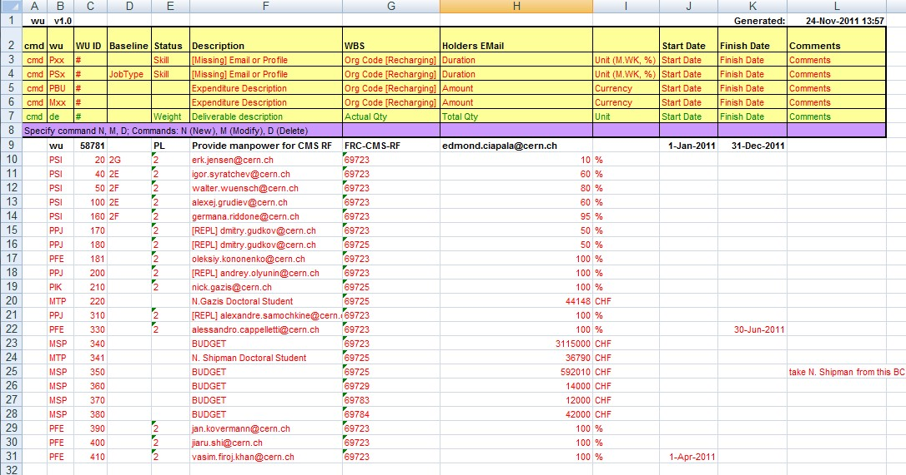
Proposed organization:
- Three “green cross” meetings for follow up:
- 11th January 2012
- 1st February 2012
- 15th February 2012 with the DPOs of BE, TE, EN,GS
For each group the CLIC resources plan will have to be documented in an APT compatible format. Template and explanations during the first meeting:
For a few workpackages we will set up EVM follow up; but not for February

