Slide 1

ECR/Documents for Information and Approval
Giulia Romagnoli and Natalya Kahn for BE-EA, 2024-05-21
EA Documents - Agile Board - CERN Central Jira

Slide 2
LIST OF DOCUMENTS for Info
FOR INFORMATION EATM
Summary | Reporter | EA Projects | EDMS number | EDMS Status
Feasibility study - BA80 (899) | David Rodriguez Gomez | North Area, NACONS | 3024192 – SPSX-J-RPT-0008 | Released
Feasibility study - BA81 (890) | David Rodriguez Gomez | North Area, NACONS | 3024194 – SPSX-J-RPT-0009 | Released
Feasibility study - BA82 (891) | David Rodriguez Gomez | North Area, NACONS | 3024196 – SPSX-J-RPT-0010 | Released
Feasibility study - EHN2 (888) | David Rodriguez Gomez | North Area, NACONS | 3024198 – SPSX-J-RPT-0011 | Engineering check
Feasibility study - ENH1 (887) | David Rodriguez Gomez | North Area, NACONS | 3086161 – SPSX-J-RPT-0012 | Engineering check
Feasibility study - CT2 (893) | David Rodriguez Gomez | North Area, NACONS | 3086162 – SPSX-J-RPT-0013 | Engineering check
Feasibility study - BB81 (895) | David Rodriguez Gomez | North Area, NACONS | 3086163 – SPSX-J-RPT-0014 | Engineering check
Feasibility study - BX80 (902) | David Rodriguez Gomez | North Area, NACONS | 3086165 – SPSX-J-RPT-0015 | Engineering check
Feasibility study - BX82 (906) | David Rodriguez Gomez | North Area, NACONS | 3086166 – SPSX-J-RPT-0016 | Engineering check
Feasibility study - PA852 (911) | David Rodriguez Gomez | North Area, NACONS | 3086167 – SPSX-J-RPT-0017 | Engineering check
Feasibility study - PP851 (912) | David Rodriguez Gomez | North Area, NACONS | 3086168 – SPSX-J-RPT-0018 | Engineering check

Slide 3
LIST OF DOCUMENTS for Info
FOR INFORMATION EATM
Summary | Reporter | EA Projects | EDMS number | EDMS Status
Feasibility study - BX83 (918) | David Rodriguez Gomez | North Area, NACONS | 3086173 – SPSX-J-RPT-0019 | Engineering check
Thermo-mechanical Assessment and Possible Design Modifications of the NA XTAX-T4 for the High-Intensity Beam Delivery to ECN3 | Alvaro Romero | North Area, NACONS | 3028077 – SPSX-T-NOT-0001 | Released
FEM analysis of the T4 Target for the ECN3 high intensity scenarios | Calum Sharp | North Area, NACONS | 2812842 – SPSX-T-NOT-0002 | Released
FEM analysis of the T4 XTAX for the ECN3 high intensity scenarios | Alvaro Romero | North Area, NACONS | 2812843 – SPSX-T-NOT-0003 | Released
FEM analysis of the beam windows in T4 for the ECN3 high intensity scenarios | Alvaro Romero | North Area, NACONS | 2812844 – SPSX-T-NOT-0004 | Released
Consolidation of the Beam Intercepting Devices Cabling and Controls of the North Experimental Area | Jérôme Lendaro | North Area, NACONS | 2488118 – SPSX-C-WD-0001 | Engineering check
North Area Beam Instrumentation Consolidation Type: NA-CONS Groups: BE-BI & EN-EA | Jocelyn Tan | North Area, NACONS | 2206350 – SPSX-B-WD-0003 | Released
Consolidation of North Area Beamline Magnets | Philip Schwarz | North Area, NACONS | 2710129 – SPSX-M-WD-0001 | Released
Integration of the North Experimental Area | Michael Lazzaroni | North Area, NACONS | 2488117 – SPSX-LJ-WD-0001 | Engineering check
Fire Detection, Protection, and Voice Alarm Systems for SPS North Area Underground Facilities | Rachid Haddad | North Area, NACONS | 2476161 – SPSX-SF-WD-0001 | Under Approval

Slide 4
LIST OF DOCUMENTS for Info
FOR INFORMATION EATM
Summary | Reporter | EA Projects | EDMS number | EDMS Status
Sprinkler Systems in the North Area – Consolidation Work Package Description | Anna Suwalska | North Area, NACONS | 2476161 – SPSX-SF-WD-0005 | Under Approval
North Area Consolidation - 4.5 Electrical and Fibre Infrastructure Work Package Description | Eva Cano Gonzalez | North Area, NACONS | 2669639 – SPSX-E-WD-0002 | Under Approval
Mandate of the Planning Officer of the NA-CONS Project | Deepti Kandhol | North Area, NACONS | 2458833 – SPSX-PM-MG-0003 | Under Approval
BCR Template | Yacine Kadi | North Area, NACONS | 3084731 | Under Approval
User Requirements for the XCSH/V, XCHV and XCBV Collimators | Nikolaos Charitonidis | North Area, NACONS | 2742301 – SPSX-TC-ES-0004 | Released
Asset Replacement Request - MSN.X0220031 | Philip Schwarz | North Area, NACONS | 2997649 – SPSX-M-ARR-0001 | Released
Comparative Analysis of Motor XTAX Design Concepts: A Preliminary Reliability and Dose Rate Study | Iasonas Chatzigeorgiou | North Area, NACONS | 2931313 – SPSX-T-ER-0003 | Released
Installation d'un Contrôle d'Accès Provisoire à la Porte YDPZ01.853=BX83 | Fernando Pedrosa | North Area, NACONS | 2967321 – SPSX-S-PRD-0001 | Under Approval
Assessing Jaw Apertures and Faults in Magnetic Collimators (XCM) at M2 Beamline through Measurements | Jan Buesa Orgaz | North Area, NACONS | 3069473 – SPSX-TC-OP-0001 | Under Approval
TDC2-TCC2 Cable Exposure Analysis | Fernando Pedrosa | North Area, NACONS | 3071544 – SPSX-E-ES-0001 | Released

Slide 5
LIST OF DOCUMENTS for Info
FOR INFORMATION EATM
Summary | Reporter | EA Projects | EDMS number | EDMS Status
Safety Analysis of the Cherenkov Counters (XCET) of the Neutrino Platform Beamlines | Jan Buesa Orgaz | North Area, NACONS | 2718341 – SPSX-X-SSR-0001 | Under Approval
Thermal conductance calculation thermal housing | Yannis Fiamingo | North Area, NACONS | 2930472 | Released
Replacement of AD Target Sub-Assembly PXTARH_060 and PXTARAD003 | Edouard Grenier-Boley | AD | 3024759 – AD-TARAD-PRD-0002 | Released
Replacement of AD Horn Sandwich Line PXTHOR_001 and PXTHOR_002 | Edouard Grenier-Boley | AD | 3024760 – AD-THOR-PRD-0007 | Released
Asset Replacement Request - DI.HOR6000 | Edouard Grenier0-Boley | AD | 3000232 – AD-THOR-ARR-0001 | Released

Slide 6
LIST OF DOC for FUTURE APPROVAL
ECR INFO/FUTURE APPROVAL EATM
Summary | Reporter | EA Projects | EDMS number | EDMS Status
Smoke Detector in EHN1 Galleries | Michael Jeckel | North Area – NACONS | 3072500 – SPSX-SF-EC-0008 | Engineering check
BA80 Fire Detection Equipment | Florian Andre Deperraz | North Area – NACONS | 2997829 - SPSX-SF-EC-0005 | Under Approval
Shielding Improvement for the High Intensity Hadron Operation of M2 | Dipanwita Banerjee | North Area | 2868386 - SPSX-J-EC-0002 | Engineering check
User Requirement for the XABS Absorbers in M2 Line in North Area | Dipanwita Banerjee | North Area – NACONS | 3012379 – SPSX-T-ES-0007 | In Work
User Requirements for XTAX Absorbers in North Area Beamlines | Miguel Lino Diogo Dos Santos | NACONS, Equipment | 2747997 - SPSX-T-ES-0003 | In Work
Replacement of Big Vertical Collimator XCBV on M2 Beamline in TT84 | Giulia Romagnoli | North Area – NACONS | 2976670 - SPSX-TC-EC-0002 | Under Approval
Installation of XCET Detectors in Neutrino Platform NP02 and NP04 | Giulia Romagnoli | North Area | 2811758 - SPSX-X-EC-0001 | Under Approval
TBIU Spare Disassembly for Construction of New TBIU | Jean-Louis Grenard | North Area – NACONS | 3089574 - SPSX-B-EC-0006 | In Work
Power Converters for the Quadrupole Magnets DI.QDE6030, DI.QFO6040, DI.QDE6050 and DI.QFO6060 for AD injection | Jean-Marc Cravero | AD | 3076867 - AD-R-EC-0006 | Engineering check
EHN1 Workshop Refurbishment | Iliasse Derrag | North Area – NACONS | 3089621 - SPSX-J-EC-0005 | In Work

Slide 7
LIST OF MISSING ECRS for YETS 23/24
MISSING ECRS
Summary | Reporter | EA Projects | EDMS number
NP Platform Installation on H4 | Filippo Resnati | North Area | Coming soon…
Installation Tuyauterie BA81-TT81/Installation Baie SDI - Detection Incendie | Rachid Haddad | North Area – NACONS | Coming soon…

Slide 8
LIST OF DOCs for APPROVAL
ECR APPROVAL EATM
Summary | Reporter | EA Projects | EDMS number | EDMS Status
Space Reservation Request Fire-resistant Partitions | Adem Kaymak | North Area – NACONS | 2907780 – SPSX-SF-EC-0003 | Under Approval
NA-CONS Fire Safety and Access WP 5.1.3 Fire-Resistant Partition | Adem Kaymak | North Area – NACONS | 3010259 - SPSX-SF-EC-0006 | Under Approval
Installation Water Cherenkov Test Experiment in T09 beamline During YETS 23-24 | Dipanwita Banerjee | EA | 2960989 - PSZ-J-EC-0003 | Under Approval

Slide 9
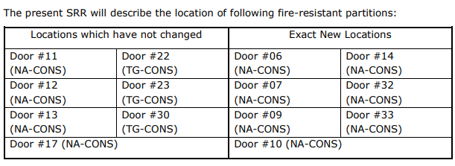
ECR for Approval
SPSX-SF-EC-0003
Version 0.3
Space Reservation Request Fire-Resistant Partitions
This SRR aims to reserve the required space for the installation of 11 of 36 fire-resistant partitions for NA-CONS and 3 of 22 fire-resistant partitions for the TG-CONS project, which are located in the NA facilities (head of the shafts, TT tunnels, TDC2/TCC2, BA80/BA81/BA82, EHN1/EHN2, TT81/TT82/TT83/TT84/TT85, TDC85/TCC8, ECN3) and galleries.
By Adem Kaymak
An assessment by HSE found that fire-resistant partitions do not exist in several locations, so the NA site is not compliant with current safety rules and regulations.
The main goal of compartmentalizing the NA is to:
Limit the propagation of fire and smoke
Make personnel evacuation easier and safer.
Prevent potentially radioactive smoke from spreading and not propagate to other parts of the facility.
By design, the doors on fire-resistant partitions will be controlled and triggered automatically upon detection of smoke by the detection systems.

Slide 10
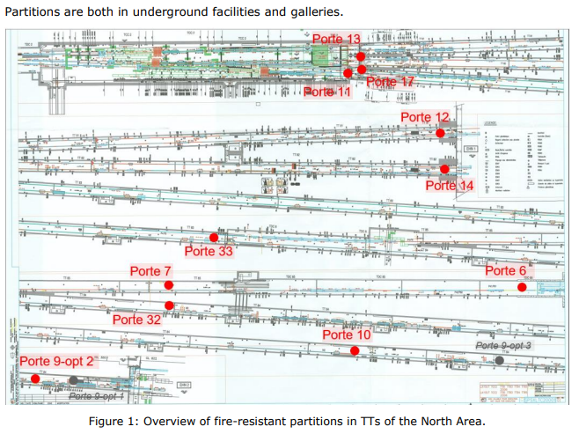
ECR for Approval
SPSX-SF-EC-0003
Version 0.3
Space Reservation Request Fire-Resistant Partitions
By Adem Kaymak

Slide 11
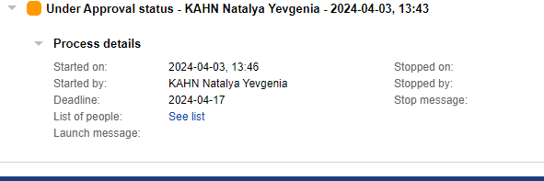
ECR for Approval
SPSX-SF-EC-0003
Version 0.3
Space Reservation Request Fire-Resistant Partitions
By Adem Kaymak
Seeking approval from EATM

Slide 12
ECR for Approval
SPSX-SF-EC-0006
Version 0.2
NA-CONS Fire Safety and Access WP 5.1.3 Fire-Resistant Partitions
By Adem Kaymak
This ECR concerns the installation of fire-resistant partitions, doors, frame sets and ancillaries for the creation of fire compartments in the NA facilities.
An assessment by HSE found that fire-resistant partitions do not exist in several locations, so the NA site is not compliant with current safety rules and regulations.
The main goal of compartmentalizing the NA is to:
Limit the propagation of fire and smoke
Make personnel evacuation easier and safer.
Prevent potentially radioactive smoke from spreading and not propagate to other parts of the facility.
By design, the doors on fire-resistant partitions will be controlled and triggered automatically upon detection of smoke by the detection systems.
Following the CPRs for NA-CONS and TG-CONS, this ECR proposes the installation of
For NA-CONS:
  Fire-resistant partition #48b
  Fire-resistant partition #50
  Fire-resistant partition #50b
For TG-CONS:
  Fire-resistant partition #22
  Fire-resistant partition #23
  Fire-resistant partition #30

Slide 13
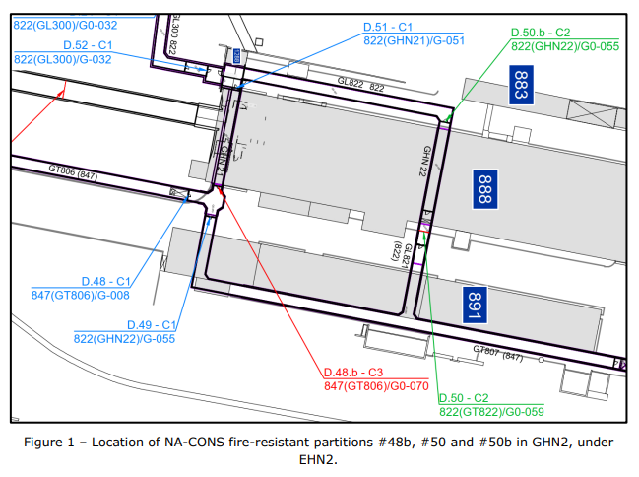
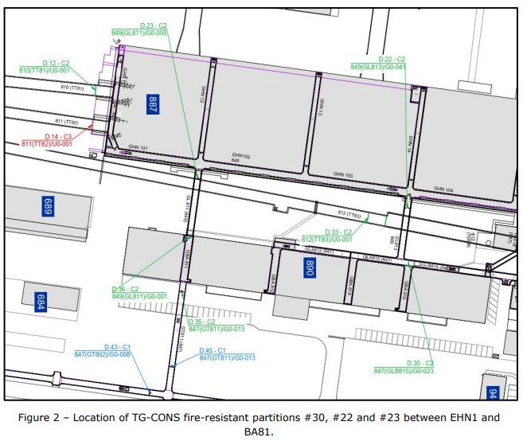
ECR for Approval
SPSX-SF-EC-0006
Version 0.2
NA-CONS Fire Safety and Access WP 5.1.3 Fire-Resistant Partitions
By Adem Kaymak

Slide 14
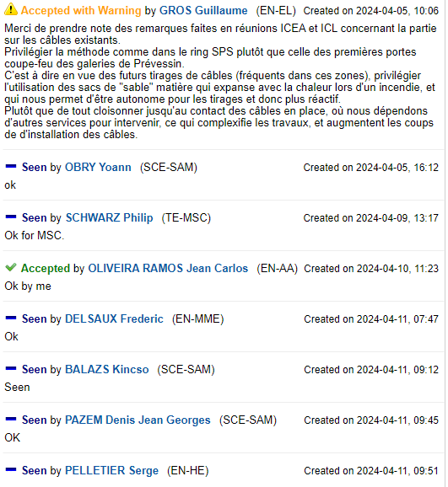
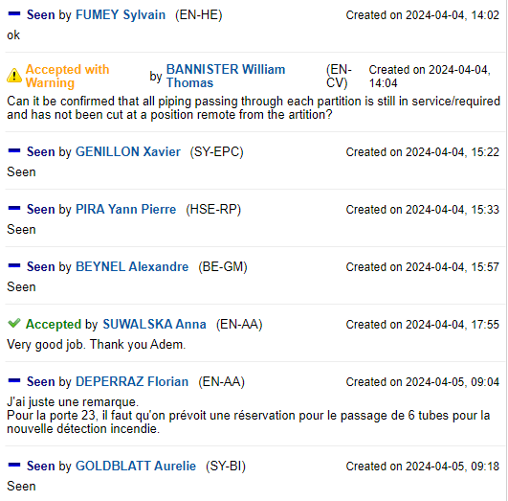
ECR for Approval
SPSX-SF-EC-0006
Version 0.2
NA-CONS Fire Safety and Access WP 5.1.3 Fire-Resistant Partitions
By Adem Kaymak
Seeking approval from EATM

Slide 15
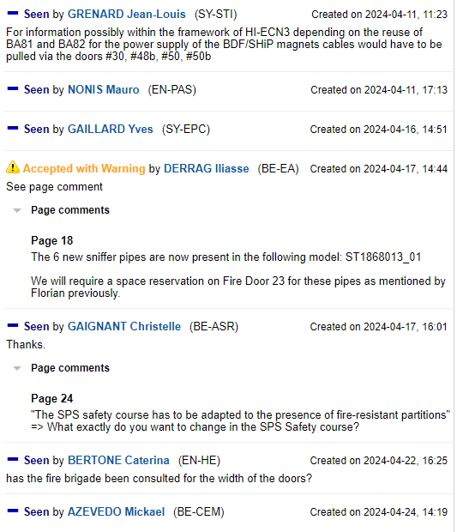

ECR for Approval
SPSX-SF-EC-0006
Version 0.2
NA-CONS Fire Safety and Access WP 5.1.3 Fire-Resistant Partitions
By Adem Kaymak
Seeking approval from EATM

Slide 16
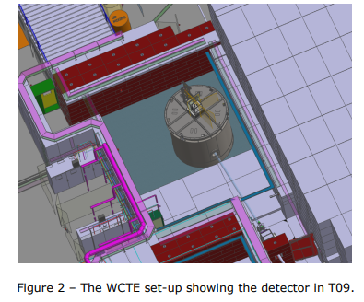
ECR for Approval
PSZ-J-EC-0003
Version 0.2
Installation Water Cherenkov Test Experiment in T09 beamline During YETS 23-24
By Dipanwita Banerjee
This ECR summarises the required changes and infrastructure support needed for the installation of the Water Cherenkov Test Experiment (WCTE) – an approved 50-ton water Cherenkov experiment to be operated in the T09 beamline in the East Area at CERN, starting from 2024.
The requested user requirements include:
The T09 beam and zone for the experimental installations and beam time for about 12.5 weeks in 2024.
Assembling a 4-m-high and 4-m-diameter cylindrical tank in the East Area Hall as well as transporting it to the T09 experimental zone and installing it there.
Occupancy of the East Hall for the assembly between November 2023 and March 2024.
Demineralised water for initial filling of the tank to about 50 tons.
A water-purification system as well as a mechanism to load Gadolinium (Gd) into the water are required.
Connection of the water-purification system to the tank.
Means to empty the tank and drain the water from the experimental area, following verification by RP that there is no activation nor contamination of the water.
Installation of a 0.1-Tm permanent magnet.
Racks to house the DAQ systems and space to install the racks.
Ethernet and power to connect the detectors and DAQ, as well as grounding for the electrical connections.
A dedicated control room.

Slide 17
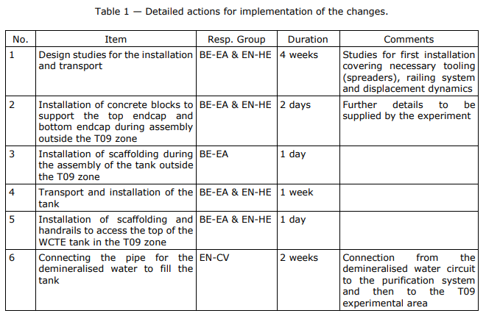
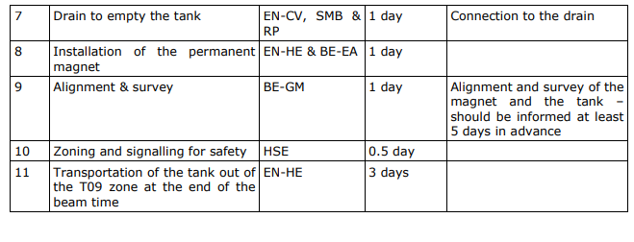
ECR for Approval
PSZ-J-EC-0003
Version 0.2
Installation Water Cherenkov Test Experiment in T09 beamline During YETS 23-24
By Dipanwita Banerjee

Slide 18
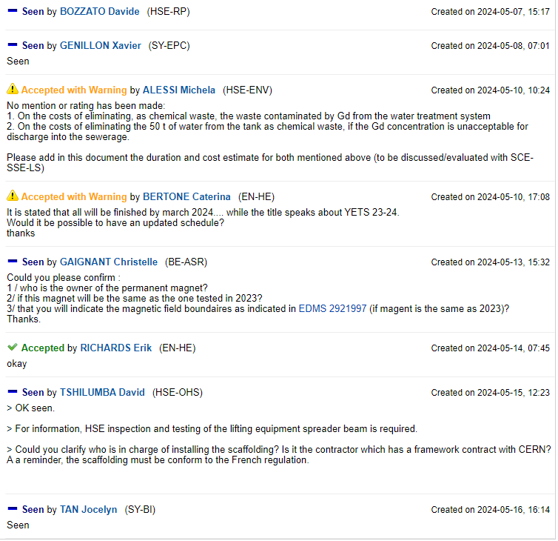
ECR for Approval
PSZ-J-EC-0003
Version 0.2
Installation Water Cherenkov Test Experiment in T09 beamline During YETS 23-24
By Dipanwita Banerjee
Seeking approval from EATM

Slide 19
Thank you!

