Slide 1
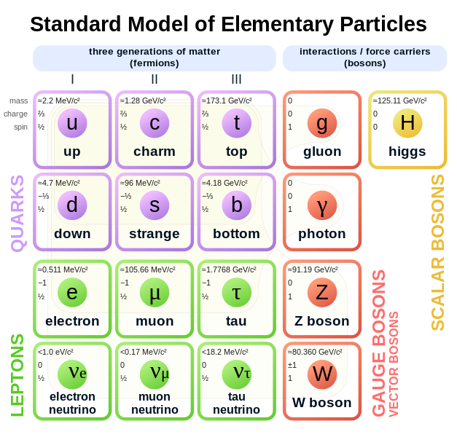

Slide 2
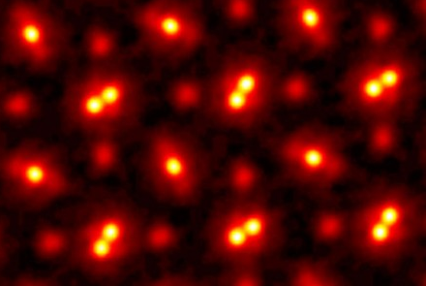
Atoms
Dalton’s Atomic Model (1804):
Smallest building block of matter
Neutral hard sphere
Cannot be broken down further
praseodymium orthoscandate (PrScO3) crystal,
zoomed in 100 million times (Cornell University)

Slide 3

How do we know the things we can’t see?
Senses (qualitative):
See
Touch
Smell
Hear
Taste
Devices (quantitative):
Temperature
Mass
Size
When measuring something small, the probe must also be small
A girl and a glue gun by Kim West
Notes:
When measuring something small, the probe must also be small (particles)

Slide 4


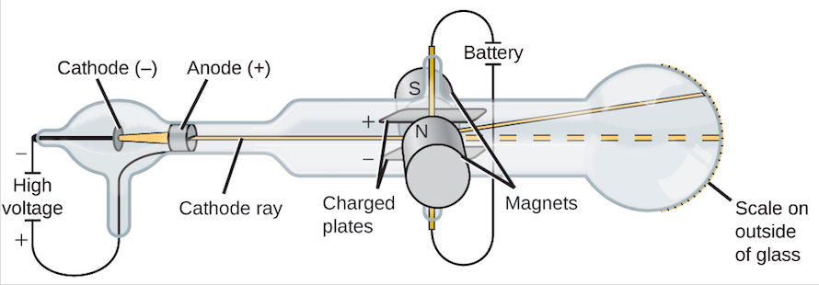
Electron
Experiment (Thompson 1897)
Cathode ray produced when applying high voltage across cathode and anode
Bends towards positive plate (negatively charged)
Deflection by magnetic field gives mass-to-charge ratio smaller than anything known
Theory (Plum Pudding Model)
Atoms have overall neutral charge
Electrons floating in soup of positive charges
Image from Openstax

Slide 5
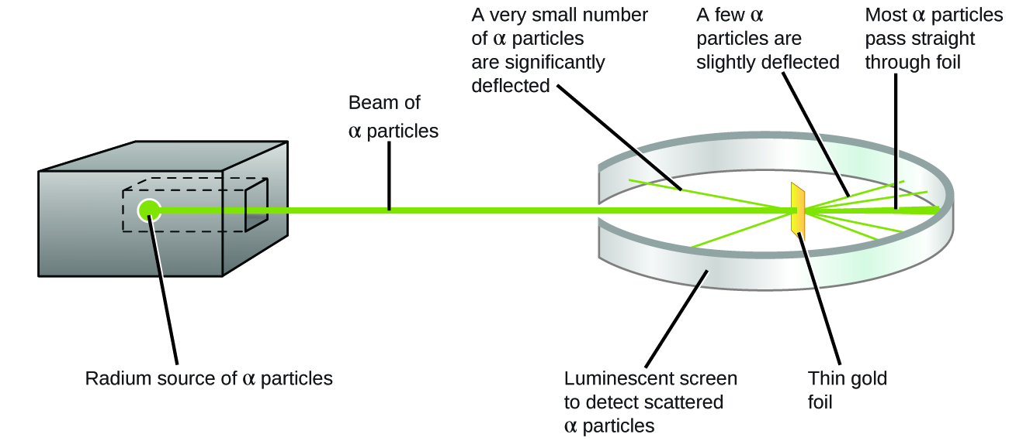

Nucleus
Experiment (Rutherford 1911)
Fire alpha particles (tiny positively charged) at gold foil
Most passed through, some deflected
Theory (Nuclear Atomic Model)
Atoms are mostly empty
Tiny core of heavy positive charge (nucleus) and sphere of light negative charge cloud (electron)
Image from Openstax

Slide 6
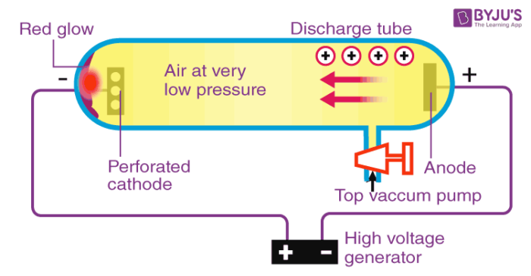

Proton
Theory (Moseley 1913)
Spectral line experiment comparing frequency to nuclear charge Z
Different elements in periodic table had different nuclear charge
Experiment (Rutherford 1919)
Fire alpha particles at Nitrogen and detected hydrogen nuclei
$^{14}N+α→ ^{17}O+p$
Protons are responsible for nuclear charge
Light

Slide 7
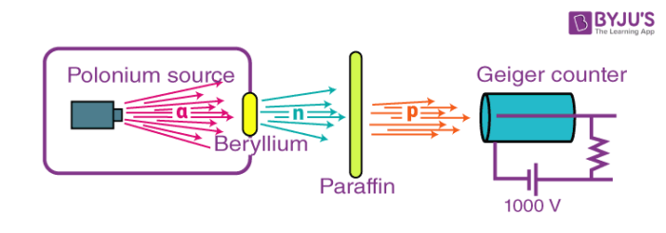
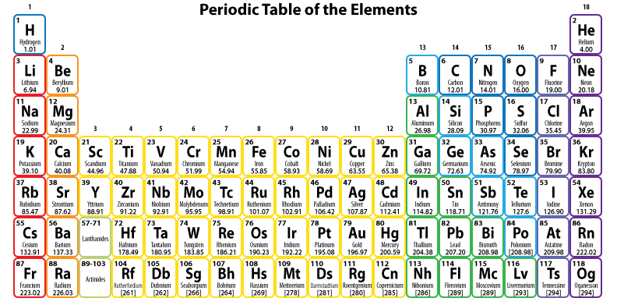

Neutron
Theory (Rutherford 1920)
Isotopes are same elements with different masses (Soddy 1913)
Number of protons determine the element
Neutrons are responsible for different masses
Experiment (Chadwick 1932)
Firing alpha particles at Beryllium produced neutral radiation
$^{9}Be+α→ ^{12}C+n$
Mass equivalent to proton, calculated from ejected proton

Slide 8
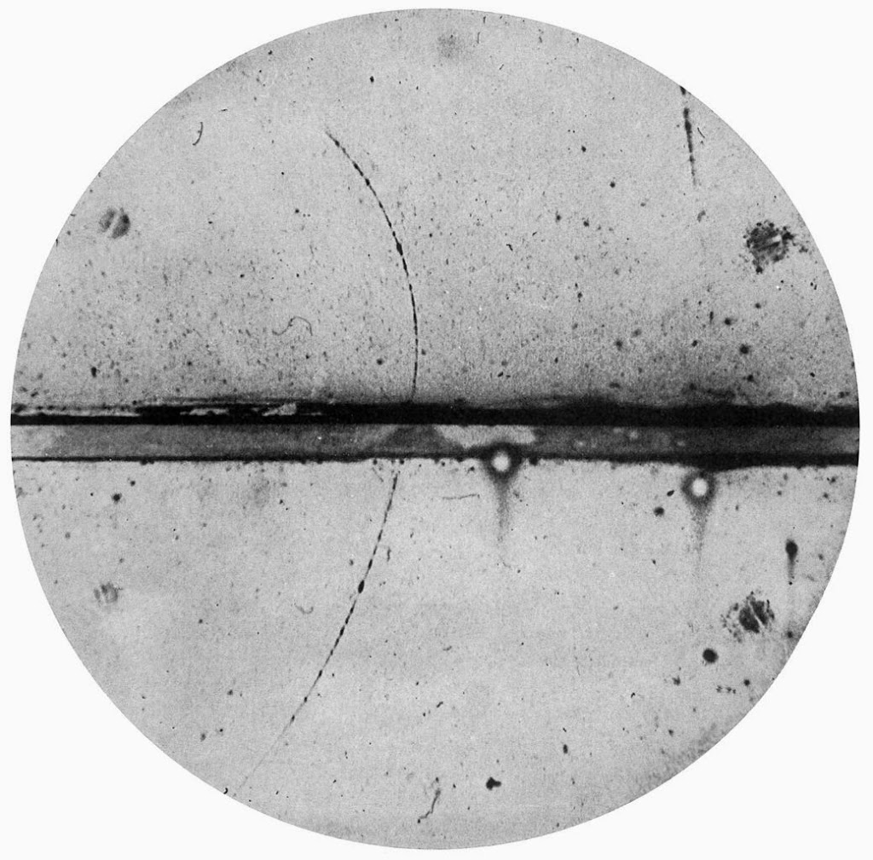
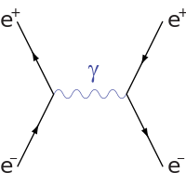
Positron
Experiment (Anderson 1932)
Wilson cloud chamber tracks path of charged particles
Found pair paths produced from cosmic ray bending in opposite direction under magnetic field
Radius of curvature determines mass
Theory (Anti-particle)
Positron has all property of electron except its charge
Pair Production: Electron (particle) and positron (anti-particle) are produced in pairs from energy
Pair Annihilation: particle and anti-particle can collide to annihilate themselves producing energy
Anderson 1932

Slide 9
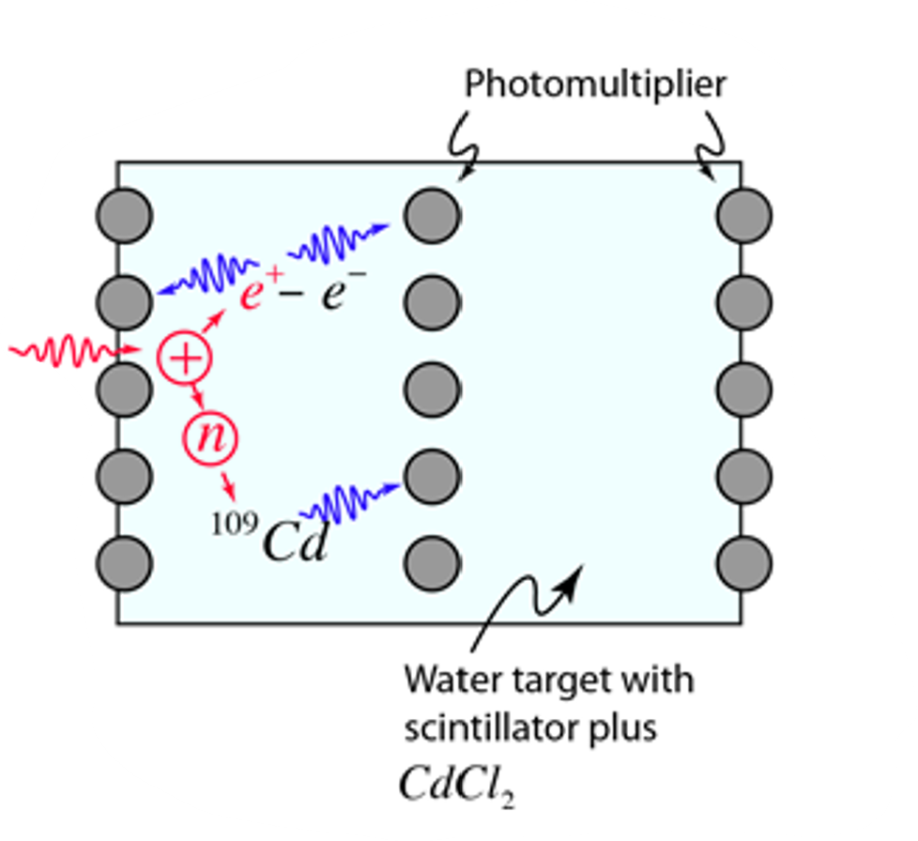
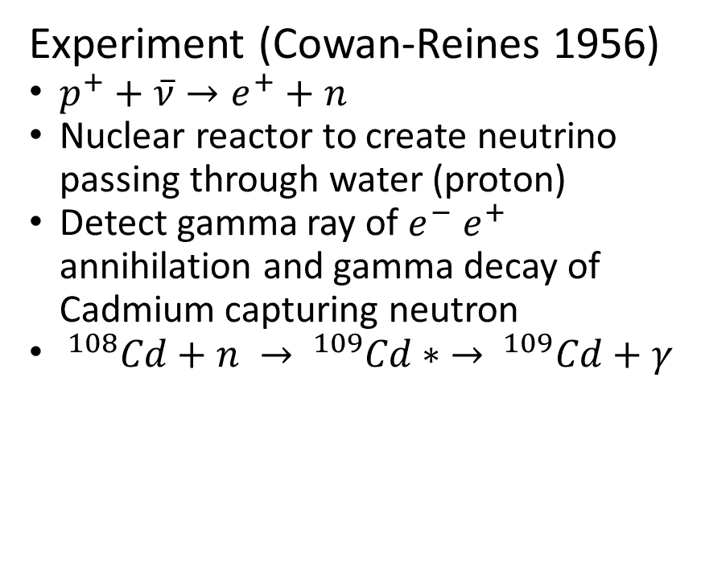
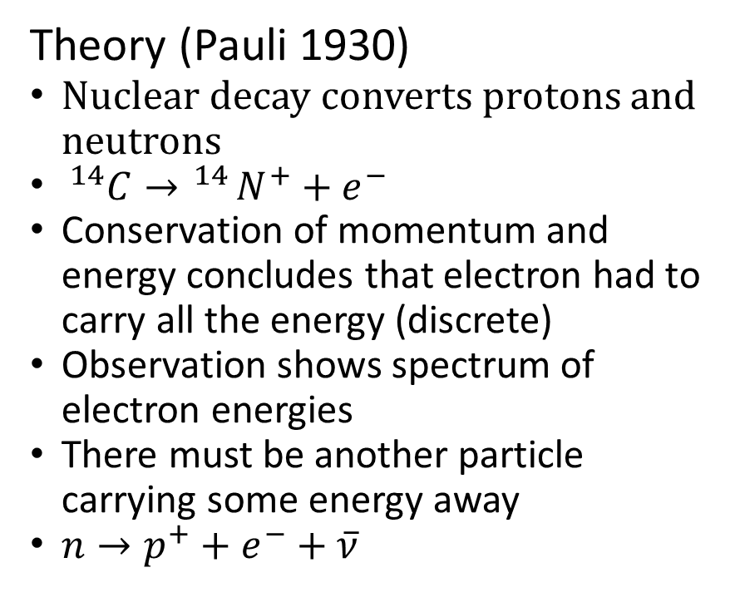
Neutrino
Theory (Pauli 1930)
Nuclear decay converts protons and neutrons
$^{14}C→ ^{14}N^{+}+e^{−}$
Conservation of momentum and energy concludes that electron had to carry all the energy (discrete)
Observation shows spectrum of electron energies
There must be another particle carrying some energy away
$n→p^{+}+e^{−}+\overline{ν}$
Experiment (Cowan-Reines 1956)
$p^{+}+\overline{ν}→e^{+}+n$
Nuclear reactor to create neutrino passing through water (proton)
Detect gamma ray of $e^{−} e^{+}$ annihilation and gamma decay of Cadmium capturing neutron
$^{108}Cd+n → ^{109}Cd∗ → ^{109}Cd+γ$
Image from hyperphysics

Slide 10
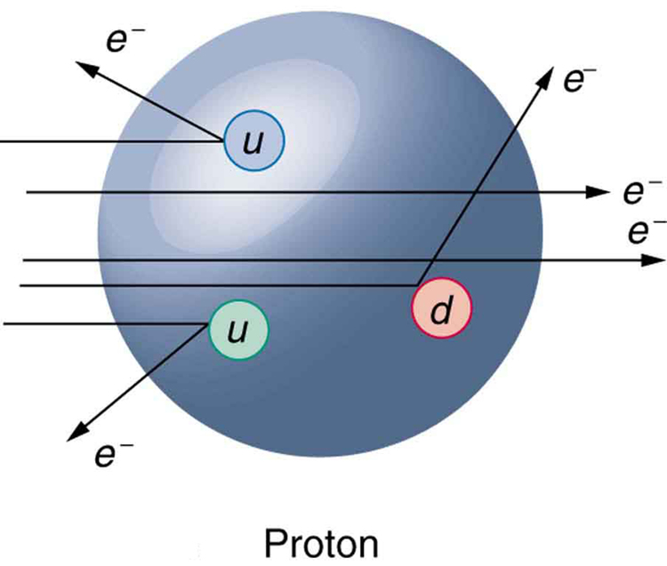
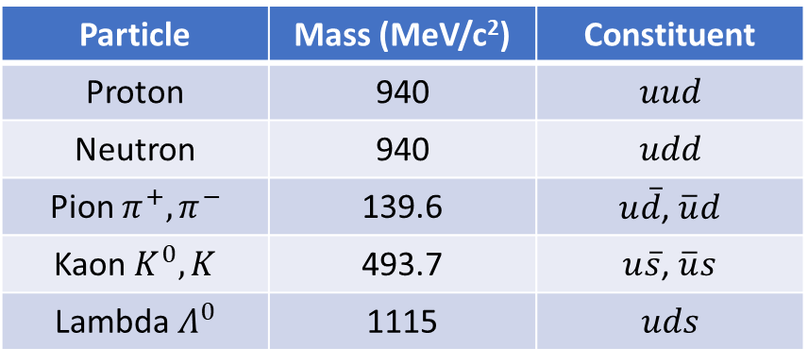
Quarks
Theory (Gell-Mann, Zweig 1964)
Protons, neutrons, and other particles found are not fundamental
Made of quarks
Experiment (SLAC 1969)
Smash electrons at protons at Stanford Linear Accelerator Center (SLAC)
Electrons scattered off point-like particles inside proton and neutron
Series of experiments revealed the charges and masses of each u and d
Particle | Mass (MeV/c²) | Constituent
Proton | 940 | $$uud$$
Neutron | 940 | $$udd$$
Pion $π^{+},π^{−}$ | 139.6 | $u\overline{d}$, $\overline{u}d$
Kaon $K^{0}, K$ | 493.7 | $u\overline{s}$, $\overline{u}s$
Lambda $Λ^{0}$ | 1115 | $$uds$$
Image from University of Central Florida
Notes:
Now we are questioning proton and neutron as fundamental particles (decay into each other, anti particle existence)

Slide 11
Elementary Particles of Standard Model
Quarks bind together to form Hadrons:
Mesons (doublets)
Baryons (triplets)
Leptons exist on their own
Three generations with increasing mass and stability
Anti-particle partner with opposite charge

Slide 12
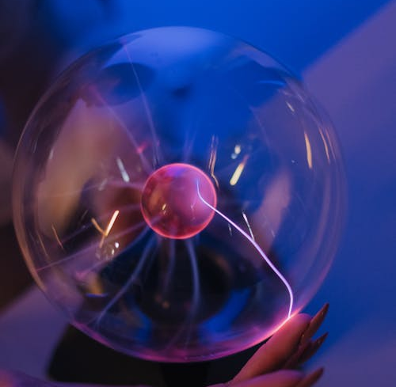


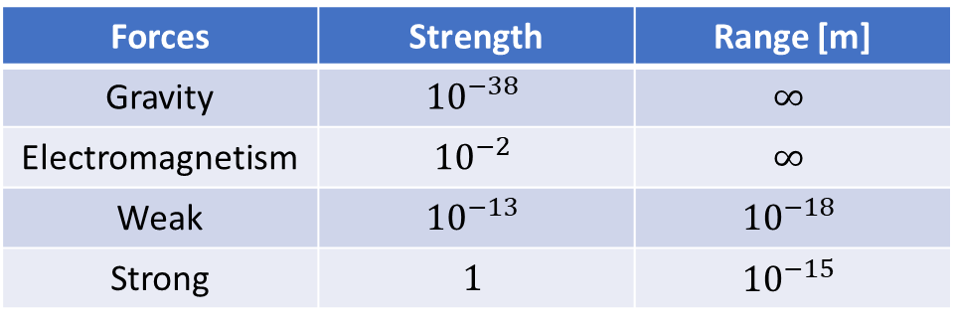
Fundamental forces of universe
Forces | Strength | Range [m]
Gravity | $${10}^{−38}$$ | $$∞$$
Electromagnetism | $${10}^{−2}$$ | $$∞$$
Weak | $${10}^{−13}$$ | $${10}^{−18}$$
Strong | $$1$$ | $${10}^{−15}$$

Slide 13
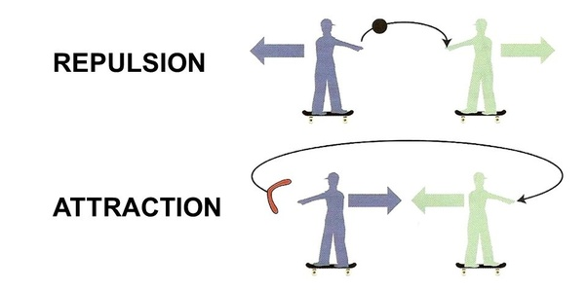
Forces as Exchange of Particles
Images from Quora, Wikipedia

Slide 14
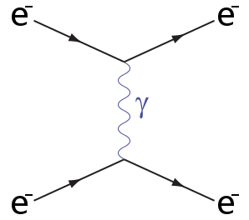
Electromagnetism and Photon
Quantum Electrodynamics:
Opposite charges attract, same charges repel
Electricity and magnetism unified by Maxwell
Charged objects interact electromagnetically through exchange of photon

Slide 15
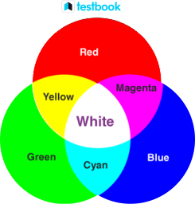
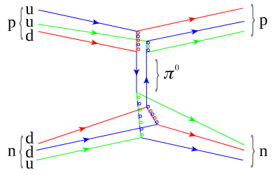
Strong Force and Gluon
Quantum Chromodynamics:
How is the nucleus glued together?
Assign color to quarks and gluons
Hadrons are colorless
Colored particles interact strongly through exchange of gluons
Predicted 1962
Detected 1979
DESY
Images from Wikipedia

Slide 16
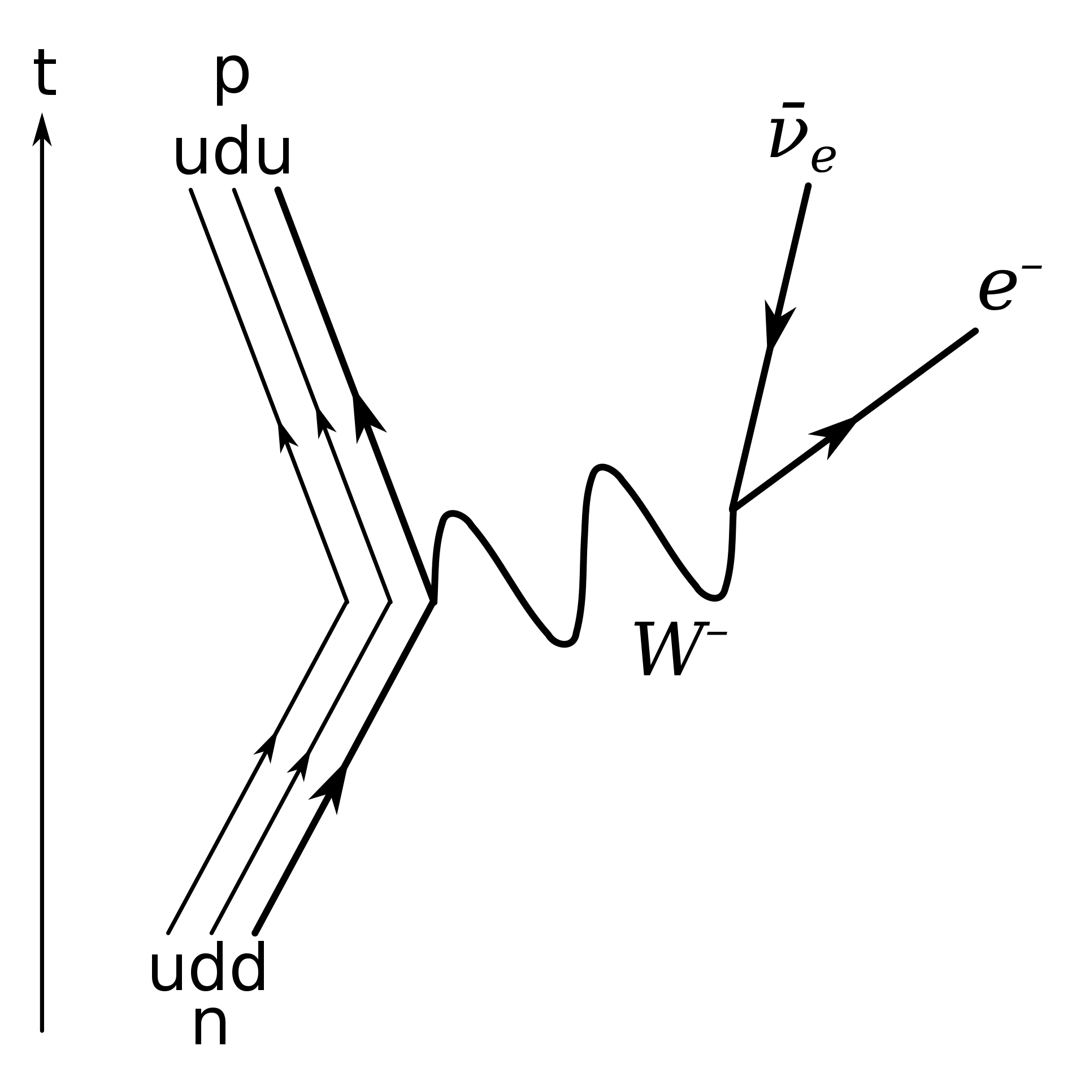
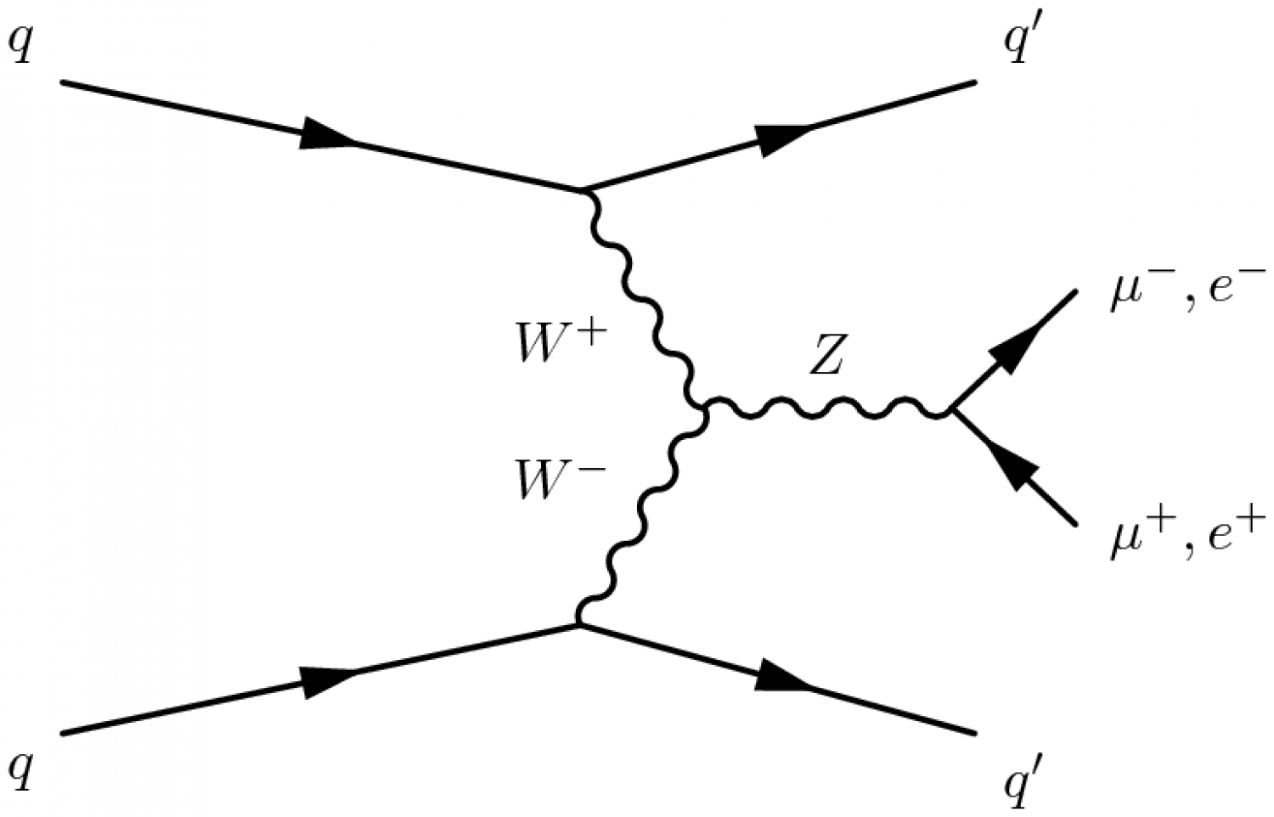
Weak Force and W, Z Boson
Quantum Flavourdynamics:
Beta decay converts proton to neutron
Assign flavor to quarks, leptons, and W/Z bosons
Particles with flavor interact weakly through exchange of W or Z bosons
Predicted 1968
Detected 1983
U1A at Cern
Images from ATLAS, Wikipedia
Notes:
Neutral Z boson exchange looks like EM ->electroweak unification

Slide 17
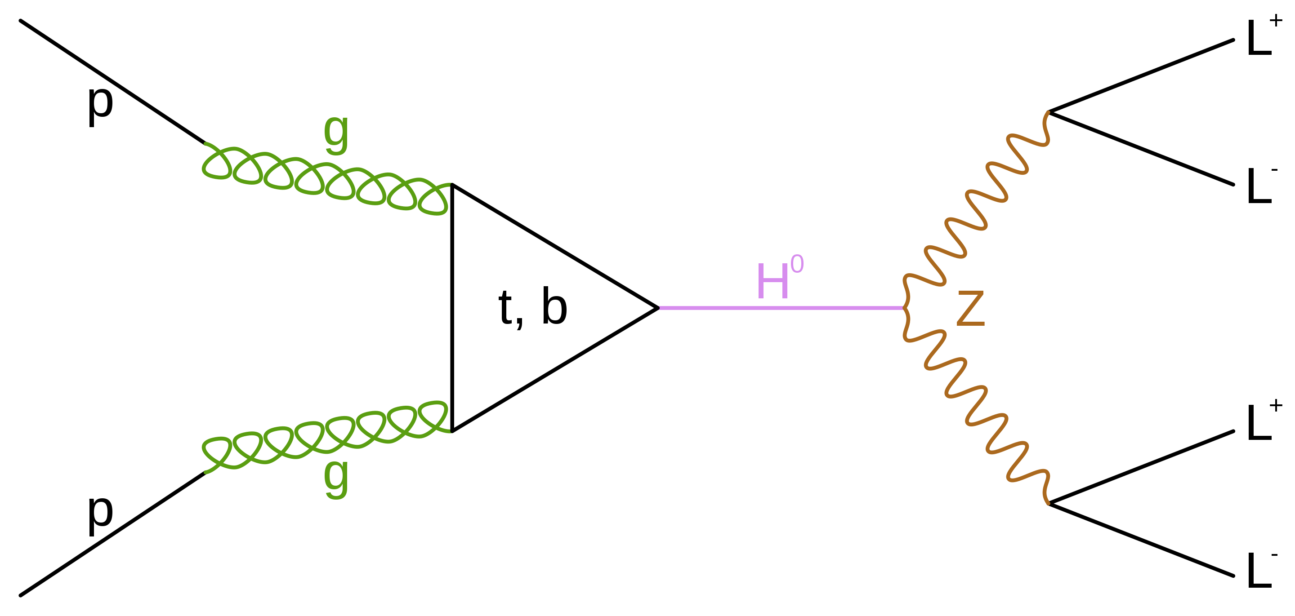
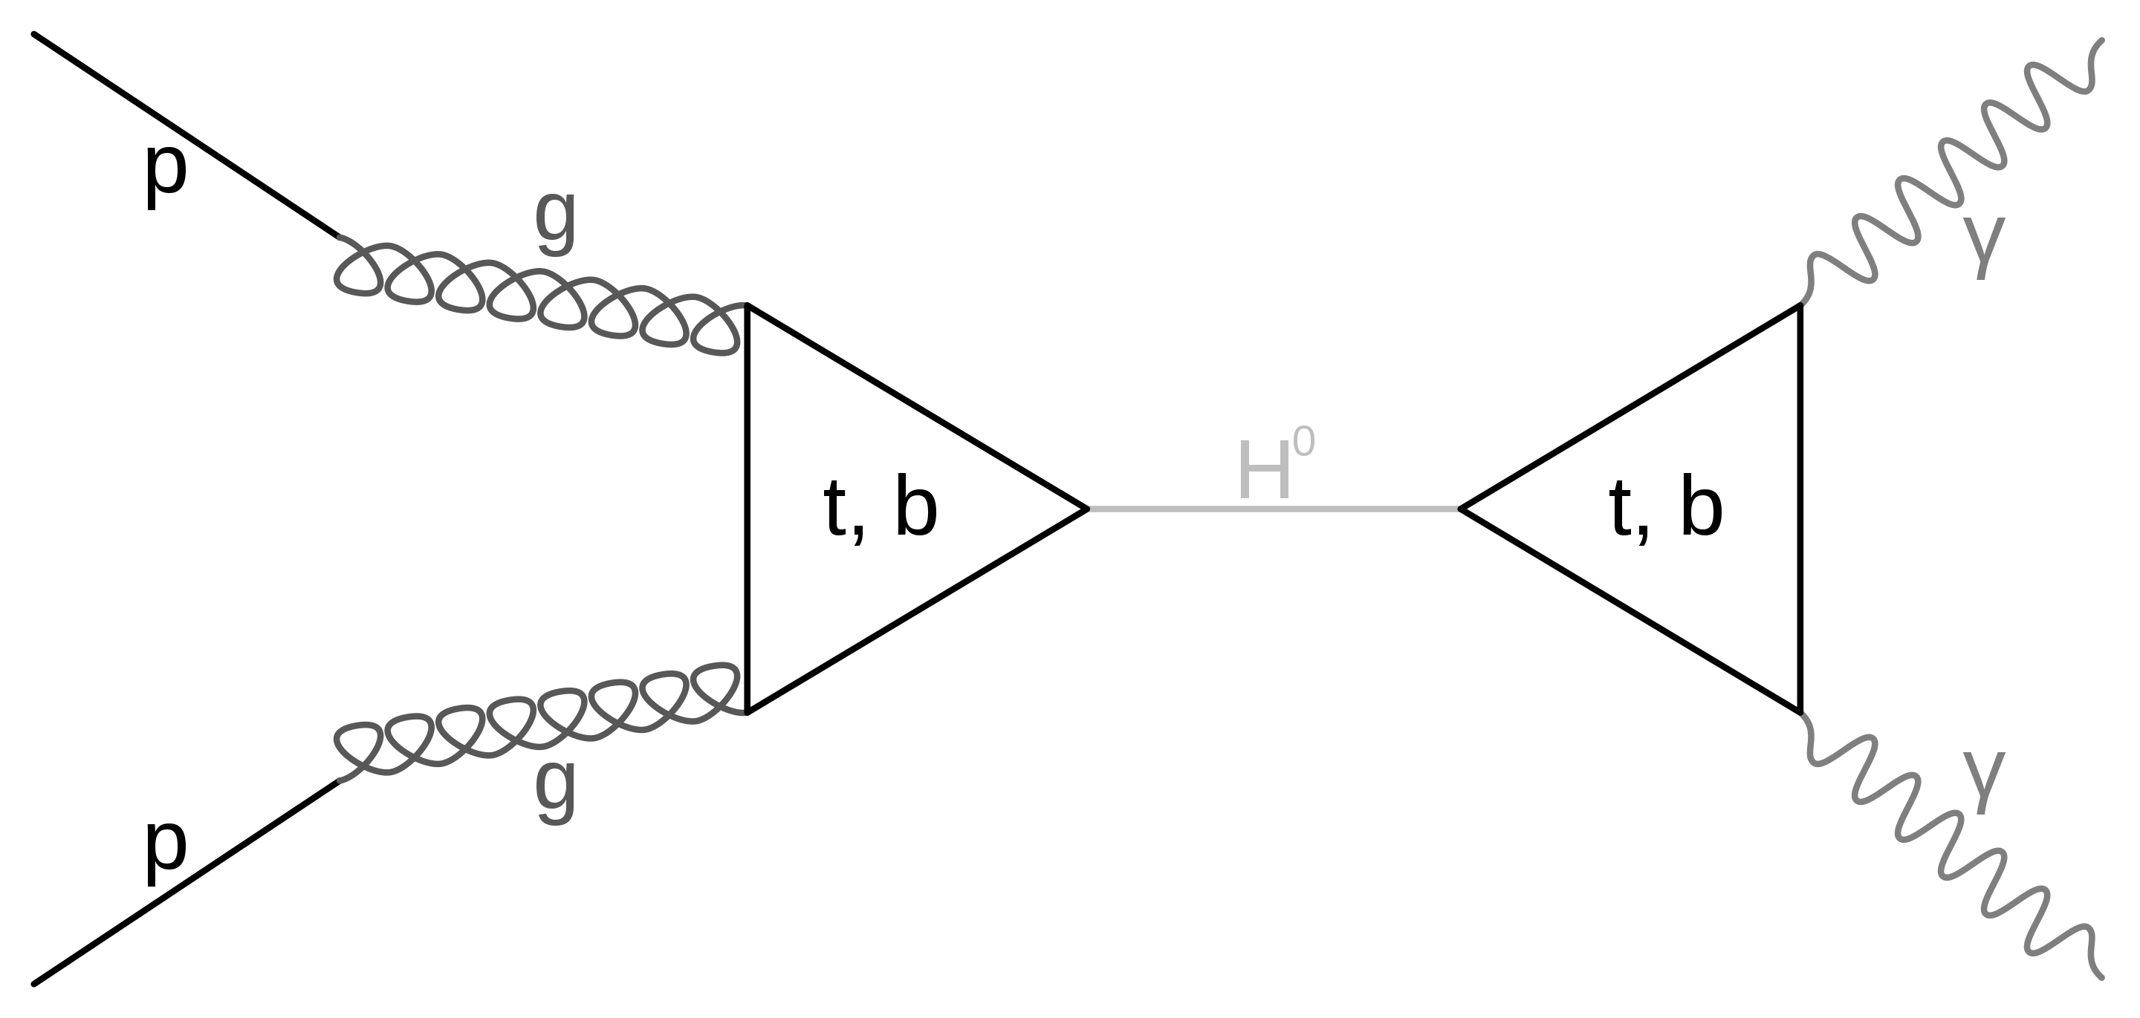
The Last Particle
Higgs Mechanism
Why are quarks massive but not gluons?
Why are photons massless but not Z/W?
Introduce Higgs boson
Interacts with particles to give them mass
This is not a force! Interaction between massive particles is gravity
Predicted 1964
Detected 2012
ATLAS at Cern

Slide 19
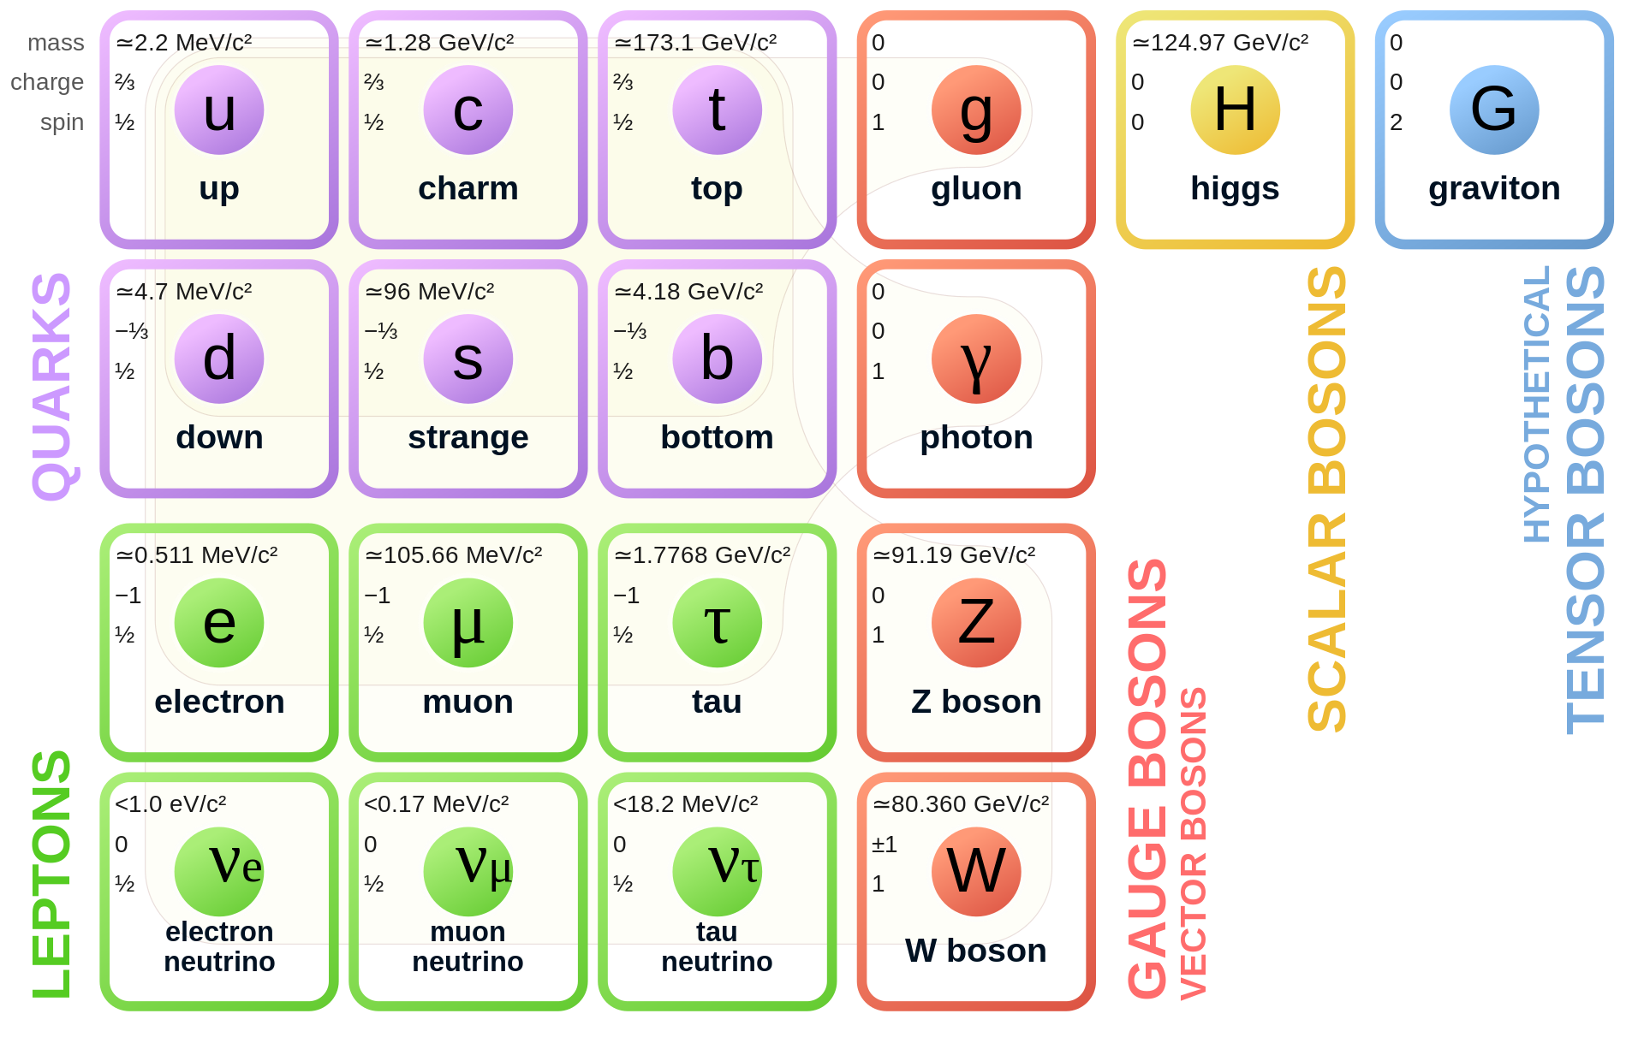
Unanswered Questions
Where is gravity?
95% of universe is unknown
Neutrino Mass?
Where is anti-matter?

Slide 20






Looking For Answers
Theory
Experiment
Notes:
Collaboration between theory and experiment (historically and continuing presently)

