Slide 1




Field Free Magnetic Length
H. Prin
CERN, May the 30th 2024

Slide 2
Outlook
Item stack up and integration
Field Free Length among the LHC and HL-LHC magnets with numbers
Quantification of the length of items along the FFML
Some ideas to minimize the FFML
Summary

Slide 3
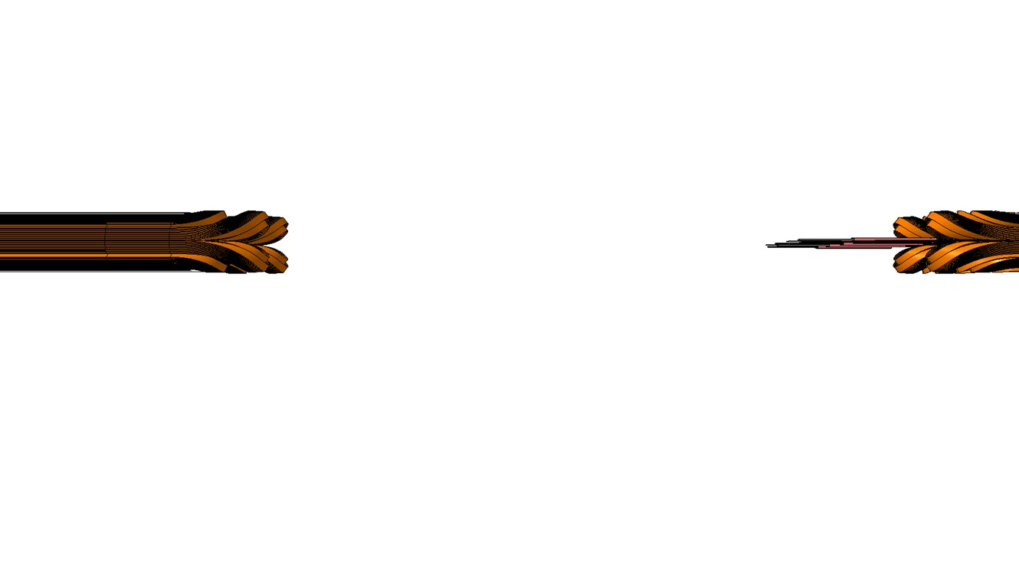
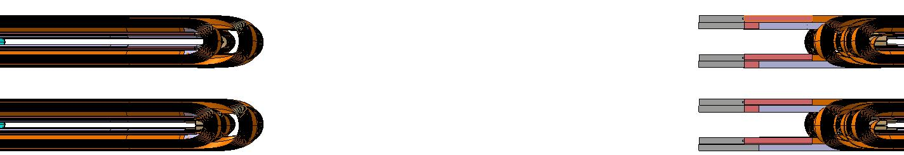
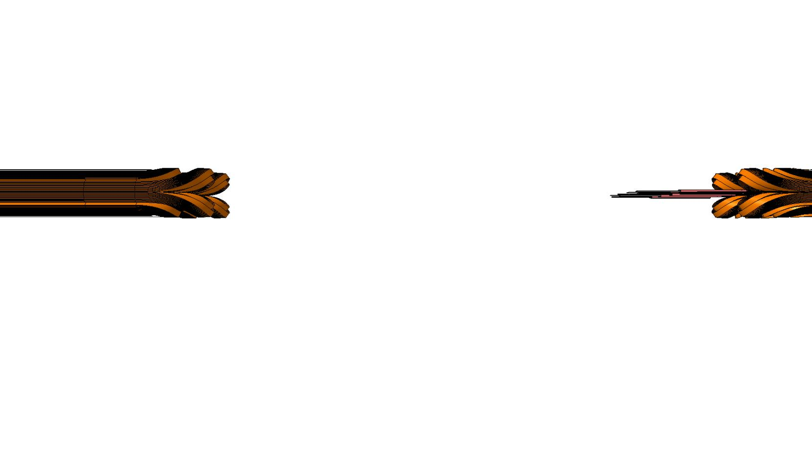
Magnetic Length/Coils
Magnetic Filed
Splices
NbTi leads
S
(sortie)
Coil heads on the non connection side (NCS)
Nb₃SN coil leads
e
(entrée)
Coil heads on the connection side (CS)
FFML
ML
ML
Mag. Length
L_{s/head}
L_{head/e}

Slide 4
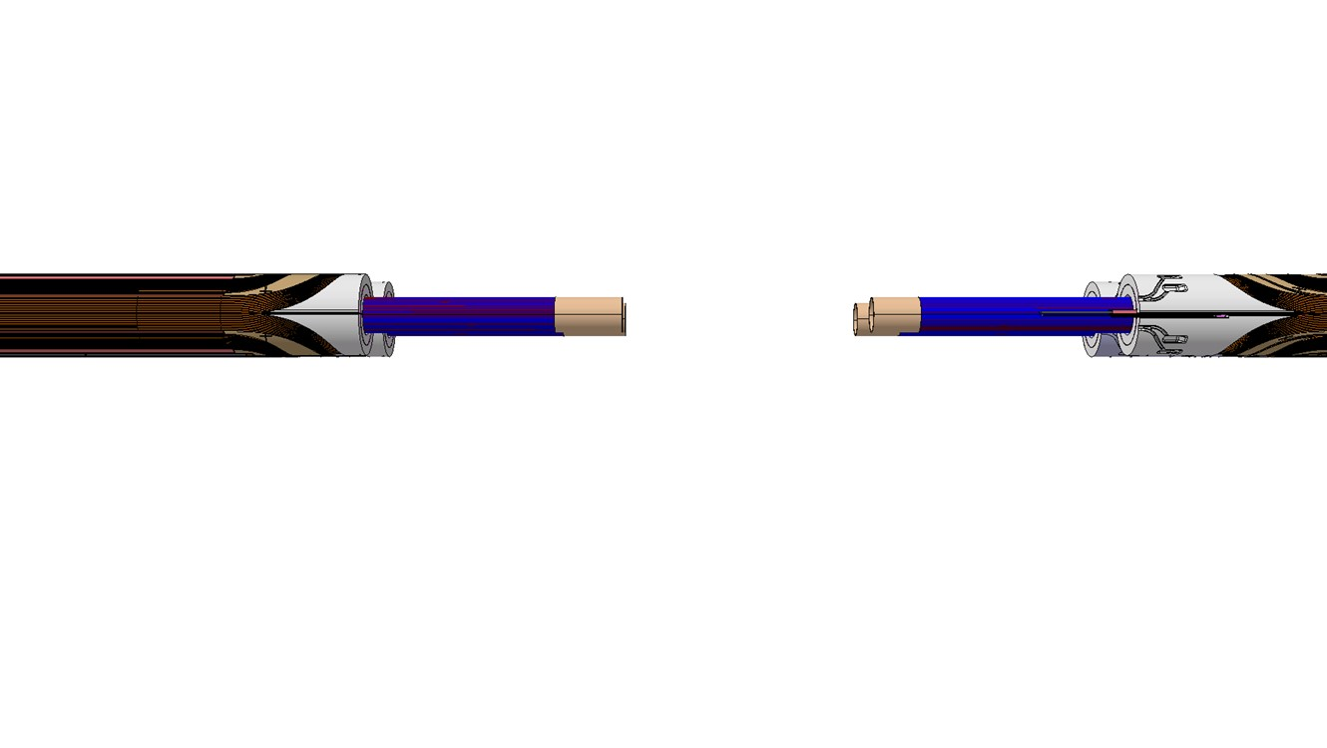

Coil head end spacers (the extremity saddles)
Beam Pipe (Cold Bore Tube)
Coil head end spacers (NCS)
Coil head end spacers (CS)
Materials can be Epoxy G11, EPGC22 or Al₂O₃ coated 316LN stainless steel.
It must be electrically non-conductive and stiff enough to react to the coil longitudinal forces.
Geometry depends on the magnet aperture, high dimensional precision required.
On the Connection Side of the Nb₃Sn magnets, the coil head spacer is housing the NbTi/Nb₃Sn splices, minimum additional length is at least a cable pitch.

Slide 5
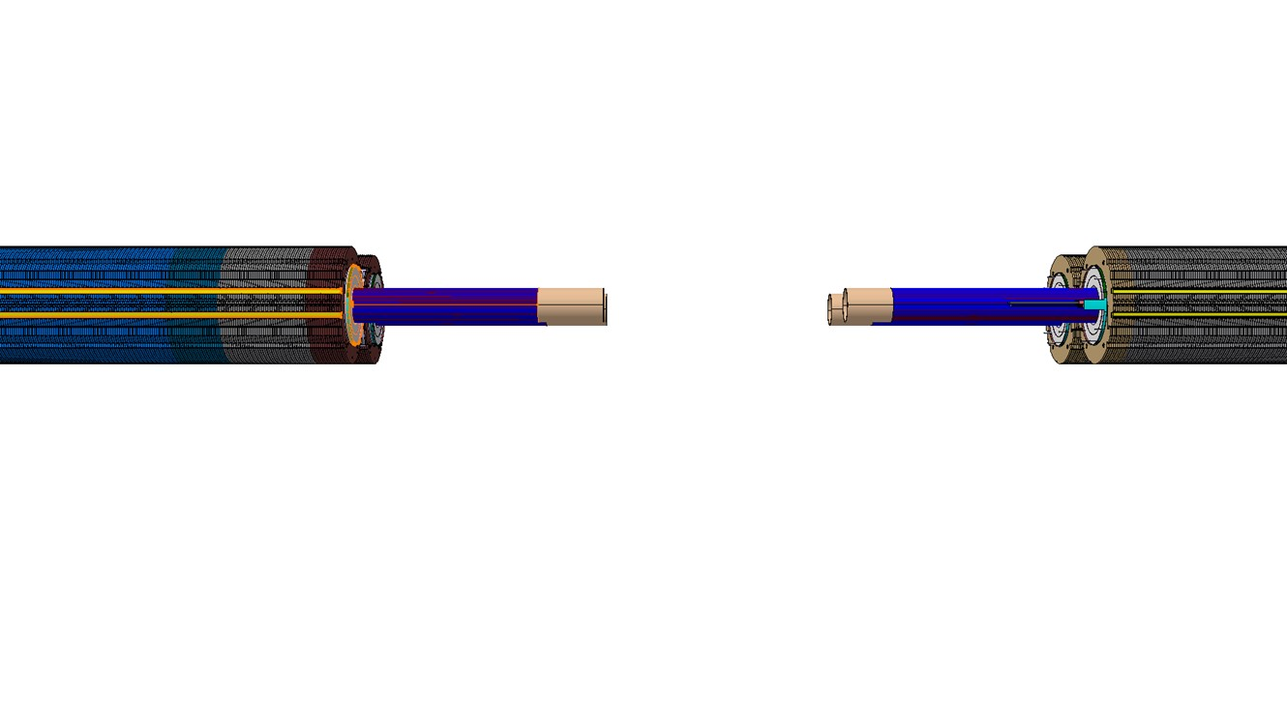

Radial and Azimuthal Pre-stress
Stainless Steel Collars
Collaring key extrusions
The collars do not compromise the longitudinal space envelope

Slide 6
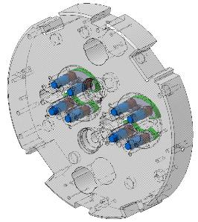
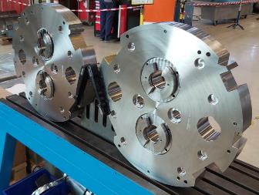
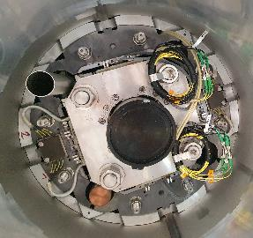
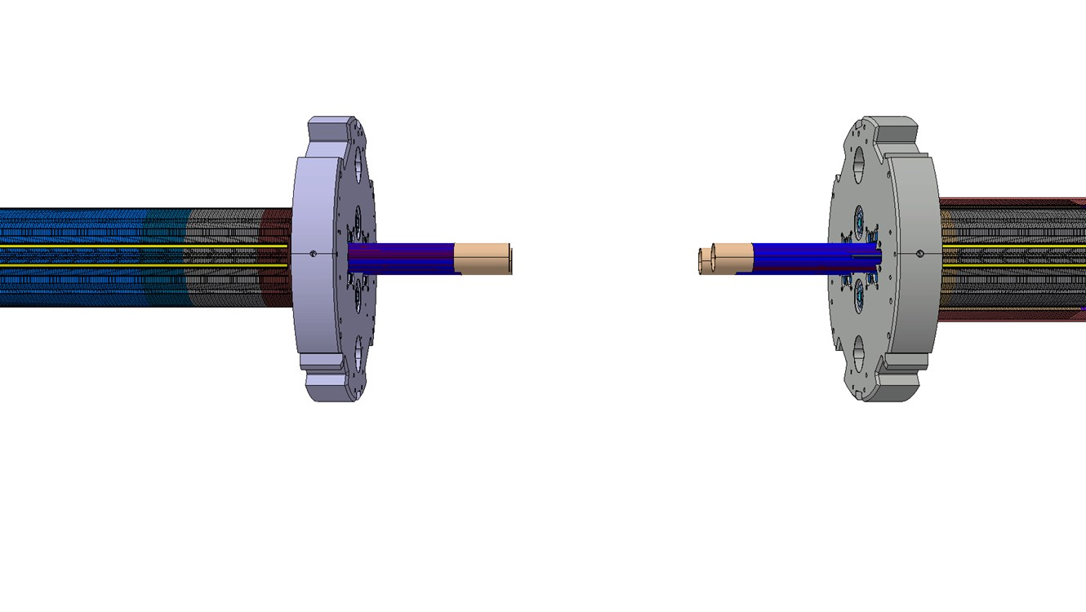

Longitudinal Constraint
MQXFB end plate
11T end plate
Tie rods
Pushers
Tie rods
Magnet end plate (NCS)
Magnet end plate(CS)
The thickness required is proportional to the longitudinal load, factors including the magnetic field, the aperture, the magnet diameter and the materials.
Compressive forces are transmitted from the coils to the end plate using pushers (bullets), additional plates can be inserted to enhance the contact distribution.
Tensile forces are transmitted either to the cryogenic vessel through orbital welds and/or to the other side of the magnet through tie rods threaded at their extremities. Depending on the design the nuts can be embedded in the end plates.

Slide 7
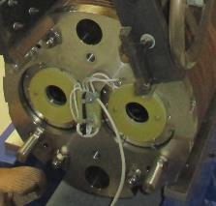
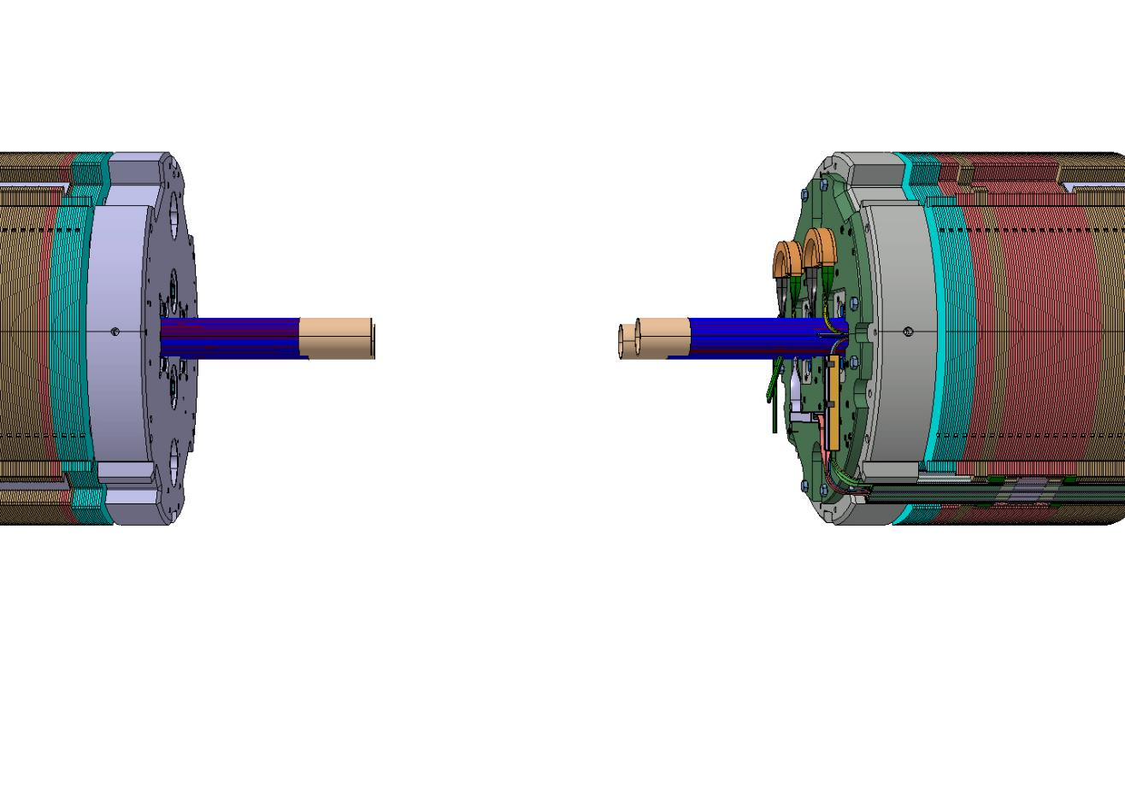
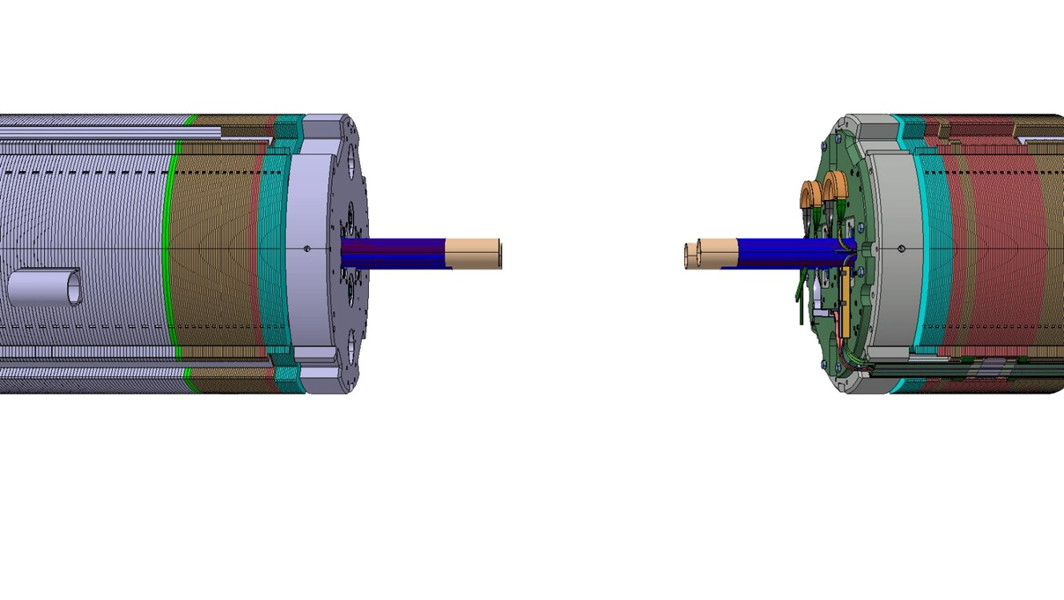
Coil lead splices
Coil splices
Inter-aperture splice
Non-magnetic steel Yoke
Low carbon steel Yoke
Non-magnetic steel laminations can be used to adjust the magnetic cut back on both magnet extremities and in some cases provide a favorable environment for the internal coil splices.
Even by folding the coil leads radially to splice them, a minimum longitudinal space is required to house the connections.
On the so-called non connection side (NCS), longitudinal space can be used to splice some quench heaters (LHC Main quads, MQXFB…)

Slide 8
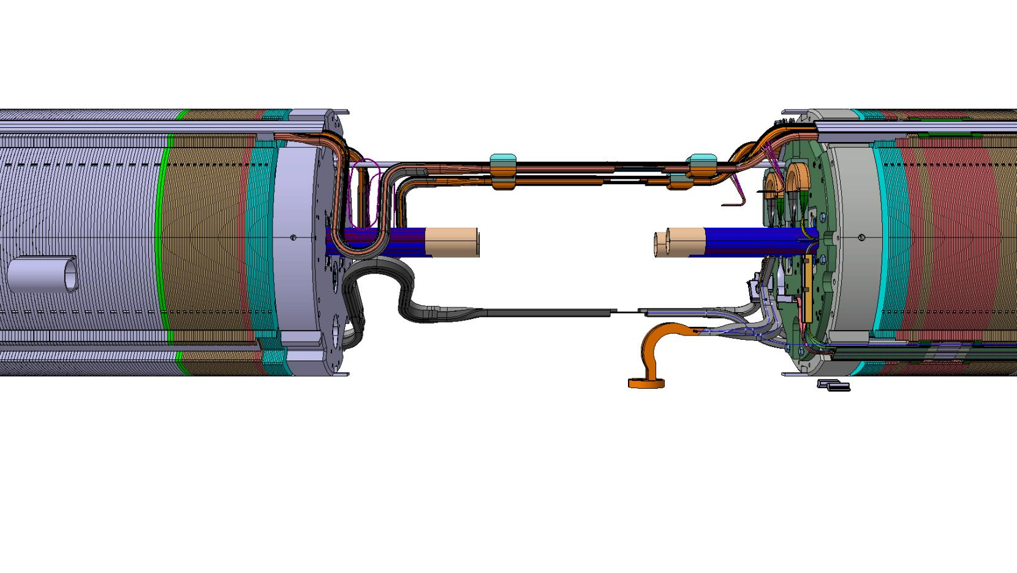
Busses Integration (splices and expansion loops)
Busbars fixed point
Quadrupole circuits busbars
Magnet splice to the main circuit
Dipole circuit busbars
Busbar expansion loops
Protection Diode busbars
Busbar fixed points are usually located close to the splices on the connection side.
Splices from the magnet leads to the busses are generally in the shadow of the magnet splices (counter example of the LHC SSSS).
The expansion loops are usually located on the opposite side and must absorb the thermal contraction (3 to 4mm per meter)
Several types of expansion shape exist: lyre, double lyre, omega, S, pig tails…

Slide 9
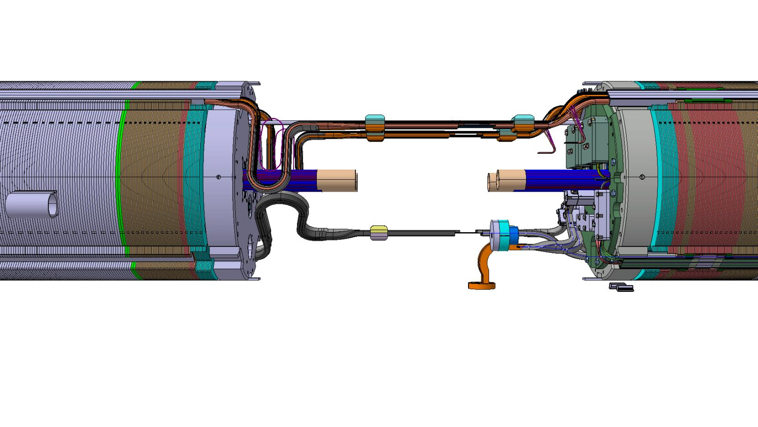
Insulation Assemblies
Splice insulation boxes
Protection Diode busbars
Additional thickness is required around the splice volumes to insert fixation points, protection and insulation boxes and covers.

Slide 10
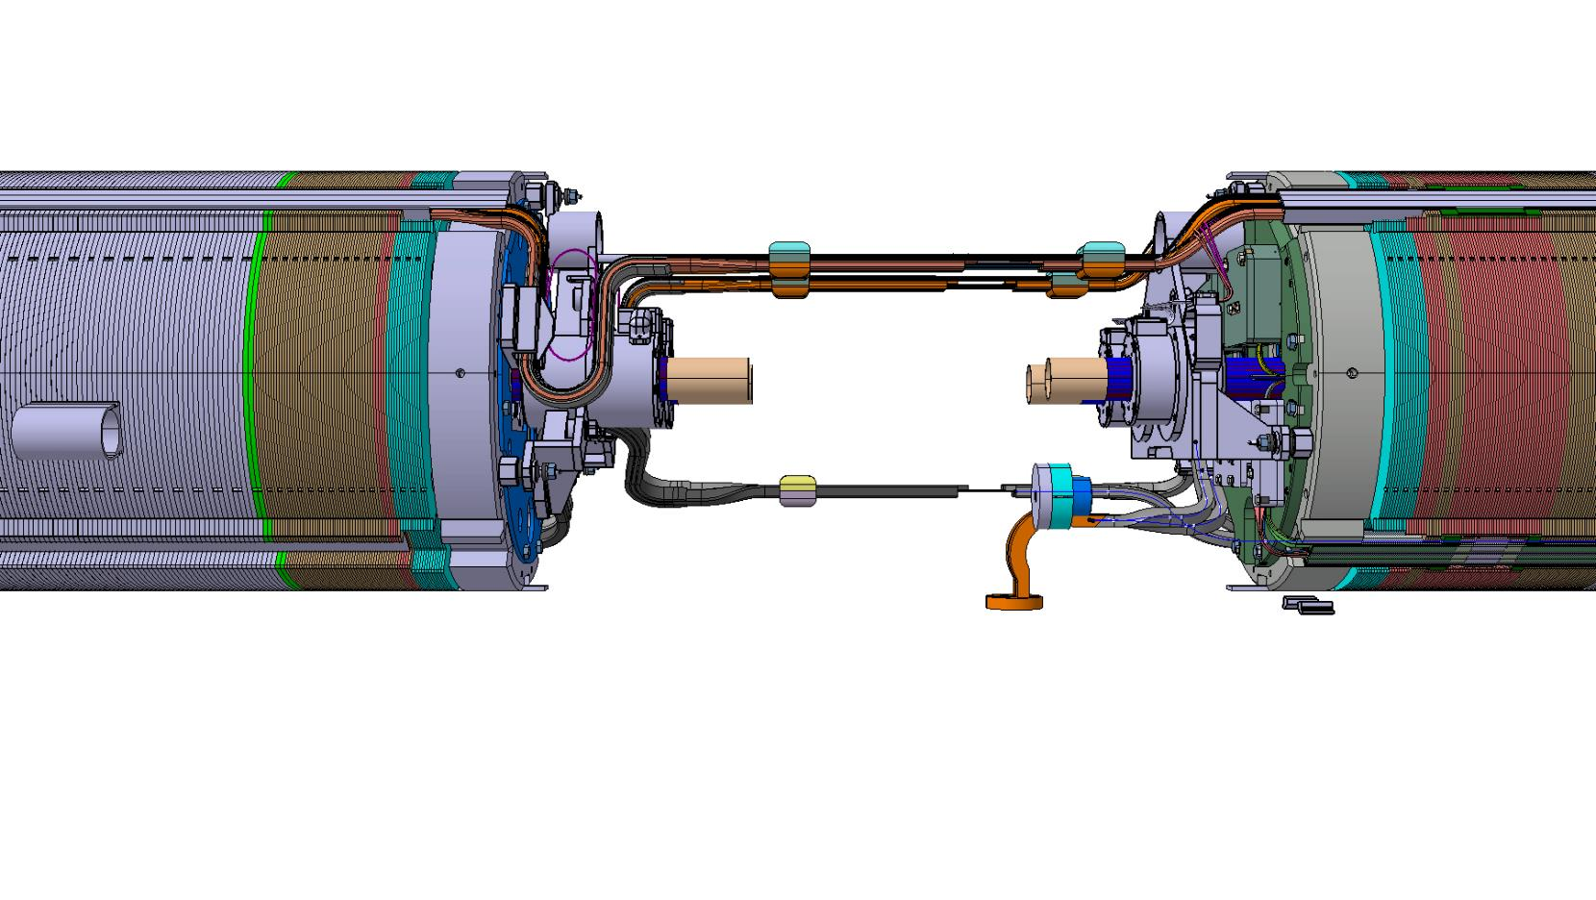
Spool Piece (Correctors) Integration
Octupole and dodecapole
spool pieces and support
Sextupole
spool pieces and support
In the case of the LHC dipoles cold masses, MCS and MCDO spool piece correctors are integrated at the main dipole extremities.

Slide 11
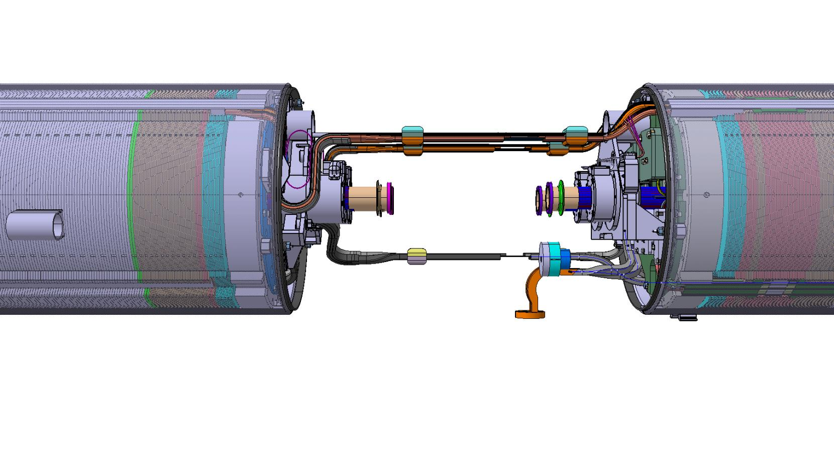
Cold Mass Shells – Cryogenic Vessel
Helium vessel
End plate fillet weld
End plate fillet weld
Closure orbital weld preparation
The cryogenic helium vessel is generally composed of two stainless steel half shells welded longitudinally. In the case of the LHC SSS (with the main quads), the cryogenic vessel is an inertia tube.
The magnet end pates are welded to helium vessel to hold the longitudinal forces.
Overlengths in the extremities are needed to butt weld the cold mass closures.

Slide 12
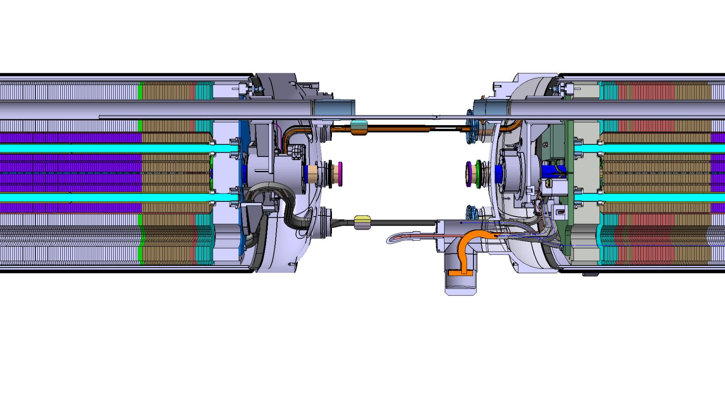
Cold Mass End Covers – Cryogenic Vessel Closures
CS end cover
NCS end cover
End covers are closing the volume of the cold masses in the extremities.
End covers volume houses the busses expansion loops and the spool pieces correctors.
Dished end covers can be used, flat ones also exist (SSS on the CS, HL-LHC cold masses). In this last case, material thickness must be adapted to sustain the pressure. It is not guaranteed that longitudinal space can be saved.

Slide 13
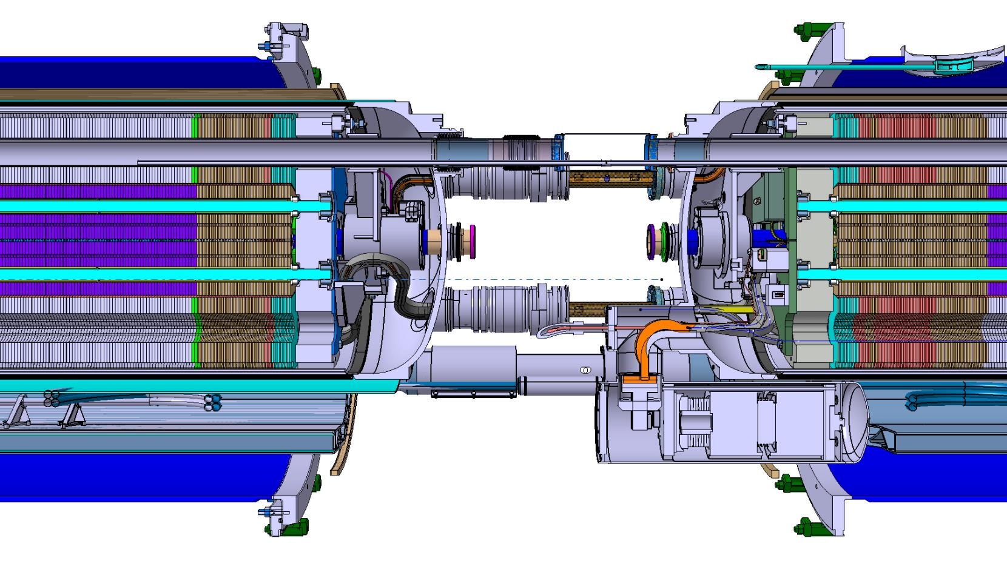
Interconnection of Cryogenic Transfer Lines and Busses
Interconnection bellows
Busbar splices
Longitudinal space between the end covers is needed to splice the busses and connect the magnets in series.
Cryogenic Transfer lines must be connected also to transfer helium from one volume to the other through bellows and to absorb the cold masses thermal contraction.
Protection Diode

Slide 14
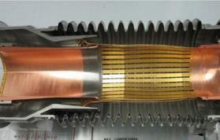
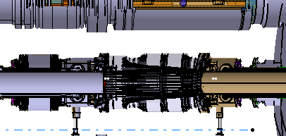
Interconnection of Beam Lines
CBT connection flange
Nested bellow
Exit tube
PIM
Exit tube
Along the beam lines, the following equipment must be located:
  The nested bellow to absorb thermal contraction between the beam screen and the cold bore tube.
  The beam screen cooling capillaries.
  The plug-in module (PIM) to provide RF continuity
In certain interconnections (not represented in this sketch)
  The beam pipe pumping lines.
  The pick-ups beam positioning monitors (BPM)

Slide 15
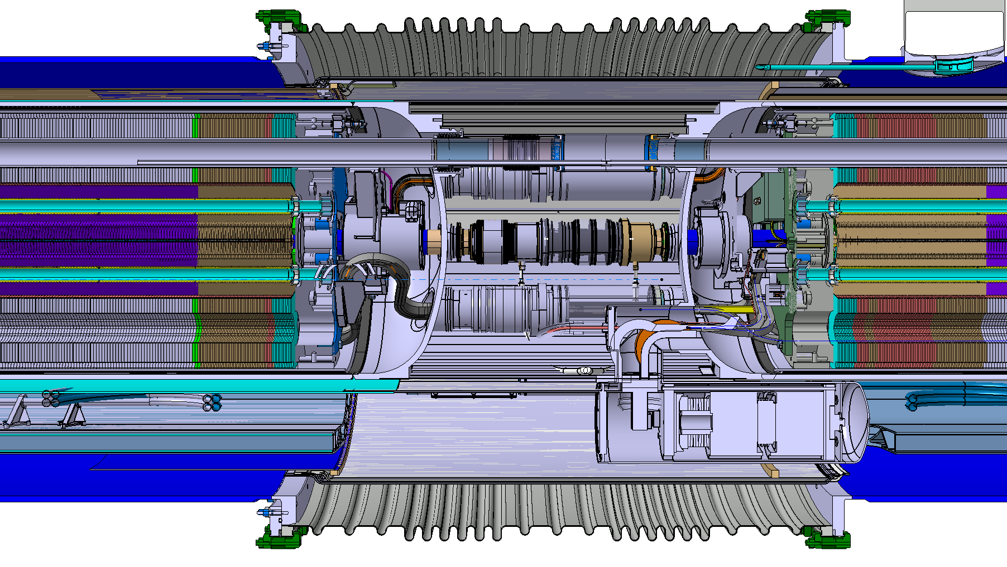
Closure of the Thermal Shield and Vacuum Envelope
s
e
FFML
ML
ML
Mag. Length

Slide 16
Field Free Length among the LHC and HL-LHC magnets with numbers
Upstream Magnet | Downstream Magnet | FFML (mm) | Comments
MB | MB | 1’360
MB | MQ | 2’365 | Busbar splices, MQT, MQS, MO corrector, BPM, drift tubes
MQ | MB | 2’365 | MSCB, busbars on top of the combined corrector
MB | MQM | 1’898
MB | MBH (11T) | 1’402.5 | Splice NbTi/Nb₃Sn
MBH (11T) | CWT | 1260.5 | Distance to Cold to Warm Transition extremity
MBH (11T) | MB | 1’402.5 | Symmetry
MQXFB | MQXFB | 2’090 | Q2A-Q2B interconnection for HL-LHC Flat end covers, Cryogenics distribution density, BPM, expansion loops on both sides, end plates thickness

Slide 17
Quantification length of items along the Free Field Length
 |  | MB (mm) | MBH(11T) (mm) | MQXFB (mm)
Magnetic length |  | 14’300 | 5’307 | 7’172
Coil length |  | 14’536 | 5’417 | 7’281
Magnetic Length/Coils | CS+NCS | 236 | 110 | 109
Coil head end spacers | CS | 17 | 160 | 171
 | NCS | 14 | 66 | 33
Longitudinal Constraint | CS | 70 | 93 | 115
 | NCS | 70 | 93 | 90
Magnet end plate/cold mass extremity Coil lead splices Busses Integration Insulation Assemblies Spool Piece Cold Mass Shells Cold Mass End Covers | CS | 226.5 | 226.5 | 228
 | NCS | 226.5 | 240.5 | NA
Interconnection of Cryogenic Transfer Lines and Busses |  | 500 | 500 | 1’000
Interconnexion of Beam Lines |  | 372 | 372 | 880

Slide 18
LHC Dipoles Interconnection
s
e
FFML = 1’360mm for MB/MB
1’402mm for MB/MBH
ML
ML
Mag. Length
500mm

Slide 19
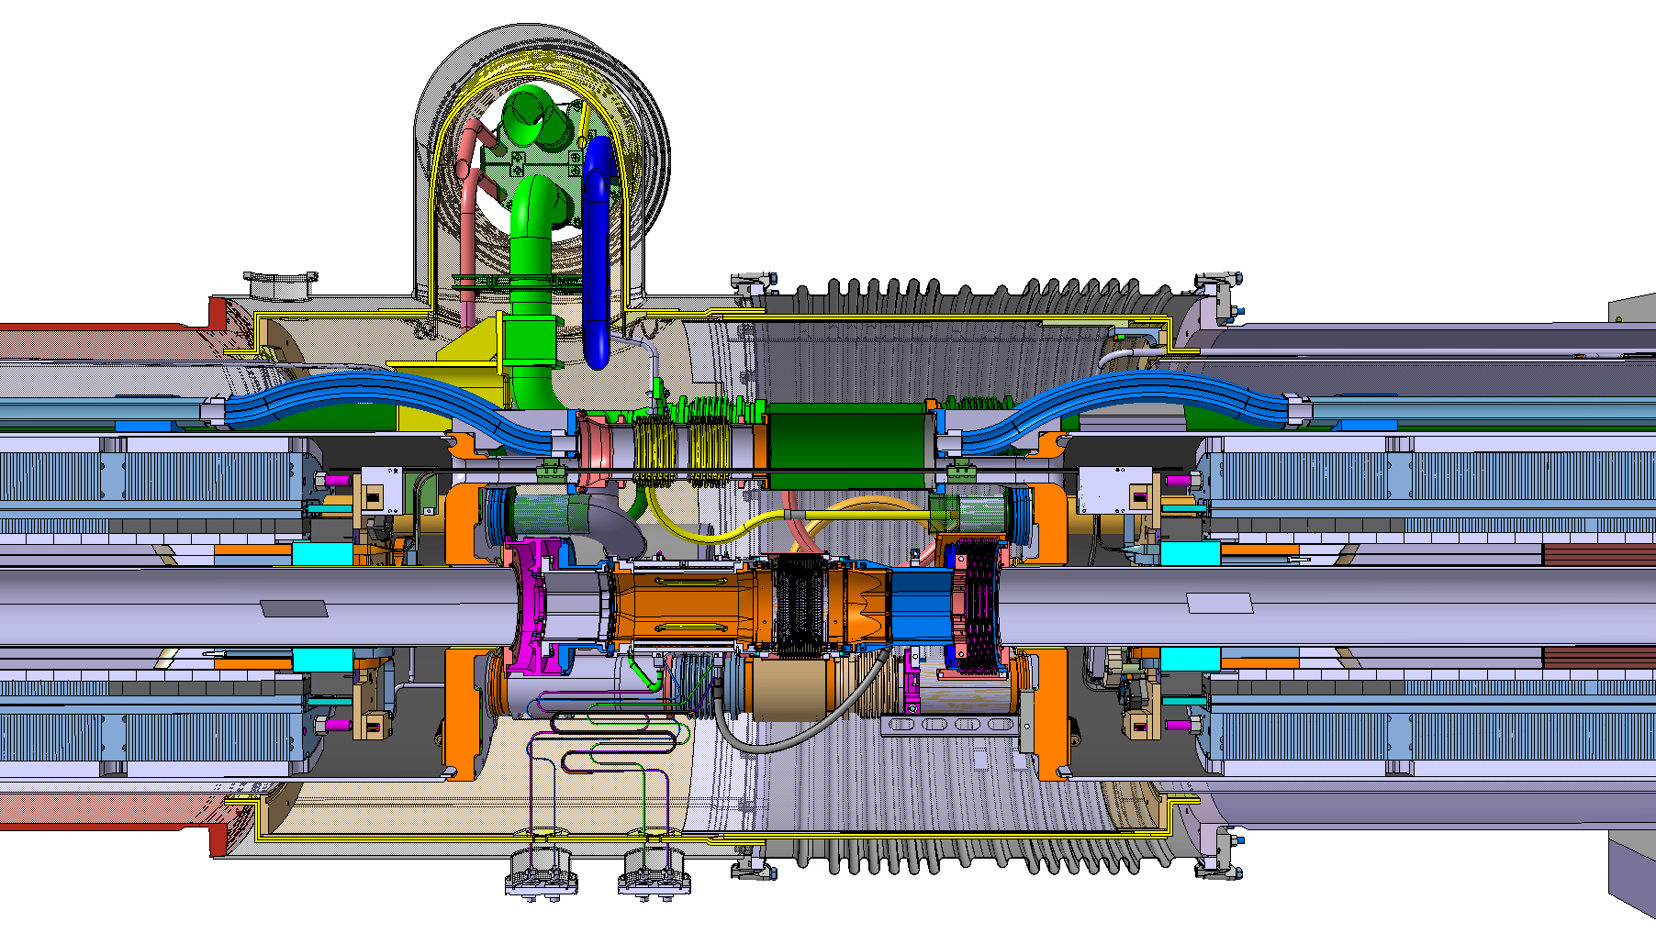
HL-LHC Inner Triplet Interconnection
s
e
FFML = 2’090mm for Q2A/Q2B in HL-LHC
ML
ML
Mag. Length
1000mm

Slide 20
Some ideas to minimize the FFML
Enhance the ratio of Magnetic Length/Coil length (coils head optimization, no splice in the interlayer…).
Minimize end spacer thickness, including the splice length and distance to the leads.
Optimize the longitudinal constraints & retaining system to fit closer to the coils head and reduce its thickness.
Integrate the busses expansion loops in parallel to the magnet yoke (see the example of the LHC arc SSS in the next slide).
Enhance the cold mass end cover design:
  Dished cap better to distribute the pressure ( thickness) but loss of volume,
  Flat cap for either increasing the volume on the outside or to get closer magnet extremity.
Develop the interconnection between the cold masses taking into account:
  For the beam line: the beam screen cooling lines continuity, the Plug In Module design to adapt the thermal expansion, the necessity of Beam Positioning Monitors, the beam vacuum pumping.
  For the ancillary lines: the splicing lengths (minimum one cable pitch for LHC), the welding accessibility, the opening procedures in case of consolidation or magnet exchange, the ergonomics…

Slide 21

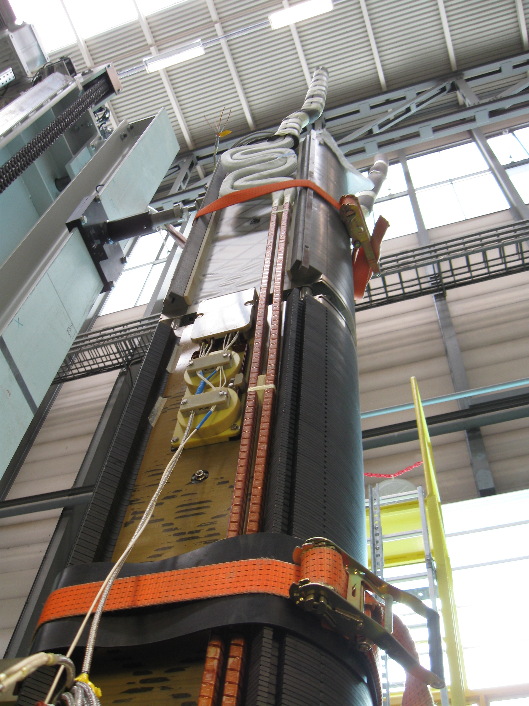
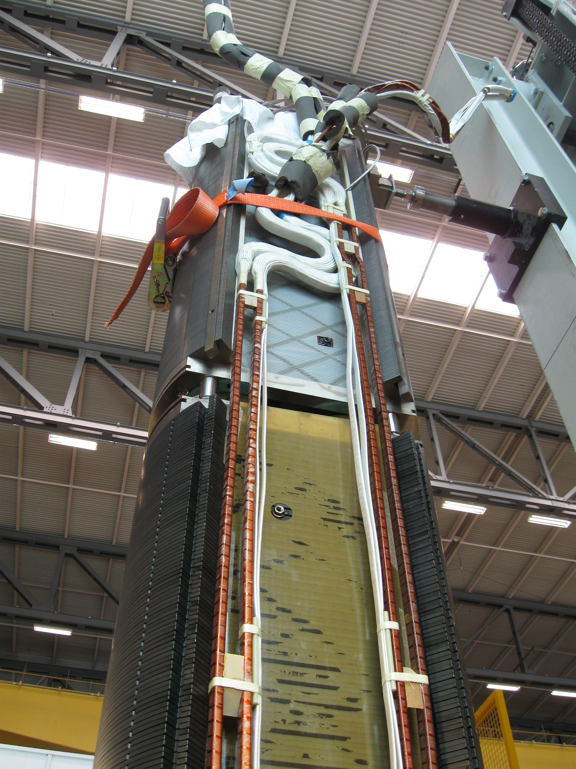
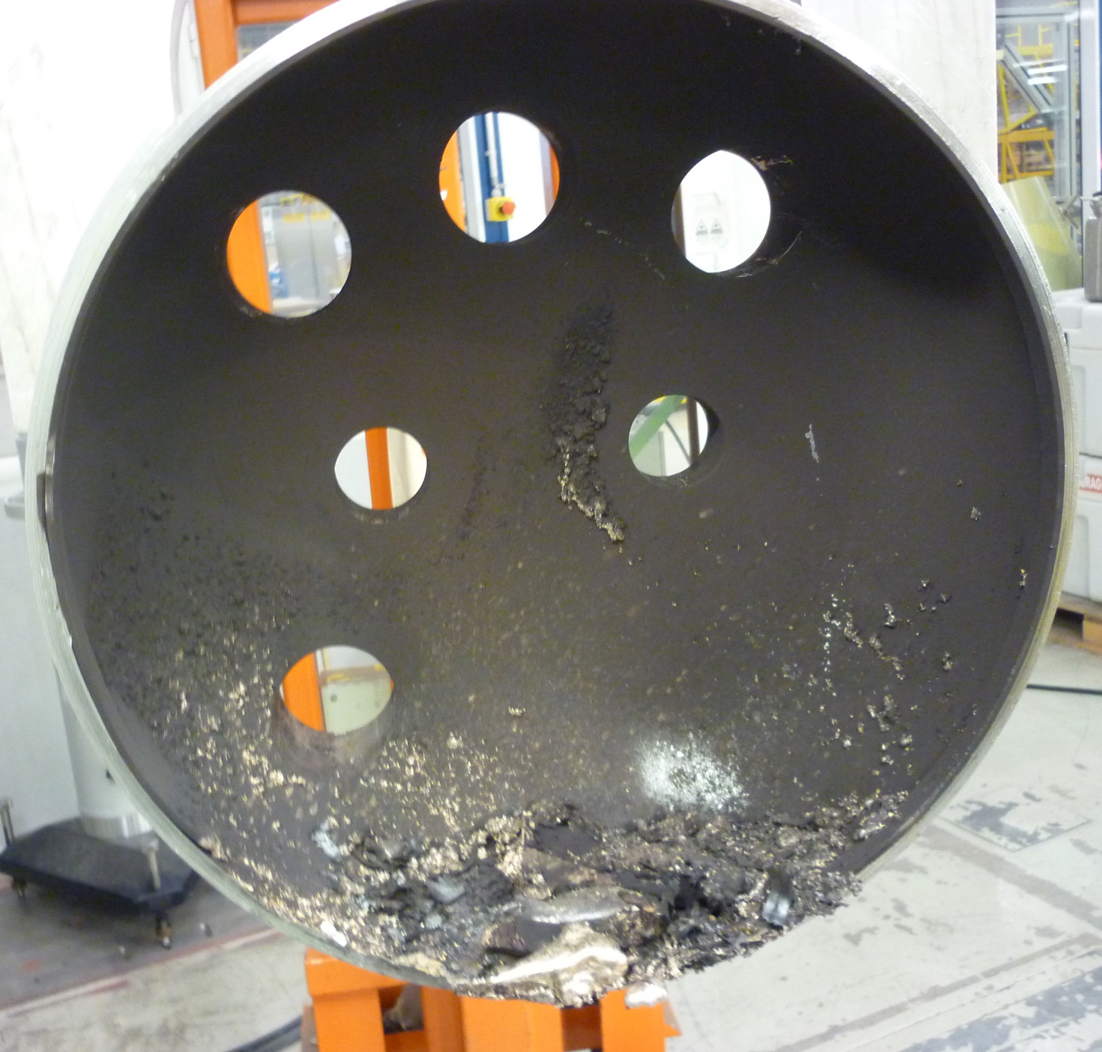
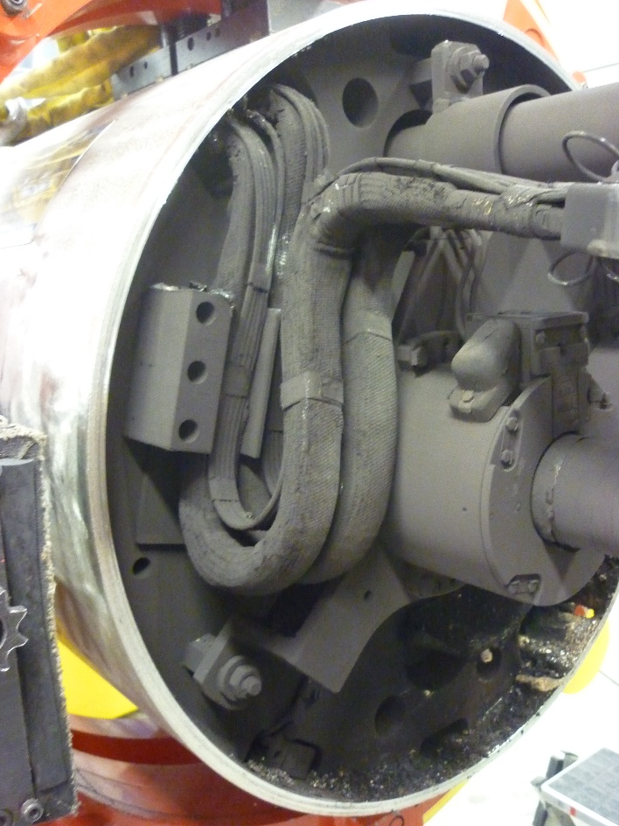
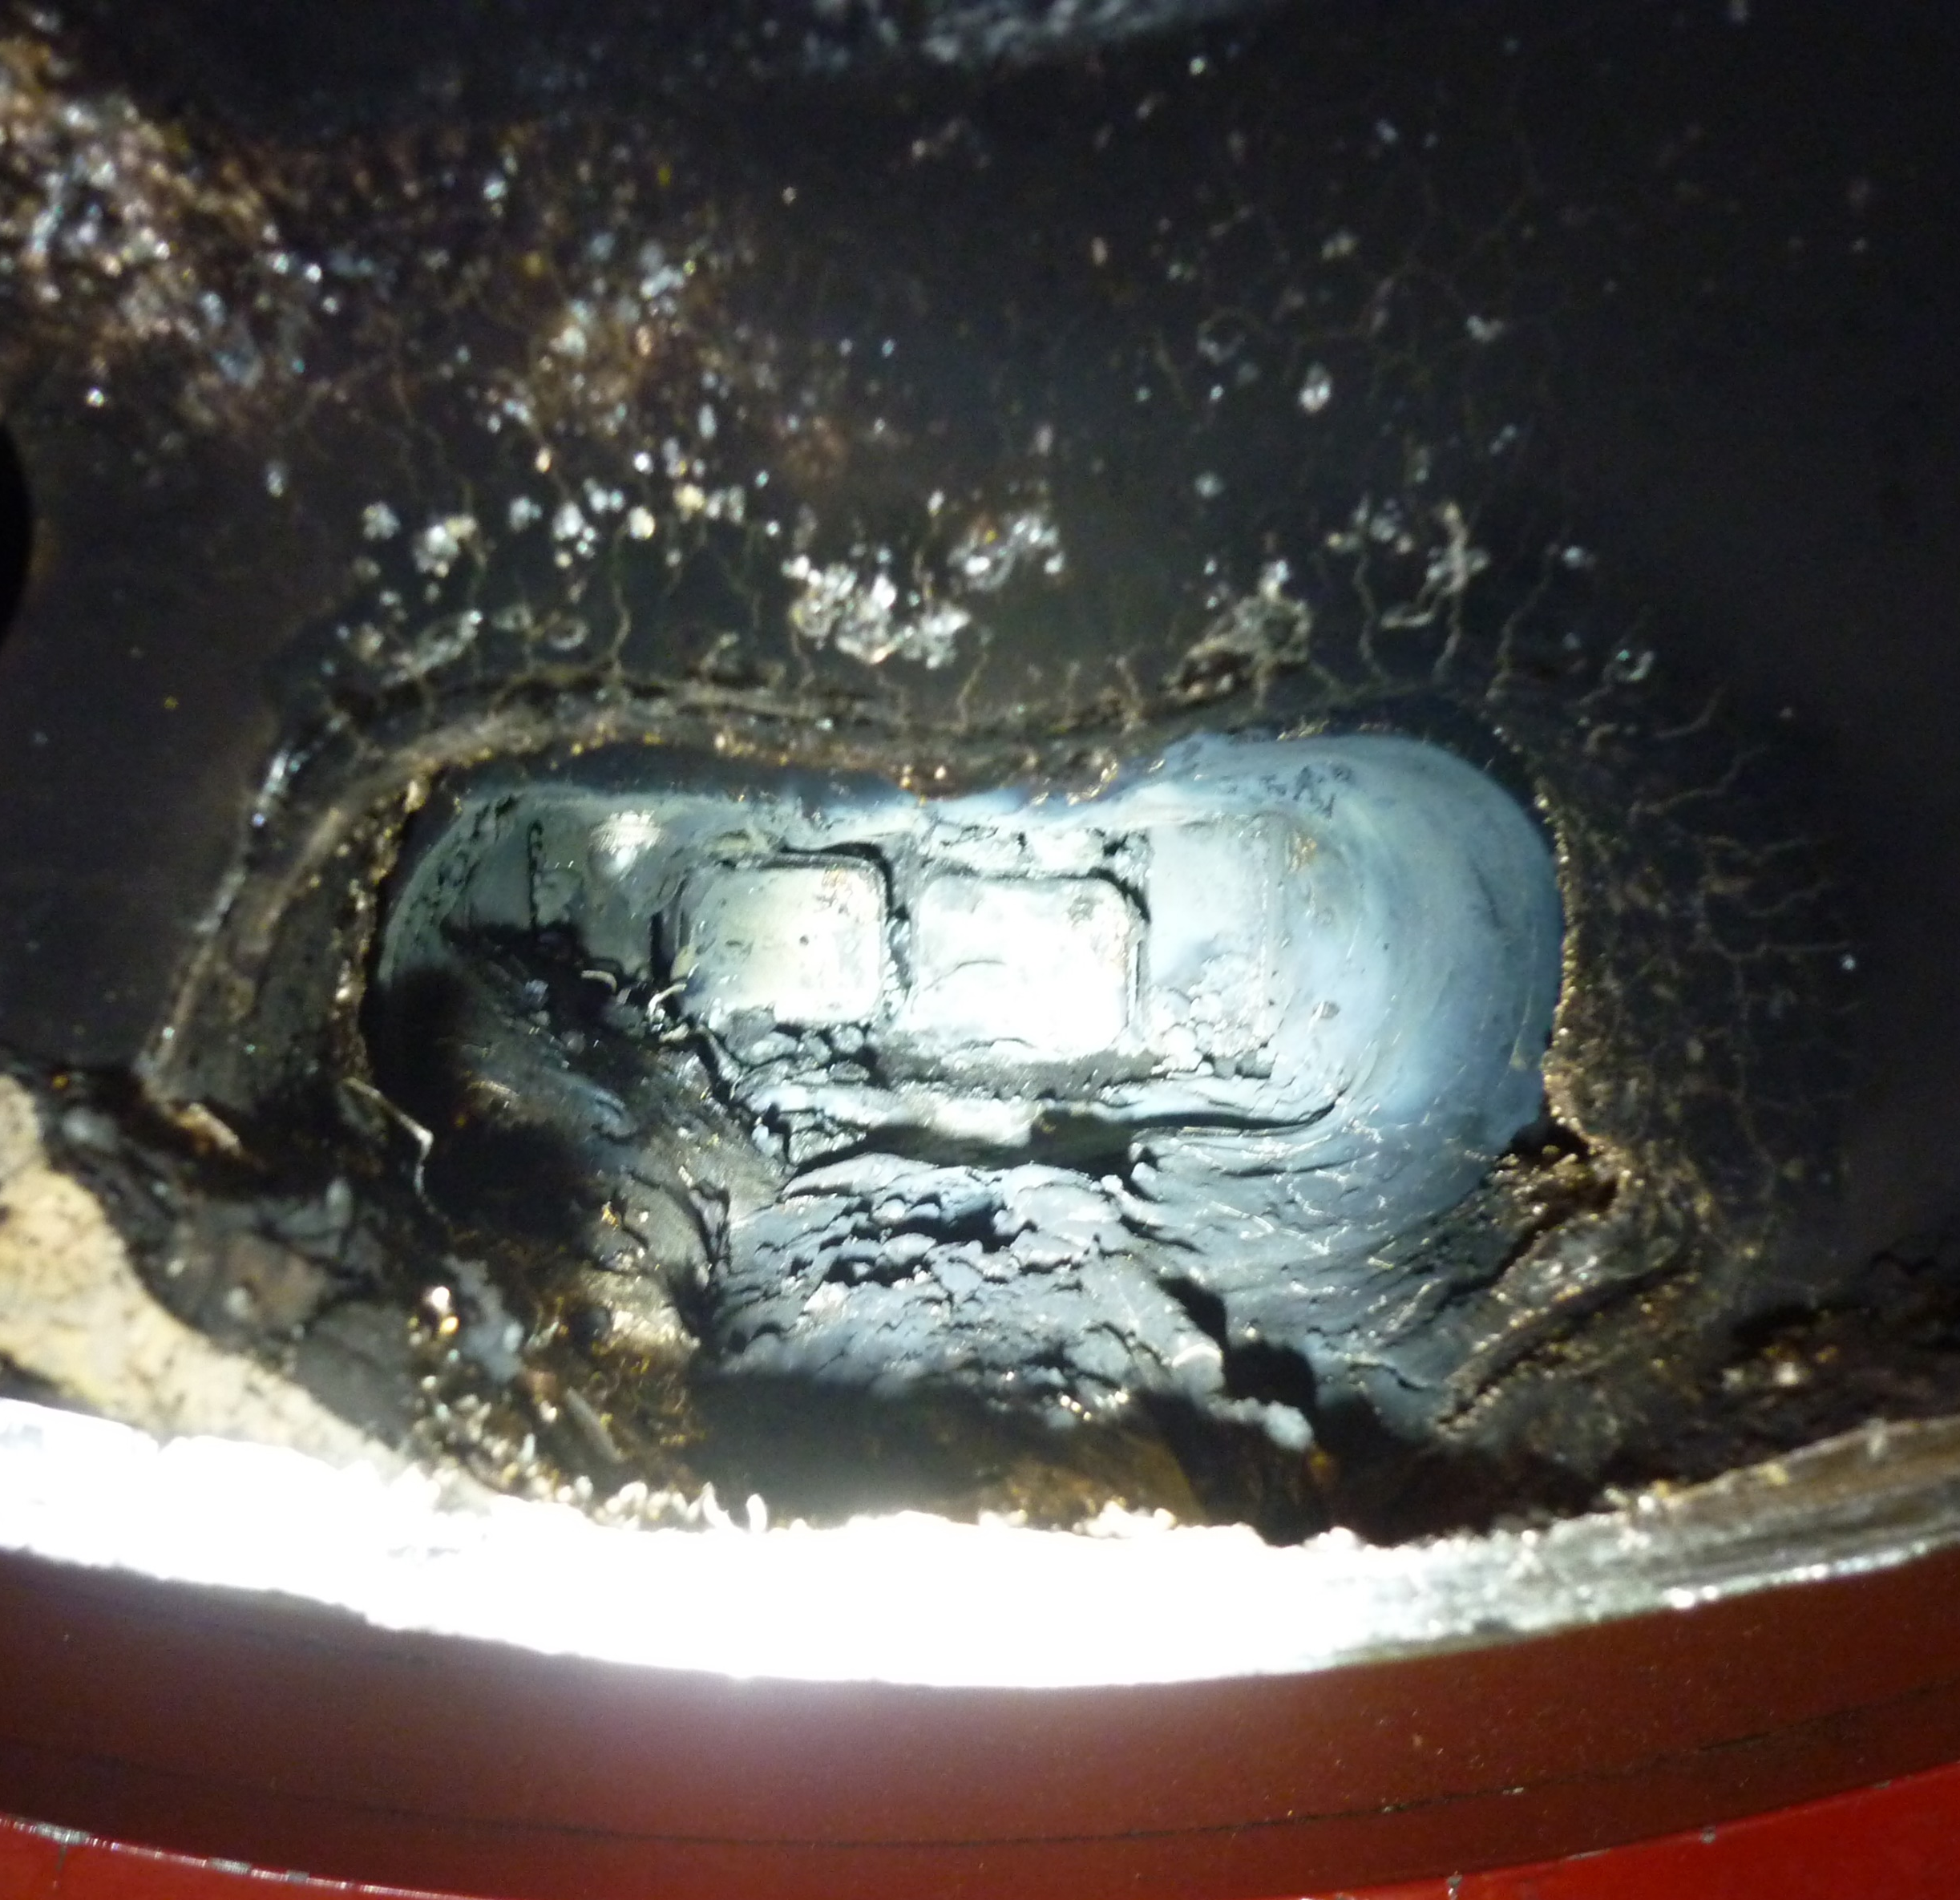
Example of Expansion loops integration inside the magnet yoke
LHC SSS MB busses integration inside the yoke
LHC SSS QF and QD busses busses integration inside the yoke
Integration to be carefully studied to prevent short to GND
Pictures of a short in MB1109 (C23R3).
226m away from the incident started in Sector 3-4 in 2008

Slide 22
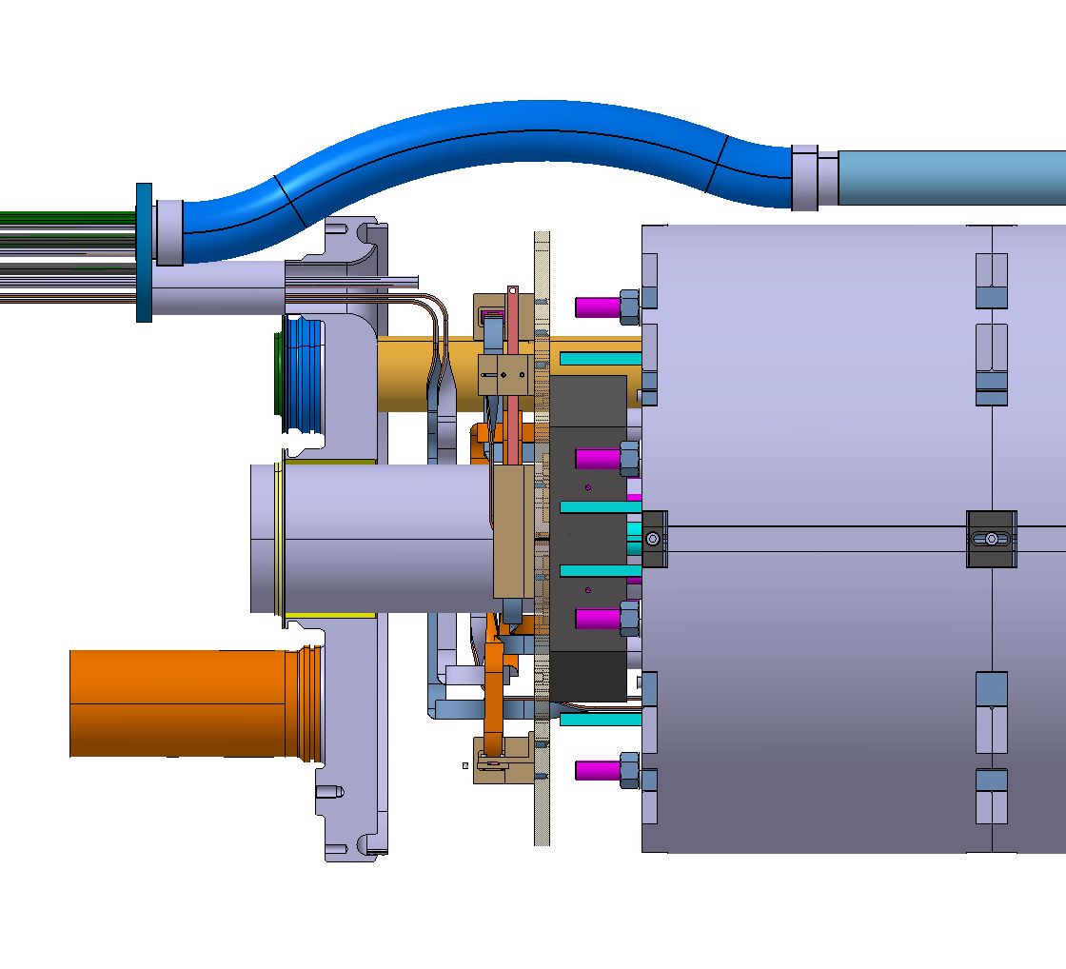
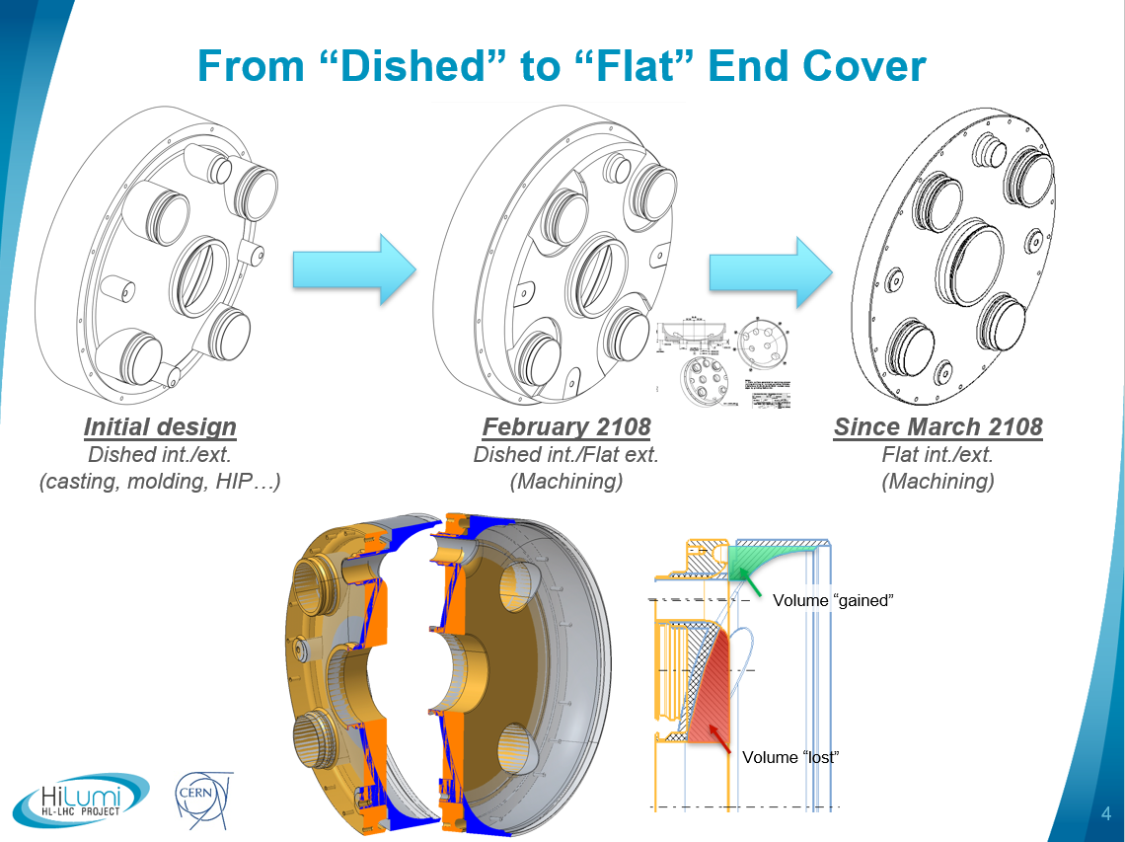
Cold mass end covers
End plate
+
Connection box
+
Leads
12mm thick
50mm thick

Slide 23
Summary
The LHC NbTi and HL-LHC Nb3Sn magnet configurations for mechanical components and their integration in the field free length were presented.
The situation in between two LHC main dipoles is one of the most advanced and optimized that could have been designed.
Only a few millimeters could have been gained here and there to minimize the field free length. In total this represents less that 10cm over 1.36m between the exit (s) of the magnetic length of a magnet and the entry (e) of its neighbor.
Alternatives are possible but should be considered carefully to guarantee safe operation.
For different technologies to the present superconducting magnet used in accelerator, not requiring HeII or beam screen cooling for example, the topology could be significantly different, but cold masses interconnections will still require longitudinal space to splice the busses, absorb the thermal dilatations and meet the needs in terms of ergonomics.

