Slide 1
GBT-FPGA Interface
Carson Teale

Slide 2
GBT
New radiation tolerant ASIC for bidirectional 4.8 Gb/s optical links to replace current timing, trigger, and control system of LHC experiments
Will be required when luminosity increases since the amount of data will also increase
GBT modules located at detectors

Slide 3
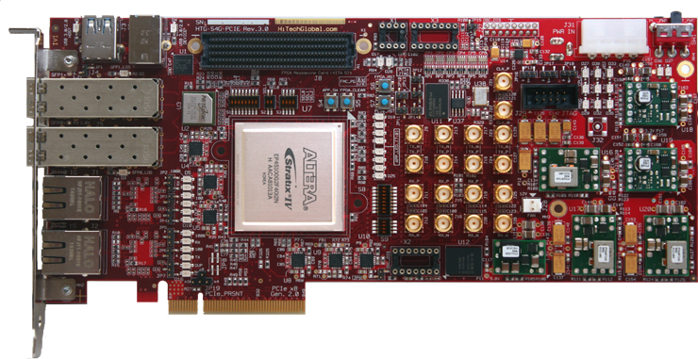
FPGA
Counting room electronics don’t need to be radiation hard
Implement transceiver using commercial FPGA
High Tech Global board with Altera Stratix IV FPGA and two SFP+ transceivers.
SFP+ transceivers
Stratix IV FPGA

Slide 4
GBT Module
PC running Linux
RAM
2GB DDR2 800MHz
GBT 4.8Gb/s
HTG Dev board
DMA Controller
SFP+
SFP+
Stratix IV FPGA
PCIe 2 8x
32 Gb/s
Intel Core 2 Duo

Slide 5
What I’ve done since last time
I’ve been modifying a linux driver
  Changing configurations in driver to match those of the PCI IP core in the FPGA
  Updating code for newer kernel
Testing GBT interfacing code through internal loopback
  Make sure process of receiving and transmitting data using GBT protocol is working on FPGA end
  Debugging using LEDs and maybe simulations

Slide 6
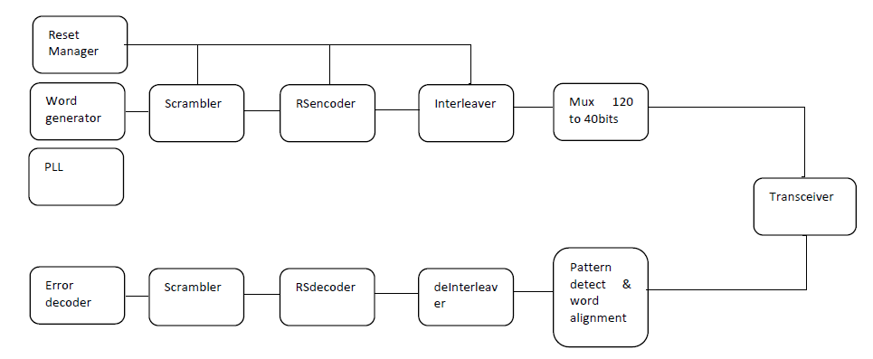
GBT Serialization-Deserialization Procedure
Transmitting
Receiving

Slide 7
What I need to do
Fix problems with the linux DMA driver and modify it to allow board to read/write to memory through PCIe bus
Interface with GBT module using SFP+ transceiver
Run tests to verify speed and accuracy of GBT module

Slide 8


