Slide 1
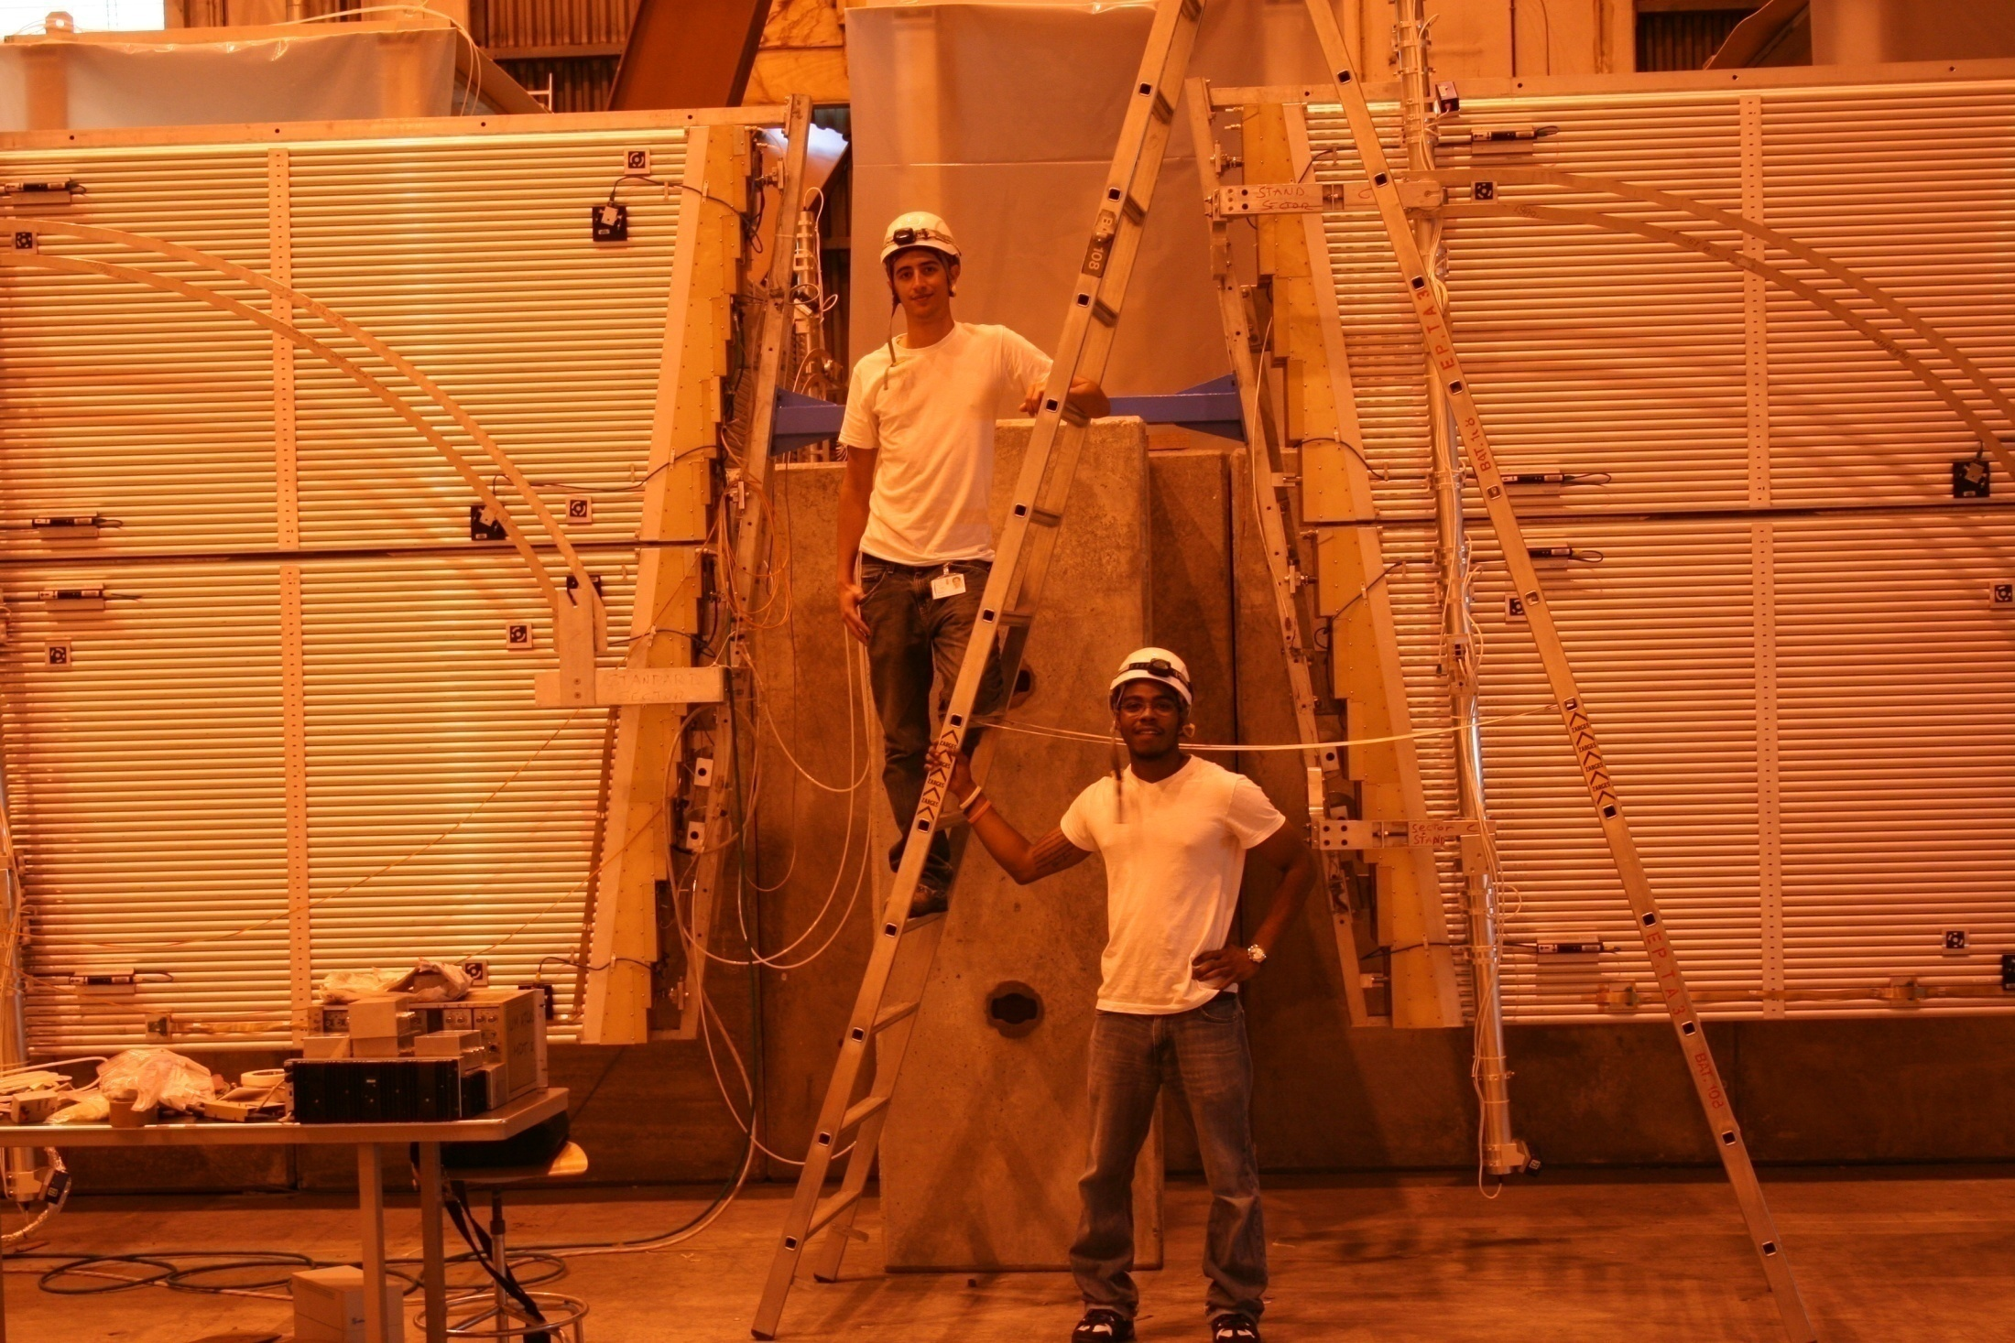
EE Chamber Commissioning
By: Eric Seabron

Slide 2
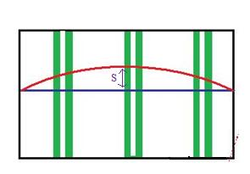
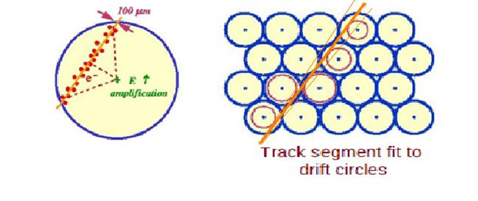
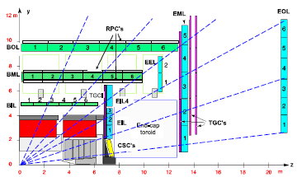

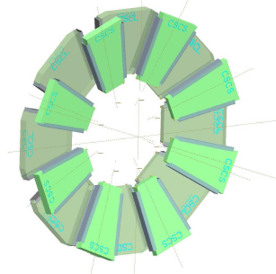

Slide 3

How to find Momentum using MDTs
Find To Values => t – to = td
Create R-T functions to find drift radius (rd) where, rd ≡ f(td)
R = Rd ± r where,
r ≡ Resolution Function
R values are used to find the Sagitta value (S)
N = # of position measurements
k = distance between each measurement

Slide 4
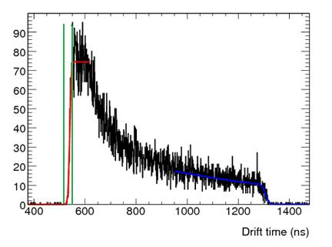
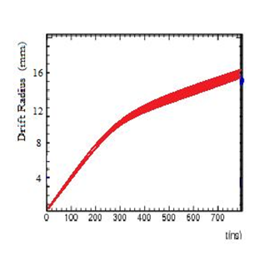
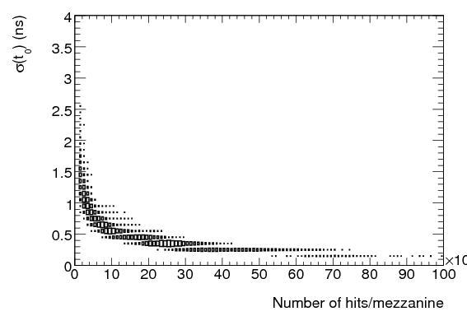
To Values & R-T Graphs

Slide 5
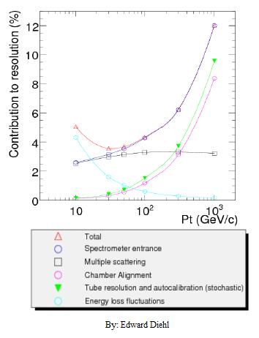
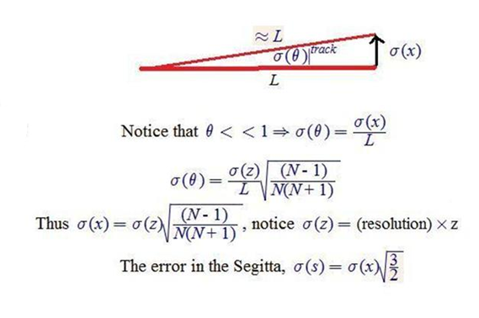
Tracking Resolution

Slide 6
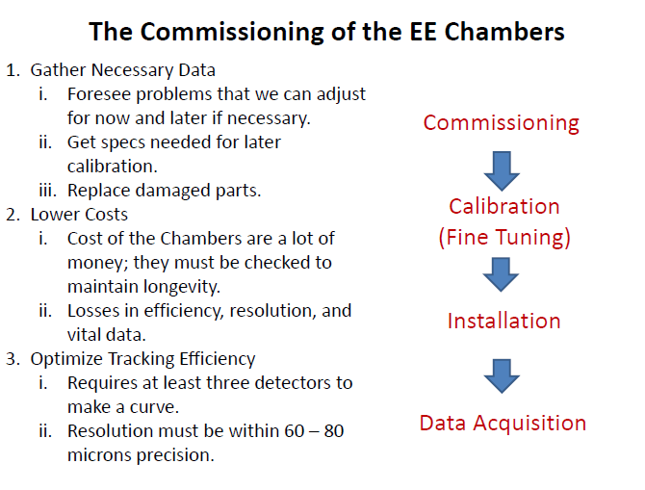

Slide 7
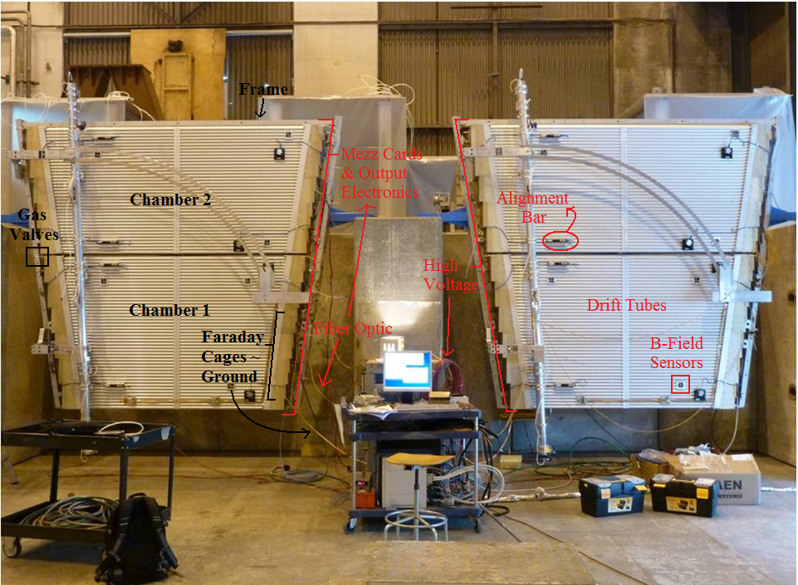

Slide 8

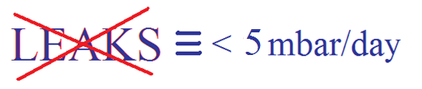
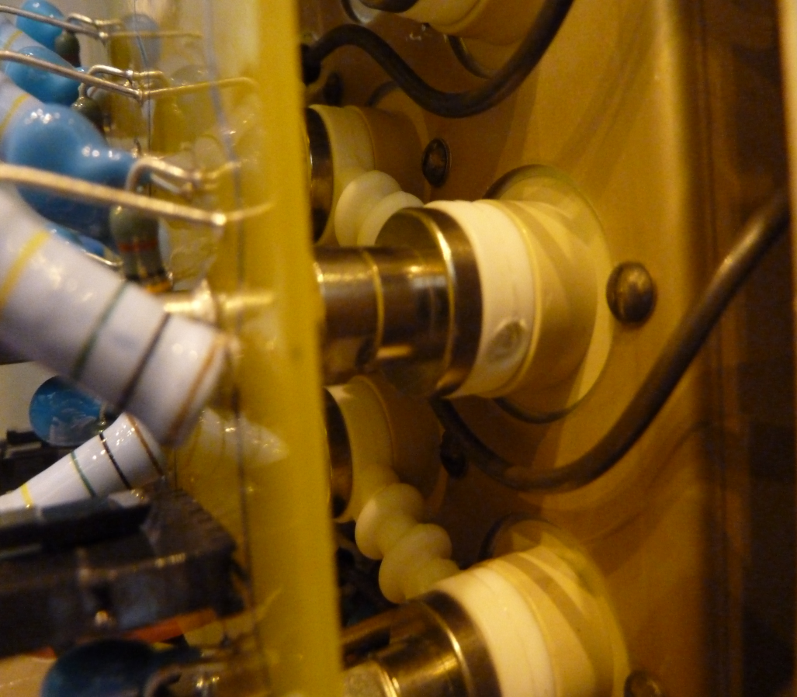

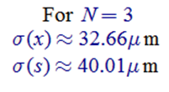

Slide 9
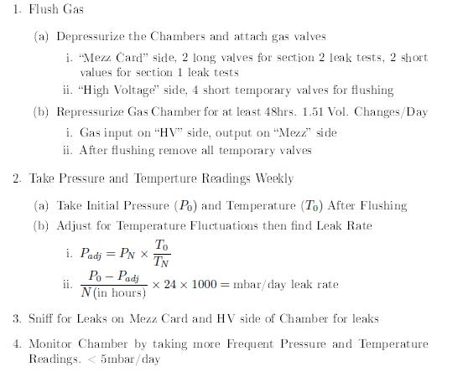
Finding Leaks and Fixing Leaks

Slide 10
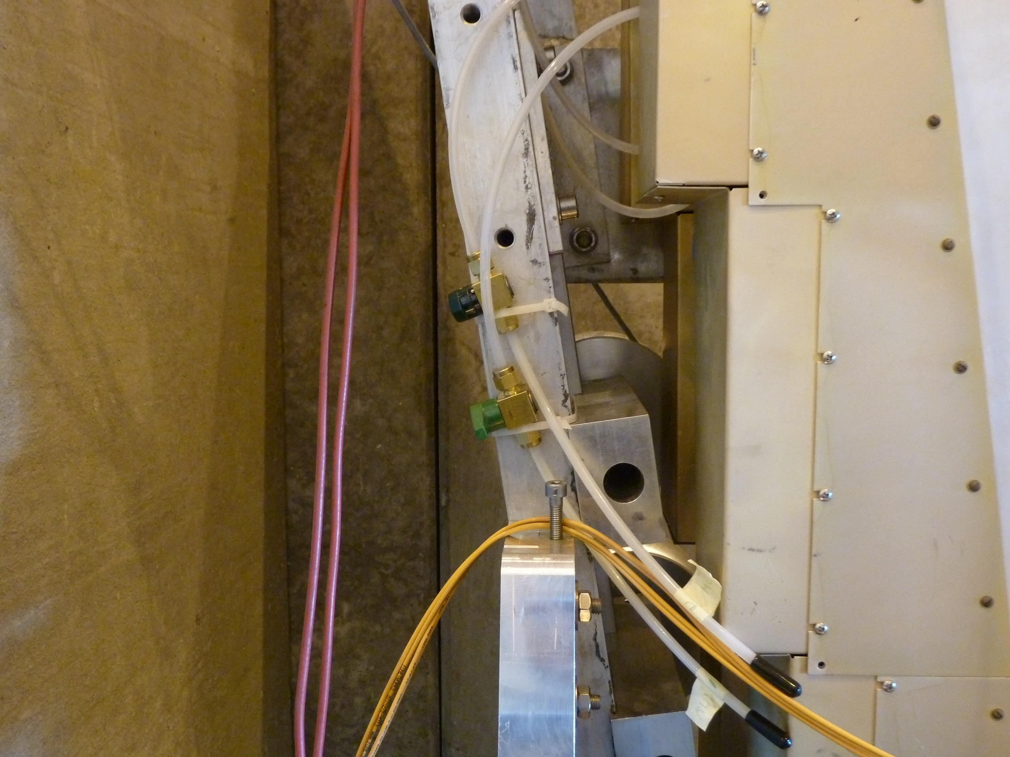
~5.18 Volume Exchanges/Day

Slide 12
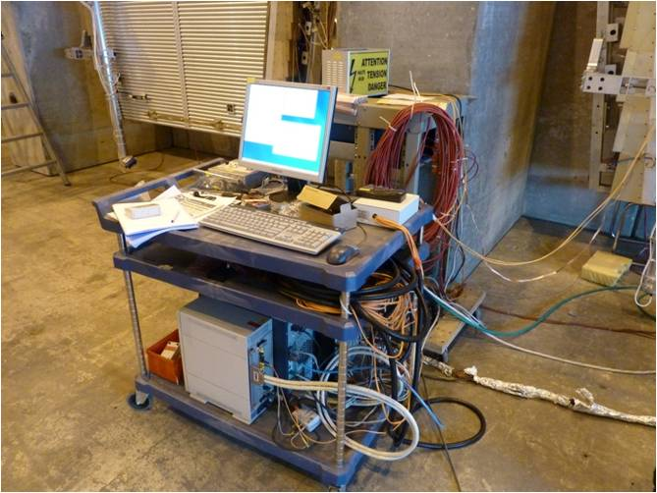
Low Voltage Electronics Testing
1) Stress Test with 3-15 hour High Voltage Tests
2) Look for Errors and Bugs which indicate faulty electronics
3) Replace Faulty Electronics and Restart HV Stress Tests
If Lucky the Chambers will pass all tests and can be put back in storage
DAQ System

Slide 13
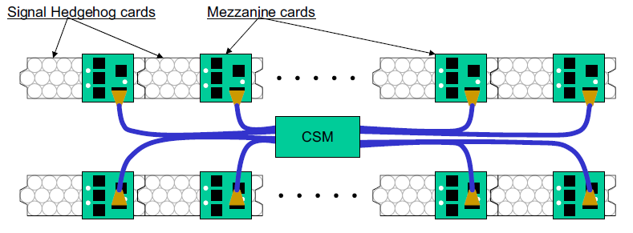
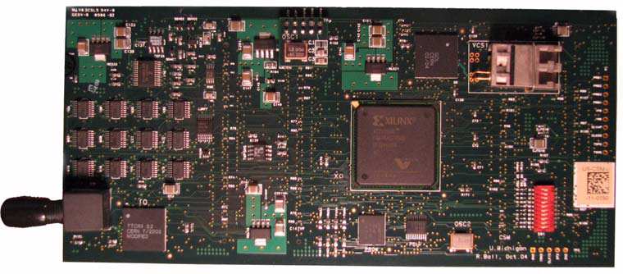
•The Mezzanine card processes 24 tubes using 3 ASD (Amplifier Shaper Discriminator) chips and a TDC (Time to Digital Converter) chip.
•The CSM uses an passive interconnection of all 18 Mezz Cards to obtain is data which it sorts through using a active components including a Multiplexer.
CSM Board

Slide 14
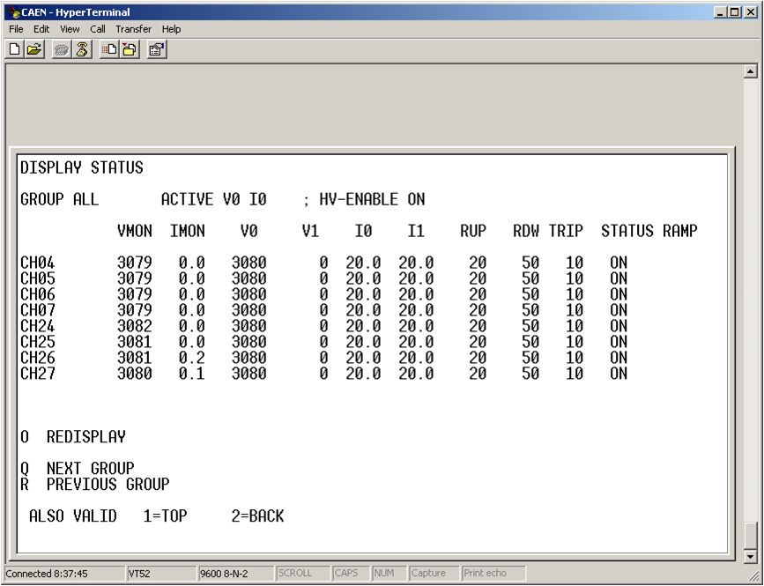
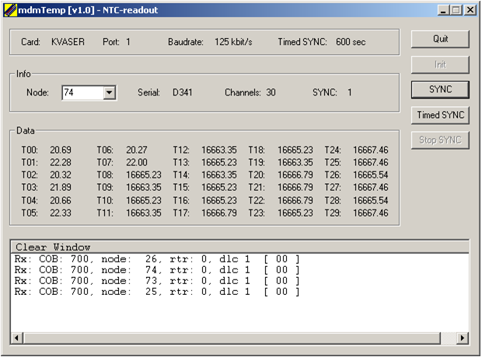
Dark Currents
< 2uA
Chamber Temperature Probes

Slide 15
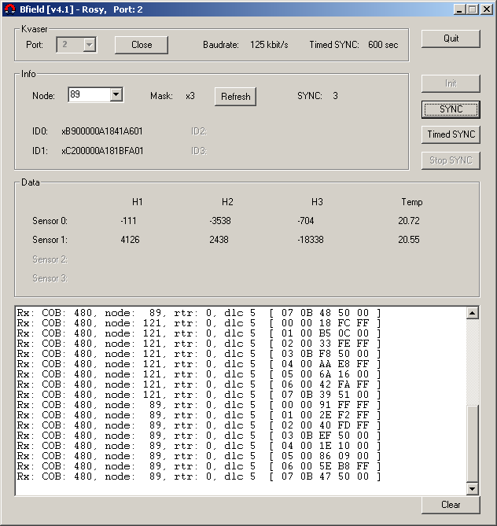
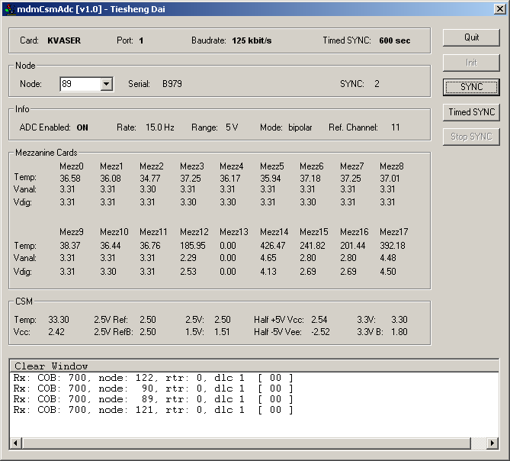
B-Field
Irregular Magnetometer Reading
Mezz Temp. Probes

Slide 16
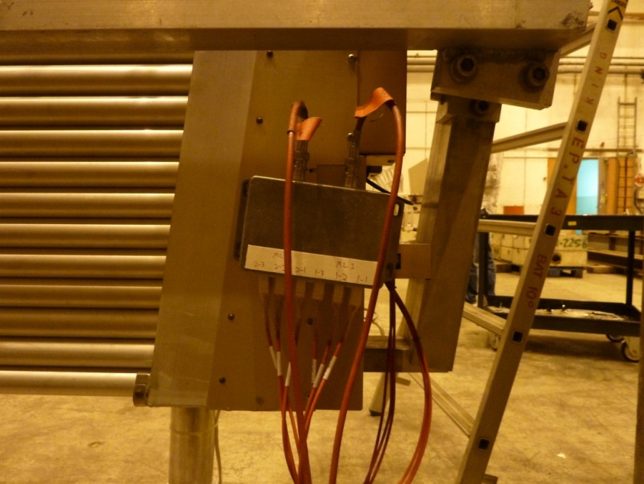
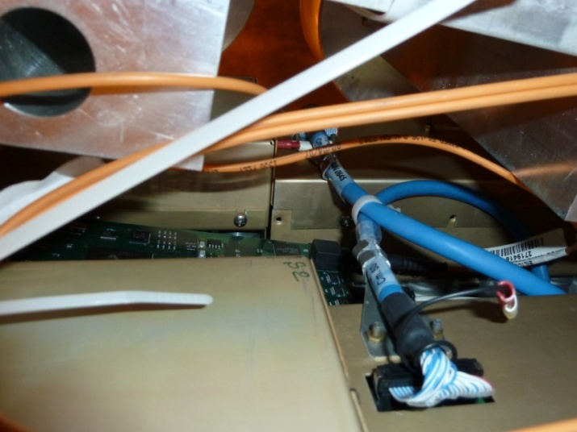
More Electronics Hardware
We must remove screws between the multilayers from electronics covers for easier access to the Mezz Cards in the pit.
Reinstall mounting plates for HV splitter boxes with better fortified copper plate backs.

Slide 17
Summary
In total we …
Commissioned 8 sectors ~ 16 Chambers.
Removed >1000 screws.
Installed 16 HV boxes.
Ran >80 stress tests.
Intimately learned about the EE Chambers … we treated each one as if it were our own.
Our Commissioning Team:
Kareem Hegazy, Rex Brown, Eric Seabron, Lulu Liu, Dr. Junjie, Dr. Bing, Dr. Tiesheng, Dr. Jianbei
Questions???

