Slide 1
Study of Single and Diboson Z Production at the LHC
David Sweigart
Massimiliano Bellomo, Supervisor
Matthias Schott, Supervisor
European Organization for Nuclear Research
11 August 2011

Slide 2


A Toroidal LHC ApparauS
Particles decay rapidly after being formed
End products interact with ATLAS detector
Identified by a series of sub-detectors
Goal: Measure properties for general study
  Used to search for Higgs, SUSY, etc.
ATLAS

Slide 3
Data Analysis
Small groups use the stored data to explore the high energy frontier for new discoveries
Create sophisticated data analysis programs to find interesting events for their searches
Rigorous data analysis can easily take up to several months to complete

Slide 4
My Project
Goal: To understand how data analysis is used in high energy physics
Simple Data Analysis Program
Coded program to understand fundamentals of data analysis
Single Z Production
Used my group’s code to look for Z→μμ channel
Double Z Production
Modify code to instead look for ZZ→μμνν channel

Slide 5
Simple Data Analysis Program
Most data analysis programs are composed
of the same basic structure
Cut-based approach: loop through events and apply some selection criteria to each particle
Objective: Emphasize the signal of desired process by reducing the background noise

Slide 6
Simple Data Analysis Program
List of
data files
ROOT
Read Event
Cutflow:
At least one muon in event
|η| < 2.4
p_{T} > 20 GeV
E_{T}^{MISS} > 25 GeV
M_{T} > 40 GeV
Good Run List
Require event to be in the GRL
Read Muon
Cuts
Require muons to satisfy specific conditions
Fill Histograms
Submit to Cluster
Loop through Muons
Loop through Events

Slide 7
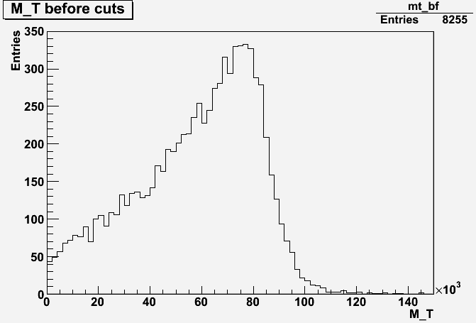
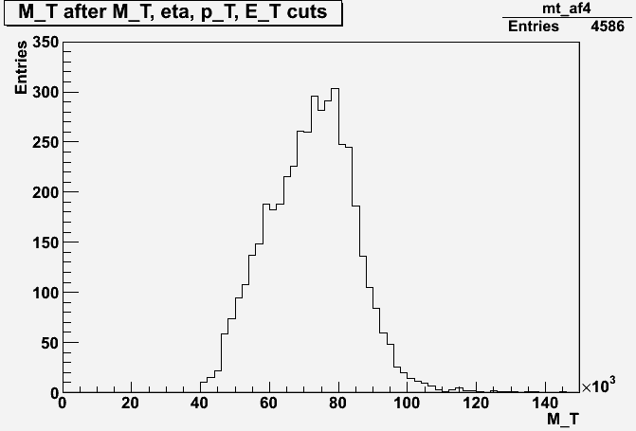
Simple Data Analysis Program
55.6 +- 0.6% (stat)
(MeV)
(MeV)
Transverse mass of muons before cuts
Transverse mass of muons after cuts on M_{T}, η, p_{T}, E_{T}^{MISS}
Removed low energy background
Produced sharper peak around 80 GeV
Acceptance of 55.6±0.6% (stat)

Slide 8
Single Z Production
Switched over to W/Z Data Analysis group’s cut-based code
Goal: “Rediscover” single Z boson production in Z→μμ channel using 0.84 fb⁻¹ of 2011 data
  Need to always be able to reproduce results to show that we understand our experiment
  Z boson is an excellent test because we know its mass and width to a very high precision

Slide 9
Single Z Production
Implemented analysis code to run on 2011 data and MC simulations
Applied MC corrections:
  Pileup reweighting tool: To correct for different pileup conditions between data and simulations
  Smearing: To better match the inherently worse muon momentum resolution in the data
Applied “base” cuts:
  GRL, trigger, primary vertex, basic dimuon identification, and dimuon quality cuts

Slide 10
Single Z Production
Applied “extra” cuts:
  Pair of oppositely charged muons
  76 < m_{μμ} < 106 GeV
Invariant mass after base cuts
Invariant mass after base + extra cuts

Slide 11
Diboson Z Production
Important test on high energy behavior of electroweak interactions via gauge couplings
Anomalous coupling will cause enhanced diboson production cross-sections
Allows us to set limits on many theories predicting physics beyond SM

Slide 12
Diboson Z Production
Goal: Study diboson Z production in the ZZ→μμνν channel
Axial component of E_{T}^{MISS} cut
  Neutrinos are almost back-to-back
  E_{T}^{MISS} is in opposite direction of other Z boson
  Mathematically:
No jets with p_{T} > 20 GeV cut
  Reduces background from the tt events
-

Slide 13
Diboson Z Production
E_{T}^{MISS,Ax} after base + extra cuts
E_{T}^{MISS,Ax} after base + extra
+ E_{T}^{MISS,Ax} + jet cuts
Background has been further reduced
ZZ process slightly more prominent at higher energies
Further study needed to draw conclusions

Slide 14
Future Study
Apply further MC corrections such as for muon identification efficiency
Calculate corresponding cross-sections for single and diboson Z production
Compare results with theory
  Could serve as a stringent test of the SM and potentially indicate the presence of new physics

Slide 15
Summary
Exposed to how data analysis is used in high energy physics
Learned how to implement some of the basic techniques in this field
  Programming in ROOT
  Implementing cuts
  Running jobs on the cluster
  Applying MC corrections
Acquired a new understanding of what it is like to be a high energy physicist

Slide 16



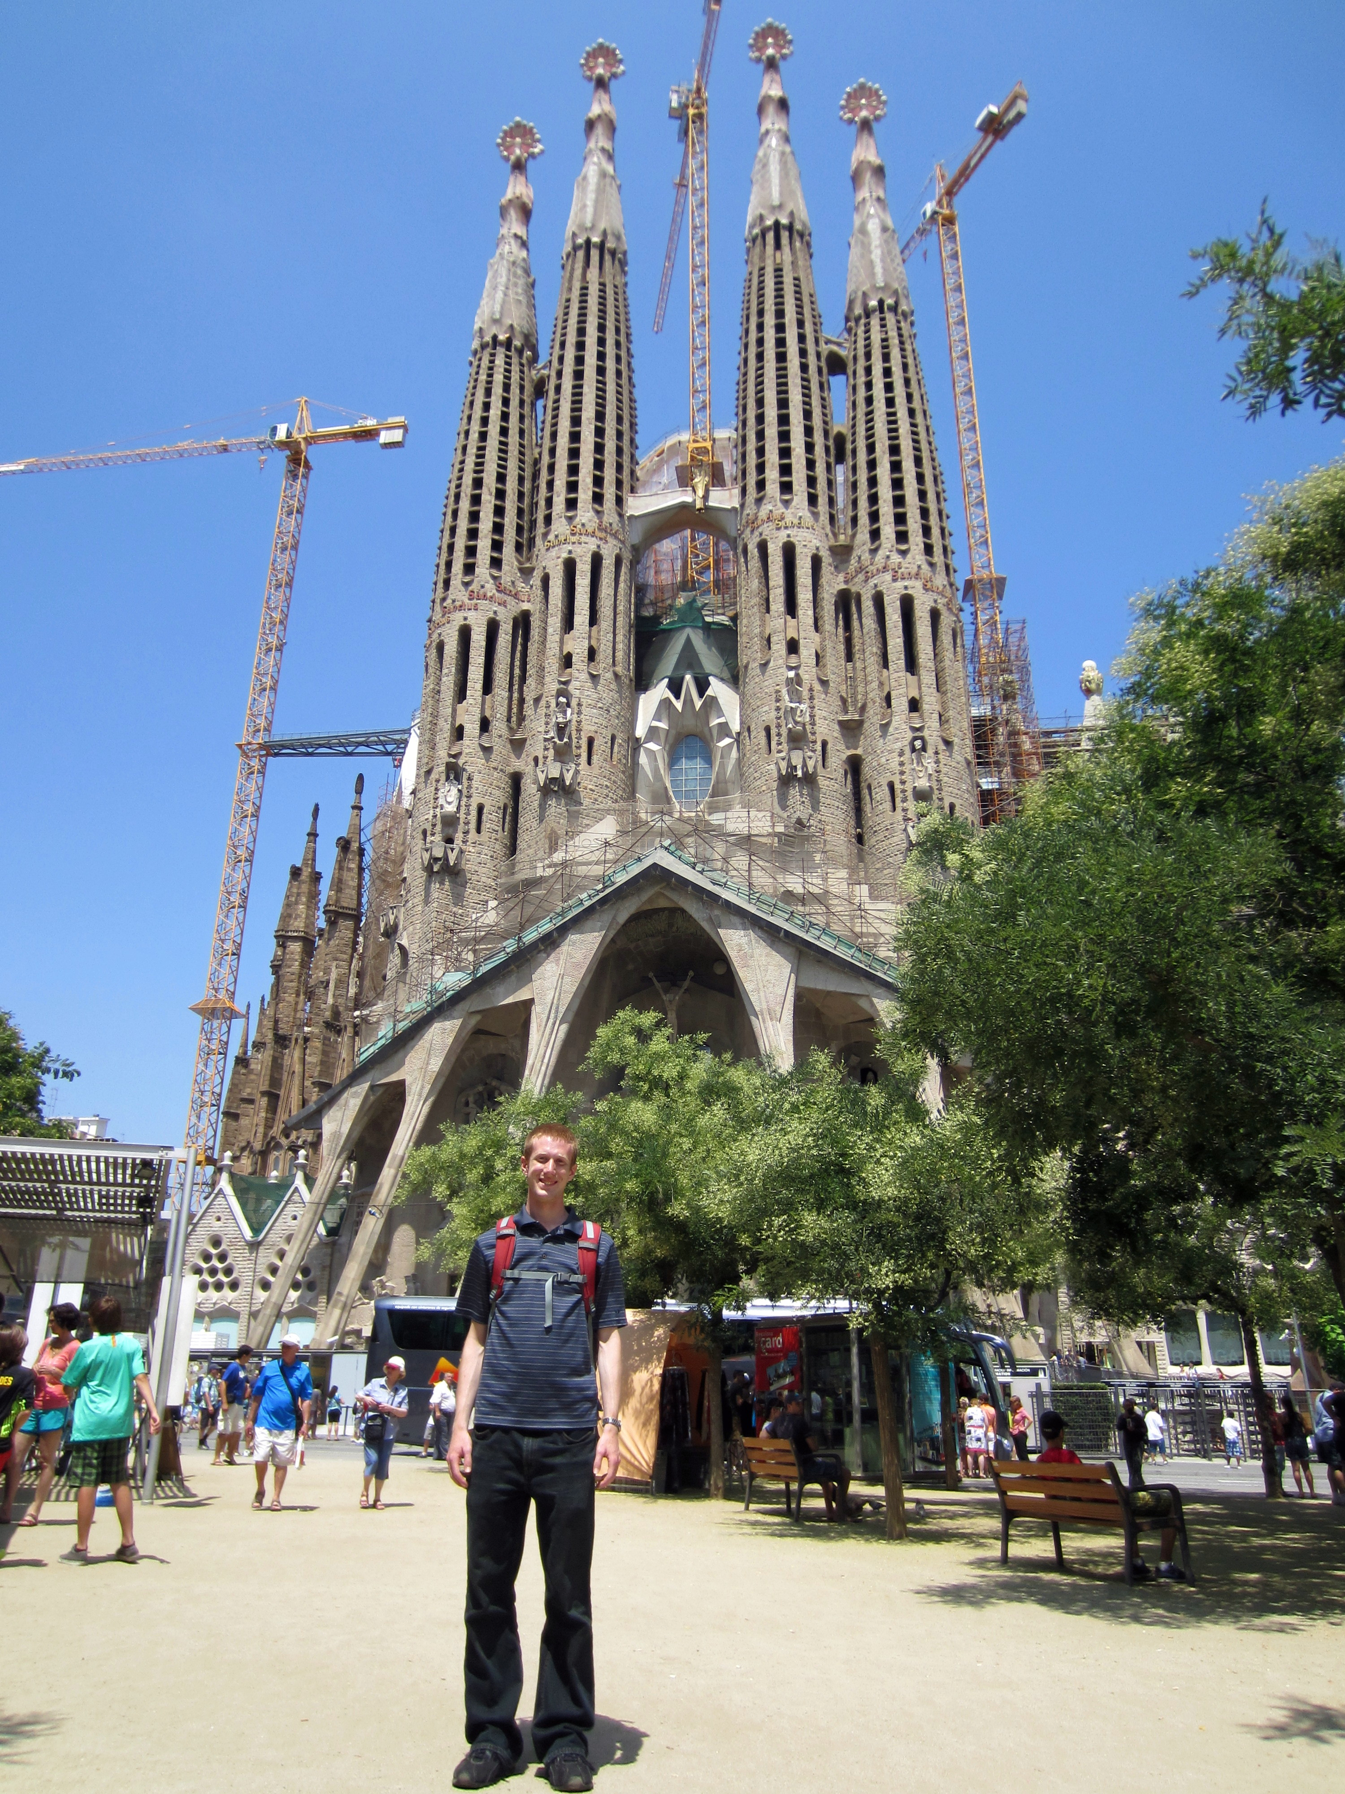


Colosseum
Matterhorn
Eiffel Tower
Tour of Europe
La Sagrada Família
Berlin Wall
Houses of Pariament

