Slide 1
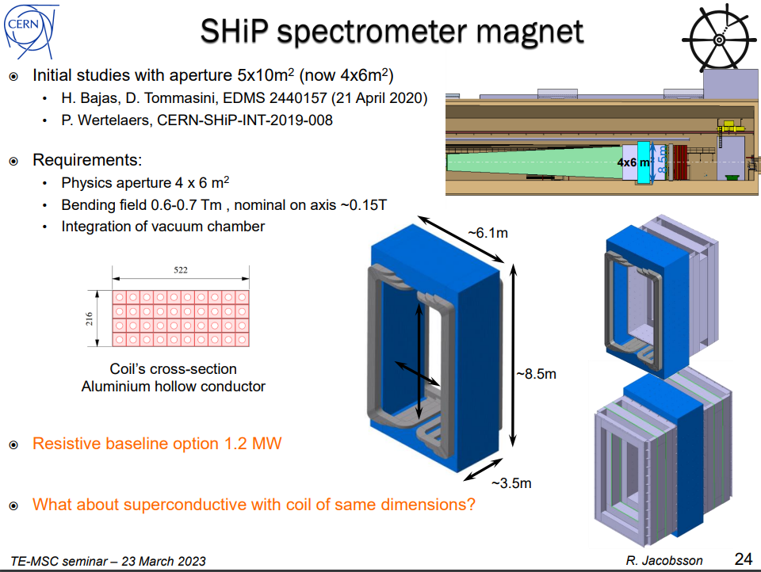
Requirements/Specifications
In Hugo’s report, 0.65 T.m, from -2.5 m to +2.5 m along magnetic axis with respect to the magnet center, without reference

Slide 2
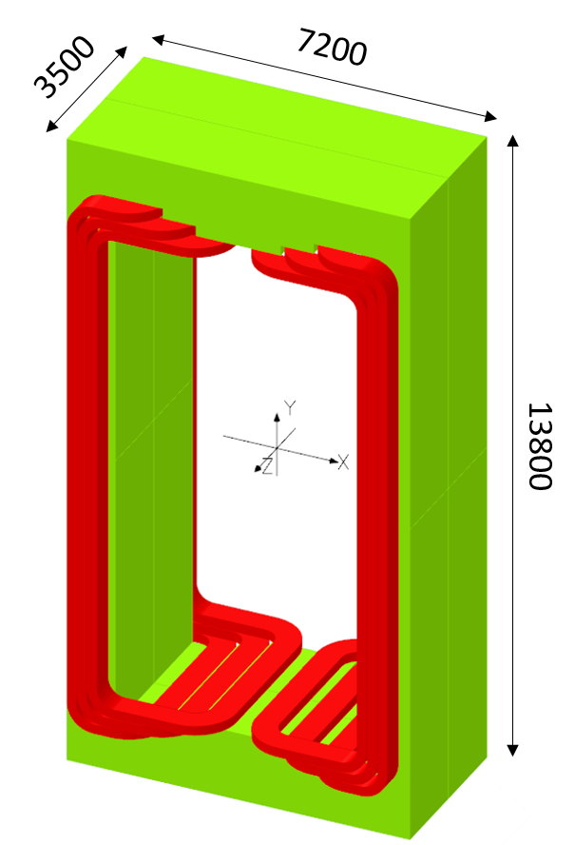
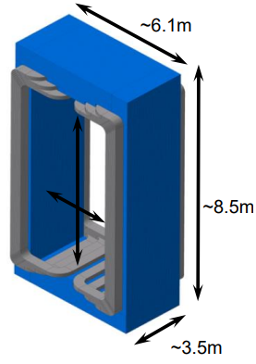
Analytical formulation
 |  |  |  |  | Bedstead shape | Racetrack Shape
 |  | Hugo Resistive | Hugo Nb3Sn | Hugo MgB2 | MgB2 N72 | MgB2 N72
Acceptance Vertical | mm | 10000 | 10000 | 10000 | 6000 | 6000
Acceptance Horizontal | mm | 5000 | 5000 | 5000 | 4000 | 4000
Space reservation Vacuum vessel | mm | 100 | 100 | 100 | 100 | 100
Space reservation Coil support | mm | 100 | 100 | 100 | 100 | 100
Longitudinal | mm | 4000 | 4000 | 4000 | 4000 | 4000
Backleg thickness vertical | mm | 1000 | 1000 | 1000 | 1000 | 1000
Backleg thickness horizontal | mm | 1500 | 1500 | 1500 | 1500 | 1500
Backleg depth longi | mm | 3500 | 3500 | 3500 | 3500 | 3500
Mass of iron | tons | 1125 | 1125 | 1125 | 832 | 832
Gap | mm | 5400 | 5400 | 5400 | 4400 | 4400
Magnet efficiency | [-] | 0.9 | 0.9 | 0.9 | 0.9 | 0.9
B0 at I operation Design value | [T] | 0.15 | 0.15 | 0.15 | 0.148 | 0.148
NI total | A.turn | 716197 | 716197 | 716197 | 575787 | 575787
I operation | A | 3000 | 500 | 200 | 4000 | 4000
Number of turns | [-] | 239 | 1432 | 3581 | 144 | 144
Number of turns Design value | [-] | 240 | 1440 | 3600 | 144 | 144
Number of Coil | [-] | 6 | 6 | 6 | 2 | 2
Number of turns/coil mini | [-] | 39.8 | 239 | 597 | 72 | 72
Number of turns/coil design | [-] | 40 | 240 | 600 | 72 | 72
Number of layers/coil | [-] | 4 |  |  | 6 | 6
Number of turns/layer | [-] | 10 |  |  | 12 | 12
Coil width | mm | 522 |  |  | 141.4 | 141.4
Coil thickness | mm | 216 |  |  | 89.4 | 89.4
Length of one turn | m | 37.2 | 70.83 | 35.6 | 24.7 | 20.7
Cable Unit | m |  |  |  | 1778 | 1492
Length of cable | m | 8881 | 102000 | 128000 | 3556 | 2985
B0 at I operation Obtained in FEM | [T] | 0.153 |  | 0.153 | 0.157 | 0.145
Bending Field -/+ 2.5 m along the central axis at Operational current | [T.m] | 0.65 | 0.65 | 0.65 | 0.67 | 0.599
E, stored energy | [J] |  | 4.63E+06 | 4.60E+06 | 3.20E+06 | 2.88E+06
L, calculated from stored energy in report | [H] |  | 37 | 230 | 0.400 | 0.360
H.Bajas’s 3D model
Updated model

Slide 3
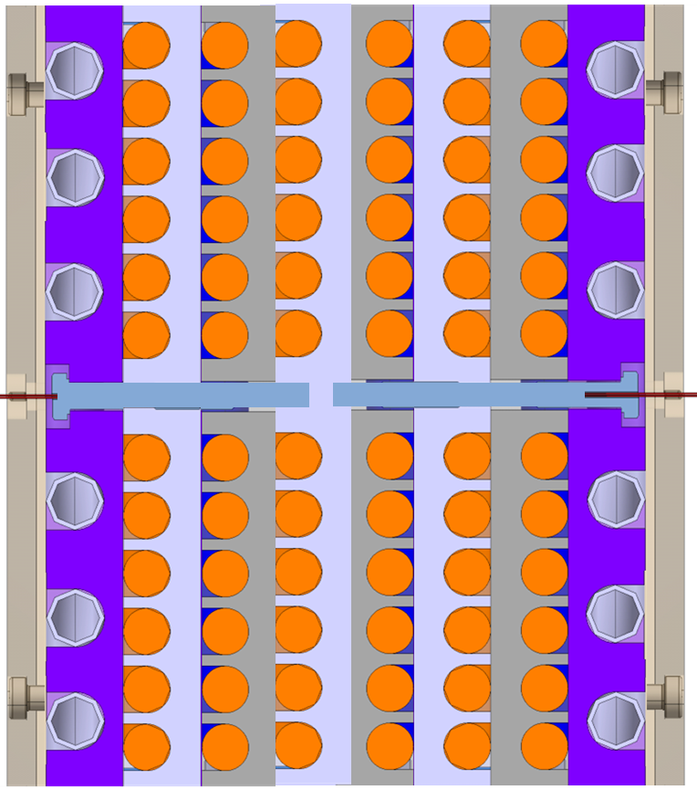
1 coil/pole
6 layers/coil
6 layers/coil = 90 mm
Interturn distance | mm | 12
Interlayer distance | mm | 16
Cable diameter | mm | 9.4
Pole width | mm | 141.4
Pole thickness | mm | 89.4
12 turns/layer = 142 mm
Schematic cross section of conductor configuration around 1 pole.
It features in blue the space reserved for cryostat, in purple the plates including the cooling circuit in purple and conductor in orange.
*CAD model of the coil adapted from EESD phase 2

Slide 4
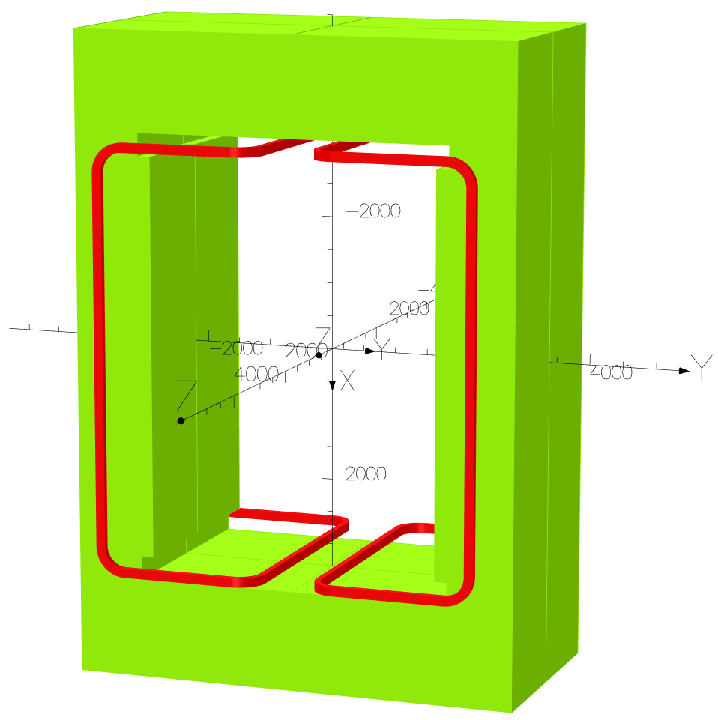
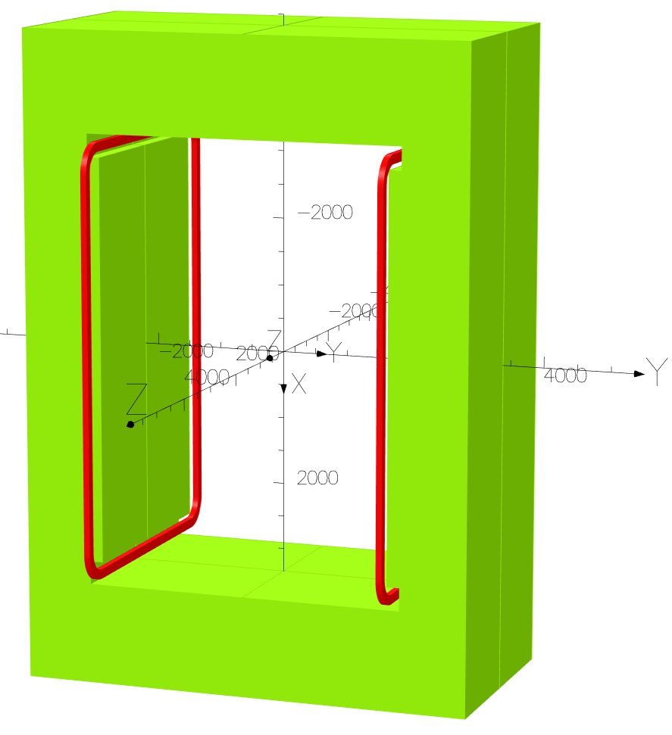
Bedstead shape coil
Racetrack shape coil
Total cable length: ~ 3.6 km
Total cable length: ~ 3 km
H.Bajas’s 3D model

Slide 5
Field Maps
In acceptance volume, traversal plan
  Field map
  Relative error wrt. B field at (0,0,0)
In acceptance volume, longitudinal plan
  Field map
  Relative error wrt. B field at (0,0,0)

Slide 6
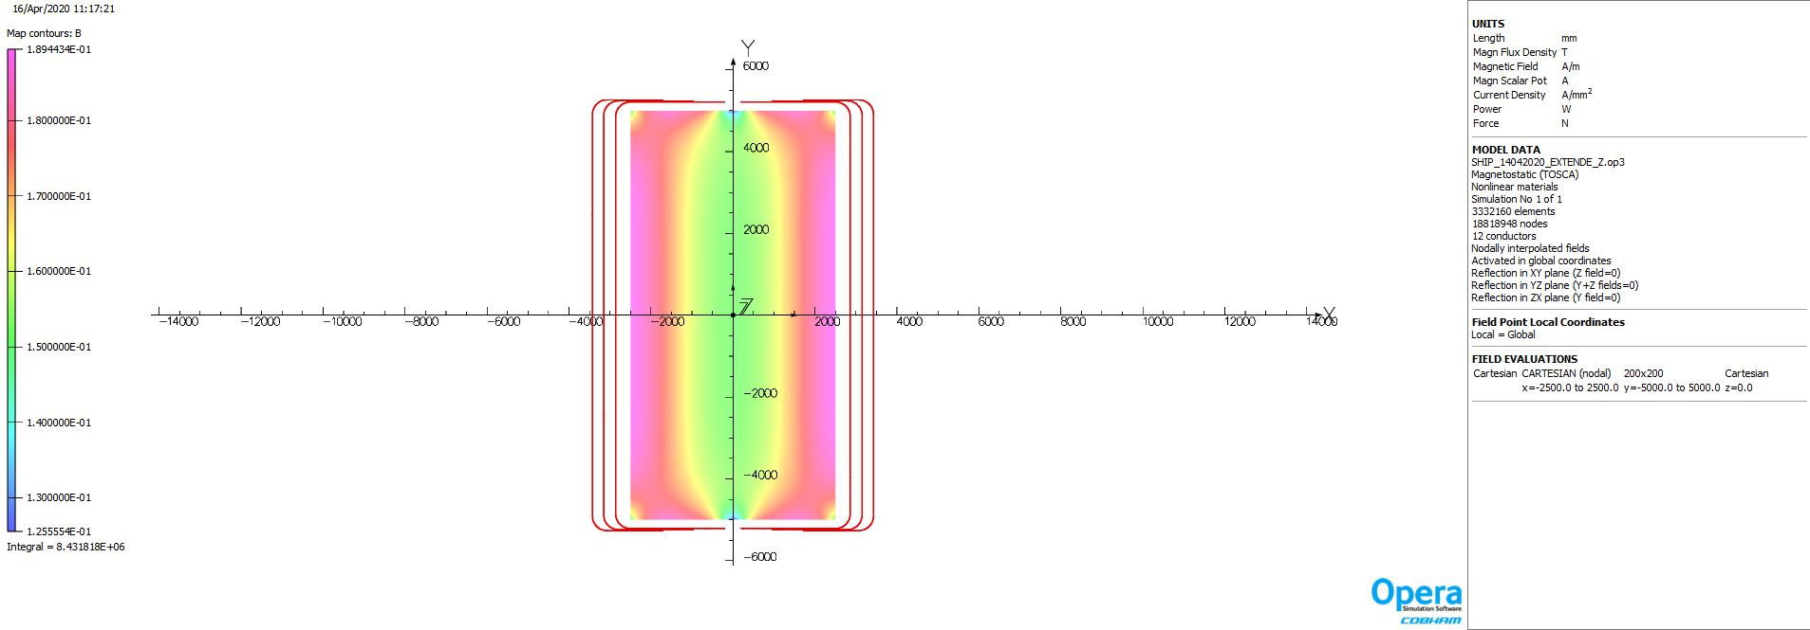
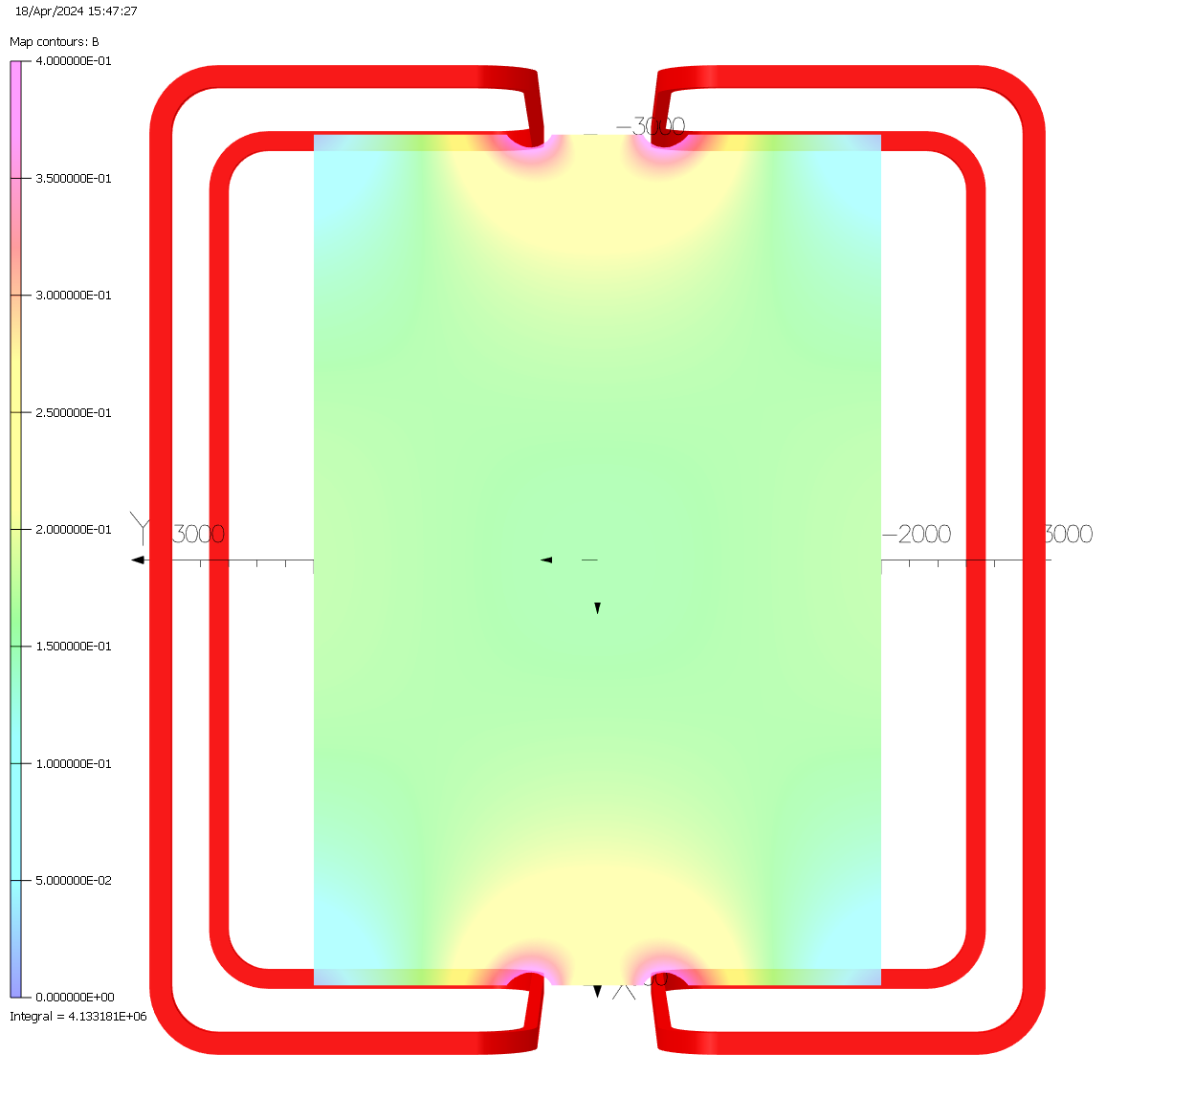
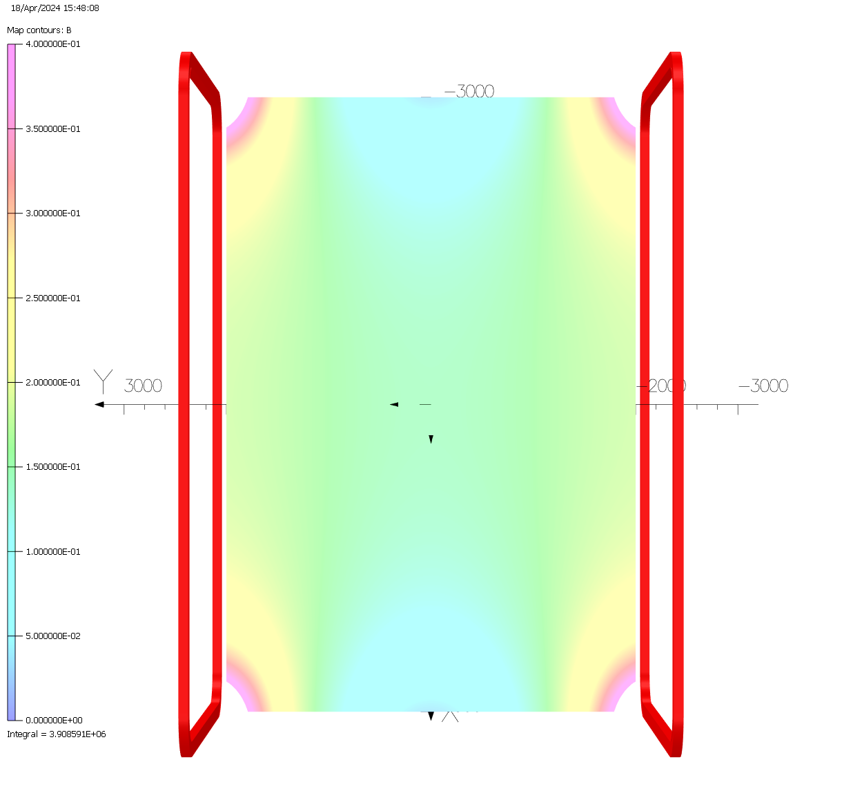
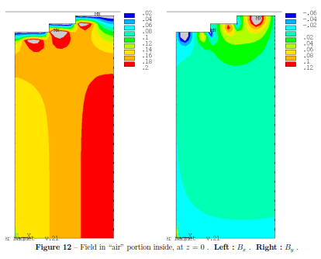
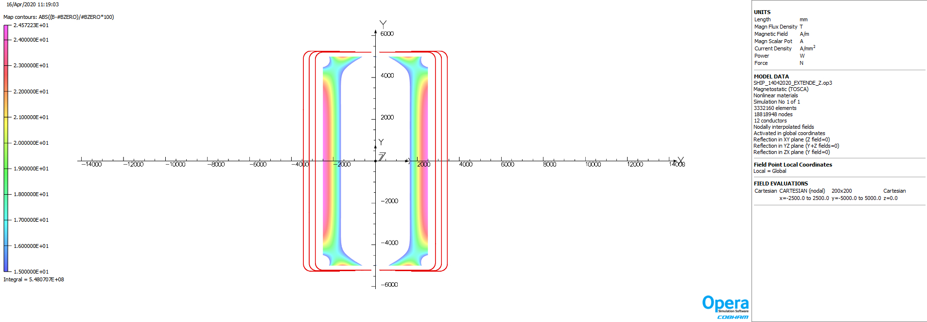
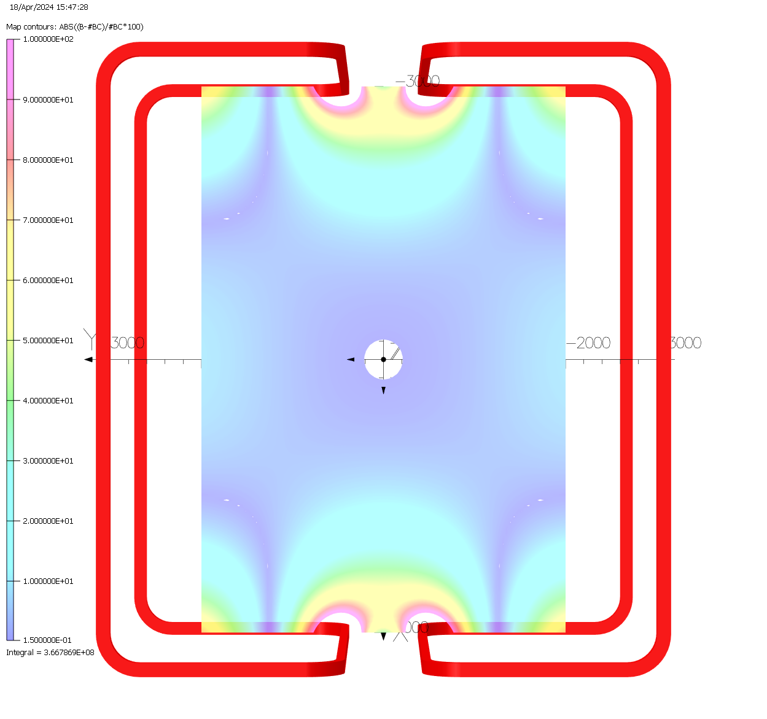
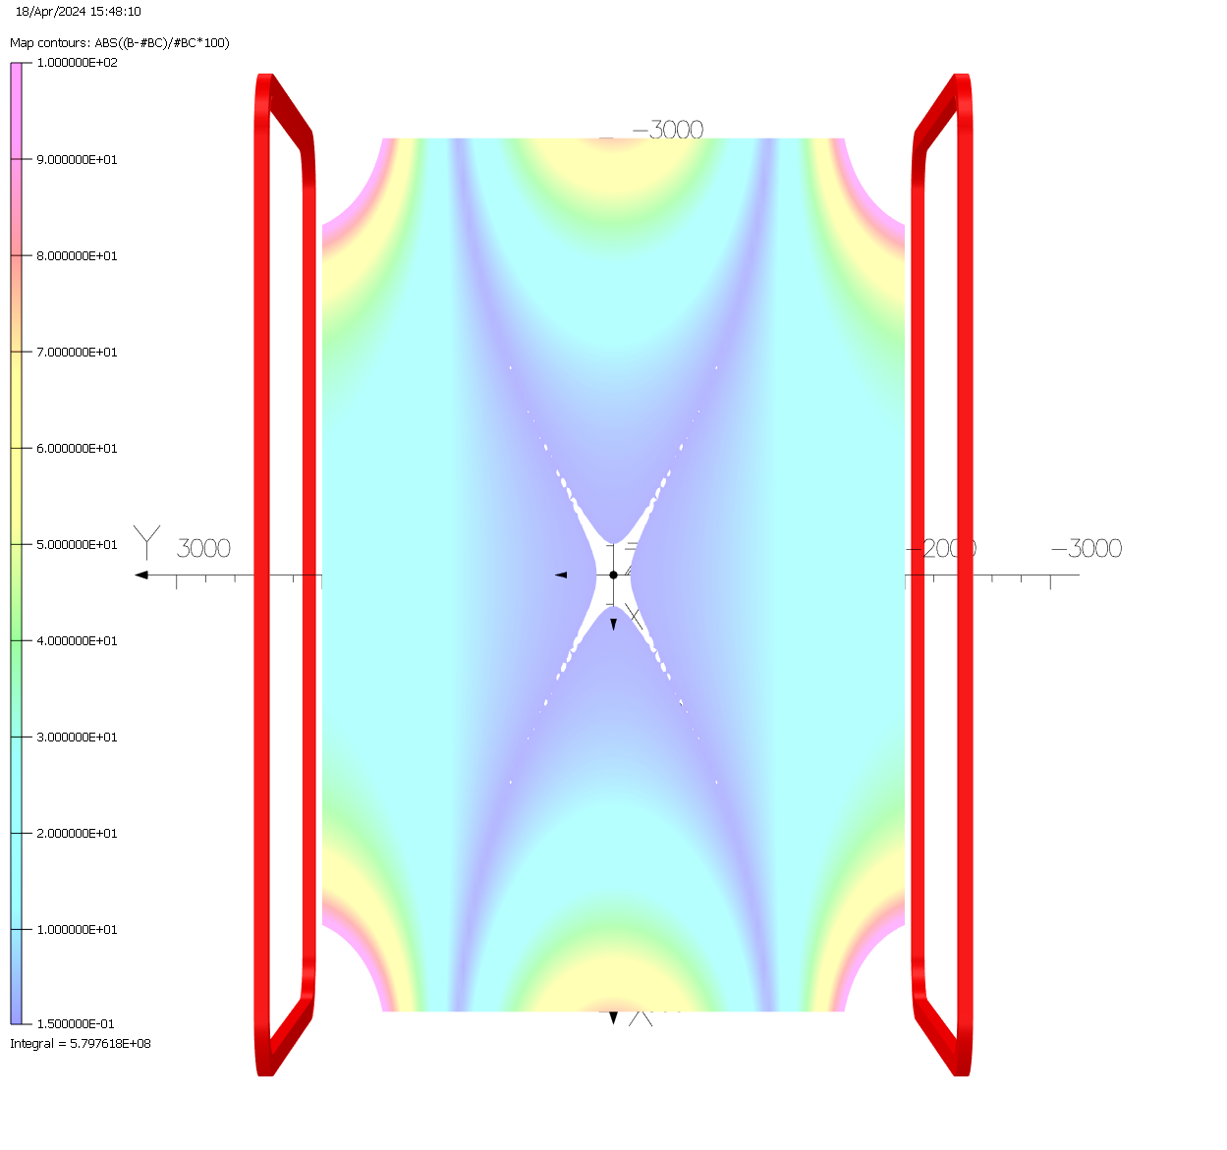
Bedstead shape coil
Racetrack shape coil
H.Bajas’s 3D model
P. Wertelaers model
In traversal plan
Top row : Field maps
Bottom row: relative error wrt. B field at (0,0,0)

Slide 7
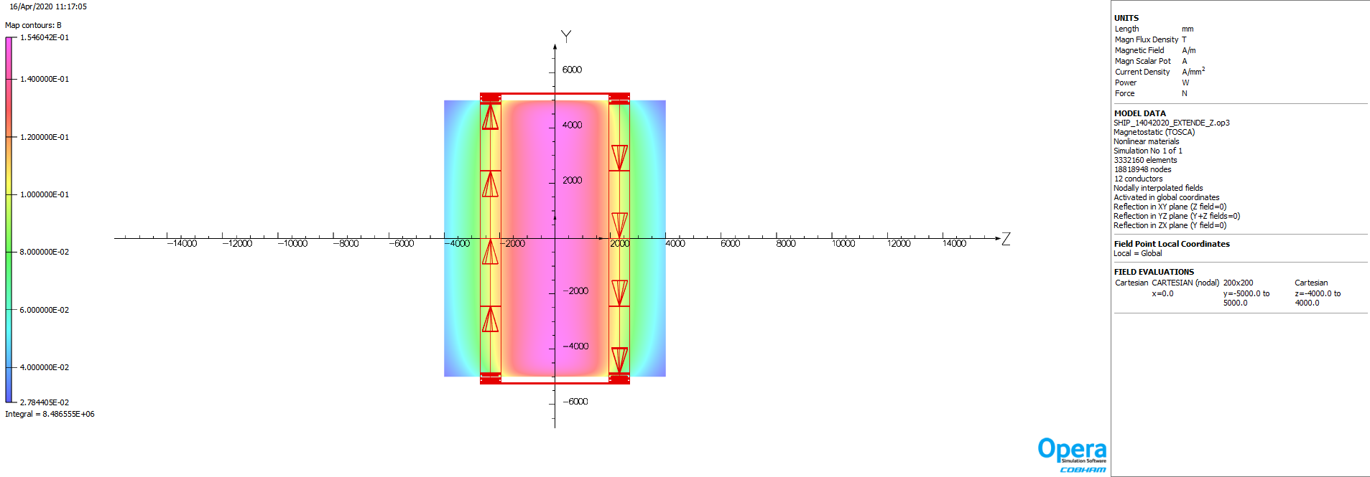
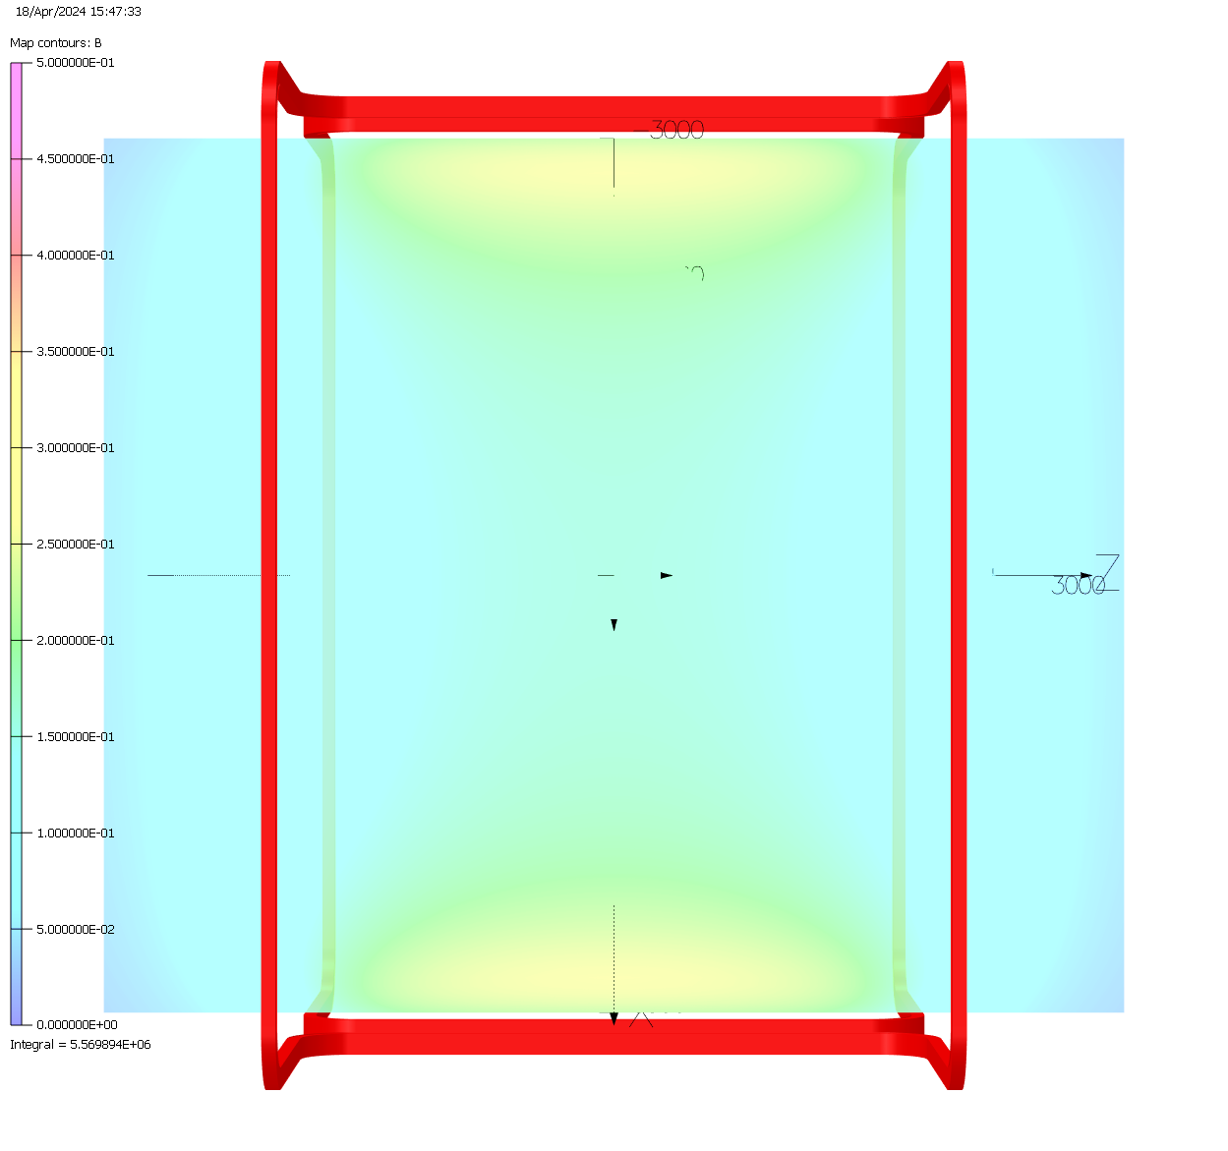
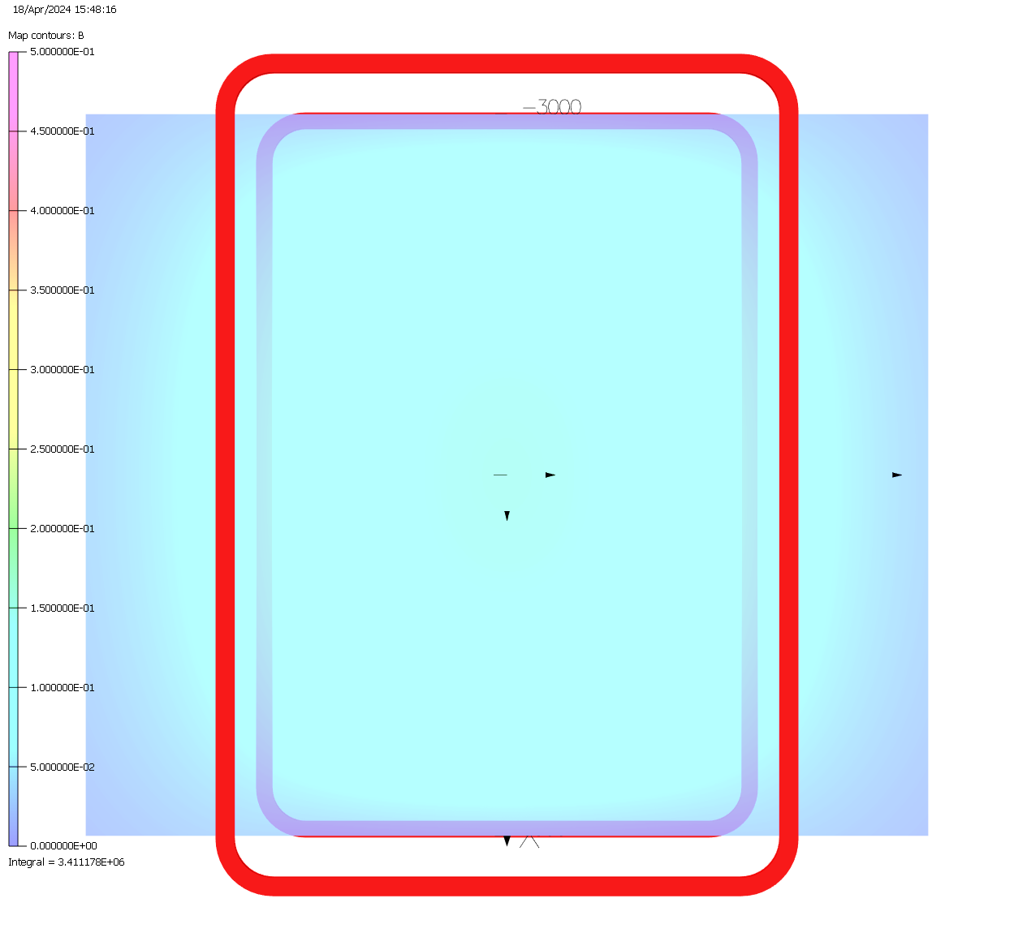
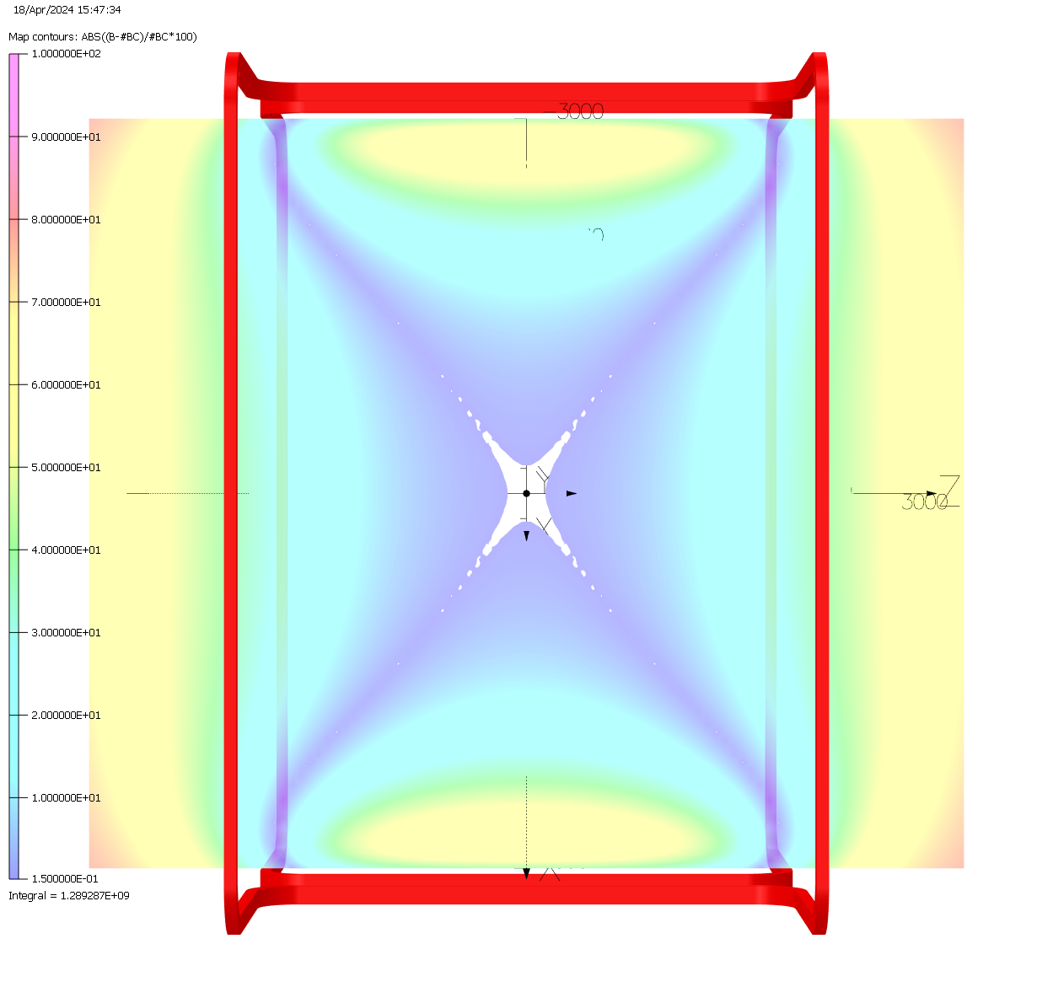
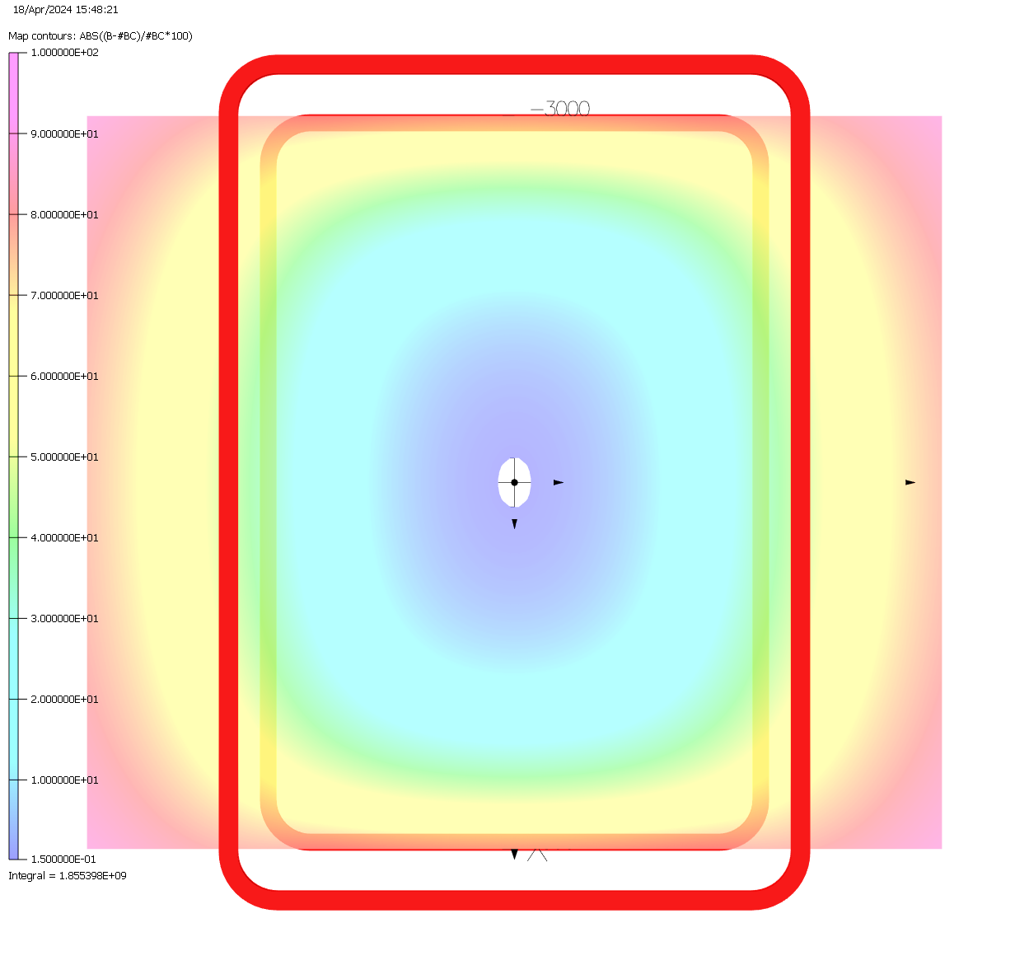
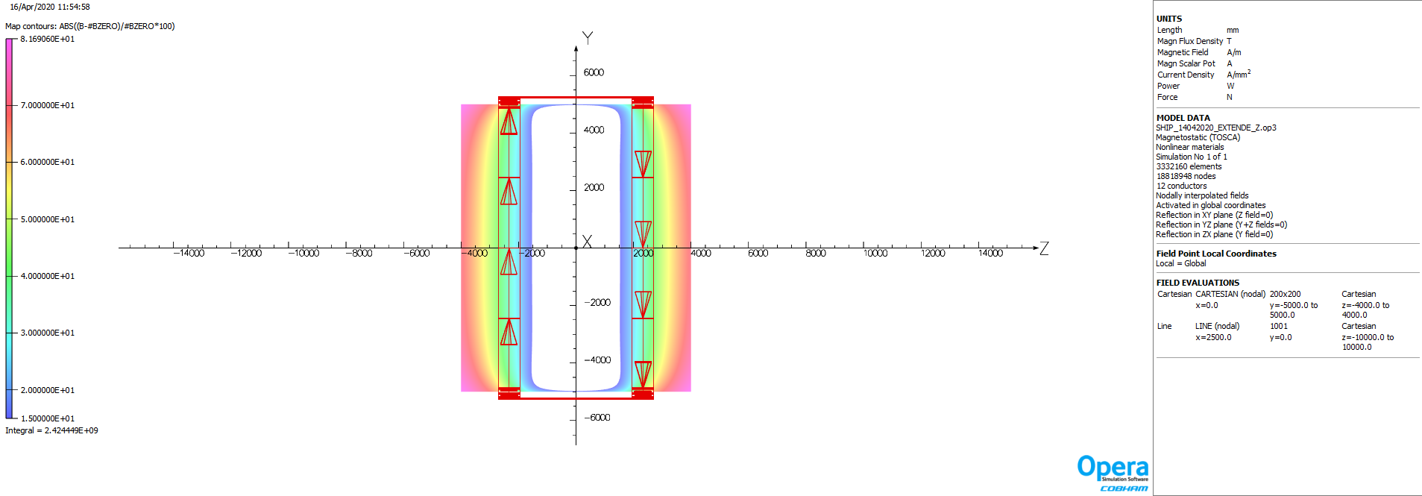
Bedstead shape coil
Racetrack shape coil
H.Bajas’s 3D model
In longitudinal plan
Top row : Field maps
Bottom row: relative error wrt. B field at (0,0,0)

Slide 8
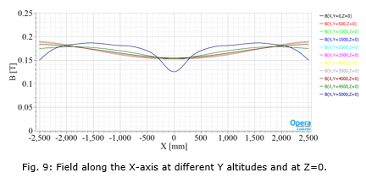
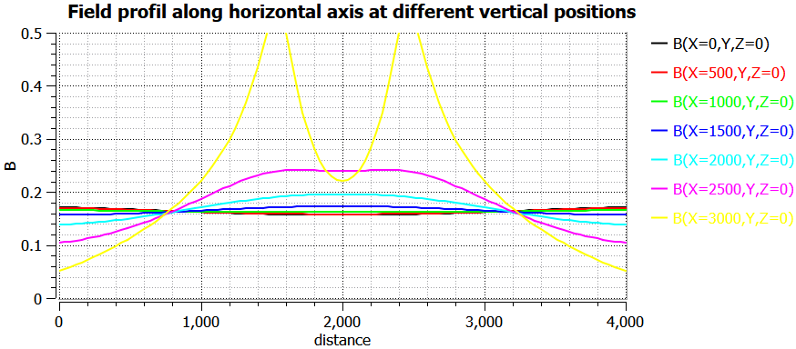
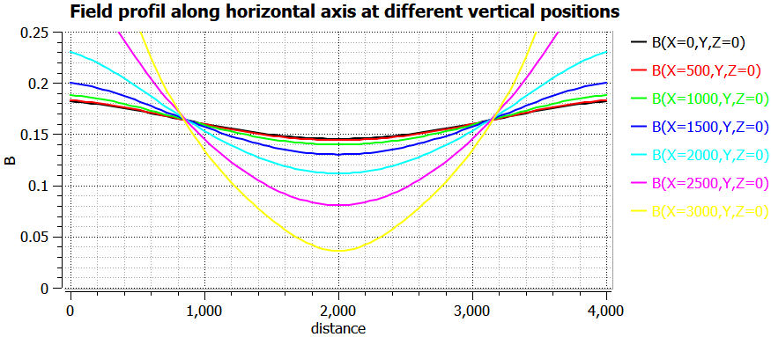
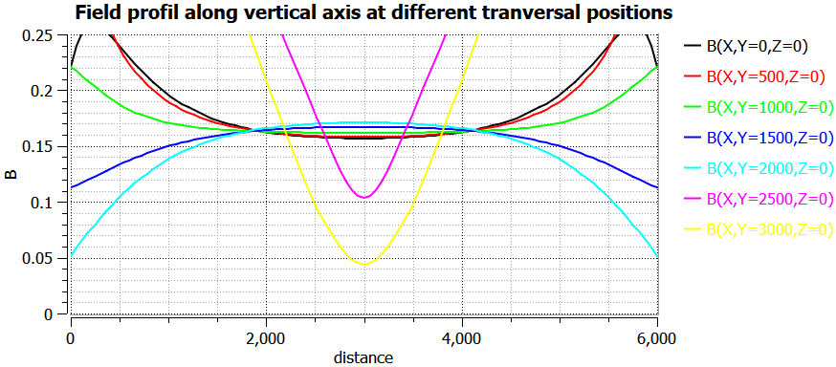
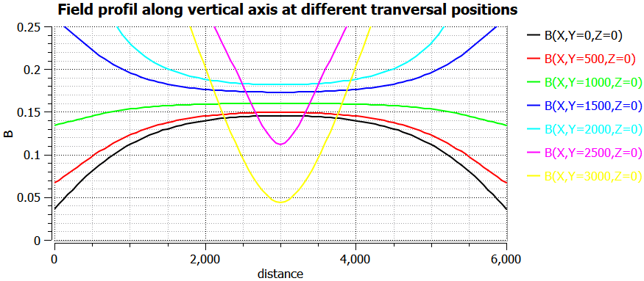
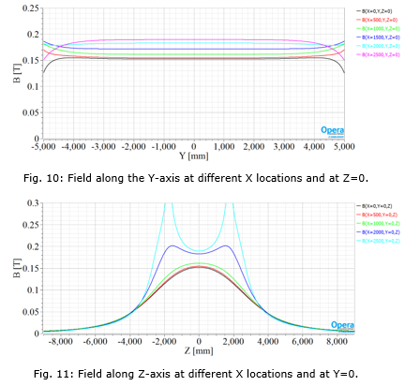
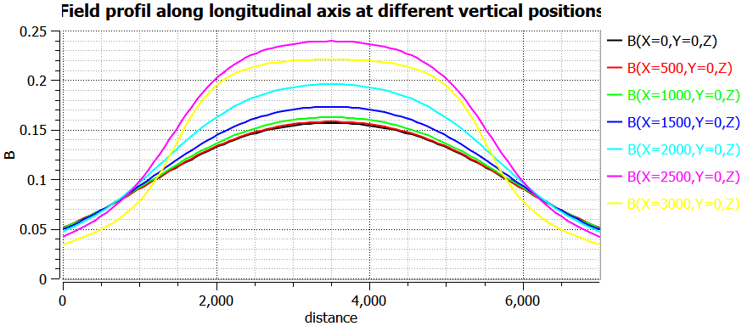
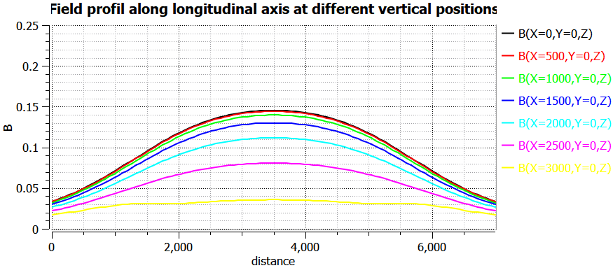
Bedstead shape coil
Racetrack shape coil
Hugo’s report

Slide 9
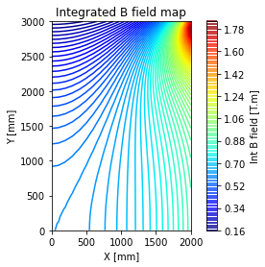
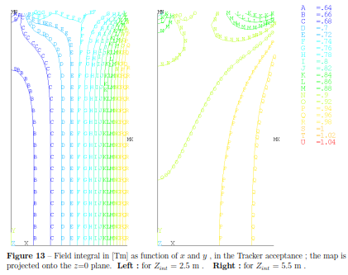
Dipole field integral in [T.m] as function of x and y position in the acceptance. The map is projected onto Z=0 plane. Integration distance +/- 2.5 m

Slide 10
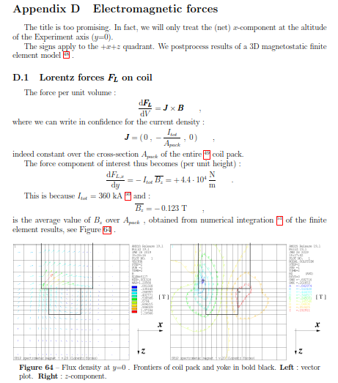
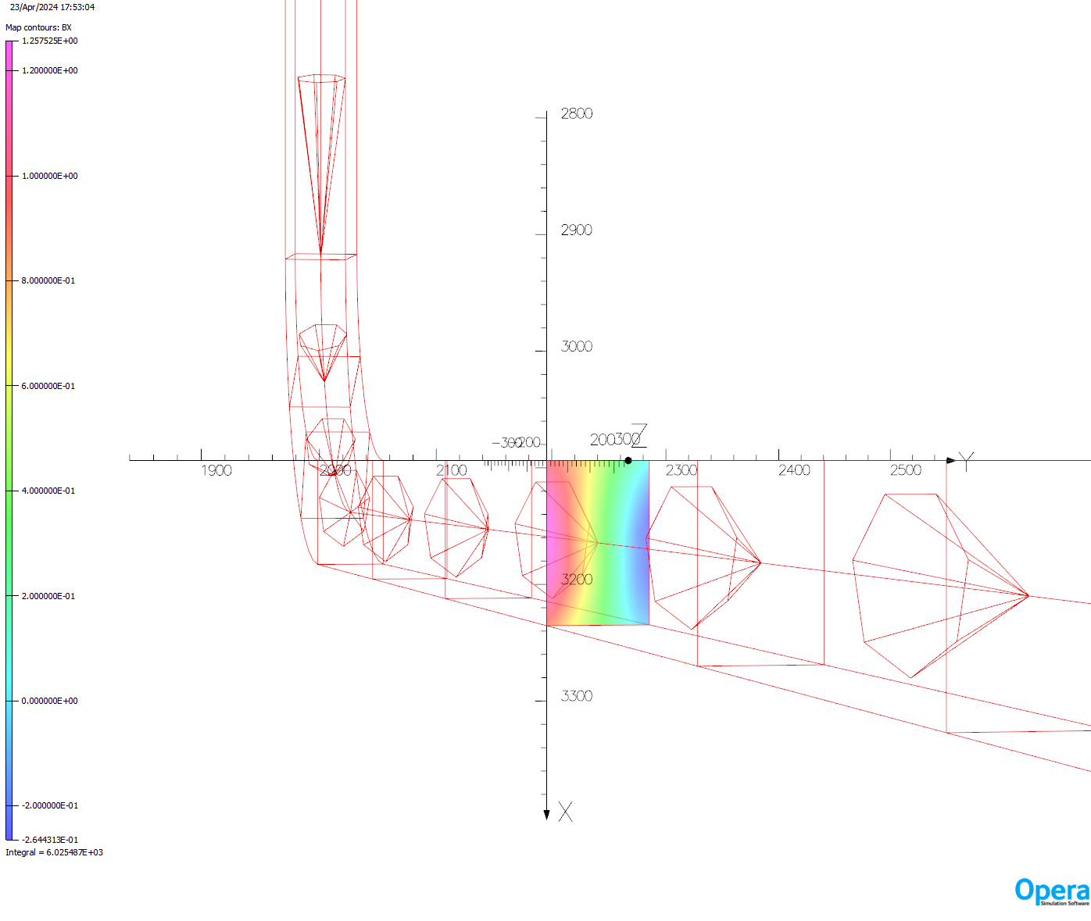
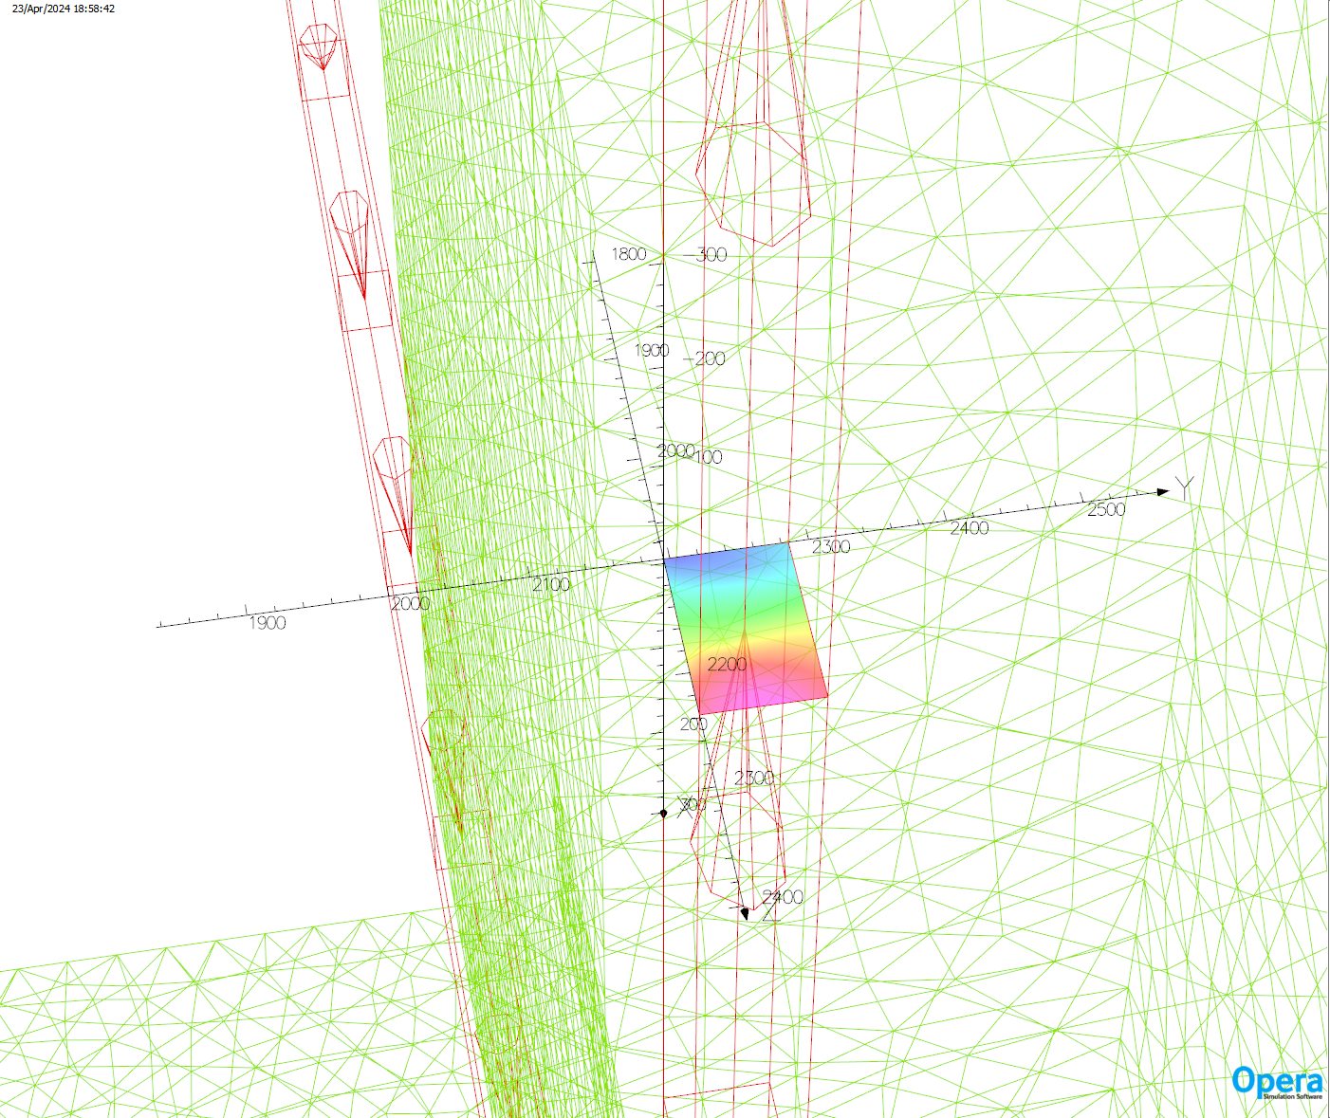
Bpeak = 1.323 T
Integral BX=6025 T.mm²
Averaged BX= + 0.472 T
FY= + 139 712 N/m (with I = 74*4000)
Integral BY= -1957 T.mm²
Averaged BY= - 0.1534 T
FX= + 45 406 N/m (with I = 74*4000)
FY= + 139 712 N/m
FX= + 45 406 N/m
BPeak = 0.886 T
Integral BY= -168 T.mm²
Averaged BY= - 0.013 T
FZ= + 3 848 N/m (with I = 74*4000 )
Integral BZ= + 1075 T.mm²
Averaged BZ= 0.084 T
FY= + 24 864 N/m (with I = 74*4000 )
FY= + 24 864 N/m
FZ= + 3 848 N/m

Slide 11
45 kN/m
45 kN/m
140 kN/m
140 kN/m
25 kN/m
25 kN/m
4 kN/m
25 kN/m
4 kN/m
4 kN/m
140 kN/m
140 kN/m
45 kN/m
45 kN/m

Slide 12
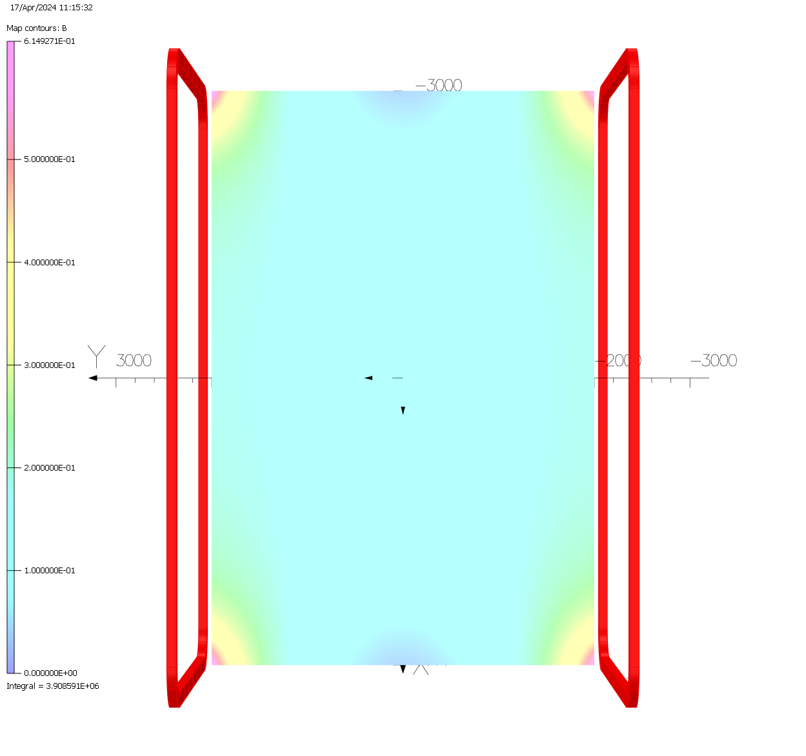
3 double pancakes per coil,
12 turns per layer
4 kA per turn
B₀ = 0.145 T
B_{p} = 1.3 T
Int B.dl [-2.5 m; 2.5m] = 0.599 T.m
Stored energy: ~ 2.88 MJ
Total cable length: ~ 3.6 km
Total cable length: ~ 3 km

Slide 13
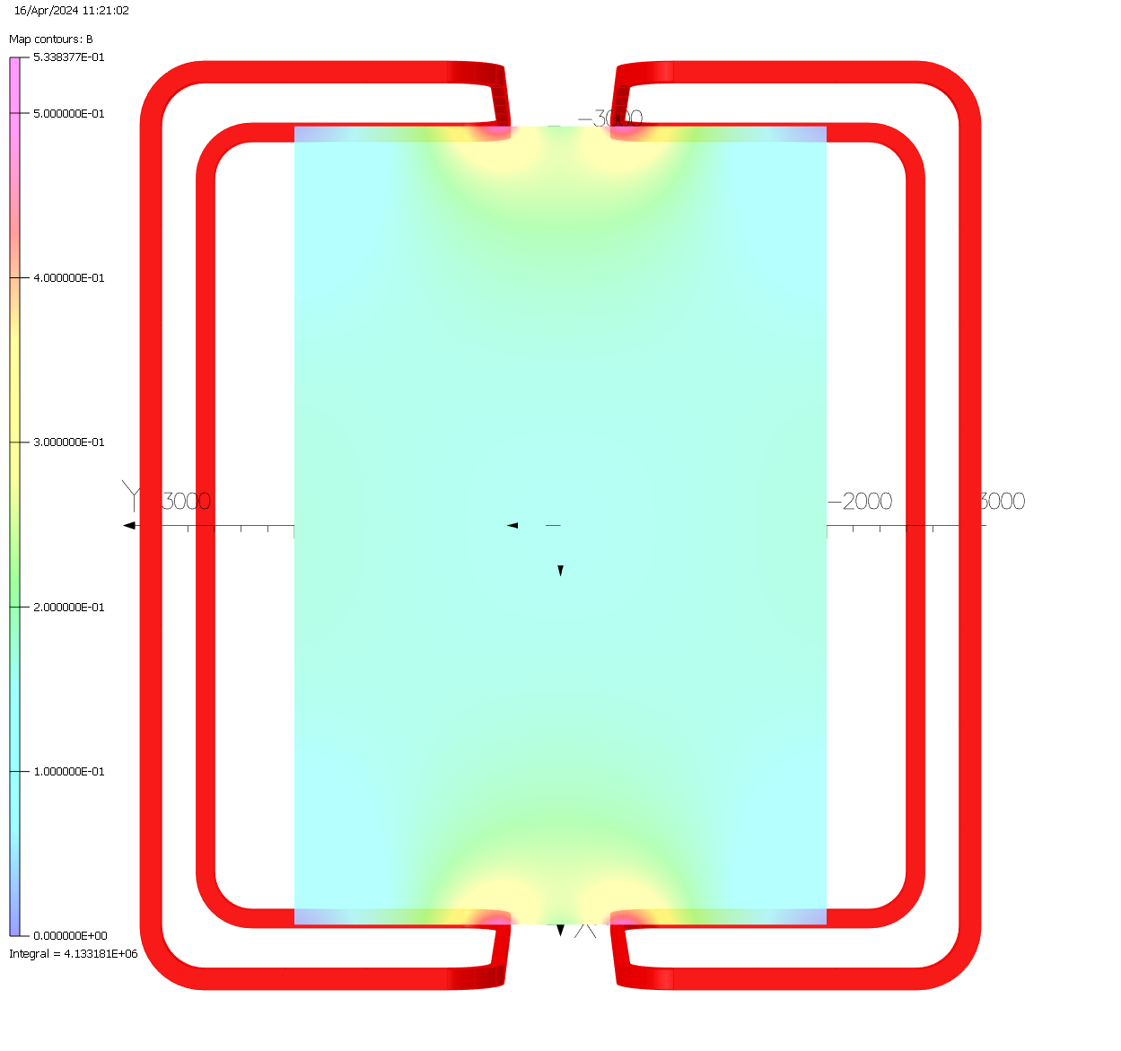
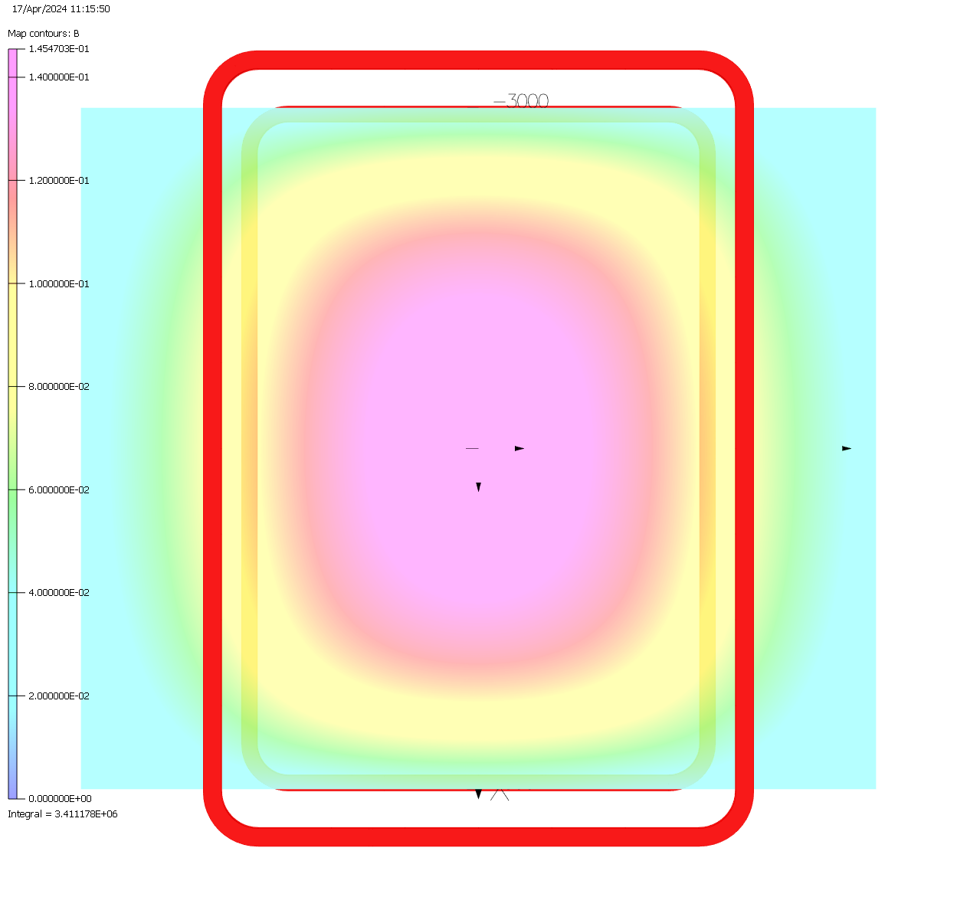
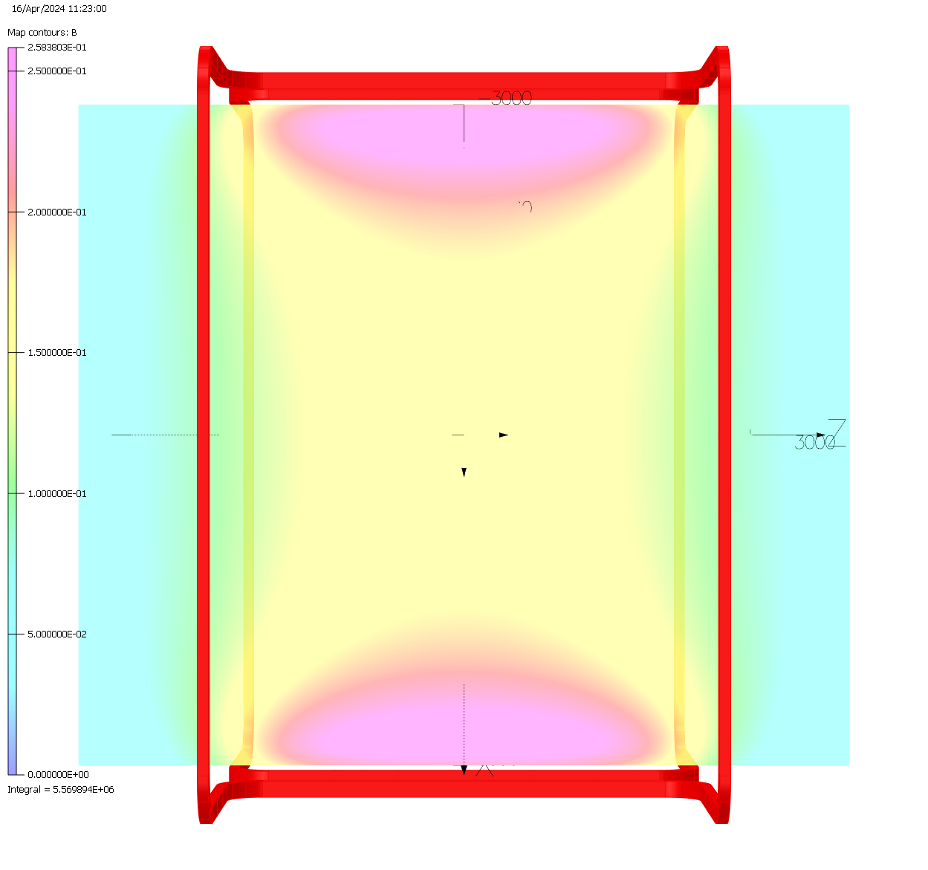

Slide 14
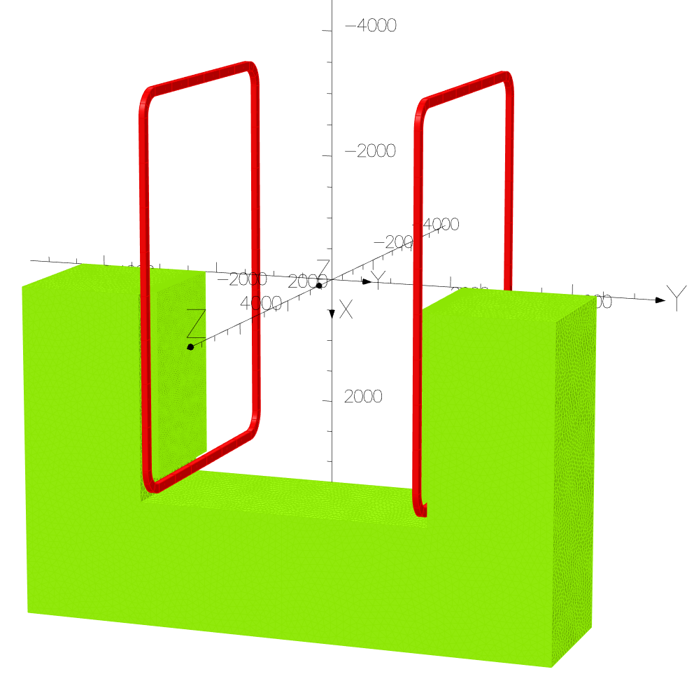
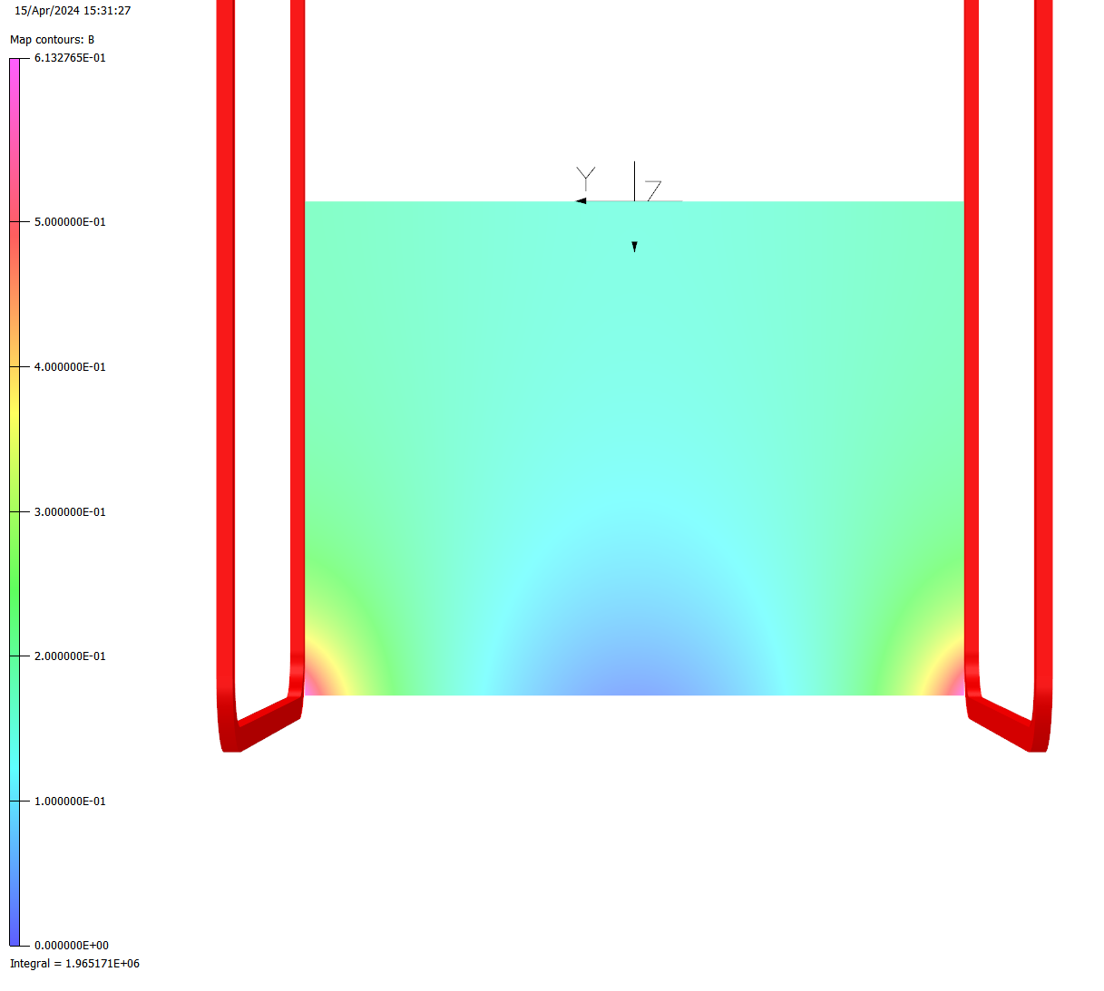
3D Opera - Model
2x1x6x12 = 72 turns
Racetrack
B0 = 0.149 T
Integral B along longitudinal axis = 0.86 T.m
Stored energy = 786 kJ
1 coil/pole
6 layers/coil
6 layers/coil = 90 mm
B0 = 0.149 T
12 turns/layer = 142 mm
Schematic cross section of conductor configuration around 1 pole.
It features in blue the space reserved for cryostat, in purple the plates including the cooling circuit in purple and conductor in orange.
*CAD model of the coil adapted from EESD phase 2
Global view of the Opera 3D ¼ symmetric model for the SHiP HSS.
It features in green color the iron yoke (dimension to be optimized) and in red the coils (1 coil per pole)
Magnetic field map on the acceptance limit rectangle on the transversal plan.
Current par conductor = 4 kA

Slide 15
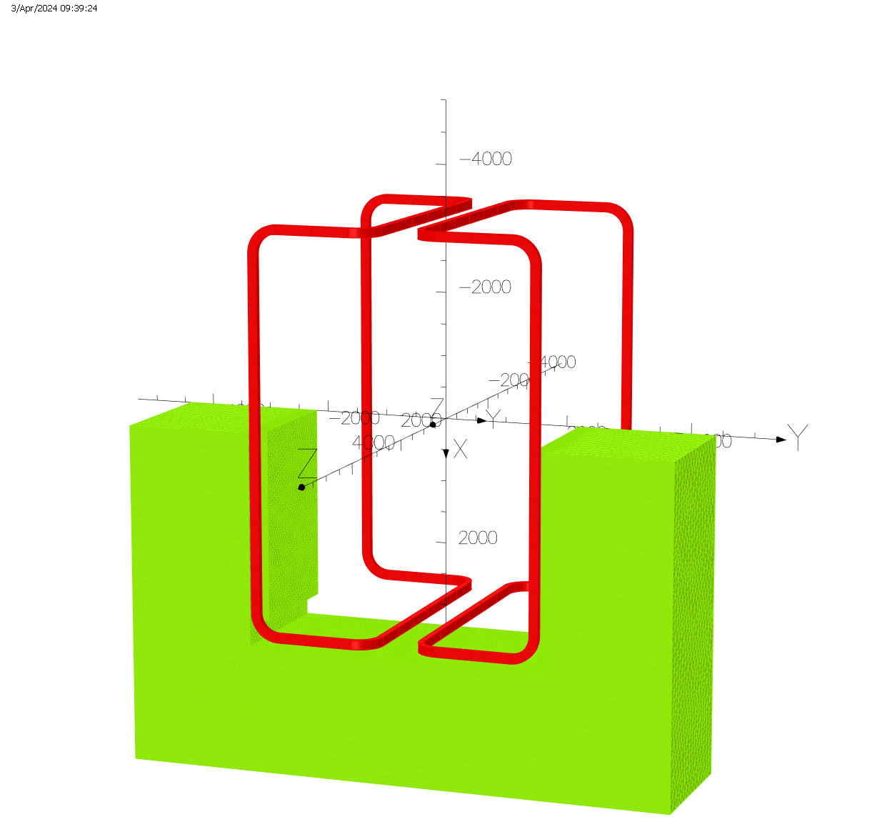
3D Opera - Model
Alternative bedstead coil design

