Slide 1
ET Pilot Planning & Alignment
Luigi SCIBILE

Slide 2
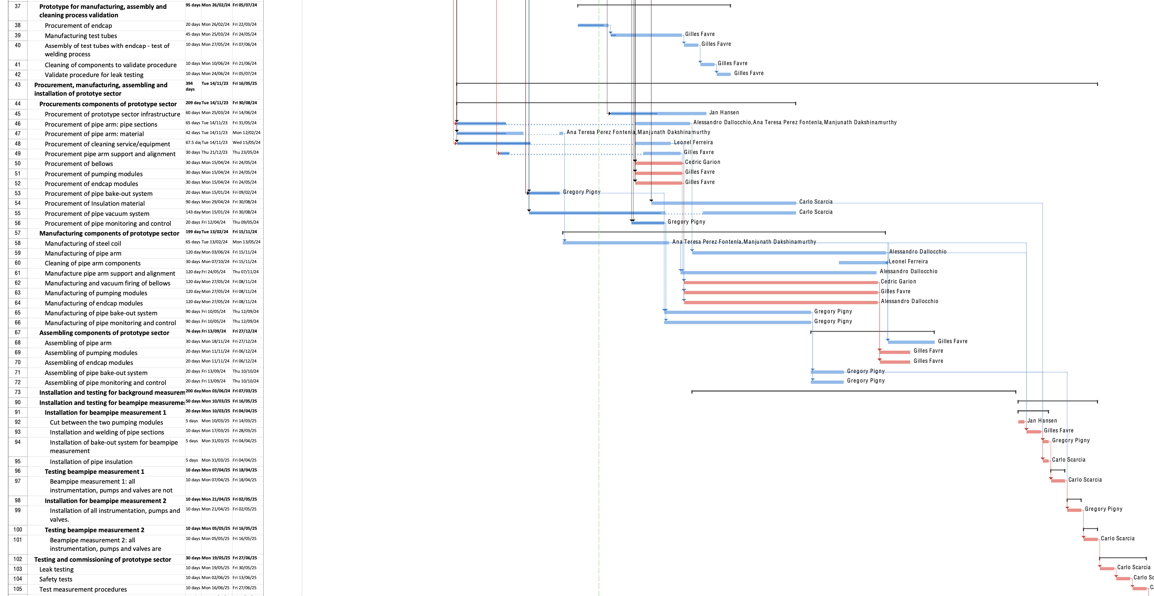
ET Pilot Planning & Alignment
October/November 2024 - Trace the floor plan based on an integration drawings
November 2024 - Help with the alignment of the vacuum supports during installation
December 2024 - Geometrical verification of the chambers and baffles after fabrication and before installation.
January 2024 + June 2025 - Align vacuum chambers with respect to a drawing before welding and after welding.
Second pipe non shown yet on the schedule
April/May 2025 - Check the position of the chambers when the system is under vacuum and baked.

