Slide 1
Approach for Large Scale Metrology for
Physics Detectors
Experience from LHC and Prospects
Antje BEHRENS, Jean-Christophe GAYDE, Dirk MERGELKUHL
(CERN BE-GM-ESA)
25.04.2024

Slide 2
Table of content
Mandate of survey team
Preparation and requirements
Toolbox
Equipment
  Photogrammetry
  Leica AT401/402/403
  Total Stations and optical levels
Scanning
Conclusion

Slide 3
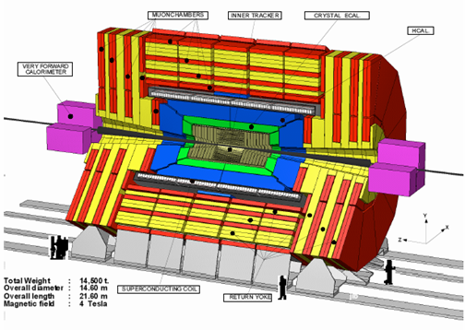
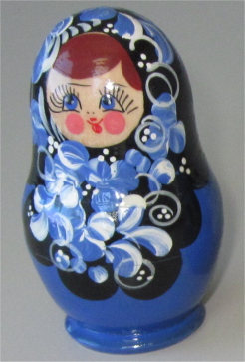
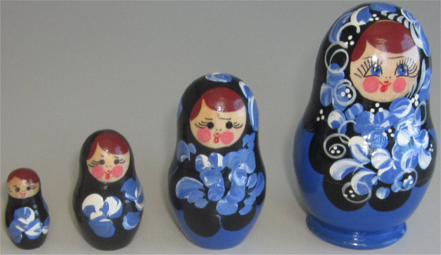
Large Scale Metrology Section
BE-GM-ESA Experiment metrology team
Mandate:
  The geometrical infrastructure for the detector installation
  Detector metrology for assembly and alignment on the beam lines
  The as-built measurements following with the installation phases
This includes:
  Prototypes, deformation tests, quality control, (pre-)assembly, alignment
What we see…
What we want to know…

Slide 4
Pre-Discussion
Discussion with physicist/engineer/designer for each tasks
  Define precisely the needs for geometrical control / alignment / survey
  Define all stages when survey will be needed
  Find reasonable solutions
  Include alignment to the design (references and space)
  Define local coordinate system
  We have to adapt to the experimental schedules
Typically provided measurement precision (1 sigma)
  Detector control at manufacturing before assembly
    0.02-0.30 mm (max. 0.50 mm)
  Deformation of detectors under special conditions
    ~ 0.02-0.10 mm
  Relative position of detectors wrt other detectors
    < 0.30 mm
  Absolute position of detectors wrt accelerator geometry
    < 1.0 mm

Slide 5
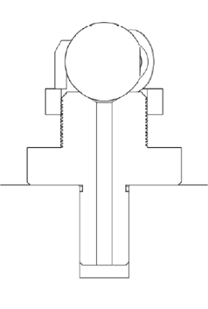
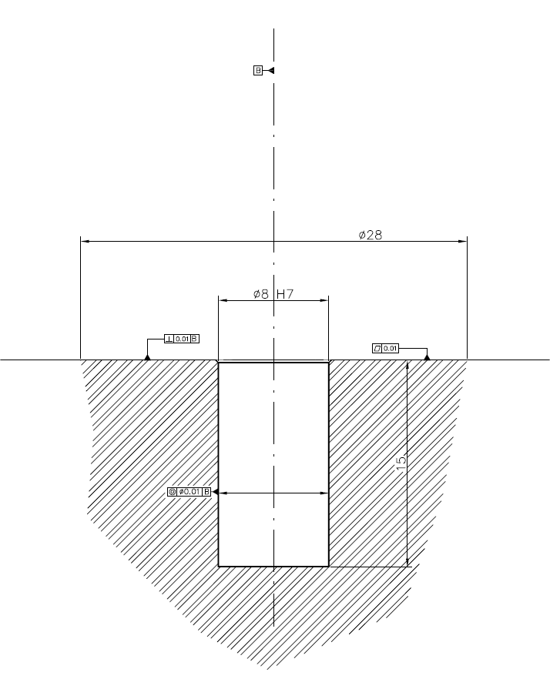
Preparation
Survey reference points
  Different survey targets have to be placed on object
  3D – survey reference hole
  ➔ best solution, highest flexibility
20.0 mm
Define survey reference holes on detector
  Already early in the design phase
  Reference hole accessible and visible during ALL phases
  Position on stable support
  On individual detector elements as later on assembled groups
  For total station, laser tracker or photogrammetry
  Coordinates are given for centre of survey target
  Sensitive elements are referred to reference holes by constructor
8H7 reference hole
28 mm contact surface
15 mm depth
WARNING: the values are given as indications
Every new values must be discussed and agreed!

Slide 6
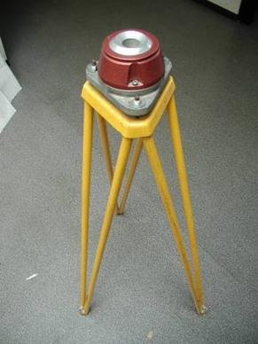
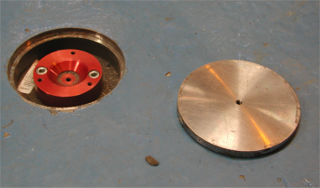
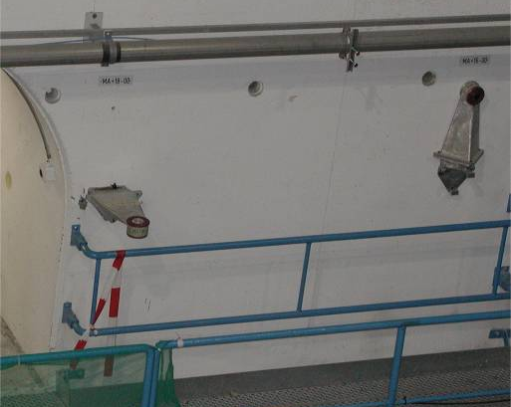
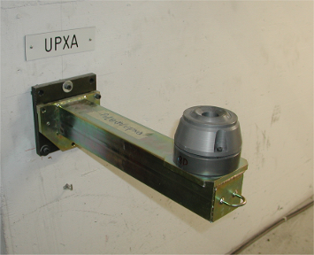
Additional survey requirements
Local network
  Tripods bolted to the floor or brackets on walls
  Support points permanently fixed on walls / stable pillars
  Temporary network points glued around detector
Stable floor for theodolite or laser tracker measurements (concrete)
Access to detector for temporary installation of survey target
Line of sight between instrument station and points
Constant temperature for significant results for dimension

Slide 7
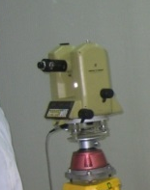
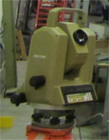
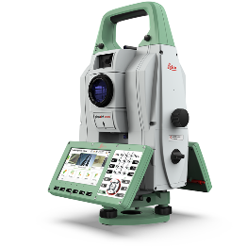


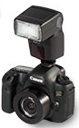
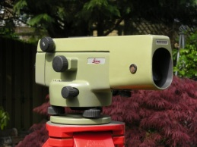
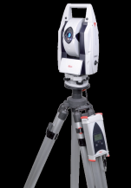
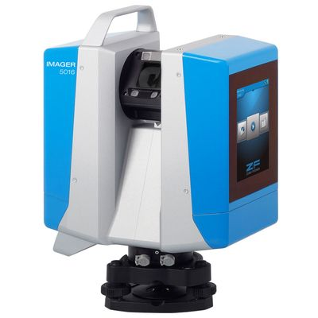


Survey Toolbox
T3000
TC2002/TS60
SU software
TOOLBOX
Experiment metrology
Canon
5Ds
NA2
Commercial software
Z+F IMAGER® 5016
AT401/402/403
➔ Line of sight between instrument and object required!

Slide 8
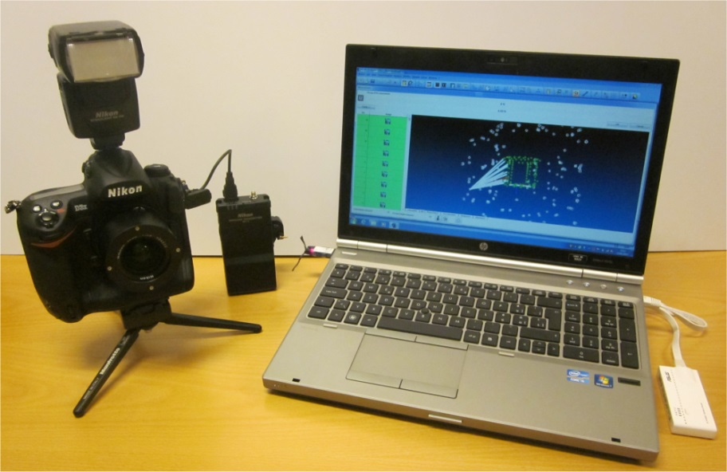
Photogrammetry
Image acquisition needs no stable station
  Photos taken on platform, scaffolding or cherry-picker
Mobile System with ‘high’ precision
  Off-site interventions in factory (Pisa, Aachen…)
  Clean rooms, assembly halls and experimental caverns
  Inner detector components < 1m (1 sigma < 50 microns)
Limited measurement time for large amount of points
  Short interruption for installation, production process
Camera system
  PC (Windows 10)
  Nikon D3X - 24MP
  Canon EOS 5DS - 50MP
  Wireless module
  Different lenses (17-28 mm)
  Top flash, ring flash
Software
  AICON 3D Studio V. 12.00.14 – DPA PRO

Slide 9
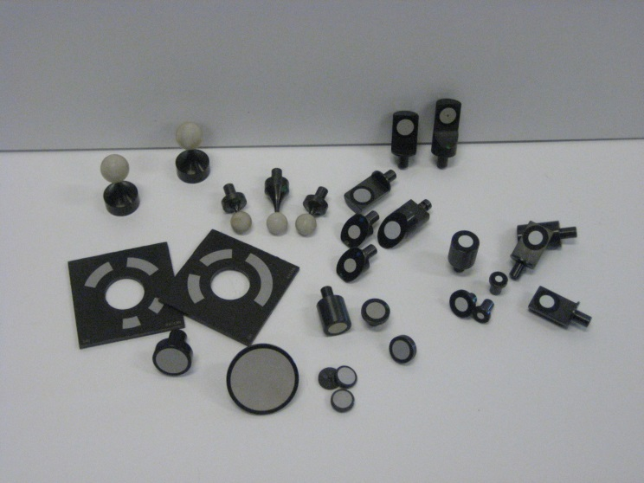
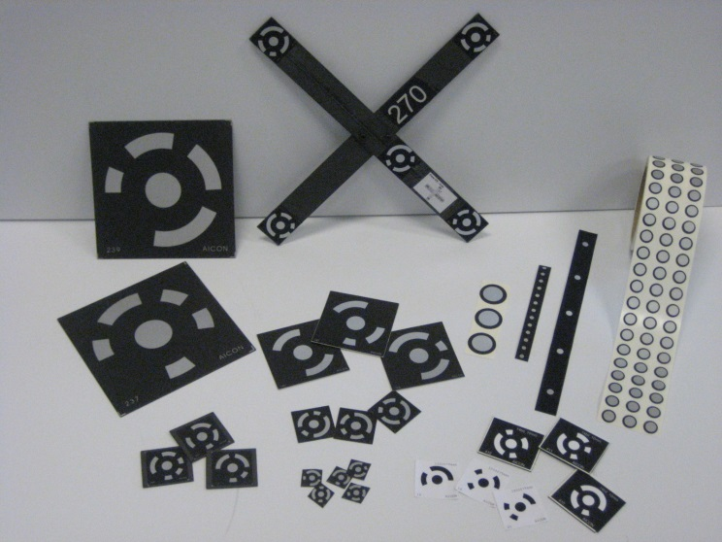
Photogrammetry
References for scale
  Carbon fibre scale bars (max. 1.5 m)
    Calibration on CMM
  Geodetic measurements
    Laser tracker AT401/402
    Total station TC2002
Targets
  Coded / non-coded
  Retroreflective / non-retroreflective
  Button targets Hubbs / GMS / Aicon
  Sticker targets of different types
  System optimized for measurement of
  signalized points only = highest precision
  ➔ We have to access and touch the detector

Slide 10
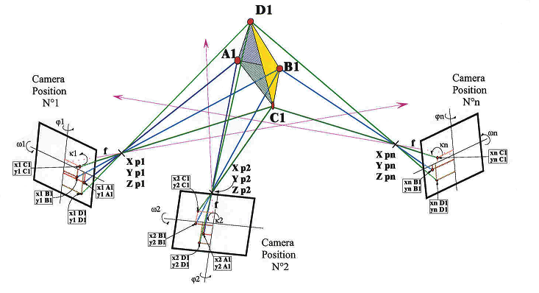
Photogrammetry principle
IST and VI 180
PST UX15
DST SR1

Slide 11
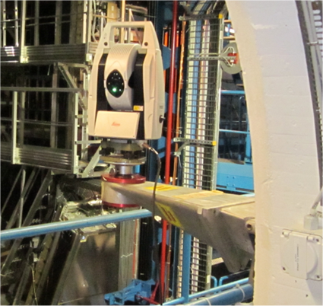
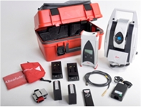
Leica AT401/402/403
Laser tracker in “theodolite” housing
As flexible and light as theodolite
Measures on special prisms
For different volumes as
  experimental cavern network
  individual detectors
  Max. +- 80 m
Instrument can be remote controlled
➔ automation possible (ALARA)
Instrument has same support as theodolite
➔ existing survey infrastructure can be used
Specifications for precision
  15µm + 6µm/m MPE
  7.5µm + 3µm/m typical
  ➔ Precision at 10m distance < 0.05mm typical (1 sigma)

Slide 12
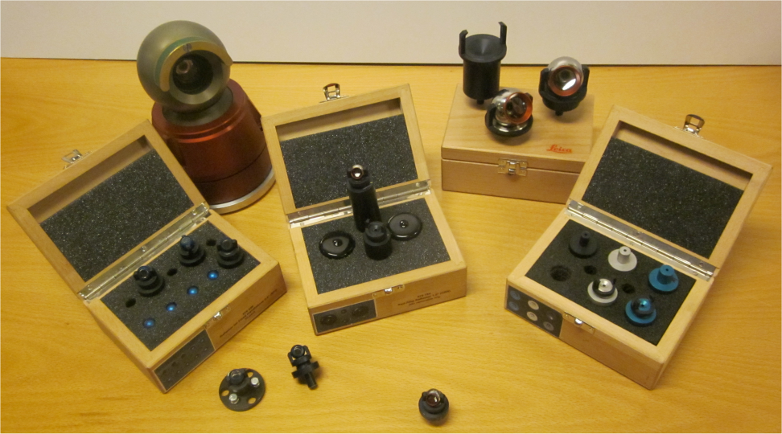
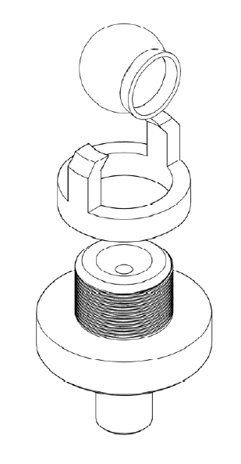
Leica AT401/402
AT401/402/403 is measuring with respect to previous equipment:
  5x better for distances
  2x better for angles
Targets are prisms with 1.5” and 0.5” diameter and adapters
Interchangeable tooling to photogrammetric and total station targets available for survey reference holes
2x AT401, 2x AT402 and 1x AT403
gain in precision, time and human resources!

Slide 13
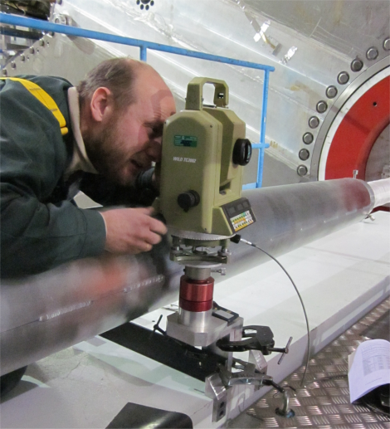
Total Station and Optical Level
Total stations measures polar coord. (Hz, Vz, Dist.)
TC2002/T3000/TS60 is measuring with precision of:
  0.3 mm for distances (spec 1.0 mm)
  Measures on retro-stickers
  5.0 cc for angles (spec 1.5 cc)
Targets are balls (angles) and prisms (distance)
Measurement is manual (operator needed)
Interchangeable tooling to photogrammetric and total station targets available for survey reference holes
Optical level measures height (1D) wrt horizontal pane
NA2/N3 precision is 0.05 mm for individual measurement
Levelling rod can directly touch surface

Slide 14
Laser Scanning
Scan data can bring as-built dimensions into the 3D CAD model to have most accurate of CAD models for future upgrades etc.
Scanners exist for different precisions from μm to cm level
  Level for integration at 3-5 mm
Special properties for surfaces to get good quality:
  Not transparent (glass, resin)
  Not completely black or complementary colour of scanner laser
  Not too reflective (no mirrors, polished or shiny surfaces
  => Surface could be prepared with spray, adhesive tape, paint etc.
Geo-referencing necessary to link the scan to coordinate system of object or to global reference system
  by known targets distributed in object space
  link between scans by measurement arm, tracker, CMM
  transformation of point clouds (only relative)

Slide 15
Treatment of scan data
Different steps for point cloud treatment:
  Data acquisition and transfer in the field
  Pre-treatment
    Assembly of scan stations
    Referencing to survey coordinate system
    Removal of obvious parasite measurements
    Reduce point data to keep parts of interest
    Export point cloud (xyz files)
  Meshing has been performed (point cloud => triangular mesh)
  Mesh has been cleaned, small holes filled up
  (Creation of surfaces – reverse engineering)
  Export to CAD
You can find point clouds everywhere BUT very few final models!!! There is a reason why…
GM-ESA
???

Slide 16
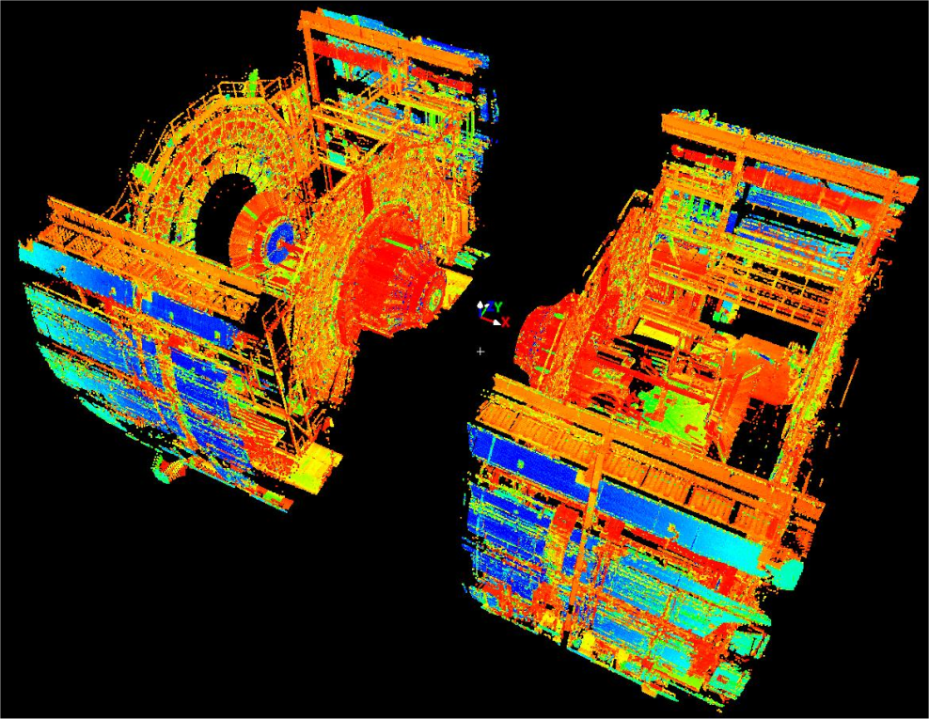
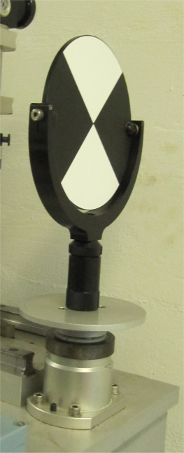
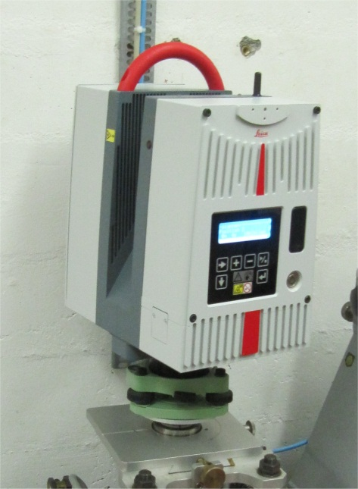
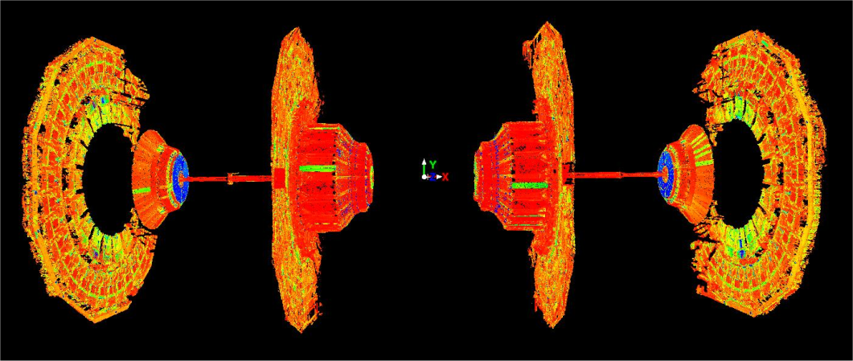
Leica HDS 6200 Laser Scanner
Up to 1 000 000 points/sec
Phase shift distance measurement
Point accuracy at 5m = +-3mm
Spot size = 5.0mm @ 10m
Field of view: 360° x 310°
Point cloud as result

Slide 17
Conclusion
BE-GM-ESA can be implicated in survey requests for detector upgrades
  Design
  Validation / test phase
  Construction
  Installation
Photogrammetry and Laser Tracker are well adapted tools
We are flexible in method and can adapt it to working conditions
➔ BE-GM-ESA decides as function of the constraints the optimal method
Precision with respect to machine geometry has to cope with long term deformations at civil engineering level
Mechanical adjustment systems need to be integrated
Permanent contact between BE-GM-ESA and detector responsible
➔ BE-GM participation to design at early stages – integration of reference holes

Slide 18
… for future upgrades and projects
Define carefully the control and alignment needs
  What has to be measured?
  With respect to what?
  At what stage?
  Where?
  What is the required precision / error budget?
Definition of reference holes and special equipment (adapter…) needed by SU
First fiducialisation of sensitive elements at construction site
➔ references carry the detector geometry information
If there are NO references there is a high risk that NO precise survey can be performed!
No detailed as-built model is available for LHC experiments (services etc.)
Measurement equipment has progressed since LHC construction
Detector installation/maintenance will be more complex – ALARA procedure
➔ An early discussion for each individual detector is necessary
➔ Questionnaire can be found at: https://edms.cern.ch/document/1074957

Slide 19
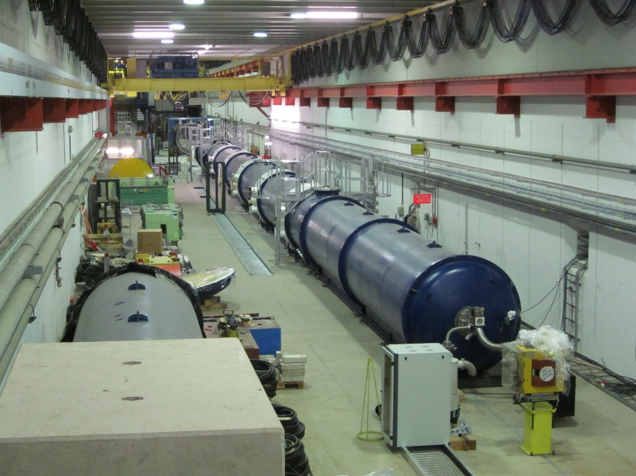
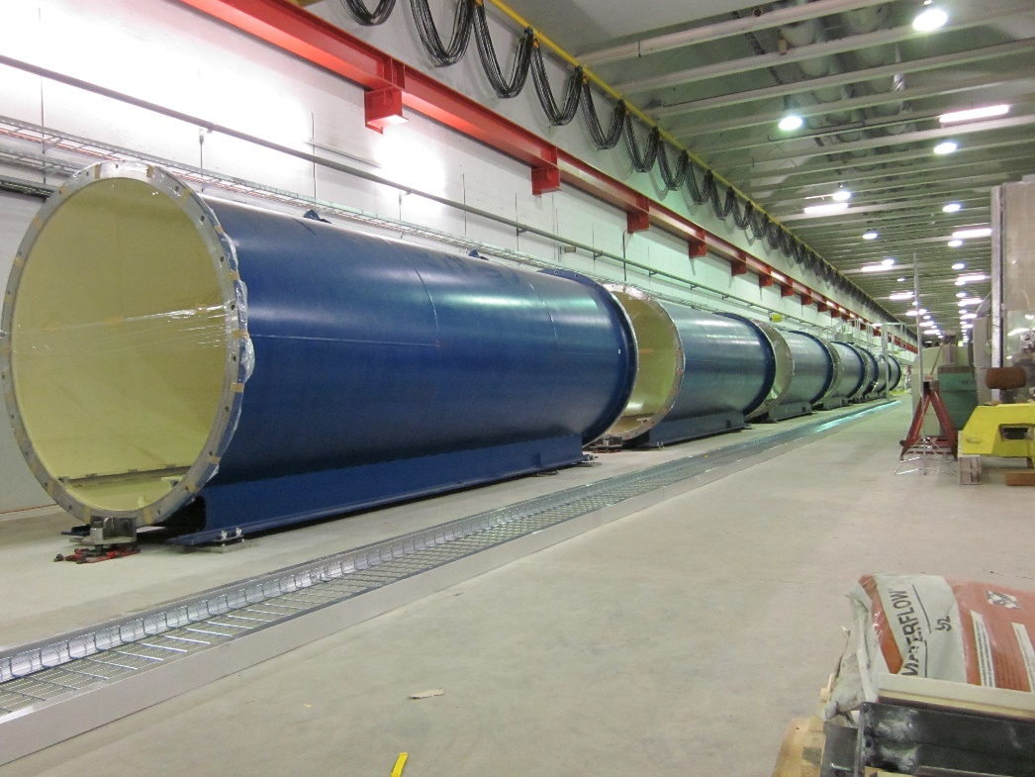
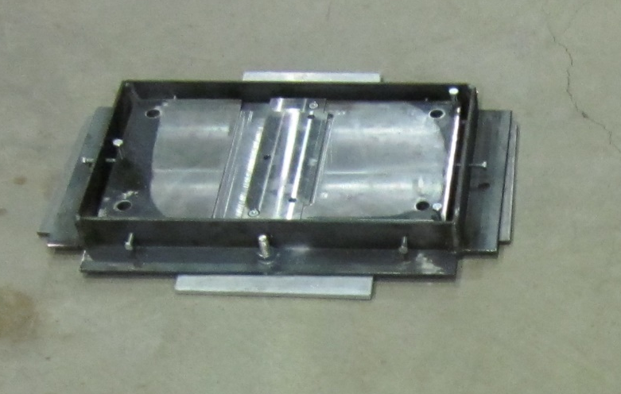
NA62 – Blue Tubes

Slide 20
20.0 mm
8H7 reference hole
28 mm contact surface
15 mm depth
Thanks for your attention!
Antje BEHRENS, Jean-Christophe GAYDE, Dirk MERGELKUHL
(CERN BE-GM-ESA)

Slide 21
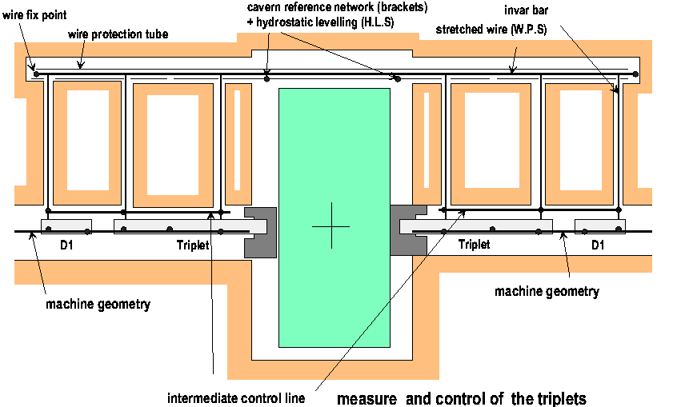
Link Machine – Experiment (ATLAS+CMS)
➔ NO survey galleries for ALICE and LHCb!

