Slide 1
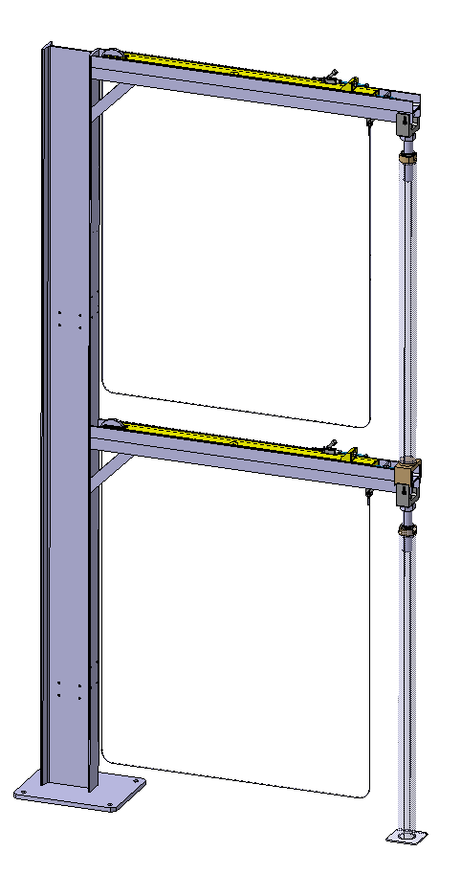
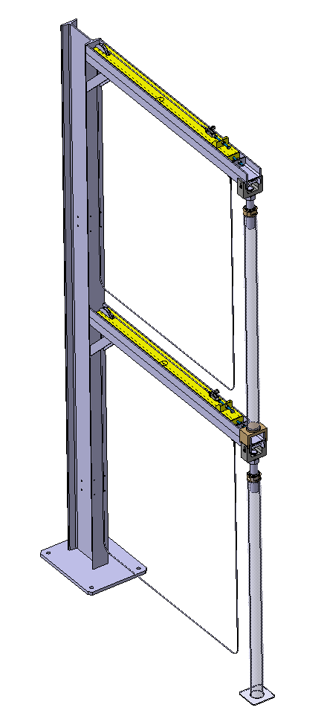
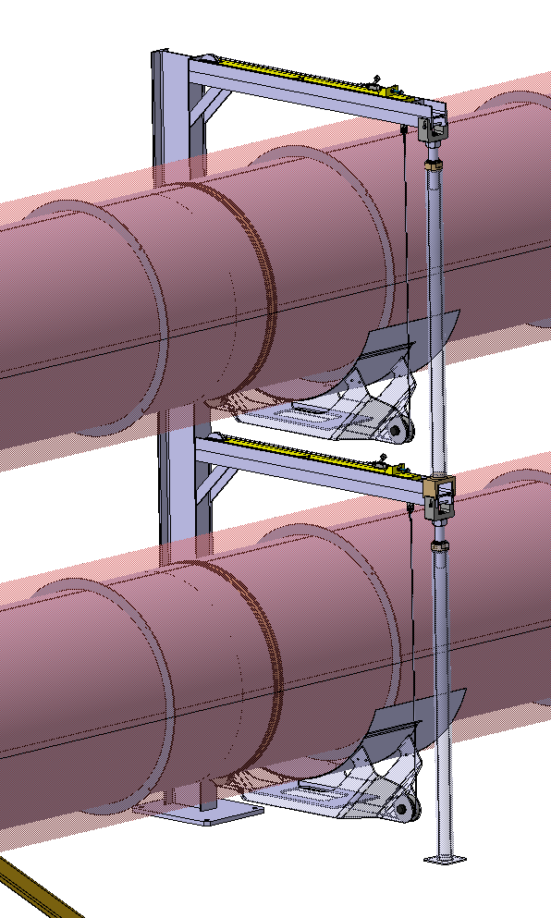

Slide 2
A la LHC approach

Slide 3
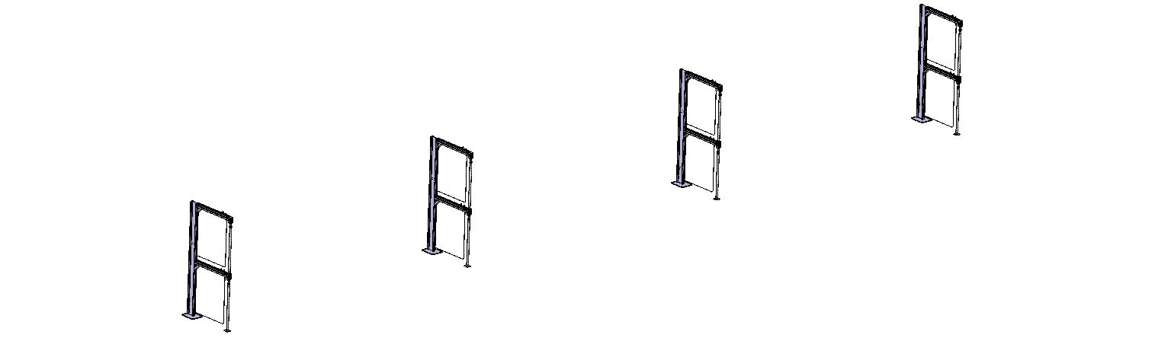
Phase 1: Alignment of the supports
Base plate aligned to +/- 1 mm with respect to a reference line.
Shimming to ensure a good horizontality of the transversal beams (+/- 1 mrad?).
Perpendicularity of the support w.r.t. reference line?

Slide 4
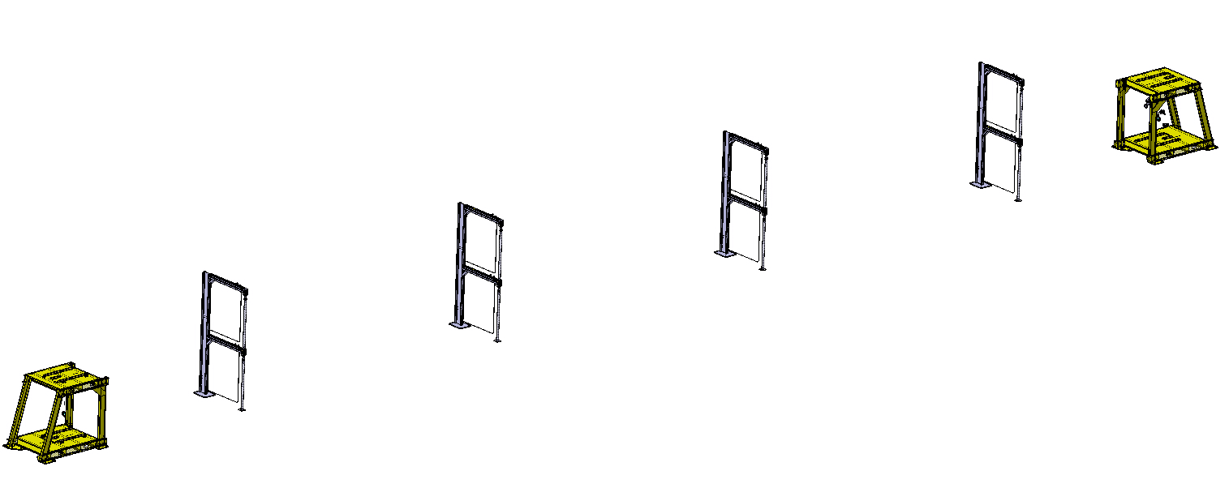
Phase 2: Alignment of the end supports
Positioning to +/- 1 mm with respect to a reference line.

Slide 5
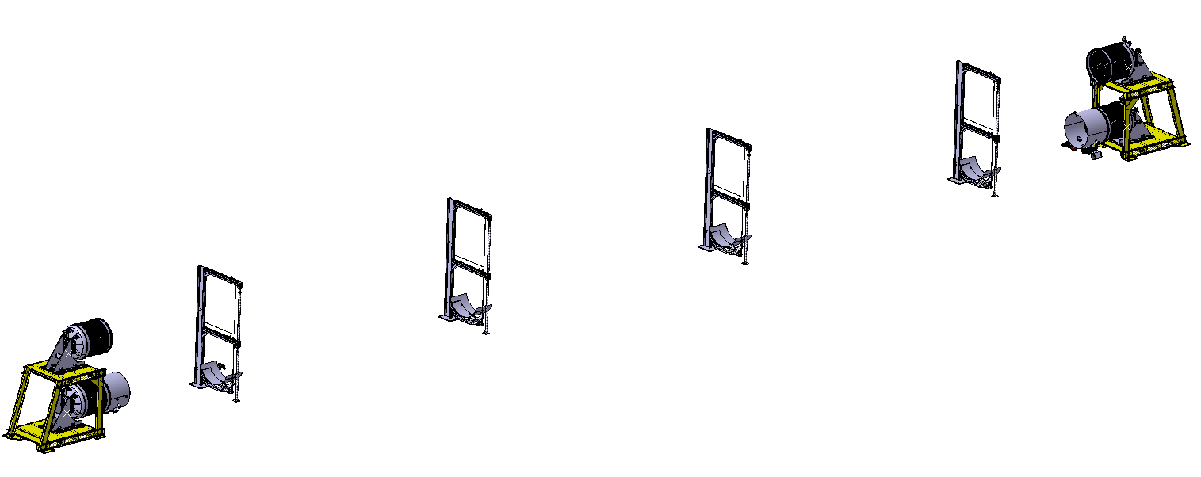
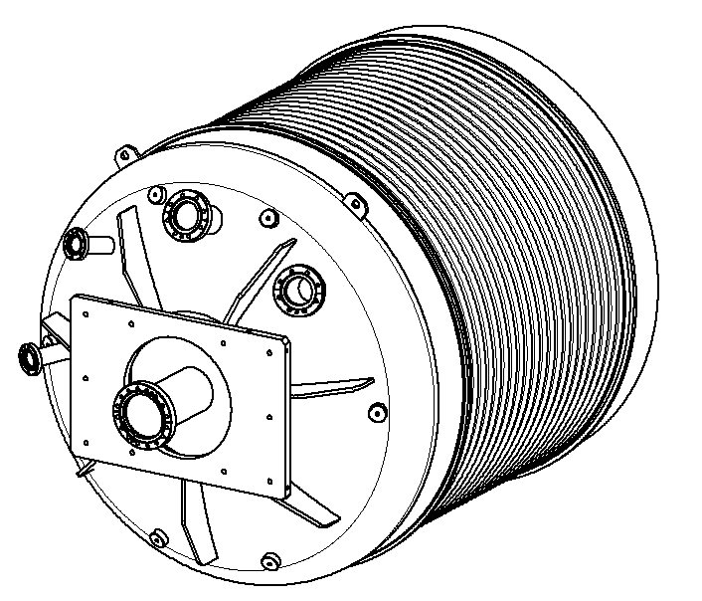
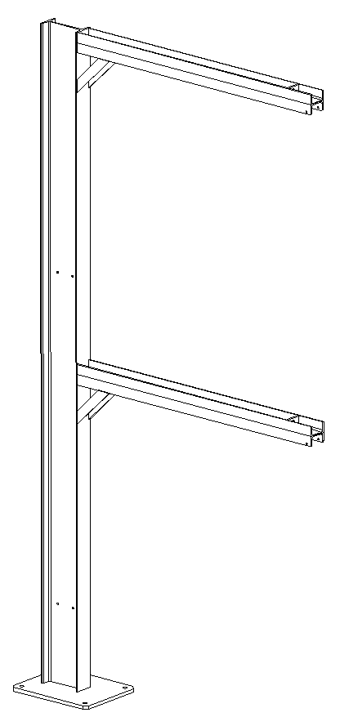
Phase 3: Alignment of the end caps
A: best plane defined by the lower transversal beams
B: best plane defined by the upper transversal beams
Target interface
B
A
D
C
A1
C: best line defined by the lower transversal beam extremities
D: best line defined by the upper transversal beam extremities
B
D
The positioning of the end caps (EC) is done with respect to and
A
C
C1
+/- 0.5 mm?

Slide 6
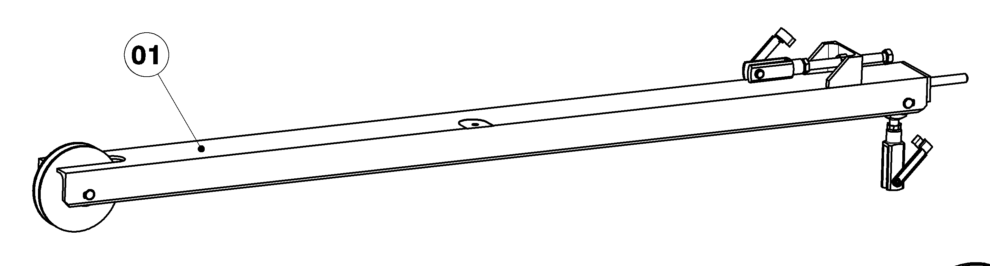
Phase 3: Alignment of the mobile beam
Target interface
B
A
EC1-EC2
A
EC1-EC2
The positioning of the mobile beam is done with respect to
+/- 0.2 mm?

Slide 7
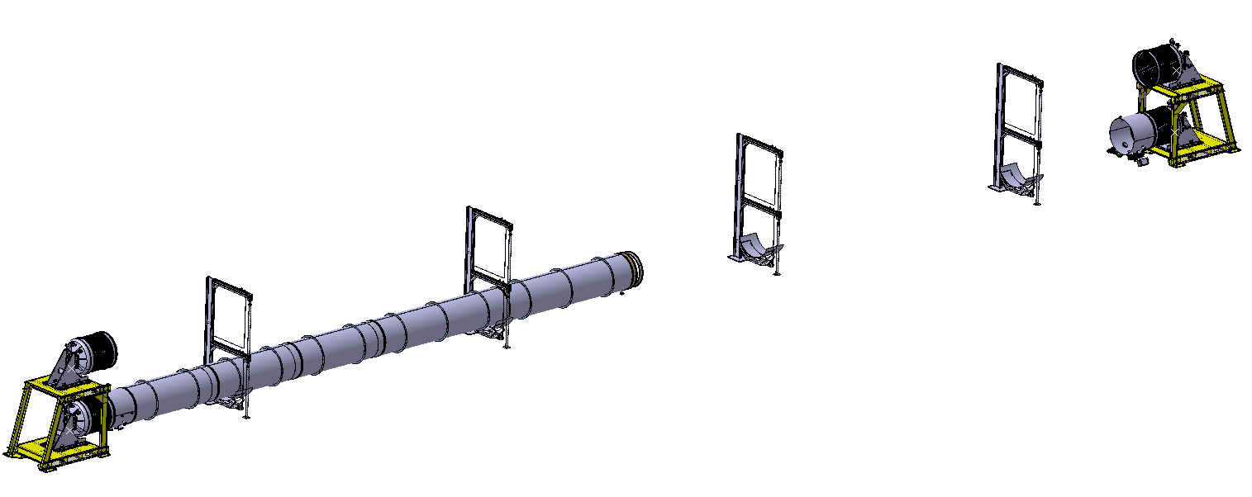
Phase 4: Installation of the chambers
Installation of chambers on dedicated adjustable supports

Slide 8
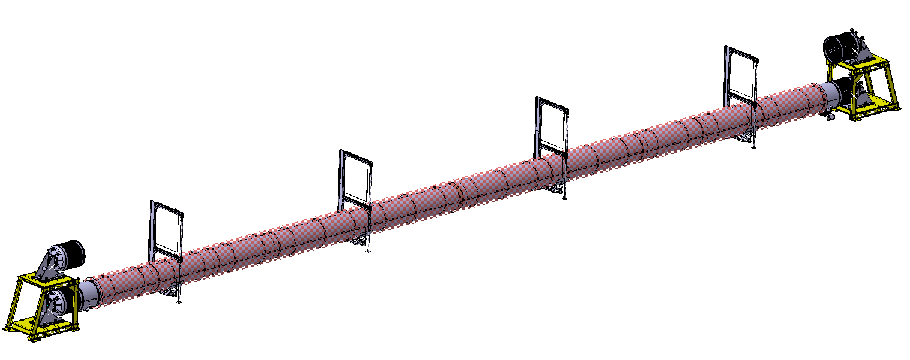
Phase 4: Installation of the chambers
Installation of chambers on dedicated adjustable supports.
Adjustment of the chamber extremities to enable the sleeve sliding, alignment with respect to .
EC1-EC2
EC1-EC2

Slide 9
Phase 5: Suspension of the chambers
Alignment of the chamber in vertical directions (cable length).
+/- 0.5 mm with respect to EC1-EC2 ?
EC1-EC2

Slide 10
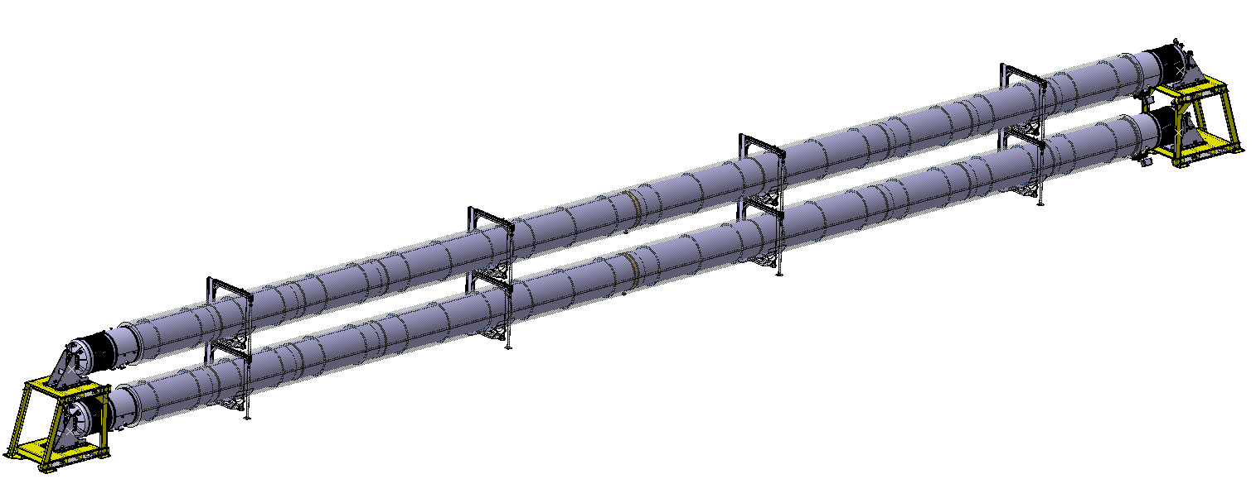
Phase 6: Upper chamber
Same approach for the upper chamber

Slide 11


Slide 12
A la ET approch

Slide 13
Phase 1: Alignment of the supports
Theoretical laser axis are defined first.
B2
B1
Base plate aligned to +/- 1 mm with respect to the reference plane B1-B2.
Shimming to ensure a good horizontality of the transversal beams (+/- 1 mrad?).
Perpendicularity of the support w.r.t. B1-B2.

Slide 14
Phase 2: Alignment of the end supports
Positioning to +/- 1 mm with respect to the reference plane B1-B2.

Slide 15
Phase 3: Alignment of the end caps
Target interface
The positioning of the end caps (EC) is done with respect to B1 and B2.
+/- 0.5 mm?

Slide 16
Phase 3: Alignment of the mobile beam
Target interface
B1-B2
The positioning of the mobile beam is done with respect to
B1-B2
+/- 0.2 mm?

Slide 17
Phase 4: Installation of the chambers
Installation of chambers on dedicated adjustable supports

Slide 18
Phase 4: Installation of the chambers
Installation of chambers on dedicated adjustable supports.
Adjustment of the chamber extremities to enable the sleeve sliding, alignment with respect to .
B1
B1

