Slide 2
Nb₃Sn coil packs: mechanical characterization & modelling
25/04/2024

Slide 3
Context – Nb₃Sn magnets design
Issue: Degradation occurs in some magnets at computed stress below the “limit”, some other work at computed stress higher than the “limit” (e.g. 11T can degrade at simulated 60 MPa, RMM can work at simulated 200 Mpa).
Non comprehensive list of unsolved questions in a general context
More accurate definition of the stress limit on conductor (3D)
Model and experimental data are not in phase during cooldown and requires fine tuning (loss of prestress at cold)
Local structural effect (peak stresses)
Stress during reaction
Our objectives:
Improve modelling of the coil material during the life steps of a magnet (assembly, reaction, cooldown, powering)
Provide harmonized and model adapted experimental data of the coil pack (ID card for each coil)
In particular, in the context of HFM program
12T, Cosinus theta type dipole
14T+, Block coil type dipole

Slide 4
A standard 10-stack sample
Focus put on the harmonization of the fabrication and the characterization
Standard fabrication: Identical sample configurations, repeatable and documented fabrications
Void / pressure
Reaction cycle
Impregnation cycle
Standard characterization: List of measurements and measurement methods
Stress/strain (3 directions, 2 temperatures)
CTE (3 directions)
Dimensions (non reacted/impregnated samples)

Slide 5
Toward a standard 10-stack Id card
Phase 1: Resolve some open questions
Relevant sample configuration
Stress/strain measurements methods: global vs local
Influence of sample’s length
Effect of surface
Load effect on CTE
Phase 2: Only then
Characterize and compare 10-stack for different magnets/coils
Investigate impact of resin fraction
Investigate new fiber,
…

Slide 6
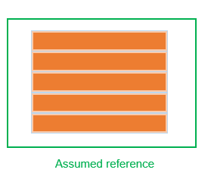

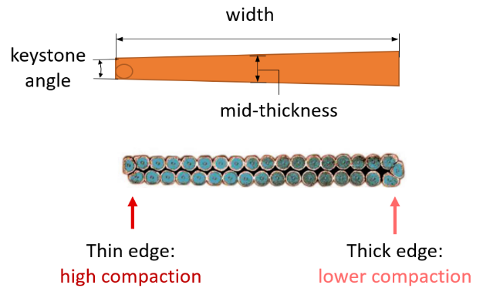

Toward a standard 10-stack Id card
1. Which version of the keystoned stack is more representative of the non-keystoned stack (model)?
Proposed study: Compare stress/strain curves and DIC for 3 configurations using identical samples
It is not only a difference in stress decomposition:
varying stiffness along the width of cable
Assumed reference
In models
Cable representative
Coil representative

Slide 7
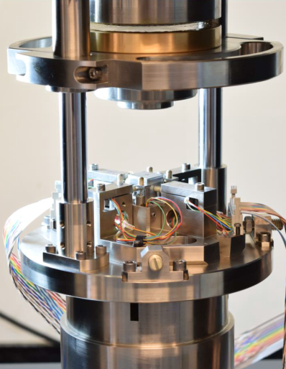
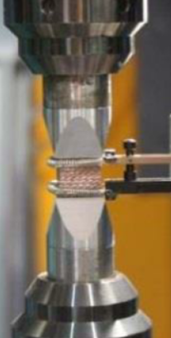
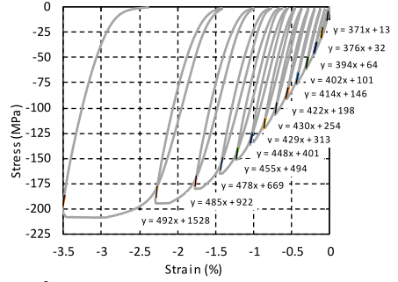
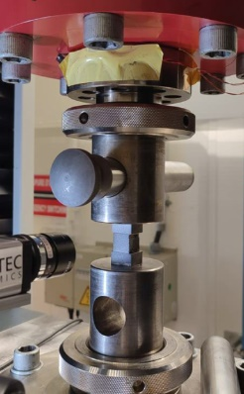
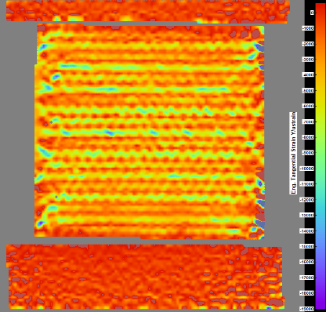
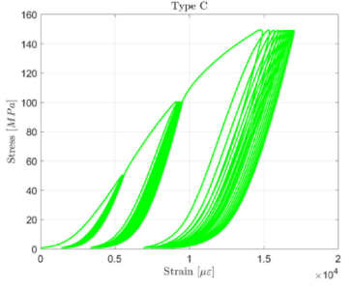
Toward a standard 10-stack Id card
2. Are global (LVDT) and local (DIC, extensometer) technics measuring the same thing?
Proposed study: Measure simultaneously the deformation under load with both LVDT and DIC.
Fichera et al., IEEE Trans. Appl. Supercond., 29 (2019)
Wolf et al., IEEE Trans. Appl. Supercond., 29 (2019)
Cable stack compression – DIC observation
(EDMS 2714314)

Slide 8
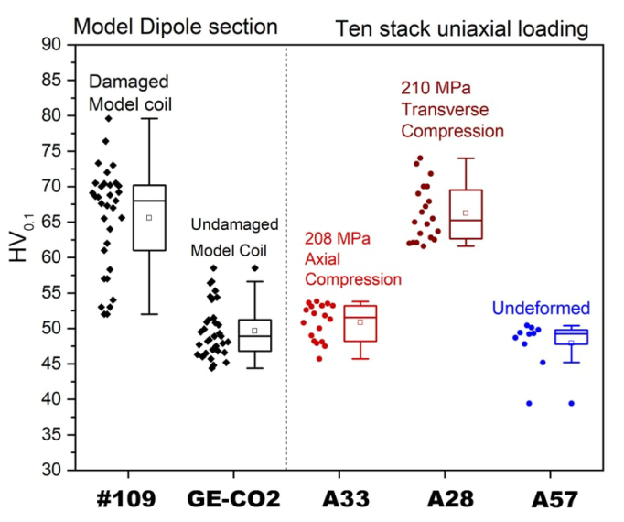
Toward a standard 10-stack Id card
3. Is the length of the sample influencing the measurement?
Proposed studies:
With transverse load applied, compare stress gradient on the longitudinal direction for sample of different length
After load cycles, a Vickers measurement to compare hardening of copper for different length
Balachandran et al., Supercond. Sci. Technol., 34 (2021)

Slide 9
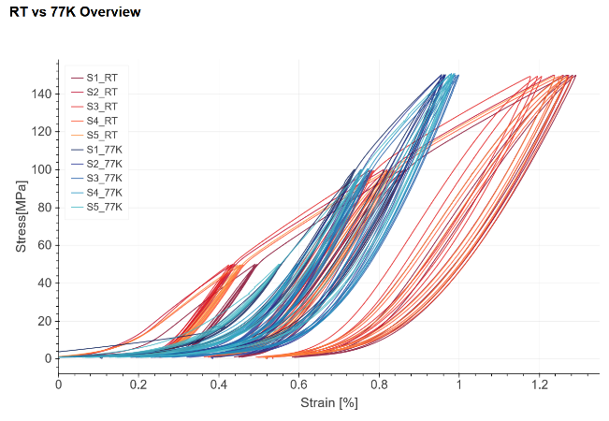
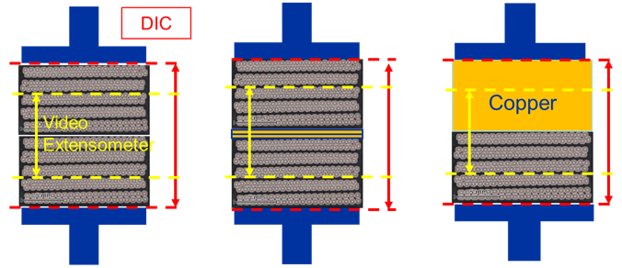
Toward a standard 10-stack Id card
4. Understand the effects of interfaces during measurements: surface irregularities, double stacks,…
Proposed study: DIC measurements with stacks sandwiched by different interfaces.
Cable stack
to cable stack
Intermediary material
Cable stack
to wedge
sitting effect

Slide 10
Toward a standard 10-stack Id card
5. How does the load influence the thermal contraction of the stack?
Proposed studies:
Compare CTE (3 directions) before and after load cycles.
Measure CTE on samples under load (Reiter et al., IEEE Trans. Appl. Supercond., 11 (2001))

Slide 11
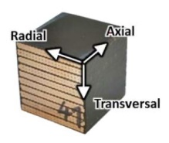
Preliminary Test plan
s: short sample – 15 mm
l: long sample – 50 mm
Study case cable: 11T and SMC
1s
Vickers
1s
CTE (tr)
CTE (ax)
CTE (ra)
Strain (tr) – LVDT+DIC (ax)
CTE (tr)
CTE (ax)
CTE (ra)
Strain (tr)
LVDT+DIC (ax)
1s
CTE (tr)
CTE (ax)
CTE (ra)
2s
1s
Vickers
Flat (reference)
8s + 2l
2s
Strain (ax)
LVDT + DIC (ra)
1s
CTE (tr)
CTE (ax)
CTE (ra)
1s
Vickers
2s
1s
CTE (tr)
CTE (ax)
CTE (ra)
Strain (ra)
LVDT + DIC (ax)
1s
1l
Vickers
1l
Strain (tr) – LVDT+DIC (ax)
1l
Vickers
Strain (tr) – LVDT+DIC (ra)
CTE (tr)
CTE (ax)
CTE (ra)
Keystone – non compensated
Strain (tr) – LVDT+DIC (ax)
CTE (tr)
CTE (ax)
CTE (ra)
4s
Keystone - compensated
Strain (ax) – LVDT+DIC (ax)
CTE (tr)
CTE (ax)
CTE (ra)
4s
Strain (ra) – LVDT+DIC (ax)
CTE (tr)
CTE (ax)
CTE (ra)

