Slide 1



LHCOPN-LHCONE Logistics
LHCOPN-LHCONE Meeting at IHEP
Fazhi QI
Fazhi Qi
LHCOPN-LHCONE meeting, 9.10.2024

Slide 2


LHCOPN-LHCONE meeting #53
October 09-12
hybrid workshop
- 40 people in person
- 10 remote participations
One session “Network performance assessment” added.
Agenda and presentations at：https://indico.cern.ch/event/1410638/

Slide 3
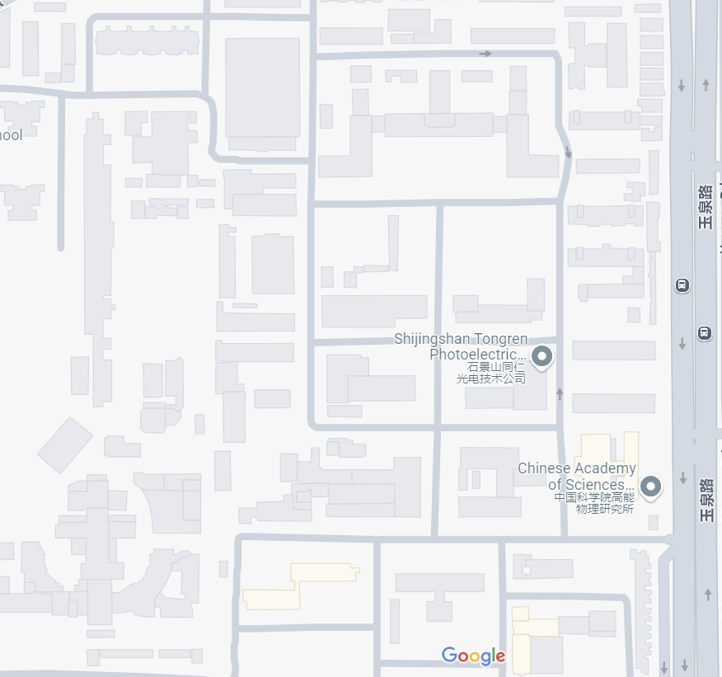
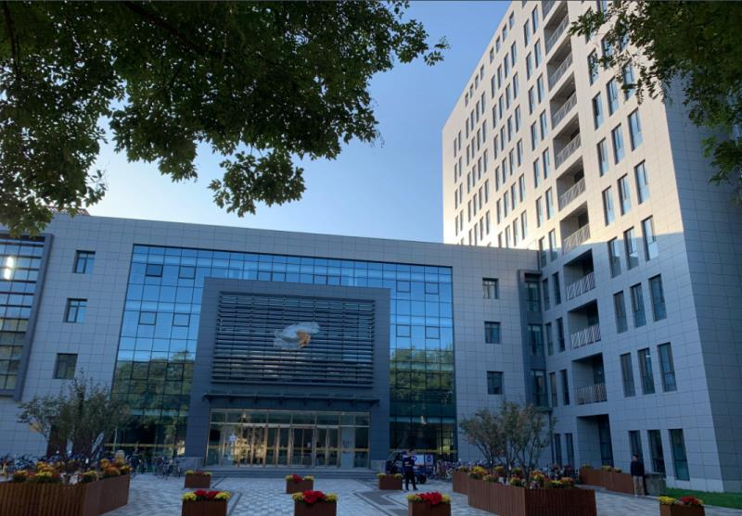
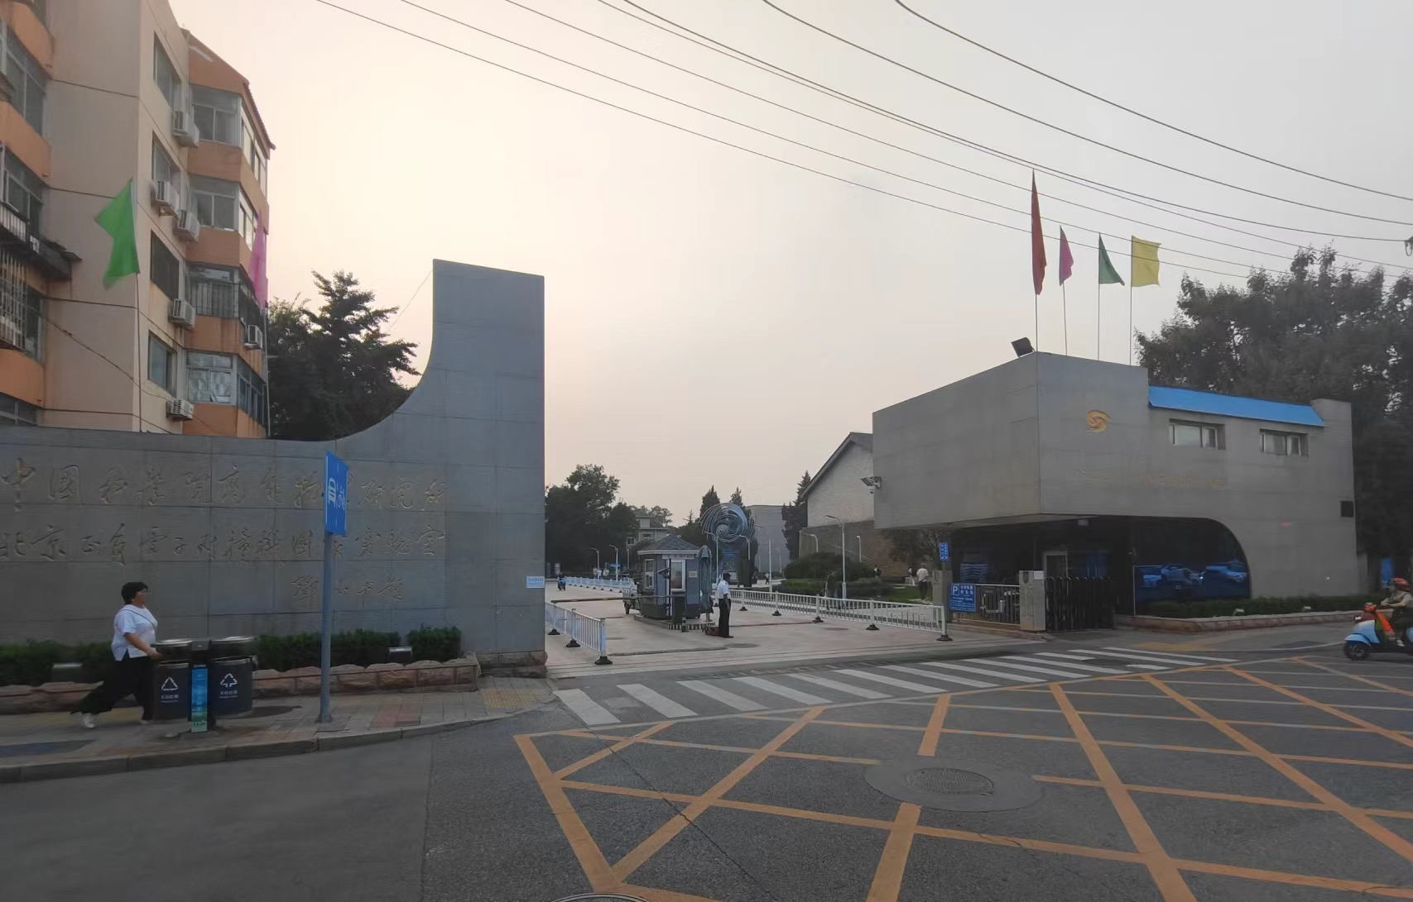
Access to Meeting Room
IHEP Multidisciplinary Building
(Conference Venue)
Room 124，Multidisciplinary Building
Accessible during the workshop.
IHEP

Slide 4
Network Access
Eduroam
Wireless SSID: IHEP
  Connect to IHEP SSID.
  Open your browser and visit any website. You will be prompted to register for network access; select the option “4. I have a Meeting Code.”
  Enter your name and the Meeting Code: LHCOPN-LHCONE.
  Proceed and submit your information.

Slide 5
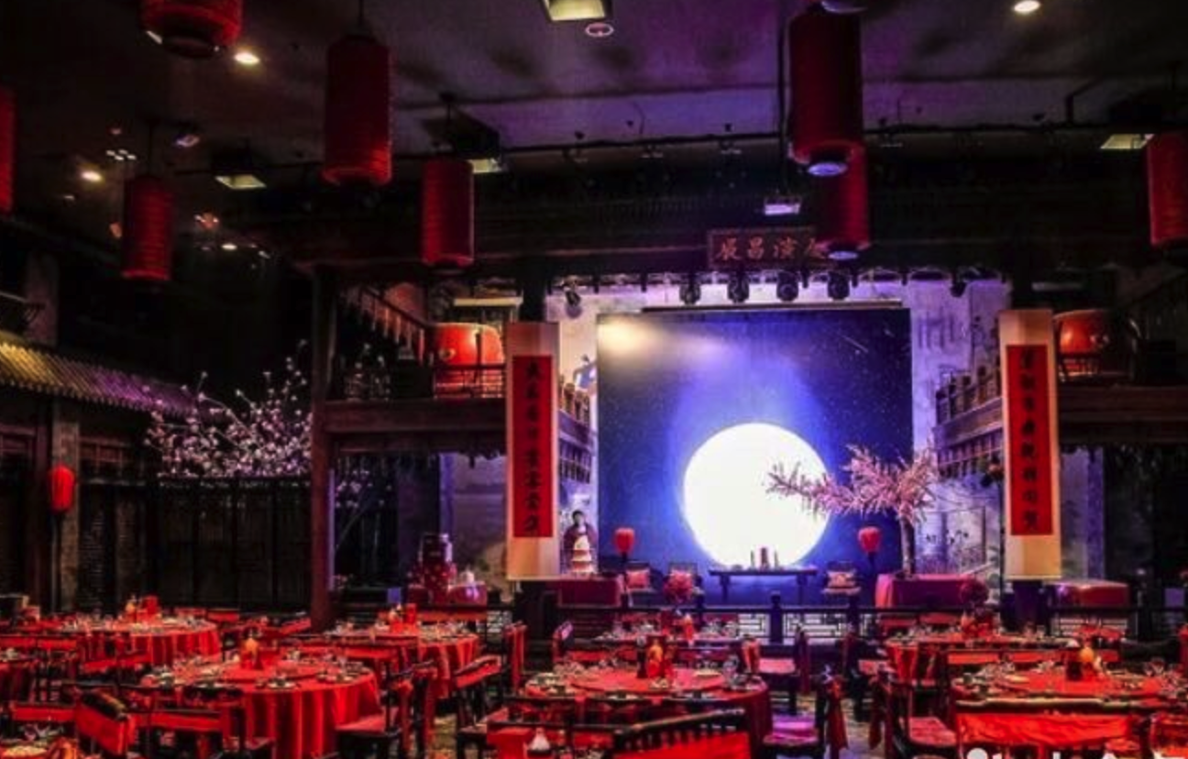
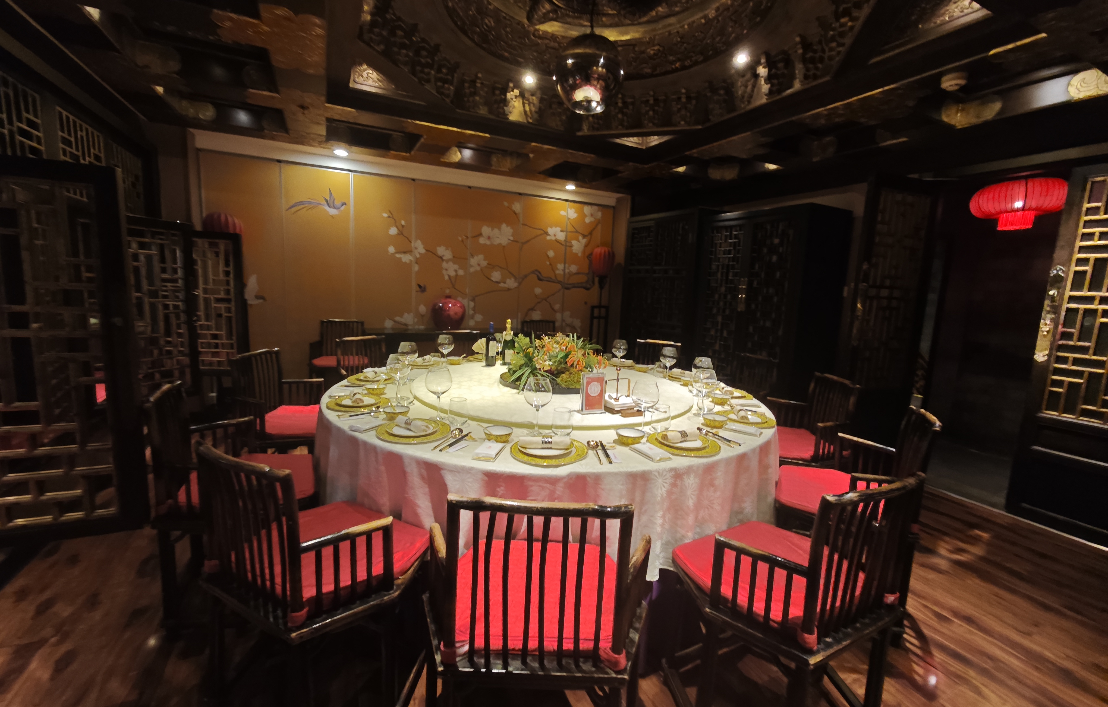
Meal & Coffee Breaks
October 9-10: Lunch box & Coffee break are provided
Dinner on October 9: Zhengyuan Dazhaimen, a bus will pick up us from the meeting room at 18:00
No dinner arrangement for 10 and 11, free time for you!

Slide 6
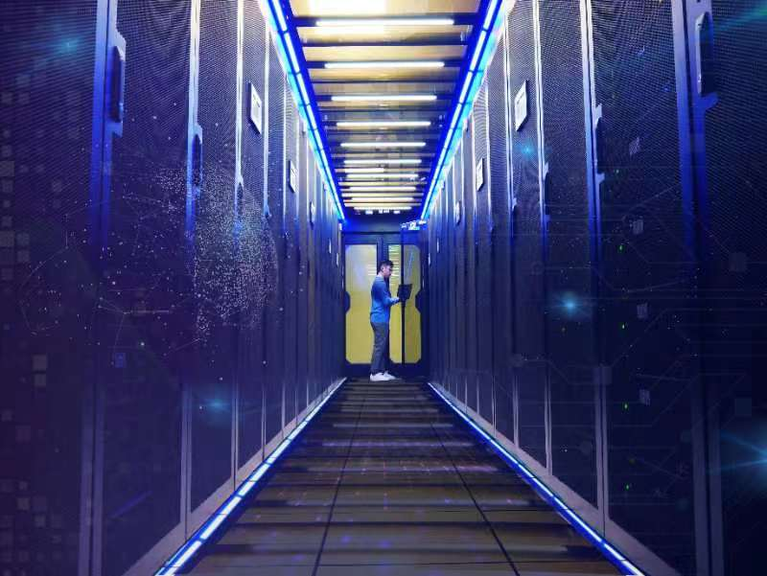
Beijing T1&T2/IHEP CC Visit
October 10, 12:25-
5 minutes walk from the meeting room to IHEP CC.

Slide 7
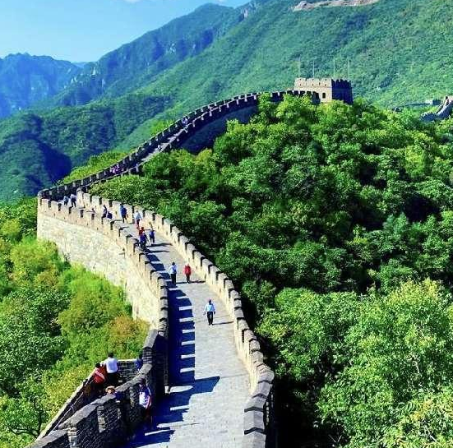
Mutianyu Great Wall
North of Beijing, 81 kilometers from the IHEP approximately a 2-hour drive, with a visit duration of 2 hours.
Mutianyu Great Wall was built on the basis of the Northern Qi Dynasty Great Wall, with a history of 1400 years, well-preserved.
High vegetation coverage, beautiful natural scenery.
Fewer tourists.

Slide 8
Tour of the Great Wall
  Guests visiting the Great Wall, please fill in your passport information(only be used to make advance ticket reservations) and pay 30 Eur (Cash or Credit card) at the registration desk before the end of the 9th meeting.
  07:45~08:00: Pick up at hotels (to be finalized)
  10:00~10:15: Arrive at Mutianyu Great Wall
  10:30~12:40: The Great Wall Tour, by foot or sightseeing car/cable car(tickets included)
  12:40~14:00: Lunch
  14:00~16:00: Return to the hotels
Contacts: Ran Yan; yanran@ihep.ac.cn; +8615330051775
Xiaowei Jiang; jiangxw@ihep.ac.cn; +8615313111338

Slide 9
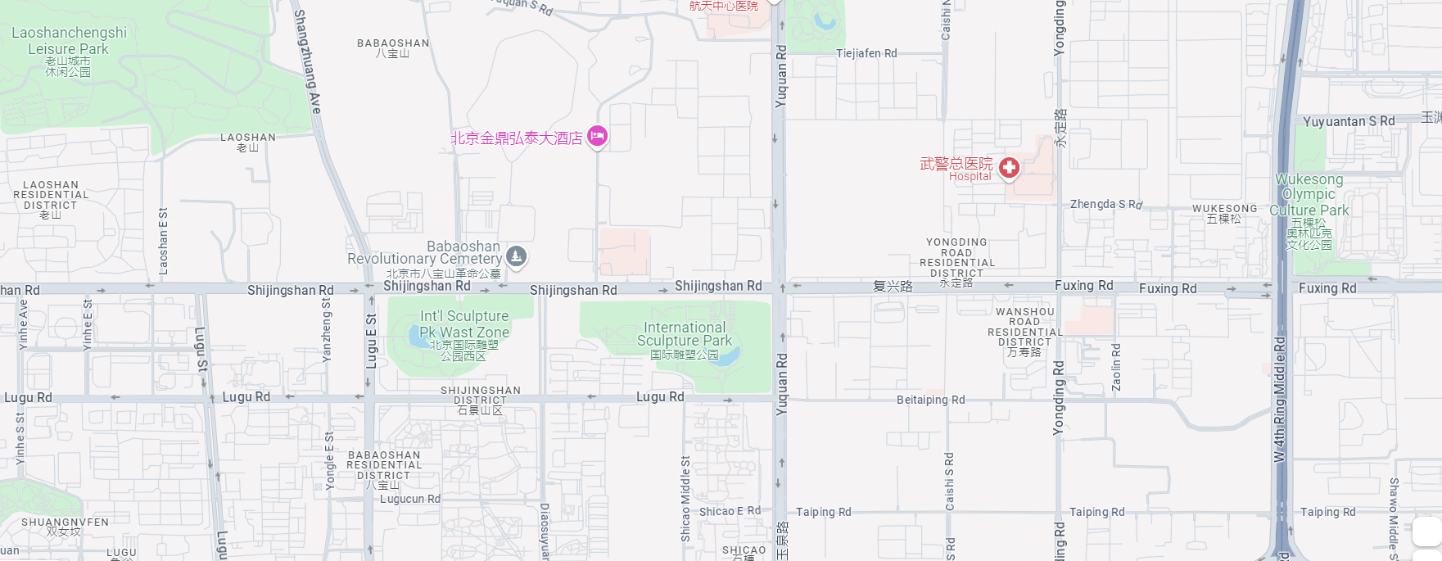

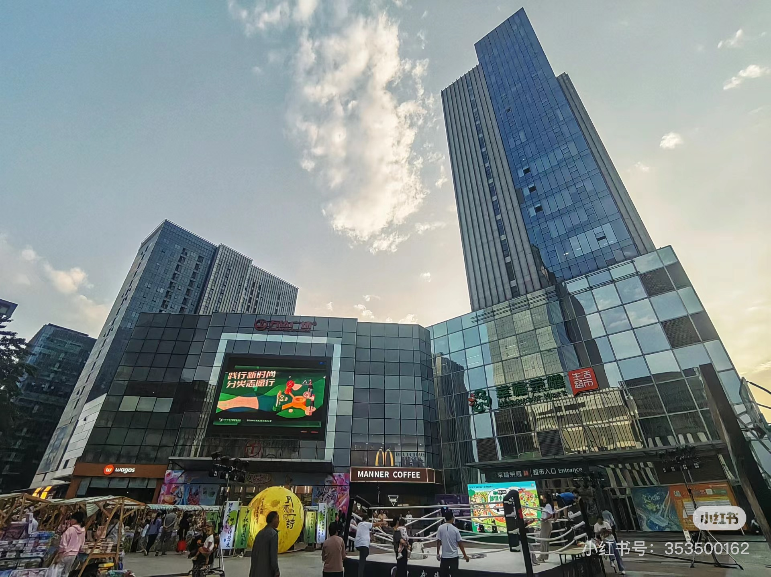

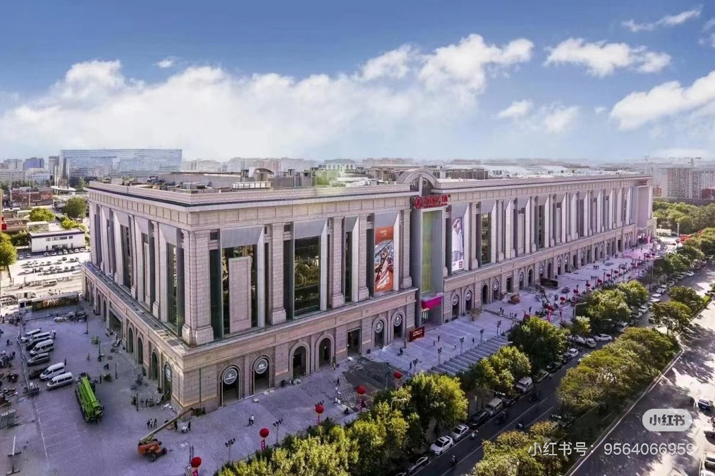
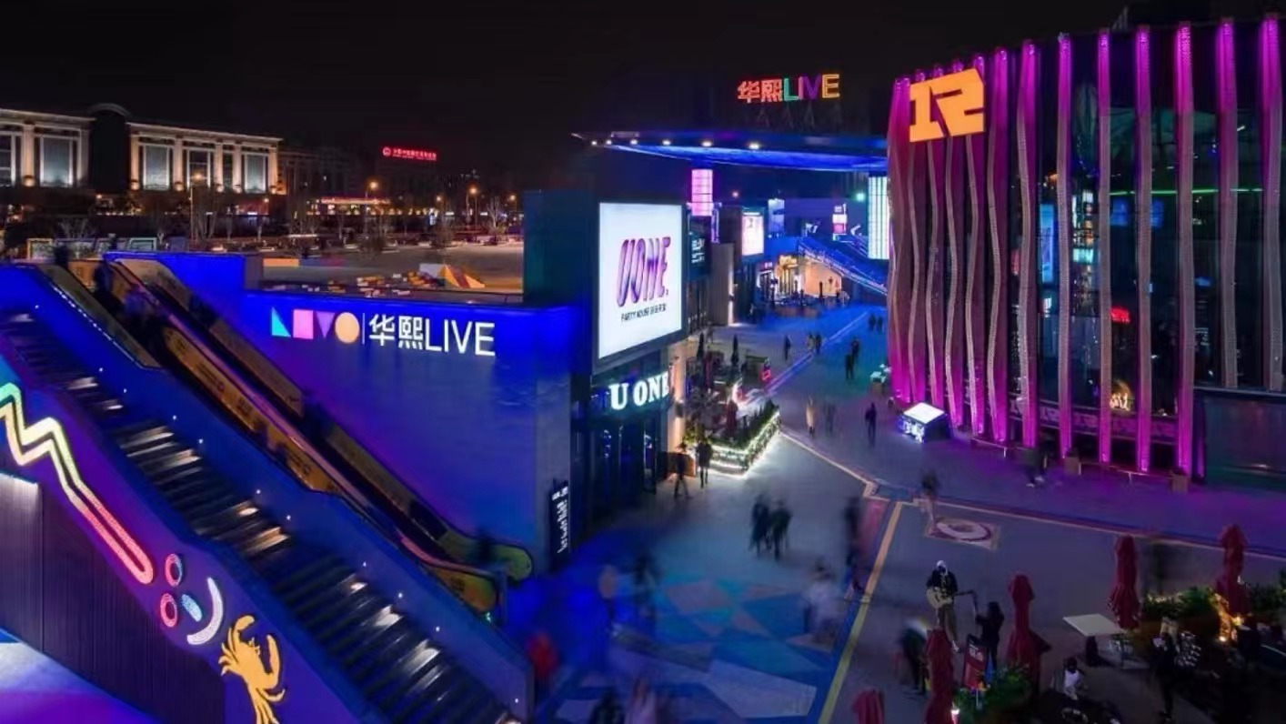
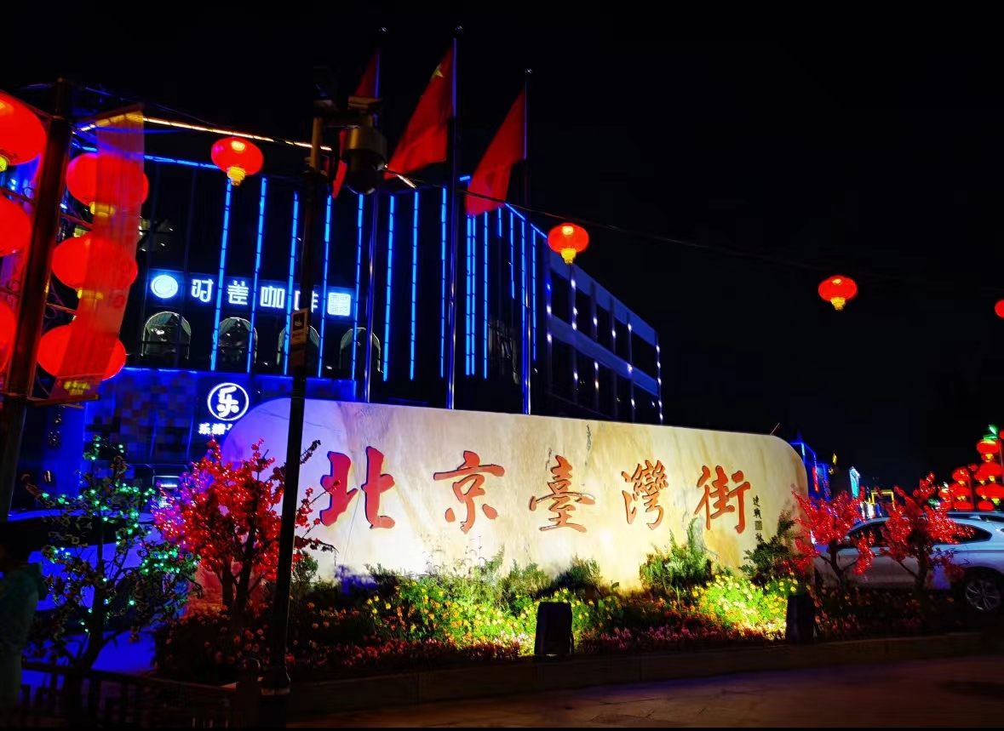
Some places for food and drinks
IHEP Guest House
Wanda Plaza
(Shijingshan Branch)
IHEP
Holiday Inn Chang An West Beiiing
Shijingshan Wanda Plaza integrates eating, drinking and entertainment
The Supermarket
McDonald’s
Wanda Plaza
(Beijing Haidian Branch)
Huaxi LIVE
WU MART
The Huaxi LIVE and Wanda Plaza are comprehensive commercial complexes that seamlessly integrate retail, dining, and entertainment facilities.
Taiwan Street
Special food street
The subway/bus card can be recharged and reuesd.

Slide 10
In case of urgent needs
Fazhi QI. +8618910760801
Thank you
谢 谢

