Slide 1
Timetable of The Great Wall Tour
Location: The Great Wall at Mutianyu (Because of The Great Wall at Badaling need for a reservation 15 days in advance(with the passport information ) and October being a peak tourist season with heavy crowds, so we have chosen to visit The Great Wall at Mutianyu.)
Mutianyu Great Wall is well-preserved, surrounded by lush greenery, with relatively fewer tourists. Ticket purchase is convenient and can be done on-site. The scenic area facilities are well-equipped.
07:45~08:00: Meet at the entrance of Holiday Inn Hotel and then to IHEP guest house, depart by bus, estimated arrival at 10:00.
10:00~10:15: Purchase tickets (Please bring your passport.).
10:30~12:40: Tour the Great Wall by sightseeing car and cable car (If you choosing to hike the Great Wall, there are no cable car stations along the way).
12:40~14:00: Lunch
14:00~16:00: Return to the hotel
Guests visiting the Great Wall, please fill in your passport information at the registration desk before the end of the 9th meeting. This information will only be used to make advance ticket reservations for you.

Slide 2
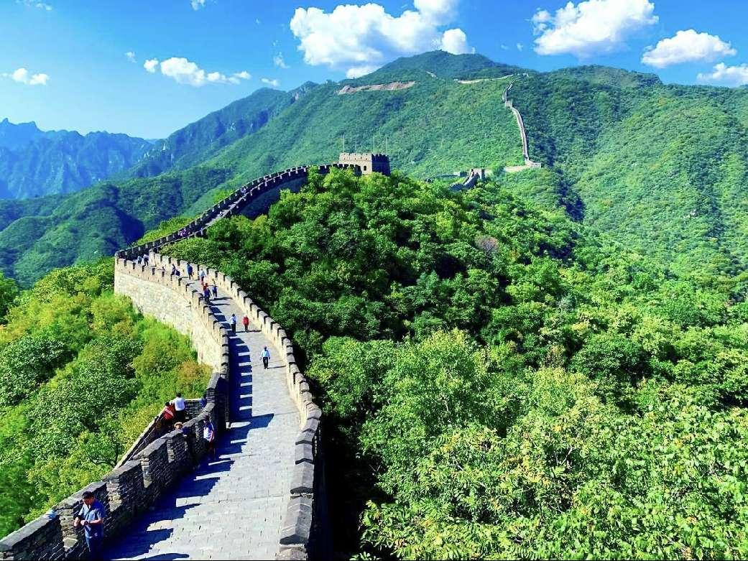
Introduction to The Great Wall at Mutianyu
Location: Mutianyu Village, Bohai Town, Huairou District, Beijing, 81 kilometers from the IHEP, approximately a 2-hour drive, with a visit duration of 2 hours.
Introduction to Scenic Area Features: The Great Wall at Mutianyu was built on the basis of the Northern Qi Dynasty Great Wall, with a history of 1400 years. The vegetation coverage on the two mountains is high, offering beautiful natural scenery.
Advantages: The Great Wall at Mutianyu is well-preserved, surrounded by lush greenery, with relatively fewer tourists. Ticket purchase is convenient, and tickets can be purchased offline with a passport. The scenic area facilities are well-equipped.

