Slide 1
AMBER LH2 target, pressure requalification status and ancillary
TE-CRG, O. Pirotte

Slide 2
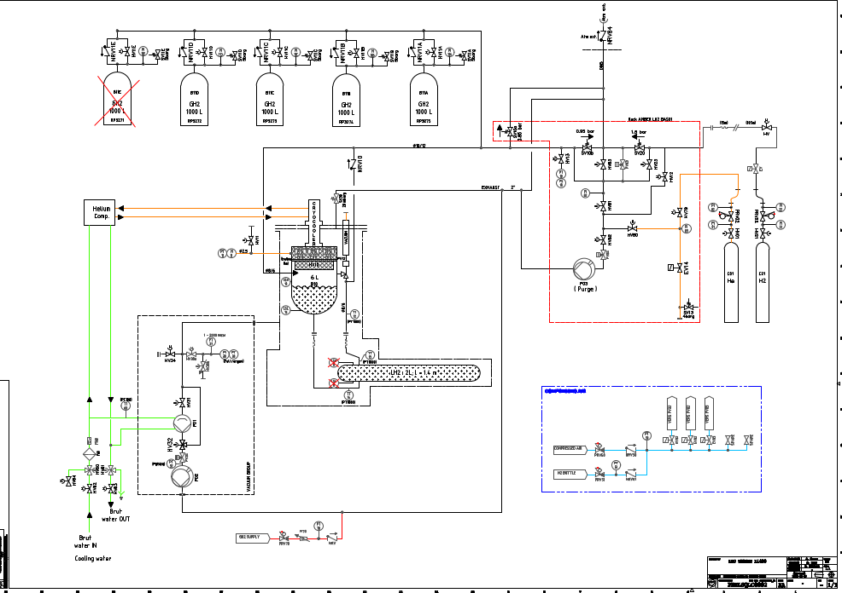
Design and drawings status
Main studies and drawings completed.
Final PID released: PRELSQLC0002
Remaining task in progress : sizing of buffer safety valve (SV11x)

Slide 3
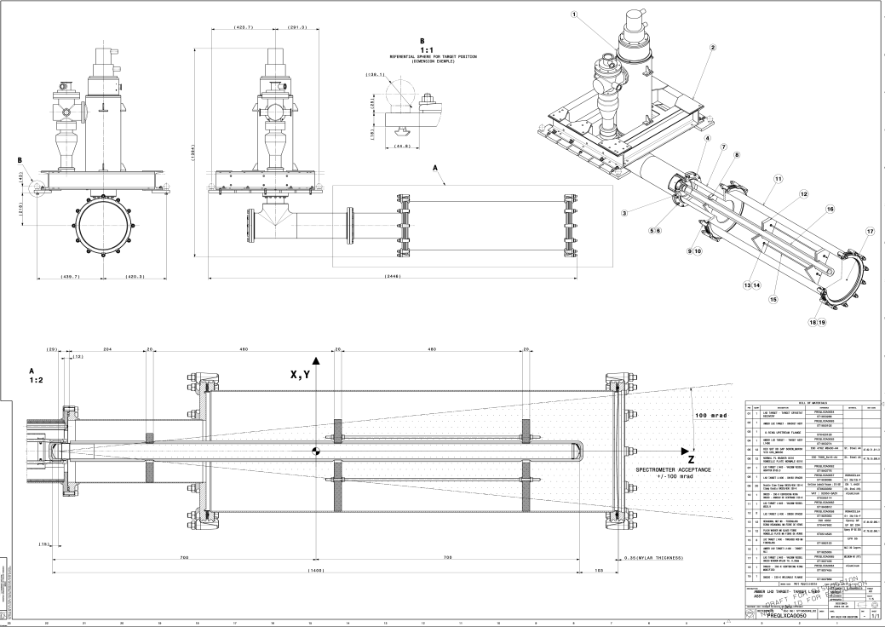
Design and drawings status
Archiving of drawings in progress in CERN drawing database
Main assembly : PREQLXCA0050

Slide 4
Pressure equipment qualification status
All sub-assemblies pressure tested as agreed with HSE (see SRF EDMS 3077198)
Summary report in progress : EDMS 3083858

Slide 5
On-going tasks
Tasks in progress
Installation of LH2 system with target and associated infrastructure
Sizing of buffer safety valve
Documentation : technical note, qualifcation file, …

