Slide 1
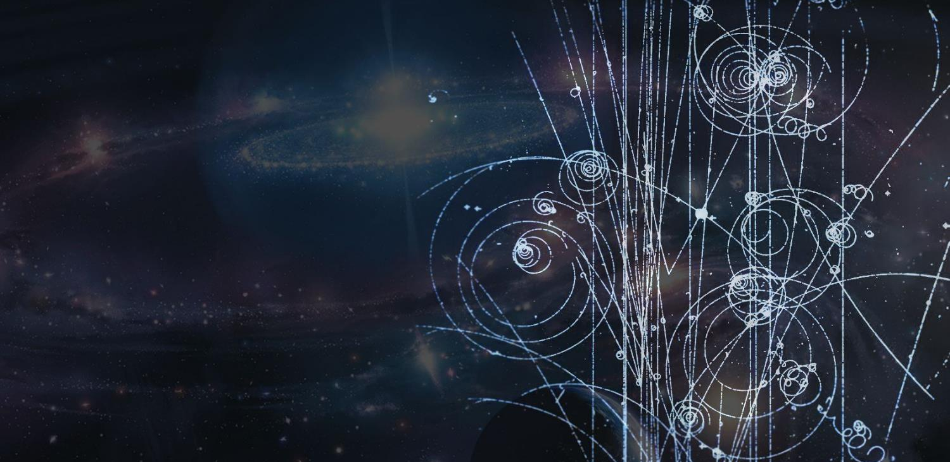
Herzlich Willkommen
Gratulation zu eurem Gewinn von Physik im Advent!
Dr. Sarah Zöchling
School and Student Programmes Manager
CERN
Notes:
Einen wunderschönen Nachmittag wünsche ich euch und herzlich Willkommen zu diesem Vortrag über das CERN. Ein paar Hinweise zu Beginn, während des Vortrags bitte Kamera und Mikro abschalten und die Chat-Box unten rechts öffnen. In der Frage-Antwort-Runde könnt ihr auch gerne Kamera und Mikro aufdrehen, wenn ihr eine Frage stellen möchtet. Wenn ihr während des Vortrags eine Frage habt, dann schreibt die bitte einfach in den Chat. Wer von euch die Chat-Box erfolgreich geöffnet hat, schreibt gleich mal so etwas wie gefunden in den Chat!

Slide 2




Was erwartet euch?
WER redet hier?
WER arbeitet hier?
WAS ist CERN?
?
?
???
!
?
Q&A
p
WAS untersuchen wir?
?
p
WIE untersuchen wir?

Slide 3
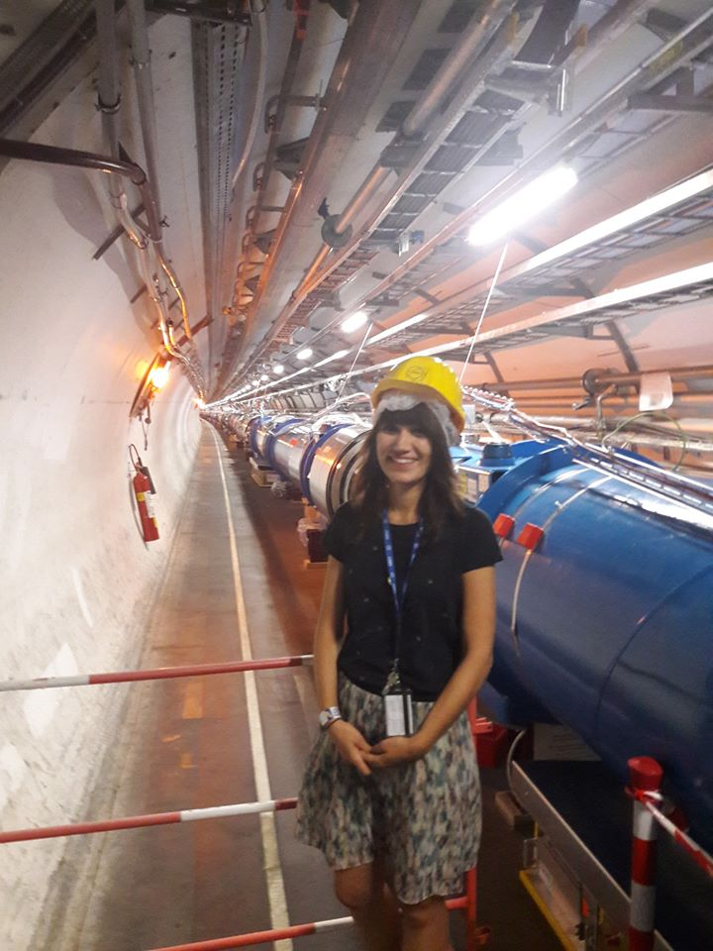
Wer redet hier?
sarah.zoechling@cern.ch
Notes:
Present yourself: Name, Ausbildung
Your background: Masterarbeit, Lehrerin
Your (dis)interest in science: Physik als große Liebe – Doktorandin am CERN, um herauszufinden, welche Themen und Kontext besonderes Interesse an Physik wecken

Slide 4
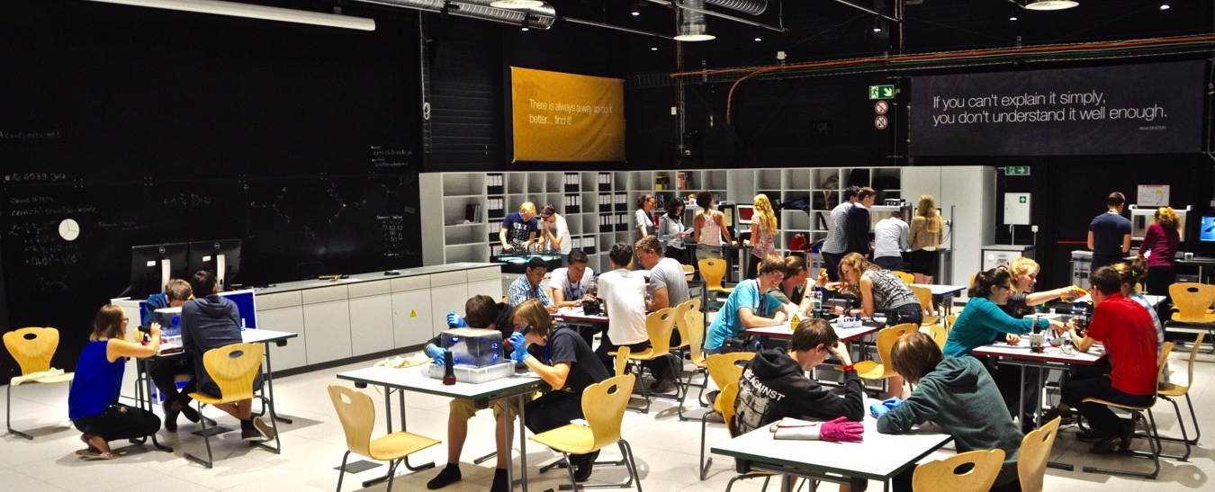
S’Cool LAB
Schüler*innenlabor für Teilchenphysik des CERN
cern.ch/scool
Notes:
KLICK
Derzeitige Umstände

Slide 5
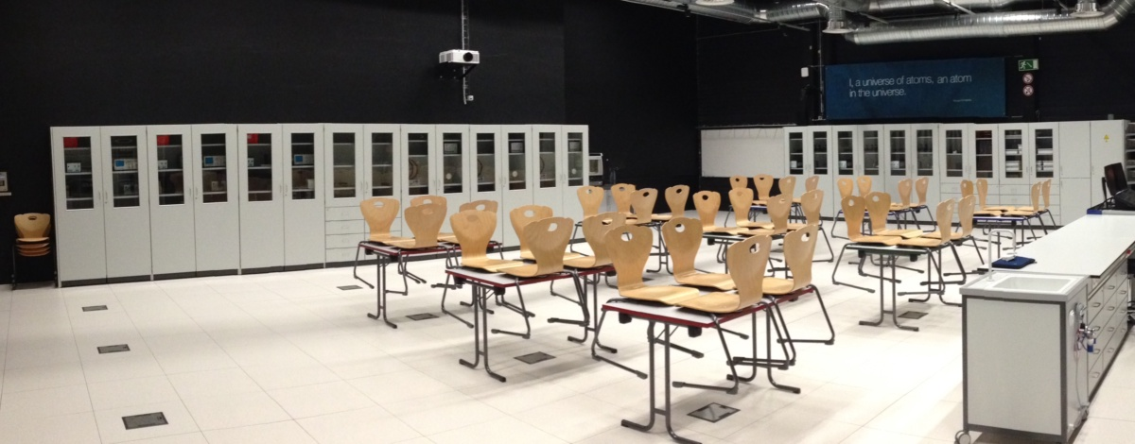
S’Cool LAB
Schüler*innenlabor für Teilchenphysik des CERN
cern.ch/scool
Notes:
KLICK
Derzeitige Umstände

Slide 6

CERN
Was ist das?

Slide 7
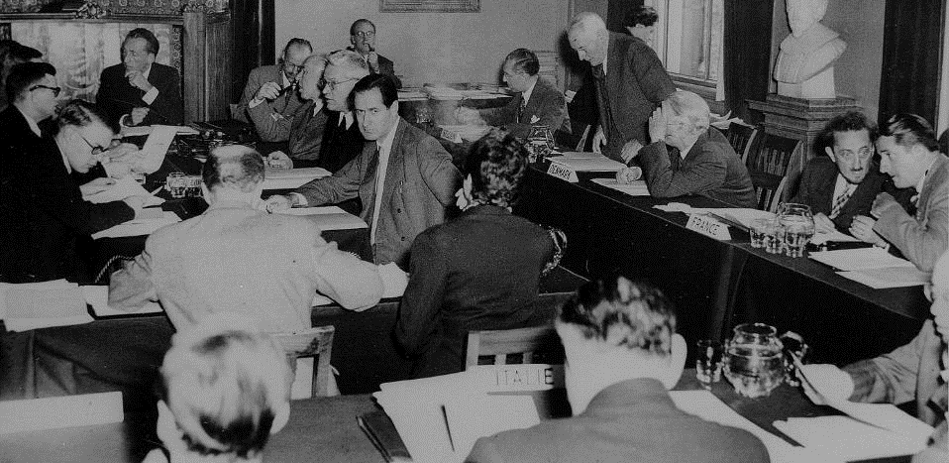


Wofür steht CERN?
1953/54
Notes:
Chat: Wofür steht das Akronym «CERN»?
eminent scientists gathered in meetings to setup a structure to continue fundamental research in physics in Europe.
They were gathered as a «Council», also einen Rat, which means there were just holding meetings and they did not (yet) had a lab or led experiments.
Chat: Was glaub iht, warum hat man das in den 50ern gemacht? Was war da davor?
After WW II, fundamental research in Europe was not leading anymore. Many scientists were flying away to the United States.
In order to stop this movement. The images are from Amsterdam meeting in 1953 when the CERN convention was signed.
It is decided to build the «European Organization for Nuclear Research». It comes into existence in 1954.
Geneva is chosen for its central location, the neutrality of Switzerland.
International Organization format was chosed to guarantee neutrality and independance.
The Organization, unlike the Council, has labs and has research activties.
But as the Organization is still «led» by a Council, the CERN acronym was kept.

Slide 8
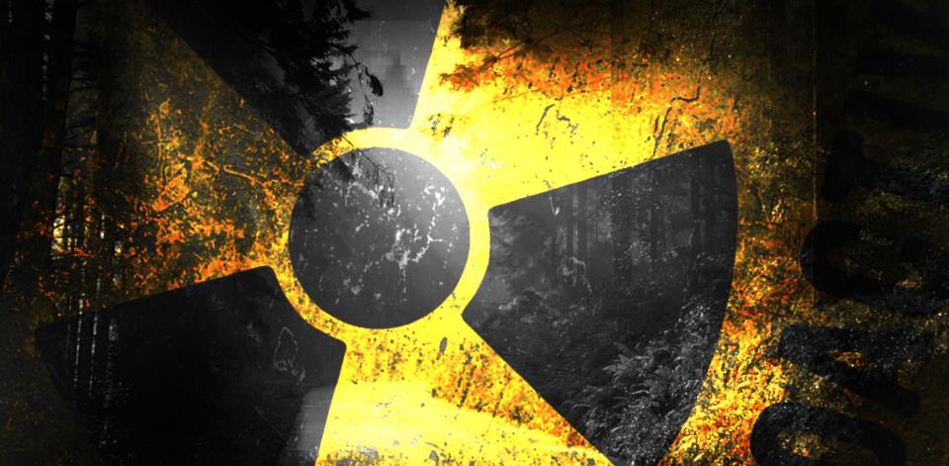


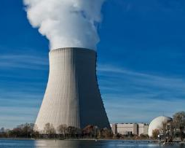
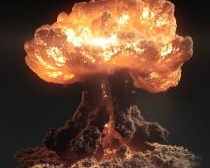
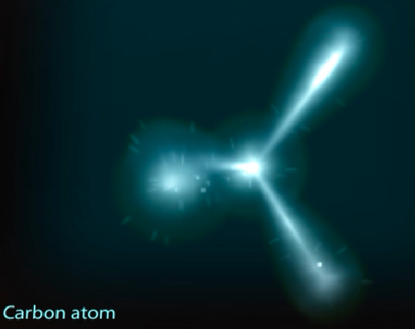
Nuklear?
Europäisches Labor für Teilchenphysik
Notes:
So wie C für council statt O für organisation ist das N für «Nuclear» nicht mehr ganz richtig:
- CERN does not produce electricity (but consumes a lot)
- CERN does not produce military applications out of nuclear power (forbidden by CERN convention, and, anyway, all research results are made publicly available and there are scientists from many countries in each experiment… therefore no risk that exclusive military applications are developed).
- CERN studies the structure of matter. In the 50s, the nucleus is the main object of study about matter. The word «Nuclear» comes from that.
Nowadays CERN is studying the components of the components of the nucleus. Therefore CERN can use an alternative «branding» which is more accurate and less open to interpretation: « European laboratory for particle physics »

Slide 9
CERN
Wer arbeitet hier?
Notes:
Chat: Wie viele Nationen arbeiten am CERN zusammen?

Slide 10
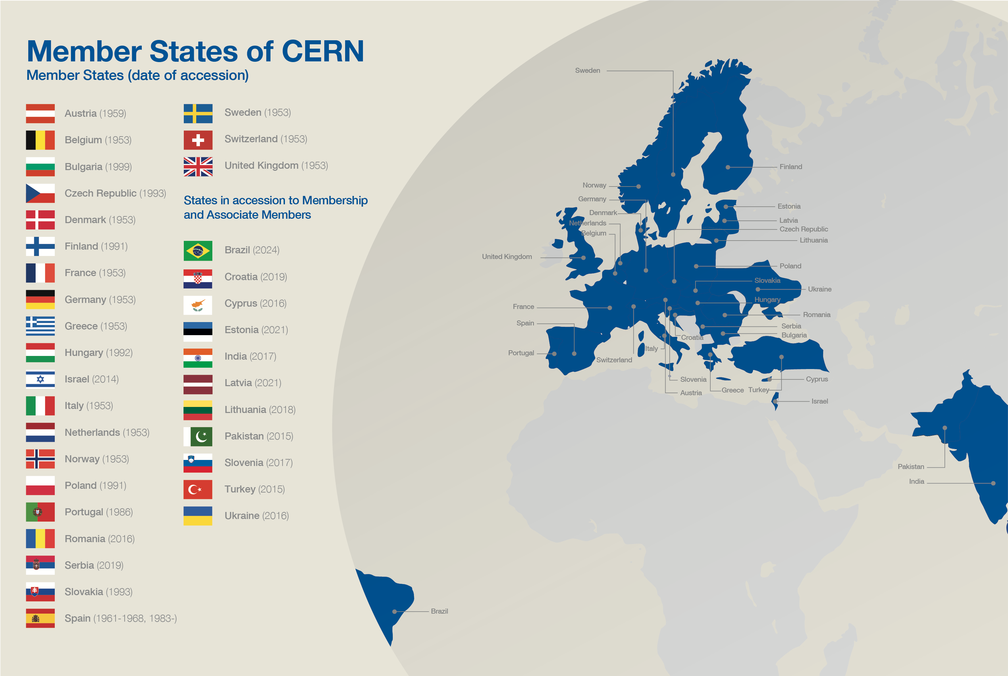
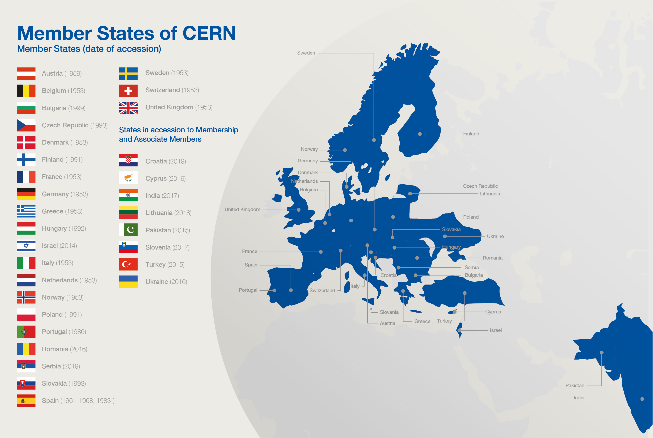
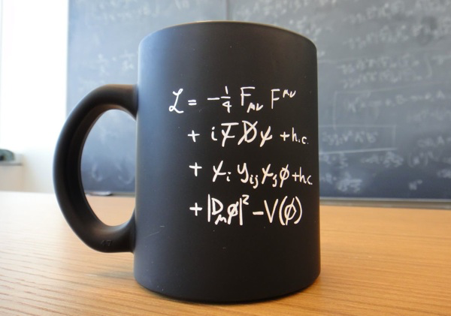






Mitgliedsstaaten
Assoziierte
Assoziierte
Budget (2023)
1,2 Mrd. CHF
LHC
Notes:
First CERN is funded by 23 Members States and 8 Associated Members. NEU: Estland ist assoziiert und Verhandlungen mit Brasilien und Kanada
Each country participates proportionnally to GDP. Brutto-Inlands-Produkt
The total budget corresponds to about the price of a cup of coffee (but Swiss price!) per inhabitant per year.
The budget allows CERN to fulfill its main mission: build accelrators, but also maintain site, pay energy, personnel etc.

Slide 11
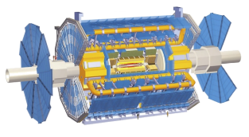






Kollaborationen – ein Beispiel
ATLAS
Die ATLAS Kollaboration besteht aus
  >40 Ländern
  >180 Forschungsinstituten
  >6000 Mitgliedern
Notes:
Second, in addition to Member States, any country (see USA and China on the illustration but there are many more) can join CERN activities through scientific «collaborations».
A collaboration is an agreement with many differents research institutions (universities, national laboratories etc) to put resources in common: money and people. Each institution decide which collaboration they want to join or not. Not all countries participate to all collaborations.
Collaborations typically plan, design, build and operate an experiment (usually a detector)l
There are dozens of collaborations/experiment at CERN even though 4 of them drive most of the resources, the 4 LHC experiments.

Slide 12
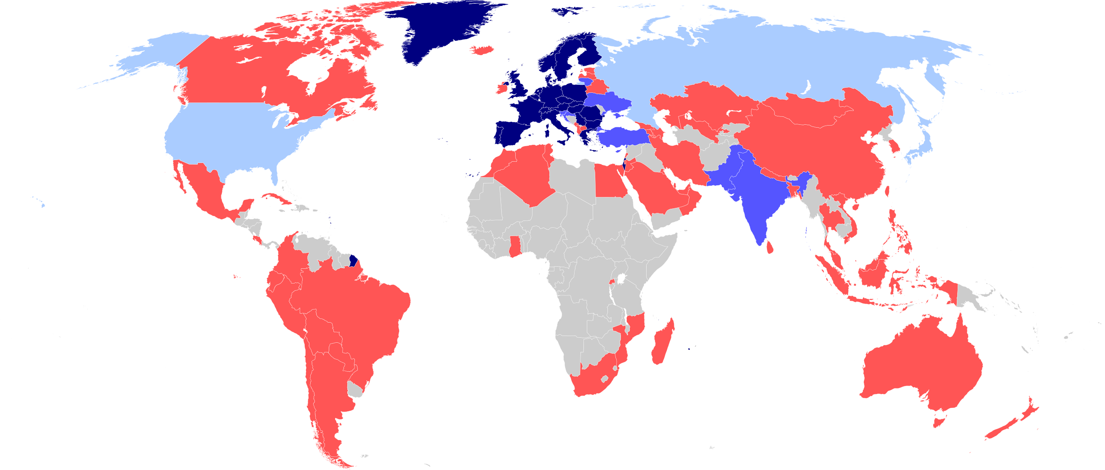
Weltweite Kollaboration
23 Mitglieder
11 Assoziierte
3 Beobachter
61 Kooperationen
Notes:
Number of countries involved in CERN activites at various levels

Slide 13










20 000!
Wer arbeitet am CERN?
2 600 Staff
800 Fellows
(PostDocs)
550 Studierende
15 000 User
2 000 Externe
Firmen
Notes:
CERN employs «only» 3400 persons (Staff, Fellows, Apprentices).
CHAT: Wie viele fest angestellte Physiker*innen am CERN?
In which there are «only» 70 research physicists (you can ask the audience if they can guess this).
Fellows and Apprentices are here for a first employement experiences.
The core population of CERN is made of about 15’000 «users», called like that because they are here to «use» CERN’s facilities.
They are NOT employed by CERN and come in the frame of the collaborations.
They are not all the time at CERN. Some spend 5% of their time at CERN (a few days a year), some spend 100% of their time. It really depends on their function in the collaboration, on the need for them to be on site, or, on the other hand, the possibility for them to work remotely.
Given the size for CERN’s population, many services are externalized (mail, transport, restaurants, etc) to firms.

Slide 14
CERN
Was untersuchen wir?

Slide 15

Grundlagenforschung
Notes:
CERN’s goal is FUNDAMENTAL research, not APPLIED research.
CERN is not to improve the way electricity is produced or rockets are launched.
CERN is to help answering questions and for a better understanding of the Universe.

Slide 16
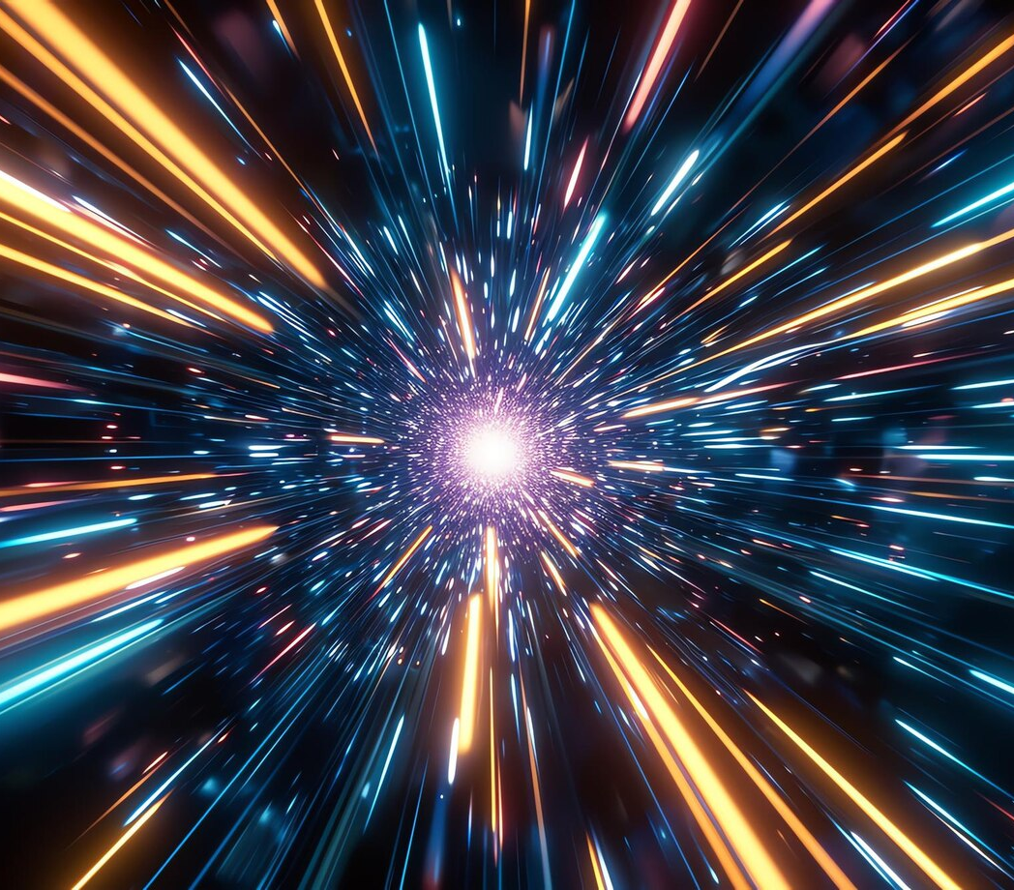
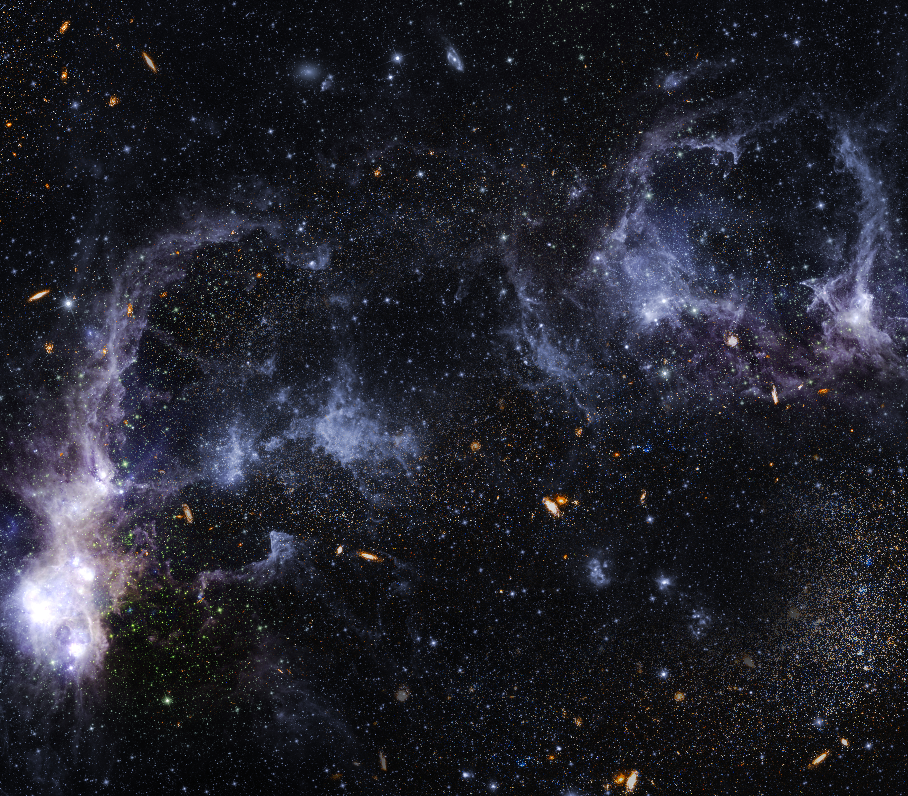
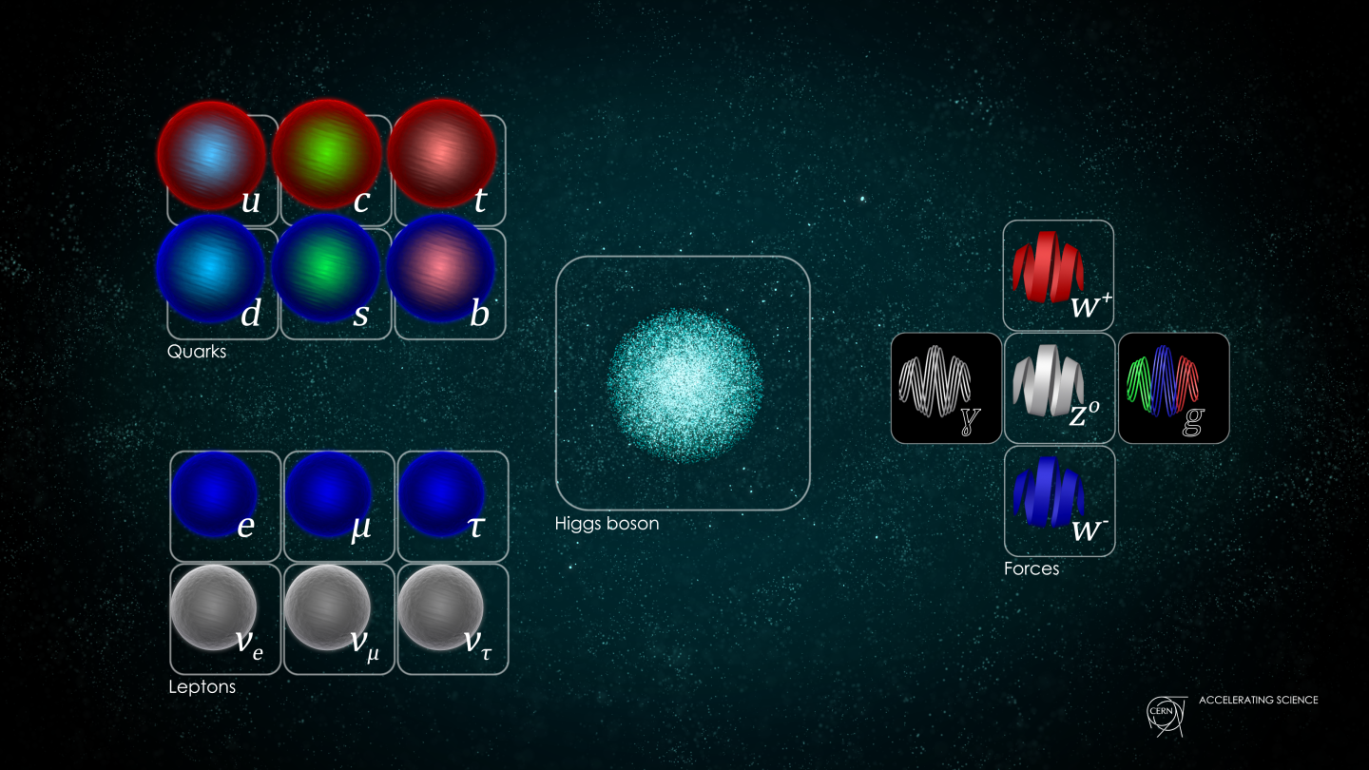
Grundlegende Fragen der Menschheit
Woraus bestehen wir?
Woher kommen wir?
Wohin gehen wir?

Slide 17
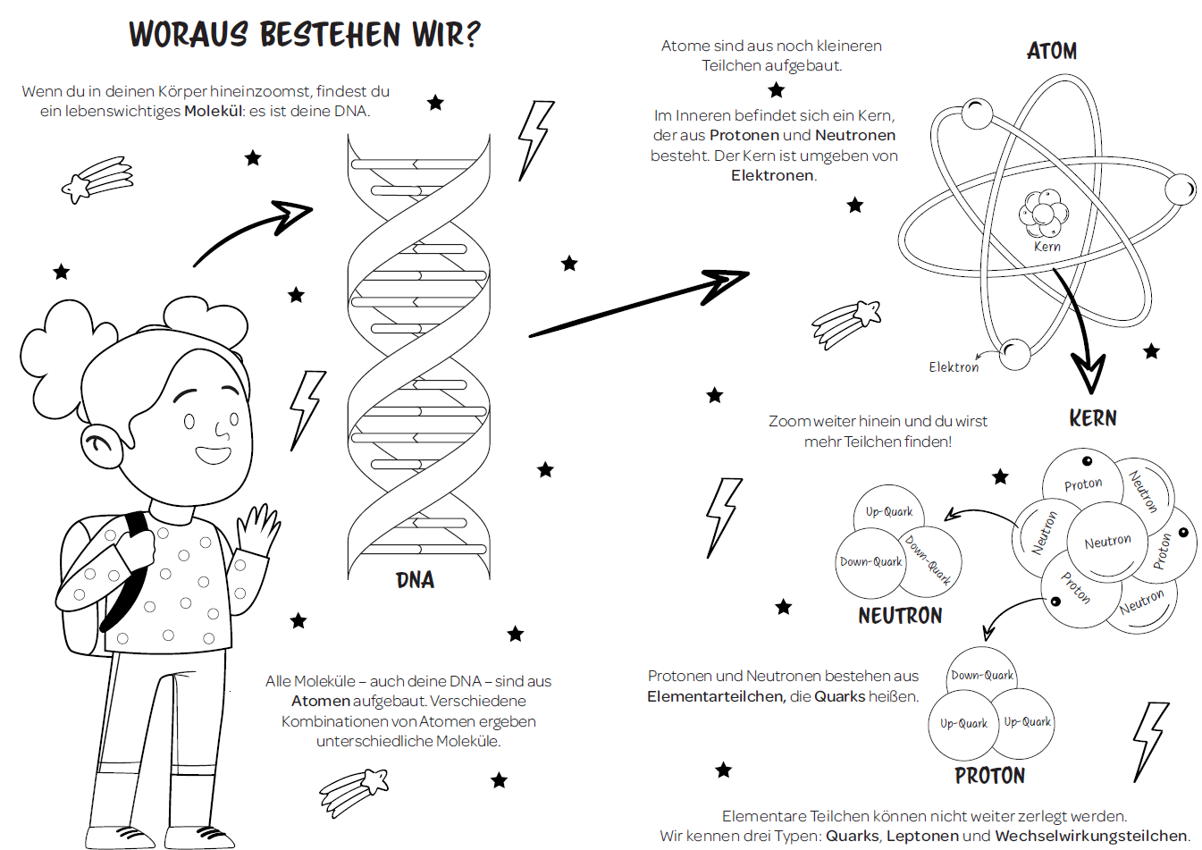

Slide 18
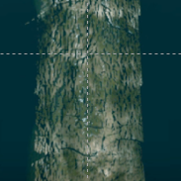
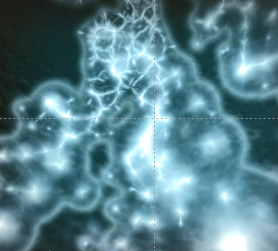
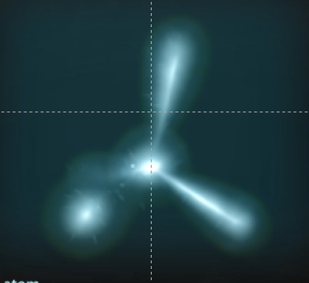
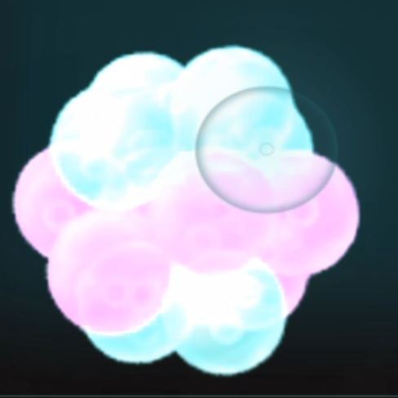
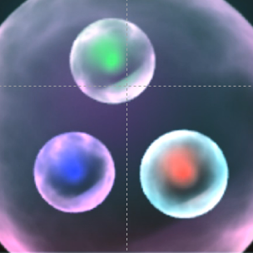
Woraus besteht ein Haar?
Menschliches
Haar
Keratin-
Molekül
Kohlenstoff-
Atom
Atomkern-
Bereich
Teilchensystem
«Proton»

Slide 19
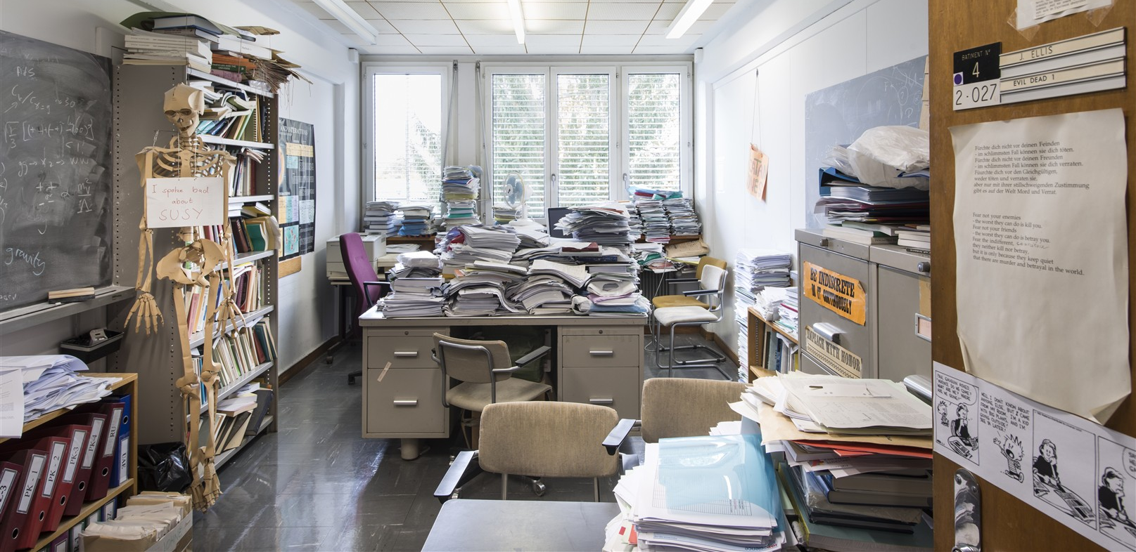
Theorie
Notes:
To understand our universe better, there are 2 essential research components that need to work well together
Die erste Komponente ist die
Theory: Come up with new ideas to describe the universe … string theory, extra dimensions, …
For CERN: That’s the «cheaper» type of physicists, they only need paper (lots of it), black boards, offices, and computers

Slide 20
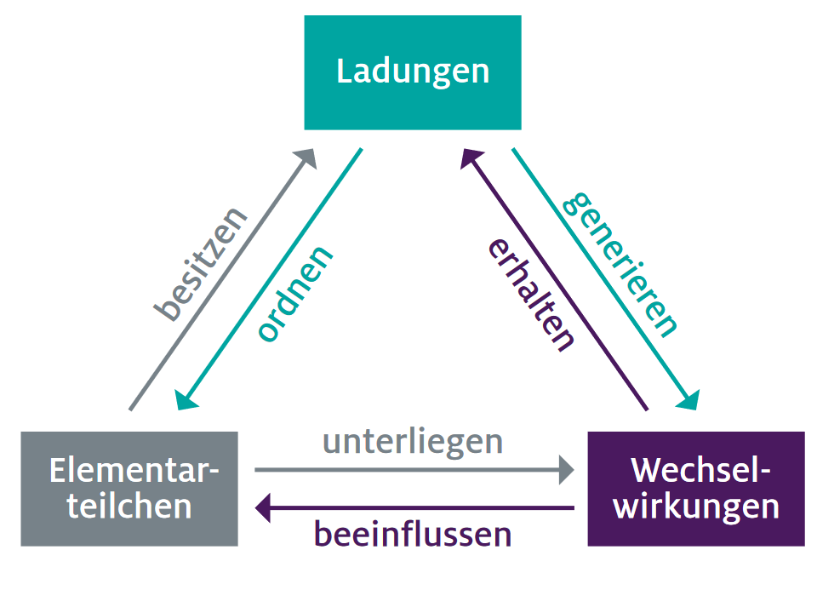
Das Standard Model
der Teilchenphysik
www.teilchenwelt.de
Notes:
The Standard Model of particle physics is the most important achievement of high energy physics to date. There are three important terms: - -
- fundamental interactions, Wechselwirkungen (Chat: Kennt ihr Wechselwrikungen und wenn ja, welche? strong, weak, electromagnetic, gravity)
charges (correponding to the interactions, in school: almost only electric charges, but there is also strong/colour charge and a weak charge)
and elementary particles (cannot be devided further, example: electron. Is the proton an elementary particle? No, protons are formed by 3 elementary particles called quarks. Hence, we should call protons «particle systems»)
The Standard Model of particle physics is something like a particle physics book of rules:
It sorts elementary particles according to their respective charges and describes how they interact through fundamental interactions. In this context, a charge is a property of an elementary particle that defines the fundamental interaction by which it is influenced. We then say that the corresponding interaction particle 'couples' to a certain charge. For example, gluons, the interaction particles of the strong interaction, couple to colour-charged particles.
Of the four fundamental interactions in nature, all except gravity are described by the Standard Model of particle physics: particles with an electric charge are influenced by the electromagnetic interaction (quantum electrodynamics, or QED for short), particles with a weak charge are influenced by the weak interaction (quantum flavour dynamics or QFD), and those with a colour charge are influenced by the strong interaction (quantum chromodynamics or QCD).

Slide 21

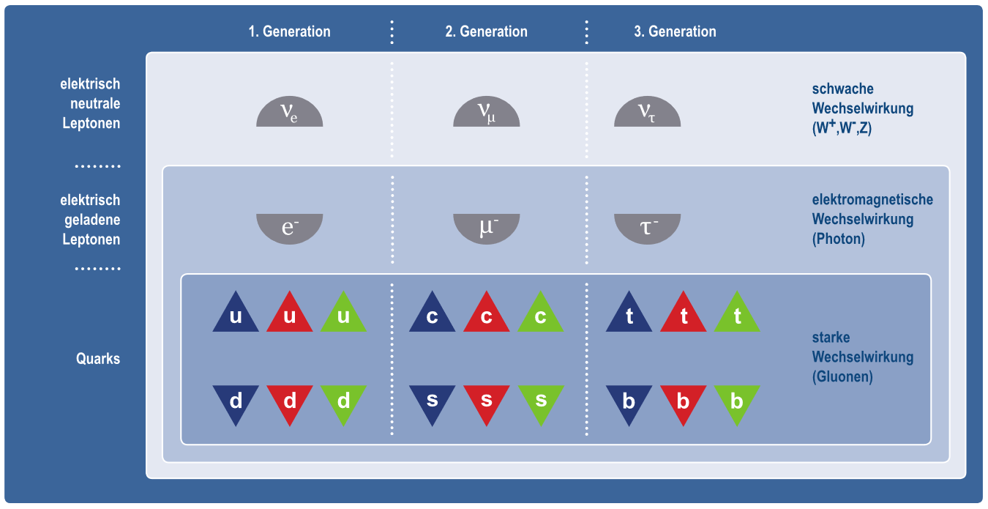


www.teilchenwelt.de
Notes:
Interactions are mediated by their respective interaction particles: photons (γ) for the electromagnetic interaction, the weak bosons (W ⁻, W ⁺ , and Z ⁰) for the weak interaction, and gluons (g) for the strong interaction. Furthermore, an elementary particle can be influenced by more than one fundamental interaction, in which case it has several charges. For example, due to its electric and weak charges, a muon is influenced both by the electromagnetic interaction and the weak interaction.
So far, with the help of different experiments, we have discovered 12 elementary particles and 12 correspodning anti-particles in addition to these interaction particles. For example, quarks and anti-quarks, neutrinos and anti-neutrinos, …
An anti-particle has the same mass as its correspodning particle but opposite charges, such as an opposite electric charge - a bit like a reflection in a mirror. With antiparticles you can make antiatoms, therefore antimatter.
[Zusatz
Have you every manipulated antimatter? I hope not as matter and antimatter when they get in touch «anihilate», which means they stop existing and out of the energy released by this process (E=mc^2), new pairs of interactions particles are produced. That means that 1g of matter put together 1g of antimatter would wipe out Geneva and its surroundings… So better not shake hands when you meet your antiyou.]
WICHTIG:
It seems that 3 elementary particles are sufficient to form all atoms (up quark and down quarks form protons and neutrons hence all nuclei, if you add electrons you have any atom…)
What are the others? They are particles which exists briefly in extreme conditions of energy. They tend to transform into less massive, more stable particles like the ones on the first generation.
At CERN we are reproducing these extreme conditions of energy (on a microscopic and harmless level) which allows us to produce and observe these particles.

Slide 22



Das Standardmodell
Was ist das häufigste Elementarteilchen
in Deinem Körper?
Up-Quarks
Elektronen

Slide 23


Das Standardmodell
Was ist das häufigste Elementarteilchen
in Deinem Körper?
$$≈6,4⋅{10}^{28}$$
$$≈2,3⋅{10}^{28}$$

Slide 24
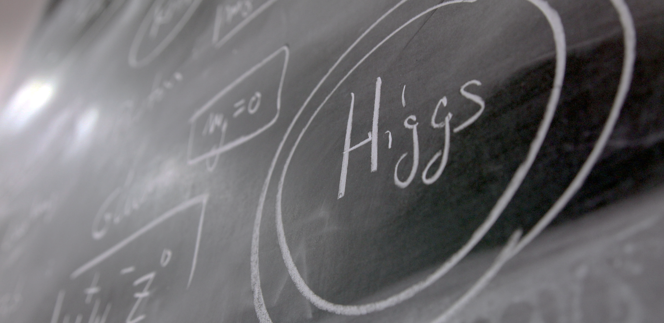
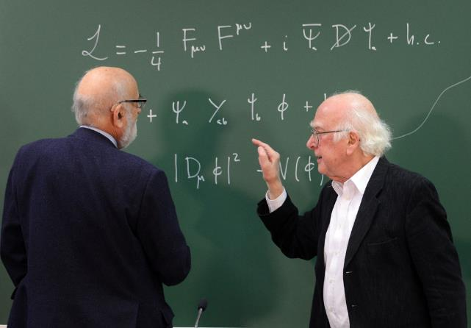
Offene Fragen
Higgs?
Notes:
The development of the Standard Model of particle physics started in the early 1970s and has so far withstood every experimental test. The latest success was the verification of the Brout–Englert–Higgs field by ATLAS and CMS at CERN's Large Hadron Collider in 2012. Both experiments successfully detected the quantised excitation of the BEH field—the so-called Higgs boson. This confirmed the Higgs mechanism, which associates elementary particles with their respective mass.
The Higgs boson was predicted in 1964 by 2 Belgian physicists (François Englert and Robert Brout), then by the Scottish physicist (Peter Higgs) and others later.
If took 48 years to have the experiments (ATLAS and CMS) which proved its existence. The discovery was announced at CERN on 4th July 2012.
This discovery led François Englert and Peter Higgs (only surviving of the 3) to be rewarded by a Nobel Prize in 2013.
Der Trick um einen Nobel-Preis zu erhalten, ist etwas ganz früh zu entdecken und dann lange genug zu leben!

Slide 25
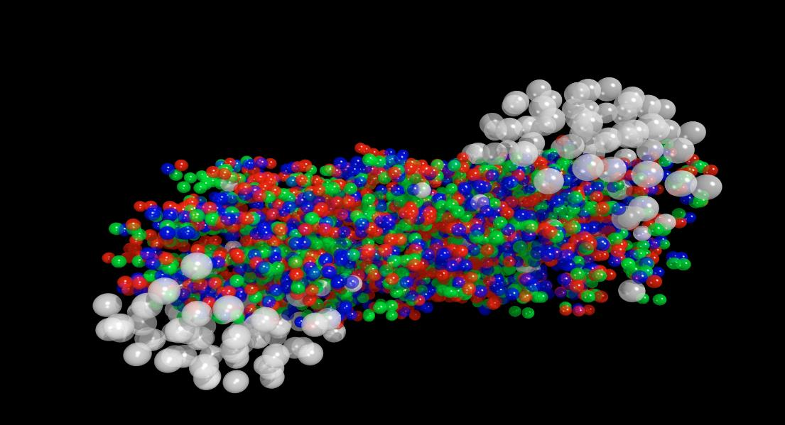
Offene Fragen
Quark Gluon Plasma?
Notes:
One question CERN is trying to answer: theorists believe that at the very early moments of the Universe, quarks were not yet «gluing» together thanks to the Gluons. There was a primordial (ursprüngliche) «soup» of particles called the «Quark-gluon plasma».
CERN’s ALICE experiment tried to reproduce droplets of this state of matter for very short time and observe it.
This will help us understand the way the Universe evovled and why it is as it is now.

Slide 26
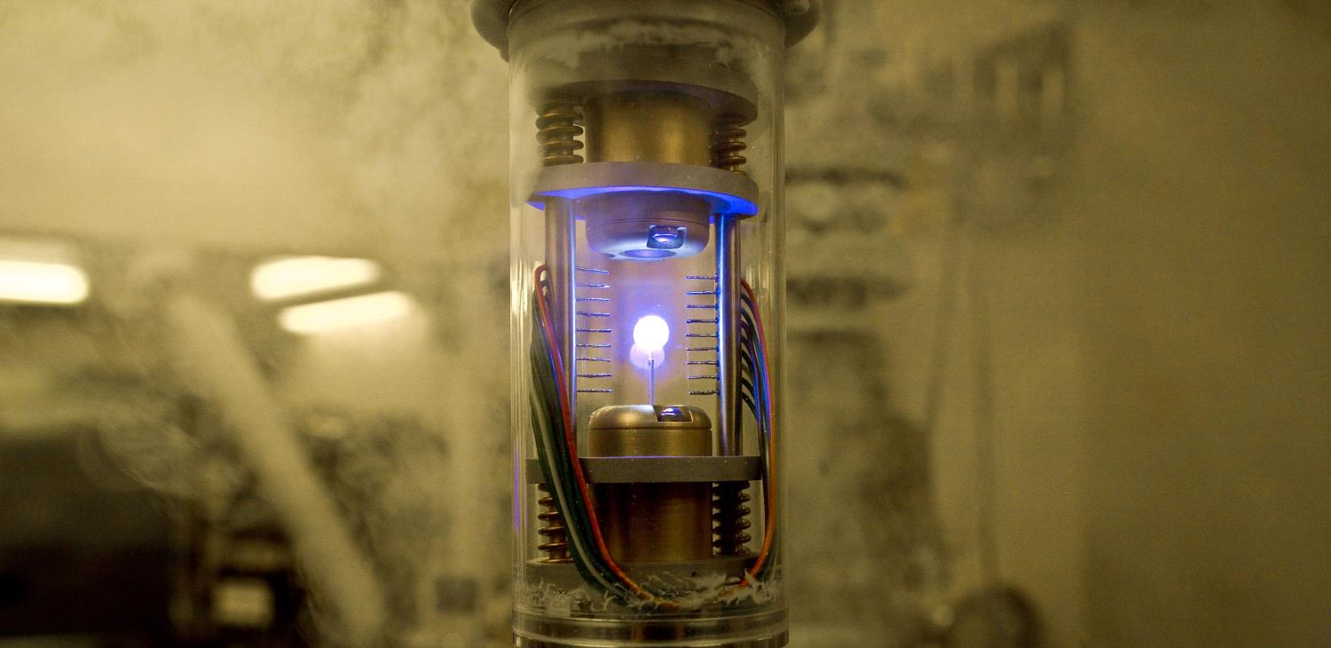
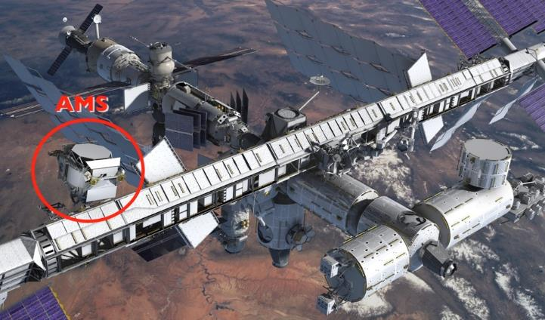
Offene Fragen
Antimaterie?
Notes:
Theorists believe that at the moment of the Big Bang, the universe started to expand from a tiny space of pure energy. Out of this energy, pairs of particles and antiparticles were created, weil Teilchen und Antiteilchen immer nur paarweise entstehen. Ein Problem ist allerdings, dass sie sich auch paarweise wieder auslöschen! It is also believed that the first instants of the universe was a gigantic anihilation of partcles and their counter anti-particles which were just created. But it seems that out of 1 billion particle-antiparticle anihilation, 1 particle survived… And that what makes the current Universe… apparently made only of matter. Warum bestehen wir dann nur aus Materie und wo ist die ganze Antimaterie hin?
CERN is looking at that question with various experiments amongst which:
AD (Antimatter Decelerator) slows down anti-protons to creates stable anti atoms in special traps (the image here is the one from Angels and Demons movie, our trap is bigger and consumes much more energy)
AMS is an experiment on the International Space Station which looks for traces of primordial {ursprúnglich} antimatter from space. It needs to be there outside of the Earth’s atmosphere where many particle collisions occur and produce briefly anti-particles. The AMS Control Centre is located at CERN and receives signals from the experiment.

Slide 27


Das Standardmodell
Was ist schwerer?
Elektron
Anti-Elektron

Slide 28
Das Standardmodell
Was ist schwerer?
Elektron
~0,511 MeV/c²
~0,511 MeV/c²
Positron

Slide 29
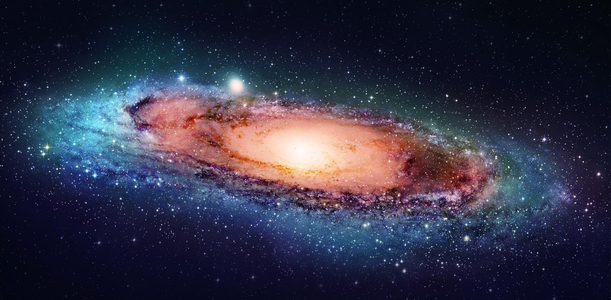
Offene Fragen
Dunkle Materie?
Notes:
But we have many more questions unanswered.
For example when we look at galaxies far away, and at their rotation speed, the estimated mass of the visible matter (stars, planets, clouds of gas etc) is not sufficient to «keep it together». At the speed it rotates, this galaxy should split away.
And the worrying thing is that is seems we are missing a large fraction of the needed mass…

Slide 30
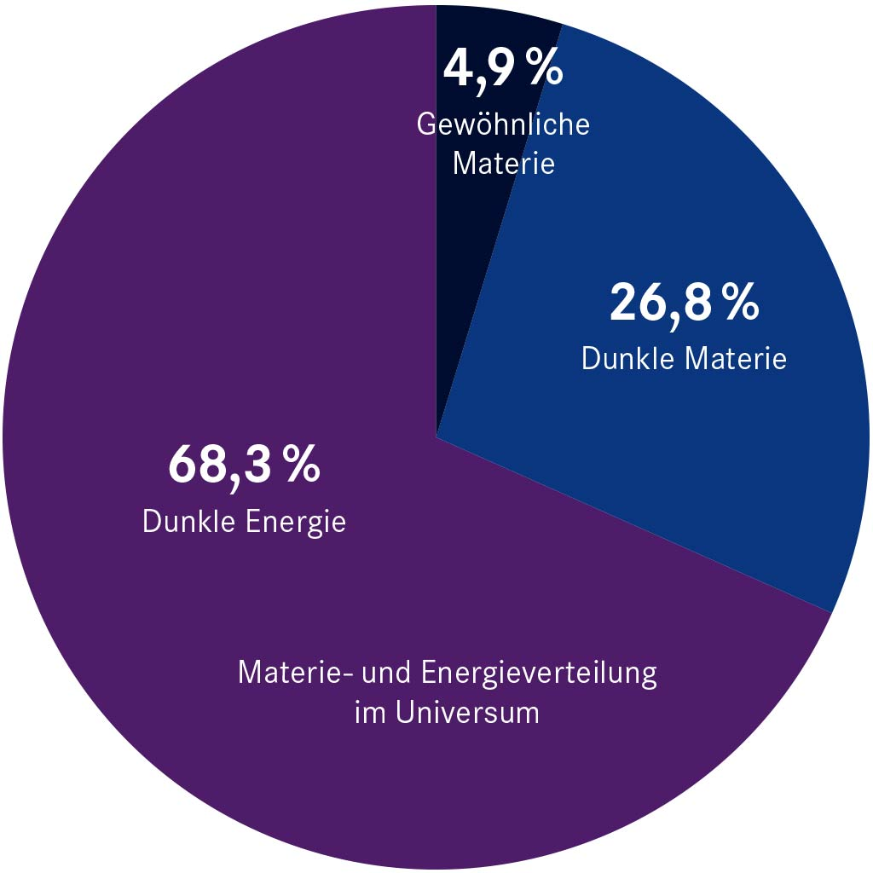
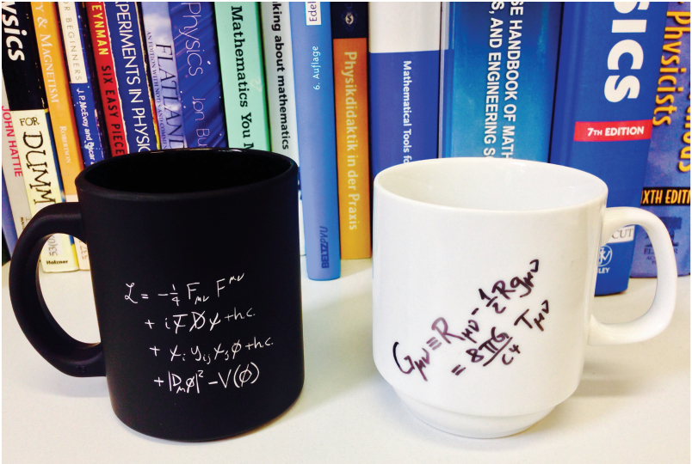
Offene Fragen
Notes:
Only about 5% of the matter and energy content of the universe is «visible matter» (stars, humans, …)
What is the remaining 95% of the universe’s mass & energy?
From the rotation of galaxies we assume that about 27% is dark matter …
Dark energy? There are many theories again (Supersymetry amongst others). CERN may help finding out more about it.
Great unified theory: Can we merge the Standard Modell and General Relativity?

Slide 31
CERN
Wie untersuchen wir?
Notes:
Now we have many questions to answer. But how are we going to proceed?

Slide 32
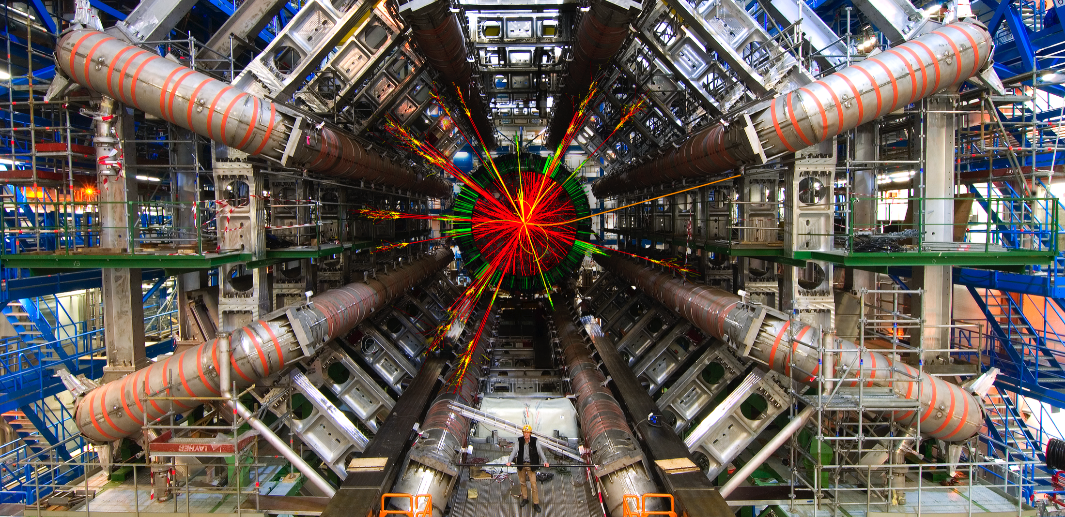
Experiment
Notes:
On the more expensive side, experimentalists
Physicists, engineers, technician build huge machines to test the predictors from ideas the theorists developped
Most exciting: It the observations differ from the predictions!

Slide 33
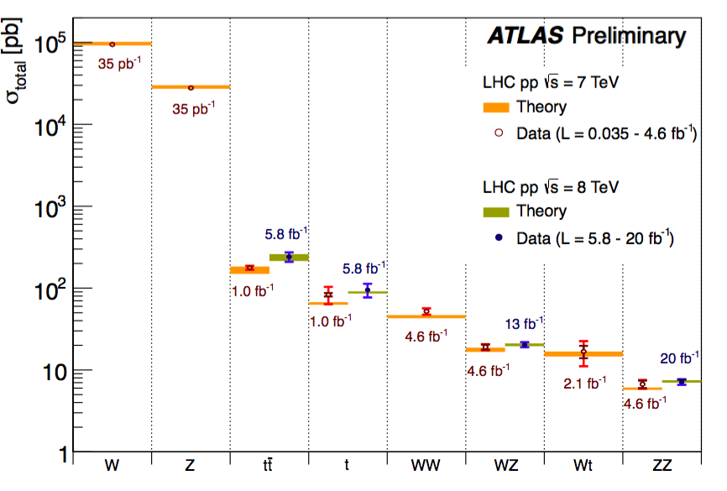
https://twiki.cern.ch/twiki/bin/view/AtlasPublic
Notes:
In many experiments at CERN, we compare the prediction from theory (in the graph, horizontal bars coming from prediction of the standard model of particle physics) with experimental data from the experiment (in the graph, dots coming from the ATLAS experiment).
So far, we see no significant deviation from the Standard Model predictions to the experimental data
One might think that, given this great success story, the particle physics community is happy and content. But, as a matter of fact, the exact opposite is the case! While the Standard Model of particle physics provides a unique and elegant description of fundamental interactions between elementary particles, it is assumed that this quantum field theory is only part of a broader theory. Indeed, the Standard Model of particle physics describes only about 5% of the universe. It does not explain dark matter or dark energy..
Their description can only be achieved by theories which go beyond the Standard Model of particle physics. Hence, any signs of irregularities between the predictions of the Standard Model of particle physics and experimental results would spark tremendous excitement. After all, this would enable the physics community to update and modify the current description of nature.

Slide 34
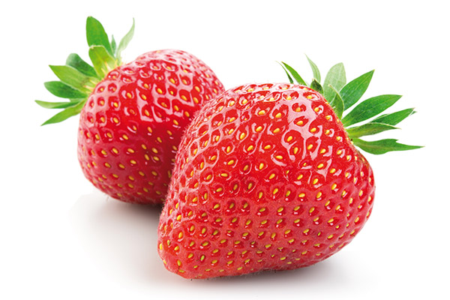
Beschleunigung und Kollision
Notes:
Most of CERN’s experiments are made of collisions. We take 2 objects and smash them together at very high speed.
Let’s take 2 Erdbeeren. What happens if we smash them together?
At very low speed, not much. They will stop each other.
At higher speed, they will damage each other, change direction, slow down.
At very high speed (imagine we use Erdbeer cannons), things will get very messy and sticky. Kleine Erdbeerstücke fliegen davon.
We have all experienced such collisions: with cars, bikes, ourselves (not «Level 3» hopefully).

Slide 35
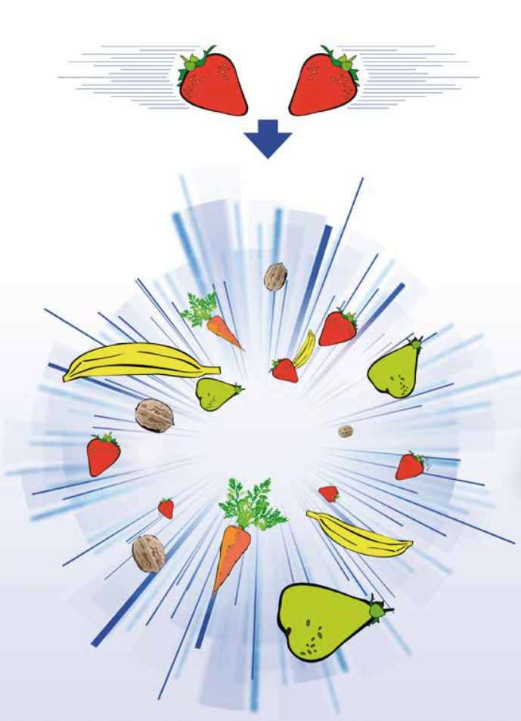
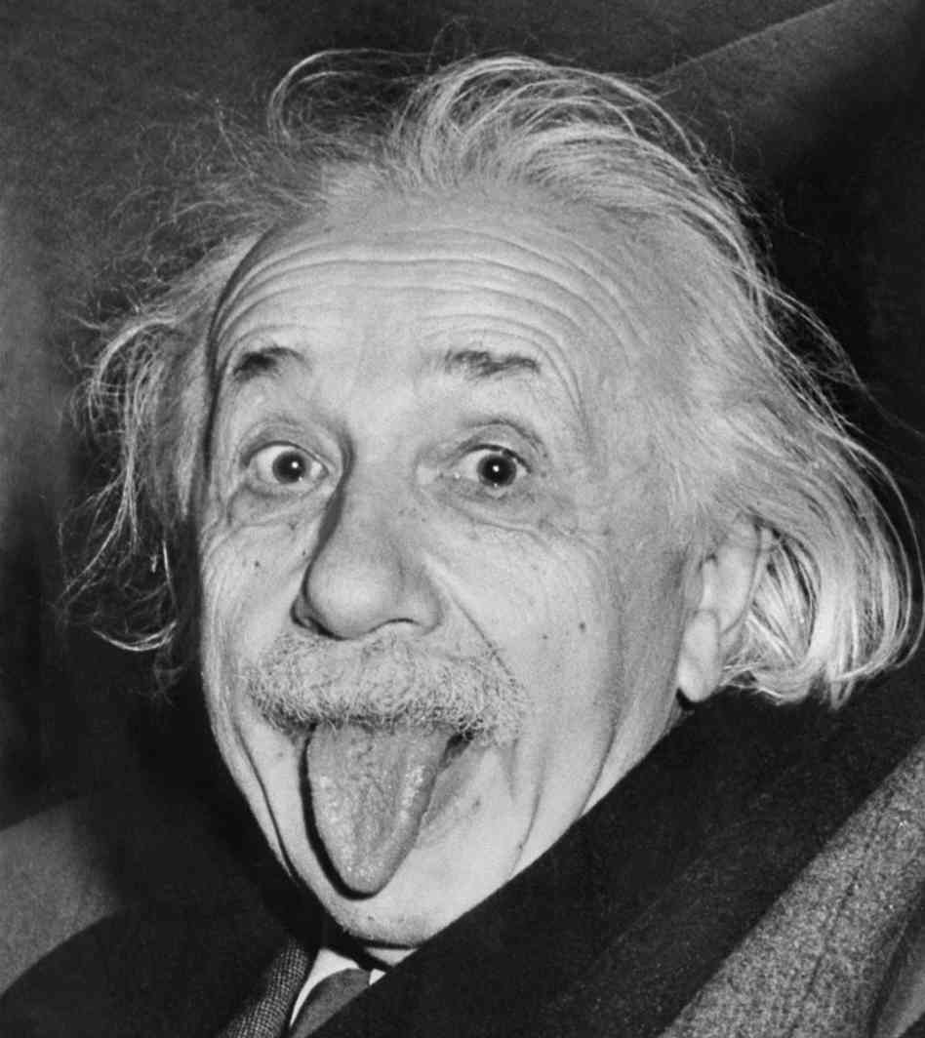

E=mc²
Notes:
Chat: Wie lautet die berühmteste formel von einstein?
Dank dieser formel entstehen, wenn man 2 erdbeeren mit enorm hoher energie aufeinander schiesst, ganz viele und noch dazu massereichere neue Früchte, ein ganzer Obstkorb sozusagen!
Das ist der Grund weshalb man teilchen auf so hohe energien beschleunigen muss!
At CERN we collide with protons (instead of Erdbeeren…) In these collisions, the colliding protons stop existing, their mass transforms into energy (remember E=mc^2), and out of the energy new particles can be created such as Higgs bosons, electrons and positrons, or new protons and anti-protons.

Slide 36
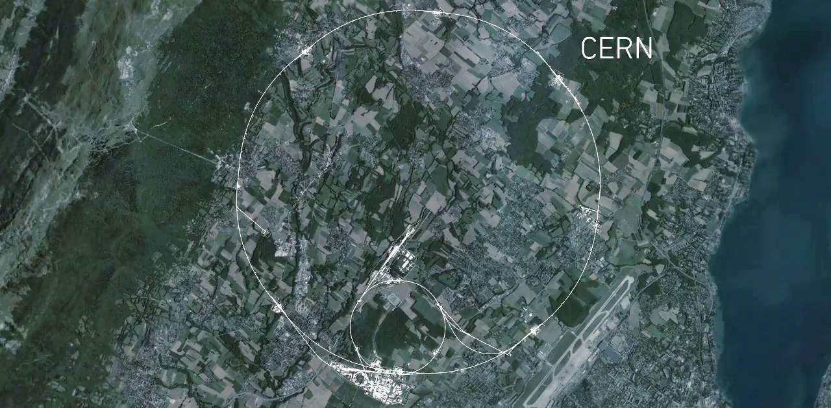


CMS
LHC
Beschleunigung
ALICE
ATLAS
LHCb
Notes:
This is a map of the complex of main accelerators of CERN.
The dotted line is the French-Swiss border.
The 2 main CERN sites are Meyrin and Prévessin (as big, but not as built nor populated)
The PS is the tiny 600m ring on the Meyrin site, the SPS goes accross the border and the LHC takes all the space between Geneva airport and the Jura (dark green on the left).
Acceleration occurs only in one point, over a few hundred metres. But this is sufficient as the protons pass through it 11’250 times per second
The other 4 red dots represent where the 4 detectors are located.

Slide 37

Notes:
This is a map of the complex of main accelerators of CERN.
The dotted line is the French-Swiss border.
The 2 main CERN sites are Meyrin and Prévessin (as big, but not as built nor populated)
The PS is the tiny 600m ring on the Meyrin site, the SPS goes accross the border and the LHC takes all the space between Geneva airport and the Jura (dark green on the left).
Acceleration occurs only in one point, over a few hundred metres. But this is sufficient as the protons pass through it 11’250 times per second
The other 4 red dots represent where the 4 detectors are located.

Slide 38
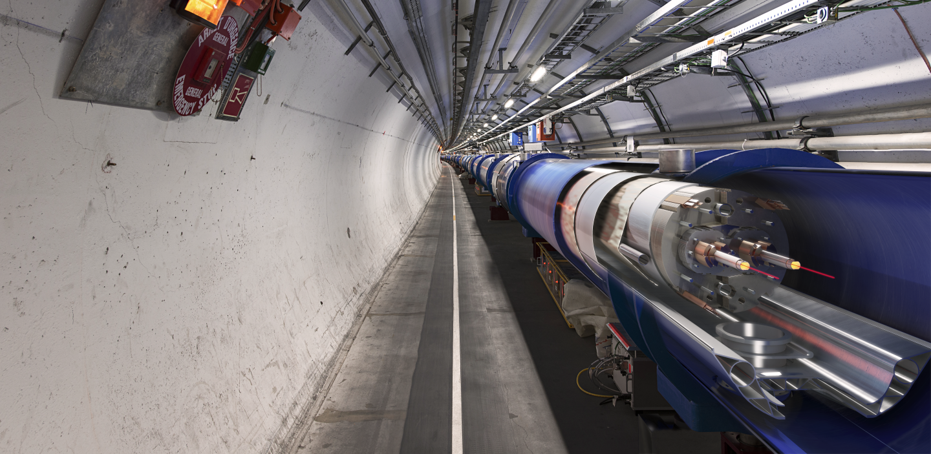
Extrem starke
Elektromagnete
Notes:
The LHC is built underground, mainly for financial reasons (would have cost too much to buy all the land and would have been impractical anyway).
It also provide natural shielding of radiation for the population but also shielding from cosmic rays to the 4 detectors.
You can see on the picture that the 2 counter-rotating beams are hosted in different pipes, making collisions impossible there.
The LHC is mainly hosted in a 3m diameter tunnel containing mostly superconducting magnets.
Chat: Wie heißt die Kraft auf elektrische geladene Teilchen im Magnetfeld?
The magnetic field which curves the beam, is provided by the coils surrounding the pipes. the magnets must deliver a tremendous magnetic field of 9 T (tesla). This equates to 200’000 times the magnetic field of Earth (ca 45 micro tesla)
For that, each of the small electric cable you see around the vacuum pipes (1mm by 10mm section) a current of 11’000 amperes (in comparison in your home there is a current of about 20 amperes in the wires).

Slide 39

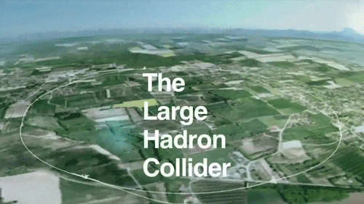
CERN in Zahlen
Größerer jährlicher Bedarf an
elektrischer Energie?
Das ganze CERN Gelände im Betrieb
Der gesamte Kanton Genf

Slide 40
CERN in Zahlen
Größerer jährlicher Stromverbrauch?
1,2 TWh
3 TWh

Slide 41
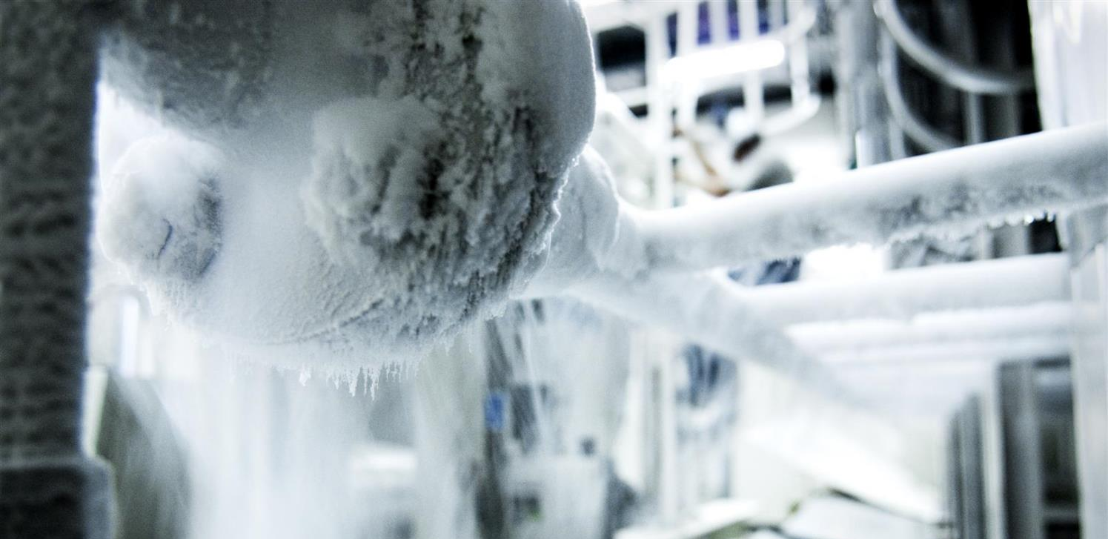
Sehr niedrige Temperaturen
Notes:
We need to cool down the cables to the lowest temperature possible.
Ask participants why in chat
We have to reach -271°C (or 1.9° kelvin, which is 1.9° above the absolute zero).
At that temperature, the cables made of Niobium Titanium (NbTi) are «superconducting», it means they don’t heat up anymore as they have no electric resistance.
LHC is colder than the vast majority of the Universe whose average temperature is 2.725° kelvin (if you look for a «cool» place to work, CERN is a good one)
This is possible thanks to cryogenic facilities using 120 tonnes or 700’000 litres of Helium!

Slide 42

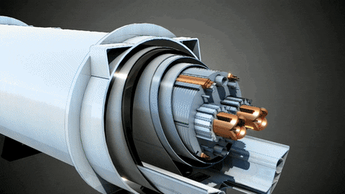
CERN in Zahlen
Wo ist es kälter?
Auf der Mondoberfläche bei Nacht
Im Inneren des LHC Strahlrohrs

Slide 43
CERN in Zahlen
Wo ist es kälter?
-160°C
-271°C

Slide 44
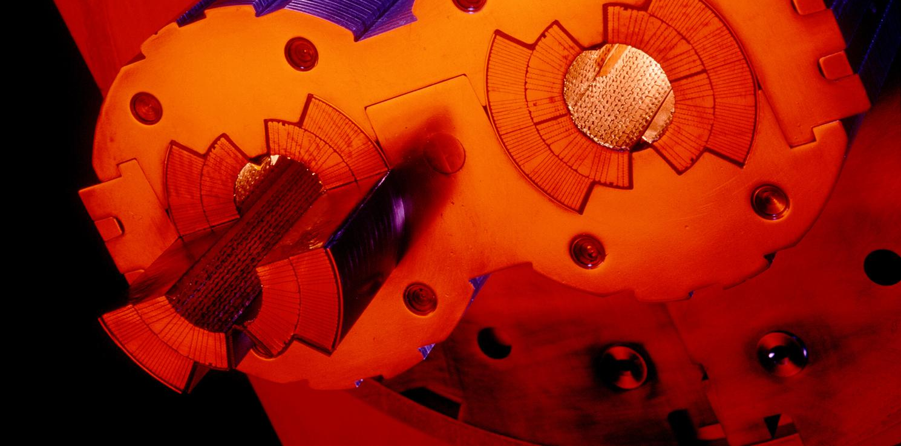
Ultra-Hoch-Vakuum
Notes:
These 2 pipes need to be as empty as possible (otherwise protons would hit air molecules all the time).
Thanks to turbo-molecular pumps and other technologies, we reach a vacuum of 10^-13 atmosphere in the centre of the pipes: this is 10 times emptiers than on the surface of the Moon or as empty as in the solar system.

Slide 45
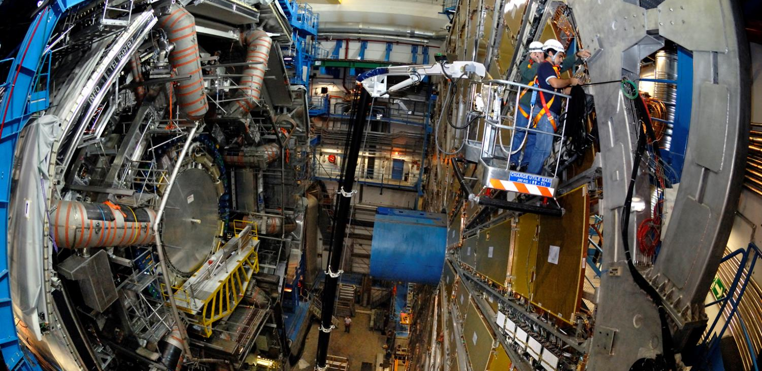
ATLAS
Notes:
Here is a real picture of ATLAS.
Noticed the man at the bottom?
ATLAS is a multi-purpose experiment looking for the Higgs Boson (which it has found in 2012), dark matter candidates etc.
It gathers 3000 physicists from 174 universities and institutes in 38 countries.

Slide 46
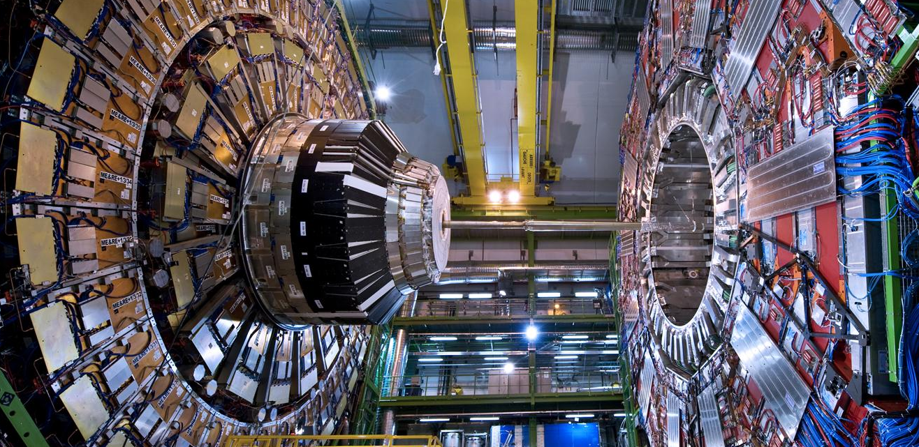
CMS
Notes:
Here is a CMS.
Like ATLAS, this is another multi-purpose experiment. It also discovered the Higgs Boson in 2012.
The C in CMS stands for Compact. Even though it does not look compact to most of you, this experiment is twice as small as ATLAS but twice as heavy: 2 times the Eiffel Tower (14’000 tonnes)!
It gathers 2600 physicists from 182 universities and institutes in 42 countries.

Slide 47
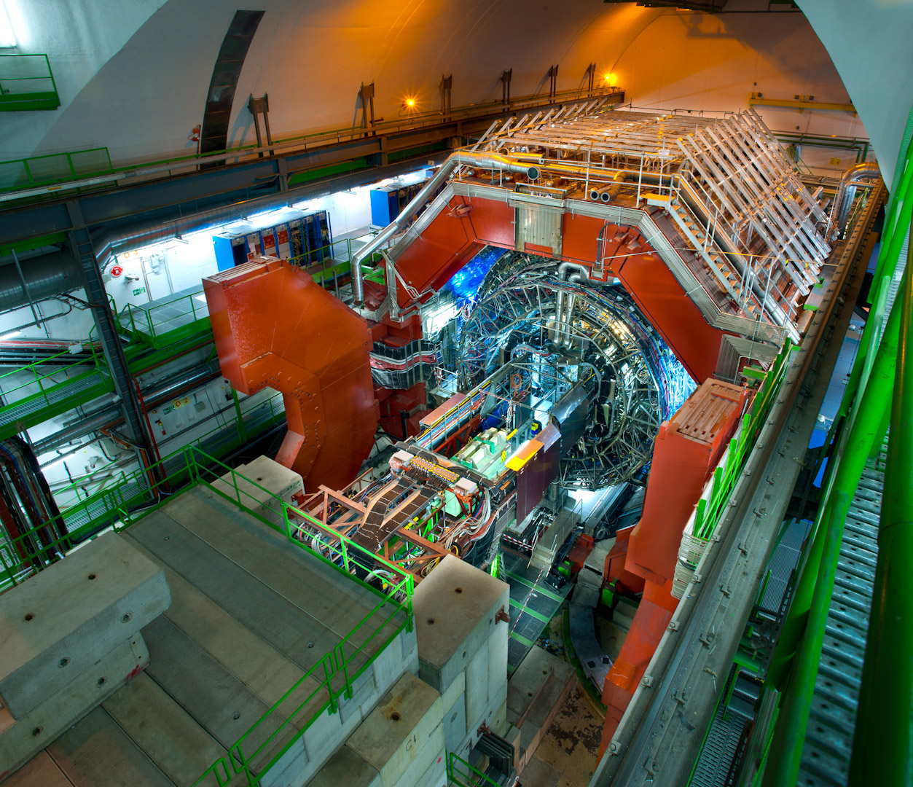
ALICE
Notes:
Here is a ALICE.
This experiment looks more particularly at the creation of the «Quark Gluon Plasma» state of matter which existed moments after the Big Bang.
For that it wait for the beams of Lead Nuclei which occur about 10% of the beamtime of the LHC.
It gathers 1500 physicists from 154 universities and institutes in 37 countries.

Slide 48
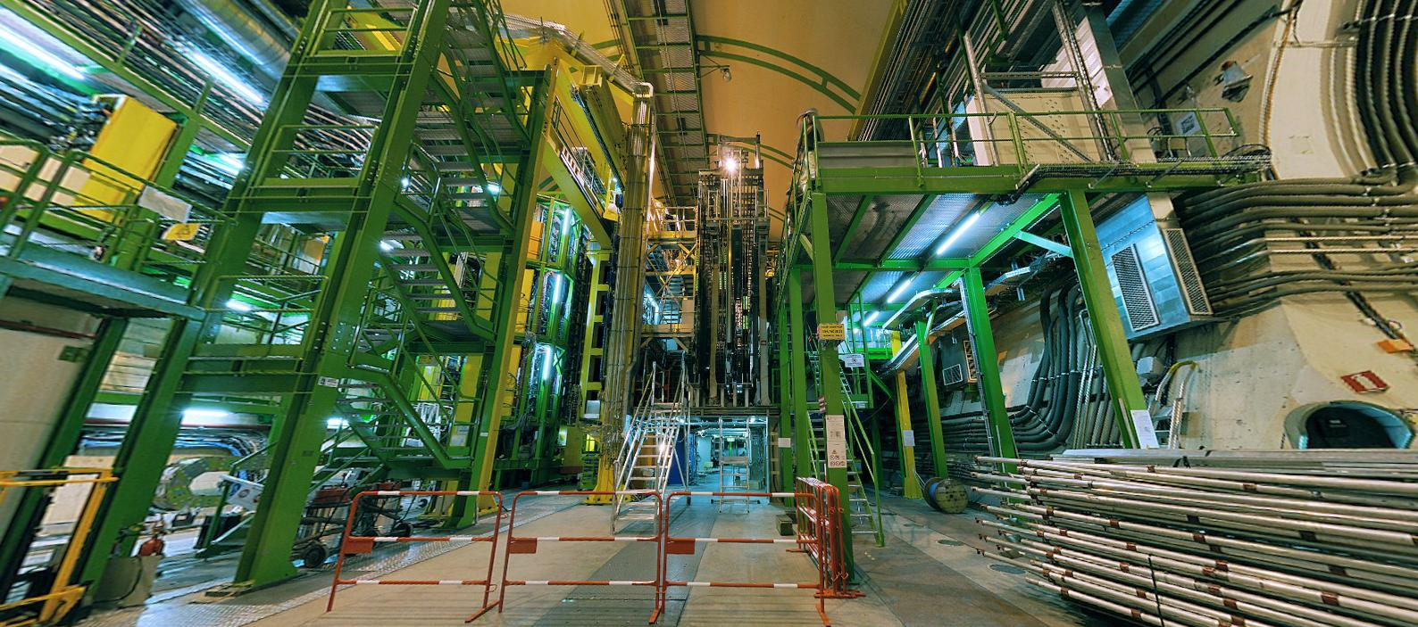
LHCb
Notes:
And the final experiment on the LHC is LHCb. Is is name after the «b» quark (bottom quark) which it studies.
In fact LHCb studies the behaviour difference between the b quark and the anti-b quark.
It tries to find difference in the symmetry which may account for the lack of antimatter in the Universe.
It gathers 800 physicists from 69 universities and institutes in 17 countries.

Slide 49
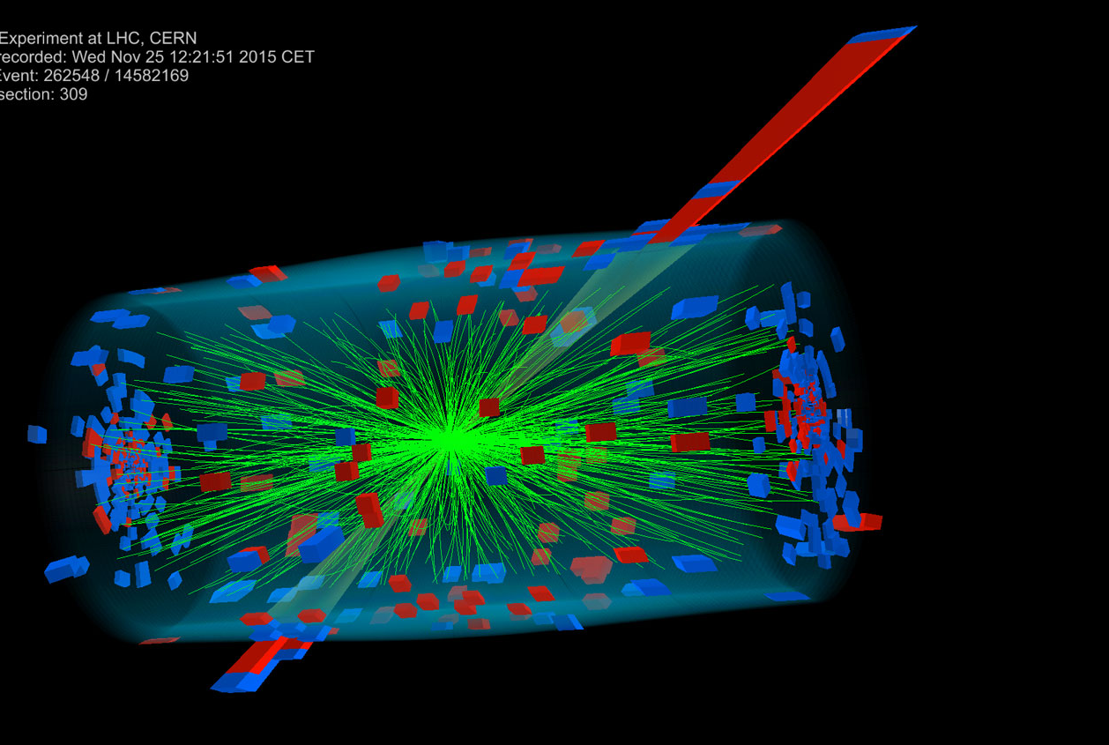
Millionen von Kollisionen
Notes:
The 2 beams are circulating in separate pipes and in 4 places we cross the 2 pipes over so that collision occur there and only there.
We have built particle detectors which will observe and record the traces of new particles created in the collision.
There are so many protons and they go so fast that around 600 million collisions will occur every SECOND in each of the 4 detectors.
These detectors are a bit like huge digital cameras of about 100 Megapixel resolution. Guess the size of the SD card to store the LHC’s pictures?

Slide 50

Das größ­te
Computer-Netzwerk
Notes:
All these detectors will generate loads of data… about 1 PB (petabyte = million of gigabyte per… SECOND!)
Impossible to store so much data. Anyway not needed.
The event the experiments are trying to create and observe are very rare.
That’s why we make so many collisions but we keep only the interesting ones.
Therefore next to each detector is a «trigger», a kind of filter made of various layers (first electronic, then computers) which will select and keep only 1 collision out of a million average.
In the end will still generate dozens of Petabytes of data each year. We need more than 800’000 computer CPUs to analyze this data.
As CERN has only about 200’000 CPUS we share the date over more than 100 computer centre over the planet (usually located in the physics institutes participating to the LHC collaboration). This is the Computing Grid, a gigantic planetary computer and hard drive!

Slide 51


CERN in Zahlen
Wo liegen mehr Daten?
Im CERN Datenzentrum
Auf den Servern von YouTube

Slide 52
CERN in Zahlen
1 EB = 1000 PB = 10^6 TB
Wo liegen mehr Daten?
1 PB = 1000 TB
200 PB
Einige EB
Notes:
Exa byte

Slide 53
CERN
Und was geht mich das an?
Notes:
That was «how» we make research at CERN.
You may now wonder if this is useful for you in your everyday life?
The answer is simply… probably not.
As explained earlier, fundamental research is not made for practical applications. It helps us to understand the universe we live in.
But…
To make its fundamental research, CERN had to organize the largest scientific collaborative project, build the largest machine on Earth, build the coldest place in the galaxy, make the highest vacuum, build the largest and heaviest experiments, build the largest computing grid…
All these technological challenges ended up in new technologies which can find application on a much shorter scale…
Let’s review some of them

Slide 54


World Wide Web
Notes:
How do you share data and documentation amongst 10’000 physicists?
The internet was invented in the 70’s but was really not user friendly.
One man proposed a system to unify it in1989. He is Tim Berners-Lee and was working at CERN.
Like any technology developed by CERN, it was freely given to the World in 1993. Which made the Web a planetary star!

Slide 55

Medizinische Anwendungen
Notes:
If you have brain tumor, you may try to use chemotherapy to cure it. But the cure goes all over your body and damage healthy organs.
You may use conventional radiotherapy, but this will certainly damage some of the healthy tissues around the tumor (image on the right).
Or you can use proton therapy using acceleration techniques directly derived from CERN’s technology. Proton therapy will damage more precisely leaving healthy tissued basically untouched (image on the left).
…

Slide 56


Medizinische Anwendungen
Hadronen-Therapie
Tumorbehandlung mit Ionen
Teilchenbeschleuniger
Notes:
If you have brain tumor, you may try to use chemotherapy to cure it. But the cure goes all over your body and damage healthy organs.
You may use conventional radiotherapy, but this will certainly damage some of the healthy tissues around the tumor (image on the right).
Or you can use proton therapy using acceleration techniques directly derived from CERN’s technology. Proton therapy will damage more precisely leaving healthy tissued basically untouched (image on the left).
…

Slide 57

Medizinische Anwendungen
Teilchendetektion
Bildgebende Verfahren
z. B. Positronen-Emissions-Tomografie (PET)
Notes:
If you have brain tumor, you may try to use chemotherapy to cure it. But the cure goes all over your body and damage healthy organs.
You may use conventional radiotherapy, but this will certainly damage some of the healthy tissues around the tumor (image on the right).
Or you can use proton therapy using acceleration techniques directly derived from CERN’s technology. Proton therapy will damage more precisely leaving healthy tissued basically untouched (image on the left).
…

Slide 58

Touchscreen
Notes:
Kapazitiver Touchscreen – erfunden von Bent Stumpe 1973

Slide 59


Vielen Dank für Eure Aufmerksamkeit!
Mehr Informationen…
home.cern
visit.cern
careers.cern
Welches Elementarteilchen passt am besten zu dir? cern.ch/identities
Notes:
We have invented the web, so please use it! ;-)

Slide 60
www.teilchenwelt.de
Notes:
Interactions are mediated by their respective interaction particles: photons (γ) for the electromagnetic interaction, the weak bosons (W ⁻, W ⁺ , and Z ⁰) for the weak interaction, and gluons (g) for the strong interaction. Furthermore, an elementary particle can be influenced by more than one fundamental interaction, in which case it has several charges. For example, due to its electric and weak charges, a muon is influenced both by the electromagnetic interaction and the weak interaction.
So far, with the help of different experiments, we have discovered 12 elementary particles and 12 correspodning anti-particles in addition to these interaction particles. For example, quarks and anti-quarks, neutrinos and anti-neutrinos, …
An anti-particle has the same mass as its correspodning particle but opposite charges, such as an opposite electric charge - a bit like a reflection in a mirror. With antiparticles you can make antiatoms, therefore antimatter.
[Zusatz
Have you every manipulated antimatter? I hope not as matter and antimatter when they get in touch «anihilate», which means they stop existing and out of the energy released by this process (E=mc^2), new pairs of interactions particles are produced. That means that 1g of matter put together 1g of antimatter would wipe out Geneva and its surroundings… So better not shake hands when you meet your antiyou.]
WICHTIG:
It seems that 3 elementary particles are sufficient to form all atoms (up quark and down quarks form protons and neutrons hence all nuclei, if you add electrons you have any atom…)
What are the others? They are particles which exists briefly in extreme conditions of energy. They tend to transform into less massive, more stable particles like the ones on the first generation.
At CERN we are reproducing these extreme conditions of energy (on a microscopic and harmless level) which allows us to produce and observe these particles.

