Slide 1
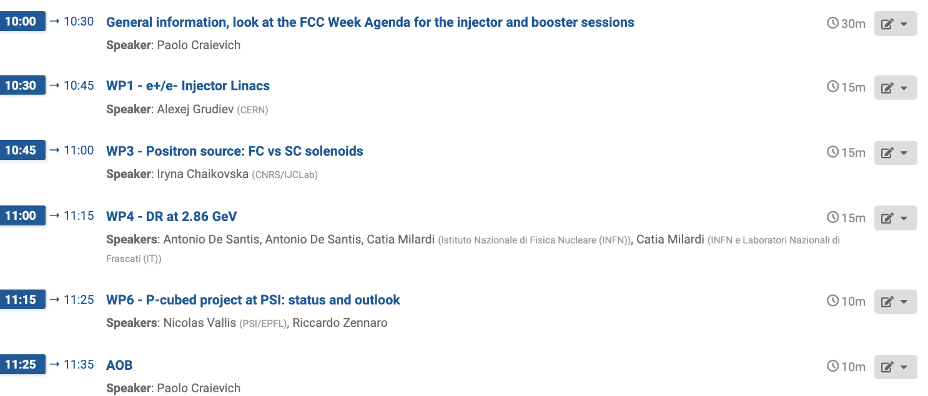
Agenda

Slide 2






FCC-ee Injector study coordination meeting #18
General information, look at the FCC Week Agenda for the injector and booster sessions
P. Craievich – 06.06.2024

Slide 3
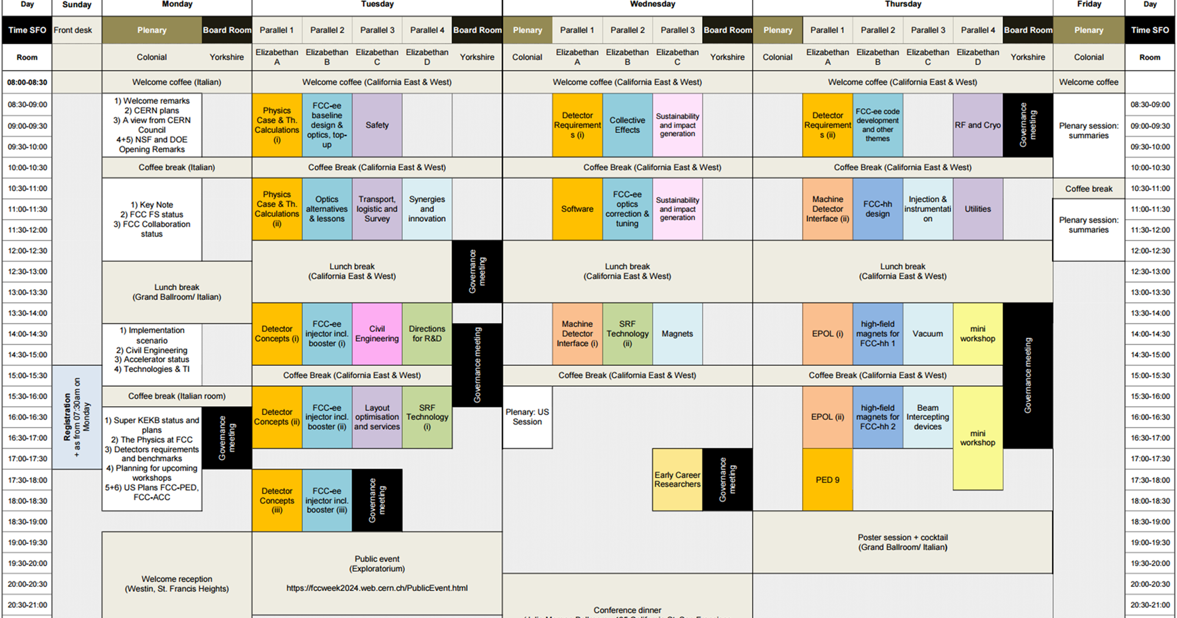

Slide 4
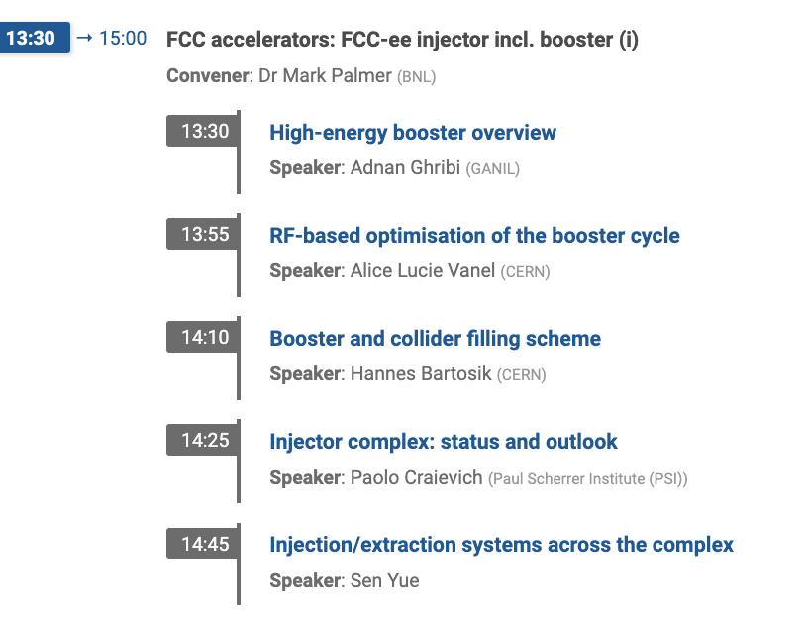
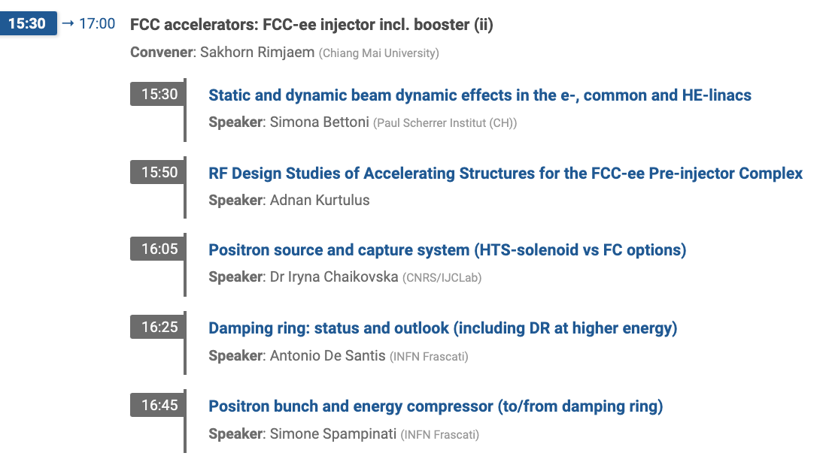
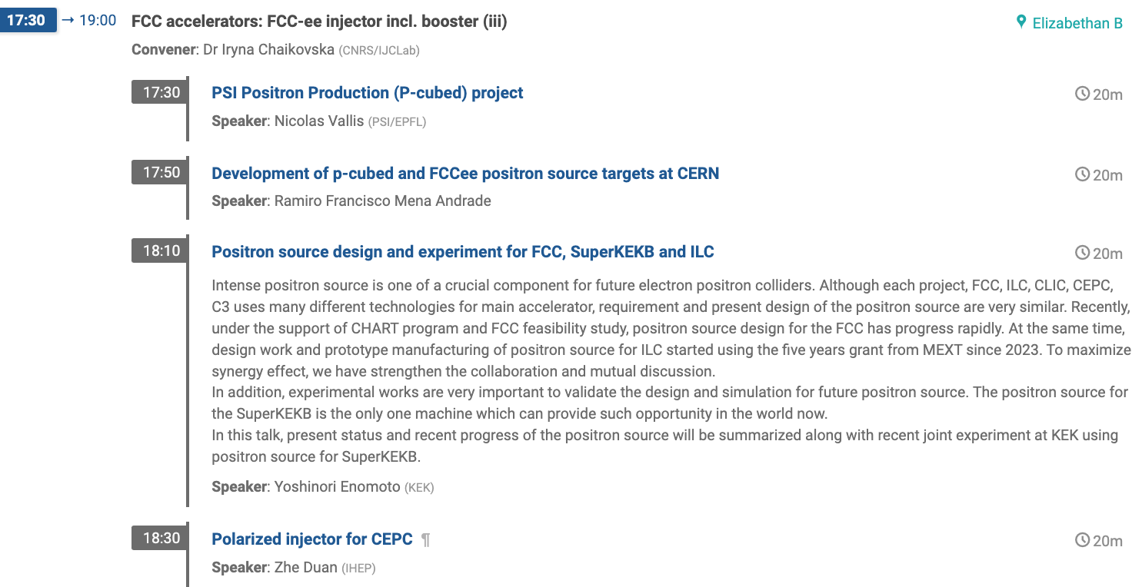
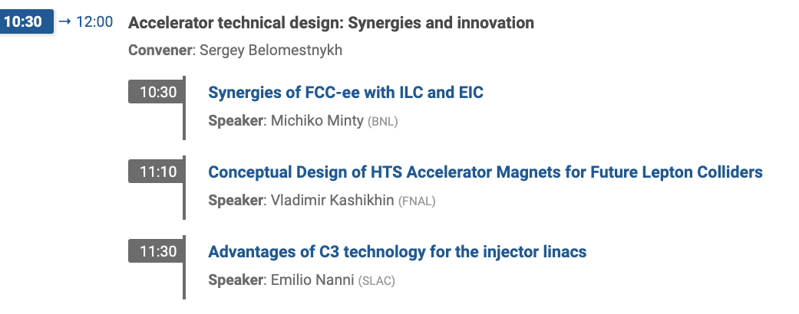
Session 1
Session 2
On Zoom
Session 3
For who is interested, we discuss this topic with Emilio’s group today at 18:00.

Slide 5
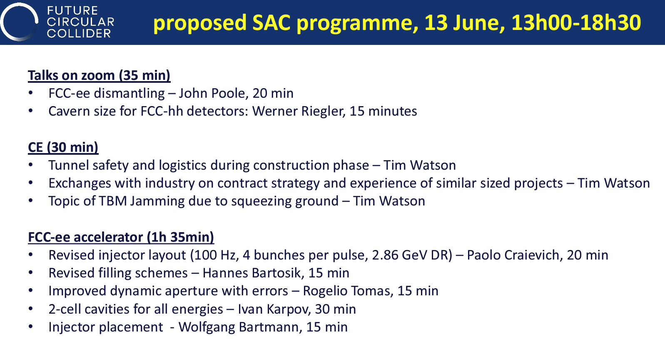
F. Zimmermann

Slide 6
Topics for SAC review during FCC Week 2024
from M. Benedikt
Identify all topics from the MTR, feedback from CH and FR and other items that could already be presented to SAC during the FCC Week
Main recommendations SAC, CRP, SPC, FC, Council:
Decision on FCC-ee injector system (SAC, SPC) and cost (CRP)
For final report provide well-defined baseline layout for all aspects of the FCC ee machine (SPC)
  SLS vs HE linac – OK
  Injector baseline layout, now we have an optional injector layout – decision to be taken after the FCC week

Slide 7
Technical finding/recommendations from SAC:
[…] A maximum of 5 nC bunches are expected to be delivered by the injector, based on the assumption of 80% transmission efficiency in the whole pre-accelerator chain up to the collider injection. The SAC suggests considering the scenario where the setting of the pre-accelerator does not guarantee such transfer efficiency and to reserve a larger margin.
  Question: is this 20% margin on the charge enough? i.e., Higher charge → strong impact on the injector complex
For these normal-conducting pre-injector LINAC systems, operating at S and C-Band and specifically at expected gradients >25 MV/m and repetition rates up to 400 Hz, being able to stably power these LINAC structures for such demanding parameters will be challenging. A careful technical risk assessment for the pre-injector LINAC systems is needed, to ensure a robust system implementation can be achieved at an acceptable cost.
  The point here is the reliability of the injector complex, particularly for the top-up operation for Z mode.

Slide 8
Technical finding/recommendations from CRP:
Main Recommendation: optimize the Injector, especially the linac design and subsequently adjust Technical Infrastructure cost for length and power density
Points to take under consideration for the linac optimization:
The overall linac design, while based on SwissFEL technology, […] has not yet been optimised for capital or operations cost.
The present design base is very detailed and can easily be used as a basis for such optimisation. The optimisation will likely lead to changes in tunnel length (linear cost going up), while the cost of the subsystems should go down, as they scale with the square of the accelerating gradient.
While the design and cost estimate are very detailed and scaled from the costs of SwissFEL, the operating parameters and/or subsystem cost estimates are a stretch compared to standard S-band linac designs and will have to be verified using full-size prototypes to be produced by industry.
The linac estimate was presented as category 3 but seems more likely to be a category 4 estimate, with possibly increasing cost. The same applies to the cost of the associated linac technical infrastructure, which has a higher power density than that of the SwissFEL linac.

Slide 9
Injector complex: status and outlook
Outline
Review of the baseline layout
Specifications and parameters (last news from Booster and transfer line)
Electron source
Reccomandation form MTR
  (Partially) addressing recommendations (Alexej’s slides)
Introduction to new layout with DR at 2.86 GeV
…

Slide 10
Collider and booster parameters related to the Injector
Source: mid-term review report
Running mode | Z | WW | ZH | ttbar | Unit
Beam energy at inj. end | 20 |  |  |  | GeV
Number bunches/ring | 11200 | 1780 | 440 | 60
Maximum bunch charge | ≥ 4 |  |  |  | nC
Bunch charge in top up | 3.43 | 1.39 | 1.11 | 1.49 | nC
Number of bunches | 2 | 2 | 2 | 2
Linac rep. rate | 200 | 100 | 50 | 50 | Hz
Bunch spacing | 25 | 150 | 600 | 4400 | ns
Norm. emittance (x, y) (rms) | <10,10 |  |  |  | mm mrad
Bunch length (rms) | ~1 |  |  |  | mm
Energy spread (rms) | ~0.1 |  |  |  | %
For filling from scratch
Target values for inj. design
Z-mode: Overall trasmission efficiency 80%/73%, charge at the Injector ~5/5.5 nC
Considering the charge needed for top-up 67%/62%,

Slide 11
Injector parameters (Z-mode)
Injector parameters (Z-mode)
11
 | HE Linac | Unit
Injection energy | 20 | GeV
Number bunches/ring | 11200
Bunch spacing | 25 | ns
Bunch charge both species | 5.5 | nC
Repetition rate | 200/100 | Hz
Number of bunches/rf pulse | 2/4
Norm. emittance (x, y) (rms) | 10,10 | mm mrad
Bunch length (rms) | ~1 | mm
Energy spread (rms) | ~0.1 | %
These two parameters may change due to e-cloud instability, i.e. bunch spacing 50 ns
Emittance and energy spread for BR (By Antoine):
Case 1. Initial beam parameters (rms): 10x10 𝜇𝑚, 𝜎_{Δp/𝑝}=0.1%
Case 2. Initial beam parameters: 20x2 𝜇𝑚, 𝜎_{Δp/𝑝}=0.1%
From linac simulations (by Simona): relative energy spread with linac on-crest is 0.75%, using an EC OR operating the linac off-crest up to less 0.1%, we decided to indicate <0.25%
  The values of 20 µm x 2 µm are indicative for the high energy damping ring + linac acceleration: in all cases, a smaller vertical emittance will help.
Notes:
In this table the main parameters for the injector are summarized. They are the specifications for the Injector design needed for the Z-mode, the more demanding operational mode of the collider in terms of charge and repetion rates.
The maximum charge to be injected into the collider ring is 4 nC.
In order to meet the specification during the filling from scratch and for the top up operation, 2 bunches at 200 Hz are requested.
Bunch spacing is 25 ns.
A normalized emittance of 10x10 mm mrad and a target bunch length and energy spread at the linac end of 1 mm and 0.1% are requested.
Read the slide

Slide 12
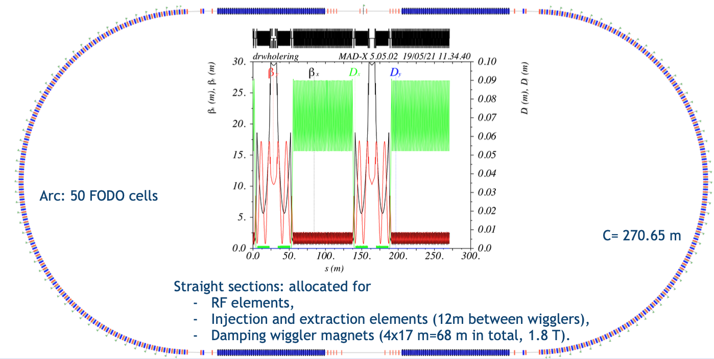
Modified baseline layout (2/4 bunches)
CO84, version 10, 02.06.24
X + Y + 895.5/1308 m, overall length < ~1.35 km (without energy compressor)
78/123 m
X m
247.5/360 m
Y m
570/825 m
Transfer line to BR
and energy compressor,
2.8 GHz, 8 RF struct., 4 mod.
Electron Linac 2.8 GHz,
29.5/18.8 MV/m, 11/9 RF modules
Common Linac 2.8 GHz, 2 different acc. structures,
22.5-25.4/16.1-17.9MV/m, 33/24 rf modules
High-energy Linac, 2.8 GHz, 32.2/22.5 MV/m
200 Hz, 76/55 rf modules
Electron source
2.8 GHz, 200 Hz
200/100 Hz
400 Hz /200 Hz
200/100 Hz
to positron source
from positron BC
6 GeV electron
from common linac
140 m
to common linac
Positron linac 2 GHz, 20 MV/m
200 Hz, 31 RF structures and 16 module
E = 1.54 GeV
Q = 13.5 nC
Bunch dechirping
Injection section
~10 m
Positron
Source
Positron/Electron
Separation at 200 MeV
Energy collimator
and compressor
Triple Bend Achromat
Cell for Arcs
E = 6 GeV
Q = 1.9-2.1 nC
1.54 GeV – 4.8 nC
σ_{z} = … mm
σ_{δ} = … %
ε_{N,proj.} < 5.1 μm
C = 242 – 271 m
E = 1.54 GeV
Q_{b} = 5.4 nC
Bunch compressor (BC)
106 m
65 m
53 m
Damping ring
Triple Bend Achromat
Cell for Arcs
Return transfer line
FODO and matching section
Extraction section
Energy Chirp for Bunch compressor
~400 m

Slide 13
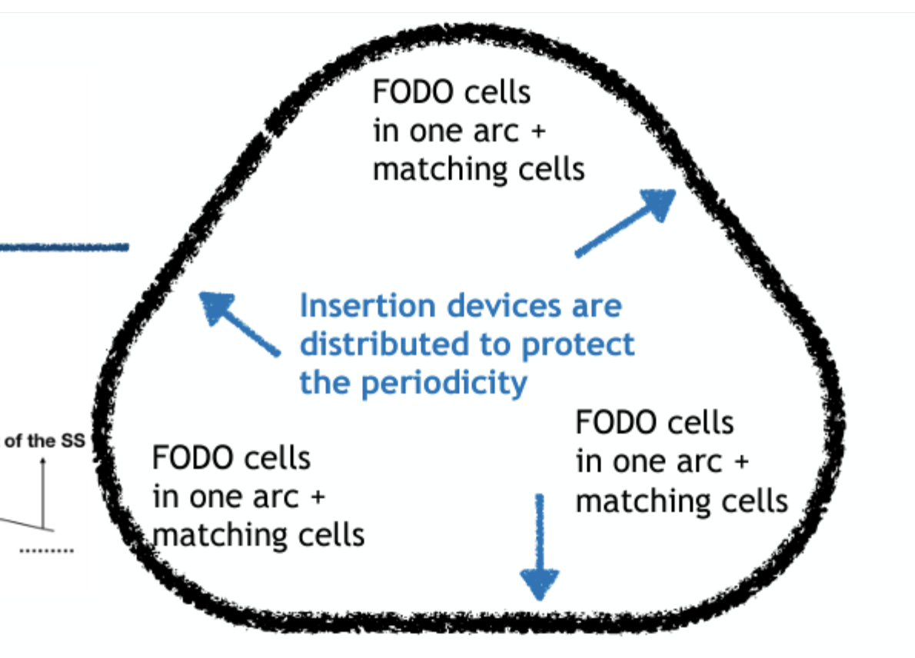
Optional Injector layout with DR at higher energy
910/1225 m + DR building = 940/1255 m
690/1005 m (+ 50 m, BC) = 740/1055 m
50 m
120 m
HE linac (main linac)
690/1005 m
32.2/22.5 MV/m
92/67 rf modules
p-linac
247/353 m
20/14 MV/m
26/19 rf modules
e⁺
20 GeV
2.86 GeV
e⁻
2.86 GeV
120 m
electron source and e-linac
140/200 m
28.1/20.5 MV/m
19/14 rf modules
electron transfer line
2.86 GeV
e⁺
e⁻
343/492 m
387/ 553 m (+ 10 m, TL)=397/563 m
11 m
15 m
120x120 m, ring
building 140x140 m?
343/492 m
397/563 m (+ 10 m) = 407/573 m
750/1065 m
50 m
140 m
940/1255 m
with Jean-Yves’s modification on 5.6.24

Slide 14
FCCee Injector Complex with Damping Ring at 2.86 GeV
Linacs Specs, Power Consumption and Cost Estimates
Linac | Rep. rate [Hz] | Nb. struct. per mod. | Nb. modules | Acc. gradients [MV/m] | Linac lengths [m] | Power consumptions [MW]
e-linac | 200 | 2 / 4 | 18+1 / 13+1 | 28.1 / 20.5 <a/λ>=0.15 | 140 / 200 | 5 / 4
p-linac | 200 | 2 / 4 | 26 / 19 | 20 / 14 | 247 / 353 | 10 / 7
HE-linac | 200 | 2 / 4 | 92 / 67 | 32.2 / 22.5 <a/λ>=0.12 | 690 / 1005 | 26 / 19
 |  |  |  |  |  | 41 / 30
Linac | Nb. struct. per mod. | Hardware costs [MCHF] | 10-year operating costs [MCHF] | Building lengths [m] | Building costs [MCHF] | Total costs [MCHF]
e-linac | 2 / 4 | 38 / 37 | 17 / 14 | 407 / 573 | 49 / 69
p-linac | 2 / 4 | 56 / 54 | 34 / 25
HE-linac | 2 / 4 | 182 / 178 | 91 / 66 | 343 / 492 | 27 / 39
 |  | 276 / 269 | 142 / 105 | 750 / 1065 | 76 / 108 | 494 / 482
Jean-Yves Raguin
5 June 2024

Slide 15
Other points
Schedule:
  After FCC week: decision on the layout to be included in the Feasibility Report
  End 2024: Completion of technical work for Feasibility Study for editing
  April 2025: FCC design study complete and available
  May 2025 –September 2025: FCC DS Final Review: SAC, CRP, Council committees

Slide 16
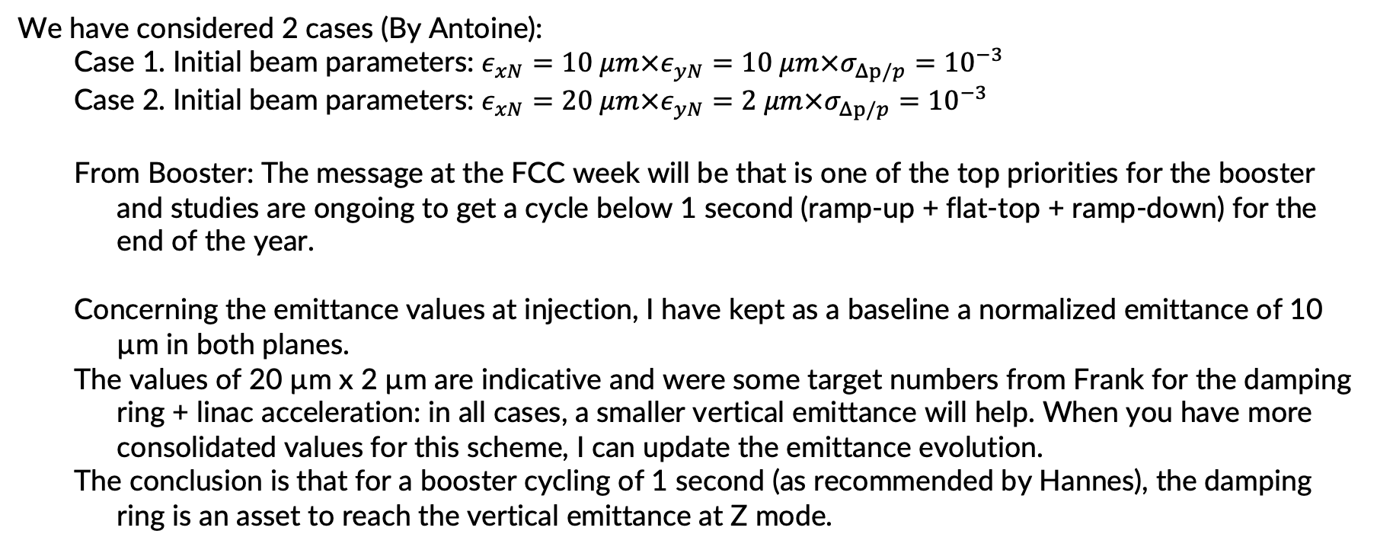
We have considered 2 cases (By Antoine):
  Case 1. Initial beam parameters: $ε_{xN}=10 μm×ε_{yN}=10 μm×σ_{Δp/p}={10}^{−3}$
  Case 2. Initial beam parameters: $ε_{xN}=20 μm×ε_{yN}=2 μm×σ_{Δp/p}={10}^{−3}$
  From Booster: The message at the FCC week will be that is one of the top priorities for the booster and studies are ongoing to get a cycle below 1 second (ramp-up + flat-top + ramp-down) for the end of the year.
  Concerning the emittance values at injection, I have kept as a baseline a normalized emittance of 10 µm in both planes.
  The values of 20 µm x 2 µm are indicative and were some target numbers from Frank for the damping ring + linac acceleration: in all cases, a smaller vertical emittance will help. When you have more consolidated values for this scheme, I can update the emittance evolution.
  The conclusion is that for a booster cycling of 1 second (as recommended by Hannes), the damping ring is an asset to reach the vertical emittance at Z mode.

Slide 17
New layout siting:
Wolfgang and Paolo’s meeting:
Energy spread, 0.75% or 0.1%, I see both numbers in your slides here, slide 6 and 12, is the target of 0.1% assuming already the energy compressor?https://indico.cern.ch/event/1378927/contributions/5835366/attachments/2812816/4909643/20240305_FCCeeBooster_CO84.pdf
Injector sketch, add 50 m downstream the HE linac to assume for a compressor, brings us closer to 1300 m total length
    Energy compressor or longer linac
Can swap electron/positron linacs to other side of DR, increases length
Can have link between DR and linacs, needs correct matching in TL
Check bending angles for transfer between DR and linacs to confirm if ~50 m sufficient, triangular shape clearly helping
Check arguments for bldg. size for L4 and SWISSFEL
Best solution to push full complex further back on Prevessin site, let’s meet during first days of FCC week with Tim Watson to clarify CE possibilities

