Slide 1
WP1 report and new baseline proposal for FCCweek2024
Alexej Grudiev for WP1
6/06/2024

Slide 2
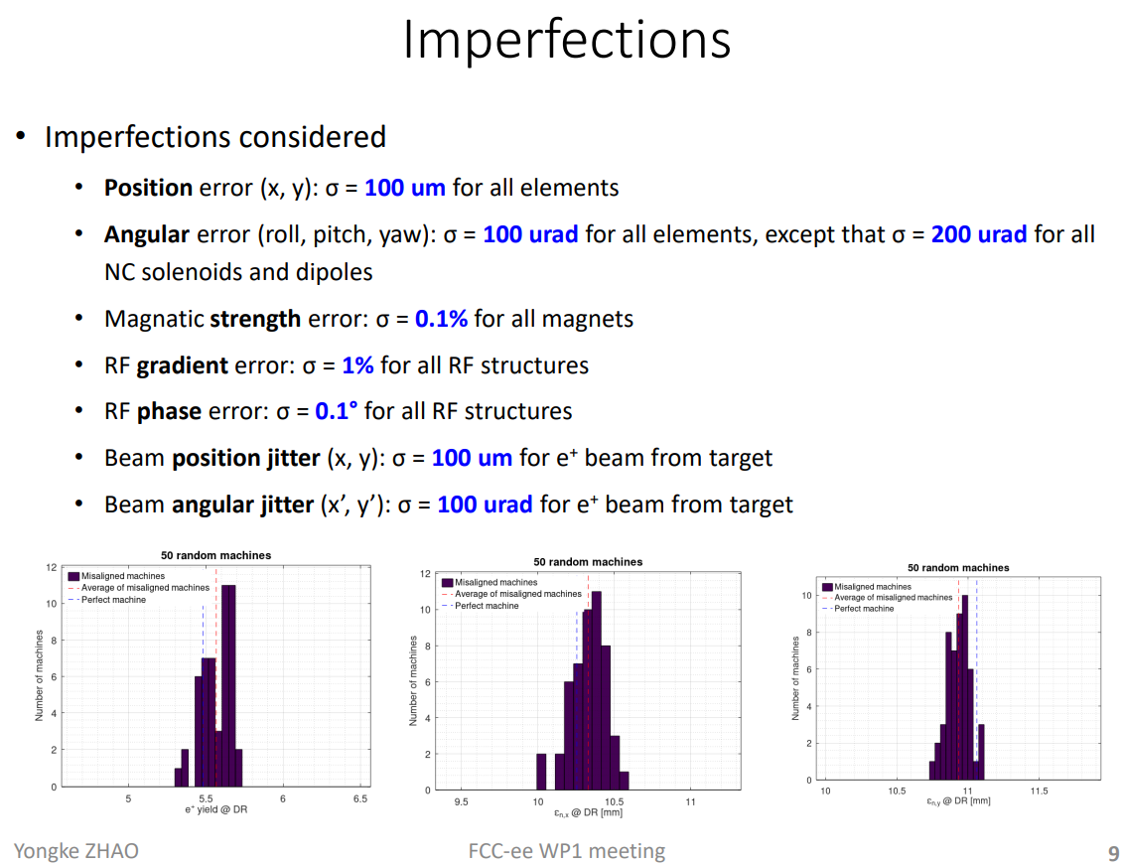
Significant progress in the positron linac beam dynamics studies
Benchmarking for V0 is finished
Configuration for V1 is implemented
Space charge and short-range wakes are included (small effect)
Static imperfections studies has been performed (small effect)
Transmission versus RF structure aperture scan (beam loss 2.5%/mm)
Beam loss in the chicane (~20%)
Preliminary study of the DR@2.86GeV option
Looks good!

Slide 3
New baseline proposal

Slide 4
Current Baseline (some parameters) FCCweek 2023 and mid-term review
Bunch repetition rate:
200 Hz x 2 bunches in Z-mode,
100 Hz or lower in other modes
RF module layout:
2 AS per module,
1 quad per AS
Acc. Structure (AS):
Active length = 3m,
average aperture <a>/λ=0.15,
RF frequency = 2.8 GHz
Mid-term review recommendations:
Optimize linac design in term of cost and power
Overall power consumption 43.5 MW is too high. Reduction of at least factor 2 or more is necessary
High average and peak power (relatively high gradient for S-band) operation reliability has been questioned

Slide 5
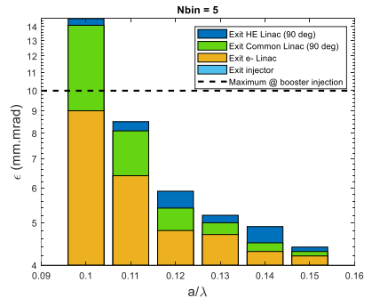
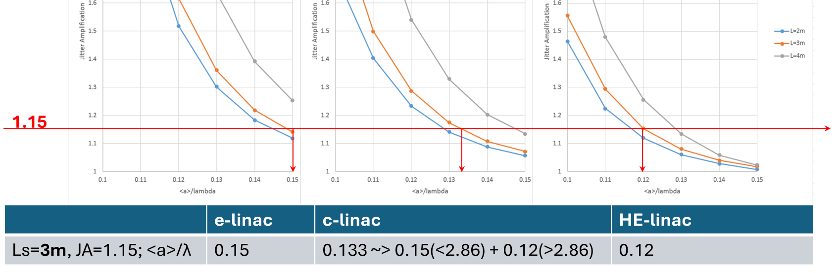
Acc. Structure (AS) parameters for new baseline
Static effects
Dynamic effects
Factor 2 margin in the emittance budget
New AS design with smaller aperture and higher shunt impedance: <a>/λ=0.12
AS length remains 3 m, since not strong motivation to change
AS aperture has been defined in different linacs based on the acceptable emittance growth (margin x2) and acceptable jitter amplification budget (15% per linac => 52% for all 3 linacs):
e-linac: <a>/λ=0.15
c-linac: <a>/λ=0.15 below 2.86 GeV and <a>/λ=0.12 above
HE-linac: <a>/λ=0.12

Slide 6
Latest round of cost and power optimization
Cost
Power
Size
Linac | Total cost [MCHF]
Rep. rate [Hz] | 200 x 2b |  | 100 x 4b
N of AS/module | 2 | 4 | 2 | 4
e-linac | 37.5 | 39.5 | 32 | 35.5
c-linac | 127 | 124.5 | 102 | 106
HE-linac | 252.5 | 249 | 211 | 218
All together | 417 | 413 | 345 | 359.5
Linac | Power consumption [MW]
Rep. rate [Hz] | 200 x 2b |  | 100 x 4b
N of AS/module | 2 | 4 | 2 | 4
e-linac | 2.7 | 1.8 | 1.4 | 1
c-linac | 11 | 8.3 | 5.6 | 4.2
HE-linac | 20.8 | 15.3 | 10.7 | 7.9
All together | 34.5 | 25.4 | 17.7 | 13.1
Linac | Length [m] |  | Gradient [MV/m]
N of AS/module | 2 | 4 | 2 | 4
e-linac | 78 | 123 | 29.5 | 18.8
c-linac <2.86GeV | 247.5 | 360 | 22.5 | 16.1
c-linac >2.86GeV |  |  | 25.4 | 17.9
HE-linac | 570 | 825 | 32 | 22.5
All together | 892.5 | 1305
Small cost difference between 2 and 4 AS/module
Lower cost for lower rep. rate
Power consumption is reduced:
200 and 100 Hz, by factor 2
2 and 4 AS/module, by ~30%
Linacs are longer for 4 AS/module, 40% ☹

Slide 7
New Baseline proposal for FCCweek2024
Mid-term review recommendations addressed:
☺ Linac design is optimized in term of cost and power including new accelerating structure with higher shunt impedance
☺ 200 to 100 Hz rep. rate in Z-mode reduces
power consumption by almost factor 2 and
average power in the linacs by factor 2.
This increases reliability and
reduces the cost of the linacs
😐 However, 4 bunches per pulse are required
e and p sources (seems to be no problem)
beam loading compensation (no problem)
long range wakefield suppression (no problem)
☺ 2 to 4 AS per module reduces the gradient by 40% and power per meter by another factor 2. Further improvement of the reliability and power consumption
☹ The linacs are longer, BUT they still fits on CERN domain ☺ and it has small impact on total cost ☺
☺ This potentially allows easier upgrade to higher energy by adding more RF power sources, in case it is needed in the future…
Bunch repetition rate:
100 Hz x 4 bunches in Z-mode,
100 Hz or lower in other modes
RF module layout:
4 AS per module,
1 quad per AS
Acc. Structure (AS):
Active length = 3m,
average aperture <a>/λ:
0.15 <2.86GeV
0.12 >2.86GeV
RF frequency = 2.8 GHz

Slide 9
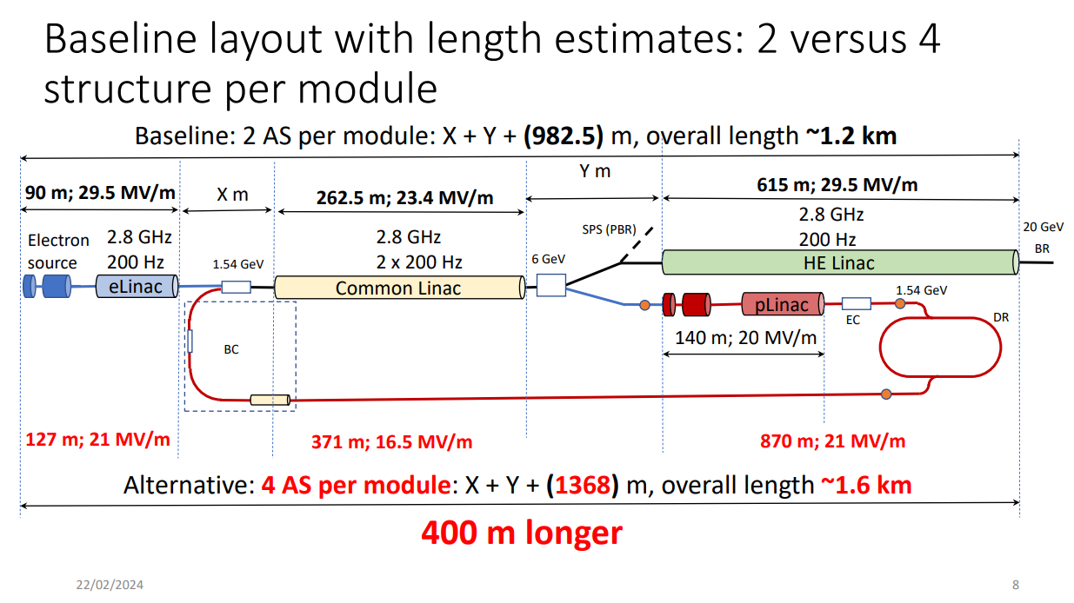
Addressing partially the concerns by gradient reduction: 2 -> 4 AS per RF module
What are the consequences for cost?
Can this still be improved?

